Slide 1
02
Storage of Potato
Notes:
Then, I will take some examples. First, we will introduce potato storage.

Slide 2
1 Introduction
2 Postharvest Characteristics
3 Status of Storage Facilities
Storage of Potato
4 Ventilation Technology
5 Storage Management Technology
6 Preservation and Bud Inhibition
7 Prospect
Notes:
The first part is the storage technology of potato, which I will introduce in the following aspects.

Slide 3
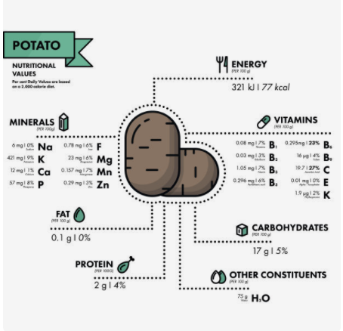
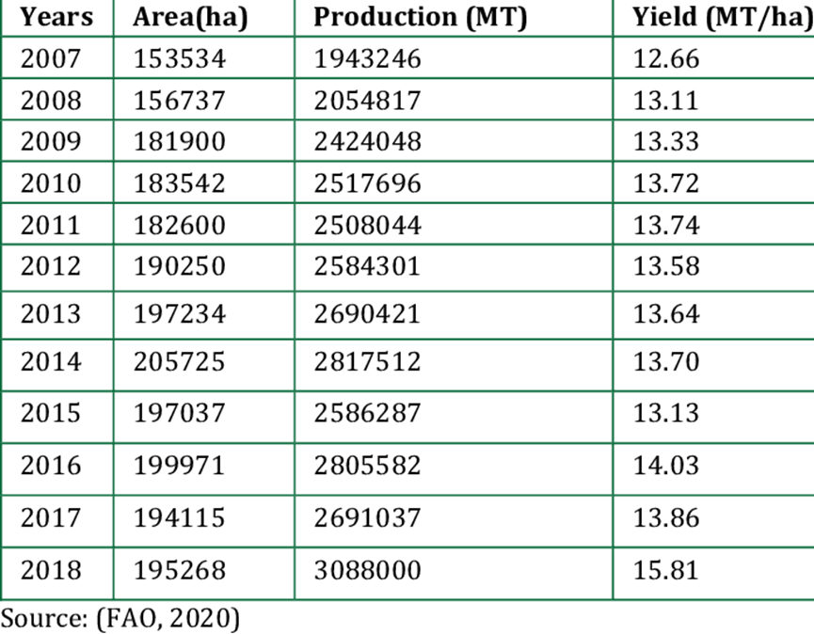
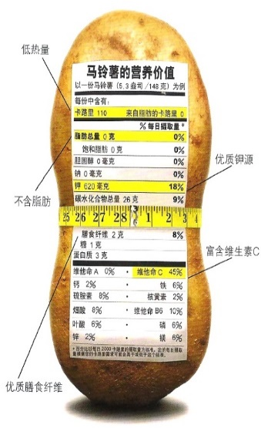
Storage of Potato
1. Introduction
Potato has high yield and economic efficiency;
Potato is a fully nutritious food, containing high anthocyanins, polyphenols and other functional ingredients;
Potato has low glycemic index;
Whole potato flour and starch have long shelf life (2 years);
Potatoes are of great significance to economic and social development, political stability and national security.
Table 1 Potato production in Nepal
Notes:
Potato is a kind of nutrient-rich food, containing high anthocyanins, polyphenols and other functional components, Its glycemic index is low, high yield, good economic benefits, and the shelf life of flour and starch is up to 2 years;

Slide 4
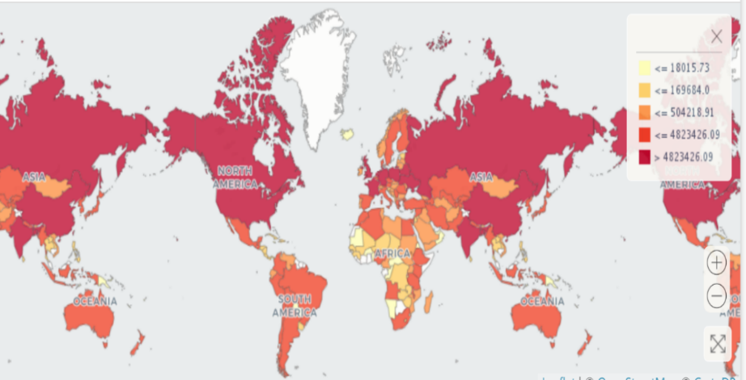
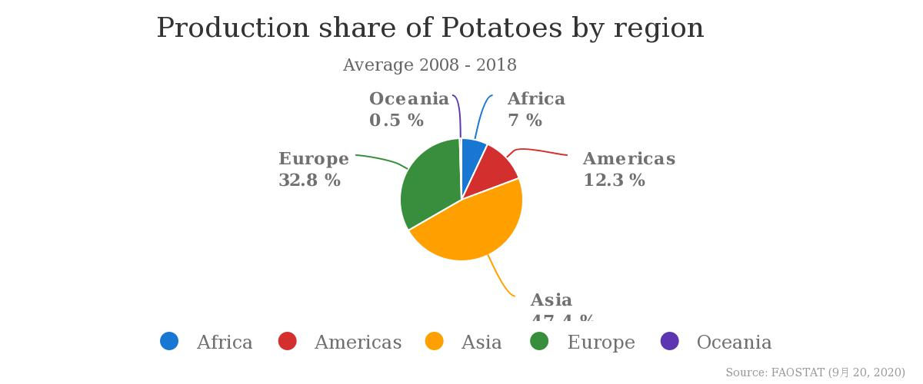
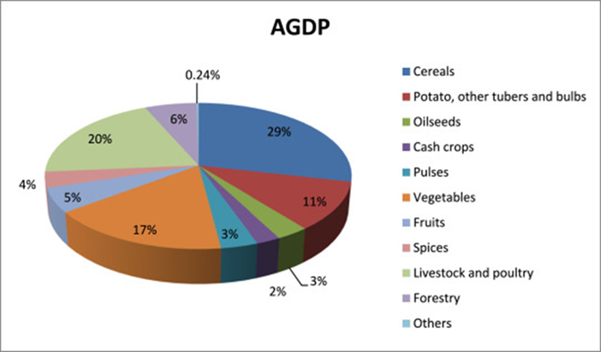
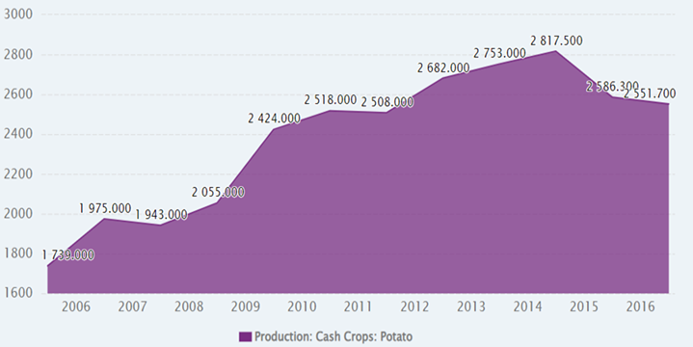
Storage of Potato
1. Introduction
Overview of Potato Industry
Distribution Map of World Main Potato Producing Areas
Worldwide potato yield distribution (%)
Agricultural GDP composition of Nepal 's crops
Potato cultivation area in Nepal
As the fourth largest staple food in the world, potato has drought resistance and wide adaptability, which is suitable for planting in arid and semi-arid areas.
The Baglung is one of the potato planting potential areas with high production and good market reputation in Nepal.
Notes:
According to the statistics of recent 10 years, China is the world's largest potato production country, followed by India and Russia.

Slide 5
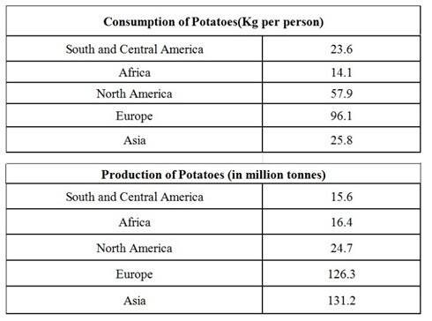
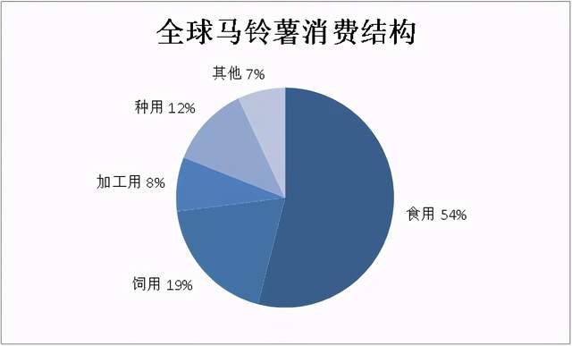
Storage of Potato
1. Introduction
Overview of Potato Industry
Consumption and Utilization of Potatoes in the World : Mainly Fresh and Frozen Potatoes. Huge amount of transit deficit in potato in Nepal.
World annual consumption: 32 kg per person; developed country 74 kg per person, developing country 20 kg per person; Developed countries consume more potatoes than developing.
Notes:
Potato consumption in the world is dominated by fresh potatoes and frozen potatoes. Nepal has a huge potato transport deficit, 32 kg per capita in the world; 74 kg per capita in developed countries and 20 kg per capita in developing countries; Developed countries consume more potatoes than developing countries.

Slide 6

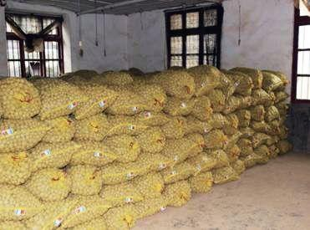

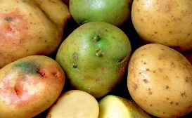
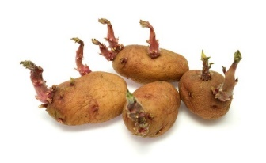
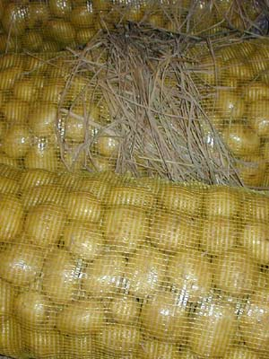
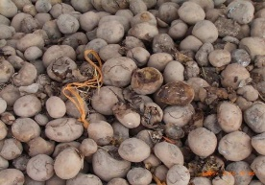
Storage of Potato
2. Postharvest Characteristics
The potatoes remain living organisms after harvest. Tubers are both storage organs and reproductive organs, and there are vigorous physiological and biochemical activities.
Respiration
Composition
change
Sprouting
Greening
Water loss
Chilling injury
Dormancy
Heat injury
Cold storage
Wound healing
Disease
Notes:
Potatoes are still living organisms after they are harvested. Tuber has vigorous physiological and biochemical activities, such as respiration, germination, water loss, greening and other life activities will cause potato storage failure.

Slide 7
Highlights of potato storage
(1)Harvest at 10-20 °C;
(2)Remove field heat;
(3)Wound healing (＜21 °C, 95% RH for 15-30 days);
(4)Reduce temperature by 0.5 °C per day for 7-10 days for long term storage. Faster rates may cause browning of the potato skin;
(5)Maintain 80-85% RH to avoid dehydration;
(6)Avoid excess accumulation of soil for maintaining proper ventilation;
(7)Avoid humid environments, which may cause rot. It is best not to wash potatoes before long-term storage.
Storage of Potato
Storage of Potato
2. Postharvest Characteristics
Notes:
When storing potatoes, it is important to harvest at 10-20°C; Remove site heat; for long-term storage. cooling 0.5°C per day for 7-10 days, faster rates may lead to Browning of potato skins; Maintain the relative humidity of 95-98% to avoid dehydration; Avoid excessive soil accumulation to maintain proper ventilation; Avoid moist environments, which may cause rot. It's best not to wash potatoes before long-term storage.

Slide 8
Storage of Potato
2. Postharvest Characteristics
Storage phases of potato
Equalization/Drying phase
Dry surface moisture. A fan can be used for ventilation.
Wound healing /PRE-Conditioning phase
10-20 °C and 85-90% RH for 15-30 days. Avoid water condensation.
Cooling phase
Temp. Brought down to 7-10 °C by 0.5-1 °C per day. Cooling air temp not less than 1.5 °C, 85-95% RH.
Holding phase
Temp. and RH maintained. Ventilation is possible to prevent the accumulation of CO₂.
Reconditioning phase
Temp. and RH maintained. Ventilation is possible to prevent the accumulation of CO₂.
Notes:
Potato storage is divided into the following stages; Drying stage: surface dry moisture; Pretreatment phase: 10-20°C and 85-90% relative humidity for 15-30 days. Avoid water condensation; Cooling stage: Temperature drops by 0.5-1°C to 7-10°C daily, the cooling air temperature is not less than 1.5°C, and the relative humidity is 85-95%; Hold stage and repair stage, temperature and relative humidity remain the same. Ventilation prevents the build-up of carbon dioxide.

Slide 9
Storage of Potato
2. Postharvest Characteristics
Respiration
Dormancy
Different varieties of potato have different respiration intensity at different temperatures.
The higher the respiratory intensity, the more organic matter consumed, and the shorter the storage life. Anaerobic respiration occurs when O₂ content is less than 5 %, which is unfavorable for storage.
The main factors affecting respiration: variety, cultivation factors, maturity, ambient temperature and humidity, mechanical damage, etc.
At the end of growth, tubers accumulated a lot of nutrients, physiological activity slowed down, metabolism, respiration and transpiration reduced, weakened, reduced, which is dormant.
Dormancy is a favorable physiological phenomenon.
Notes:
Different varieties of potatoes have different respiration intensity at different temperatures. The higher the respiratory intensity, the more organic matter consumed and the shorter the storage period. Anaerobic respiration occurs when the oxygen content is below 5% and is not conducive to storage. At the end of growth, the tuber has accumulated a large amount of nutrients, its physiological activity slows down, its metabolism, respiration and transpiration are reduced, weakened and reduced, and it is in a dormant state.

Slide 10
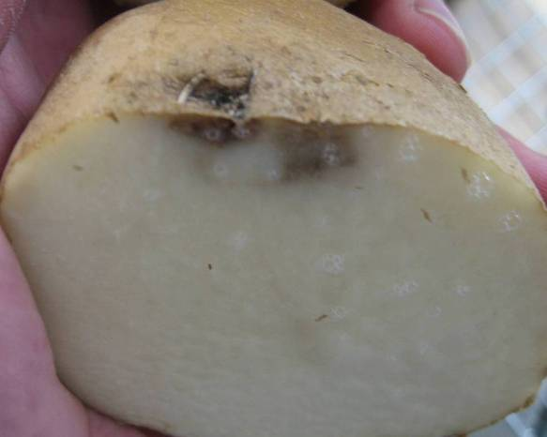
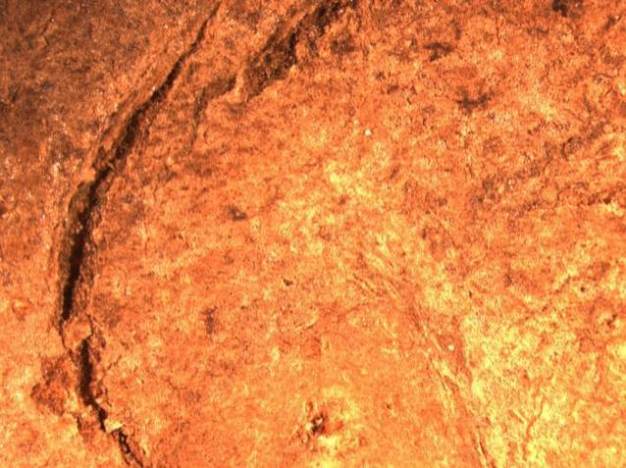
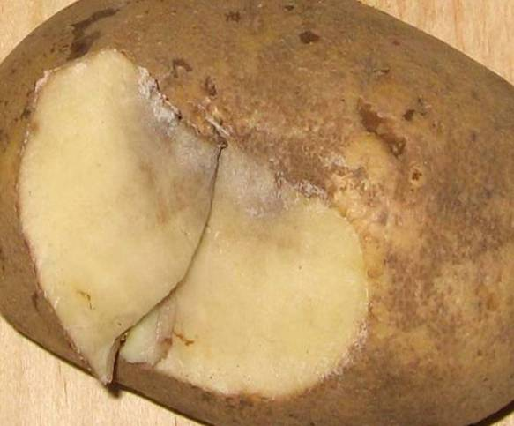
Storage of Potato
2. Postharvest Characteristics
Wound curing
Water loss
Potatoes after wound healing, reduce water evaporation and pathogen invasion, which is beneficial with storage;
The wound caused by the squeeze does not heal;
Young potatoes heal quickly;
Higher temperature is conducive to wound healing, 85-93% RH is suitable, high O₂ and low CO₂ is conducive to curing.
Water loss is closely related to itself and storage environment;
Internal factors: surface area ratio, surface protection structure, cell water holding capacity, metabolism, respiratory intensity;
Environmental factor: Humidity, temperature, air velocity, air pressure;
The higher the storage temperature, the faster the sprout, the more water loss.
Notes:
After potato wound healing, water evaporation and pathogen invasion can be reduced, which is conducive to storage. A squeeze wound will not heal; Higher temperatures are favorable for wound healing, humidity of 85-93% is appropriate, and high oxygen and low carbon dioxide are favorable for curing. Water loss is closely related to oneself and storage environment; In the aspect of itself, surface area ratio, surface protection structure, water holding capacity, metabolism and respiration intensity of cells all affect water conservation. Outside: humidity, temperature, wind speed and air pressure also affect water loss to varying degrees.

Slide 11
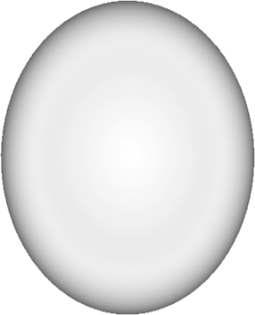
Storage of Potato
2. Postharvest Characteristics
Chilling and freeze injury
Chilling injury
Freeze injury
Temperatures above freezing. The critical temperature of chilling injury is 0℃, and the chilling injury occurs after long-term storage.
Temperatures below freezing. The freezing temperature is about -0.6℃.
Chilling and
freeze injury
Symptoms of chilling injury
Symptoms of freeze injury
The epidermis is concave and convex, the tissue is brown, and then rot. The symptoms of chills became more severe when room temperature returned.
The tissue is brown and spongy, with water leaking from the injury and the eye. The chips turn pink, then turn black and rot.
Notes:
When potatoes are stored for a long time, cold damage will result, which is manifested as convex skin, brown tissue, and then rot. When the room temperature returned, the symptoms of chills became worse. Cold storage can lead to frostbite, brown and spongy tissue, and leaky wounds and eyes. The fries turn pink, then black and rot.

Slide 12
Storage of Potato
2. Postharvest Characteristics
Guarantee Storage Quality of Seed Potato
Potato storage control factors
Equipment
Technology
Controlling
temperature
Disease
control
Potato storage
45-55%
Controlling
humidity
Sprout
inhibition
25-35%
10-20%
Reduce
decay
Reduce
germination
and nutritional
loss
Reduce
water
loss
Avoid
chilling
injury
Good
ventilation
Avoid
lighting
10-20%
Notes:
Potato storage is mainly treated from the aspects of reducing decay, germination and nutritional loss, water loss. The operation method is low temperature, low humidity, ventilation and light avoidance, in order to prevent disease and inhibit germination.

Slide 13
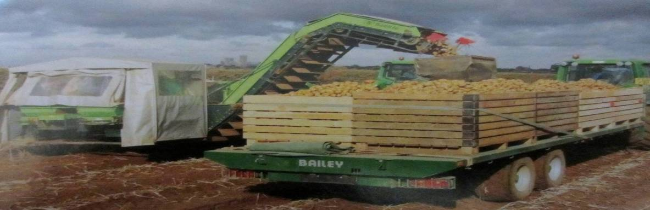
Storage of Potato
3. Status of Storage Facilities
Status of Developed Countries
70% of total agricultural input is used for post-mining storage, transportation and processing, and 30% for pre-mining links;
Low-temperature storage and fresh-keeping accounted for 70%-80% of the yield;
Postharvest loss: 5%-8%;
Large-scale, standardized and modern technology integration, low temperature with mechanical air conditioning whole-process cold chain technology system.
Notes:
In developed countries, 70% of agricultural expenditure goes to post-mining storage, transportation and processing, and 30% to pre-mining. For products, low-temperature storage and fresh food account for 70% ~ 80%; Postharvest losses account for 5%-8%; Therefore, large-scale and modern preservation is needed.

Slide 14
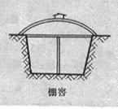
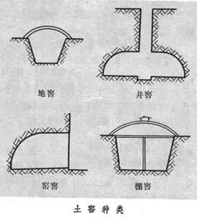
Storage of Potato
3. Status of Storage Facilities
Traditional potato storage methods
It is mainly produced and stored by farmers;
By taking advantage of the low temperature in winter and the thermal insulation characteristics of pits, farmers built small pits in household;
The facilities are simple, unscientific and unstandardized;
Loss of storage:15-25%, even more serious 30-40%.
Notes:
Traditional potato storage is to take advantage of the low temperature in winter and the thermal properties of the pit to build small pits in the home; The facilities are simple, unscientific and non-standard; High storage loss.

Slide 15
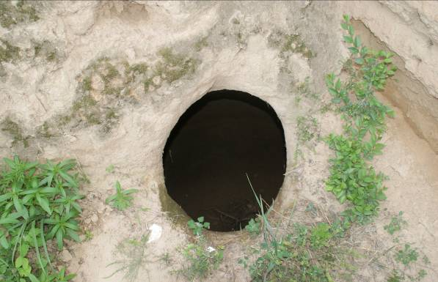
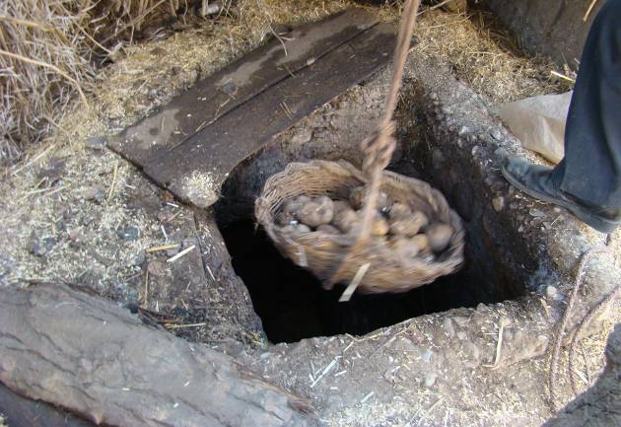
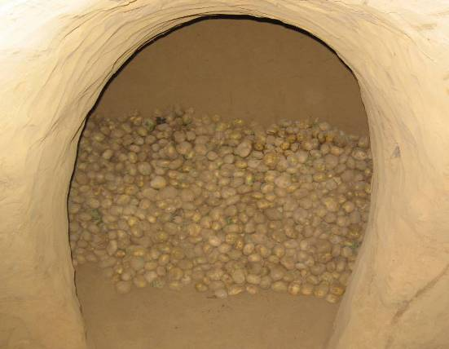
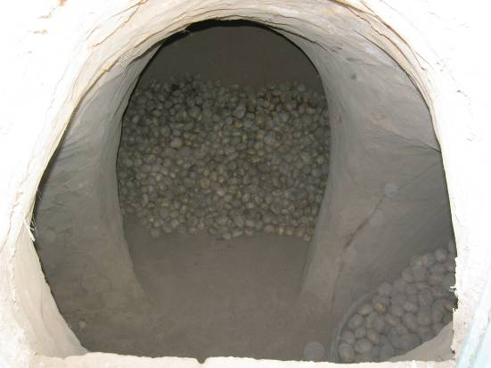
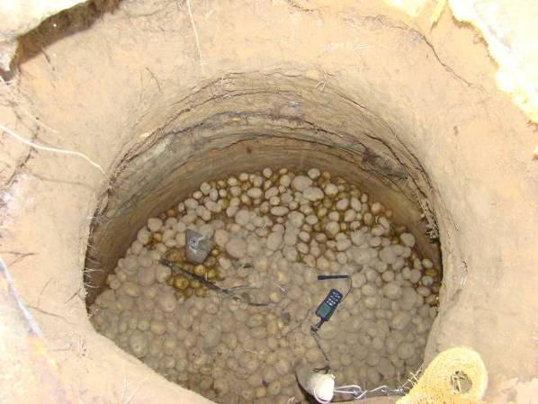
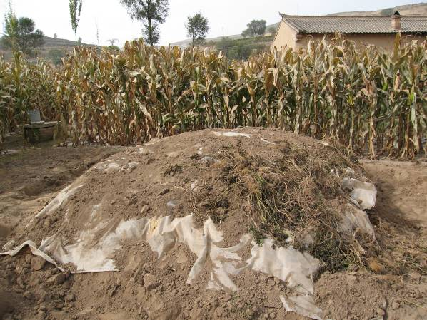
Storage of Potato
3. Status of Storage Facilities
A variety of traditional pits storage
Notes:
Here are some pictures of how potatoes are traditionally stored.

Slide 16
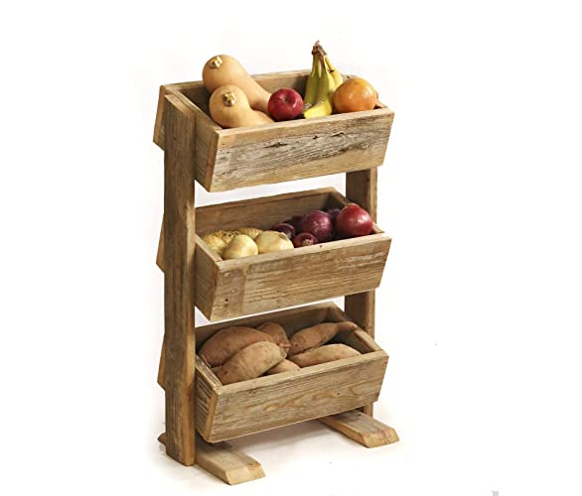
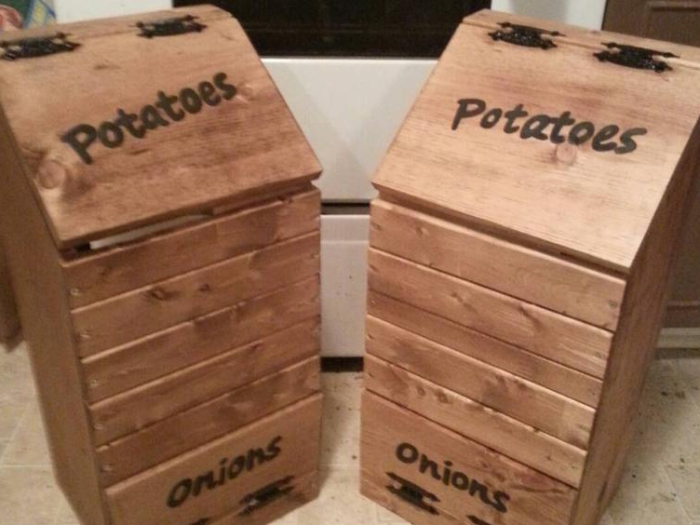
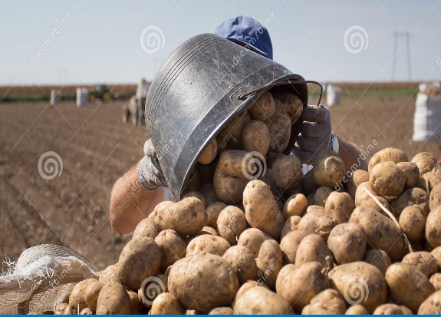
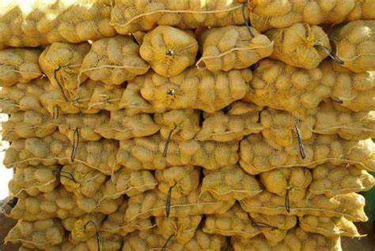
Storage of Potato
3. Status of Storage Facilities
Current Situation in Nepal
Lack of storage facilities like cold stores in regional basis;
Lack of marketing facility and cooperative for collection of seeds, storage and distribution;
No regular supply of electricity and no any subsidy in diesel (fuel) used to run the cold store houses;
There is no insurance of potato stored in cold house.
No separate compartment in cold stores for storing seed potato, ware potato and processing potatoes;
Lack of training to technicians, traders and entrepreneurs about new technology of storage.
Rustic storage
Bin storage
Field storage
Heap storage
Notes:
There are still some problems in potato storage in Nepal, such as lack of regional cold storage and other storage facilities; There is no regular supply of electricity, nor any subsidy for diesel used to run cold storage; Potatoes stored in cold rooms are not safe; The cold storage has no separate compartments for seed potatoes, dish potatoes and processed potatoes; Lack of training for technical and production personnel on new storage technologies.

Slide 17
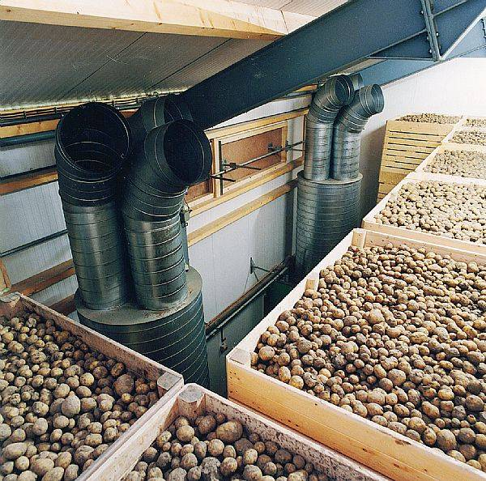
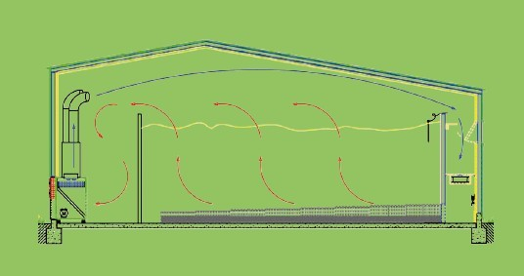
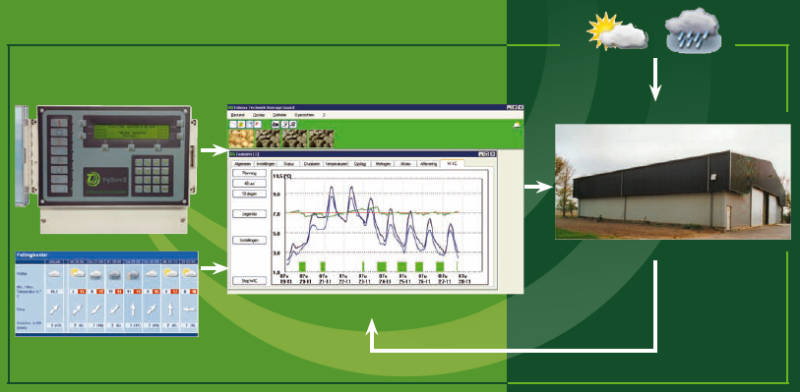
Storage of Potato
3. Status of Storage Facilities
Present situation of potato storage facilities in developed countries
Refrigeration, ventilation, heating system and automatic control technology, communication technology, sensing technology and three preservation technology (sprout, rot, water loss) perfect combination, to achieve precise potato storage.
Notes:
In developed countries, the perfect combination of refrigeration, ventilation and heating systems with automatic control technology, communication technology, sensing technology and three kinds of preservation technology (germinating, rotting, water loss) enables precise potato storage.

Slide 18
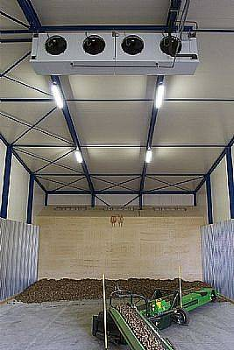
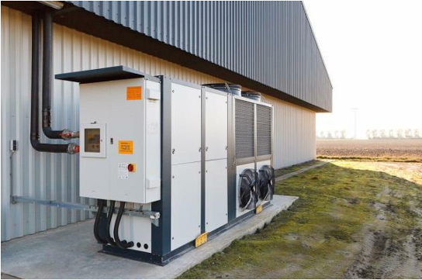
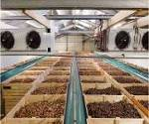
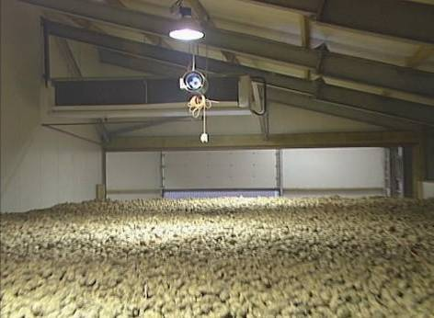
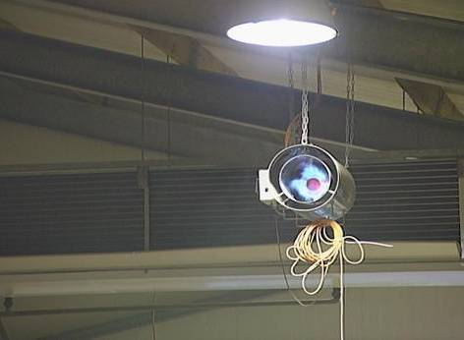
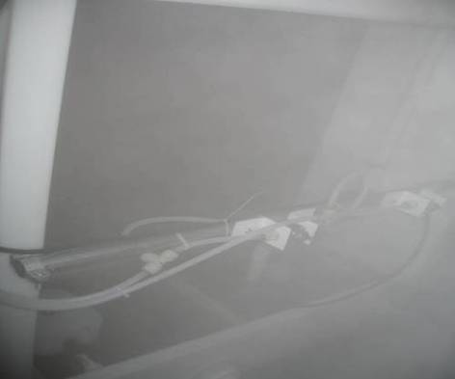
Storage of Potato
3. Status of Storage Facilities
Atomizing equipment
Refrigeration
system
Heating system
Humidification system
Notes:
This is pictures of potato processing and storage tools in developed countries.

Slide 19
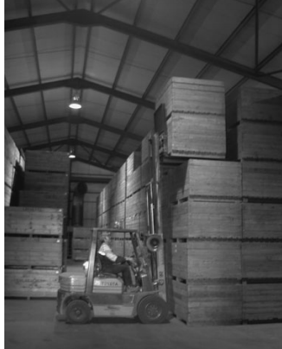
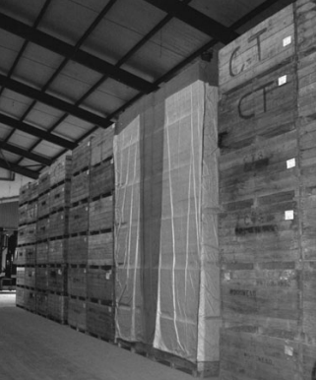
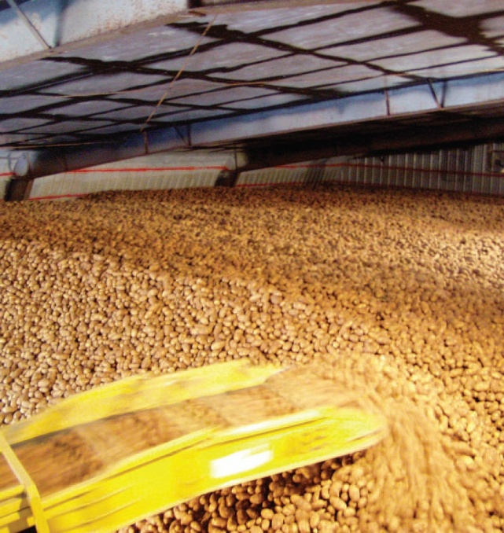
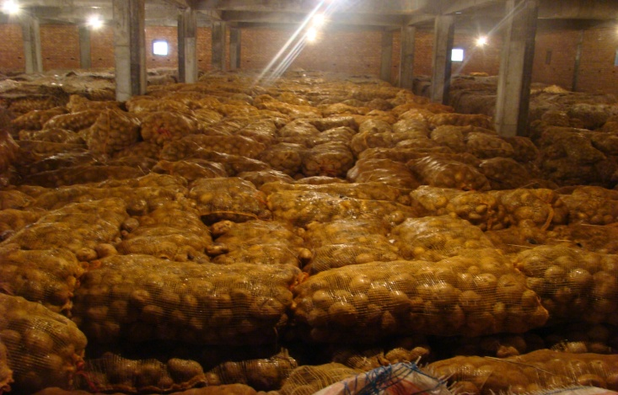
Storage of Potato
3. Status of Storage Facilities
Storage: heap storage and box storage. Short-term storage with soft bags (sacks, woven bags, etc.) packing.
Seed and commercial potato are storage in box.
Packed
in boxes
In bulk
In bags
Notes:
In potato storage, stacking and packing are the main methods for long-term storage. For short-term storage use soft bags , seeds and commercial potatoes stored in boxes.

Slide 20
Storage of Potato
3. Status of Storage Facilities
Type of storage facility
Natural ventilation underground/semi-underground/aboveground storage (enterprises, cooperative organizations, farmers, no energy consumption);
Forced ventilation storage (cooperative organization, processing and marketing and potato seed enterprises); Mechanical constant temperature and ventilation storage (processing and sales enterprises);
Forced ventilation, refrigeration and heating, online monitoring system (high-end large-scale processing enterprises).
Facilities construction: temperature control, humidity control, shading, convenient access, necessary facilities.
Notes:
Most of its potatoes are stored in forced ventilation equipment, only a few farmers use natural ventilation

Slide 21
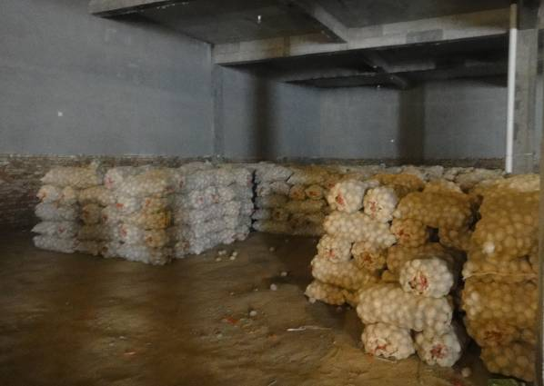
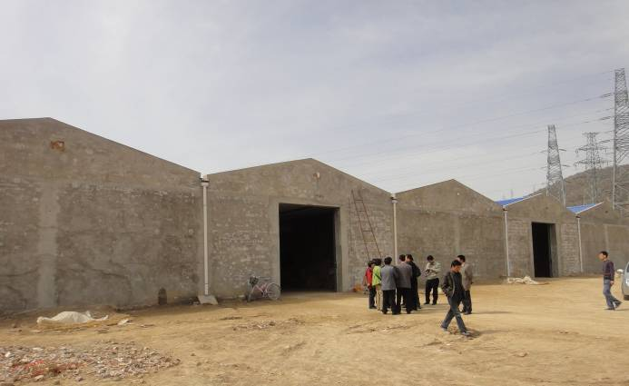
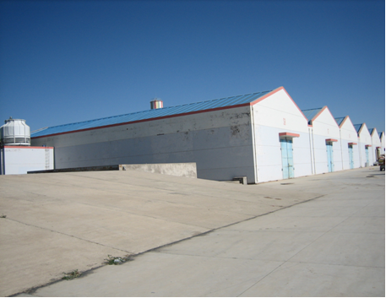
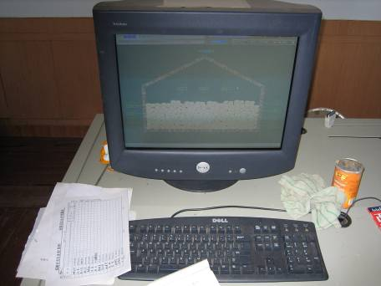
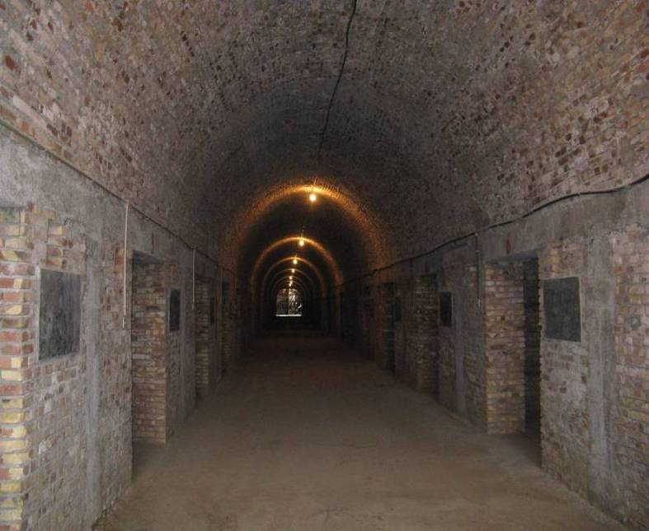
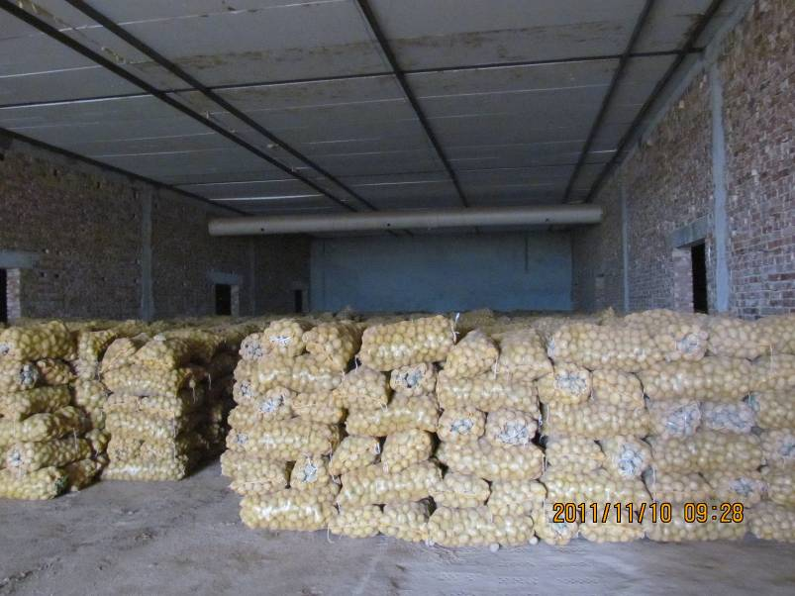


Storage of Potato
4. Ventilation Technology
20,000 tons of commodity potato storage (realize the effective combination of mechanical refrigeration , forced ventilation and automatic control).
Large naturally ventilated storage
Notes:
Some pictures about large naturally ventilated storage.

Slide 22
Storage of Potato
4. Ventilation Technology
It is a way to use the temperature difference between inside and outside the storage or the wind pressure to exchange air inside the storage. It is energy saving, economical, but difficult to control.
Natural ventilation
Methods
It uses fans and ventilation systems to supply air to the inside of storage or exhaust air to the outside, forcing air circulation inside and outside the storage. It is less affected by external conditions, energy consumption, easy to control.
Forced ventilation
Air supply type - The direction of air flow in the potatoes: from the bottom up.
Exhaust air type - The direction of air flow in the potatoes: from the top down.
Notes:
In terms of ventilation, there are two kinds: natural ventilation and forced ventilation. Natural ventilation uses the temperature difference or wind pressure inside and outside the warehouse to exchange the air inside the warehouse, which is energy-saving, economical, but difficult to control. Forced ventilation uses fans and ventilation systems to supply or expel air inside the warehouse, forcing air to circulate inside and outside the warehouse. Less affected by external conditions, large energy consumption, easy to control.

Slide 23


Storage of Potato
4. Ventilation Technology
Potato pit storage-Air supply type
Potato pit storage-Exhaust air type
Notes:
Forced ventilation is divided into supply air and exhaust air. The flow direction of supply air in the potato pile is: from the bottom to the top.

Slide 24




Storage of Potato
4. Ventilation Technology
Installation positions of ventilation pipes:
Above ground air duct: The ventilation pipe can be moved, with semicircle or triangle, and the surface of the pipe is provided with ventilation holes;
Underground air duct: There is a semicircle or square air duct, and the ventilation pores are opened above the pipe.
Above ground air duct
Underground air duct
Integral ground ventilation grille
Notes:
The installation position of the ventilation pipe in the storage room is divided into the following types: ground duct: the ventilation pipe can be moved, has a semicircle or triangle, and the surface of the pipe is provided with a ventilation hole; ; Underground air duct: there is a semicircle or square air duct, and the ventilation hole is opened above the pipe.

Slide 25


Storage of Potato
5. Storage Management Technology
Storage methods and technical points
Heap storage
Groove storage
Pit storage
Cold storage
Potatoes cultivated in autumn have a longer storage time.
Temperature: 3~5 °C
Humidity: 80~85% RH
Light: Prolonged exposure to sunlight can cause potatoes to turn green.
Notes:
SPotatoes are planted in autumn with temperature of 3~5 ° C and humidity of 80~85% RH, and the storage time is long. The main storage methods of potatoes include heap storage, Groove storage, pit storage and cold storage.

Slide 26

Video file 6；3.5min

Slide 27

Storage of Potato
5. Storage Management Technology
Pit storage
The storage capacity is determined
Pre-storage facility treatment
Potatoes shall not exceed 65 % of the total capacity of the pit. A 1m³ potato tuber is generally 650-750 kg in mass.
Suitable storage capacity (kg) ＝ Total volume of storage pit ×750×0.65
（1） Ventilation: 1-2 months before storage, open the pit door for 7-10 days.
（2） Disinfection About 2 weeks before storage, fumigate with sulfur powder (8-12g/m³). Lime water sprayed the ground.
Notes:
Before pit storage, fumigate with sulfur powder (8-12g/m3), spray lime water on the ground, and open the pit door for 7-10 days. The amount of potatoes in storage shall not exceed 65% of the total capacity of the pit. The mass of 1 m3 potato tuber is generally 650-750 kg.

Slide 28




Storage of Potato
5. Storage Management Technology
Heap storage
Storage in bags
Forced ventilation warehouse, the height of heap: 3-4m.
Naturally ventilated pit, the height of heap: 1.5-2m.
Small hole bags: 35-45 kg/bag;
Stack after bagging: 7-9 floors, interval: 0.8-1m.
Notes:
Stacked storage is mainly adopted, which is stored in a forced ventilation warehouse with a stack height of 3-4m; It shall be stored in the natural ventilation pit with a pile height of 1.5-2m.

Slide 29
Storage of Potato
6. Preservation and Bud Inhibition
Methods for inhibiting sprouting of potato during storage
Potatoes will sprout after dormancy, resulting in reduced starch content, increased lonaponin, water loss and soft, quality deterioration. The commonly used methods of sprout inhabitation are physical methods and chemical methods.
Physical methods
Low Temperature:
Low temperature storage: 2-4 ℃.
Radiation Treatment:
The ⁶⁰Co γ-ray treatment: 8000~10000 R .
Chemical methods
CIPC:
The MRL of CIPC is 30 mg/kg.
Notes:
Potatoes will sprout after dormancy, resulting in the reduction of starch content, water loss and softening, which will reduce their quality. Common methods to inhibit potato germination include physical and chemical methods, including low temperature and radiation treatment, and the chemical method is CIPC.

Slide 30


Storage of Potato
6. Preservation and Bud Inhibition
Table 2 CIPC usage and precautions
Type | CIPC concentration | Dosage
Powder | 2.5% | Long-term storage ( > 3 months): 0.8 kg/ton Short-term storage ( < 3 months): 0.5 kg/ton
Emulsifiable concentrate | 30% | 40-60 g/ton
Aerosol | 50%
➢ CIPC can inhibit potato healing and forming corkification. Potatoes should not be administered CIPC for 2 to 3 weeks after harvest.
➢ CIPC should not be used for seed potatoes. Otherwise, it may affect the germination of seed potatoes and cause economic losses to producers.
Notes:
Precautions for use of CIPC: CIPC can inhibit the healing and corking of potatoes, which cannot be used within 2 to 3 weeks after harvest, and will affect the germination of potato seeds, causing economic losses.

Slide 31













（5）抑芽防腐技术
Storage of Potato
6. Preservation and Bud Inhibition
Effect of high energy electron beam irradiation on inhabitation sprouting of potato
Control Different dose of high energy electron beam
50 d
2020.1.1-2020.2.24
110 d
2020.1.1-2020.4.19
High-energy electron beam irradiation can decontaminate, disinfect, sterilize and keep fresh, which has certain potential in potato quality control.
175 d
2020.1.1-2020.5.22
Within a certain range, high-energy electron beam irradiation has a remarkable effect on bud inhibition. When the dose exceeds a certain range, it will accelerate the wilting and decay of potato tubers
Notes:
High energy electron beam irradiation has the functions of decontamination, disinfection, sterilization and fresh-keeping. It has a significant effect on inhibiting potato germination, but when the dose exceeds a certain range, it will accelerate potato tuber decay.

Slide 32










Storage of Potato
6. Preservation and Bud Inhibition
（4）Effects of different doses of electron beam irradiation on sprouting and storage quality of potato
0 Gy
0 Gy
25 d 50 d 75 d 100 d
400 Gy
300 Gy
300 Gy
400 Gy
300-500 Gy electron beam irradiation inhibited sprout at 8±1℃ for 9 months and reduced the decrease of starch and Vc.
125 d 150 d 175 d 200 d
Notes:
After storage for 50 days, the germination rate reached 31% after 75 days, and the bud was completely germinated after 125 days, with a length of 5-30 cm; It may be that the epidermal tissue was damaged, which accelerated the evaporation of water. The weight loss rate of tubers increased rapidly after germination. The growth of buds required a lot of water and nutrients, and there was no significant difference from the end of storage. The higher dose of irradiation resulted in dry rot of tubers during storage, and the rot rate was low.

Slide 33

Storage of Potato
7. Prospect
Preservation technology
Storage facilities
(1) Pre-harvest:
Select shelf-stable variety, standardized and mechanized cultivation.
(2) Harvest:
Mechanical harvesting, handling, grading and sorting.
(3) Post-harvest:
Sprouting inhibition;
Energy-saving, labor-saving, low-cost storage technology.
(1) Energy conservation;
(2) Automatic control system;
(3) Online monitoring of storage environment;
(4) Develop supporting facilities simultaneously.
Notes:
Low cost storage technology was used to inhibit germination of potato after harvest.
Storage facilities: adopt energy-saving automatic control system and online monitoring of storage environment, and simultaneously develop supporting facilities.

