Slide 1
Development History and Achievements of
Electronic Grain Trading in China
中国粮食电子交易发展历程及成效
国家粮食交易中心 王 新
Wang Xin National Grain Trade Center
05. 05. 2023 Beijing
Notes:
唐峰设计：https://v.youku.com/v_show/id_XNTg4OTcwMDM3Ng==.html

Slide 2
目 录
CONTENTS
01
国家粮食交易平台发展历程
Development History of the National Grain Electronic Trading Platform
02
国家粮食交易平台建设成效
Achievements of Building the National Grain Electronic Trading Platform
03
支持加纳农产品交易电子化
Support the Digitization of Agricultural Product Trading in Ghana
03

Slide 3
01
国家粮食交易平台发展历程
Development History of the National Grain Electronic Trading Platform

Slide 4
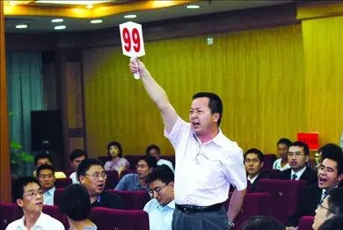
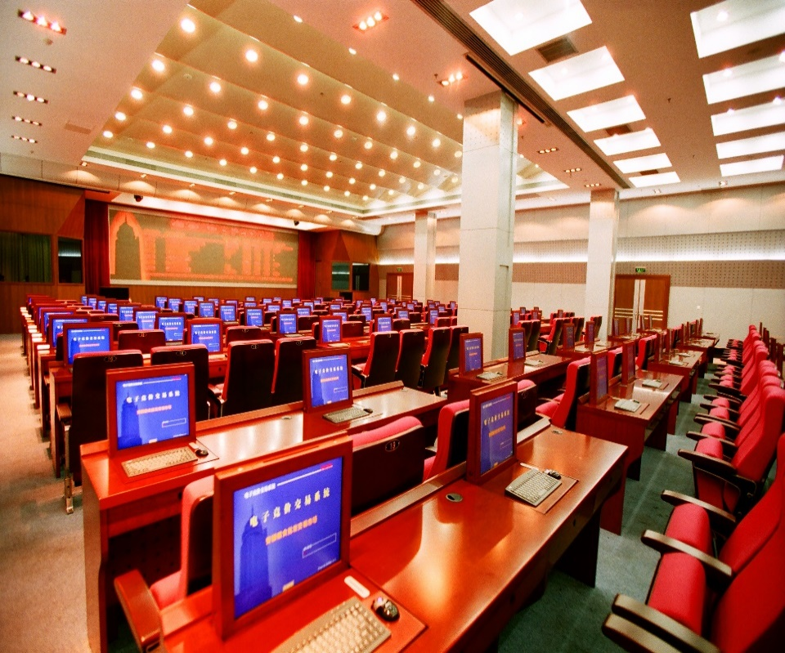
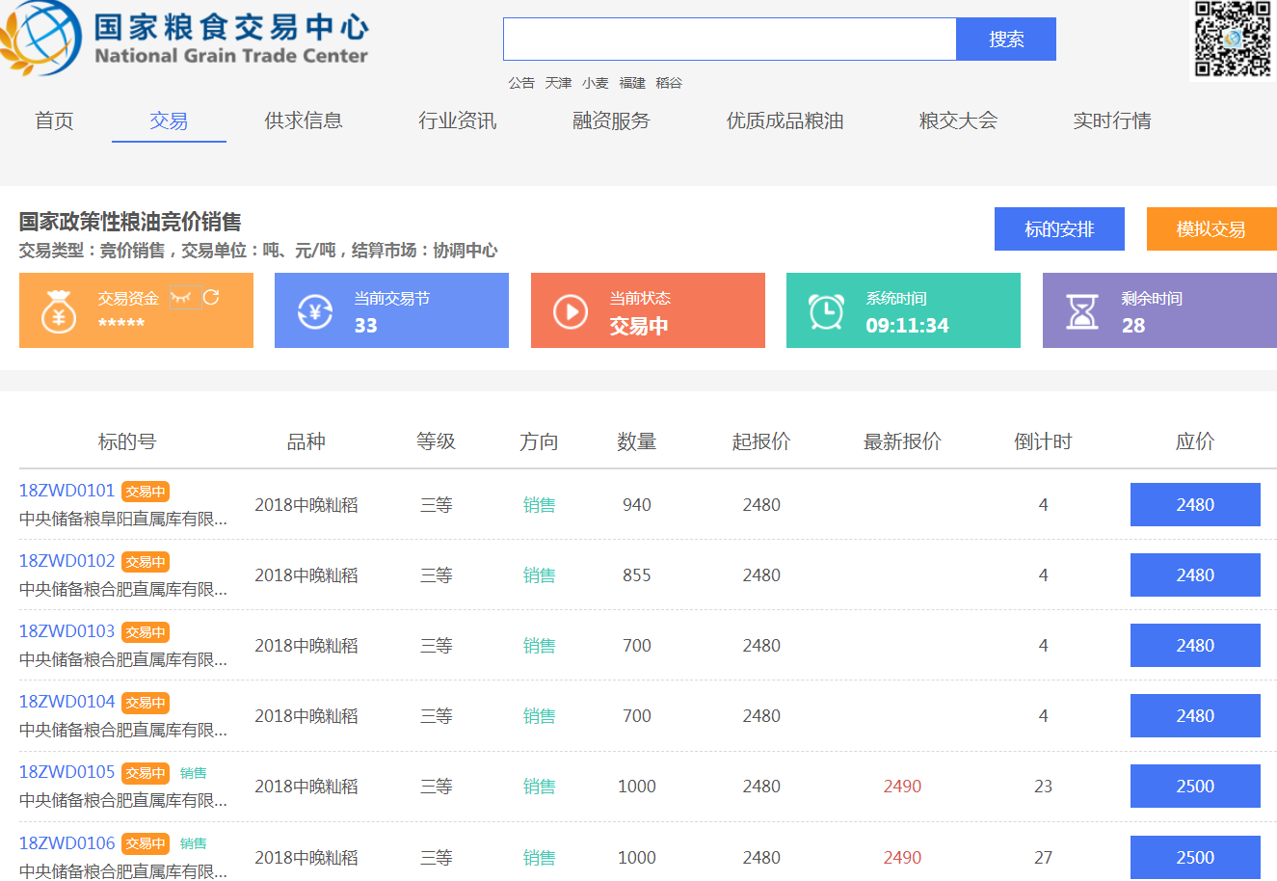
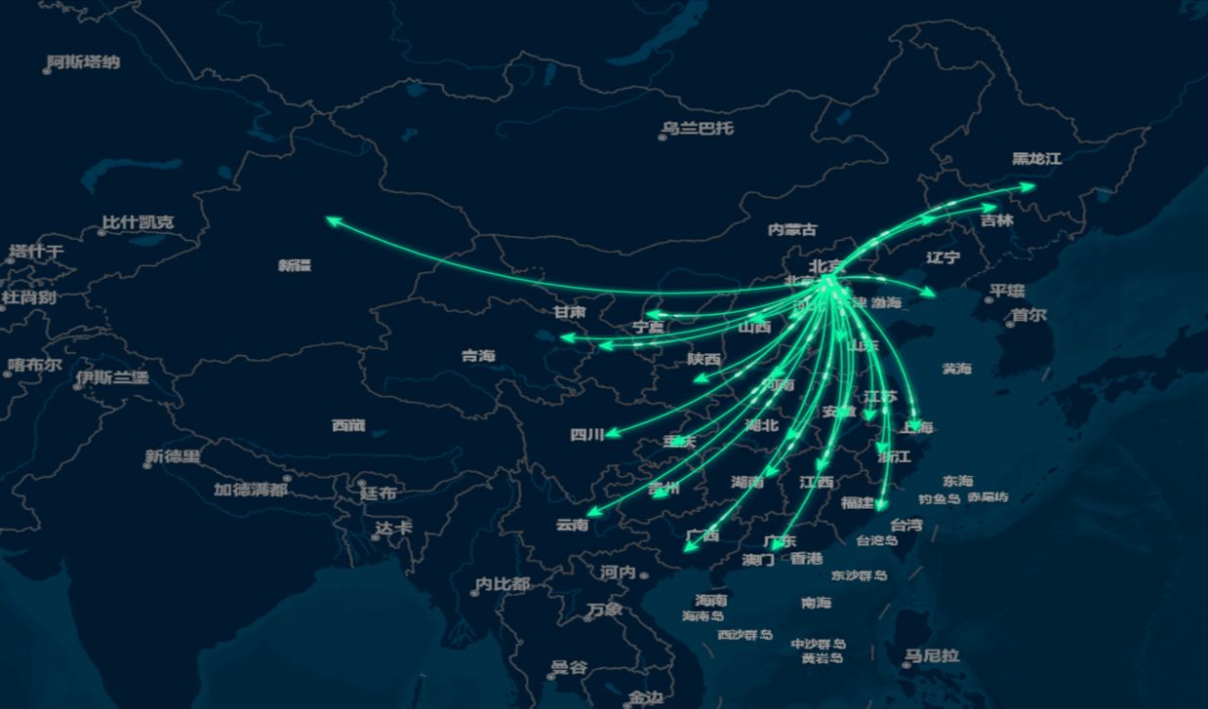
探索转型时期
Exploration & Transition Period
构建国家平台
Building the National Platform
传统拍卖模式
Conventional Auction
2006年以前Before 2006
2006-2015年
2006-2015
2016年以来Since 2016

Slide 5
现场举牌拍卖存在诸多问题
Problems exist in on-site bidding auction
中介环节多
Process with Multiple Intermediaries
存在暗箱操作、恶意串标、盲目竞标等损害交易者利益的行为，交易无序。
Unscrupulous practices such as behind-the-scenes manipulation, malicious bid rigging and blind bidding that harm the interests of traders and lead to disorderly trading
交易成本高
High Trading Costs
交通、住宿、餐饮等费用提高采购成本、时间成本高。
Increased procurement and time costs due to transportation, accommodation, and dining expenses
信息不对称
Information Asymmetry
不能体现 “公开·公平·公正”的交易原则。
Fail to adhere to the principles of openness, fairness, and equity in the trading
流通效率低
Low Circulation Efficiency
履约规则不统一，手续复杂、效率低下。
Inconsistent contract performance rules, complex procedures, and low efficiency

Slide 6
粮食电子竞价交易势在必行
Imperative electronic grain bidding trading
国家有关部门积极探索在电子商务带动下与现代电子信息技术相结合的新型粮食流通模式，构建符合国情的粮食电子化交易系统，逐步形成公平竞争、规范有序、全国统一的粮食交易大市场。
Relevant national departments have actively explored new grain circulation models that are driven by e-commerce and combine with modern electronic information technology, built a grain electronic trading system in line with national conditions, and gradually formed a fair, competitive, standardized, orderly, and nationally unified grain trading market.
进一步规范粮食现货交易活动，降低流通成本、提高交易透明度、防范交易过程中恶意串标、盲目竞标等行为，粮食流通“中介环节多、信息不对称、交易成本高、流通效率低”等问题亟待解决。
To further regulate spot grain trading, reduce circulation costs, increase transparency in the trading, and prevent malicious activities such as bid-rigging and blind bidding, it is urgent to address issues such as “multiple intermediaries, information asymmetry, high trading costs, and low circulation efficiency” in grain circulation.
技术有支撑Technological Support
21世纪初，电子商务几乎席卷所有行业，粮食行业也在与电子商务进行对接，创造一种全新的粮食现货销售组织形式--由面对面到网上见，快捷高效完成交易。
In the early 21st century, e-commerce had swept through almost all industries, and the grain industry has also integrated with e-commerce to create a new form of spot grain sales - from face-to-face to online transactions, enabling quick and efficient trading.
政府有引导Government Guidance
现实有需求
Realistic Demand

Slide 7
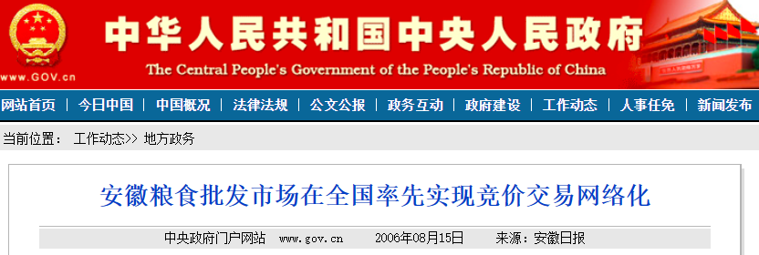
粮食电子竞价交易拉开序幕
Electronic grain bidding trading commences
2006年8月14日，记者从安徽省粮食局获悉，自8月8日湖南汉寿县金玉米业有限公司，成为全国首个通过互联网成功购买到最低收购价稻谷标的的客户后，又有4笔网上交易成功，标志着安徽粮食批发交易市场在全国率先实现竞价交易网络化的新突破。
On 14 August, 2006, according to Anhui Provincial Food and Strategic Reserves Administration, it was reported that since August 8, when Hunan Hanshou County Jinyu Rice Co., Ltd. became the first customer in the country to successfully purchase rice at the minimum purchase price through the internet, another 4 online transactions were successfully conducted. This marks a new breakthrough for Anhui's grain wholesale market to take the lead in achieving networked bidding trading across the country.

Slide 8
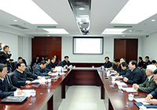
组建专门机构
Establish specialized institutions
2013年1月15日
Jan 15, 2013
2014年2月14日
Feb 14, 2014
李克强同志到国家粮食局科学研究院考察调研
Premier Li Keqiang visited the Academy of National Food and Strategic Reserves Administration.
国家事业单位登记管理局批准国家粮食局组建“国家粮食局粮食交易协调中心”
National Food and Strategic Reserves Administration was approved to establish the “Grain Trade and Coordination Center” by the State Administration for Public Institutions Registration.
2014年9月18日
Sep 18, 2014
2016年1月8日
Jan 8, 2016
国家粮食局成立国家粮食局粮食交易协调中心筹备组，搭建电子竞价交易系统并做好上线准备工作
The National Food and Strategic Reserves Administration set up a preparatory group for the Grain Trade and Coordination Center and established an e-bidding trading system, making preparations for its launch.
国家粮食电子竞价交易系统正式上线运行，标志着中国粮食交易开启新纪元
The National Grain E-Bidding Trading System was officially launched, marking a new era of grain trading in China.

Slide 9
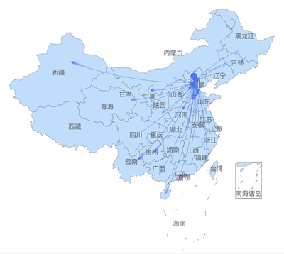
完善国家粮食交易中心体系（ 1+30 模式）
Improve the national grain trade center system (1+30 model)

Slide 10
拓展平台功能
Expand platform functionalities
交易功能（构建新型粮食购销体系）
粮食品种：原粮、成品粮
交易方式：竞价、邀标、定向、挂牌、协商、购销一体化
交易主体：向生产者和消费者两头延伸
Trading (building a new grain buying and selling system)
Grain types: raw and finished grain.
Trading methods: bidding, invitation, targeted, listing, negotiation, integrated buying and selling.
Trading parties: both producers and consumers.
信息功能（形成价格风向标）
系统数据真实准确权威
粮油市场价格信息采集、分析和发布体系
粮食监测预警委员会
Information (forming a price guide)
Accurate and authoritative system data.
A system collecting, analyzing, and releasing grain and oil market price information.
Grain monitoring and early warning committee.
融资功能（缓解粮企贷款难）
监管账户确保资金走向安全
仓单融资、订单融资、物流融资、供应链融资
交收库建设
Financing (alleviating difficulty in obtaining loans for grain companies)
Regulatory account to ensure the safety of capital flows.
Warehouse receipt financing, order financing, logistics financing, and supply chain financing.
Construction of delivery warehouse.
物流功能（助力打通北粮南运通道）
整合社会既有物流资源
结合交收库组织仓单交易
掌控粮源有效防范风险
Logistics (facilitating the integration of grain transportation channels from the North to the South)
Integrating existing social logistics resources.
Coordinating with delivery warehouses to organize warehouse receipt trading.
Controlling grain sources to prevent risks.

Slide 11
02
国家粮食交易平台建设成效
Achievements of Building the National Grain Electronic Trading Platform

Slide 12
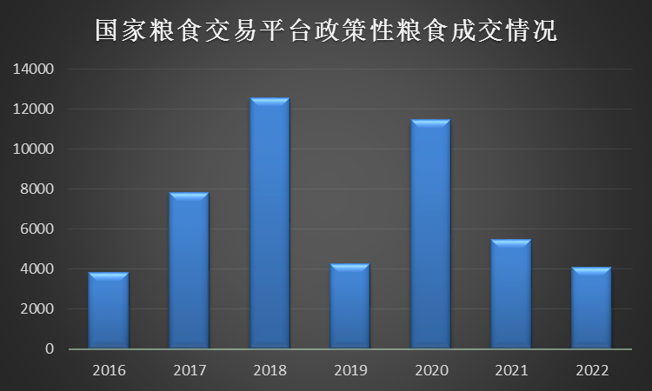
（一）服务粮食宏观调控
I. Support Macroeconomic Regulation of the Grain Industry
2016年至今，国家粮食交易平台组织粮食竞价交易会2万余场次，累计成交粮油6亿吨，成交额1.2万亿元。充分发挥粮食库存消化主渠道作用，有效促进粮食产销衔接和粮食流通体制改革，更好地服务粮食宏观调控。
Since 2016, the National Grain Trading Platform has organized over 20,000 grain auctions, with a cumulative trading volume of 600 million tons of grain and oil and a turnover of RMB 1.2 trillion, giving full play to its major role of destocking the grain, effectively promoting the connection between grain production and sales and the reform of the grain circulation system, and better regulating the grain industry from a macro perspective.

Slide 13
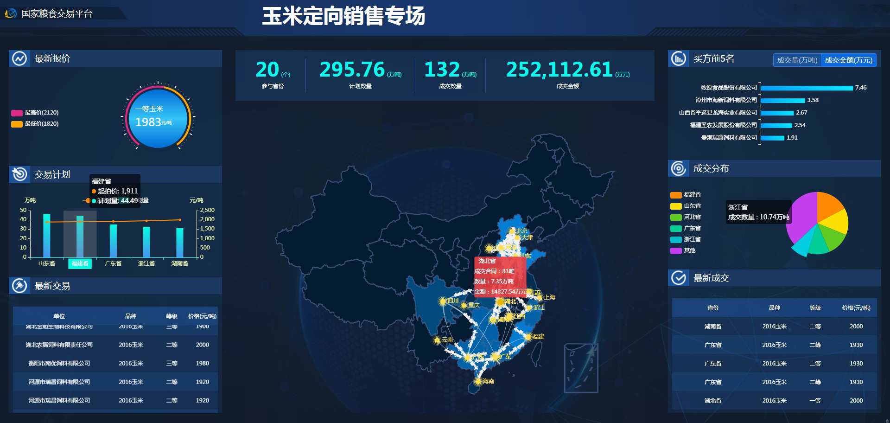
（二）服务疫情防控
II. Assist in COVID-19 Pandemic Prevention and Control
2020年2月，受新冠疫情影响，湖南湖北养殖企业饲料原料供给告急，及时通过平台举办专场粮食交易会，定向销售存储在当地小麦和稻谷367万吨、玉米296万吨，适时地保障了封控区域市场有效供给。
In February 2020, the feed raw materials for breeding enterprises in Hunan and Hubei were in short supply due to the COVID-19 pandemic. A special grain trade fair was held on the platform timely, selling 3.67 million tons of wheat and rice and 2.96 million tons of corn stored in local areas, effectively ensuring the stable supply of the locked-down regions.

Slide 14
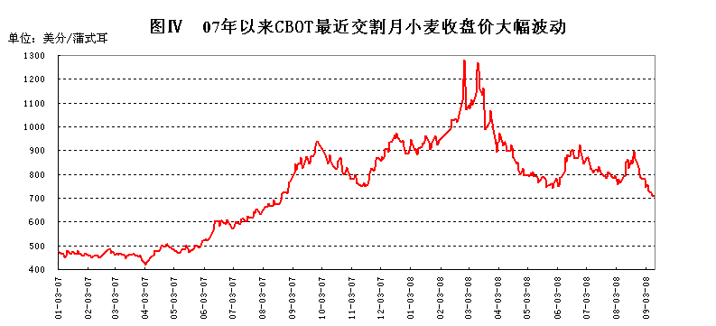
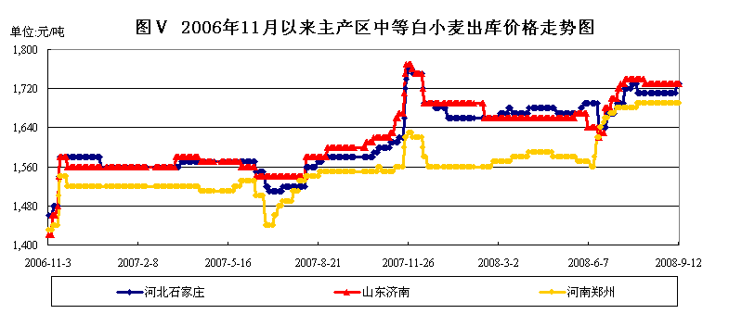
（三）服务保供稳市
III. Stabilize Grain Supply and Market
07年以来CBOT最近交割月小麦收盘价大幅波动
Significant price fluctuations in CBOT wheat closing prices for the most recent delivery month since 2007
06年11月以来主产区中等白小麦出库价格走势图
Ex-warehouse price trend of medium-grade white wheat in the main production areas since November 2006
Shijiazhuang, Hebei
Jinan, Shangdong
Zhengzhou, Henan

Slide 15
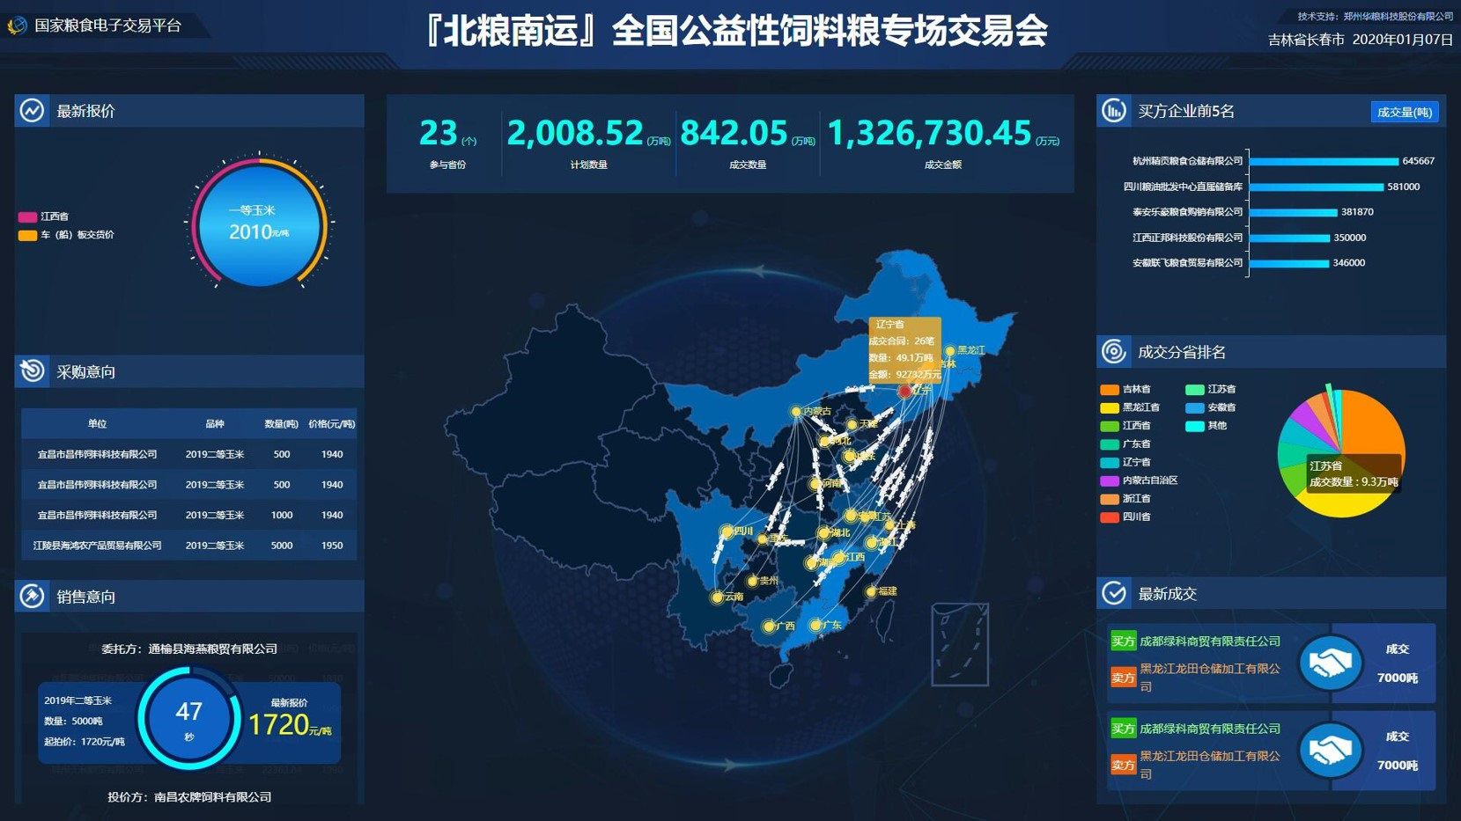
2020年1月在吉林长春举办“全国公益性饲料粮专场交易会”，通过平台组织粮源2009万吨，成交842万吨。促进北粮南运和玉米产销衔接，有效缓解市场流通压力。
In January 2020, the “National Public Welfare Feed Grain Trade Fair” was held in Changchun, Jilin Province. Through the platform, 20.09 million tons of grain were organized, with a turnover of 8.42 million tons. The transportation of grain from the north to the south and the connection between corn production and sales were therefore effectively promoted to alleviate the pressure of market circulation.
（四）服务产销衔接
IV. Connect Production and Sales

Slide 16
（五）服务乡村振兴和产业扶贫
V. Facilitate Rural Revitalization and Poverty Alleviation
利用平台会员众多等资源优势，积极帮扶贫困地区实现优粮优价、优粮优销。先后组织开展安徽阜南优质小麦、宁夏枸杞专场交易会，成交阜南小麦20余万吨，宁夏枸杞95吨。
Leveraging the resources and abundant members of the platform to actively support poverty-stricken areas to achieve better prices and sales for their quality grains. Special trade fairs have been successively organized for crops such as high-quality wheat from Funan, Anhui, and goji berries from Ningxia, with a turnover of more than 200,000 tons of wheat in Funan and 95 tons of goji berries in Ningxia.

Slide 17
03
支持加纳农产品交易电子化
Support the Electronic Trading of Agricultural Products in Ghana

Slide 18
国家粮食交易中心愿意为加纳构建农产品电子竞价交易提供帮助。一方面可以提供技术支持，另一方面还可以提供人员培训等工作。
The National Grain Trade Center is willing to help Ghana to build an electronic bid trading system for agricultural products by providing technical support, personnel training and other assistance.
进一步加强中加两国沟通交流。
Further strengthen communication and exchanges between China and Ghana.

Slide 19
THANKS FOR LISTENING
感谢您的聆听
Notes:
唐峰设计：https://v.youku.com/v_show/id_XNTg4OTcwMDM3Ng==.html

