Slide 1


WFP’s CONTRIBUTION TO BUILDING RESILIENCE IN THE CONTEXT OF THE GLOBAL FOOD CRISIS
By Volli Carucci, Director - Resilience and Food Systems Service (PROR) – Rome, HQ
Beijing - 25 May 2023

Slide 2

1. Context

Slide 3
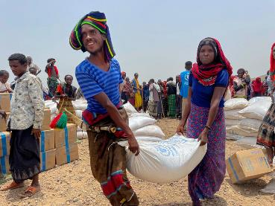
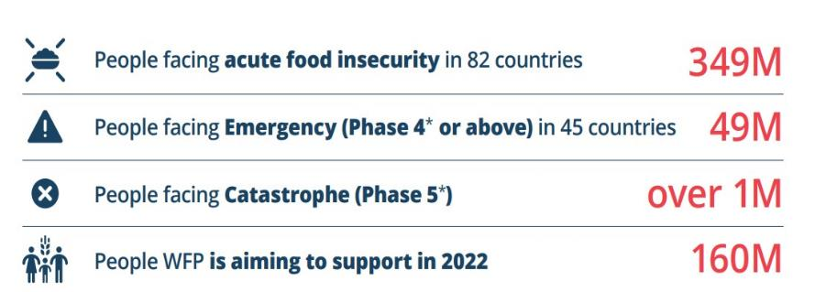
The Global Food Crisis in Numbers: clear and present danger
Update on the Global Food Crisis fuelled by Ukraine conflict, climate shocks, COVID and spiralling costs of food, fuel and fertilizer (Dec 2022)
Responding to urgent needs: an absolute priority now
Restoring ecosystems functions: an obligation for the future

Slide 4
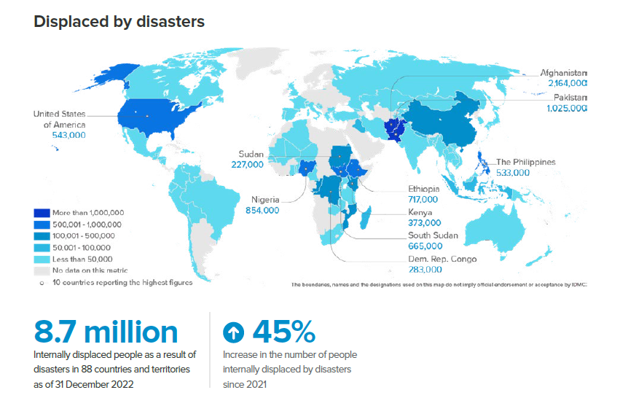
Climate disasters on the rise compounding on multiple fragilities
Internal Displacement Monitoring Centre (IDMC)’sternal Displacement

Slide 5


Climate shocks fall on existing fragilities and intensifies their impacts – examples….
    Water scarcity:
    3.2 billion people live in agricultural areas with high to very high water shortages or scarcity.
1.2 billion of them live in severely water-constrained agricultural areas mostly in developing countries (SOFA, 2021).
2 billion people lack safely managed drinking water services.
3.6 and 2.3 billion people lack safely managed sanitation services and basic handwashing facilities respectively (UN WATER, 2021).
    Soils degradation: Globally, up to 40% of land is degraded, directly affecting half of the world population, especially rural communities. (UNCCD, 2022)
About 2 billion people live on the drylands that are vulnerable to desertification, which could displace an estimated 50 million people by 2030 (UNCCD 2022).
Vulnerable communities — including the rural poor, smallholder farmers, women, youths, and Indigenous peoples — are disproportionately affected by land degradation and drought (UNCCD 2022).

Slide 6
2. Priority actions & examples

Slide 7
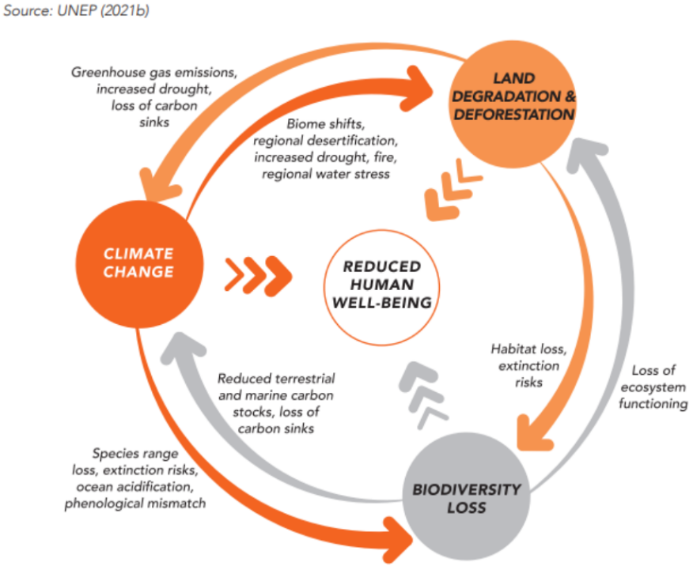
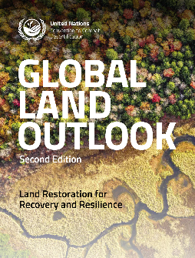
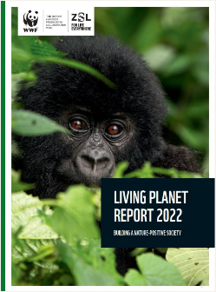
NOT ONLY A CLIMATE EMERGENCY…
FOOD SECURITY
… BUT ALSO, AN ENVIRONMENTAL ONE

Slide 8
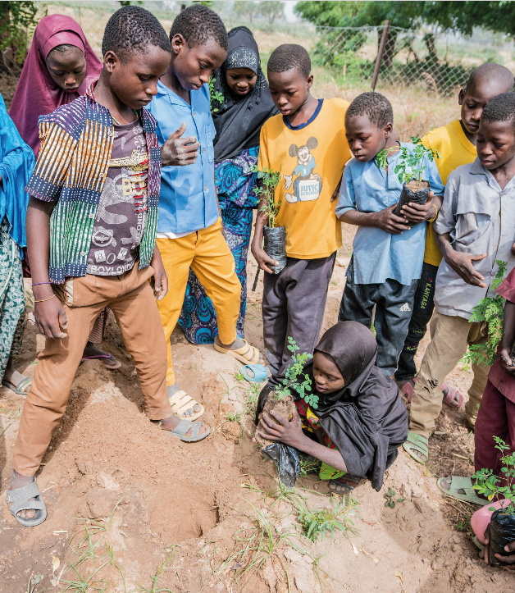
The importance of livelihood assets creation as foundational activities for resilience, including climate
  Asset creation is the biggest adaptation-oriented activity within WFP.
  Asset Creation and Livelihoods (with or without food assistance) promotes the building or rehabilitation of assets that improve soil and water management and availability and regenerate landscapes.
  More than 9.9 million beneficiaries reached in 2022.
  Communities and partnerships at the centre of the approach.
  Mitigation co-benefits.

Slide 9
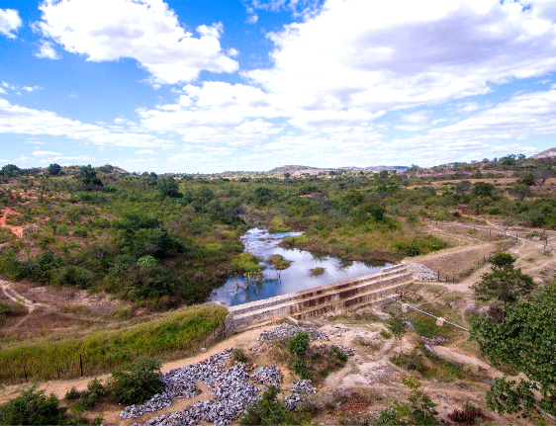
ASSET CREATION AND ADAPTATION I
Protecting (and rehabilitating) from major climatic shocks:
Protecting Communities from Floods
(Pakistan)
Water Storage for Drought periods
(Zimbabwe)

Slide 10
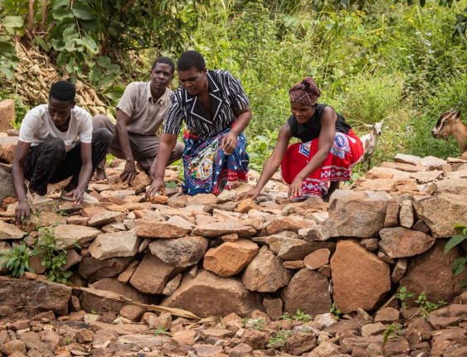
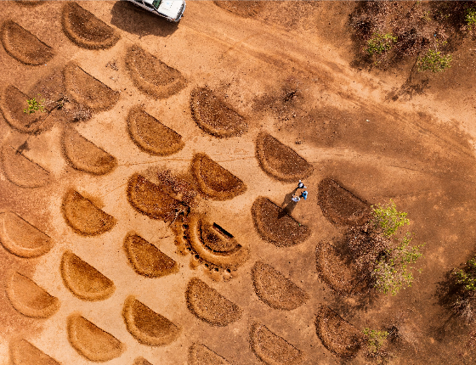
ASSET CREATION AND ADAPTATION II
Lowering stressors (Environmental Degradation):
(Re)building check dams for SWC
(Malawi)
Land Restoration efforts
(Niger) + Mitigation Co-Benefits

Slide 11
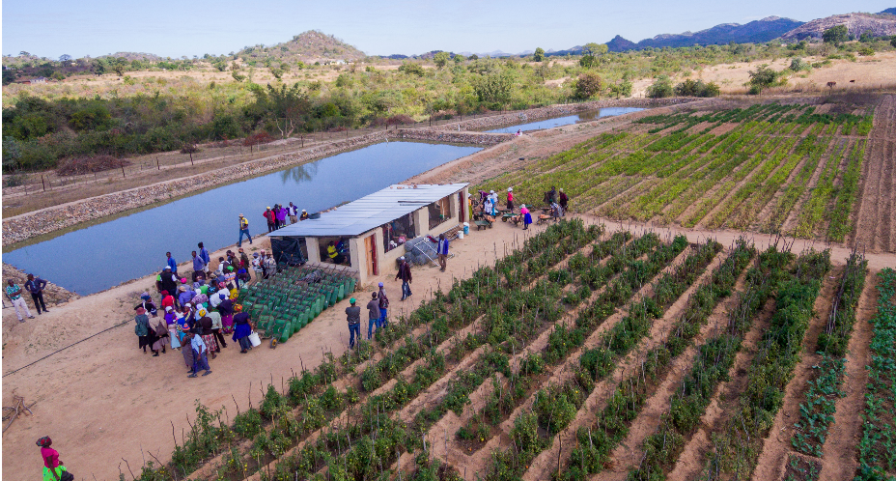
ASSET CREATION AND ADAPTATION III
Improving livelihoods & reducing climate sensitivity:
Irrigation facilities, fishponds, solar water pumps and chicken coops (Zimbabwe)

Slide 12
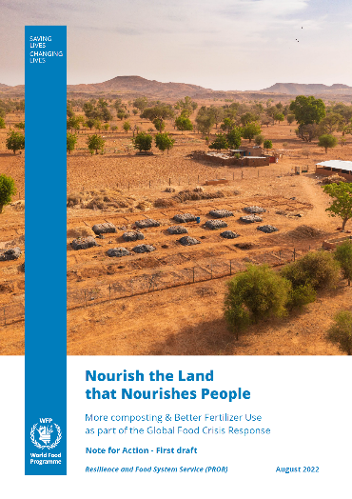
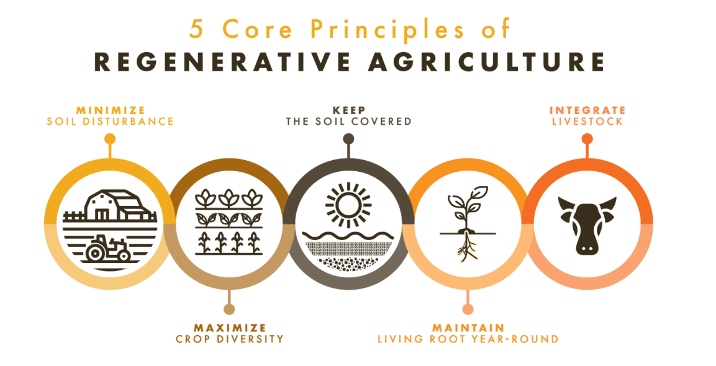
ATTENTION TO SOIL HEALTH
Adaptation + Mitigation

Slide 13
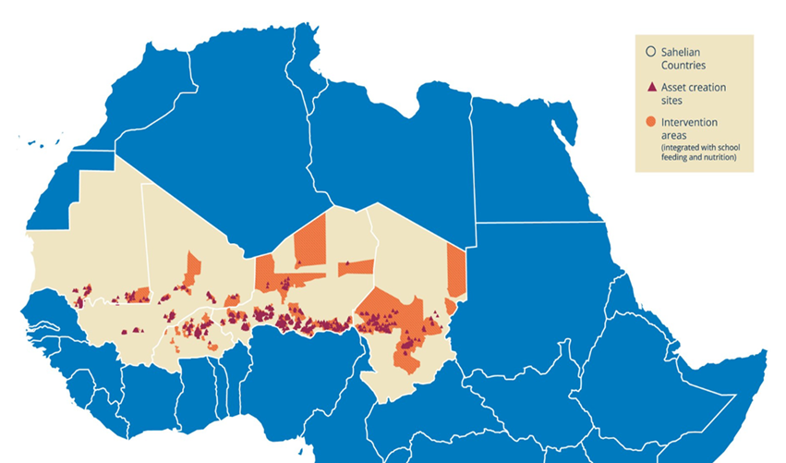
Integrated resilience: reducing humanitarian needs whilst generating co-benefits for climate, social cohesion and agroecology
  G5 Countries (Mauritania, Mali, Burkina Faso, Niger, Chad).
  Multiple challenges: high levels of food insecurity and malnutrition, unequal access to basic services, poorly integrated markets, land degradation, droughts and erratic rainfall.
  Climate change a major aggravating factor.
  Insecurity, instability and migration across the region and beyond is increasing.
Notes:
G5 or «Group of Five»

Slide 14
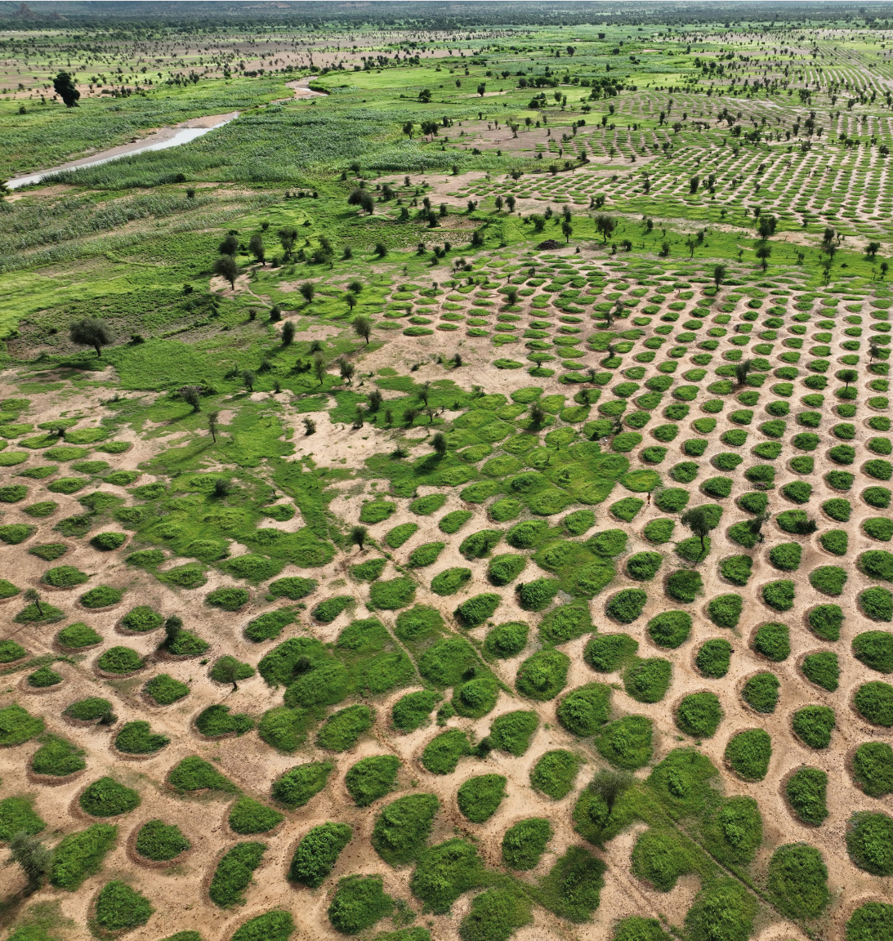
  https://www.wfp.org/publications/integrated-resilience-sahel
THE APPROACH
  Restoring ecosystems through asset creation.
  Promoting the (re) introduction of drought resistant crops (e.g. millet, sorghum, etc.)
  Providing nutritious school meals.
  Delivering nutrition-specific and nutrition-sensitive interventions.
  Supporting smallholder farmers to reduce post-harvest losses, develop value chains, and increase access to markets.
  Capacity strengthening of government institutions, local communities and academia
  Integrating lean season food/cash and nutrition support to safeguard resilience gains during the peak hunger period.
  Integrate and layer EW and Anticipatory Action, financial protection and other efforts

Slide 15
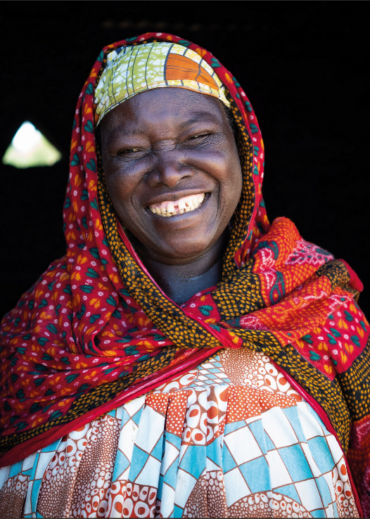
RESULTS I
  Food consumption remained stable or improved.
  Resilience interventions contribute to reducing humanitarian needs.
    During one of the worst droughts in decades, 80% of WFP resilience villages that had previously participated in asset creation activities and located in highly affected areas did not require humanitarian assistance.
  Improved access to natural resources.
    220,300 ha land rehabilitated.
    55% increase in vegetative cover in treated areas.
    In Niger, Carbon sequestration potential of 4.8 million of Co2 up to 2030.
  https://www.wfp.org/publications/integrated-resilience-sahel

Slide 16
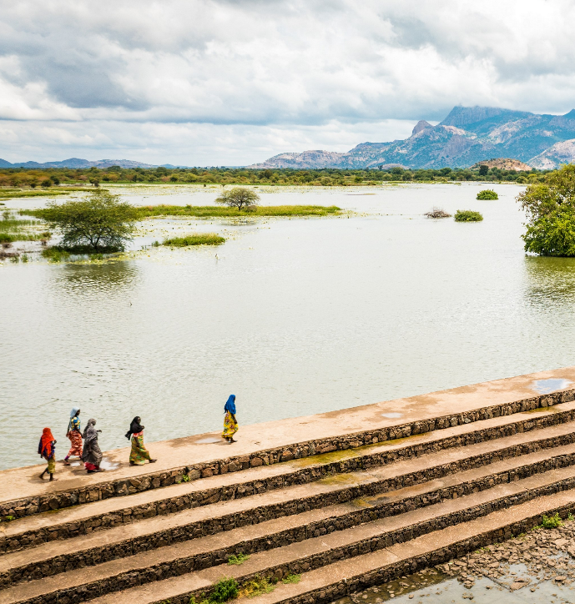
RESULTS II
  Better Protection against climate hazards.
    On average, 71% of households found that the assets created or rehabilitated in their communities contributed to the protection of their household, their belongings and their production capacities (fields, equipment, etc.) against the impacts of floods and/or droughts.
  Reduction of hardships for water and energy (75% HH).
  Improved access to services and markets (77% HH).
  Social inclusion and empowerment.
  https://www.wfp.org/publications/integrated-resilience-sahel

Slide 17
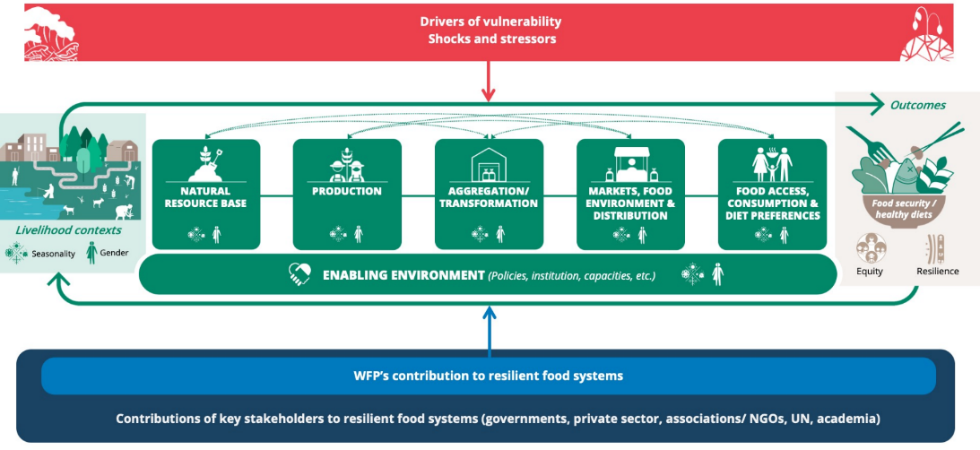
1. Work at ‘resilient food systems’ for food security and healthy diets in the face of multiple shocks and stressors (contexts getting more complex and difficult)
2. Put people, territories and local foods at the centre of planning
3. Invest in making more resilient the FS segments where we can leverage our programmes and services
A FEW REFLECTIONS & WAY FORWARD

Slide 18
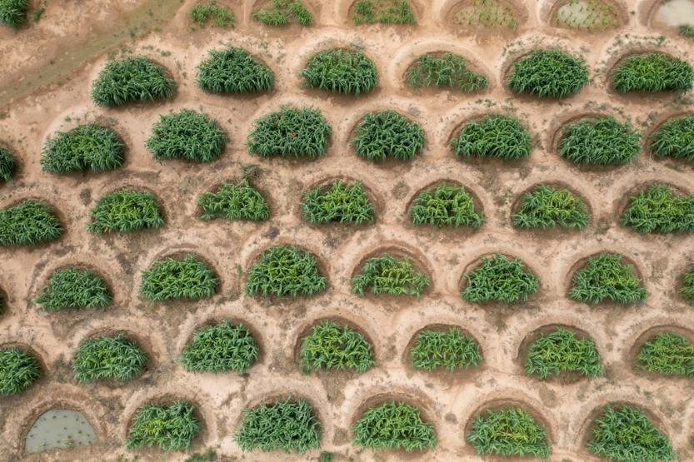
THANK YOU

