Slide 1
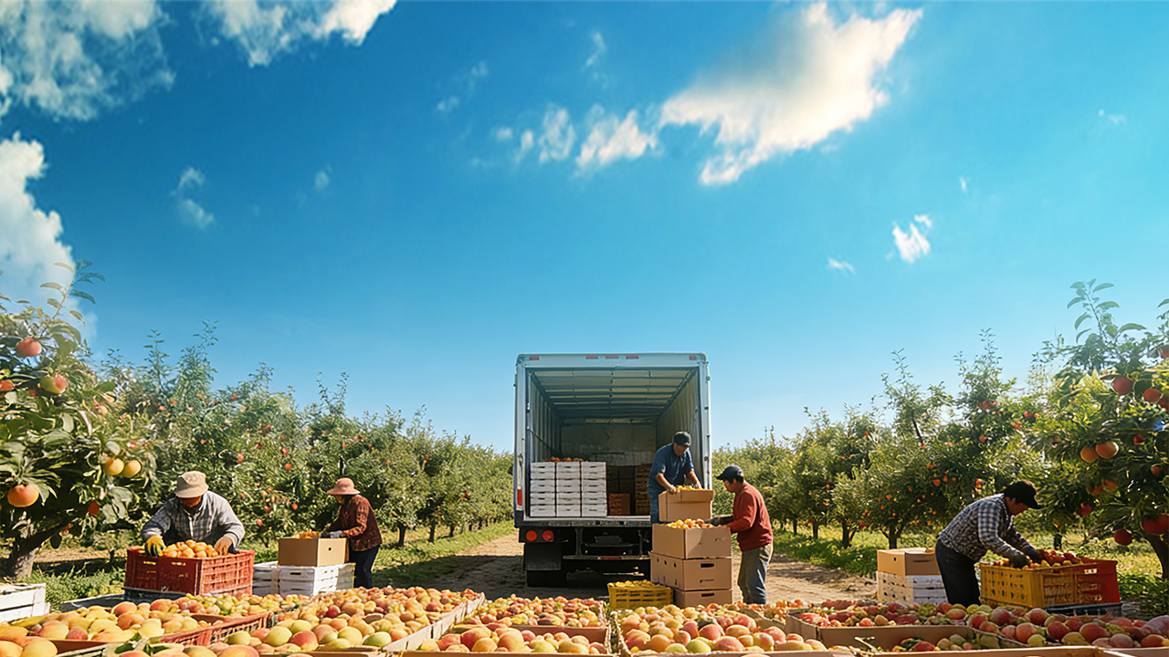

Postharvest Quality Deterioration and Preservation/Loss Reduction Technologies in Fruits and Vegetables
Notes:
果蔬采后品质劣变及保鲜减损控制技术
Postharvest Quality Deterioration and Preservation/Loss Reduction Technologies in Fruits and Vegetables

Slide 2

PART.02
Postharvest Preservation and Loss-Reduction Technologies for Fruits and Vegetables
Notes:
接下来我们进入本课程的第二模块——果蔬采后保鲜减损技术。
Next, we move on to the second module of this course — Postharvest Preservation and Loss-Reduction Technologies for Fruits and Vegetables.

Slide 3
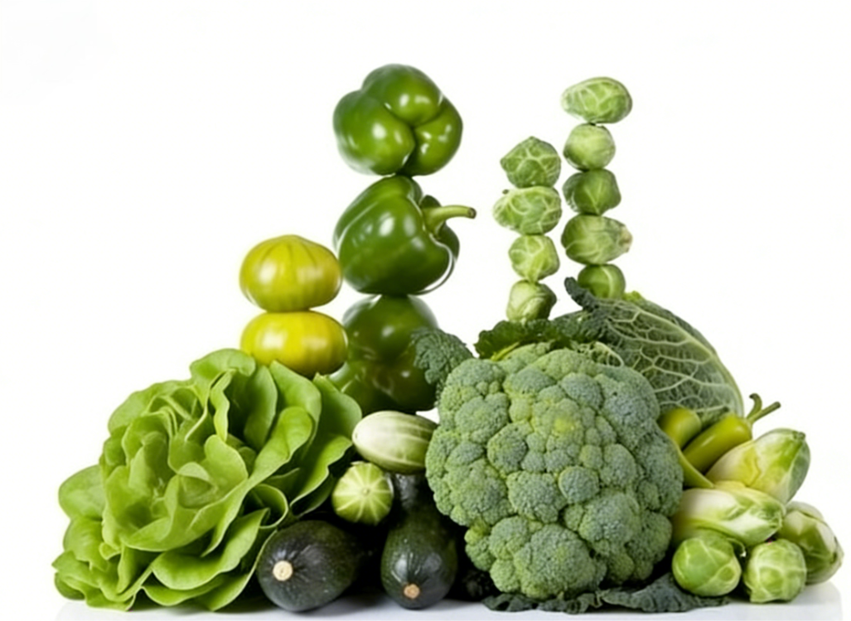
Key Technical Elements
Across the Entire Postharvest Chain
01
Harvesting
02
Grading
03
Precooling
04
Packaging
05
Storage
Key Control Measures at Each Stage
Farm-to-Table
Notes:
本模块将系统讲解果蔬从采收、分级、预冷、包装到贮藏的全链条技术要点，聚焦“从农场到餐桌”各环节的关键控制措施，帮助大家掌握科学的保鲜减损方法。
本部分内容将分为五个核心环节展开，现在我们首先学习第一个环节：采收技术。
This module systematically introduces the key technical elements across the entire postharvest chain, including harvesting, grading, precooling, packaging, and storage.
It focuses on key control measures at each stage of the “farm-to-table” supply chain, aiming to help learners master scientific methods for postharvest preservation and loss reduction.
This module is organized around five core stages. We begin with the first stage: harvesting technologies.

Slide 4
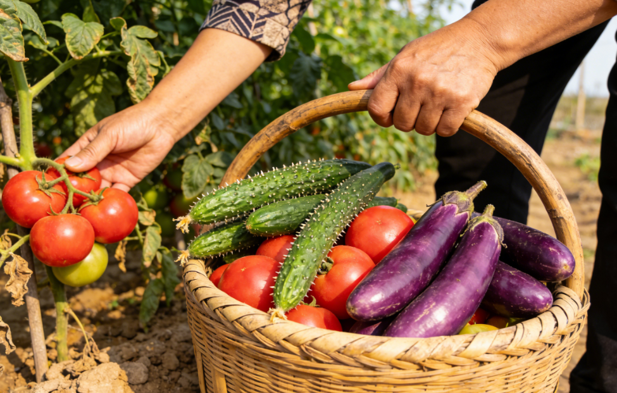

1. Harvesting of Fruits and Vegetables
(1) Harvesting Methods — Manual Harvesting
Overview
  Two harvesting categories: manual harvesting & mechanical harvesting.
Operational Advantages of Manual Harvesting
  Minimizes mechanical damage to both the produce and the plant.
  Highly flexible, allowing harvesters to precisely adjust actions according to specific characteristics and sizes of different fruits and vegetables.
  Accommodates a wide range of crop types.
Quality & Maturity Control Advantages of Manual Harvesting
  Enables precise control over harvest timing and standards.
  Allows for selective and staggered harvesting based on differences in individual maturity levels.
  Ensures quality of mature produce + gives immature fruits and vegetables additional time to develop.
Effectively improves overall yield and harvest quality.
Notes:
一、果蔬采收
1.采收方法—人工采收
果蔬采收主要分为人工采收和机器采收两类。人工采收的核心优势在于能最大程度减小果蔬及植株的机械损伤，且操作灵活性极强，采收人员可根据不同果蔬的性状、大小精准调整采收动作，适配多样果蔬的采收需求。同时，人工采收便于精准控制采收节奏与标准，可针对果蔬个体成熟度的差异进行分批采收，既能保障已成熟果蔬的品质，又能为未成熟果蔬预留生长时间，从而有效提升整体采收的产量与质量。
I.Harvesting of Fruits and Vegetables
1.Harvesting Methods — Manual Harvesting
Harvesting of fruits and vegetables can be broadly divided into two categories: manual harvesting and mechanical harvesting.
The primary advantage of manual harvesting lies in its ability to minimize mechanical damage to both the produce and the plant.
In addition, manual operations are highly flexible, allowing harvesters to precisely adjust their actions according to the specific characteristics and sizes of different fruits and vegetables,
thereby accommodating a wide range of crop types.
Moreover, manual harvesting enables precise control over harvesting timing and standards.
It allows for selective and staggered harvesting based on differences in individual maturity levels.
This approach not only ensures the quality of mature produce but also gives immature fruits and vegetables additional time to develop,
thereby effectively improving overall yield and harvest quality.

Slide 5
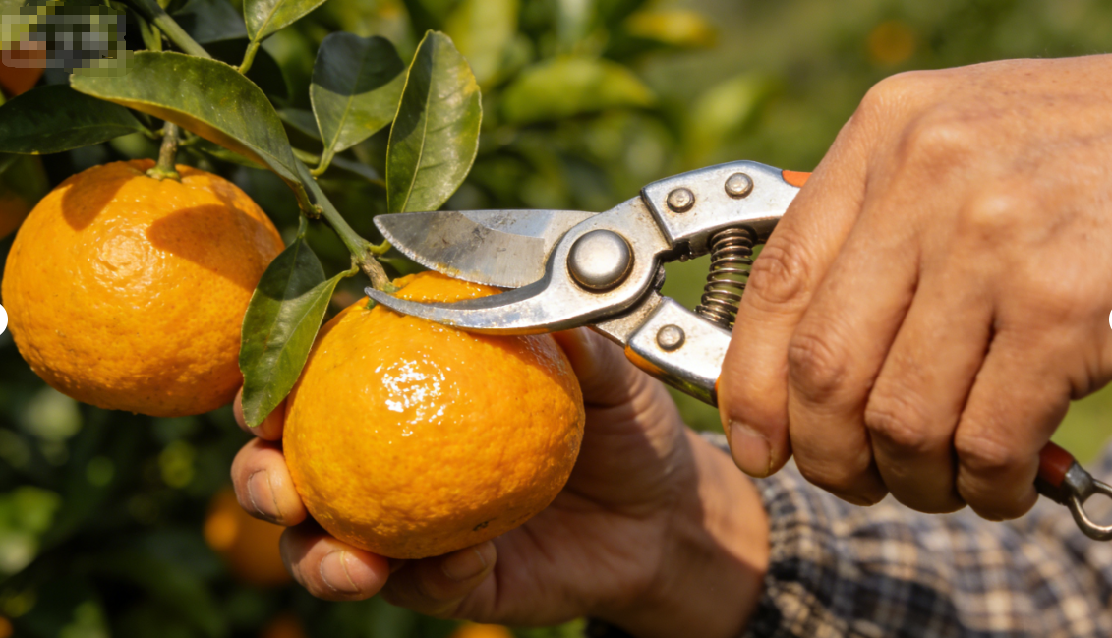
1. Harvesting of Fruits and Vegetables
(1) Harvesting Methods — Manual Harvesting
Precautions for Manual Harvesting
Core Principle
  Standardized and proper operations to reduce damage and ensure effective harvesting.
Selection of Appropriate Harvesting Tools
  Sharp, well-aligned tools suitable for the specific type of fruit and vegetable should be used (e.g., round-tip pruning shears for citrus harvesting).
  Clean all tools in advance to prevent contamination from rust or debris.
  During harvesting, produce should be cut gently and handled with care.
  Pulling, tearing, or breaking branches by hand is strictly prohibited →otherwise these actions damage plants and cause mechanical injury, potentially affecting yield in the following seasons.
Notes:
人工采收注意事项
人工采收的优势需要通过规范操作才能真正实现，为了减少损伤、保证采收效果，作业过程中要重点注意以下内容：
(1)选用合适采收工具：优先选用锋利、合缝且符合果蔬品类特性的刀具（如柑橘采收用圆头果剪），工具需提前清洁，避免锈蚀或污物污染果蔬。采收时轻剪轻放，严禁用手拉拽、掰断植株枝条，防止造成植株损伤及果蔬机械损伤，进而影响来年果实产量。
Precautions for Manual Harvesting
The advantages of manual harvesting can only be fully realized through standardized and proper operations. To reduce damage and ensure effective harvesting, the following key points should be emphasized during harvesting activities:
(1)Selection of appropriate harvesting tools
Sharp, well-aligned tools that are suitable for the specific type of fruit or vegetable should be used (e.g., round-tip pruning shears for citrus harvesting).
All tools must be cleaned in advance to prevent contamination from rust or debris.
During harvesting, produce should be cut gently and handled with care.
Pulling, tearing, or breaking branches by hand is strictly prohibited, as such actions can damage plants and cause mechanical injury to fruits and vegetables, potentially affecting yield in the following seasons.

Slide 6
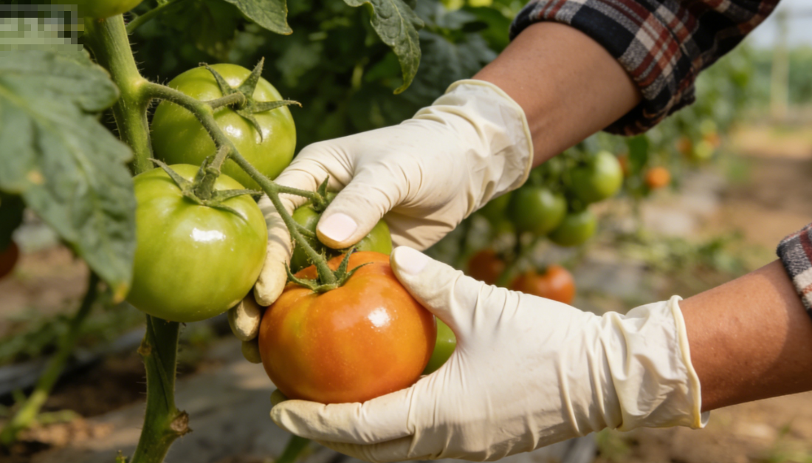
1. Harvesting of Fruits and Vegetables
(1) Harvesting Methods — Manual Harvesting
Precautions for Manual Harvesting
Proper Use of Protective Gloves
  Harvesters must wear gloves.
  → Prevents injuries from branches and thorns.
  → Prevents fingernail from scratching the surface of fruits
  and vegetables.
  → Damage to the epidermis stimulate rise in respiration rate,
  accelerates senescence & spoilage, and reduces storability.
Notes:
(2)规范佩戴防护手套：采收人员必须佩戴手套，一方面可避免手部被植株枝条、尖刺划伤，保障自身安全；另一方面能防止手指甲划伤果蔬表面，而果蔬表皮损伤会刺激其呼吸作用增强，加速果实衰老变质，显著降低耐贮藏性能。
(2)Proper use of protective gloves
Harvesters must wear gloves during harvesting operation.
This not only protects workers’ hands from being injured by branches or thorns but also prevents fingernails from scratching the surface of fruits and vegetables. Damage to the epidermis can stimulate a rise in respiration rate, accelerate senescence and spoilage, and significantly reduce storability.

Slide 7
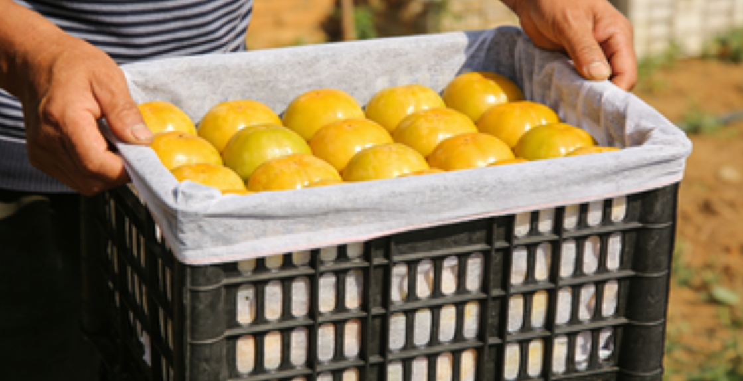
1. Harvesting of Fruits and Vegetables
(1) Harvesting Methods — Manual Harvesting
Precautions for Manual Harvesting
Use of Suitable Handling Containers
Basic Container Requirements
Appropriately sized, lightweight, sturdy, and well-ventilated.
Inner surfaces should be smooth.
Soft cushioning materials such as foam or nonwoven fabric may be used to reduce impact damage.
Avoid Improper Container Size
  Oversized containers → compression injuries to produce at the bottom due to excessive stacking.
  Undersized containers → increase turnover frequency and costs.
Proper Filling Level
  Containers generally be filled to about 80% capacity to avoid excessive stacking pressure.
Notes:
(3)选用适宜周转容器：周转箱需满足大小适中、轻便牢固、透气良好的要求，内侧需保持平滑，可铺垫软质材料（如泡沫、无纺布）减少碰撞损伤。
容器过大易导致底部果蔬被上层果实挤压受伤，过小则会增加运输频次与成本，通常装果量控制在八成满左右，避免过度堆叠挤压。
(3)Use of suitable handling containers
Harvesting containers should be appropriately sized, lightweight, sturdy, and well-ventilated. The inner surfaces should be smooth, and soft cushioning materials (such as foam or nonwoven fabric) may be used to reduce impact-related damage.
Oversized containers can cause compression injuries to produce at the bottom due to excessive stacking, while undersized containers increase turnover frequency and costs.
In practice, containers should generally be filled to about 80% capacity to avoid excessive stacking pressure.

Slide 8
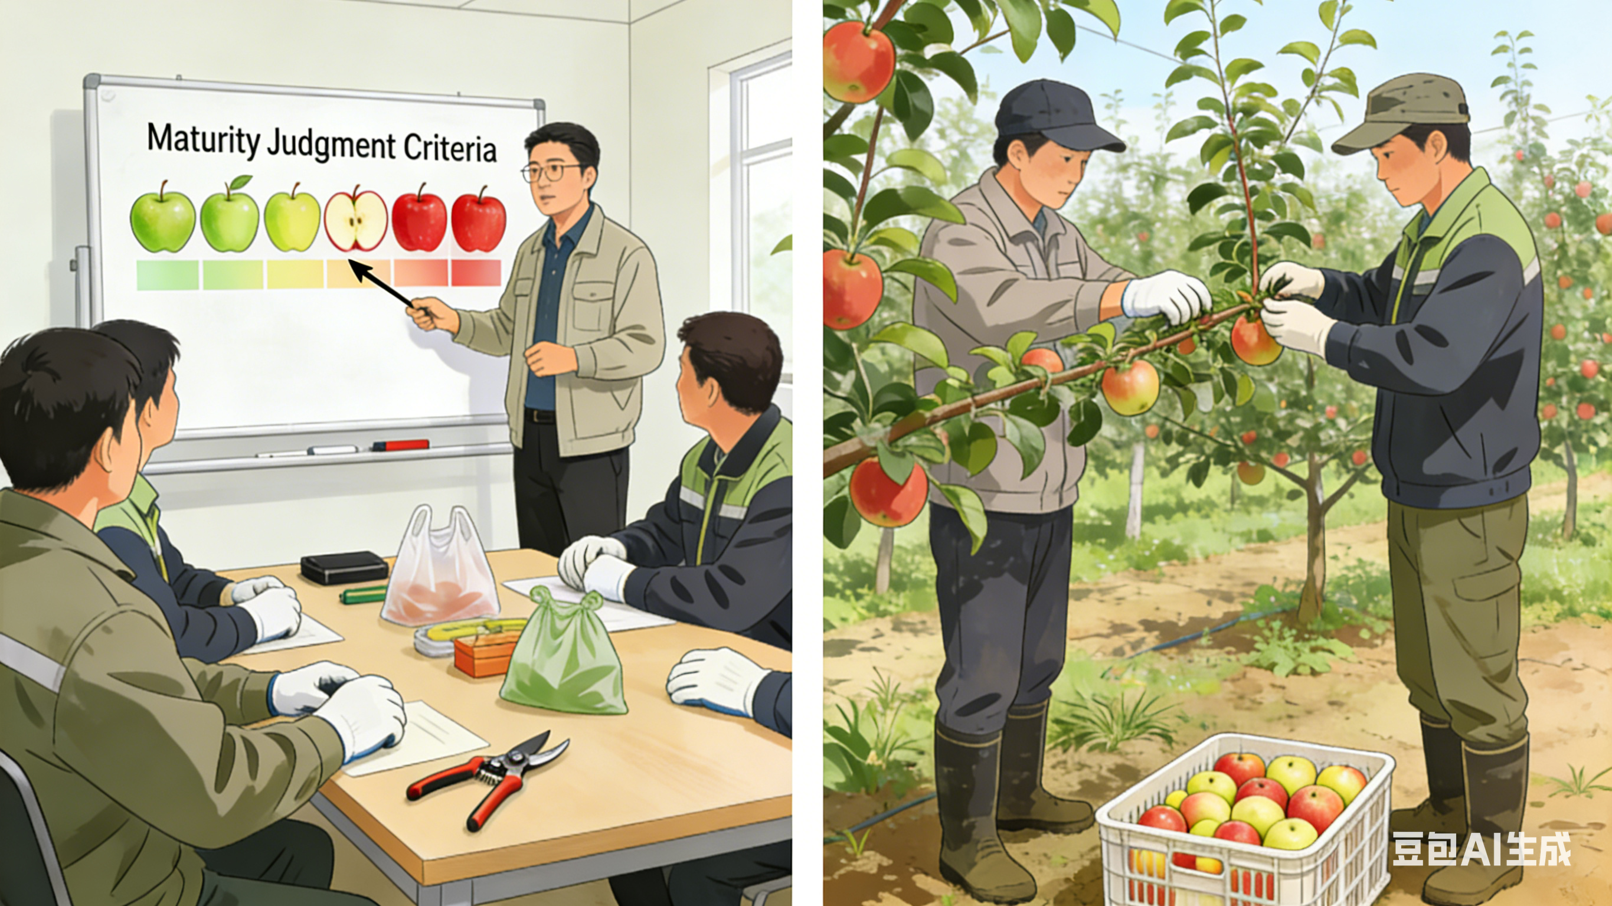

1. Harvesting of Fruits and Vegetables
(1) Harvesting Methods — Manual Harvesting
Precautions for Manual Harvesting
Strengthening Training of Harvesting Workers
Systematic Pre-Harvesting Training
  Provided to harvest workers in advance.
  Ensure workers are proficient in correct use of tools, accurate assessment of maturity indicators and quality requirements.
Purpose of Standardized Harvesting Techniques
  Help prevent damage to plant branches and harvested produce caused by improper handling.
  Ensure efficient and orderly harvesting process.
Notes:
(4)强化采收人员培训：提前对采收人员开展系统培训，使其熟练掌握工具的正确使用方法、不同果蔬的成熟度判断标准及质量要求，规范采收动作，避免因操作失误对植株枝条、果蔬产品造成损伤，保障采收工作高效有序开展。
(4)Strengthening training of harvesting workers
Systematic training should be provided to harvest workers in advance to ensure they are proficient in the correct use of tools, accurate assessment of maturity indicators for different fruits and vegetables, and quality requirements. Standardized harvesting techniques help prevent damage to plant branches and harvested produce caused by improper handling, ensuring an efficient and orderly harvesting process.

Slide 9
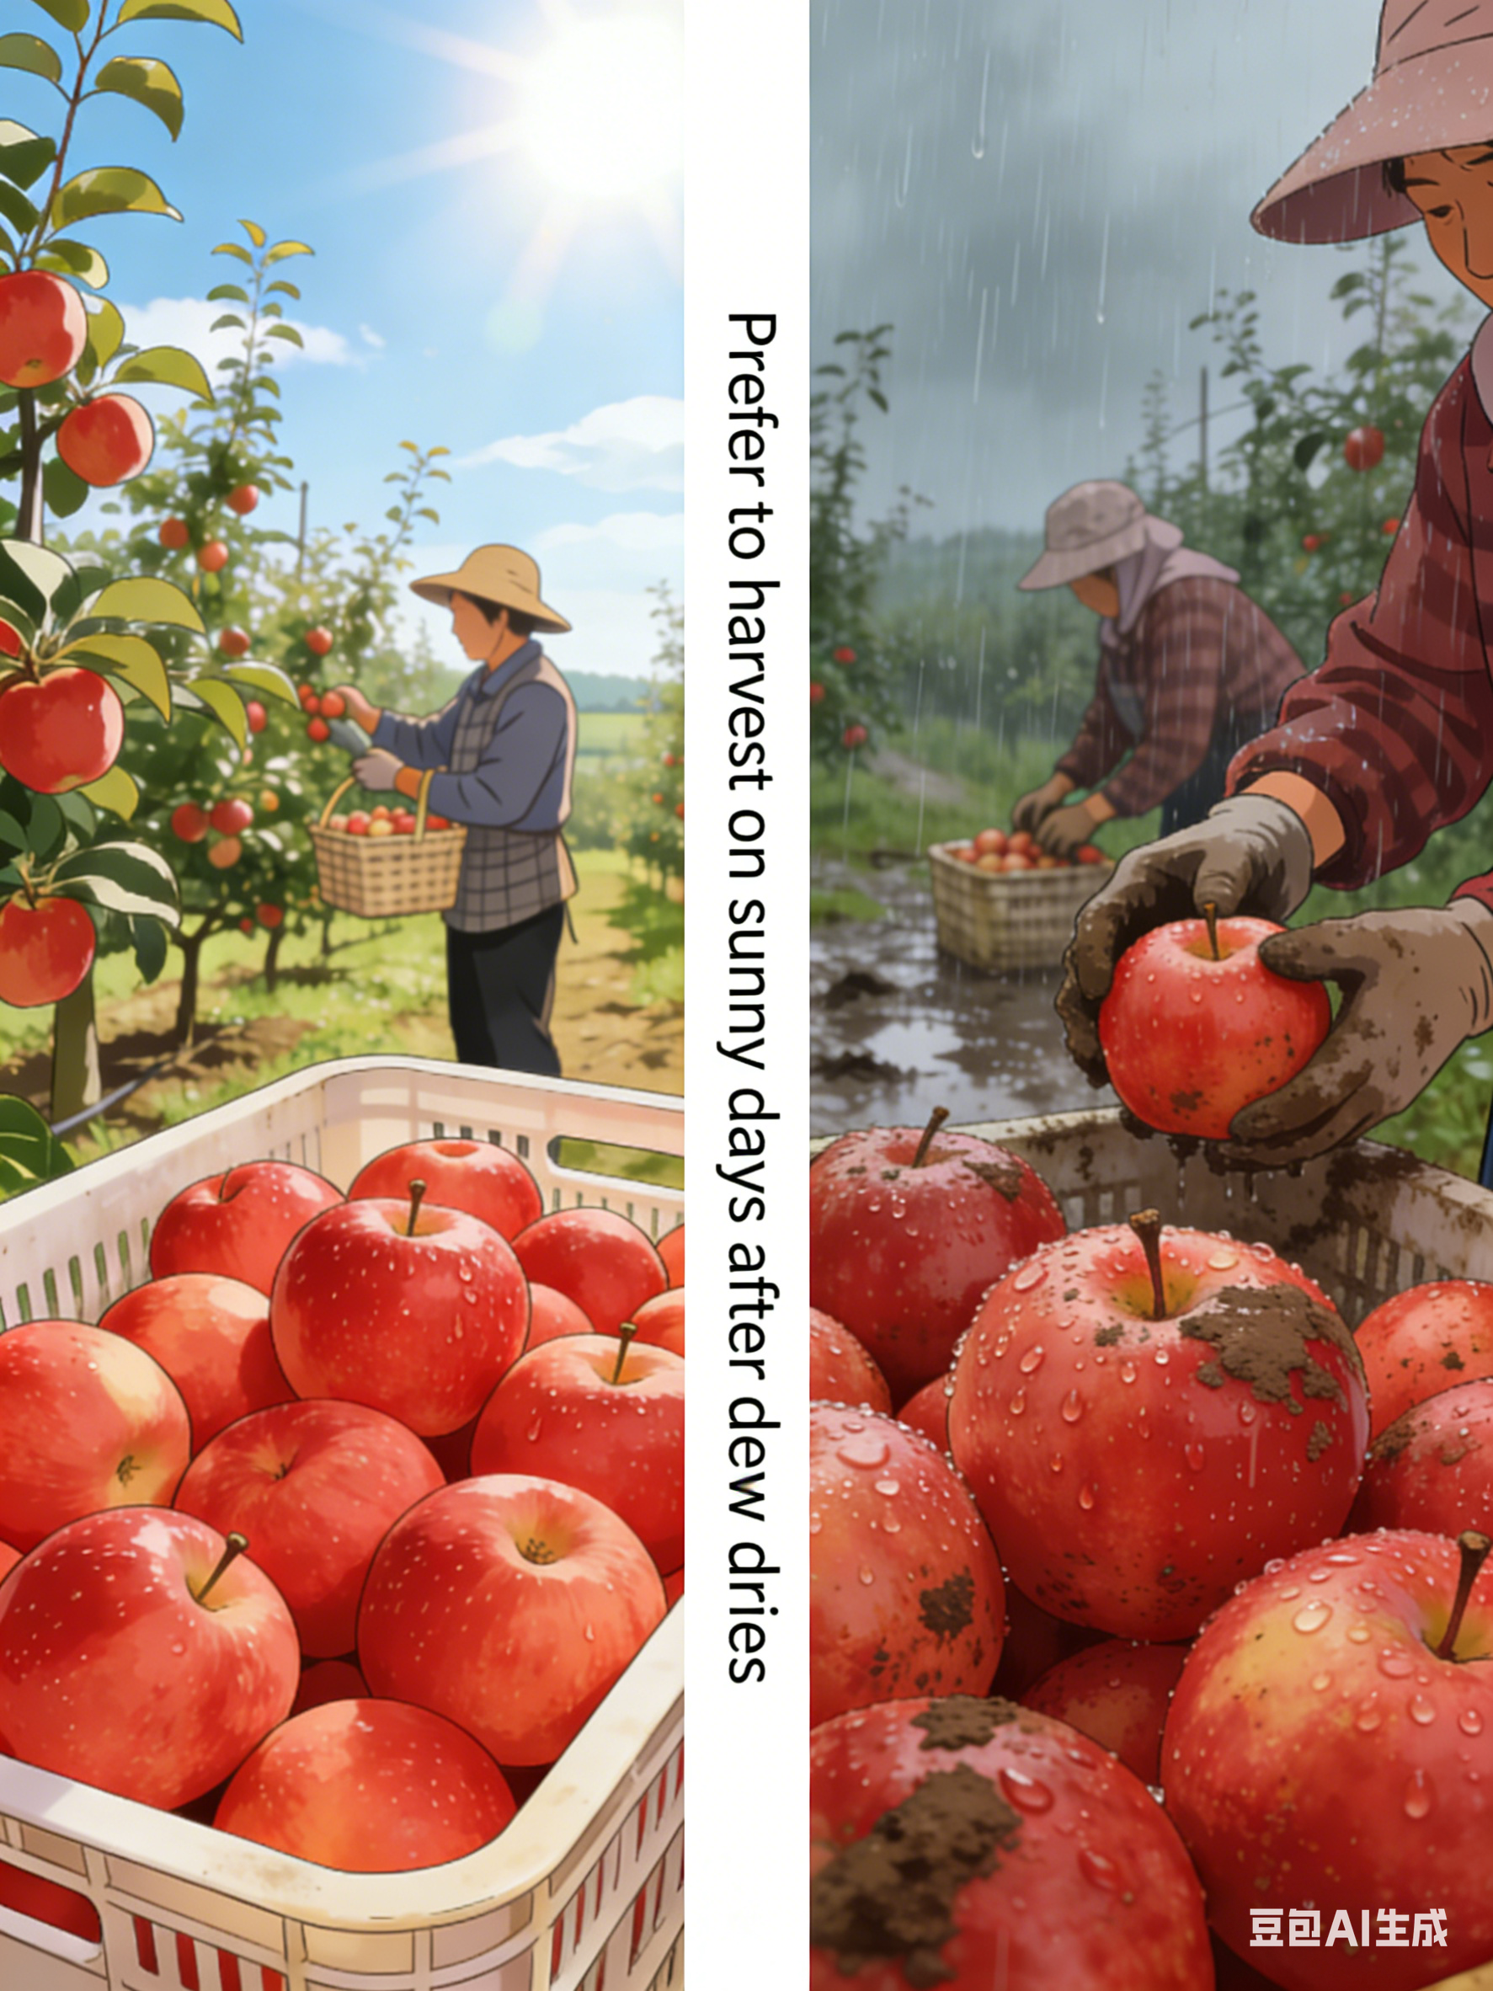

1. Harvesting of Fruits and Vegetables
(1) Harvesting Methods — Manual Harvesting
Precautions for Manual Harvesting
Selection of appropriate harvesting time
Prefer Sunny Conditions
Harvesting should be conducted on sunny days after surface dew has completely evaporated.
Avoid Rain or Dew → Reduce Risks
Avoid harvesting during rainy conditions or when dew is present
to reduce microbial growth risk.
to prevent excess surface moisture which may cause cellular rupture and exacerbate mechanical injury.
Notes:
(5)选择采收时段：优先选择晴天、果蔬表面露水完全干燥后进行采收，避免雨天或露水未干时采收，减少微生物滋生风险，同时防止水分过多导致果蔬细胞破裂，加重机械损伤。
(5)Selection of appropriate harvesting time
Harvesting should preferably be conducted on sunny days after surface dew has completely evaporated. Harvesting during rainy conditions or when dew is present should be avoided to reduce the risk of microbial growth and to prevent excess surface moisture, which may cause cellular rupture and exacerbate mechanical injury.

Slide 10
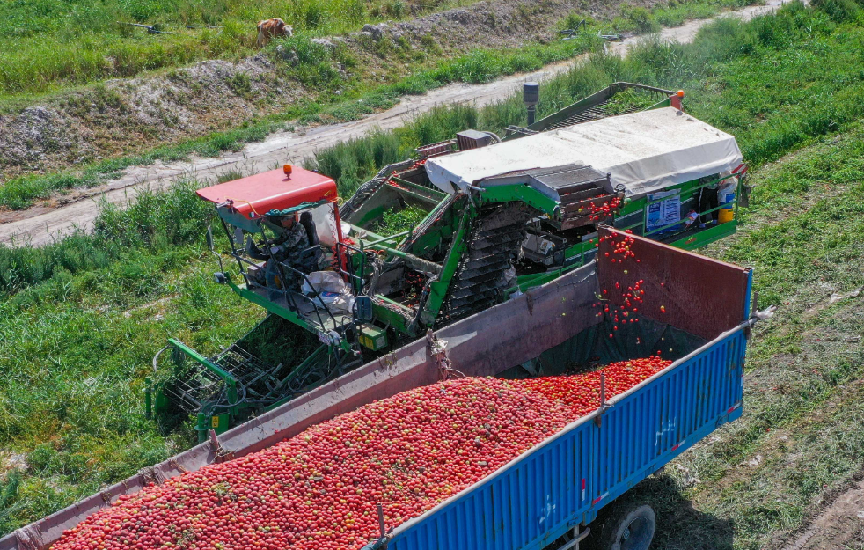
1. Harvesting of Fruits and Vegetables
(2) Harvesting Methods — Mechanical Harvesting
Overview
  In contrast to manual harvesting, mechanical harvesting is an important method in large-scale fruit and vegetable production.
High Harvesting Efficiency
  Greatly shortens the harvesting period.
  Meets the needs of large-scale production systems.
  Significantly reduces labor costs.
Notes:
2.采收方法—机械采收
与人工采收相对应，机械采收是规模化果蔬种植中的重要采收方式，其核心特点如下：
(1)采收效率高：这是机械采收最显著的优势，能大幅缩短采收周期，适配大规模种植场景的采收需求，降低人工成本。
2.Harvesting Methods — Mechanical Harvesting
In contrast to manual harvesting, mechanical harvesting is an important method in large-scale fruit and vegetable production. Its key characteristics are summarized as follows:
(1)High harvesting efficiency
This is the most prominent advantage of mechanical harvesting. It can greatly shorten the harvesting period, meet the needs of large-scale production systems, and significantly reduce labor costs.

Slide 11
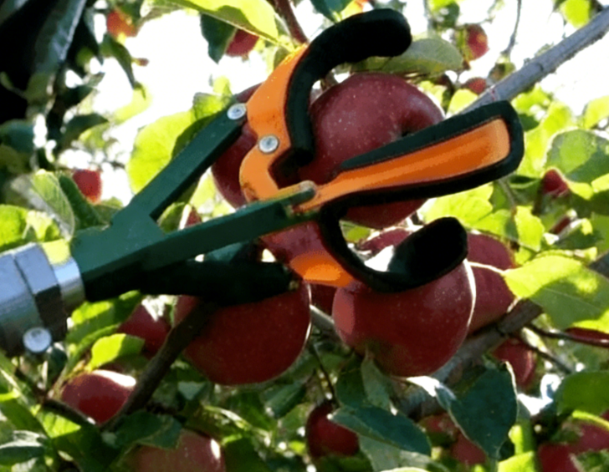
1. Harvesting of Fruits and Vegetables
(2) Harvesting Methods — Mechanical Harvesting
Suitable for processing-oriented produce with high tolerance to mechanical injury
  Higher mechanical injury
Mechanical injury in mechanically harvested fruits and vegetables is significantly higher than in manual harvests.
  More suitable for immediate processing
Mechanical harvesting is more suitable for fruits and vegetables for immediate processing, where tolerance to surface damage is higher and negative effects of mechanical injury on storage can be avoided.
  Limitations for fresh marketing and storage
If intended for fresh marketing or storage, mechanical damage may stimulate respiration, accelerate ripening and senescence, and shorten storage life.
Notes:
(2)适配加工类果蔬，对机械损伤耐受度高：机械采收的果蔬损伤率显著高于人工采收，因此更适用于采收后直接加工的产品，
这类产品对机械伤痕的要求较低，可规避损伤对贮藏性的影响——若用于鲜销贮藏，损伤会刺激果蔬呼吸作用加强，加速后熟衰老，降低耐贮性。
(2) Suitable for processing-oriented produce with high tolerance to mechanical injury
The incidence of mechanical injury in mechanically harvested fruits and vegetables is significantly higher than that in manually harvested produce.
Therefore, mechanical harvesting is more suitable for fruits and vegetables intended for immediate processing, where tolerance to surface damage is relatively high.
In such cases, the negative effects of mechanical injury on storage performance can be avoided. If mechanically harvested produce is intended for fresh marketing and storage, mechanical damage may stimulate respiration,
accelerate ripening and senescence, and reduce their storage life.

Slide 12
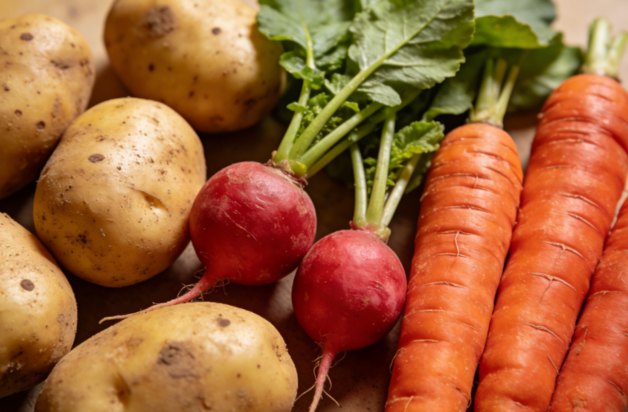
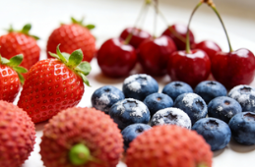
1. Harvesting of Fruits and Vegetables
(2) Harvesting Methods — Mechanical Harvesting
Specific requirements for fruit and vegetable categories
  Conditions for Suitable Mechanical Harvesting
  Typical suitable crops (examples)
  Unsuitable crops (examples)
Relatively high firmness and uniform maturity.
Root and tuber crops such as potatoes, radishes, and carrots.
Have relatively uniform maturity and can be harvested in a single operation.
Have firm tissues that are less affected by minor impact-related damage.
Berries and soft fruits such as strawberries, blueberries, litchi, and cherries.
Have tender flesh and are highly susceptible to loss of freshness and decay even with slight damage.
Notes:
(3)对果蔬品类有特定要求：适宜机械采收的果蔬需满足硬度较高、成熟度一致的条件。
例如土豆、萝卜、胡萝卜等根茎类作物，成熟度相对均一，可一次性集中采收，且果肉硬度高，轻微磕碰对品质影响较小；而草莓、蓝莓、荔枝、樱桃等浆果类及软质水果，果肉柔软鲜嫩，轻微损伤即会导致失鲜、腐烂，不适宜采用机械采收。
(3)Specific requirements for fruit and vegetable categories
Fruits and vegetables suitable for mechanical harvesting generally exhibit relatively high firmness and uniform maturity. Typical examples include root and tuber crops such as potatoes, radishes, and carrots, which have relatively uniform maturity, can be harvested in a single operation and possess firm tissues that are less affected by minor impacts-related damage. In contrast, berries and soft fruits such as strawberries, blueberries, litchi, and cherries have tender flesh and are highly susceptible to loss of freshness and decay even with slight damage, making them unsuitable for mechanical harvesting.

Slide 13
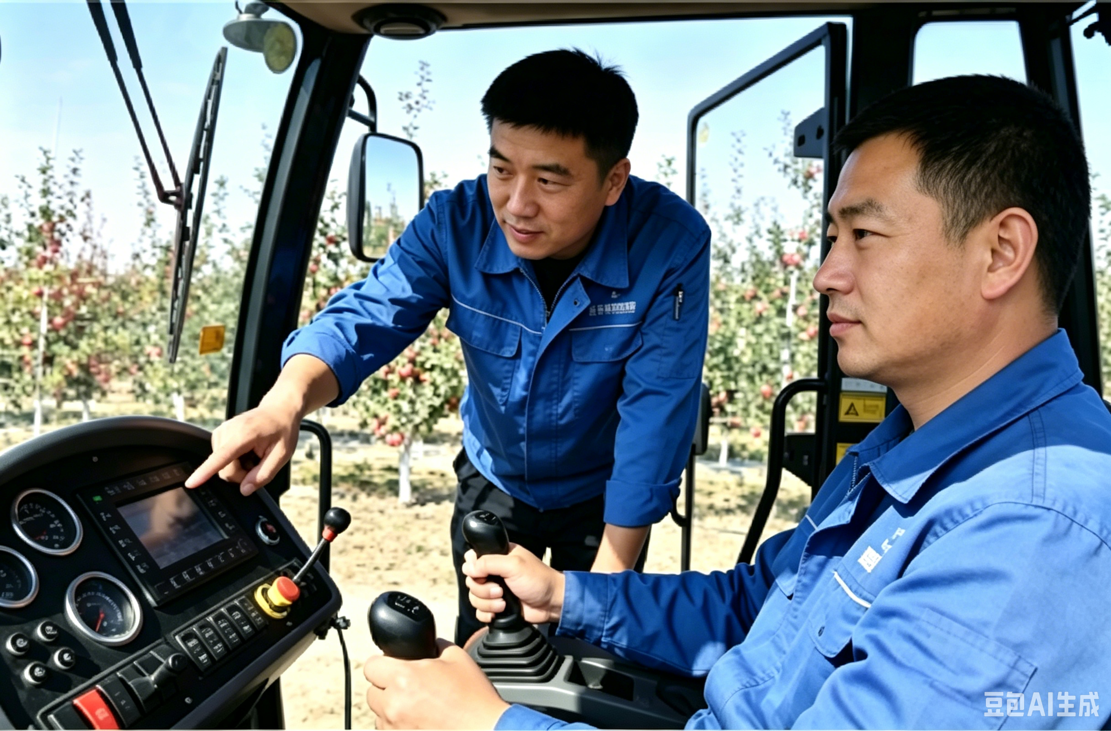
1. Harvesting of Fruits and Vegetables
(2) Harvesting Methods — Mechanical Harvesting
Precautions for Mechanical Harvesting
Overview
  Mechanical harvesting features high efficiency and suitability for large-scale operations.
  Because it relies heavily on equipment operation and associated with higher incidence of mechanical injury, following issues require particular attention.
Well-Trained Operators
  Precision Requirement
Mechanical harvesting depends on precise equipment operation.
  Robotic Operation Needs
Robotic harvesting of fruits (e.g., apples) requires precise fruit localization and appropriate gripping and detachment force.
  Training Necessity
Improper operation → easily cause fruit injury + damage equipment and plant branches → operators must undergo systematic training → be proficient in equipment operation protocols and harvesting techniques.
Notes:
机械采收注意事项
与人工采收相比，机械采收的核心特点是效率高、适配规模化场景，但因依赖设备操作且损伤率较高，需注意以下问题：
(1)配备训练有素的操作员：机械采收依赖设备精准操作，如苹果等水果的机械手采收，需精准定位果实位置与采摘力度。
操作不当不仅易造成果实损伤，还可能损坏设备及植株枝条，因此操作员必须经过系统培训，熟练掌握设备使用规范与采收技巧。
3.Precautions for Mechanical Harvesting
Compared with manual harvesting, mechanical harvesting features high efficiency and suitability for large-scale operations. However, because it relies heavily on equipment operation and is associated with a higher incidence of mechanical injury, the following issues require particular attention:
(1)Well-trained operators
Mechanical harvesting depends on precise equipment operation.
For example, robotic harvesting of fruits such as apples requires precise fruit localization and appropriate gripping and detachment force. Improper operation can easily cause fruit injury and may also damage equipment and plant branches.
Therefore, operators must undergo systematic training and be proficient in equipment operation protocols and harvesting techniques.

Slide 14
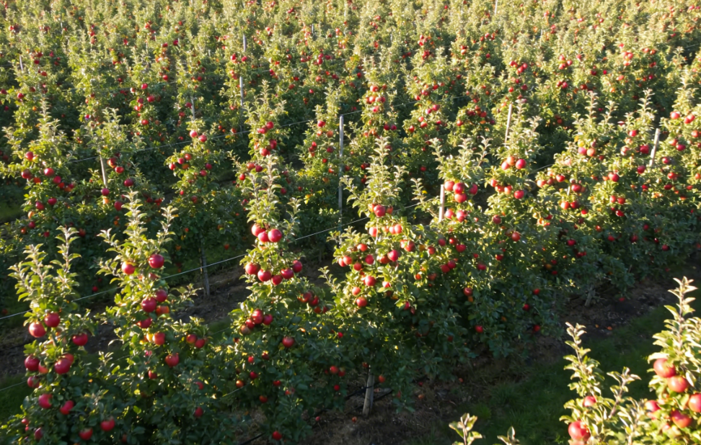
1. Harvesting of Fruits and Vegetables
(2) Harvesting Methods — Mechanical Harvesting
Precautions for Mechanical Harvesting
Suitability for large-scale cultivation systems
High Investment Requirements
Harvesting machinery requires high initial investment and maintenance costs.
  Scale-Dependent Economic Feasibility
Economic feasibility can only be achieved when supported by a sufficient production scale; large-scale cultivation facilitates machinery access and improves operational efficiency.
  Cost Distribution Benefits
Batch harvesting helps distribute equipment purchase and maintenance costs, ensuring overall economic viability.
Notes:
(2)适配规模化种植场景：采收机械设备初期投入成本较高、价格昂贵，需依托一定的种植规模才能实现经济收益平衡。一方面，规模化种植便于机械设备进场作业、提升作业效率；另一方面，可通过批量采收摊薄设备购置与运维成本，确保经济可行性。
(2)Suitability for large-scale cultivation systems
Harvesting machinery requires high initial investment and maintenance costs. Economic feasibility can only be achieved when supported by a sufficient scale of production. Large-scale cultivation facilitates machinery access and improves operational efficiency, while batch harvesting helps distribute equipment purchase and maintenance costs, ensuring economic viability.

Slide 15
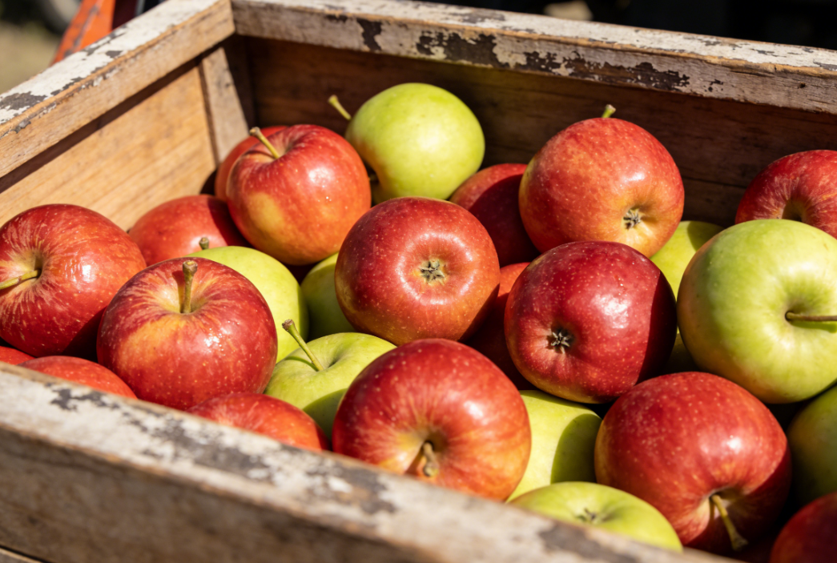
1. Harvesting of Fruits and Vegetables
(2) Harvesting Methods — Mechanical Harvesting
Precautions for Mechanical Harvesting
Inability to Precisely Distinguish Individual Maturity Levels
Limitations of Mechanical Harvest
Conducted as a one-time bulk operation.
Cannot selectively harvest fruits and vegetables according to individual maturity differences.
  Uneven Maturity Outcomes
Harvested produce may exhibit uneven maturity → negatively affect the consistency of subsequent processing/storage.
Notes:
(3)无法精准区分个体成熟度：机械采收为一次性集中采收，难以像人工采收那样针对单个果实的成熟度差异分批采收，可能导致采收果实成熟度不均，影响后续加工或贮藏的一致性。
(3)Inability to precisely distinguish individual maturity levels
Mechanical harvesting is typically conducted as a one-time, bulk operation and cannot selectively harvest fruits and vegetables according to individual maturity differences as manual harvesting does. As a result, harvested produce may exhibit uneven maturity, which can negatively affect the consistency of subsequent processing or storage.

Slide 16
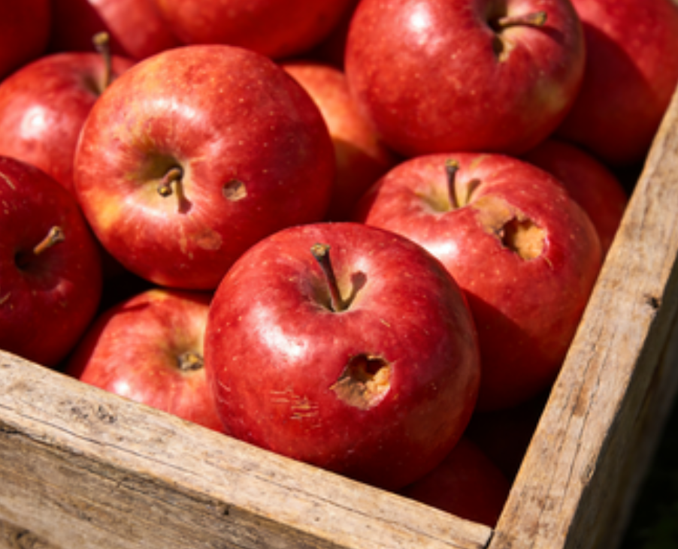
1. Harvesting of Fruits and Vegetables
(2) Harvesting Methods — Mechanical Harvesting
Precautions for Mechanical Harvesting
Impact of mechanical injury on commercial value
Consequences of Injury
Causes more severe mechanical injury → reduces visual quality and storability of produce.
  Impact on Commercial Value
Lowers commercial value of fresh market produce.
  Evaluation Needed
Use of mechanical harvesting for fresh-market fruits and vegetables should be carefully evaluated.
Notes:
(4)机械损伤影响商品价值：机械采收对果蔬的机械性伤害较严重，会降低果实外观品质与耐贮存性，进而影响鲜销产品的商品价值，因此鲜销类果蔬需谨慎选用机械采收方式。
(4)Impact of mechanical injury on commercial value
Mechanical harvesting often causes more severe mechanical injury, reducing the visual quality and storability of produce and consequently lowering the commercial value of fresh-market produce. Therefore, the use of mechanical harvesting for fresh-market fruits and vegetables should be carefully evaluated.

Slide 17
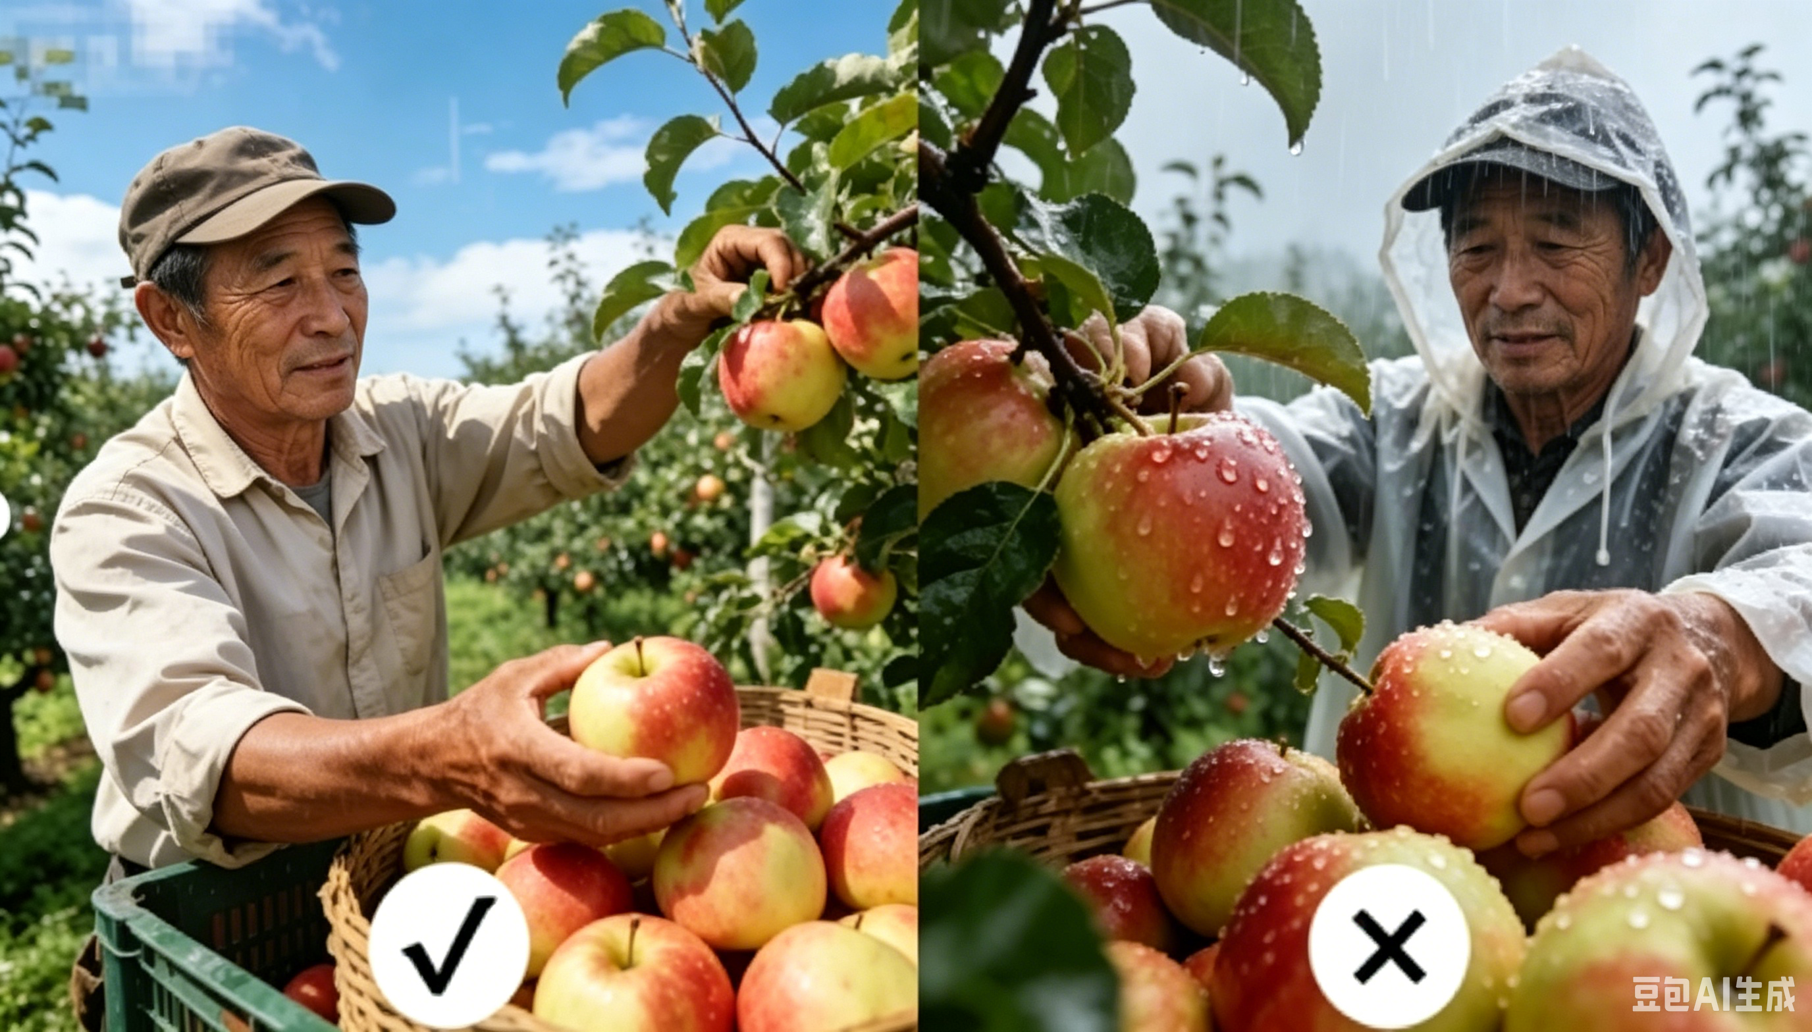
1. Harvesting of Fruits and Vegetables
(3) General Harvesting Guidelines Applicable to Both Manual and Mechanical Methods
① Harvesting Time
  Optimal Weather & Timing
Preferably harvest during cool periods on sunny days, ideally after dew has dried until 9:00–10:00 a.m.
  Avoid Moisture Conditions
Avoid harvesting during rainy weather, immediately after rainfall, or when dew is present.
Surface moisture → increase microbial contamination and cellular rupture → reduce storage performance.
  Avoid High-Temperature Periods
Avoid harvesting at midday under high temperatures.
Excessive field heat → lead to rapid water loss and wilting + intensifies respiration, shortening shelf life.
Notes:
除上述人工/机械采收的专用操作细节外，两类采收方式均需遵守以下通用规范，以保障采收后品质基础：
(1)采收时间：优先选择晴天凉爽时段采收，以清晨露水干后至上午9-10点为宜。阴雨天、雨后或露水未干时采收，
果蔬表面残留的水分会加剧微生物污染与细胞破裂，降低贮藏性能 ；正午高温时段采收，田间热过高，叶菜类等果蔬易失水萎蔫，且高温会加速呼吸作用，缩短货架期。
3.General Harvesting Guidelines Applicable to Both Manual and Mechanical Methods
In addition to method-specific operational details, both manual and mechanical harvesting should comply with the following general guidelines to ensure postharvest quality preservation:
(1)Harvesting time
Harvesting should preferably be carried out during cool periods on sunny days, ideally from after the morning dew has dried until about 9:00–10:00 a.m. Harvesting during rainy weather, immediately after rainfall, or when dew is present should be avoided, as surface moisture can increase microbial contamination and cellular rupture, reducing storage performance. Harvesting at midday under high temperatures should also be avoided, as excessive field heat can lead to rapid water loss and wilting—especially in leafy vegetables—and high temperatures intensify respiration, shortening shelf life.

Slide 18
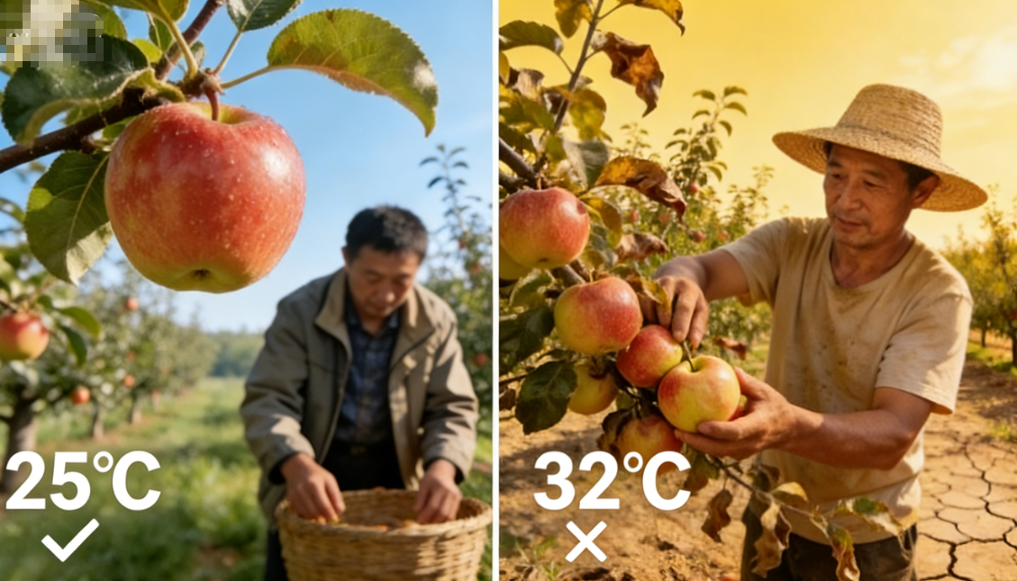
1. Harvesting of Fruits and Vegetables
(3) General Harvesting Guidelines Applicable to Both Manual and Mechanical Methods
Harvesting Temperature
  Recommended Harvest Temperature
Harvesting under high-temperature conditions should be strictly avoided.
AI生成
Ambient temperature during harvesting: ≤27°C.
  Effects of High Harvest Temperature
Harvesting at > 30°C → field heat difficult to remove quickly during precooling → increasing energy consumption.
Higher temperatures intensify respiration and accelerate senescence → dramatically shortening shelf life and affecting storage quality.
Notes:
(2)采收温度：严格避免高温环境采收，建议环境温度不超过27℃。若在30℃以上高温采收，果蔬携带的田间热难以通过后续预冷快速去除，增加预冷能耗；同时温度越高，果蔬呼吸作用越强，衰老速度越快，货架期大幅缩短，这是影响果蔬贮藏品质的核心因素。
(2)Harvesting temperature
Harvesting under high-temperature conditions should be strictly avoided,
and the ambient temperature during harvesting is recommended not to exceed 27°C.
When harvesting at temperatures above 30 °C, field heat carried by the produce is difficult to remove quickly during subsequent precooling, increasing energy consumption.
Moreover, higher temperatures intensify respiration and accelerate senescence,
dramatically shortening shelf life—one of the core factors affecting storage quality.

Slide 19
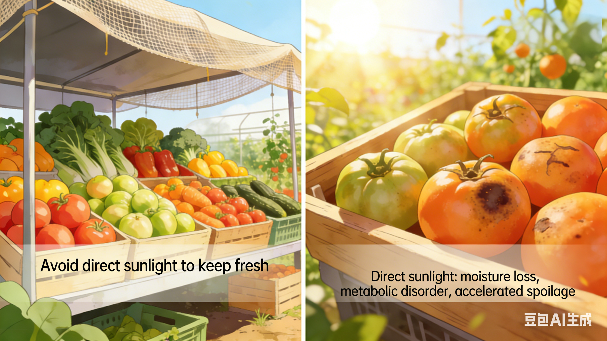
1. Harvesting of Fruits and Vegetables
(3) General Harvesting Guidelines Applicable to Both Manual and Mechanical Methods
Light exposure control
  Protection From Sunlight
During harvesting and temporary postharvest holding, fruits and vegetables should be protected from direct sunlight.
  Effects of Direct Solar Radiation
Water loss & wilting —Accelerates water loss, causing rapid wilting and dehydration.
Metabolic disruption — Disrupts cellular metabolism and accelerates senescence and deterioration.
Quality reduction — Ultimately reduces commercial value and market quality.
Notes:
(3)光照控制：采收及采后临时存放期间，应避免阳光直射。阳光直射会加快果蔬体内水分的流失，让果蔬快速发蔫、变干，进而引起细胞代谢紊乱，加速果实衰老、变质，最终降低商品价值和售卖品质。
(3)Light exposure control
During harvesting and temporary postharvest holding, fruits and vegetables should be protected from direct sunlight. Direct solar radiation accelerates water loss, causing rapid wilting and dehydration, disrupts cellular metabolism, accelerates senescence and deterioration, and ultimately reduces commercial value and market quality.

Slide 20
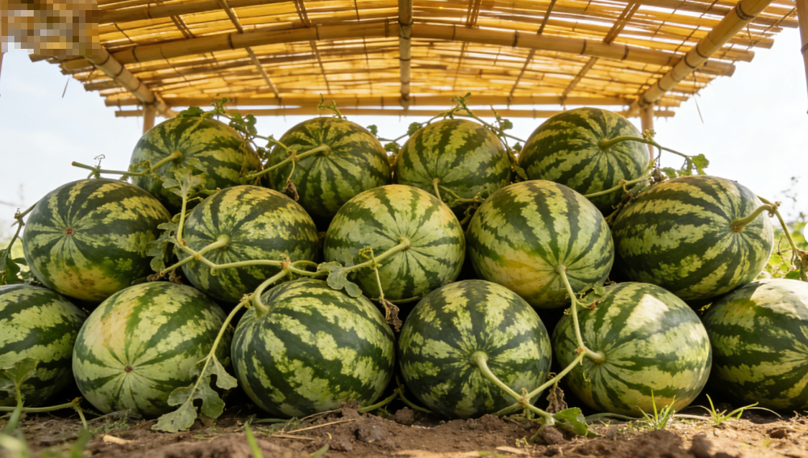
1. Harvesting of Fruits and Vegetables
(3) General Harvesting Guidelines Applicable to Both Manual and Mechanical Methods
Immediate shading
  Shading at Harvest Sites
  Timely Transport to Precooling
Temporary shading structures or natural shade (e.g., trees at the field edge) → to provide a cool environment + prevent water loss due to sun exposure.
Fruits and vegetables transported to precooling facilities as soon as possible after harvest → to minimize field heat accumulation and quality loss.
Notes:
(4)即时庇荫：采收现场可搭建临时遮阳棚或利用地头树荫，为采后果蔬提供阴凉环境，防止暴晒失水。条件允许时，应在采收后尽快将果蔬转运至预冷设施，减少田间热积累与品质损耗。
(4)Immediate shading
Temporary shading structures or natural shade (e.g., trees at the field edge) should be used at harvesting sites to provide a cool environment for harvested produce and prevent water loss due to sun exposure. When conditions permit, fruits and vegetables should be transported to precooling facilities as soon as possible after harvest to minimize field heat accumulation and quality loss.

Slide 21
1. Harvesting of Fruits and Vegetables
(3) General Harvesting Guidelines Applicable to Both Manual and Mechanical Methods
Timely precooling
  Temperature–Respiration Relationship
Respiration increase — Every 10°C increase raises respiration rate by 1.0–1.5×, with shelf life shortened by 1.0–1.5×.
Need for rapid precooling — Harvested produce moved into precooling facilities as quickly as possible.
  Precooling Methods and Functions
Purpose of precooling — Removes field heat, suppresses respiration, and extends storage duration and shelf life.
Forced-air cooling — Relies on fans to circulate cold air → achieving uniform temperature reduction; widely applied as a standard method.
Pressure-differential precooling — Creates a pressure gradient → forces cold air rapidly through packaging and interspaces → faster and more uniform cooling; suitable for rapid precooling of packaged produce.
  Precooling Time Requirement
Fresh fruits and vegetables generally be cooled to appropriate precooling temperatures within 48 hours after harvest.
Notes:
(5)及时预冷：环境温度每升高10℃，果蔬呼吸作用强度会增加1-1.5倍，货架期相应缩短1-1.5倍。因此采收后需尽快将果蔬送入预冷房，通过冷风、压差预冷等方式降低田间热，抑制呼吸作用，延长贮藏期与货架期。其中，冷风是借助风机循环冷空气，使果蔬周围环境均匀降温，是应用广泛的常规预冷方式；压差预冷则是在果蔬包装箱两侧形成压力差，强制冷空气快速穿过包装与果蔬间隙，降温更快、冷却更均匀，适合包装果蔬的快速预冷。鲜果类果蔬建议在采收后48小时内降至适宜预冷温度。
(5)Timely precooling
For every 10°C increase in environmental temperature, respiration rate of fruits and vegetables increases by approximately 1.0–1.5 times, with a corresponding shortening of shelf life by 1.0–1.5 times. Therefore, harvested produce should be moved into precooling facilities as quickly as possible. Precooling methods such as forced-air cooling and pressure-differential precooling are commonly used to remove field heat, suppress respiration, and extend storage duration and shelf life.
Forced-air cooling relies on fans to circulate cold air, achieving uniform temperature reduction around the produce, and it is widely applied as a standard precooling method. Pressure-differential precooling creates a pressure gradient across packaged produce, forcing cold air rapidly through packaging and the interspaces between fruits and vegetables, resulting in faster and more uniform cooling. This method is particularly suitable for rapid precooling of packaged produce. Fresh fruits and vegetables should generally be cooled to appropriate precooling temperatures within 48 hours after harvest.

Slide 22
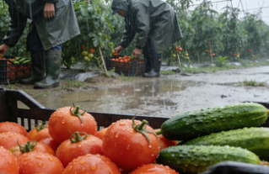
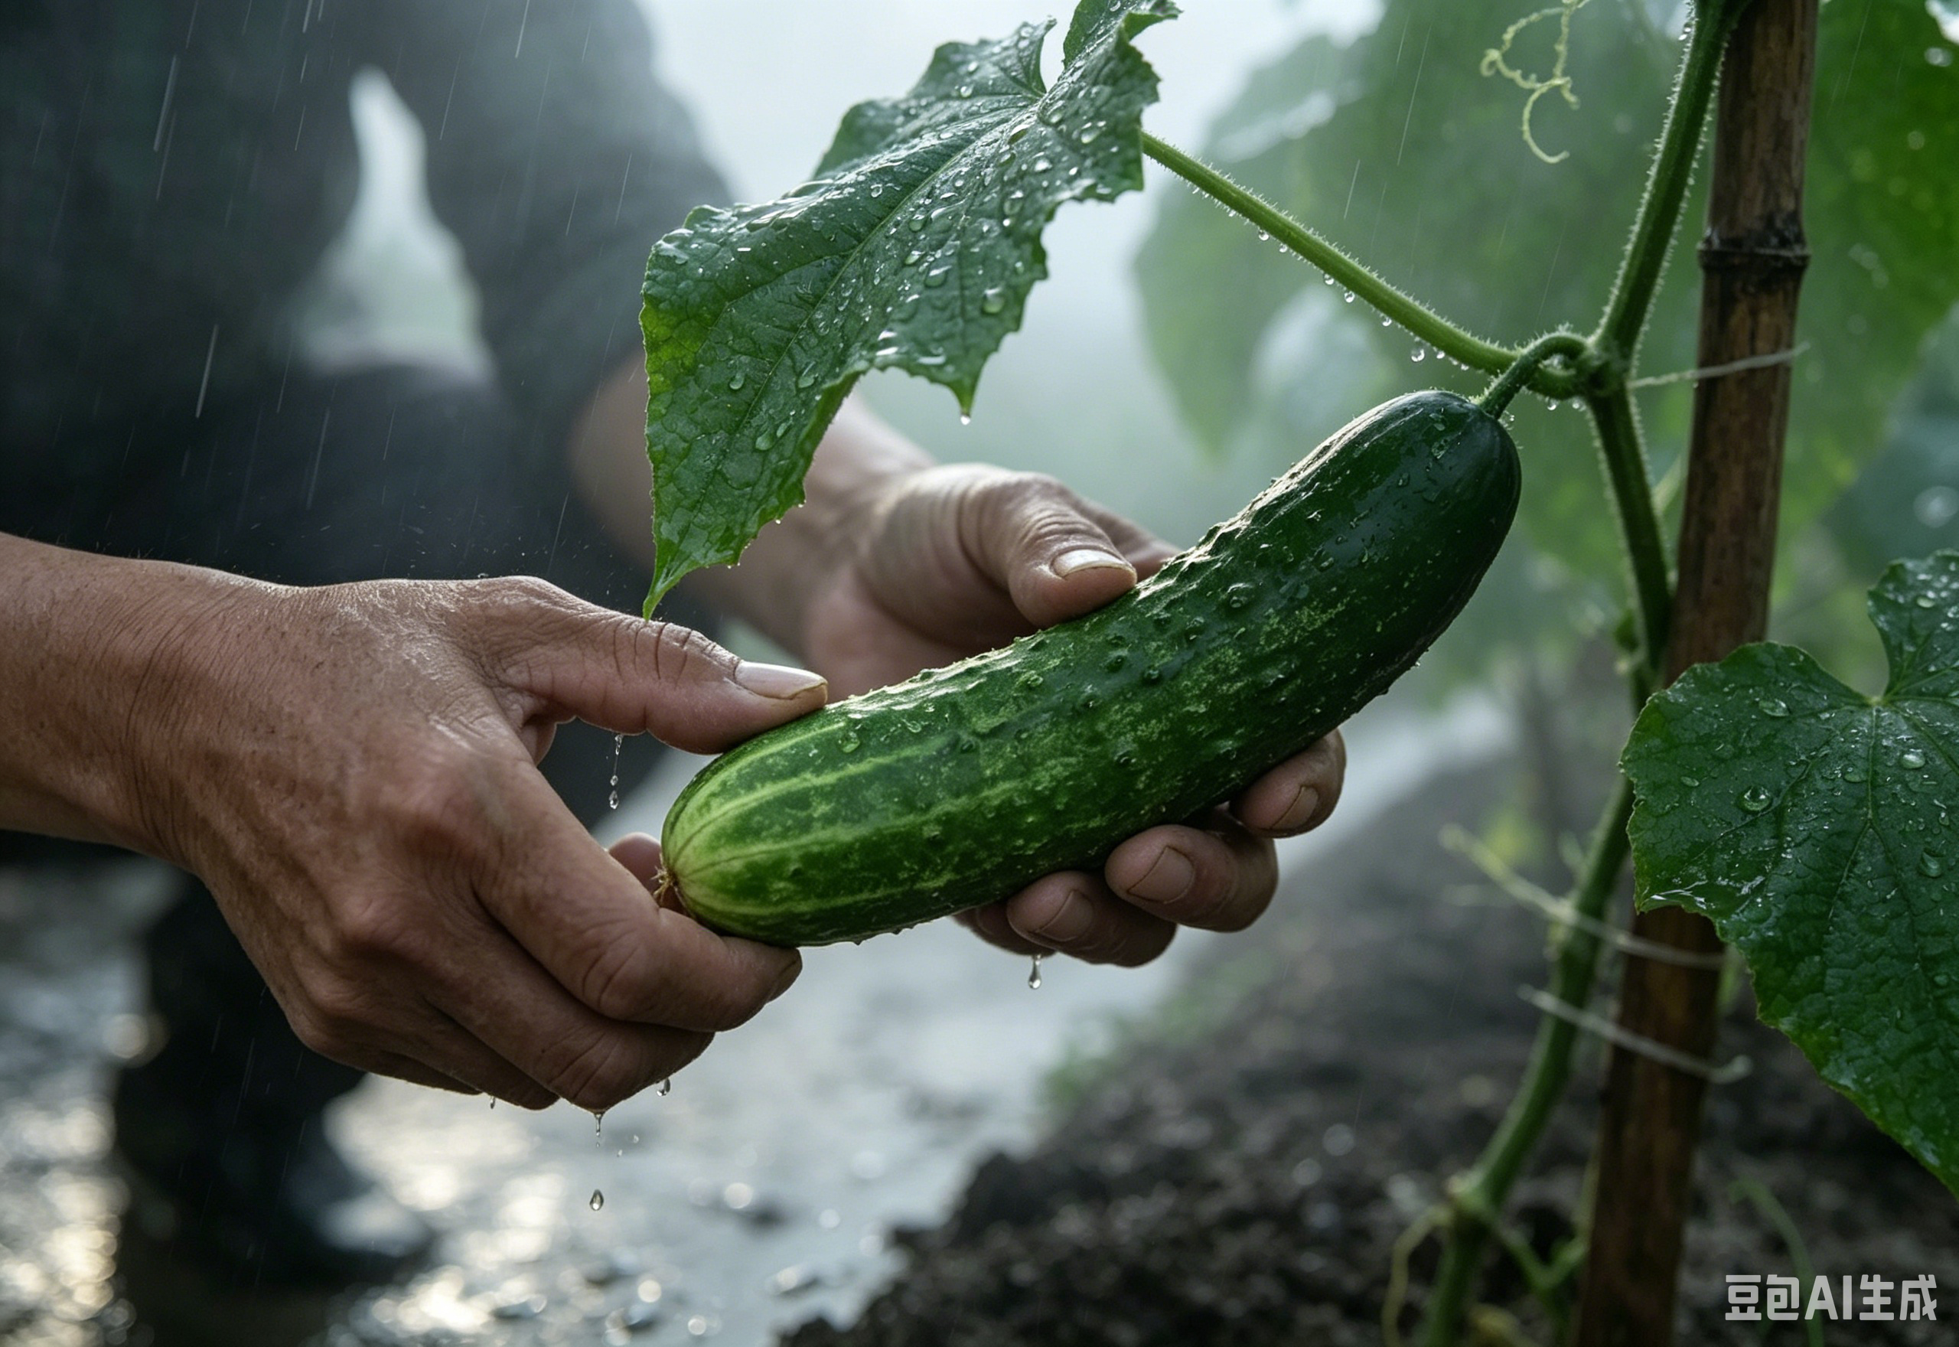
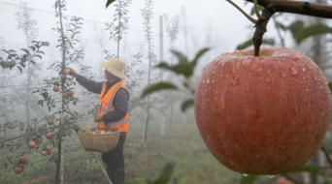

1. Harvesting of Fruits and Vegetables
(3) General Harvesting Guidelines Applicable to Both Manual and Mechanical Methods
Prohibited harvesting conditions
  Weather Restrictions for Harvesting
Harvesting is strictly prohibited during rainy weather, after rainfall, or under heavy fog or heavy dew to prevent surface water accumulation and microbial contamination.
  Irrigation Restrictions Before Harvest
Irrigation should be avoided 1–2 days before harvest.
Excessive irrigation → overhydration → increasing the risk of skin cracking and reducing flavor quality and storage stability.
Notes:
(6)禁忌采收场景：雨天、雨后、大雾及露水严重的天气严禁采收，避免果蔬表面结水引发微生物污染；采收前1～2天不宜灌溉，过度灌溉会导致果蔬吸水饱和，不仅易造成表皮开裂，还会降低果实风味与贮藏稳定性。
(6)Prohibited harvesting conditions:
Harvesting is strictly prohibited during rainy weather, after rainfall, or under heavy fog or heavy dew, to prevent surface water accumulation and subsequent microbial contamination. In addition, irrigation should be avoided 1–2 days prior to harvest. Excessive irrigation can lead to overhydration of fruits and vegetables, increasing the risk of skin cracking and reducing flavor quality and storage stability.

Slide 23
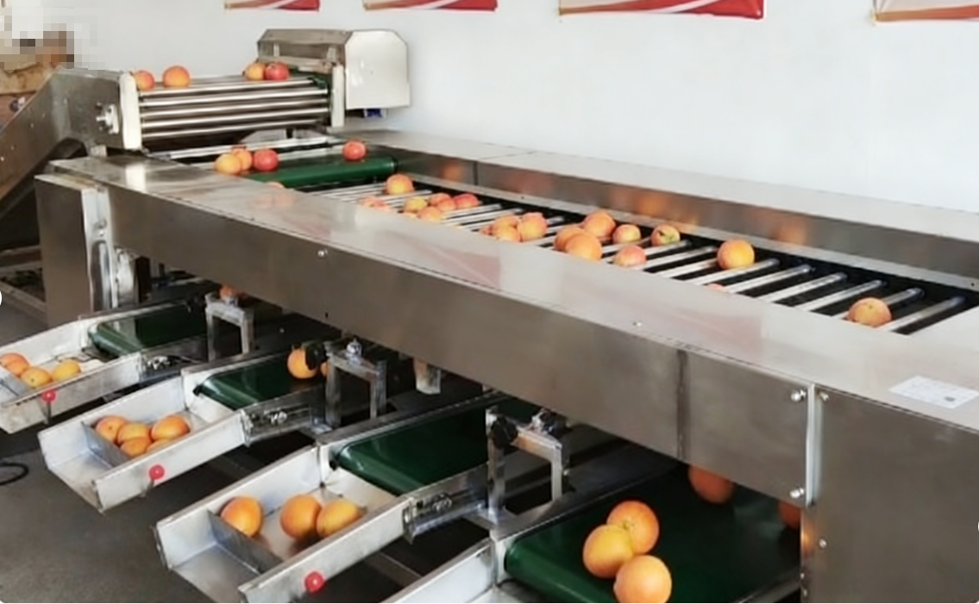
2. Grading of Fruits and Vegetables
Timeliness of Grading
  After harvesting, fruits and vegetables should be graded in a timely manner.
Importance in Commercialization
  A core step in the commercialization process.
  Has a direct impact on subsequent storage, transportation, marketing, and overall commodity value.
Notes:
二、果蔬分级
果蔬采收后，需及时进行分级处理，这是果蔬商品化处理的核心环节，直接影响后续储运、销售及商品价值。
II.Grading of Fruits and Vegetables
After harvesting, fruits and vegetables should be graded in a timely manner. Grading is a core step in the commercialization process and has a direct impact on subsequent storage, transportation, marketing, and overall commodity value.

Slide 24
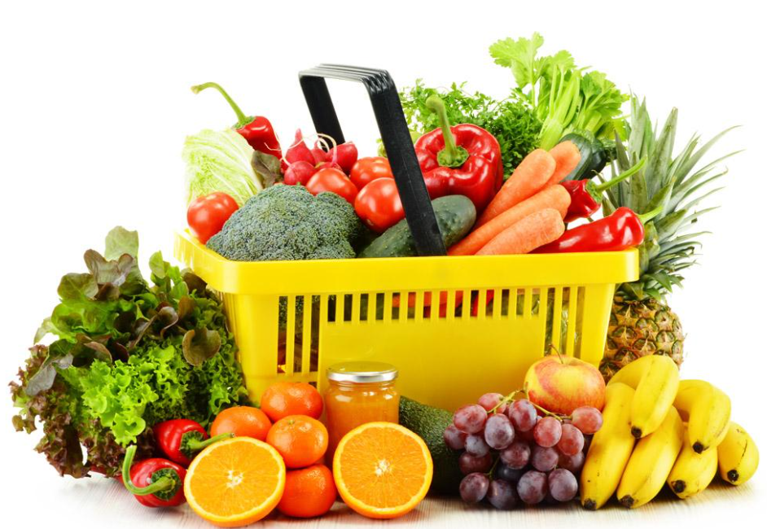
2. Grading of Fruits and Vegetables
(1) Purpose of Grading
Definition of Grading
  The standardized practice of classifying harvested produce into different grades according to predefined quality standards and size specifications.
Core Purpose
  Enhance product standardization and marketability.
Significance of Grading
  Consistency Within Grades
    High Quality – High Price Mechanism
Ensures that fruits and vegetables within the same grade are consistent in terms of quality, color, size, maturity, and cleanliness.
Facilitates standardized management during storage and transportation.
Reduces losses caused by compression-related damage, uneven maturity, and other issues arising from individual variability.
Enables “high quality – high price” mechanism.
Clearly differentiating grades →premium-quality fruits and vegetables directed to high-end markets → significantly increases product value and growers’ income.
    Reduces Communication and Identification Costs
Reduces communication and identification costs between production and marketing stages.
Provides clear references for market procurement and consumer selection.
Establishes efficient quality alignment from field to table.
Notes:
1.分级的目的
果蔬分级是指按照既定的品质标准和大小规格，将采收后的果蔬划分为若干等级的标准化措施，其核心目的是提升产品的标准化、商品化程度。分级的核心意义体现在多方面：一是使同等级果蔬在品质、色泽、大小、成熟度、清洁度等指标上趋于一致，便于储运过程中的规范化管理，减少因个体差异导致的挤压损伤、成熟度不均等损耗；二是实现“优质优价”，通过明确等级区分，让优质果蔬对接高端市场，显著提升商品价值与种植户收益；三是降低产销两端的沟通与鉴别成本，为市场采购、消费选择提供清晰依据，打通从田间到餐桌的品质对接通道。
1.Purpose of Grading
Grading of fruits and vegetables refers to the standardized practice of classifying harvested produce into different grades according to predefined quality standards and size specifications. The fundamental objective of grading is to enhance product standardization and marketability. The significance of grading is reflected in several key aspects.
First, grading ensures that fruits and vegetables within the same grade are consistent in terms of quality, color, size, maturity, and cleanliness. This uniformity facilitates standardized management during storage and transportation and reduces losses caused by compression-related damage, uneven maturity, and other issues arising from individual variability.
Second, grading enables a “high quality – high price” mechanism. By clearly differentiating grades, premium-quality fruits and vegetables can be directed to high-end markets, significantly increasing product value and growers’ income.
Third, grading reduces communication and identification costs between production and marketing stages. It provides clear references for market procurement and consumer selection, thereby establishing an efficient quality alignment from the field to the table.

Slide 25
2. Grading of Fruits and Vegetables
(2) Grading Standards
Commodity-Specific Standards
  Developed in accordance with biological characteristics of different commodities.
  China established dedicated agricultural grading standards for products such as fresh fruits and leafy vegetables.
Quality Grading Attributes
  External attributes — Shape, colour, integrity, mechanical injury, pest and disease damage, and cleanliness.
  Internal attributes —Soluble solids content (sugar level), firmness, flavour.
Quality Grades and Example
  Common grades — Premium, Grade I, Grade II.
  Alternative designations — A+, A, B.
  Blueberry — Incorporate fruit diameter, soluble solids content, and anthocyanin levels → more precise grade differentiation.
Notes:
2.分级标准
果蔬分级标准具有品类特异性，需结合不同果蔬的生物学特性制定，中国已针对新鲜水果、叶类蔬菜等制定了专门的农业行业分级规范。
品质等级划分主要依据果蔬外观及内在特性，外观指标包括形状、色泽、完整度、外伤程度、病虫致伤情况、洁净度等；部分品类还需考量内在品质指标，如糖度、硬度、风味等。常见品质等级划分为特等、一等、二等，部分试点地区及团体标准会采用A+、A、B等分级表述，如蓝莓分级标准就结合了果径、糖度、花青素等指标细化等级。
2.Grading Standards
Grading standards for fruits and vegetables are commodity-specific and must be developed in accordance with the biological characteristics of different commodities. In China, dedicated agricultural industry grading standards have been established for various products, such as fresh fruits and leafy vegetables.
Quality grading is primarily based on external and internal attributes of fruits and vegetables.
External indicators include shape, color, integrity, extent of mechanical injury, pest and disease damage, and cleanliness. For certain commodities, internal quality parameters — such as soluble solids content (sugar level), firmness, and flavor — must also be considered. Common quality grades include Premium, Grade I, and Grade II. In some pilot regions and group standards, alternative designations such as A+, A, and B are used.
For example, blueberry grading standards may incorporate fruit diameter, soluble solids content, and anthocyanin levels to achieve more precise grade differentiation.

Slide 26
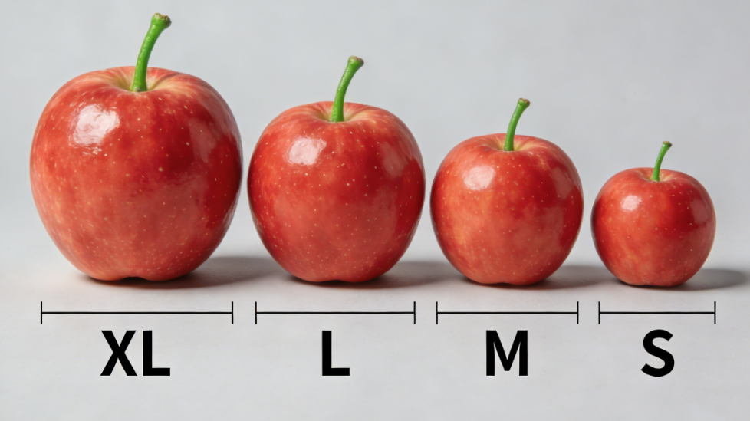
2. Grading of Fruits and Vegetables
(2) Grading Standards
Basis of Size Grading
  Quantifiable physical parameters — weight, diameter, and length.
Size Categories and Adjustments
  Four size categories — Extra Large (XL), Large (L), Medium (M), Small (S).
  Adjustable thresholds — Number of size classes and threshold values may be adjusted according to practical requirements.
Commodity Examples
  Apples and oranges — commonly graded on diameter.
  Stem vegetables (asparagus)— primarily graded by length.
Notes:
大小等级划分则以可量化的物理指标为依据，包括重量、直径、长度等，通常分为特大（XL）、大（L）、中（M）、小（S）四个等级，
部分品类会根据实际需求调整分级数量及指标临界值。例如苹果、橙子等水果多以直径为核心指标分级，芦笋等茎类蔬菜则以长度为主要分级依据。
Size grading is based on quantifiable physical parameters, including weight, diameter, and length. Produce is typically classified into four size categories: Extra Large (XL), Large (L), Medium (M), and Small (S).
For certain commodities, the number of size classes and threshold values may be adjusted according to practical requirements.
For instance, apples and oranges are commonly graded based on diameter, whereas stem vegetables such as asparagus are primarily graded by length.

Slide 27
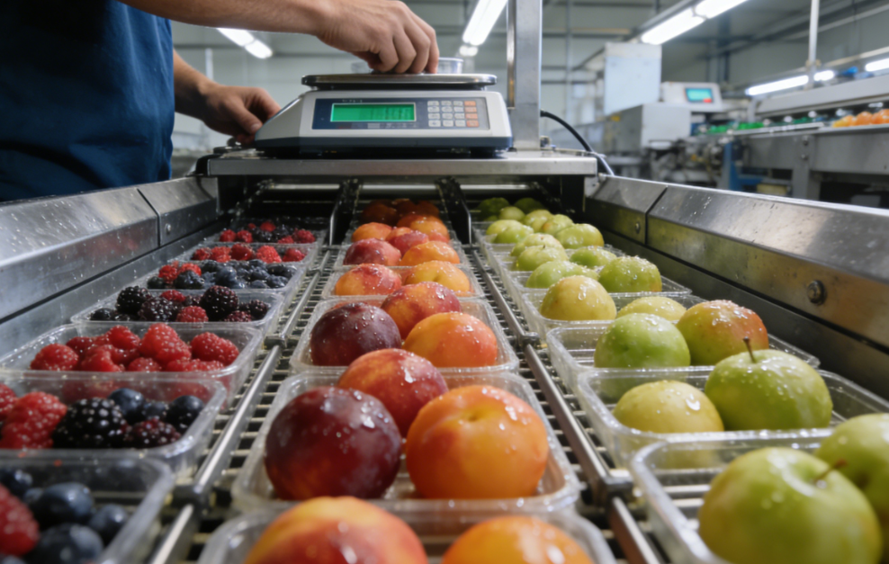
2. Grading of Fruits and Vegetables
(3) Grading Methods
Basis for Selecting Grading Methods: physical characteristics, firmness, market requirements.
Common grading approaches include the following
Mass Grading (Weight-Based Grading)
Applicability
Suitable for produce with irregular shapes or soft tissues that are prone to damage.
Grading Basis
Weight → minimizes mechanical injury during the grading process + ensures consistent weight within each grade.
Typical Applications
Commonly used for berries and other soft fruits and vegetables.
Equipment Requirements
Accurate weighing equipment is required to ensure consistency at grade thresholds.
Notes:
3、分级方法
需根据果蔬的性状、硬度、商品化需求等选择适配的分级方法，常见方式如下：
(1)质量分级（重量分级）：适用于性状不规则、果肉柔软易受伤的果蔬，通过称重方式划分等级，能最大程度减少分级过程中的机械损伤，保证同等级果蔬重量一致，常见于浆果类、软质果蔬分级。分级时需搭配精准称重设备，确保重量临界值的统一性。
3.Grading Methods
Appropriate grading methods should be selected based on the physical characteristics, firmness, and market requirements of fruits and vegetables. Common grading approaches include the following:
(1)Mass grading (weight-based grading)
This method is suitable for produce with irregular shapes or soft tissues that are prone to damage. Grading is performed based on weight, which minimizes mechanical injury during the grading process and ensures consistent weight within each grade. It is commonly used for berries and other soft fruits and vegetables. Accurate weighing equipment is required to ensure consistency at grade thresholds.

Slide 28
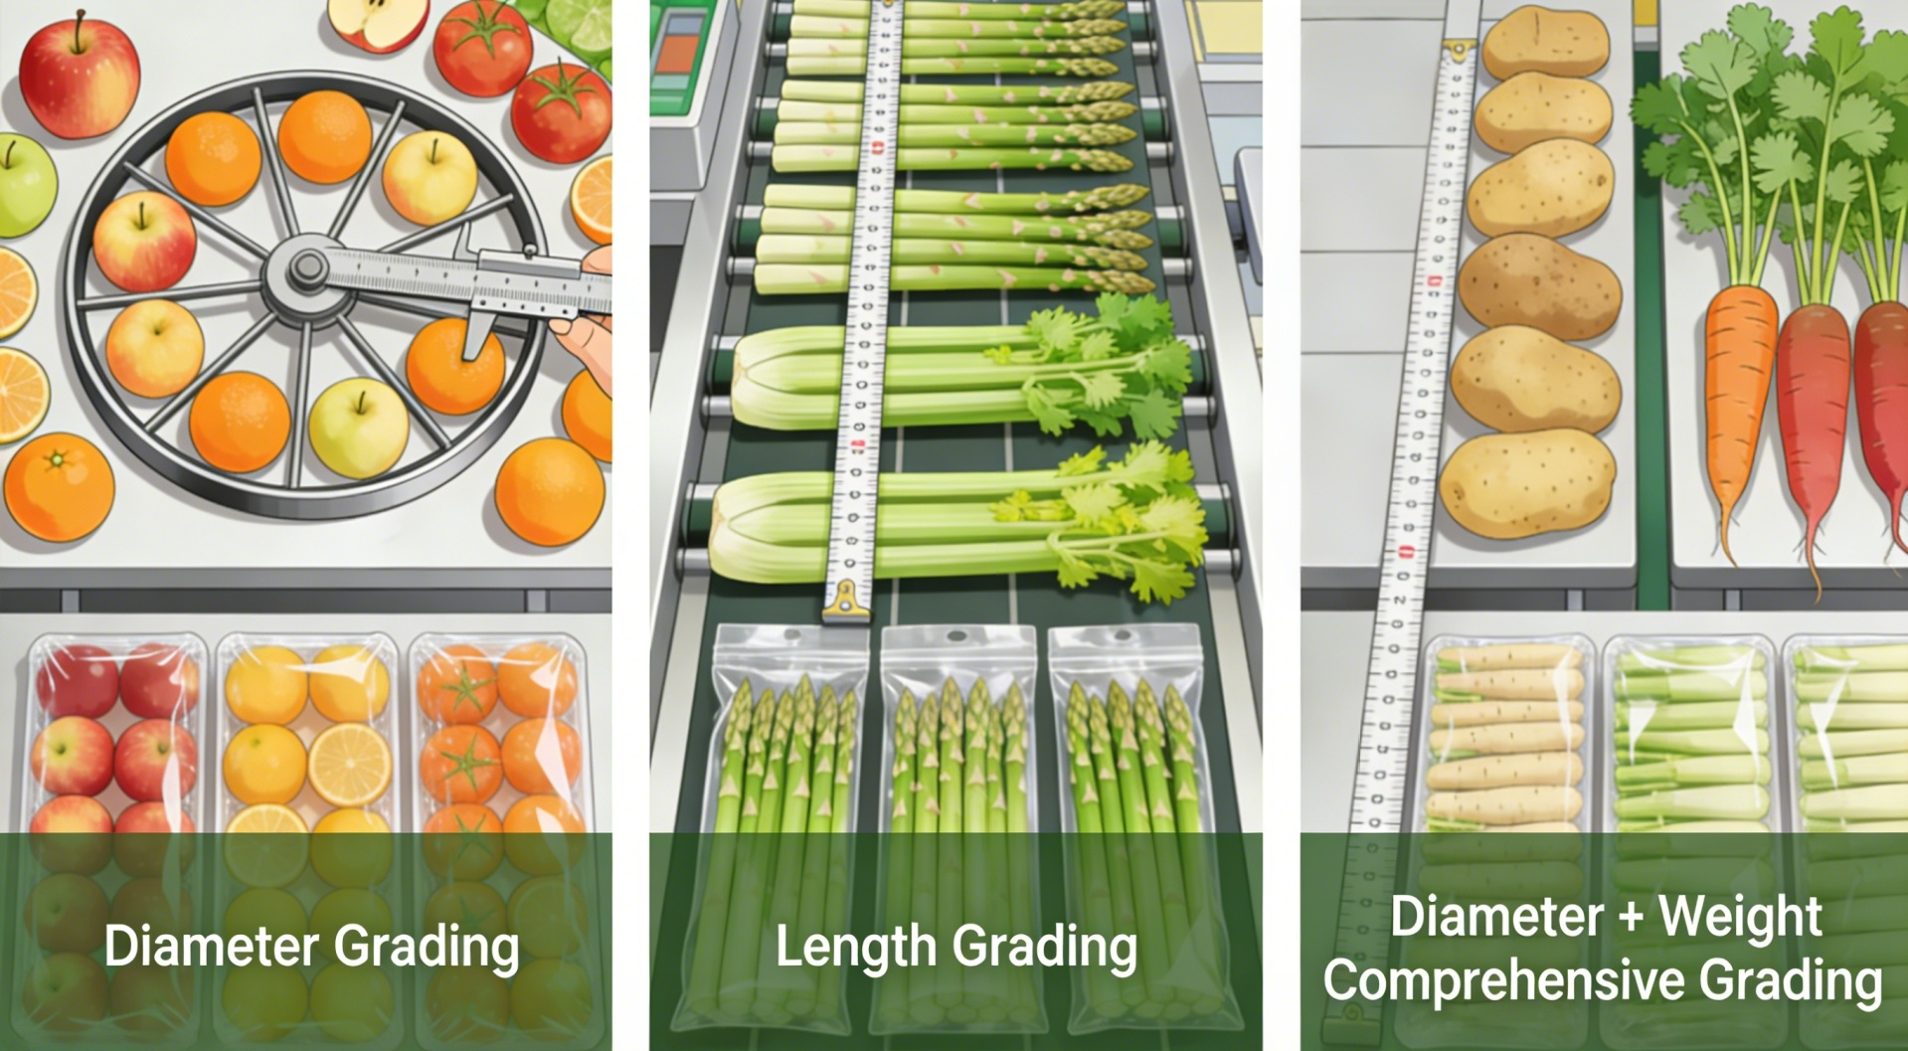
2. Grading of Fruits and Vegetables
(3) Grading Methods
Size Grading
  Applicability
Appropriate for fruits and vegetables with firm flesh and regular shapes.
  Grading Criteria
Depending on the commodity, diameter or length may be used as the grading criterion.
  Typical Applications
Apples, oranges, etc. → graded by diameter.
Asparagus, celery, etc. → graded by length.
Potatoes, radishes, etc. → graded by diameter + weight.
  Outcome
Ensures visual uniformity within each grade, facilitating packaging and display.
Notes:
(2)大小分级：适配果肉坚硬、形态规整的果蔬，可根据品类特性选择直径、长度等指标作为分级依据。如苹果、橙子等水果采用直径分级，芦笋、芹菜等茎类蔬菜采用长度分级，土豆、萝卜等根茎类蔬菜可结合直径与重量综合分级。该方法能保证同等级果蔬外观整齐度，便于包装与陈列。
(2)Size grading
This method is appropriate for fruits and vegetables with firm flesh and regular shapes. Depending on the commodity, diameter or length may be used as the grading criterion. For example, apples and oranges are graded by diameter, asparagus and celery by length, and root and tuber crops such as potatoes and radishes by a combination of diameter and weight for greater accuracy. Size grading ensures visual uniformity within each grade, facilitating packaging and display.

Slide 29
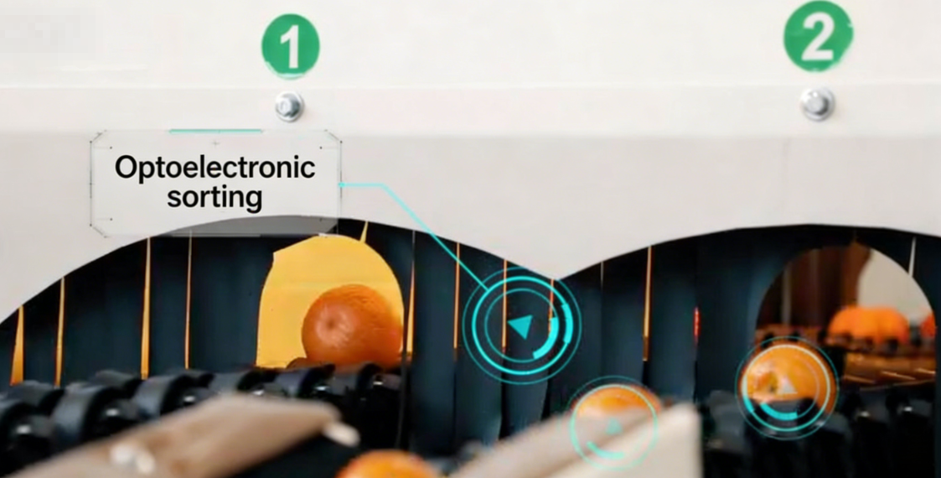
2. Grading of Fruits and Vegetables
(3) Grading Methods
Optical and electronic grading
  Applicability
An advanced and widely used grading technology in large-scale production systems and is typically fully automated.
  Measurement Capabilities
Using photoelectric sensors → accurately measure physical attributes such as size and diameter + assess color uniformity and surface defects (e.g., russeting).
  Internal Quality Assessment
Some high-end systems can simultaneously measure internal quality attributes such as sugar content and firmness → enabling integrated grading based on both external and internal quality.
  Core Advantages
Offers high efficiency and precision → meets the precision grading requirements of high-end fruit and vegetable commercialization.
Notes:
(3)光电分级：是目前规模化生产中应用广泛的先进分级技术，属于全自动分级方式。通过光电感应设备，不仅可精准识别果蔬的大小、直径等物理指标，还能检测色泽均匀度、果皮锈斑情况，部分高端设备可同步测定糖分、硬度等内在品质指标，实现物理与内在品质的同步分级。该方法分级效率高、精度高，能满足高端果蔬商品化的精细化需求。
(3)Optical and electronic grading
Optical–electronic grading is an advanced and widely used grading technology in large-scale production systems and is typically fully automated. Using photoelectric sensors, this method can accurately measure physical attributes such as size and diameter, as well as assess color uniformity and surface defects (e.g., russeting). Some high-end systems can simultaneously measure internal quality attributes such as sugar content and firmness, enabling integrated grading based on both external and internal quality. This method offers high efficiency and precision and meets the precision grading requirements of high-end fruit and vegetable commercialization.

Slide 30
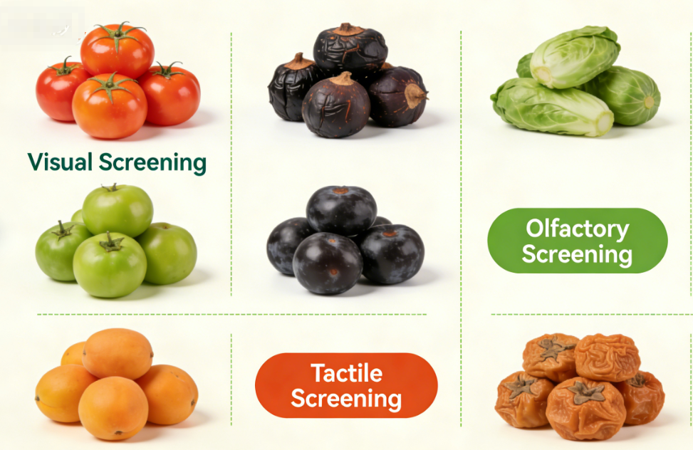
2. Grading of Fruits and Vegetables
(3) Grading Methods
Sensory Evaluation
  Traditional grading practices often incorporate sensory evaluation as a supplementary method.
Components of Sensory Evaluation
  Visual assessment of color and shape defects.
  Olfactory evaluation of aroma.
  Tactile assessment of freshness.
Requirements
  Follow relevant industry standards → ensure consistency and reliability in grading results.
Notes:
此外，传统分级中还会结合感官评判辅助分级，如通过视觉判断色泽、畸形度，嗅觉评判风味，触觉感知新鲜度等，感官评判需遵循对应的行业规范，确保分级一致性。
In addition, traditional grading practices often incorporate sensory evaluation as a supplementary method, including visual assessment of color and shape defects, olfactory evaluation of aroma, and tactile assessment of freshness. Sensory evaluation should follow relevant industry standards to ensure consistency and reliability in grading results.

