Slide 1
WFP SSTC COVID-19 Opportunity Fund Pilot in Libya supported by China
SOILLESS CULTURE
Liu Wei, Ph.D. Vegetable Science, Professor
WFP Centre of Excellence for Rural Transformation
Beijing Academy of Agriculture and Forestry Sciences
Sharing for Learning

Slide 2
03
Water and Nutrients

Slide 3
Soil or
Substrate,
Nutrient solution
Soil provides four needs to the plant:
(1) a supply of water,
(2) a supply of essential nutrients,
(3) a supply of oxygen,
(4) support for the plant root system.

Slide 4
What kinds of water source can be used to make nutrient solution?
Rain water
Well water
Melted snow
Distilled seawater
Tap water
Surface water
(river, stream, etc)
Waste water
stable quality
unstable quality
unknown / variable chemical composition
infected by pathogens ??
(Van Os, 2004)

Slide 5
Water quality
A complete analysis of the water to be used for any type of soilless culture system is essential.
Most soilless culture systems require relatively pure water.
Natural water supplies usually contain sizeable concentrations of some of the essential elements, which will affect the nutrient formulae.
Filtering or other forms of pretreatment are required to ensure that the water used to prepare the nutrient solution is free from undesirable organisms, as well as suspended matter.

Slide 6
Essential elements for higher plants growth
Essential Elements | Major Elements | C | CO₂
 |  | H | H₂O
 |  | O
 |  | N | Fertilizers: Ca(NO₃)₂, KNO₃, KH₂PO₄, K₂SO₄, MgSO₄, Fe-EDTA, etc.
 |  | P
 |  | K
 |  | Ca
 |  | Mg
 |  | S
 | Minor Elements | Fe
 |  | Mn
 |  | B
 |  | Zn
 |  | Cu
 |  | Mo
 |  | Cl

Slide 7
Methods of mixing fertilizers
There are two principal systems for mixing fertilizers:
The bulk tank system
The injector or proportion system

Slide 8
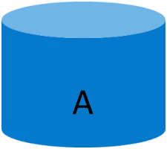
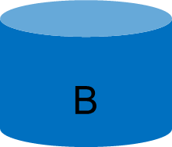
Nutrient tank
At least two stock tanks are needed. This is because certain fertilizer sources when mixed together in concentrated form will lead to insoluble precipitates. The most common of these are calcium phosphate (Ca₃(PO₄)₂) and calcium sulfate (CaSO₄ ·2H₂O).
A: contains potassium nitrate, calcium nitrate and iron chelate
B: contains the phosphorus source, magnesium sulfate, micronutrients, potassium chloride, or some of the potassium nitrate

Slide 9
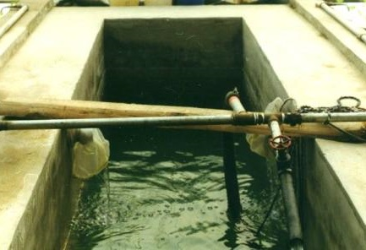
Preparing the nutrient solution
Bulk tank
①
A
②
B
③
Acid

Slide 10
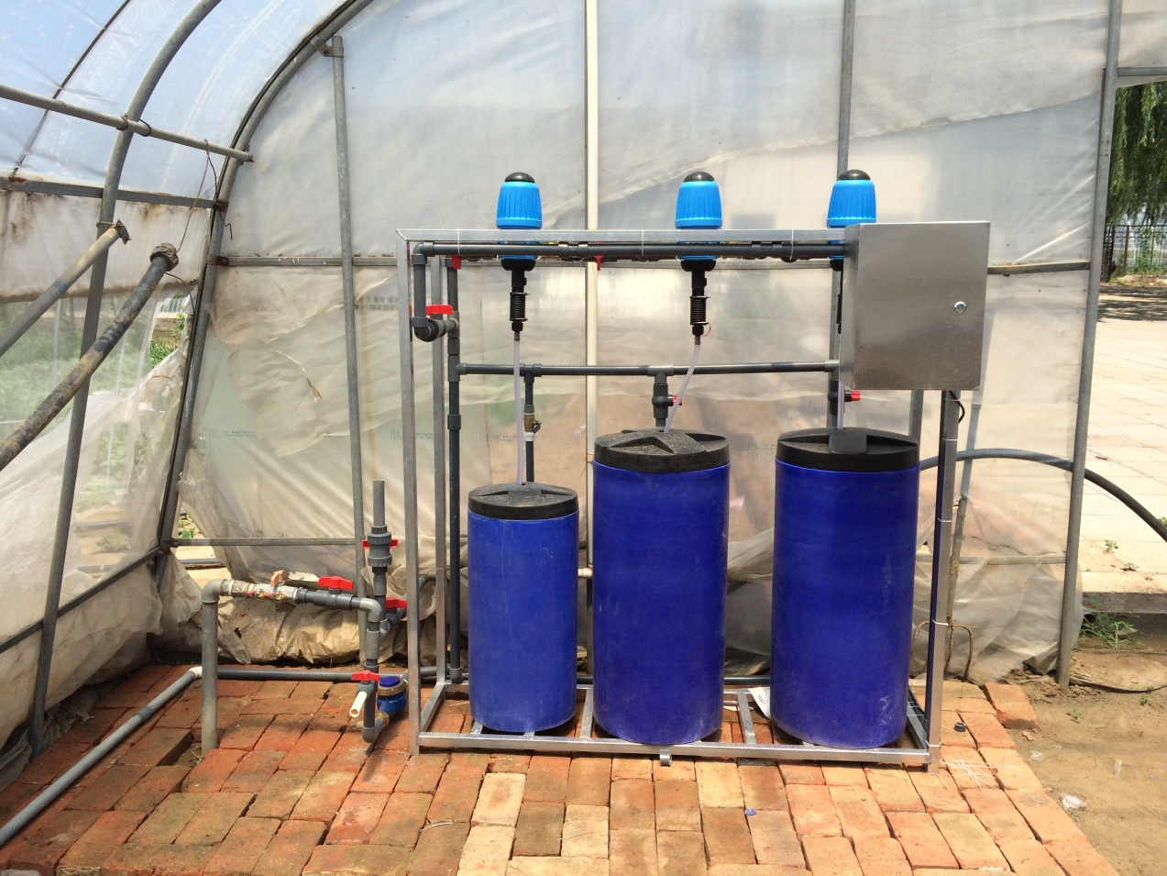
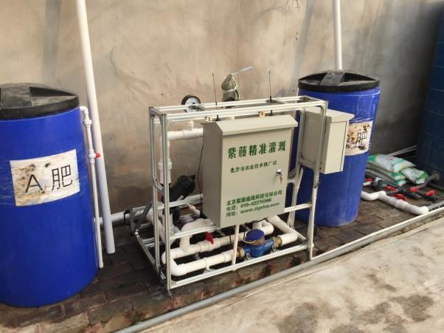
Simple
proportion system
Proportion system

Slide 11
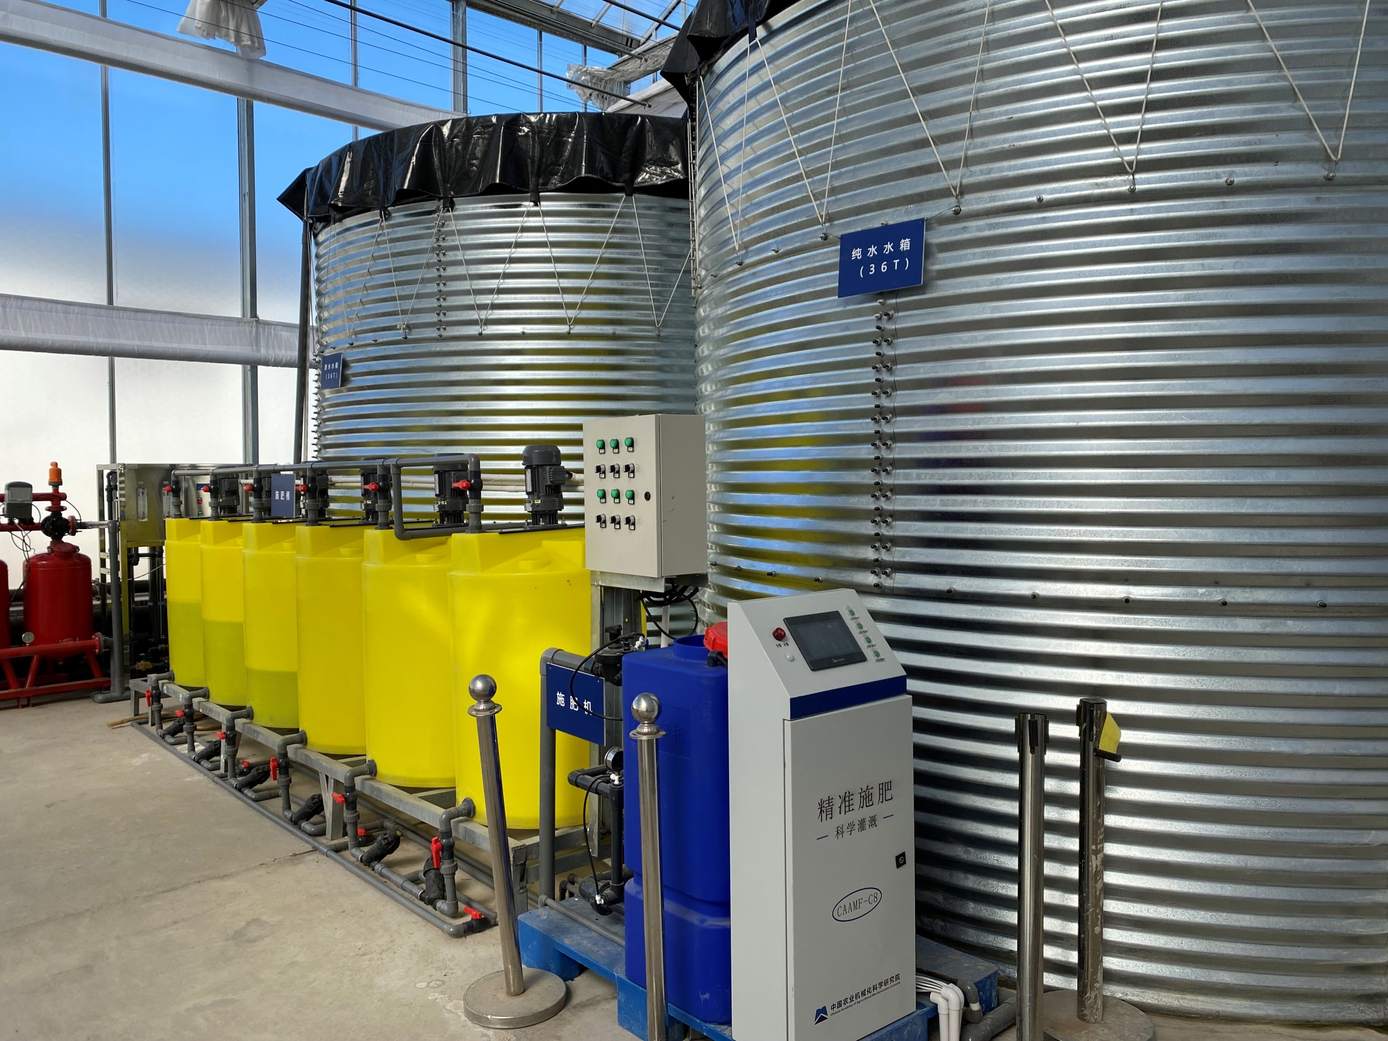
Fertigation system

Slide 12
Factors affected nutrient formulae
Hundreds of different formulae have been used in soilless culture over the years. It’s impossible to say which one is the best. Because conditions may be dissimilar. An optimum formulation would depend on the follow variables:
a) water analysis
b) plant species and variety
c) stage of plant growth
d) season & weather (temperature, light intensity, sunshine hours)

Slide 13
Acidity and alkalinity (pH)
PH value is a measure of acidity or alkalinity.
The pH of the solution refers to the concentration of hydrogen ions (H+) in the solution.
The pH of the solution is important because certain plant nutrition aspects are influenced by pH such as solubility of essential elements. Most elements are absorbed best with a pH of 5.5 to 7.0.

Slide 14
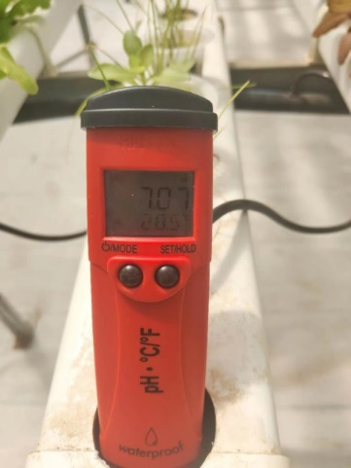
PH
The pH of the nutrient solution can be adjusted by adding acid or alkali.
Solutions of either sodium or potassium hydroxide (NaOH, KOH) are suitable alkalis for raising the pH.
Solutions of sulphuric or phosphoric acid(H₂SO₄, H₃PO₄) are often used for lowering the pH.
A pH meter is used to monitor the pH of nutrient solution.
The pH of a balanced nutrient solution won’t shift greatly during recirculated use.
Although daily monitoring of nutrient solution is recommended, daily pH adjustment is unnecessary.

Slide 15
Electrical conductivity (EC)
Electrical conductivity is an estimate of the total soluble salt content of the water.
EC varies not only to the concentration of salts present, but also to the chemical composition of the nutrient solution.

Slide 16
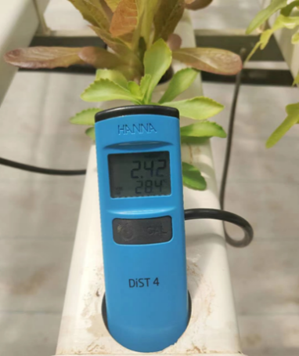
EC
EC is often expressed as millimhos/cm (mS/cm), with the desired range 2.0 to 4.0.
We should adjust EC according to different plant species and different conditions.
The lower values (1.5-2.5) are preferred by crops such as lettuce, 2.0-3.0 are preferred by cucumbers, while higher values (2.5-3.5) are better for tomatoes.
In winter or poor light conditions higher EC is better.

Slide 17
Steering water content in substrate
Irrigation starting time
Irrigation stopping time
Irrigation – frequency
Water volume per irrigation

Slide 18
Closed system
nutrients
A
B
water
EC
pH
mixing supply water
disinfection
drain collection
storage drain water
storage
disinfected water
(Van Os, 2004)
With the introduction of closed systems, the risk of spreading pathogens increased dramatically.

Slide 19
Disinfection of nutrient solution
Methods | Caption
Heat treatment | Effective, expensive
UV radiation | Easily operated
Ozone | Effective, human exposure to ozone may cause irritation of mucous membrane.
Slow sand filtration | Low cost, reliable

Slide 20
Heat treatment
Dosage: 95ºC for 30 s
Energy: 1 m³ gas to heat 1 m³ nutrient solutionfor
Advantage:
Reliable and easily to understand the principle.
Disadvantage:
The cost (gas) to heat the water is high.
(Van Os, 2004)

Slide 21
UV radiation
Advantage:
UV radiation is an easily operated method to disinfect nutrient solution.
Disadvantage:
The risk that pathogens can hide behind suspended particles is considered a big disadvantage.

Slide 22
Thank You
Contact info:
Beijing Academy of Agriculture and Forestry Sciences
Beijing 100097, China
E-mail: liuwei@nercv.org
The SSTC project is funded by: Ministry of Agriculture and Rural Affairs P. R. China
Sharing for Learning
Sharing for Learning

