Slide 1





SAVING LIVES
CHANGING LIVES
Anticipatory Action for Agriculture and Food Security
Proactive strategies to protect food systems sustainably

Slide 2
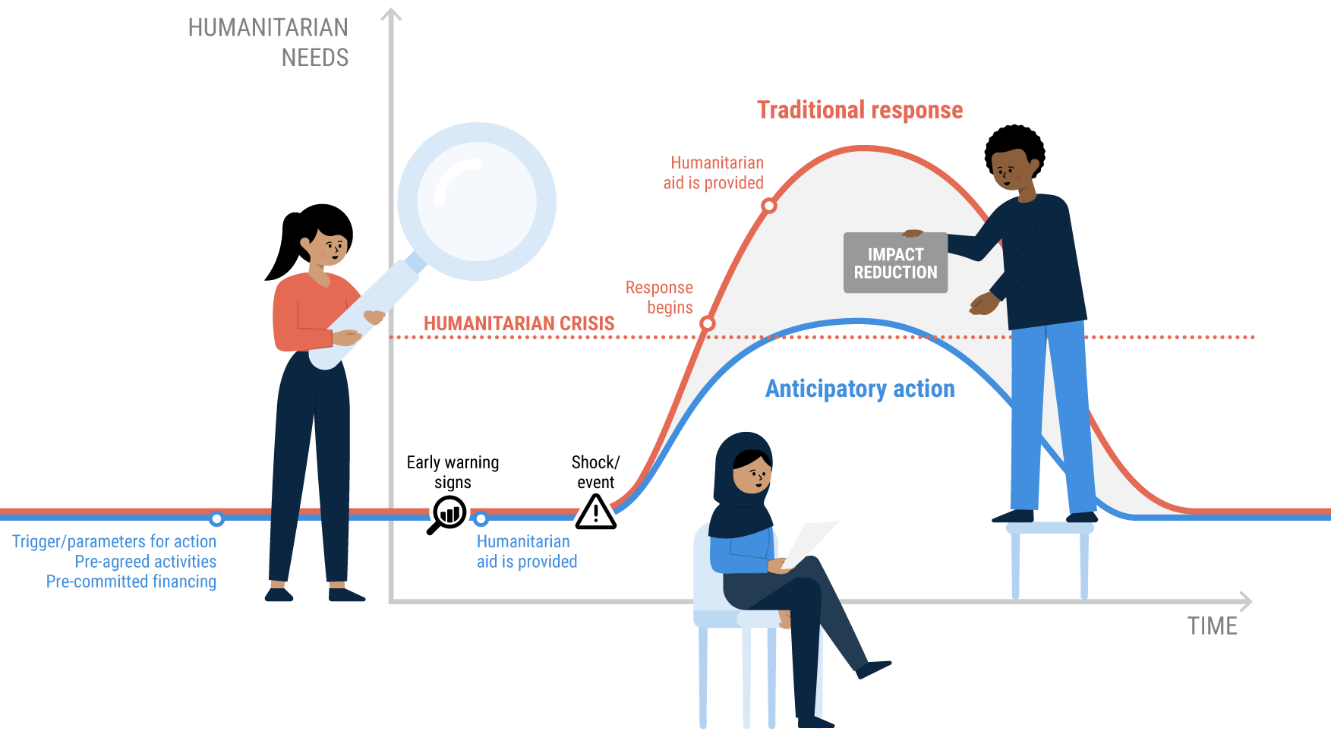

What is Anticipatory Action?
"Acting ahead of a predicted hazardous event to prevent or reduce impacts on lives and livelihoods and humanitarian needs before they fully unfold"
Grand Bargain Caucus on Anticipatory Action, Dec 2024
Source: UN OCHA
Notes:
To be considered anticipatory action, 3 parameters must be met:
The objective is to reduce the potential impacts of forecasteable hazards
Actions are designed based on forecasts or predictive analyses of when and where a hazard will occur
Action as implemented before a hazard occurs, or before its most acute impacts are felt

Slide 3




How does it work
The three elements of
anticipatory action
Pre-agreed triggers
Pre-agreed activities
Pre-arranged financing
Anticipatory
Action
Reduced
Crisis
Source: UN OCHA
Notes:
And with these pillars in place, we can effectively change the sequencing of events compared to traditional response. Rather than the shock materializing first, we now have a system in place to signal that a shock, for example a flood, is coming, which immediately triggers the release of funds for actions that are specifically designed to mitigate the expected impact, which ideally results in a less severe crisis for affected people.

Slide 4

Goals of Anticipatory Action
  Cross-sectoral
Enable communities to make informed decisions
Reduce risks of negative coping strategies
  Food Security & Nutrition
Safeguard agricultural production & avoid loss of livelihoods
Prevent deterioration in food security
Prevent rise in severe malnutrition
  Health & Protection
Avoid an increase in preventable (maternal) deaths and morbidity
Ensure continuity of access to emergency health services
Mitigate risks of gender-based violence

Slide 5











AA ALONG THE NEXUS OF CHANGING & SAVING LIVES
WFP – Anticipatory Action: The Basics
Activation of Anticipatory Action Plans (AAPs)
Anticipatory Action System Building
CHANGING LIVES
SAVING LIVES
Forecast Trigger
ENABLING
DELIVERING
Climate Change Adaptation
Long-term resilience building
Minimum/Advanced Preparedness Actions
Life-Saving Emergency Response
Strengthening smallholder value chains and access to markets
Strengthening Early Warning Systems
Contingency Planning/ Developing Emergency Response SOPs

Slide 6








BRIDGING A GAP WITHIN THE DRM CYCLE
WFP – Anticipatory Action: The Basics
Bridging the gap between longer-term disaster preparedness and DRR
and the life-saving window of
emergency response
Disaster Impact
Forecast/ early warning
PREPAREDNESS
The knowledge and capacities developed to effectively anticipate, respond to, and recover from the impacts of likely, imminent or current disaster/emergencies
ANTICIPATORY ACTION
Prevents or mitigates potential impacts of disasters/crisis prior to a shock or before acute impacts are felt
(EARLY) RESPONSE
Save lives, meet basic needs and avoid further losses. Respond to ongoing and cascading hazards and impacts
RECOVERY
Support people’s efforts to cope, recover, and rebuild by restoring services and assets
in a resilient manner
DISASTER RISK REDUCTION

Slide 7







DROUGHT AA SYSTEM
WFP – Anticipatory Action: The Basics
WHAT ARE THE ACTIONS TO PREVENT THE IMPACT OF DROUGHTS & WHEN SHOULD THEY BE TRIGGERED?
DRY SEASON
PLANTING
GROWING
HARVESTING
MONTHS TO IMPACT
-11 -10 -9 -8
-7
-6
-5
-4
-3
-2
-1
0
READINESS
EARLY RESPONSE
MONITORING
ANTICIPATORY ACTION
FORECASTING
WINDOW OF INTEREST

Slide 8





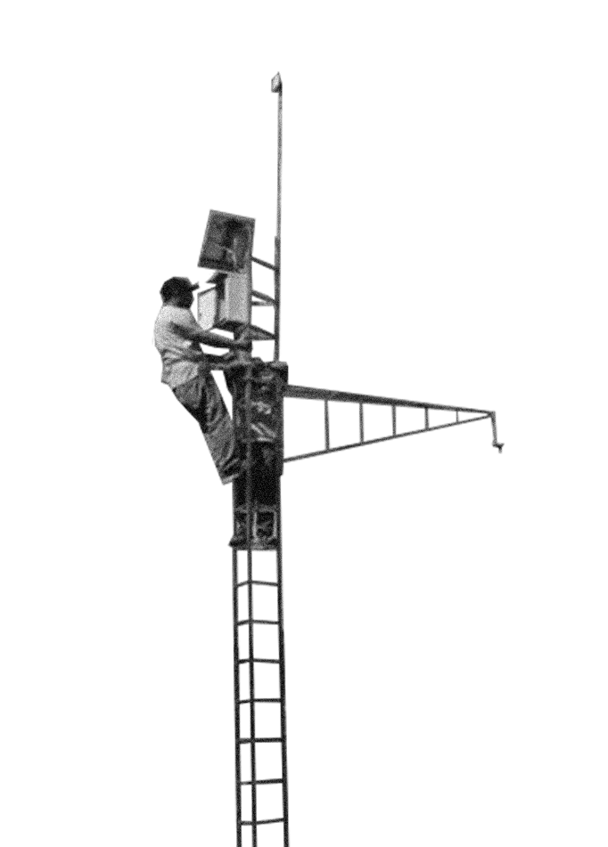






CORE COMPONENTS OF THE ANTICIPATORY ACTION PLAN (AAP)
WFP – Anticipatory Action: The Basics
TRIGGERS
Matching forecasts and risks (exposure, impact, vulnerability)
ANTICIPATORY ACTIONS
Reducing impact
2
1
ANTICIPATORY ACTION PLAN
4
3
FINANCING MECHANISM
Automatic allocation
of funds before the disaster strikes
M&E AND EVIDENCE GENERATION
Developing AA M&E frameworks
and conducting of post-activation impact evaluations

Slide 9
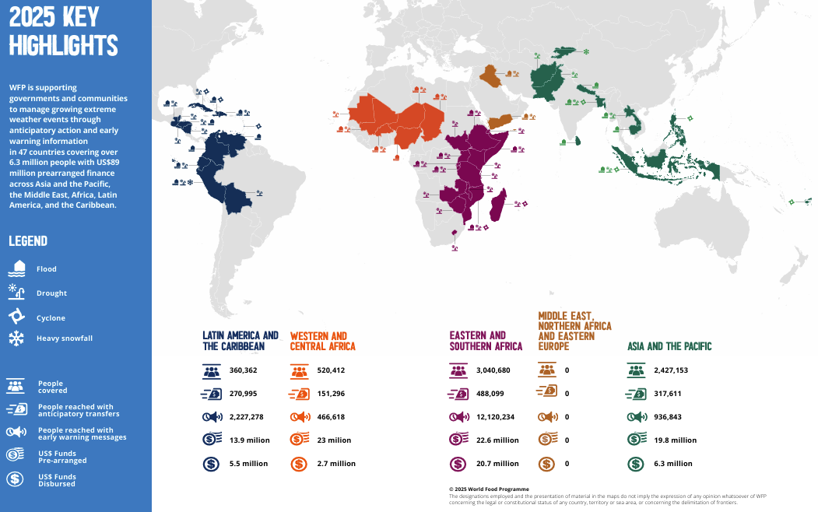

Slide 10


Anticipatory Action - a critical shift in humanitarian response
  Regional Coordination & Governance
Regional AA coordination led by IGAD’s Climate Prediction and Applications Centre.
Oversight of the Regional AA Roadmap and Technical support for national roadmaps
Institutionalization & National/Local Ownership
Government led inter-agency AA coordination & Progress in AA Integration into national DRM systems.
Co-designed AAPs in for drought and floods.
Improved Scientific forecasting & Timely AA delivery
Strengthened Early Warning Systems (Technical assistance to National Meteorological institutions on trigger development).
Strong operational readiness (partnerships, processes and systems)

Slide 11
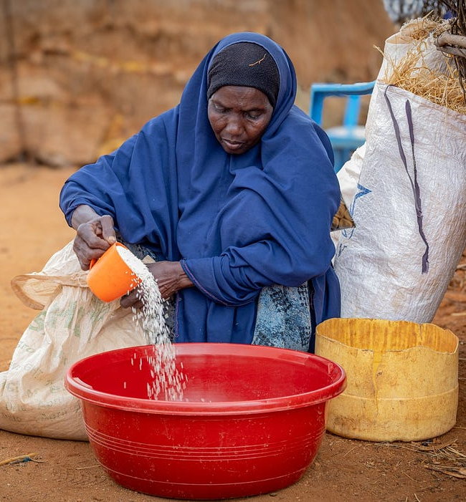

Anticipatory Action Plan
Government led AA coordination and joint planning
Multi-sectoral and inter-agency Country AA TWGs for alignment with national DRM systems.
Anticipatory Action Plans co-designed with government and partners.
Defined roles for delivery of actions across sectors and mandates.
Pre-agreed trigger thresholds, monitored and communicated by Kenya Meteorological Department (KMD).

Slide 12
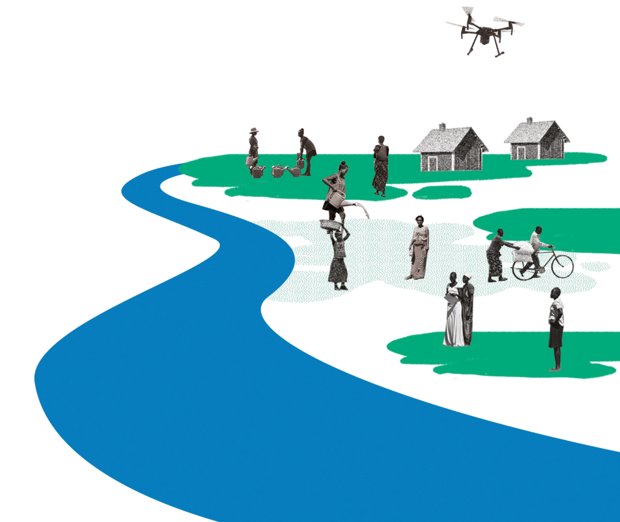
OPPORTUNITIES
Where to focus next for stronger anticipatory action.
1
Strengthen early warning systems
Integrate fragmented data, expand observation networks and connect community alerts to national decision-making.
2
Make financing trigger-ready
Pre-commit scalable funds and diversify reliable triggers beyond drought to floods and rapid-onset shocks.
3
Align coordination & governance
Reinforce national platforms with shared triggers, joint plans and common monitoring frameworks.
Act before impacts unfold.

Slide 13


EVIDENCE IN ACTION – FAO & wfp
Early action protects food consumption: AA consistently improves Food Consumption Scores and reduces reliance on negative coping strategies before drought impacts peak
Prevents irreversible coping and wellbeing loss: Evidence shows that delayed assistance leads to worse food security, harmful coping, and declines in mental wellbeing—highlighting the value of acting early
Safeguards livelihoods and production: Early support increases crop yields (25–70%), protects livestock, and preserves productive assets—stabilising food systems
Timing drives impact at scale: AA reaches vulnerable households up to 6–10 months earlier, helping maintain food access and resilience before crises escalate
Delivers strong value for money: Anticipatory action generates 3–7x returns in avoided losses and response costs compared to late response

Slide 14
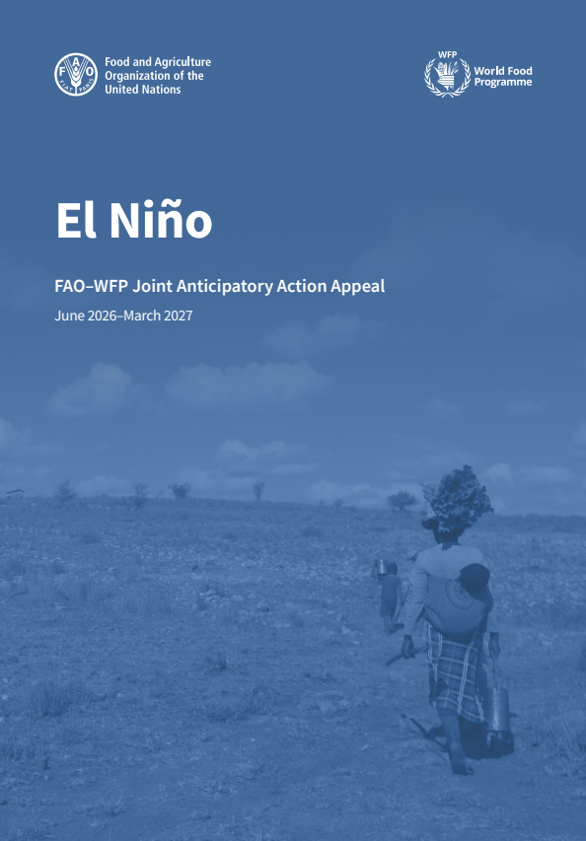
Thank you
https://www.wfp.org/publications/el-nino-fao-wfp-joint-anticipatory-action-appeal-june-2026-march-2027

