Slide 1
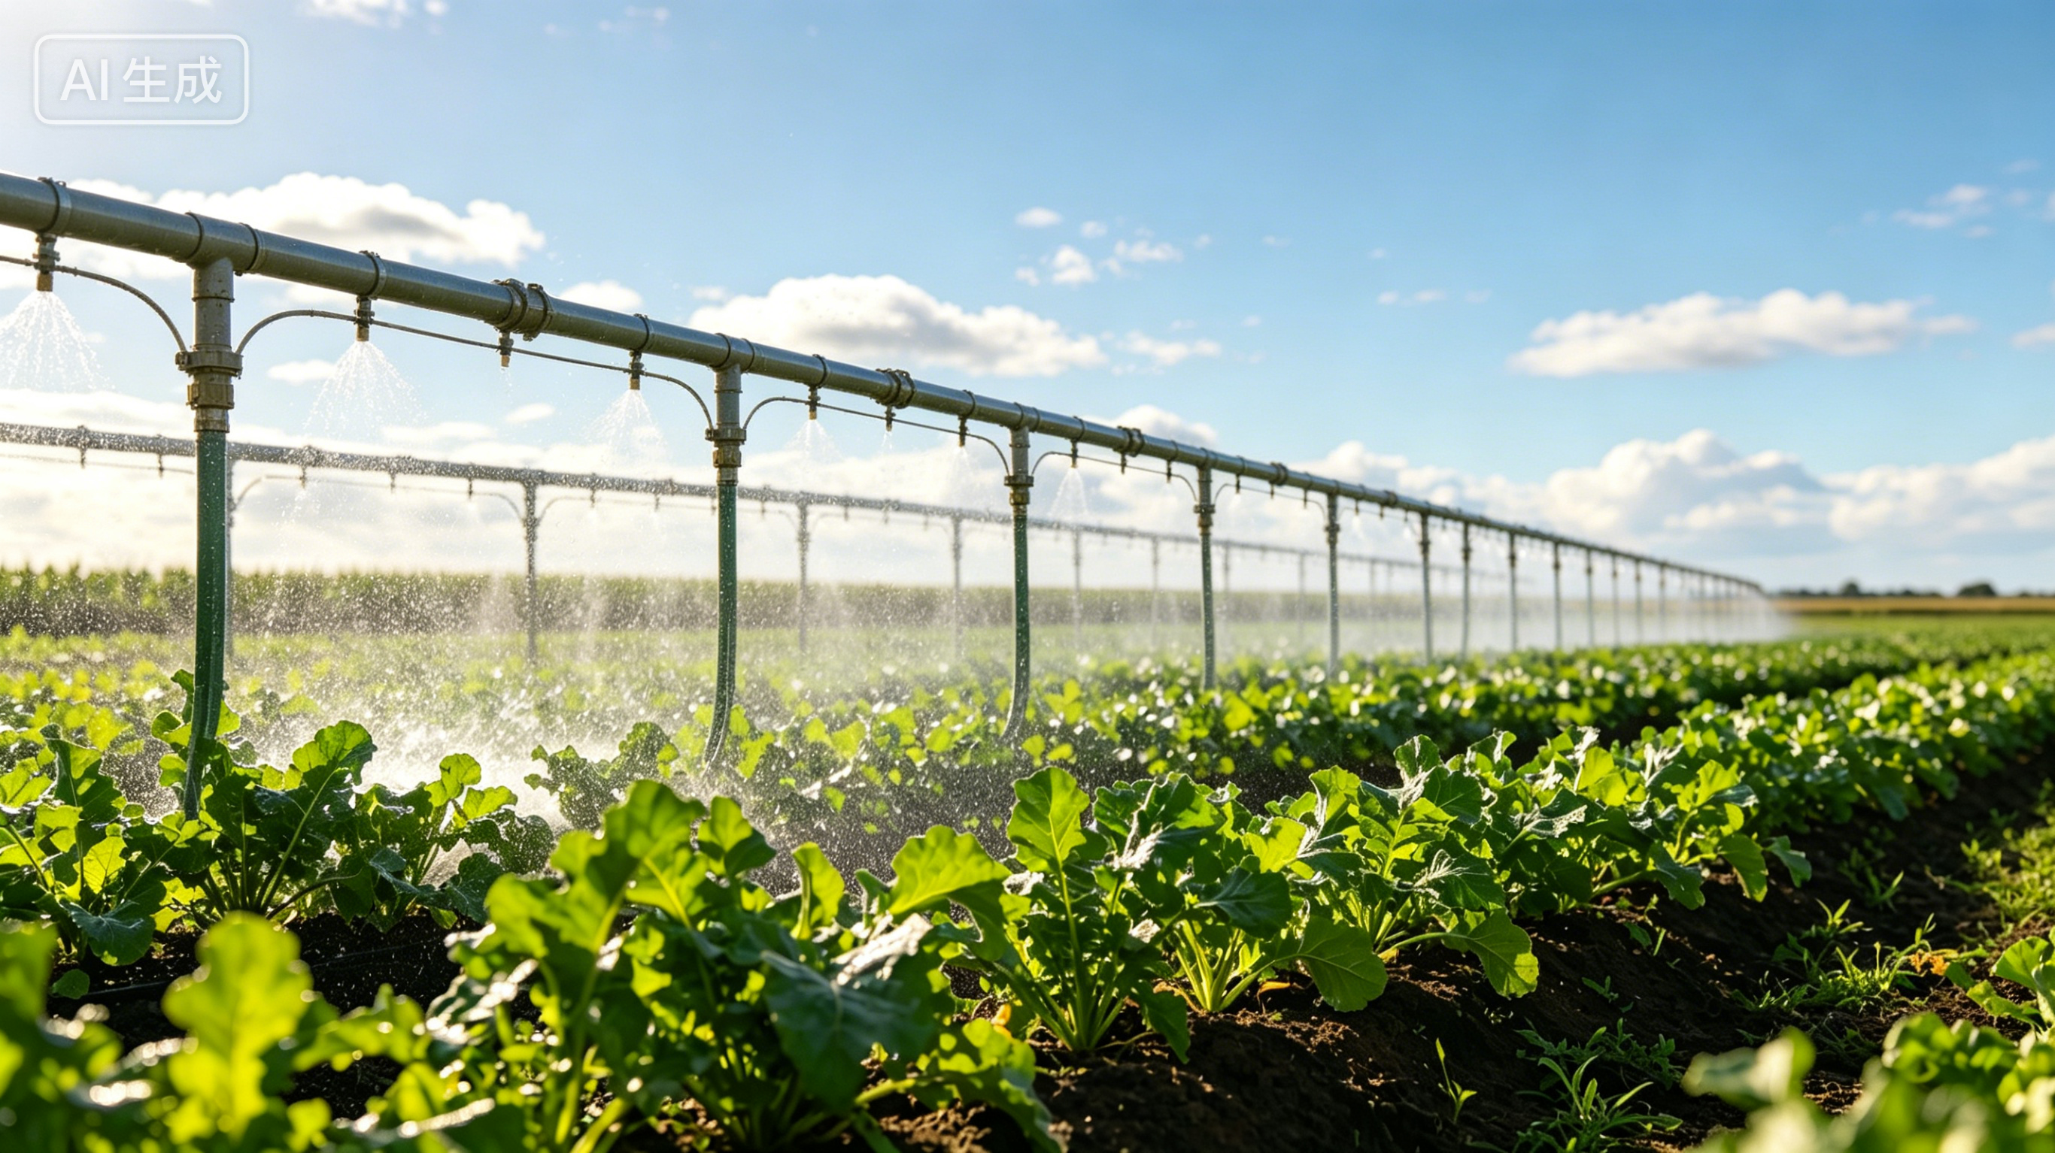

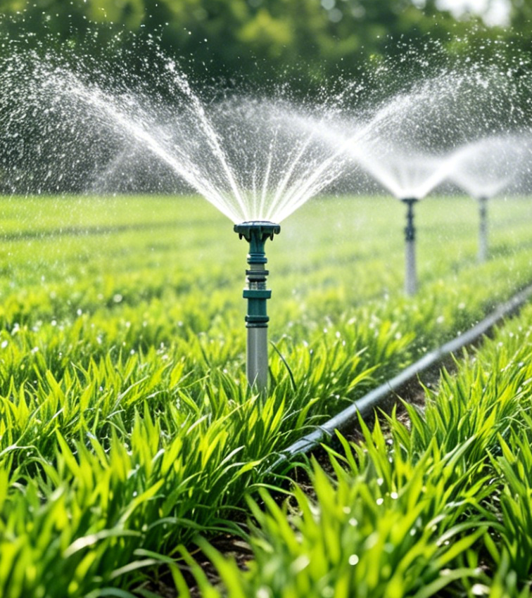
INTRODUCTION TO FOUR MAJOR WATER-SAVING IRRIGATION TECHNOLOGIES
Notes:
Introduction to Four Major Water-Saving Irrigation Technologies
四大节水灌溉技术介绍

Slide 2
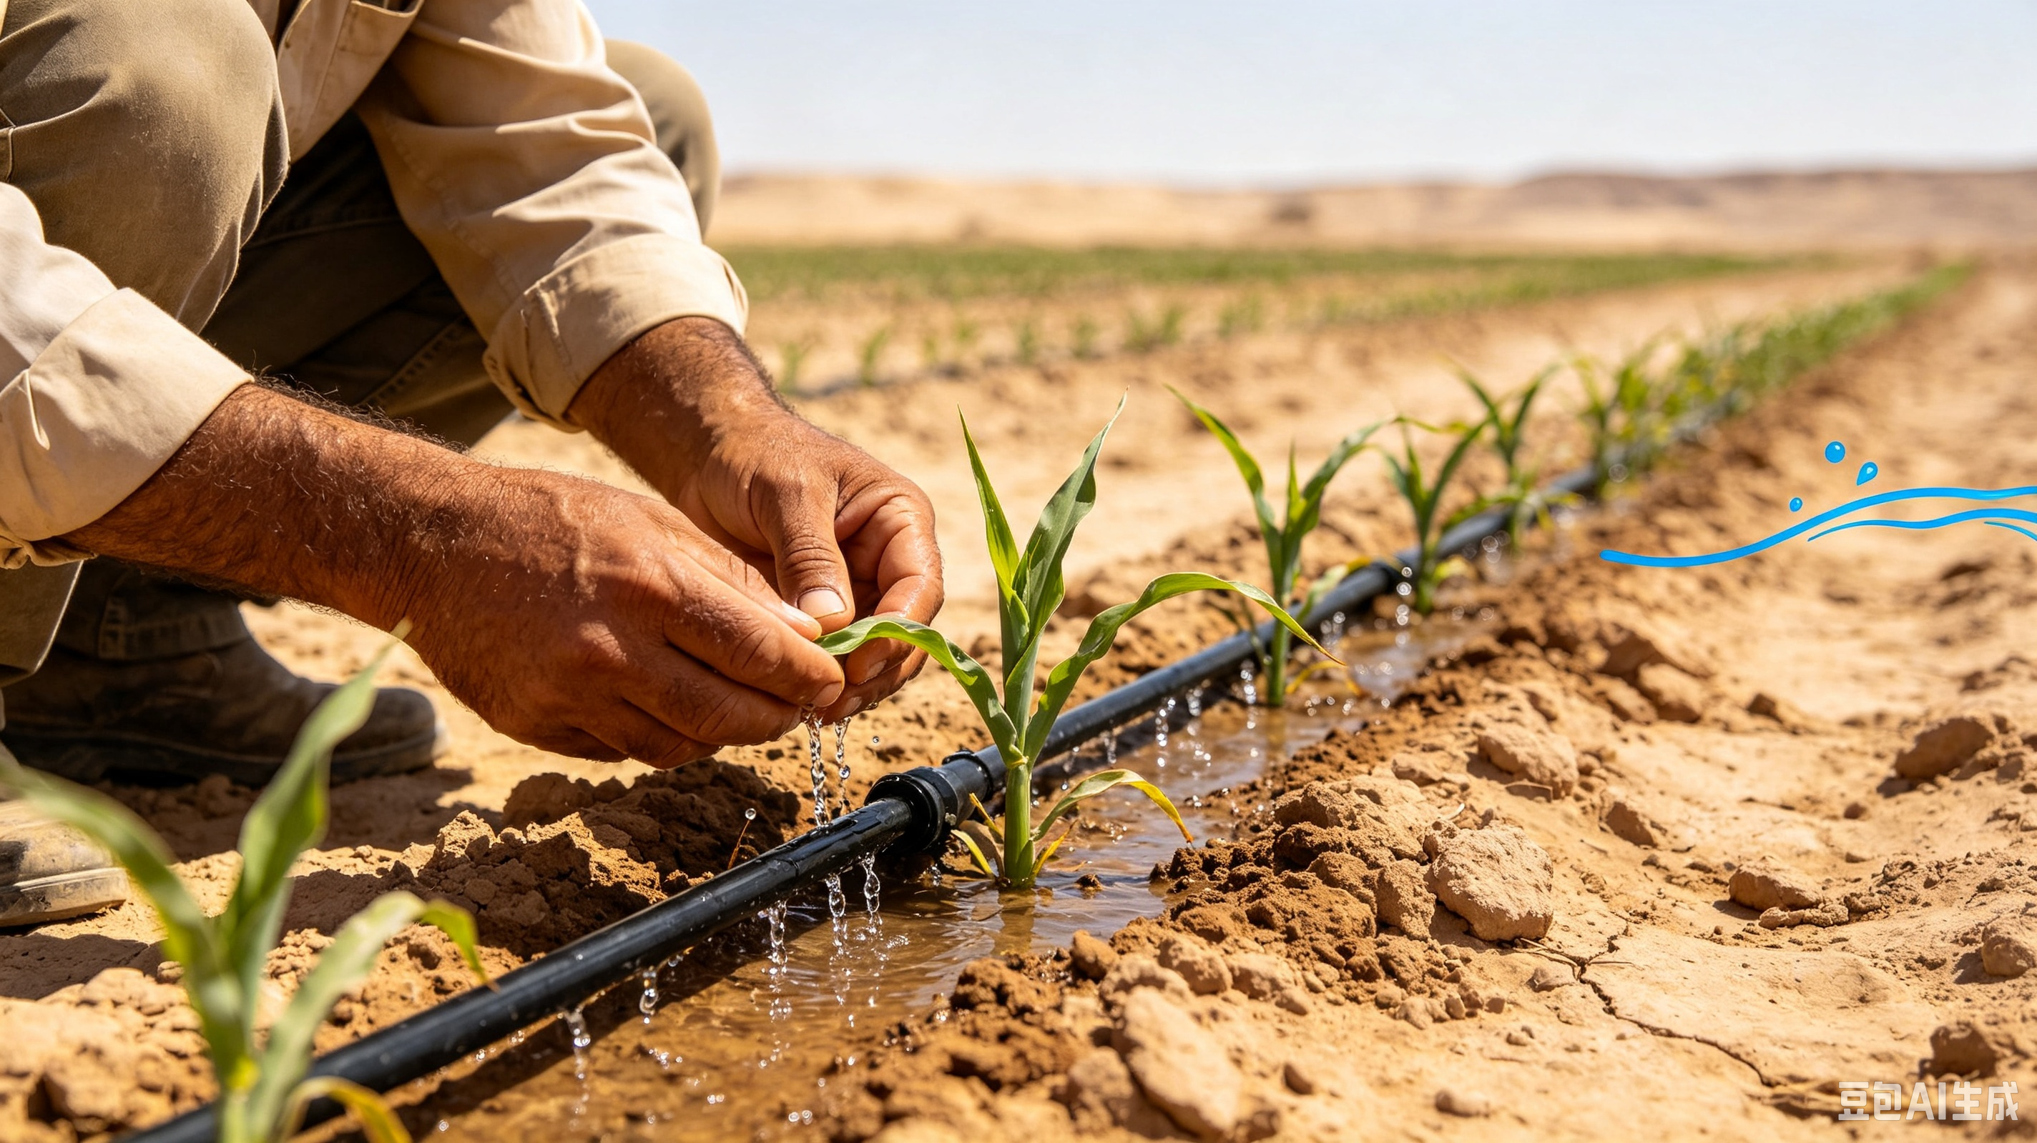

Background
Challenges
  Arid and semi-arid agricultural regions worldwide face dual challenges:
    Water scarcity.
    Need for more efficient water use.
Key Pathways
  Developing water-saving agriculture.
  Optimizing water resource allocation.
Notes:
全球农业干旱半干旱地区，正面临着水资源短缺与高效利用的共同挑战。发展节水农业、优化水资源配置，是实现农业可持续发展的关键途径。
Arid and semi-arid agricultural regions worldwide are facing the dual challenges
of water scarcity
and the need for more efficient water use.
Developing water-saving agriculture
and optimizing water resource allocation are the key pathways to achieving sustainable agricultural development.

Slide 3
Part 01
On-Demand Irrigation and Soil Moisture Monitoring
Part 02
Automated Irrigation Technology
Part 03
Fertigation
Part 04
Tidal Irrigation Technology
Notes:
本课程将系统介绍四种主流的节水灌溉技术：按需灌溉、自动化灌溉、水肥一体化及潮汐灌溉。它们各有优势，适用于不同场景：
This course provides a systematic introduction to four major water-saving irrigation technologies:
on-demand irrigation,
automated irrigation,
fertigation
and tidal irrigation. Each technology has its own advantages and is suitable for different application contexts.

Slide 4
Four Major Water Saving Irrigation Technologies
On-Demand Irrigation
Automated Irrigation
  Core features: Precisely matches crops’ water-demand patterns.
  Key mechanisms: Data-driven decision-making.
  Outcomes:
  Core feature: Unattended operation and remote control.
  Outcomes:
    Reduces labor costs.
    Improves operational efficiency.
    Improves water-use efficiency.
    Delivers uniform and stable water distribution.
    Enables controlled response to drought and waterlogging.
  Key mechanisms: Automatically adjusts irrigation volume and timing in response to changes in weather and soil moisture.
    Provides a scientific basis for irrigation management.
Fertigation
  Core features: Enables simultaneous application of water and nutrients.
  Outcomes:
Tidal Irrigation
  Core features and mechanism: Uses bottom-up water absorption and recycles nutrient solution.
  Outcomes:
    Reduces water and fertilizer use.
    Improves crop quality and yields.
    Improves water-use efficiency.
  Key Mechanisms:
    Reduces water and fertilizer inputs.
    Provides precise nutrient supply to root zones.
    Creates a tidy growing environment.
    Minimizes resource waste and environmental pollution.
    Ideal for seedlings and potted production.
    Adaptable to diverse terrains.
Notes:
按需灌溉，可精准匹配作物需水规律，依托数据化决策，实现节水高效、旱涝可控，为科学灌溉提供依据。
自动化灌溉，具备无人值守、远程操控，省人工、效率高，灌溉均匀稳定等特点，并可根据气象与墒情变化自动调节灌溉量和灌溉时间。
水肥一体化，做到了水肥同步施用，省水省肥、提质增产，根系精准供给，减少浪费与污染，适配多种地形。
潮汐灌溉，采取底部吸水、营养液循环利用等方式，提高水资源利用率、节水省肥，环境干净，适合育苗与盆栽种植。
•On-demand irrigation
precisely matches crops' water-demand patterns.
Supported by data-driven decision-making,
it improves water-use efficiency
and enables controlled response to drought and waterlogging,
providing a scientific basis for irrigation management.
• Automated irrigation
features unattended operation and remote control.
It reduces labor costs,
improves operational efficiency,
and delivers uniform and stable water distribution. The system can also
automatically adjust irrigation volume and timing in response to changes in weather and soil moisture conditions.
•Fertigation
enables simultaneous application of water and nutrients.
It reduces water and fertilizer use,
improves crop quality and yields,
and provides precise nutrient supply to the root zones.
The technology also minimizes resource waste and environmental pollution
and is adaptable to a wide range of terrains.
•Tidal irrigation
uses bottom-up water absorption and recycles nutrient solution.
It improves water-use efficiency
and reduces water and fertilizer inputs.
In addition, it creates a tidy growing environment,
ideal for seedlings and potted production.

Slide 5
PART.01
On-Demand Irrigation and Soil Moisture Monitoring
Notes:
一、按需灌溉与土壤墒情监测
PART.01
On-Demand Irrigation and Soil Moisture Monitoring

Slide 6
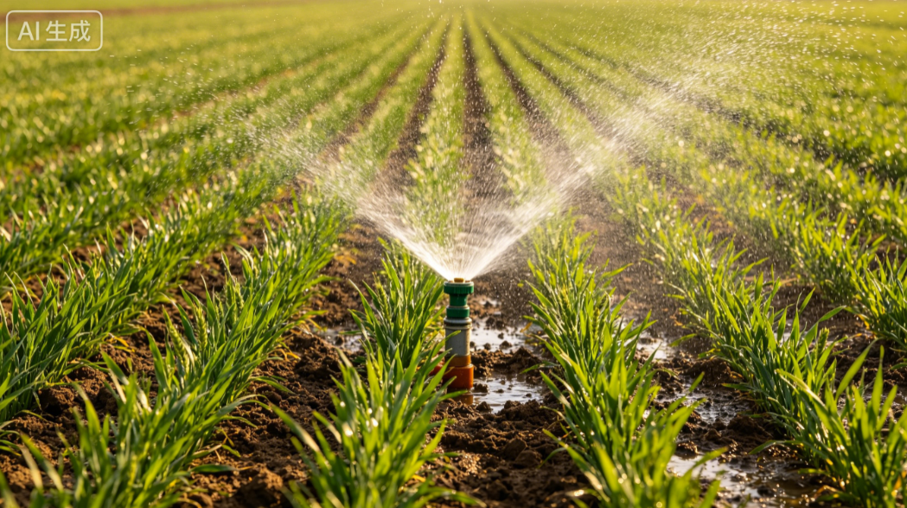
1. On-Demand Irrigation Technology
  (1) What is on-demand irrigation
Definition
  Rational regulation of water resources, including:
    Natural precipitation.
    Irrigation water.
    Soil water.
  Based on crop water-requirement patterns.
  Considers the interaction between fertilization and water supply.
  Key note:
Technical Measures
  Engineering, agronomic, mechanical, biological, and operational measures adopted.
  to meet crop water demands.
Notes:
（一）按需灌溉技术
1.什么是按需灌溉？按需灌溉是根据作物需水规律，考虑施肥与水分的关系，运用工程、农艺、农机、生物、管理等措施，合理调控自然降水、灌溉水和土壤水等水资源，满足作物水分需求。
1.1.On-Demand Irrigation Technology
1.1.1. What is on-demand irrigation?
On-demand irrigation refers to rational regulation of water resources, including
natural precipitation,
irrigation water,
and soil water.
It is based on crop water-requirement patterns
and considers the interaction between fertilization and water supply.
Engineering, agronomic, mechanical, biological, and operational measures are adopted to meet crop water demands.

Slide 7
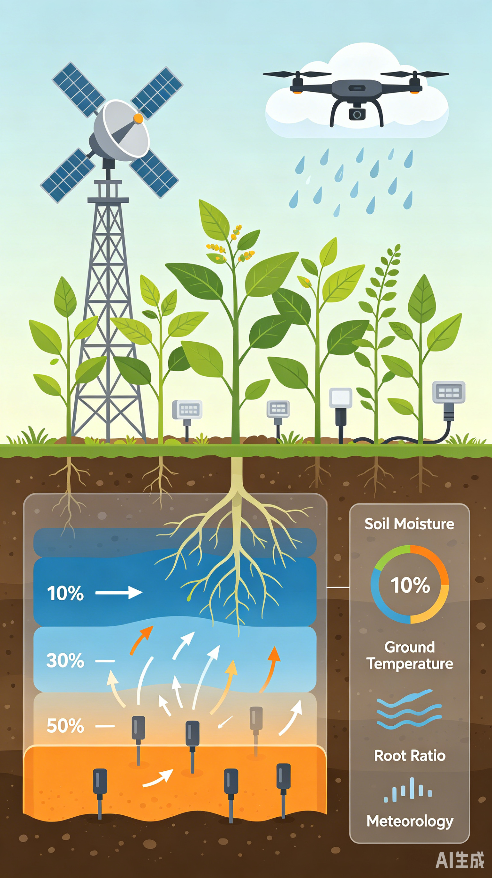
1. On-Demand Irrigation Technology
  (2) Prerequisites for achieving on-demand irrigation
Field Sensing for On-Demand Irrigation
  Comprehensive and multi-dimensional field sensing is essential.
  Sensors and monitoring devices → collect key field environmental data in real time →to support informed irrigation decisions.
Factors Covered by Field Sensing
  ⇨ Crop water demand and growing conditions:
    Soil moisture and its dynamics.
    Surface and subsurface temperature.
    Location and proportion of active crop roots.
    Meteorological data.
Notes:
2.按需灌溉实现条件。要实现真正的作物按需灌溉，首先需要全方位、多维度地现场感知，即通过传感器和监测设备实时获取田间关键环境信息，为按需灌溉提供依据。现场感知包括土壤水分及变化、地表地下温度、作物活跃根系位置及比例、气象数据等诸多对作物需水及生产环境产生影响的因素。
1.1.2. Prerequisites for achieving on-demand irrigation
To achieve true on-demand irrigation,
comprehensive, multi-dimensional field sensing is essential.
Sensors and monitoring devices collect key field environmental data in real time to support informed irrigation decisions.
Field sensing covers a range of factors affecting
crop water demand and growing conditions,
including soil moisture and its dynamics,
surface and subsurface temperature,
the location and proportion of active crop roots,
and meteorological data.

Slide 8
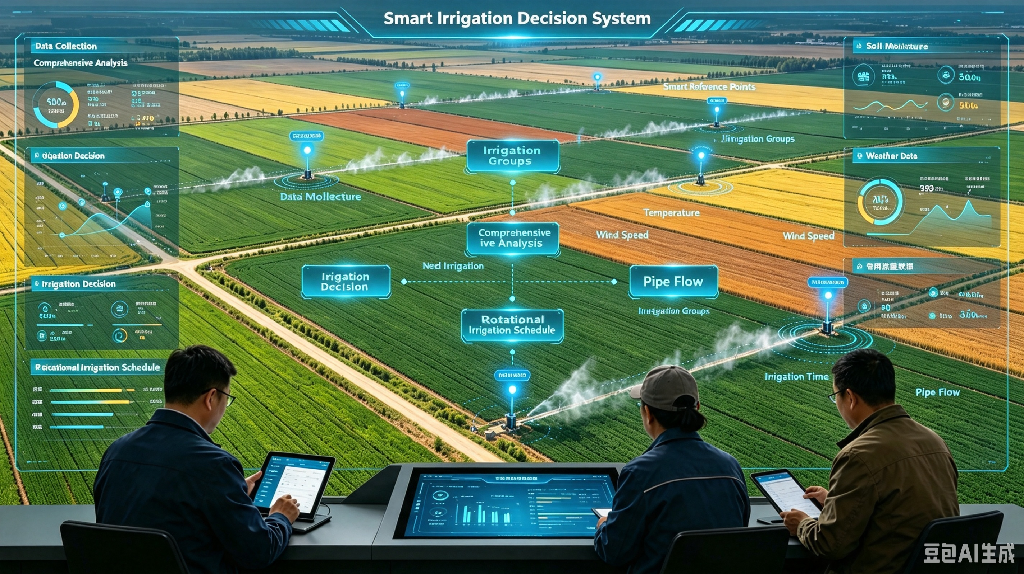
1. On-Demand Irrigation Technology
  (2) Prerequisites for achieving on-demand irrigation
Execution Mechanism
  Based on intelligent technologies and big data analytics.
  Integrated analysis and processing of soil moisture and meteorological data.
    ⇨ Irrigation decisions are made for each irrigation rotation group equipped with intelligent reference points.
    ⇨ Whether irrigation is needed + the exact timing.
System Components
  Intelligent reference points
    Field-deployed monitoring sites.
    Represent typical moisture conditions within the respective areas.
  Irrigation rotation groups
    Field areas divided into operational units for rotational irrigation.
    In accordance with water supply conditions and pipe network layouts.
Notes:
其次，基于智能及大数据决策的执行机制，通过对水分数据、气象数据的综合分析处理，为每个拥有智能参照点的轮灌组制定灌溉决策，明确是否需要灌溉以及具体的灌溉时间。其中，智能参照点是指布设在田间、用于代表区域典型水分状况的监测点；轮灌组则是按照水源条件和管网布局，将田块划分成分批轮流灌溉的作业单元。
Secondly, the execution mechanism is
based on intelligent technologies and big data analytics.
Through integrated analysis and processing of soil moisture and meteorological data,
irrigation decisions are made for each irrigation rotation group equipped with intelligent reference points,
specifying whether irrigation is needed and the exact timing.
Intelligent reference points are
field-deployed monitoring sites
that represent typical moisture conditions within the respective areas.
Irrigation rotation groups refer to
field areas divided into operational units for rotational irrigation,
in accordance with water supply conditions and pipe network layouts.

Slide 9
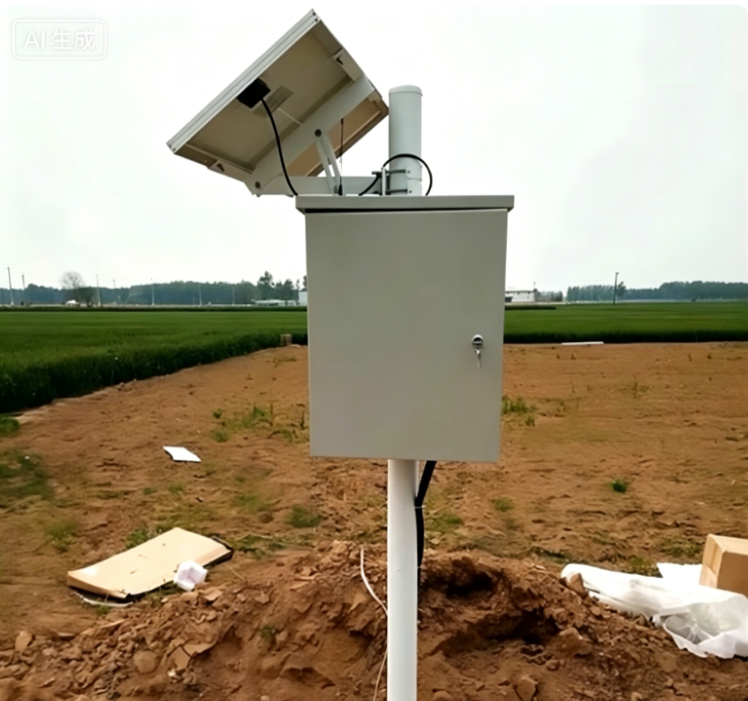
2. Online Soil Moisture Monitoring
  (1) What is online soil moisture monitoring?
Sensor Deployment
  Uses sensors and related equipment.
Fixed-Point Measurement
  Systematically measures soil moisture at fixed points.
Real-Time Field Insight
  Provides real-time insight into field moisture dynamics.
Notes:
（二）土壤墒情在线监测
1.什么是土壤墒情在线监测？在线监测是通过运用传感器等设备，对土壤水分进行定期、定点的测定，实时掌握田间土壤水分变化规律的一种在线监测技术。
1.2.Online Soil Moisture Monitoring
1.2.1. What is online soil moisture monitoring?
Online soil moisture monitoring uses sensors and other equipment
to systematically measure soil moisture at fixed points,
providing real-time insight into field moisture dynamics.

Slide 10
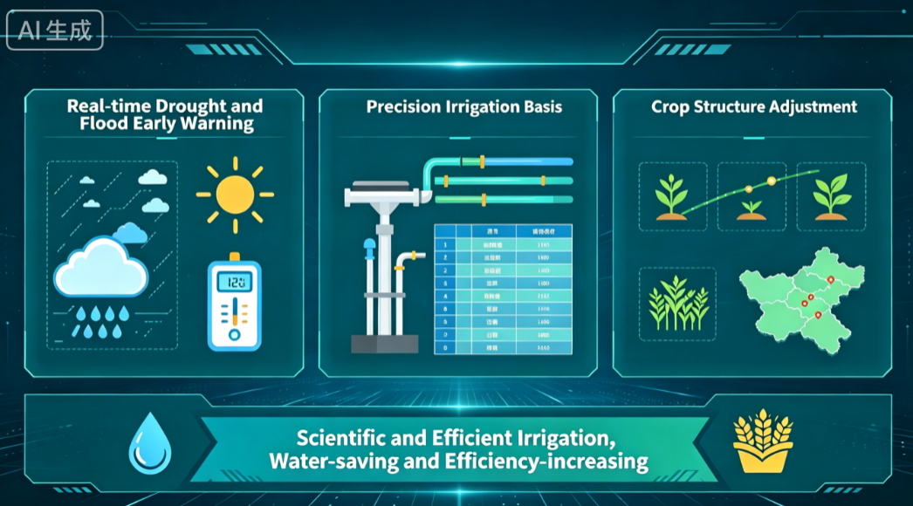
2. Online Soil Moisture Monitoring
  (2) Functions of soil moisture monitoring
Early Warning & Irrigation Scheduling
  Real-time soil moisture data
    Enables early warning against drought and waterlogging.
    Serves as a key reference for establishing accurate irrigation schedules.
Planting Structure Adjustment & Improved Irrigation Management
  Long-term accumulated soil moisture datasets
    → Support the adjustment of crop planting structures.
    → Promote more scientific and efficient irrigation management.
    Achieving water conservation and productivity improvement.
Notes:
2.土壤墒情监测作用。土壤墒情监测数据不但能够对旱涝进行实时预警，还可以作为制定准确灌溉制度的依据；长系列的土壤墒情数据积累，还有助于调整种植结构，进行科学高效的灌溉，从而达到节水增效的目的。
1.2.2.Functions of soil moisture monitoring
Real-time soil moisture data
enables early warning against drought and waterlogging,
and serves as a key reference for establishing accurate irrigation schedules.
Long-term accumulated soil moisture datasets
also support the adjustment of crop planting structures
and promote more scientific and efficient irrigation management,
thereby achieving water conservation and productivity improvement.

Slide 11
2. Online Soil Moisture Monitoring
  (3) Components of the online soil moisture monitoring system
Four-Layer Architecture
Sensor Application Layer
  Composed of soil moisture sensors.
  Captures soil moisture data at different soil depths.
Data Acquisition Layer
  Consisting of data logger enclosures.
  Collects moisture readings from sensors.
  Transfers them to data loggers.
01
02
Information Transmission Layer
  Wireless networks are used.
  Transmits locally processed data to the central receiving station.
Information Application Layer
  Comprising data-receiving hardware and supporting software.
  Performs remote data reception, processing, storage, and application functions.
03
04
Notes:
3.土壤墒情在线监测系统组成。
土壤墒情在线监测系统由四层架构构成：
传感器应用层：由土壤水分传感器构成，主要实现各层土壤水分数据的获取。
数据采集层：由采集器箱构成，将传感器获取的土壤水分数据采集到墒情采集器。
信息传输层：采用无线网络，将现场处理好的数据通过网络传送到中心接收站。
信息应用层：由接收硬件设备及相应软件组成，实现远程信息接收、处理、存储、应用等功能。
1.2.3. Components of the online soil moisture monitoring system
The system consists of a four-layer architecture:
1 Sensor Application Layer:
Composed of soil moisture sensors,
this layer primarily captures soil moisture data at different soil depths.
2 Data Acquisition Layer:
Consisting of data logger enclosures,
it collects moisture readings from sensors
and transfers them to soil moisture data loggers.
3 Information Transmission Layer:
Wireless networks are used
to transmit locally processed data to the central receiving station.
4 Information Application Layer:
Comprising data receiving hardware and supporting software,
this layer performs remote data reception, processing, storage and application functions.

Slide 12
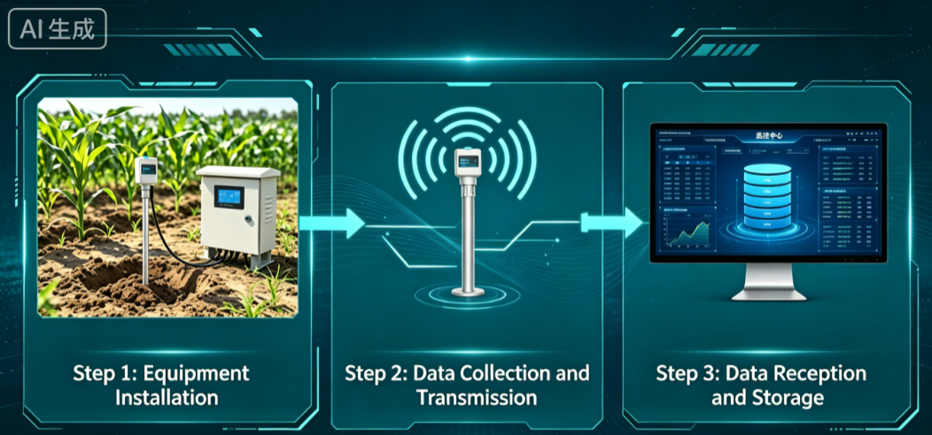
2. Online Soil Moisture Monitoring
  (4) Implementation process of the online soil moisture monitoring
Field-Installed Auxiliary Equipment
Soil moisture sensors.
Data logger enclosures.
Power supply systems.
Backend servers.
Soil moisture management software.
Communication networks.
On-Site Data Collection
  On-stie remote monitoring devices:
    → Automatically collect real-time soil moisture data.
    → Transmit the data over wireless networks.
Centralized Data Storage
  Monitoring center:
    → Automatically receives and stores data from all monitoring points in the database.
Notes:
4.土壤墒情在线监测实现流程。土壤墒情在线监测通过在田间安装土壤水分传感器、数据采集器箱、供电系统、后台服务器、墒情管理软件、通信网络等辅助设备实现。现场远程监测设备自动采集土壤墒情实时数据，并利用无线网络实现数据远程传输；监控中心自动接收、自动存储各监测点的监测数据到数据库中。
1.2.4.Implementation process of the online soil moisture monitoring
Online soil moisture monitoring is implemented through
field-installed auxiliary equipment,
including soil moisture sensors,
data logger enclosures,
power supply systems,
backend servers,
soil moisture management software,
and communication networks.
On-site remote monitoring devices
automatically collect real-time soil moisture data
and transmit the data over wireless networks.
The monitoring center
then automatically receives and stores data from all monitoring points in its database.

