Slide 1
Rice Flour Dry Milling Introduction
朱晓月 Arena Zhu, Process Innovation Manager

Slide 2
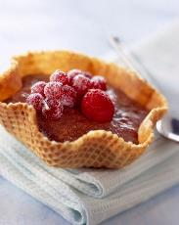
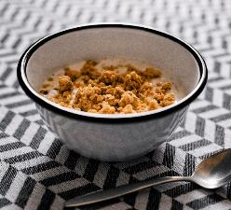
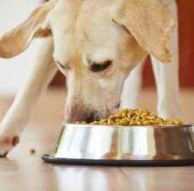
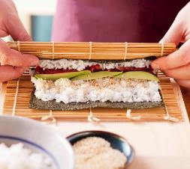
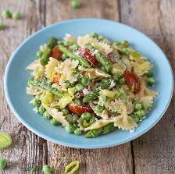
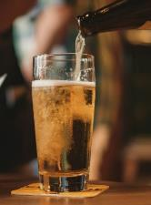
Every Day, Billions of People Come into Contact with Bühler.
06:30
07:15
10:00
15:00
19:00
07:00
07:30
12:00
18:00
20:00

Slide 3
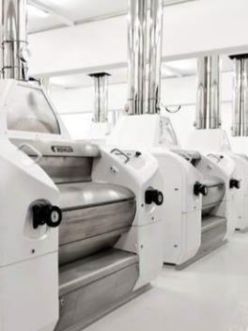
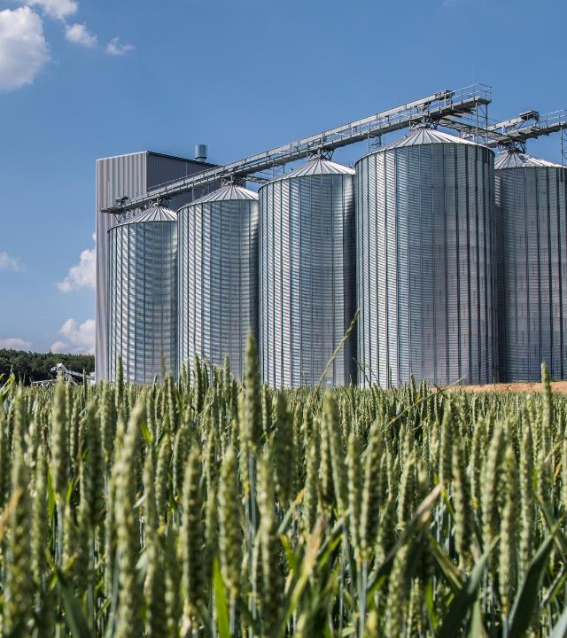
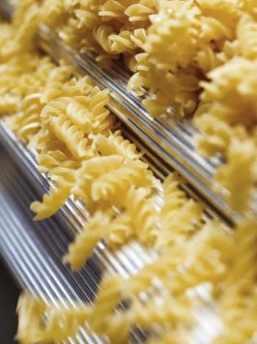
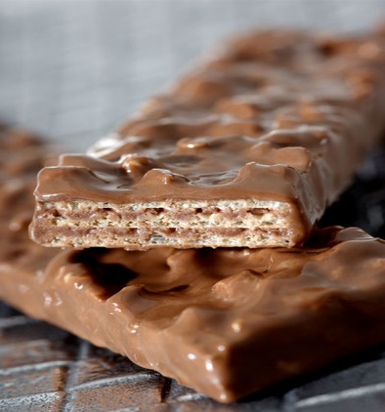
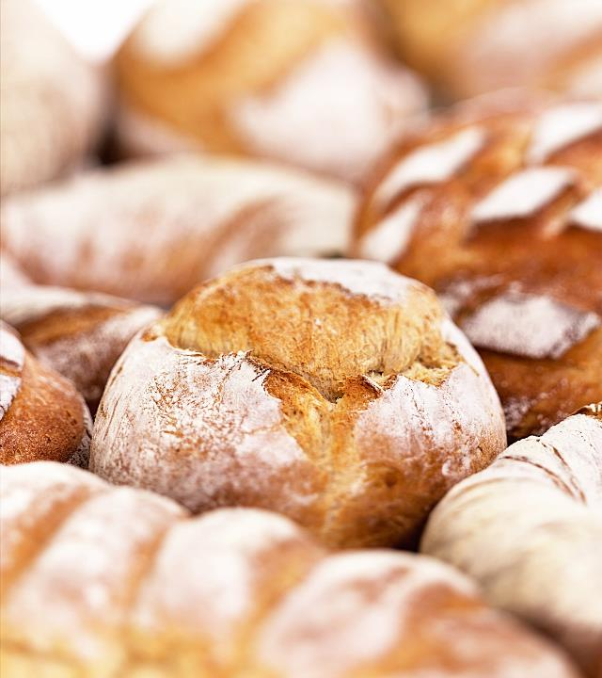
Our Business Strong Position in our Industries
MILLING SOLUTIONS
Grain Quality
DiGITAL TECH.
value nutrition
WAFER
BISCUITS
65% of world’s wheat milled on our machines
75% of global malt and 30% of rice produced with our solutions
No. 1 in optical sorting globally with >25,000 installed machines
40% of pasta 35% of cereals 20% of animal feed
50% of all wafers produced on Bühler lines
>60 years of experience in biscuits & cakes
BAKERY
Confectionery
Chocolate & Coffee
Die Casting
Grinding & Dispersion
Leybold optics
Mixing, aerating and dough preparation for complete plants
70% market share for hollow products (figurines etc.)
60% of all chocolate, from bean to bar made on Buhler
25% of all aluminum components cast on our equipmen
100% of top 10 ink producers worldwide use Buhler
50% of cars worldwide contain components with technology

Slide 4
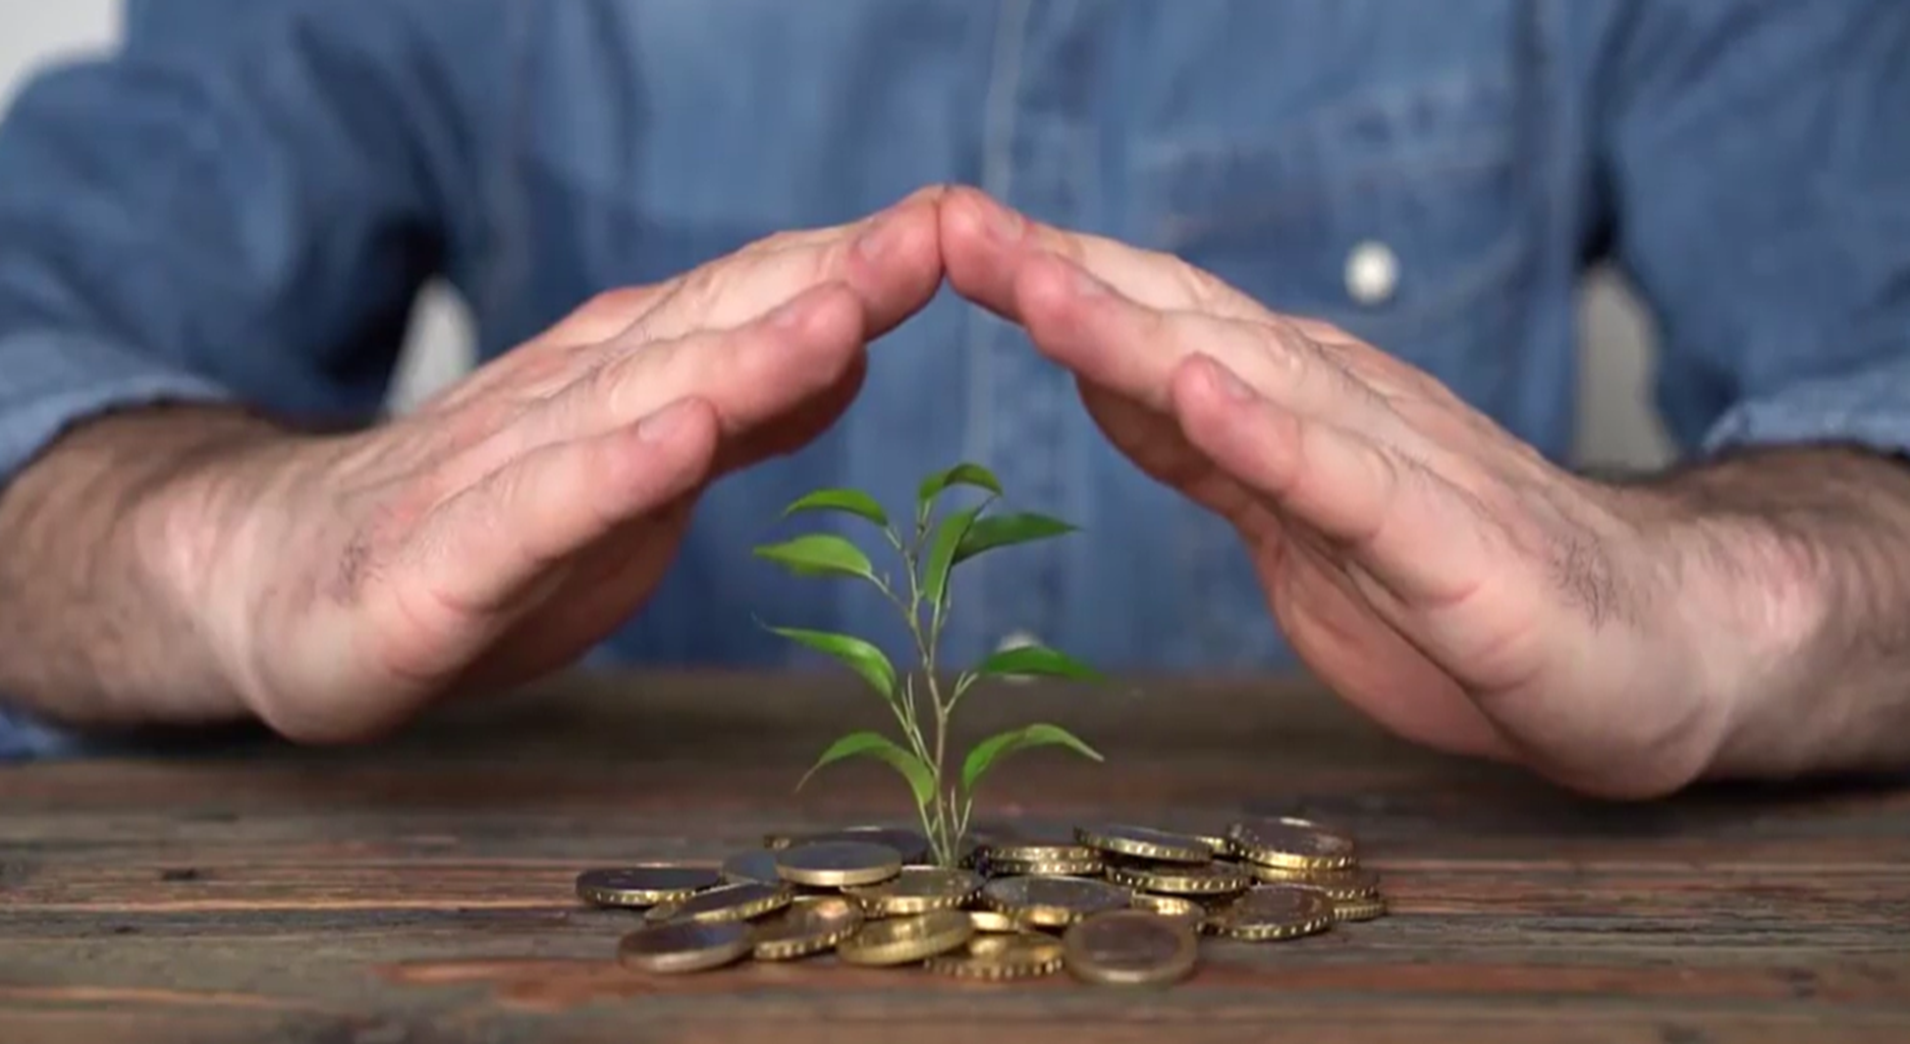
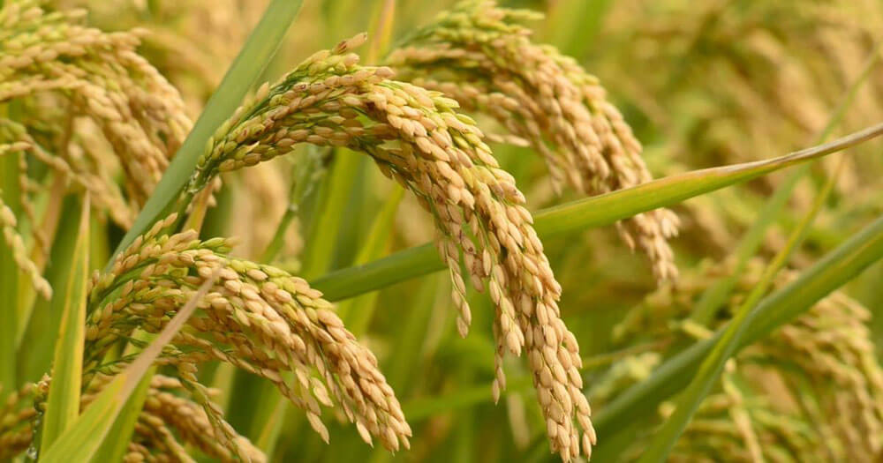
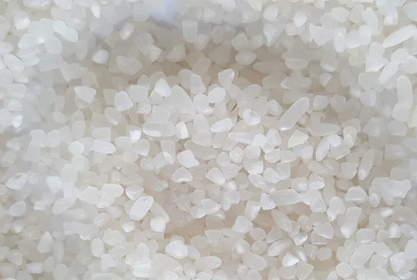
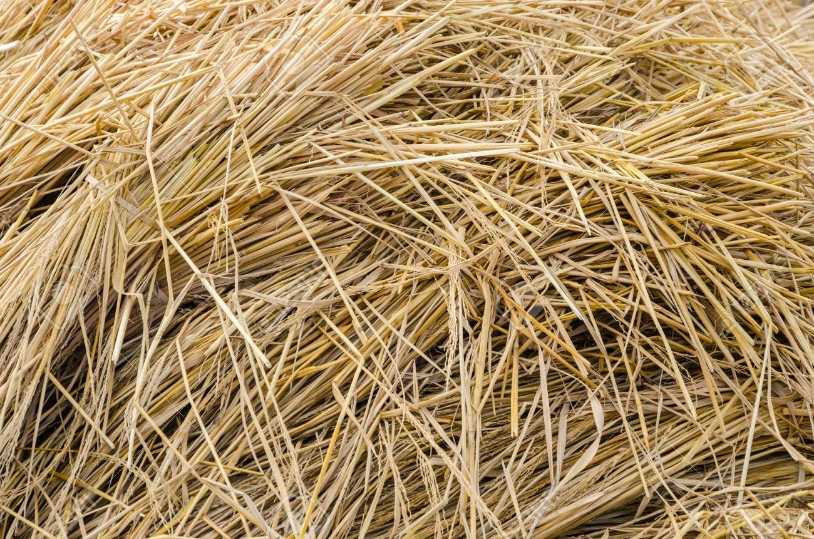
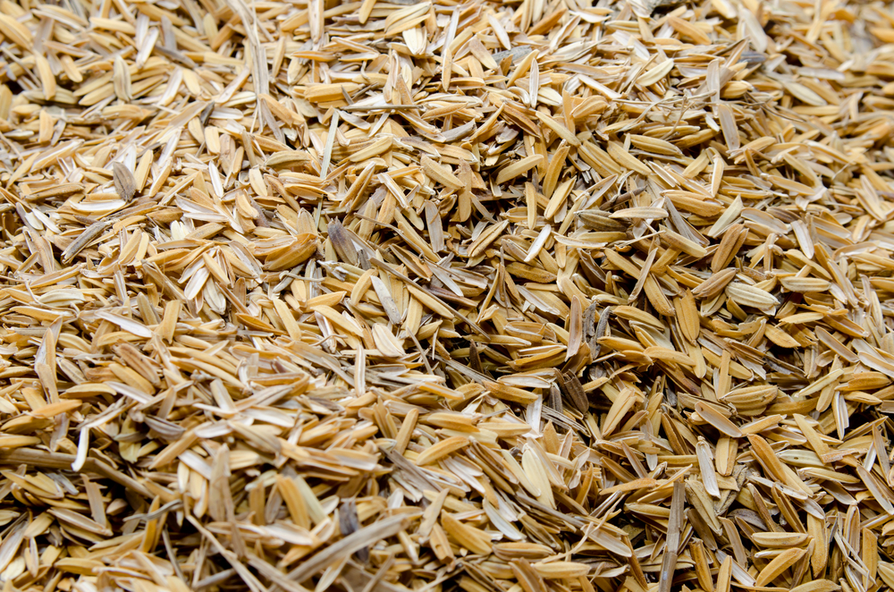
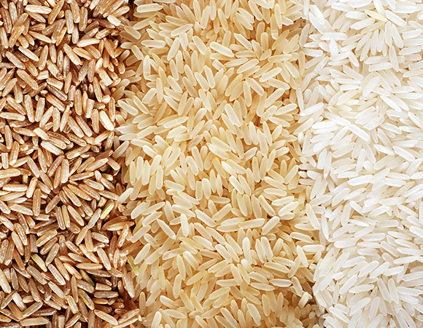
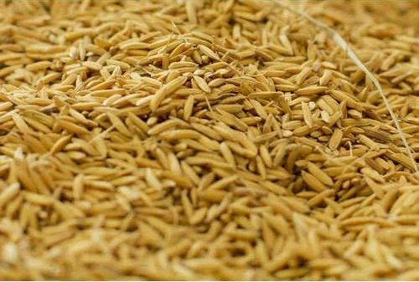
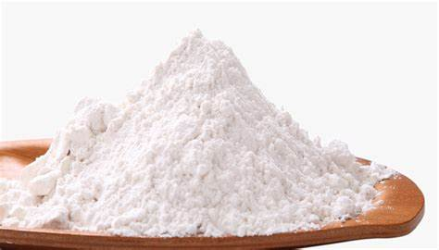
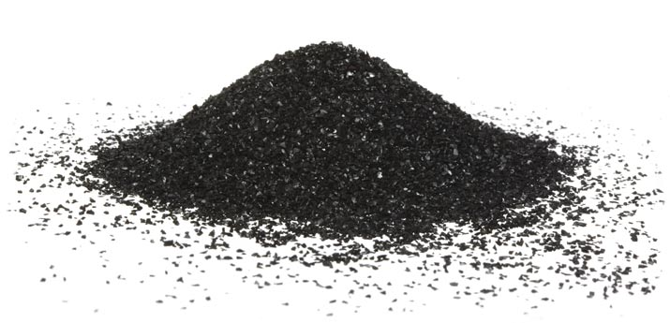
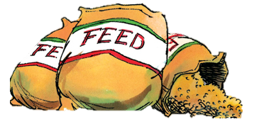
Rice Flour Position in the Rice Production & Nutrition Value Chain
Avoid
Reduce
Optimized cleaning using optical sorting
Nutritional losses
Quality losses
State of Art storage solution Drying optimization Enclosed conveyors for food safety
100%
Nutrition Ratio
5%
100%
Quality Ratio
67%
Paddy
Rice Storage
Milling
Rice
Reuse
Rice Straw
Husk
Sorting Rejects
Rice bran
Broken Rice
Side-streams valorization
Bioethanol
Activated carbon
Nano Silica
Animal Feed
Bran oil
Rice Flour
Notes:
Where what,
With economical benefit
upcycling
Rice Flour Dry Milling Solution A sustainable and nutritious solution to grind Rice for downstream applications

Slide 5
Rice Flour Dry Milling Solution Balancing the needs of Nutrition, Natural and Economy
NO Wastewater
No Water Waste
Nutrition Prevention
Reliable & Stable Process
Longer Shelf Life
Scale & Automation Available
Flexible Solution
High Flour Yield
Food Safety

Slide 6
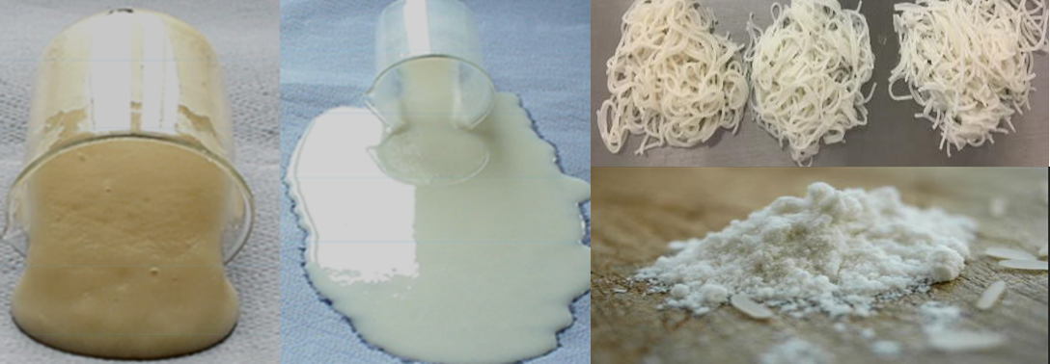
Rice Flour Dry Milling Solution Overview
With Water adding
Super Fine Grinding
White Color
Similar Properties to Wet
Rice Intake
Cleaning
Milling
Rice Flour
Goal:
Replace Wet grinding for Rice Flour
Flour quality same or better than conventional process
Quality of the flour is more Stable and easy control
Higher Flour Yield (Reduce waste)

Slide 7
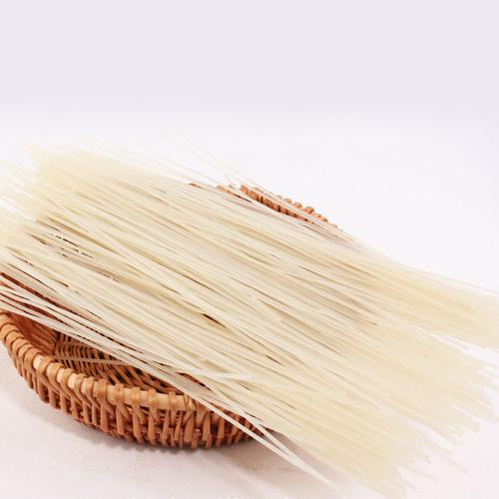
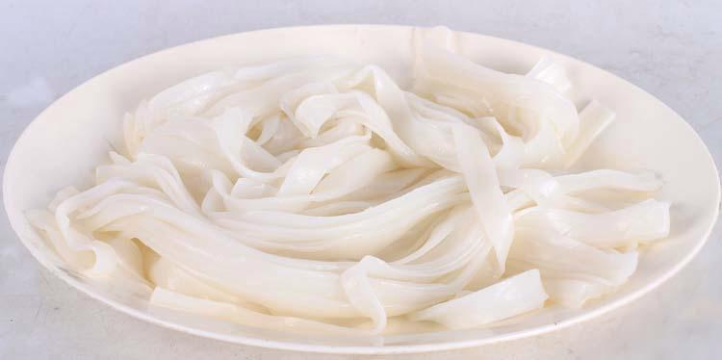
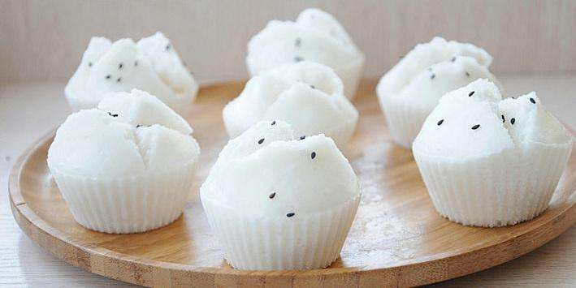
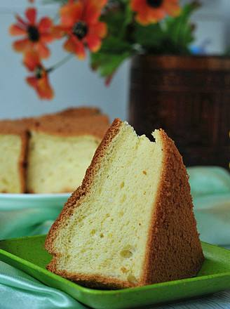
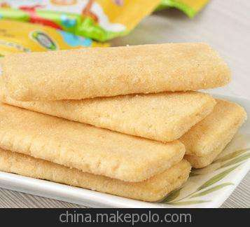
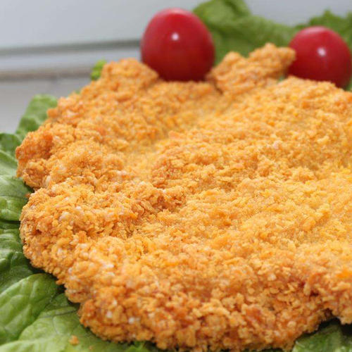
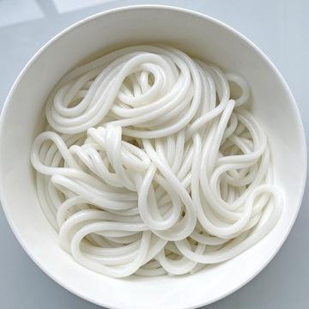
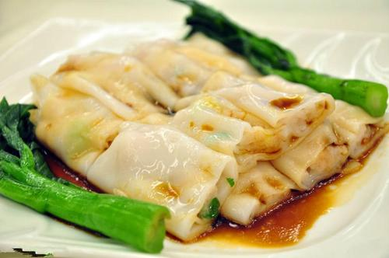
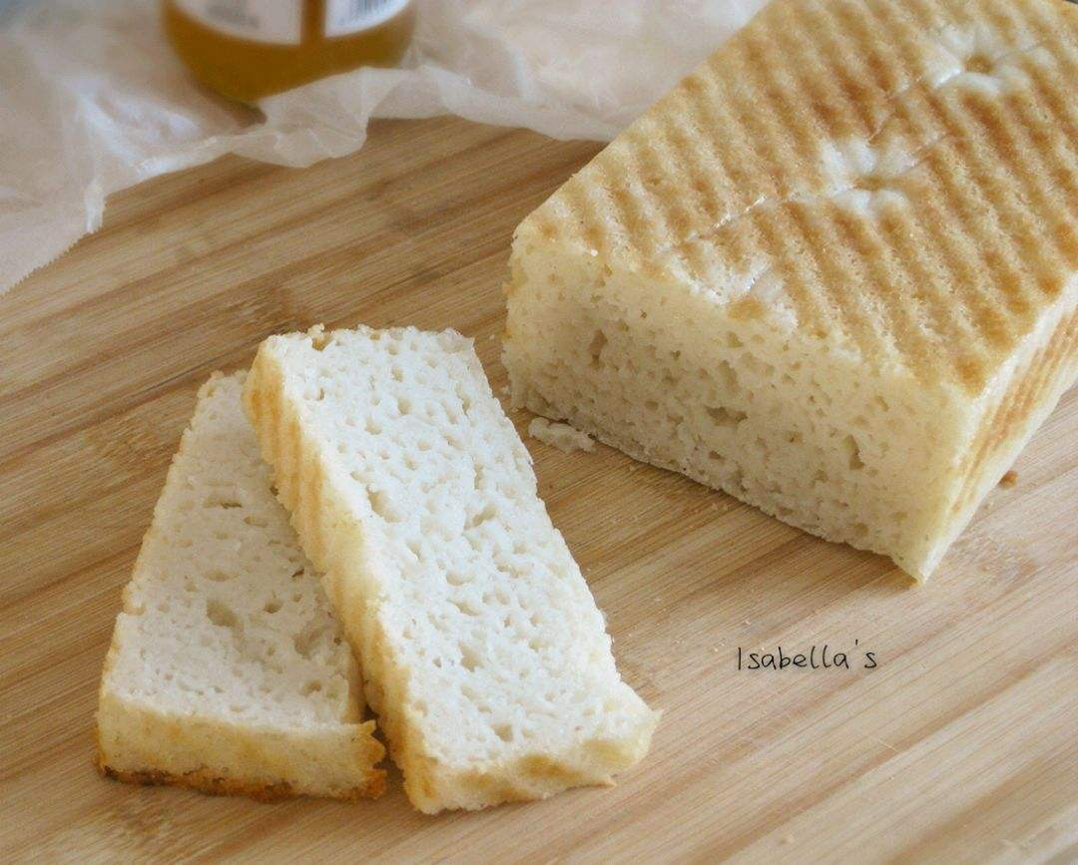
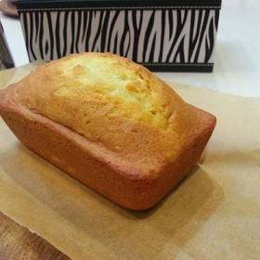
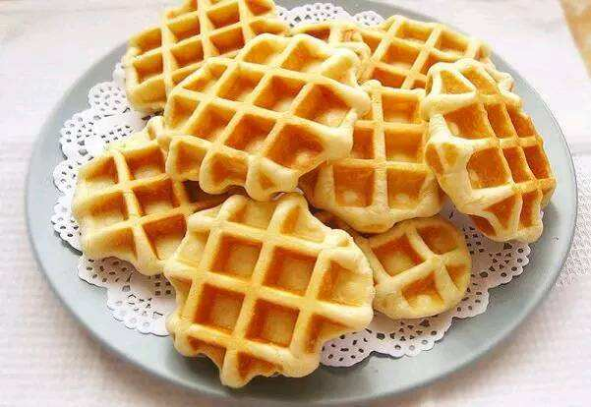
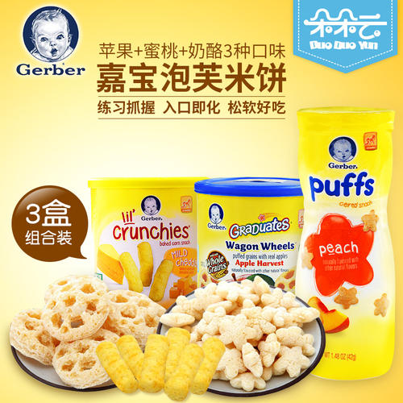
Multi- Application of Rice Flour Flexible to meet different Customer Requirements
Straight rice noodle
Fresh slice noodle
Steam rice cake
Sponge cake
Rice cracker
Batter
Fresh rice noodle
Vermicelli roll
Rice bread
Muffin cake
Waffle
Baby food

Slide 8
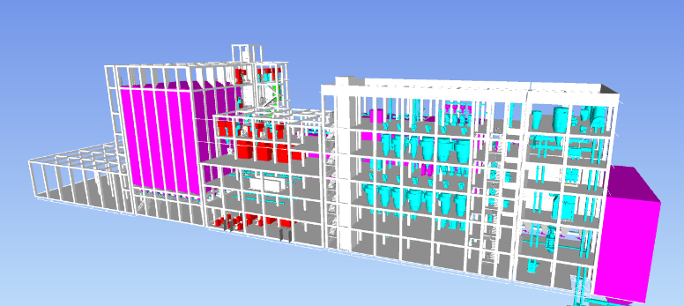
Rice Flour Dry Milling Solution Benefits of Economic and Environment
Cost | Traditional | Dry Milling | Dry Milling- Traditional
Power Consumption | 85Kwh/ton -68CNY/ton | 88Kwh/ton, -70CNY/ton | -2CNY
Water consumption | 3.75ton/ton, -7.5CNY/ton | 0.08ton/ton, -0.16CNY/ton | 7.34CNY
Yield | 97% , 3880CNY | 102%, 4080CNY | 5% ~ 200CNY
Sum | 3804CNY | 4010CNY | 206CNY
Assumption: 10t/h，Working time :10h/d，Rice flour Price 4000CNY/ton;
Raw moisture 12.5%, rice flour moisture 13.5%
Didn’t taking waste treatment cost into consider.
WATER
WASTE
ENERGY
- 98%
Due to without soaking
- 5%
Due to high flour yield
Align with wet process
Due to without drying
Notes:
Dry rice flour solution will bring ecomincal and food safe and nutrional benefit
Ntruinoal benefit comes with no washing solution, which is inline with buhler vison to reduce impact on 50% mkjad

Slide 9
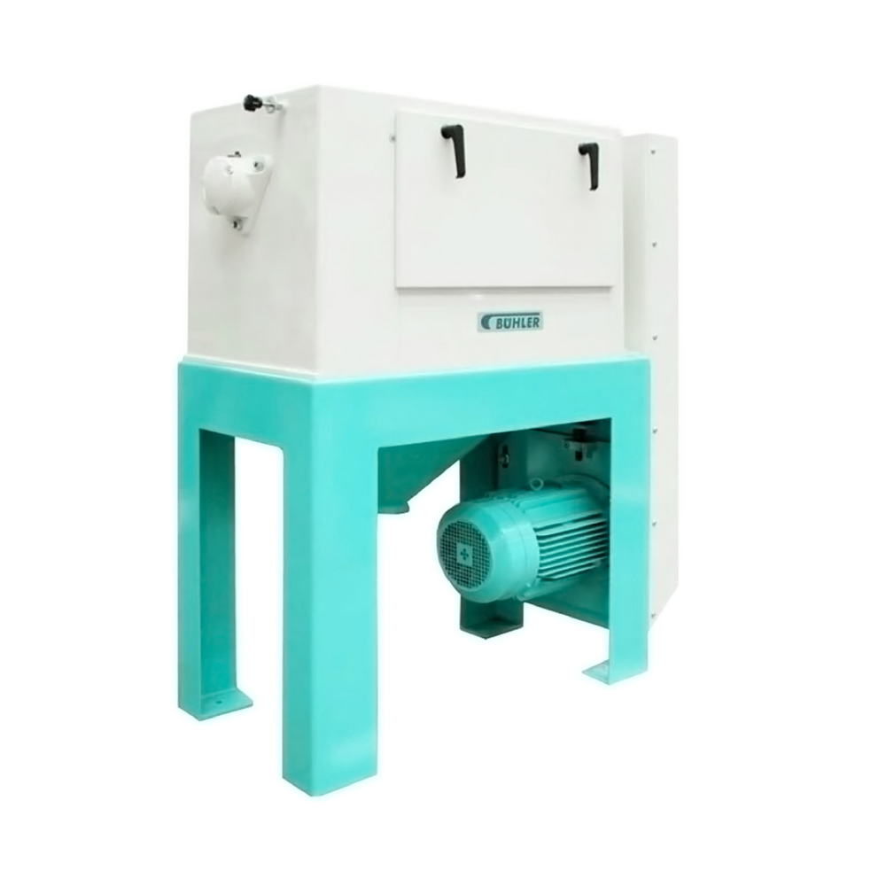
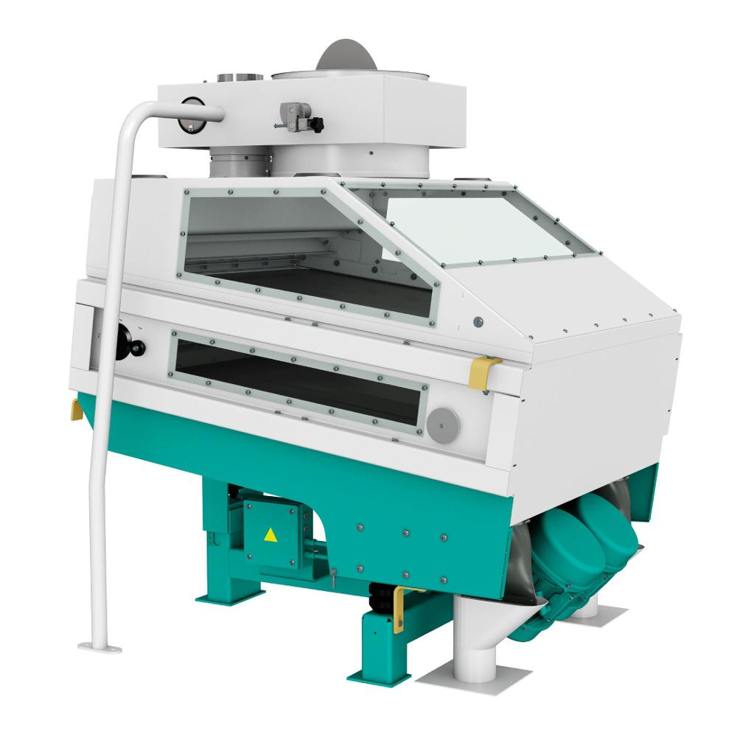
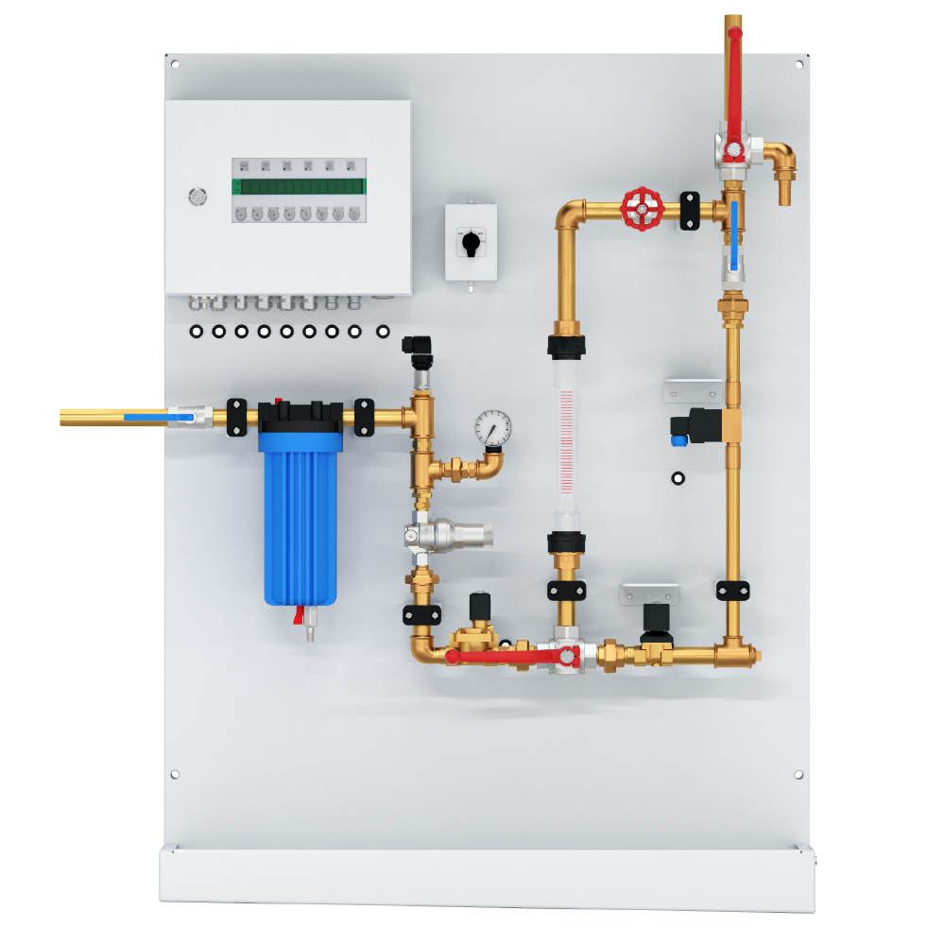
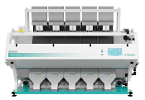
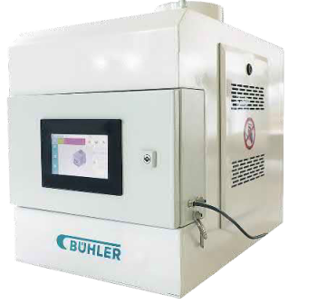
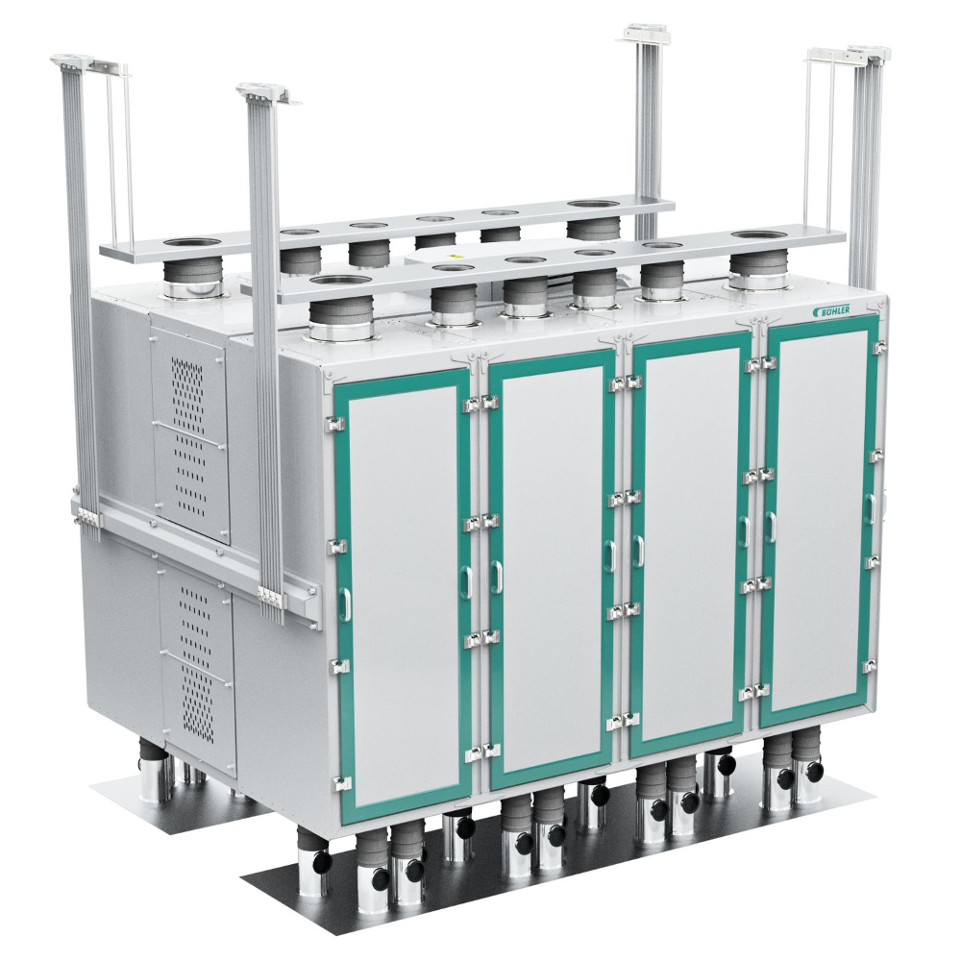
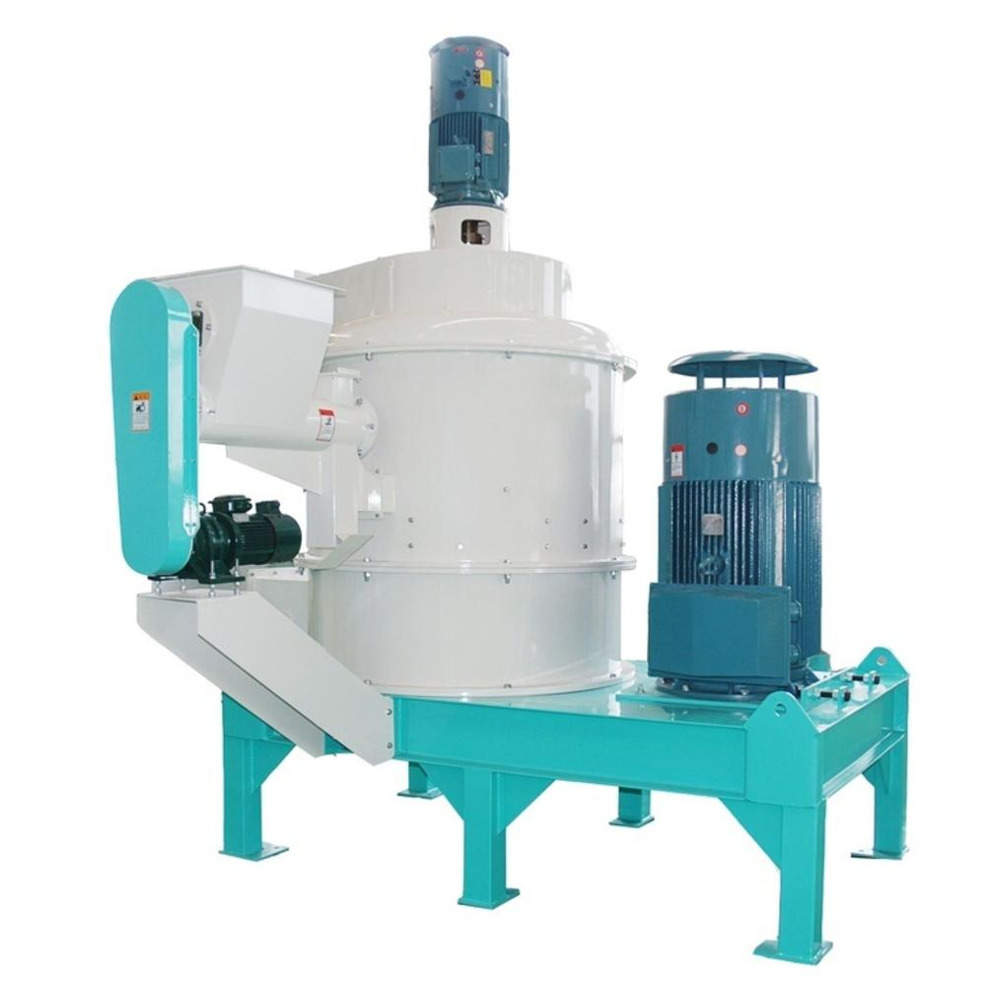
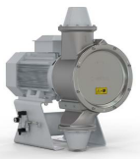
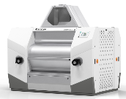
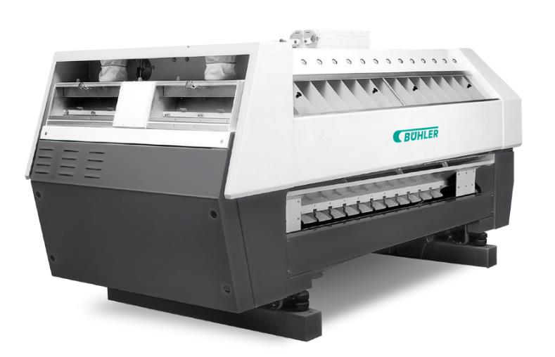
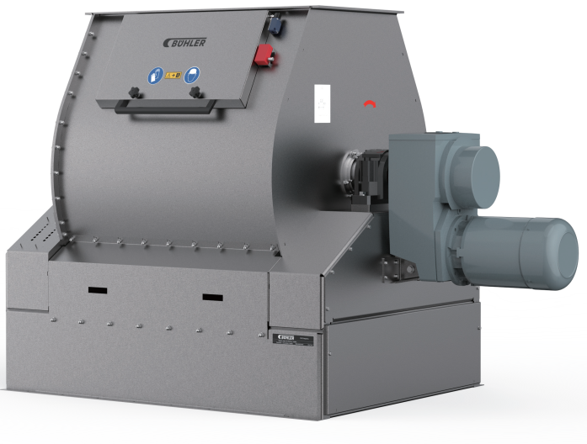
The Reliable Equipment are the Foundation Enable Stable/ Reliable/ Food Safety/ Global Available
Destoner
Color Sorter
Moisture measuring device
Liquids flow controller
Scourer
Flow Balancer
Roller Mill
Purifier
Plansifter
Pulverizer
Impact Machine
Mixture
Notes:
Foudation for nutious standable solution:
Food safe
Stabel
Reliable
High economic performance
Global vaiaLBE SE
sERIVCE

Slide 10
Imagineering the Future
Colored Rice is the brown rice which the seed coat and pericarp contain pigment.
High protein content
High amino acid content
High fat content
High dietary fiber
Parboiling is a hydrothermal treatment applied to paddy rice that causes starch gelatinization and consequently changes of rice properties.
Higher nutritional value (vitamins and minerals)
Extended shelf life
Contain more fat
Germinated Brown Rice is the brown rice being soaked under water under suitable condition to favor germination:
Increase in simple sugars
Natural enzymes become expressed
Improved minerals
Improved vitamins

