Slide 1
04
Comprehensive Utilization of Sweet Potato by-products

Slide 2
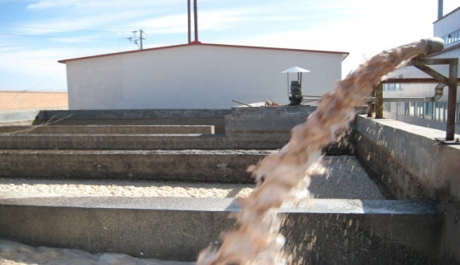
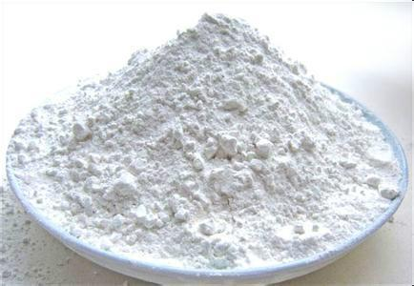
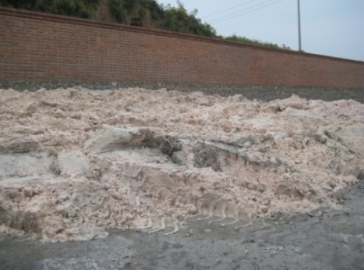
Approximately 10 to 20 tonnes of waste water and 4.5 to 5.0 tonnes of fresh residues are generated from 1 tonne of starch production.
The production of sweet potato leaves was equivalent to that of roots.
Most waste water and leaves is discharged directly;
About 20% of the residues are used as low-value animal feed; about 80% of the residues are disposed;
A major contributor to serious resource waste and environmental pollution.

Slide 3
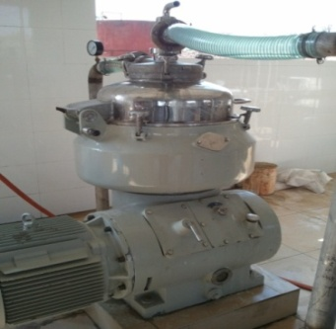
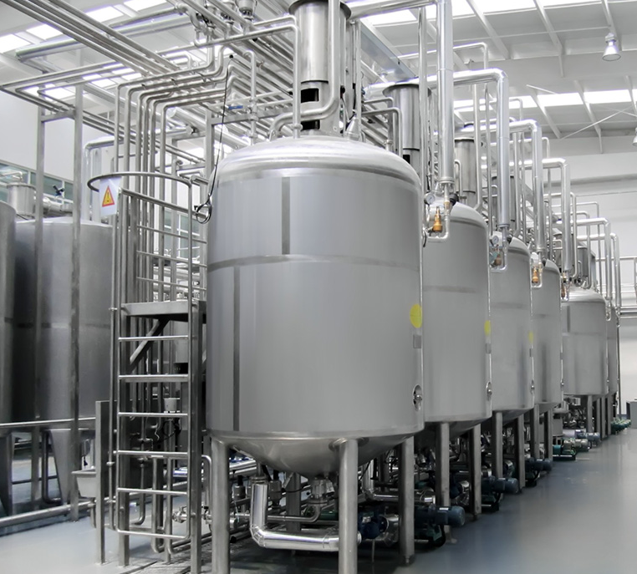
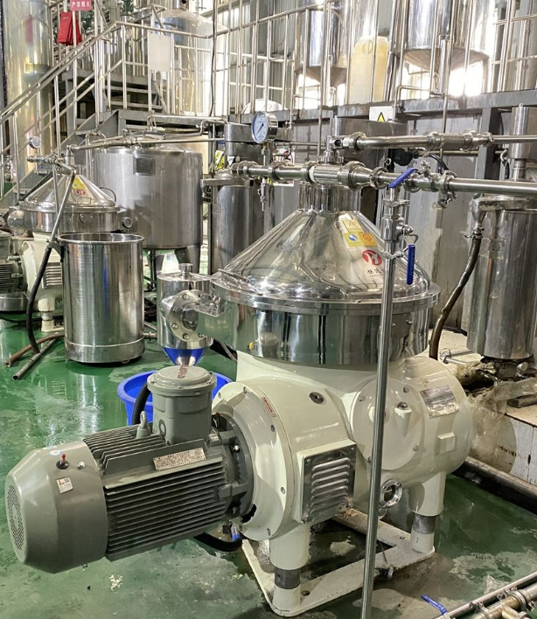
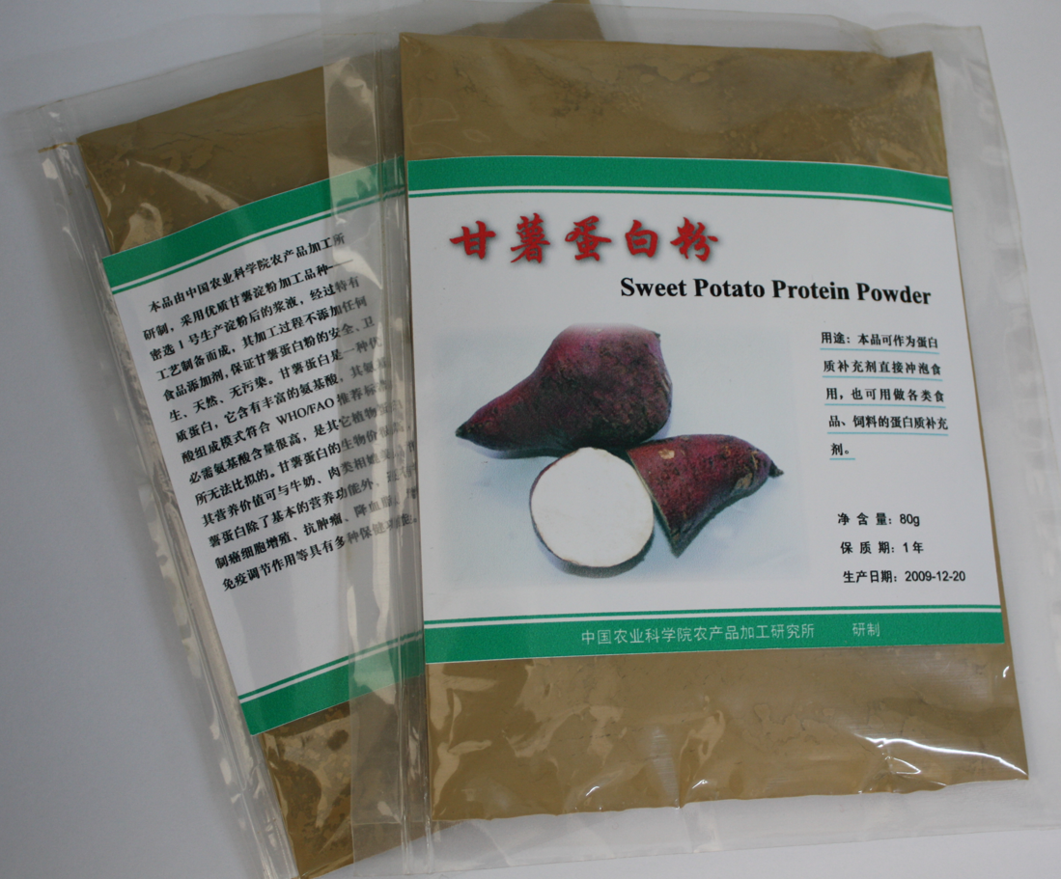
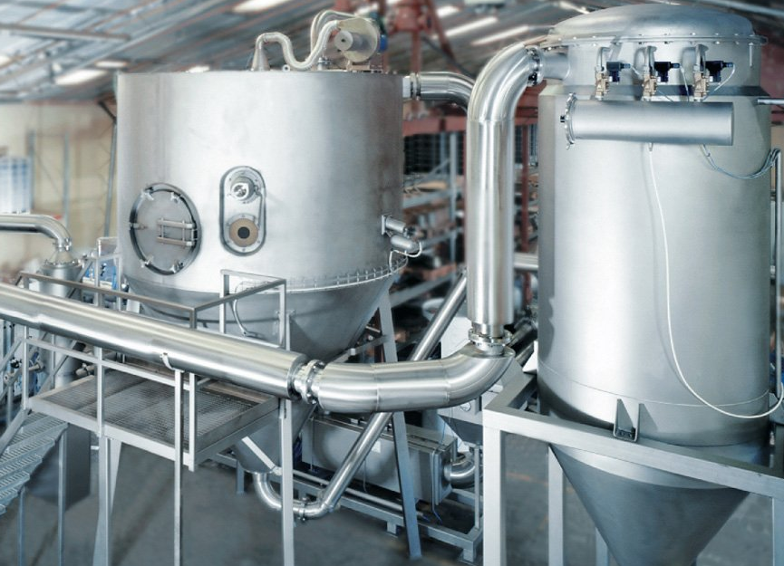
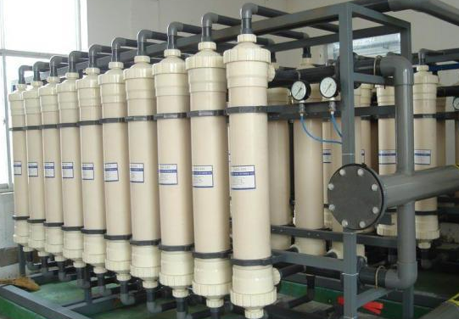
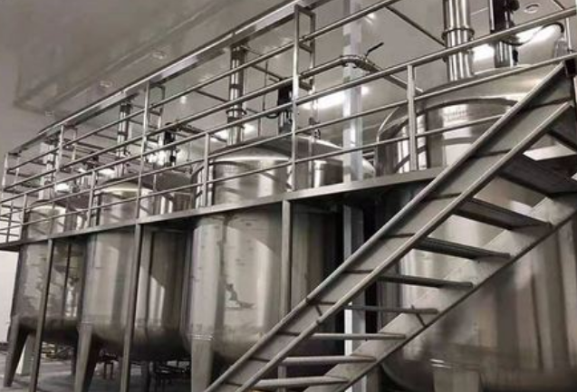
Processing technology of sweet potato protein
Waste water
Concentration
Adjusting pH to 4 with HCl and stirring extraction
Centrifugation and collecting precipitate
Native sweet potato protein
Spray drying
Ultrafiltration
Adjusting pH to 8 with NaOH
Processing technology of native sweet potato protein

Slide 4
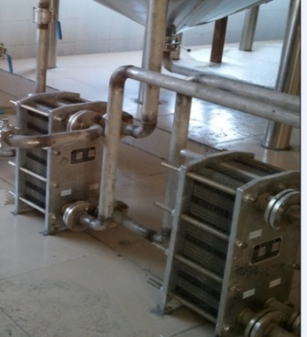
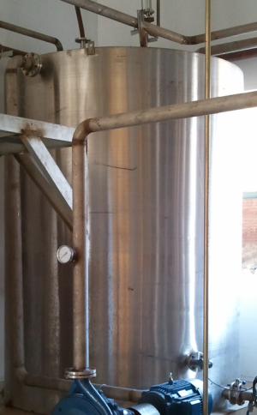
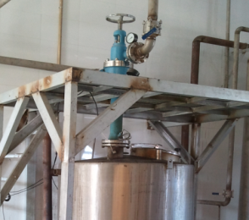
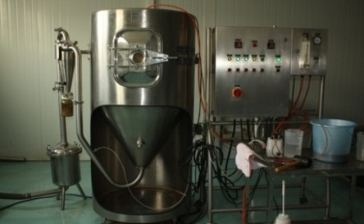
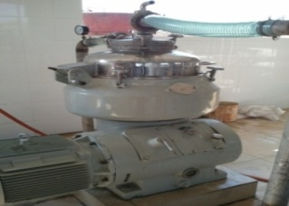
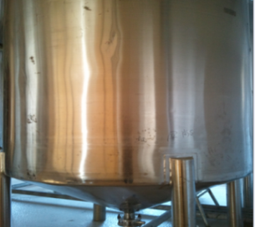
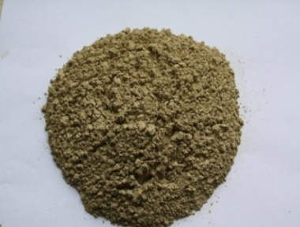
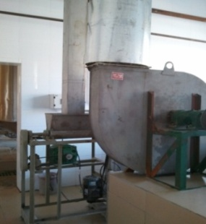
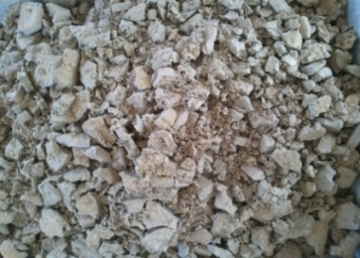
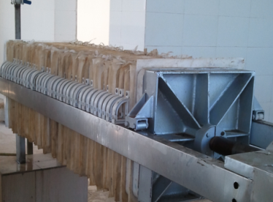
Waste water
Concentration
Preheating
Heat preservation
Steam ejector
Processing technology of denatured sweet potato protein
Protein
Spray drying
Concentration
Flocculation
Airflow drying
Wet protein
Protein
Plate-frame pressure
filtration

Slide 5
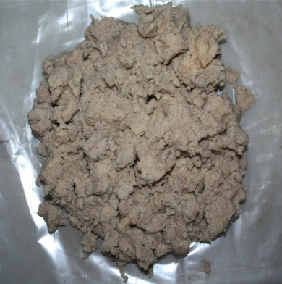
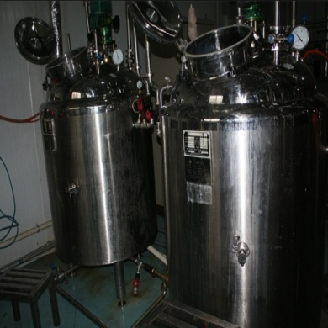
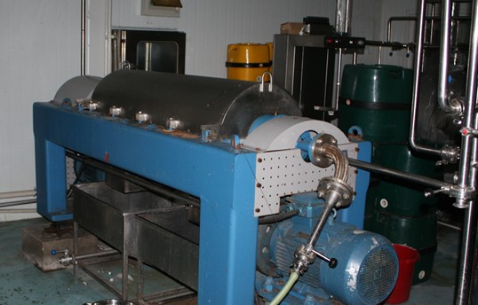
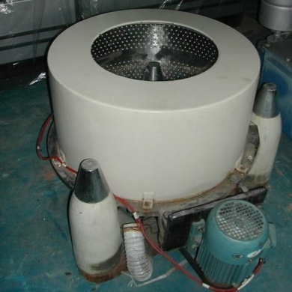
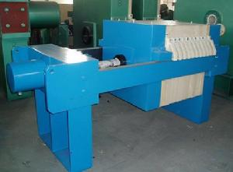
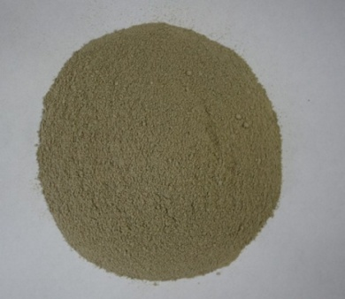
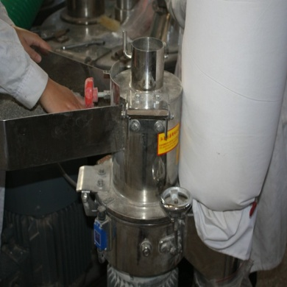
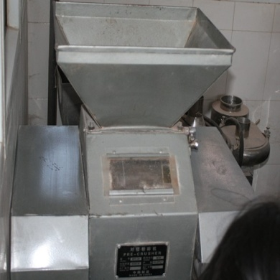
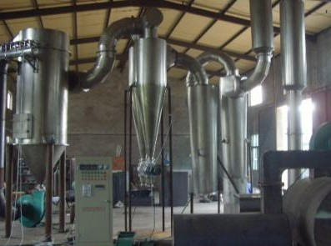
Processing technology of sweet potato dietary fiber
Sweet potato residues
Enzyme hydrolysis
Turbine centrifuging
Three-column centrifuging
Plate-frame pressure filtration
Dietary fiber
Superfine grinding
Smashing
Drying

Slide 6
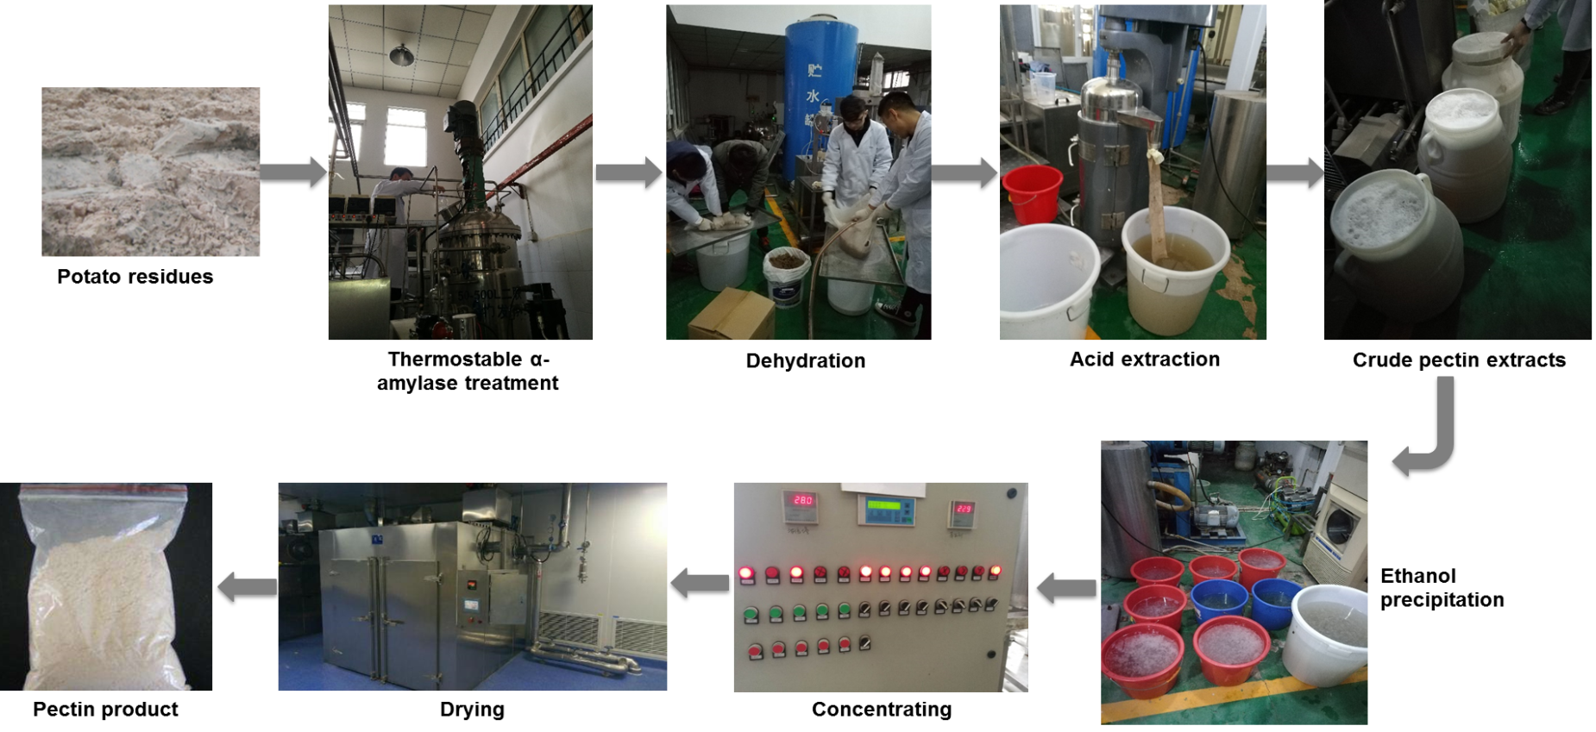
Processing technology of sweet potato pectin
Sweet potato residue
Thermostable α-amylase treatment
Centrifugation
Acid extraction from the precipitate
Crude pectin solution
Ethanol precipitation
(ethanol : crude pectin solution, 4:1, v/v)
Pectin
Drying
Centrifugation and
collecting precipitate

Slide 7
Processing technology of cellulose nanocrystals from sweet potato residues
Washing Filter
Purple sweet potato peel residues after anthocyanin extraction
Weigh 10 g
Add 25 mL 5%(w/w) α-amylase solution and 250 mL deionized water, 95℃ for 3 h
Add 200 mL of 10 wt.% sodium hydroxide solution, 60℃ for 4 h
Washing residues with distilled water to neutral pH
Ultrasonic assisted hydrolysis of cellulose by maleic acid to prepare CNCs
[the ratio between cellulose and 75 wt% maleic acid was 1:10 (g/mL), ultrasonic at 60℃ for 1 h, followed by 120℃ for 2.5 h]
The remained solid was lyophilized for 3 d to obtain cellulose
Washing residues with distilled water to neutral pH
Add 200 mL of sodium chloride (10 g/L), 70℃ for 2 h
Repeat this step for 2-4 times
CNCs

Slide 8
Processing technology of sweet potato leaf powder
Fresh sweet potato leaves
Washing
Cutting
Blanching with hot water (80-100 ℃, 1-3 min ) or steaming (90-100 ℃, 2-3 min)
Sweet potato leaf powder
Grinding
Drying
Dewatering

Slide 9
Processing technology of sweet potato leaf polyphenols
Fresh sweet potato leaves
Washing
Cutting
Fresh sweet potato leaves
Washing
Cutting
Sweet potato leaf polyphenols
Drying
Extraction and purification
Sweet potato leaf polyphenols
Drying
Extraction and purification

Slide 10
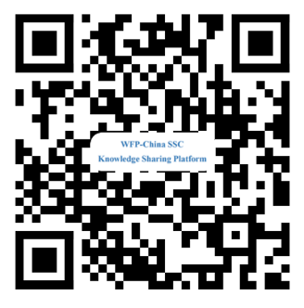
Thank You
The SSTC project is funded by: Ministry of Agriculture and Rural Affairs P. R. China
Sharing for Learning

