Slide 1


MAZU
China’s Solutions to Early Warnings for All
China Meteorological Administration
2nd July 2026

Slide 2
Outline
Part 1: What is MAZU ？
Part 2: AI Engine for Forecasting Products
Part 3: Global Crop Monitoring and Food Security
Part 4: Open Collaboration and Future Prospects

Slide 3


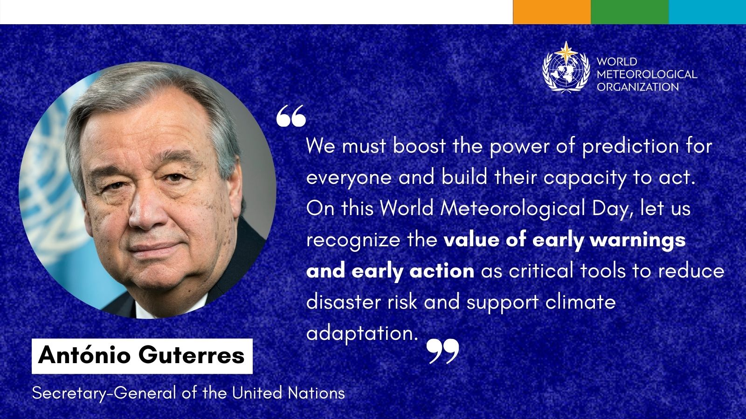
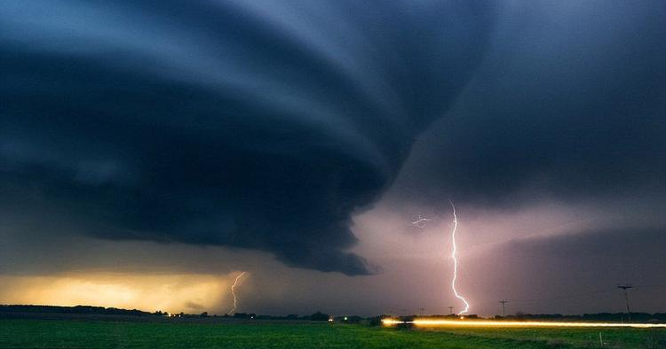
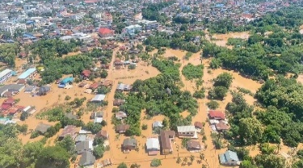
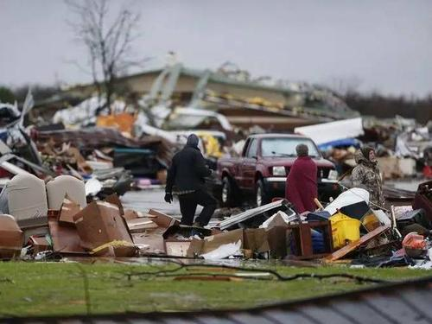
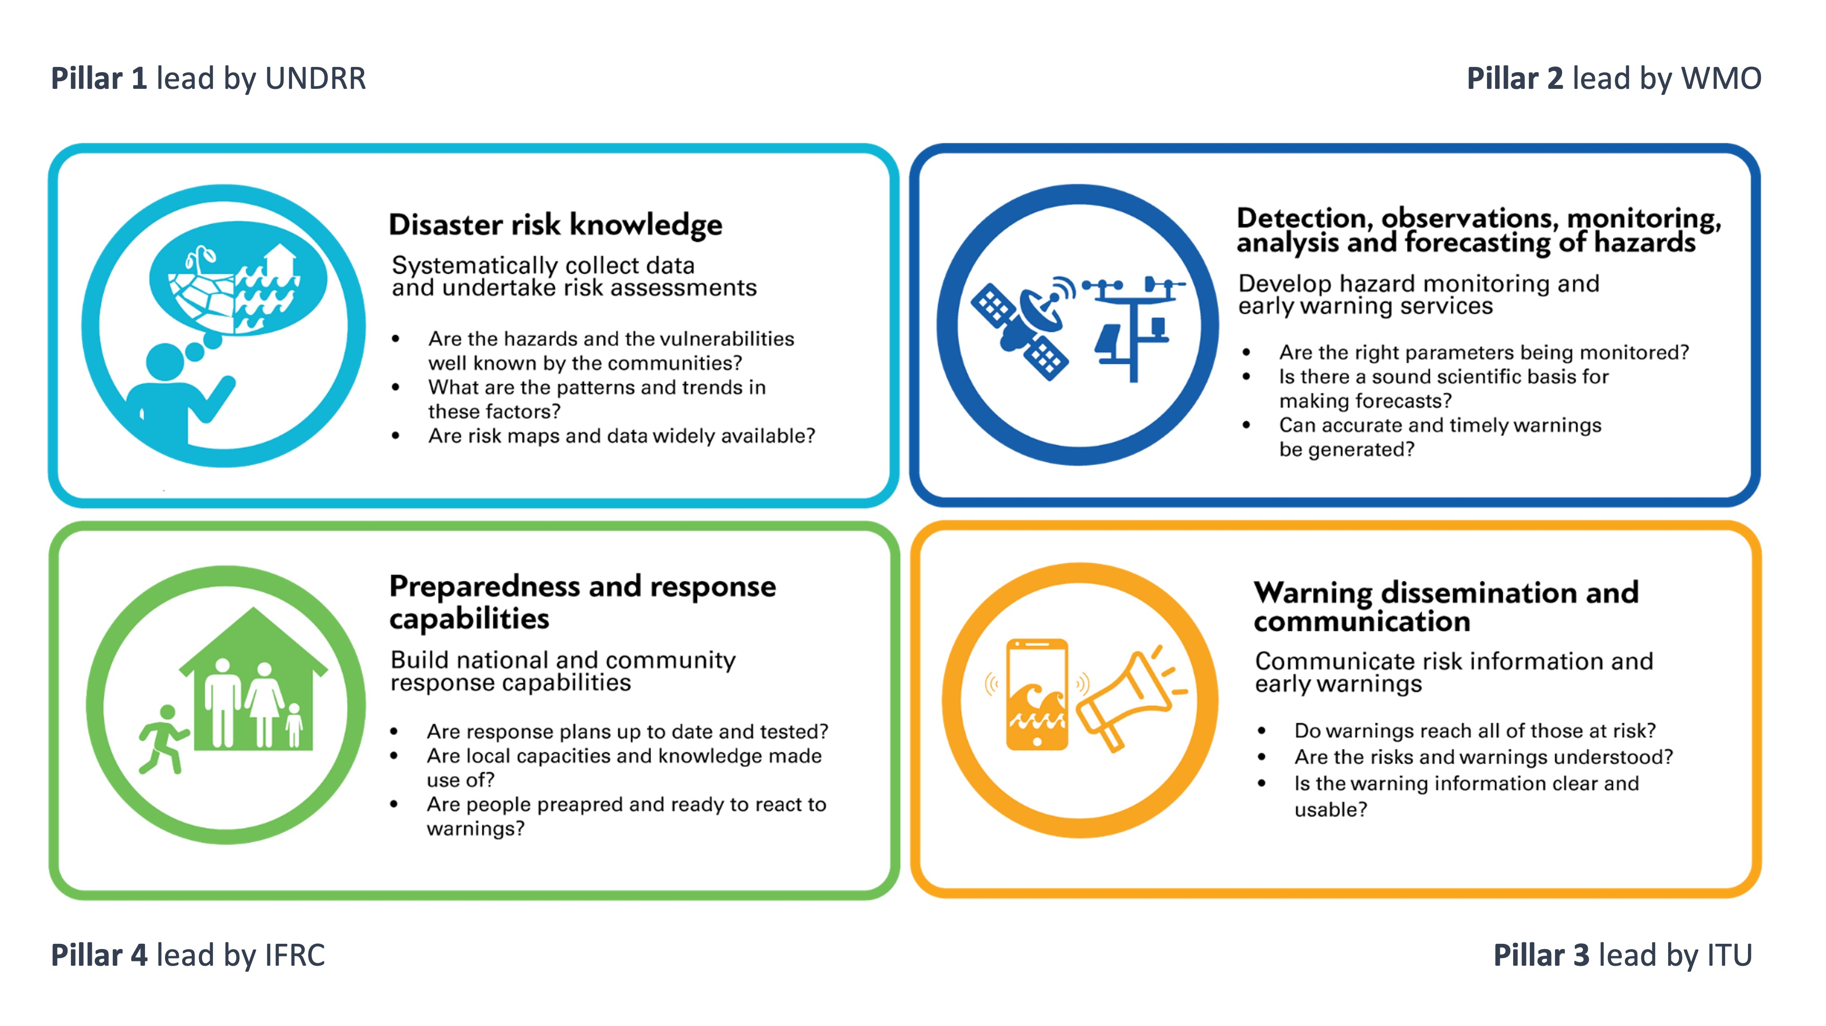

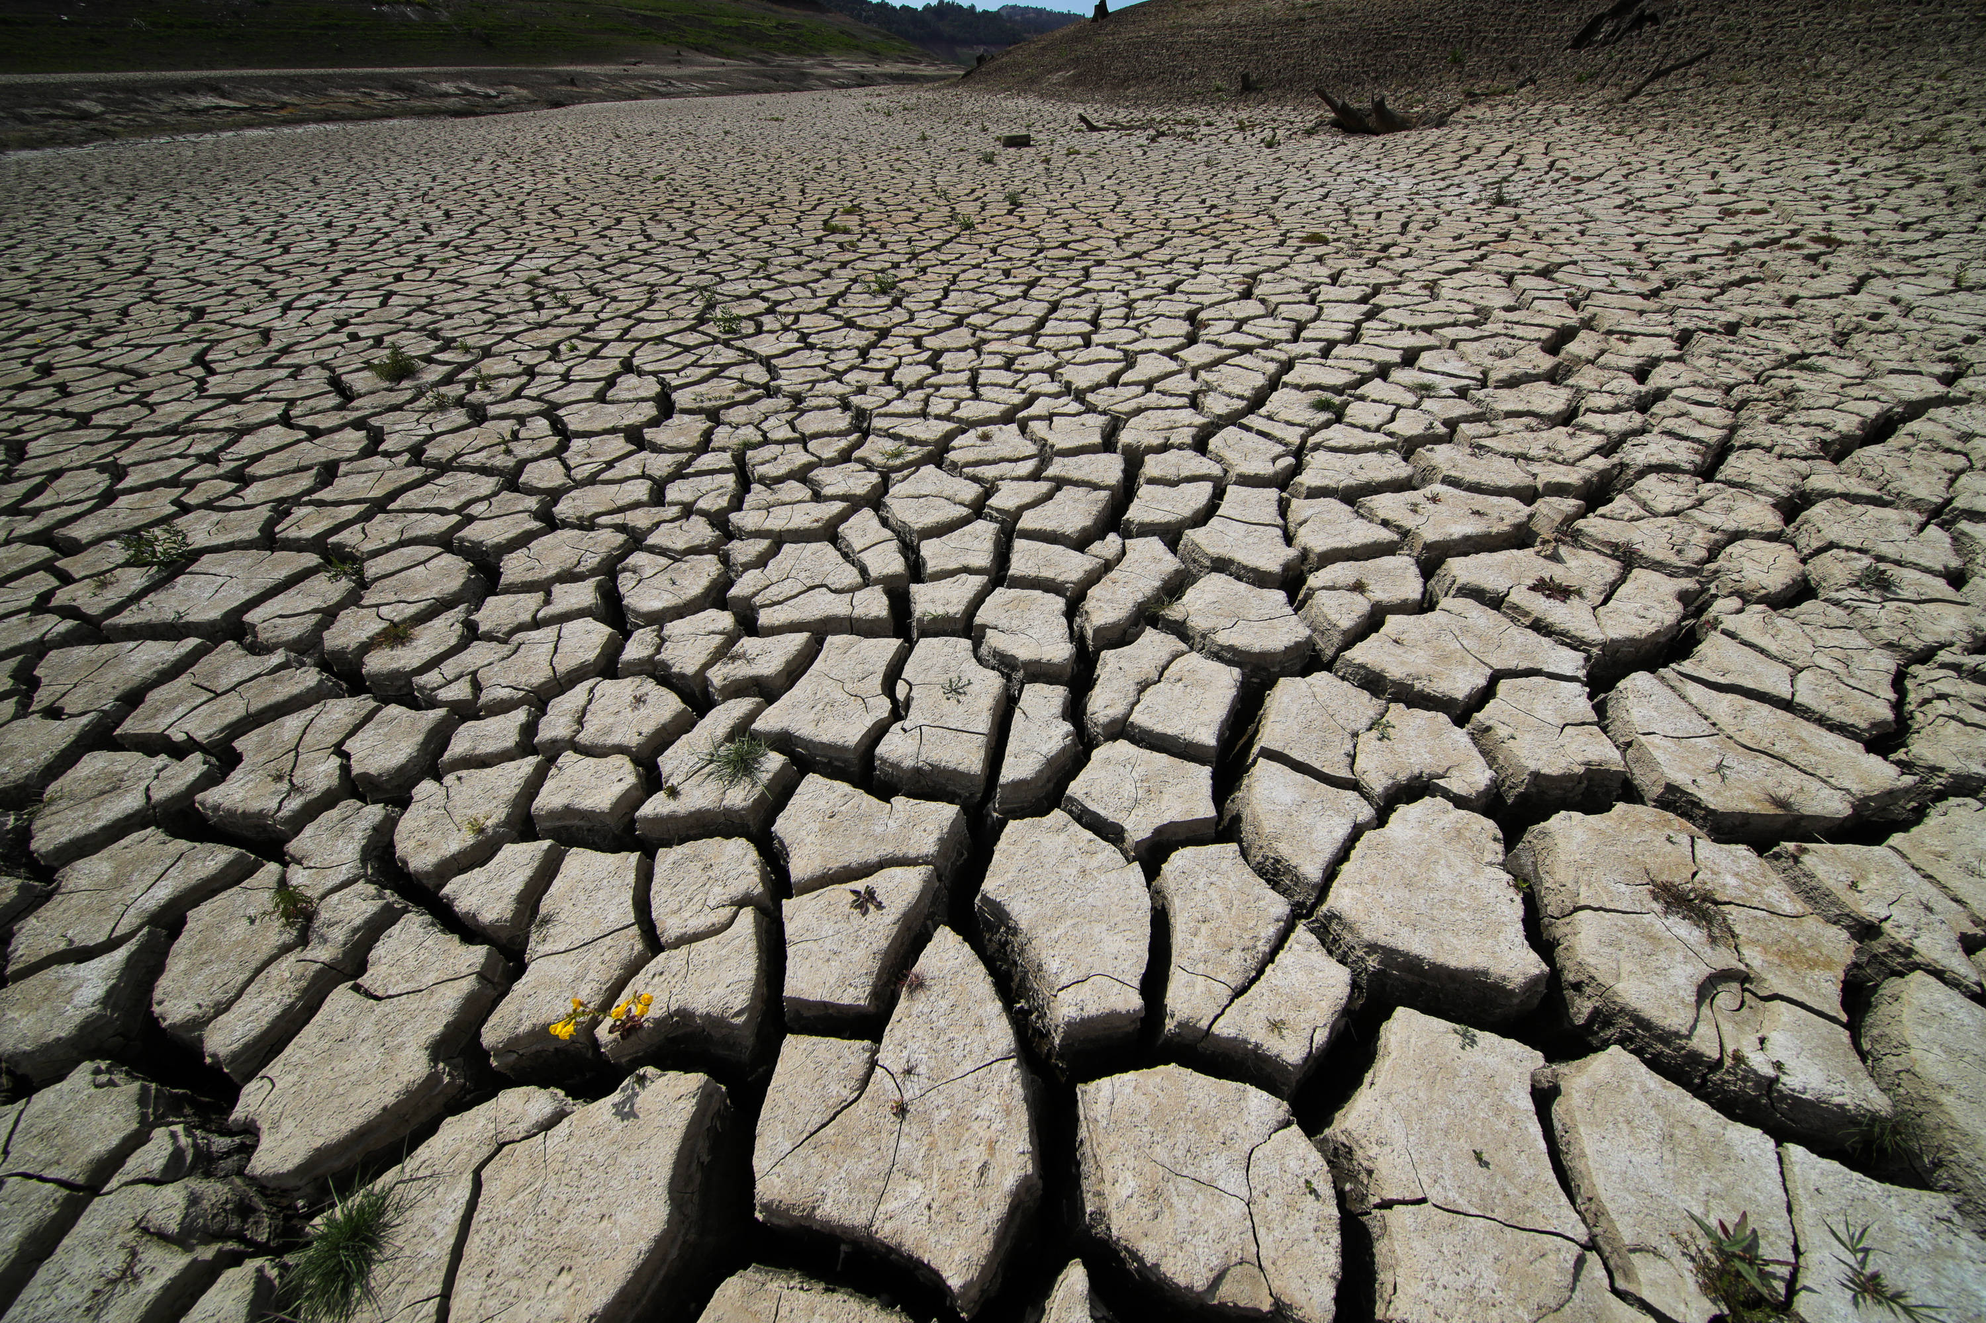
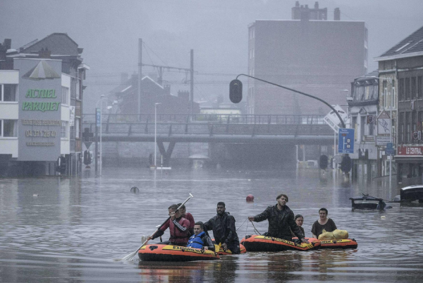
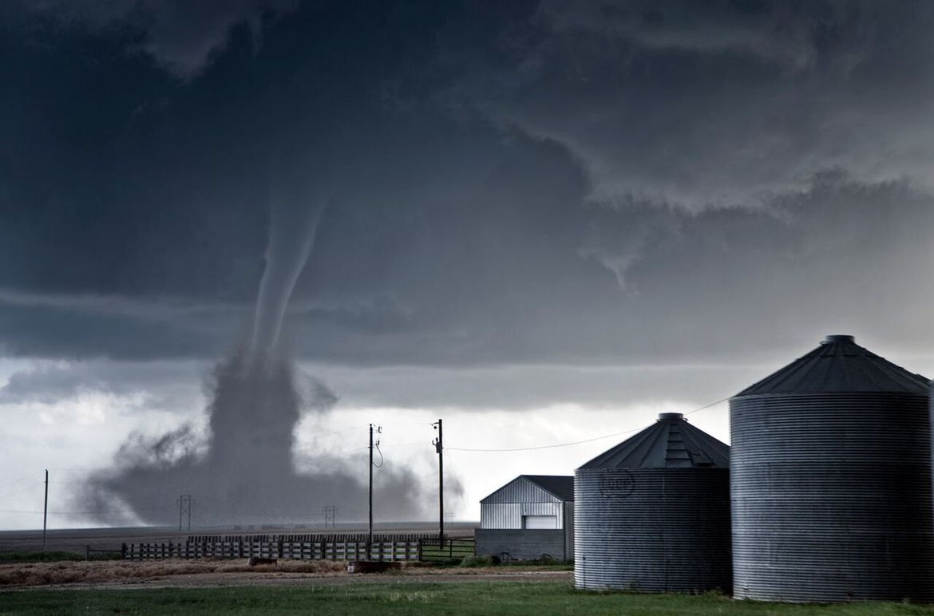
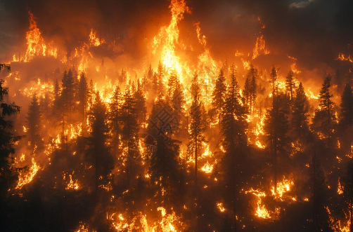
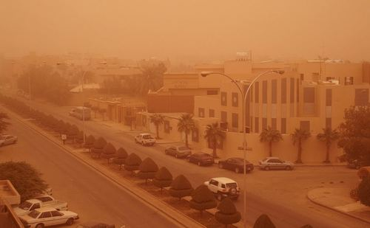
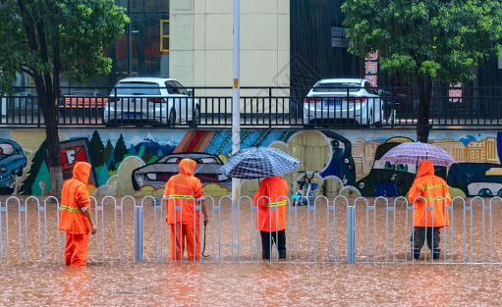
1. Background: UN Initiative Early Warnings for All
Early warning has become a key foundation for global disaster prevention and mitigation.
The Global Challenge:
- Half of the WMO members lack adequate multi-hazard
early warning systems.
- One out of every three people globally does not have
access to timely early warning information.
UN proposed EW4All initiative. WMO leads the Pillar II.
23 March 2022
Notes:
2022年，联合国发起“全民早期预警倡议”，为全球防灾减灾指明了行动方向。正如联合国秘书长古特雷斯所强调：“让我们认识到早期预警和早期行动的价值，并将其作为减少灾害风险、支持气候适应的关键工具。” 在极端天气事件频发、气候变化加剧的当下，早期预警系统已成为应对气候挑战、守护生命财产安全的最有效手段之一。
正是在这样的全球共识下，早期预警中国方案“妈祖”（MAZU）应运而生，它深度契合联合国“全民早期预警倡议”四大支柱的核心要求，为全球特别是发展中国家提供全链条、可落地的早期预警解决方案，真正将“全民早期预警”的愿景，转化为守护全人类安全的现实力量。

Slide 4
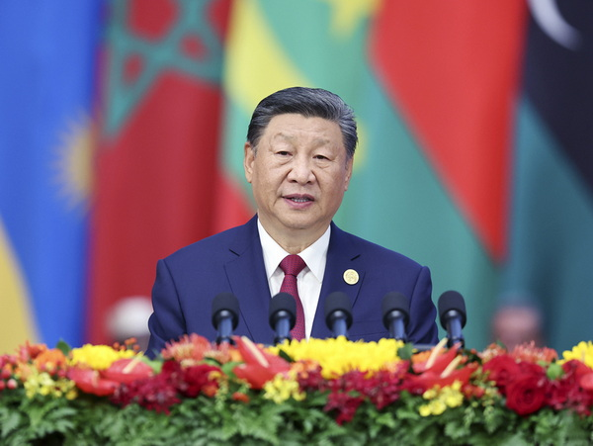

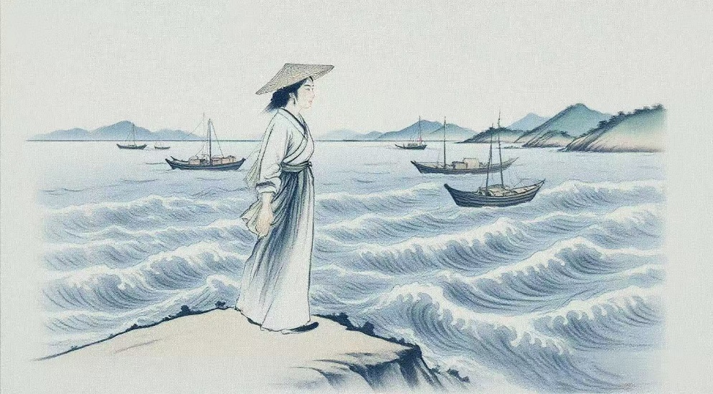
1. Background: China’s Solutions to Early Warnings for All
In July 2025, CMA has launched MAZU, China’s Solutions to Early Warnings for All, serves as a public meteorological service product, which includes disaster risk knowledge, technologies, products, operational systems, tools-boxes, equipments, and China’s experience in disaster prevention and mitigations.
Multi-hazard
Alert
Zero-gap
Universal
The concept of building a community with a shared future for mankind.
The instruction on building a meteorological early warning operational platform
MAZU is the respectful title of a sea goddess and protector against maritime disasters in China and Southeast Asia. Her birthday was 23rd March, 960 A.D, which is the same day as the World Meteorologcial Day.
Notes:
下面，我为大家介绍“妈祖”这一系统性解决方案。“妈祖”是中国气象局为响应联合国“全民早期预警”倡议而打造的全球公共气象产品。他源于习近平主席在2023年中非合作论坛北京峰会上提出的共建“气象早期预警业务平台”,于2025年7月在上海世界人工智能大会上面向全球正式发布。该方案由多灾种、预警、零差距和普惠四大要素构成，目标是构建全球气象灾害早期预警服务网络，缩小不同发展水平国家间的灾害预警能力差距。

Slide 5
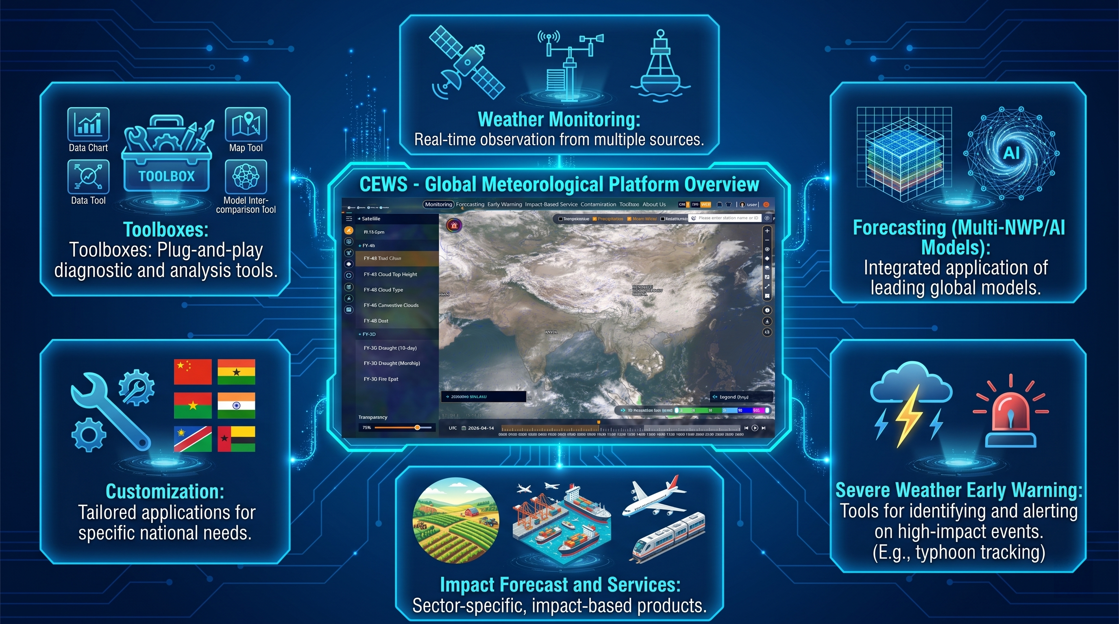
2. MAZU products and services
https://mazu.wmc-bj.net
(1) Cloud-based Early Warning System (CEWS)：An open access operational platform

Slide 6
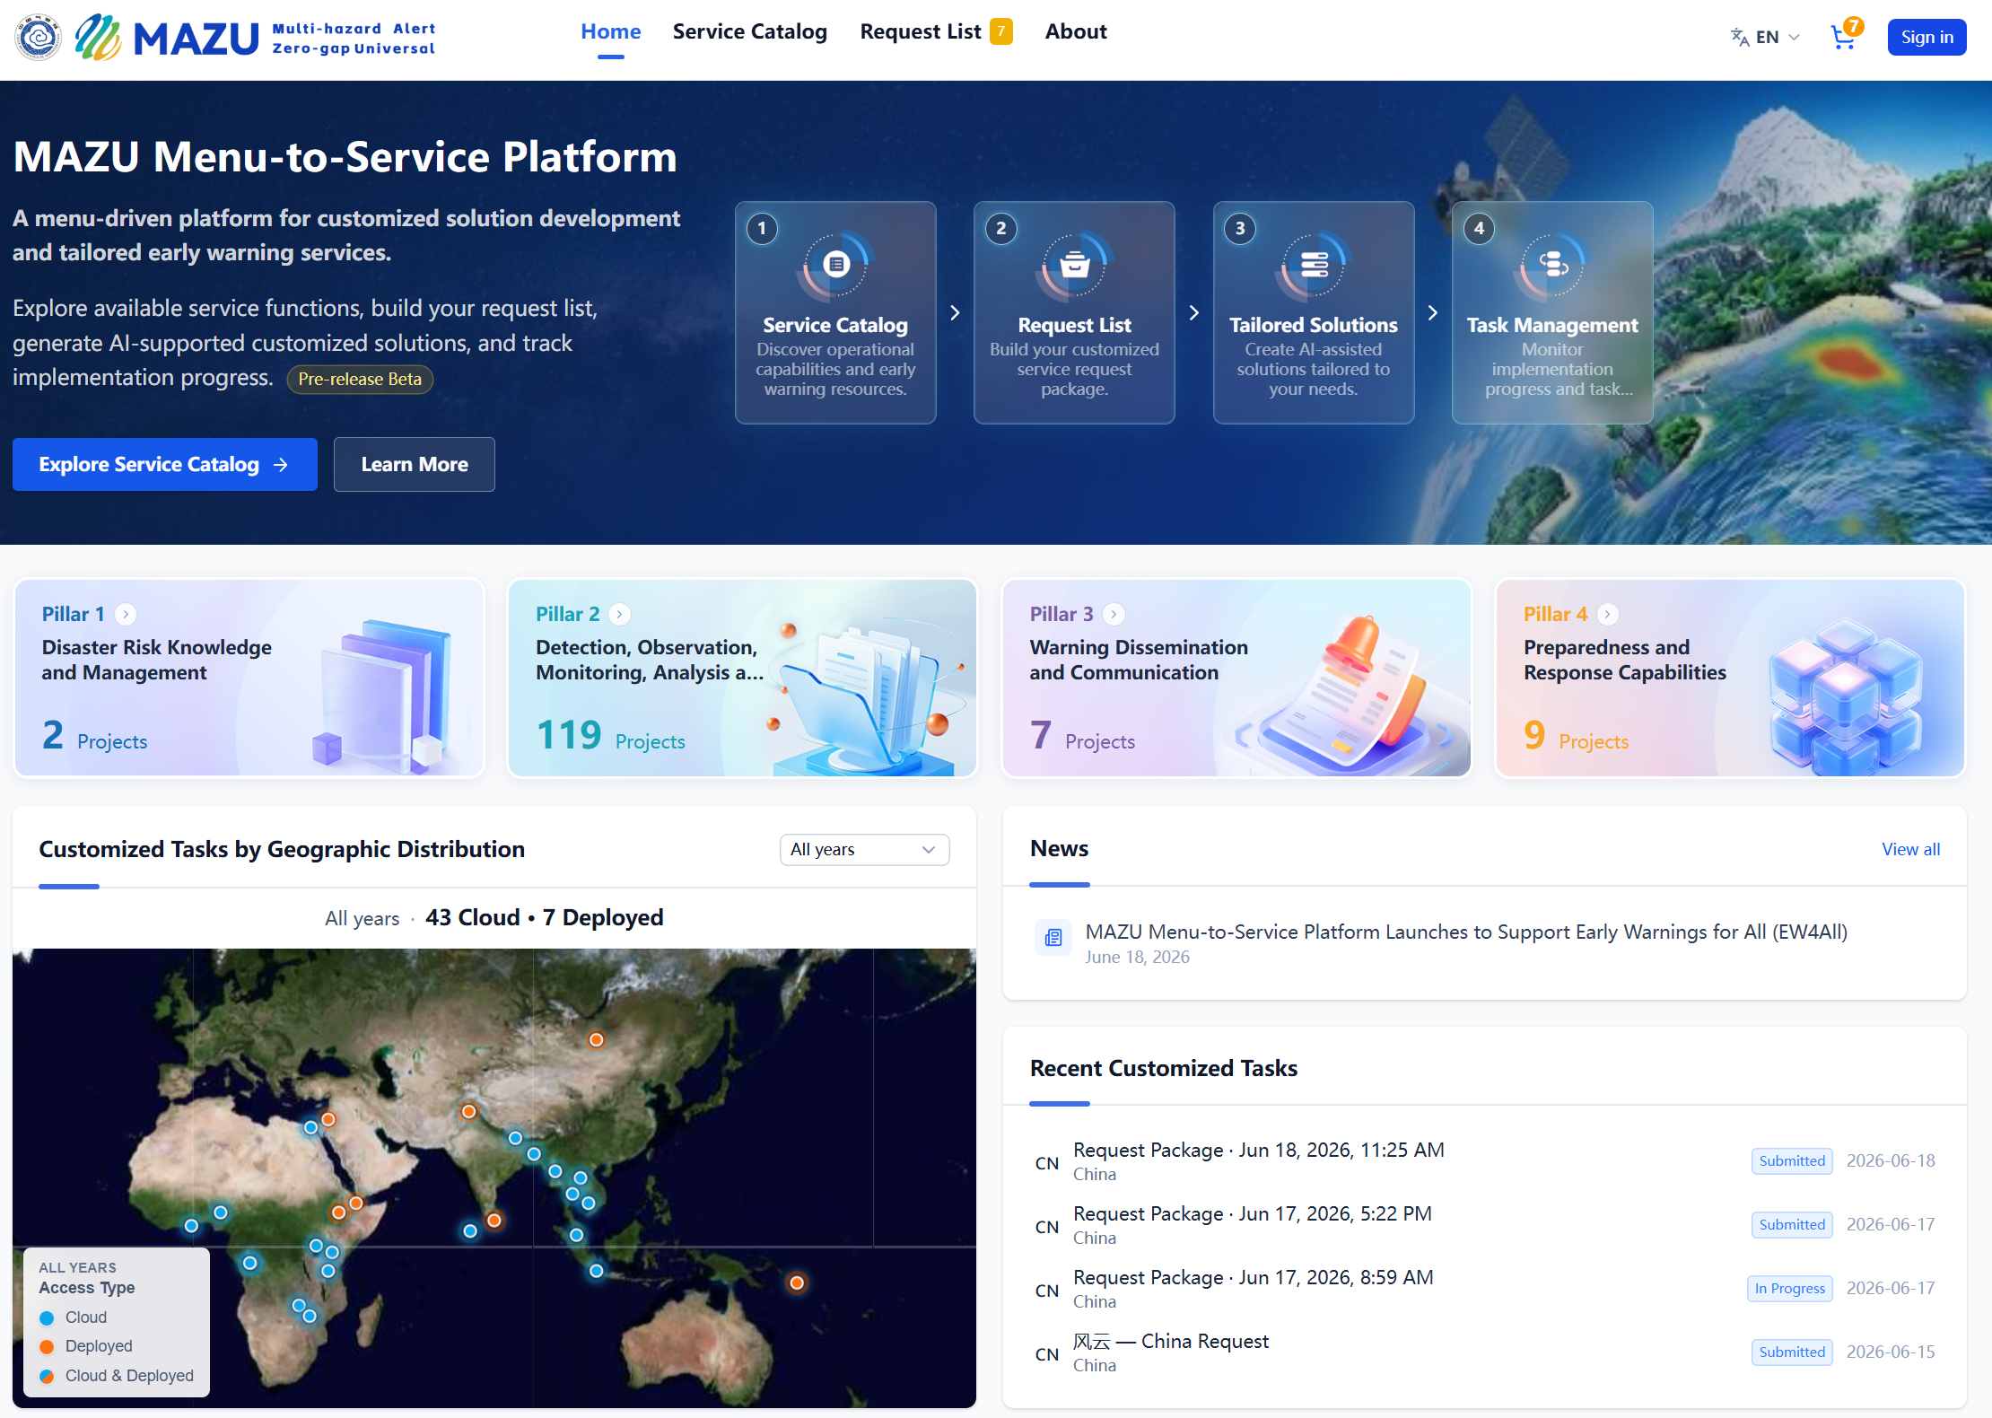
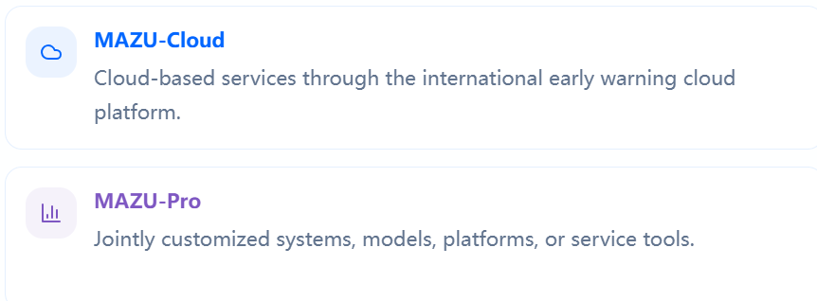
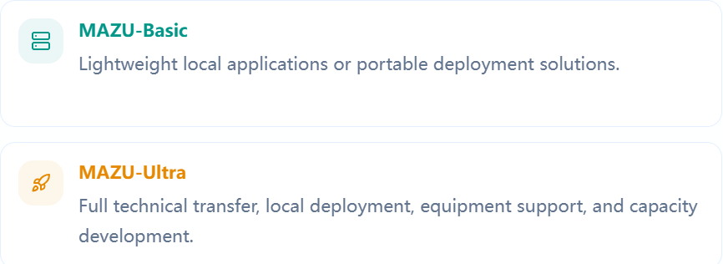
2. MAZU products and services
https://mazu.wmc-bj.net
(2) Customized Version of the Early Warning System
Designed for customization
List all the contents of MAZU

Slide 7
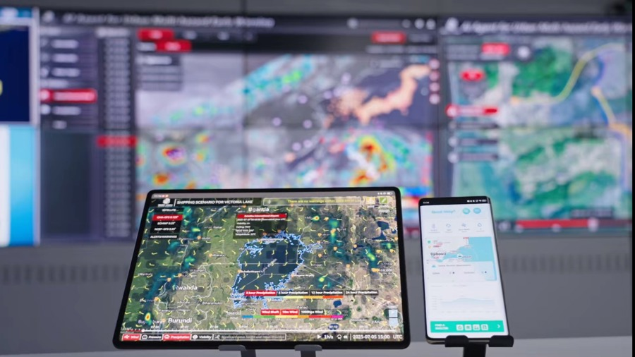
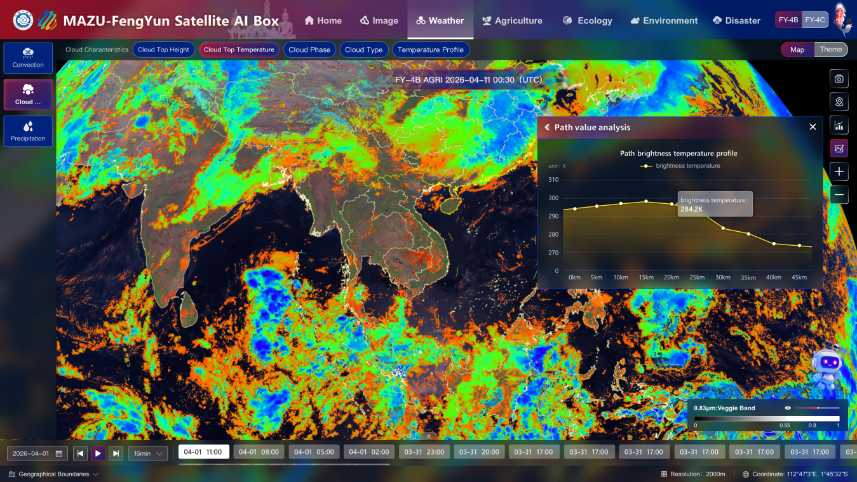
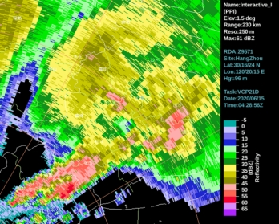
2. MAZU products and services
https://mazu.wmc-bj.net
(3) Early Warning Toolbox
a. Multi-Hazard Early Warning Intelligent Agent for Urban Applications
Powered by AI
advanced algorithms with multi-source data
b. FengYun Satellite Toolbox
Powered by AI
a one-stop satellite application solution.
c. Next-Generation Weather Radar Technology
To improve the spatial-temporal resolution of scanning

Slide 8
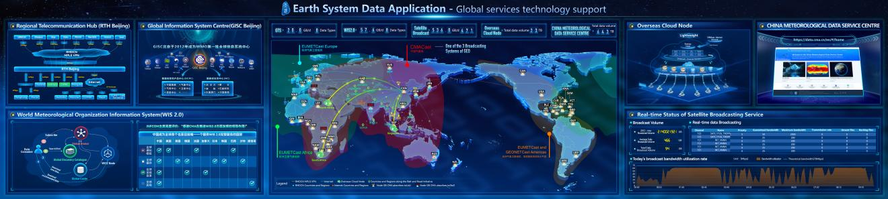
2. MAZU products and services
https://mazu.wmc-bj.net
(4) Information Support
A global data sharing service chain comprising the Global Telecommunication System (GTS), WMO Information System 2.0 (WIS 2.0), CMACast, overseas cloud nodes, and the China Meteorological Data Service Platform (International Edition), with an annual real-time data exchange volume of approximately 910 TB.

Slide 9
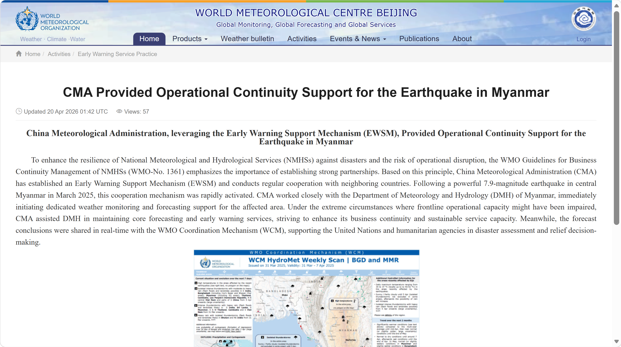
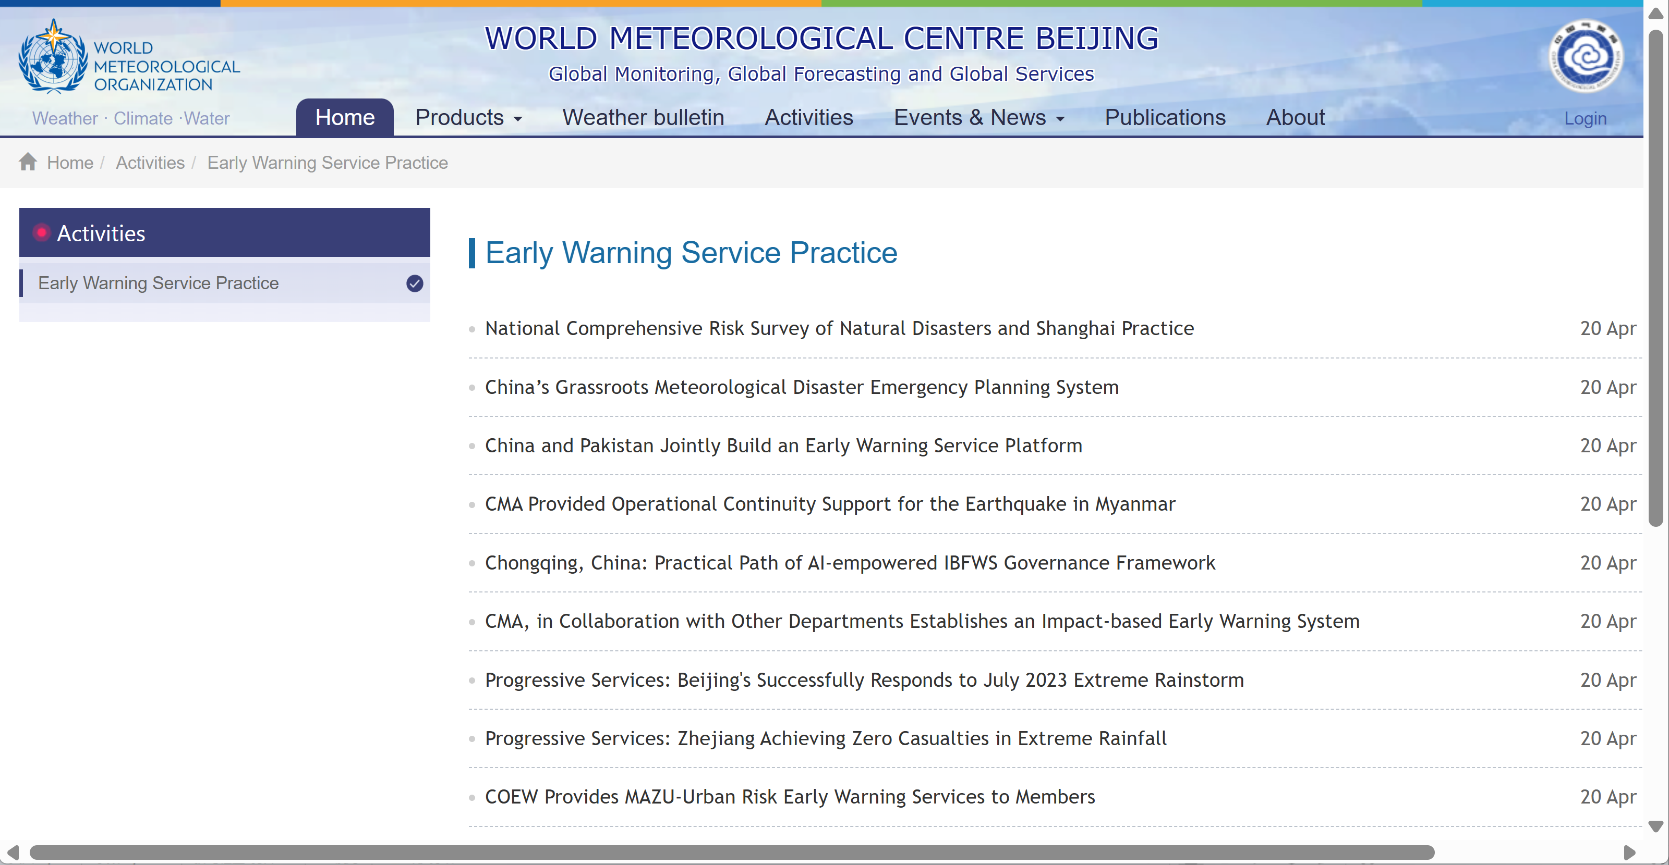
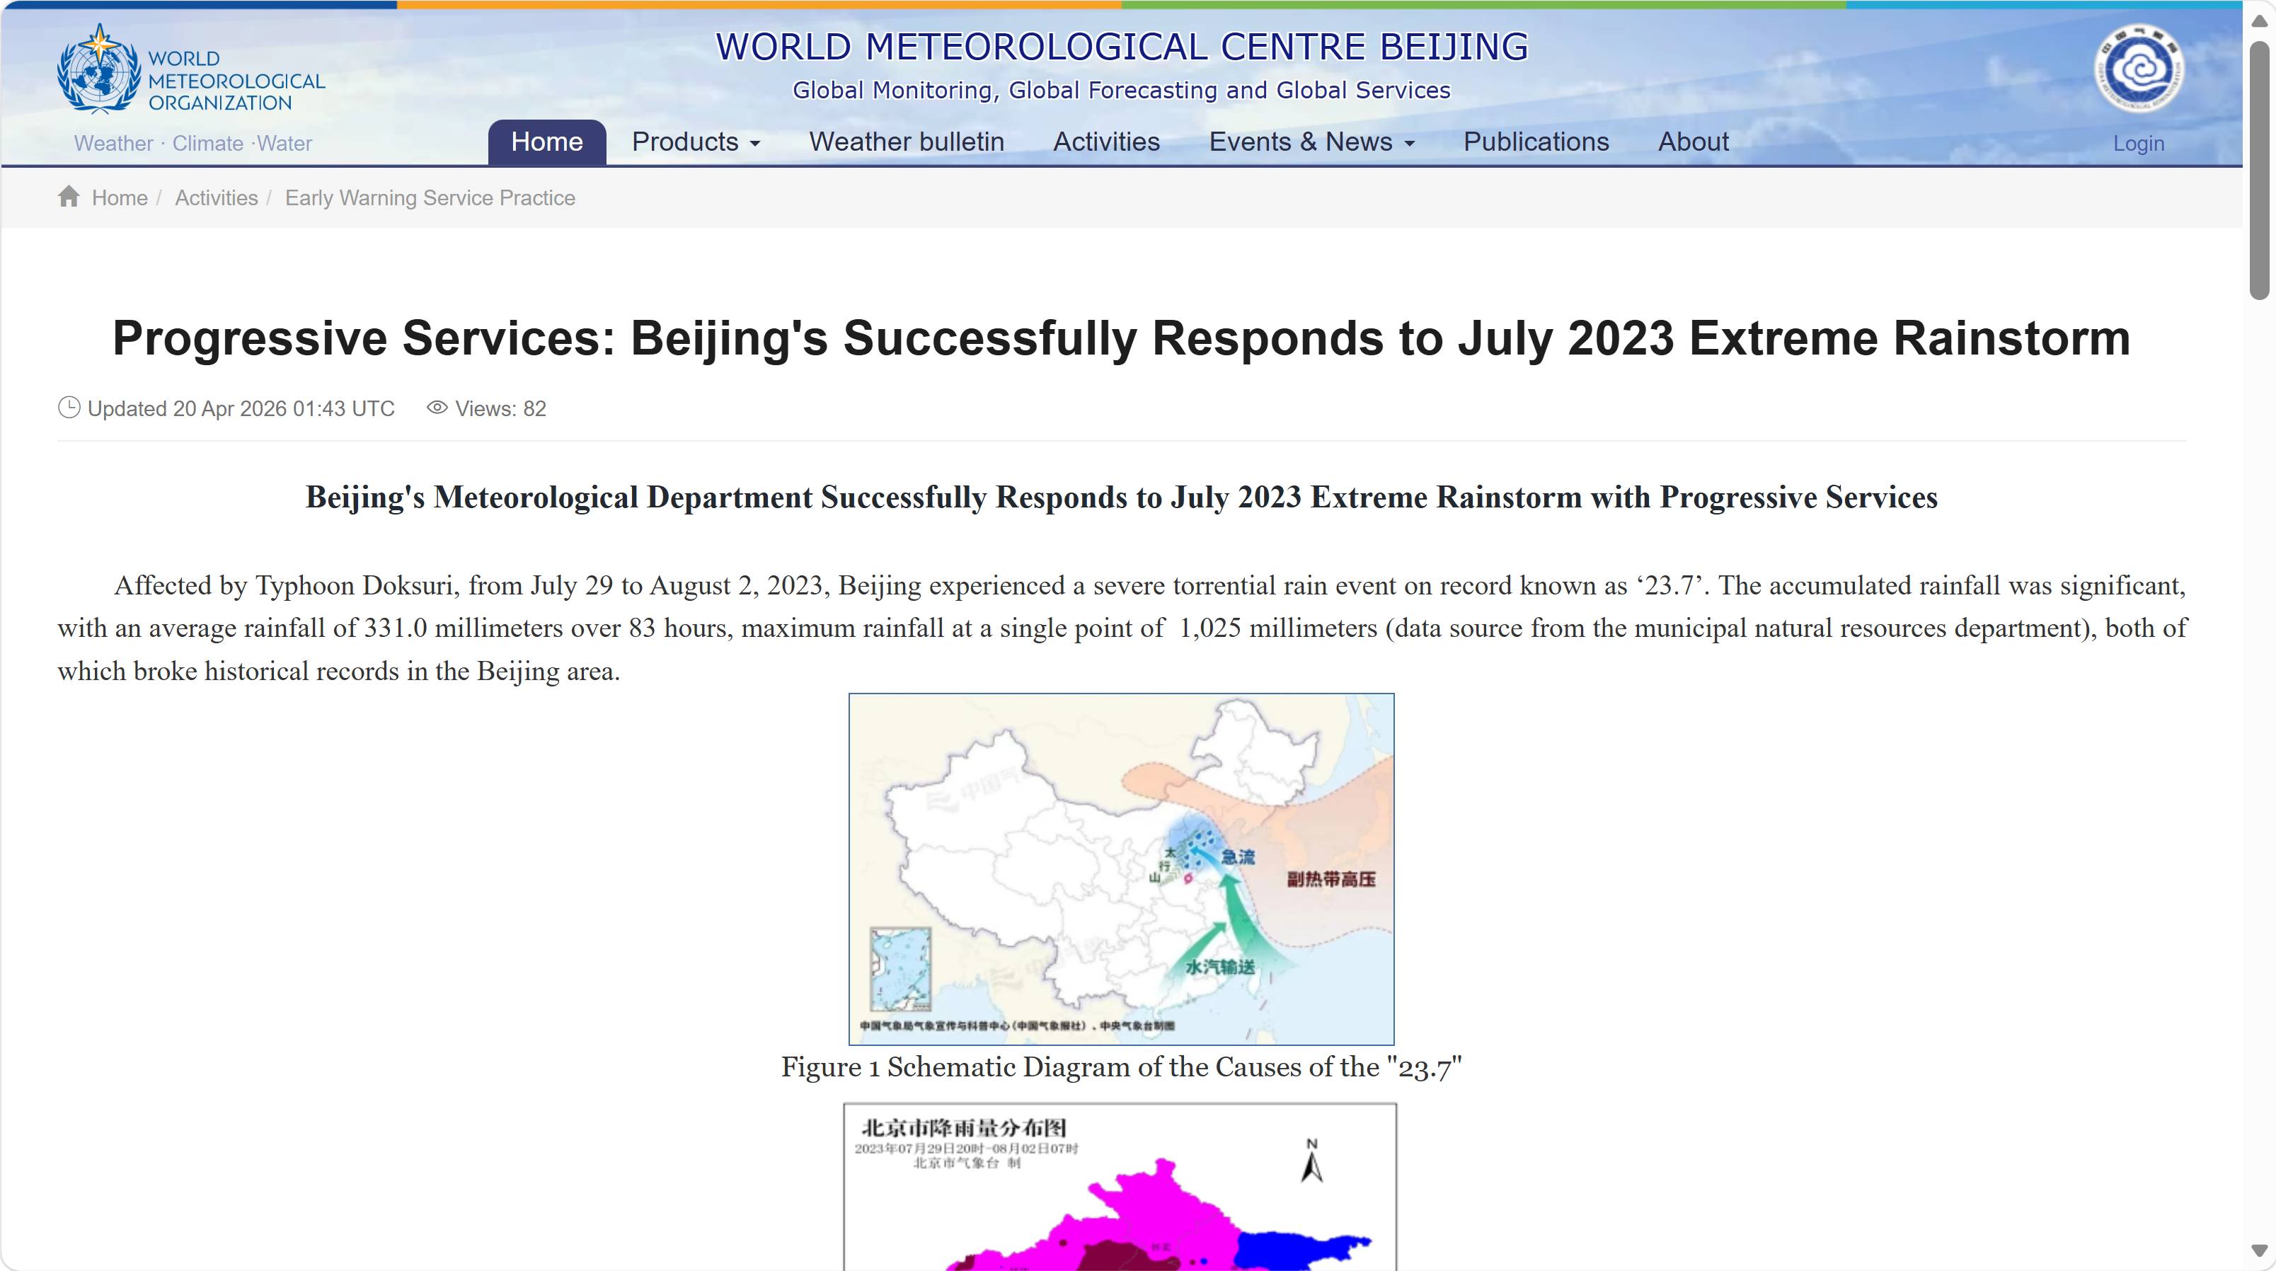
2. MAZU products and services
https://mazu.wmc-bj.net
(5) China's Experience in Disaster Prevention and Mitigation
Progressive Service Efficiency (From Medium-range to Nowcasting)
Progressive Accuracy of Affected Areas (From Regional to township/street level)
Progressive Responding Measures (From Risk Zone Identification to Take Action)

Slide 10
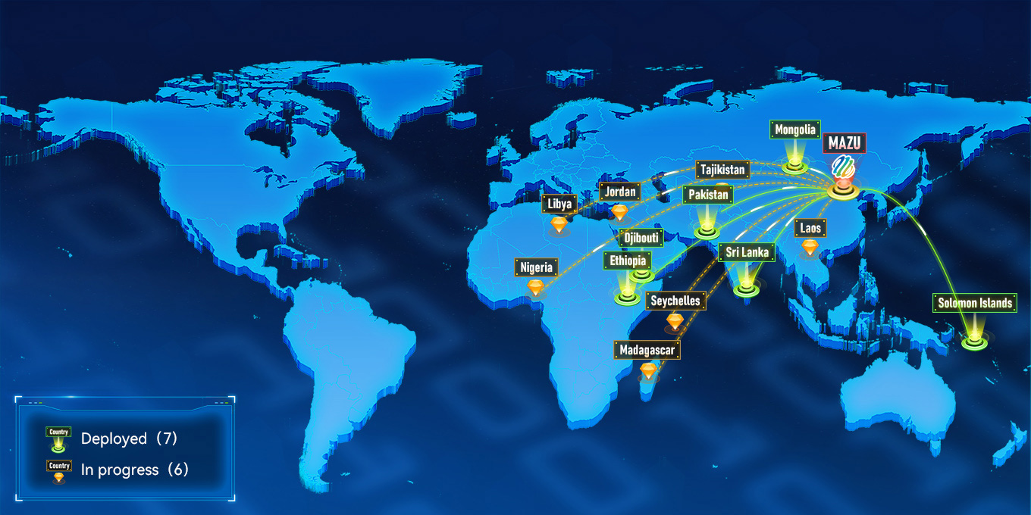
3. MAZU Application
MAZU has been applied in more than 40 countries via cloud and deployed in 7 countries.
Notes:
当前，“妈祖”已在全球40多国落地推进或试用，形成了分阶段、多渠道的合作格局。

Slide 11
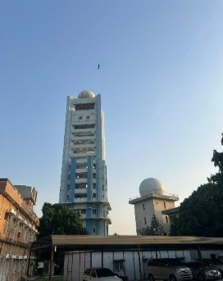
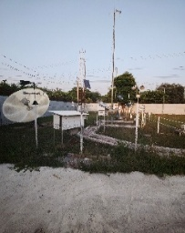
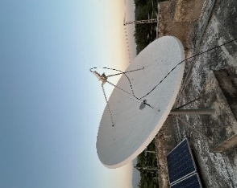
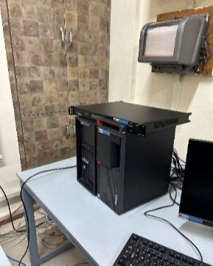
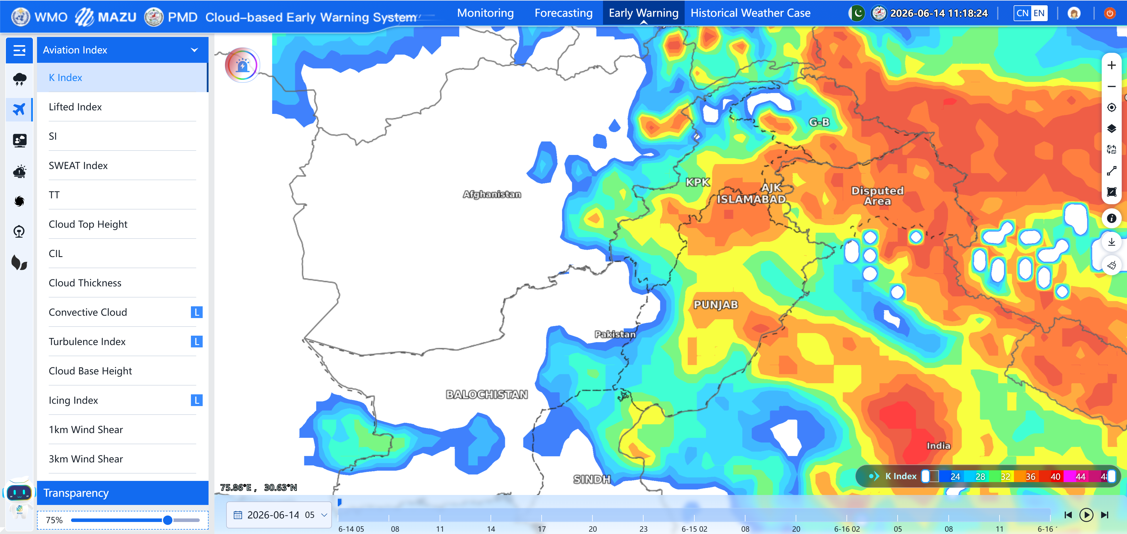
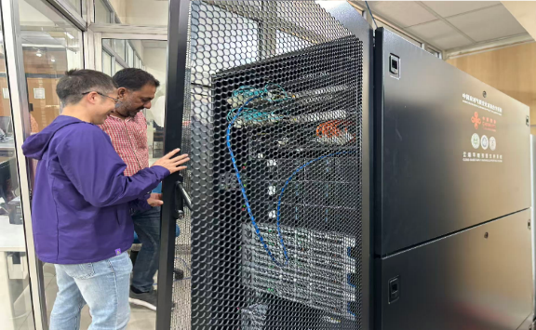
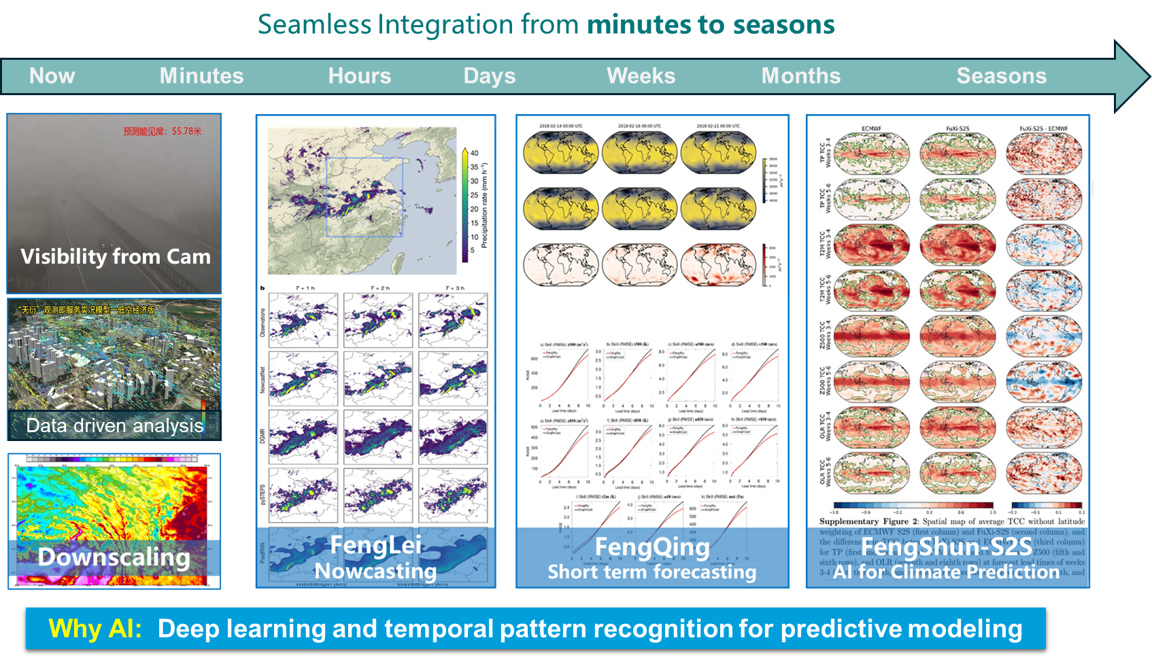
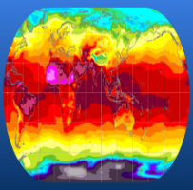
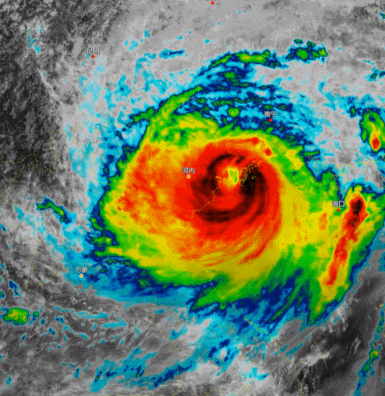
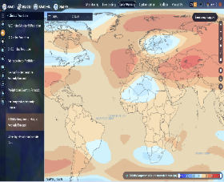
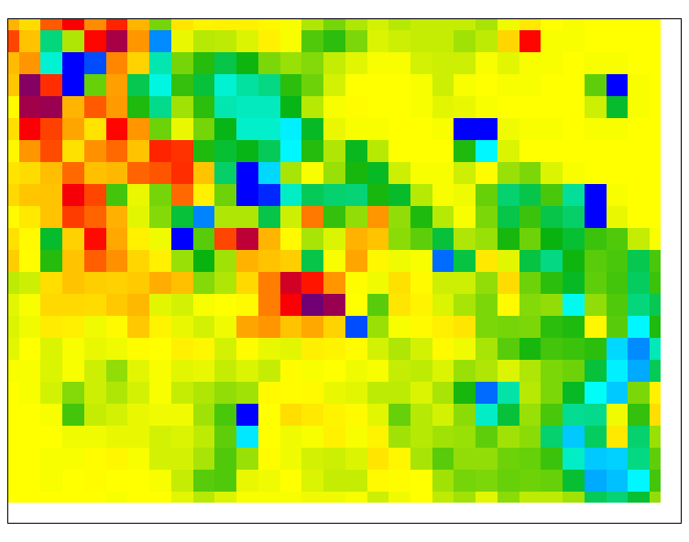
3. MAZU Application
Cloud-based Early Waring System (CEWS) Customized for Pakistan
Achieve the integration of multi-source data, including the CMADaas Platform, Overseas Cloud, CMACast, FY receiving system, 226 local ground observation stations, 2 radars, upper-air stations, lightning monitoring systems, and PMD-WRF.
Access to Local Multi-source Observation Data
All-In-One Machine
Radar
AWS
CMACast
FY receiving station
CMA-Oversea Cloud
AI Models
CMA-Reanalysis
FY-Satellites
Climate Prediction
CMA-NWP
MAZU-Pro System localization
MAZU platform interface
Notes:
我们为巴基斯坦打造了“妈祖”专业版定制系统，深度融合了风云卫星、本地雷达、地面观测站等多源数据，帮助构建了完整的预警数据处理体系，全面提升了巴基斯坦的气象防灾减灾能力。

Slide 12

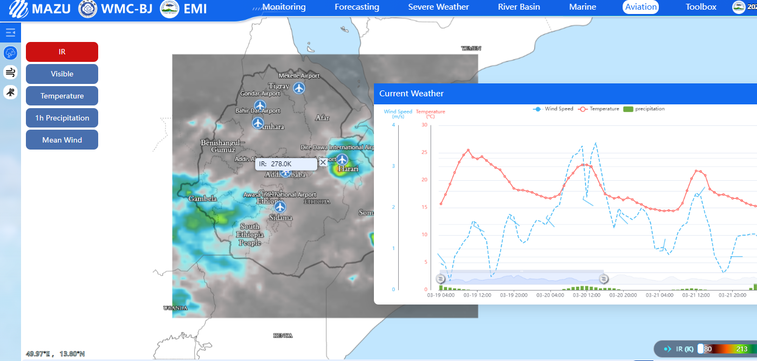
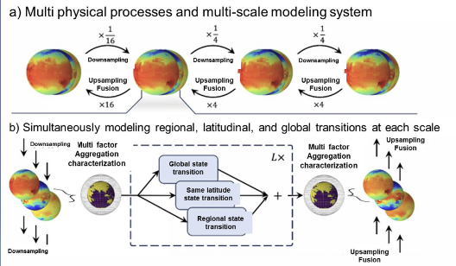
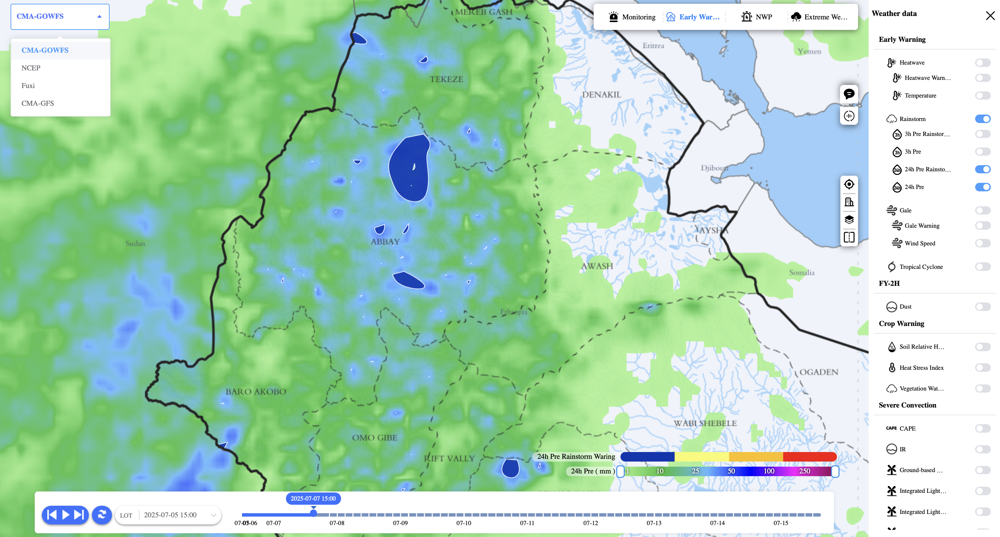
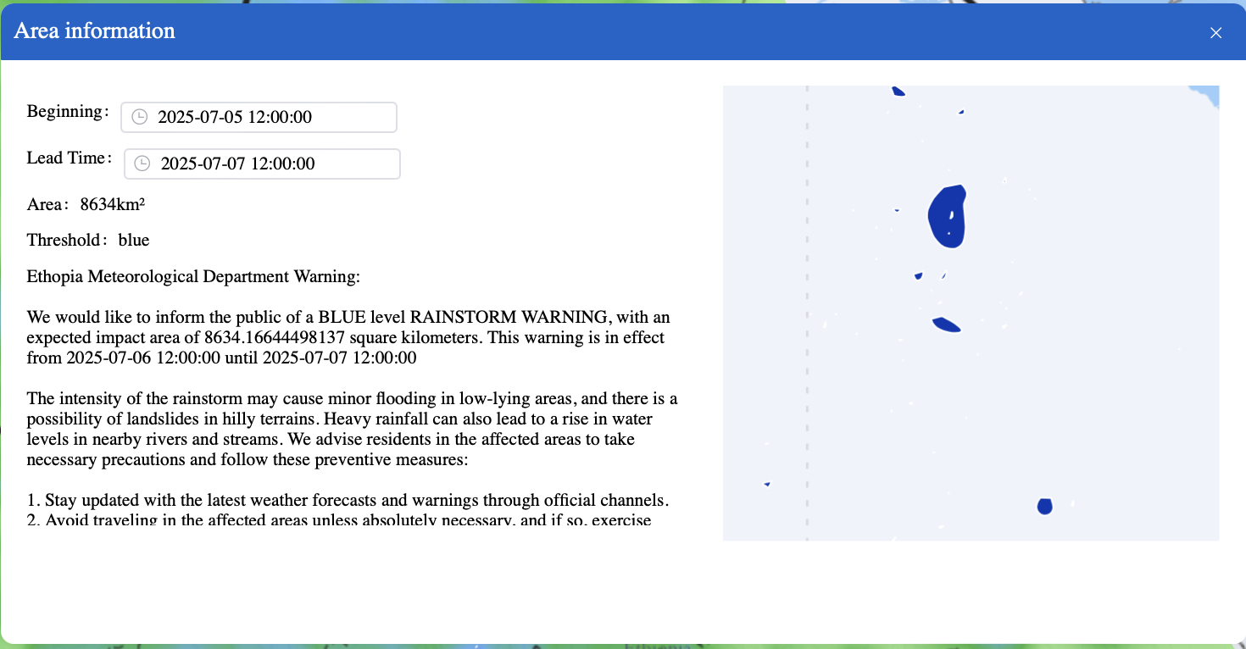
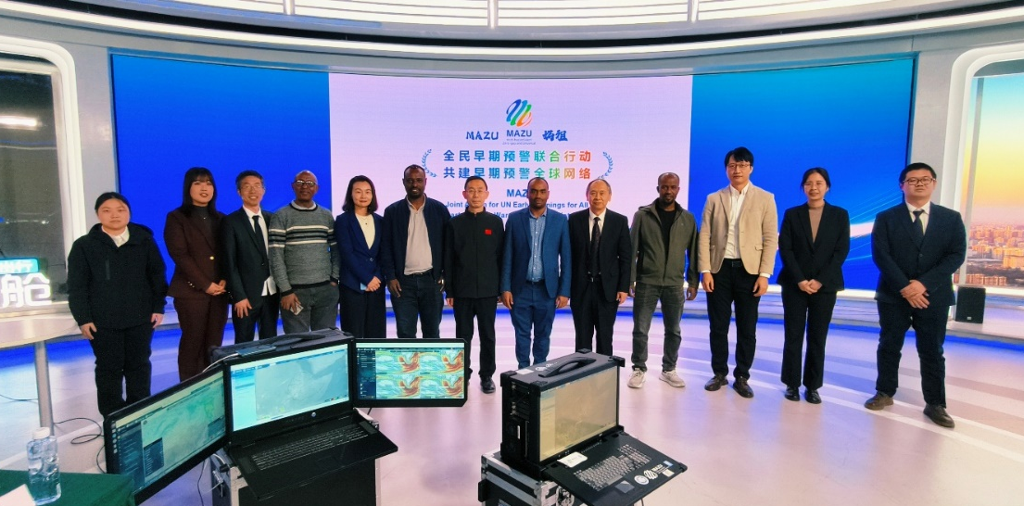
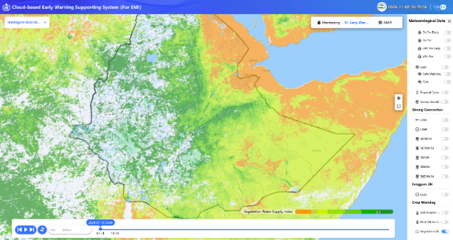
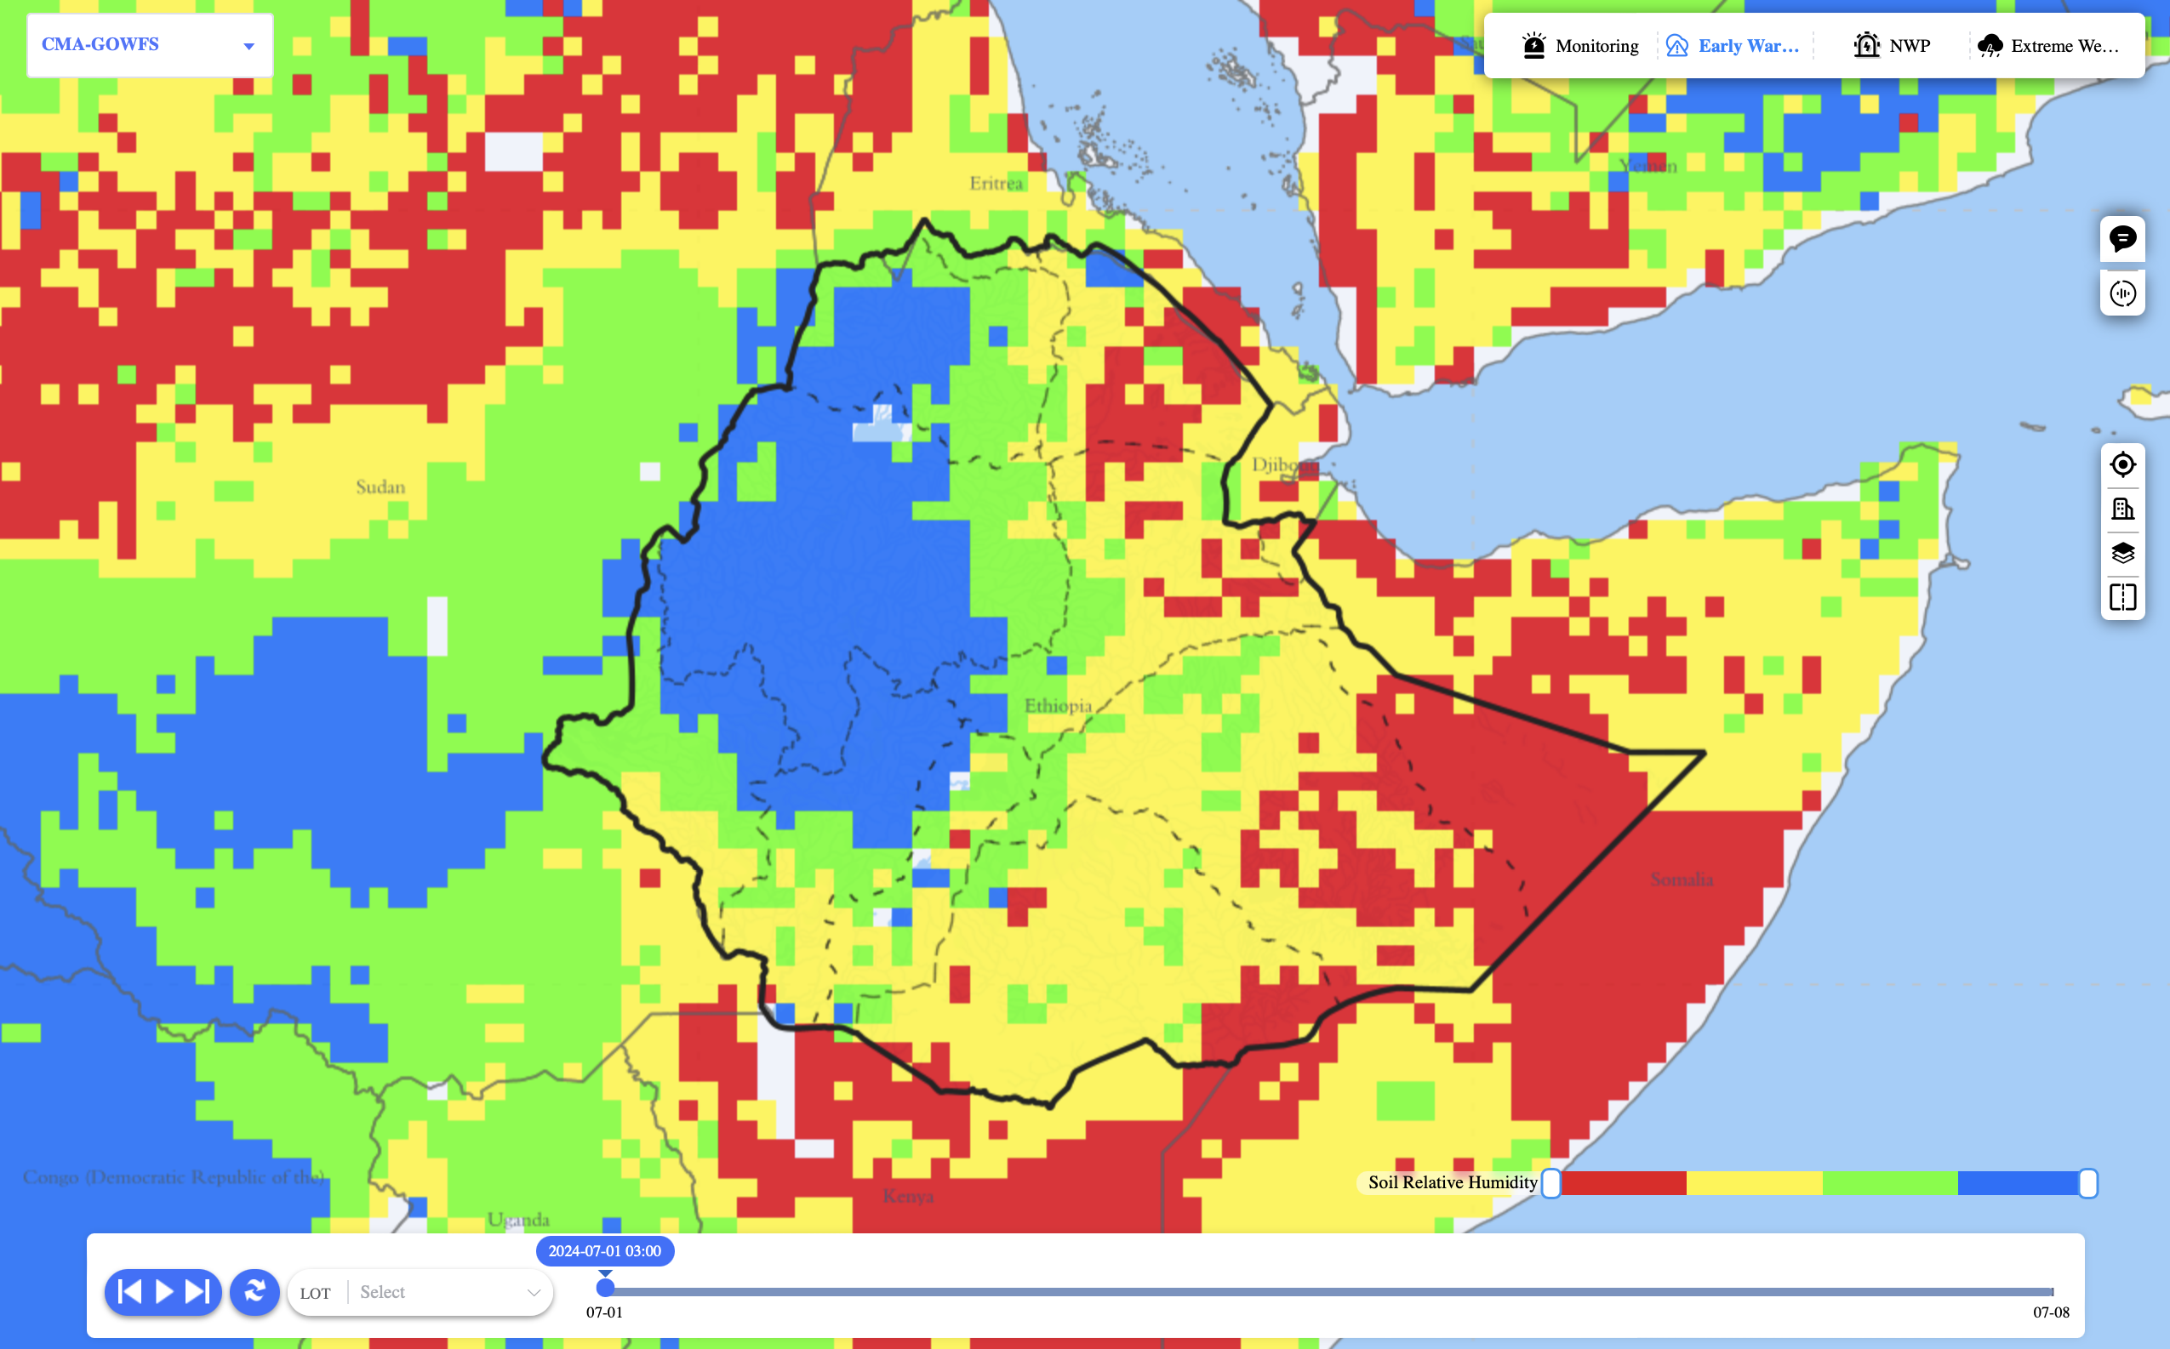
3. MAZU Application
CEWS Customized for Ethiopian Meteorological Institute (EMI)
Functions
Toolboxes
FengQing AI model localization and downscaling on all-in-one machine
Rainstorm Warning
Toolboxes of Agriculture, River Basin, Marine and Aviation.
Aviation
FengQing AI Model Downscaling for EMI
Rainstorm Warning
EMI delegation visited CMA in December, 2025
Updated CEWS for EMI
The All-in-one Machine has arrived in Addis Ababa in Jan. 2026.
Agricultural toolboxes
Notes:
针对埃塞俄比亚的“妈祖”基础版已实现多源数值模式、AI气象大模型、暴雨预警工具箱等丰富产品的接入，并逐步完善农业、海洋、航空等多场景定制化工具箱。

Slide 13
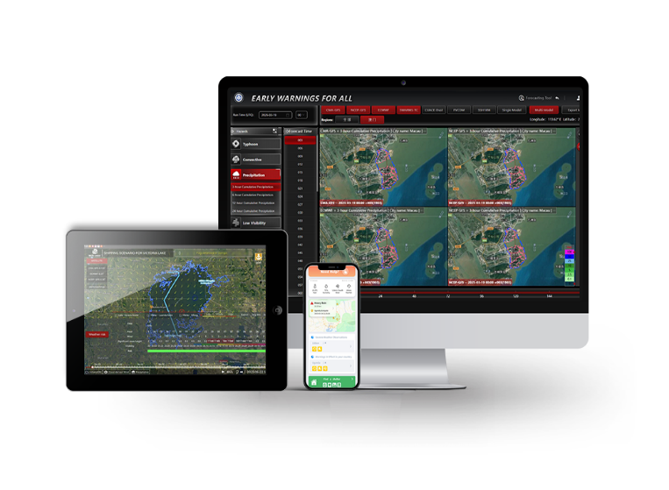
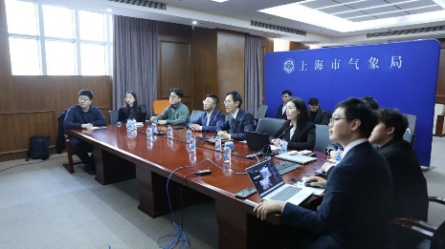
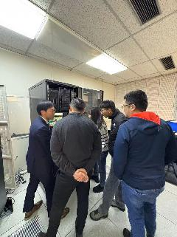
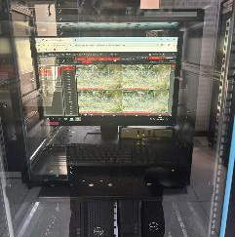
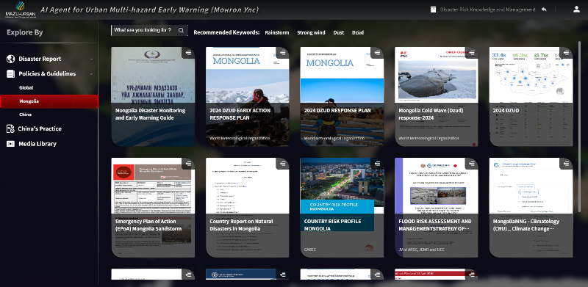
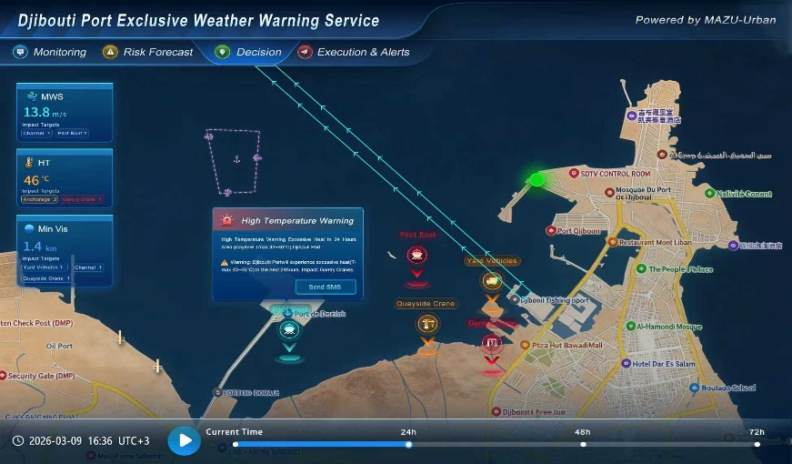
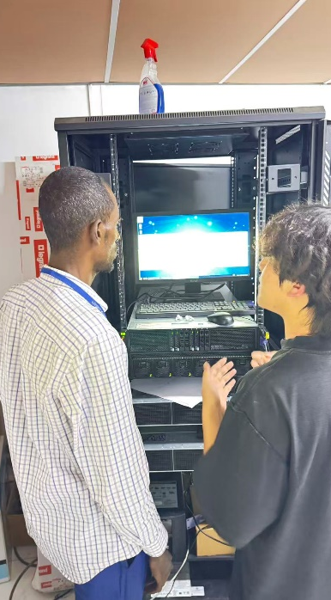




3. MAZU Application
MAZU Customized for Djibouti
On December 18, 2025, during the visit to the Republic of Djibouti led by Xu Yisong, Vice Chairman of the Standing Committee of the Shanghai Municipal People’s Congress, the launching ceremony of the Djibouti version of MAZU was held.
MAZU Customized for Mongolia
From October 16 to 17, 2025, during the 18th China-Mongolia Meteorological Bilateral Meeting (JWG-18), Mr. Song Shanyun, Deputy Administrator of the China Meteorological Administration, and the Director-General of the Mongolian Meteorological Administration formally signed the handover documents for MAZU.
Online training & on-site deployment
Early Warning Knowledge Corpus
Djibouti Port service
FengQing AI forecast
Early warning dashboard for Djibouti
Minute-Level urban disaster collections
Notes:
我们为吉布提定制了“妈祖”城市模块系统，重点打造了港口专属气象预警服务与城市预警仪表盘；为蒙古定制的城市模块搭载了“风清”模型预报、分钟级城市灾害采集等功能，精准服务蒙古的城市防灾与民生保障。

Slide 14
Outline
Part 1: What is MAZU ？
Part 2: AI Engine for Forecasting Products
Part 3: Global Crop Monitoring and Food Security
Part 4: Open Collaboration and Future Prospects

Slide 15

Global Forecasting Technologies: Driven by AI
Notes:
为什么选择“妈祖”这个名字？这背后是跨越千年的文化传承与精神共鸣。在中国东南沿海，有一名女子名叫林默娘，公元 960 年 3 月 23 日生于福建湄洲。传说她自幼聪慧，通晓天文气象，擅长航海技术，经常帮助渔民和商船安全出海，不惧风浪救助海上遇难者。她被人们尊称为“妈祖”，妈祖文化后来被认定为联合国教科文组织非物质文化遗产。
这里有一个极具意义的巧合：妈祖的诞辰3月23日，正是今天的世界气象日，这完美诠释了“从古老智慧到现代科技”的精神传承。可以说，“妈祖”的命名，承载着人类对生命平安的美好祝愿，是用现代科技传承千年守护精神的中国方案。

Slide 16




1. FengLei: 0-3 hours Nowcasting Model
Observation
FengLei forecast
of 3-h precipitation at 10-min intervals
Key Features:
Fast and efficiency: 0-3h forecasts at 1km resolution, updated every 6-10 minutes.
Technical Innovation: A Physics-AI hybrid model trained with an "Expert-in-the-Loop" mechanism to bridge the gap between objective scores and subjective forecast quality.
Data Foundation: Utilizes a high-quality, multi-source fused precipitation dataset.
Rainstorm-induced geohazards
Notes:
"Now, let's shift from the global scale to the immediate future with our nowcasting model, FengLei.
Its key features are:
Speed and resolution: It provides 0-3 hour precipitation forecasts at a 1km resolution, with updates every 6-10 minutes.
Technical Innovation: This is a Physics-AI hybrid model. A unique aspect is our 'Expert-in-the-Loop' training mechanism. This involves our senior forecasters providing feedback to fine-tune the model, which helps bridge the gap between objective scores and subjective forecast quality.
Data Foundation: It's built on a high-quality, multi-source fused precipitation dataset, which is essential for skillful nowcasting.
The results are dramatic. As noted at the bottom, for 50 mm/h heavy rainfall, we've seen a TS score improvement of over 480% compared to previous operational products."

Slide 17





2. FengQing: Global Short-Medium Forecast (0-15 Days)
Key Capabilities:
  Fast & Efficient: Delivers a 15-day global forecast in ~3 minutes on a single GPU.
  Physics-Informed: Integrates physical laws to improve model stability and reduce systematic errors.
  Impact-Oriented: Enhanced prediction of surface variables like precipitation and wind, critical for energy, agriculture, and water management.
  Open & Accessible: The model code is openly available on GitHub for research and use. https://github.com/nmcdev/CMA-AIM-GFS-Fengqing
Dust Forecast
Typhoon Forecast
Notes:
"Now let's take a closer look at our flagship global model, FengQing.
As you can see, its key capabilities are designed for both performance and practical use.
It is fast and efficient, delivering a 15-day global forecast in about 3 minutes on a single GPU.
It is physics-informed, which is crucial for stability and reducing systematic errors, a topic I'll elaborate on shortly.
It is impact-oriented, with a focus on accurately predicting surface variables like precipitation and wind, which are vital for sectors like energy and agriculture.
And importantly, it is open and accessible. The model code is available on GitHub to foster research and collaboration.
The timeline on the right shows its rapid development path, from initial research in collaboration with Tsinghua University in early 2023 to its official release and operational deployment within about 18 months."

Slide 18




3. FengShun: S2S Climate Prediction Model (15-60 Days)
Scope: Sub-seasonal to seasonal forecasting using multi-sphere data (atmosphere, ocean, land, sea ice).
Technical Innovation: A flow-dependent ensemble perturbation technique generates physically consistent ensemble members, improving forecast reliability.
Performance: Shows improved prediction skill for MJO, weekly precipitation (3-6 weeks), and extremes.
Observation
FengShun
June
Higher Skill for Precipitation Anomalies Beyond 15 Days
Compared to ECMWF, FengShun improves prediction skill for global average precipitation beyond 15 days by approximately:
21% overall
17% in the tropics
30% in extratropical regions
Skill improvement validated by Bootstrapping significance tests
Higher Skill for Monsoon Precipitation
Over two-thirds of the global population lives in the seven major monsoon regions.
Except for the South American monsoon region, Fengshun shows higher predictive skill than ECMWF IFS in monsoon precipitation prediction.
July
Notes:
"Moving to the longest timescale, we have FengShun, our model for sub-seasonal to seasonal forecasting.
It's a multi-sphere model, incorporating data from the atmosphere, ocean, land, and sea ice.
Its key technical innovation is a flow-dependent ensemble perturbation technique. This allows us to generate more physically consistent and reliable ensemble members, which is critical for S2S uncertainty quantification.
Overall, it has shown improved prediction skill for key long-range phenomena like the MJO, as well as for weekly precipitation outlooks in the 3-6 week range."

Slide 19

From NWP and AI to Digital Grid Forecasts

Slide 20


4. FengYu: Expanding AI Capabilities to Space Weather
A full-chain forecasting system from solar activity to the ionosphere. Comprises independent but jointly-trained models for Solar Wind, Magnetosphere, and 3D Ionosphere.
Notes:
"Beyond terrestrial weather, CMA is also expanding its AI capabilities into the domain of space weather with our new FengYu model.
This is a full-chain forecasting system, designed to predict conditions from the sun to the Earth's ionosphere.
It's composed of three core components, which are independent but jointly-trained models for the Solar Wind, the Magnetosphere, and the 3D Ionosphere."

Slide 21


5. FengHe: AI Meteorological Service Language Model
In October 2025, FengHe V1.0 was released as the first 100-billion-parameter generative Large Language Model (LLM) elaborately designed for meteorological service.
FengHe employs a“1+1+N”architecture. One meteorological LLM as the brain, one agent platform as the limbs, empowering N meteorological service scenarios.
Notes:
"Now let's take a closer look at our flagship global model, FengQing.
As you can see, its key capabilities are designed for both performance and practical use.
It is fast and efficient, delivering a 15-day global forecast in about 3 minutes on a single GPU.
It is physics-informed, which is crucial for stability and reducing systematic errors, a topic I'll elaborate on shortly.
It is impact-oriented, with a focus on accurately predicting surface variables like precipitation and wind, which are vital for sectors like energy and agriculture.
And importantly, it is open and accessible. The model code is available on GitHub to foster research and collaboration.
The timeline on the right shows its rapid development path, from initial research in collaboration with Tsinghua University in early 2023 to its official release and operational deployment within about 18 months."

Slide 22
Outline
Part 1: What is MAZU ？
Part 2: AI Engine for Forecasting Products
Part 3: Global Crop Monitoring and Food Security
Part 4: Open Collaboration and Future Prospects

Slide 23


China Fengyun satellites help global agriculture monitoring since 2008
FY satellites
Fengyun remote sensing and global agricultural monitoring system
Fy-3D,3E,3F,3G,3H
MERSI（optical）, MWRI(microwave)
Daily, dekad, monthly,
L1 to L3
Vegetation monitoring
Crop growth condition monitoring
Drought monitoring
Crop yield estimation

Slide 24








Global agricultural monitoring based on Fengyun-3 satellite data
Vegetation and crop growth condition
Agricultural disaster monitoring and crop loss risk assessment
Crop area and yield estimation
Global heat disaster monitoring July 21 to July 30,2024
China wheat harvest progress
Crop growth condition along with season
5-year average

Slide 25




Global Agrometeorological Analysis and Service Platform
China Agrometeorological Analysis Platform
Global Agrometeorological Analysis Platform

Slide 26




Global Agrometeorological Disaster Forecast with FengShun AI model
Developed a growth-stage-specific dynamic model for assessing yield losses caused by heat stress, cold stress, drought stress, and waterlogging stress.
Developed high-resolution assessment for high- and low-temperature disaster indices for maize across China.
Heat stress forecast in China’s major maize-producing regions using FengShun data Initialized on 16 June 2026
Operational Framework Agrometeorological Disaster Early Warning
Heat stress anomaly relative to the historical 10-year mean (2016-2025)

Slide 27









Global main crop monitoring, early warnings and food security
Wheat, rice, corn, soybean and sugar etc.
Food shortage risk assessment through crop condition monitoring and yield/production estimation
Risk assessment
stock
new production
consume

Slide 28
Outline
Part 1: What is MAZU ？
Part 2: AI Engine for Forecasting Products
Part 3: Global Crop Monitoring and Food Security
Part 4: Open Collaboration and Future Prospects

Slide 29








Next Steps —— Open Collaboration
FY Polar Orbit Satellites
Continue to build the MAZU cloud-based early warning platform for global public.
Deepen cooperation with Global South countries and relevant international and forge a closer network of global meteorological partnerships.
Take actions and scale-up support for developing countries in enhancing their capacity for early warning.
FY Geostationary Orbit Satellites
AI -Powered models:
FENGLEI
ENGQING
FENGSHUN
FENGYUAN
FENGYU
FENGHE
NWO models:
CMA-GFS：12.5km
CMA-GEPS：50km/25km
CMA-CPS：45km
CMA-REPS：10km/3km
CMA-TRAM：9km
CMA-GD：3km/ 1km
Capacity development:
Education and training
BRI visiting scholarship
Development projects
Global partnership
...
Notes:
展望未来，我们将依托世界气象中心（北京）和中国气象国际合作与培训中心，在各方的支持和参与下，持续打造面向全球的“妈祖”早期预警公共云平台，深化与全球南方国家和相关国际组织的合作，加大对发展中国家早期预警能力发展支持力度。

Slide 30



ＴＨＡＮＫＳ!
http://ew4all.wmc-bj.net/EW4ALL/
http://mazu.wmc-bj.net/mmsp/
Email: wmc-bj@cma.gov.cn

