Slide 1
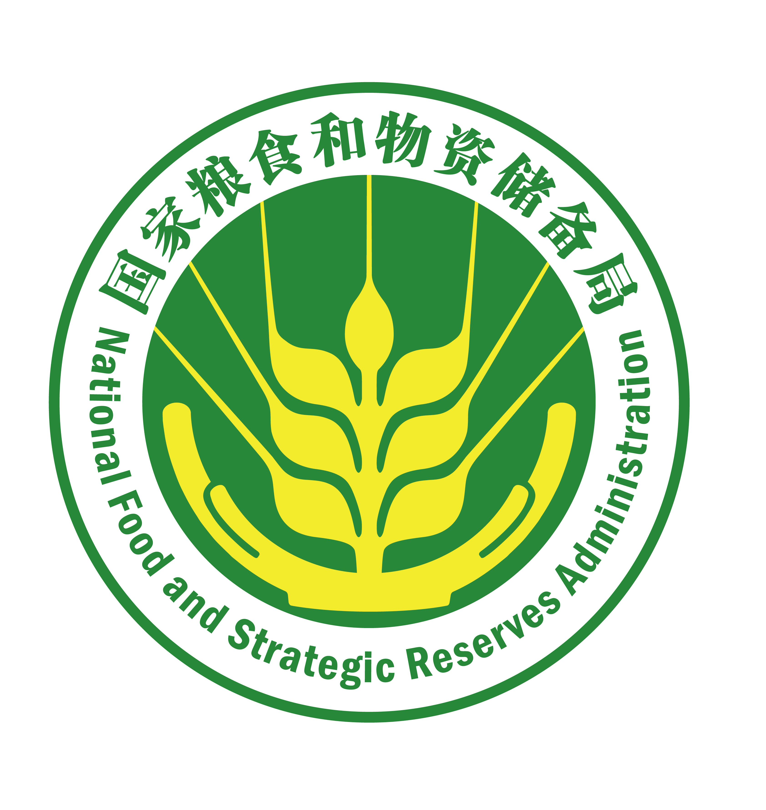
China's Systematic Action on Food Loss Reduction and Policy Support
Lecture Two

Slide 2
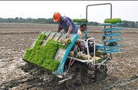
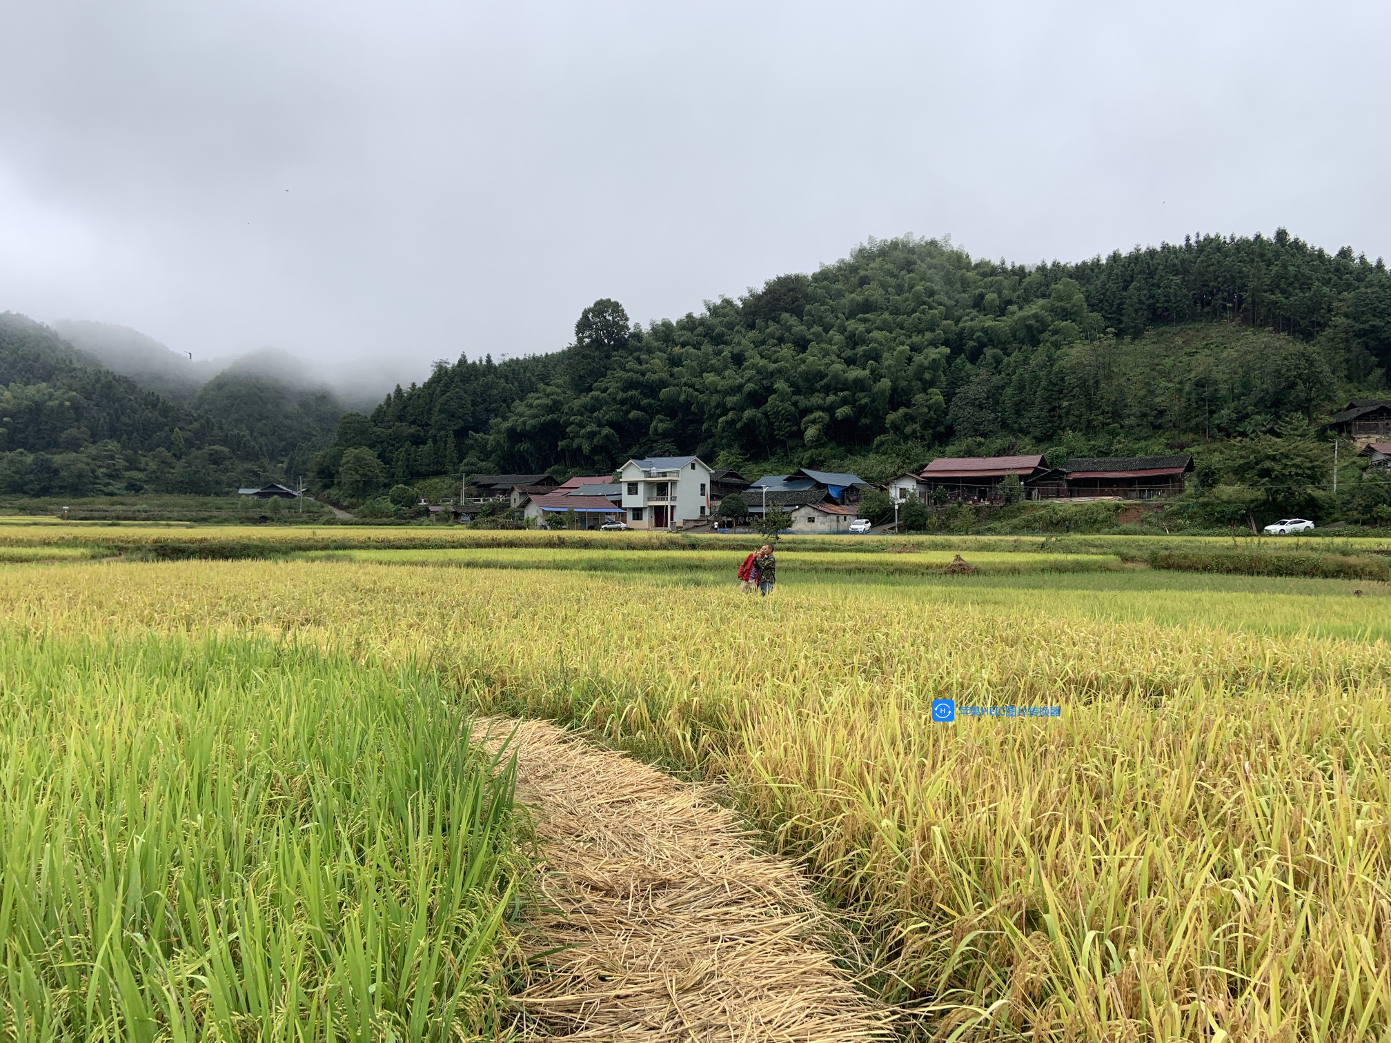
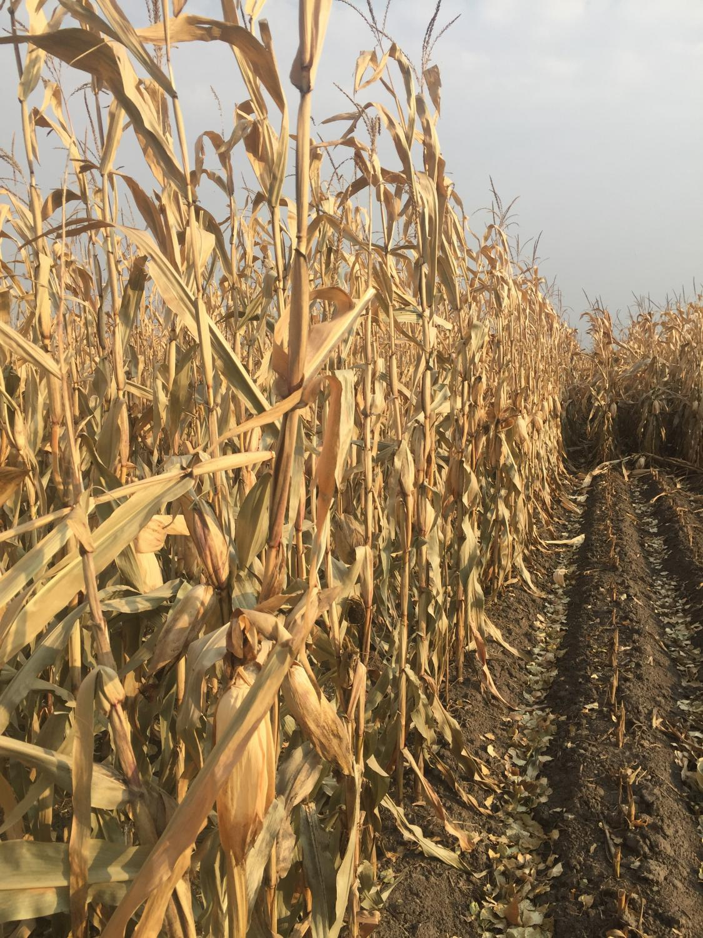
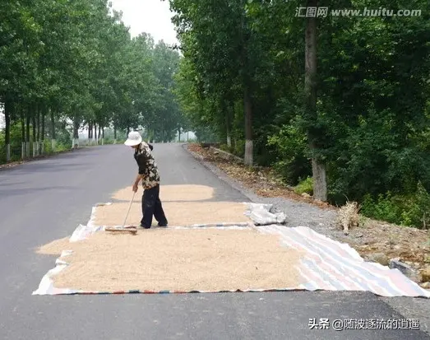
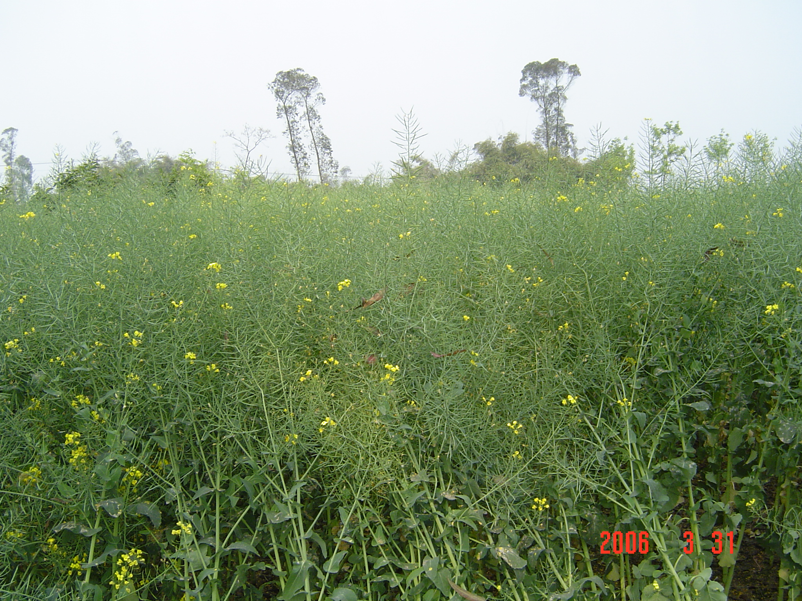
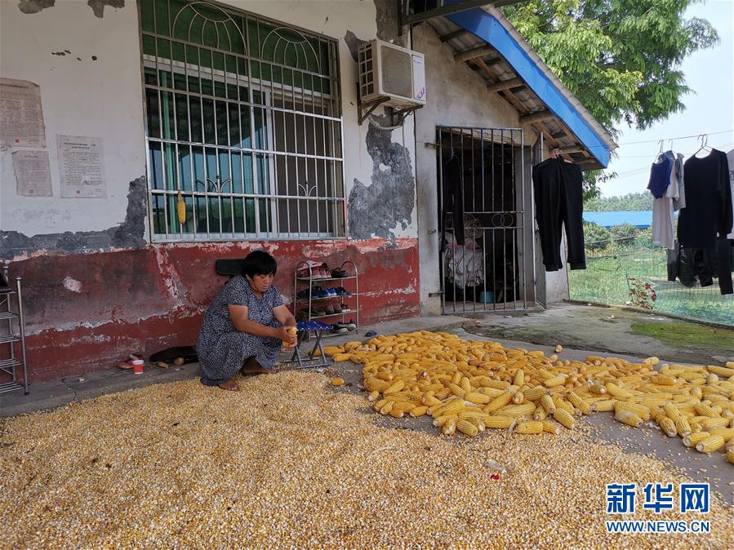
III. China's Systematic Action on Food Saving and Loss Reduction
1. Our philosophy of food saving and loss reduction
It is imperative to sort out the loss in each step of grain circulation and find out the cause of loss to design targeted measures in a bid to achieve the best result of grain loss reduction.

Slide 3
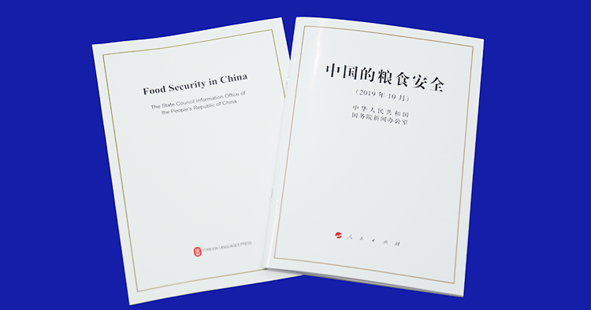
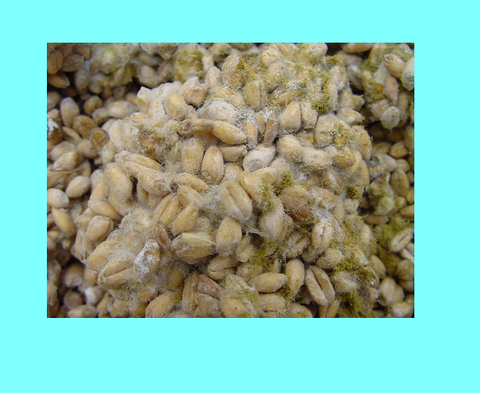
III. China's Systematic Action on Food Saving and Loss Reduction
1. Our philosophy of food saving and loss reduction
Philosophy: The post-harvest food loss is the result of the combined effects of natural, economic, and technological factors. Different cultivated land characteristics, climate conditions, production and management methods, technical equipment, etc. will all affect the loss. Under certain conditions, some losses are normal, while others can be reduced by changing ideas, improving facilities, and innovating mechanisms.
250 million people will suffer from severe hunger as a consequence of the epidemic
Moth pests make nets on grain surfaces
Mouldy and caking wheat

Slide 4
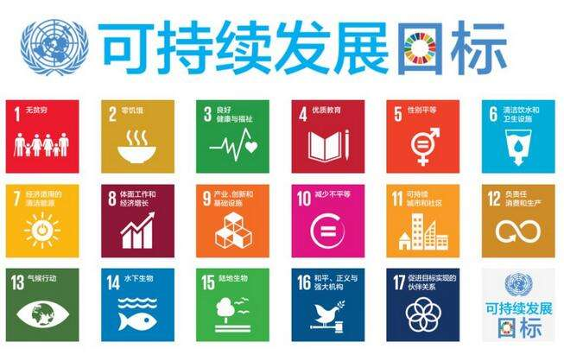
III. China's Systematic Action on Food Saving and Loss Reduction
1. Our philosophy of food saving and loss reduction
The 2030 Agenda for Sustainable Development puts forward, "By 2030, halve per capita global food waste at the retail and consumer levels and reduce food loses along production and supply chains, including post-harvest losses."
Reducing food loss has been elevated to an important initiative to ensure the better development of all mankind.

Slide 5
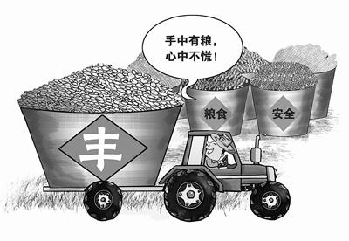
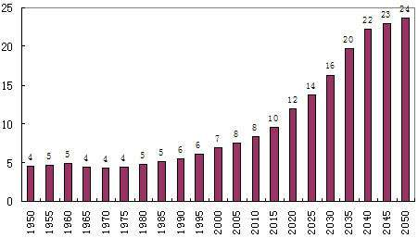
III. China's Systematic Action on Food Saving and Loss Reduction
2. Reaching a consensus on food saving and loss reduction
Generally, people have a consensus on the importance of food as the essential strategic material. However, when it comes to saving food and reducing losses, food producers, consumers and managers may have different understanding.

Slide 6
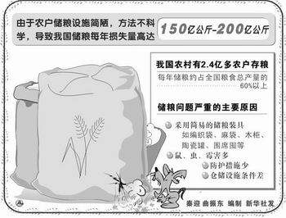
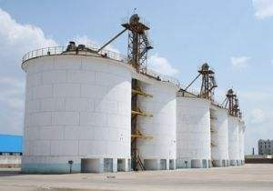
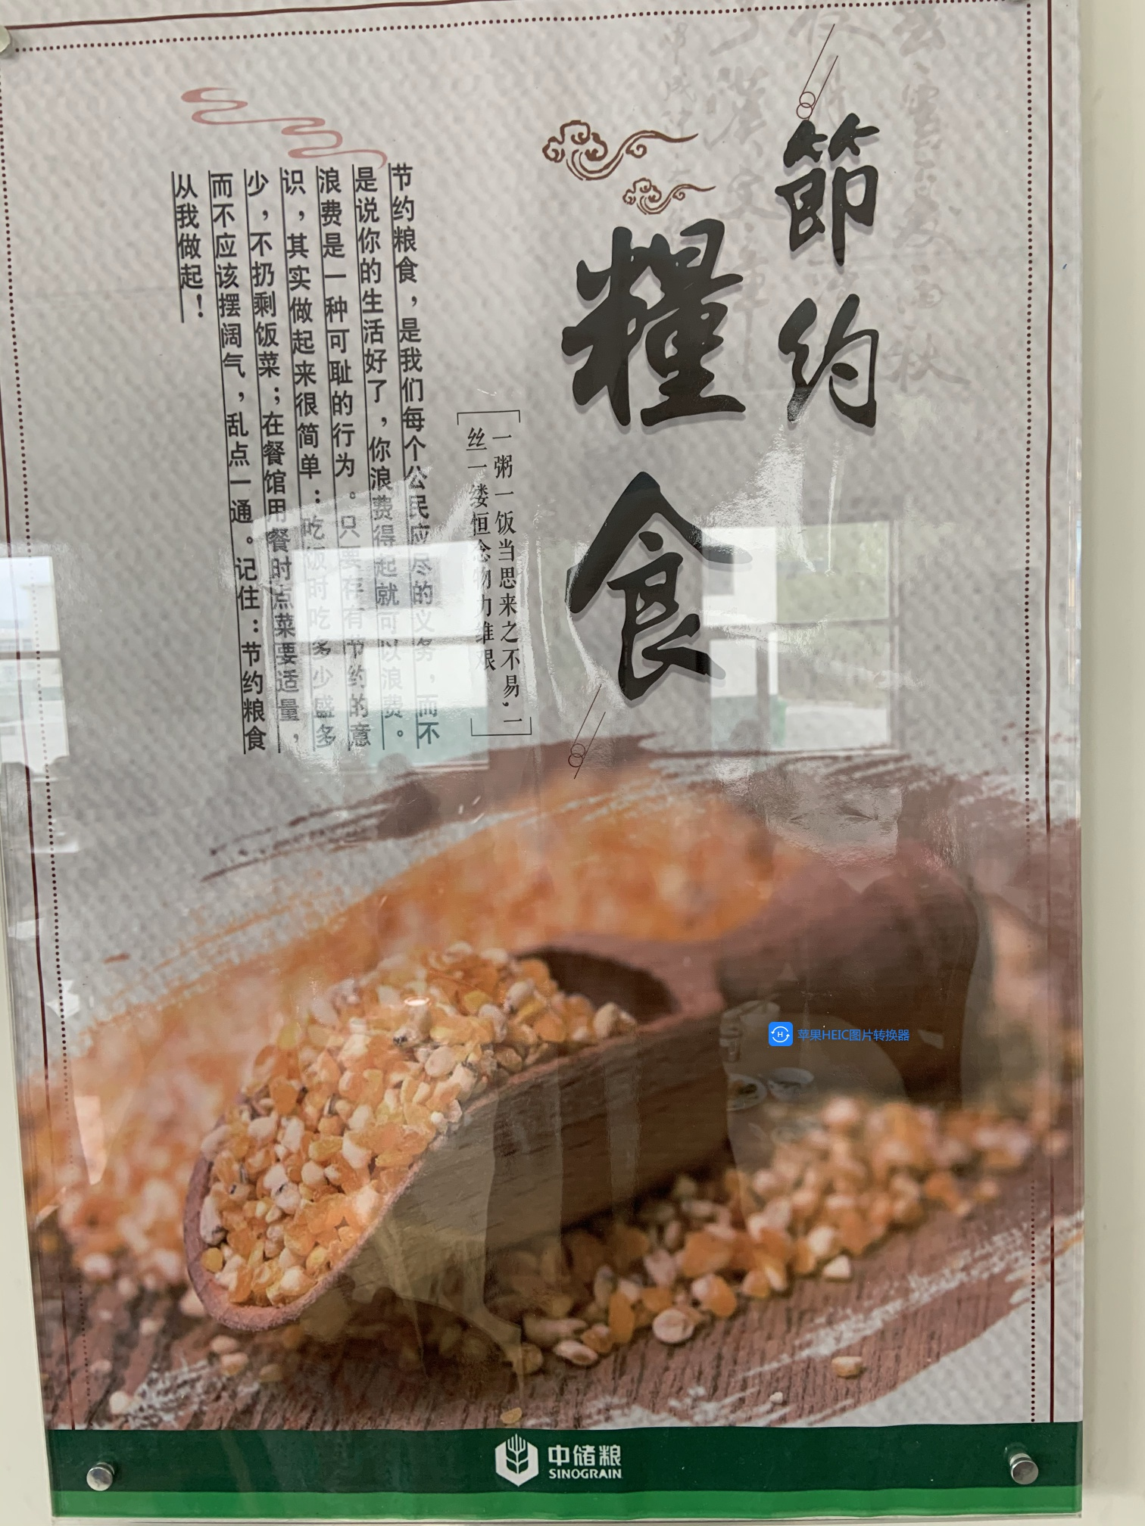
III. China's Systematic Action on Food Saving and Loss Reduction
2. Reaching a consensus on food saving and loss reduction
For food producers, their initiative of and enthusiasm in food production are declining. Therefore, we must respect the food producers and reach a consensus on the preciousness of food and the glory of growing food.

Slide 7
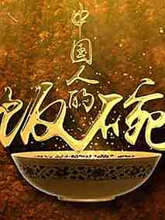
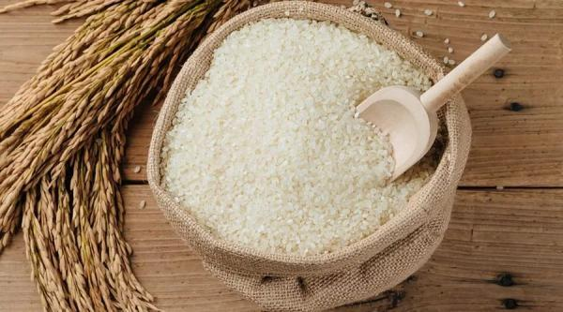
III. China's Systematic Action on Food Saving and Loss Reduction
2. Reaching a consensus on food saving and loss reduction
Having enough to eat is the bottom line for food consumers.

Slide 8
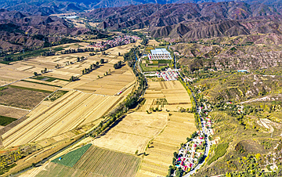
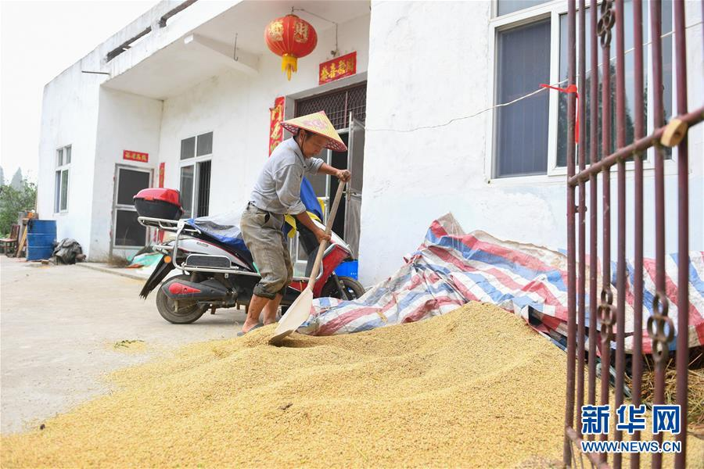
III. China's Systematic Action on Food Saving and Loss Reduction
2. Reaching a consensus on food saving and loss reduction
Food loss reduction is like developing an invisible farmland.
That each of 1.4 billion people saves one grain of rice would be 70 tons of grain.

Slide 9
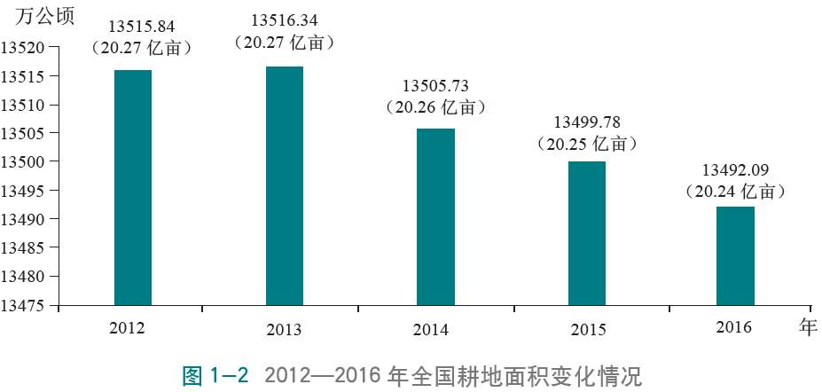
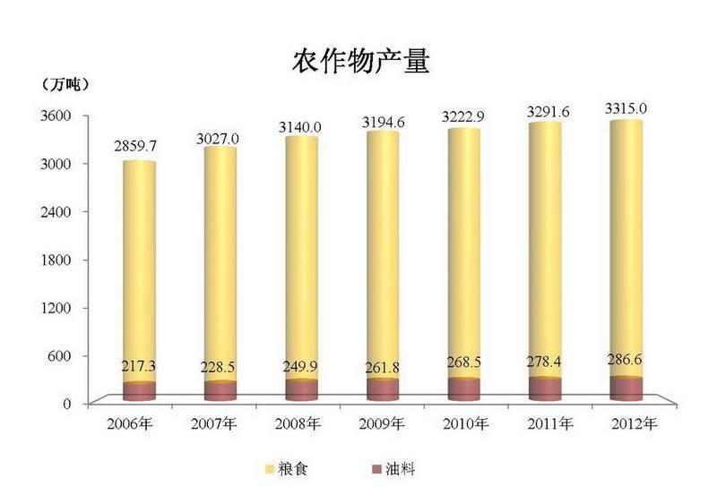
III. China's Systematic Action on Food Saving and Loss Reduction
3. Systemizing the entire industry chain to promote loss reduction.
Food saving and loss reduction call for concerted efforts of food producers, consumers, and managers, as well as coordination and promotion of the entire industry chain.
The industrial chain consisted of harvesting, farmers' storage, purchase, warehousing, logistics, processing, supply and sales links up food producers, consumers, and managers. Food loss could occur in any link and upon any subject.

Slide 10
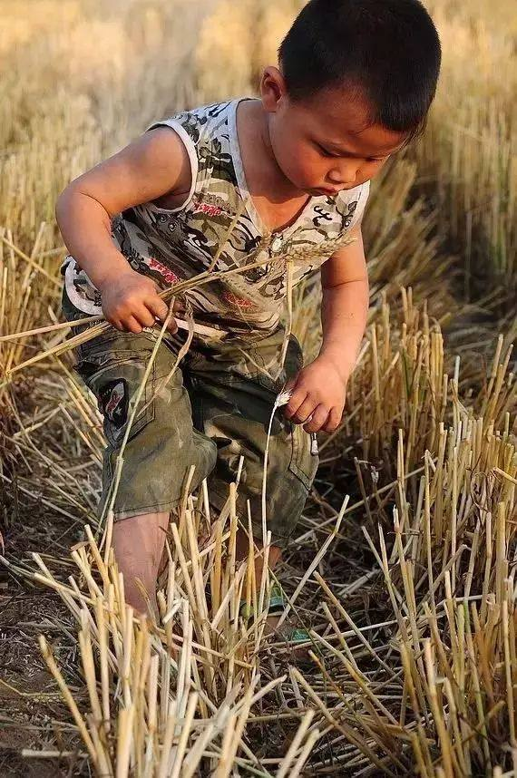
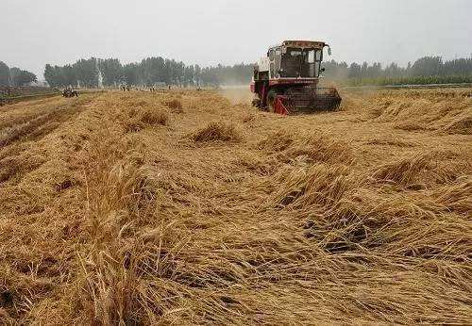
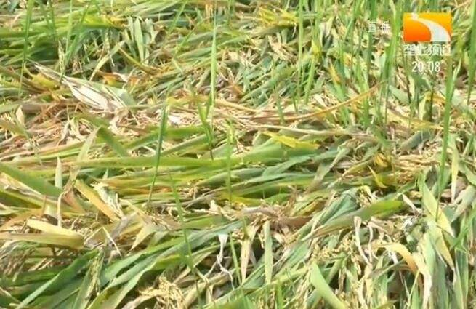
III. China's Systematic Action on Food Saving and Loss Reduction
3. Systemizing the entire industry chain to promote loss reduction.
Managers shall organize and coordinate food producers (including food circulation practitioners) and consumers to play a role in all links of the industry chain.

Slide 11
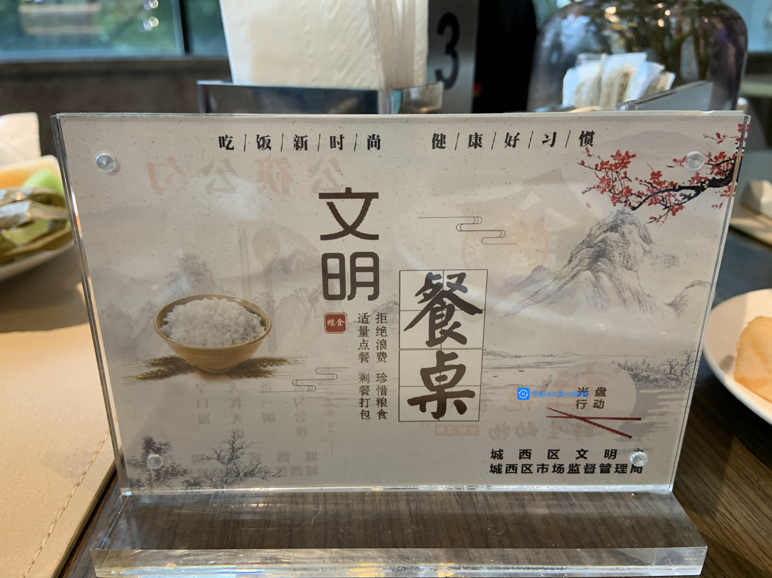
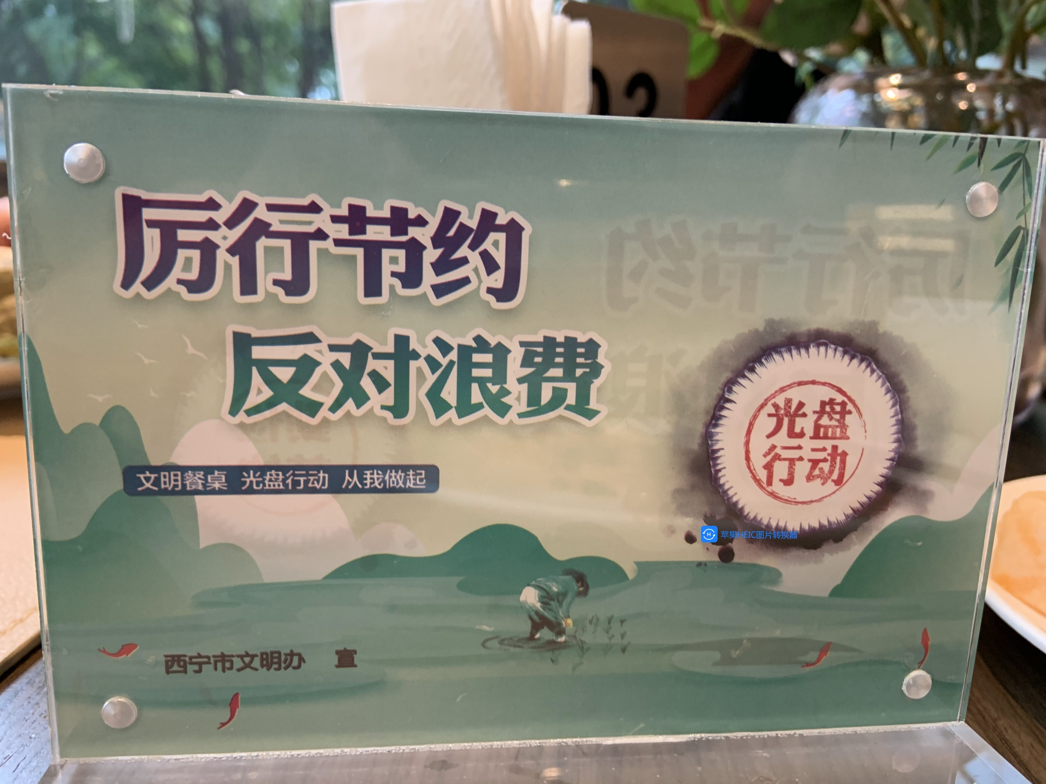
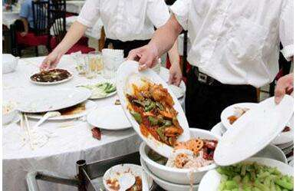
III. China's Systematic Action on Food Saving and Loss Reduction
3. Systemizing the entire industry chain to promote loss reduction
It is necessary to specify targets, standards, responsibilities and division of labor. Scientific and technological researches are carried out to address the prominent problems, and promote and apply the advanced technologies. A nationwide publicity of saving food is valued, specifically the inclusion of food saving education in the teaching materials.

Slide 12
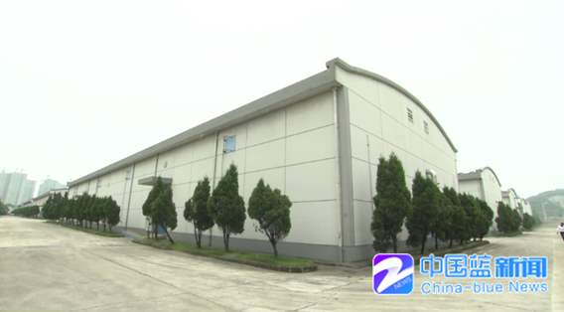
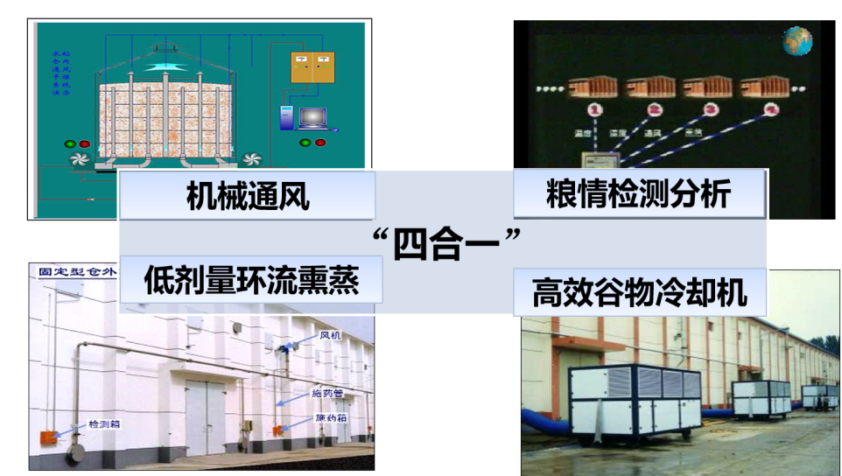
III. China's Systematic Action on Food Saving and Loss Reduction
3. Systemizing the entire industry chain to promote loss reduction
Master the mechanical harvesting precision and grasp the harvest season. Connect the field harvesting technically with grain storage system. Implement appropriate processing policies. Intensify the research and development of advanced logistics technology and equipment technology. Carry out the quality test. Guide people to consume food in a scientific and healthy manner and encourage them to reduce waste.
Mechanical ventilation
Grain condition detection and analysis
Four-in-One
Low-dosage recirculation fumigation
Highly-efficient grain chillers

Slide 13
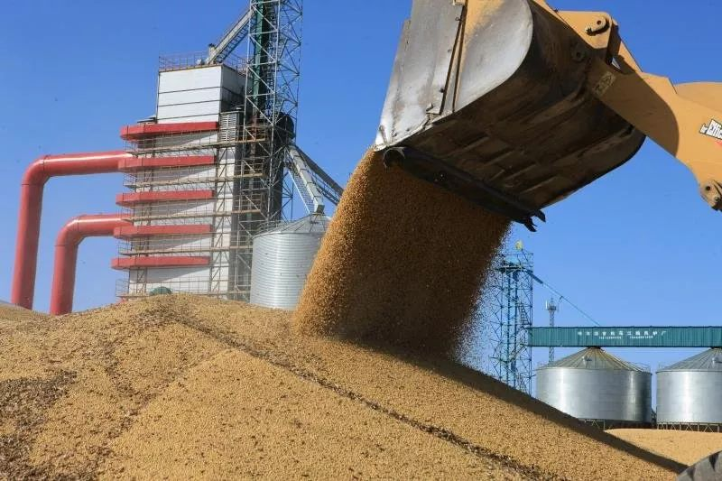
III. China's Systematic Action on Food Saving and Loss Reduction
In the past decade, China has achieved remarkable results in food loss reduction. However from a general view, the amount of loss and waste in food is still considerable.

Slide 14
IV. Laws, Policies, Standards and Management
1. The Chinese government attaches great importance to food saving and loss reduction
The Constitution, Agriculture Law, national law on food security, and the Regulation on the Administration of Grain Circulation.
Notice on Further Strengthening the Work of Saving Food against Waste, Opinions on Practicing Thrift and Opposing Waste of Food, Notice on Nationwide Action of Practicing Thrift, Morality and Food Conservation, and Opinions on Accelerating and Advancing Agricultural Supply-side Structural Reforms and Vigorously Developing the Grain Industry Economy.

Slide 15
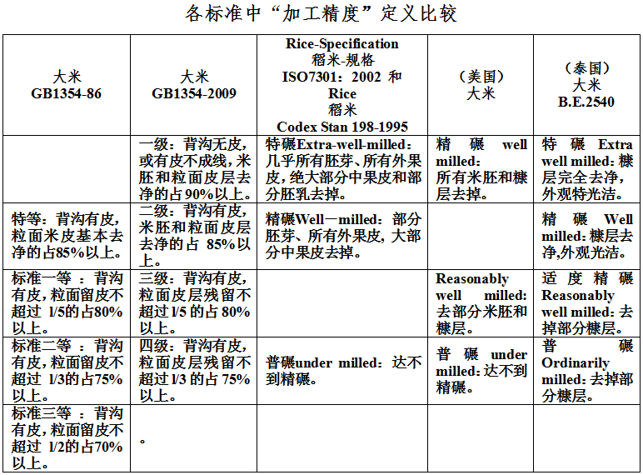
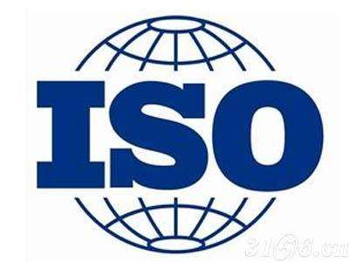
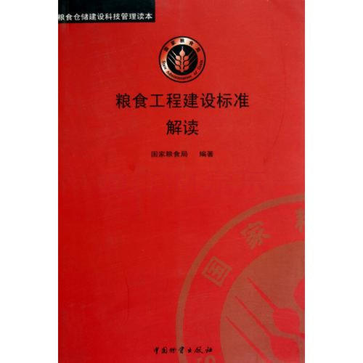
IV. Laws, Policies, Standards and Management
2. Standard revision based on new situation
As guided by the end use and the best quality of grain, grain and oil product standards are scientifically formulated and revised, the yield ratio of grain processing and the rate of multipurpose utilization are increased, effectively save grain resources.

Slide 16
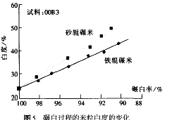
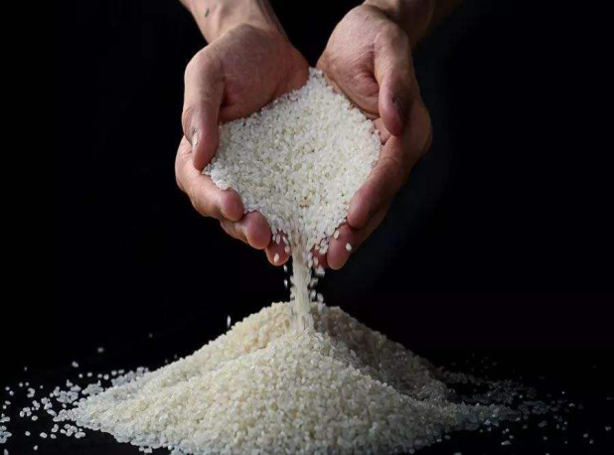
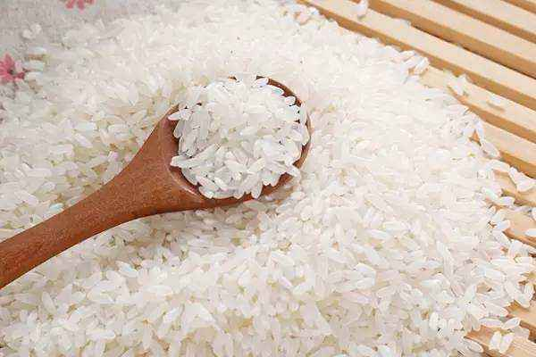
IV. Laws, Policies, Standards and Management
2. Standard revision based on new situation
The product classification of the national standard of rice was revised and the category of high-quality rice was added. The definition of broken rice and processing accuracy was revised, and requirements of packaging, labeling, storage and transportation was added.

Slide 17
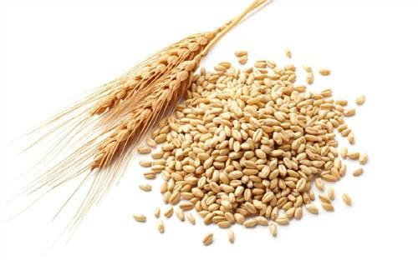
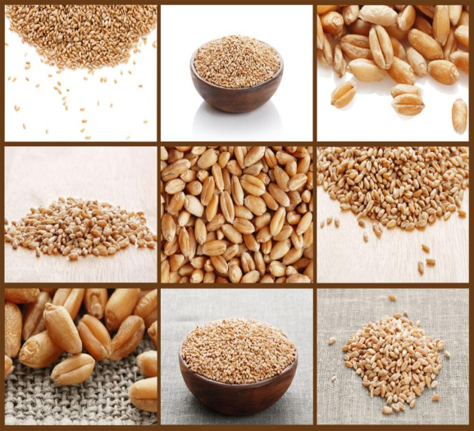
IV. Laws, Policies, Standards and Management
2. Standard revision based on new situation
The national standard of wheat was revised and adjusted from the original 9 categories to 5 categories, which will promote the wheat production and trade in China, save food and reduce losses, and comply with international standards.

Slide 18
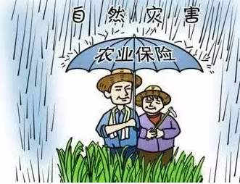
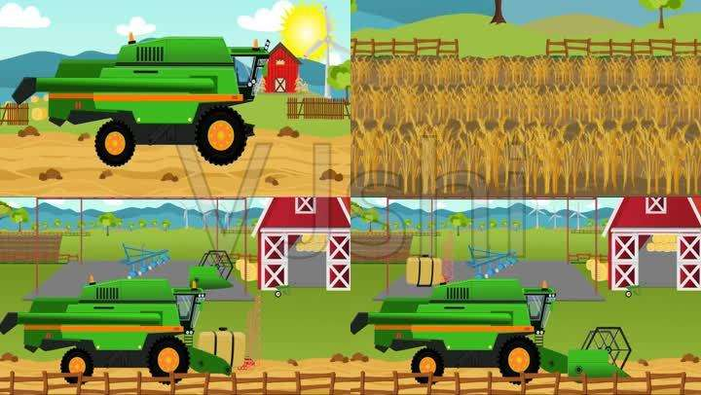
IV. Laws, Policies, Standards and Management
3. Government departments undertake related tasks by function
Government departments and agencies shall concentrate on saving food in production, storage, processing, transportation and consumption based on respective characteristics according to their division of functions. Governments at provincial, prefectural, and municipal levels shall join together to implement relevant tasks accordingly.

Slide 19
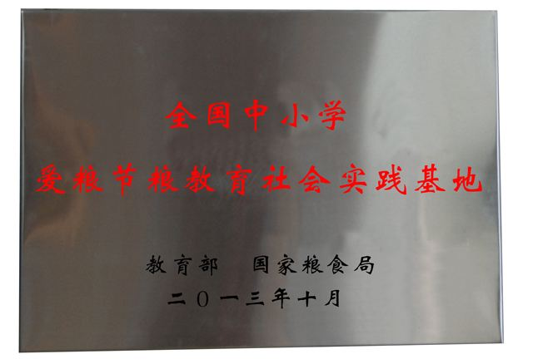
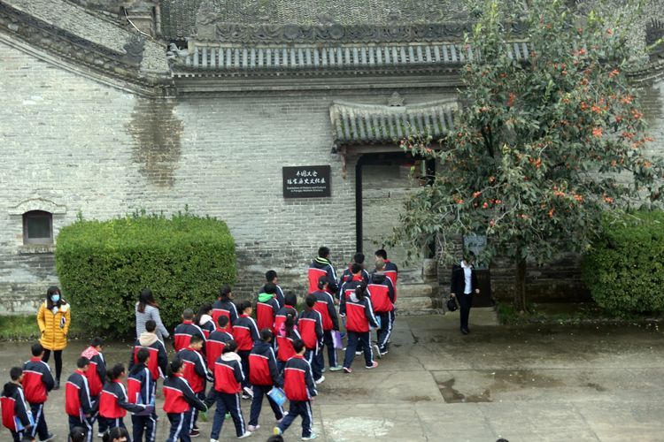
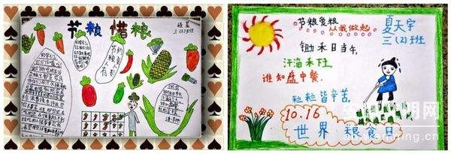
IV. Laws, Policies, Standards and Management
3. Government departments undertake related tasks by function
The state food administration has issued the Implementation Opinions of the National Food and Strategic Reserves Administration on Effectively Strengthening the Work of Saving Food against Waste, and the Notice on Promoting Grain and Oil Processing Industry to Save Food and Reduce Loss.

Slide 20
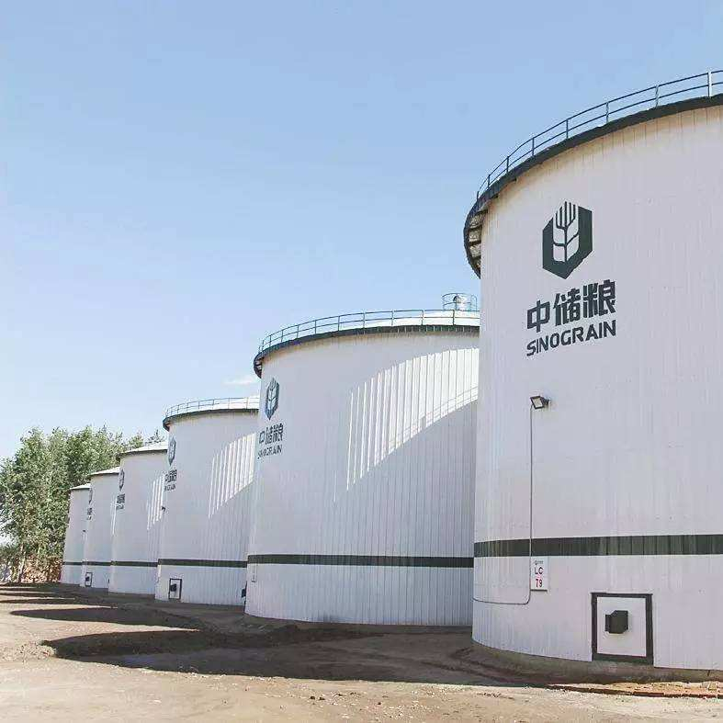
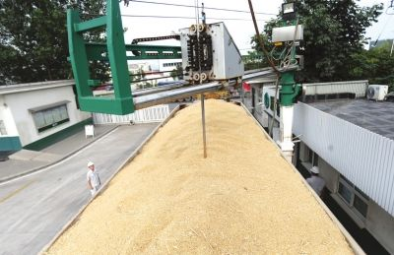
IV. Laws, Policies, Standards and Management
4. Specific measures taken by government departments
(1) Strengthen food purchase and storage management, and enhance the ability to save food and reduce losses.
On one hand, we should earnestly implement the national policies and standards, and purchase farmers‘ surplus grain in a timely manner. On the other hand, we should reinforce infrastructure construction and improve grain storage conditions.

Slide 21
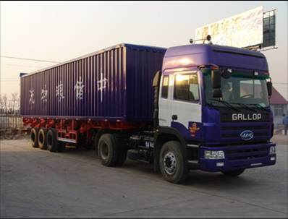
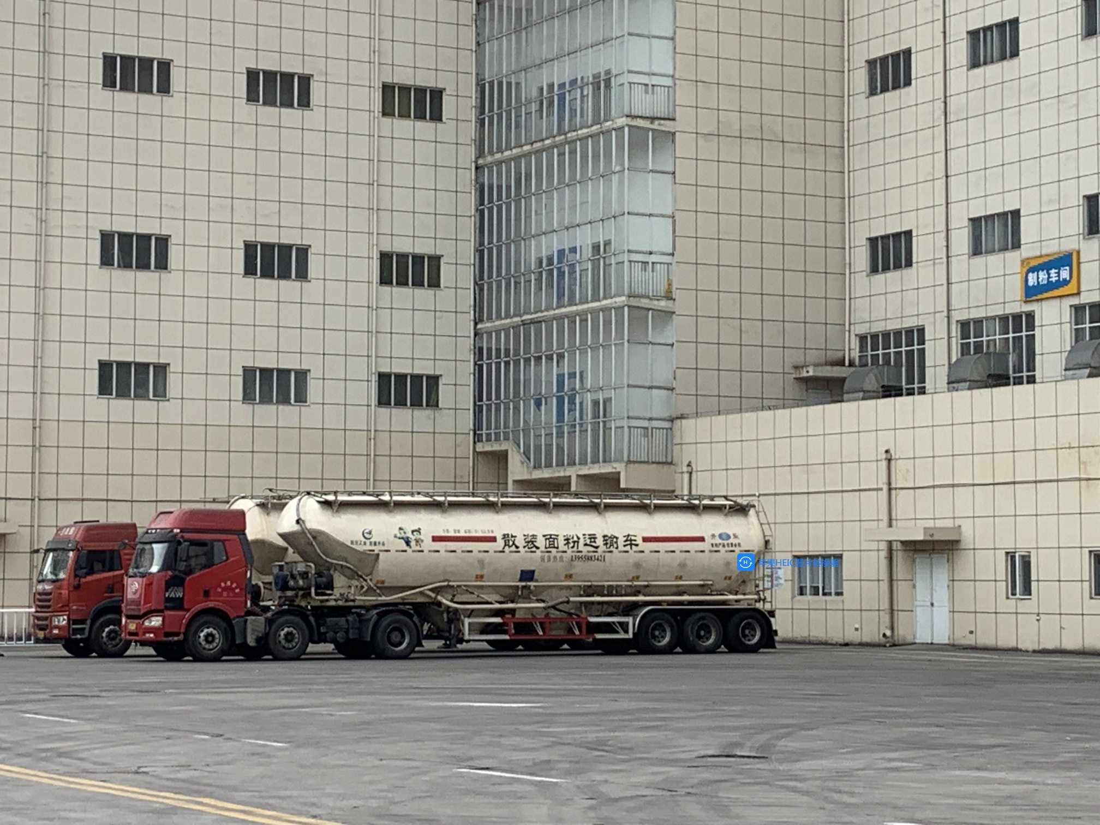
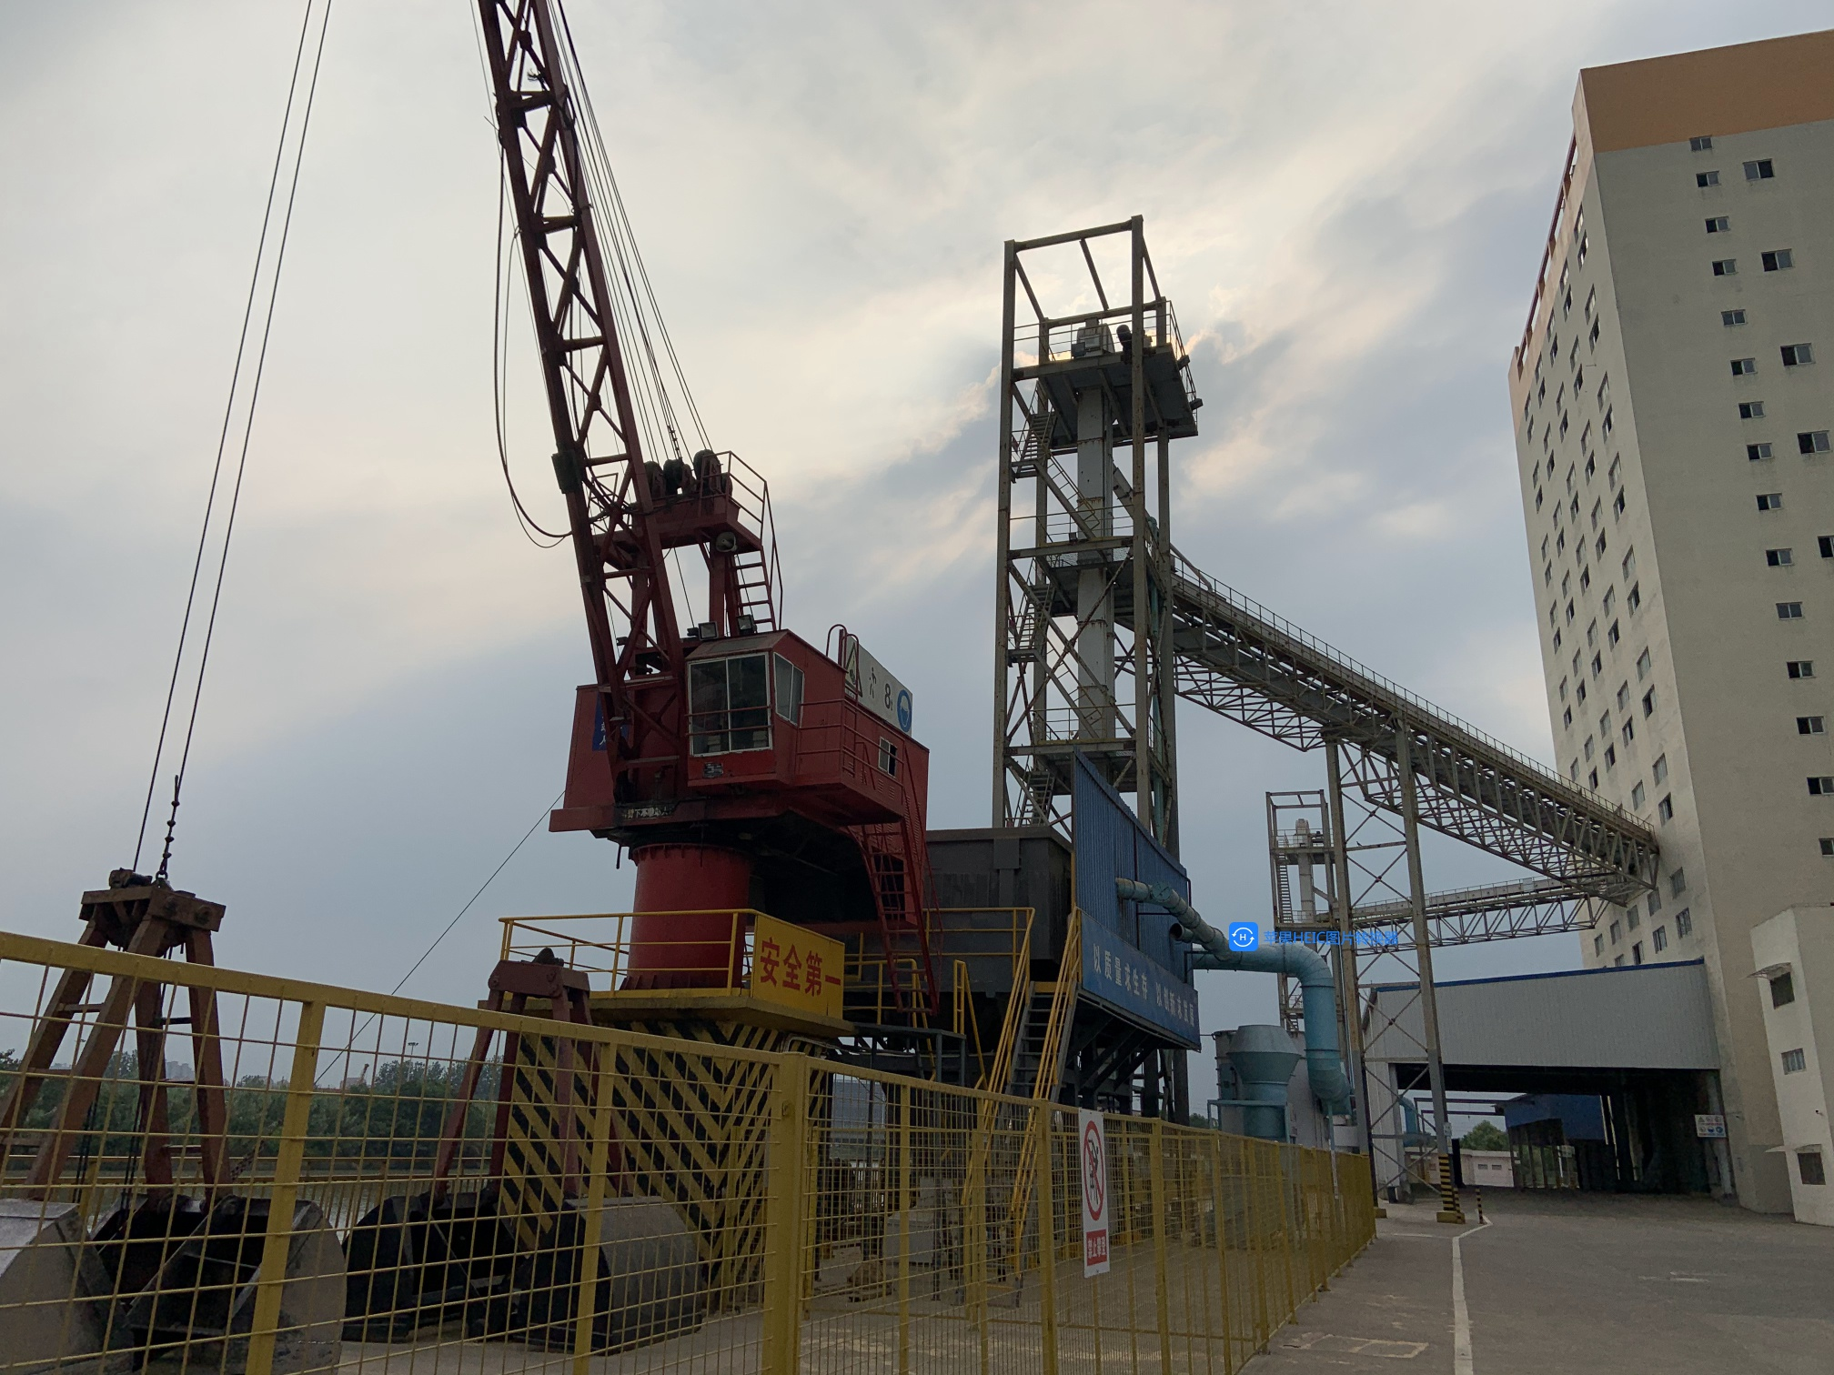
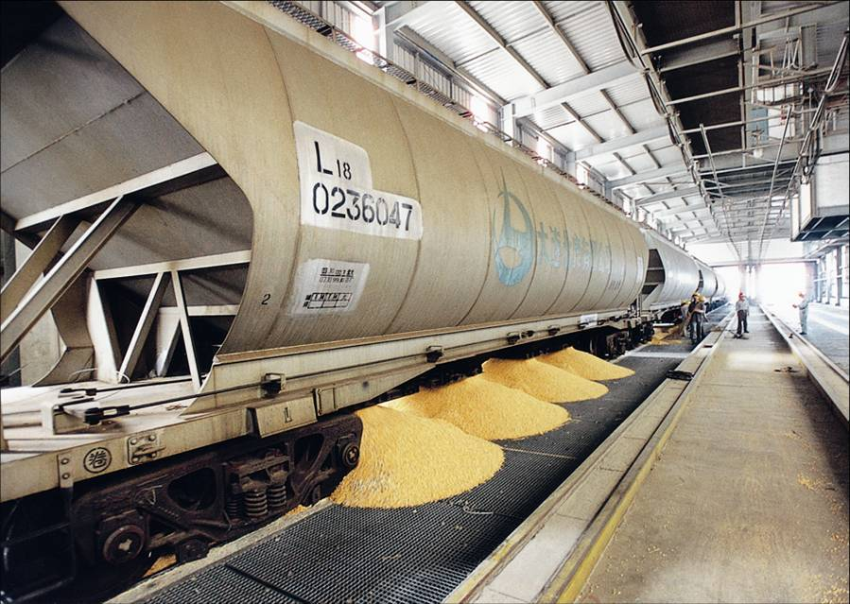
IV. Laws, Policies, Standards and Management
4. Specific measures taken by government departments
(2) Speed up the modernization of grain logistics facilities, and reduce grain losses in transportation.
We should develop new-type grain transportation equipment, strictly implement standards of grain loading and unloading operations, vigorously develop rail-sea combined transportation, improve the grain collection and distribution network, reduce transportation links, shorten transportation cycles, and finally reduce losses and waste in grain transportation.

Slide 22
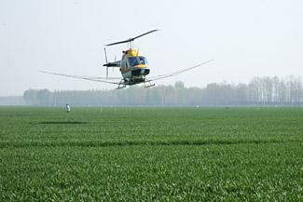
IV. Laws, Policies, Standards and Management
4. Specific measures taken by government departments
(3) Increase food production and encourage food saving in stockbreeding
Focus on food saving in the links of crop sowing, field management, harvesting as well as livestock and poultry breeding. 。
Vigorously develop food-saving herbivorous livestock breeding, and actively utilize non-food resources such as straw. Improve livestock and poultry breeding methods, promote large-scale and intensive development of animal husbandry, and increase feed conversion ratio.

Slide 23
IV. Laws, Policies, Standards and Management
4. Specific measures taken by government departments
(4) Improve the utilization rate of grain processing and conversion
We will accelerate the elimination of outdated production capacity with high grain consumption, high energy consumption and high pollution, and increase the yield rate of finished grain and oil as well as the utilization rate of by-products. Furthermore, we will study and popularize the substitution of non-food crops for food crops, and control the unreasonable processing and conversion of food.

Slide 24
IV. Laws, Policies, Standards and Management
4. Specific measures taken by government departments
(5) Reinforce scientific and technological support, and vigorously develop and promote new technologies for food saving and loss reduction.
We should study and develop more advanced and applicable storage, circulation, and processing technologies and equipment, and encourage their applications. Moreover, we should establish a relatively sound system for food science and technology innovation, and build grain and oil industry innovation centers and technological innovation alliances in different disciplines, in order to enhance the overall ability of food science and technology innovation.

Slide 25
IV. Laws, Policies, Standards and Management
4. Specific measures taken by government departments
(6) Continue to make achievements through key projects, typical examples and publicity.
We should implement the Food Purchase, Storage, Supply and Security Guarantee Project (referred to as the Food Security Project) and the High Quality Food Project. The importance and urgency of saving food and against waste are widely publicized through the events of world food day, food saving publicity week as well as food science and technology week.

Slide 26
IV. Laws, Policies, Standards and Management
4. Specific measures taken by government departments
(7) Enhance publicity and spread the awareness of saving food
We should advocate the lifestyle and food culture of thrift, scientific diet and healthy consumption via news media. The awareness of saving food and reducing waste should be integrated into school education. In addition, we will build a practice base which will organize and carry out food saving, water saving, electricity saving activities and volunteer service activities.

Slide 27
IV. Laws, Policies, Standards and Management
4. Specific measures taken by government departments
(8) Vigorously promote thrift in the catering industry
We will encourage scientific and reasonable consumption, accelerate the construction of staple food processing and distribution centers, and actively create "green" restaurants. Besides, we encourage the supply of small portions of food to suit the requirement of consumers, and kindly remind them of saving food.

Slide 28
IV. Laws, Policies, Standards and Management
5. Major projects
I. The Food Purchase, Storage, Supply and Security Guarantee Project (also known as the Food Security Project)
Integrate major channels of food logistics, and accelerate the construction of channels for transportation of food from North China to the South, as well as the southwest and northwest channels.
Comprehensively repair the dangerous and old storage facilities, and strengthen the construction of new storage facilities and storage capacity in major food production areas.

Slide 29
IV. Laws, Policies, Standards and Management
5. Major projects
II. The High Quality Food Project. The post-harvest food service system provides paid services for farmers, such as cleaning, drying, storage, processing and marketing.
Currently, more than 4,000 post-harvest service centers and 400,000 grain reserve facilities for farmers have been built.

Slide 30
IV. Laws, Policies, Standards and Management
6. Controlling mycotoxins such as Aspergillus flavus
The typical and nationally-applied or industrially-applied standard test methods of mycotoxins mainly include: high performance liquid chromatography (HPLC), liquid chromatography/mass spectrometry (LC-MS), thin layer chromatography (TLC), immunoaffinity chromatography purification by fluorescence spectrophotometry, enzyme-linked immunosorbent assay, colloidal gold test strip method, etc.

Slide 31
IV. Laws, Policies, Standards and Management
6. Controlling mycotoxins such as Aspergillus flavus
High performance liquid chromatography:
Currently, the HPLC is the main method for quantitative test of mycotoxins in grains, oils and foods. The test process generally includes sample crushing, extraction, filtration, purification, and injection analysis.

Slide 32
IV. Laws, Policies, Standards and Management
6. Controlling mycotoxins such as Aspergillus flavus
Colloidal gold test strip:
The colloidal gold method is a commonly used labeling technique. It is a new type of immunolabeling technique that uses colloidal gold as a tracer applied to antigen and antibody.

Slide 33
IV. Laws, Policies, Standards and Management
6. Controlling mycotoxins such as Aspergillus flavus
The chromatography is usually used for laboratory testing and the detection of subject matter of contract in grain trade, as well as for the quality inspection of national and provincial grain reserves. In recent years, the use of test strips for rapid detection of food mycotoxins has been increasing year by year. It only takes 3-5 minutes for the qualitative test of a sample, and about 10 minutes for the quantitative test.

