Slide 1
Grain Food Processing Technologies and Application
Na-Na Wu Professor/ph.D
Research Institute of Grain and Oil Processing
Academy of National Food and Strategic Reserves Administration
Sep 26, 2024

Slide 2
CONTENTS
Development Trends of Grain Food
The Problems that Needs to be Solved in Healthy Grain/Whole Grain Food Processing
01
02
Whole Grain Food Processing Technologies
Current Studies for the Application of Whole Grain Food Processing Technologies
03
04

Slide 3
01
Development Trends of Grain Food

Slide 4
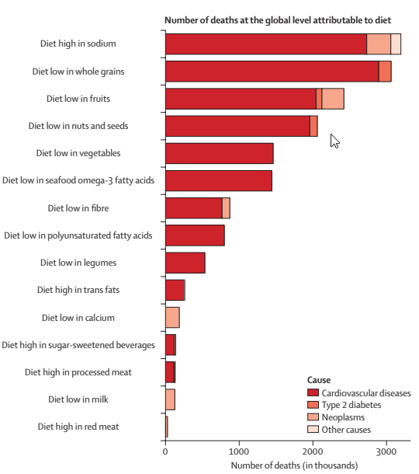
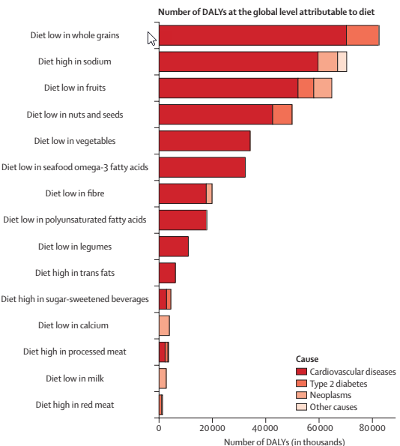
Health effects of dietary risks in 195 countries, 1990–2017: a systematic analysis for the Global Burden of Disease Study 2017
Low intake of whole grains was the leading dietary risk factor for DALYs among men and women and the leading dietary risk factor for mortality among women
Low intake of whole grains was the leading risk for deaths and DALYs among young adults (aged 25–50 years)
Reference: Lancet 2019; 393: 1958–72

Slide 5
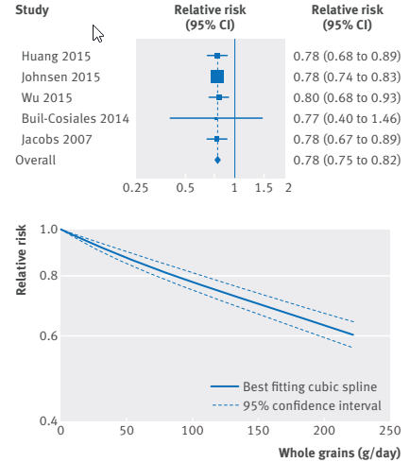
Whole grain consumption and risk of cardiovascular disease, cancer, and all cause and cause specific mortality
This meta-analysis provides further evidence that whole grain intake is associated with a reduced risk of coronary heart disease, cardiovascular disease, and total cancer, and mortality from all causes, respiratory diseases, infectious diseases, diabetes, and all non-cardiovascular, non-cancer causes.
These findings support dietary guidelines that recommend increased intake of whole grain to reduce the risk of chronic diseases and premature mortality.
Forest plot for consumption of whole grains (per 90 g/day) and risk of mortality from non-cardiovascular, non-cancer causes, with graph illustrating non-linear response
BMJ 2016;353:i2716 http://dx.doi.org/10.1136/bmj.i2716

Slide 6
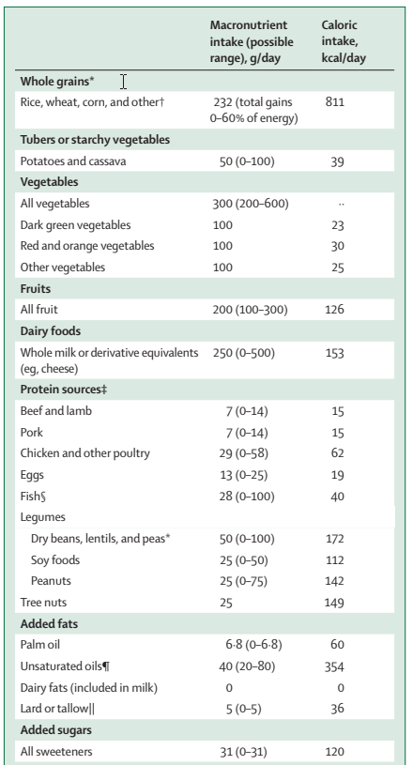
Healthy reference diet, with possible ranges, for an intake of 2500 kcal/day
Food in the Anthropocene: the EAT–Lancet Commission on healthy diets from sustainable food systems
The food we eat and how we produce it will determine the health of people and planet, and major changes must be made to avoid both reduced life expectancy and continued environmental degradation.
This Commission presents an integrated framework providing quantitative scientific targets for healthy diets and sustainable food production, which together define a safe space within which food systems should operate to ensure that a broad set of human health and environmental sustainability goals are achieved.
Applying a global food system modelling framework, we show that it is possible to feed a global population of nearly 10 billion people a healthy diet within food production boundaries by 2050.
Our universal healthy reference diet largely consists of vegetables, fruits, whole grains, legumes, nuts, and unsaturated oils, includes a low to moderate amount of seafood and poultry, and includes no or a low quantity of red meat, processed meat, added sugar, refined grains, and starchy vegetables.
Lancet 2019; 393: 447–92

Slide 7
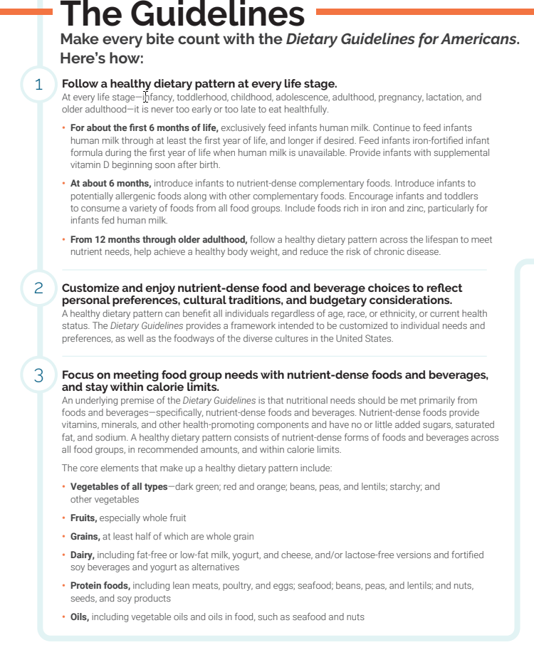
Dietary Guidelines for Americans 2020-2025
Make half your grains whole grains
• Grains, at least half of which are whole grain

Slide 8
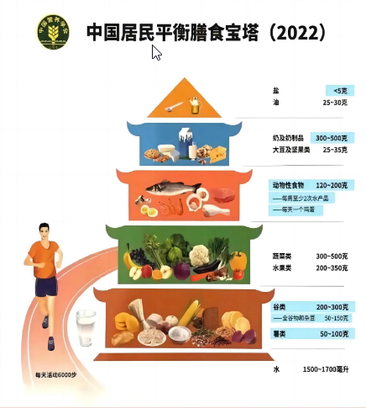
Dietary Guidelines for Chinese Residents 2022
• Wholegrains and miscellaneous beans 50-150 g

Slide 9
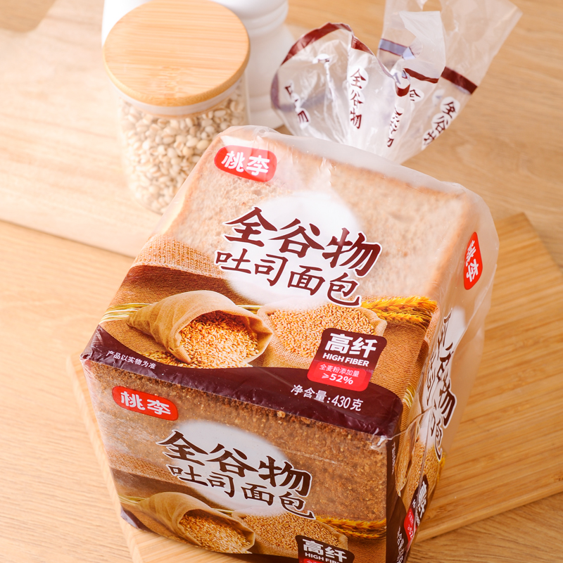
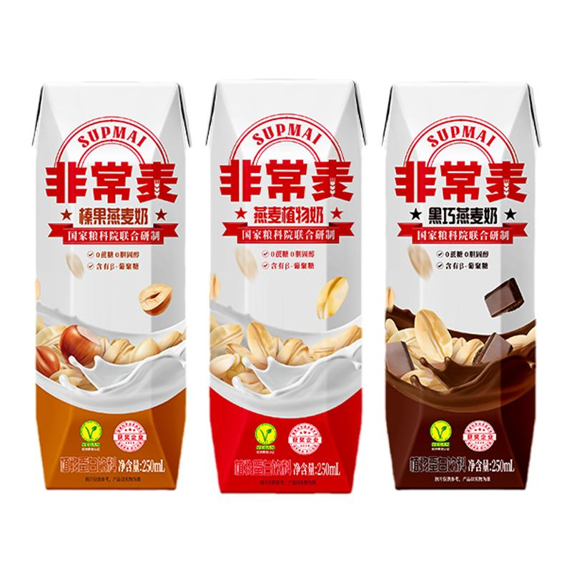
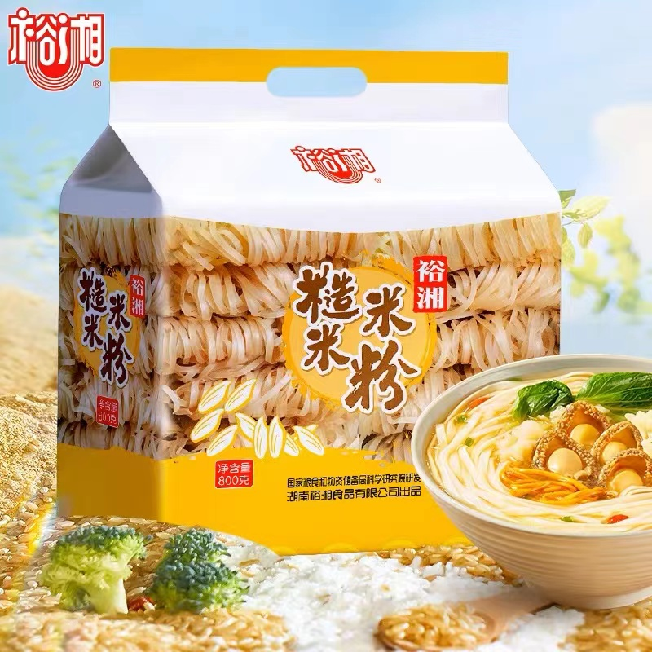
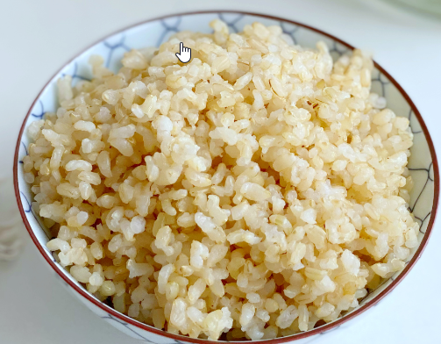
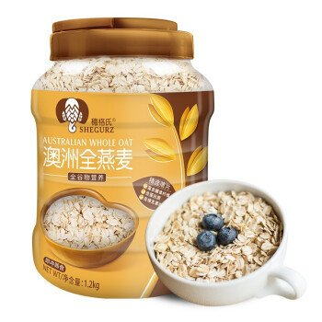
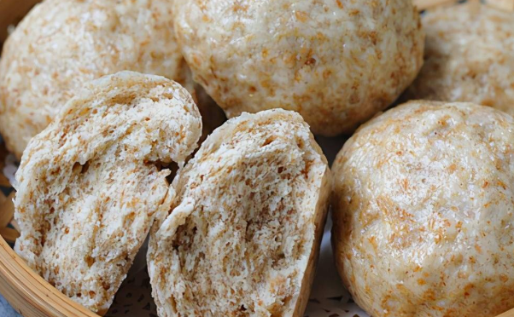
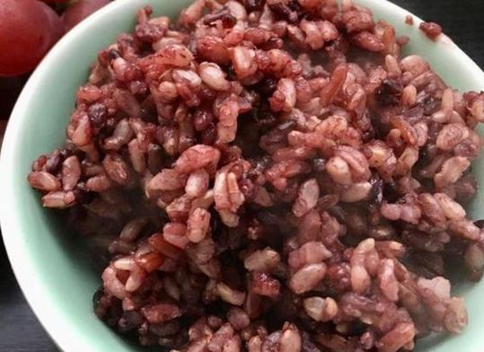
Whole grain food
Whole wheat bread
Oat milk
Brown rice noodles
Brown rice
Whole grain pasta
Whole grain biscuit
Oatmeal
Whole Wheat Steamed Bread
Brown rice

Slide 10
02
The Problems that Needs to be Solved
in Healthy Grain/Whole Grain Food Processing

Slide 11
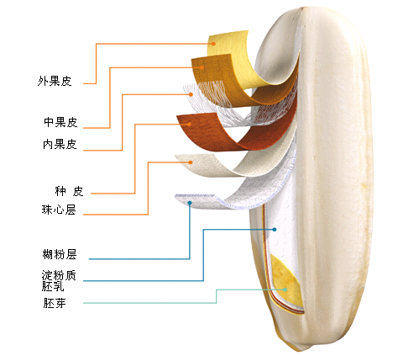
What is the difference between wholegrain and refined grain?
Dietary fiber
Vitamin
Polyphenols
Lipids
Oryzanol
Sterol …….
Starchy endosperm
Whole grain
Refined grain

Slide 12
The Problems that Needs to be Solved in Healthy Grain/Whole Grain Food Processing
Characteristics of wholegrain and wholegrain food.
Problems for wholegrain food processing.
Insoluble dietary fiber amount is more than 90%.
Oxidative hydrolytic enzymes
Lipids/Fat is prone to oxidation and rancidity.
The high fiber whole grain food matrix system is significantly different from refined grains.
Some active substances are unstable when exposed to heat during processing.
Poor taste and acceptance.
Easy to deteriorate.
Short shelf life.
The processing techniques of traditional refined grain foods are not suitable for whole grain.
Some active substances are easy to be reduced during processing.

Slide 13
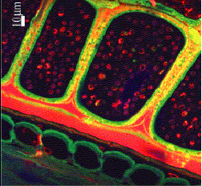
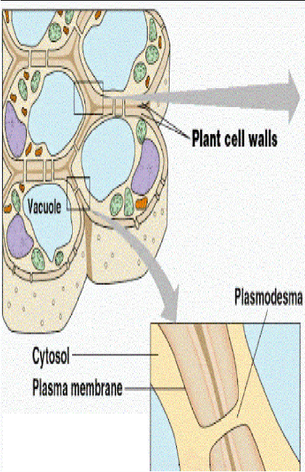
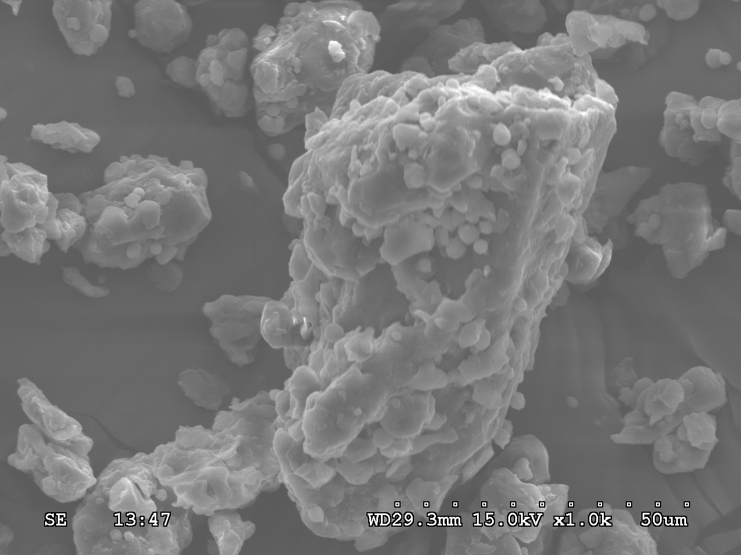
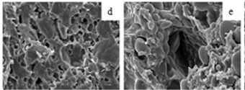
The Problems that Needs to be Solved in Healthy Grain/Whole Grain Food Processing
Wholegrain food
Cereal bran
High dietary fiber products and food ingredients
Pre-treatment
The matrix system of high fiber
Dietary fiber
The high content of water-insoluble dietary fiber leads to poor processing quality and taste of whole grain foods.
The matrix system of high fiber whole grain foods is significantly different from refined grains.
It is necessary to develop key technologies, equipment, and products for whole grain food processing.
The high content of water-insoluble dietary fiber (over 90%) limits the application of cereal dietary fiber due to its water insolubility.

Slide 14
03
Whole Grain Food Processing Technologies

Slide 15
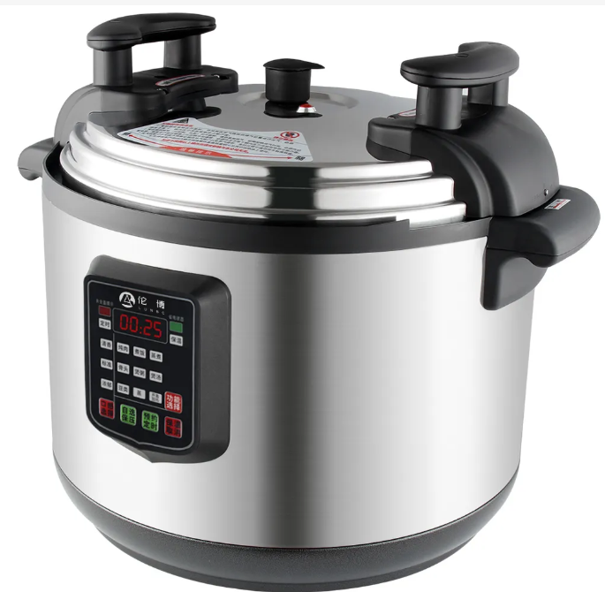
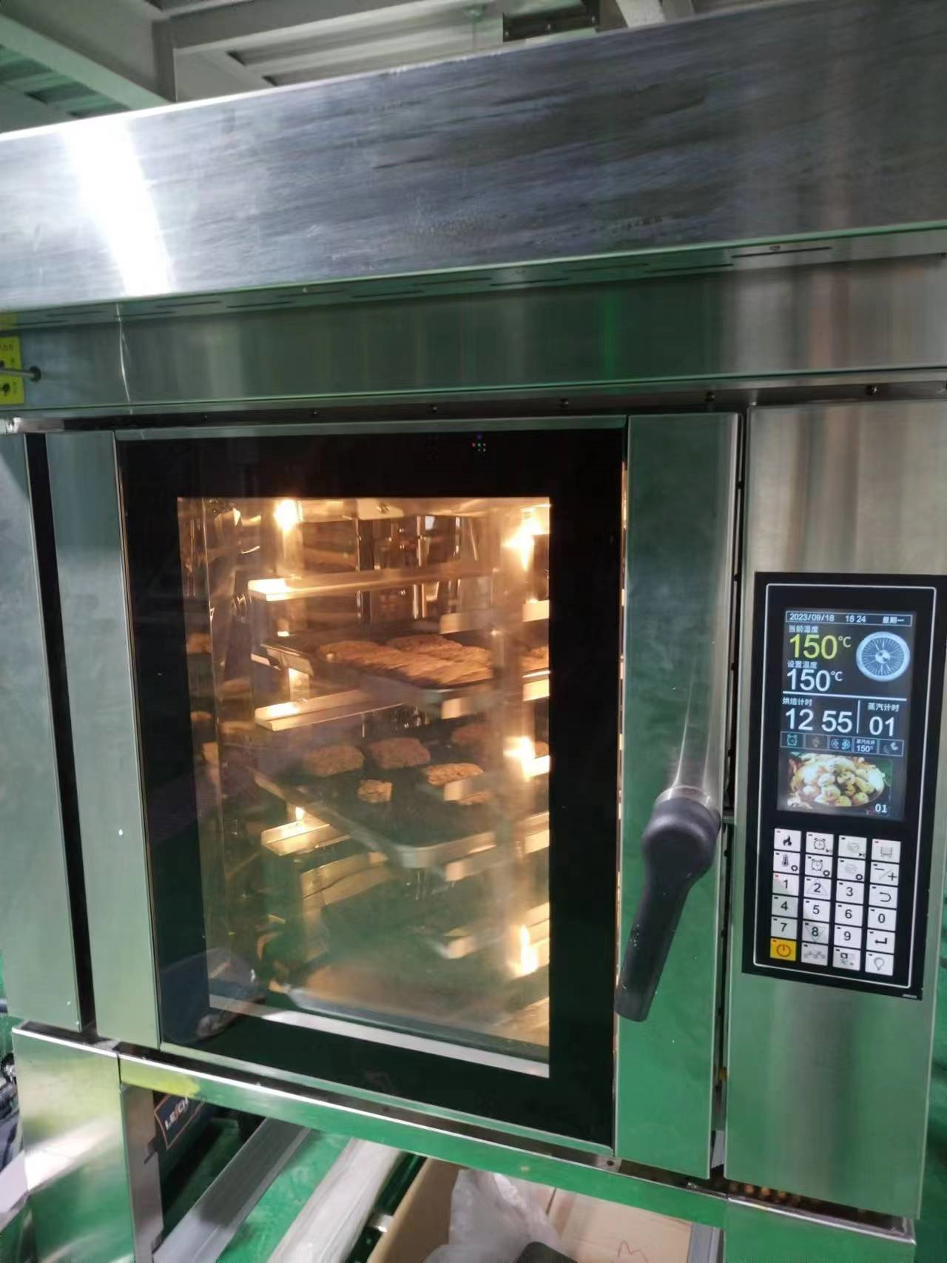
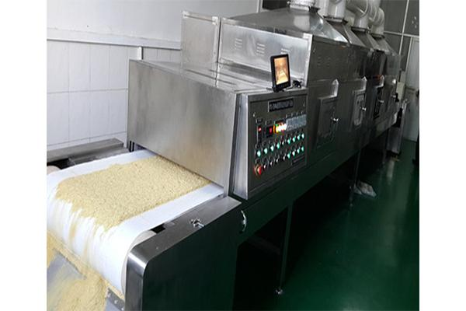
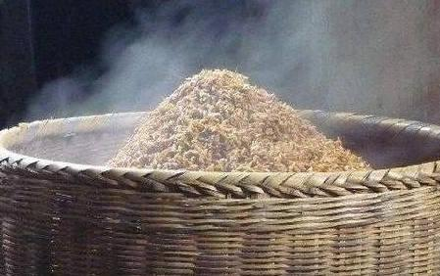
The Processing for cereal bran and wholegrain kernels
Physical processing (steaming, boiling, high-temperature treatment, baking, microwave, frying...)
Chemical modification
Fermentation (natural fermentation, inoculation fermentation)
Enzymatic hydrolysis
Combining two or more methods
High pressure steaming and boiling
Cooking
Baking
Extrusion cooking
Microwave
Fermentation

Slide 16
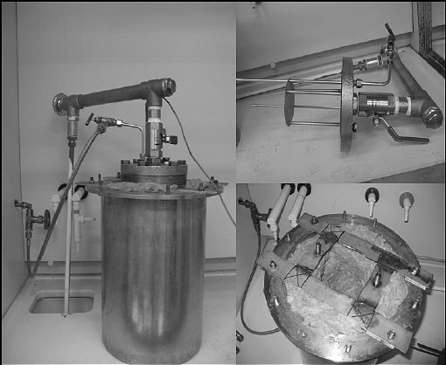
Steam explosion treatment
Equipment principle
Steam generator and pressure vessel
Grain expansion and structural destruction are achieved through the release of steam
The effect on whole grain or cereal bran
Increase SDFcontent and improve functional properties
Improve the antioxidant capacity of phenolic substances
The treatment for grain (or cereal bran) varieties
SE treatment was applied to the modification of bioactive components in wheat bran
SE treatment affected the properties and content of dietary fiber in rice bran
Steam explosion Equipment
" Food Research International 187 (2024): 114310.

Slide 17
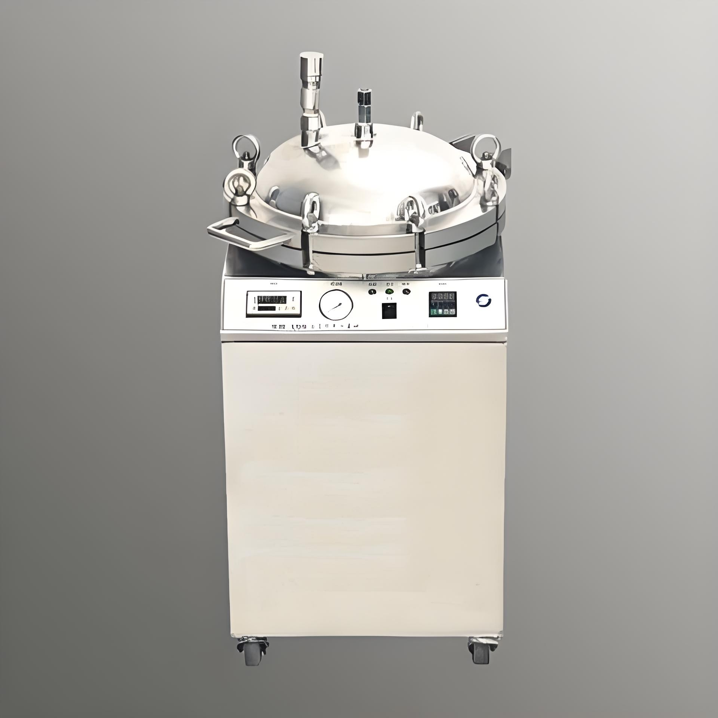
Extrusion cooking treatment
Equipment principle
Set stirring, heating, texture recombination, cooking, sterilization is equal to one.
Promote raw materials by applying pressure, heating and mechanical shear forces
Properties can be changed by changing temperature, speed and moisture content.
The effect on whole grain or cereal bran
Extrusion cooking Equipment
The treatment for grain (or cereal bran) varieties
Inhibiting starch aging
Improve the taste and texture of grains
Improve the functional properties of SDF in rice bran
Increase SDF content in rice bran
The SDF with better performance was prepared
For preparing fresh brown rice flour
Journal of Food Composition and Analysis,Volume 128,2024,106030 .

Slide 18
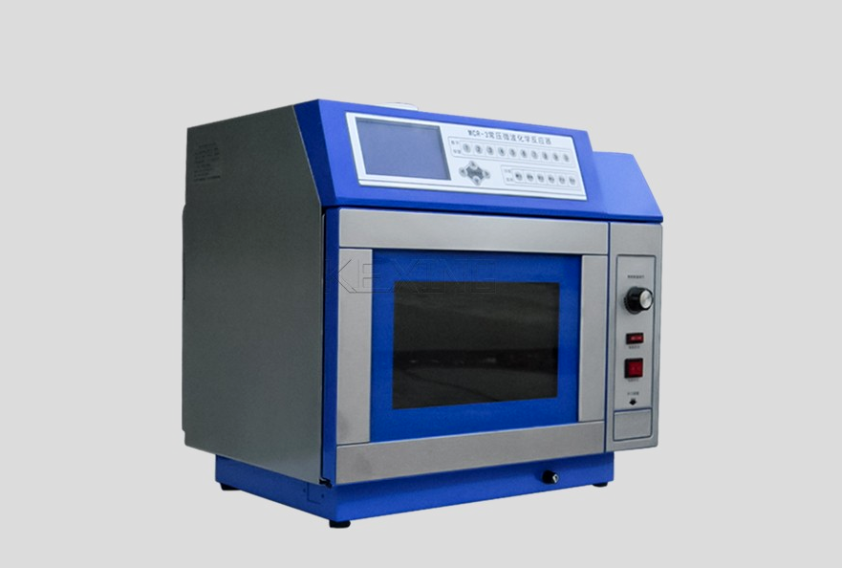
Microwave heating treatment
Equipment principle
The effect on whole grain or cereal bran
Penetrate the material
Quickly increase the temperature of the materia
Material volume heating reduces losses
Improve the properties of brown rice gel
Retain heat-sensitive nutrients in grains
Improve viscoelastic stability of brown rice
Microwave heating Equipment
The treatment for grain (or cereal bran) varieties
Microwave heating is used to stabilize the treatment of rice bran.
The characteristics and nutrition of buckwheat flour treated by microwave were improved
Cereal Chemistry 101.1 (2024): 263-273.

Slide 19
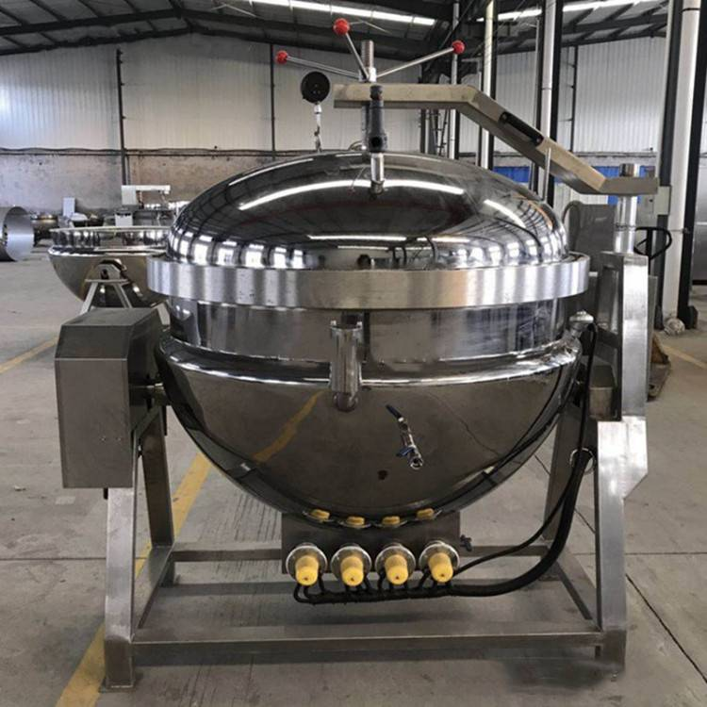
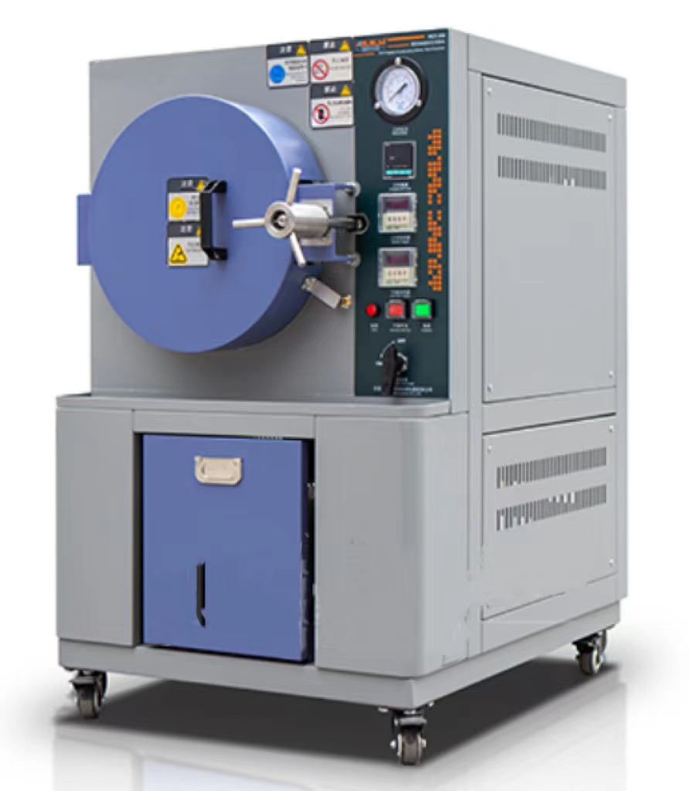
High‐pressure cooking treatment
Equipment principle
High-pressure steam to heat the material
enzyme and sterilization.
Steam can effectively penetrate into the inside of the material
The effect on whole grain or cereal bran
High‐pressure cooking Equipment
Starch changes in structure and physical properties
Enhanced health and nutritional properties
Starch Optimization of functional and rheological properties
The treatment for grain (or cereal bran) varieties
Change the physical and chemical properties of rice bran
Improve the functional properties of starch
Cereal Chemistry 101.1 (2024): 263-273.

Slide 20
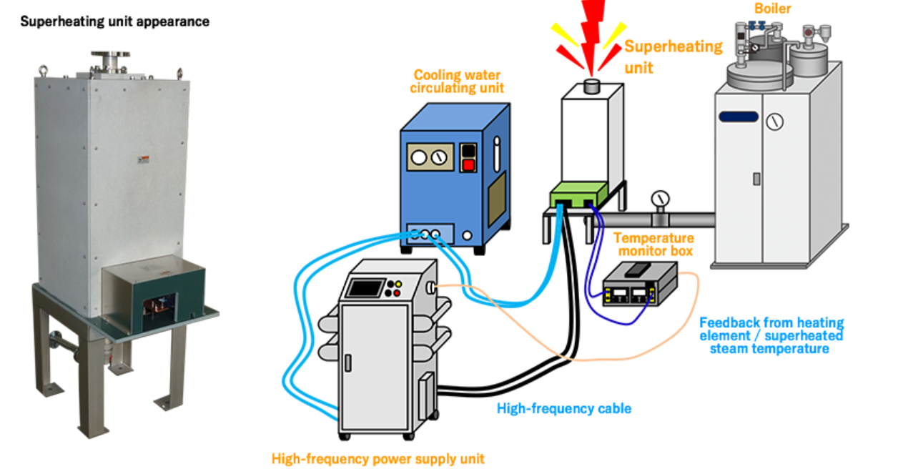
Super-heated steam treatment
Super-heated steam Equipment
The effect on whole grain or cereal bran
Wheat quality improvement
Oxidative damage reduction
Drying efficiency improvement
The treatment for grain (or cereal bran) varieties
Equipment principle
Enzyme inactivation
Degradation of mycotoxins
Starch modification
Drying
Superheated steam is generated
High heat transfer efficiency
Anaerobic environment
International Journal of Biological Macromolecules, 2020, 162: 1204–1216

Slide 21
04
Application of Whole Grain Food Processing Technologies

Slide 22
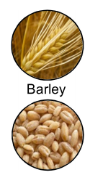
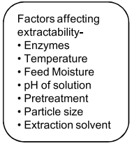
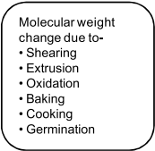
Effect of processing on barley β-glucan content, its molecular weight and extractability
Barley is gaining popularity as “functional grain” because it contains higher amounts of bioactive compounds including β-glucan (4–11%) and phytochemicals.
Various food processing techniques significantly moderate the linkage of β-glucan, improve its solubility and extractability and ultimately health benefits by the reduction in its molecular weight and viscosity.
Germination, extrusion-cooking
Process conditions should be optimized in such a way so as soluble β-glucan to be increased.
Nutritional components improvement
Value-added
higher price
International Journal of Biological Macromolecules, 2020, 162: 1204–1216

Slide 23
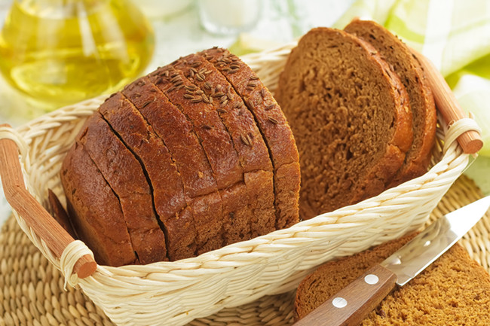
Isolation of red quinoa fibre by wet and dry milling and application as a potential functional bakery ingredient
Wet milling produced a higher yield (10.1%) and recovery (58.2%) of the fibre fraction and higher purity (72%) than the values obtained by dry milling (9.1, 52.5 and 59%, respectively).
With regard to functional properties, dry milling produced fibre with higher total antioxidant activity than that obtained by wet milling (FRAP: 1.1 times more).
The process affected their granulometry, which was lowest in the fibre obtained by wet milling, and the dispersity was greatest.
The inclusion of fibre isolated by dry milling produced bread products of higher technological quality with regard to specific loaf volume and less crumb firmness.
Food Hydrocolloids 101 (2020) 105513

Slide 24
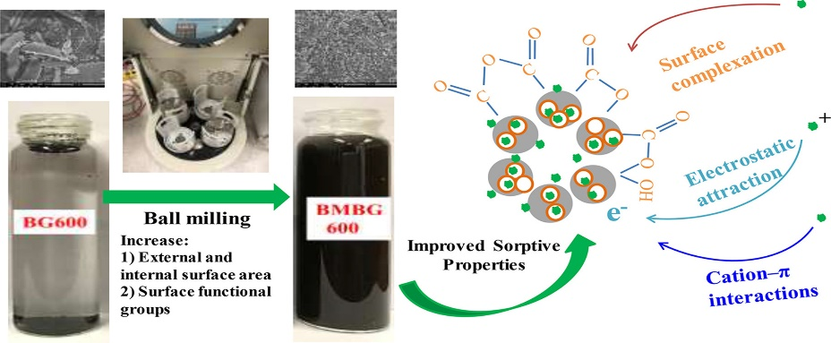
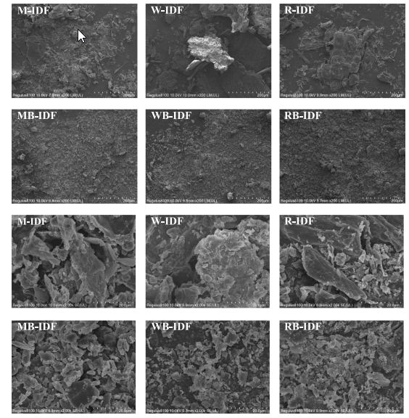
The effect of ball milling on the structure, physicochemical and functional properties of insoluble dietary fiber from three grain bran
millet bran, wheat bran rice bran
After ball milling treatment, the IDF particle size of all three types of grains significantly decreased (p<0.05).
Consistent with X-ray diffraction and thermal analysis, ball milling reduced the crystallinity of IDF for all three grains and helped increase the release of free phenols by 23.4%, 8.9%, and 12.2%, respectively;
In addition, the water holding capacity, glucose delay capacity, adsorption capacity of glucose, sodium cholate, and cholesterol, as well as the in vitro digestibility of starch and fat, have all been improved to varying degrees;
Animal experiments have shown that ball milling treatment can effectively slow down postprandial blood glucose (especially IDF of rice bran) and blood lipids (especially IDF of millet bran);
Therefore, ball milling treatment is a potential dietary fiber improvement method in the food industry.
Food Research International 163 (2023) 112263

Slide 25
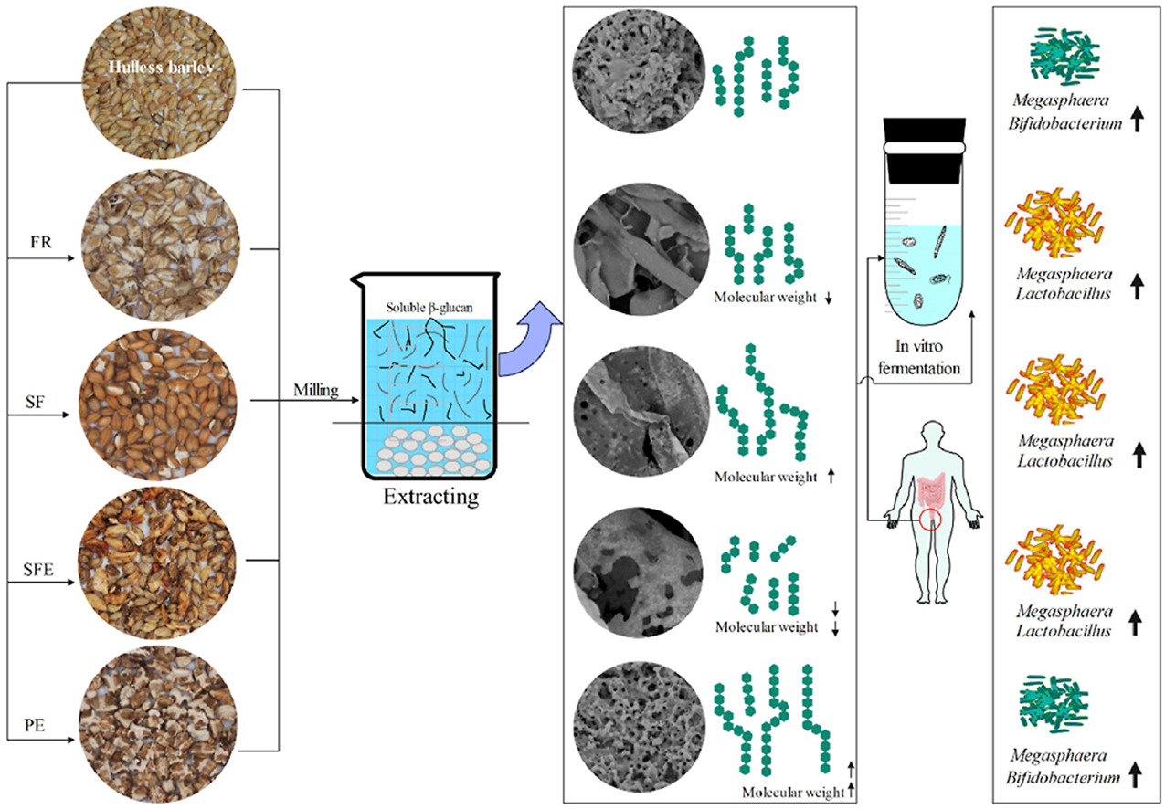
Effect of various thermal processing on the structural and in vitro prebiotic characteristics of β-glucan from Hulless Barley
four different thermal methods: flaking-roasting (FR), stir-frying (SF), steam-flash explosion (SFE) and popping expansion (PE).
All thermal processing had no impact on the type of chemical groups.
Compared with the native β-glucan, the molecular weight of PE-β-glucan increased, whereas its crystallinity index decreasing.
Expectedly, PE-β-glucan exerted the highest availability and increased the relative abundance of Bifidobacterium, while FR-, SF-, and SFE-β-glucan tended to promote the growth of Megasphaera and Lactobacillus.
The level of total SCFAs, acetate, propionate, and butyrate in PE-β-glucan were dramatically higher than those in other β-glucan.
Overall, the chain conformation of β-glucan played a pivotal role in determining its bioavailability and probiotic characteristic, which could be improved evidently by PE processing.
Food Hydrocolloids, 2023, 142: 108818

Slide 26
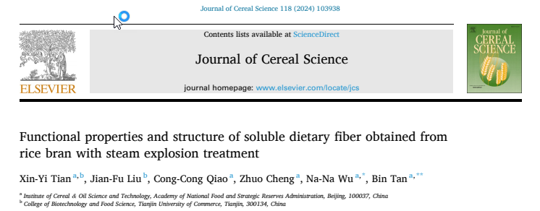
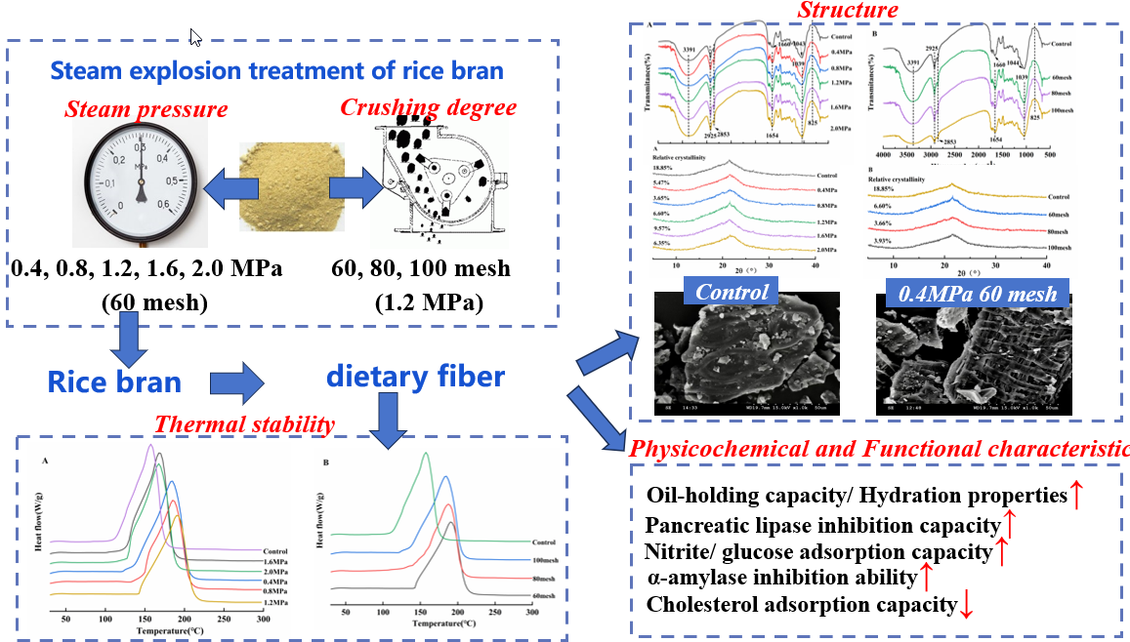
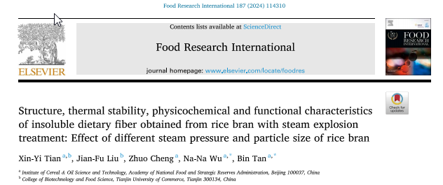
Effect of steam explosion treatment of rice bran on Functional properties, physicochemical properties of soluble and insoluble dietary fiber

Slide 27
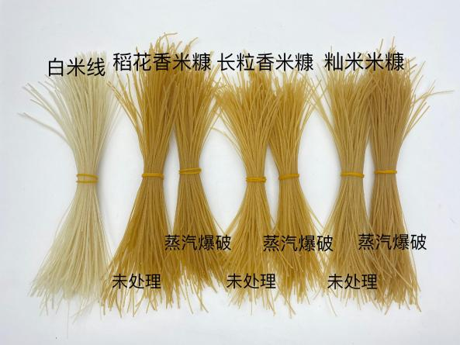
Effect of steam explosion treatment of rice bran on brown rice noodles
The cooking quality of brown rice noodles made with rice bran added after steam explosion is improved compared to brown rice noodles made with untreated rice bran, and the cooking quality is closer to that of white rice noodles.

Slide 28
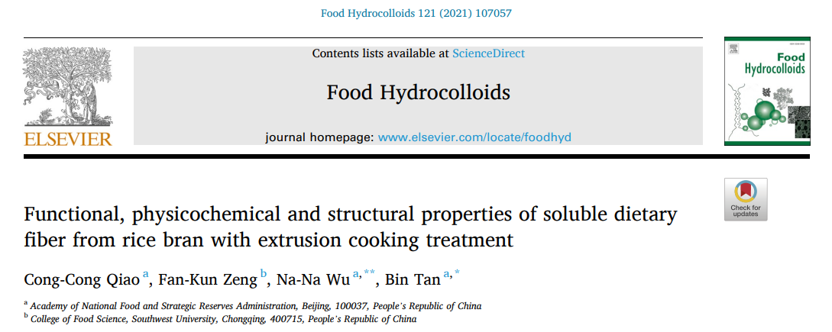
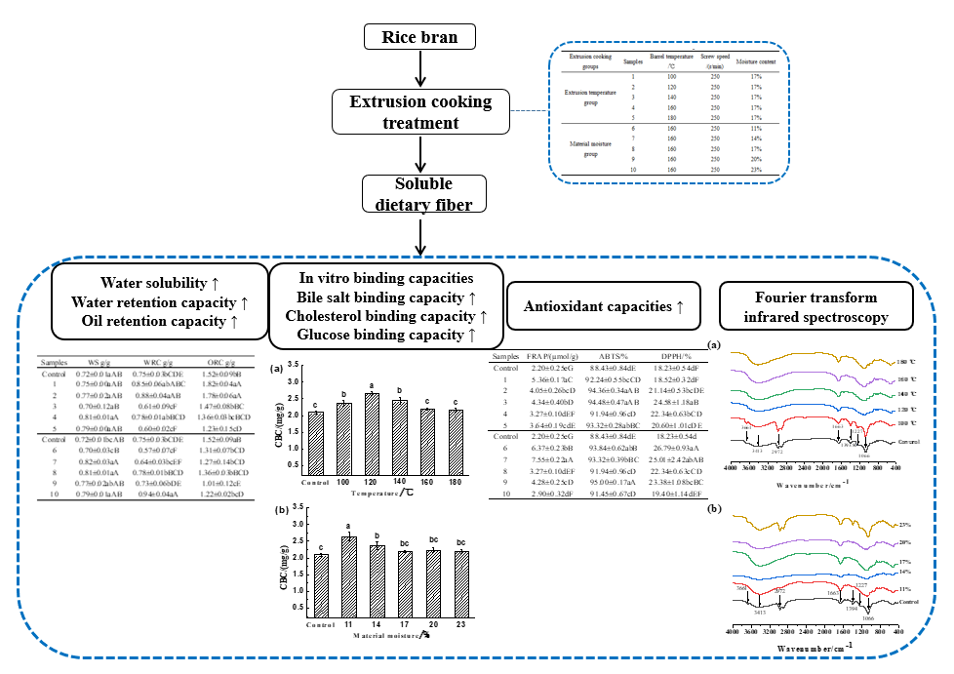
Effect of extrusion cooking treatment of rice bran on Functional properties, physicochemical properties of dietary fiber
Control extrusion cooking treatment conditions
screw speed, extrusion cooking temperature, material moisture
When the extrusion temperature is 100 ℃, the water and oil holding capacity, water solubility, in vitro binding capacity (bile salt, cholesterol, and glucose binding capacity), and antioxidant capacity of SDF are relatively high.
When the material moisture content is 11% and 14%, the in vitro binding capacity and antioxidant capacity of SDF are relatively high.
Low temperature and low moisture extrusion cooking treatment is more favorable for the performance of SDF.
This study can provide basic information for the utilization of SDF in rice bran through extrusion cooking treatment.

Slide 29
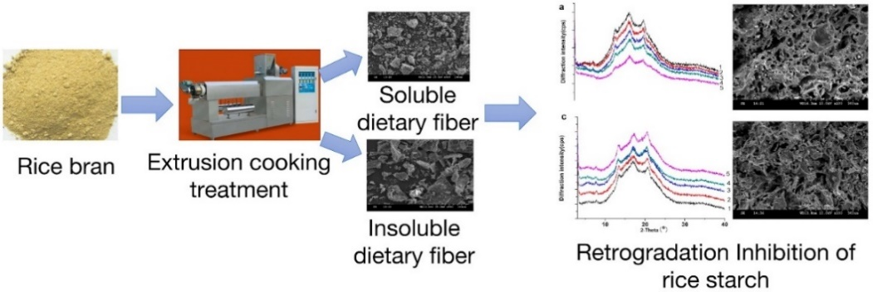
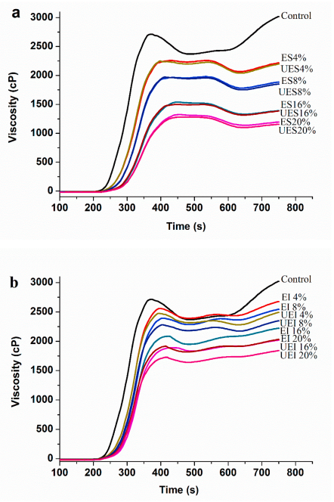
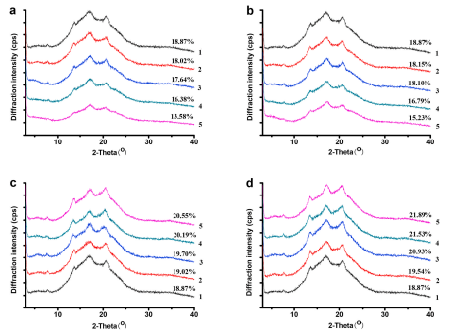
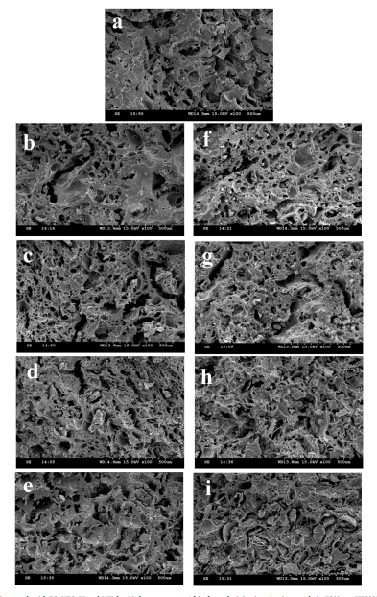
Effect of extrusion cooking treatment of rice bran on properties of rice starch
ES and EI are more conducive to the formation of rice starch gelatinous structure;
Research has shown that dietary fiber from extruded rice bran can be used to inhibit long-term aging of rice starch and improve the quality of rice products.
Food Hydrocolloids, 2021, 113: 106488

Slide 30
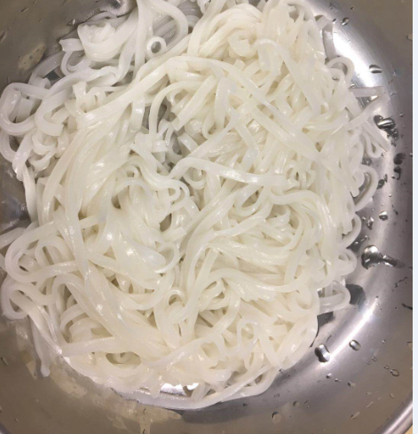
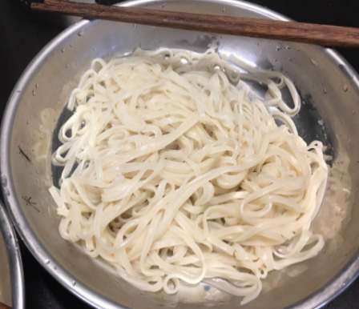
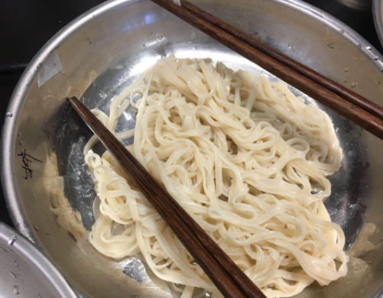
Nutritional and cooking quality improvement of brown rice noodles prepared with extruded rice bran
Fresh brown rice noodles
Fresh brown rice noodles prepared with extruded rice bran
Fresh white rice noodles
The brown rice noodles with extruded rice bran had higher contents of nutritional components than brown rice noodles with un-extruded rice bran and white rice noodles, and better cooking and textural properties than brown rice noodles with un-extruded rice bran.
The results provided the evidences that brown rice noodles prepared with extruded rice bran might become functional foods from the sources of staple rice products.
Cereal Chemistry, 2021, 98:346–354

Slide 31
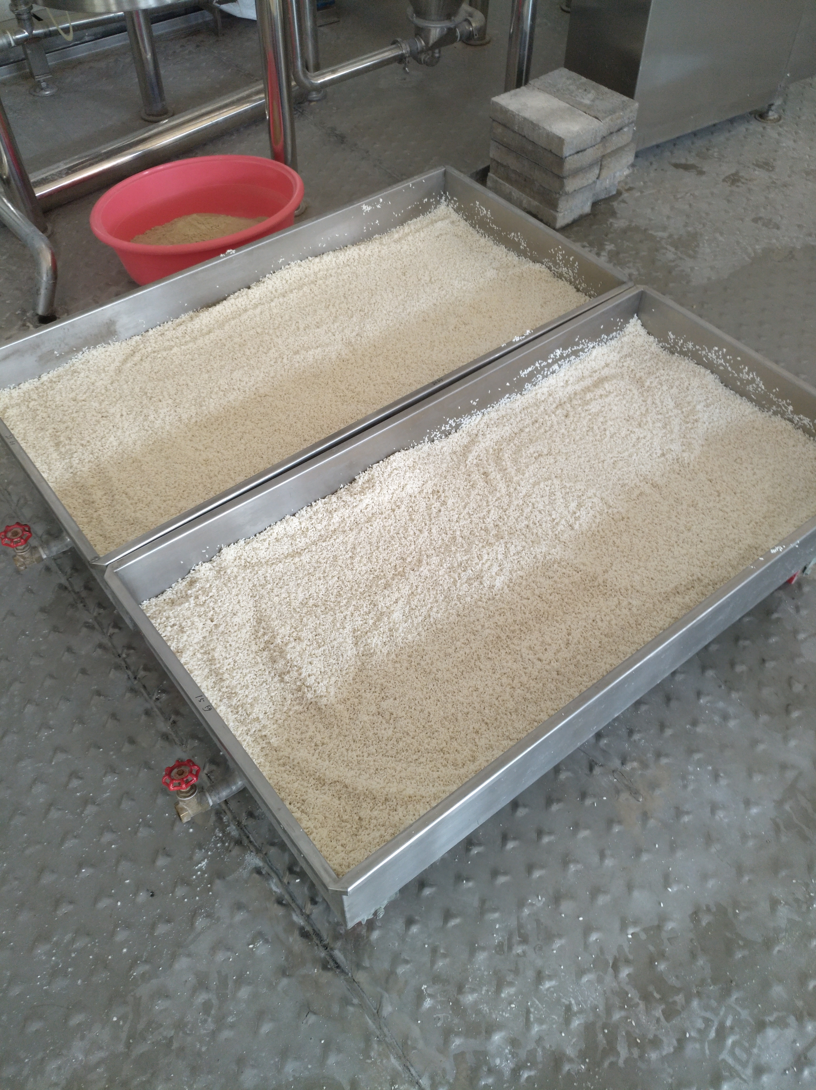
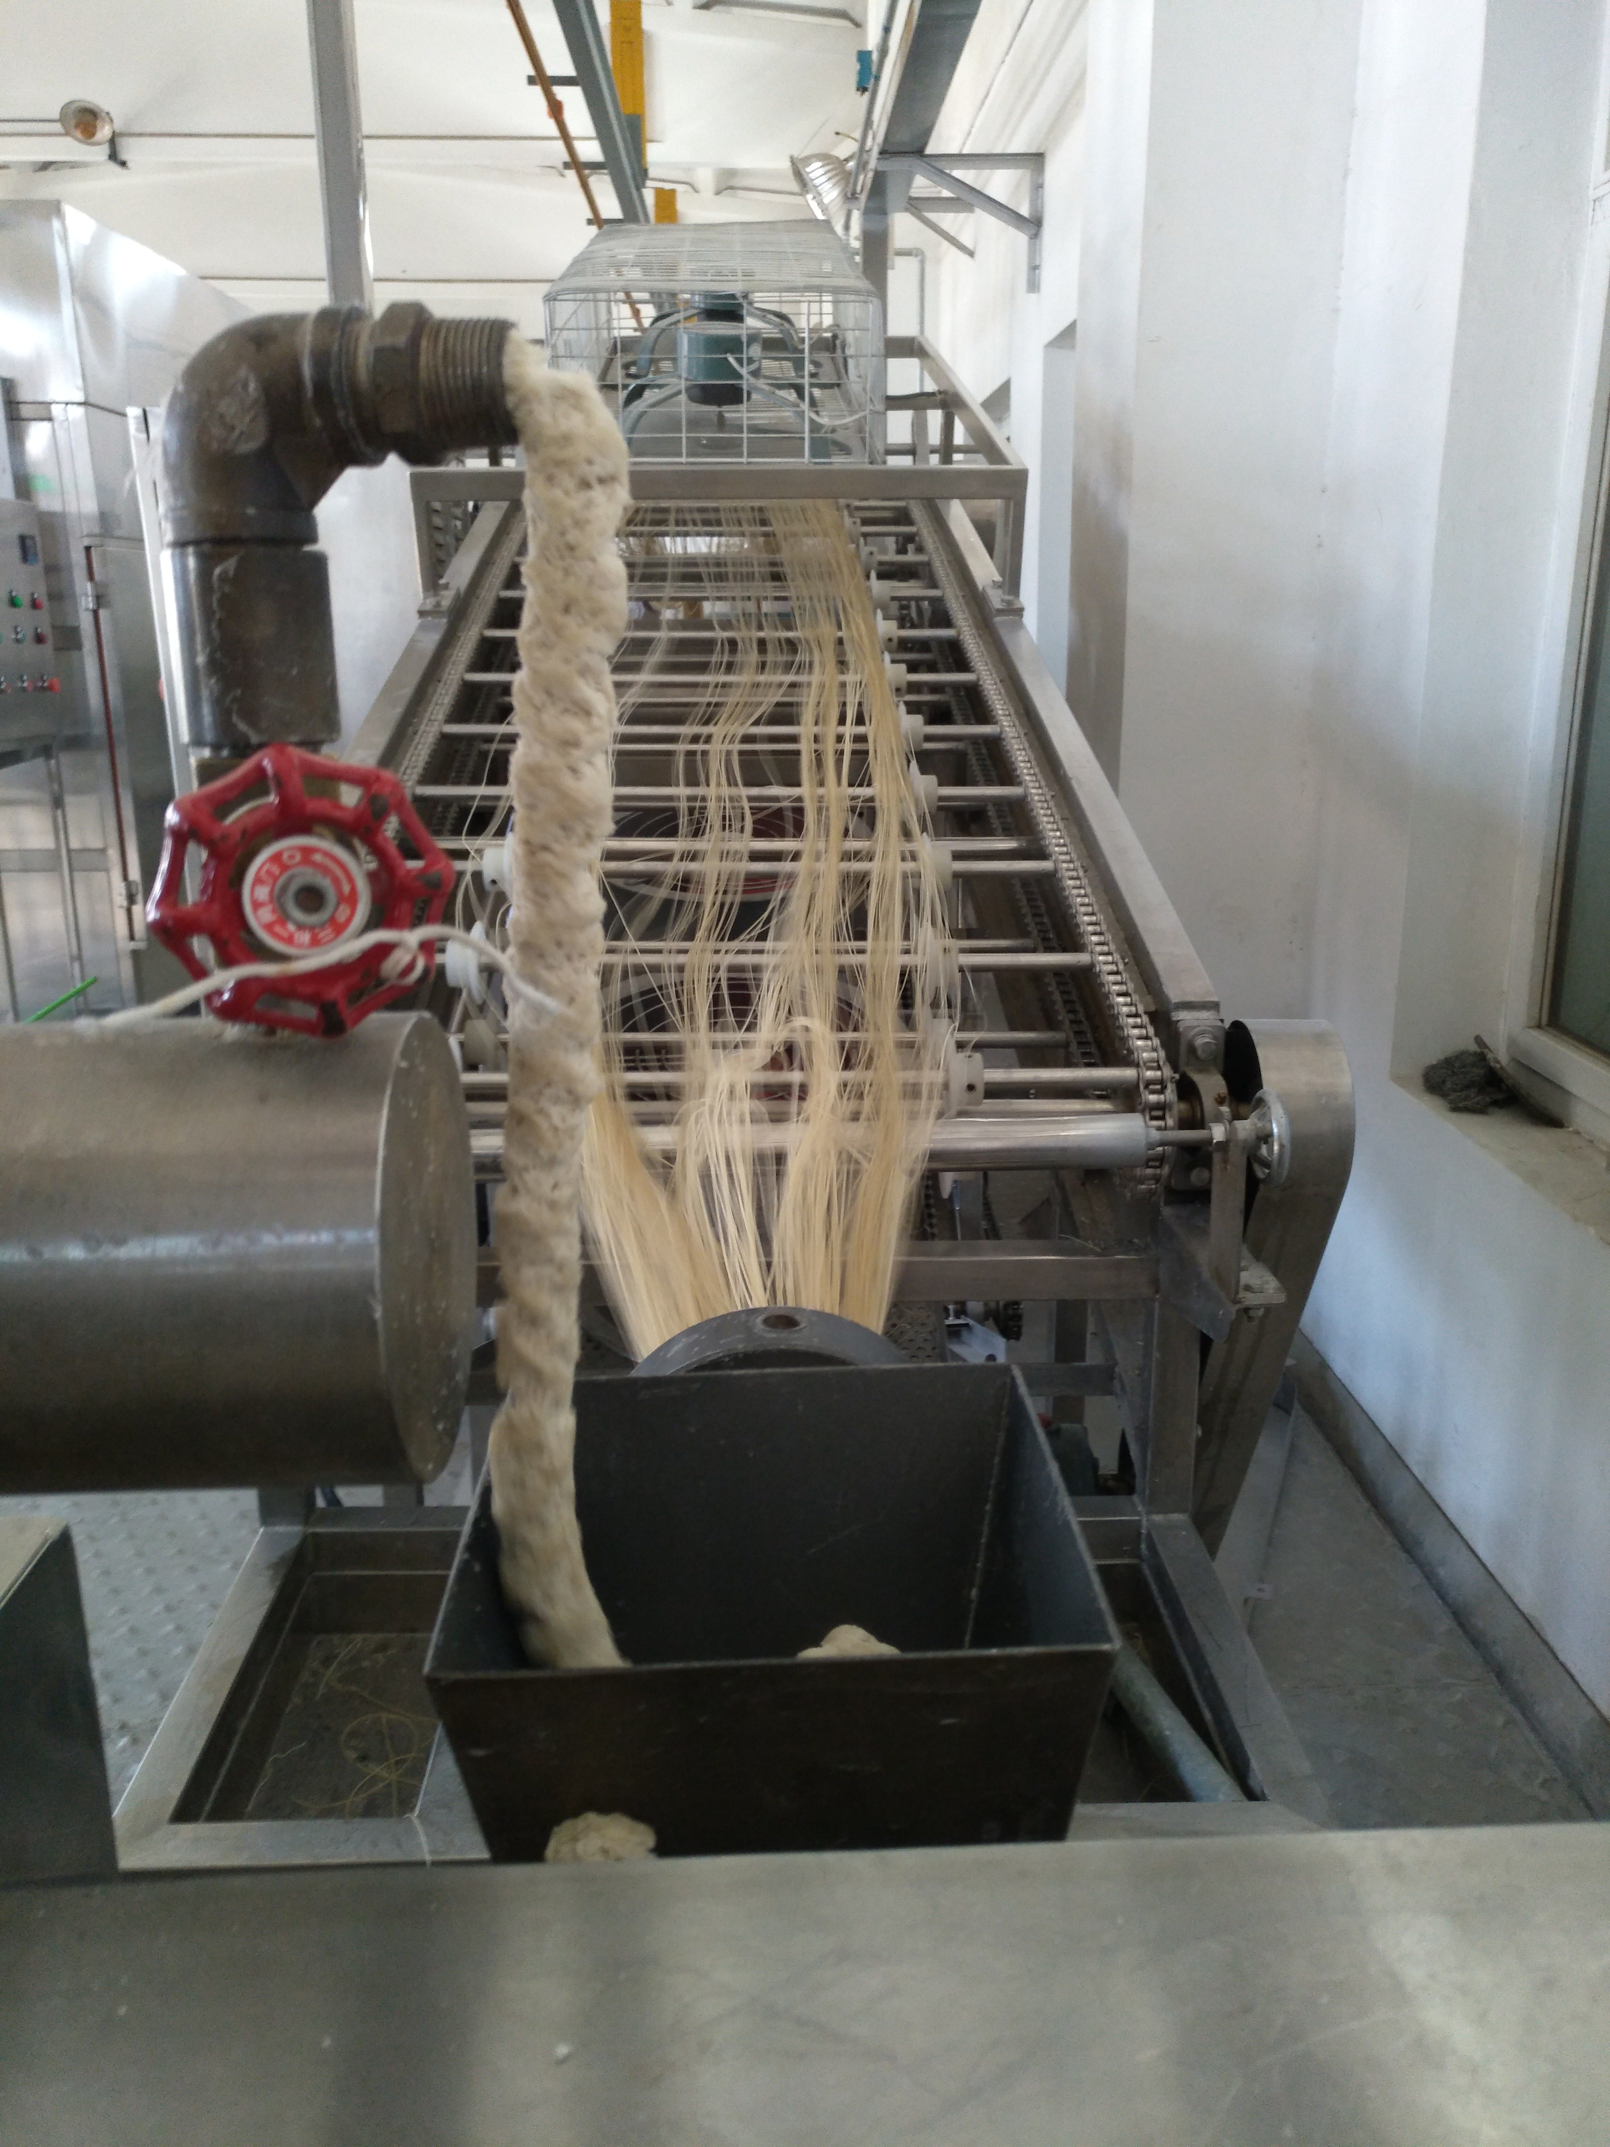
The aging of fresh brown rice noodles during storage is suppressed and the quality is improved by extrusion cooking treatment of rice bran
Raw material
Fresh brown rice noodles
The hardness of FBRN was significantly increased, but the pH and moisture content were decreased with the increase of storage time.
The microstructure of FBRN stored at 4 ◦C showed less and smaller pores and cracks from the results of SEM and CLSM.
This study provided the quality information of FBRN stored at different temperatures, which might be beneficial for the consumption and circulation of FBRN in food market.
Journal of Cereal Science, 2022, 104: 103434

Slide 32
The combined effect of cold plasma pretreatment and germination on nutritional quality and texture properties of brown rice cakes
The contents of GABA, total c-oryzanol, total phenolics, total flavonoids, individual phenolic acid, individual flavonoid and antioxidant activity in germinated brown rice cake with cold plasma pretreatment (CGRC) were significantly higher.
Compared with WRC and BRC, CGRC had the highest content of resistant starch and the lowest starch in vitro digestibility.
Additionally, the textural characteristics of CGRC were enhanced with lower hardness and higher elasticity compared to WRC and BRC.
The combination of cold plasma pretreatment and germination may be the prospective approach for enhancing the nutritional quality and textural properties of brown rice cakes.
International Journal of Food Science and Technology, 2023, doi:10.1111/ijfs.16397

Slide 33
Other whole grain foods developed by our research group
Brown rice cake
Instant whole grain rice porridge
Whole grain noodles
Oat milk
Whole wheat bread
Oat sweet mash
Germinated whole grain rice
Whole grain rice cooked with white rice for the same long time

Slide 34
Thank You
Na-Na Wu
Research Institute of Grain and Oil Processing, Academy of National Food and Strategic Reserves Administration, Beijing 100037, China.
Tel: +86-10-81902400; +86-13716771865
e-mail: wnn@ags.ac.cn;
Sharing for Learning

