Slide 1
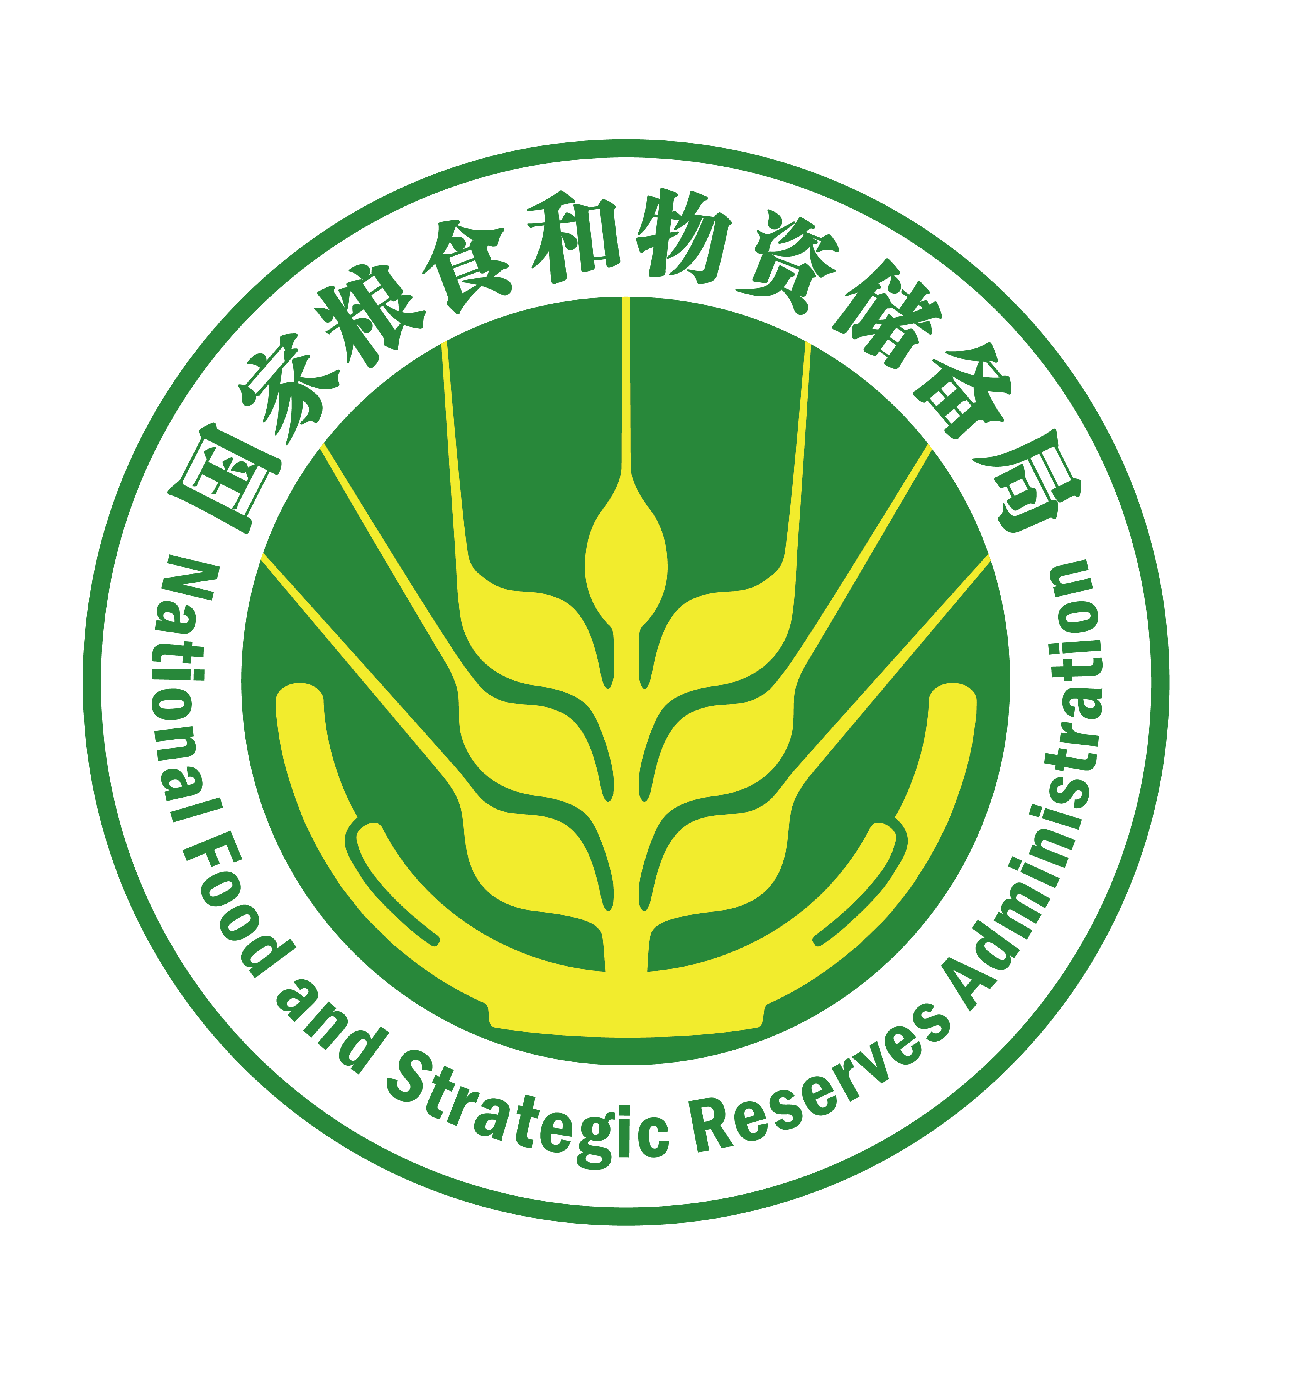
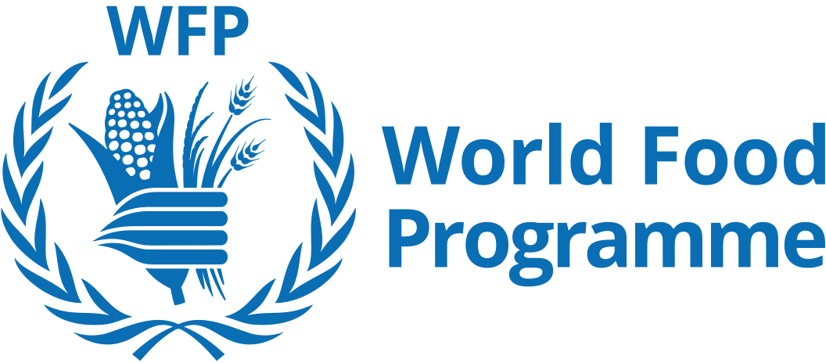

China's Experience in Post-Harvest Food Loss Reduction
Zhang Chengzhi
National Food and Strategic Reserves Administration
September 2020

Slide 2
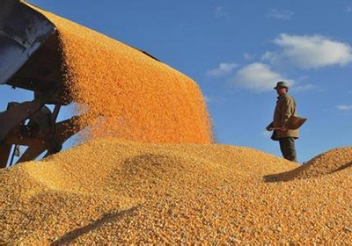
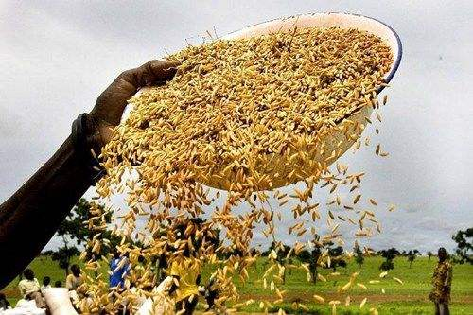
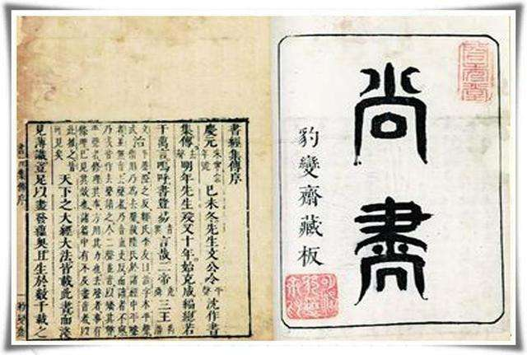
Eliminating hunger is the common hope of all people on earth, and safeguarding food security is the common goal of all countries. Food security, at all times and in all countries, has been treated as a top state issue.
Salute to World Food Programme - the Winner of 2020 Nobel Peace Prize

Slide 3

I. World Food Situation and Security Risk
II. China's Achievements in Food Saving and Loss Reduction as well as Food Security
III. Systematic Promotion of Food Saving and Loss Reduction
IV. China's Policies and Regulations on Food Saving and Loss Reduction
V. Technology and Application Equipment
VI. Cultural Atmosphere of Food Saving and Loss Reduction
VII. Food Saving and Loss Reduction of Farmers
VIII. Guaranteed Food Supply for Fight against COVID-19

Slide 4
Lecture One
World Food Situation and China's Food Security

Slide 5
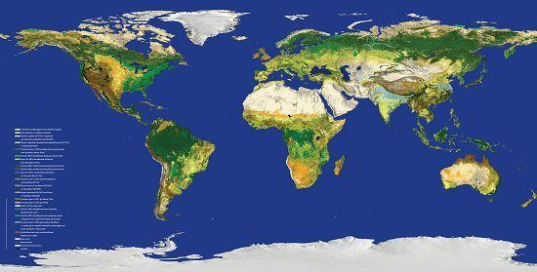
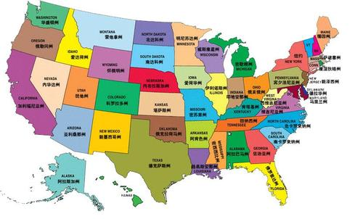
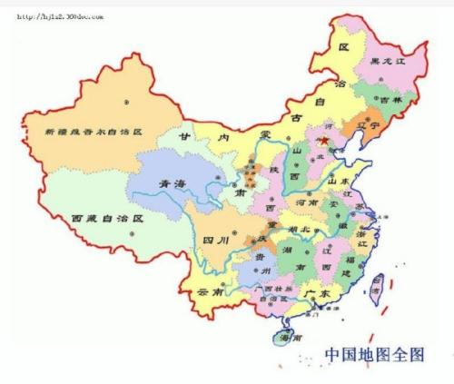
I. World Food Situation and Security Risk
Global food output
America's food output
China's food output
2017: 2.627 billion tons;
2018: only 2.587 billion tons, the lowest in three years;
2017: nearly 500 million tons;
The largest exporter of agricultural products, with an annual export of 140.5 billion US dollars;
The total soybean yield is 119 million tons, of which 32.86 million tons are exported to China.
2017: 618 million tons (140.31 million tons of summer crops and 445.85 million tons of autumn crops), accounting for 23.5% of the world;
Ranks first in the world in food output;

Slide 6
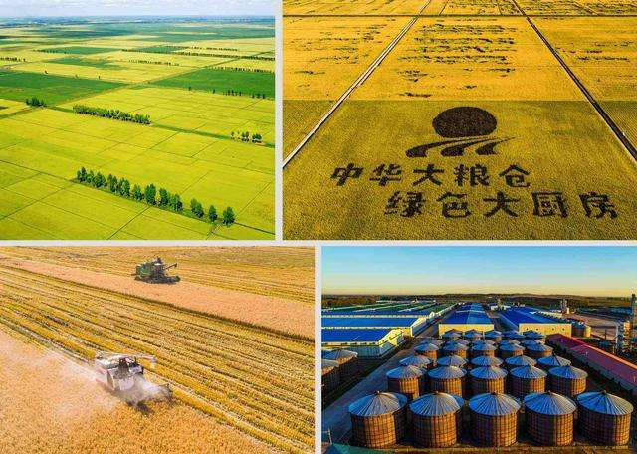
I. World Food Situation and Security Risk
In 2019, the global food output was 2.71 billion tons. China's total food output was 663.84 million tons.
The red line of China’s arable land area is 1.8 billion mu, normally maintaining at 1.8 -1.9 billion mu, which is about 1.2 million square kilometers, accounting for 12.5% of the territorial area; America has 2.8 billion mu of arable land, which is about 1.86 million square kilometers, accounting for 19.9% of its territorial area.

Slide 7
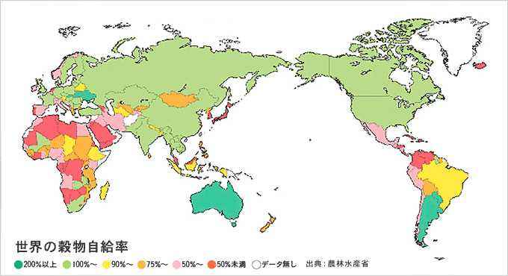
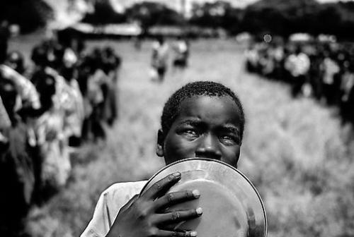
I. World Food Situation and Security Risk
The world is still facing severe food security challenges. Over 800 million people are suffering from hunger.
Severe food security challenges

Slide 8
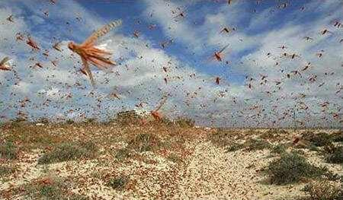


I. World Food Situation and Security Risk
1. The global food supply and demand situation and price trends are extremely complicated
Locust plague. If the locust plague continues, global food output will drop by 30% in 2020.
Forest fire. The forest fire-burned area reached 12 million hectares in Eastern and Southern Australia.
COVID-19. Due to food hoarding and ban on the export of agricultural products, the futures prices of some agricultural products have risen.
Unforeseen challenges
8

Slide 9
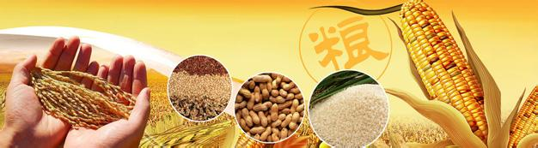
I. World Food Situation and Security Risk
2. The global food supply and demand are in balance on the whole
From the perspective of the global food supply and demand situation, the global grain output in 2019/2020 reached 2.71 billion tons, the grain trade volume was 420 million tons, and the grain stock volume was 860 million tons, growing by 27%, 54% and 97% respectively, compared with 2007;
The grain stock-to-use ratio reached 30%, 10% higher than that in 2007; both the wheat and rice stock-to-use ratios reached 35%, growing by about 13% compared with 2007.
China's substantial increase in food production, increased stock, and large-scale poverty alleviation have contributed to global food security.
9

Slide 10

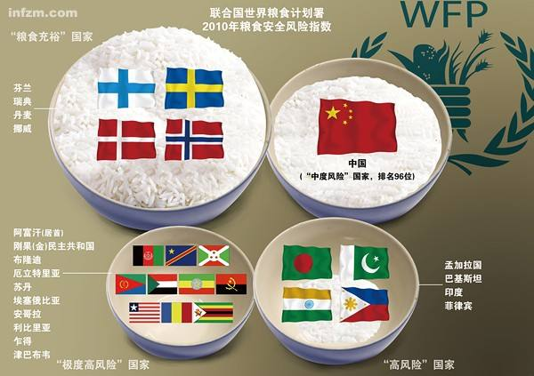
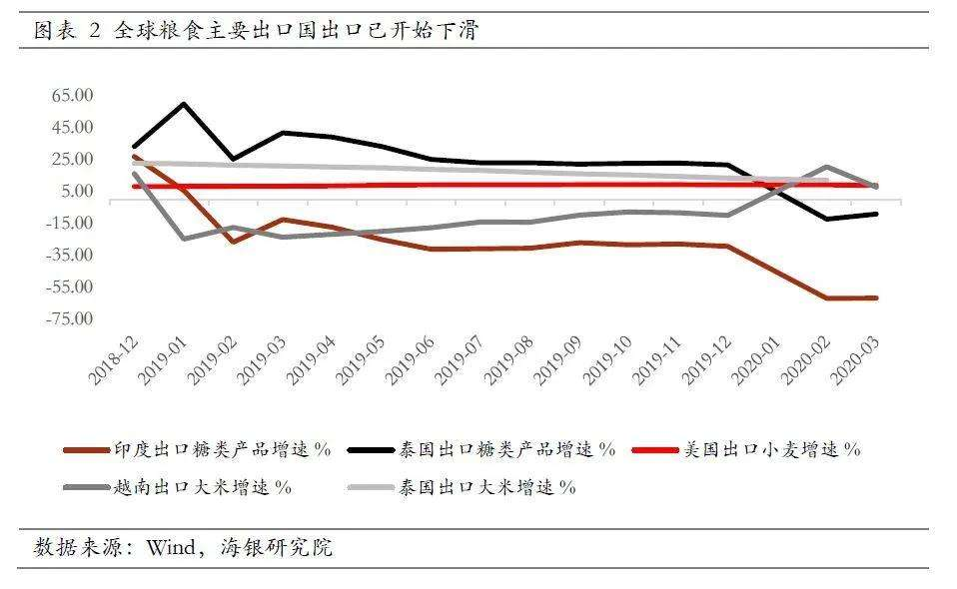
I. World Food Situation and Security Risk
2. The global food supply and demand are in balance on the whole
The world's food supply and demand are basically in balance (tight balance) on the whole, but regional food shortage and food insecurity remain prominent, and the risk of food crises still exists.
The per capita share of grain is steadily increasing, but the regional imbalance and regional differences are obvious. Despite the overproduction of food in developed countries, the food supply in developing countries is insufficient, and there are still 821 million people suffering from hunger and malnutrition.
10

Slide 11
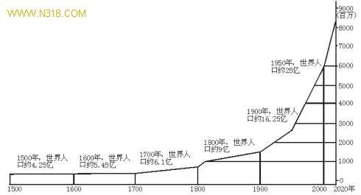
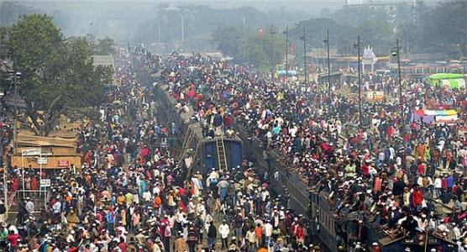
I. World Food Situation and Security Risk
2. The global food supply and demand are in balance on the whole
The world‘s population will increase by 34%, from 6.9 billion in 2010 to 9.1 billion in 2050, and 70% of the world's population will live in cities. To achieve world food security by 2050, the world’s total food output must increase by 70%, and the developing countries’ food output must increase by 100%. It is an enormous challenge.

Slide 12
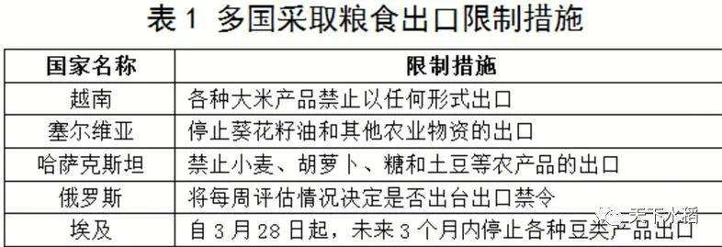
I. World Food Situation and Security Risk
3. The COVID-19 outbreak has impacted the food production and trade, and undermined the food availability.
The lockdown measures and self-isolation implemented in response to the COVID-19 outbreak will reduce the supply of labor, may further lead to a reduction in the arable land area and restrict crop management, ultimately resulting in a decline in harvests.

Slide 13
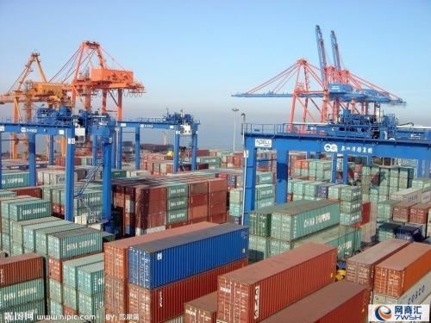
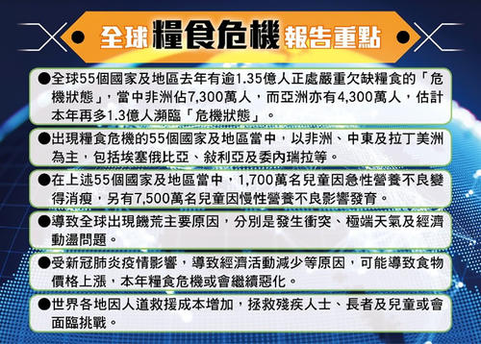
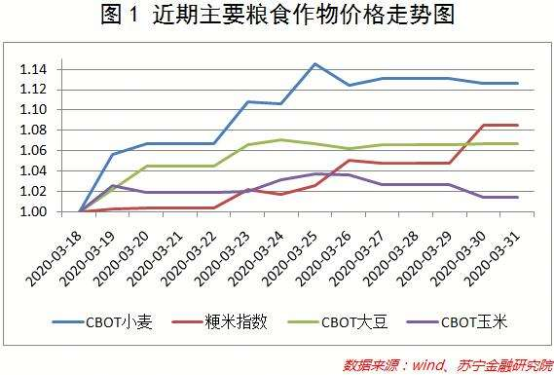
I. World Food Situation and Security Risk
3. The COVID-19 outbreak has impacted the food production and trade, and undermined the food availability.
As the COVID-19 spreads around the world, some food exporting countries have begun to worry about their own agricultural underproduction and insufficient food supply, and introduced bans or restrictions on food export.
13

Slide 14

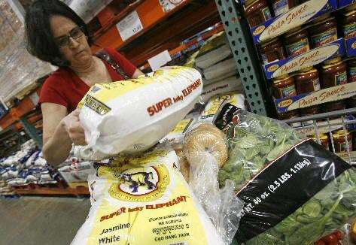

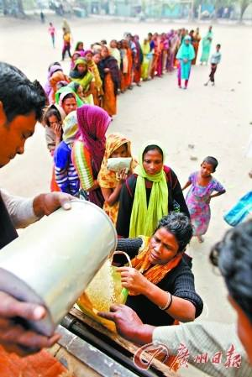
I. World Food Situation and Security Risk
3. The COVID-19 outbreak has impacted the food production and trade, and undermined the food availability.
Even worse, the spread of the COVID-19 will lead to port closures and logistical hurdles, causing the interruption of the food trade chain.
14

Slide 15
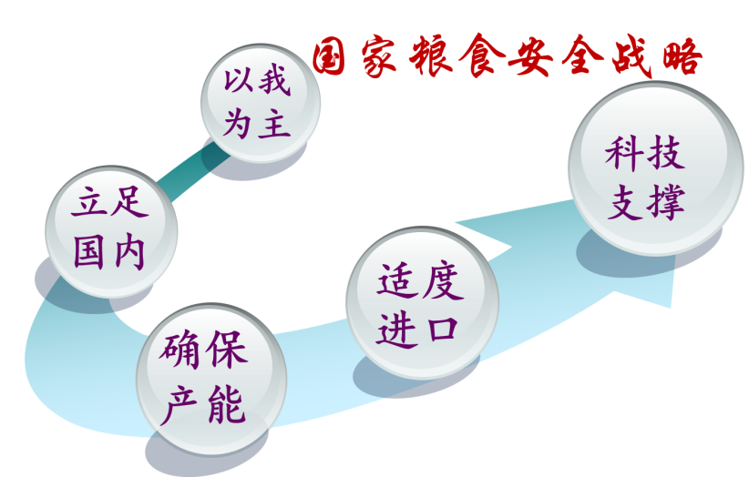

II. China's Achievements in Food Saving and Loss Reduction as well as Food Security
Chinese people now have not only enough to eat, but also have a greater range of choices. Compared to past times when they were underfed, this historical change has been made possible by the Chinese themselves through hard work and development. It is also a key contribution to world food security.

Slide 16

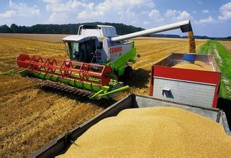
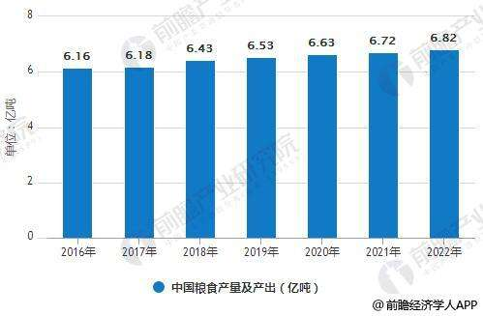
II. China's Achievements in Food Saving and Loss Reduction as well as Food Security
1. Steady growth in food output
Currently, China's per capita food output is around 470 kg. It took nearly 70 years for China to achieve an increase in food output of more than 100%. The average food output per hectare is more than 5,000kg in 2010.

Slide 17
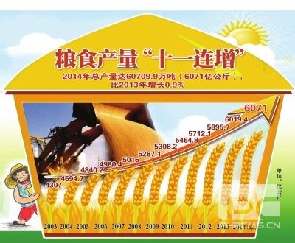
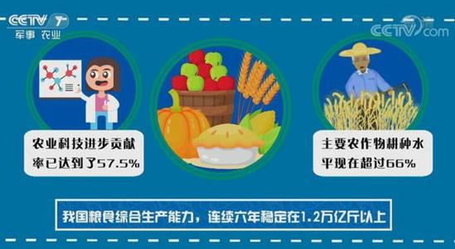
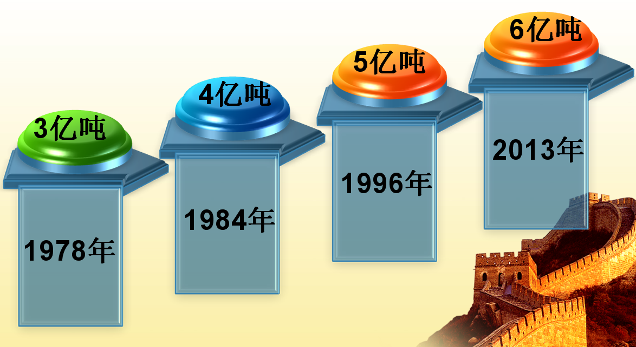
II. China's Achievements in Food Saving and Loss Reduction as well as Food Security
1. Steady growth in food output
China's total food output maintained at over 650 million tons for four consecutive years from 2016 to 2019. Although affected by the floods in the south of China, this year's summer crops still had a bumper harvest, with an output of 285.6 billion kg and an increase of 2.42 billion kg, achieving a record high.

Slide 18
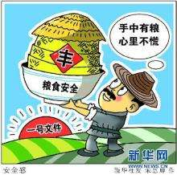
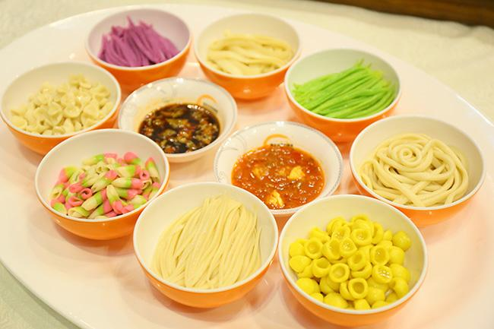
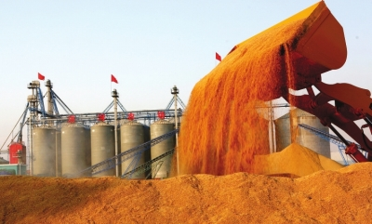
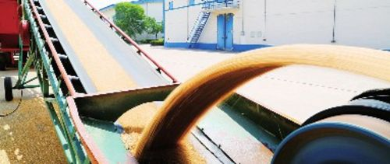
II. China's Achievements in Food Saving and Loss Reduction as well as Food Security
1. Steady growth in food output
The yield of rice and wheat was 209.61 million tons and 237.27 million tons, respectively, a large part of which has been put in grain reserve facilities.

Slide 19
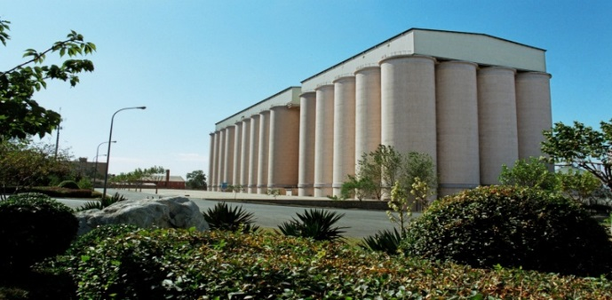
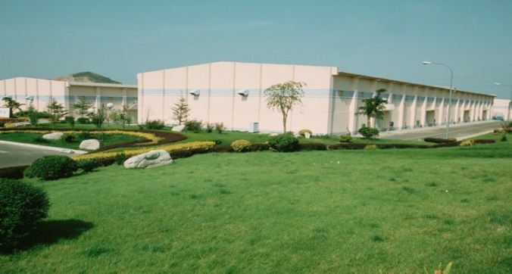
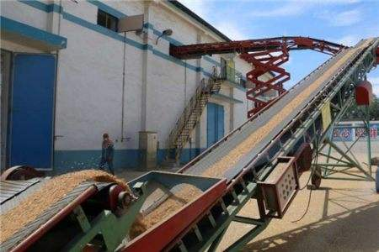
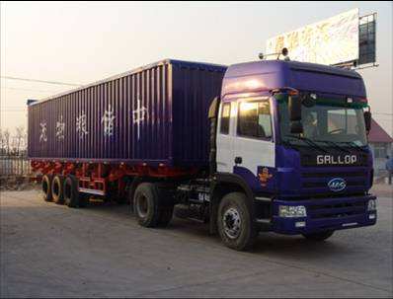
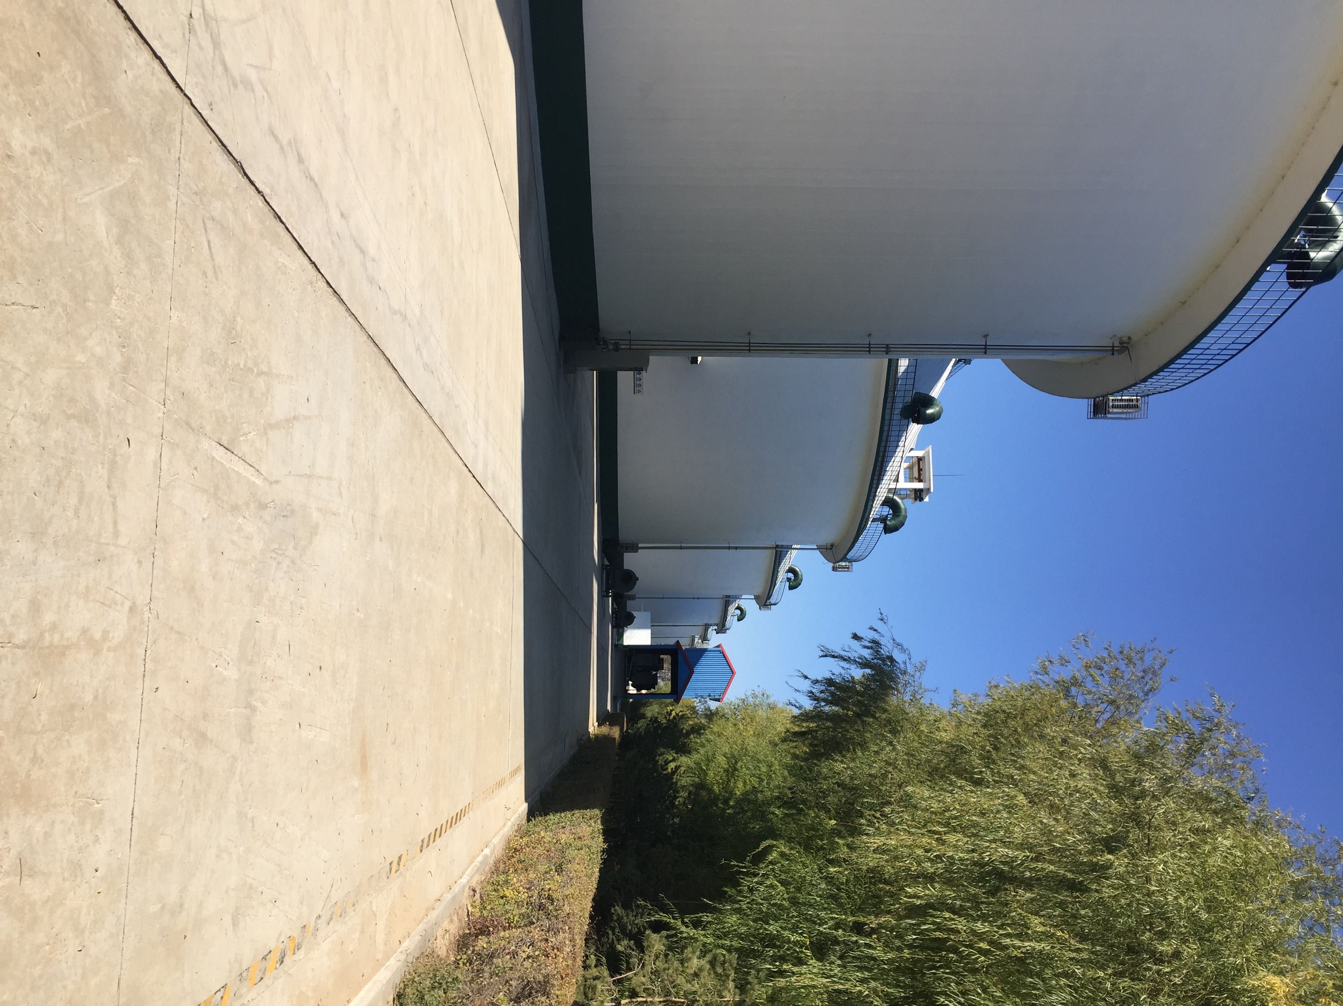
II. China's Achievements in Food Saving and Loss Reduction as well as Food Security
2. Greater food reserve capacity
In 2018, the total effective warehouse capacity grew by 31.9% over 1996. The total tank capacity for edible oils saw a seven-fold increase over 1996.

Slide 20

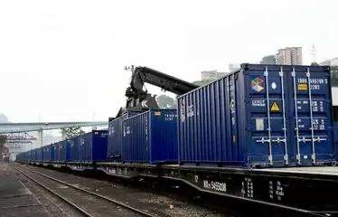
II. China's Achievements in Food Saving and Loss Reduction as well as Food Security
2. Greater food reserve capacity
All major channels of food logistics have been integrated. Moreover, a network of emergency reserves has been in place. They play an important role in response to natural disasters and public emergencies.

Slide 21

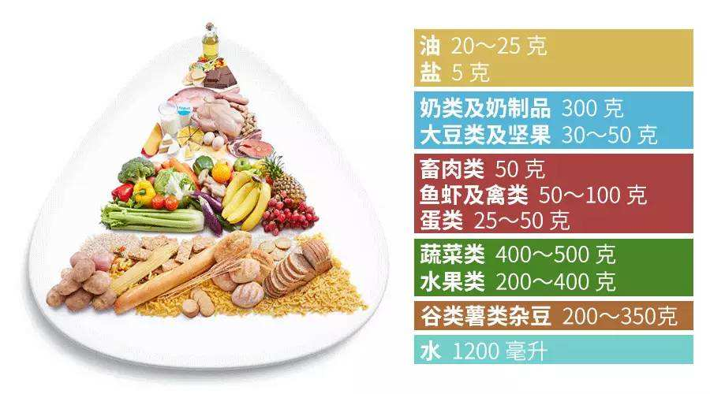
II. China's Achievements in Food Saving and Loss Reduction as well as Food Security
3. Improved nutrition for residents
The per capita direct consumption of staple grains has decreased, and the consumption of non-grain foods such as meat and fish, ligneous foods, vegetables, and fruits has increased, the Chinese have more choices in what they eat.
The government has carried out extensive nutrition improvement programs in poor areas for young students, infants, children, pregnant women, and the elderly, as a result of which there have been noticeable improvements in their nutrition and health.

Slide 22

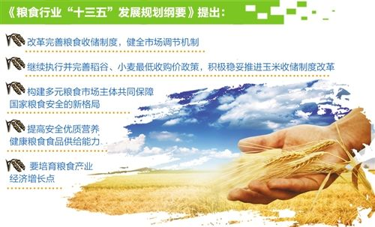
II. China's Achievements in Food Saving and Loss Reduction as well as Food Security
4. Effective implementation of food security plan
Outline of the Thirteenth Five-year Plan for National Economic and Social Development of the People's Republic of China
Outline of the Medium-and Long-term Plan for National Food Security
National Plan for an Increase of Production Capacity for 50 Billion Kg of Food
Outline of China's Food and Nutrition Development
National Agriculture Sustainable Development Plan
National Land Planning Outline
National Rural Vitalization Strategic Plan
Outline of the 13th Five-year Development Plan for the Food Industry

Slide 23
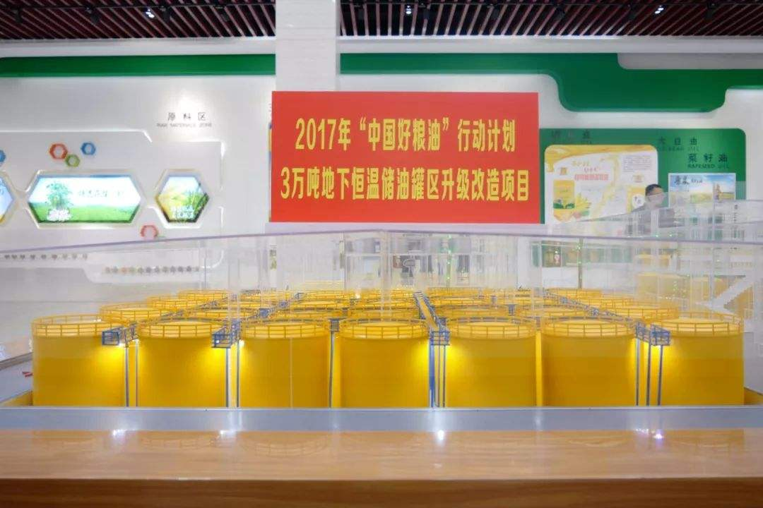
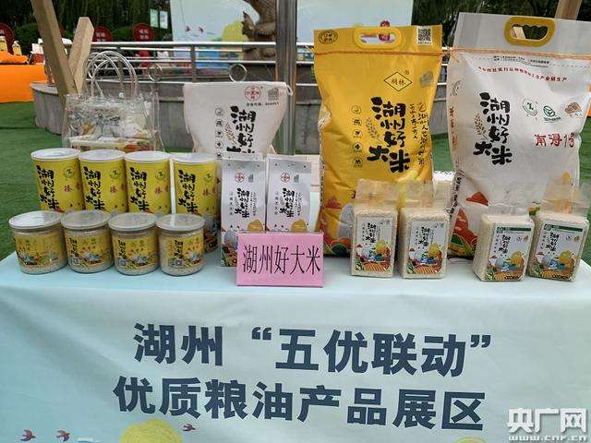
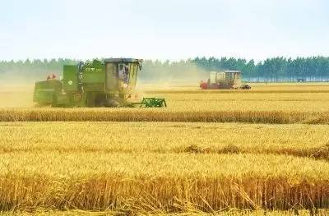
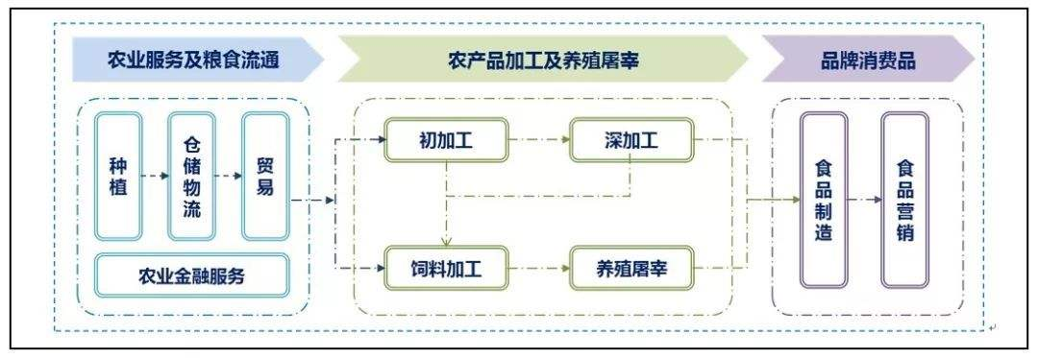
II. China's Achievements in Food Saving and Loss Reduction as well as Food Security
5. Developing the grain industry economy to a high level
China will promote the connection between grain production, purchase, storage, processing and marketing, give full play to the role of processing enterprises as the engine, and implement an overall strategy by building demonstration cities and counties, industrial parks and backbone enterprises to raise national food security to a higher level.

Slide 24
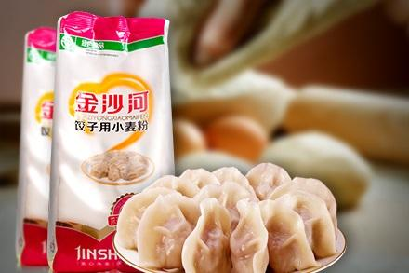

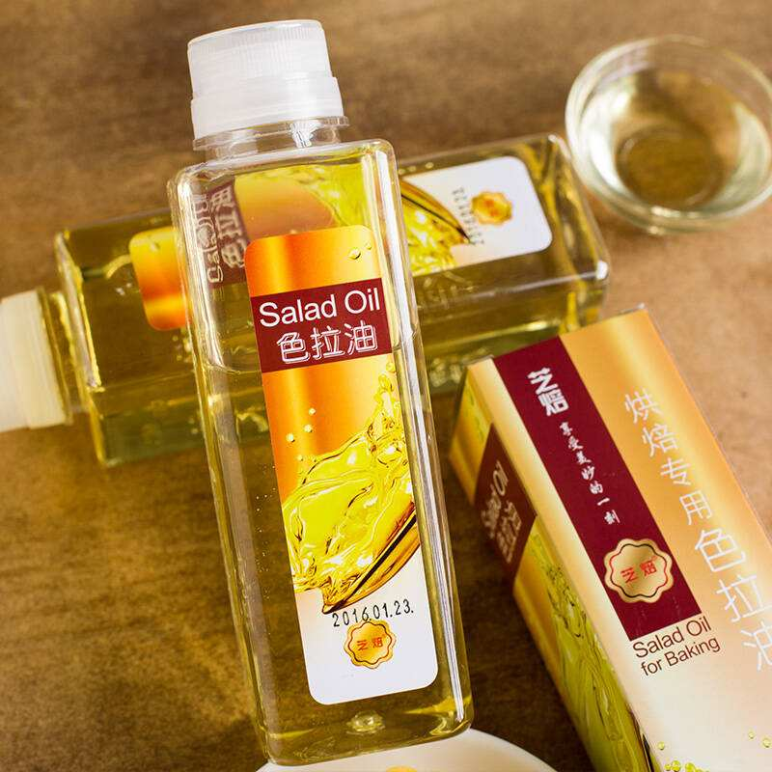
II. China's Achievements in Food Saving and Loss Reduction as well as Food Security
5. Developing the grain industry economy to a high level
China will transform grain processing into refined and deep processing, increase the effective supply of special rice, special flour, special oil, functional starch sugar and protein, and promote dietary diversity among the people.

Slide 25
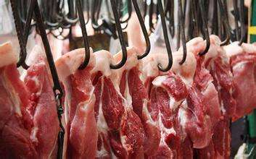
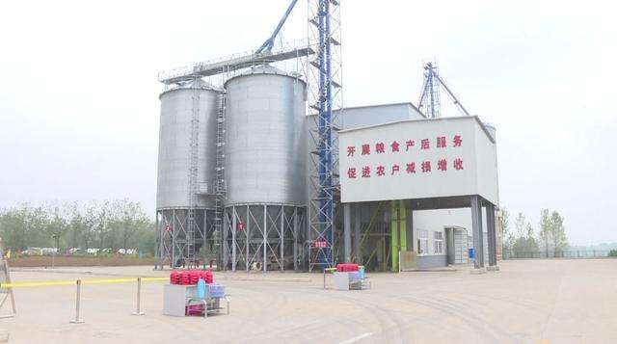
II. China's Achievements in Food Saving and Loss Reduction as well as Food Security
5. Developing the grain industry economy to a high level
Meet the nutritional needs of residents for meat, eggs and milk, promote feed processing and transformation, and facilitate the development of livestock and poultry breeding.
Establish professional post-production grain service centers to provide cleaning, drying, storage, processing and marketing services for farmers.

Slide 26
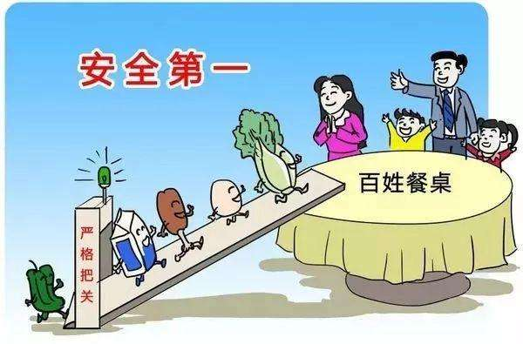

II. China's Achievements in Food Saving and Loss Reduction as well as Food Security
5. Developing the grain industry economy to a high level
China has established and improved a grain quality and safety inspection and monitoring system, and also formulated and issued a series of standards for grain and oil to upgrade the quality of grain and oil products.

Slide 27


II. China's Achievements in Food Saving and Loss Reduction as well as Food Security
6. Raise the technical level of the whole industry chain through science and technology innovation
Strengthening scientific and technological support for grain production. High quality crop varieties have been popularized and applied over large areas, covering almost all major food crops.

Slide 28
II. China's Achievements in Food Saving and Loss Reduction as well as Food Security
6. Raise the technical level of the whole industry chain with science and technology innovation
Applying agricultural science and technology. In 2018, the contribution of scientific and technological progress to agriculture reached 58.3%. The development and application of post-harvest food loss reduction technology have achieved good results.

Slide 29



II. China's Achievements in Food Saving and Loss Reduction as well as Food Security
6. Raise the technical level of the whole industry chain with science and technology innovation
Upgrading the science and technology of food storage and transportation. China has overcome a series of key technological problems in grain loss reduction, and systematically addressed the technical problems of container transportation in bringing bulk grain from North China to the South.

Slide 30




II. China's Achievements in Food Saving and Loss Reduction as well as Food Security
China's food security is guaranteed by high-level grain productivity, low-loss grain circulation, high-quality grain processing, and highly-efficient food supply.

