Slide 1
小农户粮食储藏
质量管理和有害生物防治
Quality Management and Pest Control
for Smallholder Grain Storage
许胜伟（高级工程师）
Shengwei Xu
Senior engineer
中储粮成都储藏研究院
Sinograin Chengdu Storage Research Institute

Slide 2
CONTENTS
农户安全储粮基本要求
Basic Requirements of Safe Smallholder Grain Storage
粮食的基本特性
Basic Features of Grain
01
02
主要粮种的储藏特点和储藏方法
Features and Methods of Major Grain Storage
农户常用防治储粮有害生物的方法
Common Methods of Pest Prevention and Control for Smallholders
03
04

Slide 3
01
农户安全储粮基本要求
Basic Requirements of Safe Smallholder Grain Storage

Slide 4
Dry and clean place.
Do not airing on the asphalt road.
Grain to be stored with safe water ratio.
Clear sound when the dry grain is bit
Well-filled grain.
Less fragmentized grains
对粮食的基本要求
Basic requirement for grain
场地要干净、干燥。
不能在柏油路上晾晒。
待储粮食的水分在安全水分以内。
干的粮食用牙咬会发出清脆的声响。
粮食应充分成熟后收割，粮食的籽粒充分成熟，干瘪粒越少越好；
待储的粮食破碎粒越少越好
干燥
Dry
粮食
Less impurities without straw, husk, weeds, dirt, stones.
By hands, windmill, sieving, etc.
杂质少。将粮食中秸杆、谷（麦）壳、杂草、泥土、石块等清理干净；
可用手工、风车、过筛、风力等方法。
饱满
干净
grain
Full
clean

Slide 5
Cleanliness of warehouse
Moisture-proof pad at the bottom of storage equipment or the bottom at a certain height from the ground to keep dry and moisture-proof with the function of rodent prevention
做好仓房内清洁卫生：保持仓内干净，清除虫源、清除害虫的食物来源。
对仓房、装具的要求
装具底部应有防潮垫或仓底距离地面一定高度，能保持粮仓的干燥、防潮。储粮装具应具有防鼠功能。
Requirements for Warehouses and equipment
做好隔离
有虫粮和无虫粮要分开，陈粮与新粮要分开。
Separation
Grains with pests separated from none-pest grains.
Newly harvested grains separated from ageing grains.
Problems are found and tackled timely .
发现问题及时处理。
定期检查
Periodic Check

Slide 6
Normally, for household storage:
储藏期限
一般情况下，在农户家中，小麦可安全储藏2～3年，稻谷可安全储藏1～2年，玉米可安全储藏1～2年。
Expiration date
稻谷
Paddy
储藏时间1～2年
Storage period: 1-2 years
小麦
Wheat
储藏时间2～3年
Storage period: 2-3 years
玉米
Corn
储藏时间1～2年
Storage period: 1-2 years

Slide 7
02
粮食的基本特性
Basic Features of Grain

Slide 8
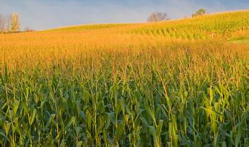
一、粮食的新陈代谢特性
Metabolic properties of grains
★ 水份越高，呼吸越强
小麦安全储藏水份12.5%; 稻谷安全储藏水份13.5%；
玉米储藏的安全水分，一般要求在13－14％之间。
★ 温度越高，呼吸越强。
温度越低，越有利于安全储藏，温度低于18℃对品质保持良好。
Higher the water ratio, stronger the breathing
The safe water ratio of
Wheat: 12.5%, Paddy: 13.5%, Corn: 13%-14%
Lower temperature, better safe storage. The temperature below 18℃ is good for quality control.
Higher the temperature, stronger the breathing

Slide 9
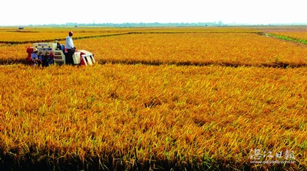
二、粮食的后熟特性
Post-ripening features of grains
★ 稻谷基本无后熟期
★ 春小麦30－40天；冬小麦80天
★ 玉米后熟期很短（2-3周）
paddy
Without post-ripening period.
post-ripening period of
Spring wheat: 30-40 days; Winter wheat: 80 days
wheat
经过后熟的小麦，品质才能达到最佳
The best quality of the wheat can only be gained after the post-ripening period
corn
Short post-ripening period: 2-3 weeks

Slide 10
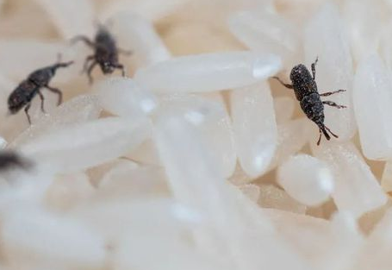
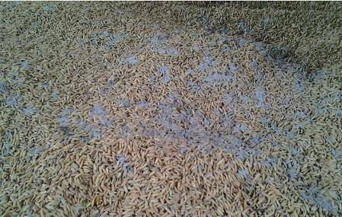
三、粮食是其他生物体的食物源
Grain is the food source for other creatures
★ 虫
★ 霉
★ 鼠
Insect
Mould
Rodent

Slide 11
03
主要粮种的储藏特点和储藏方法
Features and Methods of Major Grain Storage

Slide 12
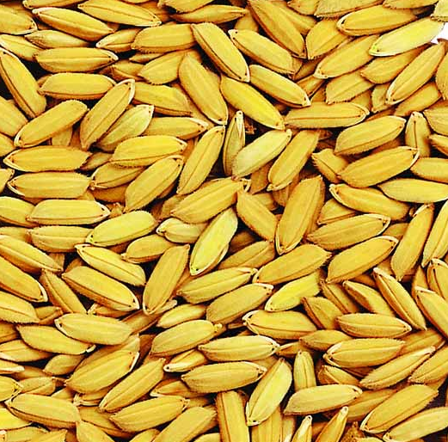
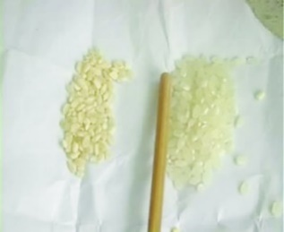
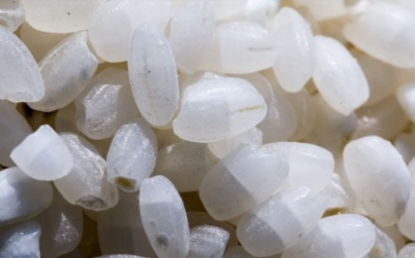
一、稻谷
Paddy
（一）稻谷的储藏特点
Characteristics of paddy storage
不耐高温
稻谷的颖壳较坚硬，对籽粒起到一定的保护作用，能在一定程度上抵抗虫害及外界温、湿度的影响。因此，稻谷比一般成品粮好保管。但是，稻谷不耐高温，易生芽，过夏的稻谷容易陈化 ；烈日下暴晒的稻谷，或暴晒后骤然遇冷的稻谷，容易出现“爆腰”现象，需要特别注意。
Not resistant to high temperatures
The husks of rice are relatively hard and could protect grains, which can resist insect and the influence of external temperature and humidity to a certain extent. Therefore, paddy is easier to be stored than rice. However, paddy is not resistant to high temperatures and is prone to sprouting, while paddy is prone to aging after summer. The paddy which is exposed to direct sunlight too much or suddenly cold after exposure to sunlight can be cracked easily, which needs extra attention.

Slide 13
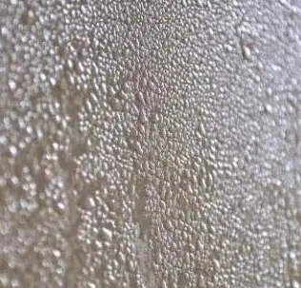
基本无后熟期
大多数稻谷(如籼稻) 无后熟期，在收获时就已生理成熟，具有发芽能力。同时稻谷萌芽所需的吸水量低。因此，在收获稻谷时，如连遇阴雨，未能及时收割、脱粒、整晒，那么稻谷在田间、场地就会发芽。If it is raining during the harvest season, the paddy will sprout in the field without reaping, threshing and drying in the timely manner.
易结露
新稻谷入仓后不久，如遇气温下降，往往在粮堆表面结露，使表层粮食水分增高，不利储藏，应及时降低表层粮食的水分。储藏中的稻谷，如果结露、返潮或遭遇漏雨时,也容易生芽。稻谷脱粒、整理晾晒不及时，连草堆垛，容易沤黄。生芽和沤黄的稻谷，品质和保管的稳定性都大为降低。The newly harvest paddy is prone to condensation when the temperature is becoming lower. The water ratio of the grain should be reduced. The stored paddy is also prone to sprouting when it condenses, becomes damp, or experiences leaking rain. Inadequate threshing, sorting, and drying of paddy, as well as stacking of straw, can easily cause yellowing.
No post-ripening period basically
Prone to condensation

Slide 14
（二）稻谷的储藏方法
Methods of paddy storage
保证入仓稻谷质量
水分大、杂质多、不完善粒多的稻谷，容易发热霉变，而不耐久藏。因此，提高入仓稻谷质量，是稻谷安全储藏的关键。稻谷的安全水分标准，应根据品种、季节、地区、气候条件考虑决定。一般籼稻谷在13%以下，粳稻谷在14%以下。杂质和不完善粒越少越好。如入仓稻谷水分大、杂质多，应分等、分水分储存，及时晾晒或烘干，并进行过筛或风选清除杂质。 Paddy with high water content, more impurities, and unsound kernels is prone to heat and mould and less durable for storage. Therefore, improving the quality of paddy to be stored is the key for safe paddy storage. The standard of safe water ratio for paddy should be determined according to the variety, season, region, and climatic conditions. Generally, indica rice is below 13%, while japonica rice is below 14%. The less impurities and unsound kernels, the better grain quality. If the paddy to be stored contains high water and impurities, it should be stored in different grades and water ratios, dried in a timely manner, and screened or air-selected to remove impurities.
Ensuring the quality of the paddy in the warehouse

Slide 15
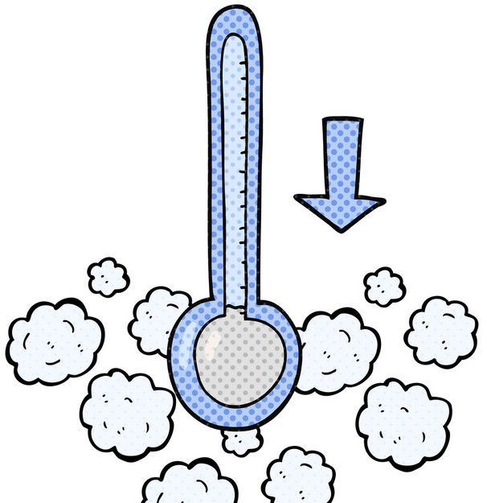
适时通风
新稻谷由于呼吸旺盛、粮温和水分较高，应适时通风，降温降水。特别一到秋凉，粮堆内外温差大，这时更应加强通风，结合深翻粮面，散发粮堆湿热，以防结露。有条件可以采用机械通风。Due to its vigorous respiration, high grain temperature and water ratio, newly harvest paddy should be ventilated in a timely manner to reduce temperature and moisture. During the cool autumn when there is a large temperature difference between the inside and outside of the grain bulk, ventilation should be strengthened by deeply flipping grains over to reduce the moisture and temperature and prevent condensation. Mechanical ventilation can be adopted if it is possible.
低温密闭
充分利用冬季寒冷干燥的天气，进行通风，使粮温降低到10℃以下，水分降低到安全标准以内，在春季气温上升前进行压盖密闭，以便安全度夏。Making full use of the cold and dry weather in winter, ventilation lowers the grain temperature to below 10 ℃, and lower the water ratio to safe standards. Covering and sealing before temperature rising in spring to ensure the safe storage in summer.
Ventilation at the right time
Low temperature sealing

Slide 16
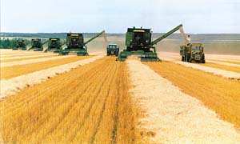
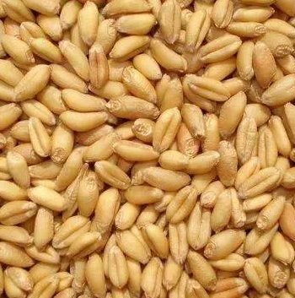
二、小麦
wheat
（一）小麦的储藏特点
Characteristics of wheat storage
吸湿性强：
小麦种皮较薄，组织结构疏松，吸湿能力较强。
Wheat has a thin seed coat and loose organism structure for strong hygroscopicity.
后熟期长：
大多数品种后熟期从两周至两个月不等。完成后熟作用之后，品质有所改善，储藏稳定性还有所提高。Most varieties have the post-ripening period ranging from two weeks to two months. After going through the post-ripening process, the quality has been improved, as well as the storage stability.
Strong hygroscopicity
Long post-ripening period

Slide 17
较耐高温：
小麦具有较强的耐热性。水分在13％以下时，曝晒温度不超过54℃，不会影响小麦的酶活性和发芽力。磨成的小麦粉工艺品质不降低，反而有所改善，做成馒头松软膨大。When the water ratio is below 13% and the exposure temperature does not exceed 54 ℃, it will not affect the enzyme activity and germination ability.
具有耐储性：
完成后熟的小麦，呼吸作用微弱。正常的小麦，水分在标准以内（12.5％），在常温下一般储存3-5年或低温（15℃）储藏5－8年，其食用品质无明显变化。Normal wheat with the water ratio within the standard (below 12.5%), could be stored at room temperature for 3-5 years or at low temperature (15 ℃) for 5-8 years without significant changes in its edible quality.
易受虫害
小麦是抗虫性差、染虫率较高的粮种，几乎能被所有的储粮害虫侵染，其中以玉米象、麦蛾等危害最严重。Wheat is a grain with poor insect resistance and a high insect infection rate, which can be infected by almost all pests. Corn weevils and wheat moths would be the biggest challenge.
High temperature resistance
Storable
Susceptible to insect infestations

Slide 18
（二）小麦的储藏方法
method of wheat storage
降水、降杂入仓储藏
小麦收获后应充分利用自然条件，日光暴晒将粮食水分降至12.5%以下，晾晒时场地要干净，不能在公路，尤其不能在柏油路上晾晒；并经风扬等方法除去小麦中的麦秸、杂草等杂质和瘪粒、灰尘、泥土、石块等，然后入仓储藏。Utilizing natural conditions to reduce the water ratio to below 12.5% by direct sunlight exposure. Clean drying place rather than highways especially asphalt roads. Removing impurities such as wheat straw and weeds, as well as unsound kernels, dust, soil, stones, etc. before warehousing.
储藏期间防潮、防霉
储藏期间做好防潮工作，粮仓应具有良好的防潮性，避免小麦再次吸潮而发生霉变。During the storage period, the granary should be moisture-proof to prevent mould from absorbing water again.
做好防虫、防鼠工作
Reduce moisture and impurities before warehousing
常规储藏
Common practice of wheat storage
Moisture-proof and mildew-proof storage
Pest and rodent prevention

Slide 19
热密闭储藏
Heat tightness storage
准备适当的装具
最好利用气密性较好的装具，并预先做好清仓杀虫工作。Equipment with good airtightness. Pre-cleaning and pest control measures.
暴晒杀虫
晒麦时要掌握迟出早收、薄摊勤翻的原则。先将晒场晒热，将小麦薄摊于晒场上，使麦温达到42℃以上，最好是50℃～52℃。到下午把粮食收拢，堆成一堆，热闷半小时至1小时，再趁热入仓。For wheat drying, the late beginning and early finishing are important, as well as slight amount and frequent flipping. Warming the drying place by exposure to sunlight and then spreading the wheat in the place to make sure the wheat temperature reaches 42 ℃ or above, preferably 50 ℃ to 52 ℃. Collecting the grains as bulks in the afternoon for 0.5-1 hour to keep warm, and then storing them in the warehouse.
Prepare the appropriate equipment
Exposure to the sun and deinsectization

Slide 20
检查小麦水分是否符合要求
小麦的含水量不能高于12％，最好在11％以下。The water ratio of wheat should be no more than 12%. Below 11% would be ideal.
趁热密闭
入仓麦温若在46℃左右则需要密闭2～3周，才能达到杀虫目的。但要注意防潮、防虫。The hermetic period will be 2-3 weeks when the temperature of wheat warehousing is about 46℃. Be careful of moisture and insect prevention.
Check whether the water ratio of the wheat meets the requirements
Hermetic storage when it is hot
注意事项
热密闭最好一次入满仓，以免麦温失散，影响杀虫效果
Cautions
Full warehousing for one-time hermetic storage to avoid affecting the result of pest control negatively due to the wheat temperature decreasing

Slide 21
自然缺氧储藏
Natural hypoxic storage
准备气密性好的装具
自然缺氧储藏的首要条件是储粮装具必须具有足够的气密性。PVC软体气密仓可以采用自然缺氧储藏，若其它仓型，则需要内衬塑料薄膜。The primary condition for natural hypoxic storage is that the grain storage equipment must have sufficient airtightness.
选择适合的小麦
自然缺氧储藏方法只适用于新收获的小麦，陈粮的呼吸较微弱，不能采用。Natural hypoxic storage is only for newly harvested wheat
Prepare the equipment with sufficient airtightness
Choose the newly harvested wheat

Slide 22
尽快入仓储藏
收获后要尽快晒干、扬净，一周内完成入仓密闭工作。After harvesting, it is necessary to dry and clean as soon as possible, and complete the warehousing works within one week.
经常检查气密性
要经常检查进出粮口的密闭情况及整个粮仓的完好情况。如发现密闭不严或仓体破损，则不能继续采用自然缺氧的方法储藏。除此之外，还要做好防虫、防潮、防鼠及日常的粮情检查等工作。Frequently check the airtightness of the grain gates and the overall condition of the warehouse. The natural hypoxic storage cannot be applied further if the airtightness is not sufficient, or the warehouse is damaged.
Put it in granary as soon as possible
Check the airtightness frequently

Slide 23
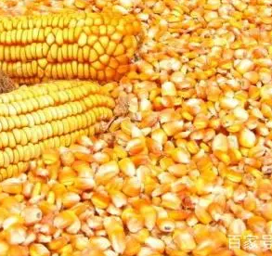
三、玉米
corn
（一）玉米的储藏特点
Storage characteristics of corn
玉米的胚大，呼吸旺盛
玉米的胚几乎占玉米籽粒总体积的1/3，占籽粒重量的10%～12%。玉米的胚含有30%以上的蛋白质和较多的可溶性糖，所以吸湿性强，呼吸旺盛。The corn germ accounts for almost one-third of the total volume of corn grains and 10% to 12% of the grain weight. The corn germ contains more than 30% protein and more soluble sugars, so it has strong moisture absorption and vigorous respiration
The corn germ is large and breathes vigorously

Slide 24
玉米胚部含脂肪多，容易酸败
玉米胚部含有整粒中77-89％的脂肪，所以胚部的脂肪酸值始终高于胚乳，酸败也首先从胚部开始。The corn germ contains 77-89% of the fat in the whole grain. The fatty acid value of the corn germ is always higher than that of the endosperm, and the sourness starts from the germ.
玉米胚部的带菌量大，容易霉变
玉米胚部营养丰富，微生物附着量较多。玉米胚部是虫、霉首先为害的部位，胚部吸湿后，在适宜的温度下，霉菌即大量繁殖，开始霉变。The corn germ is rich in nutrients and has a high amount of microbial attached. The corn germ is the first area damaged by insects and mould. After the corn germ absorbs moisture, at a suitable temperature, the mould will multiply in large numbers and begin to mould.
Corn germ contains a lot of fat and is prone to rancidity
The corn germ has a large amounts of bacteria and is easy to mildew

Slide 25
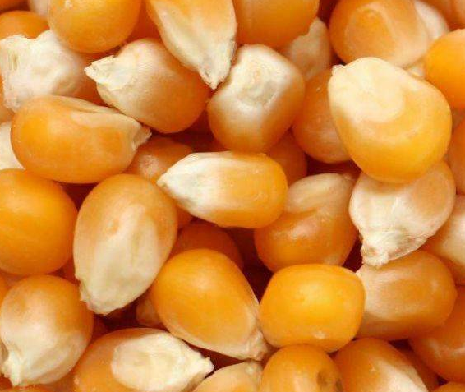
（二）玉米的储藏方法
method of wheat storage
玉米粒储藏
干燥密闭储藏。玉米要安全储藏的关键是提高入仓质量，降低粮食水分。收获后的玉米入仓前应进行充分干燥，在降低到安全水分之后过筛清杂，趁低温晴天入仓密闭储藏。Dry and sealed storage. The key to safe storage of corn is to improve the warehousing quality and reduce the water ratio of grain. The harvested corn should be thoroughly dried before being stored in the warehouse. After reducing to the safe water content, it should be sieved and cleared of impurities. It should be stored in a closed warehouse with low temperature on sunny day.
Corn kernel storage

Slide 26
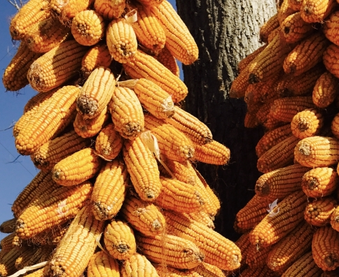
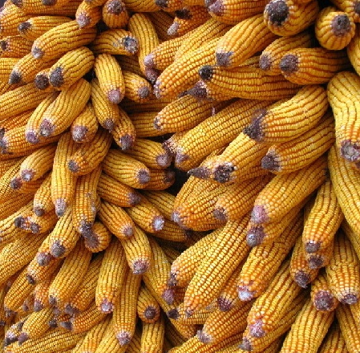
玉米果穗储藏
果穗堆内孔隙度大（可达51.7%），通风条件好，又值低温季节，因此，可在冬春季节长期通风条件下，玉米得以逐步干燥。当水分降到14.5%～15%时，即可脱粒转入粒藏。The porosity inside the ear pile is large (up to 51.7%), with good ventilation conditions, and it is also in the low-temperature season. Therefore, under long-term ventilation conditions in winter and spring, corn can be dried gradually. When the water ratio drops to 14.5% to 15%, it can be threshed and transferred to grain storage as corn kernels.
玉米果穗储藏，籽粒胚部埋藏在果穗穗轴内，对虫霉侵害有一定的保护作用，不易生虫和发霉。此外，穗轴内的养分在初期仍可继续输送到籽粒内，增加籽粒的养分。The storage of corn ears, when the germ of kernels is buried within the ear axis, could be protected from insect and mould damage. In addition, nutrients within the tassel can still be transported to the kernels at the beginning to increase the nutrient content of the grains.
Corn ear storage

Slide 27
04
常用防治储粮有害生物的方法
Common Methods of Pest Prevention and Control for Smallholders

Slide 28
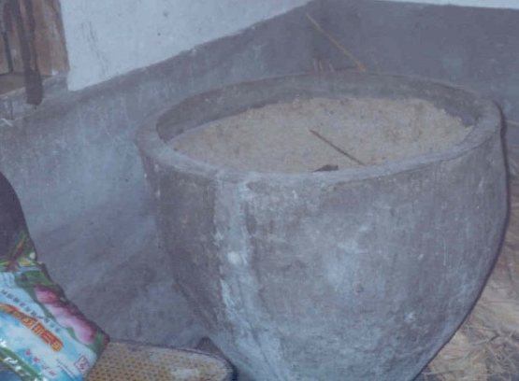
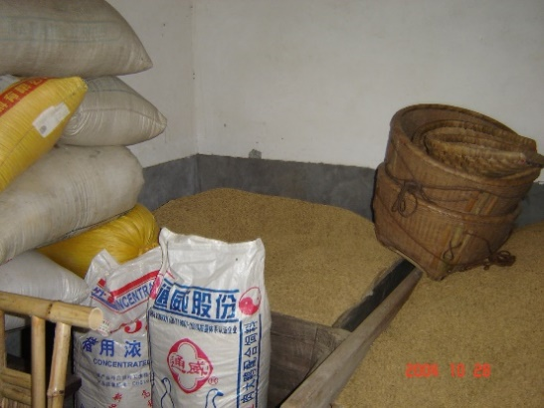
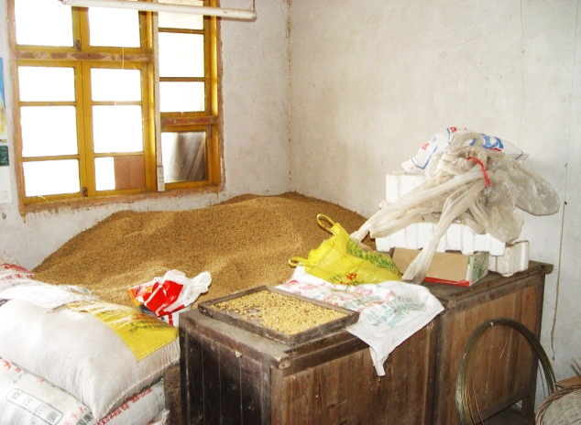
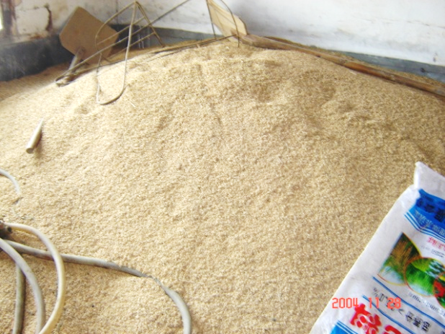
The storage equipment is at the primary level
农户储粮装具简陋
农户传统的简陋储粮方式
农户储粮损失较大，2005年全国农户储粮损失率为 8% 左右
中国粮食年产量大约一半储存在农户家中
损失原因：鼠害损失约占总损失量的49%，霉变的损失约占总损失量的30%，虫害的损失约占总损失量的21%。
Grain loss by rodent(49%), grain loss by mould (30%), grain loss by pests (21%)
Large storage quantities in households: around half of annual grain production in China
The rate of grain smallholder storage loss is high: around 8% in 2005 nationwide

Slide 29
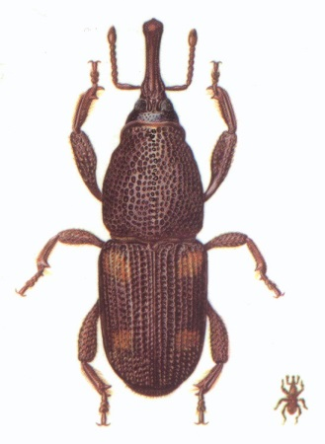
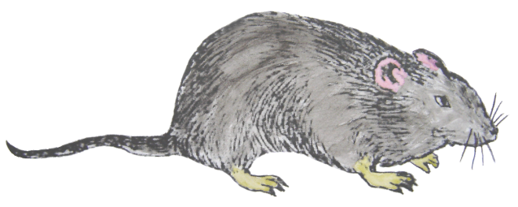
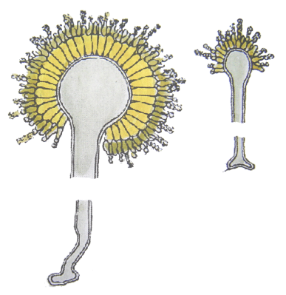
防虫、防鼠、防霉要点
优先采用密闭、翻晒、冷却等物理防治方法。
Key points of Pest, rodent and mildew prevention and control
Prioritize physical prevention and control methods such as sealing, drying, cooling, etc.
★ 防虫害
★ 防鼠害
★ 防霉变
Pest control
Anti-rodent damage
Mildew resistant

Slide 30
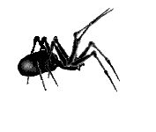
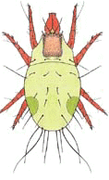
（一）防虫害
Pest control
基本情况：储粮害虫226种。 分为：甲虫、娥类和螨类。
There are 226 species of stored grain pests. Include: beetles, moths and mites
甲 虫
蛾
螨
Beetles Moths Mites

Slide 31
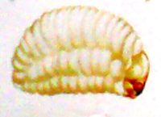
Sitotroga cerealella (Olivier)
一个生活周期分为四个虫态：卵、幼虫、蛹、成虫
害虫最喜欢的温度：25 ℃ ～35 ℃
危害最大的阶段：幼虫
A life cycle is divided into four insect states: egg, larva, pupa, and adult
Pest's favorite temperature: 25 °C ~ 35 °C
The most harmful stage: larvae
Sitophilus zeamais（Motschulsky）

Slide 32
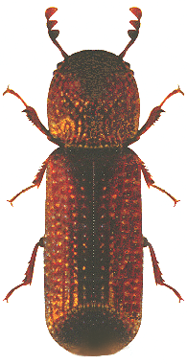
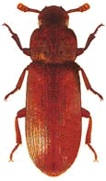
农户储粮常见的储粮害虫
Common stored grain pests
玉米象
谷 蠹
赤拟谷盗
锯谷盗
Sitophilus zeamais（Motschulsky）
Rhizopertha dominica (Fabricius)
Tribolium castaneum (Herbst)
Oryzaephilus surinamensis (Linnaeus)
麦 娥
Sitotroga cerealella (Olivier)

Slide 33
中国虫粮等级划分
Classification of grain damaged by pests in China
粮油种类 | 虫粮等级 | 害虫密度 | 主要害虫
原 粮 | 基本无虫 | ≤5 | ≤2
 | 一般虫粮 | 6～30 | 3～10
 | 严重虫粮 | ＞30 | ＞10
成品粮 | 应无虫
grade
Major pests
Types of grains and oils
Pest density
Basically insect-free grain
Grain with insect infestation
Raw grain
Grain with severe insect infestation
There should be no pests
Finished grain

Slide 34
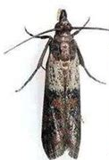
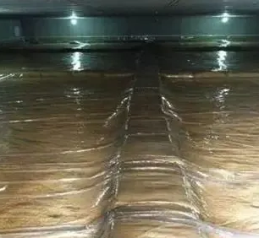
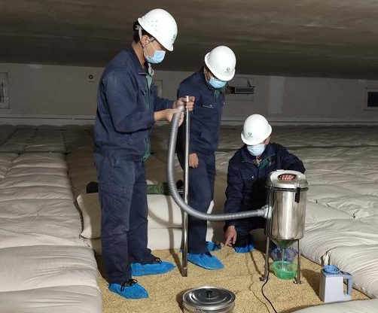
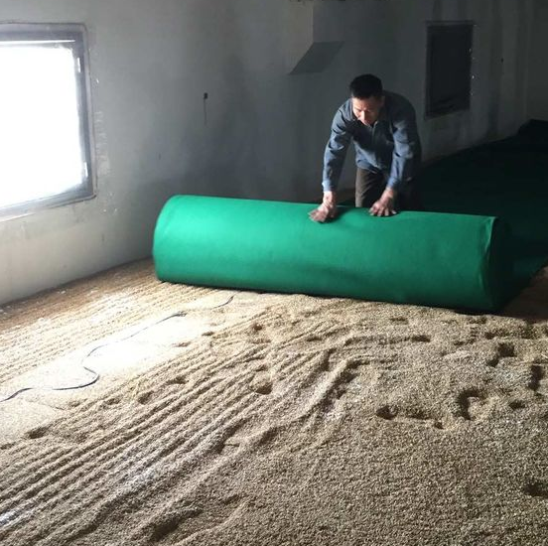
防治储粮害虫的方法
Methods of controlling stored grain pests
日光暴晒杀虫
一般情况下温度50℃左右持续2～4小时，即可将害虫全部杀死（注意：对稻谷不能采用日光曝晒！）。Normally if the temperature is around 50 ℃ for 2-4 hours, all pests can be killed (Note: paddy cannot be exposed to the sunlight directly!)
压盖粮面防虫
用来防治蛾类(主要是麦蛾)成虫，阻止其在粮面产卵；并能使粮粒内羽化出来的成虫无法活动而死亡。同时可以预防害虫感染。For controlling the adult moths (mainly wheat moths) to prevent them from laying eggs on the grain surface. It can make the adult insects that emerge from the grain unable to move and die. It can also prevent pest infections.
Pest control by exposure to sunlight
Covering the grain surface to prevent insects

Slide 35
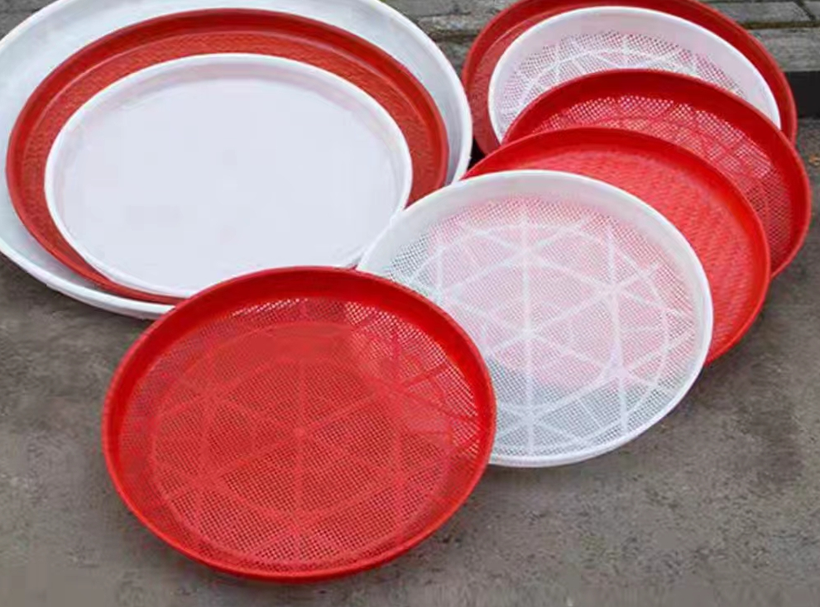
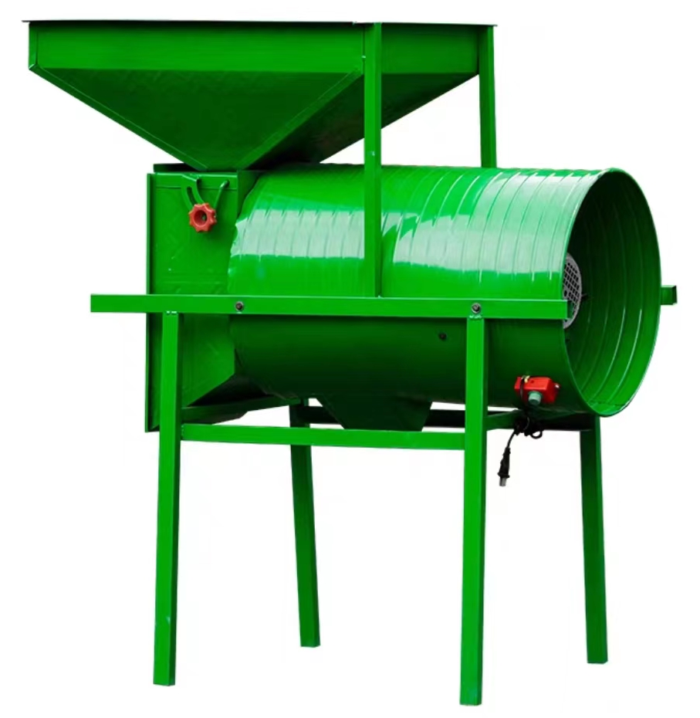
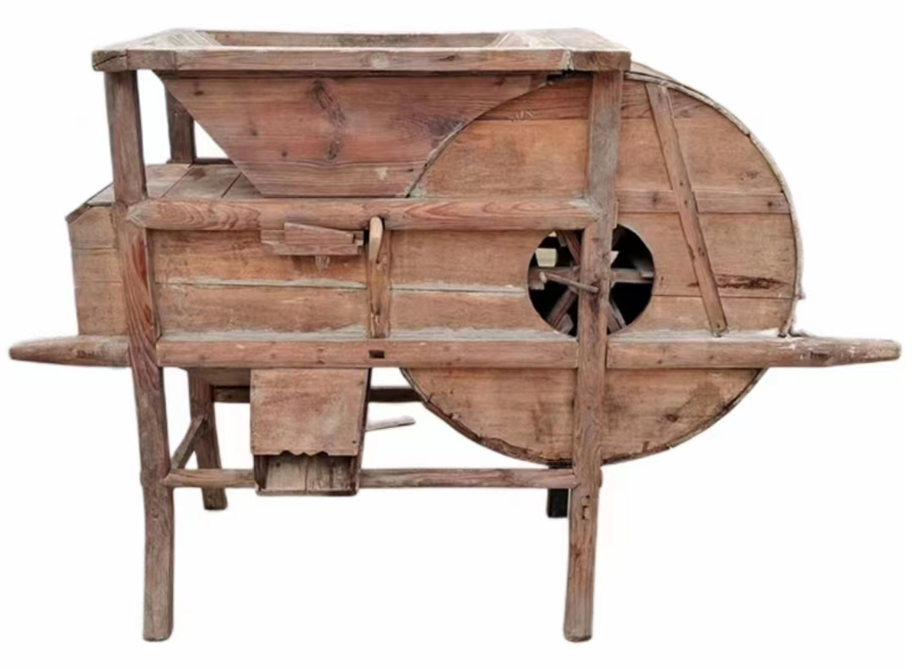
筛子除虫
利用粮粒和害虫的大小形状不同，用适当大小筛孔的筛子，通过过筛使它们分开。在筛中粮食厚度以2－3厘米为宜。For different sizes and shapes of grains and pests, using the sieve with proper sized holes to separate them through sieving. It is advisable the thickness of grain in the sieve is 2-3 centimeters.
风车除虫
由于比重和形状不同，比重轻的害虫、尘杂被风吹至较远的地方，比重大的粮粒落到较近的地方，使害虫与粮粒分离。Due to different densities and shapes, pests and dust with lighter densities are blown farther away by the wind, while grains with heavier densities fall closer, which could separate pests from grains.
Use a sieve to remove pests
Sieve
Use windmills to remove insects
Motor-driven windmill
Manual windmill

Slide 36
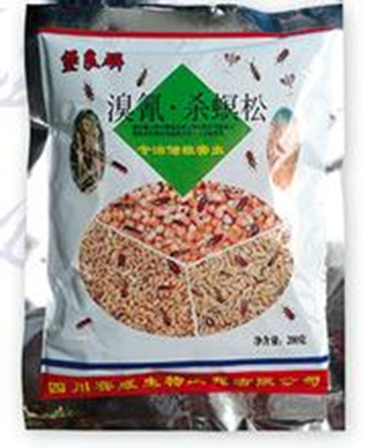
化学防治方法
经过配方筛选和反复试验，开发了专门用于农村储粮的防虫药剂（堡良磷），主要成分溴氰·杀螟松 。
Pesticide for grain storage in rural areas
Chemical control methods
Broad spectrum of insecticidal insects
配方独特，杀虫谱广
微胶囊缓释技术，有效期长
高效低毒，用量少
符合国家卫生标准
没有安全隐患
Long validity period
High efficiency and low toxicity
Meet the hygienic standards
no safety hazards

Slide 37
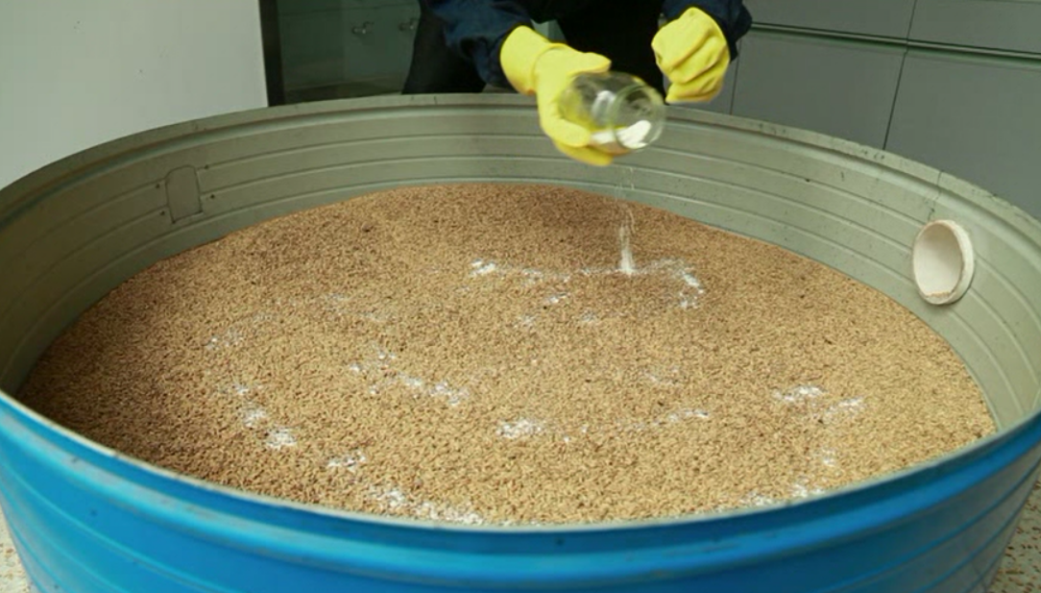
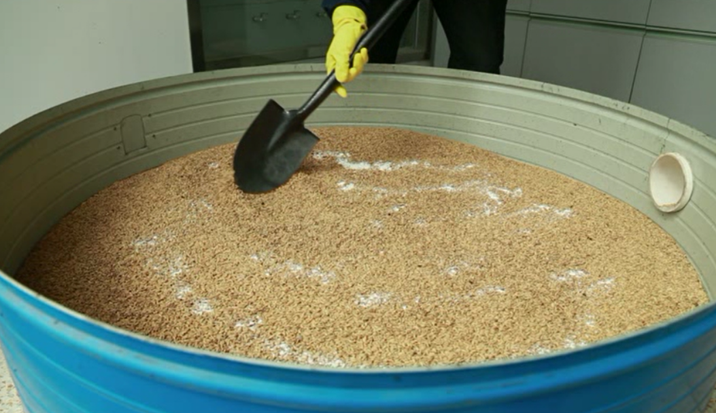
拌堡良磷防虫
Mix Baoliang Phosphorus to prevent insects
堡良磷用药量与原粮的比例为1：2500。即每袋100克的堡良磷可拌和原粮250公斤。
拌粉时，可戴纱布手套、风镜和纱布口罩，以防药粉污染皮肤或进入呼吸道。
如发现人员中毒，应及时送医院治疗。
The ratio of dosage to grain is 1:2500
Wear gauze gloves, goggles, and a gauze mask
If a person is found to be poisoned, should be sent to the hospital for treatment in time

Slide 38
！
注意事项
Finished grain
Cautions
堡良磷主要用于原粮和种子粮的防虫，不可用于成品粮；
使用堡良磷时，粮食一定要干燥（符合安全水分标准）；
适用于粮食无虫或基本无虫；
工作结束后，及时更换衣服,用肥皂洗手和洗脸。
cannot be used for finished grains
Dry grain with the safe water ratio
Suitable for grain without pests
Change clothes, wash hands and face

Slide 39
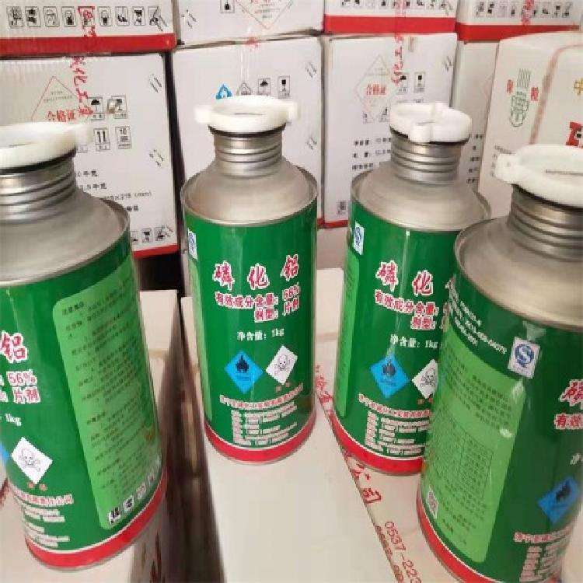
注意 事项
！
Cautions
中国对化学药剂的管理非常严格，严禁购买三证不全的储粮药剂。
（农药生产许可证或者农药生产批准文件、农药标准、农药登记证）
The management of chemical agents is very strict in China. It is strictly prohibited to purchase grain storage agents without three certificates: Pesticide Production License or Pesticide Production Approval Document, Pesticide Standards, Pesticide Registration Certificate)
农户储粮不要使用磷化铝进行熏蒸杀虫！
The aluminum phosphide for fumigation and insecticide is not applicable for smallholder grain storage!

Slide 40
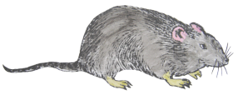
（二）防鼠害
Prevent rodent infestation
老鼠不但偷吃我们的粮食，而且还会污染粮食，对我们的身体健康造成危害。
据统计，全球每年因老鼠损失贮粮3500多万吨，因鼠害减产5000万吨，损失严重。
老鼠还是各种鼠源性疾病的传染源。全球90%的鼠种，携带着200多种病原体，能使人致病的病原体主要有57种。
解决防鼠问题，粮仓（装具）是关键。
Prevent grain storage from the rodent infestation, grain equipment is the crucial.

Slide 41
具体措施
Ways to prevent rodent infestation
环境防鼠：粮仓周围不堆放杂物，保持环境干净、整洁。
堵：经常清除杂物，搞好室内外卫生。把室内外鼠洞堵死、墙根压实，使老鼠无藏身之地，才易被发现并便于捕杀。
查：查鼠洞，摸清老鼠常走的鼠道和活动场所，为下毒饵、放捕鼠器提供线索。
Environment: clean and tidy granary without sundries nearby
Obstruction for rodents
Examine rodent burrows

Slide 42
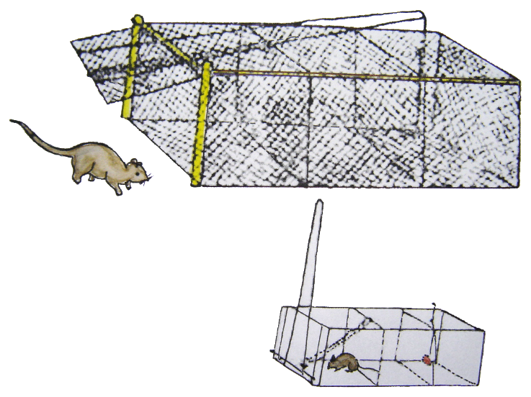
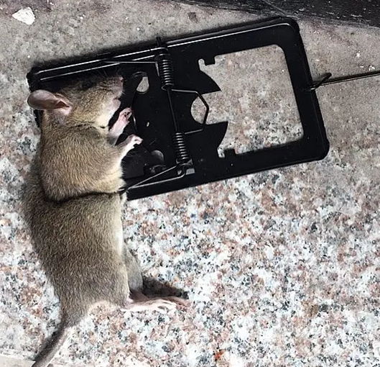
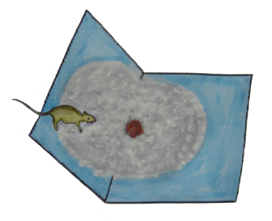
器械防鼠
放置鼠夹、鼠笼、粘鼠板等防治鼠害。用特制捕鼠用具如捕鼠笼、鼠夹、粘鼠胶等诱捕。安放鼠笼（夹）要放在鼠洞口，应与鼠洞有一定距离，有时用些伪装，可以提高捕杀效果；鼠笼上的诱饵要新鲜并勤换，应是鼠类爱吃的食物。一般第一个晚上老鼠不易上笼，二、三天后上笼率会提高。要勤查捕鼠器械，保持捕鼠器械干净、无异味。Placing the cage at the entrance of the mouse hole, at a certain distance from the hole. Sometimes camouflage is helpful. The bait on the rat cage should be fresh and frequently changed, which should be attractive food for mouse. Generally, it is not easy for mouse to get into cages on the first night, and the catching rate will be increased after two or three days. Checking the rat catching equipment frequently and keep it clean and odourless.
Use instruments to prevent hazards of rodent infestation
Mousetrap cage
Sticky rat board
Mouse traps

Slide 43
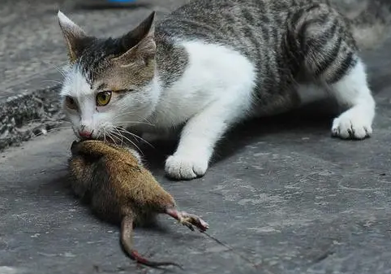
生物防鼠
猫是老鼠的主要天敌。猫善跳跃和攀登，眼睛调节焦距的能力很强，在漆黑的夜里也能“洞察一切”。猫的耳廓可自由转动，爪锋利，能伸缩，掌部有肉垫，行走无声，常常出其不意地奔到老鼠跟前，置鼠于死地。
Biological methods to prevent rodent infestation
养猫是农户最简单、有效的防鼠方法
Raising cats is the simplest and most effective way for farmers to prevent mouses

Slide 44
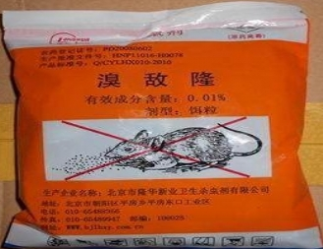
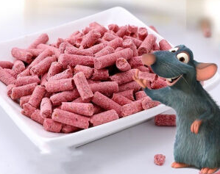
化学防鼠
饿：保管好食物，断绝鼠粮，清除垃圾，迫使老鼠食诱饵。
采用当地允许使用的杀鼠药剂治鼠。灭鼠一般应采用安全、高效的慢性灭鼠药，如杀鼠迷、敌鼠钠盐、溴敌隆等。通常可用小麦、稻谷、碎玉米等原粮作诱饵（要勤换诱饵），不宜用熟食，更不能用饼干、方便面等，以免被人误食。毒饵必须选用一般食品不用的深蓝或黑色作为警告色。
Prevent rodent infestation with chemicals
注意：必须是当地允许使用的杀鼠剂
尤其注意儿童和牲畜的安全
The rodenticide must be permitted locally
Cautions
Pay attention to the safety of children and livestock

Slide 45
注意 事项
！
Cautions
一定要购买当地允许能使用的鼠药，应到防疫部门或正规的销售点购买鼠药，不要从小商贩那里购买当地禁止使用的急性鼠药（剧毒鼠药）。Local permission of rodenticide
不能同食物、饲料混放，以防人畜误食中毒。Away from food and forage
要按规定用量投放毒饵，且要投到安全隐蔽的地方。居民点投放毒饵。灭鼠期间要照顾好幼儿。同时管好禽畜，数天后将鼠药全部收回，集中处理，并组织人员收集和掩埋鼠尸。Following instructions and use it in safe ways
发现有人中毒应立即送往医院救治。Emergency treatment in hospital for poisoning

Slide 46
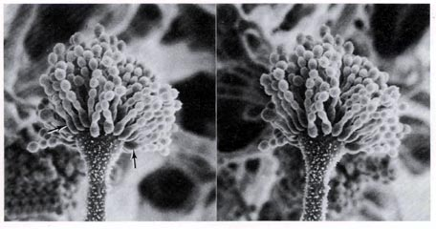
（三）防霉变
Mildew resistant
最重要的防霉措施：干燥
The most important anti-mildew measure: drying
★ 粮食必须干燥到安全水分才能安全储藏
Grain must be dried at the safe moisture level for safe storage
霉菌很小
当粮食发霉时，我们可看到粮食上会“长毛”，这就是霉菌。右图是在高倍显微镜下看到的霉菌图像。
Tiny mould

Slide 47
霉菌广泛存在于各种粮食中
低水分粮食的变质，几乎都是曲霉活动造成的。有些曲霉在代谢过程中能产生毒素，如黄曲霉毒素而使粮食带毒，危害人体健康。
The deterioration of low moisture grains is almost entirely caused by the activity of Aspergillus. Some Aspergillus can produce toxins during the metabolic process, such as aflatoxin, which can poison food and pose a threat to human health.
Mold is widely found in a variety of grains

Slide 48
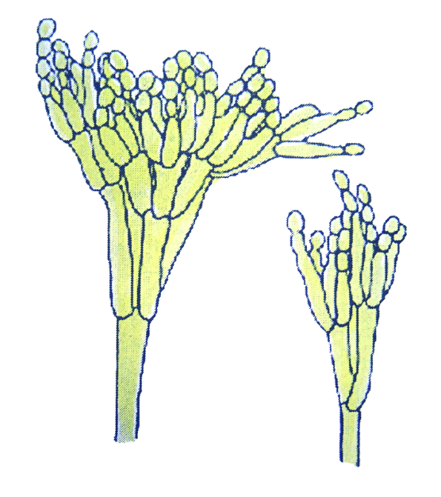
粮食上常见的霉菌有曲霉、青霉、毛霉和根霉，其中曲霉和青霉对储粮安全影响最大。Aspergillus and Penicillium have the greatest impact on the safety of grain storage
粮食发热霉变后，首先要查明原因，然后有的放矢地采取各种应急措施加以处理。After the grain is heated and mouldy, the first step is to identify the cause, and then take targeted emergency measures to deal with it.
发热霉变的粮食经过处理后，应单独存放。The heated and mouldy grains should be stored separately after processed.
对发热霉变粮食应根据品质劣变情况和霉菌毒素的检测，确定取舍及用途。The selection and utilization of heated and mouldy grains should be determined based on quality deterioration and detection of fungal toxins.
使用防霉剂处理过的粮食，不得供人食用。Grain treated with antifungal agents shall not be consumed by humans.

Slide 49
储粮霉变具体处理方法
Specific treatment methods for mouldy grain
Mouldy grain due to increasing of water content: exposure to sunlight to reduce the moisture
粮食含水量增高引发发热霉变：应采取日晒降低水分。
粮堆结露引起的上层发热霉变，要勤翻粮面，降温散湿。若上层发热霉变严重，则需将霉变粮食取出单独处理，除湿散热。
Mouldy grain due to condensation of grain bulks: flipping the grain surface, cooling and dispersing moisture. If the upper layer is severely heated and mouldy, the mouldy grains need to be taken out and treated separately for dehumidification and heat dissipation.

Slide 50
Mouldy grain due to excessive levels of impurities: removing impurities by sieving or winding
含杂过多引发霉变：应采取过筛或风选等方法除杂。
虫害集聚引发霉变：应采取曝晒、过筛除虫等办法处理。
下层粮食浸水、受潮等引发霉变：应倒仓，将底部发热霉变的粮食取出单独处理，同时检查仓底和铺垫情况，及时处理所存在的问题。
包装粮食发热霉变，应将发热霉变粮包取出摊晾。
Mouldy grain due to insect pest accumulation: exposure to sunlight and sieving
Mouldy grain due to packaged grain mildew: taking out the grain package for exposure to sunlight
Mouldy grain due to damped grain at the bottom: Cleaning the whole warehouse, taking out the heated and mouldy grains at the bottom and treated them separately. At the same time, checking the condition of the warehouse bottom and bedding, and promptly address any existing issues.

Slide 51
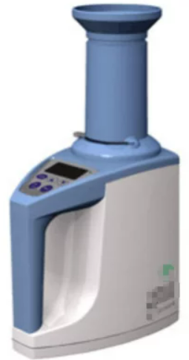
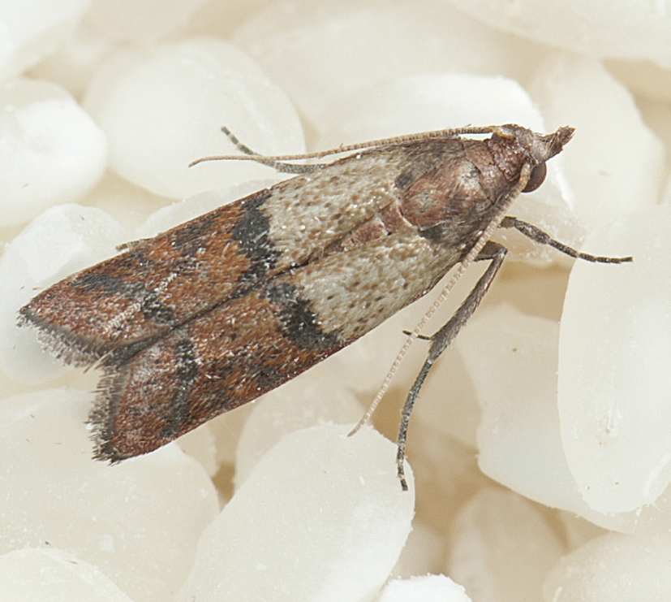
储藏期间的其他注意事项
Other cautions during grain storage
粮堆温度检测 检测方法： 通过将手伸进粮堆进行感官检测。
水分检测 检测方法： 通过手抓或牙咬进行感官检测。
虫口密度检测 检测方法： 定期检查有无害虫发生（可用筛子）。
Check the temperature of the grain: sensory testing by reaching into the grain bulk
Check the water ratio of the grain: sensory testing is performed through hand grasping or tooth biting.
Density inspection of pests in grains: periodic check (sieve is applicable)

Slide 52
Thank You
Sharing for Learning

