Slide 1
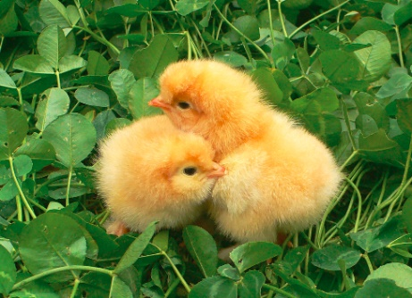
Incubation and hatching eggs
Qin Chu
Institute of Animal Husbandry and Veterinary Medicine，
Beijing Academy of Agriculture and Forestry Sciences

Slide 2

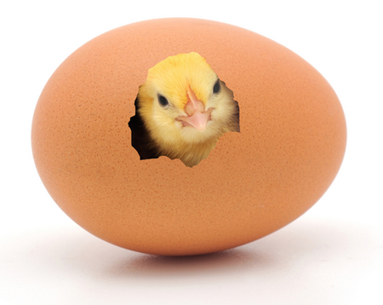
The purpose of chicken eggs
For
consumption
For
producing chicks

Slide 3
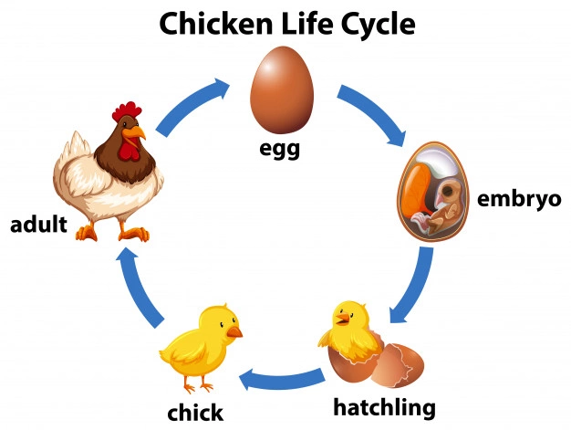
Incubation/
Hatching

Slide 4
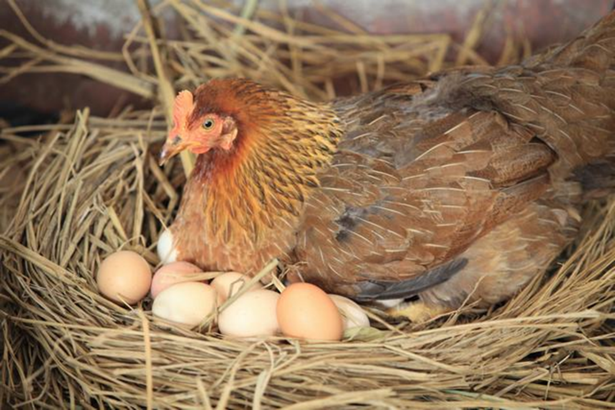
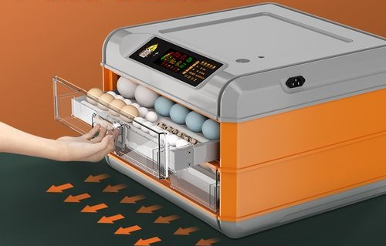
Chicken incubation types
Natural incubation
Artificial incubation
Broody hen
Incubator

Slide 5
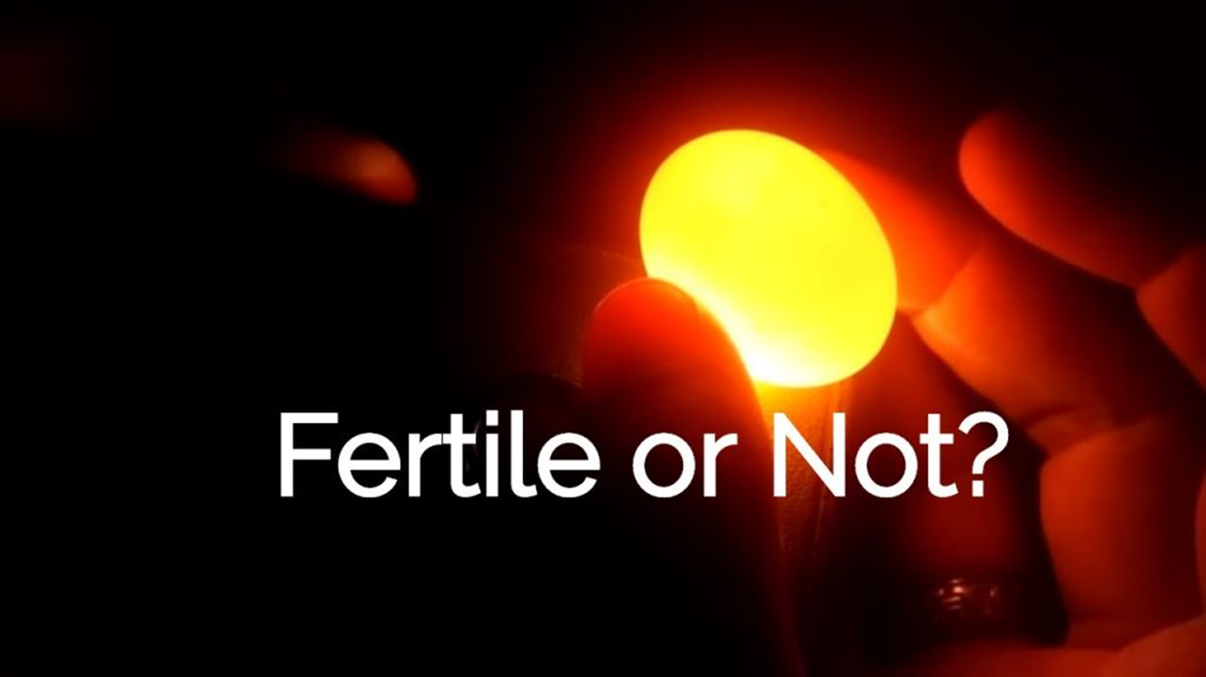

Slide 6
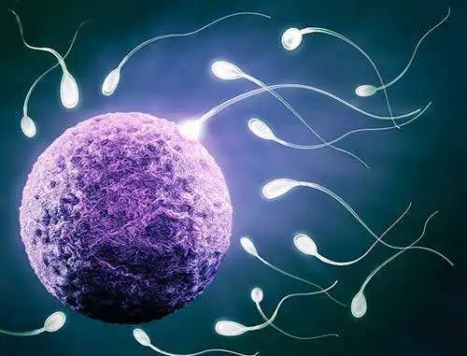

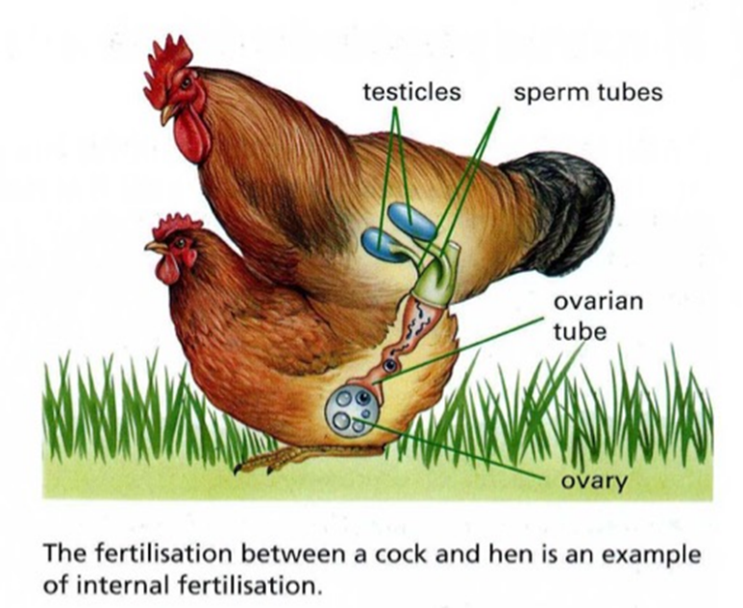
Hatching Egg
Also called fertile egg, which means the egg has been fertilized by a rooster and can develop into a baby chicken.
Fertilization occurred inside the hens 24 hours before the egg is laid.
In the hen’s body, a fertile egg begins the first step of embryonic development (a “bastodisc” to a “blastoderm”)
But, after laying out, it does not develop any further without incubation.
Fertilization
-24hours

Slide 7
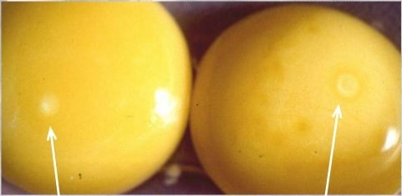
Fertile and Infertile Egg
20-60 thousand cells
4-5mm
Single cell
2-3mm
Infertile egg with blastodisc
= small white spot
Fertile egg with blastoderm
= bullseye appearance

Slide 8
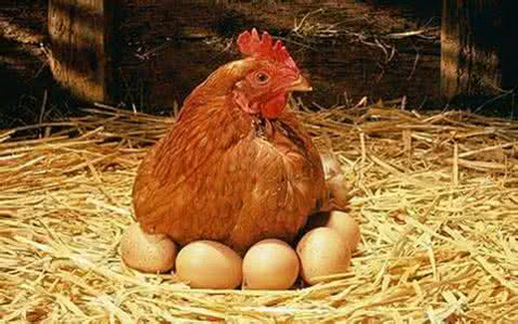
Hatchability is an important parameter
Hatchability is an index to measure the success of hatchery.
Percentage of hatchability
=
Number of chicks hatched
×100
Number of eggs incubated

Slide 9
Factors that affect hatchability
Breeder
Egg storage and transfer
Hatchery condition
Breeder genetics
Breeder age
Breeder health
Breeder nutrition
Correct male and female weight
Mating activity
Storage time
Storage conditions
Egg damage
Egg sanitation
Sanitation
Egg damage
Incubation management
Chick handling

Slide 10
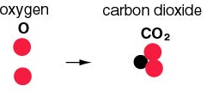
Incubation conditions for chicken
Hatching period: 21 days
Incubation temperature: 36.5-38.5℃
Humidity: 60-75%
Gas exchange: especially near the end of the incubation period.
Egg turning: 4 times a day
Transfer day: 18-19 day
Egg candling: 7-17 day

Slide 11
An example of incubation conditions (Beijing)
Day | Temperature (incubator) | Humidity | Ventilation | Note
1 | 38.0℃ in summer and autumn, 38.2℃ in winter and spring | 65% | 0
2
3
4
5
6
7 | Decreasing from 38.1℃ to 37.9℃ gradually | 60% | Grade 3
8
9
10 |  |  |  | Candling eggs
11 |  |  | Grade 6
12
13
14
15
16 |  |  | Grade 9
17
18
19 | 37.6 | 75% |  | Transfer eggs
20
21

Slide 12
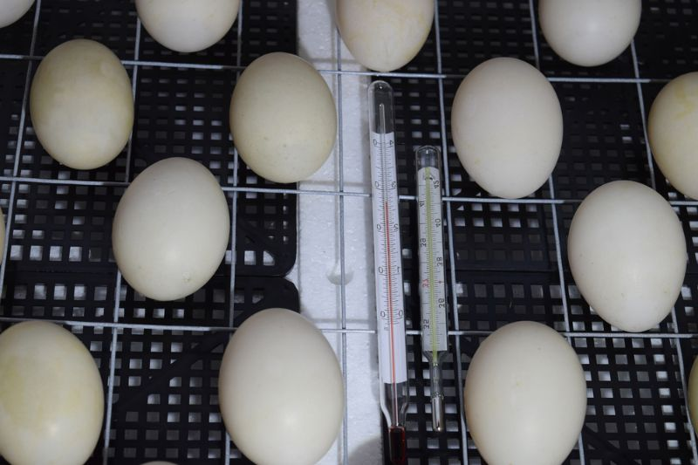
The importance of temperature on incubation
Temperature is the most critical factor in the incubation process.
The determining factor is not the temperature of the air, but the temperature of the embryo, which can be detected by the eggshell.
The optimal eggshell temperature is 37.7-38.0℃.
Eggshell temperature (℃) | Condition | Results
36.6-37.7 | Too cold | Slow hatch, poor chick quality
37.7-38.0 | Optimum | Good hatch, good chick quality
38.0-38.8 | Too warm | Good hatch, poor chick quality
39.0-40.0 | Too hot | Fast hatch, poor chick quality
Put a good thermometer near the egg.
Check the temperature at least twice a day.

Slide 13
What we need to do for hatching an egg?
Selection of an incubator
Selection of hatching eggs
Putting eggs into incubators: incubator sanitization, adjusting temperature and humidity and ventilation, setting the automatic turner; pre-warming eggs
To start incubating: turning eggs, candling eggs
Hatcher operation: after 18-19 days of incubation, transfer eggs to hatching baskets and stop turning
Chick take-off and processing

Slide 14
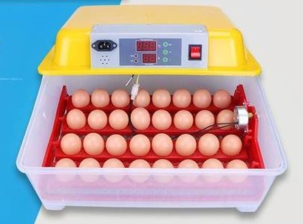
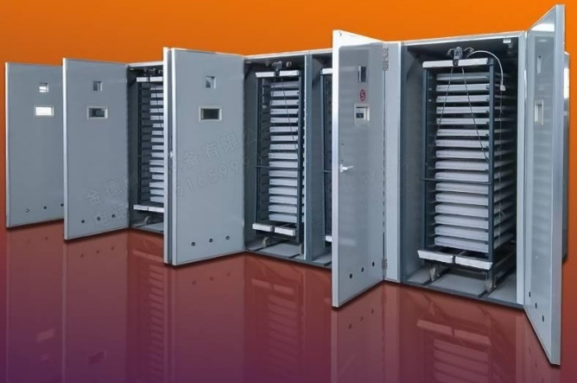
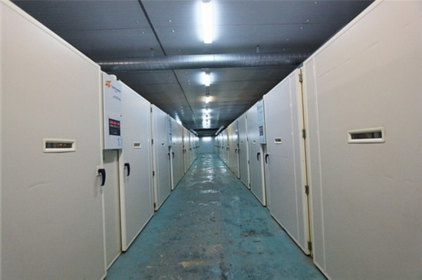
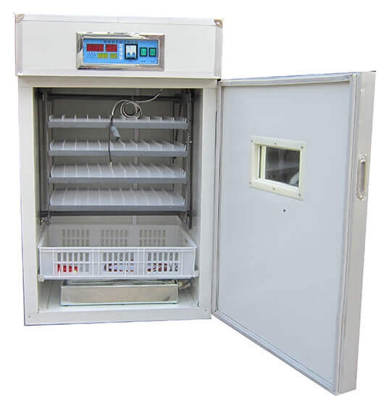
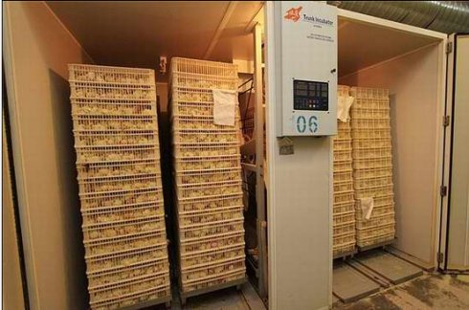
1. Selection of incubators
An incubator is basically a box that holds eggs while maintaining an appropriate temperature, humidity and oxygen level.
Incubators have varying capacities and adaptors for eggs.
Incubator room

Slide 15
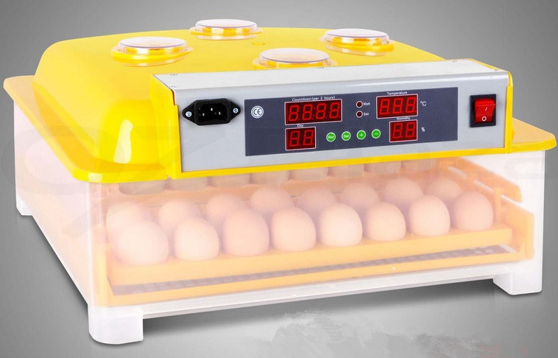
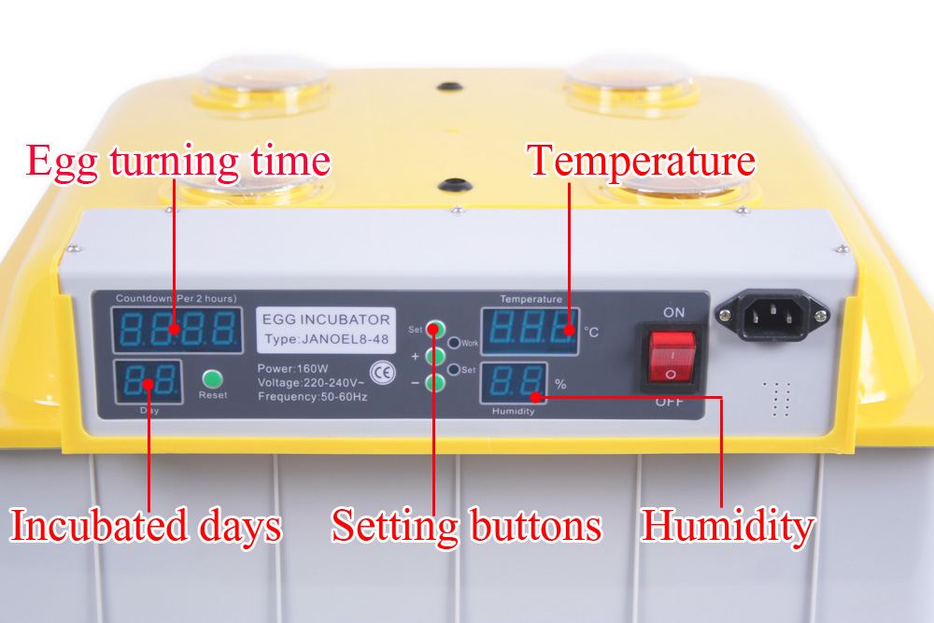
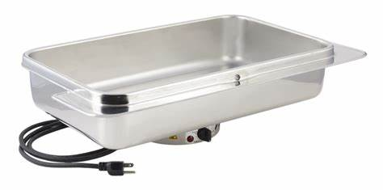
Small incubators
Small incubators can be used at home and for small numbers of eggs.
Small incubators have no ventilation system or fans
Some small incubators have no automatic turners. You need to turn the eggs manually.
Need to add water to the water pan frequently.

Slide 16
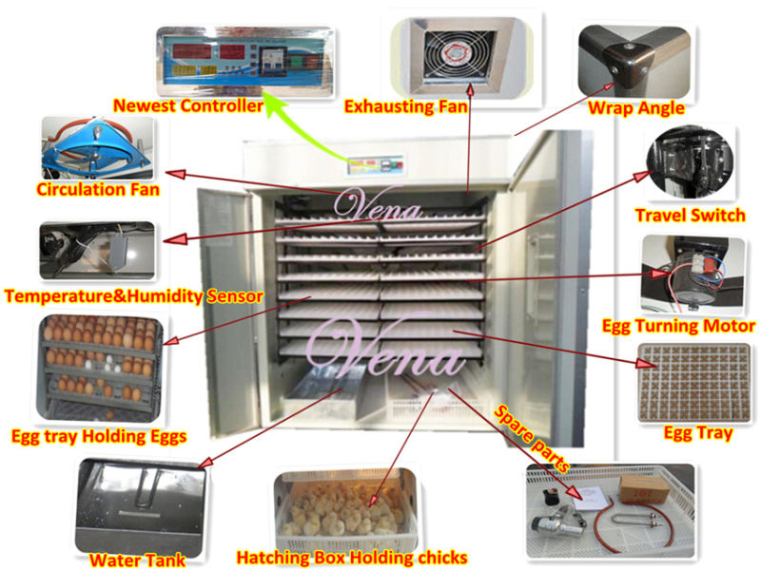
Medium or big incubators
These types of incubators often include humidifiers, temperature controllers, and ventilation systems, and automatic turners
The temperature and humidity in this type is more consistent!
Whenever possible, use it!

Slide 17
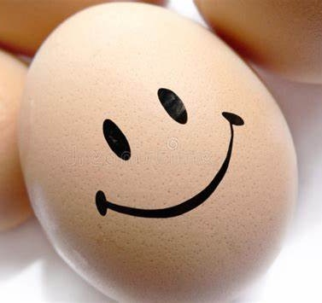
2. Selection of hatching eggs
Select eggs from breeders that are well developed, matured, mated and healthy.
Avoid eggs excessively large or small
Avoid eggs with cracked or thin shells.
Avoid eggs excessively misshapen.
Keep only clean eggs for hatching.

Slide 18
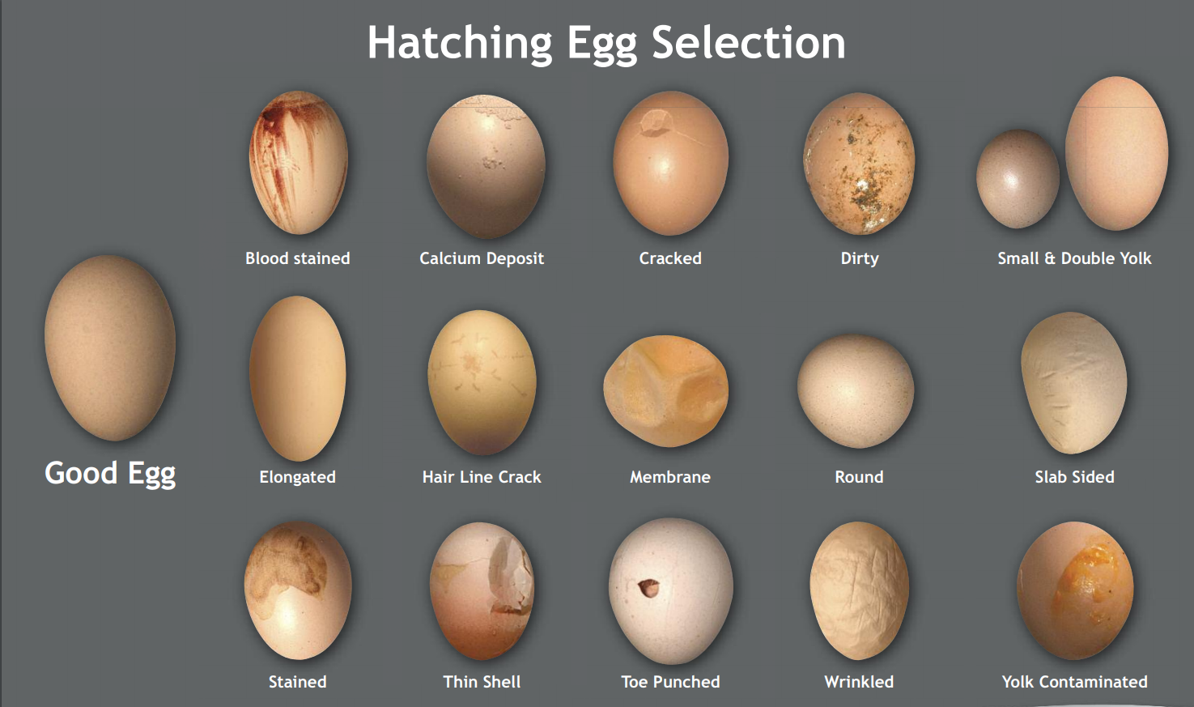

Slide 19
3. Putting eggs into incubators
Previous preparation
Sanitizing the incubator
Testing the temperature, humidity and ventilation, setting the automatic turner
Pre-warming eggs

Slide 20
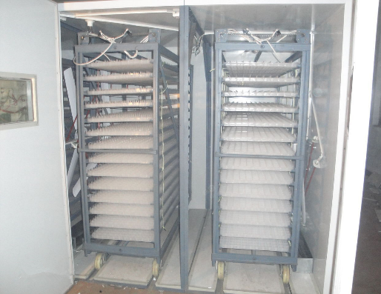

Sanitization
Fumigation with disinfectant is usually used at one or two days before starting incubation.

Slide 21
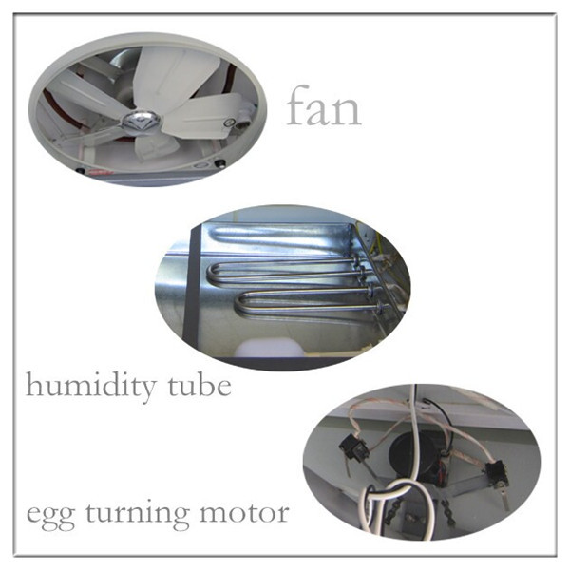
Testing the incubator
Run the incubator for several days before setting the eggs.
Ensure the incubator is maintaining the proper temperature, relative humidity,ventilation and egg turning.

Slide 22
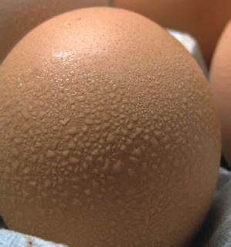
Pre-warming eggs
Prior to incubating, eggs should be removed out from the egg room and warm to room temperature for 4-8 hours.
Benefits:
Reduce the risk of embryo shock
Prevent condensation forming on the shell
Reduce the variation among egg temperatures at the time of incubating
condensation

Slide 23
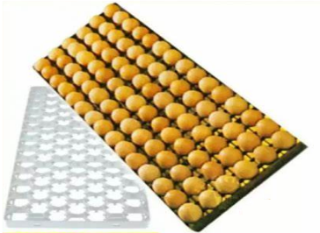
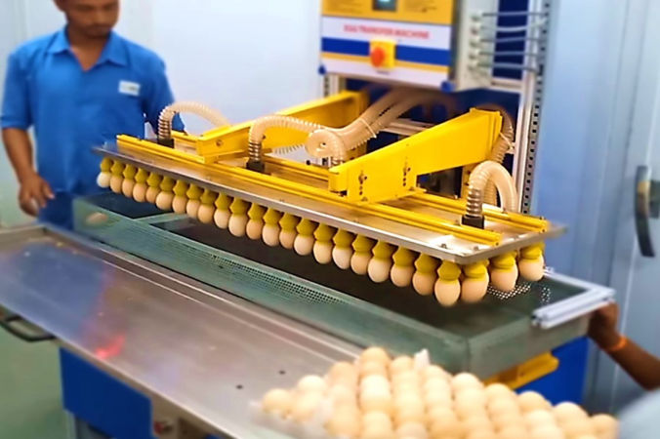
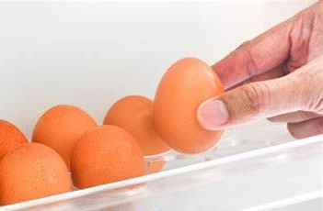

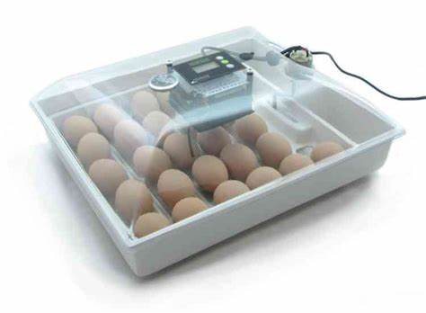
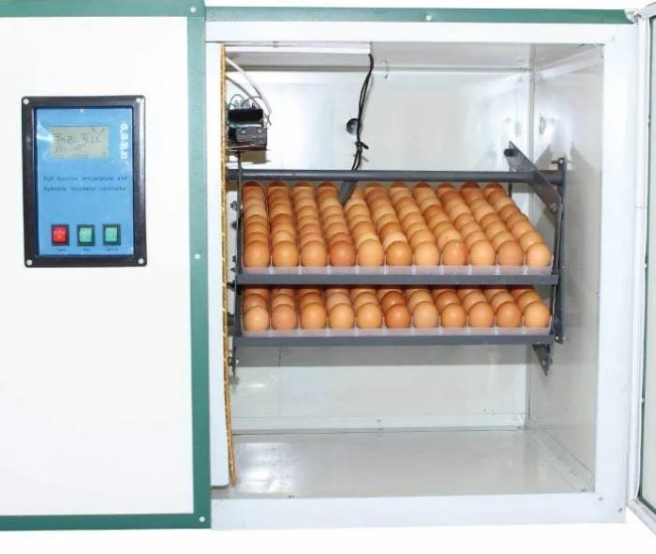
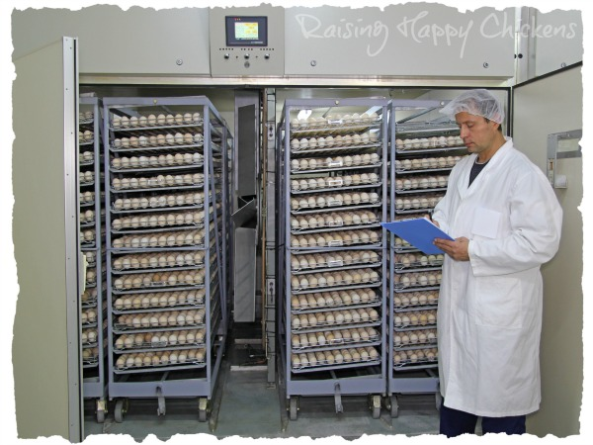
Putting eggs into the incubator
plastic egg setting tray
Putting eggs into the egg setting trays
Transferring to the incubator

Slide 24
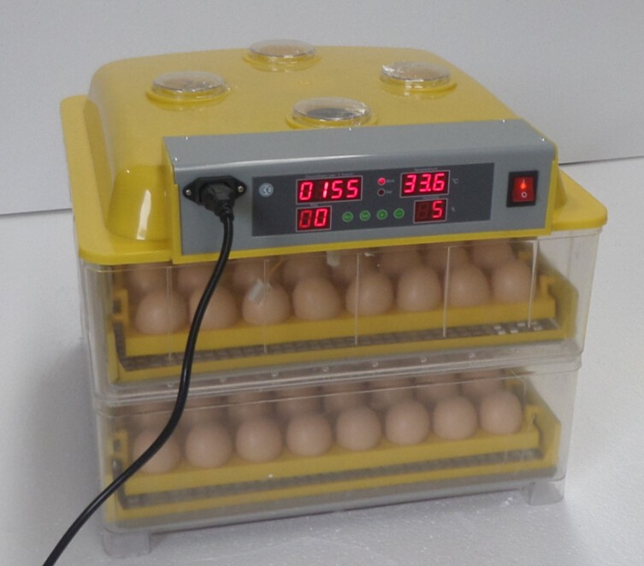
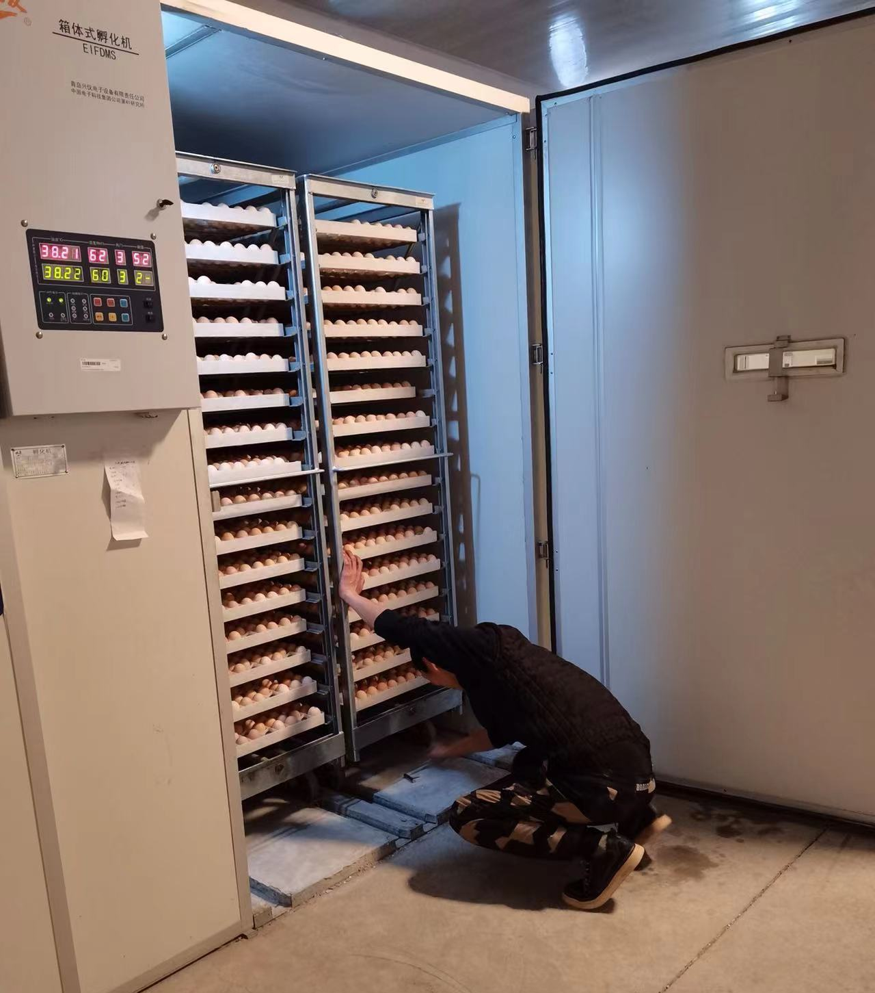
4. Start incubating
♥ ♥ ♥ Eggs are usually fumigated again in the incubator, before starting incubation.
Fumigation

Slide 25
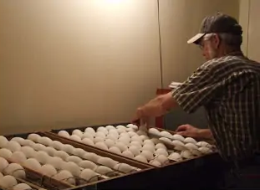
4. Start incubating
Maintaining the proper temperature, humidity
Turning eggs correctly.
When embryos begin to develop, they start their life on the upper side of the yolk.
If not turning the egg for a long period, the embryo may touch the shell member, and stick to the shell and die.
Turning eggs allow the embryos to encounter fresh nutrients and oxygen, and move away from metabolic wastes inside the eggs.
Turning eggs
by hand
Turning eggs
automatically

Slide 26
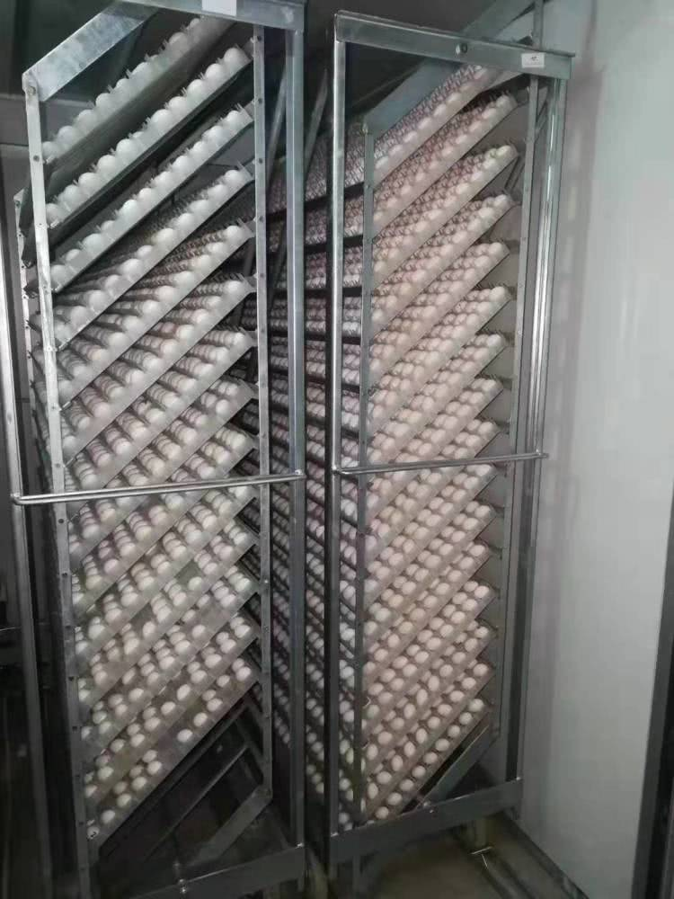
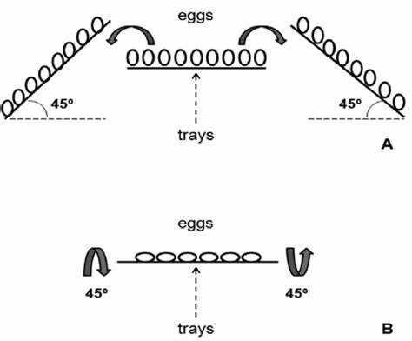
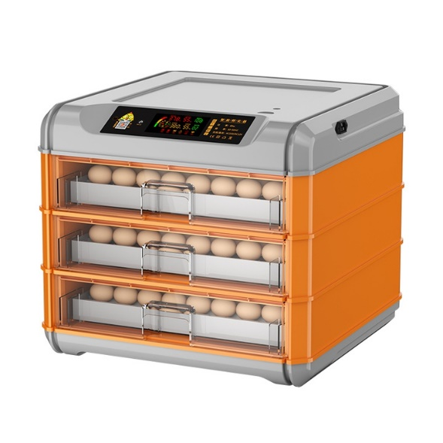
Egg turning in vertical and horizontal incubators
Eggs require to be rotated 90 degrees.
Vertical incubator
This is achieved by horizontally tilting the trays (vertical setters) or the eggs (horizontal setters) 45º angle from side to side.
Horizontal incubator

Slide 27
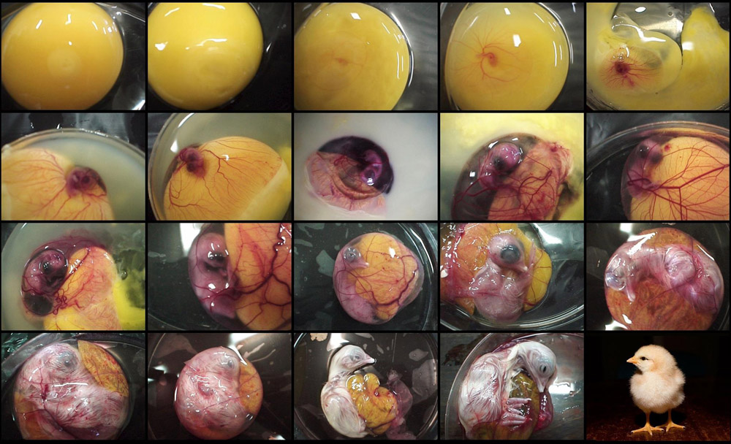
4. Start incubating
With the proper temperature, humidity, and egg turning, the embryo begins to develop day by day.
D1
D2
D3
D4
D5
D6
D7
D8
D9
D10
D11
D12
D13
D14
D15
D16
D17
D18
D19-20
Chicken embryo development

Slide 28
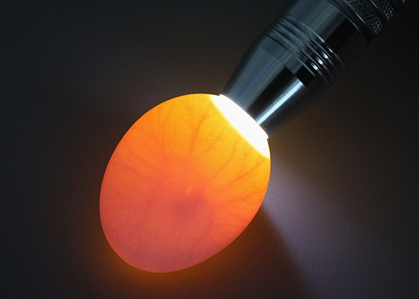
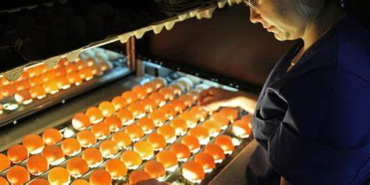
Candling eggs
Candling is the process of using light to help determine the quality of an egg.
Egg candler

Slide 29
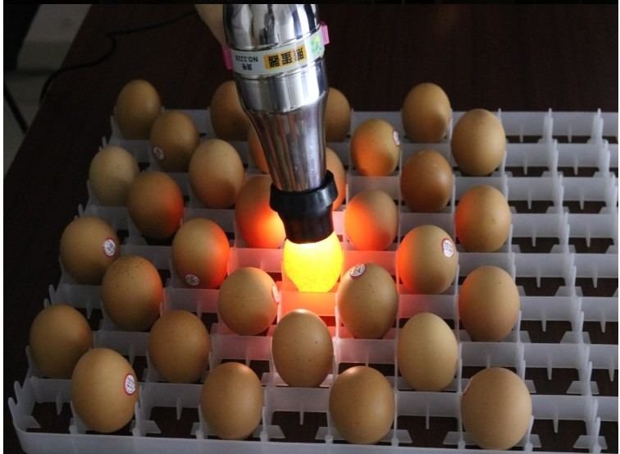
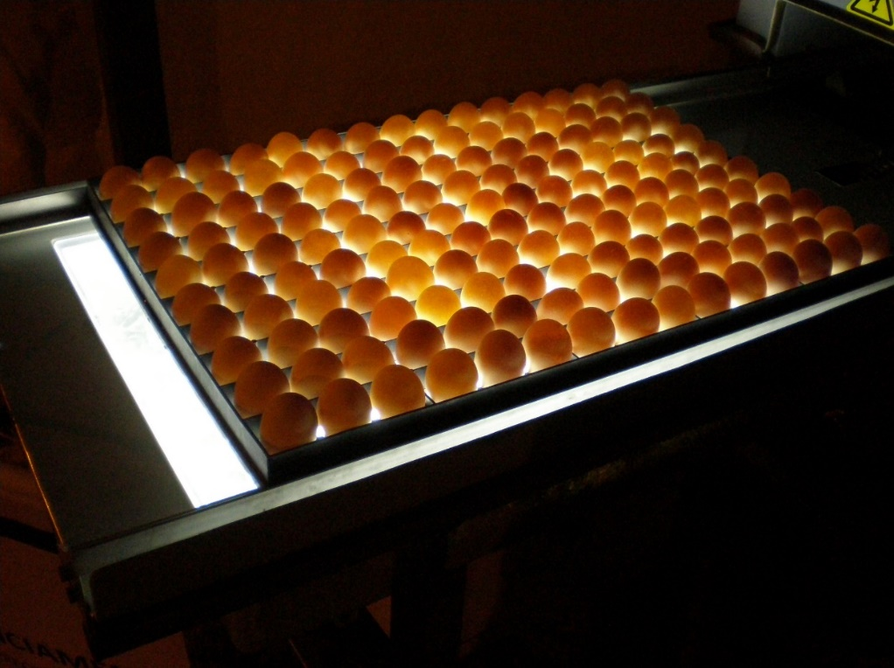
How to candle eggs?
For best results, candle eggs in a darkened room.
The candler should be held right against the shell at the larger end of the egg where the air sac is located.

Slide 30
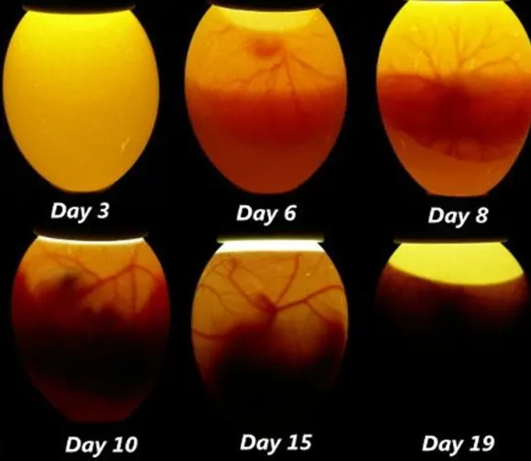
When should you candle eggs?
Time: 7-17 day for many times or once (at 10-11day)
The last few days of incubation are not recommended for candling since the chick moves into position to hatch.
Day 6 - developing embryo with healthy blood vessels
Day 15 – growing embryo with fully spread vein system - larger air cell
Day 10 - growing embryo and healthy spreading vein growth - larger air sac
Day 19 – almost fully developed embryo – dark mass with larger air cell

Slide 31
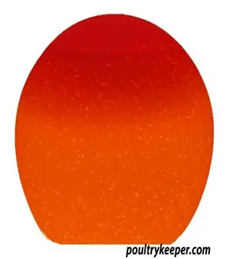
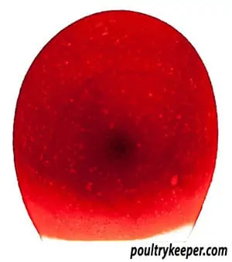
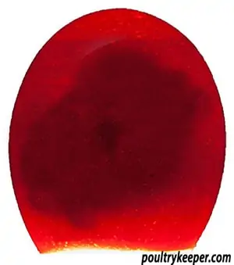
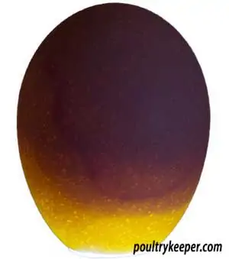
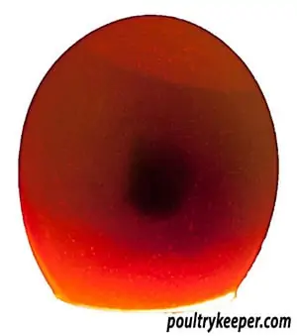
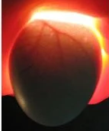
What you’re looking for inside the egg
At day 7
Infertile Eggs
Viable Embryo
A Quitter
Early Deaths
The embryo is in the middle. Spider-like veins are stretching out into the yolk.
We see the embryo.
But, contents are cloudy and move around.
The egg is clear.
A thin ring around the inside of the egg
A Quitter
Viable Embryo
The egg is getting full. It’s harder to see inside. Veins are visible.
Small dark area.
Contents are cloudy and move around.
At day 14

Slide 32


5. Egg transfer
At day 18, stop turning eggs
Transfer eggs from the incubator tray to the hatcher basket for piping

Slide 33

5. Egg transfer
Adjust the conditions in incubator/hatcher
Decrease the temperature
Increase the humidity
Ensure adequate ventilation

Slide 34

6. Chick take-off and processing
Once chicks successfully leave the shell, increase the ventilation and leave them inside for about 12 hours or until their feathers are dry.
Remove chicks out from the incubator/hatcher.

Slide 35

6. Chick take-off and processing
Remove chicks to a warm brooder
Give them water and feed.

Slide 36


Cleaning and Sanitizing the incubators
Dry cleaning (Remove all egg shells, dust and extra materials with a broom or vacuum)
Wet cleaning (Using a high pressure water gun, wash the incubator, incubating trays and hatcher baskets with water and disinfectant solution)
Fumigation (Dry the incubator and put the trays and baskets back. Then, fumigate for half an hour)

Slide 37
Reminders for incubation
Place the incubator in a room with a constant temperature, no drafts or direct sunlight.
Sanitize the incubator.
Wash hands before touching eggs. Keep germs, dirt and oil away from incubating eggs.
Keep the small end of the egg lower than the large end in vertical incubators.
Keep a watchful eye on temperature and humidity inside.
Record of incubator data daily.

Slide 38


Daily record
Incubator Data Chart
Hatchability and Mortality Record

Slide 39

Thanks for your attention!

