Slide 1

Construction of Grain Conservation and Loss Reduction Standard System
节粮减损标准体系建设
Lifei Yang, Senior Engineer
Standards and Quality Center, National Food and Strategic Reserves Administration

Slide 2
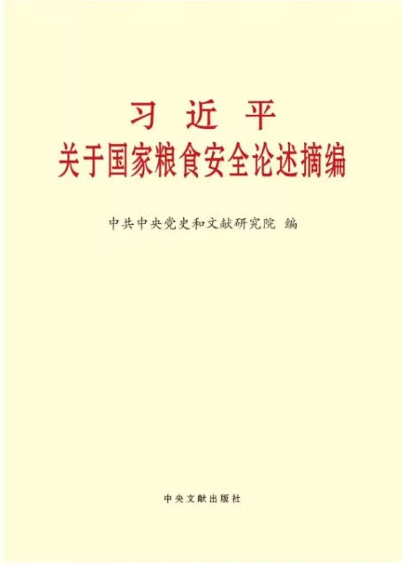
Chinese President Xi Jinping attaches great importance to food security and the work of saving and reducing grain losses
Food security is of paramount importance to the country, and solving the problem of food security has always been a top priority in governance.
Food security includes both quantity and quality safety
Food security is a fundamental issue concerning human survival, and reducing food loss is an important way to ensure food security; To ensure food security, efforts should be made simultaneously to increase production and reduce losses.

Slide 3
CONTENTS
节粮减损技术与节粮减损标准涵义界定
Definition of Grain Conservation and Loss Reduction Technologies and Standards
01
标准体系概念与节粮减损标准体系构建
Concept of Standard System and Construction of Grain Conservation and Loss Reduction Standard System
02
节粮减损典型标准和推动标准实施举措
Typical Standards for Grain Conservation and Loss Reduction and Measures to Promote Standard Implementation
03

Slide 4
01
节粮减损技术与节粮减损标准涵义界定
Definition of Grain Conservation and Loss Reduction Technologies and Standards

Slide 5
（一）节粮减损的涵义 Grain conservation and loss reduction
  损失与浪费：发展中国家损失严重，发达国家浪费严重。
  Loss and waste: developing countries suffer serious losses, while developed countries suffer serious waste.
  种植环节：节约用种，减少种子的使用
  Planting stage: Save seeds and reduce the use of seeds.
  收获环节：机械收割与人工收割
  Harvesting stage: Mechanical harvesting or manual harvesting?
  收购环节：增加收购粮源，快速收购
  Purchasing stage: Expand grain purchasing sources; rapid purchasing

Slide 6
  储存环节：减少储存期间的损耗
  Storage stage: Reduce losses during storage.
  运输环节：减少运输过程中的撒漏
  Transportation stage: Reduce grain leakage during transportation.
  加工环节：增加出品率，加强综合利用
  Processing stage: Increase production rate and strengthen comprehensive utilization.
  销售环节：设计更合理的包装规格
  Marketing stage: Design more reasonable packaging specifications.
  消费环节：适量点餐，减少浪费
  Consumption stage: Ordering meals moderately to reduce waste.

Slide 7
（二）节粮减损标准相关法律、政策文件 Legal and policy documents related to grain conservation and loss reduction standards
  《反食品浪费法》 Anti-Food Waste Law of the People’s Republic of China
  国务院商务主管部门应当加强对餐饮行业的管理，建立健全行业标准、服务规范。
  The commerce department of the State Council shall strengthen the management of the catering industry, establish and improve industry standards and service standards.
  国家粮食和物资储备部门应当加强粮食仓储流通过程中的节粮减损管理，会同国务院有关部门组织实施粮食储存、运输、加工标准。
  National Food and Strategic Reserves Administration shall strengthen the management of grain saving and loss reduction in the process of grain storage and circulation, and implement the standards of grain storage, transportation, and processing in conjunction with relevant departments of the State Council.

Slide 8
  国家完善粮食和其他食用农产品的生产、储存、运输、加工标准，推广使用新技术、新工艺、新设备，引导适度加工和综合利用，降低损耗。
  The state improves the production, storage, transportation, and processing standards of grain and other edible agricultural products, promotes the use of new technologies, processes, and equipment, and guides moderate processing and comprehensive utilization, to reduce losses.
  制定和修改有关国家标准、行业标准和地方标准，应当将防止食品浪费作为重要考虑因素，在保证食品安全的前提下，最大程度防止浪费。
  The formulation and revision of national, industry, and local standards should take the prevention of food waste as a significant consideration factor. Ensuring food safety as a priority, efforts should be made to maximize the prevention of waste to the greatest extent possible.

Slide 9
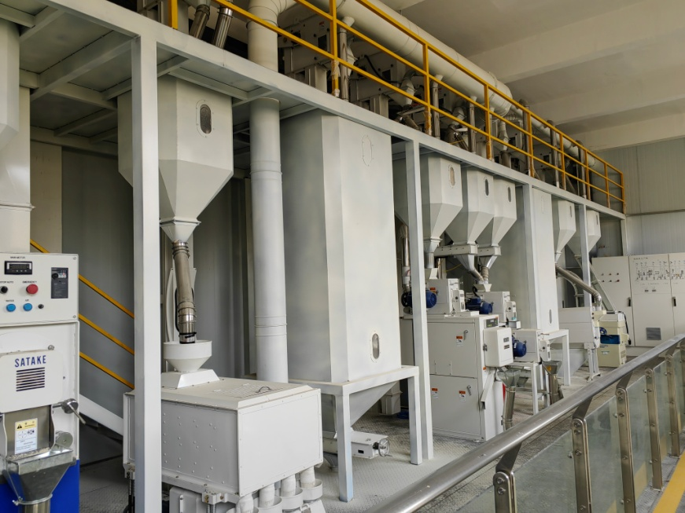
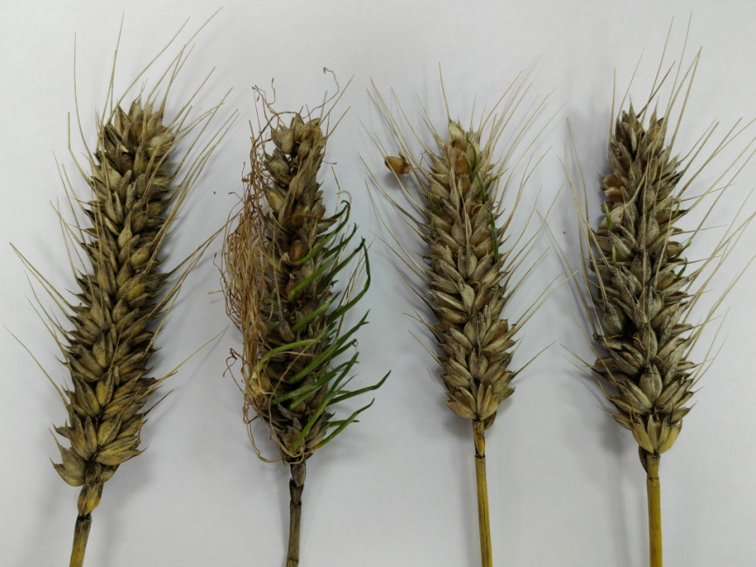
  《粮食安全保障法》Food Security Law of the People’s Republic of China
  有关粮食食品学会、协会等应当依法制定和完善节约粮食、减少损失损耗的相关团体标准，开展节约粮食知识普及和宣传教育工作。
  Relevant organizations such as grain and food associations should formulate and improve relevant group standards for saving food and reducing losses in accordance with the law, and carry out knowledge dissemination and publicity education on saving food.

Slide 10
  《粮食节约行动方案》 Food Conservation Action Plan
  到2025年，粮食全产业链各环节节粮减损举措更加硬化实化细化，推动节粮减损取得更加明显成效，节粮减损制度体系、标准体系和监测体系基本建立。
  By 2025, the measures for reducing grain conservation and loss reduction in the entire grain industry will be further strengthened, refined and more practical, achieving more significant results in grain conservation and loss reduction. The institutional system, standard system, and monitoring system for grain conservation and loss reduction will be basically established.
  制定修订水稻、玉米、小麦、大豆机收减损技术指导规范。
  Develop and revise technical guidelines for reducing mechanized harvesting losses of rice, corn, wheat, and soybeans.
  鼓励开展绿色仓储提升行动和绿色储粮标准化试点。
  Encourage the implementation of green storage improvement campaigns and pilot projects for green storage standardization.

Slide 11
  开展物流标准化示范。发展规范化、标准化、信息化散粮运输服务体系。
  Carry out the demonstration of logistics standardization. Develop a standardized, and information-based transportation service system for bulk grains.
  制定修订小麦粉等口粮、食用油加工标准，完善适度加工标准，合理确定加工精度等指标。
  Develop and revise processing standards for wheat flour and other staple foods, edible oil, improve moderate processing standards, and reasonably determine processing accuracy and other indicators.
  完善餐饮行业反食品浪费制度，健全行业标准、服务规范。
  Improve the anti-food waste system in the catering industry, establish standards of industry and service.

Slide 12
  研究运输工具标准化技术。
  Research on standardized technology for transportation vehicles.
  加快建立符合节粮减损要求的粮食全产业链标准，制定促进粮食节约的国家标准和行业标准。行业协会要制定发布全链条减损降耗的团体标准。
  Accelerate the establishment of standards for the entire grain industry that meet the requirements of grain conservation and loss reduction, and develop national and industry standards to promote grain conservation. Industry associations should develop and publish group standards for reducing losses and consumption throughout the entire value chain.

Slide 13
（三）流通环节节粮减损标准分类Classification of Grain Conservation and Loss Reduction Standards in Circulation Processes
  降低损失损耗相关标准 Standards related to reduce loss
  粮食收购标准 Standards related to grain purchasing
  粮食储存标准 Standards related to grain Storage
  粮食运输标准 Standards related to grain transportation
  粮食销售标准 Standards related to grain marketing
  提高产出相关标准 Standards related to improve output
  适度加工标准 Standards related to Moderate processing
  全谷物标准 Standards related to Whole grain
  强化综合利用标准 Standards related to strengthen comprehensive utilization

Slide 14
02
标准体系概念与节粮减损标准体系构建
Concept of Standard System and Construction of Grain Conservation and
Loss Reduction Standard System

Slide 15
中国标准类型
Standard Types in China
政府标准
市场标准
Government-issued
Standards
Market-issued
Standards
国家标准
团体标准
National Standards
Group Standards
行业标准
Industry Standards
企业标准
地方标准
Enterprise Standards
Local
Standards
推荐性标准
强制性标准
Voluntary Standards
Mandatory Standards

Slide 16
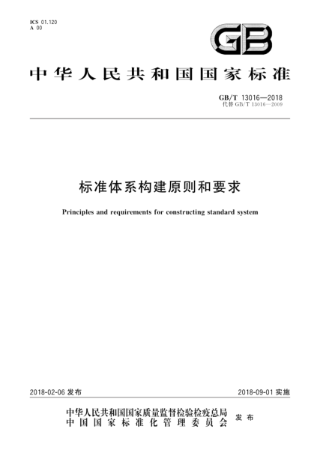
（一）标准体系的概念
标准体系：一定范围内的标准按其内在联系形成的科学的有机整体。
Standard system: A scientific organic formed by the internal connections of standards within a certain range.
标准体系表 Standard System Table
  标准体系结构图 Standard Architecture Diagram
  标准明细表 Standard Detail Table
  标准统计表 Standard Statistical Table
GB/T 13016-2018

Slide 17
（二）节粮减损标准体系的构建原则 Principles for the Construction of Grain Conservation and Loss Reduction Standard System
目标明确：围绕节粮减损构建标准体系。
Clear goal: build a standard system on grain conservation and loss reduction.
全面成套：粮食收购、储存、加工、运输、销售全链条的现行标准。
Comprehensive set: current standards for the entire value chain of grain purchasing, storage, processing, transportation, and marketing.
层次适当：共三个层次
Appropriate hierarchy: three levels in total
划分清楚：按粮食流通过程划分边界，以粮食领域国家标准、行业标准为主。
Clear delineation: delineate the boundaries of standards according to the process of grain circulation, mainly based on national and industry standards in the field of grain.

Slide 18
（三）
Framework of Grain Conservation and Loss Reduction Standard System
1 Purchasing standards
2 Storage standards
4 Transportation standards
1.2 Oil material
1.1 Raw grains and miscellaneous grains
3 Processing standards
5 Marketing Standards
2.3 Storage quality assessment
2.1 Green grain storage
2.2 Grain silo construction
6 Evaluation Standards
3.1 Processed grain
3.3 Whole grains
3.4 Moderate processing
3.5 Utilization of by-products
4.2 Transportation packaging
4.1 Transportation management
3.2 Vegetable oil
5.1 Marketing packaging
6.1 Evaluation for Indicators of Grain Conservation and Loss Reduction
6.2 Evaluation for Effects of Grain Conservation and Loss Reduction
2.4 Storage machinery
4.3 Transportation machinery
3.6 Processing Machinery

Slide 19
（四）节粮减损标准体系明细表 Detailed Table of Grain Conservation and Loss Reduction Standard System
原粮、杂粮标准子体系标准明细表（部分示例）
List of Standard Sub-systems for Raw Grains and Miscellaneous Grains (Partial Examples)
标准体系编号 Standard system No. | 子体系名称 Sub-system Name | 标准编号 Standard No. | 标准名称 Standard name | 标准级别 Standard level
1.1 | 原粮、杂粮 Raw grains and miscellaneous grains | GB 1350-2009 | 稻谷 Paddy | 国家标准 national standard
 |  | GB 1351-2023 | 小麦 Wheat | 国家标准 national standard
 |  | GB 1353-2018 | 玉米 Maize | 国家标准 national standard
 |  | GB/T 11760-2021 | 青稞 Hulles barley | 国家标准 national standard

Slide 20
油料标准子体系标准明细表（部分示例）
List of Standards for Oil Standard Sub-system (Partial Examples)
标准体系编号 Standard system No. | 子体系名称 Sub-system Name | 标准编号 Standard No. | 标准名称 Standard name | 标准级别 Standard level
1.2 | 油料 Oil material | GB 1352-2023 | 大豆 Soybean | 国家标准 national standard
 |  | GB/T 11761-2021 | 芝麻 Sesame seed | 国家标准 national standard
 |  | GB/T 11762-2006 | 油菜籽 Rapeseed | 国家标准 national standard
 |  | GB/T 1532-2008 | 花生 Peanut | 国家标准 national standard
 |  | GB/T 15681-2022 | 亚麻籽 Flaxseed | 国家标准 national standard

Slide 21
绿色储粮标准子体系标准明细表（部分示例）
List of Standard Sub-systems for Green Grain Storage (Partial Examples)
标准体系编号 Standard system No. | 子体系名称 Sub-system Name | 标准编号 Standard No. | 标准名称 Standard name | 标准级别 Standard level
2.1 | 绿色储粮 Green grain storage | GB/T 25229-2010 | 粮油储藏 平房仓气密性要求 Grain and oil storage - Requirement of airtightness of horizontal warehouse | 国家标准 national standard
 |  | GB/T 26879-2011 | 粮油储藏 平房仓隔热技术规范 Grain and oil storage - Technology regulation of heat insulation in warehouse | 国家标准 national standard
 |  | LS/T 1225-2022 | 氮气气调储粮技术规程 Code of practice for nitrogen-controlled atmosphere grain storage | 行业标准 industry standards
 |  | LS/T 1226-2022 | 粮库智能通风控制系统 Intelligent ventilation system for grain warehouse | 行业标准 industry standards
 |  | LS/T 1227-2022 | 惰性粉储粮防虫技术规程 Code of practice for inert powder against pests in grain storage | 行业标准 industry standards

Slide 22
粮仓建设标准子体系标准明细表（部分示例）
List of Sub-system Standards for Grain Storage Construction (Partial Examples)
标准体系编号 Standard system No. | 子体系名称 Sub-system Name | 标准编号 Standard No. | 标准名称 Standard name | 标准级别 Standard level
2.2 | 粮仓建设 Grain Storage Construction | LS/T 8012-2023 | 气膜钢筋混凝土圆顶仓设计规范 Code for design of air membrane reinforced concrete dome silo | 行业标准 industry standards
 |  | LS/T 8013-2023 | 气膜钢筋混凝土圆顶仓工程施工与验收规范 Code for construction and inspection of air membrane reinforced concrete dome silo | 行业标准 industry standards
 |  | LS/T 8014-2023 | 高标准粮仓建设标准 Construction standard for high-standard granary | 行业标准 industry standards

Slide 23
植物油标准子体系标准明细表（部分示例）
List of Standard Sub-systems for Vegetable Oil (Partial Examples)
标准体系编号 Standard system No. | 子体系名称 Sub-system Name | 标准编号 Standard No. | 标准名称 Standard name | 标准级别 Standard level
3.2 | 植物油 vegetable oil | GB/T 1534-2017 | 花生油 Peanut oil | 国家标准 national standard
 |  | GB/T 1535-2017 | 大豆油 Soya bean oil | 国家标准 national standard
 |  | GB/T 1536-2021 | 菜籽油 Rapeseed oil | 国家标准 national standard

Slide 24
全谷物标准子体系标准明细表（部分示例）
List of Standard Sub-systems for Whole Grains (Partial Examples)
标准体系编号 Standard system No. | 子体系名称 Sub-system Name | 标准编号 Standard No. | 标准名称 Standard name | 标准级别 Standard level
3.3 | 全谷物 Whole grains | GB/T 42173-2022 | 发芽糙米 Germinated brown rice | 国家标准 national standard
 |  | GB/T 42227-2022 | 留胚米 Germ-remained milled rice | 国家标准 national standard
 |  | LS/T 3244-2015 | 全麦粉 Whole wheat flour | 行业标准 sector standards
 |  | LS/T 3321-2023 | 马铃薯全粉 Whole potato flour | 行业标准 sector standards

Slide 25
适度加工标准子体系标准明细表（部分示例）
Moderate Processing Standard Sub-system Standard Detail Table (Partial Examples)
标准体系编号 Standard system No. | 子体系名称 Sub-system Name | 标准编号 Standard No. | 标准名称 Standard name | 标准级别 Standard level
3.4 | 适度加工 Moderate processing | LS/T 1231-2023 | 稻米加工技术规程 Technical procedures for rice processing | 行业标准 industry standards
 |  | 质检办便函〔2014〕15号 | 菜籽油适度加工技术规程 Technical procedures for moderate processing of rapeseed oil | 行业标准计划 industry standards Plan
 |  | 国粮办发〔2017〕177号 | 花生油适度加工技术规程 Technical procedures for moderate processing of peanut oil | 行业标准计划 industry standards Plan
 |  | 质检办便函〔2014〕15号 | 大豆油适度加工技术规程 Technical procedures for moderate processing of soybean oil | 行业标准计划 industry standards Plan

Slide 26
副产物利用标准子体系标准明细表（部分示例）
List of Standard Sub-systems for By product Utilization (Partial Examples)
标准体系编号 Standard system No. | 子体系名称 Sub-system Name | 标准编号 Standard No. | 标准名称 Standard name | 标准级别 Standard level
3.5 | 副产物利用 Utilization of by-products | GB/T 35131-2017 | 油茶籽饼、粕 Oil-tea camellia seed cake and meal | 国家标准 national standard
 |  | GB/T 42225-2022 | 小麦麸 Wheat bran | 国家标准 national standard
 |  | LS/T 3269—2020 | 油用米糠 Rice bran for edible oils | 行业标准 industry standards
 |  | LS/T 3320—2020 | 米糠粕 Rice bran meal | 行业标准 industry standards

Slide 27
03
节粮减损典型标准和推动标准实施举措
Typical Standards for Grain Conservation and Loss Reduction and
Measures to Facilitate Standard Implementation

Slide 28
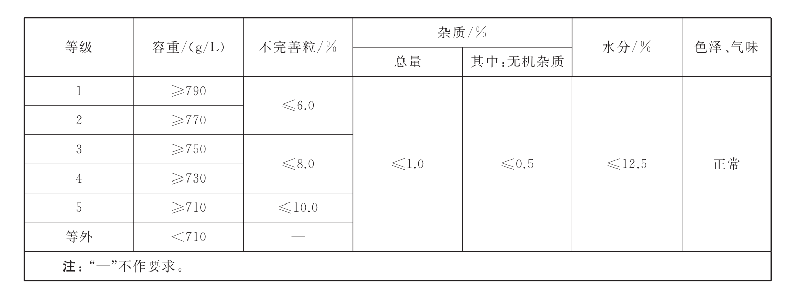
（一）节粮减损典型标准Typical Standards for Grain Conservation and Loss Reduction
GB 1351-2023《小麦》 Wheat
从质量要求指标看，2023版与2008版相比，质量要求没有变化.
From the perspective of quality requirements, there is no change in quality requirements between the 2023 version and the 2008 version.

Slide 29
《小麦》标准修订要点Key points for revising the "Wheat" standard
主要修改内容 Main modifications | 重要意义 Significance
生芽粒定义：芽或幼根虽未突破种皮但胚部种皮已破裂或明显隆起且与胚分离的颗粒，或芽或幼根突破种皮不超过本颗粒长度的颗粒。 | 以种皮破裂来判断可以解决实际检测难把握的问题，提高“不完善粒率”准确度，减少对增扣量、质价标准的不利影响，更有利于小麦收购政策的执行。
Definition of budding granules: granules that have not yet broken through the seed coat but have ruptured or significantly risen from the embryo, or granules that have not broken through the seed coat by more than the length of the granule. | Judging by the rupture of seed coat can solve the problem of testing difficulty, improve the accuracy of “incomplete granules rate", reduce the adverse effects on the deduction amount and quality price standards, and support the implementation of wheat purchase policies.

Slide 30
《小麦》标准修订要点Key points for revising the "Wheat" standard
主要修改内容 Main modifications | 重要意义 Significance
生霉粒定义： 籽粒粒面生霉的颗粒 | 解决了生霉粒、霉变粒定义交叉混淆的问题，有利于提高粮食收购、储存等过程中的检验一致性
Definition of moldy kernels: the surface of grain kernels with mold | Solved the problem of cross-contamination between moldy grains and severely moldy kernels, which is beneficial for improving the consistency of inspection during grain purchasing, storage and other stages

Slide 31
GB 1352-2023《大豆》 Soybean
《大豆》标准修订要点Key points for revising the "Soybean" standard
重要影响：等内大豆占比约从66%提高到90%，有利于调动农民种粮积极性，有效增加收购粮源，减少等外大豆损失浪费，促进国产大豆生产。
Important impact: The proportion of domestically produced soybeans has increased from approximately 66% to 90%, which encourages farmers' enthusiasm for grain cultivation, effectively increasing the purchasing grain sources, reducing losses and waste externally produced soybeans, and promoting the domestic soybean production.
等级 Grade | 原标准损伤粒率 Original standard of damage particle rate | 新标准损伤粒率 New standard of damage particle rate
1 | ≤1.0% | ≤4.0%
2 | ≤2.0% | ≤6.0%
3 | ≤3.0% | ≤8.0%
4 | ≤5.0% | ≤10.0%
5 | ≤8.0% | ≤12.0%

Slide 32
GB/T 1355-2021《小麦粉》Wheat flour
《小麦粉》标准修订要点Key points for revising the "Wheat Flour" standard
除了小麦和水，不允许添加任何食品添加剂和辅料。
Except for wheat and water, no food additives or excipients are allowed to be added.
产品等级由“特制一等”“特制二等”“标准粉”“普通粉”调整为“精制粉”“标准粉”“普通粉”三个类别，降低了加工程度要求，理论上总出粉率能提高0.5%-3%。
The product grade has been adjusted from "Special First Class", "Special Second Class", from "Standard Powder“ and "Ordinary Powder" to three categories: "Refined Powder", "Standard Powder", and "Ordinary Powder". By reducing the processing requirements, the total powder yield can be increased by 0.5% -3% theoretically.

Slide 33
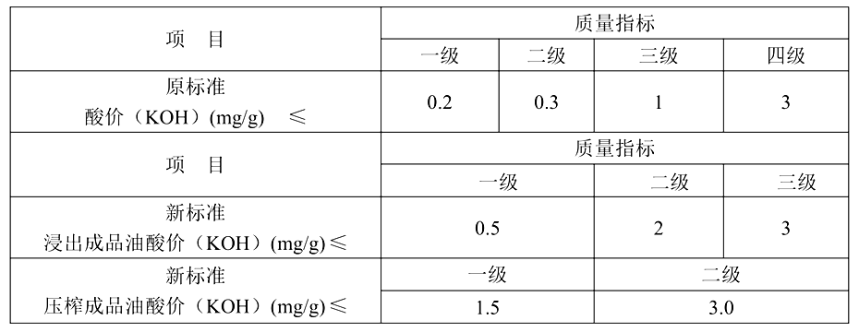
GB/T 1536-2021《菜籽油》“Rapeseed Oil”
《菜籽油》标准修订要点Key points for revising the "Rapeseed Oil" standard
降低了酸价、烟点等指标要求，如酸价做了较大幅度的调整，促进企业适度加工，增加出油率，保留更多营养物质。
Reduced the requirements for indicators such as acid value and smoke point and made significant adjustments to acid value to promote moderate processing by enterprises, increase oil yield, and retain more nutrients.

Slide 34
GB/T 1354-2018《大米》Rice
《大米》标准修订要点 Key points for revising the "Rice" standard
对加工精度要求设置上限；
Set upper limits for processing accuracy requirements;
规定加工精度超出规定范围的产品，判定为非等级产品；
Products with a processing accuracy that exceeds the specified range shall be judged as non-grade products;
适当弱化了加工精度要求；
Moderately weakened the requirement for processing accuracy;
适当弱化了碎米及其中小碎米含量要求。
Moderately weakened the requirements for broken rice and content of small and medium-sized broken rice.

Slide 35
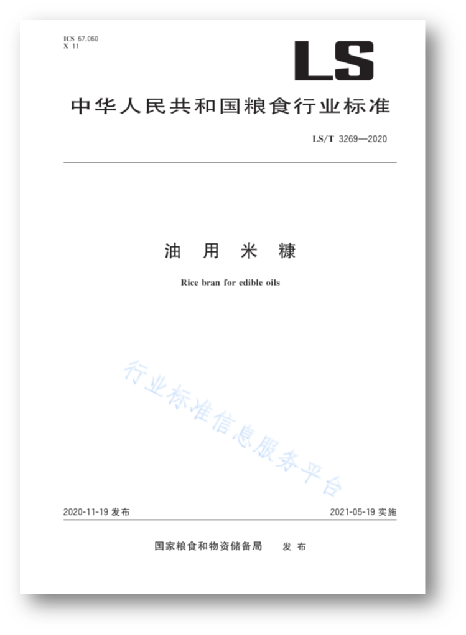
LS/T 3269-2020《油用米糠》Rice bran for edible oils

Slide 36
米糠是稻谷的精华，含有稻谷中绝大部分营养生理活性成分，因此米糠油是营养价值很高的优质食用油。
Rice bran is the essence of rice, which contains most of the nutritional and physiological active ingredients in rice. Therefore, rice bran oil is a high-quality edible oil with high nutritional value.
米糠组分：粗脂肪含量15%～22%、蛋白质含量11%～15%、淀粉含量34%-62%、粗纤维24%～29%、矿物质6.6%～9.9%。新鲜的米糠水分≤13%，呈浅黄白色至黄褐色，有淡淡的米香味。
Rice bran’s components: crude fat content of 15% -22%, protein content of 11% -15%, starch content of 34% -62%, crude fiber content of 24% -29%, minerals content of 6.6% -9.9%. Fresh rice bran has a moisture content of ≤ 13%, presenting a light-yellow white to yellow brown color with a faint rice aroma.
米糠特性：脂肪酶的含量及活性很高，新鲜米糠若不及时钝化酶类，其中的脂肪快速酸败分解，造成米糠酸价大幅升高，并产生陈腐气味。
Rice bran’s characteristics: The content and activity of lipase are very high. If the enzymes in fresh rice bran are not passivated in time, the fat in it will quickly decay and decompose, causing a significant increase in the acid value of rice bran and producing a stale odor.

Slide 37
《油用米糠》的技术经济效益：The technical and economic benefits of " Rice bran for edible oils ":
通过制定油用米糠标准以及对油用米糠定等分级，可以引导稻米加工和米糠油加工企业充分重视米糠质量，促使企业通过采用先进工艺技术和加强管理提升米糠质量。
By establishing standards for rice bran used in oil and grading rice bran used in oil, it can guide rice processing and rice bran oil processing enterprises to fully value the quality of rice bran, and encourage them to improve the quality of rice bran by adopting advanced technology and strengthening management.
提高米糠质量，可显著降低米糠毛油酸价、色泽，提升毛油品质，提高米糠油精炼得率，避免过度精炼，高效保留米糠油中的营养成分，减少有害成分生成，降低米糠油生产中的能量消耗，提高米糠制油利用率，助力米糠油产业可持续发展。
Improving the quality of rice bran can significantly reduce the acidity and color of rice bran crude oil, enhance the quality of crude oil, increase the refining yield of rice bran oil, avoid excessive refining, efficiently retain the nutritional components in rice bran oil, reduce the generation of harmful components, lower energy consumption in rice bran oil production, and help promote the sustainable development of the rice bran oil industry.

Slide 38
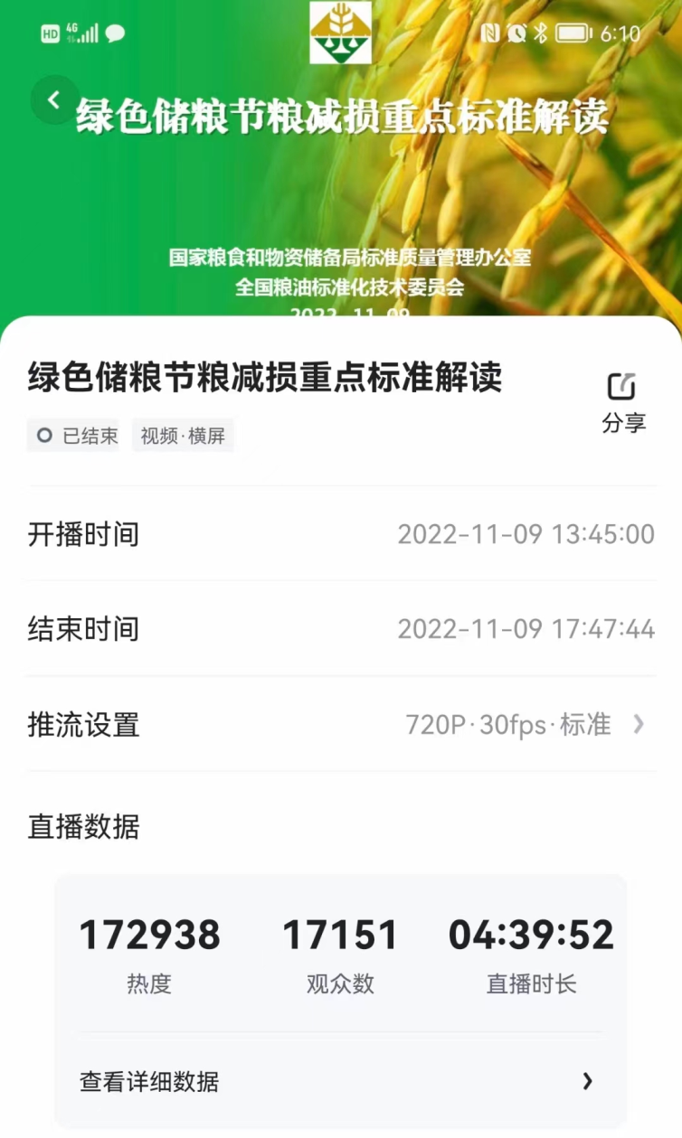
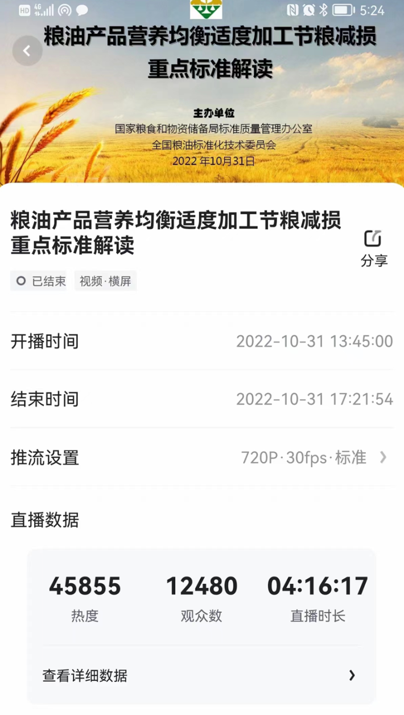
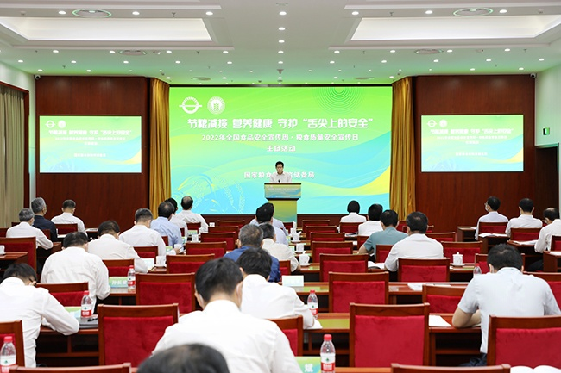
（二）推动节粮减损标准实施的举措
Measures to facilitate the implementation of grain conservation and loss reduction standards
开展多种形式的重点标准宣传解读。
Carry out various forms of promotion and interpretation of key standards.

Slide 39
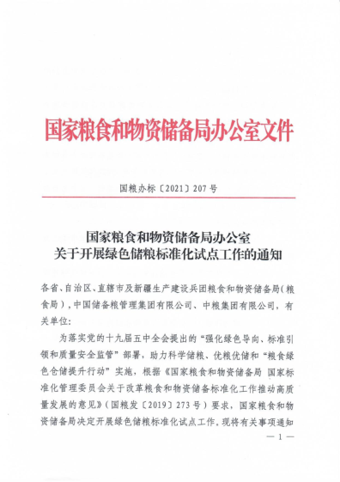
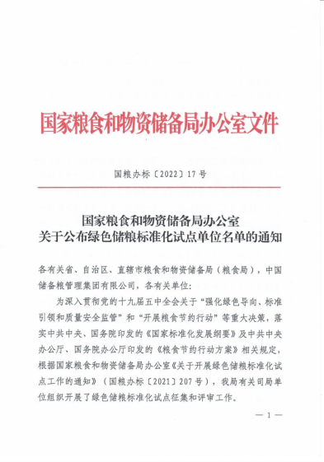
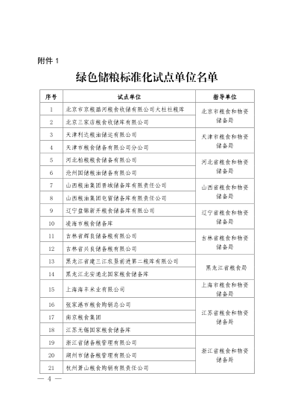
开展绿色储粮标准化试点，推进绿色储粮标准实施
Carry out pilot projects for green grain storage standardization and facilitate the implementation of green grain storage standards.

Slide 40
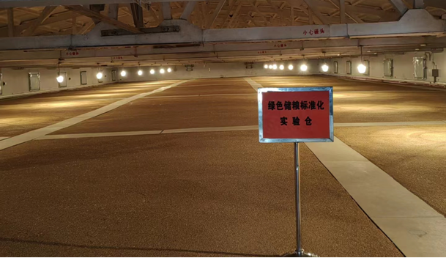
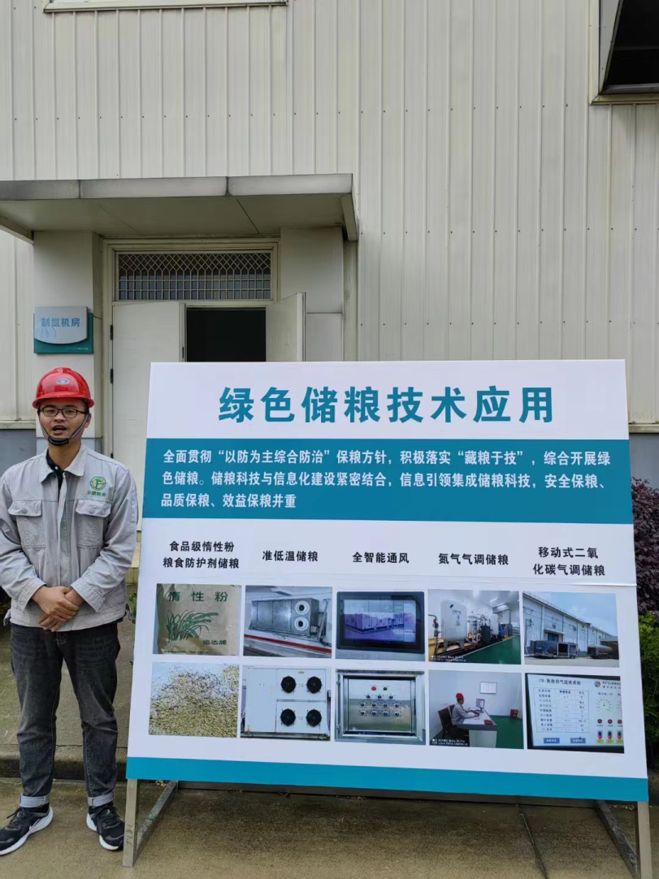
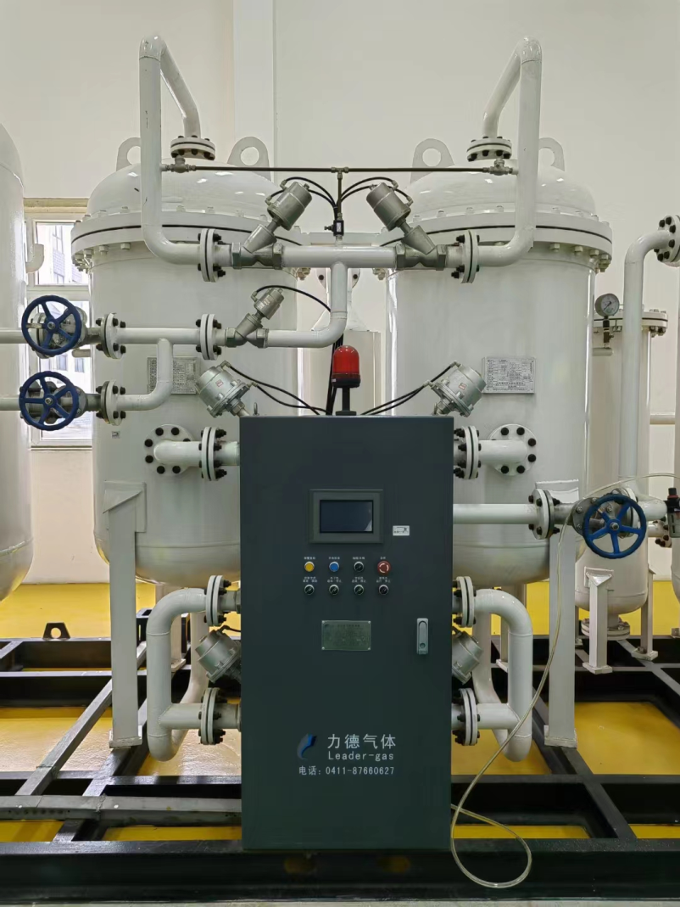
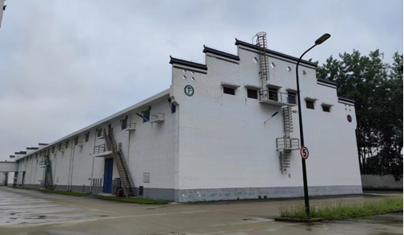

Slide 41
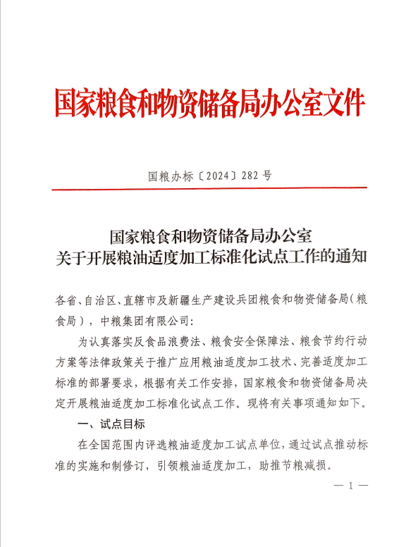

开展粮油产品适度加工标准化试点，推进适度加工标准实施。
Carry out pilot projects for moderate processing standardization of grain and oil products, and facilitate the implementation of moderate processing standards.

Slide 42
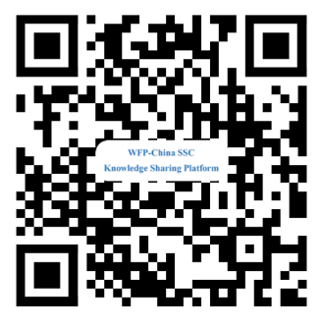
Thank You
Lifei Yang, Senior Engineer
Sharing for Learning

