Slide 1

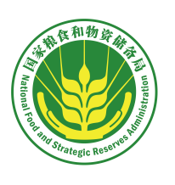
China Food Quality and Security
Standards and Supervision
Vice President and Secretary-General of Chinese Cereals and Oils Association
Wang Lirong, Senior Engineer
August 2020

Slide 2
Contents
China’s Food Security Challenges
I
China’s Food Quality and Safety Standards
II
China’s Regulation of Food Quality and Safety
III

Slide 3
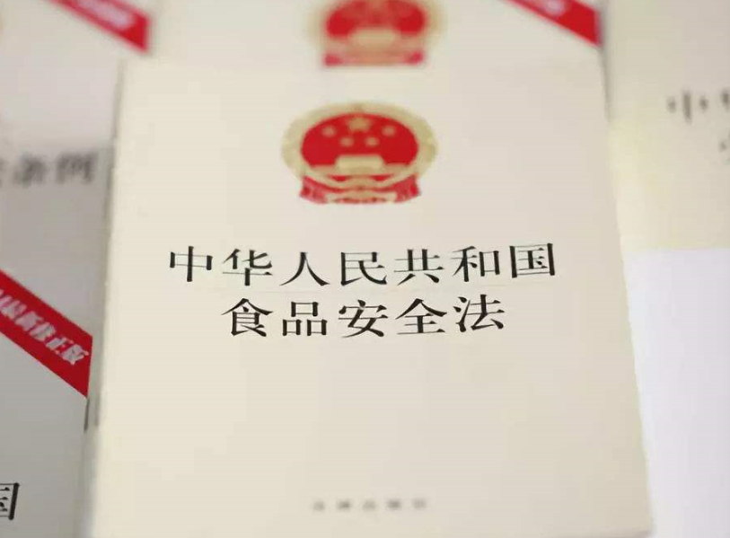
01
Relevant Regulations and Rules of Food Quality and Safety Supervision
Food Safety Law
A supervision system is established: giving priority to prevention, implementing risk management and whole-process control, and encouraging the whole society to participate.
It is the strictest law ever.

Slide 4

01
Relevant Regulations and Rules of Food Quality and Safety Supervision
Agricultural Products Quality Safety Law
Product range: primary products sourced from agriculture.
Subjects: producers and sellers, manager, inspector, etc.
Management Processes: environment of places of origin of agricultural products, scientific and reasonable use of agricultural inputs, market access management, etc.

Slide 5
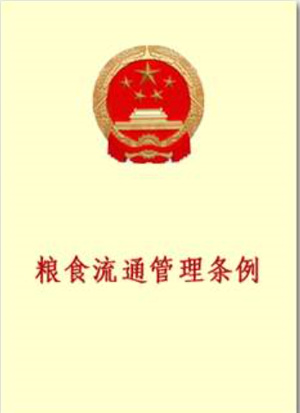
01
Relevant Regulations and Rules of Food Quality and Safety Supervision
Regulations on the Administration of Grain Circulation
It was issued on May 26, 2004, in the form of the Decree of the State Council, and was revised in 2013 and 2016 respectively.
In the process of supervision and inspection, food administrative departments shall inspect food stocks in the grain business sites, as well as food quality and unprocessed food hygiene during purchase and storage.

Slide 6
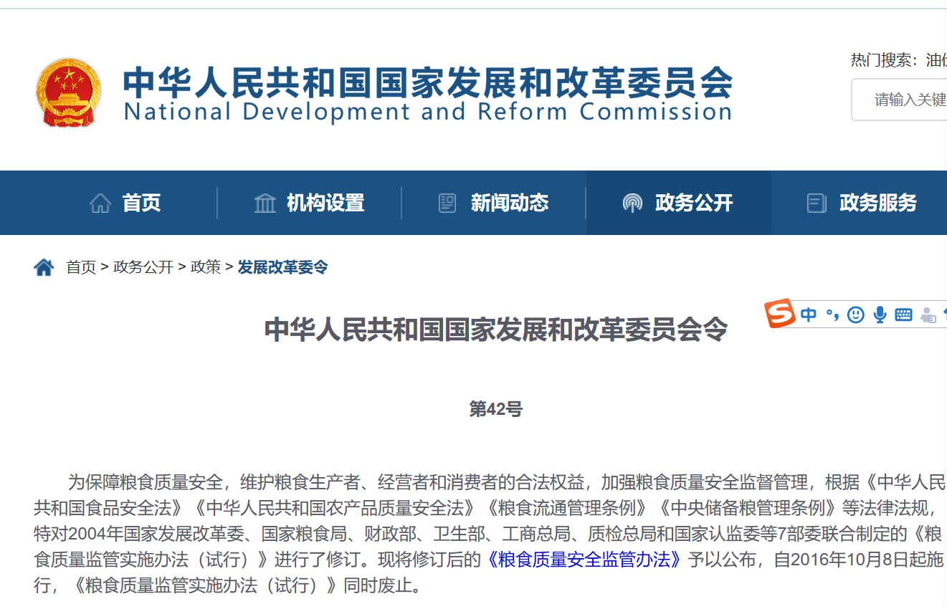
01
Relevant Regulations and Rules of Food Quality and Safety Supervision
Measures for the Supervision and Administration of Grain Quality and Safety
The decree No. 42, 2016 of the National Development and Reform Commission was issued.
Detailed provisions are stipulated on activities concerning grain quality and safety, including grain purchase, storage, transportation, policy-oriented grain processing, and sales of unprocessed grain and policy-oriented grain.
Decree of the National Development and Reform Commission of the People's Republic of China

Slide 7
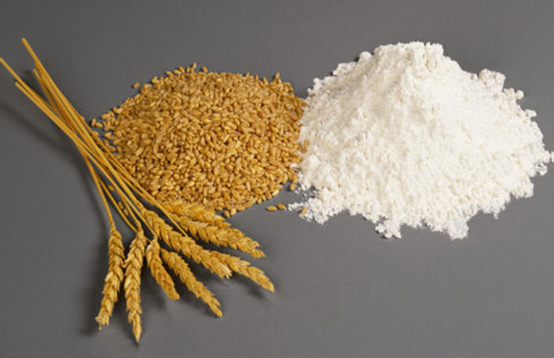
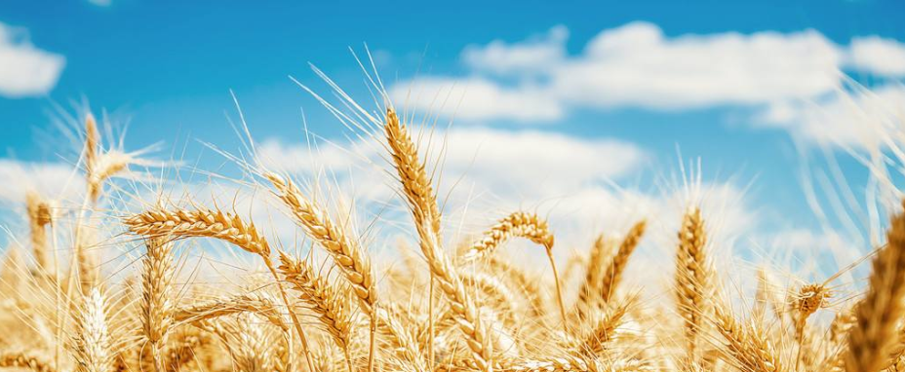
02
Food Quality and Safety Supervision System and Measures
Food Quality and Safety Supervision System
Sessional management through the whole process from the farmland to the dining table
Ministry of Agriculture and Rural Affairs: farmland
National Food and Strategic Reserves Administration: purchase, storage, and transportation
Administration for Market Regulation: processing, sales and meal

Slide 8
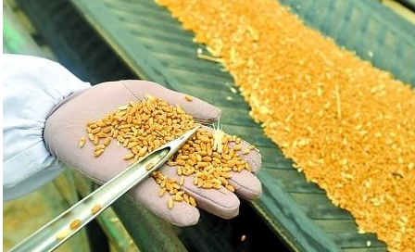
02
Food Quality and Safety Supervision System and Measures
Set up food quality and safety monitoring mechanism: on quality level, inherent quality, sprouts and mildew, pharmaceutical residues in food production and storage, as well as the pollution caused by other hazardous substances like mycotoxins and heavy metal.
Food Quality and Safety Supervision Measures

Slide 9
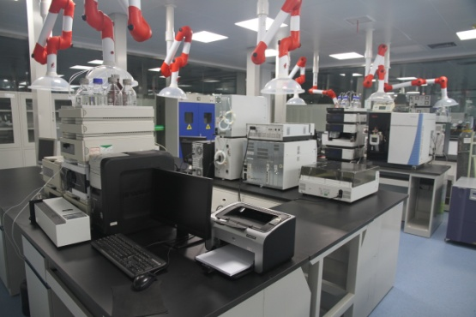
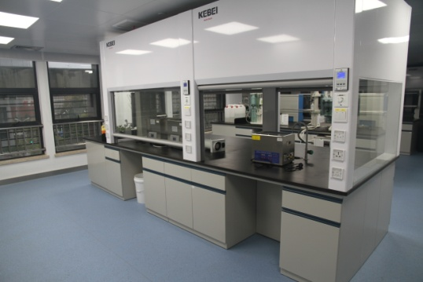
02
Food Quality and Safety Supervision System and Measures
Food quality and safety monitoring system: we have established a food quality and safety inspection and monitoring system that bases on the national conditions and food availability in China, with national regional centers as the head, provincial institutes as the backbone, municipal institutes as the support, county institutes as the foundation, and enterprises as the auxiliary, and realize the full coverage of the monitoring network.

Slide 10
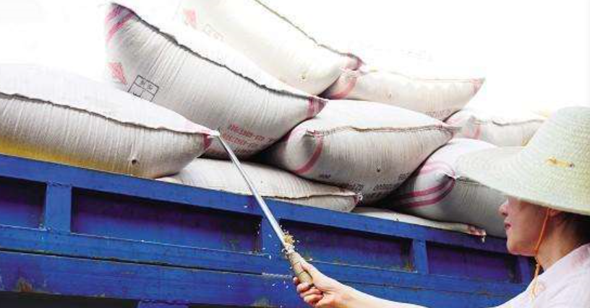
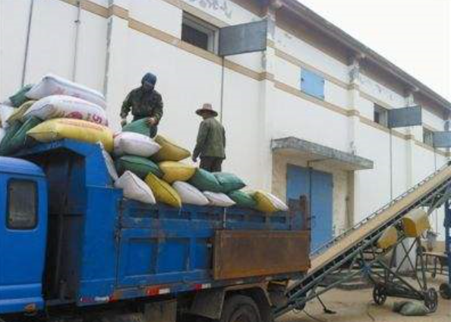
02
Food Quality and Safety Supervision System and Measures
Quality and safety inspection system for food purchase and storage: according to relevant regulations on food quality standards and food safety standards, carry out inspections on relevant food quality and safety projects. Mark the price clearly; ensure the level of grain moisture and impurities are within standards; prohibit mixed storage.

Slide 11
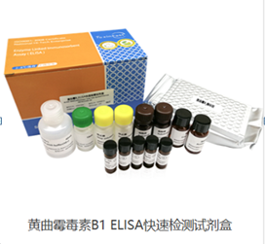
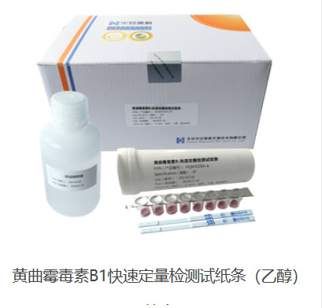
On-site rapid detection of mycotoxins
02
Food Quality and Safety Supervision System and Measures
Inspection of grain and oils—Rapid test of aflatoxin B₁ in cereal—Immunochromatography method LS/T6108-2014
Inspection of grain and oils—Detection of aflatoxin B₁ in grain—Rapid quantitative method of colloidal gold technique LS/T6111-2015
Reagent kit of Aflatoxin B1 ELISA rapid detection
Test strips of aflatoxin B1 detection through rapid quantitative method (ethyl alcohol)

Slide 12
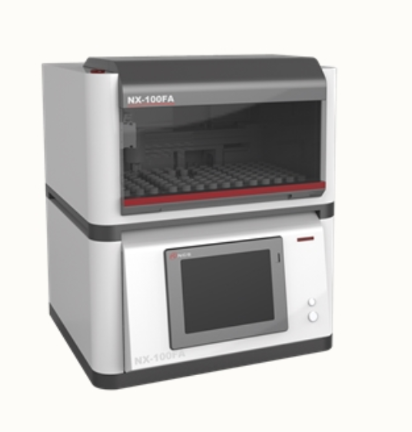
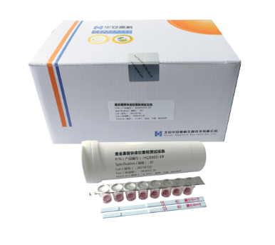
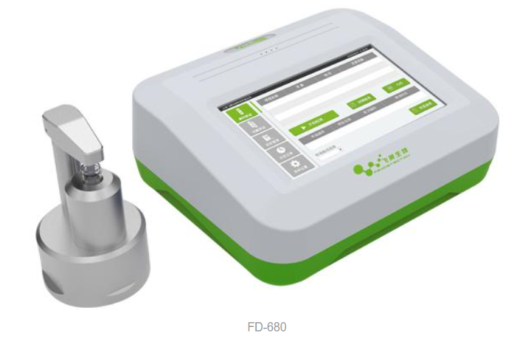
On-Site Rapid Detection of Heavey Metal
02
Food Quality and Safety Supervision System and Measures
Inspection of grain and oils—Rapid determination of cadmium in rice—X-ray fluorescence spectrometry LS/T6115-2016
Inspection of grain and oils—Rapid determination of cadmium in grain—Solid sample introduction atomic fluorescence spectrometry method LS/T6125-2017
Fluorescence spectrophotometer
Test strips of colloidal gold
Electrode method

Slide 13
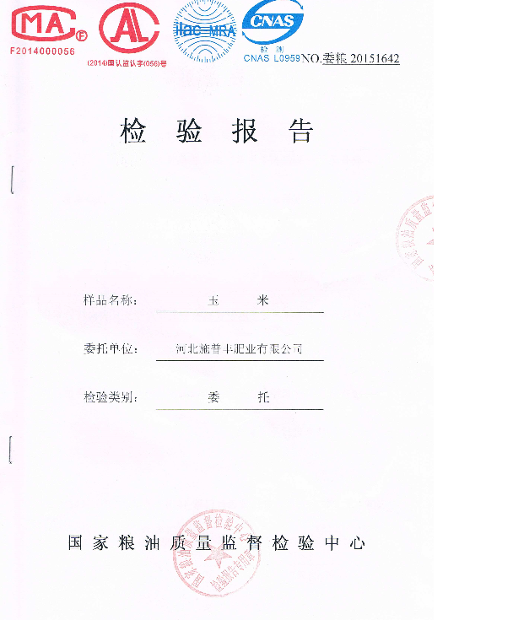
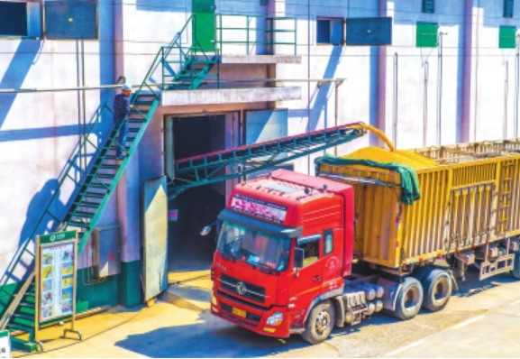
02
Food Quality and Safety Supervision System and Measures
Food sale and out-of-storage quality and safety inspection system: Carry out inspections according to food quality standards and food safety standards, and provide inspection reports. Inspection of food within the regulated storage period shall be performed by enterprises; inspection of food beyond the regulated storage period shall be performed by specialized institutes.
Notes:
The storage period of wheat is 5 years, of rice and corn is 3 years, of edible fat and oil and beans is 2 years.

Slide 14
02
Food Quality and Safety Supervision System and Measures
Food quality and safety filing system: Create files and record important information; files will be kept for 5 years (from the day of sale and out-of- storage).
Sample of XX(name of an enterprise) food quality file

Slide 15
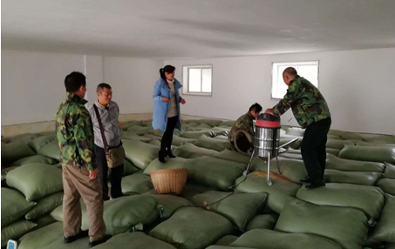
02
Food Quality and Safety Supervision System and Measures
Carry out food quality and safety inspections: develop annual supervision and management plans. National food administrations shall conduct inspections at least once a year, while local food administrations shall conduct inspections at least twice a year.
Establish oriented disposal mechanism for unqualified food: carry out oriented disposal (of industrial alcohol) under whole-process supervision.

Slide 16
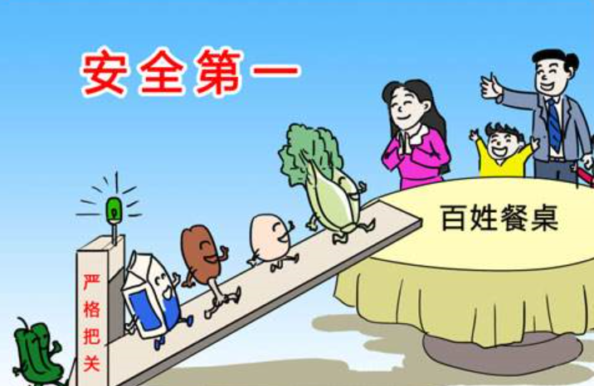
02
Food Quality and Safety Supervision System and Measures
To prevent food that doesn‘t meet food safety standards from entering the market, we are firm in doing all we can in “five key aspects”: inspections on purchase and storage, daily inspections on grain stocks, spot checks by supervision authorities, sales and out-of-storage, and supervision on unqualified food.

Slide 17
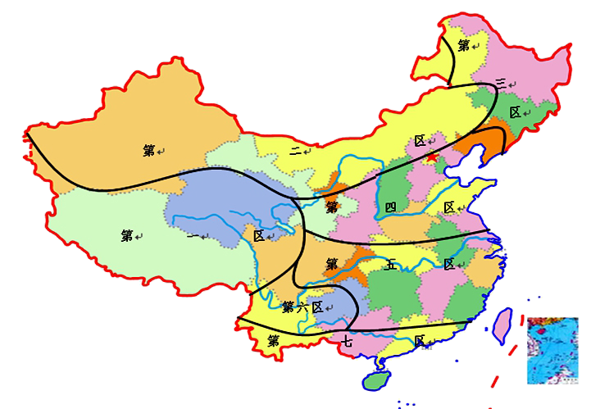
03
Food Storage Technology Management
Theoretical Research Achievements of China’s Food Storage Ecosystem
Area 1: High-Altitude Cold and Dry Area
Area 2: Low-Temperature and Dry Area
Area 3: Low-Temperature and High-Humidity Area
Area 4: Medium-Temperature and Dry Area
Area 5: Medium-Temperature and High-Humidity Area
Area 6: Medium-Temperature and Low-Humidity Area
Area 7: High-Temperature and High-Humidity Area

Slide 18
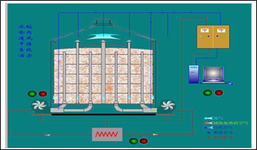
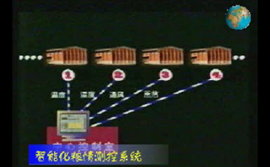
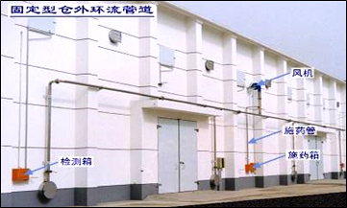
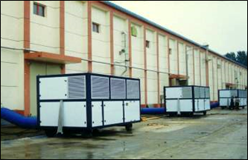
03
Food Storage Technology Management
Food Storage "Four in One" Technology Integration and Innovation
Mechanical Ventilation
Food Inspection and Analysis
Four in One
Recirculation Fumigation with Low Dosage
Highly Effective Cereal Cooler
Notes:
Overcome technology challenges one by one and achieve integration and innovation

Slide 19
03
Food Storage Technology Management
Technological Measures Taken by Different Food Storage Ecological Areas
Storage Zone | Natural Ventilation, Drying in Low Temperature | Food Inspection | Mechanical Ventilation | Drying of High-Moisture Food | Recirculation Fumigation |  |  |  | Cereal Cooler
 |  |  |  |  | Vertical Silo | Squat Silo | Large Warehouse | Ordinary Warehouse
1
2
3
4
5
6
7

Slide 20
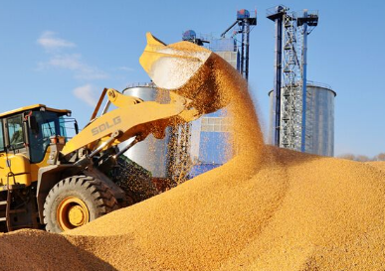
03
Food Storage Technology Management
"Four in One" Storage Technology
"Four in One" food storage technology is a new type of food storage technology researched and applied in 1998. After 10 years’ improvements, it won the first prize of the National Science Progress Award in 2010.
The technology will guarantee the security of food in storage in the most economical way by utilizing computer temperature measurement, mechanical ventilation, insect expelling through recirculation fumigation, and mechanical cooling, in accordance with the characteristics, varieties of food in storage, and warehouse conditions of different areas.

Slide 21
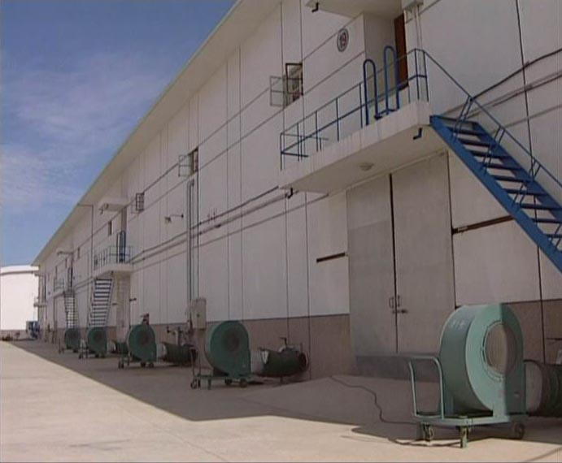
03
Food Storage Technology Management
Mechanical Ventilation Technology

Slide 22
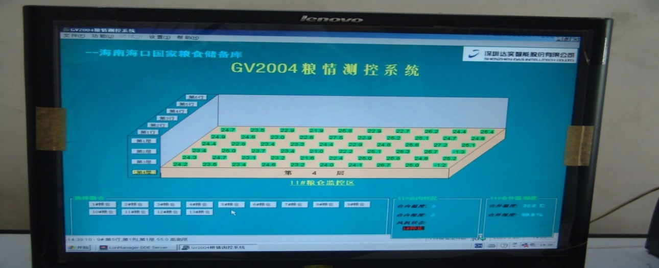
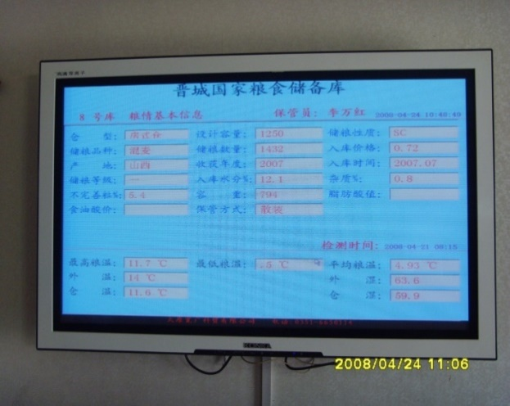
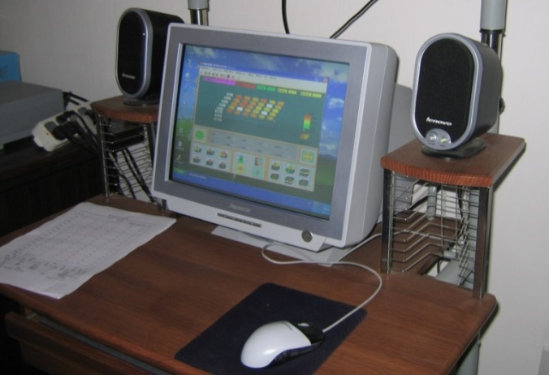
03
Food Storage Technology Management
Computer Temperature Measurement Technology

Slide 23
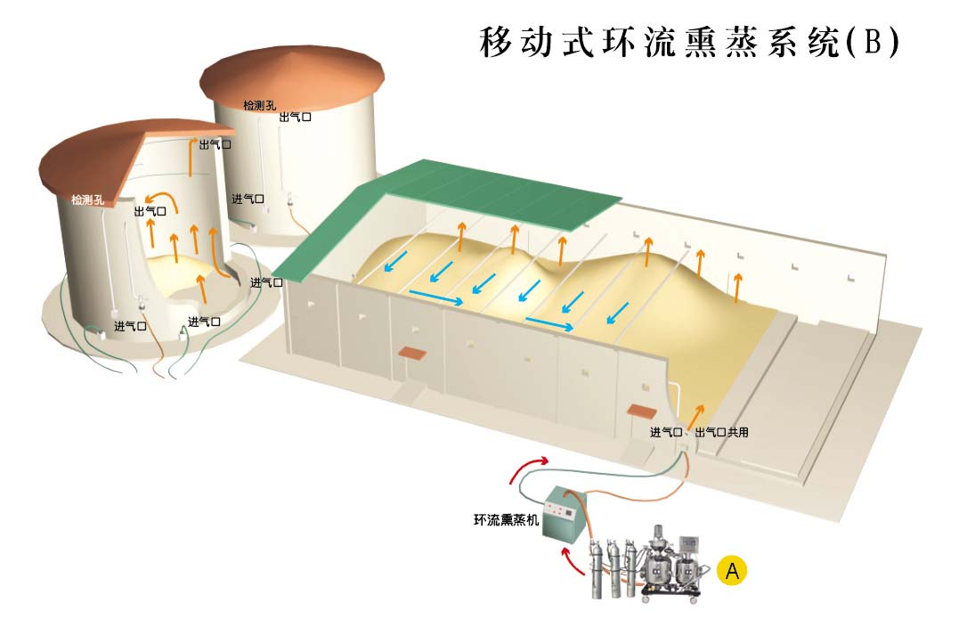
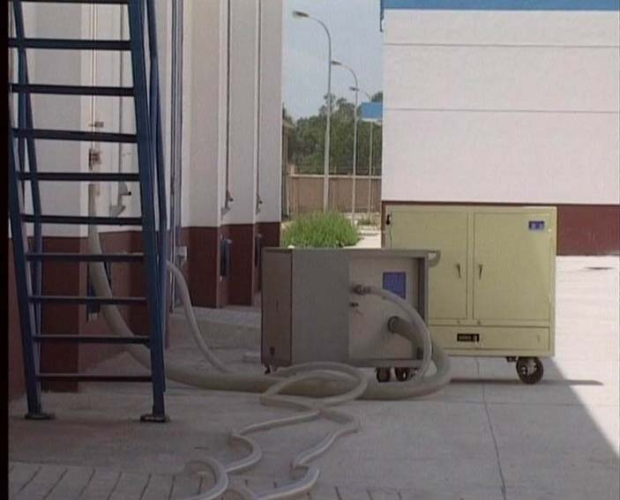
03
Food Storage Technology Management
Recirculation Fumigation Technology
Mobile Recirculation Fumigation System (B)
Inspection Hole
Air Outlet
Inspection Hole
Air Outlet
Air Inlet
Air Inlet
Air Inlet
Air Inlet
Air inlet and outlet
Circulating Fumigator

Slide 24
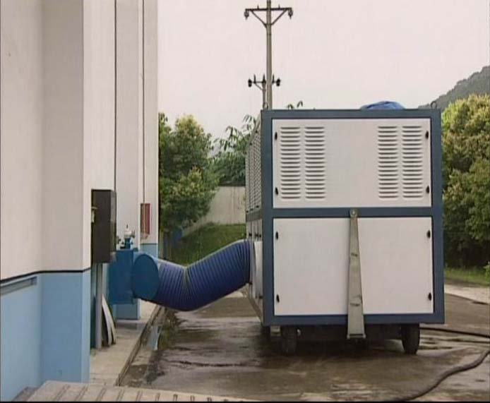
03
Food Storage Technology Management
Cereal Cooling Technology

Slide 25
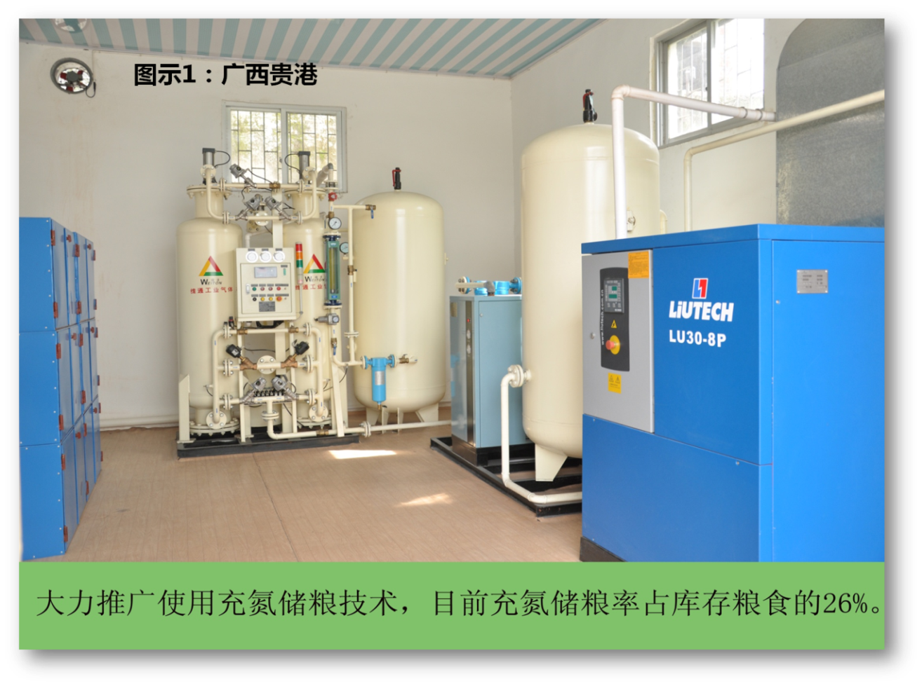
03
Food Storage Technology Management
Air-Control Food Storage Technology
Picture 1: Guigang Port, Guangxi Province
Nitrogen-filled food storage technology is highly recommended. At present, nitrogen-filled food storage only accounts for 26% of all food storage.

Slide 26
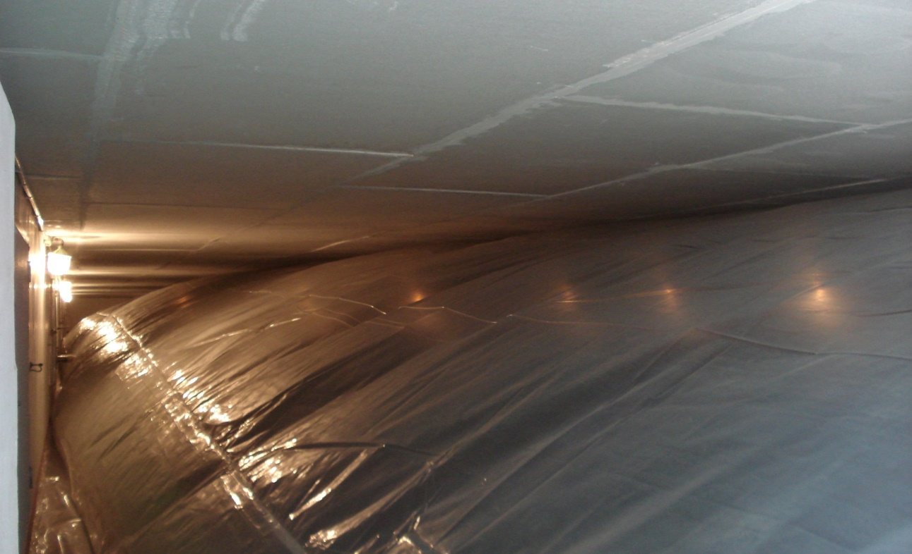
03
Food Storage Technology Management
Inflated gasbag after filling in nitrogen

Slide 27
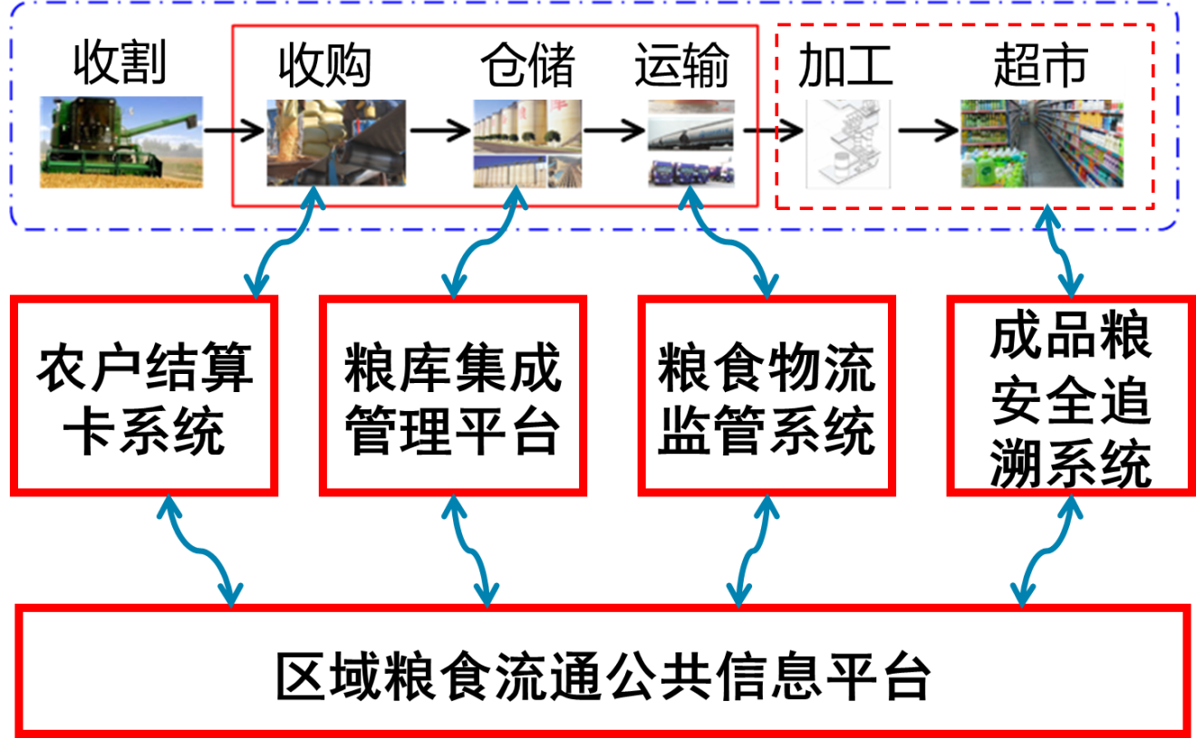
03
Food Storage Technology Management
Information Technology Applied in Food Industry
Harvest
Purchase
Storage
Transportation
Processing
Supermarket
Farmers' Settlement Card System
Integrated Management Platform for Food Storage Facilities
Food Logistics Supervision System
Finished Grain Products Security Traceability System
Public Information Platform for Regional Food Circulation

Slide 28
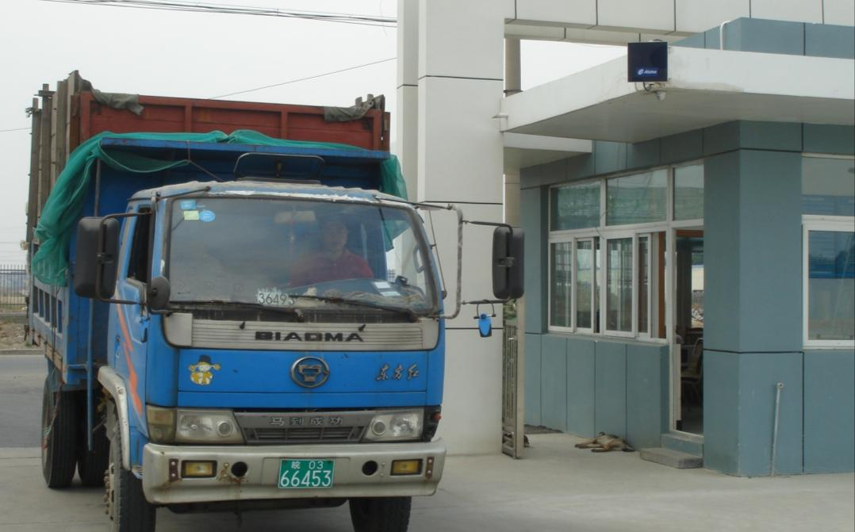
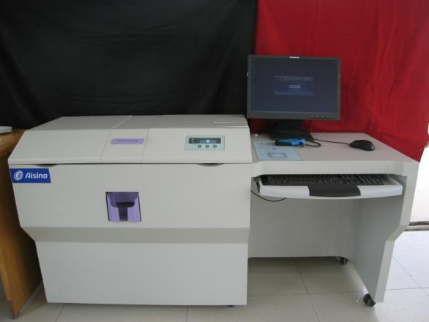
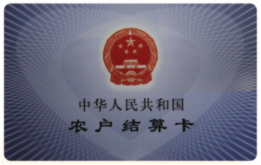
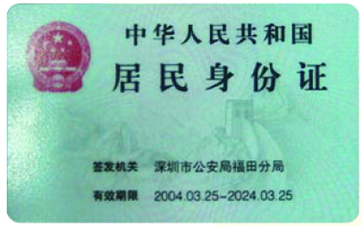
03
Food Storage Technology Management
Information Identification Card upon Food Storage

Slide 29
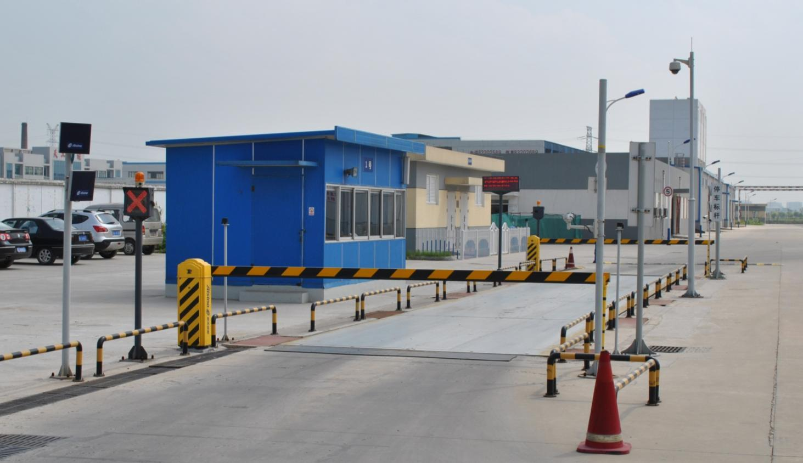
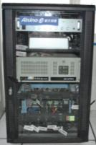
03
Food Storage Technology Management
Automatic Weighing
RFID Reader Antenna
Traffic Light, Alarm Light
Online Voice Device
Panoramic Camera
Active Infrared Intrusion Detector
Controller Cabinet
LED Screen
License Plate Camera, Driving Cab Camera
Barrier
Ground Sense Coil

Slide 30
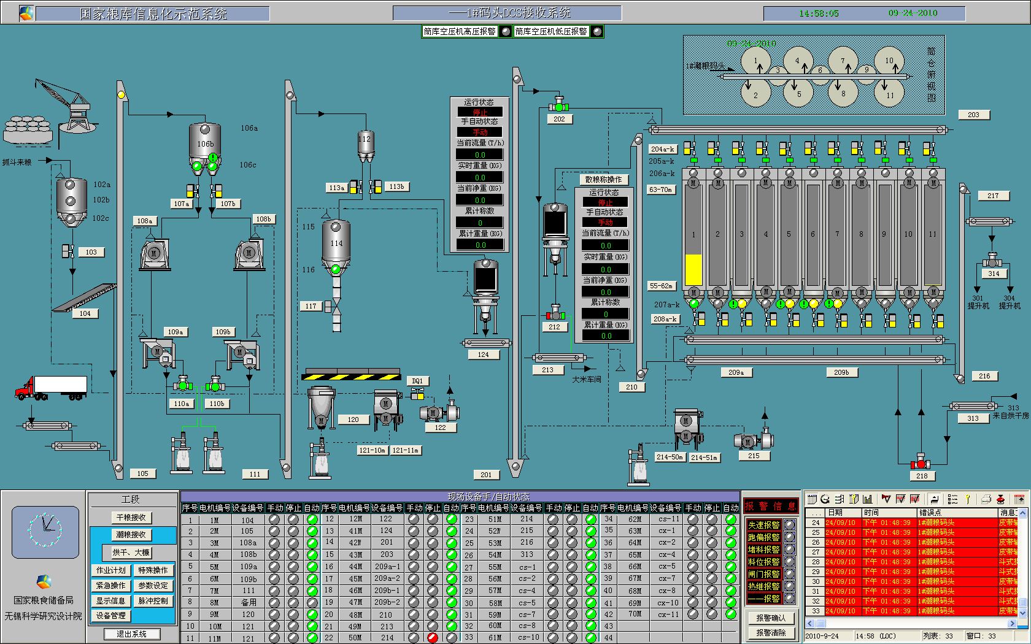
03
Food Storage Technology Management
Automatic Storage

Slide 31
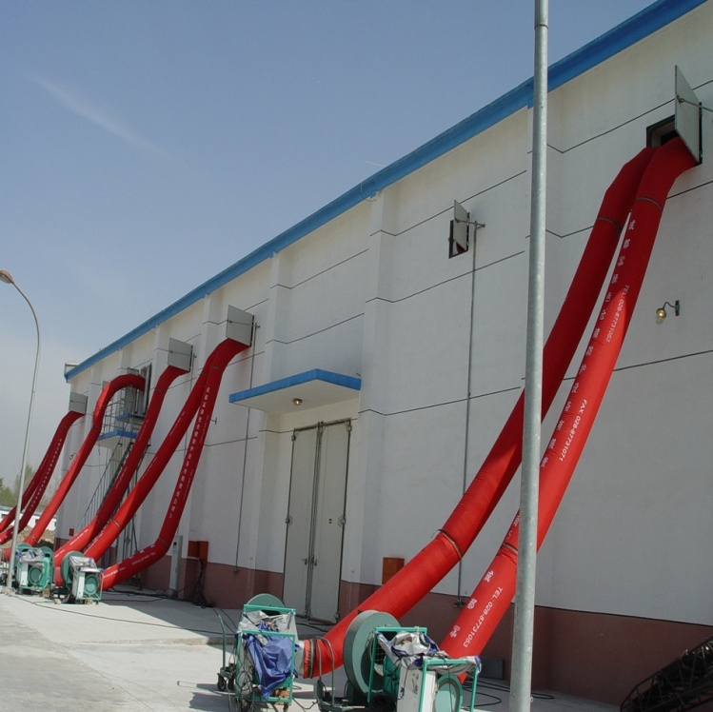
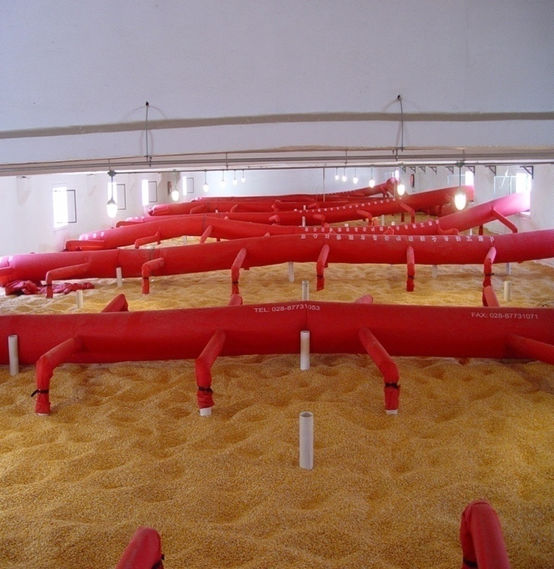
03
Food Storage Technology Management
Drying Technology upon Storage

Slide 32
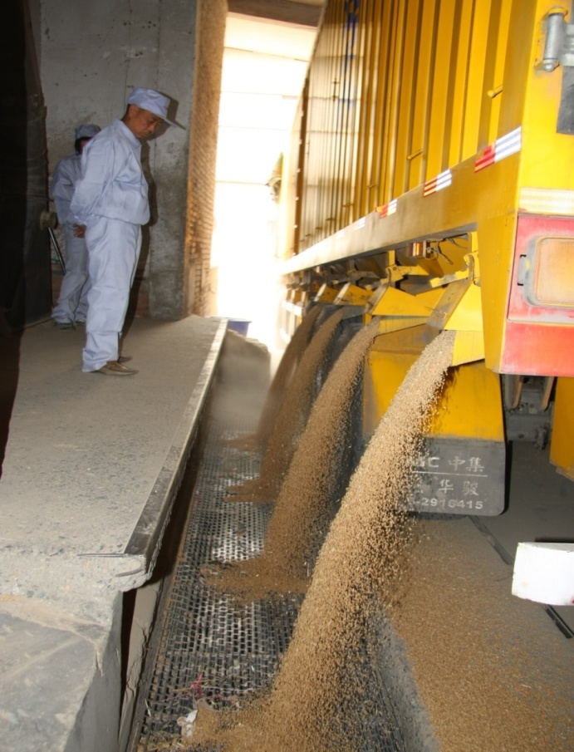
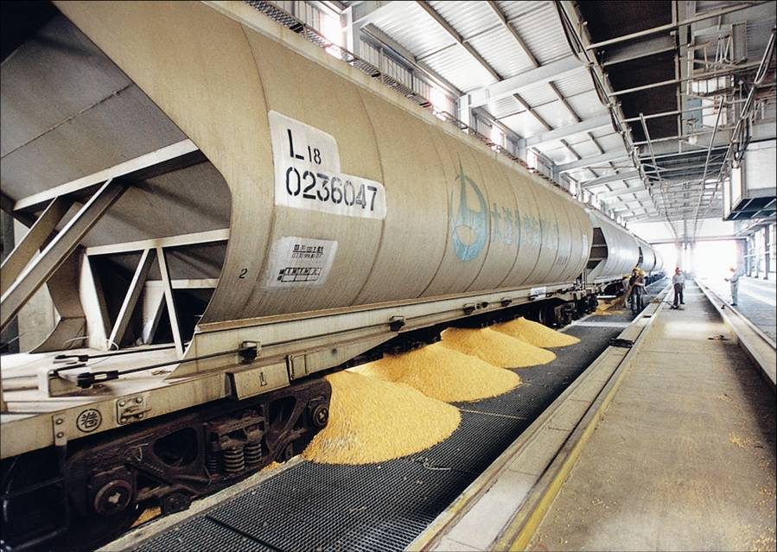
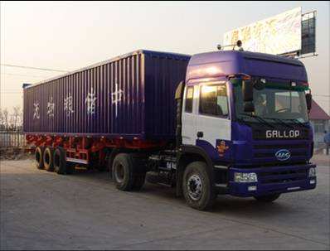
03
Food Storage Technology Management
Bulk Grain Transportation Technology

Slide 33
03
Food Storage Technology Management
Food Storage Technology Trend
High Quality
High Nutrition
High Efficiency
Low Loss
Low-level Pollution
Low Cost
"Three Hs" "Three Ls"
"Green, Eco-Friendly, and Harmonious"
food storage technology
Green food storage technology system with a combination of low temperature and air control.
Improve air impermeability to minimize chemical dosage.
Improve 200 million agricultural households' food storage conditions in order to achieve scientific food storage.

Slide 34
T
HANK YOU!

