Slide 1
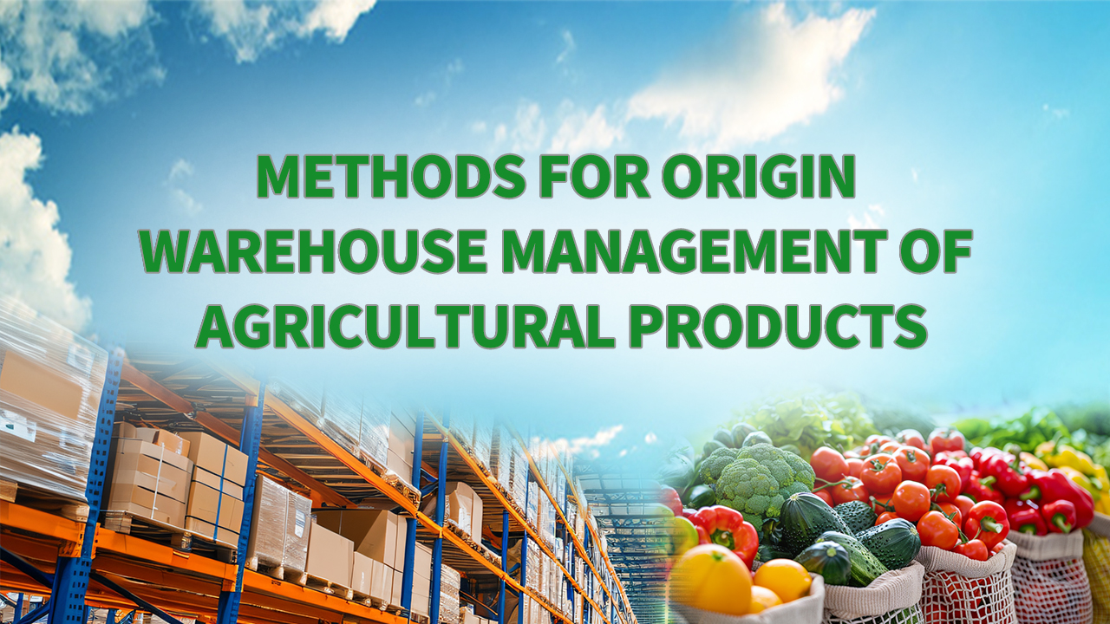
Notes:
Methodology for Origin Warehouse Management of Agricultural Products
农产品产地仓储管理方法论

Slide 2

PART.03
Food Safety and Sanitation Management for Origin Warehouses
Notes:
III.Food Safety and Sanitation Management for Origin Warehouses
三、 产地仓食品安全与卫生管理

Slide 3
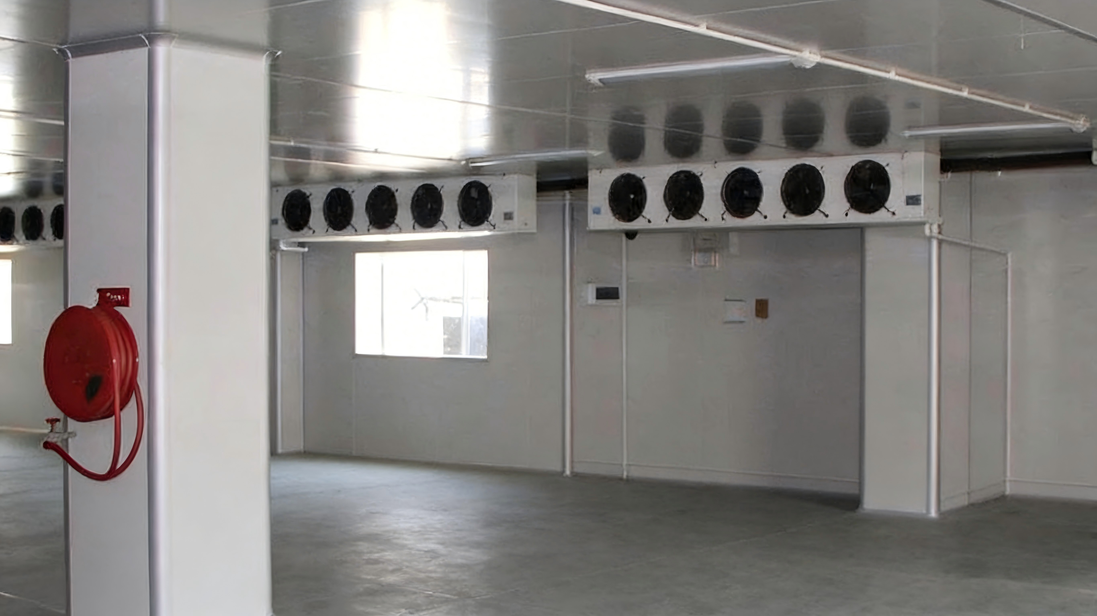
1. Sanitation Management of Cold Storage Environments
Core Objective
  Ensure food quality.
  Extend the preservation period of agricultural products.
Environmental Sanitation
  Strictly maintained throughout cold storage operations:
    Inbound logistics process.
    Storage management phase.
Sanitation Compliance
  Compliance with national sanitation regulations must be enforced → minimize the risk of microbial contamination.
Notes:
1.Sanitation Management of Cold Storage Environments
To ensure food quality and extend the preservation period of agricultural products,
environmental sanitation must be strictly maintained throughout both the inbound logistics process and the storage management phase of cold storage operations.
Compliance with national sanitation regulations must be enforced to minimize the risk of microbial contamination.
（一）冷库环境卫生管理
为保证食品质量，延长农产品保藏期限，在冷库的使用中，无论是进库的作业流程，还是入库后的货物管理过程，环境卫生都是一项不可忽视的重要工作，要严格执行国家颁发的卫生条例，尽可能减少微生物污染食品的机会。

Slide 4
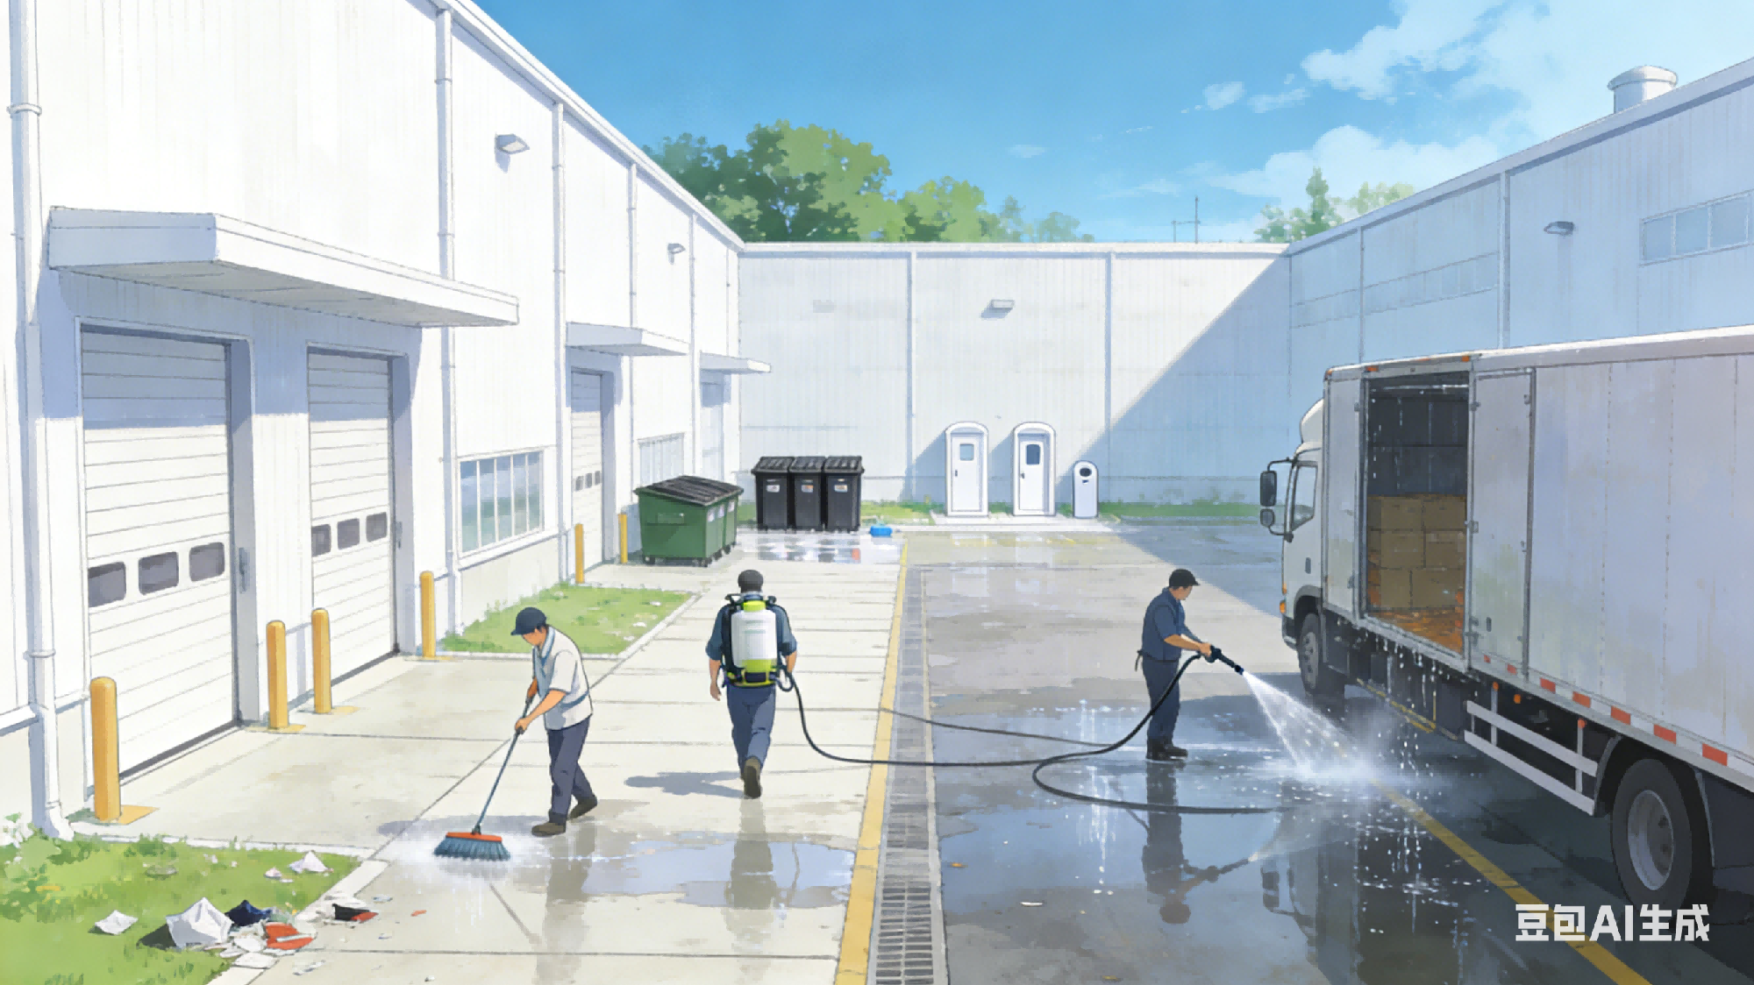
1. Sanitation Management of Cold Storage Environments
Surrounding Area Sanitation
  Areas around cold storage facilities remain free of wastewater and waste materials.
  Grounds and passageways cleaned frequently + disinfected periodically.
Waste & Facility Placement
  Garbage bins and restrooms located at a reasonable distance from the storage area + kept clean at all times.
Vehicle Sanitation
  Vehicles for cargo transport washed and disinfected before loading → prevent contamination.
Notes:
The areas surrounding cold storage facilities must remain free of wastewater and waste materials.
Grounds and passageways should be cleaned frequently and disinfected periodically.
Garbage bins and restrooms must be located at a reasonable distance from the storage area and kept clean at all times.
Vehicles used for cargo transport must be washed and disinfected before loading to prevent contamination.
因此，冷库四周不应有污水和垃圾，冷库周围的场地和走道应经常清扫、定期消毒，垃圾箱和厕所应离库房有一定距离，并保持清洁，运输货物用的车辆在装货前应进行清洗、消毒。

Slide 5
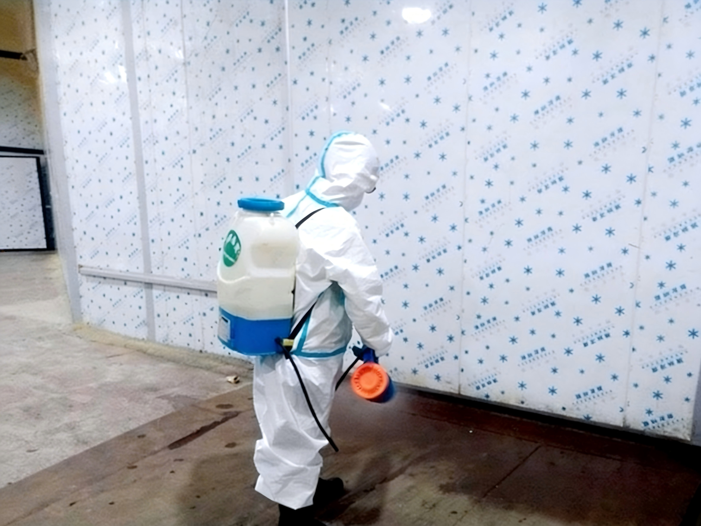
2. Sanitation Management within Cold Storage Chambers
Core Positioning
  Serves as the core area for food cold processing.
  Sanitary management constitutes the central aspect of overall cold storage hygiene control.
Disinfection Scope
  Covers both internal and external areas of the chamber.
Execution Protocol
Must undergo regular and ad hoc disinfection.
Notes:
（二）冷库库房卫生管理
冷库的库房是进行食品冷加工的地方，库房的卫生管理工作是整个冷库卫生管理的中心环节。因此，库房内外应进行不定期消毒工作。
2.Sanitation Management within Cold Storage Chambers
The cold storage room serves as the core area for food cold processing; hence, its sanitary management constitutes the central aspect of overall cold storage hygiene control. Both internal and external areas of the chamber must undergo regular and ad hoc disinfection.

Slide 6
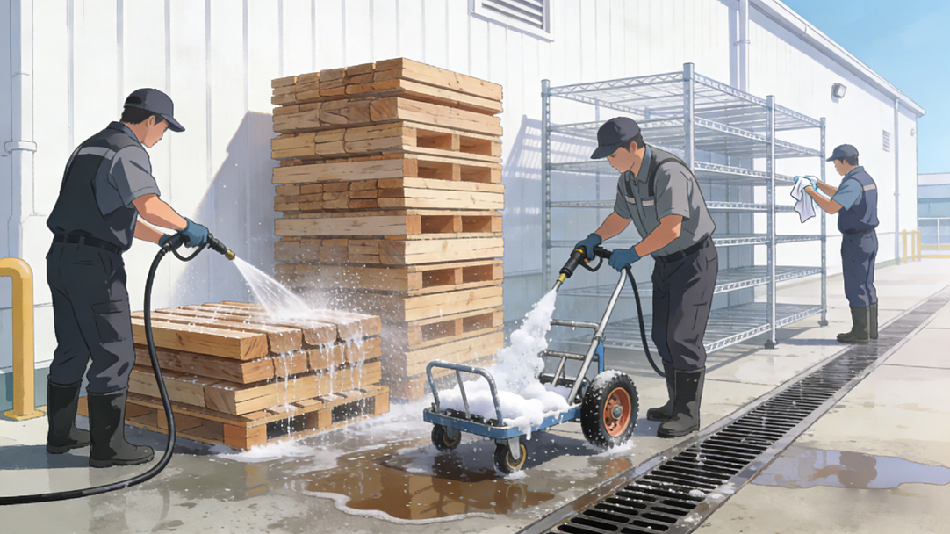
2. Sanitation Management within Cold Storage Chambers
Applicable Equipment:
  Pallets, carts, and other instruments used for handling refrigerated products.
Cleaning Requirements:
  Should be washed and disinfected regularly outside the chamber.
Standard Cleaning Procedure:
    Rinse with hot water.
    Degrease with a 2% alkaline solution.
    Disinfect using a 0.3–0.4% active chlorine bleaching solution.
Notes:
冷藏食品的垫木、小车，以及其他仪器设备都要定期在库外冲洗、消毒。可先用热水冲洗，并用2%浓度的碱水除油污，然后用含有效氯0.3%至0.4%的漂白粉溶液消毒。
Pallets, carts, and other instruments used for handling refrigerated products
should be washed and disinfected regularly outside the chamber. A standard cleaning procedure involves rinsing with hot water, followed by degreasing with a 2% alkaline solution, and then disinfection using a 0.3–0.4% active chlorine bleaching solution.

Slide 7
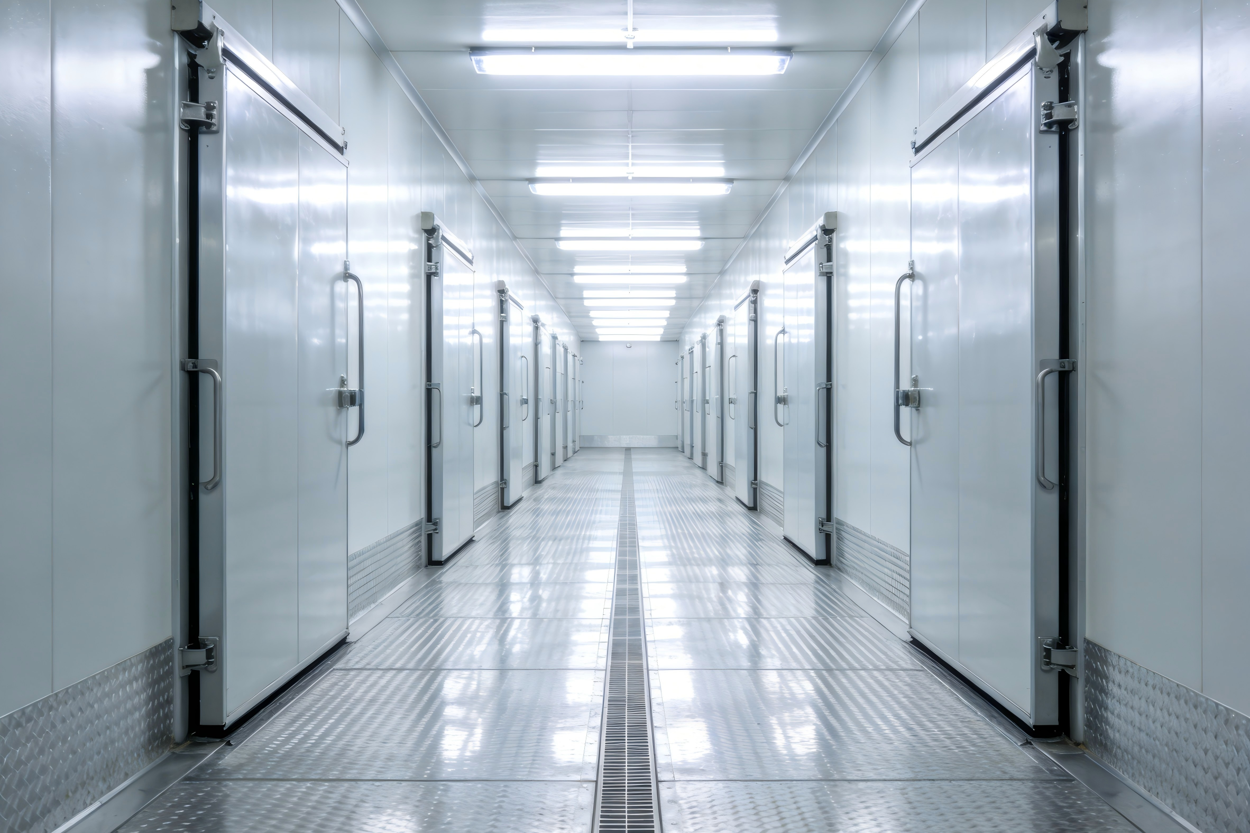
2. Sanitation Management within Cold Storage Chambers
Passageways & Staircases
  Cleaned frequently.
  Especially during loading and unloading operations.
Anti-Mold Treatment
  Mold grows faster and is more destructive than bacteria.
  Anti-mold agents mixed into whitewash materials applied on warehouse walls → prevent fungal contamination.
Notes:
冷库内的走道和楼梯要经常清扫，特别在出入库时。在库房内，霉菌较细菌繁殖更快些，并极易侵害食品，因此通常将抗霉剂与粉刷材料混合在一起，粉刷仓库来治理霉菌。
Passageways and staircases within the cold storage area should be cleaned frequently — especially during loading and unloading operations.
Since mold growth tends to be faster and more destructive than bacterial growth, anti-mold agents are often mixed into whitewash materials applied on warehouse walls to prevent fungal contamination.

Slide 8
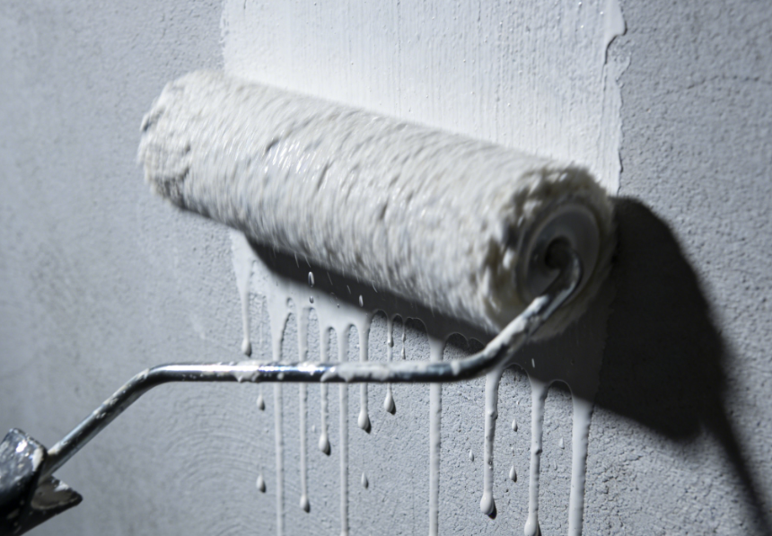
2. Sanitation Management within Cold Storage Chambers
Common Anti-Mold Whitewashing Methods
Sodium Fluoride Method
Sodium p-Hydroxybiphenyl Method
Copper Sulfate Method
Notes:
常见的粉刷方法有：氟化钠法、羟基联苯酚钠法和硫酸铜法。
Common anti-mold whitewashing methods include: Sodium Fluoride Method、Sodium p-Hydroxybiphenyl Method and Copper Sulfate Method

Slide 9
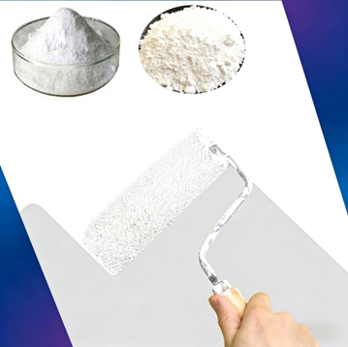
2. Sanitation Management within Cold Storage Chambers
Sodium Chloride
Kaolin
Sodium Fluoride Method
Preparation & Application
  Add 1.5% sodium fluoride to white clay, dissolve in water, and use for wall coating.
Note
  Calcium content in the white clay must be ≤ 0.7% calcium of total mass.
Notes:
氟化钠法指的是在白陶土上加入1.5%的氟化钠，配成水溶液粉刷墙壁。注意：白陶土中钙盐的质量含量不应超过白陶土总质量的0.7%。
•Sodium Fluoride Method: Add 1.5% sodium fluoride to white clay, dissolve in water, and use for wall coating. Note that calcium content in the white clay must not exceed 0.7% of total mass.

Slide 10
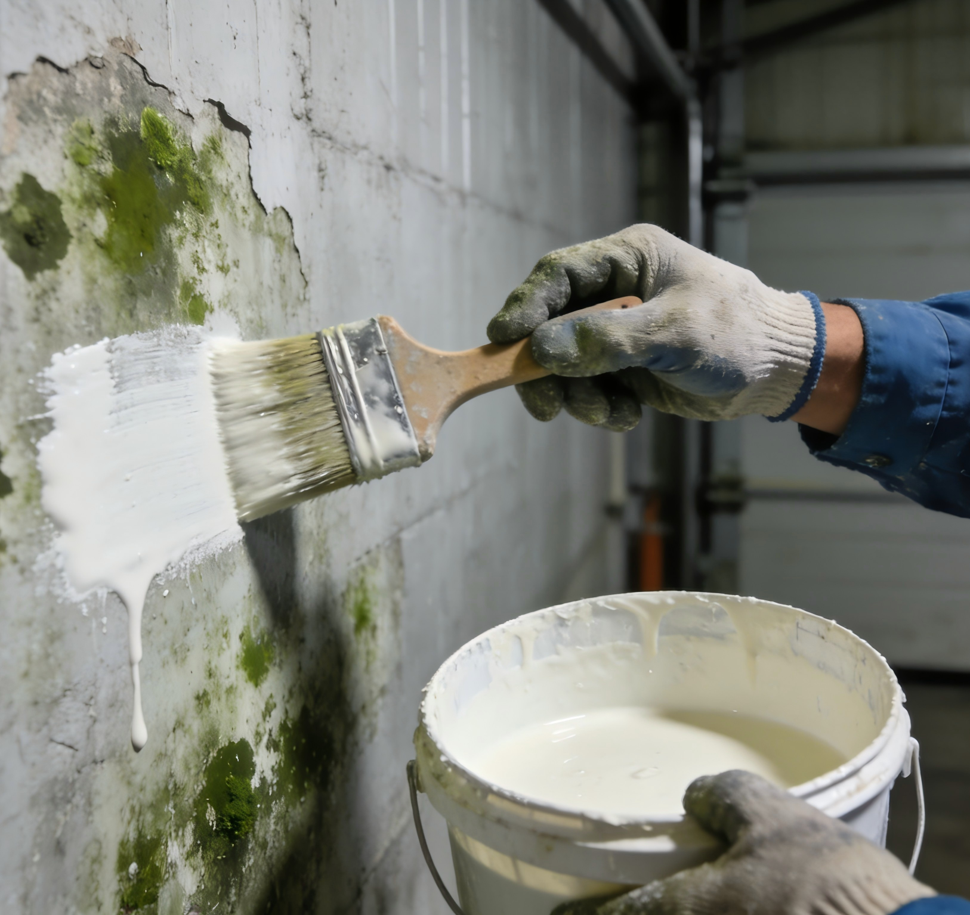
2. Sanitation Management within Cold Storage Chambers
Sodium p-Hydroxybiphenyl Method
For severe mold conditions
  Use a 2% sodium p-hydroxybiphenyl solution to brush the walls. OR
  Prepare a bleaching mixture of equivalent concentration.
Notes:
羟基联苯酚钠法:当发霉严重时，在正温库房内可用2%的羟基联苯酚钠溶液刷墙，或用同等浓度的药剂溶液配成刷白混合剂进行粉刷。
•Sodium p-Hydroxybiphenyl Method: For severe mold conditions, use a 2% sodium p-hydroxybiphenyl solution to brush the walls or prepare a bleaching mixture of equivalent concentration.

Slide 11
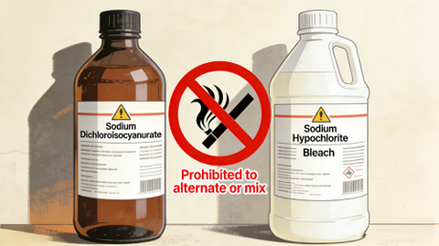
2. Sanitation Management within Cold Storage Chambers
Precautions for Sodium p-Hydroxybiphenyl Method
Prohibited Combination
  Do NOT mix or alternate use with bleaching powder (sodium hypochlorite).
  This combination generates toxic chlorine gas, causing:
    Respiratory distress.
    Surface discoloration.
Switching Disinfectants
  Allow at least 24 hours before switching.
  Ensure full ventilation.
Notes:
羟基联苯酚钠消毒后，严禁与漂白粉（含次氯酸钠）交替或混合使用，二者混合会产生有毒氯气，浓度过高时可能导致操作人员呼吸困难、呼吸道灼伤；同时使用会使墙面呈现红褐色，难以清洁。若需更换消毒药剂，需间隔24小时以上，并确保库房通风完全后再作业。
Do not mix or alternate use with bleaching powder (sodium hypochlorite), as this combination generates toxic chlorine gas that may cause respiratory distress and surface discoloration. If switching disinfectants, allow at least 24 hours and ensure full ventilation before proceeding.

Slide 12
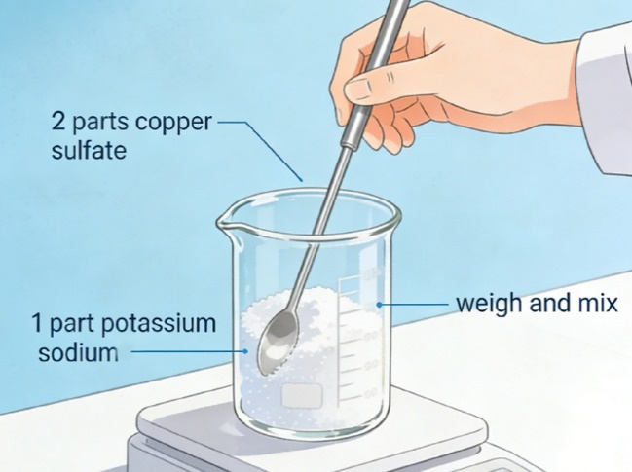
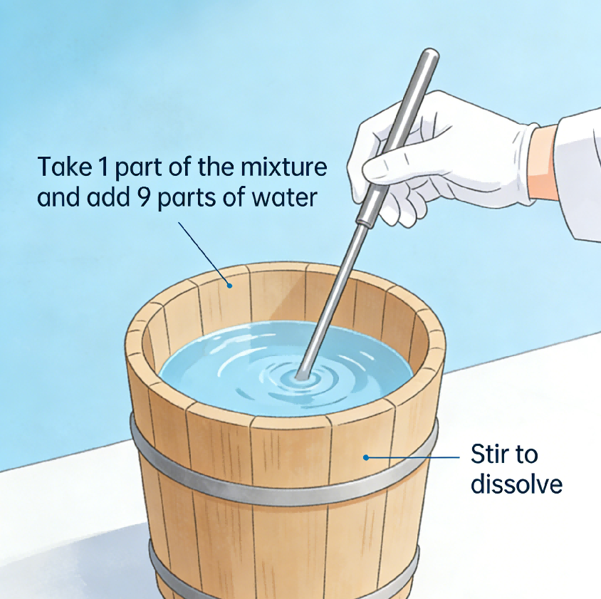
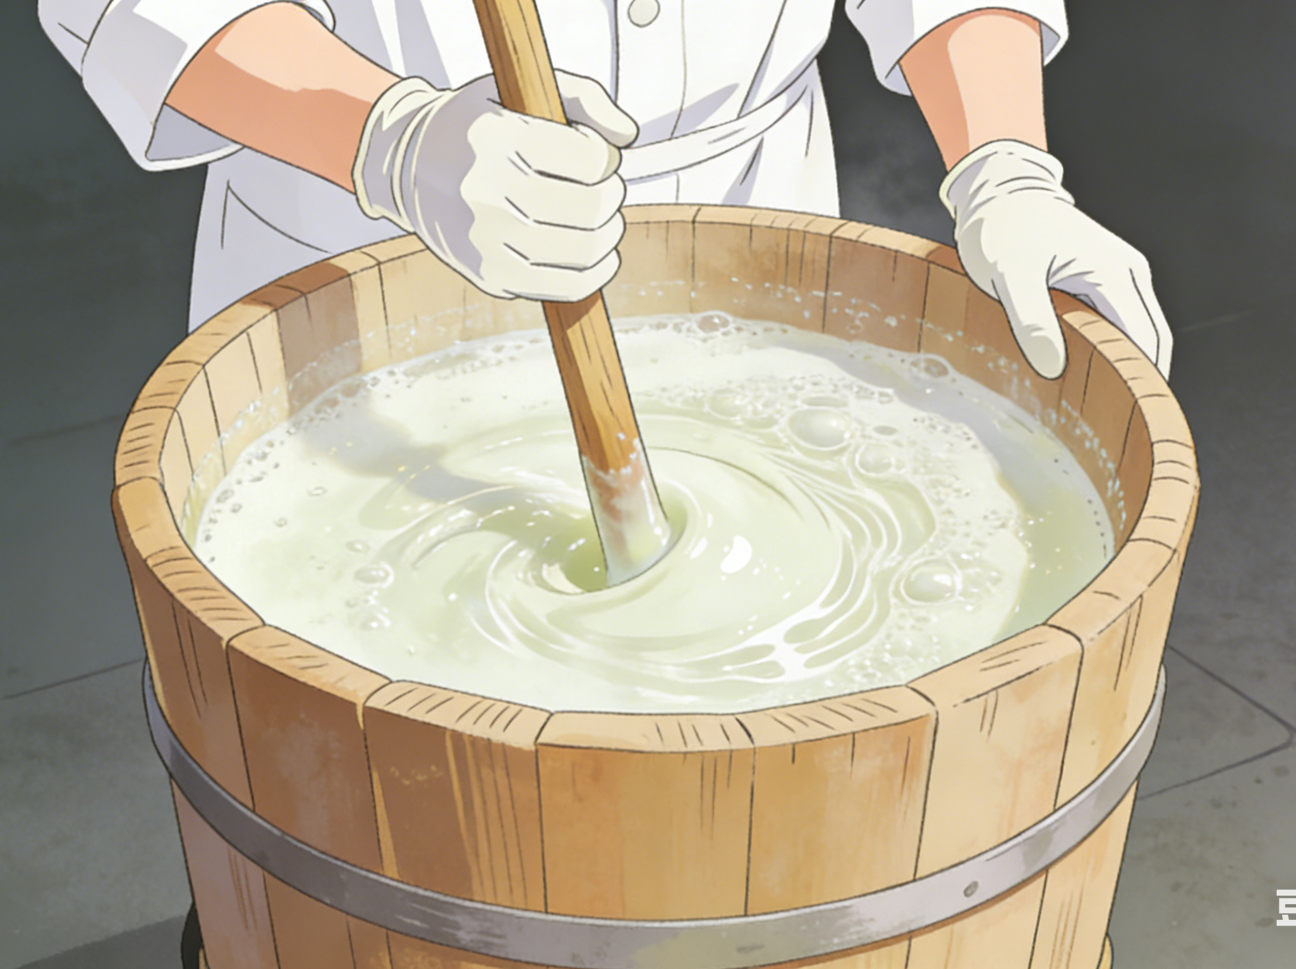
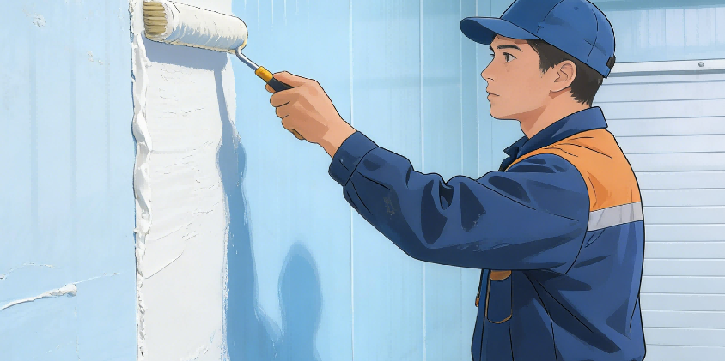
2. Sanitation Management within Cold Storage Chambers
Copper Sulfate Method
Operation Steps
  Mix 2 parts copper sulfate and 1 part potassium alum.
  Dissolve 1 part of the mixture in 9 parts water.
  Add 7 parts lime before whitewashing.
Notes:
硫酸铜法的操作方法为：将硫酸铜2份和钾明矾1份混合，取此1份混合物加9份水，在木桶中溶解，粉刷时再加7份石灰。
•Copper Sulfate Method: Mix 2 parts copper sulfate and 1 part potassium alum, dissolve 1 part of this mixture in 9 parts water, then add 7 parts lime before whitewashing.

Slide 13
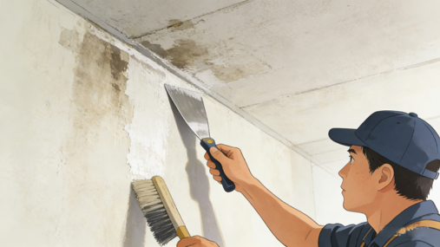
2. Sanitation Management within Cold Storage Chambers
Pre-Disinfection Requirements
  All food products removed from the chamber.
  Contaminated walls and ceilings thoroughly scraped and cleaned.
  Frost and ice on cold surfaces removed.
  Chamber temperature raised above 0°C if necessary.
Notes:
注意：库房在消毒粉刷前应将库内食品全部搬出，并清除墙和顶板上的污秽，发现有霉菌的地方应仔细用刮刀或刷子清除。在低温库内，要清除墙顶和排管上的冰霜，必要时需将库温升至正温。
Important: Before disinfection or whitewashing, all food products must be removed from the chamber.
Contaminated walls and ceilings must be thoroughly scraped and cleaned. Frost and ice on cold surfaces should be removed, and chamber temperature raised above 0°C if necessary.

Slide 14
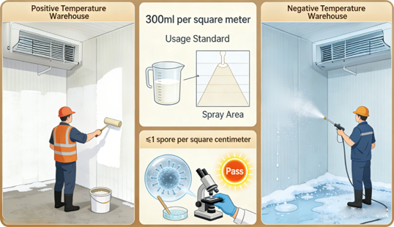
2. Sanitation Management within Cold Storage Chambers
Disinfection Application and Effectiveness
Application Methods
  For positive-temperature chambers: use brushes for coating.
  For negative-temperature chambers: use fine sprayers.
Disinfectant Usage
  Average consumption of disinfectant mixture ≈ 300 ml per m².
Effectiveness Criteria
  Assessed by measuring the reduction of mold spores.
  No more than 1 mold spore per cm² should remain after treatment.
Notes:
刷白时，正温库房可用排笔涂刷，负温时可用细喷浆器喷洒，每一平方米消毒表面所消耗的混合剂约为300毫升。消毒后，冷库内消毒的效果根据霉菌孢子的减少来评定，消毒后每平方厘米表面上不得多于一个霉菌孢子。
For positive-temperature chambers, use brushes for coating;
for negative-temperature chambers, use fine sprayers.
The average consumption of disinfectant mixture is about 300 ml per square meter.
The effectiveness of disinfection is assessed by measuring the reduction of mold spores—no more than one mold spore per cm² should remain after treatment.

Slide 15
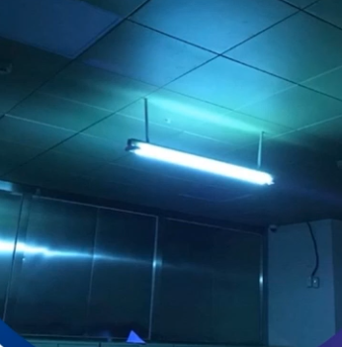
2. Sanitation Management within Cold Storage Chambers
Enhance Air Disinfection
  Install ultraviolet lamps inside warehouses
    1 W per cubic meter.
    Average exposure: 3 hours/day.
Refrigerated storage rooms for chilled products
  Disinfect at least once a year.
Use of rodenticides is strictly prohibited.
Notes:
为提高空气消毒质量，节约消毒费用，可在仓库内按每立方米1瓦的密度安装紫外线光灯，每天平均照射3小时即可对空气起到消毒作用，冷却物冷藏间每年至少消毒1次，禁止使用灭鼠药。
To enhance air disinfection and reduce costs, ultraviolet lamps may be installed inside warehouses at a density of 1 W per cubic meter, with an average exposure time of 3 hours per day. Refrigerated storage rooms for chilled products should be disinfected at least once a year. The use of rodenticides is strictly prohibited.

Slide 16
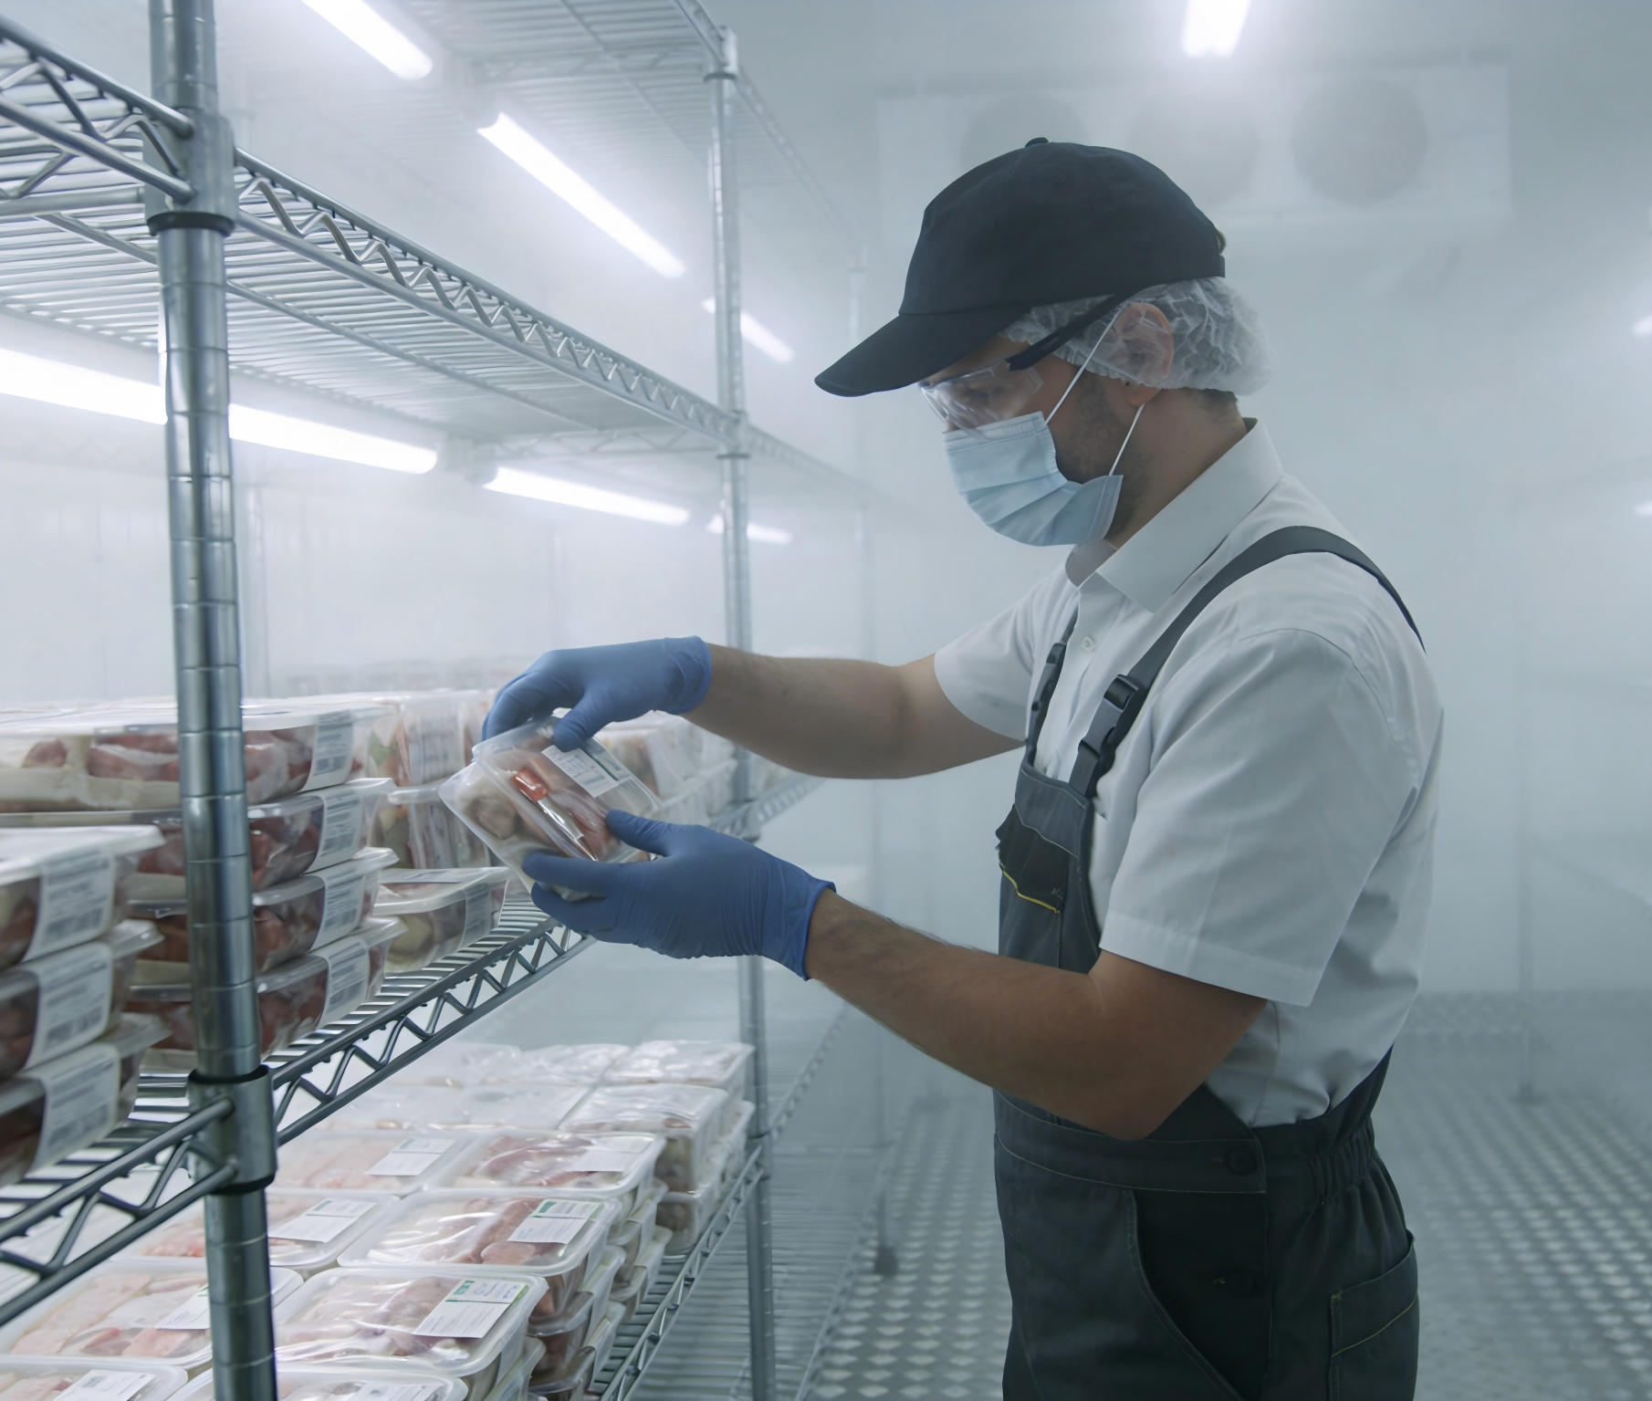
3. Personnel Hygiene Management
Importance
  The personal hygiene of cold storage personnel is critical.
  Workers frequently handle various types of food, and poor hygiene can lead to the transmission of microorganisms and pathogens.
Notes:
（三）人员卫生管理
除了空间卫生，冷库工作人员的个人卫生也非常值得重视，冷库的工作人员经常接触多种食品，如不注意卫生，就会成为微生物和病原菌的传播者
3.Personnel Hygiene Management
In addition to environmental sanitation, the personal hygiene of cold storage personnel is equally critical. Since workers frequently handle various types of food, poor hygiene can lead to the transmission of microorganisms and pathogens.

Slide 17
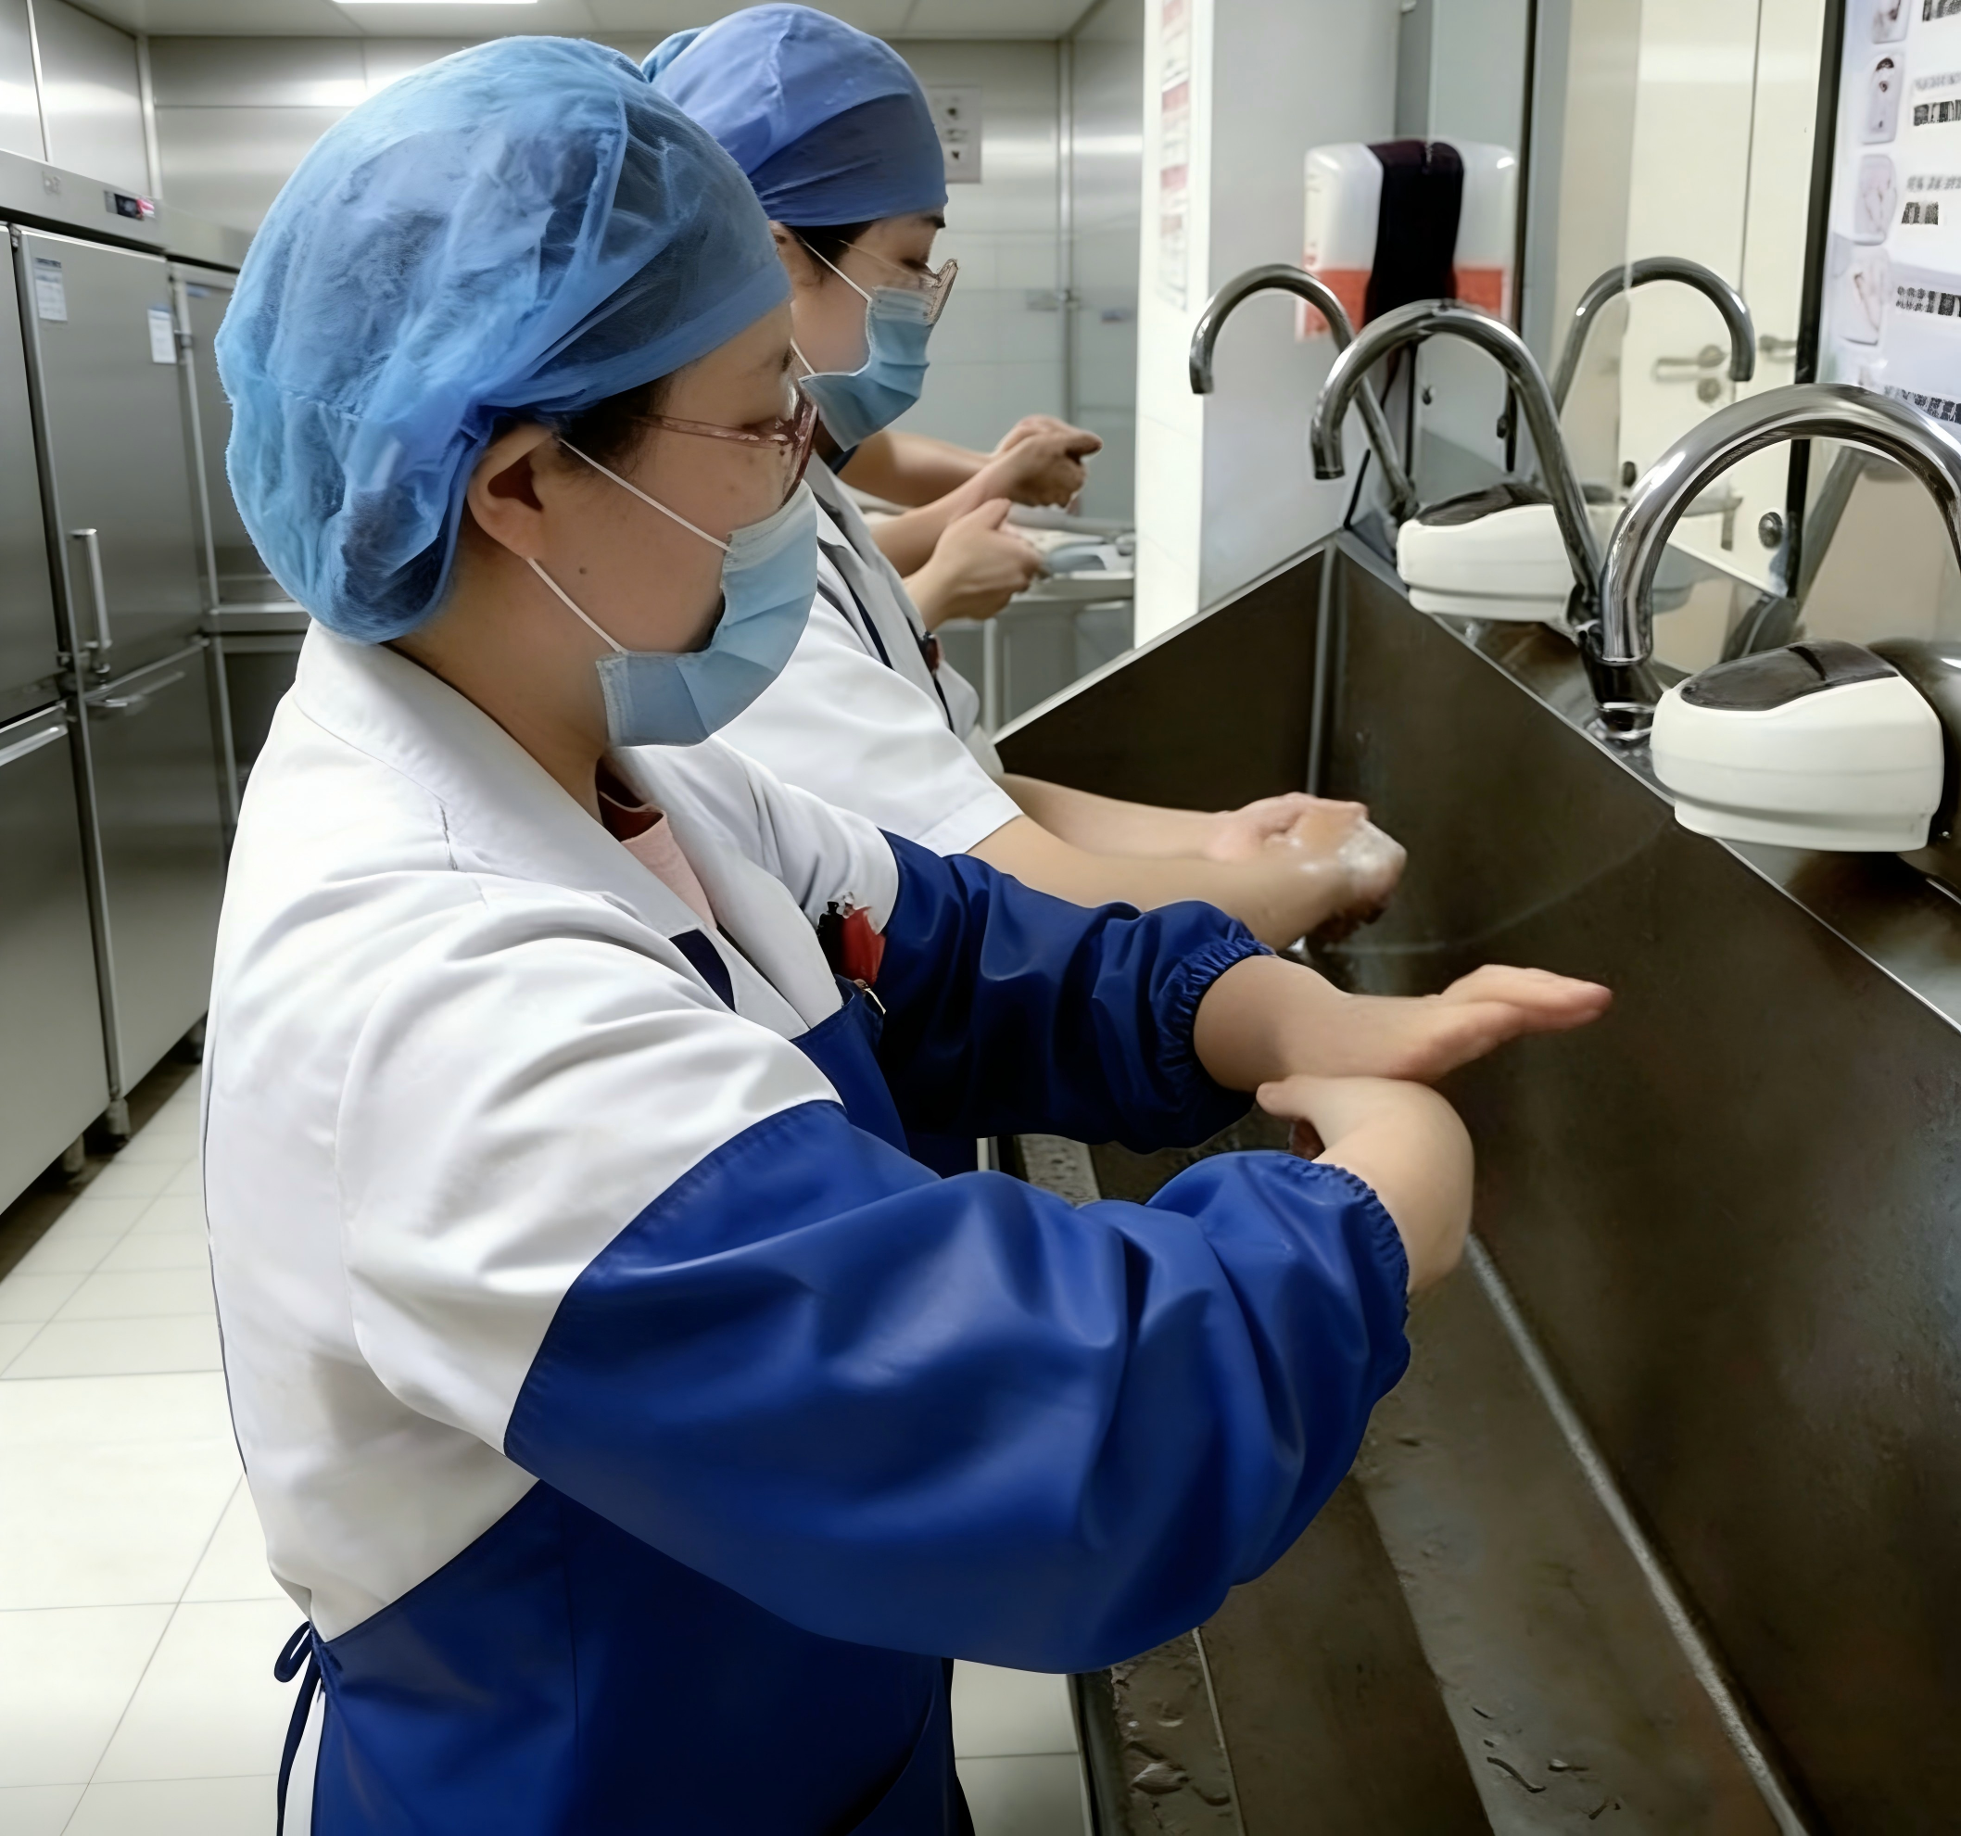
3. Personnel Hygiene Standards
Personal Hygiene
  Maintain personal cleanliness（haircuts, bathing, clean uniforms).
  Wash hands before and after work.
Uniform Management
  Work uniforms shall not be worn outside the cold storage areas, nor in cafeterias or restroom areas.
Health Requirements
  Undergo periodic medical examinations.
  Employees with infectious diseases:
    Temporarily reassigned until fully recovered.
    Prohibited from handling food during treatment.
Notes:
因此对冷库工作人员的个人卫生应有严格的要求：
冷库作业人员要勤理发、勤洗澡、勤洗工作服，工作前后要洗手，经常保持个人卫生，不应将工作服穿到食堂、厕所和冷库以外的场所。同时必须定期检查身体，如发现患传染病者应立即进行治疗并调换工作，未痊愈时不能进入库房与食品接触。
Personnel must therefore adhere to strict hygiene standards:
•Maintain personal cleanliness by regular haircuts, bathing, and washing of work uniforms.
•Wash hands before and after work;
Work uniforms shall not be worn outside cold storage areas, nor in cafeterias or restroom areas.
Undergo periodic medical examinations; employees diagnosed with infectious diseases must be temporarily reassigned until fully recovered and are prohibited from handling food during treatment.

