Slide 1
玉米全程机械化解决方案
Solution of Whole Process Mechanization
of Maize Production
Notes:
声明：文中单位亩为我国计算亩，即：1亩=666平方米
Then I would like to share some ideas about the Solution of Whole Process Mechanization of Maize Production.

Slide 2
01
中国玉米种植现有机械化水平
目录
Current Mechanization Level of Maize Planting
02
玉米全程机械化装备
Equipment of Whole Process Mechanization of Maize Production
03
玉米全程化解决方案
Solution of Whole Process Mechanization of Maize Production
Contents
04
经济效益分析
Economic Benefit Analysis
05
发展趋势和技术展望
Development trend and technology prospect
Notes:
In this part I will talk about：
01 Current Mechanization Level of Maize Planting 02 Equipment of Whole Course Mechanization of Maize Production
03 Solution of Whole Course Mechanization of Maize Production
04 Economic Benefit Analysis
05 Development trend and technology prospect

Slide 3
PART 01
中国玉米种植现有机械化水平
Current Mechanization Level of Maize Planting
Notes:
First, Current Mechanization Level of Maize Planting

Slide 4
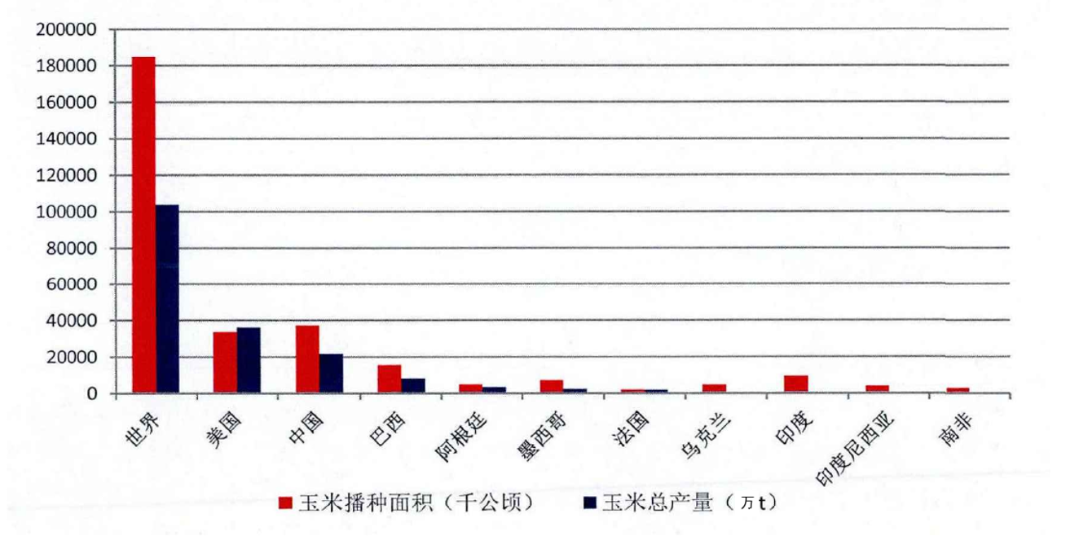
玉米种植现状
种植面积与产量 Planting area and yield
Current situation of core planting
玉米是中国第一大粮食品种，占粮食种植面积的42%。2019年，中国玉米产量2.57亿吨，消费量为2.75亿吨，进口量448万吨，出口量2万吨，进口占消费比为1.63%，进口依赖度低。
中国、美国和巴西是世界排名前三的玉米种植大国。
Corn is China's largest grain variety, accounting for 42% of the grain planting area. In 2019, China's corn output was 257 million tons, consumption was 275 million tons, imports were 4.48 million tons, and exports were 20,000 tons. Imports accounted for 1.63% of consumption, and import dependence was low. China, the United States and Brazil are the world's top three corn growing countries.
Global
US.
China
Brazil
Argentina
Mexico
French
Brazil
India
Indonesia
South Africa
sown area of maize (1000 Ha)
total output of maize (10000 Ton)
2014年玉米主产国种植面积和产量对比图
Comparison of planting area and yield in major corn producing countries in 2014
Notes:
玉米是一种重要的农作产物，它具有很强的耐旱性、耐寒性、耐贫瘠性以及极好的环境适应性。并且营养价值很高，是优良的粮食作物。在中国作为高产的粮食作物，玉米被用作畜牧业、养殖业、水产养殖业等的重要饲料来源，也是食品、医疗卫生、轻工业、化工业等的不可或缺的原料之一。
玉米是中国第一大粮食品种，占粮食种植面积的42%。2019年，中国玉米产量2.57亿吨，消费量为2.75亿吨，进口量448万吨，出口量2万吨，进口占消费比为1.63%，进口依赖度低。
中国、美国和巴西是世界排名前三的玉米种植大国。

Slide 5
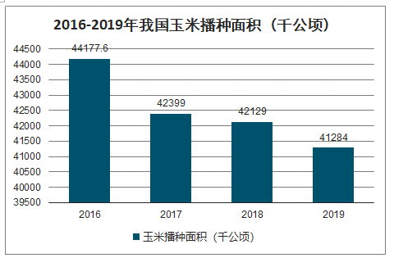
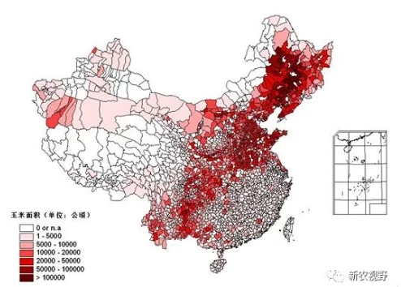
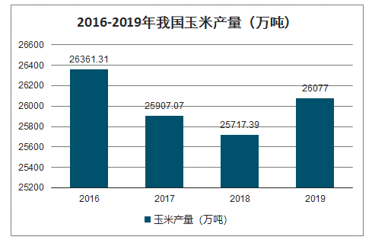
玉米种植现状
Current situation of core planting
2016-2019 sown area of maize in China (1000 Ha)
种植面积与产量 Planting area and yield
sown area of maize (1000 Ha)
2016-2019 total output of maize in China (10000 Ton)
sown area of maize (Ha)
中国玉米种植地区分布
Distribution of corn planting in China
total output of maize (10000 Ton)
Notes:
玉米在中国布局广泛，主要分布在东北、华北和西南地区，形成一个从东北到西南的狭长玉米种植带，这一带状区域集中了中国玉米种植总面积的85%和产量的90%。其中吉林、河北、山东的种植面积均占全国的10%以上。
2019年种植面积41000多千公顷，产量26000多万吨。可以看出2016年到2019年间玉米钟植面积是逐年下降的，这是因为在农业部宏观政策调整下，减少玉米种植面积5000万亩。

Slide 6
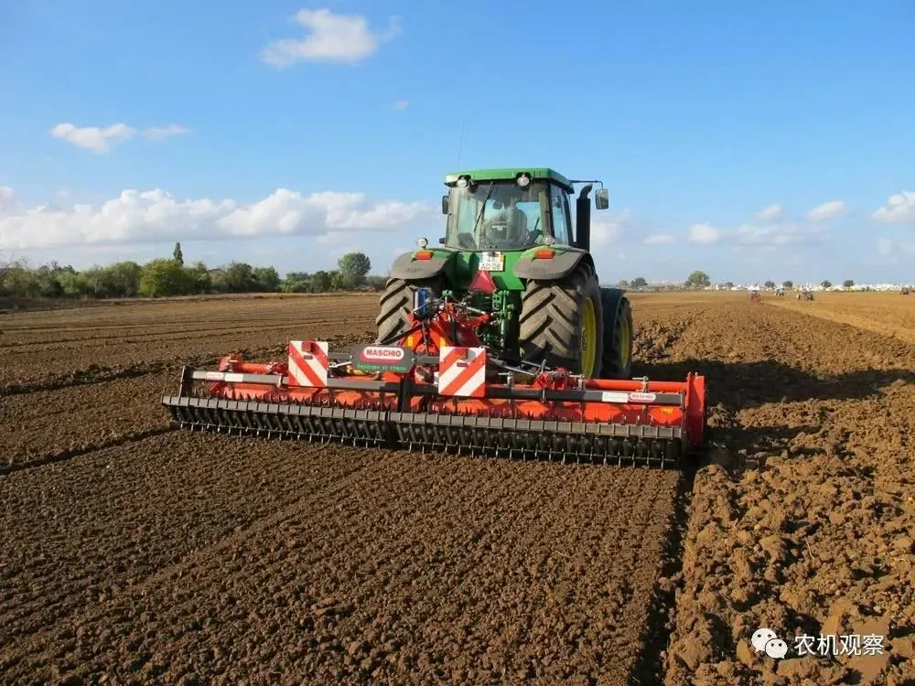
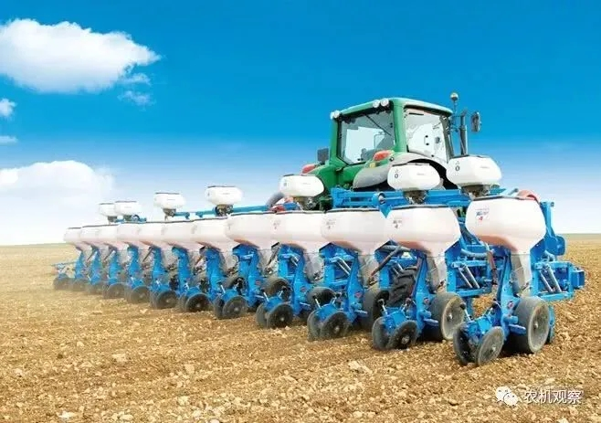
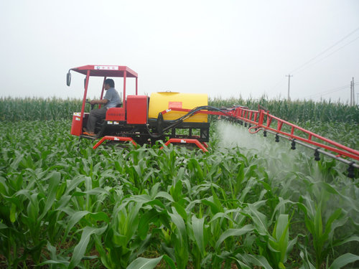
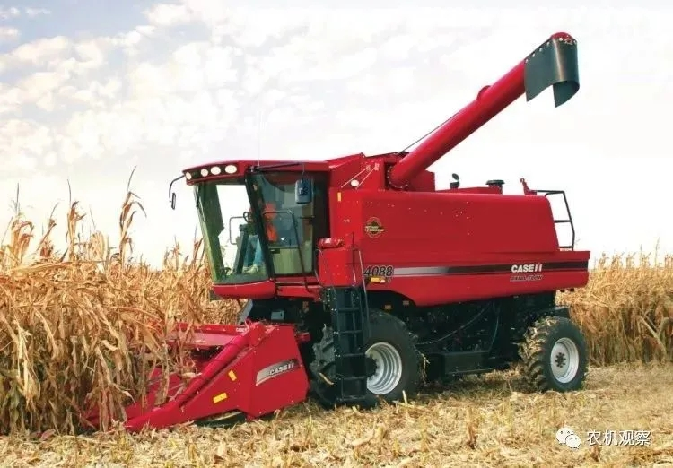
玉米种植现状
玉米全程机械化作业 Whole Process Mechanization of Maize Production
Current situation of core planting
Field management
耕整地 播种 田间管理 收获
Tillage
Sowing
Harvest
截至 2018 年，中国玉米耕、种、收及综合机械化率分别达到97.33%、88.73%、75.85%、88.31%。2019年，玉米机耕率预计达到 97.8% 左右，；机播率预计超过90%；机收率预计超过 80%；综合机械化率预计超过 90%。
As of 2018, China's corn cultivation, planting, harvesting and comprehensive mechanization rates have reached 97.33%, 88.73%, 75.85%, and 88.31% respectively. In 2019, the mechanical cultivation rate of corn is expected to reach about 97.8%; the mechanical sowing rate is expected to exceed 90%; the mechanical yield is expected to exceed 80%; the comprehensive mechanization rate is expected to exceed 90%.
Notes:
截至 2018 年，中国玉米耕、种、收及综合机械化率分别达到97.33%、88.73%、75.85%、88.31%。2019年，玉米机耕率预计达到 97.8% 左右，；机播率预计超过90%；机收率预计超过 80%；综合机械化率预计超过 90%。
在综合机械化率测算只是包含了耕整地、播种和收获三个环节，田间管理环节没有统计在内，目前田间管理机械化水平是相对较低的，主要是田间管理收种植规模、栽培模式、作物品种、农机性能等影响较大。例如：小田块，很难实现机械化的田间喷药和除草。

Slide 7
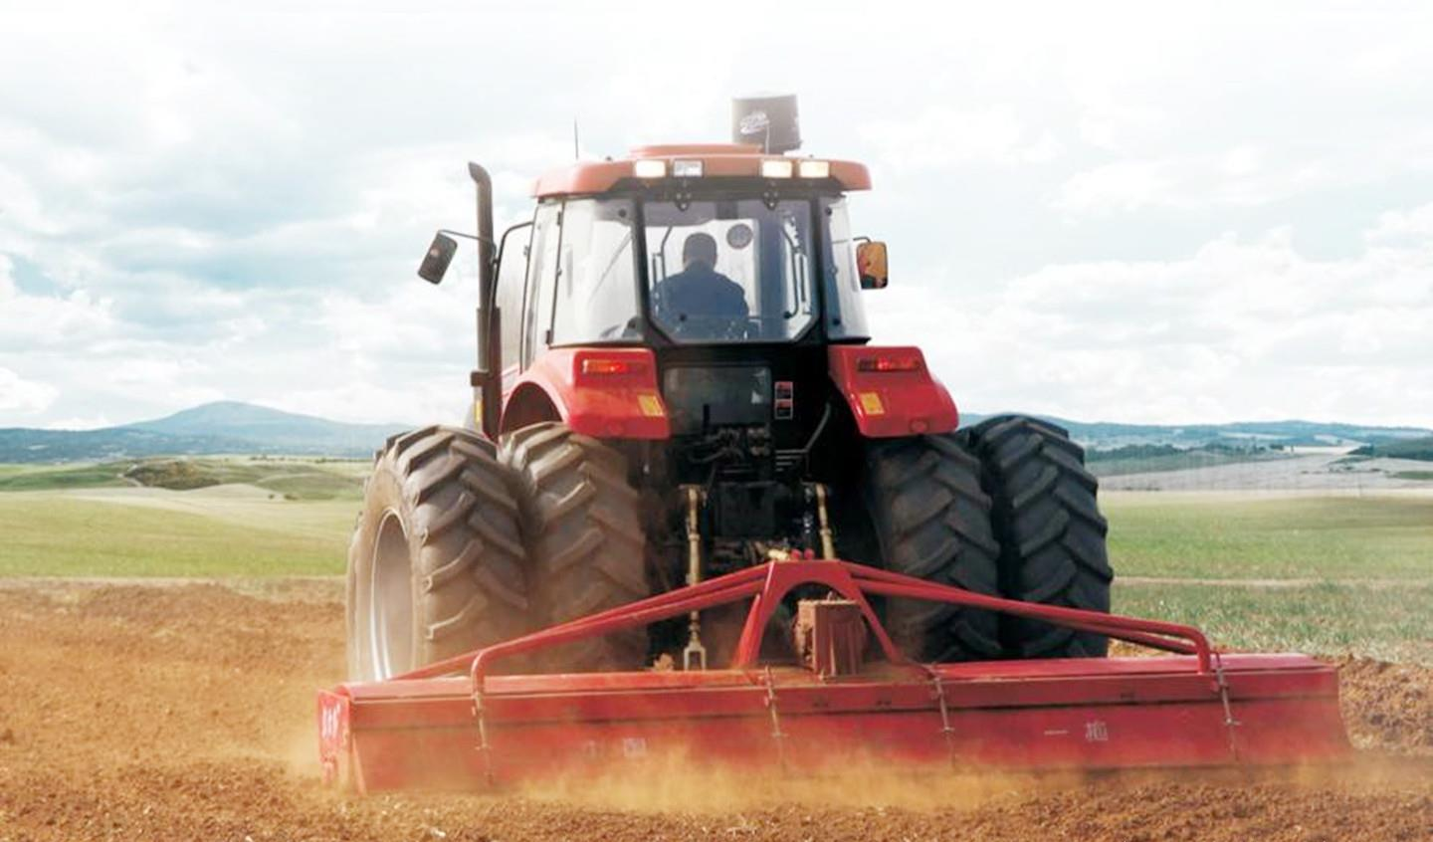
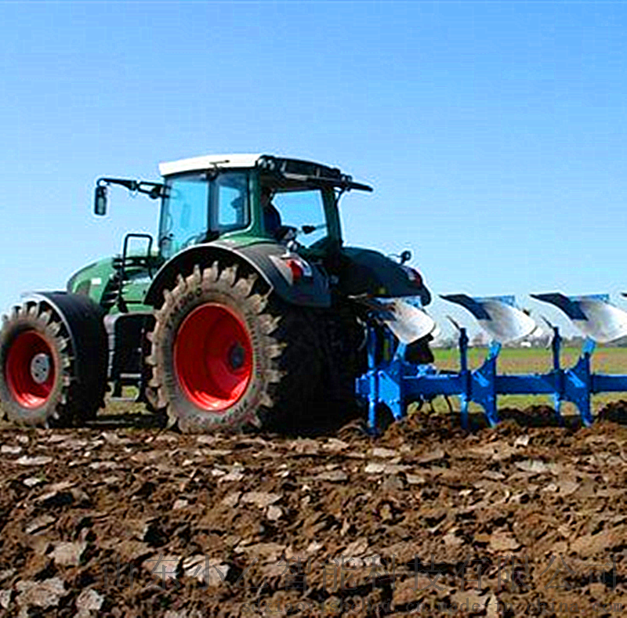
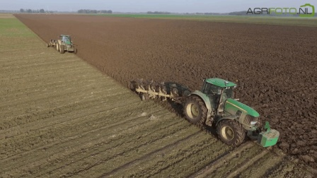
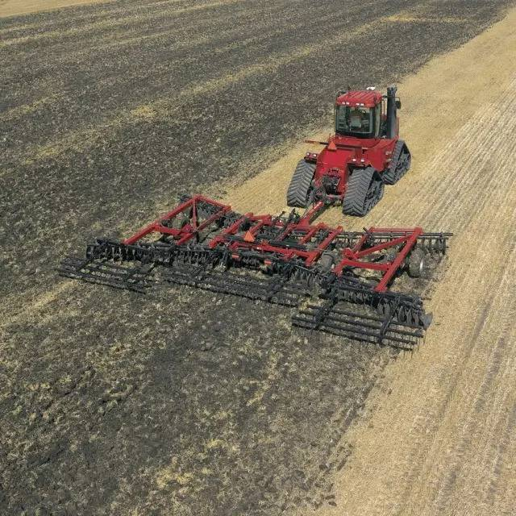
玉米种植现状
Current situation of core planting
耕整地环节
Tillage
旋耕作业 铧式犁深翻耕 圆盘耙、钉齿耙碎土
Rotary tillage
Deep plowing Disc harrow, nail-tooth harrow for soil
过去长期单一旋耕整地方式，导致了土壤“耕层浅、犁底层厚”以及玉米“不耐旱、不抗涝、不抗倒”等问题，铧式犁翻耕、深松、松耙组合等轮耕作业面积逐年扩大，对改善土壤质量和作物增产起到了明显的推动作用。
The long-term single rotary tillage method of land preparation resulted in the problems of “shallow plough layer and thick plow layer” and “intolerance of drought, waterlogging, and lodging” of corn. Combination of plowing, deep loosening and loose harrowing The area of such rotation farming operations has expanded year by year, which has played a significant role in improving soil quality and increasing crop production.
Notes:
在耕整地环节，过去长期单一旋耕整地方式，导致了土壤“耕层浅、犁底层厚”以及玉米“不耐旱、不抗涝、不抗倒”等问题，铧式犁翻耕、深松、松耙组合等轮耕作业面积逐年扩大，对改善土壤质量和作物增产起到了明显的推动作用。

Slide 8
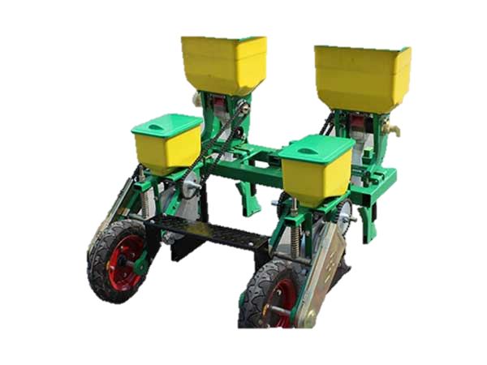
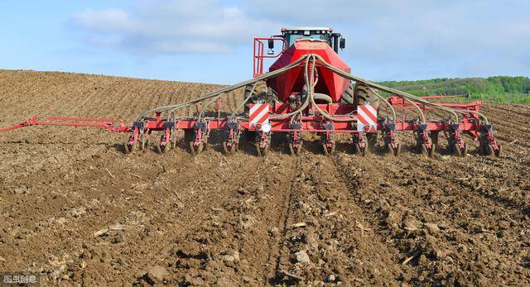
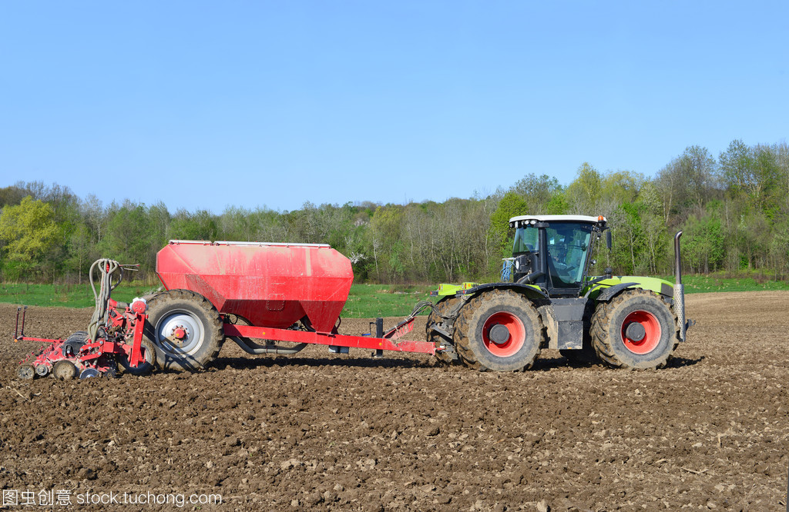
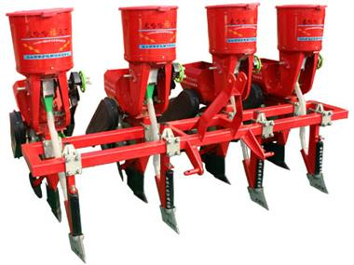
玉米种植现状
Current situation of core planting
播种环节
Sowing
精量播种面积进一步扩大，播种质量有一定提升。东北、华北一熟区和黄淮海两熟区玉米精量播种方式已占据主导地位，播种质量有所提升，尤其是免耕精量播种技术发展迅速。
The precision planting area has been further expanded, and the planting quality has been improved to a certain extent. The precision sowing methods of corn in Northeast, North China and Huanghuaihai two-cropping areas have occupied a dominant position, and the seeding quality has been improved, especially the rapid development of no-tillage precision seeding technology.
Notes:
在播种环节，精量播种面积进一步扩大，播种质量有一定提升。东北、华北一熟区和黄淮海两熟区玉米精量播种方式已占据主导地位，播种质量有所提升，尤其是免耕精量播种技术发展迅速。

Slide 9
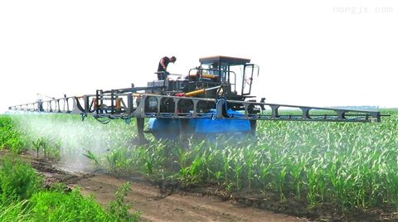
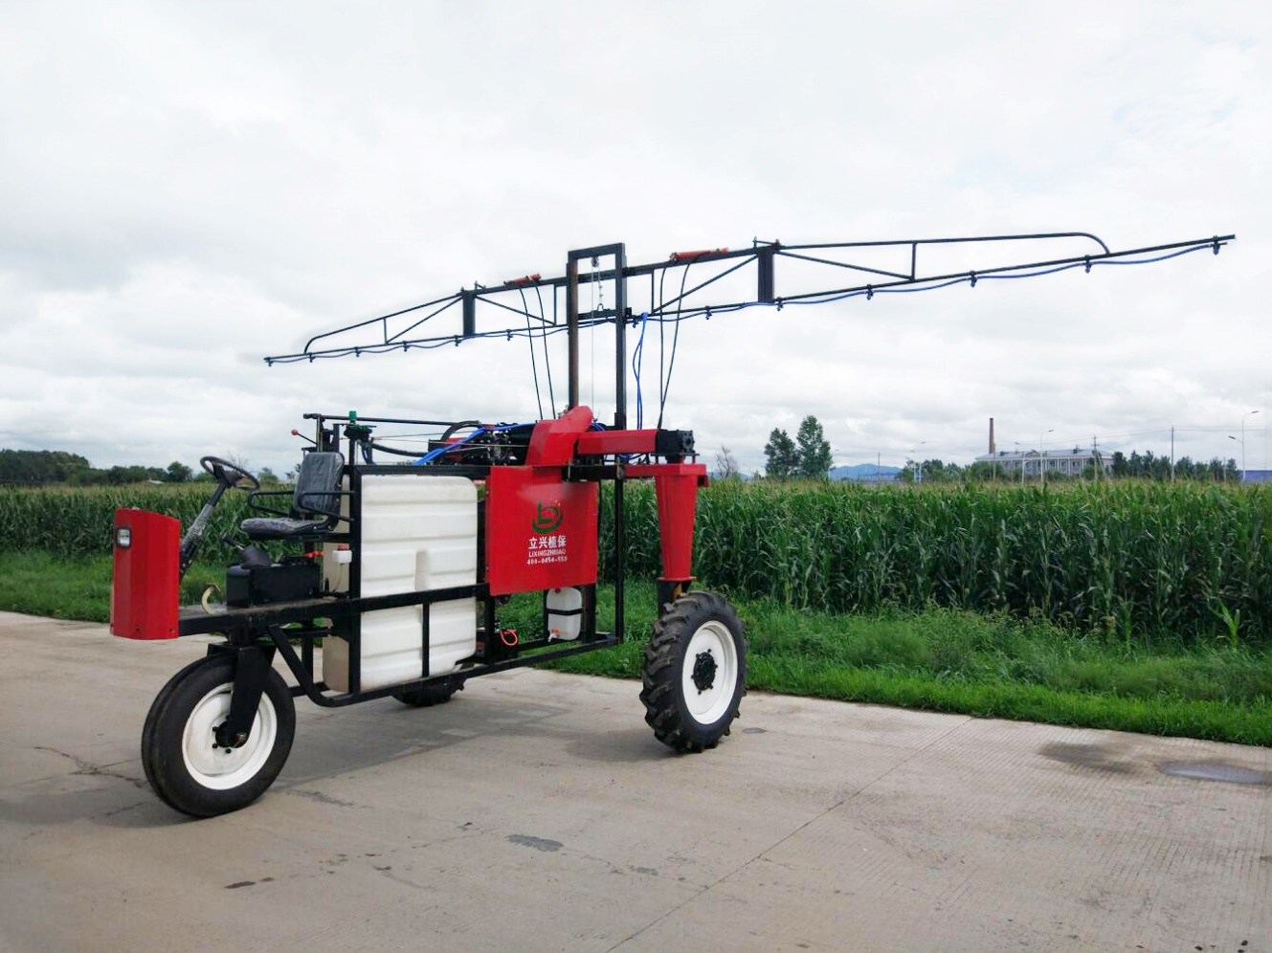
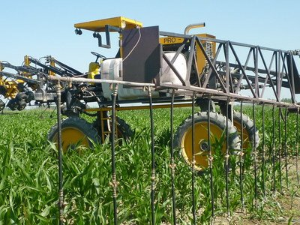
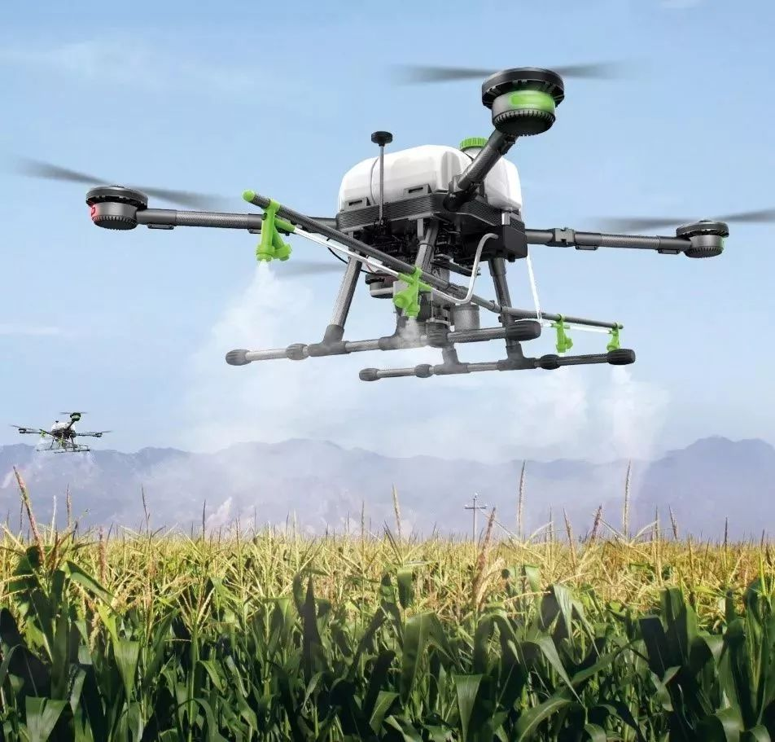
玉米种植现状
Current situation of core planting
田间管理环节
Field management
高地隙植保机械在大田生产中得到了广泛应用，无人机植保技术发展迅速，2014年全国无人植保机695架，到2018年全国无人植保机已达2.3万架，作业面积约3亿亩。但植保无人机仍然存在承载不足、续航能力弱等问题。
High ground gap plant protection machinery has been widely used in field production. UAV plant protection technology has developed rapidly. In 2014, there were 695 unmanned plant protection machines nationwide. By 2018, the number of unmanned plant protection machines nationwide has reached 23,000, with an operating area of about 300 million. mu. However, plant protection UAVs still have problems such as insufficient carrying capacity and weak endurance.

Slide 10
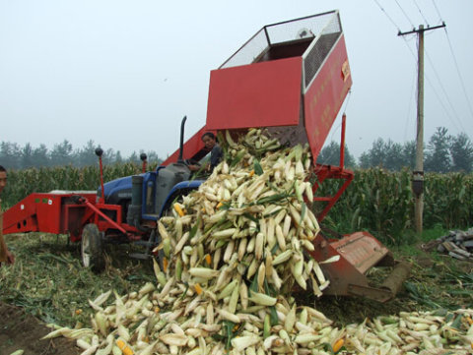
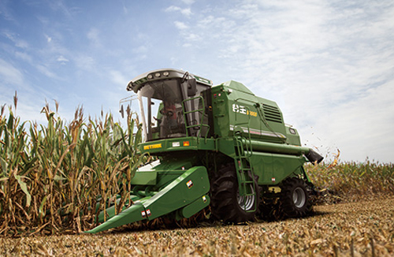
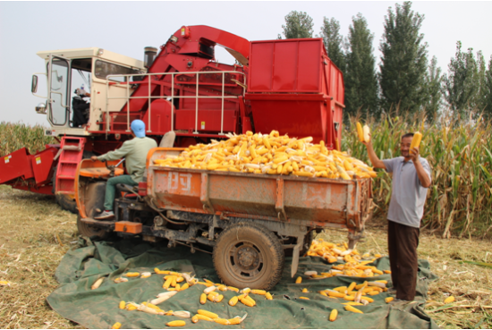
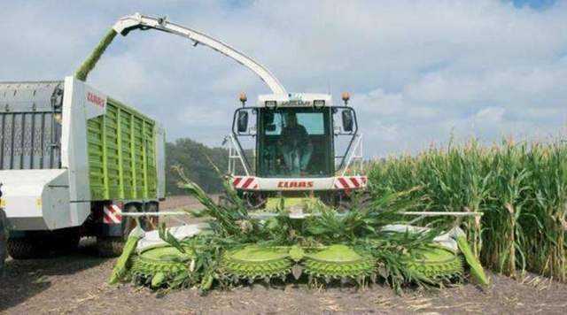
玉米种植现状
Current situation of core planting
收获环节
Harvest
中国玉米机械化收获以果穗收获为主，籽粒直收占比不足10%。果穗收获时，要求有剥皮、秸秆还田等功能，并对苞叶剥净率有较高要求。
China's mechanized corn harvesting is dominated by ear harvesting, and direct grain harvesting accounts for less than 10%. When the ears are harvested, they are required to have functions such as peeling and returning the straw to the field, and have higher requirements for the removal rate of bracts.

Slide 11
3
农机农艺分离
我国不同地区的育种、耕作、种植方式都不尽相同。会出现不在机具调整范围内的种植方式，使得机械无法使用。 In China, breeding, farming, and planting methods in different regionsare not the same. If the planting method is not within the adjustment range of the machine, the machine cannot be used.
5
机具质量有待提高
4
小农户种植方式
我国部分国产的设备技术落后，可靠性差。高端产品多需要从外国进口，造成价格高，不利于农机具普及。 Most high-end products need to be imported from abroad, resulting in high prices, which is not conducive to the popularization of agricultural machinery.
小规模农业经营一直是我国主要的农业经营方式，单一农户购买农机具是一件困难的事，尤其玉米收获机械属于大型较贵的机具。 Small-scale agricultural operation has always been the main agricultural operation method in China. It is difficult for a single farmer to purchase agricultural machinery, especially corn harvesting machinery is a large and expensive machine.
Large Regional Differences
玉米机械化存在问题
Problems in maize mechanization
1
地区差异大
我国南北地貌差距大，不同区域的经济水平和气候条件差距大。适宜机械作业地区和经济较发达区域，农民收入中对农业机械的购买投入较多，玉米机械化业生产发展速度相对较快；而经济欠发达的地区先进适用机具保有量少，玉米机械化生产的发展速度慢。
There are large differences in landforms between North and South in my country. There are also large differences in economic levels and climatic conditions in different regions. The cost on agricultural machinery accounts for more of the income of farmers in areas suitable for mechanical operations and economically developed areas, where the production of corn mechanization is developing relatively fast. However, in areas where the economy is underdeveloped, there are few advanced and applicable machines. The development of mechanized corn production is slow.
2
装备结构不合理
Unreasonable Equipment Structure
Separation of Agricultural Machinery and Agronomy
我国大中型以上拖拉机（14.7kW以上）的农机具配套比为1:1.7，与1:3的合理配套比有一定差距。其中，高性能的植保机具、籽粒收货机具保有量少，限制了玉米产量提升。
The matching ratio of agricultural machinery for large and medium-sized tractors (above 14.7kW) in my country is 1:1.7, which is far behind the reasonable matching ratio of 1:3. Among them, high-performance plant protection equipment and grain receiving equipment have a small inventory, which limits the increase in corn output
Machine Quality Need to Be Improbed
Small Farmers Cultivation
6
农机社会化服务起步阶段
The Initial Stage of Agricultural Machinery Socialized Service
我国农机服务合作社属于刚起步阶段，大部分合作社规模较小，未能形成全产业的服务能力。辐射带动能力弱，抗风险能力弱，管理不够科学规范，组织化与专业化程度低，经营者素质普遍较低，服务观念与日益发展的现代化农业需求不匹配。
Agricultural machinery service cooperatives are in their infancy. Most of the cooperatives are small in scale and fail to form the service capacity of the whole industry. The ability to drive radiation and the ability to resist risks are weak. Their management is not scientific and standardized. The degree of organization and specialization is low and the quality of operators is generally low. The service concept does not match the growing modern agricultural needs.
Notes:
总体来说，我国玉米机械化种植存在着以下多方面的问题。1…….（念PPT即可）
The problems exist in maize mechanization mainly are:
1.Large Regional Differences,
There are large differences in landforms between North and South in my country. There are also large differences in economic levels and climatic conditions in different regions. The cost on agricultural machinery accounts for more of the income of farmers in areas suitable for mechanical operations and economically developed areas, where the production of corn mechanization is developing relatively fast. However, in areas where the economy is underdeveloped, there are few advanced and applicable machines. The development of mechanized corn production is slow.
2.Unreasonable Equipment Structure,
The matching ratio of agricultural machinery for large and medium-sized tractors (above 14.7kW) in my country is 1:1.7, which is far behind the reasonable matching ratio of 1:3. Among them, high-performance plant protection equipment and grain receiving equipment have a small inventory, which limits the increase in corn output.
3.Separation of Agricultural Machinery and Agronomy,
In China, breeding, farming, and planting methods in different regionsare not the same. If the planting method is not within the adjustment range of the machine, the machine cannot be used.
4.Small Farmers Cultivation,
Small-scale agricultural operation has always been the main agricultural operation method in China. It is difficult for a single farmer to purchase agricultural machinery, especially corn harvesting machinery is a large and expensive machine.
5.Machine Quality Need to Be Improbed,
Most high-end products need to be imported from abroad, resulting in high prices, which is not conducive to the popularization of agricultural machinery.
6. The Initial Stage of Agricultural Machinery Socialized Service.
Agricultural machinery service cooperatives are in their infancy. Most of the cooperatives are small in scale and fail to form the service capacity of the whole industry. The ability to drive radiation and the ability to resist risks are weak. Their management is not scientific and standardized. The degree of organization and specialization is low and the quality of operators is generally low. The service concept does not match the growing modern agricultural needs.

Slide 12
PART 02
玉米全程机械化装备
Equipment of Whole Process Mechanization of Maize Production
Notes:
玉米全程机械化装备
分析完斯里兰卡地区的玉米种植特点后，针对斯里兰卡特殊地理因素得出结论当地比较适合中小型机械化种植设备，我们下面介绍一下农艺环节可使用的机械化设备。
Equipment of Whole Course Mechanization of Maize Production

Slide 13
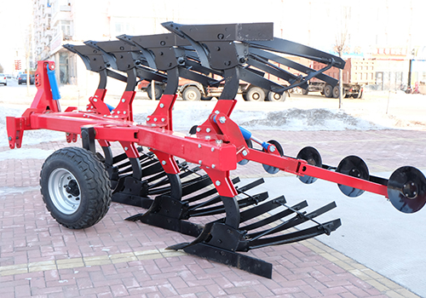
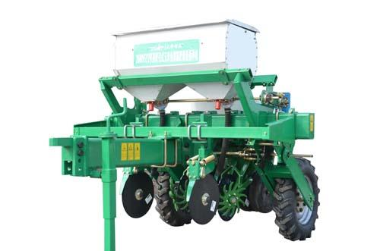
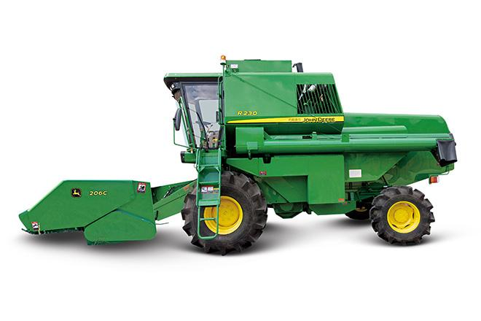
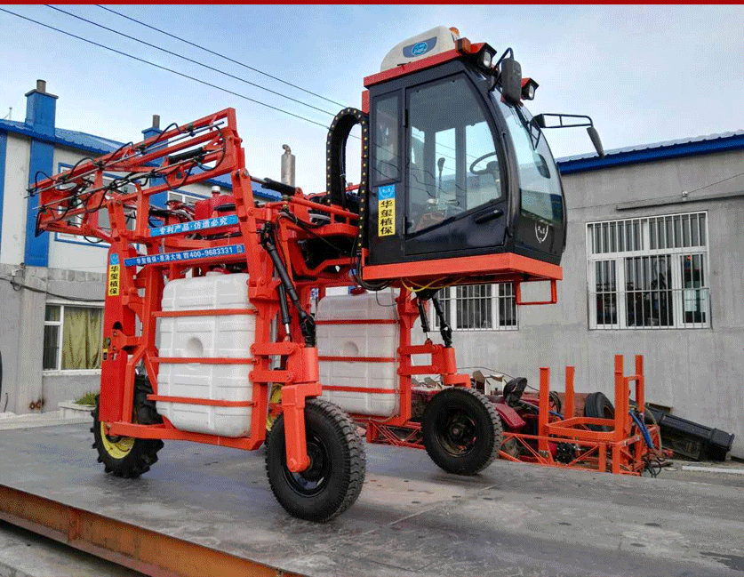
耕
播
耕地为传统农艺，松土方便播种。但近年开始流行玉米免耕播种机，简化了生产流程。
管
收
玉米全程机械化生产环节
The Whole Mechanized Production of Maize
The maize no-till seeder simplifies the production process.
The corn no-tillage machine eliminats the need for cultivation and fertilization.
Tillage
玉米免耕机，由开沟器直接开沟，种药同步播种，省去耕地、施肥等流程。
Sowing
Management
Harvest
The plant protection machinery has an arm of 3-5 m, eliminating repeated labor and improving production efficiency.
Large maize grain harvester can complete maize ear harvest and straw crushing and returning to the field.
大型玉米籽粒收获机，可单次收获多笼。可同时完成玉米果穗收获和秸秆粉碎还田等步骤。
植保机械臂展可达3-5米，单次面积大，免去重复劳动，提高生产效率。
Notes:
PPT展现了玉米种植的耕种保收四个主要生产环节，实际上，玉米种植过程中还包括着施肥、追肥、灌溉、除草等环节。但是以耕种保收这四个环节最为典型，机械化程度最高。
左上角耕地环节展示的是一台翻转犁，这种耕地设备具有翻垈、碎土、覆盖性好、耕后地表平整，入土行程短等优点。可以充分的消灭杂草，并将秸秆与土壤混合，实现秸秆还田。
播种环节展示的是一台两行免耕播种机，这种设备可以实现开沟、精准播种、施肥三种功能合于一体。并且在土地不进行翻地、耕地的情况下直接进行播种，可以减少春季土壤流失、减少整体工作量。
左下角为高地隙植保机械，车头可抬升，一般离地都在2米以上，可以在玉米田里自如行走，进行除虫、除草、施液体肥等作业。
玉米收获机械分为两大类，一类是棒收；另一类为籽粒直收，籽粒直收可以在收获过程中直接将玉米进行脱粒、收获籽粒。（青饲玉米收获又是另一种机型）
The Whole Mechanized Production of Maize mainly includes the four processes of tillage, sowing, protection and harvest. The maize no-till seeder simplifies the production process. The corn no-tillage machine eliminats the need for cultivation and fertilization. The plant protection machinery has an arm of 3-5 m, eliminating repeated labor and improving production efficiency. Large maize grain harvester can complete maize ear harvest and straw crushing and returning to the field.

Slide 14
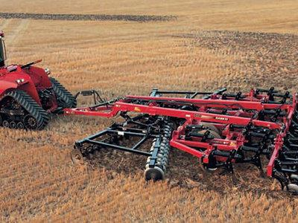
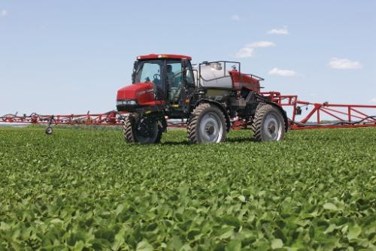
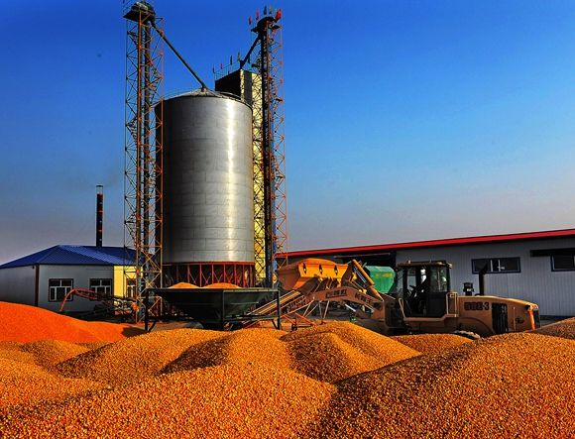
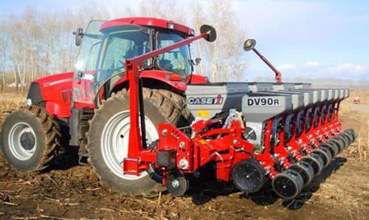
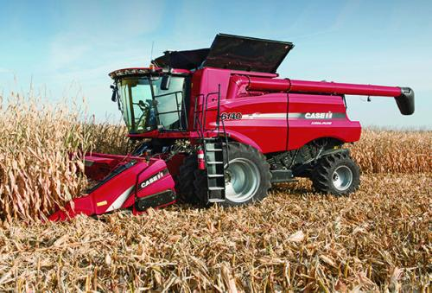
玉米全程机械化生产环节 The whole mechanized production of maize
耕整地
Land preparation
田间管理
Field management
烘干、耕地还田
Drying, straw returning
播种
Sowing
收获
Harvest
Notes:
玉米全程机械化生产全流程：一般经历耕整、播种、田间管理、收获、烘干（晾干）、耕地还田几个重要农艺环节

Slide 15
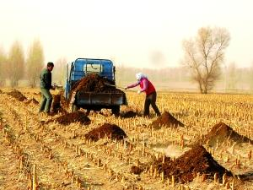
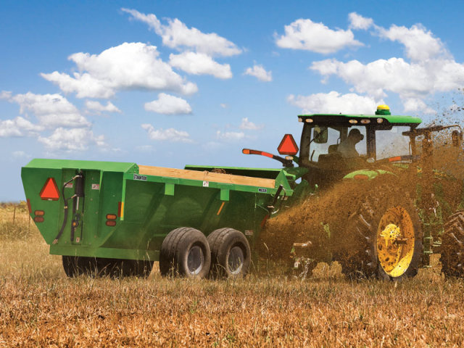
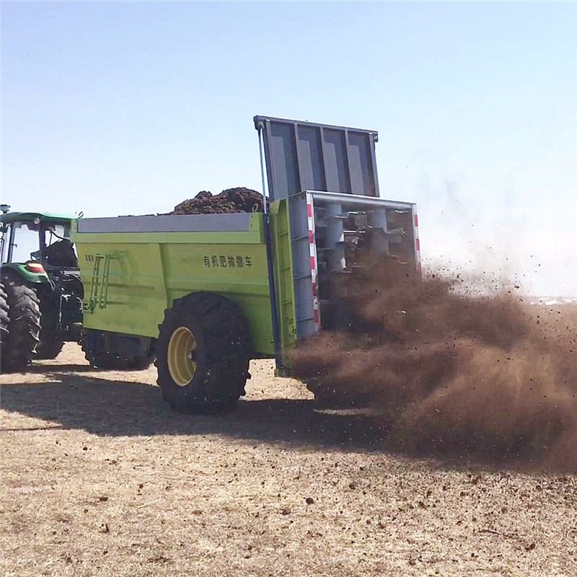
推荐机型
Model recommendation
有机肥施肥设备——中型
Medium-sized organic fertilizer application equipment
为补充土壤肥力和改善土壤有机质含量，在每年的翻耕之前，都会撒施有机肥。一般施农家有机肥通常以立方米计算。根据不同作物种类的对有机肥的需求，施肥量也不尽相同，一般为3～5立方米。科学的方法是现代的测土配方施肥技术，即节约成本，又能提高肥料的利用率，使作物高产、优质、高效生产。
In order to supplement soil fertility and improve soil organic matter content, organic fertilizers are sprinkled before plowing each year. The general application of farmhouse organic fertilizer is usually calculated in cubic meters. According to the demand for organic fertilizer of different crop types, the amount of fertilizer is not the same, generally 3 to 5 cubic meters. These are all empirical fertilization methods. What is more scientific is the modern soil testing formula fertilization technology, which saves costs and improves the utilization rate of fertilizers, so that crops are produced with high yield, high quality and high efficiency.
Notes:
为补充土壤肥力和改善土壤有机质含量，在每年的翻耕之前，都会撒施有机肥。一般施农家有机肥通常以立方米计算。根据不同作物种类的对有机肥的需求，施肥量也不尽相同，一般为3～5立方米。这些都是经验施肥方法，更科学的是现代的测土配方施肥技术，即节约成本，又能提高肥料的利用率，使作物高产、优质、高效生产。

Slide 16
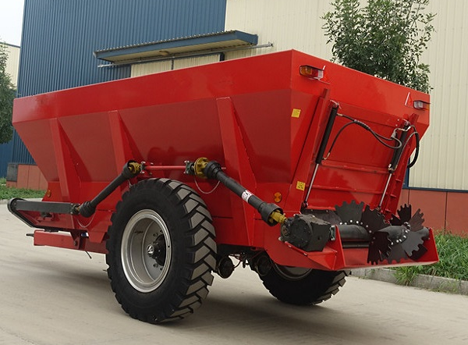
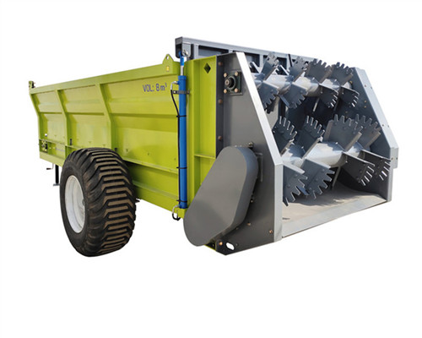
中型施肥设备 Medium-sized fertilizer equipment
推荐机型
Model recommendation
Manure spreader
Technical Parameters
Fertilizer state: manure, manure, organic fertilizer, pellet
Dimensions: 4400*2300*2400 (mm)
Fertilization form: spread
Work form: Fully automatic Fertilization amount: 1000kg/mu
Single fertilizer load: 6-10 tons
Efficiency: more than 10hm
Reference price: 25,000 yuan
撒肥机
技术参数
肥料物态：厩肥、粪肥、有机肥、颗粒
外形尺寸：4400*2300*2400（mm）
施肥形式：铺洒
作业形式：全自动 施肥量：1000kg/亩
单次装肥量：6-10吨
效率：10hm/h以上
参考价格：2.5万元
中型撒肥设备
（需配套动力设备）
Medium-sized fertilizer equipment
(Need supporting power equipment)
Notes:
有些地区进行玉米种植时依然保有施撒厩肥的习惯，普通人力施肥（小型撒肥设备）设备单次作业量少，人力劳动量。
厩肥：家畜粪尿和垫圈材料、饲料残茬混合堆积并经微生物作用而成的肥料。富含有机质和各种营养元素。垫圈材料有秸秆、杂草、落叶、泥炭和干土等。经嫌气分解腐熟。在积制期间，其化学组分受微生物的作用而发生变化。
Meaning of distributing fertilizer
The organic matter in organic fertilizer is an important evaluation index of soil fertility. When the organic matter content in the soil drops to a certain level, the yield of soil crops will drop significantly. Then the land needs a long fallow period to restore land production (chemical fertilizers have limited impact on land organic matter). Therefore, it is necessary to apply organic fertilizer to the land. If organic fertilizer cannot be applied, straws returning is also helpful to ensure soil fertility.
In some areas, the habit of spreading manure (*) when planting corn is still maintained. Traditional human fertilization equipment (small-scale fertilization equipment) has a small amount of single operation and a large amount of human labor.
Mixture of livestock manure and washer materials and feed residues that Fertilizer of livestock manure, gasket material, and feed residue mixture that have been affected by microorganisms is rich in organic matter and various nutrients. The gasket materials include straw, weeds, fallen leaves, peat and dry soil, etc.. These materials are decomposed by anaerobic decomposition. During the accumulation period, its chemical composition is changed by the action of microorganisms.
中型自动撒肥机，单次装肥量可达到6-10吨，每天撒肥作业面积可以达到200亩以上，节省了大量人力。撒肥机需要配套拖拉机等动力设备，以8吨容量撒肥机为例，需要配套90马力以上拖拉机，农户承担能力有限。
The medium-sized automatic fertilizer spreader can load 6-10 tons of fertilizer in a single time, and the daily spreading area can reach more than 200 acres, saving a lot of manpower. The fertilizer spreader needs to be equipped with tractors and other power equipment. Taking the 8-ton fertilizer spreader as an example, it needs to be equipped with a tractor of more than 90 horsepower, and the farmers' ability to bear it is limited.

Slide 17
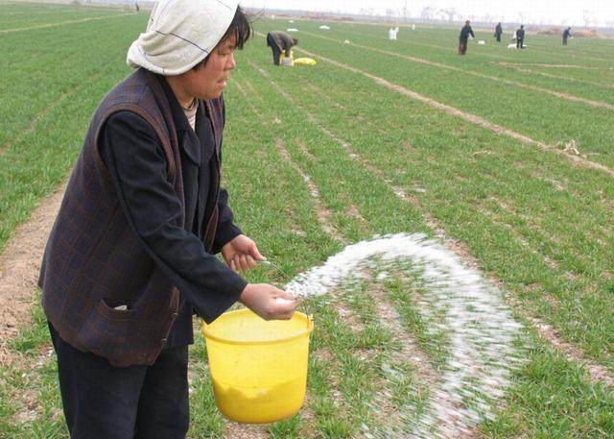
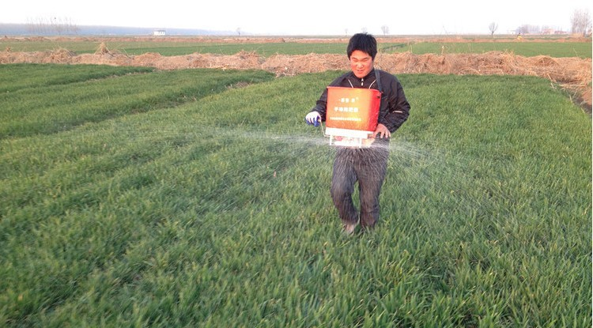
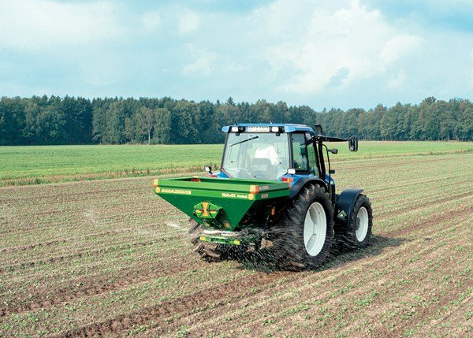
推荐机型
Model recommendation
颗粒肥、化肥撒施设备 Pellet fertilizer, chemical fertilizer spreading equipment
玉米拔节前需要进行中耕除草和追肥，肥料是颗粒状化肥为主，一般在灌溉或者下雨前，撒到地表，遇水溶解后，渗入土壤被玉米根系吸收。每公顷一般追施化肥450-750千克。
Before jointing corn, weeding and top dressing are required. Fertilizers are mainly granular chemical fertilizers. Generally, they are sprayed on the ground before irrigation or rain. After being dissolved in water, they will penetrate into the soil and be absorbed by the corn roots. Generally, 450-750 kg of chemical fertilizer is applied per hectare.
Notes:
玉米拔节前需要进行中耕除草和追肥，肥料是颗粒状化肥为主，一般在灌溉或者下雨前，撒到地表，遇水溶解后，渗入土壤被玉米根系吸收。
每公顷一般追施化肥450-750千克。撒肥的方式也相对简单，地块小的，农户直接有手撒，有的购买小型电动离心撒肥器，撒的更均匀一些，地块大的，就是拖拉机悬挂的离心撒肥机，撒的幅宽10米以上，肥料也均匀，效率很高，每小时可以撒肥2公顷以上。

Slide 18
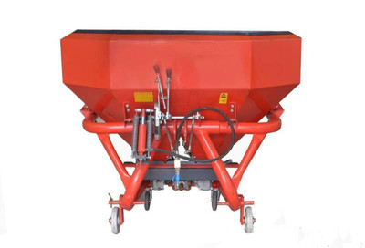
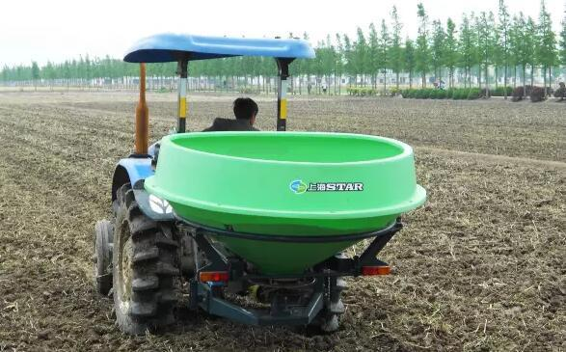
推荐机型
Model recommendation
颗粒肥中大型型施肥设备 Large size fertilizer equipment
双圆盘离心撒肥机
技术参数
肥料物态：颗粒
外形尺寸：1600*1600*1400（mm）
撒肥幅宽：10-20m可调
挂接形式：三点悬挂 作业速度：1-1.8m/s
作业效率：1.8-6.8hm/h
参考价格：5000元
Double disc centrifugal fertilizer spreader
Technical Parameters
Fertilizer state: Pellet
Dimensions: 1600*1600*1400 (mm)
Spreading width: 10-20m adjustable
Work form: Fully automatic Fertilization Mounting form: three-point Working speed: 1-1.8m/s
Operating efficiency: 1.8-6.8hm/h
Reference price: 5,000 yuan
Notes:
离心式双圆盘撒肥机的动力来源于选配的配套拖拉机，通过万向联轴器传递到机具的齿轮传动箱再传至撒肥摆动口，进行撒肥作业。采用三点悬挂的方式挂接到拖拉机上，撒肥幅宽10-20m可调，田间作业速度1-1.8m/s，每小时撒肥1.8-6.8hm。通过液压系统控制撒肥量，适用于各种颗粒肥料、小麦、豆类、药草种子、以及融雪剂的路面撒播。

Slide 19
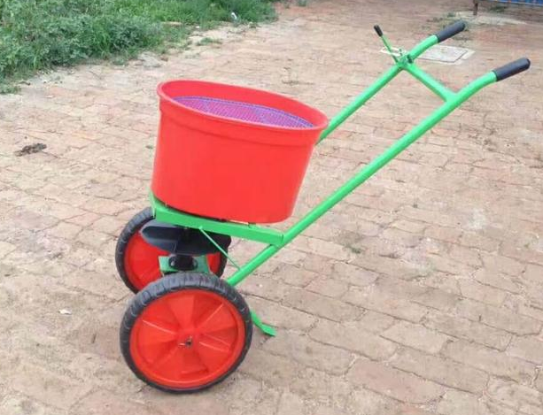
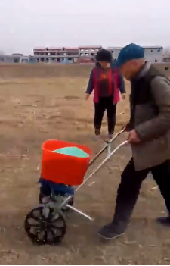
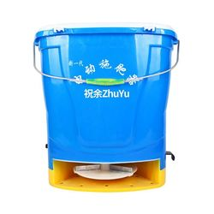
颗粒肥小型施肥设备 Small fertilizer equipment
推车式撒肥机 Cart type fertilizer spreader
推荐机型
Model recommendation
推车式撒肥机
技术参数
肥料物态：颗粒
外形尺寸：1200*500*1200（mm）
施肥幅宽：3000-5000（mm）
作业形式：半自动 施肥效率：0.3-0.5hm/h
参考价格：300元
Cart type fertilizer spreader
Technical Parameters
Fertilizer state: granular
Dimensions: 1200*500*1200 (mm)
Fertilization depth: 30-50 (mm)
Work form: semi-automatic fertilizer rate: 80-120kg/mu
Reference price: 300 yuan
推车式撒肥机 Cart type fertilizer spreader
Notes:
对于小地块的颗粒化肥撒施，可使用背负式电动撒肥器和推车式的撒肥机，撒肥的原理与大型撒肥机样，肥料由肥箱落入离心转盘，转盘告诉旋转将颗粒肥均匀甩出去。这类机型，价格低廉，作业效率、肥料均匀度都显著高于人工作业。

Slide 20
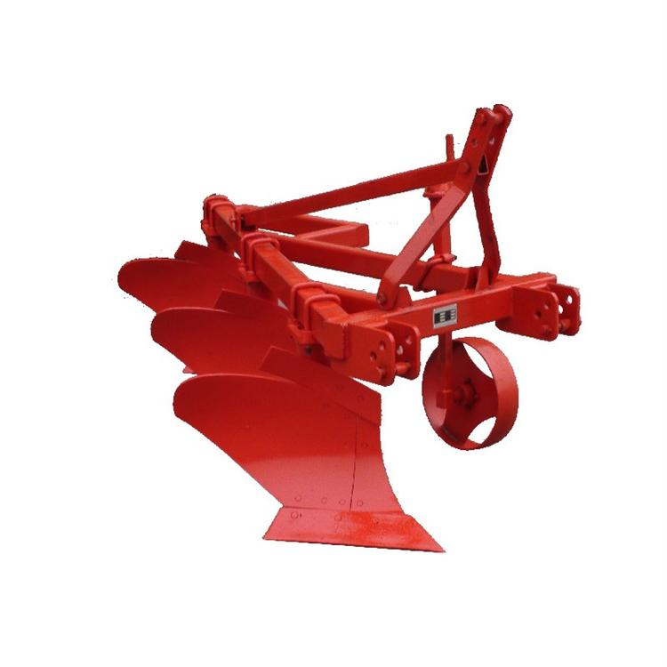
推荐机型
Model recommendation
中型耕地设备 Middle tillage equipment
The split plow is mainly suitable for stubble removal in farmland, breaking the surface compaction, chopped straw and returning to the field, and crushing the soil after ploughing. The split-type plow has high efficiency, strong ability to crush the soil, and the ground surface after harrowing is smooth, and it has strong versatility for heavy soil, wasteland and places with many weeds. There are mainly two characteristics:
1. The plow tip adopts a vertical inclined insertion type, which reduces the resistance of the ploughshare into the soil and can smoothly realize deep ploughing.
2. The overall ploughshare and the traction direction form an angle of 45 degrees, which is conducive to plowing and breaking the soil, and can bury the weeds on the surface deeply to maintain soil moisture. Deep ploughing every season can continuously improve the soil quality and balance the soil. PH value, preserve moisture and store water.
铧式犁主要适用于农田耕地灭茬，破除地表板结，秸秆切碎还田，耕后碎土。铧式犁作业效率高，入土碎土能力强，耙后地表平整，对粘重土地、荒地和杂草多的地方具有很强的通用性。主要有一下两个特点：
1、犁尖采用垂直斜插式，减少了犁铧入土的阻力，能顺利实现深耕。
2、犁铧整体与牵引方向成45度夹角，有利于铧式犁的翻土碎土，并能将地表的杂草深埋，保持土壤水分，每季进行深耕可不断改善土壤质量，平衡土壤酸碱值，保墒蓄水。
铧式犁
技术参数：右表
参考价格：1万元（4行）
Plow
Technical parameters: right table
Reference price: 10,000 yuan (4 lines)
Working width
Tillage depth
Number of plows
Weight
Supporting power
Hooked method
Hooked by three points
Notes:
中型设备中的铧式犁和翻转犁一般耕作深度可以达到20-35cm之间，不同深度取决牵引设备马力。翻转犁在犁地的同时可以实现土地和秸秆的混合及覆盖，有助于秸秆发酵分解。
Working width
The common plow and flip plow in medium-sized equipment can generally reach 20-35cm tillage depth, and the different depth depends on the horsepower of the traction equipment. The flip plow can realize the mixing and covering of the land and the straw while plowing, which is helpful for the fermentation and decomposition of the straw.

Slide 21
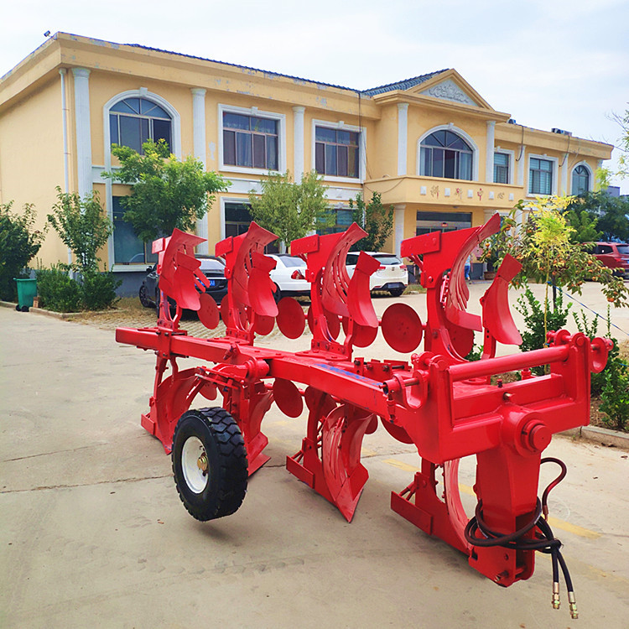
推荐机型
Model recommendation
The flip plow is actually a combination of up and down plows, which are rotated by hydraulic pressure, so that after the single-row operation is completed, there is no need to return to the starting side to cultivate the land. Mainly have the following characteristics:
1. The turning plough adopts a combined type as a whole, which is convenient for maintenance and replacement of wearing parts. Both the ploughshare and the upper and lower ploughs are assembled by bolts, which reduces the cost of maintenance.
2. The turning plough adopts hydraulic turning, which can improve turning efficiency and turning stability, and reduce the damage to tractor and plough caused by impact.
3. The three-point suspension connection method is adopted to facilitate the adjustment of the tillage depth, the work is stable, and the ridge turning is smooth.
4. The weight of the heavy-duty flip-type plow is more than 1,000 kg, which can meet the high-intensity and high-load work of the plow under the high-horsepower tractor.
中型耕地设备 Middle tillage equipment
翻转犁实际为上下铧式犁组合，利用液压进行旋转，实现单行作业完毕不必再回到起始侧再进行耕地。主要有以下特点：
1、翻转犁整体采用组合式，便于维修和更换易损件。犁铧上下犁均采用螺栓装配，降低了维修保养的成本。
2、翻转犁采用液压翻转，可提高翻转效率和翻转稳定性，减少撞击对拖拉机和犁造成的伤害。
3、采用三点悬挂的连接方式，方便调节耕深，工作稳定，翻垄平整。
4、重型翻转铧式犁整机重量在1000公斤以上，能满足铧式犁在大马力拖拉机下的高强度 高负荷的工作。
翻转犁
技术参数：右表
参考价格：3万元（4行）
Flip plow
Parameters: right table
Reference price: 30,000 yuan (4 lines)
Boundary dimension
Supporting power
Working width
Number of plows
Weight
Notes:
中型设备中的铧式犁和翻转犁一般耕作深度可以达到20-35cm之间，不同深度取决牵引设备马力。翻转犁在犁地的同时可以实现土地和秸秆的混合及覆盖，有助于秸秆发酵分解。
The common plow and flip plow in medium-sized equipment can generally reach 20-35cm tillage depth, and the different depth depends on the horsepower of the traction equipment. The flip plow can realize the mixing and covering of the land and the straw while plowing, which is helpful for the fermentation and decomposition of the straw.

Slide 22
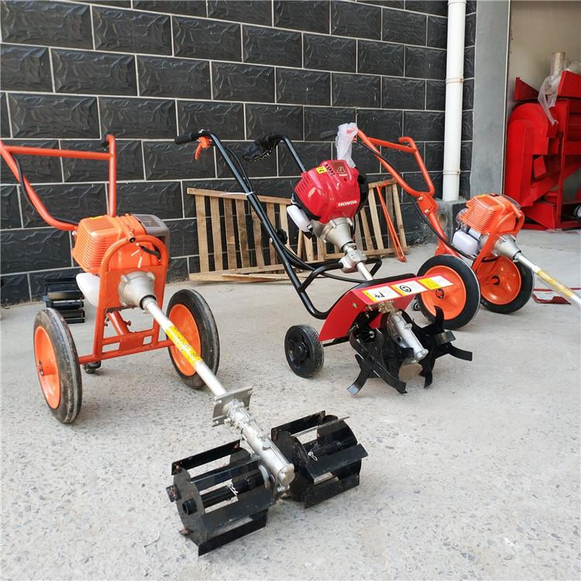
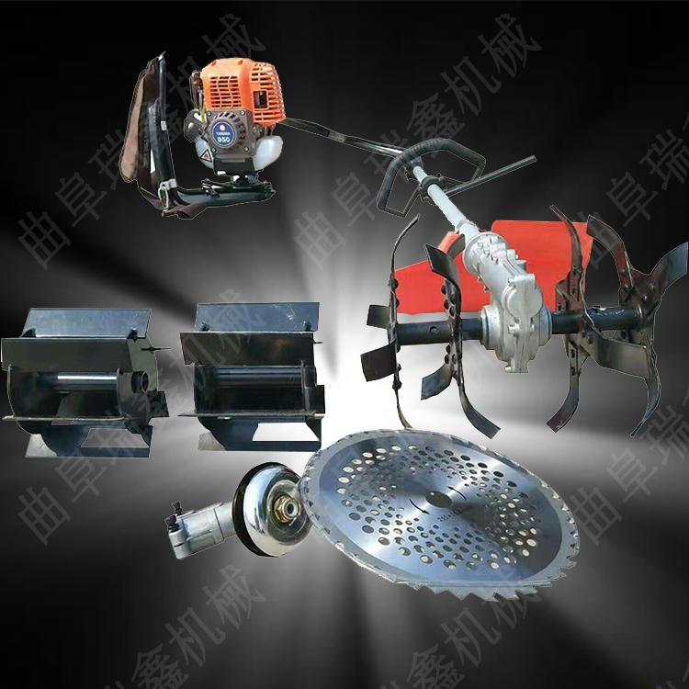
小型耕地设备 Mini tillage equipment
手持耕地设备 Handheld tillage equipment
推荐机型
Model recommendation
手持翻地机
技术参数
动力：汽油
外形尺寸：主耕地杆1500（mm）
耕幅：150（mm） 耕深：50-150（mm）
效率：2（亩/小时）
参考价格：2000元
Hand-held turning machine
Technical Parameters
Power: Gasoline
Dimensions: main arable land pole 1500 (mm)
Tillage width: 150 (mm) Tillage depth: 50-150 (mm)
Efficiency: 2 (mu/hour)
Reference price: 2000 yuan
Notes:
耕地在很多地方都是重要的农艺环节。
手持简易翻地设备成本低，翻地效果一般
Cultivated land is an important agronomic link in many places.
Hand-held simple ground turning equipment has low cost and average turning effect

Slide 23
小型耕地设备 Small tillage Equipment
推荐机型
Model recommendation
小型耕地设备 Mini tillage equipment
Walk-behind turner
Technical Parameters
Power: single cylinder diesel engine (8kw)
Dimensions: 2170*845*1150 (mm)
Tillage width: 800-1200 (mm) Tillage depth: 150-300 (mm)
Efficiency: 10-15(mu/hour)
Reference price: 8000 yuan
手扶式翻地机
技术参数
动力：单缸柴油机（8kw）
外形尺寸：2170*845*1150（mm）
耕幅：800-1200（mm） 耕深：150-300（mm）
效率：10-15（亩/小时）
参考价格：8000元
Notes:
手扶式的翻地机一般旋耕深度在10cm-20cm之间，根据不同动力匹配深度差距很大，图中一般旋耕深度可以达到15cm，基本可以满足种植要求，但不利于玉米长期种植，玉米植株高大，根系发达，长期种植会让土地中残留的根系和化肥混合，在地下30cm附近形成犁底层，让土质变硬，作物不再容易扎根、土壤蓄水能力下降。
The hand-supported soil turning machine generally has a rotary tillage depth between 10cm-20cm, and the matching depth varies greatly according to different powers. The general rotary tillage depth in the figure can reach 15cm, which can basically meet the planting requirements, but is not conducive to long-term corn planting. The corn plant is tall and has a well-developed root system. Long-term planting will mix the remaining root system and chemical fertilizers in the land, forming a plow layer near 30cm underground, which hardens the soil and makes the crop no longer easy to take root and the soil's water storage capacity decreases.

Slide 24
小型播种设备 Small sowing equipment
推荐机型
Model recommendation
推车式播种器有五锥、六锥和七锥三种款式，对应株距分别为36.3cm，30cm和25cm满足不同地区和农户的要求。
提式播种器自动化程度更低，也不适合在土壤过硬或者过湿的土地上使用，但使用方便，不单可以进行玉米播种，也可以用作大豆、棉花等穴播作物的播种设备，效率明显高于纯人力，可达到7（亩/天）左右
The cart-type planter has three styles of five cones, six cones and seven cones. The corresponding plant spacing is 36.3cm, 30cm and 25cm to meet the requirements of different regions and farmers.
The lift-type planter has a lower degree of automation. It is not suitable to use on hard or wet land, but it is easy to use. It can not only be used for corn planting, but also can be used as a planting equipment for soybean, cotton and other hole planting crops. The efficiency can reach about 7 (mu/day), which is obviously higher than manpower.
手动播种器
Hand-held planter
Notes:
小型设备中，图为手持式播种机，前播种盘固定指夹式结构，漏播率低，相比人工播种可节省大量的人力。
Among the small equipment, the picture is a hand-held planter. The front seeding disc has a fixed finger-clamp structure, and the missed seeding rate is low. Compared with manual seeding, it can save a lot of manpower.

Slide 25
推荐机型
Model recommendation
小型播种设备 Small sowing equipment
小型两行播种机
技术参数
配套动力：12kw拖拉机
外形尺寸：1350*1100*995（mm）
种箱容积：2*7（L） 肥箱容积：78（L）
效率：2-5（亩/小时）
参考价格：5000元
Small two-row planter
Technical Parameters
Supporting power: 12kw tractor
Dimensions: 1350*1100*995 (mm)
Seed tank volume: 2*7 (L) Fertilizer tank volume: 78 (L)
Efficiency: 2-5 (mu/hour)
Reference price: 5000 yuan
两行播种机（需配套动力）
two-row planter (supporting power required)
Notes:
小型两行播种机，可带肥箱，实现播种施肥一体化作业，需要配套50马力以上拖拉机实现作业
The small two-row planter can be equipped with a fertilizer box to realize the integrated operation of planting and fertilization. It needs a tractor with more than 50 horsepower for operation.

Slide 26
中型播种设备 Midium sowing equipment
推荐机型
Model recommendation
四行免耕播种机
技术参数
配套动力：90kw拖拉机
外形尺寸：2060*1280*900（mm）
行距：400-650（mm）
种箱容积：21（L） 肥箱容积：82（L）
播种深度：40-60（mm）
施肥深度：60-80（mm）
效率：4-8（亩/小时）
参考价格：7万元
Four-row no-tillage planter
Technical Parameters
Supporting power: 90kw tractor
Dimensions: 2060*1280*900 (mm)
Line spacing: 400-650 (mm)
Seed tank volume: 21 (L) Fertilizer tank volume: 82 (L)
Sowing depth: 40-60 (mm)
Fertilization depth: 60-80 (mm)
Efficiency: 4-8 (mu/hour)
Reference price: 70,000 yuan
四行免耕播种机（需配动力、带施肥）
Four row no till planter (need power and fertilizer)
Notes:
中型播种设备以四行、六行免耕播种机为主，免耕播种顾名思义，可以在为耕土地上进行播种。免耕播种机主要包含开沟、播种、施肥、敷土镇压几个机构环节，可在作业时一体完成，部分播种机携带播种检测设备，可以对漏播、重播等异常播种进行监测，动力一般需要70马力以上拖拉机。
Medium-sized planting equipment is mainly four-row and six-row no-tillage planters. No-tillage planting, as the name suggests, can be used for planting on cultivated land. No-tillage planters mainly include ditching, seeding, fertilization, and soil suppression, which can be completed during operation. Some planters carry seeding detection equipment, which can monitor abnormal seeding such as missed seeding and reseeding, with average power A tractor with more than 70 horsepower is required.

Slide 27
免耕的意义 The advantage of no-tillage
推荐机型
Model recommendation
免耕播种的优势：
1、免耕直播省去了耕地作业，节省了耕地费，播种期提前；若遇阴雨天，免耕更能体现争时的增产效应。
2、免耕地块蓄水保墒能力强；由于地表有秸秆覆盖，土壤的水、肥、气、热可协调供给，干旱时土壤不易裂缝，雨后不易积水。与翻耕的比玉米生长快，苗情好。另外，肥料不易流失，产量也相应提高。
3、原有土体结构未受到破坏，玉米根系与土壤固结能力强，所以玉米抗倒伏能力强。
4、免耕秸秆还田可以增加土壤有机质含量。
免耕作业效果图
No-till operation effect picture
No-tillage seeding has many advantages:
1.No-tillage live broadcast saves farmland operations, saves farmland fees and advances the planting period. In case of rainy days, no-tillage can better reflect the effect of increasing production during competition.
2.The no-tillage plot has strong water storage and moisture retention capacity. Due to the straw covering on the ground, the water, fertilizer, gas and heat of the soil can be supplied in a coordinated manner. The soil is not easy to crack during drought and water is not easy to accumulate after rain. Compared with maize in the land after plowing, maize grows faster and the seedlings are better. In addition, the fertilizer is not easy to lose and the output is increased accordingly.
3.No-tillage keeps the original soil structure undamaged. The maize root system has a strong ability to consolidate with the soil and the maize has a strong lodging resistance.
No-tillage straw returning can also increase the soil organic matter content.

Slide 28
推荐机型
Model recommendation
田间管理-灌溉方式 Irrigation
大水漫灌 微喷灌（膜下喷灌） 移动式精准灌溉
Flood irrigation Micro sprinkler irrigation (under film) Mobile precision irrigation
Notes:
在中国北方地区，水资源是相对缺乏的，在玉米生长季至少需要灌溉1-2次，传统灌溉方式就是大水漫灌，水资源利用率很低，只有40%，同时也稀释了土壤肥力，造成土壤板结；
第二种方式是微喷灌，可有效提高水的利用率，需要铺设主管道、支管路和微喷带，水泵将灌溉水以一定压力打入主管道即可。微喷带使用寿命2-3年，价格0.3-0.5元/m；微喷灌容易引起土壤盐分聚集和上浮到土壤表面，需要在耕整地时进行深翻，或者降雨量大时淋洗，可缓解。
大型移动式喷灌是设备，造价成本很高，目前在中国也是在一些试验示范基地有应用。

Slide 29
小型灌溉设备 Small irrigation equipment
推荐机型
Model recommendation
汽油水泵
技术参数
动力：单缸汽油机（5kw）
外形尺寸：500*350*450（mm）
口径：50（mm） 流量：30（$m^{3}$/h）
扬程：20（m）
吸程：8（m）
重量：20（kg）
参考价格：500元
Gasoline water pump
Technical Parameters
Power: single-cylinder gasoline engine (5kw)
Dimensions: 500*350*450 (mm)
Caliber: 50 (mm)
Flow rate: 30 (m3/h)
Head: 20 (m)
Suction range: 8 (m)
Weight: 20 (kg)
Reference price: 500 yuan
汽油、柴油抽水泵
Gasoline, diesel pump
Notes:
这是一款小型灌溉（排灌）用汽油水泵，配备5kw的汽油机，尺寸小，重量轻20kg，扬程20m，流量30立方/h，价格便宜，只有500元，适用于小规模田块。

Slide 30
中型灌溉设备 Medium-sized irrigation equipment
推荐机型
Model recommendation
卷盘式喷灌机
技术参数
动力：汽油机（13kw）
外形尺寸：5190*2010*2620（mm）
口径：14-24（mm） 流量：13-38（$m^{3}$/h）
扬程：47-74（m）
喷洒幅宽：47-74（m）
重量：1500（kg）
参考价格：3.5万元
Reel sprinkler
Technical Parameters
Power: gasoline engine (13kw)
Dimensions: 5190*2010*2620 (mm)
Caliber: 14-24 (mm)
Flow rate: 13-38 (m3/h)
Head: 47-74 (m)
Weight: 1500 (kg)
Reference price: 35,000 yuan
卷盘式喷灌设备
Reel sprinkler irrigation equipment
Notes:
灌溉机械现在很多样，一次性成本投入少，多以水泵、卷盘式喷灌机铺管为主；
但是，目前世界范围内流行喷灌和滴灌技术，并且结合水肥一体化技术，可以更好的实现节本增效。

Slide 31
推荐机型
Model recommendation
田间管理机械
Field management machinery
3WWDZ-16植保无人机
3WWDZ-16 plant protection drone
东风井关JKB18-H350撒肥机
Dongfeng Jingguan JKB18-H350 fertilizer spreader
3WP-700喷杆式喷雾机
3WP-700 boom sprayer
背负式喷雾喷粉机
Knapsack spray duster
Notes:
田间管理机械又分深施肥机械、排灌机械、植保机械三大类，主要机具有：化肥深施器、弥雾机、喷粉机、水泵、电机、水管等。
The field management machinery is divided into three categories: deep fertilization machinery, irrigation and drainage machinery, and plant protection machinery.

Slide 32
小型植保设备 Small plant protection equipment
推荐机型
Model recommendation
背负式打药机
技术参数
动力：汽油、电池
外形尺寸：420*500*730（mm）
射程：>12（m）
容积：26（L） 净重：12（kg）
效率：2（亩/小时）
参考价格：800元
Knapsack sprayer
Technical Parameters
Power: gasoline, battery
Dimensions: 420*500*730 (mm)
Range: >12 (m)
Volume: 26 (L) Net weight: 12 (kg)
Efficiency: 2 (mu/hour)
Reference price: 800 yuan
背负式、小型背负式
Backpack, small backpack
Notes:
植保设备主要针对植株的施药（防虫、除草）和部分作物液体肥施肥过程的机械设备。
小型的植保设备主要有人力背负式和小型自走式打药机，左图为人力背负式打药机，一般可携带10kg左右药量，动力一般为电池供电，使用方便。
Plant protection equipment is mainly for plant application (insect control, weeding) and mechanical equipment for the process of fertilizing some crops with liquid fertilizer.
Small-scale plant protection equipment mainly includes human-powered backpack and small self-propelled sprayer. The picture on the left shows the human-powered backpack sprayer. Generally, it can carry about 10kg of drug. The power is generally battery-powered and easy to use.

Slide 33
中型植保设备 Medium plant protection equipment
推荐机型
Model recommendation
Self-propelled high-wheel sprayer
Technical Parameters
Power: diesel, gasoline
Dimensions: 4600*1680*2270 (mm)
Volume: 700 (L)
Ground clearance: 1.4 (m)
Spray angle: 110 (degrees) Number of nozzles: 23
Efficiency: 60 (mu/hour)
Reference price: 30,000 yuan
Hanging sprayer
Technical Parameters
Power: 50 (kw) tractor
Dimensions: 3800*3200*2000 (mm)
Volume: 1000 (L)
Ground clearance: 0.5 (m)
Spray angle: 110 (degrees) Number of nozzles: 23-32
Efficiency: 100 (mu/hour)
Reference price: 5000 yuan
悬挂式打药机
技术参数
动力：50（kw）拖拉机
外形尺寸：3800*3200*2000（mm）
容积：1000（L）
离地间隔：0.5（米）
喷雾角度：110（度） 喷头数量：23-32
效率：100（亩/小时）
参考价格：5000元
自走高轮式打药机
技术参数
动力：柴油、汽油
外形尺寸：4600*1680*2270（mm）
容积：700（L）
离地间隔：1.4（米）
喷雾角度：110（度） 喷头数量：23
效率：60（亩/小时）
参考价格：3万元
自走高地隙、悬挂式（需动力）
Self propelled high clearance, Traction backpack (power required)
Notes:
中型植保设备一般有自走型高地隙打药设备，自走型高地隙一般离地间隙可在1.4-2m之间，在玉米田中实用性强。悬挂式打药设备可挂载在拖拉机后部，省去自走机构，使用时可以用液压操控喷臂展开，进行喷药，但通常由于拖拉机后方叉臂结构原因，背负式打药机离地间隙有限，中后期无法实现植保作业。
Medium-sized plant protection equipment generally has self-propelled high ground clearance spraying equipment, and the self-propelled high ground clearance generally has a ground clearance between 1.4-2m, which is highly practical in corn fields. Suspended spraying equipment can be mounted on the rear of the tractor, eliminating the need for a self-propelled mechanism. When in use, it can be deployed with hydraulically controlled spray arms for spraying. However, usually due to the rear wishbone structure of the tractor, the ground clearance of the backpack sprayer is limited. , Plant protection operations cannot be achieved in the middle and late stages.

Slide 34
推荐机型
Model recommendation
农用无人机 Agricultural drone
整机重量轻、待电时间长； 机臂可折叠。技术参数：作业速度快（≥7m/s）,药箱容积16L，喷雾量：1600-2000ml/min；
The whole machine is light in weight and long standby time; the arm can be folded. Technical parameters: fast working speed (≥7m/s), medicine box volume 16L, spray volume: 1600-2000ml/min;

Slide 35
推荐机型
Model recommendation
收获环节
摘穗作业 穗收作业 穗收 青饲玉米收获
Picking Ear harvest Ear harvest Green forage corn harvest
Maize Harvesting

Slide 36
推荐机型
Model recommendation
小型收获设备 Small harvesting equipment
Hand-held self-propelled harvester
Technical Parameters
Power: Diesel
Dimensions: 1200*500*1500 (mm)
Working width: 420 (mm)
Job line spacing requirements: >100 (mm)
Weight: 228 (kg)
Efficiency: 1-2 (mu/hour)
Reference price: 5000 yuan
手扶自走收获机
hand-held self-propelled harvester
Notes:
单行小型棒收机，可实现玉米茎秆切割，粉碎，脱棒。
Single-row small cob harvester can cut and crush the stalk and remove cob.

Slide 37
中型收获设备 Medium harvesting equipment
推荐机型
Model recommendation
自走式玉米收获机
技术参数
动力：柴油
外形尺寸：6400*3000*2450（mm）
作业幅宽：420（mm）
重量：800（kg）
效率：3-5（亩/小时）
参考价格：5万元
Self-propelled corn harvester
Technical parameters
Power: Diesel
Dimensions: 6400*3000*2450 (mm)
Working width: 420 (mm)
Weight: 800 (kg)
Efficiency: 3-5 (mu/hour)
Reference price: 50,000 yuan
多行自走收获机
Multi-row self-propelled harvester
Notes:
中型收获设备主要有多行自走式收获机，可以实现玉米茎秆切割、粉碎、脱棒，玉米棒的收集储存。
The medium-sized harvesting equipment mainly includes a multi-row self-propelled harvester, which can cut, crush and remove the corn stalks, and collect and store corn on the cob.

Slide 38
中型收获设备 Medium harvesting equipment
推荐机型
Model recommendation
悬挂式收获机
技术参数
动力：18（kw）以上拖拉机
适用行距：350-800（mm）
作业行数：2
效率：2.5-4（亩/小时）
参考价格：1.5万元
Knapsack harvester
Technical parameters
Power: tractor above 18 (kw)
Applicable line spacing: 350-800 (mm)
Rows: 2
Efficiency: 2.5-4 (mu/hour) Reference price: 15,000 yuan
悬挂式收获机（需配套动力）
knapsack harvester (supporting power required)
Notes:
拖拉机悬挂式的玉米收获机，效率低于自走式的收获设备，但其优点在于少了自走机构，费用明显降低，但需要配套拖拉机。
玉米收获设备现在主要以棒收为主，目前只有大型玉米收获设备可以直接进行籽粒收获。
The efficiency of tractor-mounted corn harvester is lower than that of self-propelled harvesting equipment, but its advantage is that it lacks a self-propelled mechanism and the cost is significantly reduced, but it requires a matching tractor.
Corn harvesting equipment is now mainly bar harvesting, and currently only large-scale corn harvesting equipment can directly harvest grains.

Slide 39
推荐机型
Model recommendation
摘穗 脱皮 晒穗 脱粒
Picking Peeling Sun-dried Threshing

Slide 40
小型脱粒设备 Small threshing equipment
小型柜式脱粒设备 Small cabinet type threshing equipment
推荐机型
Model recommendation
柜式玉米脱粒机
技术参数
功率：2.2（kw）
尺寸：1250*600*1250（mm）
工作形式：人工上料、全自动脱粒
重量：100（kg）
效率：500（kg/h）
参考价格：1.8万元
Cabinet type threshing
Technical parameters
Power: 2.2 (kw)
Size: 1250*600*1250 (mm)
Work form: manual feeding, fully automatic threshing
Weight: 100 (kg)
Efficiency: 500 (kg/h)
Reference price: 18,000 yuan

Slide 41
中型脱粒设备 Midium threshing equipment
悬挂式玉米脱粒机 Suspended corn thresher
推荐机型
Model recommendation
Suspended corn thresher
Technical parameters
Power: tractor above 22 (kw)
Size: 5200*1600*2500 (mm)
Work form: automatic feeding, automatic threshing
Weight: >590 (kg)
Efficiency: >8 (t/h)
Reference price: 50,000-100,000 yuan
悬挂式玉米脱粒机
技术参数
动力：22（kw）以上拖拉机
尺寸：5200*1600*2500（mm）
工作形式：自动上料、全自动脱粒
重量：>590（kg）
效率：>8（t/h）
参考价格：5-10万元
Notes:
自动上料玉米脱粒机-结构新颖、紧凑、坚固耐用，使用调整方便，占用场地小产量高，省工省时，可一次完成脱粒、风选、筛选等复试作业。该机破碎率低、洁净率高、效益高深受用户好评,现有单滚筒和双滚筒两种
Automatic feeding corn thresher-novel structure, compact, sturdy and durable, easy to use and adjust, occupy small space, high output, save labor and time, and can complete retest operations such as threshing, winnowing and screening at one time. The machine has low crushing rate, high cleanliness rate, and high efficiency, and is well received by users. There are two types of single drum and double drum.

Slide 42
小型烘干设备 Small drying equipment
桶式烘干设备 Barrel drying equipment
推荐机型
Model recommendation
Power
Output
Weight
Dimensions
桶式烘干机
技术参数（参考右表）
参考价格：1-5万元
Barrel drying equipment
Technical parameters (refer to the right table)
Reference price: 10,000-50,000 yuan
Notes:
玉米烘干是农业产业工业化的一大特征，玉米种植收获后为长时间存储都会将玉米晒干，但是收获后玉米囤积量大，天气因素不定，由于堆积和阴湿会导致大量的玉米浪费，利用设备进行烘干可避免这类浪费发生。
小型烘干设备主要为烘干机一类产品，中型烘干设备则向可移动式烘干塔方向靠近，原因是塔式烘干烘干均匀、烘干面积大整体效率高。
Corn drying is a major feature of the industrialization of agriculture. Corn is dried after planting and harvesting for long-term storage. However, the amount of corn hoarding after harvesting is large, and the weather factors are uncertain. Due to accumulation and humidity, a large amount of corn will be wasted. Using equipment for drying can avoid such waste.
Small drying equipment is mainly a kind of dryer, while medium-sized drying equipment is approaching the movable drying tower because of the uniform drying and large drying area of the tower and high overall efficiency.

Slide 43
中型烘干设备 Medium Drying equipment
推荐机型
Model recommendation
塔式烘干机
技术参数
功率：22（kw）电热或煤热
进风温度：45-105（摄氏度）
装机容量：>40（ $m^{3}$）
效率：>8（吨/小时）
参考价格：8-15万元
Tower dryer equipment
Technical Parameters
Power: 22 (kw) electric heating or coal heating
Inlet air temperature: 45-105 (degrees Celsius)
Installed capacity: >40（ $m^{3}$）
Efficiency: >8 (tons/hour)
Reference price: 80-150 thousand yuan
塔式烘干机
Tower dryer equipment
Notes:
塔式烘干机一般一次性可水份25%的玉米一次入机5吨，用时4小时烘干到14%水份，用电40度，电费8角，合计用电费用是32元。用煤60公斤，每吨煤当地价格高是1000元每吨，合计用煤费用是60元。用人2位，工资10元每小时，用人费用80元。合计费用172元烘干5吨玉米，计算后每市斤玉米耗费0.0172元，折合为每降1%水分的费用是1.5厘钱。
The tower dryer generally can load 5 tons of corn with 25% moisture at a time, and it takes 4 hours to dry to 14% moisture. The electricity consumption is 40 degrees, the electricity fee is 80, and the total electricity cost is 32 yuan. With 60 kg of coal, the local price per ton of coal is 1,000 yuan per ton, and the total cost of coal is 60 yuan. Employing 2 people, the salary is 10 yuan per hour, and the employing cost is 80 yuan. The total cost is 172 yuan to dry 5 tons of corn. After calculation, it costs 0.0172 yuan per catty of corn, which is equivalent to 1.5% for every 1% moisture drop.

Slide 44
PART 03
玉米全程化解决方案
Solution of Whole Process Mechanization of Maize Production
Notes:
介绍完了各种各样的农业机械后，我们利用这些农机形成成套的作业组合方案，即全程机械化方案。
Third, Solution of Whole Process Mechanization of Maize Production

Slide 45
规模化种植玉米全程机械化解决方案
耕地
Solution of Whole Process Mechanization for large-scale Maize planting
生产环节 Process | 机械名称 Equipment | 价格（元） Price （CNY）
动力机械 Power machinery | 100马力以上带液压输出拖拉机 Tractor with hydraulic output above 100 horsepower | 150000
翻地 Plowing | 牵引式翻地犁 Traction plough | 30000
施肥、播种 Fertilization, sowing | 免耕播种机 No till planter | 70000
植保、追肥 Plant protection, top dressing | 自走式高地隙喷雾机 Self-propelled high ground clearance sprayer | 130000
收获机 Harvester | 4行玉米收获机 4-row corn harvester | 150000
烘干设备 Drying equipment | 烘干塔 Drying tower | 100000
总计 Total: |  | 63W
Tillage
播种
Sowing
施药
Pesticide application
收获
Harvesting
Notes:
首先给出的是规模化种植的玉米全程机械化解决方案。规模化种植一般以农场、大农户为主，兼有一些农机合作社，这些组织或个人每年需要经营的土地面积一般在几千到几万亩之间不等，配备设备多以中大型设备为主。
规模化种植的解决方案：
动力机械需要选择一个大马力的拖拉机，全程机械化需要拖拉机负载的设备较多，动力低无法满足耕种要求。
耕地选择4行以上的深松铲或者翻地铲，但在配合免耕播种机的时候可以在播种时省去此环节，在收获后对土地进行翻地，将剩余秸秆埋入土地当肥料。播种自然选择免耕播种，地形和经济条件合适可以选择8-12行的播种机，在我国内蒙、东北部分地区，那里土地平坦、开阔，特别适合大马力，大幅宽机具设备作业。
植保设备选择自走式宽幅高地隙打药设备， 经济实力允许可以选择风幕或者精准喷液的打药设备，可以节省农药使用节约成本，减少土地的农药污染。
收获设备选择4-8行的玉米收获机。烘干设备可自备家用烘干塔，长远来看经济效益较高。
整体解决方案没有给出灌溉、施肥等设备，这类设备通用性一般，也需要和当地农艺结合。并且植保设备可以代替施肥、灌溉设备。
This table shown the recommended selection of mechanized equipment for large-scale Maize planting.
Tractor with hydraulic output above 100 horsepower is suggested as power machinery.
Traction plough is suggested for Plowing.
No till planter is suggested for Fertilization and sowing.
Self-propelled high ground clearance sprayer is suggested for Plant protection and top dressing.
4-row corn harvester is suggested for Harvester.
Drying tower is suggested for drying equipment.
The total price is 630,000 CNY/set.

Slide 46
中等规模种植玉米全程机械化解决方案
耕地
Solution of Whole Process Mechanization for Medium-scale Maize planting
生产环节 Process | 机械名称 Equipment | 价格（元） Price (CNY)
动力机械 Power machinery | 50马力以上带液压输出拖拉机 Tractor with hydraulic output above 50 horsepower | 70000
翻地 Plowing | 牵引式翻地犁 Traction plough | 10000
播种 Sowing | 两行播种机 Two-row planter | 5000
植保、追肥 Plant protection, top dressing | 悬挂式打药机 spraye | 5000
收获机 Harvester | 2行悬挂式收获机 2-row knapsack harvester | 15000
烘干设备 Drying equipment | 烘干机 Dryer | 20000
总计 Total |  | 13.5W
Tillage
播种
Sowing
施药
Pesticide application
收获
Harvesting
Notes:
介绍完大规模全程机械化方案，接着介绍中等规模的全程机械化方案。中等规模主要针对那些个体农户，家中土地有一定规模，在几百到千亩不等，人力支出太大，需要一定的机械减轻人力负担。
动力机械可缩减至五十马力左右的带双路液压输出的拖拉机，以方便带多样的机具。
翻地如果选择四铲深松铲，对应匹配的拖拉机马力需要匹配的高一些，如果土地硬度偏高或多年未深耕，低马力拖拉机无法在正常工作深度拉动深松铲。播种选择2-4行播种机，实现播种，施肥一体化作业。由于未使用免耕播种机，耕地环节无法避免，并且根据当地农艺需要搭配不同起陇设备。
植保设备选择拖拉机背负式的打药机，背负式打药机虽使用受限（玉米长高后无法使用），但基本可以完成前期的除草剂、杀虫剂植保功能，且价格低廉。
收获设备选择2行的背负式玉米收获机，成本低廉，使用性强。
斯里兰卡是一个四面环海的热带国家，空气湿度高，直接晒干效率低，玉米损失率很大，建议准备烘干设备，桶式烘干是价格比较低的一种烘干设备，如果有些农户无法承担烘干设备的支出，可以联系一些专做烘干的企业，为当地农户提供烘干服务。
This table shown the recommended selection of mechanized equipment for Medium-scale Maize planting.
Tractor with hydraulic output above 100 horsepower is suggested as power machinery.
Traction plough is suggested for Plowing.
Two-row planter is suggested for sowing.
Knapsack sprayer is suggested for Plant protection and top dressing.
2-row knapsack harvester is suggested for Harvester.
Dryer is suggested for drying equipment.
The total price is 135,000 CNY/set.

Slide 47
耕地
小规模种植玉米全程机械化解决方案
Solution of Whole Process Mechanization for Small-scale Maize planting
生产环节 Process | 机械名称 Equipment | 价格（元） Price (CNY)
动力机械 Power machinery |  | 0
翻地 Plowing | 手扶式翻地机 walking type Plough | 8000
播种、施肥 Sowing, fertilization, | 手持 Handheld | 2000
植保、追肥 Plant protection, top dressing | 电动背负式 Electric knapsack | 500
收获机 Harvester | 手持收获设备 Handheld harvesting equipment | 1000
烘干设备 Drying equipment |  | 0
总计 |  | 11500
Tillage
播种
Sowing
施药
Pesticide application
收获
Harvesting
Notes:
小规模玉米种植主要针对一些零散农户，利用现有的技术形成的一些简单手持设备，可以大幅减少人力工作。考虑到零散农户的经济实力，拖拉机是比较大的一个负担，所以不考虑动力机械的储备。
耕地是一项极耗人力的种植环节，这里推荐零散用户使用手扶式翻地机进行翻地作业。播种环节选择手持式播种机，相比人工播种可大幅提升播种效率，缺点是没法同步进行施肥作业，需要进行手动施肥、追肥作业。
植保环节选择电动背负式打药机，这种类型的打药机喷雾均匀，更有利于覆盖更多的植株表面，起到更好的植保效果。价格更低一点有人力气压式打药机，动力由电动式变成了手动打压，喷雾密度取决于药箱内的压力，相比电动式会有喷雾不均匀的情况出现，植保效率相比低了许多。收获设备选择电动切杆的收获设备，可以自由选择玉米根茬留茬高度，省去人力切割负担。
小规模种植的玉米全程方案相对大中型方案，机械化、自动化水平下降太多，基本还是需要大量的人力劳动。考虑的小农户经济实力，更换新型的农具的方案更加可行。不同家庭经济实力的农户，可以根据第二部分介绍的中小型农机具自行组合选择，选择的宗旨基本按价格和机械化（自动化、舒适化）程度成正比关系，并且国内小型农机厂如野马、奔马等厂家，其产品已全面覆盖中小规模市场，有众多型号可以选择。
This table shown the recommended selection of mechanized equipment for small-scale Maize planting.
walking type Plough is suggested for Plowing.
Handheld equipment is suggested for sowing and fertilization.
Electric knapsack equipment is suggested for Plant protection and top dressing.
Handheld harvesting equipment is suggested for Harvester.
The total price is 11,500 CNY/set.

Slide 48
PART 04
经济效益分析
Economic Benefit Analysis
Notes:
介绍完了三种玉米种植全程方案，下面就需要分析一下，不同种植规模的农户，从他的角度出发玉米种植环节中需要解决什么样的问题。（或者说，不同规模种植者急需在种植时面临的难点）
The forth part is the economic Benefit Analysis.

Slide 49
特点
规模化种植面积大，春播、打药，收获时间紧任务重，十分适合全程机械化作业。
规模化种植玉米全程机械化经济效益分析
Analysis of Economic Benefits of the Whole Mechanization of Large-scale Maize Planting
Characteristics
Difficulty
难点
产量高，同时需处理的产物过多，生产工作时间集中。
High Yield,
Many crops to be processed at the same time.
The large-scale planting area is large, spring sowing, spraying medicine, and the harvest time is tight and the task is heavy. It is very suitable for the whole mechanized operation.
节本增效
Save cost and increase efficiency
Whole process plan
全程方案
机械化种植大幅节省人力，节本增效效果最明显。
大型机械耕地-播种-植保、田间管理-收获-脱粒-烘干-耕地。
Mechanized planting greatly saves manpower and has the most obvious effect of saving costs and increasing efficiency.
Tillage with large machinery-Sowing-Plant protection, field management-Harvest-Threshing-Drying-Tillage
Notes:
首先还是规模化种植的农户。
规模化种植的一大特点就是种植面积大，同样的播种、打药、收获时间内需要处理的土地面积更大。人力收获此时效率低，成本高，与种植者利益冲突，所以他们对机械化需求最大，基本要实现全程机械化。
建议的机械化方案就是全流程，利用中大型拖拉机实现耕地、播种环节；利用植保机械完成田间管理环节；利用玉米收获机实现收获；利用脱粒机实现脱粒，利用塔式烘干籽粒。完成全流程机械化方案。
In large-scale planting mode, the planting area is large. Spring sowing, spraying medicine, and the harvest time is tight and the task is heavy. It is very suitable for the whole mechanized operation.
The difficulty is during the harvesting time the yield of maize is high and the work time is concentrated.
Mechanized planting could greatly save manpower and has the most obvious effect of saving costs and increasing efficiency.
The whole process of maize planting includes Tillage with large machinery-Sowing-Plant protection, field management- Harvest- Threshing- Drying - Tillage.

Slide 50
特点
中等规模种植农户，长期机械化种植可节本，节省人工，短期投入比较大。 In medium-scale corn planting model, long-term mechanized planting can save costs, save labor, while short-term investment is relatively large.
中等规模玉米全程机械化经济效益分析
Analysis on Economic Benefits of Whole Mechanization of Medium-scale Maize Planting
Characteristics
Difficulty
难点
籽粒收获机等大型设备使用成本过高。
The cost of using large-scale equipment such as grain harvesters is too high.
节本增效
Save cost and increase efficiency
Whole process plan
具体节本增效成果需要根据农户投入、种植面积等因素具体计算。处于半机械化状态。Rice planting is in a semi-mechanized state.
The specific cost-saving and efficiency-increasing results need to be calculated based on factors such as farmers’ input and planting area.
全程方案
小型机械耕地-播种-植保、田间管理-收获-脱粒-烘干-耕地Tillage with small machinery-sowing-plant protection, field management-harvesting-threshing-drying-Tillage.
Notes:
中等规模种植农户
中等规模种植面积有限，种植者承担的成本有限，并且部分环节需要考虑人力成本和机械化生产收益比，所以还会有一些环节处于人力作业环节，整体流程大概处于半机械化状态。
整体方案主要会由中小型农机具组成，由中小型拖拉机匹配拖拉机背负式的播种、植保、收获机械，完成部分机械作业，后续的玉米脱粒与烘干可由各家不同方案组成。
In medium-scale planting mode, long-term mechanized planting can save costs, save labor. While short-term investment is relatively large.
The difficulty is that the cost of using large-scale equipment such as grain harvesters is too high.
Mechanized production can achieve the purpose of saving costs and increasing efficiency. While in medium-scale planting mode, Rice planting is in a semi-mechanized state. The specific cost-saving and efficiency-increasing results need to be calculated based on factors such as farmers’ input and planting area. In a semi-mechanized state.
The whole process of maize planting includes tillage with small machinery-sowing-plant protection, field management- harvesting- threshing- drying- Tillage.

Slide 51
特点
零散种植面积小，不适合大型机具作业。 The scattered planting area is small and not suitable for large-scale machine operations.
零散种植玉米全程机械化经济效益分析
Analysis of Economic Benefits of Whole Mechanization of Scattered Maize Planting
Characteristics
Difficulty
难点
籽粒收获机等大型设备使用成本过高。
The cost of using large-scale equipment such as grain harvesters is too high.
Save cost and increase efficiency
Whole process plan
节本增效
全程方案
种植面积有限，限制农户资金投入能力，无法实现机械化种植。可以使用现在现有的农机具或者农机租赁服务
The limited planting area limits the ability of farmers to invest in funds and cannot achieve mechanized planting. Existing farm machinery or farm machinery rental service can be used
小型设备翻地-人工播种-人工植保、田间管理-人工收获。
Plowing with small equipment-artificial seeding-artificial plant protection, field management-artificial harvest.
Notes:
小规模种植
小规模种植的零散农户一般拥有土地很少，基本也就几亩到十几亩之间，每年可有的收入十分有限，可以在农机上的投入更少，所以这一类农户由于经济条件限制，只会选择一些小型农机或者手动设备，以追求在低投入的情况下，尽量多的减轻人力作业的负担。
In scattered maize planting mode, the scattered planting area is small and not suitable for large-scale machine operations.
The difficulty that the cost of using large-scale equipment such as grain harvesters is too high.
The limited planting area limits the ability of farmers to invest in funds and cannot achieve mechanized planting. Existing farm machinery or farm machinery rental service can be used.
The whole process of maize planting includes plowing with small equipment-artificial seeding-artificial plant protection, field management-artificial harvest.

Slide 52
经济效益分析
Economic Benefit Analysis
机械化生产营利面积计算
Calculation of profitable area of mechanized production
 | 大规模种植Large-scale planting | 中等规模种植Medium-scale planting | 小规模种植Small-scale planting
固定成本（元） Fixed cost (CNY) | 630000 | 135000 | 11500
年均折旧成本（元） Average annual depreciation cost (CNY) | 126000 | 27000 | 2300
化肥农药成本（元/亩）Manpower, fertilizer and pesticide cost (CNY/mu) | 550 | 550 | 550
运营成本（人工、燃油等）（元/亩） | 250 | 250 | 250
营利面积（亩） Profitable area (mu) | 1260 | 270 | 23
2018年斯里兰卡亩产为250kg/亩。玉米单价1.66-1.88元/斤，单亩毛利为830-940元。单亩利润在330元左右。
The corn yield per mu in 2018 was 250kg/mu. The unit price of corn is 1.66-1.88 yuan/jin, and the gross profit per mu is 830-940 yuan. The profit per mu is around 330 yuan.
当单季种植规模大于营利面积线时，可保证在回收成本时有利润。
When the planting scale of a single season is larger than the profit area line, the profit can be guaranteed when the cost is recovered.
Notes:
后面给出了一个综合经济效益分析的表格
按之前给出的三种方案，可以得到三种不同种植规模的固定设备投入成本，分别为大规模63W，中等规模27W，小规模1.15W，设备折旧按五年平摊，成本平摊至未来五年种植收益内，年均平摊成本为12.6W、27W、0.23W。
按斯里兰卡给出的数据分析，2018年斯里兰卡的亩产为250kg/亩，单亩成本为种植成本550元、人工燃油成本250元。按单亩利润330元计算整个投入比，刨去人工、燃油等机械化种植成本，得出最后的单亩纯利润为100元。计算可得营利面积。
营利面积为不同规模种植，收支均衡平均点，大于该值开始营利，所以可以得出基本三种方案的建基本符合实际预期，大规模种植农户一般拥有种植的土地面积远大于此值，十分适合全程机械化生产；中等规模农户的土地拥有面积基本也大于营利面积；小规模种植农户的种植面积可能在红线附近，可以酌情选择农机具作业设备。
The corn yield per mu in 2018 was 250kg/mu. The unit price of corn is 1.66-1.88 yuan/jin, and the gross profit per mu is 830-940 yuan. The profit per mu is around 330 yuan.
These data is the calculation of profitable area of mechanized production. For the large-scale planting mode, the fixed cost, average annual depreciation cost, Manpower, fertilizer and pesticide cost and the profitable area is 630000, 126000, 800and 1260. For the medium-scale planting mode, the fixed cost, average annual depreciation cost, Manpower, fertilizer and pesticide cost and the profitable area is 135000, 27000, 800 and 270. For the small-scale planting mode, the fixed cost, average annual depreciation cost, Manpower, fertilizer and pesticide cost and the profitable area is 11500, 2300, 800 and 23.
When the planting scale of a single season is larger than the profit area line, the profit can be guaranteed when the cost is recovered.

Slide 53
PART 05
发展趋势和技术展望
Development Trend and Technology Prospect
Notes:
Then I would like to share some ideas about the development trend and technology prospect on maize mechanization production.

Slide 54
网络
时代是属于信息化的时代，跟不上时代潮流的必定被时代所抛弃。农业也面临着从传统农耕到信息化的转变。但受限于我国农机机械化水平落后于发达国家，农业信息也会面临诸多限制，但随着5G网络普及，电脑的普遍使用，农机农艺需要迎着时代，创造出让农民更加便利的农业装备。
玉米全程机械化发展趋势
the Development Trend of Maize Mechanization
经验
Experience
Network
5G
信息
Information
Agriculture is facing the transition from traditional farming to informatization. With the popularization of 5G networks and the widespread use of computers, agricultural machinery and agronomy will create agricultural equipment providign more convenience to farmers .
Notes:
As we know, now is the era of information technology and those who cannot keep up with the trend of the times would be abandoned by the times. Agriculture is facing the transition from traditional farming to informatization. With the popularization of 5G networks and the widespread use of computers, agricultural machinery and agronomy will create agricultural equipment providign more convenience to farmers .

Slide 55
玉米全程机械化技术展望
无人驾驶拖拉机，省去人工操作，将人工从繁重、环境条件差的情况中解放出来。
Prospects of Maize Mechanization Technology
智慧农业打造全新的种植方式，让农艺更加适合农机本身特性，提高种植效率。
Smart agriculture creates new planting methods, making agronomy more suitable for the characteristics of agricultural machinery and improving planting efficiency.
Unmanned tractor frees the labor from the heavy work.
以农机为基础单元组成联网，测量作业区域以及作业数量，从而形成我国农业种植的大数据平台。
Use agricultural machinery as the basic unit forming a network, forming a big data platform for agricultural planting in China.
Notes:
The unmanned tractor saves manual operation and liberates labor from heavy and poor environmental conditions.
Form a network based on the agricultural machinery as basic unit to measure the operation area and the number of operations, thereby forming a big data platform for agricultural planting in my country.
Smart agriculture creates new planting methods, making agronomy more suitable for the characteristics of agricultural machinery and improving planting efficiency.

Slide 56
小测试
QUIZ

Slide 57
Q1：免耕播种机的优势有哪些？
小测试
Q1：What are the advantages of no-tillage planters?
答案：1、免耕直播省去了耕地作业，节省了作业费，播种期提前，比常规平播提前1～2d。
2、免耕地块蓄水保墒能力强。由于地表有秸秆覆盖，土壤的水、肥、气、热可协调供给，干旱时土壤不易裂缝，雨后不易积水。比翻耕地的玉米生长快，苗情好。
3、玉米抗倒伏性好。免耕玉米表层根量多，主根发达，加之原有土体结构未受到破坏，玉米根系与土壤固结能力强，所以玉米抗倒伏能力强。
4、麦秸还田增加了土壤有机质含量，提高了土壤肥力，改善了土壤结构。经测算，玉米免耕地块比翻耕地块增收玉米765kg/公顷，同时可减少耕地作业费105元/公顷，间苗费60元/公顷，玉米生育期间减少1次浇水，节水节油75元/公顷。
Answer：
1、No-tillage live broadcast saves arable land operations, saves operating costs, and advances the planting date, 1 to 2 days earlier than conventional flat sowing.
2、No-tillage plots have strong water storage and moisture retention capacity. Due to the straw covering on the ground, the water, fertilizer, gas, and heat of the soil can be supplied in a coordinated manner. The soil is not prone to cracks during drought, and it is not prone to water accumulation after rain. Compared with plowing, it grows faster than corn and has better seedling conditions.
3、Corn planting with no-tillage has good lodging resistance. No-tillage corn has a large number of surface roots and a well-developed main root. In addition, the original soil structure has not been damaged, and the corn root system has a strong ability to consolidate with the soil, so corn has a strong lodging resistance.
4、Returning wheat straw to the field increases the soil organic matter content, improves soil fertility, and improves soil structure. According to calculations, corn no-tillage plots increase corn yield by 765kg/ha compared to plowed plots, and can reduce farmland operation costs by 105 yuan/ha, thinning fees by 60 yuan/ha, and reduce watering once during corn growth, saving water and oil by 75 Yuan/ha.
Notes:
Answer：
1、No-tillage live broadcast saves arable land operations, saves operating costs, and advances the planting date, 1 to 2 days earlier than conventional flat sowing.
2、No-tillage plots have strong water storage and moisture retention capacity. Due to the straw covering on the ground, the water, fertilizer, gas, and heat of the soil can be supplied in a coordinated manner. The soil is not prone to cracks during drought, and it is not prone to water accumulation after rain. Compared with plowing, it grows faster than corn and has better seedling conditions.
3、Corn planting with no-tillage has good lodging resistance. No-tillage corn has a large number of surface roots and a well-developed main root. In addition, the original soil structure has not been damaged, and the corn root system has a strong ability to consolidate with the soil, so corn has a strong lodging resistance.
4、Returning wheat straw to the field increases the soil organic matter content, improves soil fertility, and improves soil structure. According to calculations, corn no-tillage plots increase corn yield by 765kg/ha compared to plowed plots, and can reduce farmland operation costs by 105 yuan/ha, thinning fees by 60 yuan/ha, and reduce watering once during corn growth, saving water and oil by 75 Yuan/ha.

Slide 58
Q2：玉米收获后烘干有什么优势？
小测试
Q2：What are the advantages of drying corn after harvest?
答案：
1、传统晾晒受时节、天气影响大。湿玉米不利于谷物存储，又会产生大量的仓储、物流浪费。烘干可解决这类问题。
2、在美国、加拿大等世界农业领先国家中，粮食在收后晾晒、储运、加工等环节的损耗率在3%。为减少损耗率，需要提高各环节生产效率，产后谷物烘干应运而生。
Answer：
1、 Traditional drying is greatly affected by seasons and weather. Wet corn is not conducive to grain storage, and will produce a lot of storage and logistics waste. Drying can solve such problems.
2、In the world's leading agricultural countries such as the United States and Canada, the loss rate of grain after harvesting, drying, storage, transportation, and processing is 3%. In order to reduce the wastage rate, it is necessary to improve the production efficiency of each link, and post-production grain drying comes into being.

Slide 59
Q3：Will the use of mechanized operations increase my production?
小测试
Q3：使用机械化作业后会让我增产吗？
答案：
机械化作业的目的是代替人工作业，节省人力输出，保证作业品质。把更多的人力节省出来从事其他活动。农户的种植面积在其劳动能力之内时，机械化种植并不能提升农业作业品质。并且影响粮食产量的因素很多，例如雨水、虫灾、土地肥力等，所以机械化种植不一定会让粮食增产。
Answer：
The purpose of mechanized operations is to replace manual operations, save manpower output, and ensure the quality of operations. Save more manpower for other activities. When farmers' planting area is within their labor capacity, mechanized planting cannot improve the quality of agricultural operations. And there are many factors that affect grain production, such as rain, insect damage, and land fertility, so mechanized planting may not increase grain production.

Slide 60
Thank you

