Slide 1
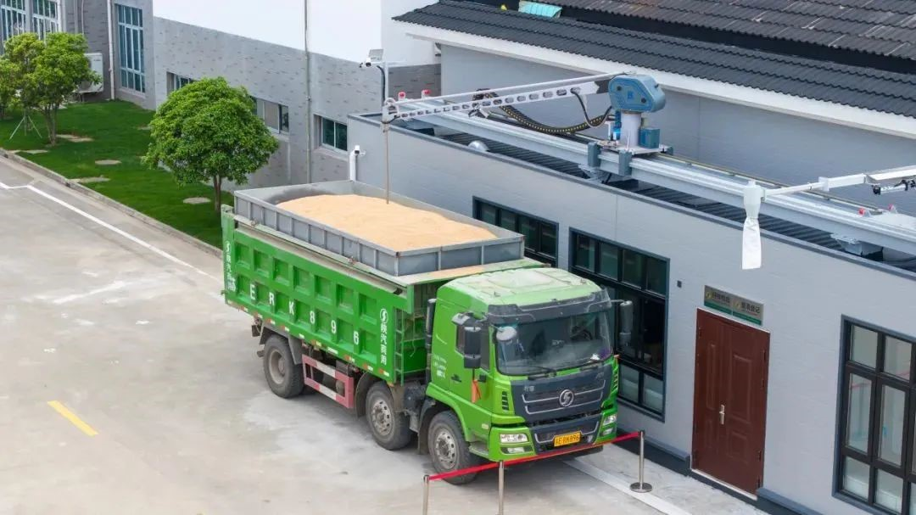
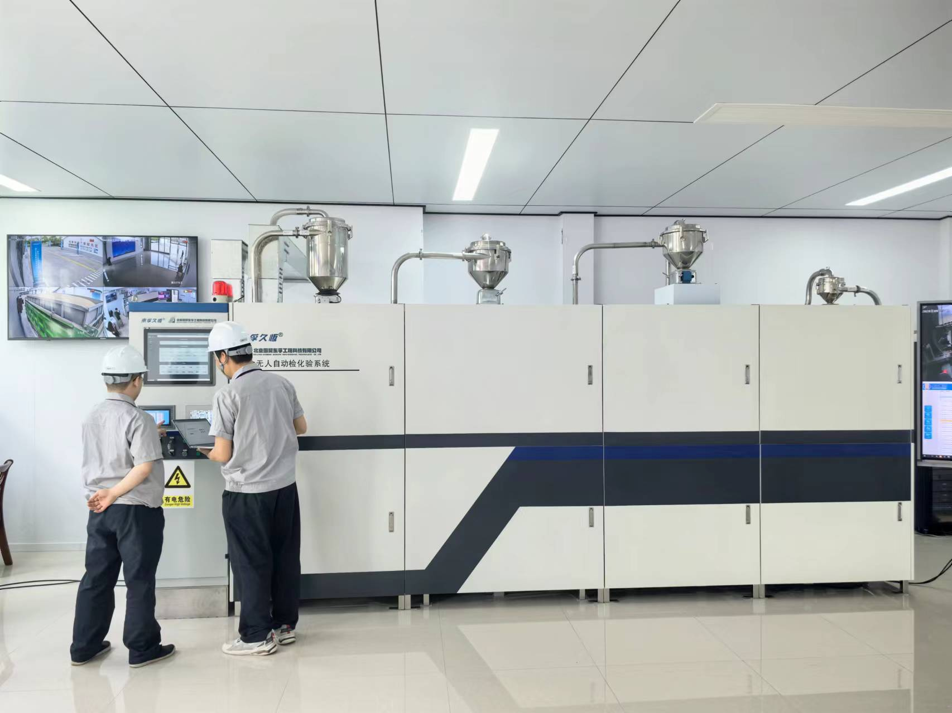
粮食智能扦检一体化系统
Intelligent Grain Sampling and Quality Inspection Integration System
赵东海
教授级工程师
Zhao Donghai
Professor Engineer
Tel：13910923510
E-mail:zdh@gmedi.cn

Slide 2
CONTENTS
传统粮食扦样、检测技术
Traditional grain sampling and inspection technology
01
02
粮食智能扦样系统的发展和应用
Development and application of intelligent grain sampling system
粮食无人自动检化验系统
Grain unmanned automatic inspection system
03
Notes:
分三部分进行介绍

Slide 3
01
传统粮食扦样、检测技术
Traditional grain sampling and inspection technology
Notes:
第一部分

Slide 4
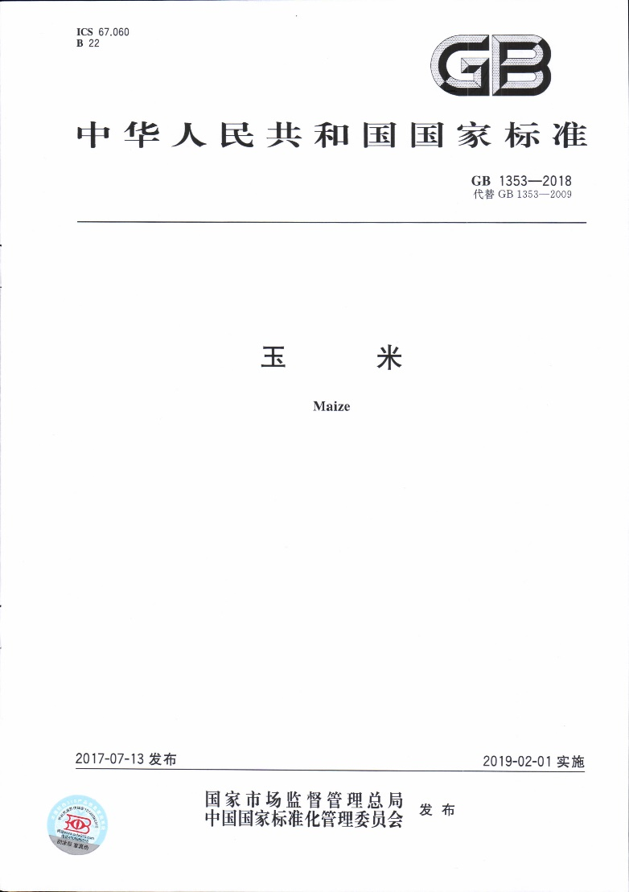
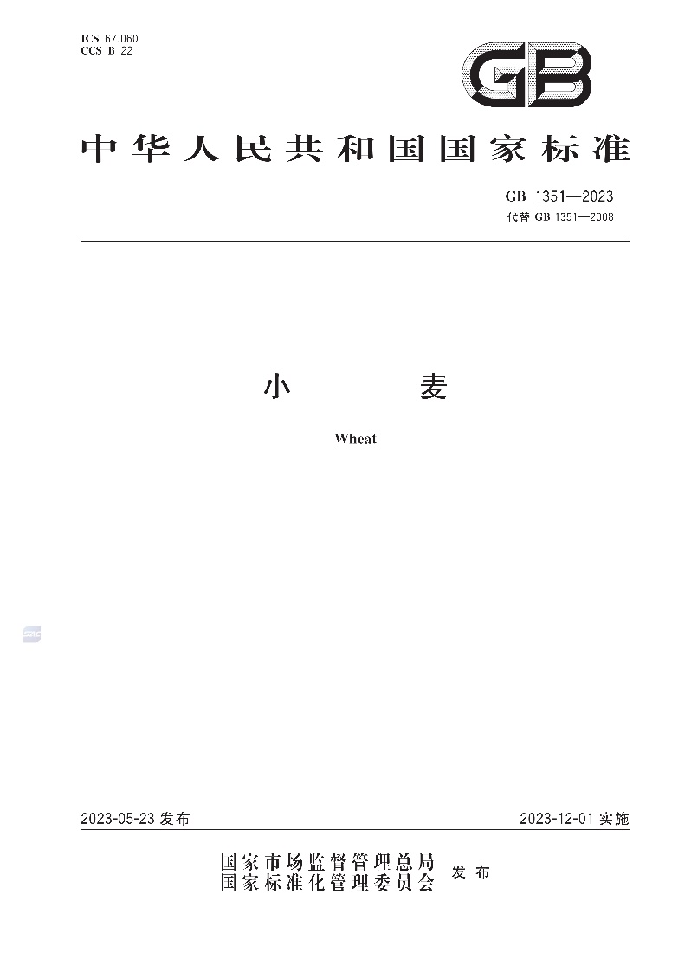
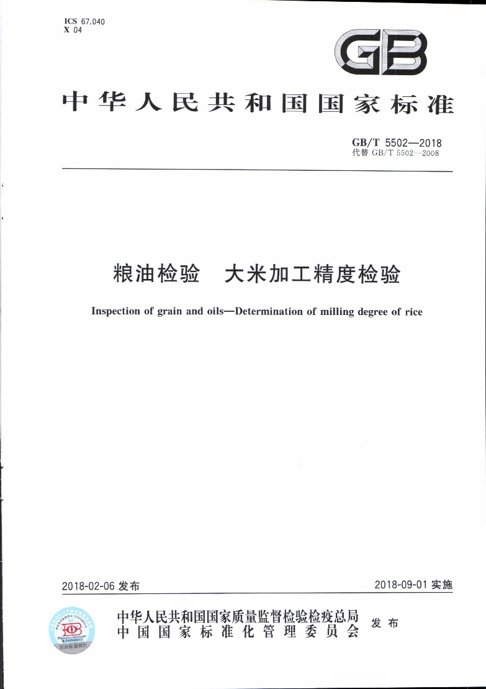
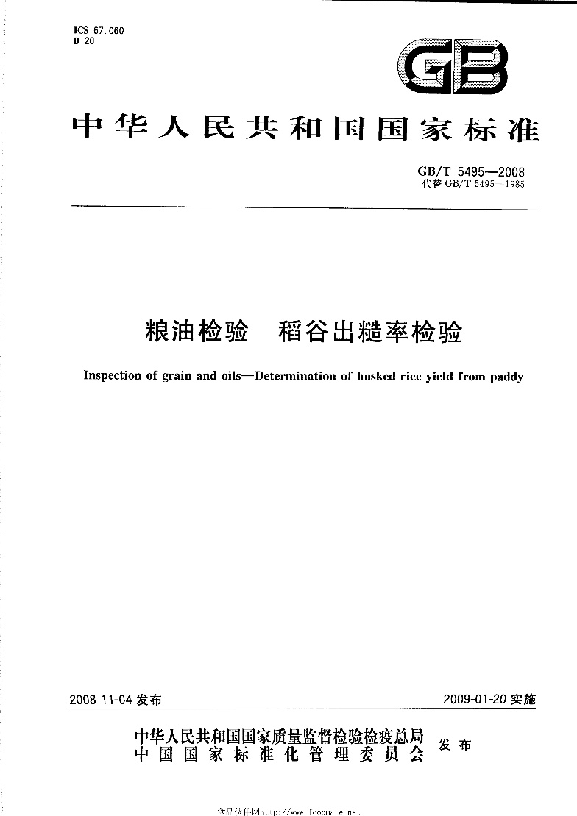
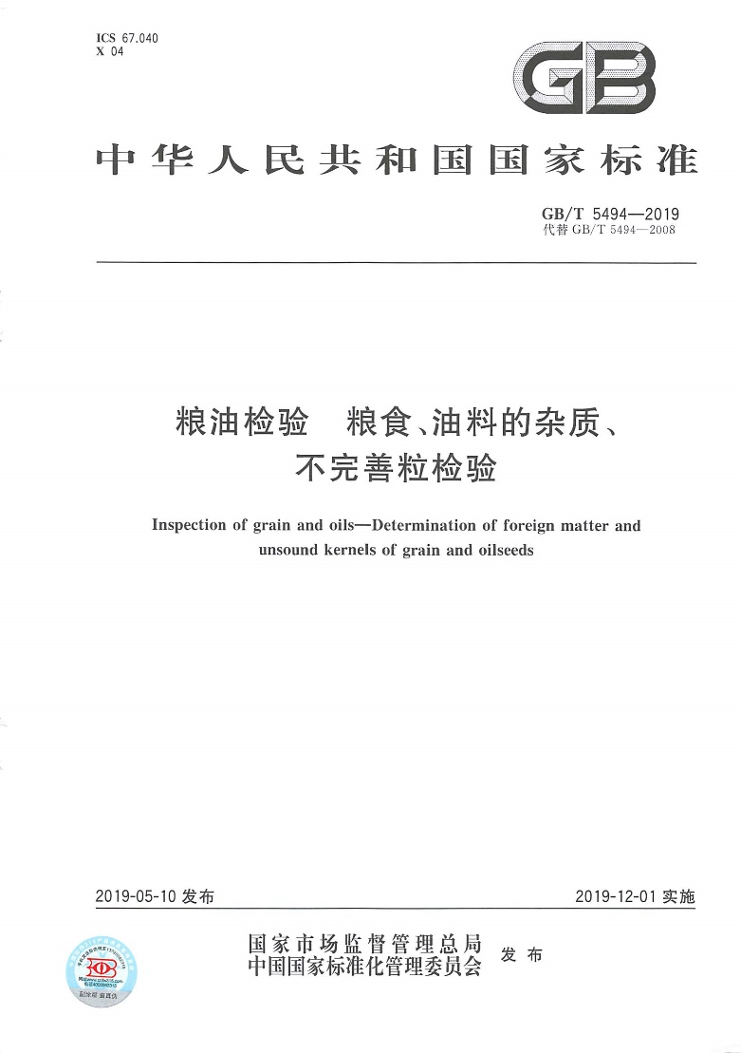
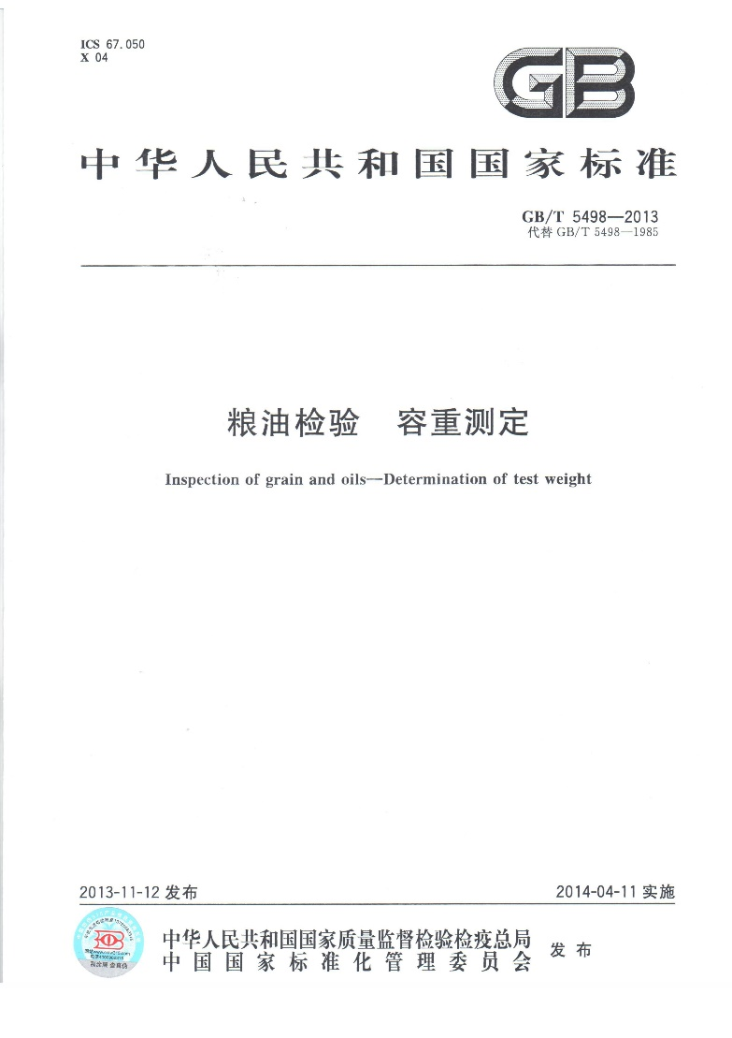
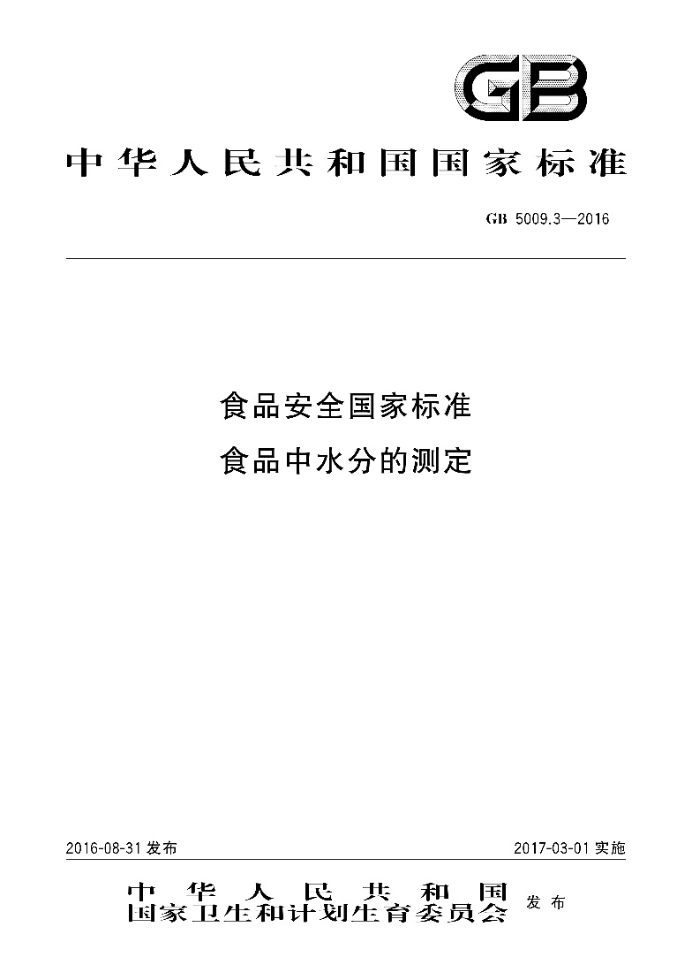
传统粮食扦样、检测技术
Traditional grain sampling and inspection technology
1、粮食扦检遵循的标准 The standard of grain sampling and inspection
部分谷物的国家标准
粮油检验的国家标准
National standards for some grains
National standards for grain and oil inspection
Notes:
粮食智能扦检遵循的国家标准

Slide 5
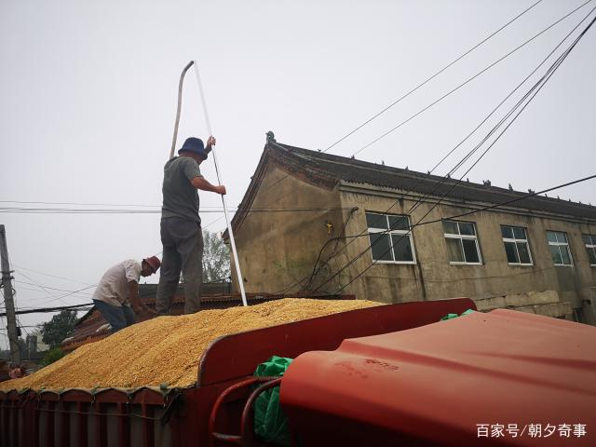
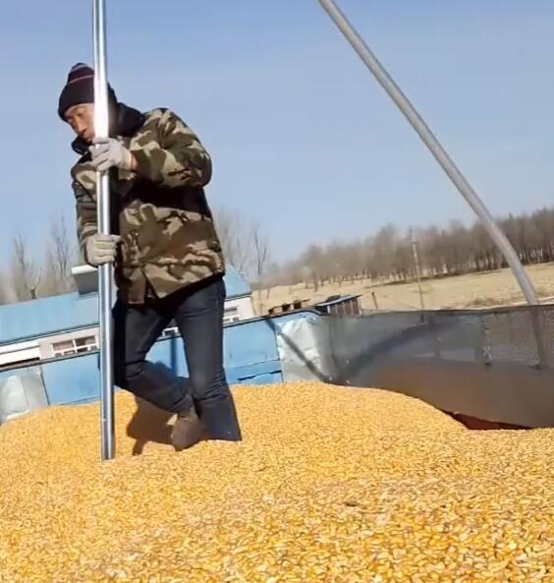
传统粮食扦样、检测技术
Traditional grain sampling and inspection technology
2、传统人工扦样 Traditional artificial sampling
unit weight
扦样
Sampling
扦样
Sampling
扦样人员爬上散粮车进行扦样 Sampling personnel climbed up the bulk grain truck for sampling.

Slide 6
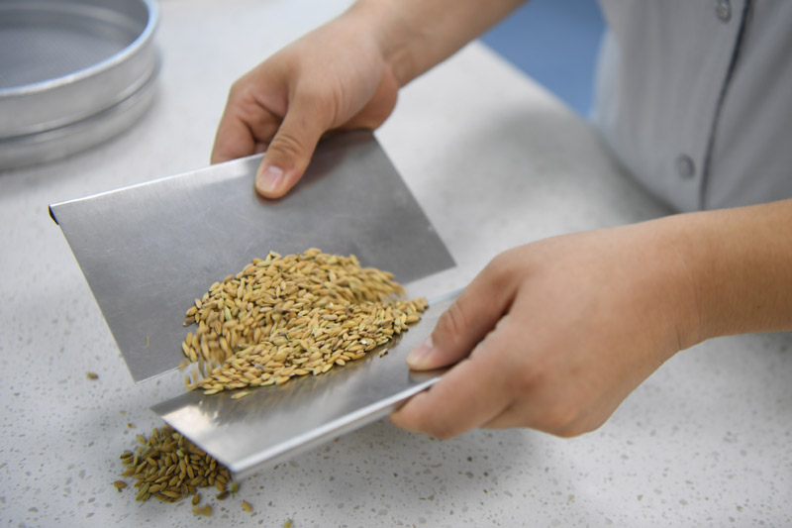
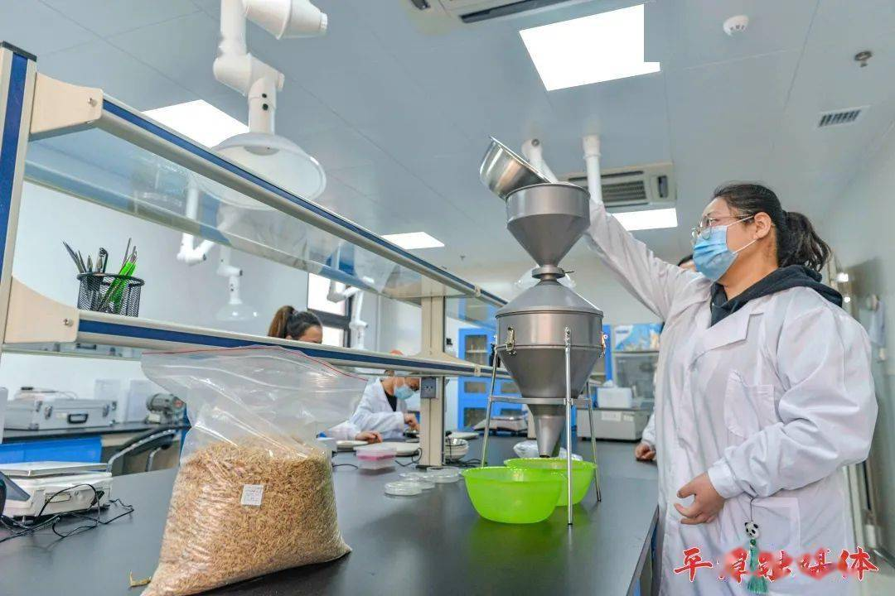
Grain sampling, testing technology status
传统粮食扦样、检测技术
Traditional grain sampling and inspection technology
3、传统人工检测 Traditional manual inspection
unit weight
unit weight
混匀
Homogenizing
分样
Aliquoting
化验人员人工进行混匀和分样 The laboratory personnels conduct homogenization and aliquot manually.

Slide 7
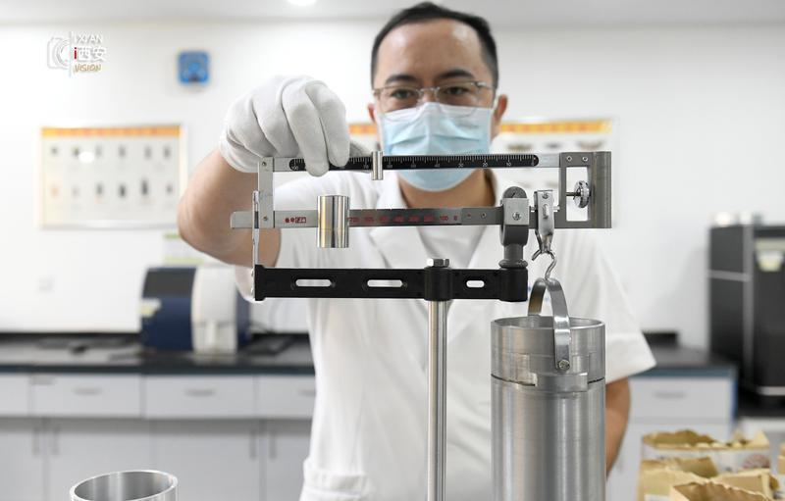
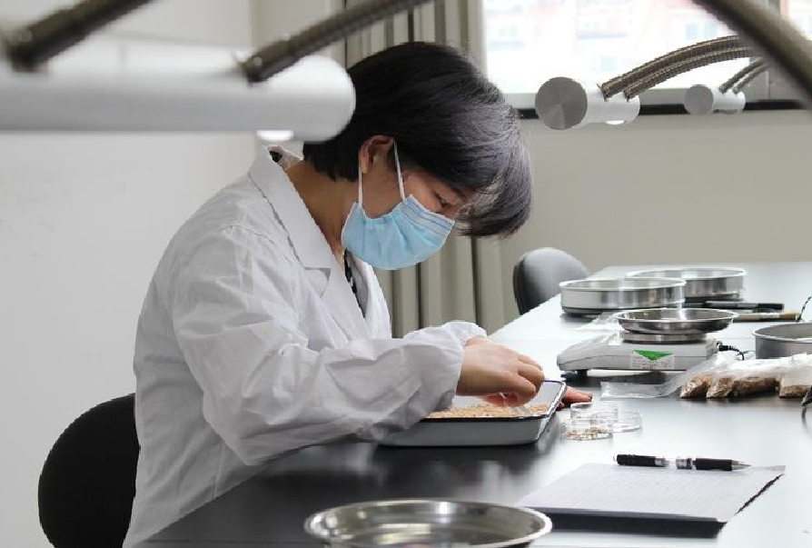
传统粮食扦样、检测技术
Traditional grain sampling and inspection technology
3、传统人工检测 Traditional manual inspection
unit weight
unit weight
容重
volume weighting
分选sorting
sizing
化验人员人工进行容重检测和不完善粒分选
The laboratory personnel manually carried out volume weight inspection and imperfect particle sorting

Slide 8
Grain sampling, testing technology status
传统粮食扦样、检测技术
Traditional grain sampling and inspection technology
4、传统人工扦样问题 Problems of traditional artificial sampling
？
扦样人员专业能力不足，扦样样品代表性差
The professional capability of sampler is insufficient, the representativeness of the samples is poor
A
在进行散粮车辆扦样时，扦样人员专业能力不足、缺乏工作经验，易发生点位分布不合理、样品数量不足、扦样方式错误等情形，导致样品代表性不足
During the sampling of the bulk grain vehicles, when the samplers lack professional competence and experience, it can easily lead to situations such as unreasonable distribution of sampling point, insufficient sample quantity, and incorrect sampling methods, resulting in adequate representativeness of the samples.

Slide 9
Grain sampling, testing technology status
传统粮食扦样、检测技术
Traditional grain sampling and inspection technology
4、传统人工扦样问题 Problems of traditional artificial sampling
？
扦样人员随意性强，不合规操作
The samplers have a high degree of randomness and do not comply with operational standards.
B
扦样人员受重复劳动、疲劳、心理、作业环境等影响，易发生扦样不到车厢底部、未覆盖车辆四周边角处、扦样点位数不足等不合规操作情形，导致样品无法真实、准确的反映粮食质量和等级
The samplers, affected by repetitive labour, fatigue, psychological factors, and the working environment, are prone to non-compliant operations such as failing to reach the bottom of the vehicle compartment, not covering the four corners of the vehicle, and insufficient sampling points. This can lead to the samples not truly and accurately reflecting the quality and grade of the grain.

Slide 10
Grain sampling, testing technology status
传统粮食扦样、检测技术
Traditional grain sampling and inspection technology
4、传统人工扦样问题 Problems of traditional artificial sampling
？
传统扦样存在安全风险，工作效率低
Traditional artificial sampling methods pose safety risks and are inefficient in terms of work efficiency.
C
扦样人员需要登上移动爬梯操作扦样机，爬梯高度3~5m，冬季严寒、暴风雪天气、夏季高温多雨等极端天气较多，重复劳动且劳动强度大，作业频繁，极易发生高处坠落事故风险
The samplers need to climb the moving ladder to operate the sampling machine as the height of the ladder is 3-5m. During the extreme weather such as cold winter, snowstorm, summer with high temperature and heavy rain, samplers with repetitive and intensive labour and frequent operations, are exposure to the risk of falling from heights accident.
传统扦样完成散粮车辆扦样需要10-15min/车，工作效率低
The traditional sampling method for bulk grain vehicle spends 10-15min for each vehicle, which has low working efficiency.

Slide 11
Grain sampling, testing technology status
传统粮食扦样、检测技术
Traditional grain sampling and inspection technology
5、传统人工检测问题 Problems of traditional manual inspection
？
检验难度大，对检验员依赖程度高
Difficult inspection with highly dependence on the inspectors
A
以玉米检验为例：分样、杂质筛分等操作要求高，检验指标多、难度大，检验技术要求较高，尤其是不完善粒、霉变粒、热损伤粒等指标由检验员进行人工感官判别，需要高水平、经验丰富的检验员进行操作，对检验员依赖性程度高
Example of corn inspection: high requirements of aliquoting and impurity screening, many difficult inspection indicators, high requirements of inspection technology, especially the artificial discrimination in indicators of imperfect grain particles, mildew particles, and particles with thermal damage, which dependence on experienced inspectors with high level of expertise.

Slide 12
Grain sampling, testing technology status
传统粮食扦样、检测技术
Traditional grain sampling and inspection technology
5、传统人工检测问题 Problems of traditional manual inspection
？
不同检验员检验结果，差异性大,重复性较差
The inspection results from different inspectors show significant variability and poor repeatability.
B
相同检验员检测相同样品在不同状态下得到的检验结果很可能不同，人工检测重复性较差.
One inspector detects the same sample at different status might achieve different results, which illustrates the repeatability of manual inspection is poor.

Slide 13
Grain sampling, testing technology status
传统粮食扦样、检测技术
Traditional grain sampling and inspection technology
5、传统人工检测问题 Problems of traditional manual inspection
？
工作效率较低,人工成本高
Work efficiency is relatively low and labor costs are high
C
因检验指标较多，需要检验的样品多，传统检验需要2~4名检验员同时进行操作，完成单辆散粮车检验需要20~30 min，工作效率低，检验工作重复性高，检验员易疲劳，影响收购效率
Due to the many inspection indicators and many samples to be tested, the traditional inspection requires 2-4 inspectors at the same time spending 15-20 mints on inspection of one bulk grain vehicle. The low work efficiency, high repeactivity of inspection work, and inspector fatigue affect the efficiency of grain purchasing.
收粮季检测人员工作时间长，人员成本高
During the grain purchasing season, the inspectors work for a long time, and the labor cost is high.

Slide 14
02
粮食智能扦样技术的发展和应用
Development and application of intelligent grain sampling technology
Notes:
第二部分

Slide 15
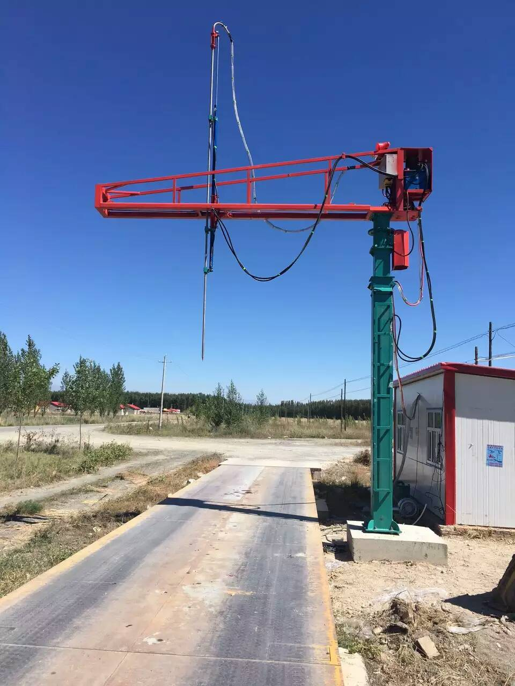
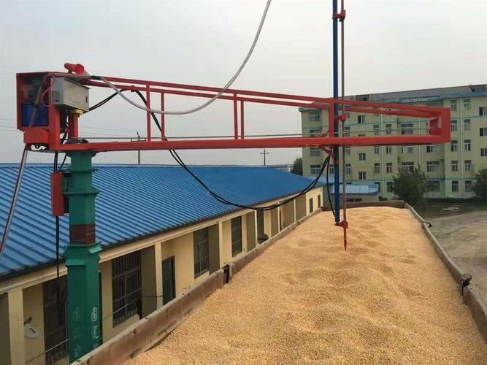
粮食智能扦样技术的发展和应用
Development and application of intelligent grain sampling system
Food cutting system
1、普通扦样机 Ordinary sampler
普通扦样机
Ordinary sampler

Slide 16
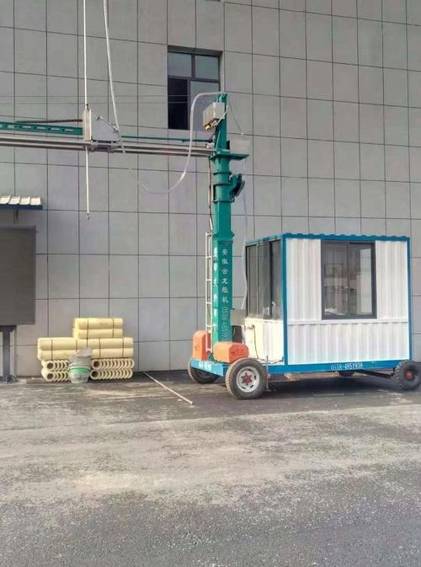
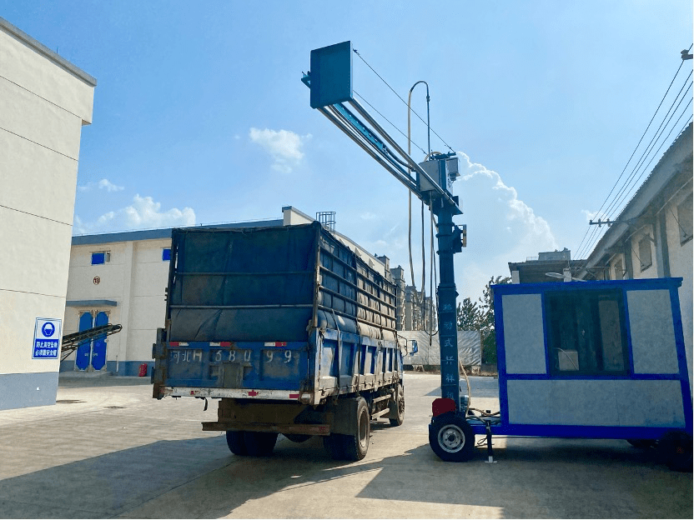
粮食智能扦样技术的发展和应用
Development and application of intelligent grain sampling system
Food cutting system
1、普通扦样机 Ordinary sampler
移动式扦样机
Removable sampler

Slide 17
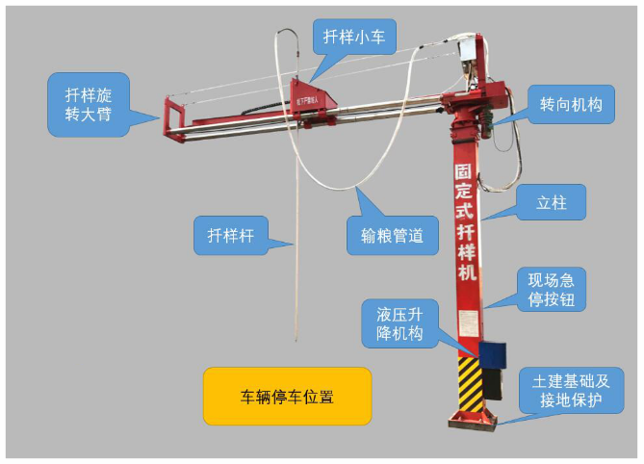
粮食智能扦样技术的发展和应用
Development and application of intelligent grain sampling system
Food cutting system
1、普通扦样机 Ordinary sampler
扦样动作
Sampling action
Sample trolley
转向机构带动扦样旋转大臂转动；
扦样小车前后移动；
扦样杆上下移动
The steering mechanism drives the rotating arm of the sampler
Move the sample trolley back and forth
Move the sampling rod up and down
Rotating arm
Sampling rod
功 能
Sampling action
车型识别
Vehicle recognition
一键启动
One-key start
随机选点
Random selection of sample points
智能语音
Intelligent voice
故障报警
Fault alarm
故障自检
Fault self-inspection

Slide 18
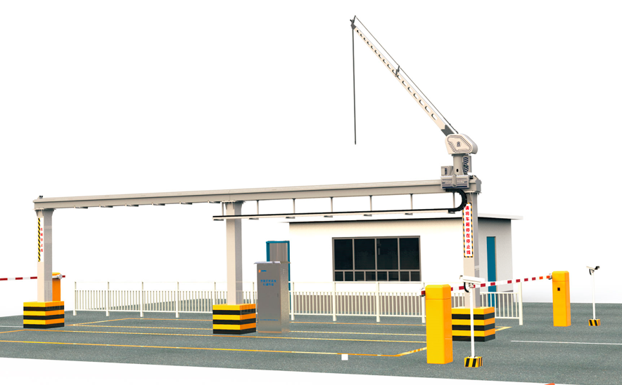
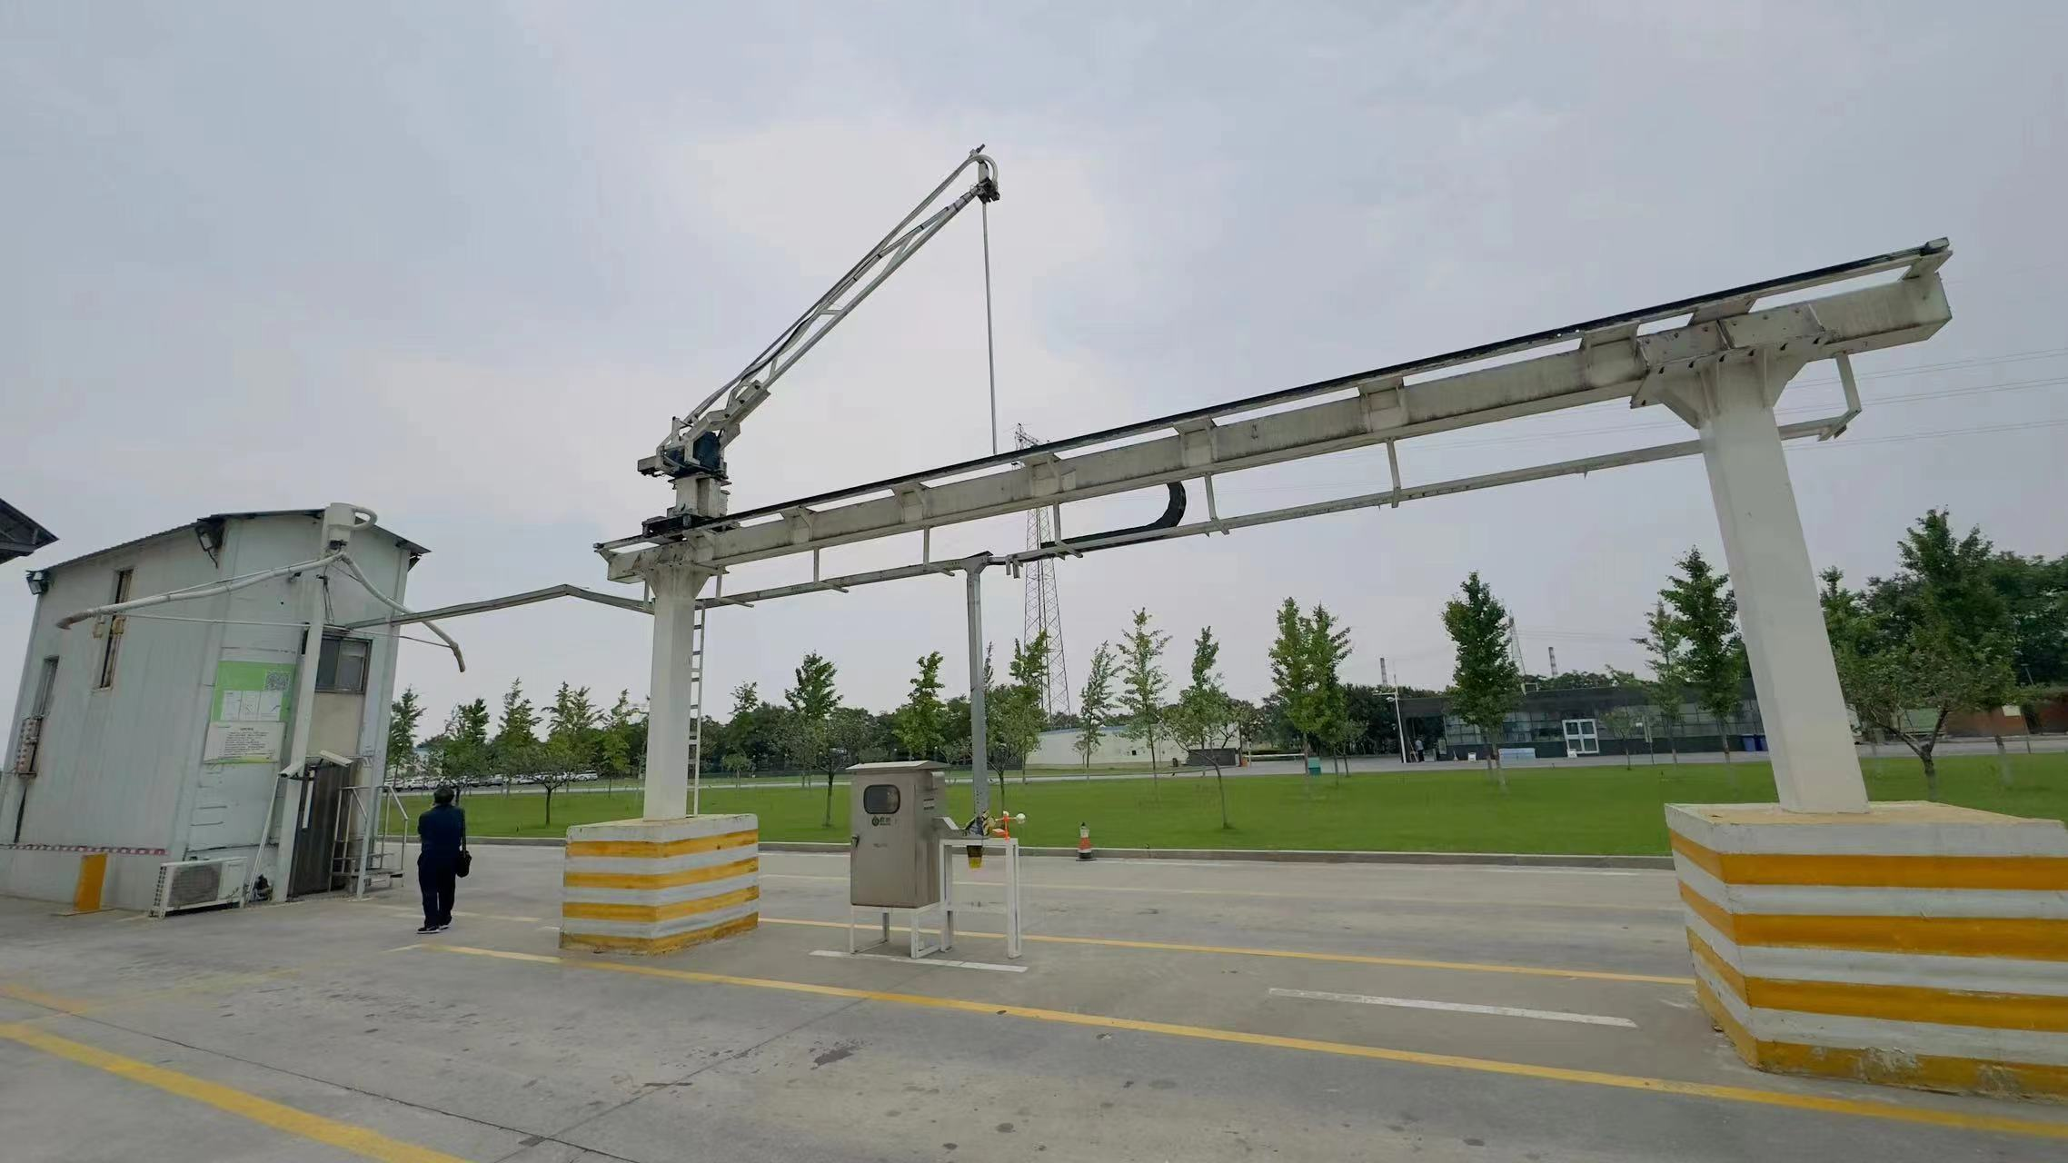
粮食智能扦样技术的发展和应用
Development and application of intelligent grain sampling system
Food cutting system
2、导轨式智能扦样机 Rail-mounted intelligent sampling machine
Picture

Slide 19
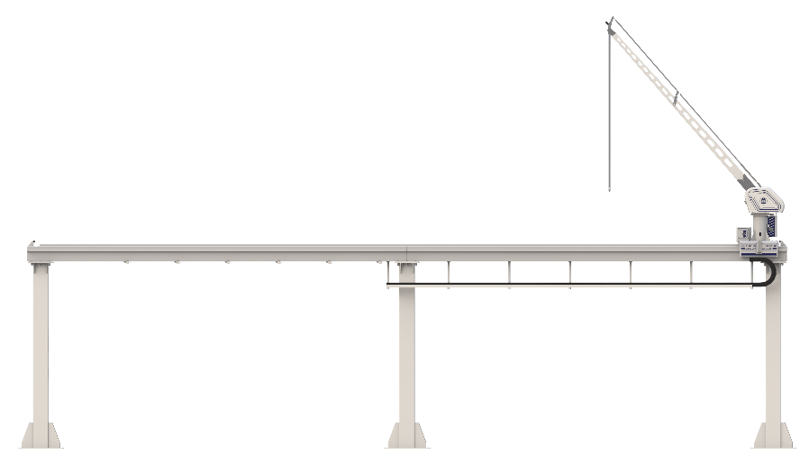
粮食智能扦样技术的发展和应用
Development and application of intelligent grain sampling system
Food cutting system
2、导轨式智能扦样机 Rail-mounted intelligent sampling machine
扦样大臂
Rotating arm
扦样小车
Sample trolley
扦样动作
Sampling action
扦样小车在导轨上移动
扦样小车水平旋转
扦样大臂上下往复运动
扦样杆上下往复移动
The sample trolley is moved on the guide rail
The sample trolley rotates horizontally
Take the rotating arm up and down
Move the sampling rod up and down
行走导轨
Walking guide rail
扦样杆
Sampling rod
功 能
Function
车型识别
Vehicle recognition
粮种识别
Grain identification
随机选点Random Selection of sample points
触底反弹
Bottom out and rebound
扦点追溯
Sampling points traceability
智能语音
Intelligent voice
一机双道
Two-lane sampling
快速高效
Fast and efficient
立柱
Upright column
拖链
Drag chain

Slide 20
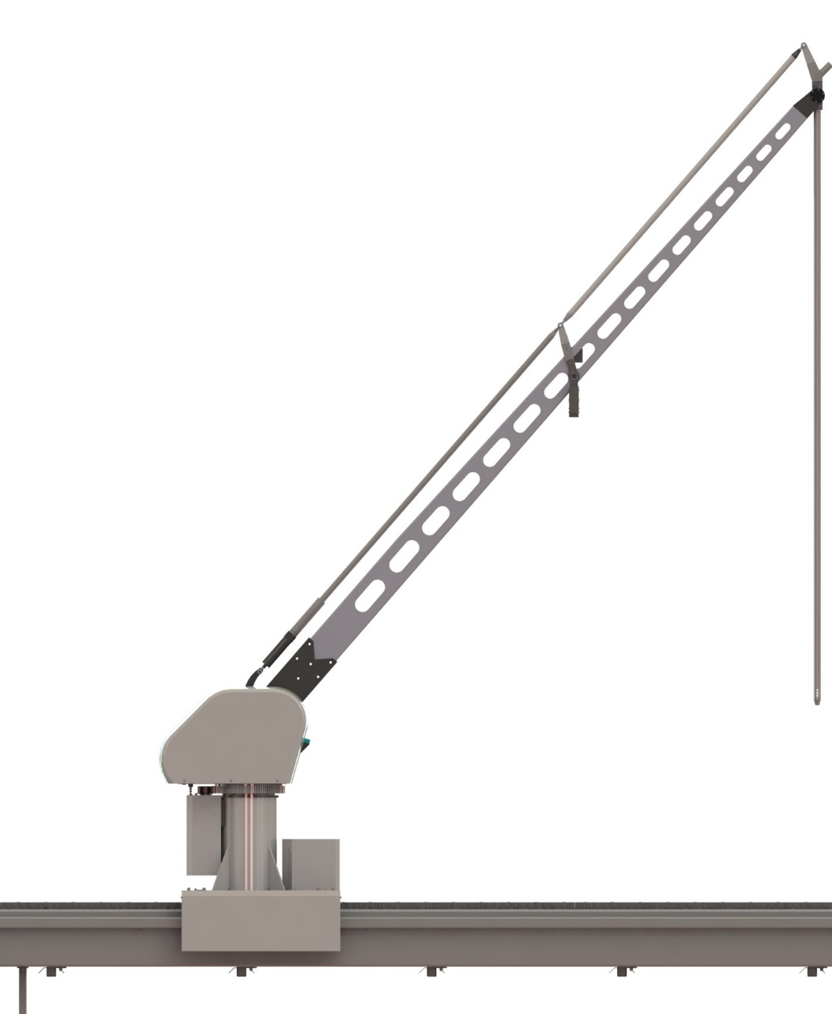
粮食智能扦样技术的发展和应用
Development and application of intelligent grain sampling system
Food cutting system
2、导轨式智能扦样机 Rail-mounted intelligent sampling machine
扦样小车
Sample trolley
采用三轴联动控制方式
实现扦样机在A、B、X三轴方向的精准运动
Adopt the three-axis linkage control mode
Realize the accurate movement of the sampler in the direction of A, B and X
A axle
B axle
X axle

Slide 21
粮食智能扦样技术的发展和应用
Development and application of intelligent grain sampling system
Food cutting system
2、导轨式智能扦样机 Rail-mounted intelligent sampling machine
视频 Video
导轨式扦样机正在进行扦样 The guide rail type sampler is sampling

Slide 22
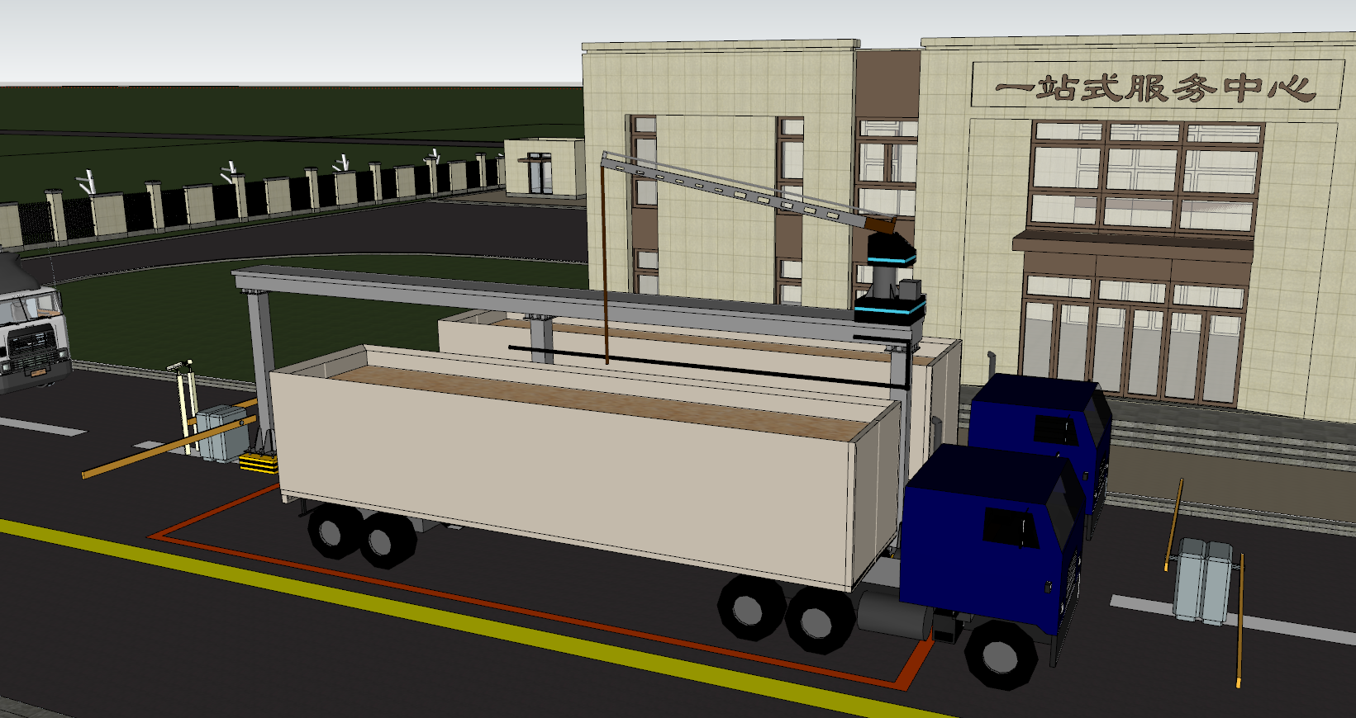
粮食智能扦样技术的发展和应用
Development and application of intelligent grain sampling system
Food cutting system
2、导轨式智能扦样机 Rail-mounted intelligent sampling machine
双车道扦样
Two-lane sampling
两个车道分别进行扦样 Two lanes were sampling separately

Slide 23
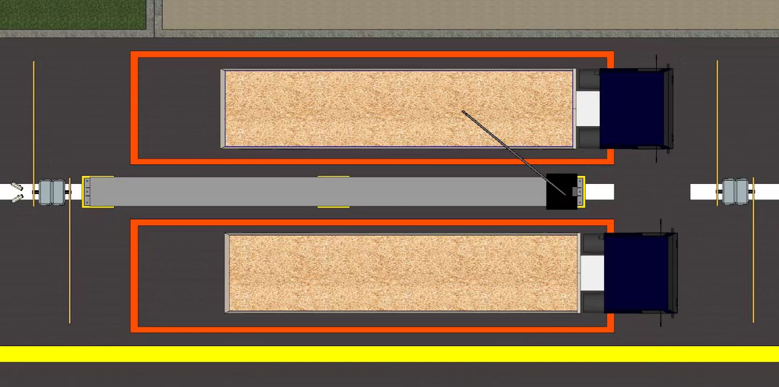
粮食智能扦样技术的发展和应用
Development and application of intelligent grain sampling system
粮食扦样系统
2、导轨式智能扦样机 Rail-mounted intelligent sampling machine
道闸
Barrier gate
扦样区域Sampling area
扦样杆Sampling rod
车厢Carriage
双车道扦样
Two-lane sampling
设置道闸，制定散粮车停放的扦样区域
The sampling machine needs to set up the barrier gate and formulate the sampling area for the bulk grain vehicle parking
Notes:
扦样机需要设置道闸，制定散粮车停放的扦样区域。

Slide 24
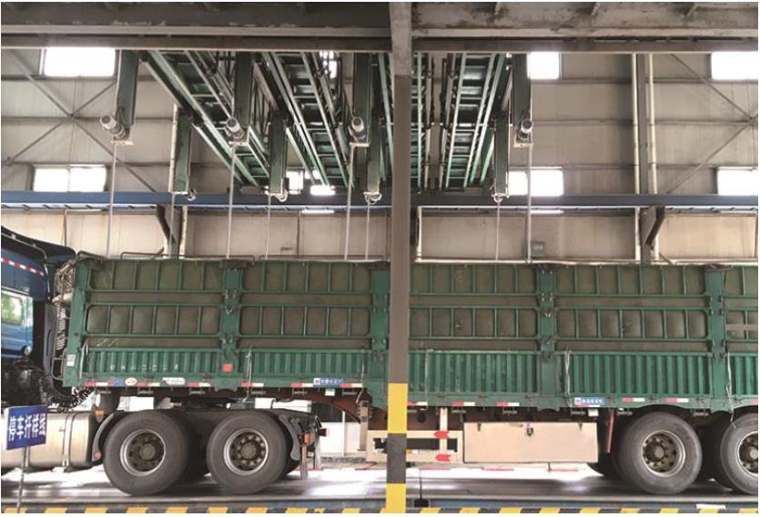
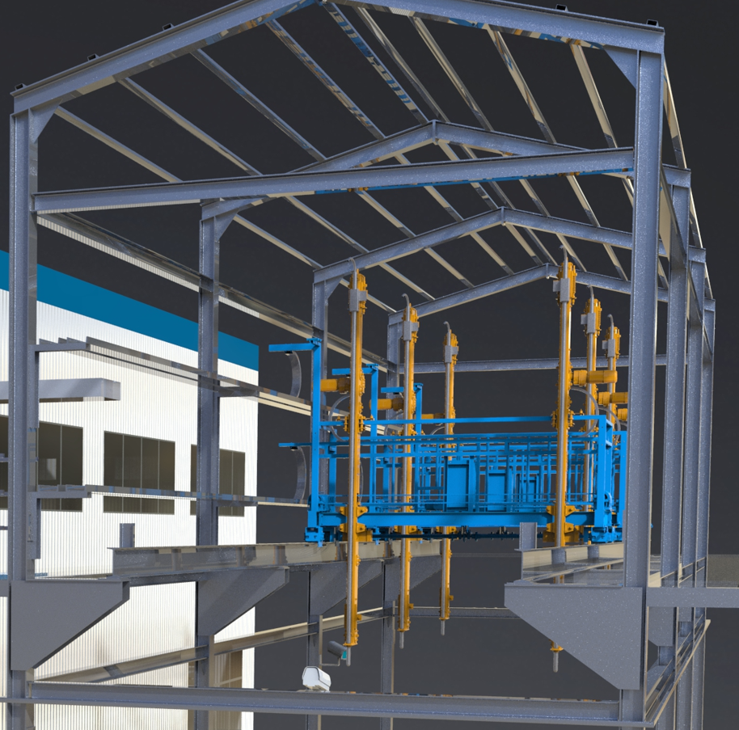
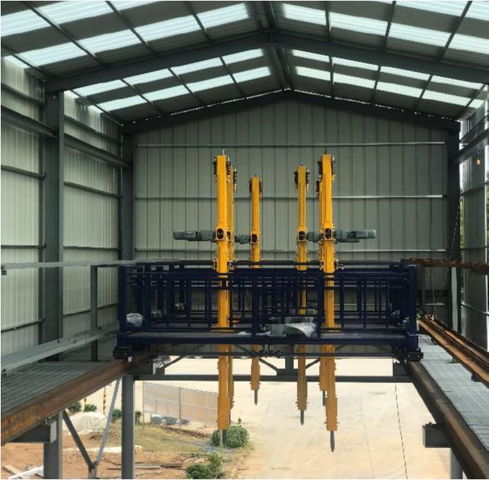
feature
feature
Food cutting system
3、多头智能扦样机 Multi-point sampling intelligent sampler
特点
Feature
4〜8个扦样头，扦样快速
4-8 sampling rod for fast sampling
扦样点的选择，自动、随机
Selection of Sample points Automatic, random

Slide 25
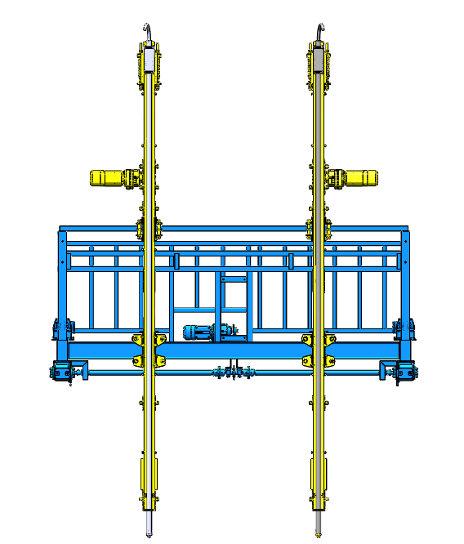
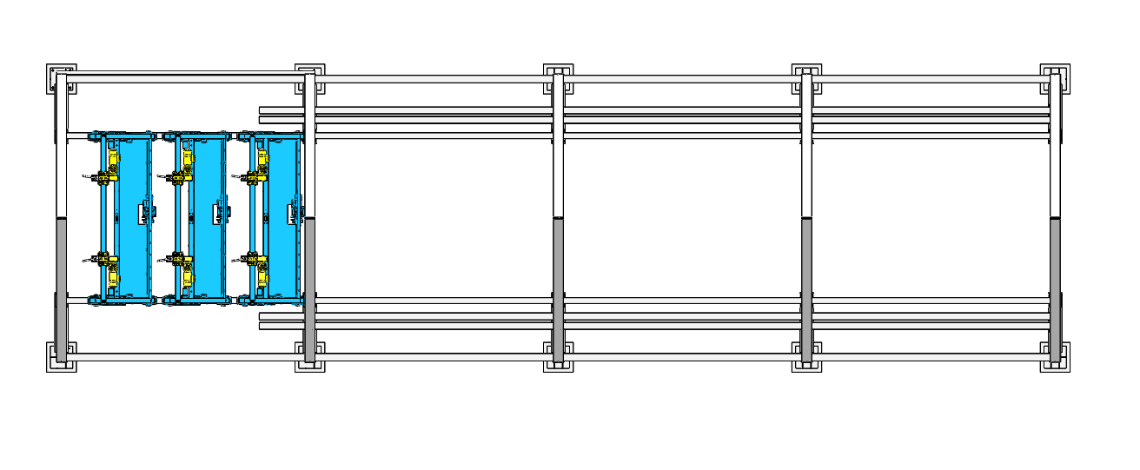
粮食智能扦样技术的发展和应用
Development and application of intelligent grain sampling system
Food cutting system
3、多头智能扦样机 Multi-point sampling intelligent sampler
扦样动作
Sampling action
“ The little cart”
“ The big cart”
A、大车沿长度方向往复移动
B、小车沿宽度方向往复运动
C、扦样杆上下往复移动
A. “The big cart” reciprocates along the length direction
B. “ The little cart” reciprocates along the width direction
C. Move the sampling rod up and down
功 能
Function
sampling rod
车辆定位
Vehicle positioning
视频监控
Video surveillance
车号识别
Car number identification
随机选点
Random selection of sample points
自动分样
Automatic reduction
交通指引
Traffic guidelines
C
A
B

Slide 26
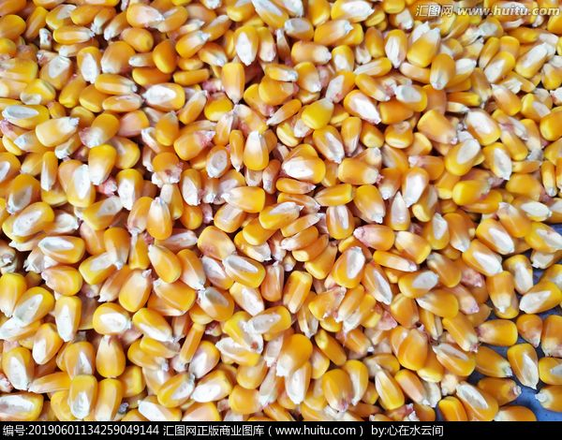
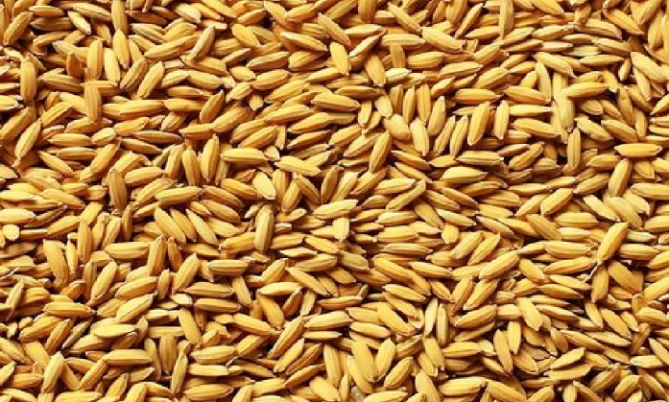
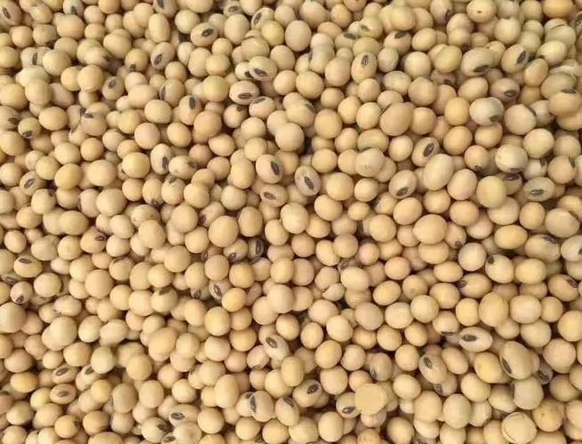
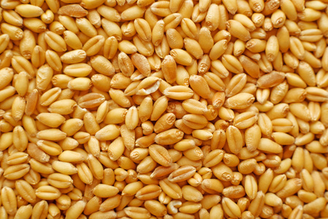
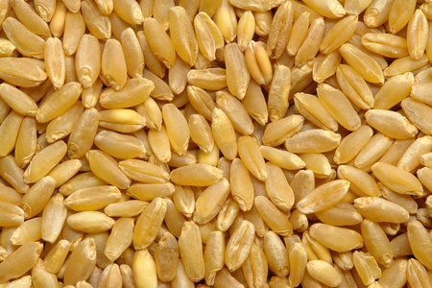
粮食智能扦样技术的发展和应用
Development and application of intelligent grain sampling system
Food cutting system
4、智能扦样的功能 The function of intelligent sampling
粮种识别
Grain identification
玉米
corn
大豆soybean
稻谷paddy
小麦wheat
corn
paddy
Grain sampling, testing technology status
可以自动识别粮食品种
Automatic identification of grain varieties
soybean
wheat

Slide 27
粮食智能扦样技术的发展和应用
Development and application of intelligent grain sampling system
Food cutting system
5、智能扦样的优点 The advantages of intelligent sampling
A
网格分区 随机选点
扦样样品具有代表性
Grid partition
Random selection of sample points
The sampling samples are representative
系统自动扫描车厢，设定扦样点位数量，将散粮粮面进行网格式划分，随机确定扦样点位，根据程序计算点位进行随机扦样。扦样点位分区设置满足规范要求，点位选择具有随机性，粮食样品具有代表性，能够真实准确的反应整车粮食质量。
The intelligent sampling system automatically scans the carriage, sets the number of sampling points, divides the bulk grain surface into the grid format, randomly determines the sampling points, and makes random sampling points according to the calculation program. The point setting meets the specification requirements, point selection is random, and the grain sample is representative, truly and accurately reflecting the quality of the vehicle grain.

Slide 28
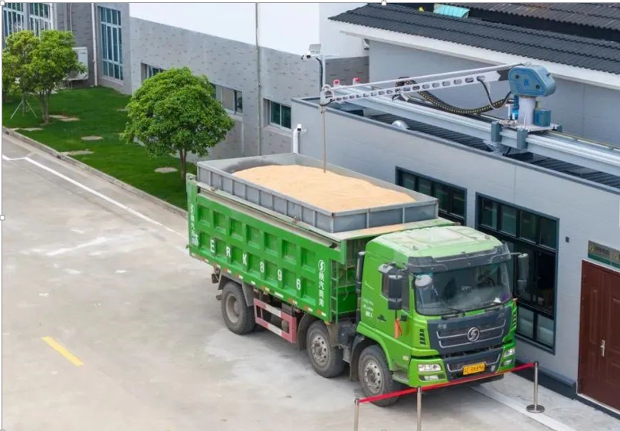
粮食智能扦样技术的发展和应用
Development and application of intelligent grain sampling system
Food cutting system
5、智能扦样的优点 The advantages of intelligent sampling
B
无人值守 自助操作
提高效率 安全生产
Unattended, self-service,
Efficiency improvement, safe production
送粮人通过智能扦样系统自助刷卡，“一键启动”扦样，自动分样和检验，无需人员操作。扦样设备无人值守，减员增效。
扦样速度3min/车，提升粮食收购效率。
避免人员登高扦样安全风险。
Grain sales personnel swipes the card through the intelligent sampling system for“one-key start”sampling, automatically aliquoting and inspection without personnel operation. Sampling equipment is unattended, save labour cost and increase efficiency.
Sampling speed is 3-mint/vehicle, improving the efficiency of grain purchasing.
Avoid the safety risk of personnel climbing sampling.

Slide 29
03
粮食无人自动检化验系统
Unmanned automatic grain inspection system
Notes:
第三部分

Slide 30
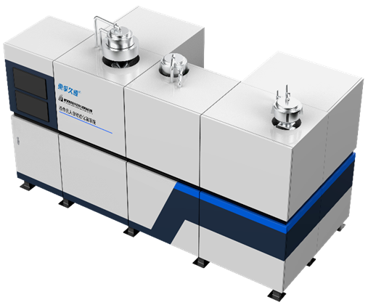
粮食无人自动检化验系统
Unmanned automatic grain inspection system
Food unmanned automatic testing system
1、适用范围和粮食收购质量指标
Scope of application and grain quality indicator
适用范围：小麦、稻谷、玉米、大豆
Scope of application: wheat, rice, corn, soybean
粮食收购质量指标：水分、容重、杂质、不完善粒、出糙率、热损伤粒、霉变粒等
Grain purchase quality indicators: moisture, volume weight, impurities, imperfect grain particle, roughness rate, thermal damage grain particle, mildew grain particle, etc
Notes:
1、 适用范围和粮食收购质量指标
适用范围：小麦、稻谷、玉米、大豆
粮食收购质量指标：水分、容重、杂质、不完善粒、出糙率、热损伤粒、霉变粒等

Slide 31
粮食无人自动检化验系统
Grain unmanned automatic inspection system
Food unmanned automatic testing system
2、检验流程 Inspection process
混匀
Homogenizing
定量取样Quantitative sampling
分样备样
Aliquoting and standby sample
筛理除杂Edulcoration
均匀分样
Uniform Aliquot
质量检测Quality inspection
样样品全部混匀
About 6kg was divided in points
3kg备份留样3kg for standby sample
大样杂质Large sample impurities
检测用小样The sample was used for inspection
水分、容重、不完善粒，色泽气味
Color smell
Mix all the cutting samples well
分取约6kg
moisture, volume weight, imperfect grain, etc
符合国家标准检验流程
According to the national-standard inspection process
Notes:
符合国家标准检验流程，分为混匀、定量取样、分样备样、筛理除杂、均匀分样、质量检测等模块

Slide 32
粮食无人自动检化验系统
Grain unmanned automatic inspection system
building block design
3、模块化设计 Modular design
所有扦取样品混合均匀后再进行均匀分样，混和均匀度＞90%，保证检测样品的代表性
All the samples were mixed evenly and then uniformly separated. The mixing uniformity is higher than 90% to ensure the representativeness of the test samples.
1-混匀分样模块
Homogenize
and uniform aliquot module
采用旋振筛筛出大样杂质；通过视觉识别和AI算法检测小样杂质及无机杂质，杂质总量检测精度≤0.3%
Rotary vibrating screen was used to screen out large sample impurities and weigh them; the small sample impurities and inorganic impurities are detected by visual identification and AI algorithm, and the inspection accuracy of total impurities is 0.3%.
2-杂质检测模块
Disability inspection
module

Slide 33
粮食无人自动检化验系统
Grain unmanned automatic inspection system
building block design
3、模块化设计 Modular design
可以检测多粮种的水分、容重、不完善粒、黄粒米、整精米率、热损伤粒等质量指标
It can detect the moisture, volume weight, imperfect grain particle, yellow grain, whole rice rate, thermal damage grain and other quality indicators.
3-质量检测模块
Quality inspection
具备全自动包装、喷码功能。标准3kg备样
With automatic packaging and code printing functions. The standard 3kg standby sample.
4-包装备样模块
Package and standby sample
module
5-余粮收集模块
Waste grain collection
module
将剩余粮食接入现场余粮罐或返回散粮车
The remaining grain will be connected to the on-site surplus grain tank or returned to the bulk grain vehicle

Slide 34
4、 性能验证
Performance erification
performance verification
①混合均匀度Mixture homogeneity
 |  | 测试一 Test a |  |  | 测试二 Test 2
 | 设置克数 Set the grams (g) | 设置克数 Set the grams (g) | 出料克数 Discharge grams (g) | 混合比例 mixing ratio (%) | 设置克数 Set the grams (g) | 出料克数 Discharge grams (g) | 混合比例 mixing ratio (%)
Channel 1 | 150 | 145.32 | 14.07 | 9.68 | 145.25 | 14.07 | 9.69
Channel 2 | 250 | 249.68 | 24.83 | 9.94 | 248.56 | 26.31 | 10.58
Channel 3 | 150 | 155.84 | 15.40 | 9.88 | 153.62 | 15.80 | 10.29
Channel 4 | 150 | 150.01 | 15.15 | 10.10 | 150.80 | 15.86 | 10.52
Channel 5 | 1000 | 1001.11 | 101.58 | 10.15 | 1006.94 | 101.09 | 10.04
Channel 6 | 150 | 150.51 | 16.00 | 10.63 | 150.14 | 15.59 | 10.38
Channel 7 | 150 | 150.31 | 15.08 | 10.03 | 149.13 | 15.51 | 10.40
Channel 8 | 1000 | 996.49 | 99.61 | 10.00 | 995.21 | 98.19 | 9.87
混合均匀度 mixture homogeneity % |  | 96.8 |  |  | 97.3
两次测试混合均匀度分别为96.8 %和97.3 %。
The mixing uniformity of the two tests was 96.8% and 97.3%, respectively.
F值=2.02＜F_{0.05}（7,8）=3.73，表明样品均匀性良好
F-value =2.02 <F_{0.05}(7,8) =3.73, indicating a good sample homogeneity.
所有扦样样品均混合均匀后再分样，混合均匀度95%以上，分取样品代表性强
All the samples were mixed evenly and then divided. The mixing uniformity of the mixed sample module is more than 95%, and the samples are highly representative.
Notes:
① 混合均匀度：两次测试混合均匀度分别为96.8 %和97.3 %。样品均匀性良好。

Slide 35
4、 性能验证
Performance erification
performance verification
②均匀分样 Uniform Aliquot
 |  | Test a |  | Test 2 |  | Test 3 |  | Test four |  | Test five |  | Test six |  | 相对标准偏差relative standard bias in statistics （%）
 | 设置克数Set the grams (g) | 出料克数Discharge grams (g) | 准确率precision （%） | 出料克数Discharge grams (g) | 准确率precision （%） | 出料克数Discharge grams (g) | 准确率precision （%） | 出料克数Discharge grams (g) | 准确率precision （%） | 出料克数Discharge grams (g) | 准确率precision （%） | 出料克数Discharge grams (g) | 准确率precision （%）
Channel 1 | 150 | 146.37 | 97.60 | 147.02 | 98.00 | 145.05 | 96.70 | 145.63 | 97.10 | 146.17 | 97.40 | 146.22 | 97.50 | 0.46
Channel 2 | 250 | 248.79 | 99.50 | 249.77 | 99.90 | 249.09 | 99.60 | 249.47 | 99.80 | 248.35 | 99.30 | 248.84 | 99.50 | 0.20
Channel 3 | 150 | 155.99 | 104.00 | 156.09 | 104.10 | 156.08 | 104.10 | 156.06 | 104.00 | 153.01 | 102.00 | 154.47 | 103.00 | 0.83
Channel 4 | 150 | 149.48 | 99.70 | 152.17 | 101.40 | 151.12 | 100.70 | 150.01 | 100.00 | 149.71 | 99.80 | 150.98 | 100.70 | 0.68
Channel 5 | 1000 | 1004.62 | 100.50 | 1001.17 | 100.10 | 1000.80 | 100.10 | 1003.81 | 100.40 | 1004.23 | 100.40 | 1004.35 | 100.40 | 0.17
Channel 6 | 150 | 149.73 | 99.80 | 148.52 | 99.00 | 148.78 | 99.20 | 147.89 | 98.60 | 149.66 | 99.80 | 149.20 | 99.50 | 0.48
Channel 7 | 150 | 152.15 | 101.40 | 150.80 | 100.50 | 150.99 | 100.70 | 151.29 | 100.90 | 151.35 | 100.90 | 151.26 | 100.80 | 0.31
Channel 8 | 1000 | 995.39 | 99.50 | 993.17 | 99.30 | 992.09 | 99.20 | 995.19 | 99.50 | 998.25 | 99.80 | 993.56 | 99.40 | 0.22
均匀分样测试结果表明：通道一到通道八重复性相对标准偏差为0.17 %~0.83 %，说明准确度达到95%以上，重复性相对标准偏差＜1%
The validation results indicate that:The relative standard deviation of repeatability from channel one to channel 8 was 0.17% to 0.83%, indicating that the accuracy is above 95% and the relative standard deviation of repeatability is below or equal 1%.

Slide 36
4、 性能验证
Performance erification
performance verification
③检测性能 Inspection performance
准确性
accuracy
配对t检验
Paired t-test
t price | t_{d}=2.06＜t_{(0.05，7)}=2.36 | t_{d}=2.01＜t_{(0.05，7)}=2.36 | t_{d}=1.13＜t_{(0.05，7)}=2.36
The t-test determines | 合格qualified | 合格qualified | 合格qualified
经配对t检验：表明仪器检验法与国家标准方法—人工定值结果之间不存在显著性差异
By the paired t-test: t_{d}＜t_{(0.05，7)}, It shows that there is no significant difference between the instrument test method and the national standard method-manual value results.
t_{d}=2.21＜t_{(0.05，7)}=2.36 | t_{d}=1.79＜t_{(0.05，7)}=2.36
qualified | qualified

Slide 37
4、 性能验证
Performance validation
performance verification
重复性repetitiveness
χ 2 test
Extreme difference vs critical extreme difference | 0.09 ＜0.29 | 4.00 ＜5.29 | 0.23 ＜0.43 | 0.03 ＜0.14 | 0.68 ＜0.71
χ2 | 1.01＜11.07 | 9.44＜11.07 | 2.61＜11.07 | 0.62＜11.07 | 9.04＜11.07
χ 2 determines that | qualified | qualified | qualified | qualified | qualified
稳定性stability
χ 2 test
Extreme difference vs critical extreme difference | 0.26 ＜0.29 | 2.00 ＜4.29 | 0.24 ＜0.43 | 0.13 ＜0.14 | 0.26 ＜0.71
χ2 | 8.17＜11.07 | 2.90＜11.07 | 3.38＜11.07 | 7.95＜11.07 | 1.41＜11.07
χ 2 determines that | qualified | qualified | qualified | qualified | qualified
对样品的质量指标进行重复实验和稳定性实验，检验合格。
Repeated experiments and stability experiments were carried out on the quality indicators of the sample, and the test was qualified
Notes:
样品检测的重复性和稳定性，对样品的质量指标进行重复实验和稳定性实验，检验合格，符合检验标准要求。

Slide 38
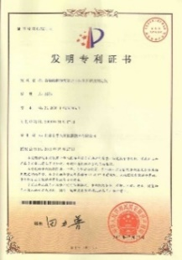
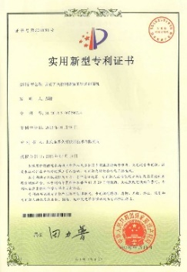
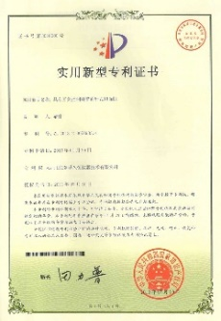
5、 知识产权
Intellectual property right
intellectual property right
5、知识产权 Intellectual property right
patent
已授权专利 7 项
7 Patents granted
一种定量取样装置
A quantitative sampling device
一种均匀分样装置
A uniform division device
一种图像采集装置
An image acquisition device
一种谷物外观检测装置
A cereal appearance inspection device
Notes:
7 patents related to the whole set of equipment have been authorized.

Slide 39
6、 技术特点
Technical feature
technical feature
6、技术特点 Technical feature
无人检测
降本增效
Automatic inspection
cost decreasing and efficiency increasing
检测效率
显著提升
Inspection efficiency has been significantly improved
安全保障
灵活扩展
Flexible expansion of security guarantee
标准流程
准确可靠
The standard process is accurate and reliable
高度集成
智能评判
Highly integrated intelligent judgment

Slide 40
Automatic inspection, and system advantages
7、自动检测系统优点 Advantages of the automatic detection system
A
涵盖四大粮种，可进行小麦、玉米、大豆、稻谷的检测
Covering inspection of four major grain species, wheat, corn, soybean, and paddy
自动识别粮食品种，按照粮食种类自动选择检测流程
Automatic identification of grain varieties, and automatic selection of inspection process according to the variety of grain

Slide 41
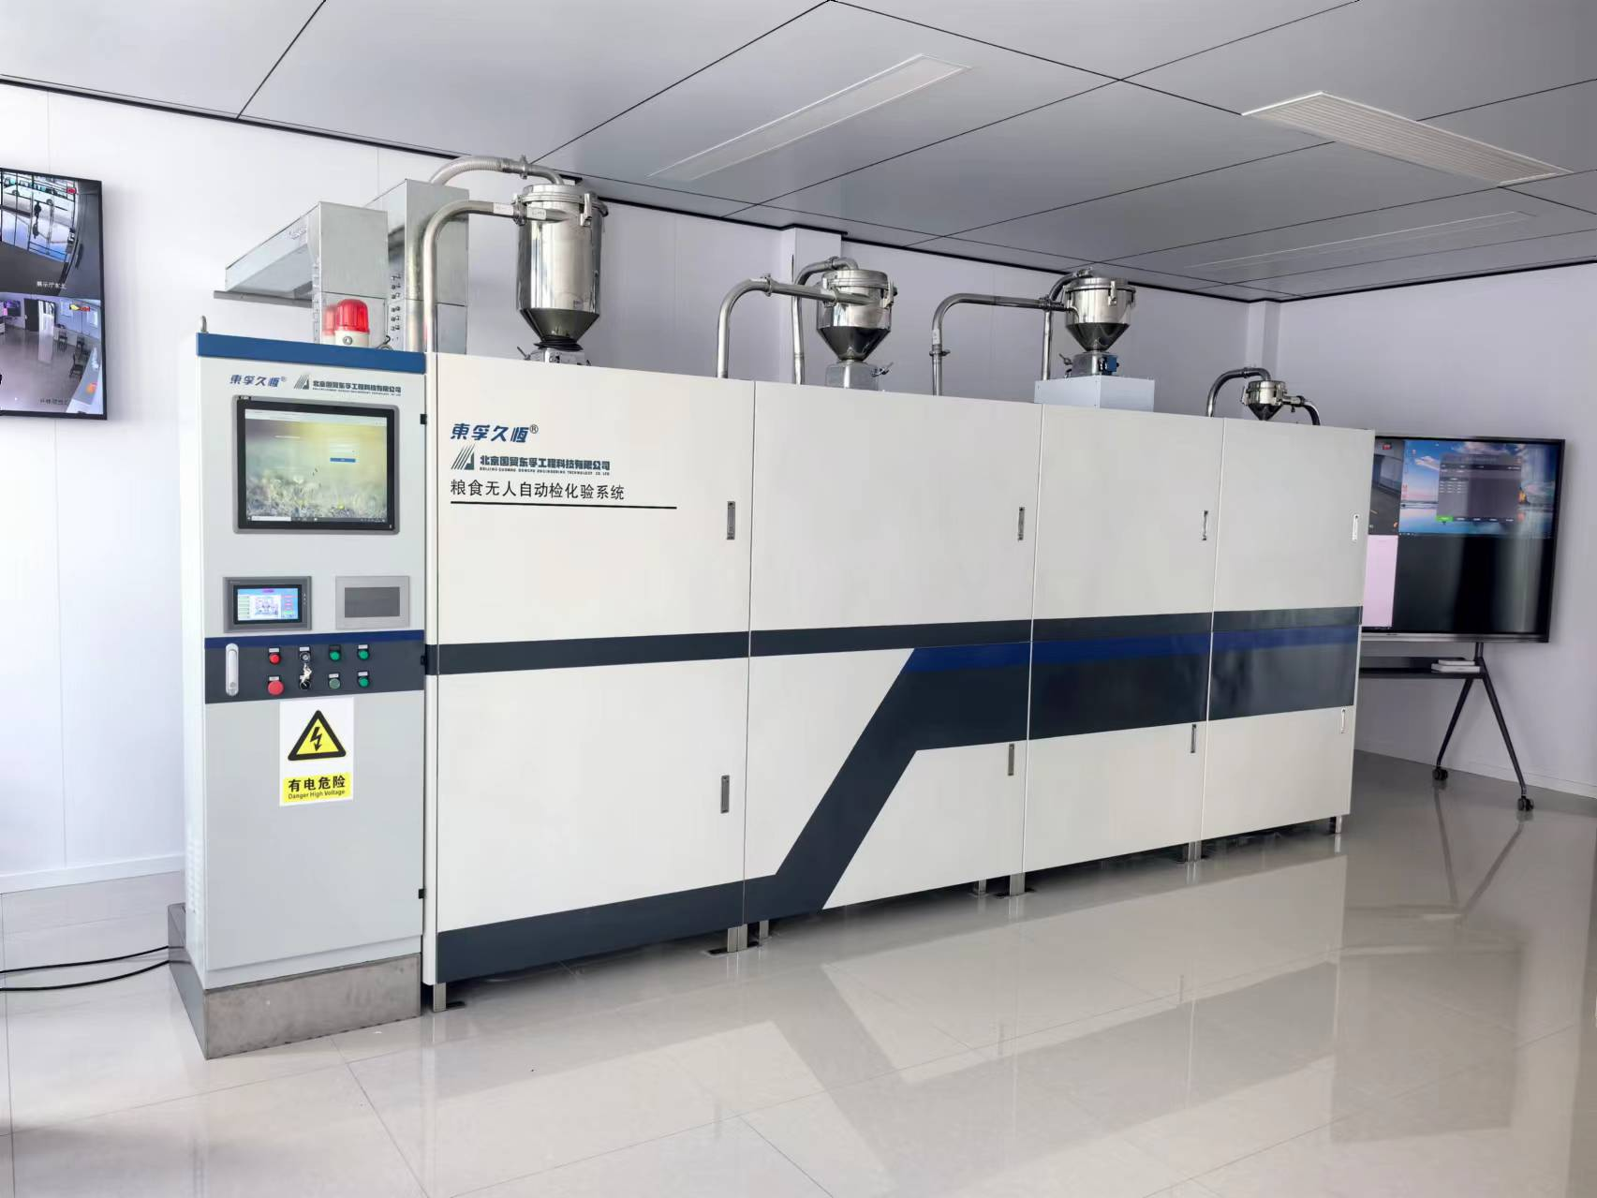
7、 自动检测系统优点
Advantages of the automatic inspection system
Automatic inspection, and system advantages
B
样品混合均匀度高，代表性强
Samples were mixed with high uniformity and strong representation
自动检测重复性、稳定性好
Automatic inspection of repeatability, good stability
系统运行稳定、检测数据准确可靠
The system runs stably, and the inspection data is accurate and reliable

Slide 42
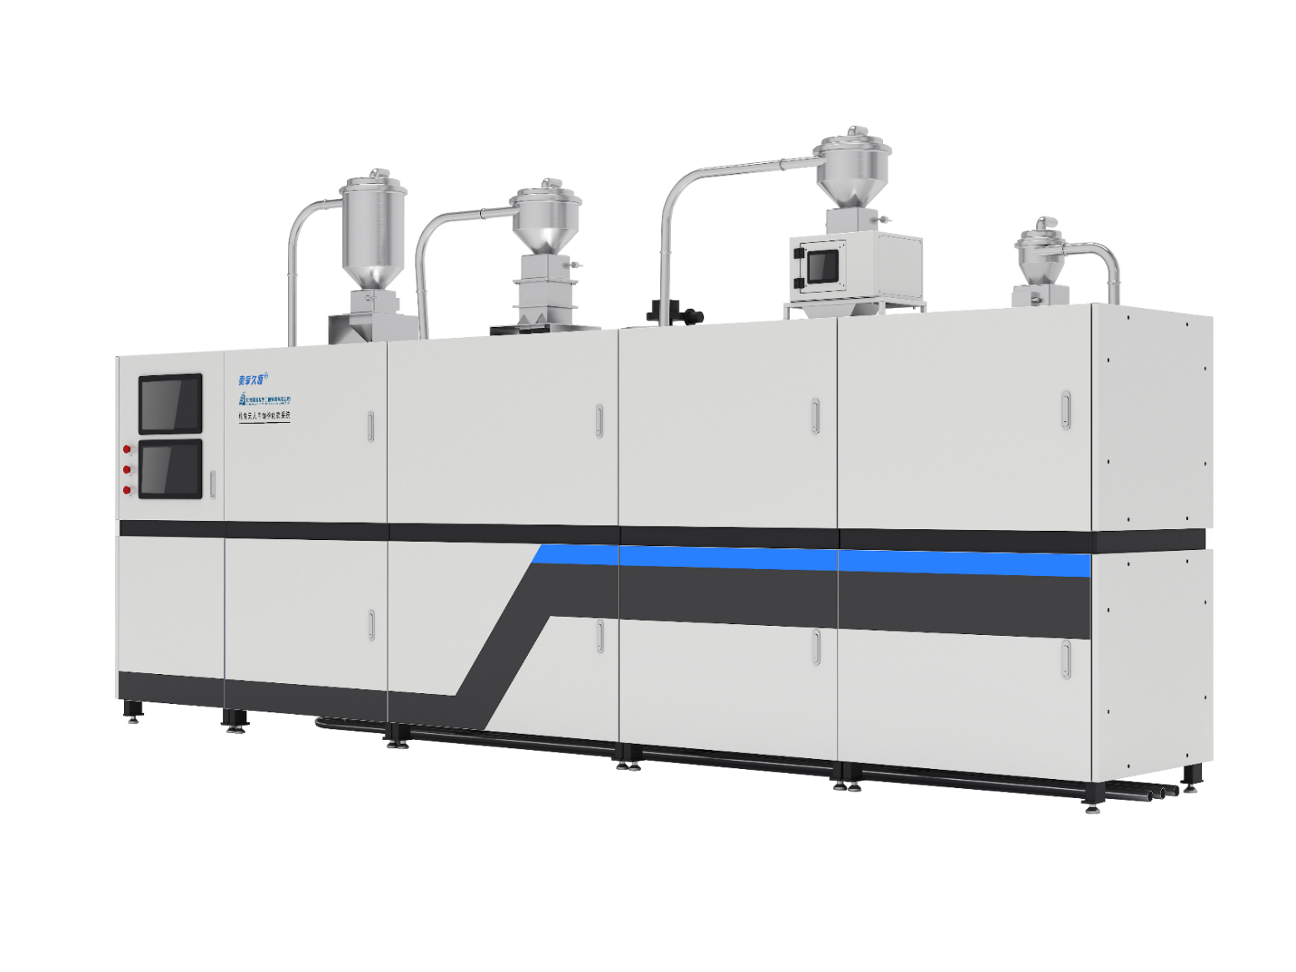
7、 自动检测系统优点
Advantages of the automatic inspection system
Automatic inspection, and system advantages
C
整套系统全自动控制,检测数据智能分析
Automatic control of the whole system; Intelligent analysis of inspection data
自动研判粮食等级,信息可上传、可追溯
Automatic analysis of grain grade, which can be uploaded and traceable
检测过程自动化可降低人工成本和劳动强度
Automate inspection process reduces labor costs and labor intensity

Slide 43
Thank You！
Tel：13910923510
E-mail:zdh@gmedi.cn
Sharing for Learning

