Slide 1

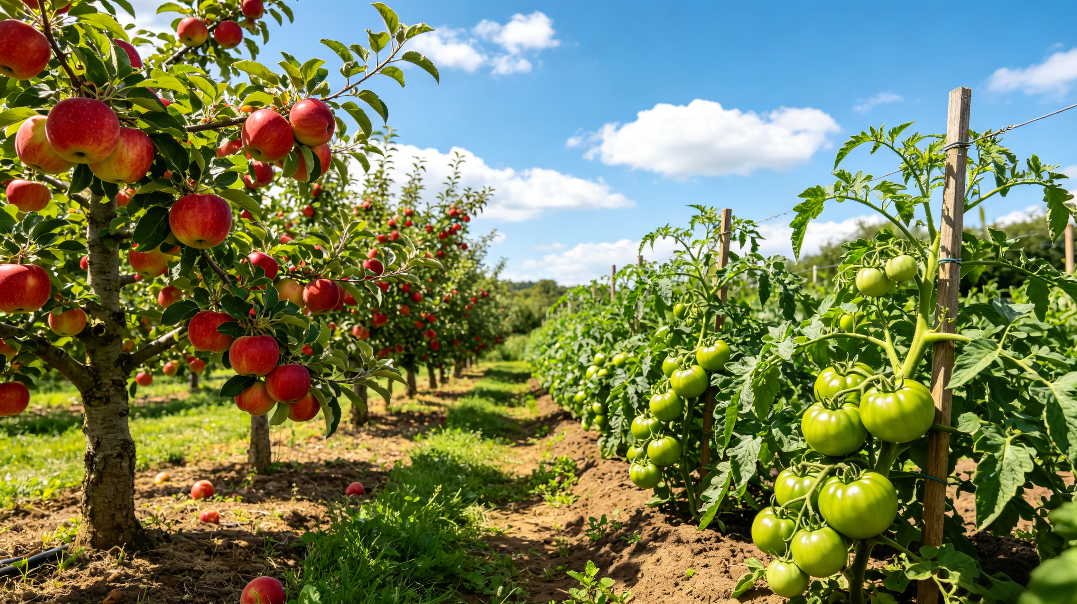

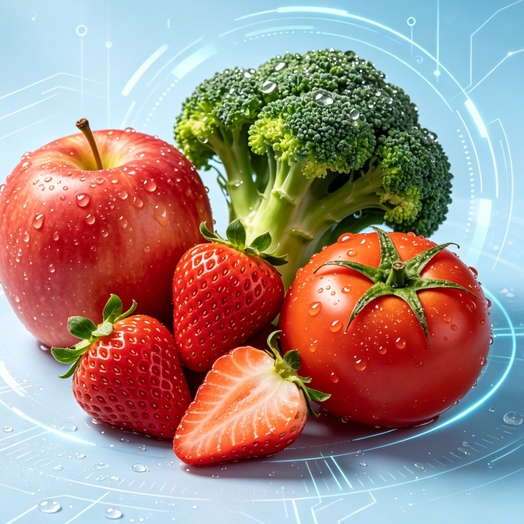
Postharvest Preservation Technologies
For Common Fruits And Vegetables
Notes:
Postharvest Preservation Technologies for Common Fruits and Vegetables
常见果蔬的保鲜技术

Slide 2

PART.02
Preservation Methods for Common Fruits and Vegetables
Notes:
二、常见果蔬的保鲜方法
II. Preservation Methods for Common Fruits and Vegetables

Slide 3
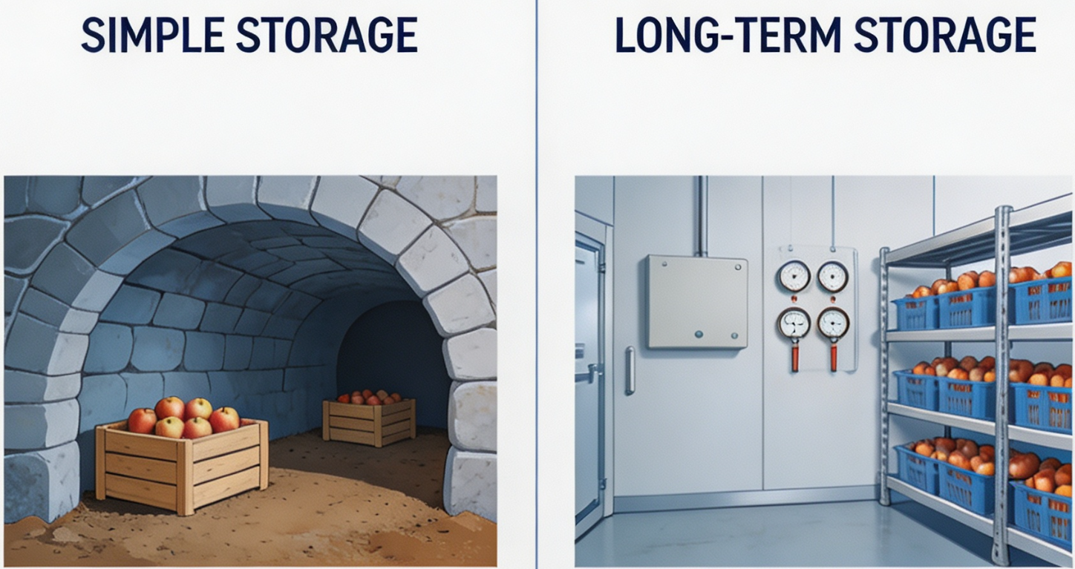
1. Preservation of Common Fruits
(1) Preservation of Fuji Apples
Short-Term Storage
  Store apples in a cellar → kept at low temperature.
Long-Term Storage
  Cold storage combined with controlled-atmosphere conditions is recommended.
AI生成
Notes:
（一）常见水果的保鲜方法
1.富士苹果的保鲜
苹果保鲜最简单的方法是放入地窖储藏，保持较低温度即可。如需长时间保存，应采用低温冷库并配合气调的方法进行贮藏。
2.1.Preservation of Common Fruits
2.1.1. Preservation of Fuji Apples
The simplest method for apple preservation is to
store them in a cellar and keep them at a low temperature.
For long-term storage,
cold storage combined with controlled-atmosphere conditions is recommended.

Slide 4
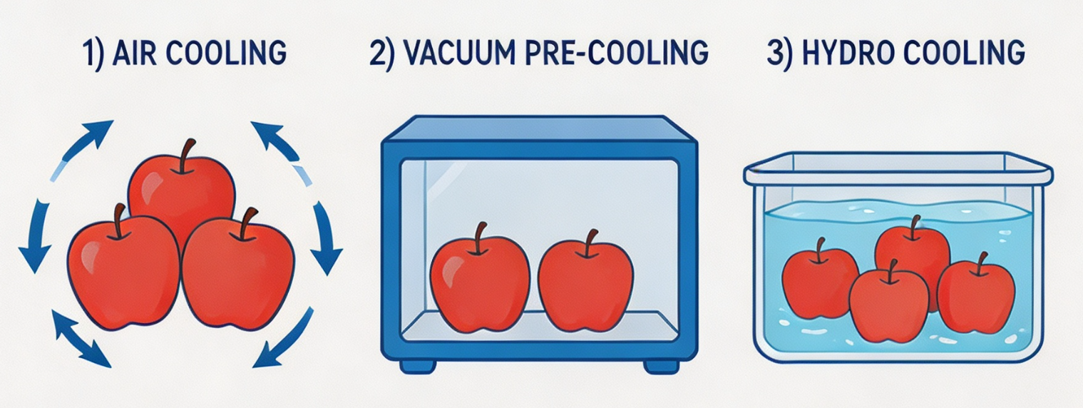
1. Preservation of Common Fruits
(1) Preservation of Fuji Apples
Pre-cooling
Three Pre-cooling Methods
  Forced-air cooling.
  Vacuum pre-cooling.
  Cold-water immersion.
Core Purpose
  Quickly lower fruit temperature.
  Suppress physiological activity.
  Help extend the storage period.
AI生成
Alternative
  Pre-cooling facilities not available →the fruit can also be placed directly into cold storage.
Notes:
具体贮藏方法可遵循以下步骤：
预处理：通过通风降温、真空预冷或冷水浸泡等方式对苹果实施预冷，迅速降低果温，抑制生理活动，有利于延长贮藏期。如不具备预冷条件，也可直接进入冷藏。
The specific storage method can follow the steps below:
▪Pre-cooling:
Apples can be pre-cooled by
forced-air cooling,
vacuum pre-cooling,
or cold-water immersion
to quickly lower fruit temperature,
suppress physiological activity, and help extend the storage period.
If pre-cooling facilities are not available, the fruit can also be placed directly into cold storage.

Slide 5
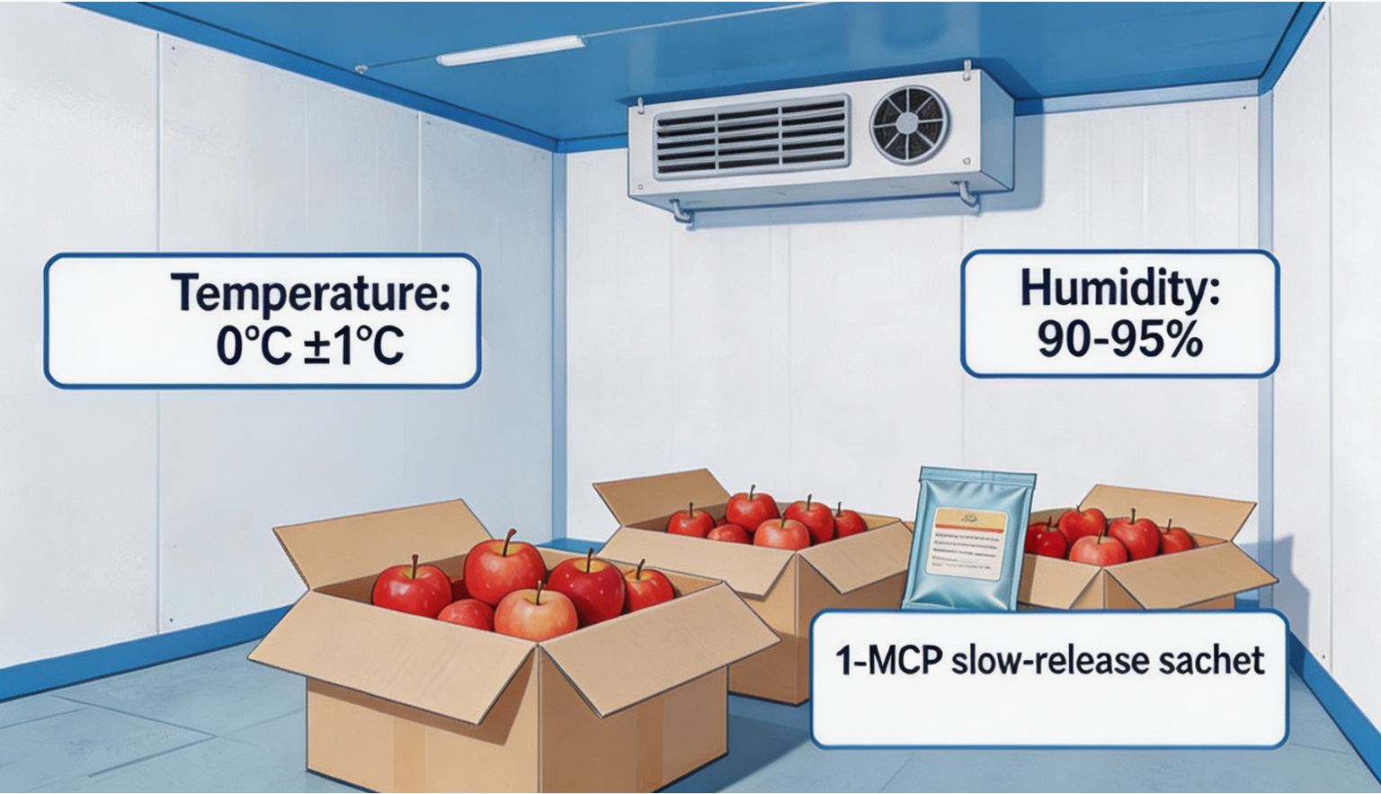
1. Preservation of Common Fruits
(1) Preservation of Fuji Apples
Cold storage conditions
AI生成
Temperature Requirements
  Maintained at 0 °C.
  Fluctuations kept within ±1 °C.
  Prolonged exposure to temperatures below 0 °C may cause freezing injury.
Relative Humidity Requirement
  Maintained at 90%–95%.
Climacteric Characteristics
  Reach a certain stage of ripening → respiration rate initially declines →a sharp climacteric rise → declines again.
  Ethylene strongly promotes ripening and senescence.
Ethylene Management
  In cold storage, 1-MCP slow-release agents can be used.
  Especially suitable for apples not bagged or boxed and directly exposed to air.
Notes:
冷库条件：冷库温度宜设定为0℃，波动幅度不超过±1℃。若温度低于0℃且持续时间过长，可能导致苹果发生冻害。冷库内相对湿度维持在90%～95%。苹果属于呼吸跃变型果实，即果实在成熟到一定程度时，呼吸速率会先降低，然后突然升高，之后又下降。乙烯对其成熟衰老具有显著促进作用。在冷库贮藏中，可放置1-MCP缓释剂。这种方法尤其适用于未经套袋或装箱、直接暴露于空气中的苹果。
▪Cold storage conditions:
The temperature of the cold storage should be
maintained at 0°C,
with fluctuations kept within ±1°C.
Prolonged exposure to temperatures below 0°C may cause freezing injury in apples.
The relative humidity in the cold storage should be maintained at 90%–95%.
Apples are climacteric fruits,
meaning that as they reach a certain stage of ripening, their respiration rate initially declines,
then exhibits a sharp climacteric rise before decreasing again.
Ethylene strongly promotes apple ripening and senescence.
In cold storage, 1-MCP slow-release agents can be used.
This method is especially suitable for apples that are not bagged or boxed and are directly exposed to the air.

Slide 6
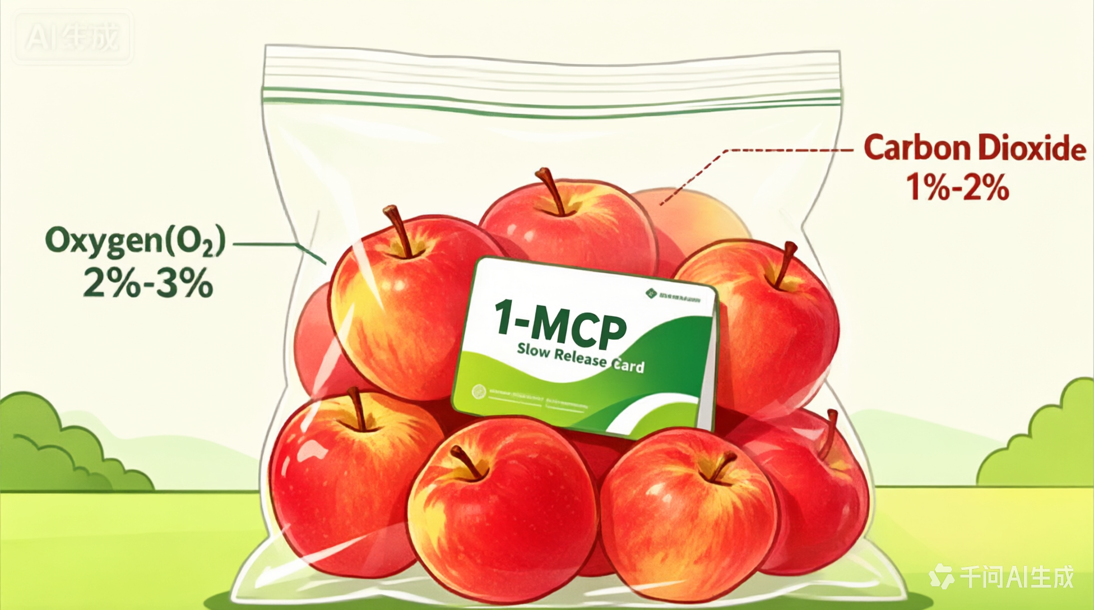
1. Preservation of Common Fruits
(1) Preservation of Fuji Apples
Controlled atmosphere storage
Controlled-Atmosphere Packaging
  Seal fruit in large packaging bags.
  Adjust gas composition to:
    2%–3% O₂.
    1%–2% CO₂.
Ethylene Management
  1-MCP slow-release cards placed inside the bags → reduce ethylene accumulation.
Notes:
气调储藏：如果采用气调包装（即装入大型包装袋密封），气体浓度宜控制为氧气2%～3%，二氧化碳1%～2%。也可在包装袋内放置1-MCP缓释卡片，减少乙烯积累。
▪Controlled atmosphere storage:
When controlled-atmosphere packaging is used--that is,
sealing the fruit in large packaging bags—
the gas composition should be adjusted to
2%–3% oxygen
and 1%–2% carbon dioxide.
1-MCP slow-release cards can also be placed inside the bags to reduce ethylene accumulation.

Slide 7
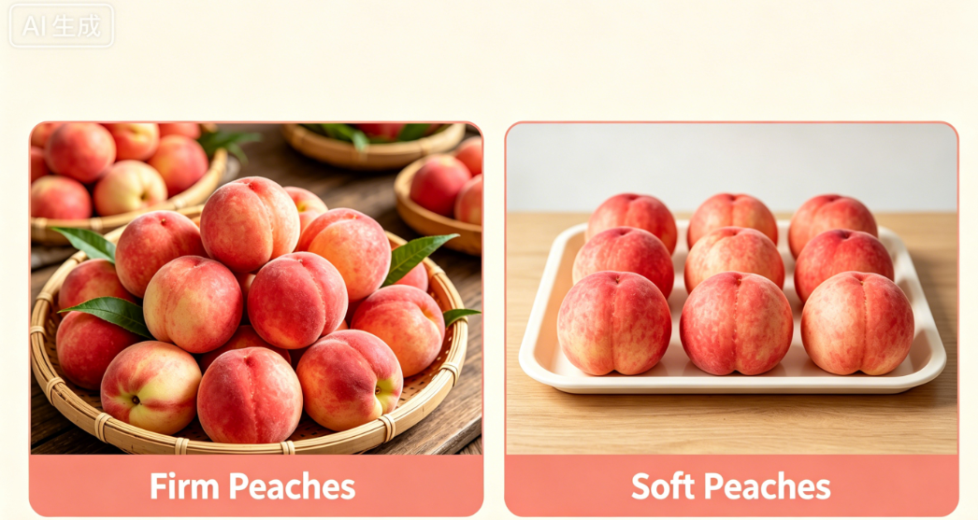
1. Preservation of Common Fruits
(2) Preservation of Peaches
Peach Types
  Soft-fleshed peaches.
  Firm-fleshed peaches.
Handling Requirement
  Peel is relatively thin.
  Careful handling during harvesting to avoid bruising.
  Skin damaged → high susceptibility to microbial infection during storage.
Storage Arrangement
  Firm peaches: stacked to some extent.
  Soft peaches: arranged in a single layer on shallow trays → avoids compression + maintains fruit quality.
Notes:
2.桃的保鲜
桃分为软桃与硬桃两类，无论何种类型，果皮均较薄，采收时需谨慎操作、避免碰伤。果皮受损后在储藏期间极易引发微生物侵染。硬桃可适量堆叠存放；软桃应平铺于浅盘上单层摆放，避免受压，从而保障果实品质。
2.1.2. Preservation of Peaches
Peaches can be broadly classified into two types:
soft-fleshed and firm-fleshed.
Regardless of type,
the peel is relatively thin.
Careful handling is required during harvesting to avoid bruising.
Once the skin is damaged, the fruit becomes highly susceptible to microbial infection during storage.
Firm peaches can be stacked to some extent during storage.
Soft peaches, however, should be arranged in a single layer on shallow trays to avoid compression and maintain fruit quality.

Slide 8
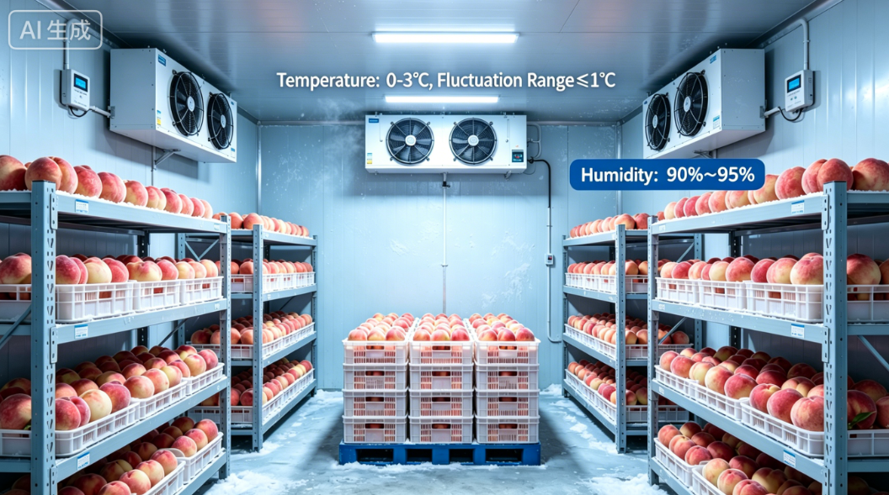
1. Preservation of Common Fruits
(2) Preservation of Peaches
Cold storage conditions
Pre-Cooling
  Recommended before the fruit placed in cold storage → rapidly reduce respiration rate.
Temperature Requirements for Peaches
  Optimal storage temperature: 0–3°C.
  Temperature fluctuations kept within 1°C.
Cold-Tolerance & Humidity
  Peaches: slightly less cold-tolerant than apples.
  Relative humidity maintained at 90%–95% → prevents moisture loss.
Notes:
冷库条件：入库前建议预冷处理，迅速抑制呼吸强度。桃的适宜贮藏温度为0～3℃，波动幅度不超过1℃。桃比苹果耐冷性稍弱，储藏环境相对湿度应维持在90%至95%，以防果实失水。
▪Cold storage conditions:
Pre-cooling is
recommended before the fruit is placed in cold storage to rapidly reduce respiration rate.
The optimal storage temperature for peaches is 0–3°C,
with temperature fluctuations kept within 1°C.
Peaches are slightly less cold-tolerant than apples,
and the relative humidity of the storage environment should be maintained at 90% - 95% to prevent moisture loss from the fruit.

Slide 9
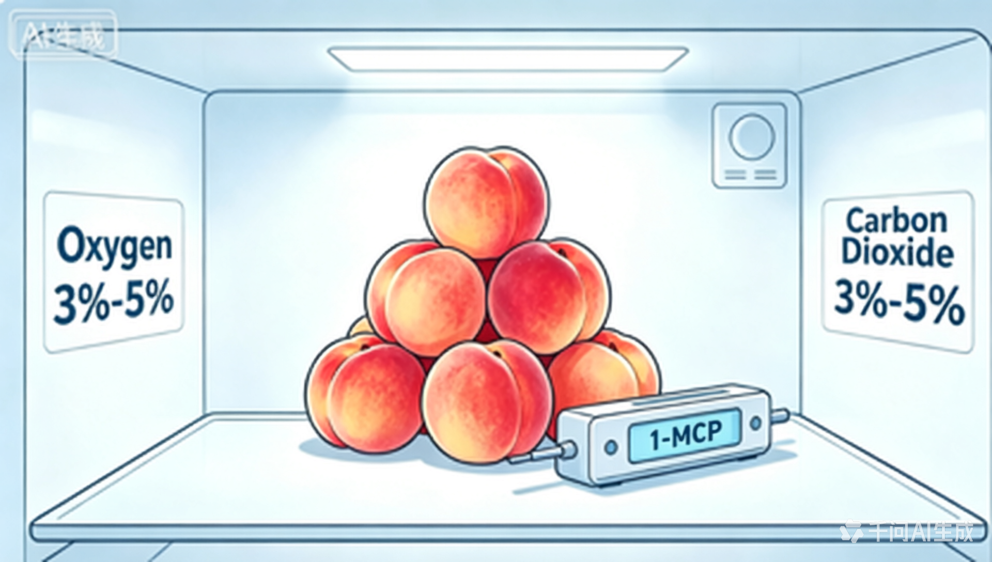
1. Preservation of Common Fruits
(2) Preservation of Peaches
Controlled-atmosphere treatment and ethylene inhibition
Climacteric Characteristics
  Peaches are climacteric fruits.
  Ethylene significantly accelerates ripening and senescence.
Ethylene Management
  Use 1-MCP slow-release agents in cold storage.
For Controlled-Atmosphere Packaging
  O₂ concentration maintained at 3%–5%, slightly higher than for apples.
  CO₂ concentration kept at 3%–5%.
Notes:
气调与乙烯抑制：桃属呼吸跃变型果实，乙烯会显著促进其衰老过程。建议在冷库中放置1-MCP缓释剂。如果采用气调包装储藏，氧气浓度宜为3%～5%，较苹果略高；二氧化碳浓度同样以3%～5%为宜。
Controlled-atmosphere treatment and ethylene inhibition:
Peaches are climacteric fruits,
and ethylene significantly accelerates their ripening and senescence.
It is recommended to
use 1-MCP slow-release agents in cold storage.
If controlled-atmosphere packaging is used,
the oxygen concentration should be maintained at 3%–5%, slightly higher than for apples,
and the carbon dioxide concentration should likewise be kept at 3%–5%.

Slide 10
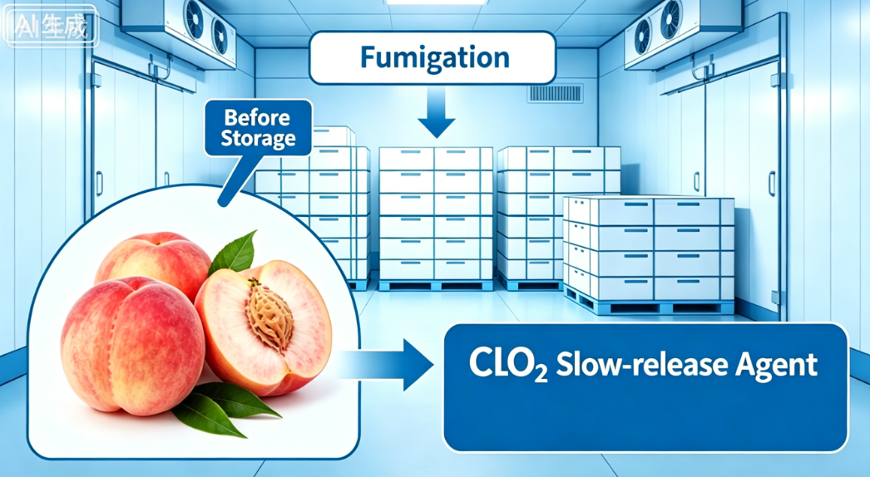
1. Preservation of Common Fruits
(2) Preservation of Peaches
Postharvest disease control measures
High Decay Risk
  Peaches are highly prone to decay during storage.
  Mainly due to high juice content and high sugar levels.
Cold Room Disinfection
  Cold storage should be thoroughly disinfected before loading fruit.
  Methods:
    Sulfur fumigation.
    Chlorine dioxide fumigation.
If Controlled-Atmosphere Packaging NOT Used
  Chlorine dioxide slow-release agents placed in the cold room → release gas gradually → continuously purifies the environment → enhances preservation effect.
Notes:
防病措施：桃在储藏中易腐烂，主要由于其汁液丰富、含糖量高。入库前应对冷库彻底消毒，可采用硫磺熏蒸或二氧化氯熏蒸等方法。若非气调包装，可在储藏期间于库内散布二氧化氯缓释剂，缓慢释放气体，持续净化环境，增强保鲜效果。
▪Postharvest disease control measures:
Peaches are highly prone to decay during storage,
mainly due to their high juice content and high sugar levels.
The cold storage should be thoroughly disinfected before the fruit is loaded,
which can be achieved by sulfur fumigation or chlorine dioxide fumigation.
If controlled-atmosphere packaging is not used,
chlorine dioxide slow-release agents can be placed in the cold room during storage to release gas gradually,
continuously purify the environment, and enhance the preservation effect.

Slide 11
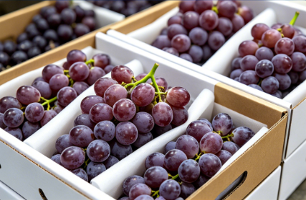
1. Preservation of Common Fruits
(3) Preservation of Grapes
AI生成
Production Expansion
  Grape production continues to expand.
Postharvest Requirements
  Standardized packaging and storage practices are needed → reduce losses + extend storage life.
Notes:
3.葡萄的保鲜
当下，葡萄种植规模持续扩大，采后需规范包装与贮藏，以减少损耗、延长保鲜期。
2.1.3. Preservation of Grapes
As grape production continues to expand,
standardized postharvest packaging and storage practices are needed to reduce losses and extend storage life.

Slide 12
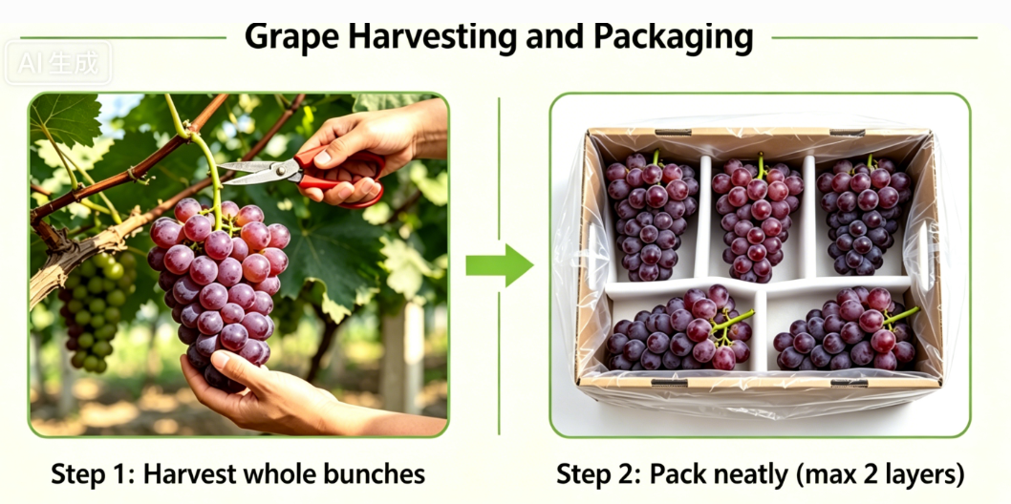
1. Preservation of Common Fruits
(3) Preservation of Grapes
Harvest and packaging
Harvest requirement
  Cut grape clusters with stems attached.
Packing Arrangement
  Arrange clusters carefully → prevents stems from puncturing or compressing berries.
  Preservation bags used as liners in packing boxes.
  Arrange clusters in two layers per box → avoids excessive stacking.
Effect
  Reduces mechanical injury from stems.
  Minimizes losses caused by compression.
Notes:
采收与包装：采收时，需将果穗与果梗一同剪下，装箱时应整齐摆放，避免果梗刺伤或挤压果粒。建议使用保鲜袋作为包装箱的衬垫，每箱以摆放两层为佳，避免过度堆放。如此，既能减少果梗引发的机械损伤，也可有效降低因挤压产生的损耗。
▪Harvest and packaging:
During harvesting,
grape clusters should be cut with their stems attached.
When packing,the clusters should be
arranged carefully to prevent stems from puncturing or compressing the berries.
Preservation bags can be used as liners in packing boxes,
and arranging the clusters in two layers in each box helps avoid excessive stacking.
This reduces mechanical injury from stems
and minimizes losses caused by compression.

Slide 13
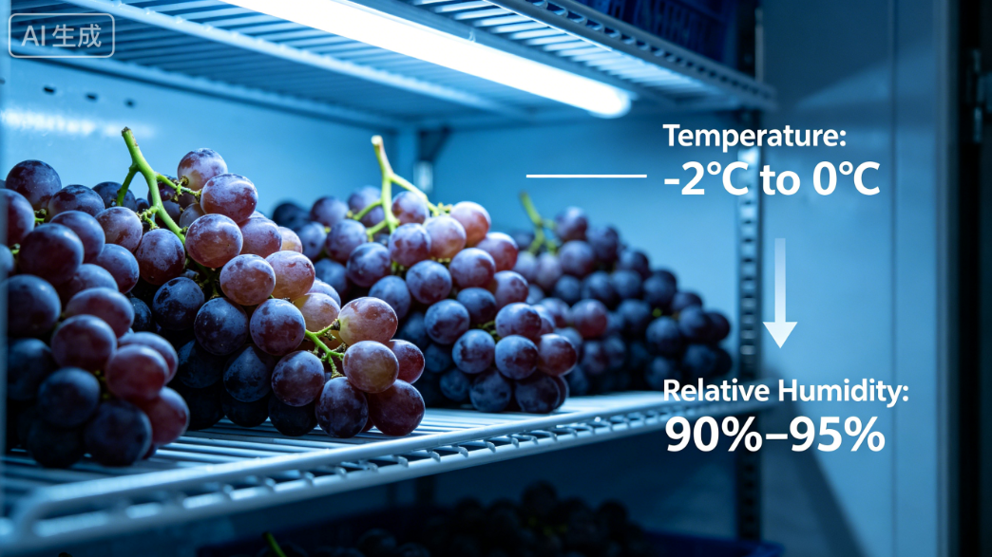
1. Preservation of Common Fruits
(3) Preservation of Grapes
Cold storage conditions
Temperature
  -2°C to 0°C.
Humidity
  Relative humidity maintained at 90%–95%.
Notes:
冷库条件：储藏的冷库环境，通常温度保持在-2℃～0℃，相对湿度维持在 90%～95%。
▪Cold storage conditions:
Cold storage conditions typically involve
temperatures of -2°C to 0°C
and relative humidity of 90%–95%.

Slide 14
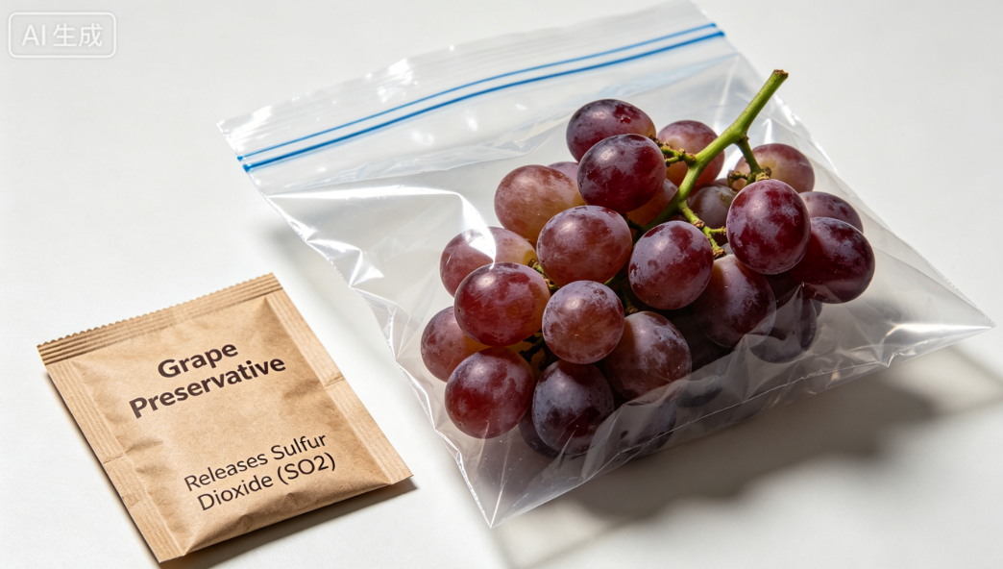
1. Preservation of Common Fruits
(3) Preservation of Grapes
Preservatives and controlled-atmosphere packaging
Preservation Method
  Place grapes in specialized preservation bags.
  Add grape-specific preservatives (e.g., CT2).
Function of Preservatives
  Main components: sodium sulfite & sodium bisulfite.
  Release sulfur dioxide upon contact with moisture.
Effects of Sulfur Dioxide
  Inhibits oxidative enzymes.
  Suppresses microbial growth.
  Delays browning.
  Helps maintain fruit colour and quality.
Notes:
保鲜剂与气调：在储藏过程中，建议将葡萄放置于专用保鲜袋内，并放置葡萄专用保鲜剂（如常见的CT2保鲜剂），其主要成分为亚硫酸钠与亚硫酸氢钠等，遇水后释放二氧化硫气体，可抑制氧化酶活性、杀菌防腐、延缓氧化褐变，保持果实色泽与品质。
▪Preservatives and controlled-atmosphere packaging:
During storage, grapes should be placed in specialized preservation bags
together with grape-specific preservatives (such as the commonly used CT2).
Its main components --- sodium sulfite and sodium bisulfite
--- release sulfur dioxide upon contact with moisture,
which inhibits oxidative enzymes,
suppresses microbial growth,
delays browning,
and helps maintain fruit color and quality.

Slide 15
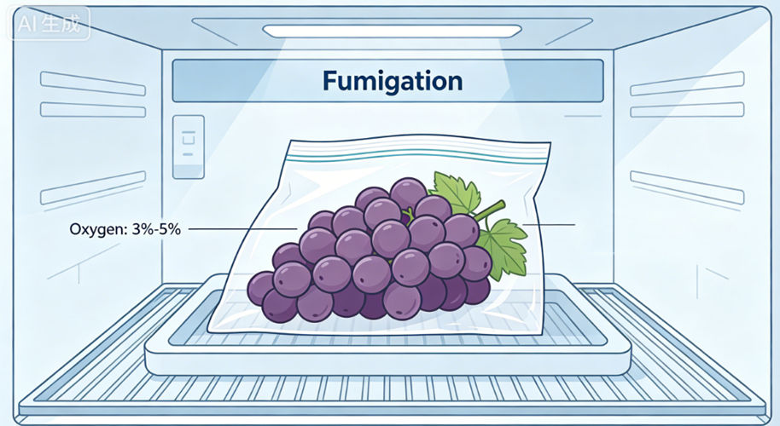
1. Preservation of Common Fruits
(3) Preservation of Grapes
Preservatives and controlled-atmosphere packaging
CA bag gas composition
  O₂ at 3%–5%, CO₂ at 5%–8%.
Pre-storage disinfection
  Cold storage must be thoroughly disinfected before loading.
Carbon Dioxide:5%-8%
During storage
  Disinfect periodically (e.g., once a month) to prevent mold and microbial growth.
Notes:
采用气调保鲜袋时，袋内气体成分宜维持在氧气浓度3%～5%，二氧化碳浓度5%～8%。葡萄入库前，须对冷库进行全面彻底消毒；贮藏期间也应定期消毒（如每月一次），预防霉菌等微生物滋生。
When controlled-atmosphere preservation bags are used,
the gas composition in the bags should be maintained
at 3%–5% oxygen and 5%–8% carbon dioxide.
Before grapes are placed in cold storage, the facility should be thoroughly disinfected.
During storage, periodic disinfection (such as once a month) is recommended to prevent mold and other microbial growth.

Slide 16
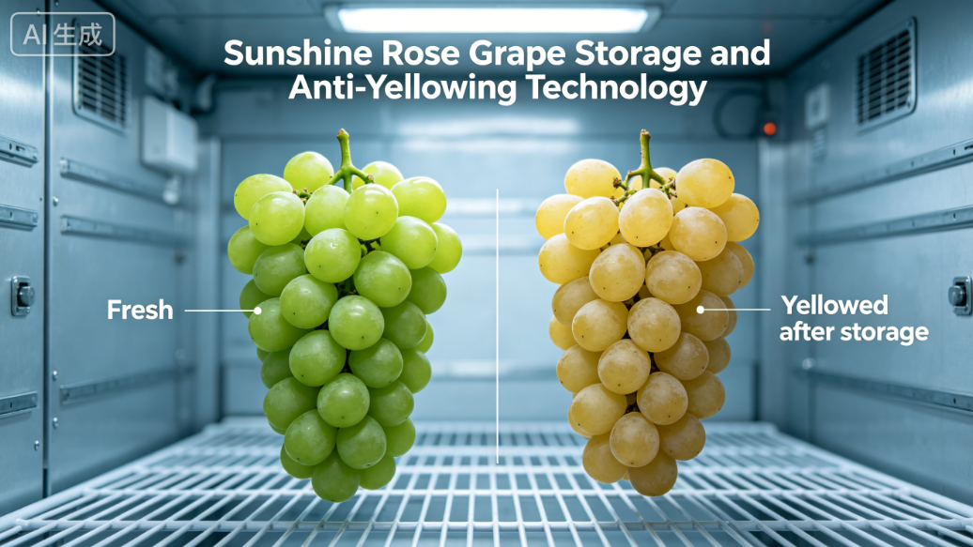
1. Preservation of Common Fruits
(3) Preservation of Grapes
Storage and Yellowing Prevention Methods for Sunshine Rose Grapes
Variety status
  Emerging variety; production scale rapidly expanding.
Fruit Characteristics
  Full & firm berries.
  Highly storable.
  Pleasant flavor.
  → popular among consumers.
Core problem
  Bright green color gradually turns yellow during storage → loss of fresh appearance → potential impact on quality assessment.
Notes:
阳光玫瑰葡萄的贮藏与防黄化技术：
阳光玫瑰葡萄作为新兴的葡萄品种，目前种植规模正不断扩大。其果实形状饱满、质地坚实，具有较强的耐储存性，且口感良好，因而深受消费者喜爱。然而，部分农户反馈，在储存期间，果实原本的翠绿色会随着储存时长的增加而逐渐变黄，致使外观色泽丧失鲜绿感，可能对品质评估产生影响。
Storage and Yellowing Prevention Methods for Sunshine Rose Grapes
As an emerging grape variety, the production scale of Sunshine Rose grapes is rapidly expanding.
The berries are full, firm, and highly storable, with a pleasant flavor, making them popular among consumers.
However, some growers report that during storage,
the fruit’s original bright green color gradually turns yellow,
causing the loss of its fresh appearance and potentially affecting quality assessment.

Slide 17
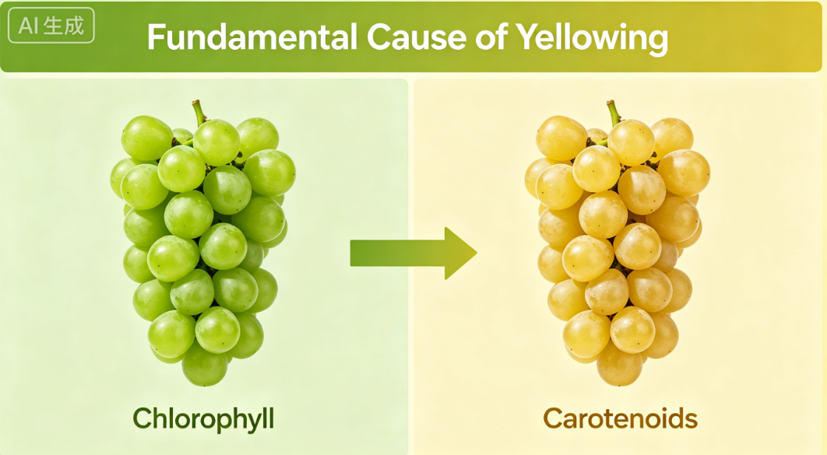
1. Preservation of Common Fruits
(3) Preservation of Grapes
Storage and Yellowing Prevention Methods for Sunshine Rose Grapes
① Fundamental causes of yellowing
Nature of Yellowing
  A typical sign of fruit ripening and senescence.
Trigger and Physiological Changes Leading to Yellowing
  Unsuitable storage conditions → premature senescence:
    Chlorophyll degrades.
    Green color fades.
    Carotenoids and other yellow pigments accumulate.
    Peel turns yellow.
Notes:
① 黄化的根本原因
变黄是果实成熟衰老、向后熟阶段转化的表现。贮藏条件不适导致提前启动衰老：叶绿素逐渐分解、绿色褪去，类胡萝卜素等黄色素积累，果皮变黄。
Fundamental causes of yellowing
Yellowing is a typical sign of fruit ripening and senescence.
When storage conditions are unsuitable, senescence begins prematurely:
chlorophyll degrades,
the green color fades,
carotenoids and other yellow pigments accumulate,
and the peel turns yellow.

Slide 18
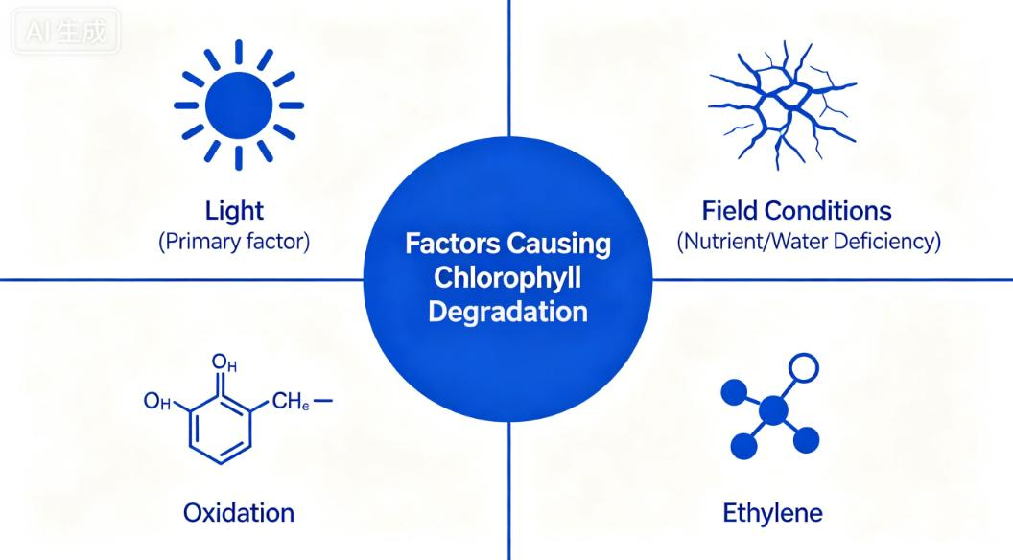
1. Preservation of Common Fruits
(3) Preservation of Grapes
Storage and Yellowing Prevention Methods for Sunshine Rose Grapes
② Factors contributing to chlorophyll degradation
Light (Primary Factor)
  Strong or prolonged light accelerates chlorophyll degradation.
  Similar to apples losing green color under intense light, grapes exposed to stronger light more prone to turn yellow.
Field Conditions
  Nutrient deficiency and soil drought before harvest → induce premature ripening and senescence → fruit more prone to losing green color and turning yellow after harvest.
Oxidation
  Excessive oxidation reactions during storage directly degrades chlorophyll → causes green color to fade.
Ethylene Influence
  Grapes are non-climacteric fruits:
    Respiration rate remains stable.
    No climacteric peak during ripening.
    Ethylene release is low.
  Trace amounts of ethylene accelerate senescence → promotes chlorophyll degradation.
Notes:
② 导致叶绿素分解的因素
光照（首要因素）：强光或长时间光照直接诱发叶绿素降解。类似苹果在强光下失绿转色，葡萄光照越强、越易黄化。
田间状况：采收前养分不足、土壤干旱缺水，会诱导果实提前成熟衰老，采后更易失绿变黄。
氧化作用：贮藏中氧化反应过强，会直接破坏叶绿素，导致绿色消退。
乙烯影响：葡萄属非跃变型果实，即果实在成熟和衰老过程中，呼吸速率不发生明显变化、不出现呼吸高峰。乙烯释放量低，但微量乙烯仍会显著加速衰老并促进叶绿素分解，作用不可忽视。
Factors contributing to chlorophyll degradation
▪Light (primary factor):
Strong or prolonged light exposure directly accelerates chlorophyll degradation.
Similar to apples that lose their green color under intense light, grapes exposed to stronger light are more prone to turn yellow.
▪Field conditions:
Nutrient deficiency and soil drought before harvest can induce premature ripening and senescence, making the fruit more prone to losing its green color and turning yellow after harvest.
▪Oxidation:
Excessive oxidation reactions during storage can directly degrade chlorophyll, causing the green color to fade.
▪Ethylene influence:
Grapes are non-climacteric fruits,
meaning their respiration rate remains relatively stable without a climacteric peak during ripening. Although ethylene release is low,
even trace amounts can significantly accelerate senescence and promote chlorophyll degradation
and thus should not be overlooked.

Slide 19
1. Preservation of Common Fruits
(3) Preservation of Grapes
Storage and Yellowing Prevention Methods for Sunshine Rose Grapes
③ Core measures for delaying yellowing
Strict Humidity Control
  Sunshine Rose grapes require higher humidity.
  Relative humidity maintained at 95%–98% during storage →to maintain moisture, reduce water loss, and delay senescence.
Controlling Lighting Conditions
  Blue/green light → effectively extends storage life.
  Red light→ accelerates chlorophyll degradation.
  Dark environment →helps maintain green appearance.
Sulfur Dioxide (SO₂) Treatment
  Before storage: fumigated with sulfur dioxide.
  During storage: sulfur dioxide slow-release agents may be used → reduce oxidative chlorophyll degradation.
  In preservation bags: sulfur dioxide slow-release card can be placed inside → effectively delays yellowing.
Ethylene Management
  When yellowing becomes pronounced, ethylene absorbers placed in the packaging bags.
  1-MCP slow-release cards or gels used → to inhibit ethylene action and delay senescence and yellowing.
Notes:
③ 延缓黄化的核心措施
严控湿度：阳光玫瑰需更高湿度，贮藏期间相对湿度宜保持在 95%～98%，稳定保湿、减少失水，延缓衰老。
控制光照条件：采用蓝光或绿光照射可有效延长储存期，红光会加速叶绿素的分解；也可将果实置于黑暗环境中，以维持其翠绿状态。
二氧化硫保鲜：在入库之前，采用二氧化硫进行熏蒸处理；在储藏期间，放置二氧化硫缓释剂等保鲜产品，以减少叶绿素的氧化分解。若采用保鲜袋存储方式，可在保鲜袋内放置一片二氧化硫缓释卡片，进而有效延缓其变黄进程。
乙烯控制：果实黄化严重时，可考虑在包装袋内放置乙烯吸收剂，或使用1-MCP 缓释卡片、缓释凝胶等制剂，阻断乙烯作用、延缓衰老与黄化。
③ Core measures for delaying yellowing
▪Strict humidity control:
Sunshine Rose grapes require higher humidity.
Relative humidity should be maintained at 95%–98% during storage to maintain moisture, reduce water loss, and delay senescence.
▪Controlling lighting conditions:
Blue or green light can effectively extend storage life,
whereas red light accelerates chlorophyll degradation.
The fruit may also be stored in a dark environment to help maintain its green appearance.
▪Sulfur dioxide treatment:
Before storage, grapes can be fumigated with sulfur dioxide.
During storage, sulfur dioxide slow-release agents may be used to reduce oxidative chlorophyll degradation.
When preservation bags are used, a sulfur dioxide slow-release card can be placed inside to effectively delay yellowing.
▪Ethylene management:
If yellowing becomes pronounced, ethylene absorbers can be placed in the packaging bags. Alternatively,
1-MCP slow-release cards or gels may be used to inhibit ethylene action and delay senescence and yellowing.

Slide 20
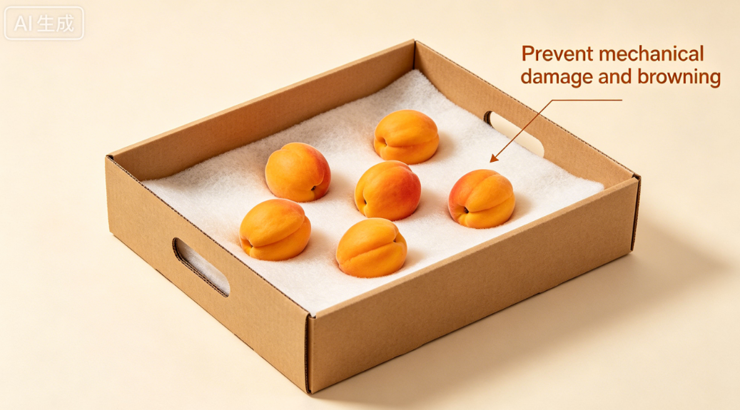
1. Preservation of Common Fruits
(4) Preservation of Apricots
Packing Requirement
  Apricots are well-liked for their sweet-tart flavor.
  Apricot flesh is soft.
    a cushioning liner should be placed in the storage box during packing.
    prevents compression-induced mechanical injury.
    avoids internal browning and reduced fruit quality.
Notes:
4.杏的保鲜
杏是备受消费者青睐的水果，风味酸甜可口。由于杏果实质地柔软，装箱时需在贮藏箱内铺设柔软内衬垫，防止挤压造成机械损伤，进而引发果肉褐变、影响果实品质。
2.1.4. Preservation of Apricots
Apricots are well-liked for their sweet-tart flavor.
Because apricot flesh is soft,
a cushioning liner should be placed in the storage box during packing to
prevent compression-induced mechanical injury,
which can lead to internal browning and reduced fruit quality.

Slide 21
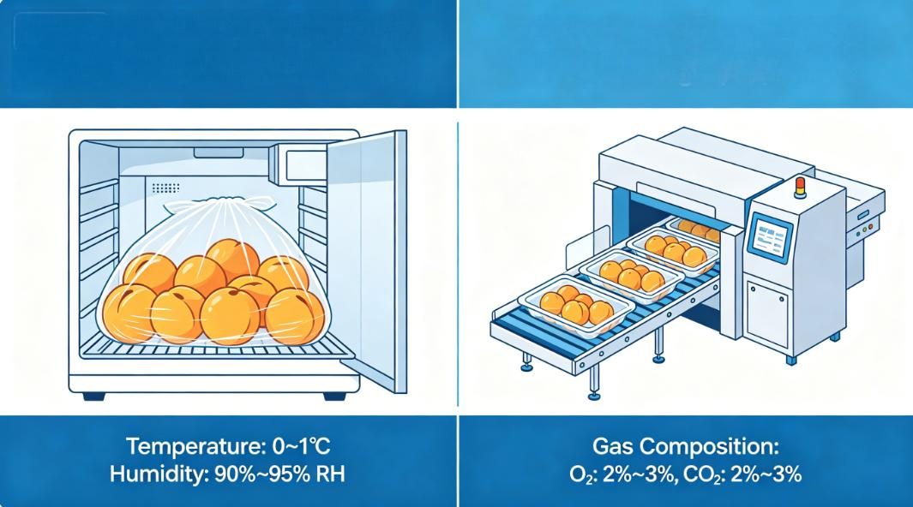
1. Preservation of Common Fruits
(4) Preservation of Apricots
Cold storage and controlled-atmosphere conditions
Self-Modified-Atmosphere Storage
  Refrigeration + breathable film.
  fruit respiration + film permeability → naturally create low O₂, high CO₂ environment.
  Cold-storage temperature maintained at 0–1°C.
  Relative humidity at 90%–95%.
Self-Modified-Atmosphere Storage
Artificial Controlled-Atmosphere Storage
Artificial Controlled-Atmosphere Storage
  For example, packaging with a controlled-atmosphere packaging machine →adjust gas composition to:
    2%–3% O₂.
    2%–3% CO₂.
Notes:
冷库与气调条件：
贮藏方面，推荐采用冷藏结合保鲜膜的自发气调贮藏方式，即利用果蔬自身呼吸及薄膜透气性，自然形成低氧、高二氧化碳环境。冷库温度控制在0～1℃，相对湿度保持在90%～95%。
若采用人工气调贮藏（例如使用气调包装机进行包装），需将气体环境调控为氧气浓度2%～3%、二氧化碳浓度2%～3%。
▪Cold storage and controlled-atmosphere conditions:
For storage, a self-modified-atmosphere method combining refrigeration with breathable film is recommended.
The fruit's respiration and the film’s gas permeability naturally create a low-oxygen, high-carbon-dioxide environment.
Cold storage temperatures should be maintained at 0-1°C,
with relative humidity at 90%–95%.
▪If artificial controlled-atmosphere storage is used
(for example, packaging with a controlled-atmosphere packaging machine),
the gas composition should be adjusted to 2%–3% oxygen and 2%–3% carbon dioxide.

Slide 22
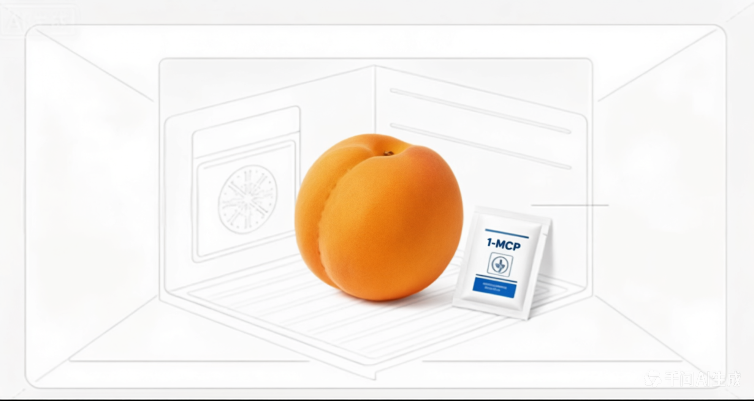
1. Preservation of Common Fruits
(4) Preservation of Apricots
Ethylene management
Fruit Characteristics:
  Apricots are climacteric fruits.
  Highly sensitive to ethylene.
  During storage:
  1-MCP slow-release agents may be used.
Management Measures
  Before storage: treated apricots with 1-MCP.
  During storage: 1-MCP slow-release agents may be used.
    → block ethylene action.
    → delay senescence.
Notes:
乙烯控制：杏属于呼吸跃变型果实，对乙烯极为敏感。因此，入库贮藏前可采用1-MCP进行熏蒸处理，或在贮藏期间放置1-MCP缓释剂，持续抑制果实自身乙烯的作用，延缓衰老。
▪Ethylene management:
Apricots are climacteric fruits
and are highly sensitive to ethylene.
Therefore,
before storage, apricots may be treated with 1-MCP,
or 1-MCP slow-release agents may be used during storage to
block ethylene action
and delay senescence.

Slide 23
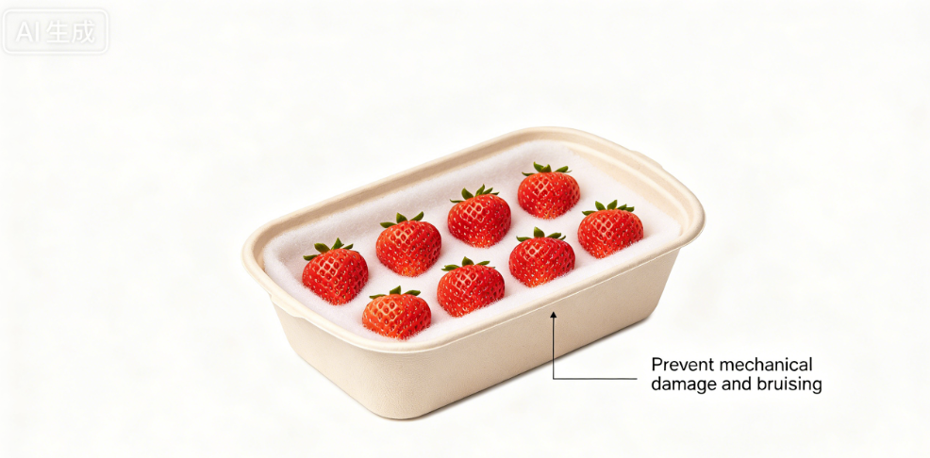
1. Preservation of Common Fruits
(5) Preservation of Strawberries
Fruit Characteristics
  Non-climacteric fruits.
  Delicate skin and poor storability.
Harvest Handling
  Handle gently during harvest → avoids mechanical injury.
Packing Requirements
  Use shallow containers lined with soft padding are recommended.
  Arranged in a single layer → prevents compression damage.
Notes:
5.草莓的保鲜
草莓属于非跃变型果实，外表皮柔嫩，耐贮性较差。为保持鲜度，采摘时需操作轻柔，避免造成机械损伤；建议采用浅型容器，内部铺设柔软衬垫，以单层方式摆放，防止果实挤压破损。
2.1.5. Preservation of Strawberries
Strawberries are
non-climacteric fruits with
delicate skin and poor storability.
To maintain freshness, strawberries should be
handled gently during harvest to avoid mechanical injury.
Shallow containers lined with soft padding are recommended,
and the fruit should be arranged in a single layer to prevent compression damage.

Slide 24
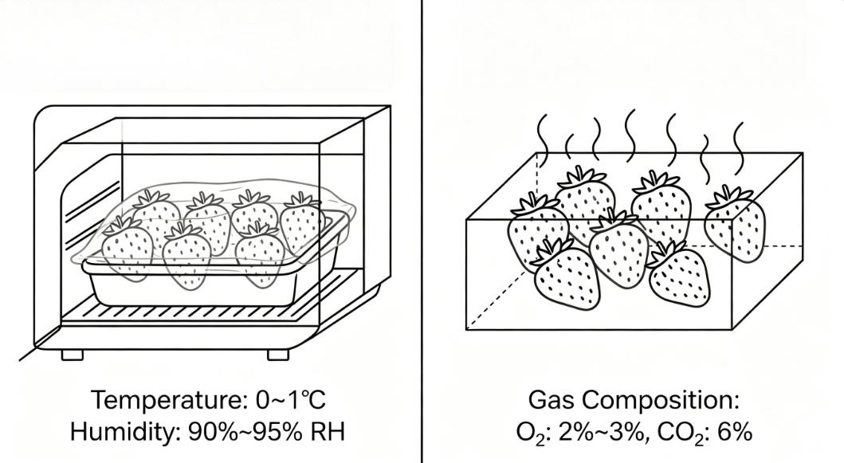
1. Preservation of Common Fruits
(5) Preservation of Strawberries
Cold storage and controlled-atmosphere conditions
Self-Modified-Atmosphere Method (Longer Storage)
  Combine refrigeration with plastic-film covering.
  Temperature: maintained at 0–1°C and not fall below 0°C.
  Relative humidity kept at 90%–95%.
Self-Modified-Atmosphere Method
Artificial Controlled-Atmosphere Storag
Artificial Controlled-Atmosphere Storage
  In combination with cold-storage conditions.
  Adjust gas composition to:
    2%–3% O₂.
    ~6 % CO₂.
Notes:
冷库与气调条件：若需较长时间贮藏，可采用冷藏结合保鲜膜覆盖的自发气调贮藏方式。冷库温度宜维持在0～1℃，严禁低于0℃；相对湿度保持在90%～95%。若采用人工气调贮藏（需与冷藏条件配合），氧气浓度控制在2%～3%，二氧化碳浓度6%左右。
▪Cold storage and controlled-atmosphere conditions:
For longer storage,
a self-modified-atmosphere method
combining refrigeration with plastic-film covering may be used.
Cold storage temperature should be maintained at 0–1°C and must not fall below 0°C,
with relative humidity kept at 90%–95%.
If artificial controlled-atmosphere storage is used
(in combination with cold-storage conditions),
the gas composition should be adjusted to 2%–3% oxygen
and approximately 6% carbon dioxide.

Slide 25
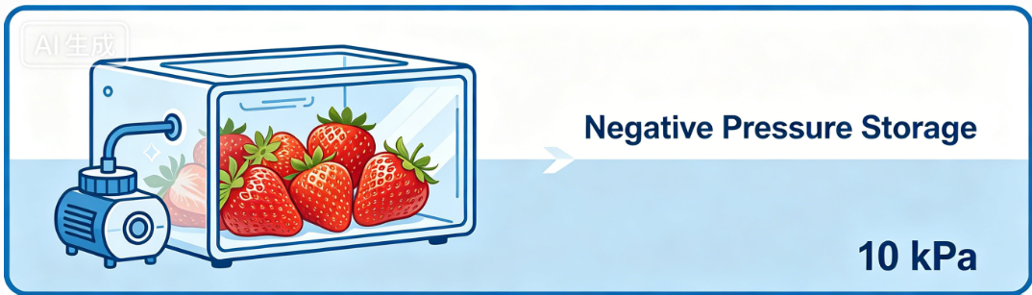
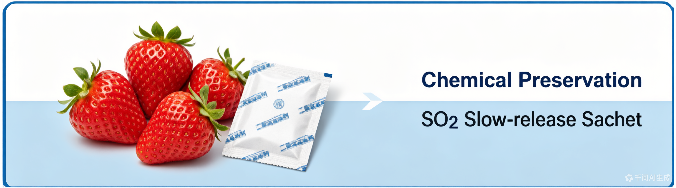
1. Preservation of Common Fruits
(5) Preservation of Strawberries
Other methods
Negative-Pressure Storage
  Equipped with negative-pressure equipment:
    reduce internal air pressure to ~10 kPa using a vacuum pump.
    a negative-pressure environment.
    continuously removes respiratory heat and volatile compounds
    reduces physiological disorders.
Chemical Preservation Methods
  Nitric oxide fumigation.
  Sulfur dioxide slow-release treatments.
    → kill microorganisms.
    → inhibit pathogen infection.
    → prevent mold development.
Notes:
其他方法：若冷库配备负压设施，可借助抽气泵将库内气压降至约10千帕。负压环境通过持续排气，及时排出果实呼吸产生的热量及挥发性气体，减轻生理性损害。此外，可采用化学保鲜方法，如一氧化氮熏蒸或二氧化硫缓释剂处理，杀灭微生物、抑制病菌侵染，避免草莓因微生物活动发生霉变。
▪Other methods:
If the cold storage is equipped with negative-pressure equipment,
the internal air pressure can be reduced to about 10 kPa using a vacuum pump.
A negative-pressure environment
continuously removes respiratory heat and volatile compounds,
thereby reducing physiological disorders. In addition,
chemical preservation methods such as
nitric oxide fumigation
or sulfur dioxide slow-release treatments may be used
to kill microorganisms,
inhibit pathogen infection,
and prevent mold development.

Slide 26
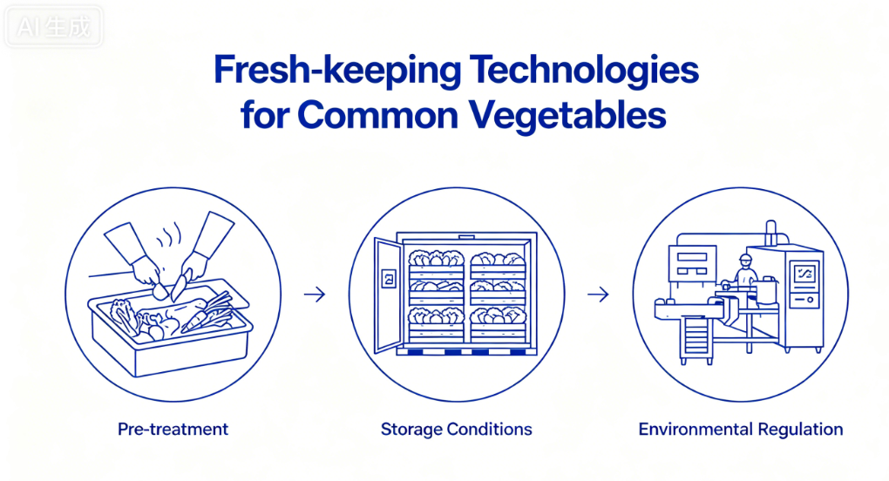
2. Preservation of Common Vegetables
Focus
  Preservation techniques for common vegetables.
Three Key Aspects
  Pre-treatment.
  Storage conditions.
  Environmental control.
Goal
  Effectively extend shelf life.
Notes:
（二）常见蔬菜保鲜方法
接下来介绍几种常见蔬菜的保鲜技术，重点聚焦预处理、贮藏条件、环境调控三大核心环节，有效延长蔬菜货架期。
2.2.Preservation of Common Vegetables
The following sections introduce preservation techniques for several common vegetables,
focusing on three key aspects
--- pre-treatment,
storage conditions,
and environmental control
--- to effectively extend their shelf life.

Slide 27
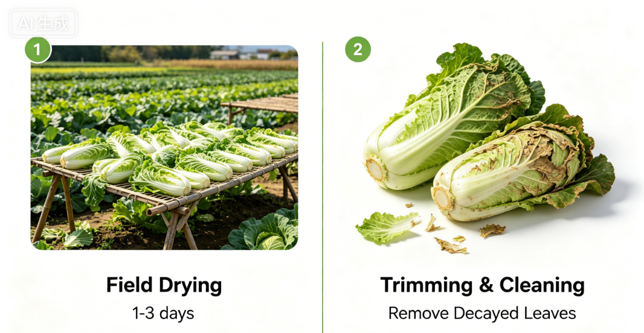
2. Preservation of Common Vegetables
(1) Chinese Cabbage
Pre-treatment
Field Air-Drying
  Air-dry harvested Chinese cabbage in the field for 1–3 days.
    → moderately reduces leaf moisture.
    → increases cell-sap concentration.
    → lowers cellular freezing point.
    → enhances cold resistance.
Trimming After Air-Drying
  Trimmed by removing decayed or damaged outer leaves.
    → keeps heads clean.
    → prepares them for storage.
Notes:
1.白菜的保鲜
1.1 前期处理
白菜采收后（通常为冬季），建议在田间晾晒1至3天，适度降低叶片水分含量，提高细胞液浓度，降低细胞结冰点，增强抗寒能力；晾晒后需对白菜进行整理，去除其表面腐烂、变质的叶片，保持叶片洁净，为后续贮藏奠定基础。
2.2.1. Chinese Cabbage
Pre-treatment
After harvesting Chinese cabbage (usually in winter), it is recommended to
air-dry the heads in the field for 1 to 3 days
to moderately reduce leaf moisture,
increase cell sap concentration,
lower the cellular freezing point,
and enhance cold resistance.
After air-drying,
the cabbages should be trimmed by removing decayed or damaged outer leaves
to keep the heads clean
and prepare them for storage.

Slide 28
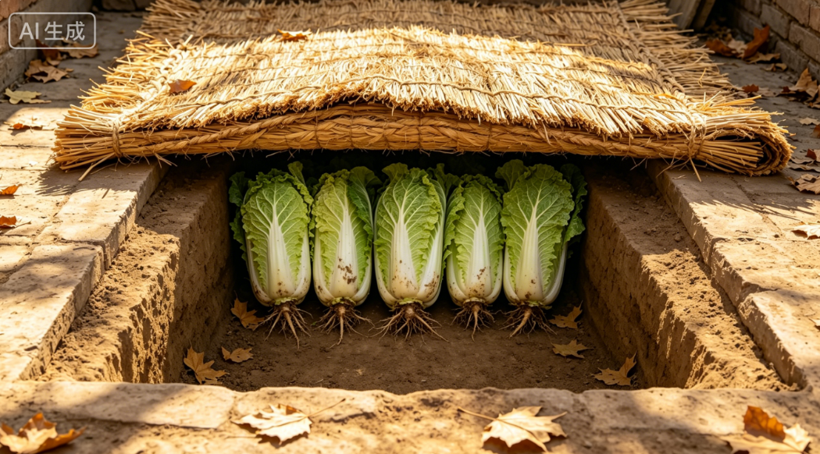
2. Preservation of Common Vegetables
(1) Chinese Cabbage
Three commonly used storage methods can be selected according to region and storage scale.
Courtyard Storage Method
Suitability
  Suitable for small-scale storage in relatively cold regions (e.g., northern China).
Procedure
  Dig a storage pit in a sheltered, sunny courtyard area: depth 15–20 cm, deeper than cabbage height.
  Arrange cabbages upright with roots downward, leaves upward.
  If outdoor temperatures drop too low → cover pit with straw mats or other insulating materials to prevent freezing injury.
Notes:
常用的贮藏方法有三种，可根据地域和储存规模选择：
第一种是庭院贮藏法，适用于中国北方地区小规模储存。具体操作方法：在庭院背风向阳处挖掘贮藏坑，坑深高出白菜高度15—20厘米；摆放时白菜根部朝下、紧密直立排列，叶片向上；若冬季室外温度过低，可在坑顶覆盖草帘等保温材料，防止冻害。
There are three commonly used storage methods, which can be selected according to the region and storage scale:
Courtyard storage method:
This method is suitable for small-scale storage in relatively cold regions, such as northern China.
Procedure:
Dig a storage pit in a sheltered and sunny area in the courtyard, with a depth 15-20 cm deeper than the height of the cabbages.
Arrange the cabbages upright with the roots downward and leaves upward.
If outdoor temperatures drop too low in winter, cover the pit with straw mats or other insulating materials to prevent freezing injury.

Slide 29
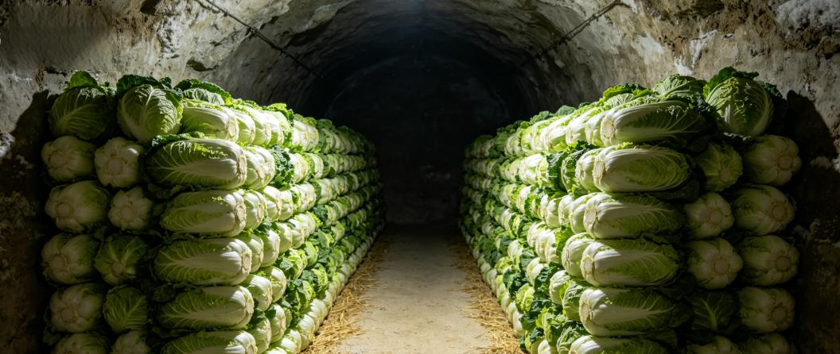
2. Preservation of Common Vegetables
(1) Chinese Cabbage
Cellar storage method
Suitability
  Suitable for cold regions.
Cabbage Arrangement
  Neatly along both sides of the cellar.
  Leave a walkway in the center.
  Stacking height ≤ 2.5 m.
  Stack width ≤ 1 m.
Pre-storage Disinfection of Cellar
  Thoroughly disinfect the cellar before use by
    Sulfur fumigation or
    Heating with charcoal
Temperature Requirement
  Maintain cellar temperature at 0–2°C.
  After fumigation: cellar ventilated for 3 days → prevents toxic-gas exposure.
Floor Preparation
  Spread fine sand, clean soil, or river sand on the cellar floor.
  Add a layer of straw or crop stalks.
Notes:
第二种是地窖储藏法，适用于寒冷地区。地窖使用前需充分消毒，可采用硫磺或炭火熏蒸，熏蒸后需通风换气3天，避免人员进入时中毒；存放前，地窖底部铺设一层细沙、洁净净土或河沙，上面再铺稻草或秸秆；将白菜码放整齐，排列在窖内两侧，中间保留人行通道，堆码高度不要超过2.5米，宽度控制在1米以内；地窖温度维持在0℃-2℃。
Cellar storage method:
This method is suitable for cold regions.
The cellar should be thoroughly disinfected before use, either by
sulfur fumigation or
by heating with charcoal.
After fumigation, the cellar must be ventilated for 3 days to prevent toxic-gas exposure before anyone enters.
Before storage, spread a layer of fine sand, clean soil, or river sand on the cellar floor,
followed by a layer of straw or crop stalks.
Arrange the cabbage neatly along both sides of the cellar, leaving a walkway in the center. The stacking height should not exceed 2.5 meters, and the stack width should be kept within 1 meter.
The cellar temperature should be maintained at 0-2°C.

Slide 30
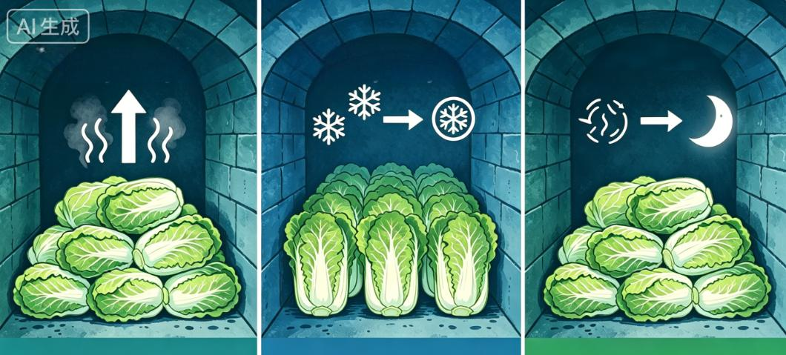
2. Preservation of Common Vegetables
(1) Chinese Cabbage
Cellar storage method
Early Storage Period
  Strong cabbage respiration.
    stacks turned every 3–5 days to release accumulated heat.
    removes decayed leaves to prevent disease spread.
Early stage:​ Turn stacks every 3–5 days.
Mid-stage: Turn stacks every 10 days.
Late stage:​ Ventilate at night to prevent rot.
Mid-Storage Period (Severe Winter)
  Focus on heat retention and freeze prevention.
  Turning frequency reduced to once every 10 days.
Late-Storage Period (Temperature Rising)
  Nighttime ventilation needed → to cool the cellar and prevent cabbage decay.
Notes:
储藏初期，白菜呼吸作用较强，需每3至5天倒菜一次，排出内部积热、剔除腐烂叶片，防止病害蔓延；中期（严冬）以保温防冻为主，倒菜频率降至每10天一次；末期（气温回升）需在夜间通风降温，防止白菜腐烂。
During the early storage period, cabbage respiration is strong, so the stacks should be turned every 3 to 5 days to release accumulated heat and remove decayed leaves to prevent the spread of diseases. In the mid-storage period (during severe winter), the focus shifts to heat retention and freeze prevention, and the turning frequency is reduced to once every 10 days. In the late-storage period (as temperatures rise), nighttime ventilation is needed to cool the cellar and prevent cabbage decay.

Slide 31
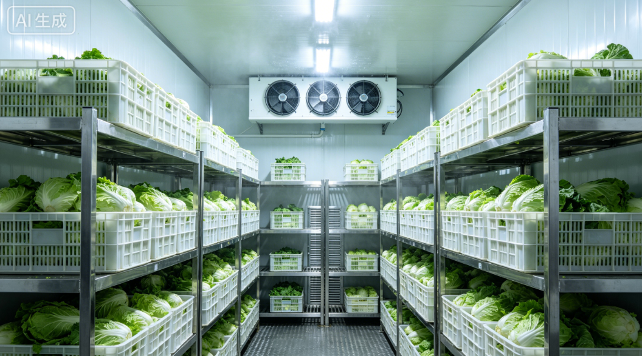
2. Preservation of Common Vegetables
(1) Chinese Cabbage
Cold storage method
Cold-Room Conditions
  Temperature: maintain at 0–2°C.
  Relative humidity: above 90%.
  Good ventilation required.
Suitability
  Suitable for large-scale storage.
Ventilation & Airflow
  Leave airflow gap of ~20 cm between storage boxes.
  Use circulating fans to removes respiratory heat.
Pre-Cooling Requirement
  Cabbages should be cooled to 4–5°C before transferring into the cold room.
Notes:
第三种是冷库储藏，适用于规模化储存。库温控制在0-2℃，相对湿度保持在90%以上，冷库需要具备良好通风条件，储存箱之间保留约20厘米通风间隙，配备循环风机，及时导出呼吸热；入库前需进行预冷处理，将白菜预冷至4-5℃后，再移入冷库储藏。
Cold storage method: This method is suitable for large-scale storage. Cold-room temperature should be maintained at 0-2°C, with relative humidity above 90%. Good ventilation is required in the cold room. Leave an airflow gap of about 20 cm between storage boxes, and use circulating fans to remove respiratory heat. Pre-cooling is required before loading; the cabbages should be cooled to 4-5°C before being transferred into the cold room.

Slide 32
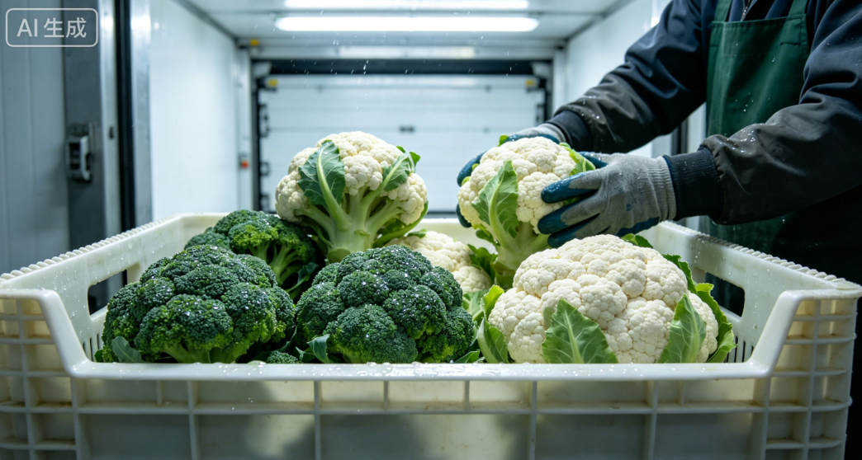
2. Preservation of Common Vegetables
(2) Cauliflower and Broccoli
Core Preservation Requirements
  Avoid mechanical damage.
  Inhibit ethylene action.
Gentle Handling During Pre-treatment
  Heads handled gently to avoid compression or impact.
  Reason:
    Delicate florets prone to browning.
    More susceptible to microbial infection and deterioration.
Pre-cooling
  Carried out pre-cooling promptly before entering cold storage.
  If ambient temperature too high → florets may prematurely open and brown → severely affects quality.
Notes:
2.花椰菜（菜花）、西蓝花保鲜
花椰菜、西蓝花的保鲜核心是避免机械损伤和抑制乙烯作用。前期处理时，需注意轻拿轻放，避免挤压、碰撞，否则娇嫩的花蕾易发生褐变，且更易受微生物侵染变质；入库前需及时预冷，若环境温度过高，花蕾易提早开花、褐变，严重影响品质。
2.2.2. Cauliflower and Broccoli
The core of preserving cauliflower and broccoli is to avoid mechanical damage and inhibit ethylene action. During pre-treatment, the heads should be handled gently to avoid compression or impact, as the delicate florets are prone to browning and become more susceptible to microbial infection and deterioration. Pre-cooling should be carried out promptly before the produce enters cold storage. If the ambient temperature is too high, the florets may prematurely open and brown, severely affecting quality.

Slide 33
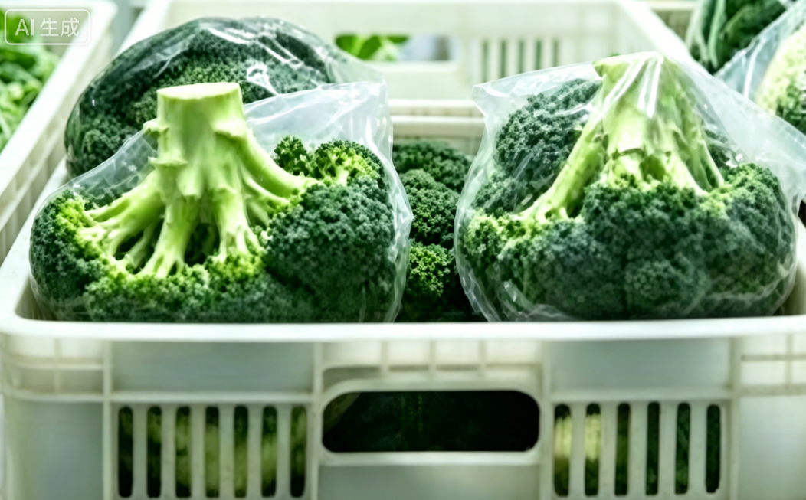
2. Preservation of Common Vegetables
(2) Cauliflower and Broccoli
Storage conditions
Single-Head Bagging Method
  Pack each head in a polyethylene film bag.
  Fold the bag opening and place bags in plastic crates.
Stacking Requirements
  Position curds downward → prevents condensation and mold caused by water droplets contacting the curd.
  Optional: a desiccant placed inside the preservation bag → further reduces condensation.
If Preservation Bags Are Not Used
  Curds placed upward → avoids direct contact with the crate and compression injury.
Cold Storage Conditions
  Temperature: 0–1°C.
  Relative humidity: 90%–95%.
Notes:
储藏条件：推荐采用单球套袋法，使用聚乙烯薄膜袋包装，套袋后折叠袋口，放入周转箱，码放时花球朝下，避免袋内结露、水滴接触花球导致霉变；也可在保鲜袋内放入吸湿剂，进一步防止结露；若不使用保鲜袋，需将花球朝上摆放，避免直接接触周转箱受压损伤。冷库温度控制在0–1℃，相对湿度维持在90%–95%。
▪Storage conditions: The single-head bagging method is recommended: pack each head in a polyethylene film bag, fold the bag opening, and place the bags in plastic crates. When stacking, position the curds downward to prevent condensation and mold caused by water droplets contacting the curd. A desiccant may also be placed inside the preservation bag to further reduce condensation. If preservation bags are not used, the curds should be placed upward to avoid direct contact with the crate and compression injury. Cold storage temperatures should be maintained at 0-1°C, with relative humidity at 90%–95%.

Slide 34
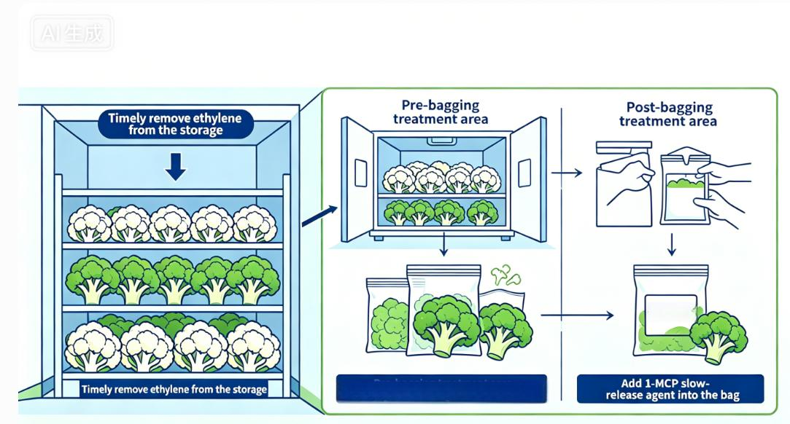
2. Preservation of Common Vegetables
(2) Cauliflower and Broccoli
Ethylene management
Ethylene Sensitivity
  Both cauliflower and broccoli are sensitive to ethylene.
  Ethylene produced by the heads accelerates senescence, floret opening, and browning.
Ethylene Removal During Storage
  Ethylene removed through proper ventilation or apply 1-MCP slow-release agents.
If Packaging Bags Are Used
  Method 1: Heads treated with 1-MCP powder in the cold room for 3–6 hours before bagging.
  Method 2: 1-MCP slow-release agents placed directly inside bags → continuously block ethylene action.
1-MCP
slow-release
Bag storage:​ Pre-treat with 1-MCP powder in cold room for 3–6 h.
Notes:
乙烯控制：花椰菜、西蓝花均对乙烯敏感，自身释放的乙烯会加速衰老、开花和褐变，因此储藏期间需及时排出库内乙烯，或投放1-MCP缓释剂；若采用包装袋储藏，可在装袋前用1-MCP粉末在冷库中熏蒸3–6小时，再进行装袋，也可在袋内直接加入1-MCP缓释剂，持续抑制乙烯作用。
▪Ethylene management: Both cauliflower and broccoli are sensitive to ethylene. Ethylene produced by the heads accelerates senescence, floret opening, and browning. Therefore, during storage, ethylene should be removed through proper ventilation, or 1-MCP slow-release agents may be applied. If packaging bags are used, the heads may be treated with 1-MCP powder in the cold room for 3–6 hours before bagging, or 1-MCP slow-release agents may be placed directly inside the bags to continuously block ethylene action.

Slide 35
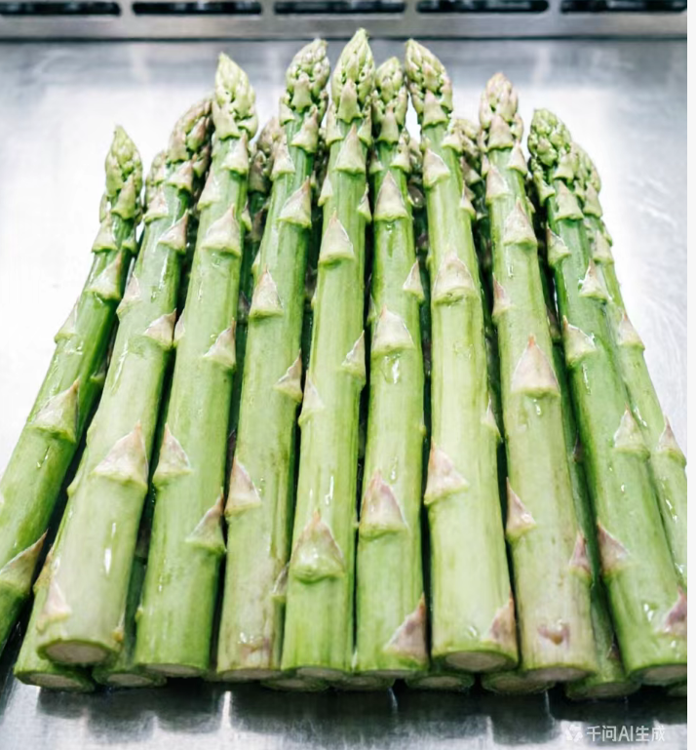
2. Preservation of Common Vegetables
(3) Asparagus
Product Characteristics
  Stems are tender.
  Widely consumed in Europe & US.
  Domestic demand in China is growing.
Preservation Focus
  Prevent senescence.
  Prevent lignification.
  Prevent mechanical damage.
AI生成
Pre-storage Cleaning
  Spears cleaned → minimizes soil carried in from the field.
  Wash if surface contamination is heavy.
Notes:
3.芦笋保鲜
芦笋茎秆柔嫩，在欧美地区消费广泛，近年来国内市场需求也持续增长，其保鲜重点是防止老化、木质化和机械损伤。入库前需做好清洁处理，尽量减少采收时附着的泥土带入冷库，若表面污物较多时可适当清洗。
2.2.3. Asparagus
Asparagus has tender stems and is widely consumed in Europe and the United States. In recent years, domestic market demand in China has also continued to grow. The focus of its preservation is to prevent senescence, lignification, and mechanical damage. Before entering cold storage, the spears should be cleaned to minimize soil carried in from the field. If surface contamination is heavy, washing may be performed.

Slide 36
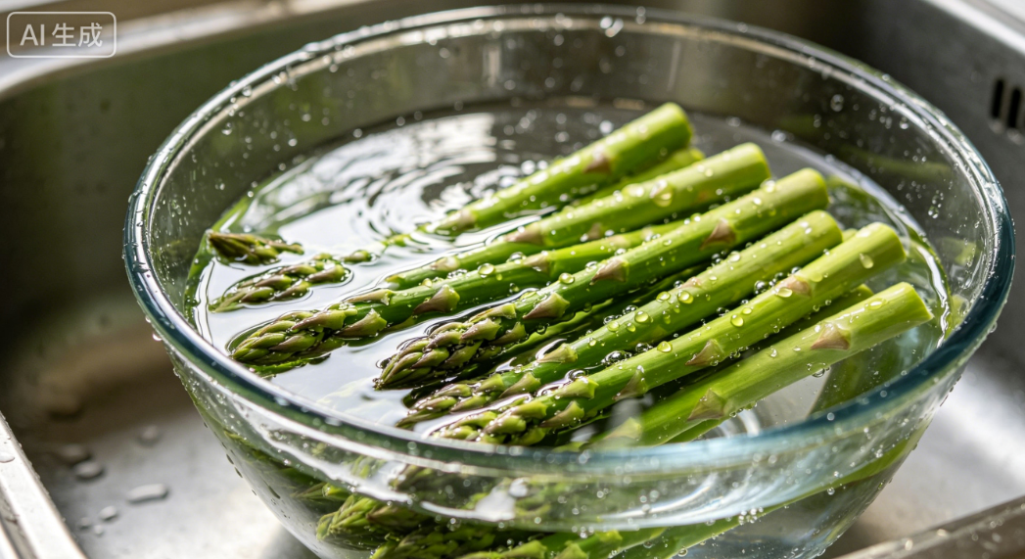
2. Preservation of Common Vegetables
(3) Asparagus
Pre-treatment
Pre-cooling
  Pre-cool before spears enter cold storage:
    reduce temperature from ambient levels to about 7°C.
    suppress respiratory heat.
    delay senescence, lignification, and fiber development.
    maintain eating quality.
Preferred Method
  Vacuum pre-cooling.
Alternative Method
  If vacuum facilities unavailable
    hydrocooling may be used with immersion time not exceeding 1 hour.
Notes:
预处理：入库前需尽可能预冷，将温度从室温降至约7℃，抑制呼吸作用产生的热量，延缓老化、木质化和纤维化，维持食用品质；预冷可采用真空预冷，若无条件，可采用冷水浸泡预冷，浸泡时间不超过1小时。
▪Pre-treatment: Pre-cooling should be carried out before the spears enter cold storage, reducing the temperature from ambient levels to about 7°C to suppress respiratory heat, delay senescence, lignification and fiber development, and maintain eating quality. Vacuum pre-cooling is preferred; if vacuum facilities are unavailable, hydrocooling may be used with immersion time not exceeding 1 hour.

Slide 37
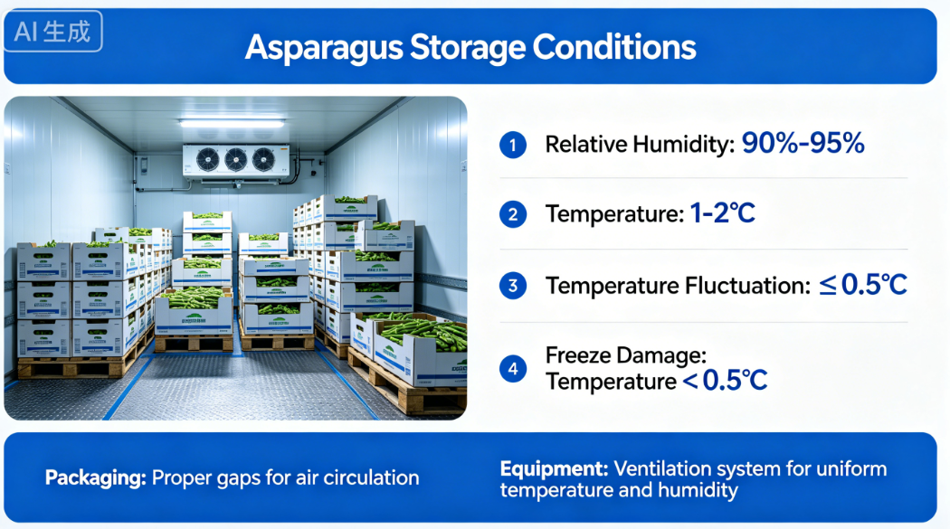
2. Preservation of Common Vegetables
(3) Asparagus
Storage conditions
Humidity Control
  Relative humidity: maintain at 90%–95%.
Temperature Control
  Temperature: 1–2°C.
  Fluctuation: not exceeding 0.5°C.
  Temperature below 0.5°C → causes freezing injury to asparagus tips.
Ventilation & Space Requirements
  Cartons or crates leave adequate gaps for air circulation.
  Equip cold room with ventilation systems → ensure uniform temperature & humidity.
Notes:
储藏条件：储藏阶段，冷库相对湿度维持在90%—95%，温度设定为1-2℃，波动幅度不超过0.5℃，温度低于0.5℃易导致芦笋嫩芽冻害；包装箱需留有适当间隙，利于空气循环，冷库建议配置通风换气设备，确保库内温湿度均匀。
▪Storage conditions: During storage, relative humidity of the cold storage should be maintained at 90%-95%, and temperatures kept at 1-2°C with fluctuations not exceeding 0.5°C. Temperatures below 0.5°C may cause freezing injury to asparagus tips. Cartons or crates should allow adequate gaps for air circulation, and the cold room should be equipped with ventilation systems to ensure uniform temperature and humidity.

Slide 38
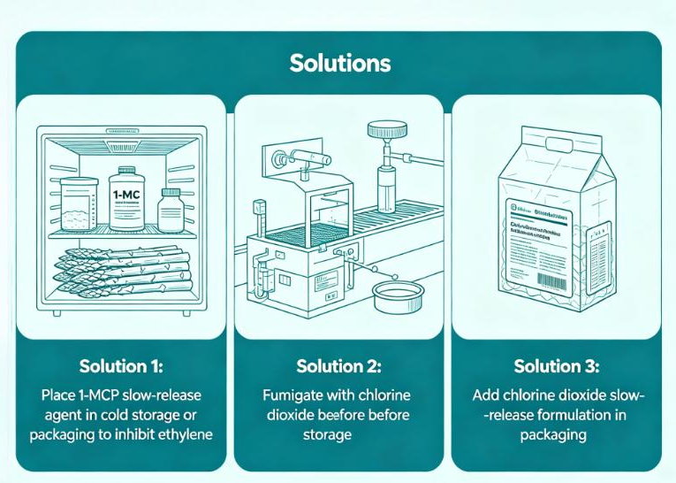
2. Preservation of Common Vegetables
(3) Asparagus
Chemical treatments
AI生成
Chemical Treatments
  Chemical treatments may be used in combination → to enhance preservation effectiveness.
  Reason:
    Asparagus is harvested by cutting.
    Wounds generate ethylene → promotes lignification, fiber development, and accelerated senescence.
1-MCP Application
  1-MCP slow-release agents may be applied in the cold room or in packaging
  → blocks ethylene action.
Chlorine Dioxide Treatment
  Chlorine dioxide fumigation applied before storage.
  Chlorine-dioxide slow-release formulations placed inside packaging.
Notes:
为提升保鲜效果，可配合使用化学试剂：芦笋采用切割采收，伤口易产生乙烯，引发木质化、纤维化，并加速衰老，可在冷库或包装箱内投放1-MCP缓释剂，抑制乙烯作用；也可在入库前用二氧化氯熏蒸，或在包装中加入二氧化氯缓释制剂。
To enhance preservation effectiveness, chemical treatments may be used in combination: Because asparagus is harvested by cutting, the wounds generate ethylene, which promotes lignification, fiber development, and accelerated senescence. 1-MCP slow-release agents may be applied in the cold room or packaging to block ethylene action. Chlorine dioxide fumigation may also be applied before storage, or chlorine-dioxide slow-release formulations may be placed inside the packaging.

Slide 39
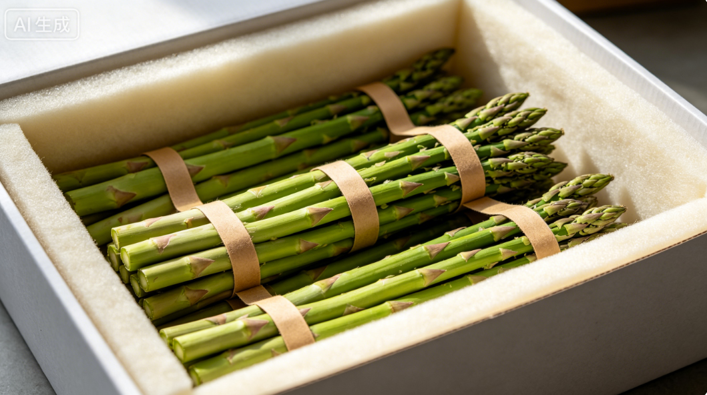
2. Preservation of Common Vegetables
(3) Asparagus
Transportation
Transport Operations
  Soft liner placed inside the transport box.
  Asparagus should be bundled and secured at the bottom.
Purposes
  Reduce mechanical impact during movement.
  Protect the integrity of the tips.
Notes:
运输过程中，需在运输箱内铺设柔软内衬，将芦笋捆扎后固定在箱底，减少晃动造成的机械碰撞，保护嫩芽完整性。
Transportation: During transportation, a soft liner should be placed inside the transport box, and the asparagus should be bundled and secured at the bottom to reduce mechanical impact from movement and protect the integrity of the tips.

Slide 40
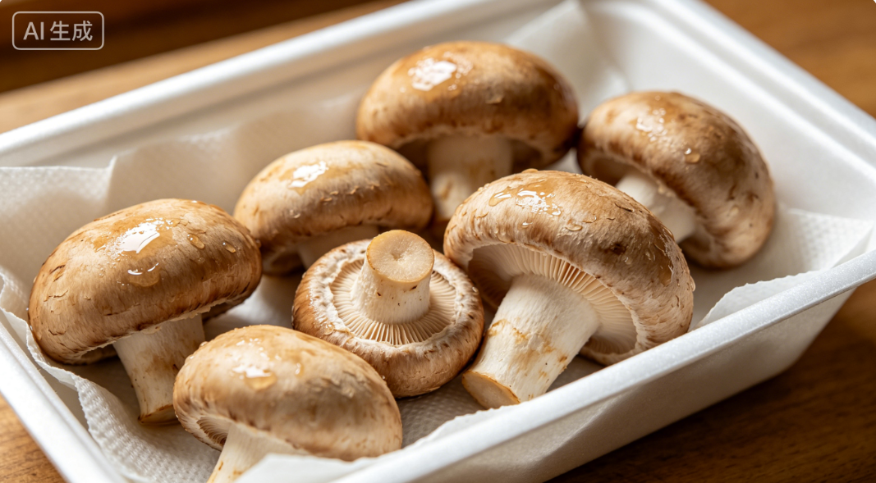
2. Preservation of Common Vegetables
(4) Mushrooms
Physiological Status After Harvest
  Fruiting bodies of edible fungi (i.e., mushrooms) remain physiologically active after harvest.
Three Main Preservation Objectives
  Maintain viability.
  Slow physiological activity (i.e., maintain low metabolic rates).
  Reduce infection by pathogens.
Core Preservation Strategy
  Similar to fruits and vegetables.
  Primarily low-temperature storage.
  Combined with modified-atmosphere packaging.
Notes:
4.食用菌的保鲜
食用菌的子实体（即蘑菇）采后仍为鲜活个体，保鲜目标有三个：维持其生命状态、抑制生理活动（保持缓慢新陈代谢）、减少病原微生物侵染。其保鲜核心与果蔬一致，以低温保鲜为主，配合气调包装等技术。
2.2.4. Mushrooms
The fruiting bodies of edible fungi (i.e., mushrooms) remain physiologically active after harvest. The three main preservation objectives are maintaining viability, slowing physiological activity (i.e., maintaining low metabolic rates), and reducing infection by pathogens. The core preservation strategy is similar to that of fruits and vegetables, relying primarily on low-temperature storage combined with technologies such as modified-atmosphere packaging.

Slide 41
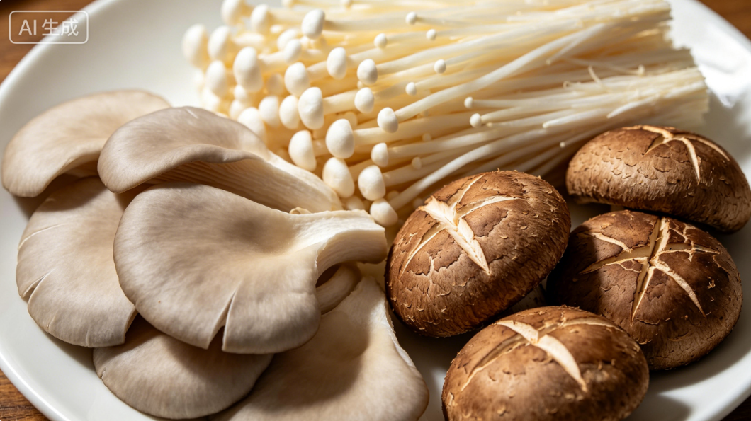
Low-temperature preservation
2. Preservation of Common Vegetables
(4) Mushrooms
Low-temperature preservation
Low-Temperature Preservation
  Low temperatures effectively:
  → Reduce respiration rate.
  → Limit water loss.
  → Slow pathogen growth.
Temperature Sensitivity
  Optimal storage temperatures vary among mushroom species.
  Excessively low temperatures → chilling injury or freezing damage.
Notes:
低温保鲜：低温可有效抑制蘑菇呼吸强度、减少水分流失、延缓病原菌生长，但不同种类蘑菇的最适保鲜温度存在差异，温度过低易发生冷害或冻伤。
Low-temperature preservation: Low temperatures effectively reduce respiration rate, limit water loss, and slow pathogen growth. However, optimal storage temperatures vary among mushroom species. Excessively low temperatures may cause chilling injury or freezing damage.

Slide 42
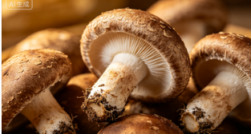
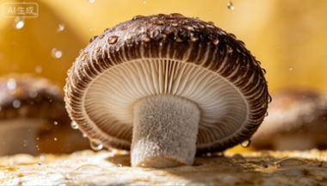
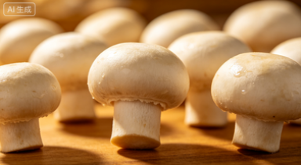
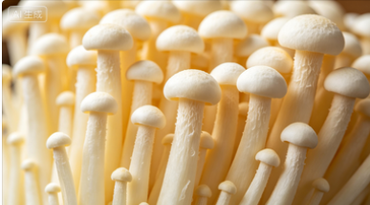
2. Preservation of Common Vegetables
(4) Mushrooms
Optimal storage temperatures
AI生成
Shiitake
  Optimal storage temperature around 1°C.
  Storage life >18 days.
AI生成
Straw mushroom
  Stored about two weeks at 0–2°C.
  At 4–6°C → autolysis easily occurs.
  At 10–15°C → only be stored 2–3 days.
AI生成
Button mushroom
  Optimal storage temperature 0–5°C.
  Storage period can reach 30–35 days at 0°C.
AI生成
Enoki mushroom
  Optimal storage temperature 2–4°C.
Notes:
不同食用菌最适保鲜温度不同：
香菇：适宜储藏温度在1℃左右，保鲜期可以到18天以上。
草菇：在0~2℃环境下可保存约两周，若温度升至4~6℃，则易发生自溶现象，在10~15℃条件下仅可存放2～3天。
双孢菇：适宜储藏温度为0~5℃，在0℃时贮藏期可达30～35天。
金针菇：适宜储藏温度在2~4℃。
Different edible fungi require different optimal storage temperatures:
▪Shiitake: The optimal storage temperature is around 1°C, and the storage life can exceed 18 days.
▪Straw mushroom: It can be stored for about two weeks in an environment of 0-2°C. If the temperature rises to 4-6°C, autolysis easily occurs, and at 10-15°C it can only be stored for 2-3 days.
▪Button mushroom: The optimal storage temperature is 0-5°C, and the storage period can reach 30-35 days at 0°C.
▪Enoki mushroom: The optimal storage temperature is 2-4°C.

Slide 43
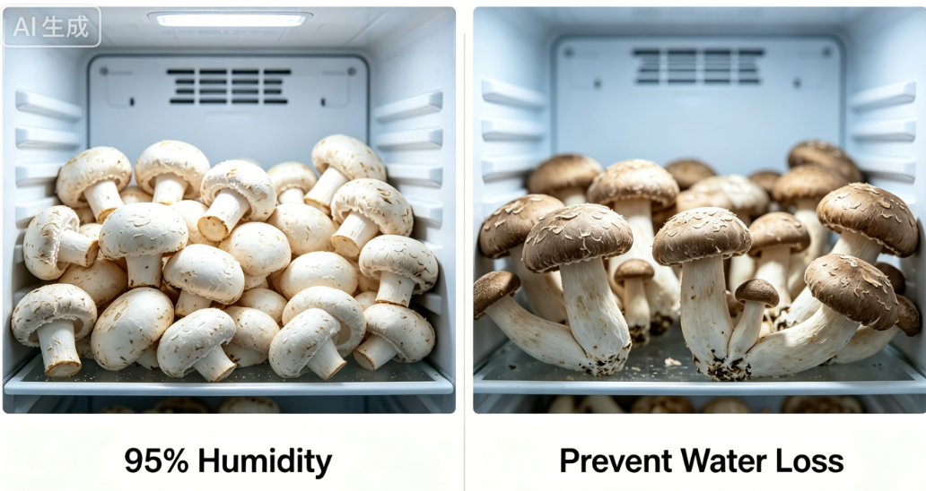
2. Preservation of Common Vegetables
(4) Mushrooms
High-humidity maintenance
Relative Humidity Requirements
  Relative humidity maintained above 95% during storage.
  Prevents water-loss-induced quality deterioration.
Effects of Water Loss
  Leads to weight loss.
  Affects appearance.
  Reduces market value.
Notes:
除温度控制外，在湿度管理方面，多数食用菌储藏期间的环境湿度需维持在95%以上，以防止失水导致品质下降。失水会引起失重，不仅影响外观，还会降低经济价值。
In addition to temperature control, relative humidity during mushroom storage should be maintained above 95% to prevent water-loss-induced quality deterioration. Water loss leads to weight loss, which not only affects appearance but also reduces market value.

Slide 44
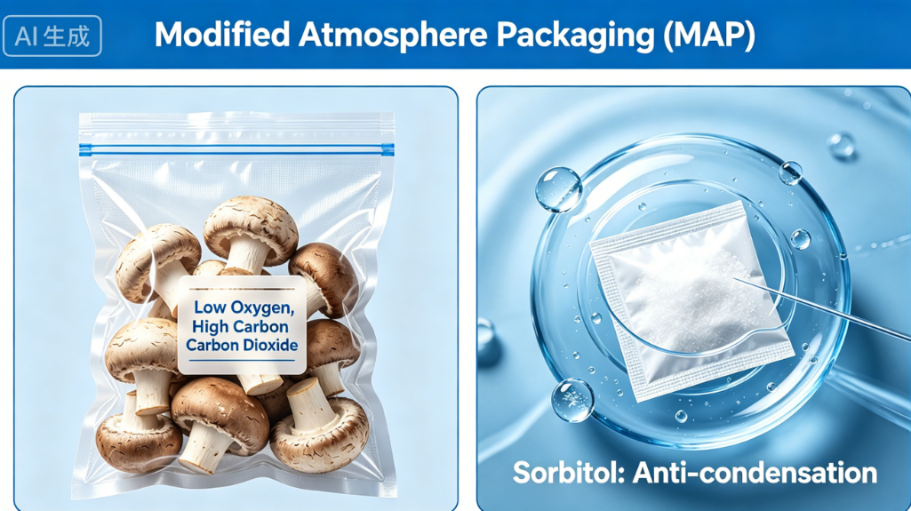
Modified-atmosphere packagingt
2. Preservation of Common Vegetables
(4) Mushrooms
Modified-atmosphere packaging
Modified-Atmosphere Packaging (MPA)
  Use breathable MAP bags to maintain a low-oxygen, high-carbon-dioxide atmosphere → to extend shelf life.
Condensation Control
  Condensation inside bags should be avoided.
  Desiccants such as sorbitol may be added to limit moisture accumulation.
Notes:
气调包装：可采用气调包装技术，使用透气性保鲜袋，维持袋内低氧、高二氧化碳环境，延长保鲜期；包装时需避免袋内结露，可添加山梨醇等吸湿剂，减少结露现象。
Modified-atmosphere packaging: Modified-atmosphere packaging can be used, using breathable packaging bags to maintain a low-oxygen, high-carbon-dioxide atmosphere to extend shelf life. Condensation inside the bags should be avoided; desiccants such as sorbitol may be added to limit moisture accumulation.

Slide 45
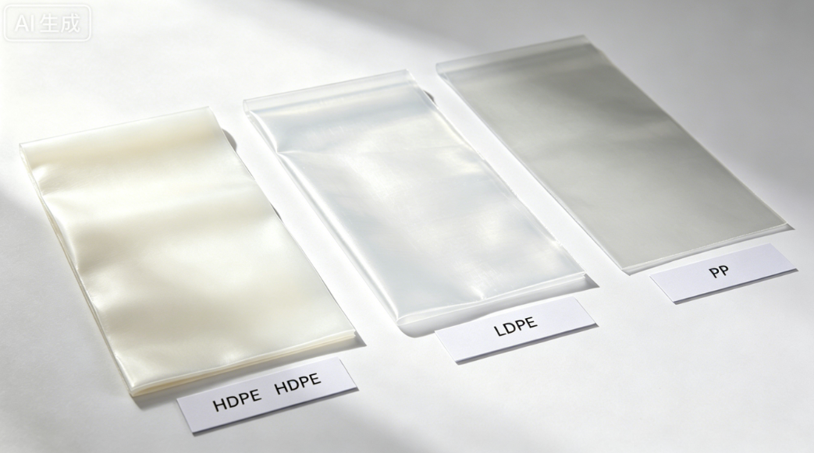
2. Preservation of Common Vegetables
(4) Mushrooms
Modified-atmosphere packaging
The materials and gas composition of modified-atmosphere packaging should be selected according to the characteristics of each mushroom species.
Common. Packaging Materials
  High-density polyethylene.
  Low-density polyethylene.
  Polyvinyl chloride.
  Polypropylene.
Material–Species Matching
  High-density polyethylene for button mushrooms.
  Low-density polyethylene for king oyster mushrooms.
  Polyethylene recommended for shiitake mushrooms.
Gas Composition Options & Examples
  Low-oxygen or medium-to-high-oxygen atmospheres.
  Low-oxygen controlled-atmosphere condition for shiitake mushrooms: 2% O₂, 10% CO₂, ~88% N₂.
  Low-oxygen controlled-atmosphere condition for button mushrooms: 1–2% O₂, 10–15% CO₂.
  Medium-to-high-oxygen atmosphere may raise O₂ to 50% or even up to pure oxygen.
Notes:
气调包装的材料和气体配比需根据菇种特性选择：常用包装材料包括高密度聚乙烯、低密度聚乙烯、聚氯乙烯、聚丙烯等，其中双孢菇宜采用高密度聚乙烯，杏鲍菇宜选用低密度聚乙烯，香菇推荐使用聚乙烯；气体配比可选择低氧气调或中高氧气调，例如，香菇低氧气调条件为氧气2%、二氧化碳10%、氮气约88%，双孢菇的低氧气调条件为氧气1%–2%、二氧化碳10%–15%。中高氧气调可将氧气浓度提高至50%，甚至使用纯氧。
The materials and gas composition of modified-atmosphere packaging should be selected according to the characteristics of each mushroom species. Common packaging materials include high-density polyethylene, low-density polyethylene, polyvinyl chloride, polypropylene, etc. Among them, high-density polyethylene is suitable for button mushrooms, low-density polyethylene is suitable for king oyster mushrooms, and polyethylene is recommended for shiitake mushrooms. Gas composition may be set to low-oxygen or medium-to high-oxygen atmosphere. For example, the low-oxygen controlled-atmosphere condition for shiitake mushrooms is 2% oxygen, 10% carbon dioxide, and about 88% nitrogen; the low-oxygen controlled-atmosphere condition for button mushrooms is 1%-2% oxygen and 10%-15% carbon dioxide. Medium-to high- oxygen atmosphere may raise oxygen levels to 50% or even up to pure oxygen.

Slide 46
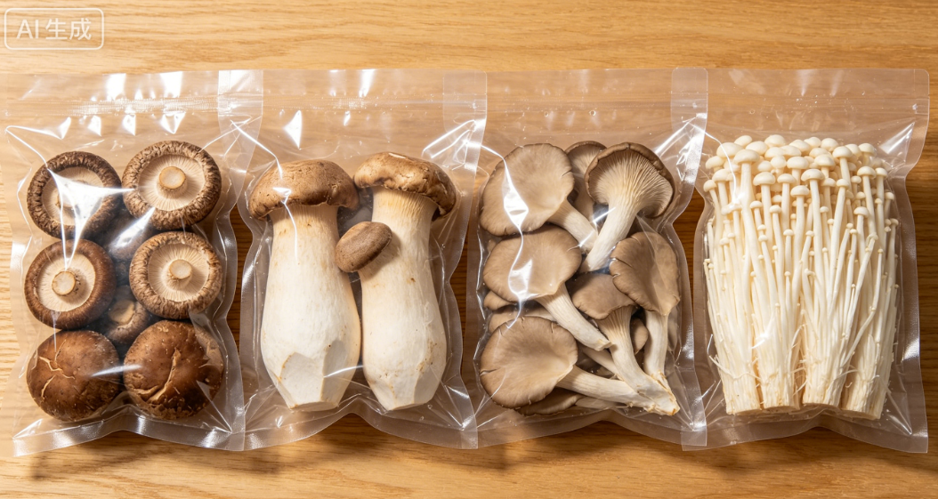
2. Preservation of Common Vegetables
(4) Mushrooms
Overall Preservation Strategy
  Balance cost and preservation requirements.
  Combine multiple technologies.
  Select appropriate methods based on intended storage duration.
Examples of Preservation Procedures
  Shiitake mushroom.
  Enoki mushroom.
Notes:
总体而言，食用菌保鲜需结合成本和保鲜需求，采用多种技术协同作用，并根据贮藏期长短选择适宜方法。这里以香菇和金针菇为例，总结具体保鲜流程，方便大家参考：
Overall, mushroom preservation should balance cost and preservation requirements, combine multiple technologies, and select appropriate methods based on the intended storage duration. Below, shiitake mushrooms and enoki mushrooms are used as examples to summarize specific preservation procedures.

Slide 47
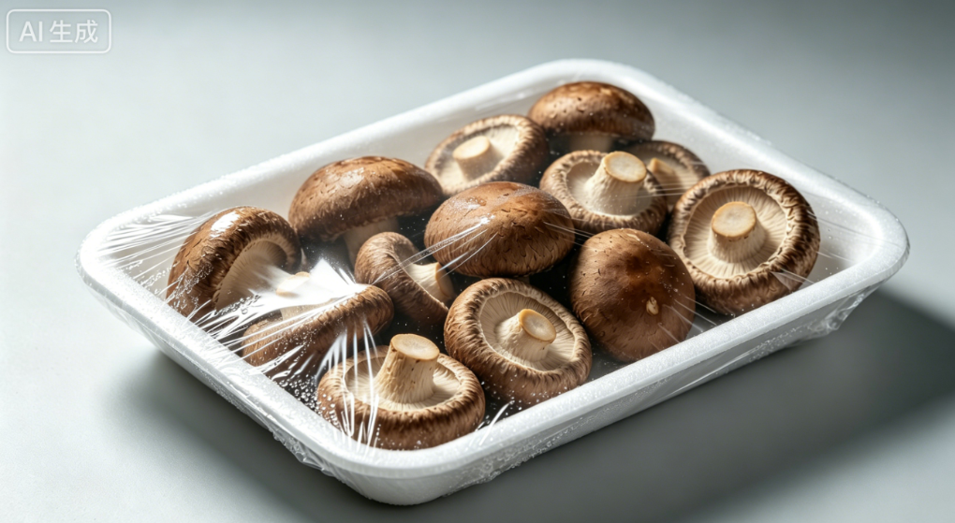
2. Preservation of Common Vegetables
(4) Mushrooms
Shiitake mushroom preservation
Pre-Cooling & Initial Handling
  Apply vacuum pre-cooling to rapidly reduce temperature.
  Removes surface moisture.
  Transfer to cold room.
  Temperature maintained at 0–5°C (optimal 0–1°C).
  Relative humidity above 90%.
Ethylene Control
  Apply 1-MCP slow-release agents in the cold room → to block ethylene action.
Condensation Reduction in Modification-atmosphere packaging
  Appropriate amount of desiccant may be placed inside the bag → to reduce condensation.
Notes:
香菇保鲜：1. 采收后采用真空预冷技术，降温排湿后转入冷藏库，库温控制在0–5℃（最佳0–1℃），相对湿度90%以上；2. 冷库内投放1-MCP缓释剂，减轻乙烯不利影响；3. 在进行气调包装时，可在袋内添加适量除湿剂。
Shiitake mushroom preservation:
▪After harvest, apply vacuum pre-cooling to rapidly reduce temperature and remove surface moisture, then transfer the mushrooms to a cold room. Storage temperatures should be maintained at 0-5°C (optimal 0-1°C) with relative humidity above 90%.
▪Apply 1-MCP slow-release agents in the cold room to block ethylene action.
▪When using modified-atmosphere packaging, an appropriate amount of desiccant may be placed inside the bag to reduce condensation.

Slide 48

2. Preservation of Common Vegetables
(4) Mushrooms
Enoki mushroom preservation
Pre-Cooling & Refrigerated Storage
  Quickly pre-cool to 0–2°C after harvest.
  Package and store under refrigeration at 0–2°C.
  Relative humidity above 90%.
Modified-Atmosphere Packaging (MAP)
  Use polyethylene MAP bags.
  Place desiccants such as sorbitol inside bags to prevent condensation.
Storage Duration
  Storage period should not exceed 15 days.
Notes:
金针菇保鲜：1. 采收后迅速预冷至0–2℃，包装后冷藏，维持库温0–2℃、相对湿度90%以上；2. 选用聚乙烯气调袋包装，袋内放置山梨醇等吸湿剂，防止结露；3. 贮藏期不超过15天。
Enoki mushroom preservation:
▪After harvest, quickly pre-cool the mushrooms to 0-2°C, then package and store them under refrigeration at 0-2°C with relative humidity above 90%.
▪Use polyethylene modified-atmosphere packaging bags, and place desiccants such as sorbitol inside the bags to prevent condensation.
▪The storage period should not exceed 15 days.

Slide 49
Summary
Fruit & Vegetable Preservation · Three Key Strategies
Control Temperature & Humidity
Maintain Environmental Cleanliness
Regulate environmental conditions.
→ Reduces metabolic activity.
→ Maintains dormancy.
Keep storage and handling areas clean and hygienic.
→ Prevents microbial contamination.
→ Reduces risk of decay.
Combine Multiple Preservation Methods
Integrate multiple techniques:
→ Achieves synergistic effects.
→ Significantly extends storage life.
    Low-temperature storage
    Modified-atmosphere systems
    Chemical treatments
Notes:
以上是本次课程关于常见果蔬保鲜方法的全部内容，已详细讲解每种果蔬保鲜要点。最后，总结延长果蔬保鲜期三个关键要点，方便记忆。
第一，控温控湿——调控温度与湿度，为果蔬创造适宜的休眠条件。
第二，环境清洁——保持环境清洁卫生，避免微生物污染。
第三，多效结合——综合应用低温、气调、化学保鲜等多种技术手段，通过协同作用有效延长产品的贮藏期限。
The above covers all the content of this course on common fruit and vegetable preservation, with detailed explanations of the key preservation points for each commodity.
To help consolidate the concepts, the three essential strategies for extending postharvest life are summarized below:
▪Control temperature and humidity – Regulate environmental conditions to reduce metabolic activity and maintain dormancy.
▪Maintain environmental cleanliness – Keep the storage and handling environment clean and hygienic to prevent microbial contamination and reduce the risk of decay.
▪Combine multiple preservation methods – Integrate techniques such as lowtemperature storage, modified-atmosphere systems, and chemical treatments to achieve synergistic effects that significantly extend storage life.

