Slide 1
Rice Value Chain Situation in Guinea
Aboubacar Demba SAMOURA
National Director of Agriculture of the Republic of Guinea

Slide 2
CONTENTS
Country Context
Food insecurity situation in Guinea (March 2022) (%)
1
2
3
Potentials and problems of the rice value chain in Guinea
National Strategies
03
4
5
Previous partnership with WFP China and CERFAM

Slide 3
01
Country Context

Slide 4
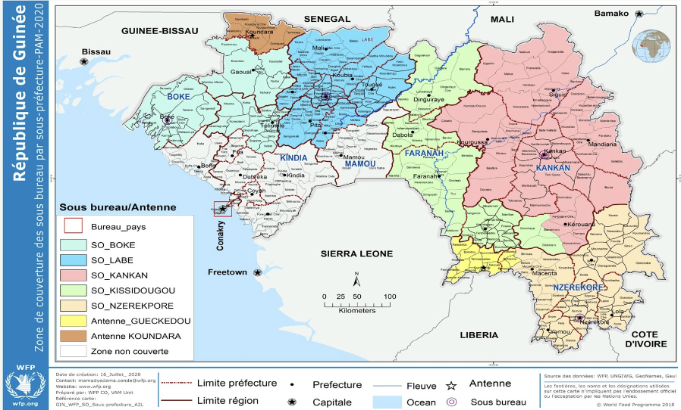
Guinea is ranked 182 out of 191 countries in the latest Human Development Index report for 2021.
With a population of 13.5 million, 55% of whom live below the poverty line.
The Guinean economy is largely dependent on mining and agriculture.
Low productivity, poor farming techniques, and high post-harvest losses plague the agricultural sector, while poor road infrastructure hinders access to markets.

Slide 5
02
Food security situation in Guinea (March 2022) (%)

Slide 6
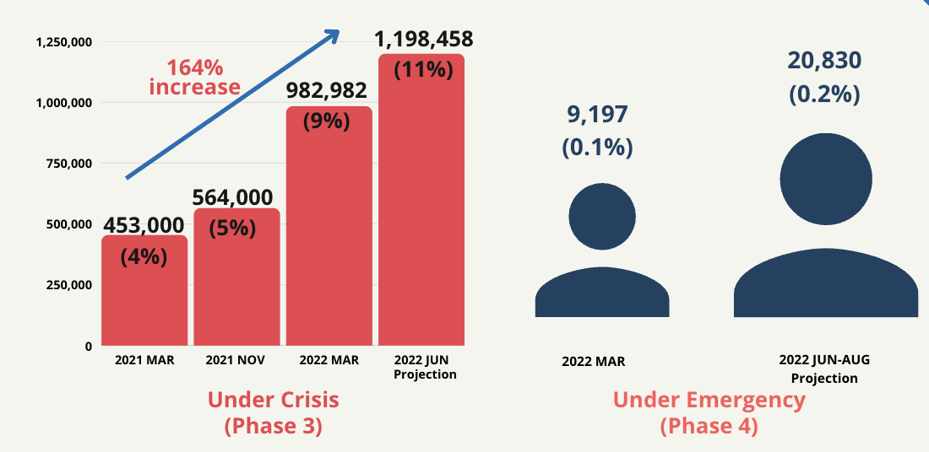
In 2022, the food-insecure population in Guinea increased significantly by 164 percent, representing 11 percent of the total population in Guinea.

Slide 7
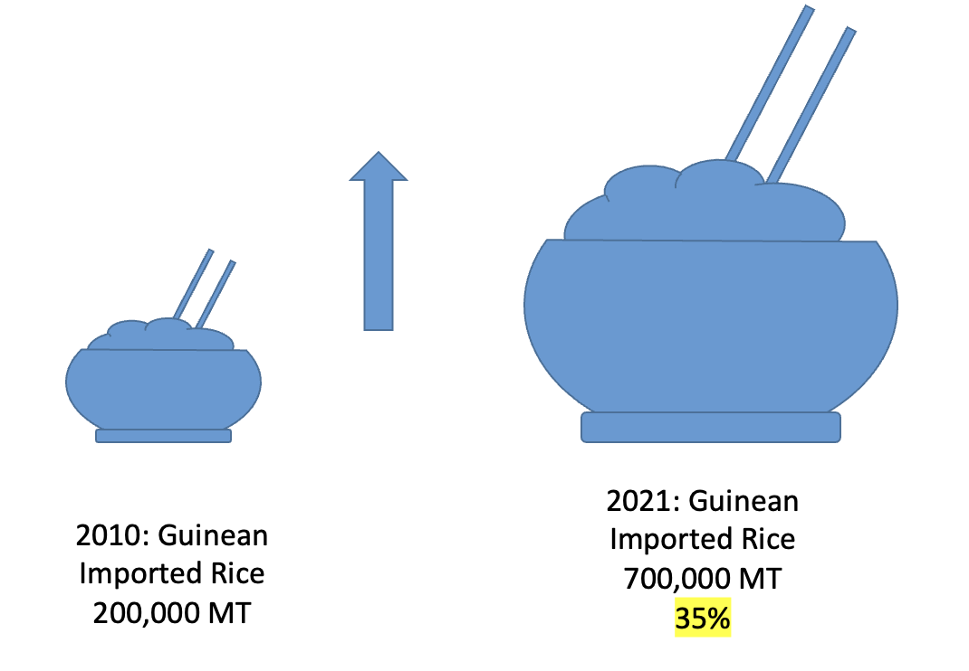
From 2010 to 2021, rice imports are expected to increase from 200,000 to 700,000 tons, which represents 35% of total rice consumption in Guinea.

Slide 8
03
Potentials and problems of the rice value chain in Guinea

Slide 9
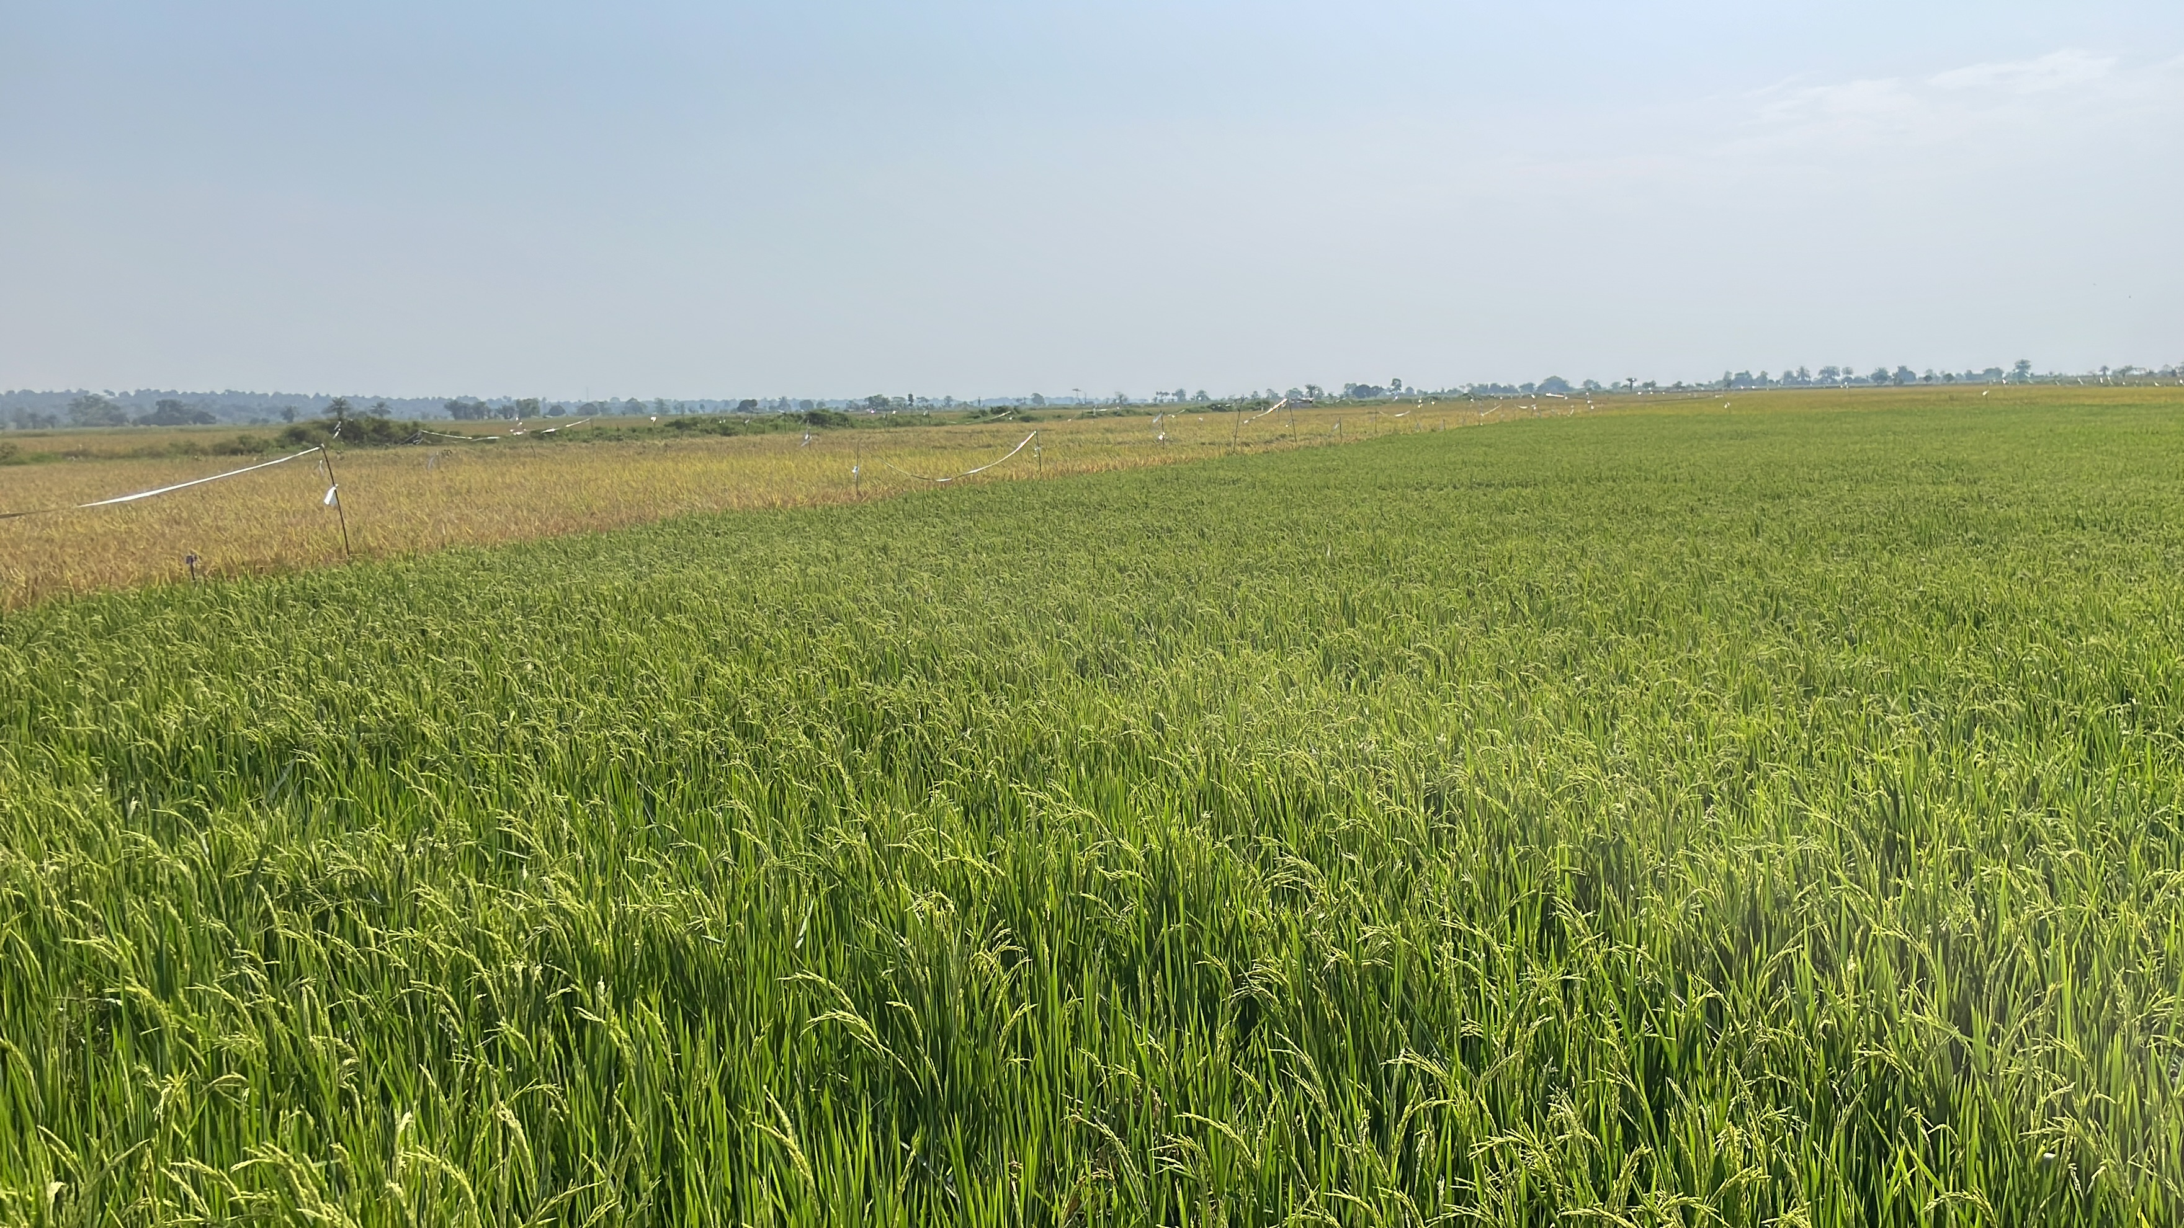
However, Guinea has very fertile land with an estimated potential of 13.7 million hectares of agricultural land, or 56% of the national territory. However, only 25% of this potential is reportedly developed.

Slide 10
Degraded soils, low fertility and low mechanization and use of inputs.
Poor storage conditions and lack of product processing.
Poor road conditions and poor access to markets.
Recurrent shocks (drought, late arrival and/or break in the rains, etc.)

Slide 11
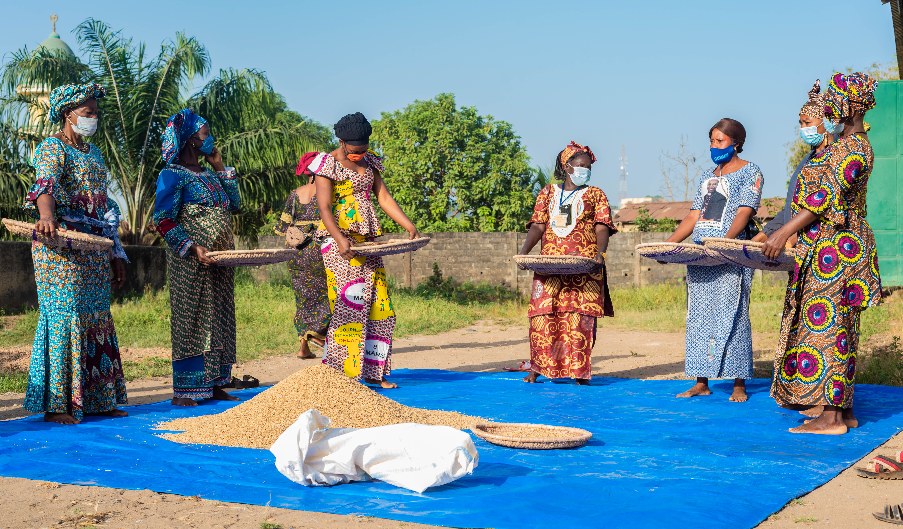
In addition, post-harvest losses for rice, a significant cause of low production in this sector, are generally high, ranging from 10 to 20%. These losses are associated with limited access to well-structured markets, weak value chain processing, and poor storage, preservation and transport systems, etc.

Slide 12
04
National Strategies

Slide 13
In accordance with the vision defined in the PNDES, the Government is committed to developing agriculture in order to reduce poverty and fight against food and nutritional insecurity. From this perspective, the development of the rice sector is a strategic priority that will enable the Government to quickly achieve food self-sufficiency and consequently reduce the rice import bill.

Slide 14
The government launched a major five-year rice value chain development project in the Republic of Guinea in July 2019. The objective of the project is (i) to increase rice production (+25%) and productivity (from 1.3 to 4 tons/ha); (ii) to increase rice self-sufficiency (from 69 to 85%) and to increase the income of 60,000 beneficiary households by 30%, in particular by strengthening the link with the market and promoting a policy and institutional environment that is conducive to the development of the rice value chain

Slide 15
05
Previous partnership with WFP China and CERFAM

Slide 16
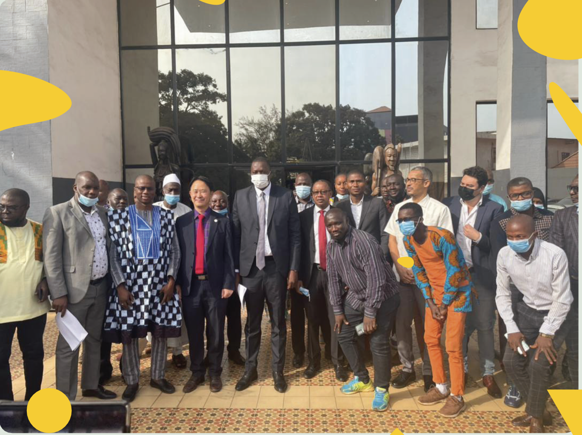
On February 24-25, 2022, a national workshop was held in Conakry to validate the results of the post-harvest loss assessment mission conducted in the rice sector in June 2021 in Guinea Conakry by Help Logistics and WFP's Supply Chain Division under the leadership of the Regional Center of Excellence against Hunger and Malnutrition (CERFAM) in collaboration with the World Food Programme in Guinea, at the request of the Government. This workshop was also funded by the Government of China.

Slide 17
tHANK YOU
Merci

