Slide 1

——·Agricultural Disaster Management·——
Improving Last Mile Disaster Preparedness through
Agricultural Disaster Warning Apps
Yi Zhang
China Meteorological Administration

Slide 2
CONTENTS
The National Emergency Warning Release System
02
01
Background & Challenges
03
"Nongzaijing" Mini Program
04
Key Takeaways

Slide 3
01
Background & Challenges

Slide 4
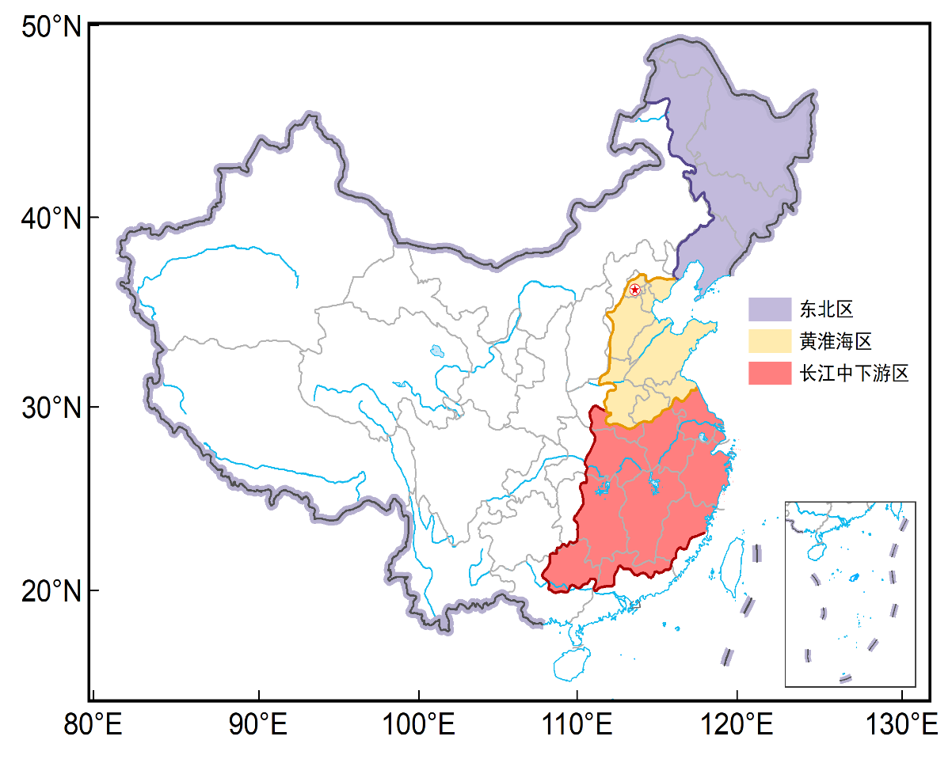



China's Agricultural Disaster Landscape
Huang-Huai-Hai Plain
Winter wheat
spring frost damage:
every 4 years
affected area: 66 million ha, 2010
Northeast China
Rice
low-temperature damage:
every 6 years
yield losses>40%, 2002
Northeast China
Corn
low-temperature damage:
every 5 years
yield losses>30%, 2009
Yangtze River Mid-Lower Reaches
Rice
heat damage:
every 5 years
yield losses>10%, 2013
Huang-Huai-Hai Plain
Winter wheat
drought:
every 4 years
affected area: 2.51 million ha, 2014
Agricultural disaster prevention is essential for ensuring food security

Slide 5
Gap Between Technology Advance and End Users
Technologies have advanced significantly
Most achievements focus on enhancing professional operational capabilities
Research outputs exist
Disaster information is mainly disseminated through established institutional channels (e.g., decision-making services)
The key challenges faced by front-line agricultural producers
Untimely access | Warnings often reach agri-producers too late for effective preventive action.
Inconvenient means | Existing channels are not sufficiently farmer-friendly or easily accessible.
Lack of relevance | Information is not tailored to specific crops, locations, or growth stages.
Research outputs have limited practical value at the farm level — the "early warning" function remain largely ineffective for those who need it most.

Slide 6
The Core Question
How can specialized meteorological monitoring and early warning information be effectively disseminated
in a
Timely User-Friendly Targeted
manner
to every agricultural producer most in need?

Slide 7
02
The National Emergency Warning Release System
Government Emergency Responders, Line Agencies, and the Public
Fast, Wide-reach, and Authoritative release

Slide 8
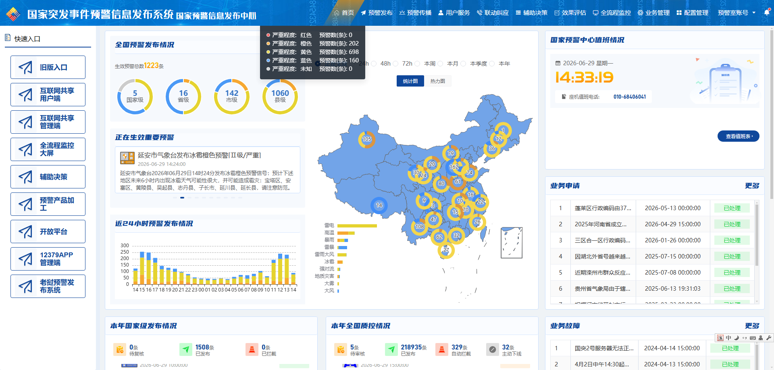
System Overview
Natural disasters
Accident disasters
Public health incidents
Social security incidents
Links departments at 4 levels: national, provincial, municipal, and county
Connects 20+ sectoral departments: emergency management, water resources, natural resources, agriculture, etc.
Average lead time for Internet-based warning dissemination: 3 min 48 s

Slide 9
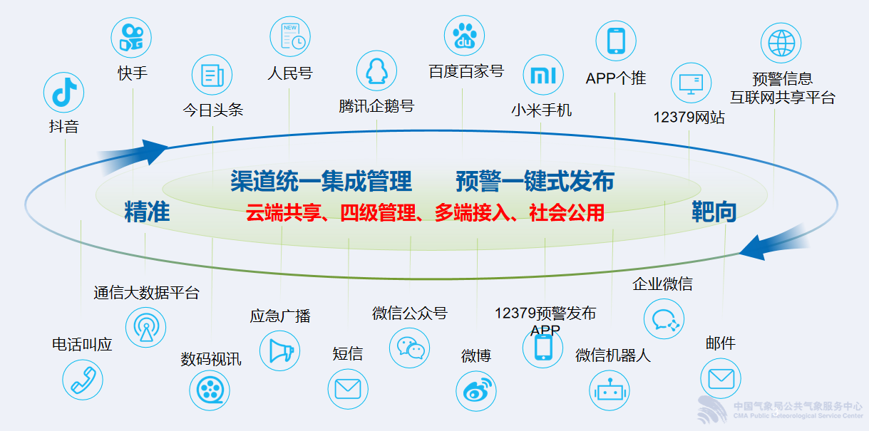
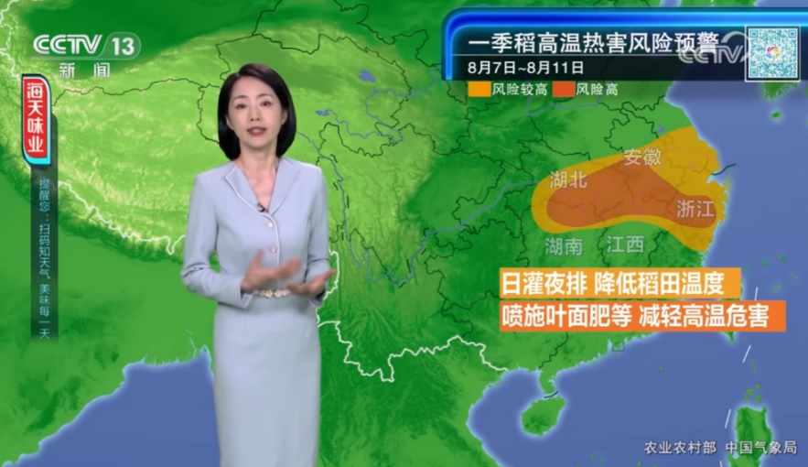
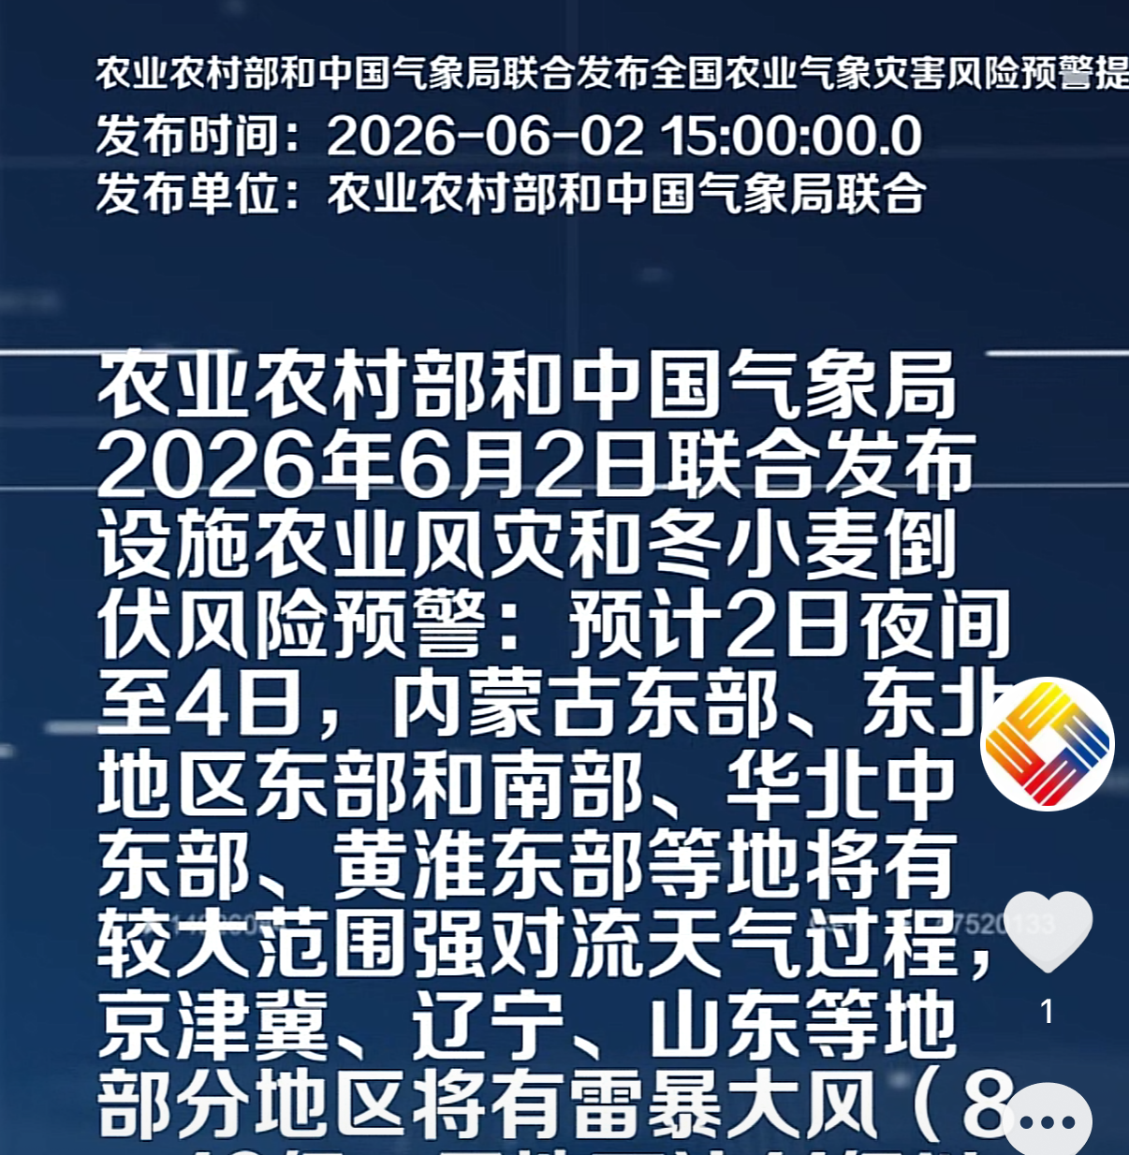
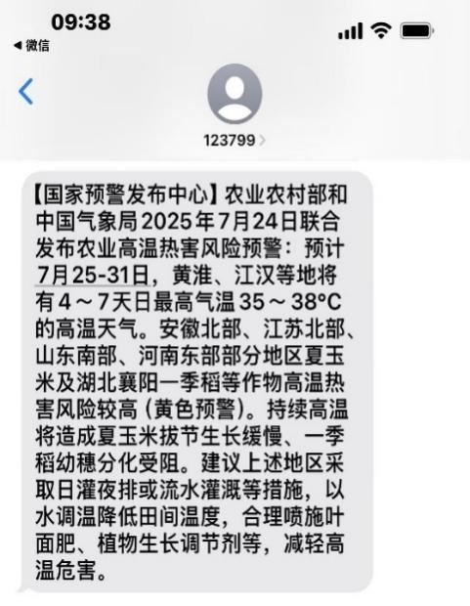
Yangshipin APP
Wide-reaching dissemination channels
Risk Early Warning of High Temperature Heat Damage for Single-season Rice
Broadcasting
TV
Various Social medias
Email
Specialized APPs
SMS Messages
Douyin
(TikTok in China)
SMS messages
Joint Inter-departmental Consultation
Risk Early Warning of Wind Disaster for Protected Agriculture and Lodging for Winter Wheat
Risk Early Warning of
Agricultural
High Temperature Heat Damage

Slide 10
03
"Nongzaijing" Mini Program
Farmer-Focused Precision Services
Accessible, Intuitive, and Action‑oriented

Slide 11
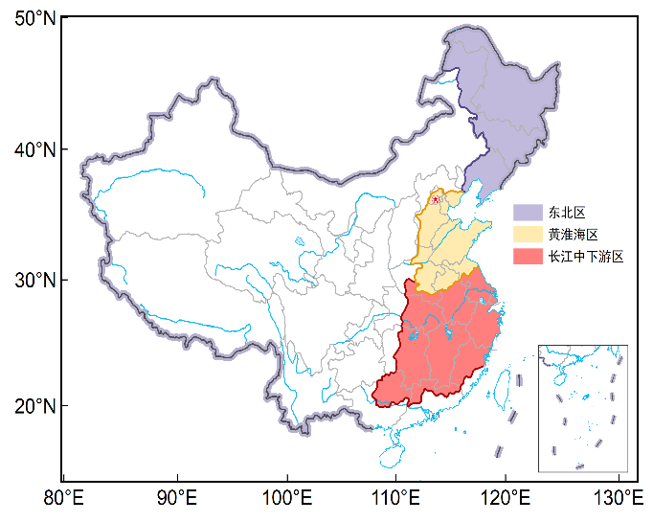
What is “Nongzaijing” - China’s First National-Level Agricultural Weather Service WeChat Mini Program
Item | Description
Launch Date | December 2025
Developer | Chinese Academy of Meteorological Sciences, CMA
Data Source | National Meteorological Big Data Platform (“Tianqing”) National agrometeorological service products
Coverage Regions | Three Core Staple Grain Regions: Northeast, Huang-Huai-Hai, Yangtze River Mid-Lower Reaches
Covered Hazards | Low-temperature chilling, drought, frost damage, heat damage
Registered Users | 110,000+
Three Core Advantages
Easy‑access design: WeChat-based, no installation required, easy to disseminate
Authoritative Source: All products from national-level platforms, 5km high precision
One-Stop Service: Pre-disaster warning → during-disaster monitoring → post-disaster response

Slide 12
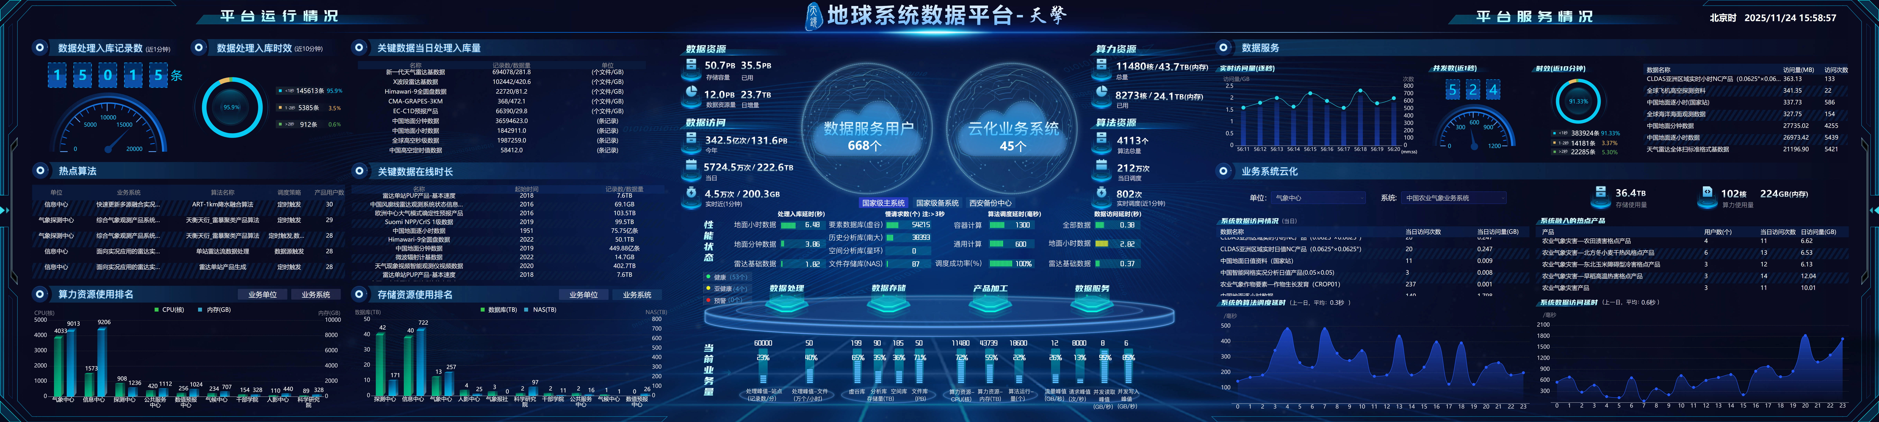
Technical Support System - Powered by the National Meteorological Big Data Platform – “Tianqing”
Cloud: Tianqing platform manages comprehensive,
authoritative meteorological data and algorithms
End: Various service terminals (Nongzaijing)
Core Feature – Integrated Data and Computing
Algorithms are deployed near to data sources
Breaks down traditional "information silos"
Data and algorithm resources are integrated and deployed in a united manner
Enables second-level data synchronization and second-level response to demands
Provided by National Meteorological Information Center, CMA

Slide 13
“Dual-Wheel Drive” Service Model
Wheel | Platform | Function | Target Users
Professional Wheel | Professional disaster monitoring and warning product generation platform (powered by "Tianqing") | Data processing, model computation, product generation | Researchers, operational experts
Service Wheel | "Nongzaijing" mini program (powered by WeChat ecosystem) | Streamlined application, targeted outreach | Front-line agricultural producers
Professional Platform ensures quality — Guaranteeing scientific and authoritative warning products
Sharing Platform expands coverage — Leveraging internet reach to directly connect with producers
Creating an efficient communication loop from professional warning products to front-line producers

Slide 14
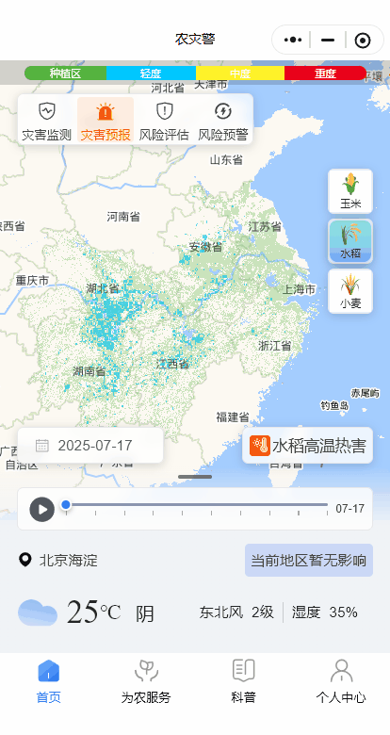
Core Functions: Targeted Coverage for Major Grain Regions
Northeast China
Corn, Rice
Huang-Huai-Hai Plain
Winter Wheat
Yangtze River Mid- Lower Reaches
Rice
Low-temperature chilling
Drought,
Spring frost
High-temperature heat damage
Real-time disaster monitoring + risk assessment
1-10 day disaster and risk warning
Automatically displays the local area by default using location services
Enabling producers to understand what the disaster is and how severe it will be.

Slide 15
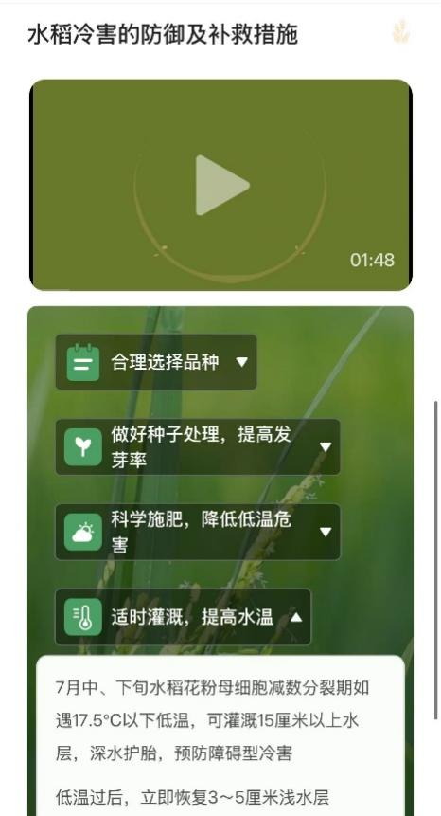
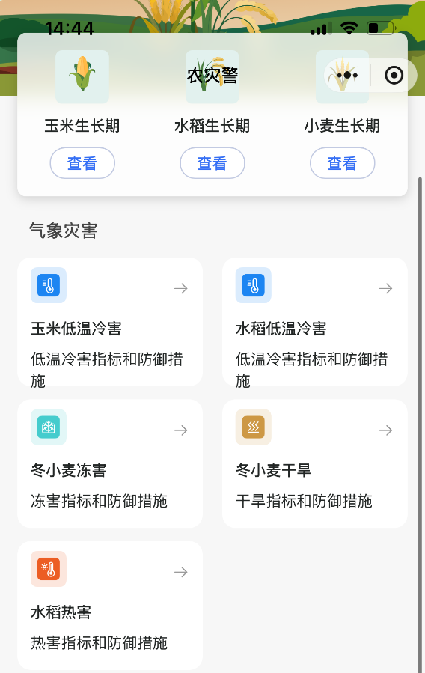


Core Functions: Science Popularization
Disaster concepts, examples, and prevention measures
Telling Producers "What to Do and Why"

Slide 16
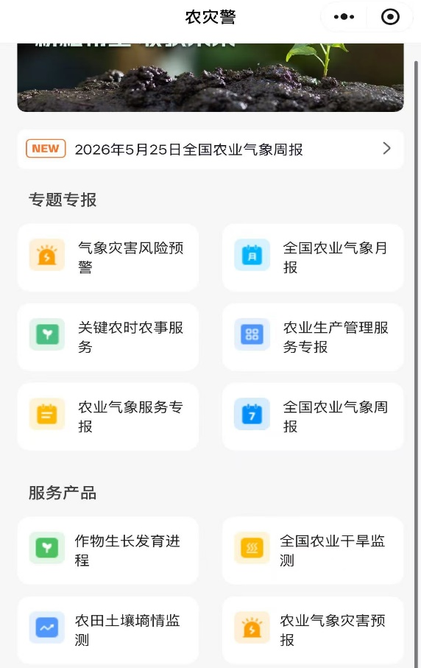
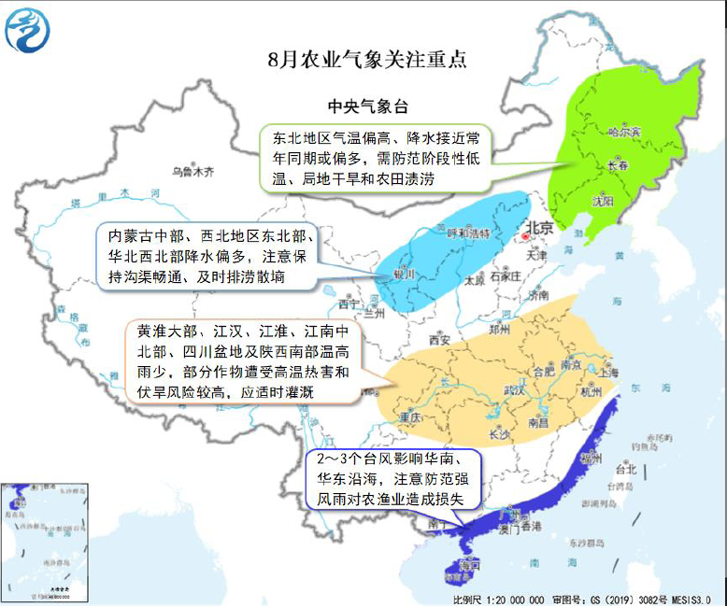
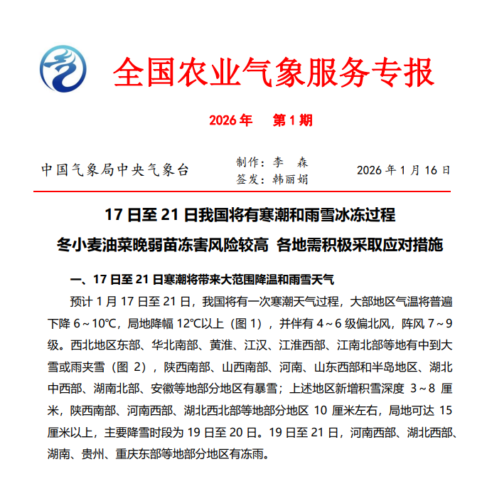
Core Functions: Agrometeorological Services
National-Level Agrometeorological Service Products
- expanding the reach of the service
National Agrometeorological Service Bulletin
protected crops, field crops, cash crops and others
Providing comprehensive support for farmers’ daily management needs across regions and crop growth cycles.

Slide 17
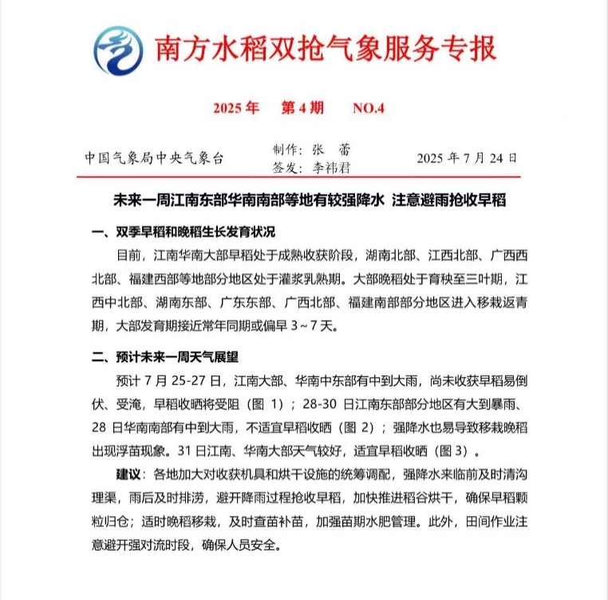
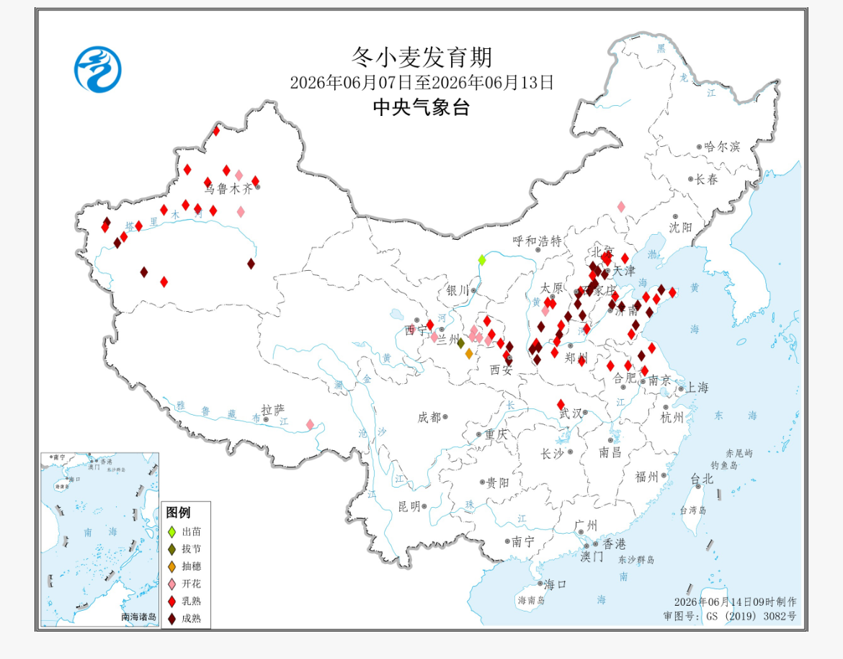
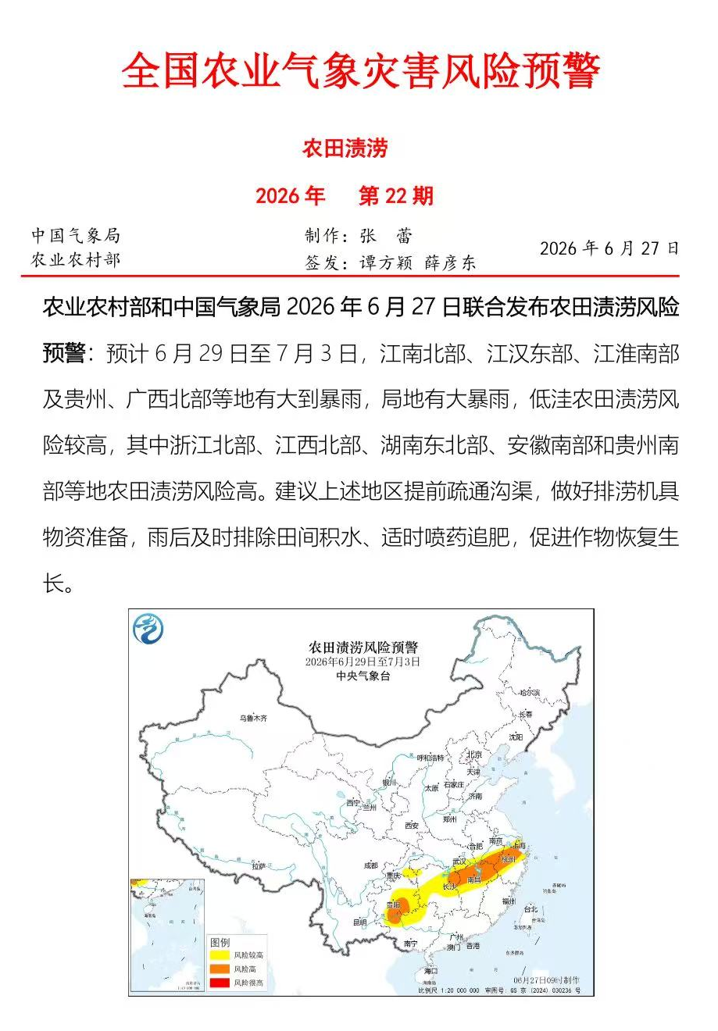
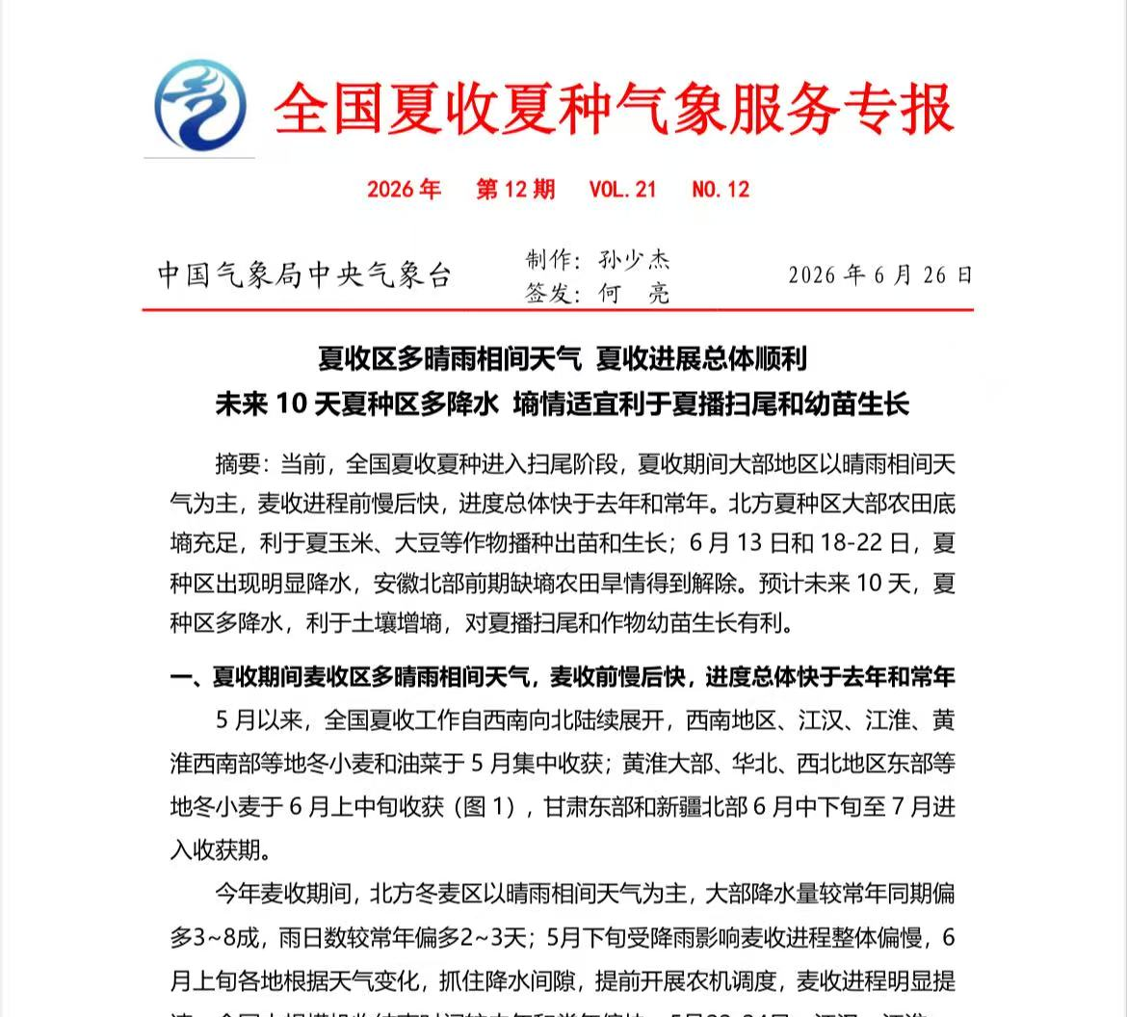
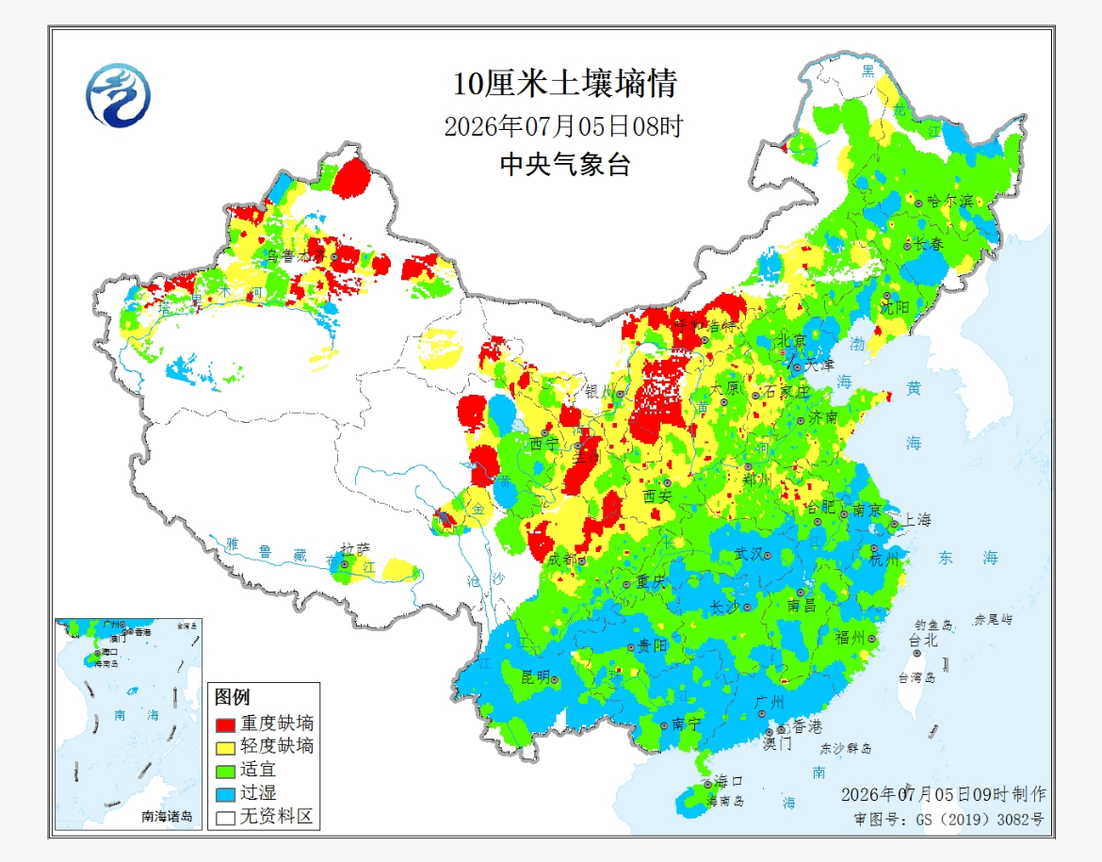
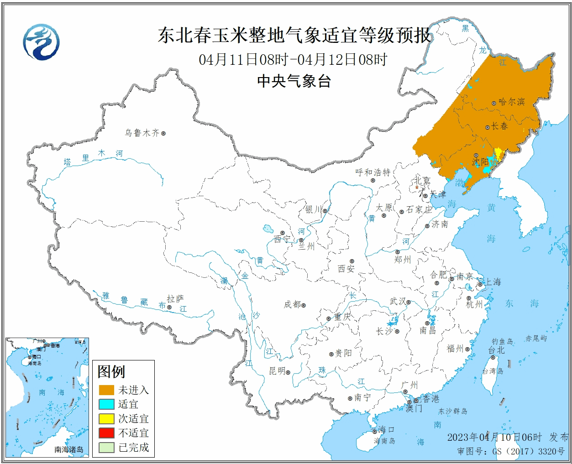
National-Level Agrometeorological Service Products
Crop Growth and Development Progress
Agricultural Production Management Service Bulletin
National Agrometeorological Disaster Risk Early Warning
Critical Agronomic Timing Services
Farmland Soil Moisture Monitoring

Slide 18
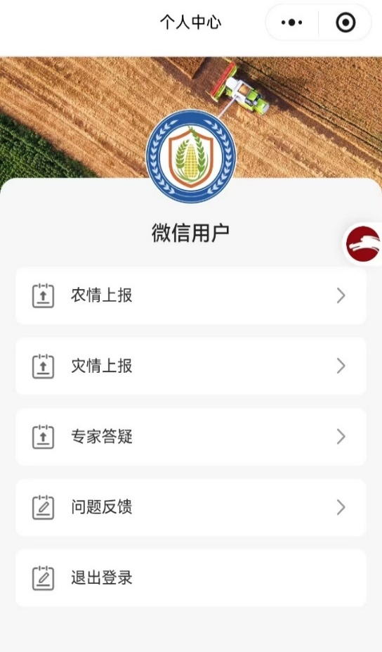
Core Functions: Two-Way Interaction
Function
Disaster Reporting
Expert Q&A
Disaster Subscription
Producers upload photos and descriptions of local field production and disaster conditions
Producers submit questions online and receive expert responses
Customized push notifications tailored to crop and hazard type
Used for disaster analysis, expert assessment, and decision support
Bridges the gap where grassroots extension capacity is limited
Reduce information overload and enables precision services
Producers evolve from simple end-users to data contributors and active participants

Slide 19
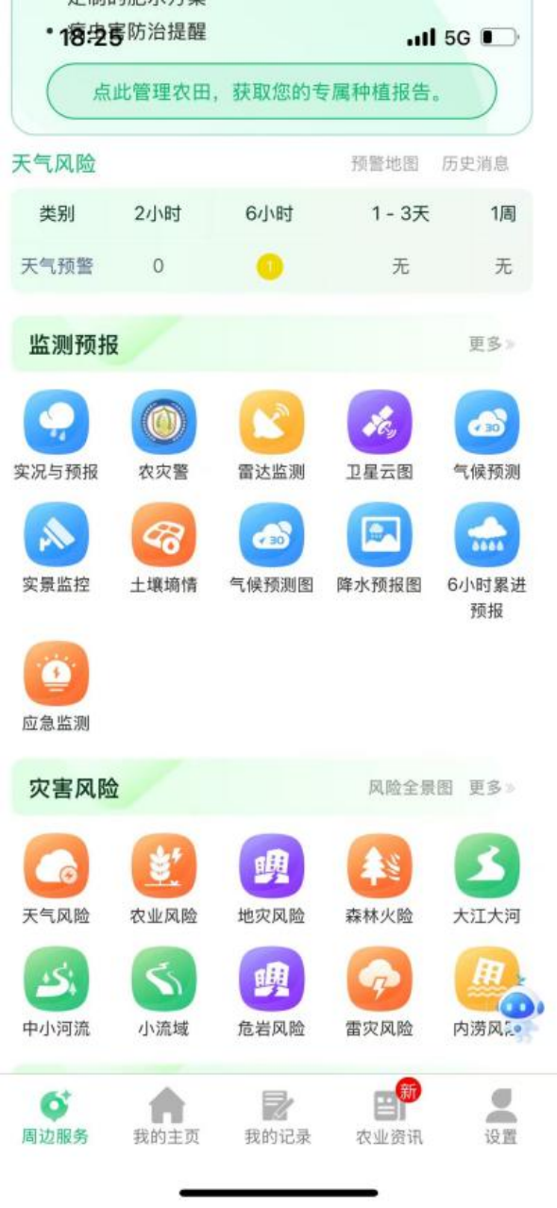
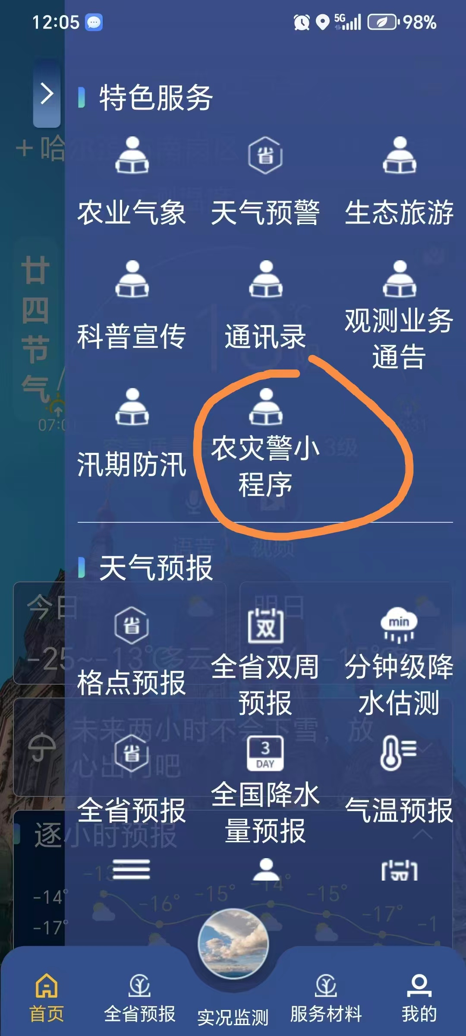
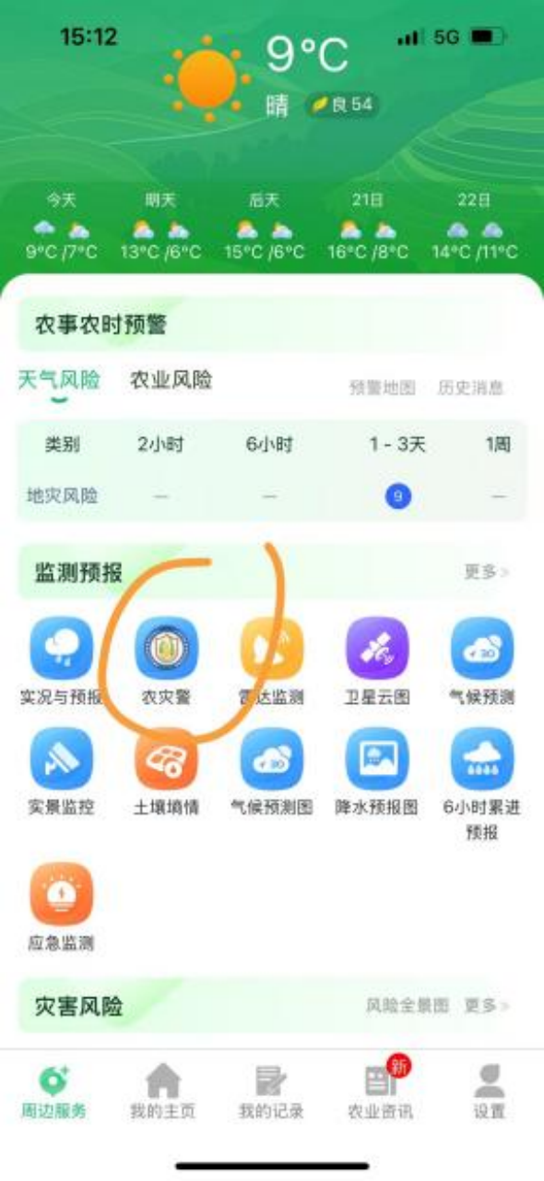
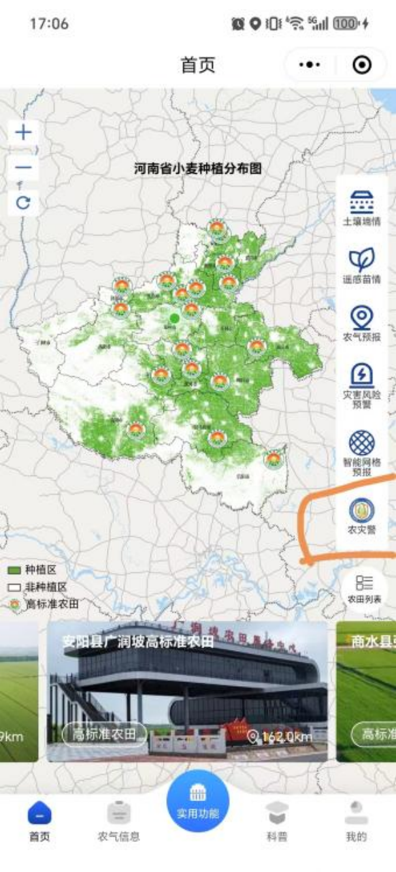
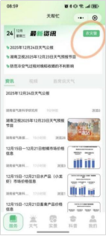
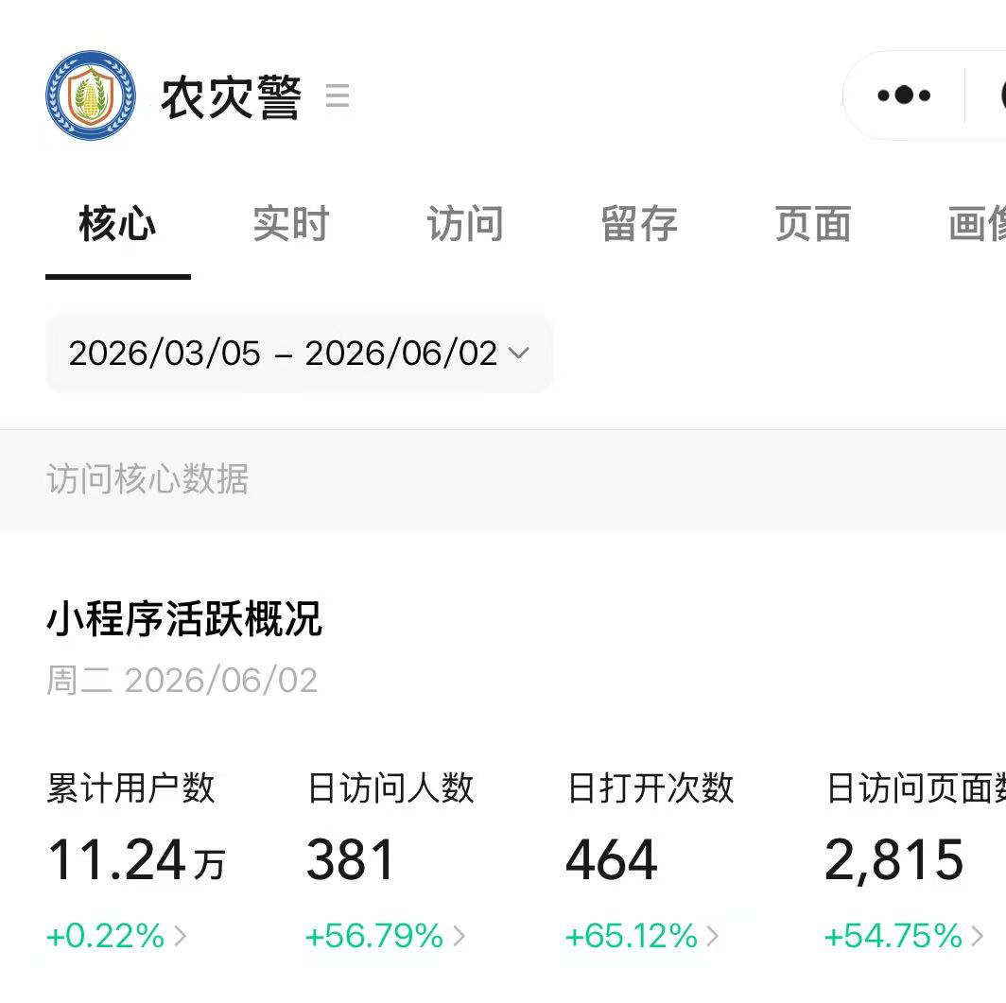
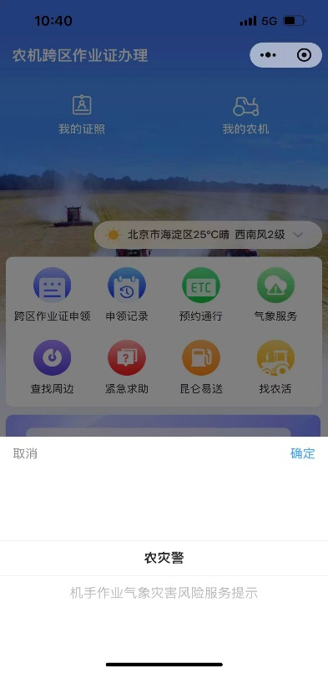
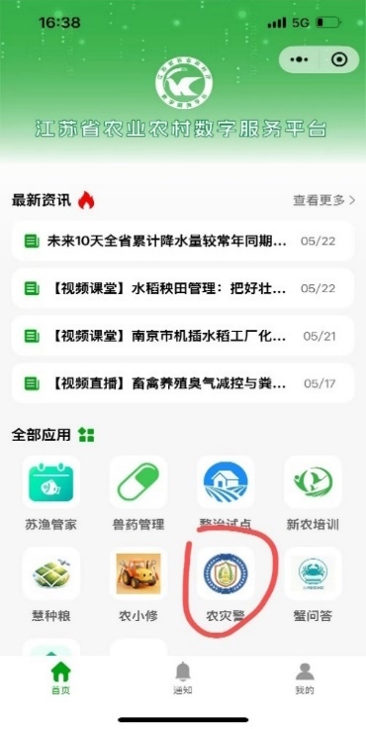
Current Deployment
Ready-to-Use, Quick Integration
Deployed as official meteorological service terminals at provincial and municipal levels
serving over 200,000 grassroots users
Regions | Typical Provinces | Users Served
Northeast China Corn, Rice | Heilongjiang | 黑龙江气象app 113051人
Huang-Huai-Hai Plain Winter Wheat | Henan | 天象微农 11879人
Yangtze River Mid- Lower Reaches Rice | Hunan Hubei | 天帮忙app 45418人 天惠农app 41843人
Integrated into Agricultural authority operational terminals

Slide 20
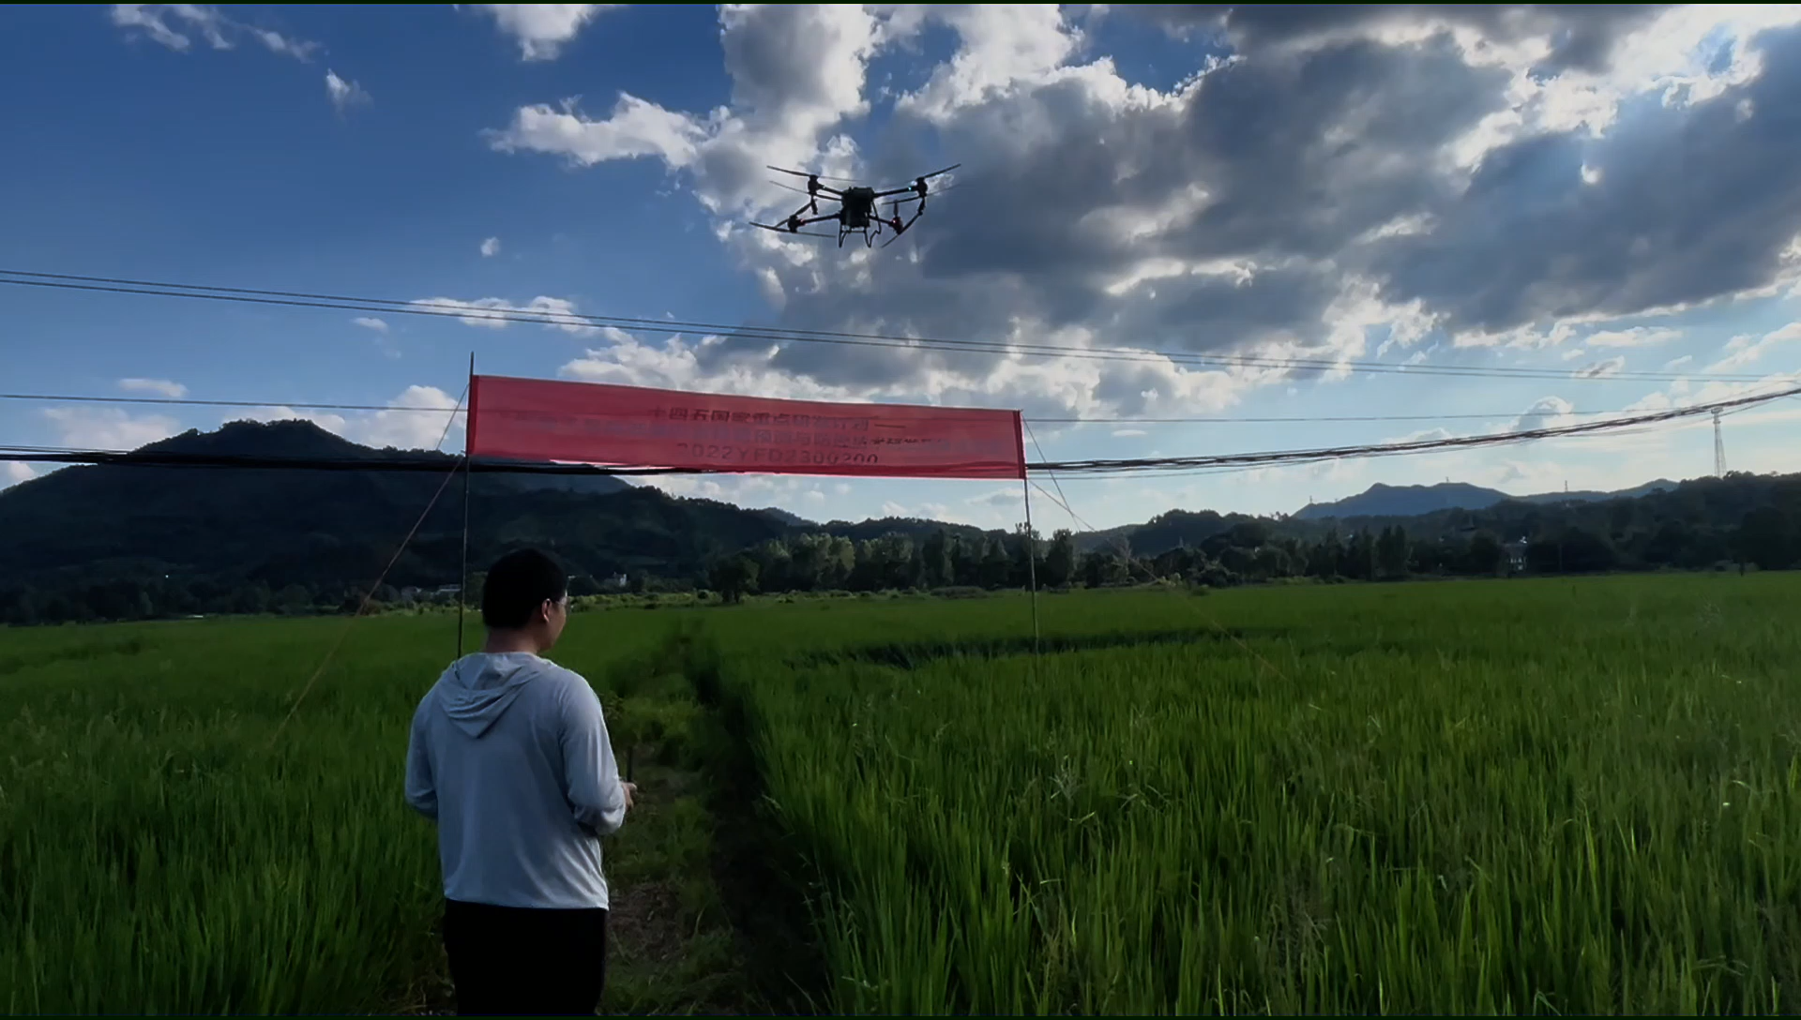
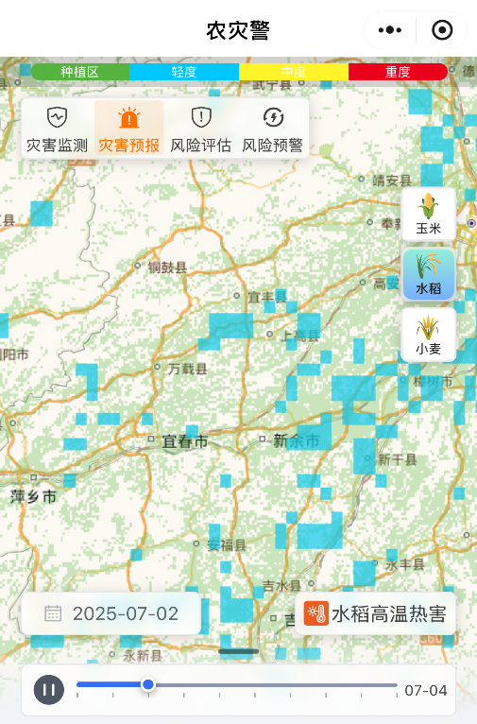
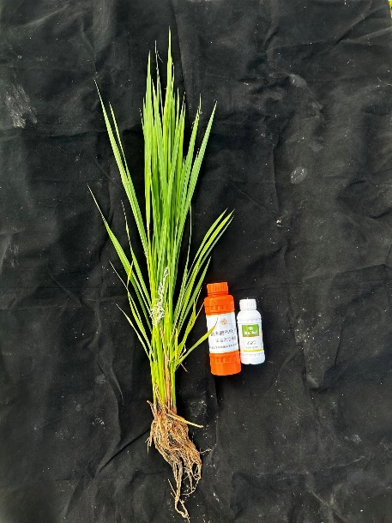
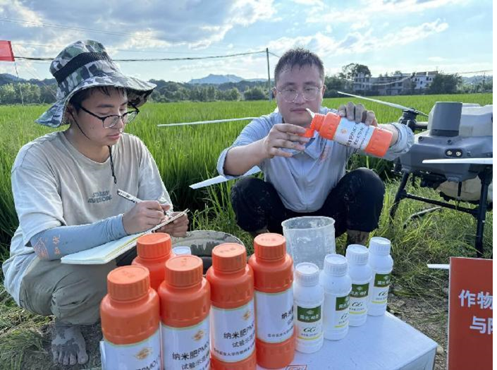
Application Case
Issue a warning
Mild
Mobilize crop protection inputs
July 2
July 3
July 4
Forecasting，July 2
Drone Spraying in Action
Specialized Agricultural Planting Cooperative，100 ha (Rice)
Chemical Application for High-Temperature Control at the Booting Stage
Achieved a 15.1% reduction in yield loss compared with no intervention

Slide 21
04
Key Takeaways
A Replicable “Toolkit”

Slide 22
Core Experience
Insight | Explanation
Digitalization is the breakthrough | "Nongzaijing" mini program disseminates professional warning information to agricultural producers at low cost and wide coverage
But digitalization is not a panacea | “Disseminating" is only the first step, "understanding it" and “Acting on it" matter just as much
Multi-channel Dissemination | Different channels serve different audiences — from broad coverage to precision dissemination, forming a complete service chain
From passive to active Engagement | Agricultural producers evolve from passive recipients to active participants, with two-way interaction improves warning accuracy and reinforces farmers' engagement

Slide 23
Essential Conditions for Developing Digital Tools
Demand-Driven Service
Start from farmers’ actual needs — not just telling them “a disaster is coming,” but also guiding them on “what actions to take”
Data Collection & Algorithm Capacity
Data collection and algorithm capacity form the foundation of the APP
Primary Platform Selection
Choose a digital platform with a large local user base and minimal access barriers as the dissemination channel
Sustained Training and Promotion
Ensuring target users know about the tool, can use it, and are willing to use it — only then can the service truly take effect

Slide 24
Ensuring that every agricultural producer - when disaster strikes - is no longer a
last‑mile blind spot, but an informed and proactive actor within the disaster
preparedness network.
Receiving warnings a day earlier and acting a step sooner captures the true value of last‑mile efforts.

Slide 25

Thank You
China Meteorological Administration
E-mail: zy@cma.gov.cn
Sharing for Learning

