Slide 1
Integrated Monitoring and Early Warning System for Natural Disasters and Practices of China
Department of Disaster Risk Monitoring and Integrated Disaster Reduction, Ministry of Emergency Management
Nov, 1st, 2023

Slide 2
CONTENTS
Integrated Monitoring and Early Warning System for Natural Disasters in China
Effectiveness of Integrated Monitoring and Early Warning of Natural Disasters in Recent Years
01
02
National Integrated Monitoring and Early Warning Platform System for Natural Disasters
Challenges and Next Steps
03
04

Slide 3
01
Integrated Monitoring and Early Warning System for Natural Disasters in China

Slide 4
Integrated Monitoring and Early Warning System for Natural Disasters in China
Define mechanisms: building a working mechanism for categorised monitoring and graded early warning
Push forward work: carrying out integrated monitoring and early warning of natural disasters
Build capacity: strengthening capacity building for integrated monitoring and early warning of natural disasters

Slide 5
(i) Building a Sound Working Mechanism for Categorised Monitoring and Graded Early Warning
Categorised monitoring and graded early warning system for natural disasters in China
Integrated monitoring and early warning of natural disasters
Meteorological disaster monitoring and early warning
Marine disaster monitoring and early warning
Drought and flood monitoring and early warning
Geological disaster monitoring and early warning
Earthquake monitoring and early warning
Forestry and grassland disaster monitoring and early warning

Slide 6
(ii) Integrated Monitoring and Early Warning of Natural Disasters
Conducting integrated multi-hazard monitoring
Targeting at typhoons, floods, earthquakes, forestry and grassland disasters as well as secondary disasters caused by them, it has carried out the integrated risk monitoring of multi-hazard disaster chain by leveraging space-air-ground-human integrated networks, and combining technical, physical and human prevention measures.
It has established a joint disaster risk consultation system on a annual and monthly basis and for key nodes and major events; organised meteorology, water resources, natural resources, and forestry and grassland departments for regular consultations to identify integrated disaster risks nationwide; and invited departments and local governments to prevent and cope with risks in light of actual conditions.
Establishing a joint disaster risk consultation system
Strengthening disaster early warning decision-making support
It has drafted administrative measures, studied and formulated grading standards, accelerated the R&D of early warning and assessment models, and, in the event of a major disaster, provided timely decision-making support to the Ministry's leadership and rescue teams, and issued early warning alerts to localities.
Enhancing the disaster early warning linkage mechanism
It has formulated and implemented departmental early-warning response linkage plans, and implemented early-warning response action measures such as early warning of impending disaster and call for response, scientific pre-loading of forces, early evacuation and relocation of people, preparation for material transfers, and adoption of social controls.

Slide 7
(iii) Capacity Building for Integrated Monitoring and Early Warning of Natural Disasters
One center
One platform
One base
Constructing a national center for integrated risk monitoring and early warning of natural disasters
Building a national platform for integrated disaster monitoring and early warning
Pushing forward the First National Census on the Risk of Natural Disasters
Relying on the National Emergency Command Headquarters, a national center for integrated risk monitoring and early warning of natural disasters has been constructed by gathering the strength of experts from support units within and outside the Ministry, domestic research institutes, colleges and universities, and central enterprises, which meets the needs of work scenarios such as on-duty watchkeeping, consultation and scheduling, disaster rehearsal, and exercise and evaluation.
It has established sound mechanisms for departmental and local information-sharing, reporting of information on disaster risks and hazards, remote sensing monitoring by satellites and drones, integrated consultation and judgement, and early warning and response.
The integrated risk monitoring and early-warning system for natural disasters has been improved by integrating with the monitoring and early-warning systems of industry sectors, ministries/departments/bureaus and localities.
It has organised the first national census on the risk of natural disasters, led a number of departments and 32 provincial units and 122 counties and municipalities across the country in successfully completing the zoning for national risk survey and evaluation, mapping disaster risks and hazards nationwide and capturing the national disaster risk profile.

Slide 8
02
Effectiveness of Integrated Monitoring and Early Warning of Natural Disasters in Recent Years

Slide 9
Effectiveness of Integrated Monitoring and Early Warning of Natural Disasters in Recent Years
Exercise overall leadership: effectiveness of work at the national level
Focus on local levels: effectiveness of work in typical local areas

Slide 10
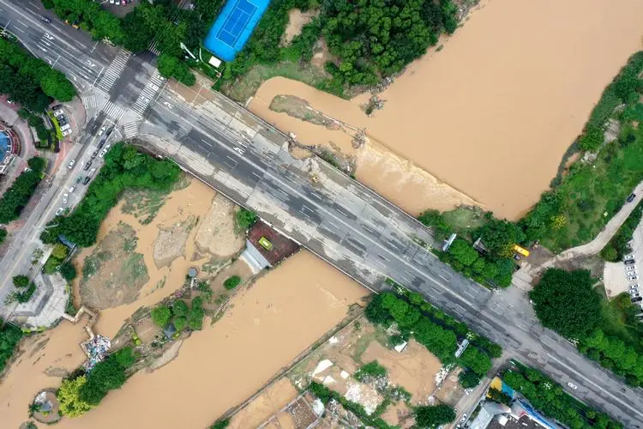
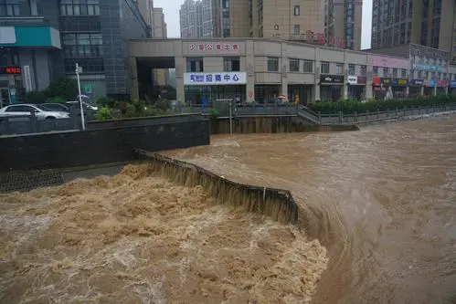
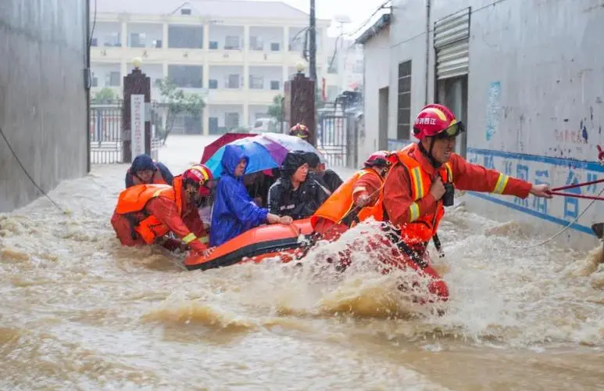
(i) Effectiveness of Work at the National Level
Take the year 2020 for example. In 2020, torrential rain and flooding occurred in many parts of China, which suffered the worst flooding since 1998. Basin-wide flooding occurred simultaneously in the Yangtze River, Huaihe River and Taihu Lake, etc., causing critical disaster risk situation.

Slide 11
(i) Effectiveness of Work at the National Level
In response to the national severe flood situation in 2020:
Ministry of Water Resources
Issued 1,904 water warnings and accurately predicted 5 numbered floods in the Yangtze River
Ministry of Industry and Information Technology
Issued 2.84 billion pieces of early warning information on flash floods, geological disasters, etc.
Ministry of Natural Resources
Successfully avoided 128 geological disasters and evacuated 5055 people from emergency
China Meteorological Administration
Initiated 25 major meteorological disaster emergencies and issued more than 210,000 pieces of early warning information of various types
Publicity Department of the CPC Central Committee
Organized all levels to strengthen news coverage, public opinion guidance and public education on flood control and disaster relief.
Ministry of Emergency Management
Organised 254 emergency consultation meetings, activated 61 emergency responses and dispatched 91 working groups to the front line.

Slide 12
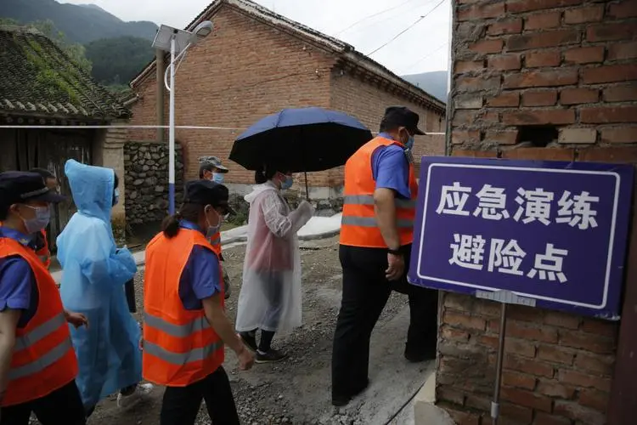
(i) Effectiveness of Work at the National Level
Scientific emergency response was carried out through accurate monitoring and early warning and effective front-loading of rescue forces:
In 2020,
A total of 4.77 million people were urgently relocated nationwide, the largest in recent years;
Number of missing persons: down by 52.6%;
Number of collapsed houses: down by 47.0%;
Number of people killed and missing in disasters: the lowest in history.

Slide 13
(ii) Effectiveness of Work in Typical Local Areas
For example, Guangdong Province has established a mechanism for "pre-judgement, impending disaster forecast and short-notice warning". "Pre-judgement" is to timely consult, study and assess the risk at an early stage, and make a scientific judgement; "Forecast" is to make an announcement in advance of the development trend of the disaster risk and the scope of the future impact based on the results of the pre-judgement; and "Warning" is to widely mobilise before the emergency response and effectively make preparations for the emergency response.
Chishikeng Village in Yuantan Township received up to 266.9mm of rainfall in the past six hours, exceeding the "one-in-50-year" rainfall
The Government of Yuantan Township urgently held a meeting to implement the village-based contact system of township cadres
Township and village cadres relocated 55 people in the village
A devastating mudslide hit the village
22:00, June 7
00:30, June 8
03:00, June 8
22:00, June 8
00:20, June 8
02:00, June 8
08:00, June 8
02:00, June 9
Short-notice warning information was issued to Yuantan Township, Qingcheng District, Qingyuan City, China
Through the video link, the Government of Yuantan Township was required to made hourly on-site reports to the Command Center
Qingcheng District activiated Level III emergency response for flood control
The last person in the village was relocated
At around 02:00 on June 9, some four hours after the villagers had been relocated, a devastating mudslide hit the village. No casualties were caused because of the timely warning and transfer.

Slide 14
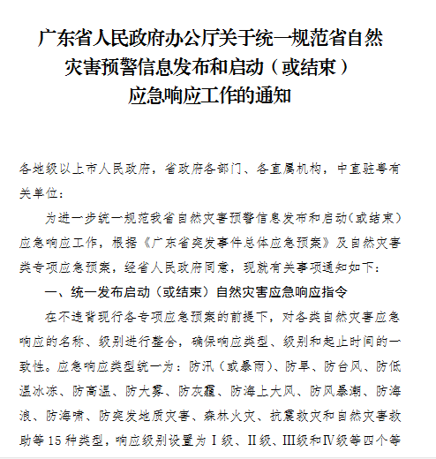
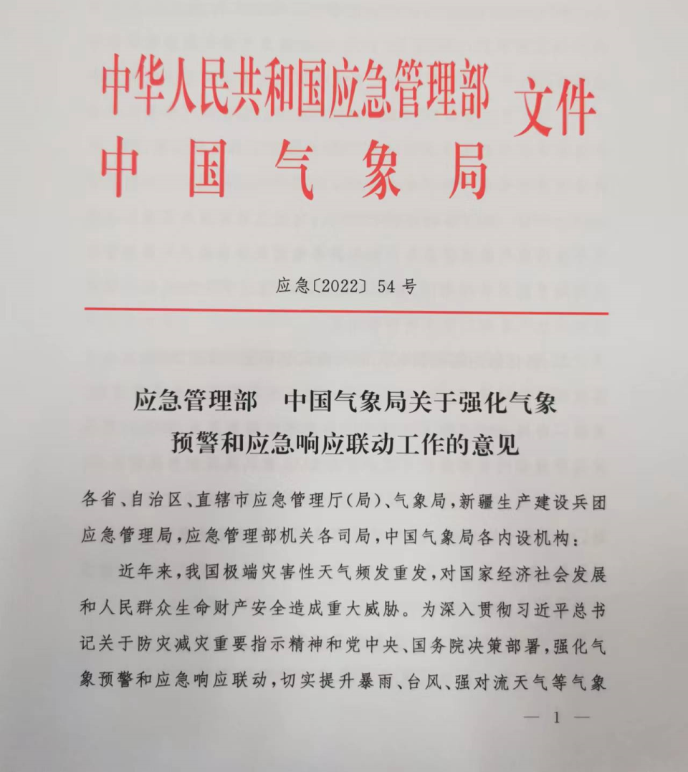
Linkage of meteorological warning and emergency response

Slide 15
Linkage of meteorological warning and emergency response
1.Horizontal communication between meteorological warning and emergency response information should be strengthened
Improve the mechanism for sharing weather forecast and early warning information, establish a 24-hour direct connection system for personnel on duty, and realize real-time sharing of weather forecast and early warning information for heavy rain, typhoons and severe convection weather.
Meteorological warning information will be released through the National Emergency Warning Information Release platform.
The Ministry of Emergency Management receives meteorological early warning information through the emergency management big data application platform.
Local emergency management departments at all levels can obtain meteorological early warning information through the comprehensive application platform of provincial emergency management.

Slide 16
Linkage of meteorological warning and emergency response
2. Strengthen the "call response" mechanism for red weather warnings reaching people in charge at the grassroots level
When the meteorological department issues the meteorological red warning information about rainstorms, typhoons and severe convection weather, it shall immediately report it to the person in charge of the flood control and drought relief headquarters at the corresponding level by telephone, and notify the main person in charge or in charge of the emergency management department at the corresponding level, and make a record after confirming the receipt.
At the county level meteorological department issued storm, typhoon, strong convective weather such as red meteorological early warning information, but also through the channels with local emergency management department is decided in advance to remind the warning cover the villages and towns (street) principal party and government and village (community) flood prevention responsible, ensure real-time warning message to the people, and preventive measures in place before a disaster.

Slide 17
Linkage of meteorological warning and emergency response
3. Strengthen the linkage mechanism between meteorological early warning and emergency response
When organizing the revision of emergency preplans for flood control and drought relief, emergency management departments at all levels shall incorporate meteorological early warning into the starting conditions of emergency response, determine the emergency response level reasonably in light of the local disaster bearing capacity, and specify action measures.
Upon receipt of meteorological early warning information, emergency management departments shall organize comprehensive consultation and evaluation of disaster risks, and timely report to the flood control and drought relief headquarters at the same level to initiate emergency response according to the pre-plan.
To put forward suggestions on the implementation of compulsory measures such as "closure and suspension", and to implement them decisively according to the plans and consultation opinions.

Slide 18
Linkage of meteorological warning and emergency response
4. Strengthen the county-level prevention and response guidance of meteorological red warning
Upon receipt of the meteorological warning information, the emergency management departments at or above the prefecture-level shall promptly guide the relevant county-level flood control and drought relief command agencies to initiate or adjust the emergency response, and urge the detailed implementation of preventive and response measures.
For county-level flood control and drought relief headquarters that have issued meteorological red warning information but have not initiated emergency response, emergency management departments at or above the prefecture-level shall timely remind and supervise them to initiate corresponding emergency response.

Slide 19
Linkage of meteorological warning and emergency response
5. Strengthen the information society release mechanism for meteorological early warning and emergency response
Meteorological department, emergency management departments at all levels should make full use of radio, television, text messages, newspaper, network, social media, the public display and the national emergency early warning information release platform, emergency broadcasting system, intelligent call out system and other channels to the widespread meteorological early warning and emergency response information, and guide the public away from the danger zone and obey safety work, And remind industrial, mining and trade enterprises to prevent production safety accidents caused by meteorological disasters.
Emergency management departments at the county level should also be urged to guide the villages and towns (street) and village (community) to loudspeakers, causeway, whistle, manual alarm, knocking at the door notice warning information, to assist the township people's government guidance administrative villages (communities) to carry out the local village (house) people especially old people who live alone, sick people, and the transfer of left-behind children responsibility measures, Do not miss a warning, do not fall a person.

Slide 20
Linkage of meteorological warning and emergency response
6. To make meteorological early warning and emergency response more scientific
Meteorological departments at all levels should further improve the progressive meteorological disaster early warning service mechanism, optimize the early warning information release rules, and realize the gradual advance of early warning information in time, continuous precision in space, and more targeted warning content.
Meteorological departments at all levels, together with emergency management departments and other departments, should make full use of the results of the comprehensive risk survey of natural disasters, take into account the actual conditions of local historical disasters, underlying surface conditions, and disaster prevention and mitigation capabilities, regularly carry out threshold assessment, and constantly optimize and improve meteorological early warning services based on disaster thresholds.
After the occurrence of a major or major disaster, the emergency management department shall, together with the meteorological department, organize the implementation effect evaluation of meteorological early warning and emergency response, further improve the linkage mechanism between meteorological early warning and emergency response initiation conditions, and make meteorological early warning and emergency response more accurate and scientific.

Slide 21
03
National Integrated Monitoring and Early Warning Platform System for Natural Disasters

Slide 22
1
Background and Rationale
CHAPTER
1
President Xi Jinping personally deployed the implementation of nine key projects, including the information technology for natural disaster monitoring and early warning, aiming to improve comprehensive capacity for disaster risk reduction
In June 2020, seven authorities jointly issued the General Plan for Natural Disaster Monitoring and Early Warning Information Technology Project, which calls for accelerating the construction of an integrated monitoring and early warning system for natural disasters.
The National Emergency Management System Plan during the 14th Five-Year Plan Period and the National Comprehensive Disaster Prevention and Mitigation Plan during the 14th Five-Year Plan Period call for building a national integrated monitoring and early warning platform for natural disasters
The programme for the division of responsibilities for the key work of the MEM Party Committee in 2023 makes it clear that it is necessary to accelerate the building of a national integrated monitoring and early warning platform for natural disasters
2
3
4

Slide 23
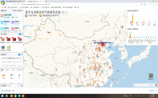
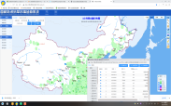
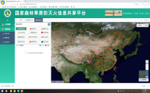
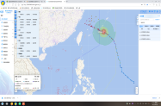
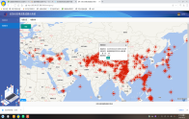
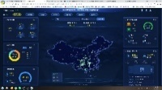
2
Objectives and Positioning
CHAPTER
信息汇聚 Information convergence
1
Achieving institutionalized, systematic and information-based integrated monitoring and early warning operations for natural disasters
Building comprehensive hub for "information convergence, business operation and decision-making assistance"
2
业务运转 Business operation
辅助决策 Decision-making assistance
Connecting with the command center of the National Emergency Command Center in an orderly manner and fully supporting the operation of the headquarters
3

Slide 24
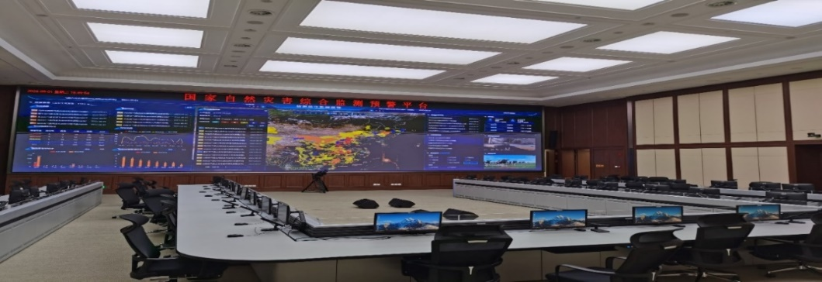
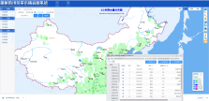
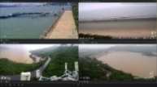
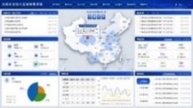
3
Components
CHAPTER
国家自然灾害综合监测预警平台 National Integrated Monitoring and Early Warning Platform for Natural Disasters
1个综合监测预警大厅 1 integrated monitoring and early warning hall
1个综合数据库 1 integrated database
N个专业系统：气象、水利、地质、海洋、地震、林草、公安、交通、应急等 N specialised systems: meteorological, water resources, geological, marine, seismic, forest and grassland, public security, transport, emergency response, etc.
1个综合系统 1 integrated system

Slide 25
3
Components
CHAPTER
1个综合数据库 1 integrated database
数据 接入Data access
自然灾害综合监测预警数据库 Integrated Monitoring and Early Warning Database for Natural Disasters
风险监测预警业务数据库 Risk Monitoring and Early Warning Operations Database
全球灾害监测数据库 Global Disaster Monitoring Database
第一次全国自然灾害综合风险普查成果 Outcomes of the First National Census on the Risk of Natural Disasters
40 项 40 outcomes
应急资源池 Emergency resource pool
产品库 Product base
案例库 Case base
全球基础数据库 Global Basic Database
数据接入 Data access
中国气象局 China Meteorological Administration (CMA)
43 类 43 categories
数据 接入 Data access
监测预警产品
Monitoring and early warning products
灾害会商产品 Disaster consultation products
灾害现场产品 Disaster site products
案例信息 Case info
措施库信息 Measure base info
全球历史灾情数据库 Global Historical Disaster Database
行业部门 Industry sectors
水利部 The Ministry of Water Resources, PRC (MWR)
2 类 2 categories
风险评估产品 Risk assessment products
风险趋势产品 Risk trend products
遥感监测产品 Remote sensing monitoring products
救灾信息 Disaster relief info
……
全球实时灾情数据库 Global Real-time Disaster Database
自然资源部 Ministry of Natural Resources, PRC
全球产品数据库 Global Product Database
8 类 8 categories
普查数据库 Census database
专题产品 Featured products
过程产品 Process products
……
知识库 Knowledge base
中国地震局 China Earthquake Administration (CEA)
4 类 4 categories
天气网 weather.com
中央气象台 National Meteorological Centre
基础库 Basic base
法律法规 Laws and regulations
预案信息 Plan info
……
水利部官网 MWR official website
国家能源局 National Energy Administration (NEA)
1 类 1 category
减灾中心邮箱 NDRCC mailbox
致灾因子 Disaster causing factors
承灾体 Hazard-affected bodies
孕灾环境 Hazard inducing environment
灾害损失 Disaster losses
专家团队 Team of experts
……
支撑数据库 Support Database
用户数据 User data
系统配置 System configuration
…
…
中国海洋预报网 oceanguide.org.cn
国家气候中心 National Climate Centre
气象数据 Meteorological data
人口 Population
地形地貌 Topography
过程库 Process base
水文数据 Hydrological data
房屋建筑 Housing construction
断裂带 Fault zone
遥感影像 Remote sensing image
运行监控 Operational monitoring
……
其他来源 Other sources
数据 接入Data access
海洋数据 Marine data
交通设施 Transport facilities
会商背景 Consultation context
灾情分析 Analysis of disaster situation
国家安全生产应急平台 National Work Safety Emergency Platform
26 类 26 categories
土壤数据 Soil data
地理信息 Geographic information
模型库 Model base
部内系统 Intra-ministerial systems
地震数据 Seismic data
水利设施 Water conservancy facilities
植被数据 Vegetation data
应急处置 Emergency response
救援救助 Rescue & relief
国家森林防灭火信息共享平台 National Forest Fire Prevention and Control Information Sharing Platform
8 类 8 categories
……
……
……
……
灾害损失 Disaster losses
……
灾种模型库 Hazard model base
参数库 Parameter database
……
网罗天下 Wangluotianxia
6 类 6 categories

Slide 26
3
平台建设内容 Components
CHAPTER
N个自然灾害相关专业系统 N Specialised Systems Related to Natural Disasters
序 号 SN. | 系 统 名 称 System Name | 来 源 Source | 序 号 SN. | 系 统 名 称 System Name | 来 源 Source
1 | 数字化决策支持气象服务系统 Digital decision supporting weather service system | 中国气象局 China Meteorological Administration (CMA) | 10 | 烟花爆竹安全生产风险监测预警系统部级平台 Ministerial platform for the fireworks work safety risk monitoring and early warning system | 中国安全生产科学研究院 China Academy of Safety Science and Technology 科学研究院
2 | 防汛抗旱防台风会商系统 Flood, drought and typhoon consultation system | 国家防总办公室 Office of State Flood Control and Drought Relief Headquarters | 11 | 全国危险化学品安全生产风险监测预警系统 National hazardous chemicals work safety risk monitoring and early warning system
3 | 国家防汛抗旱水情会商系统 National flood and drought water condition consultation system | 水利部 The Ministry of Water Resources (MWR) | 12 | 国家煤矿安全生产风险监测系统 National coal mine work safety risk monitoring system
4 | 应急信息推送集成展示系统 Emergency information push integrated display system | 地震应急搜救中心 National Earthquake Response Support Service (NERSS) | 13 | 尾矿库安全生产风险监测预警系统 Tailings pond work safety risk monitoring and early warning system
5 | 国家森林草原防灭火信息共享平台 National forest and grassland fire prevention and suppression information sharing platform | 国家森防办 Office of the National Forest Fire Command | 14 | 安全生产监测预警中心大屏 creen at the Work Safety Monitoring and Early Warning Center
6 | 雪亮工程 Xueliang Project | 公安部 Ministry of Public Security | 15 | 灾害演化多场综合动态信息采集及数据分析系统 Multi-field integrated dynamic information acquisition and data analysis system for disaster evolution | 国家自然灾害防治研究院 National Institute of Natural Hazards 防治研究院
7 | 天眼卫星监测系统 SBSS monitoring system | 应急管理部 MEM | 16 | 道路结冰预测预警系统 Road icing prediction and warning system | 国家电网 State Grid Corporation of China
8 | 网罗天下系统 Wangluotianxia system |  | 17 | 山火灾害风险预测与监测预警系统 Mountain fire disaster risk prediction, monitoring and early warning system
9 | 自然灾害综合风险监测业务系统 Integrated risk monitoring operations system for natural disasters | 国家减灾中心 NDRCC | 18 | 地质灾害实时监测预警平台 Real-time monitoring and early warning platform for geological disasters | 成都理工大学 Chengdu University of Technology

Slide 27
3
平台建设内容 Components
CHAPTER
1个综合监测预警系统 1 integrated monitoring and early warning system
自然灾害综合监测预警系统 Integrated monitoring and early warning system for natural disasters
综合风险会商研判系统 Integrated risk consultation and judgement system
灾害综合风险隐患监测系统 Integrated disaster risk and hazard monitoring system
重大灾害预警评估系统 Major disaster early warning and assessment system
灾害综合风险趋势预测系统 Integrated disaster risk trend prediction system
灾害综合风险评估区划系统 Integrated disaster risk assessment zoning system
灾害风险信息服务系统 Disaster risk information service system
数据库管理系统 Database management system
运维管理系统 O&M management system
重大灾害会商研判 Major disaster consultation and judgement
每日会商研判 Daily consultation and judgement
年月度会商研判 Annual and monthly consultation and judgement
风险模拟预判 Risk modelling and prediction
灾害综合风险监测 Integrated disaster risk monitoring
灾害风险隐患信息报送 Disaster risk hazard information reporting
无人机风险监测
UVA Drone-based risk monitoring
重大灾害监测预警 Major disaster monitoring and early warning
重大灾害风险评估 Major disaster risk assessment
重大灾害风险预警 Early warning of major disaster risks
重大灾害预警评估产品制作 Major disaster early warning and assessment product production
日周灾害风险 Daily and weekly disaster risks
灾害预警 Disaster early warning
年月度灾害风险 Annual and monthly disaster risks
风险趋势预测支撑 Risk trend forecast support
灾害综合风险评估 Integrated disaster risk assessment
灾害综合区划 Integrated disaster zoning
灾害综合风险评估区划服务 Integrated disaster risk assessment zoning services
通用工具 General tools
国家综合防灾预警一张图 One map for national integrated disaster prevention and early warning
综合减灾示范管理 Integrated disaster reduction demonstration management
全球灾害数据平台 Global disaster data platform
8 个分系统 8 branch systems
22 个子系统 22 sub-systems
325 个功能模块 325 functional modules
新建 Newly built
利旧Leveraging old resources
升级 Upgrade

Slide 28
04
Challenges and Next Steps

Slide 29
(i) Challenges
2. Integration of new technologies to be strengthened
1. Increased disaster risks
The application of new technologies such as satellite remote sensing, big data, cloud computing and intelligent interconnections in integrated early warning has yet to be further integrated and strengthened.
In the context of global climate change, there has been an increase in the number of extreme weather and climate events, an increase in the risk of disasters, and a growing spatio-temporal uncertainty and complexity in the occurrence of disasters.
3. Operational capacity for disaster risk monitoring yet to be improved
Information sharing across sectors and levels needs to be further strengthened, operational capacity for disaster risk monitoring needs to be improved, and risk assessment models and thresholds for early warning standards need to be further studied.

Slide 30
(ii) Next Steps
Three shifts
From monitoring and early warning of disaster-causing factors
to monitoring and early warning of disaster risk losses
From single-hazard monitoring and early warning
to multi-hazard and disaster chain monitoring and early warning
From monitoring and early warning
to early warning response
Four initiatives
Drafted and issued the Measures for the Administration of Integrated Risk Monitoring and Early Warning of Natural Disasters
Developed the Risk Monitoring and Early Warning Response Grading Standards
Built a national platform for integrated risk monitoring and early warning of natural disasters
Implementated the departmental information sharing and early warning response linkage mechanisms

Slide 31
Thank You
Sharing for Learning

