Slide 1
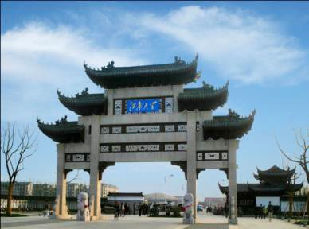
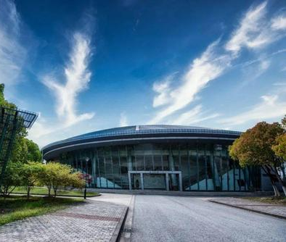
Rice Grading for Nutrition from
Food Science Perspective
Li Wang
Jiangnan University, Wuxi .2023.06.20
1

Slide 2
01
\Rice introduction
Outline
02
\Rice grading
03
\Rice nutrition
2

Slide 3
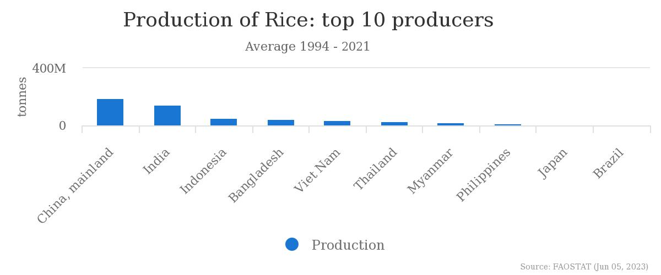
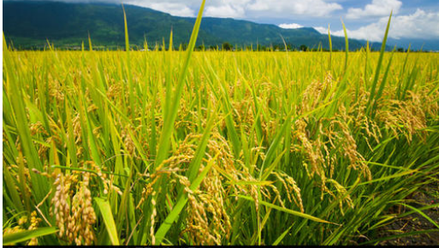
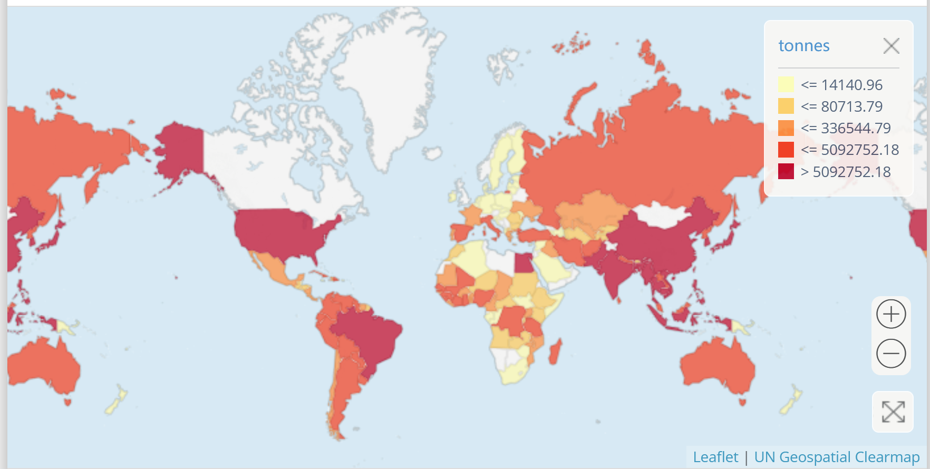
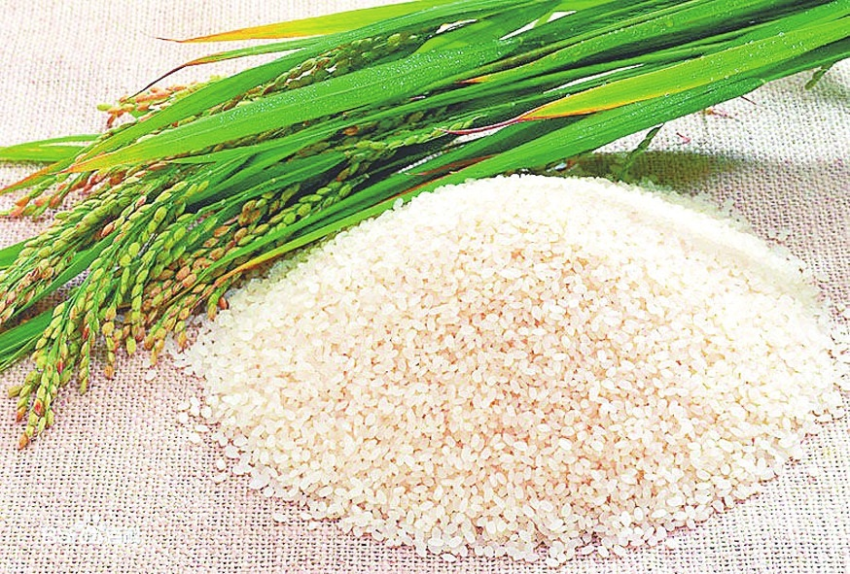
1. Rice introduction: Global Rice production
214 million tons
From the data of FAO, the highest production of rice appeared in China.
3

Slide 4
1. Rice introduction: Rice composition
The structure and nutritional composition of rice
Name of Structure | Proportion | Main nutrients
Cortices | 1-2% | Cellulose, hemicelluloses
Aleurone layer | 4-6% | Fat, protein, cellulose
Embryo | 1-2% | Vitamins, minerals
Starch endosperm | 90% | Starch, protein
Rice is mainly comprised of husk, bran, endosperm and embryo.
4

Slide 5
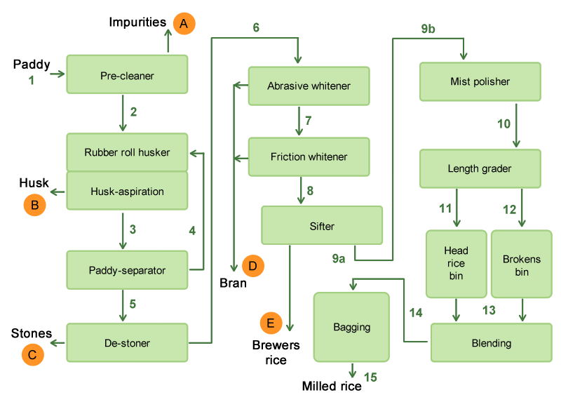
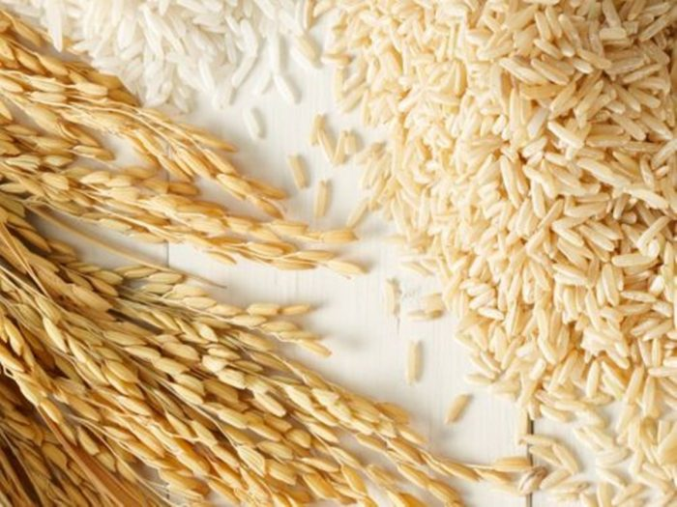
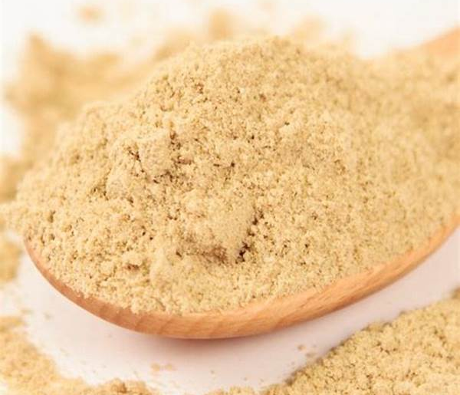
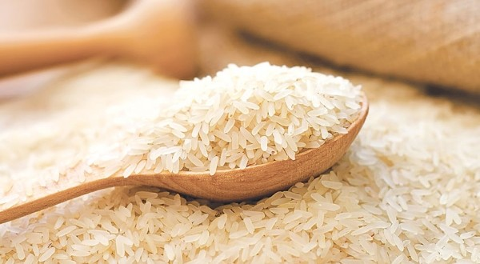
2. Rice grading
5

Slide 6
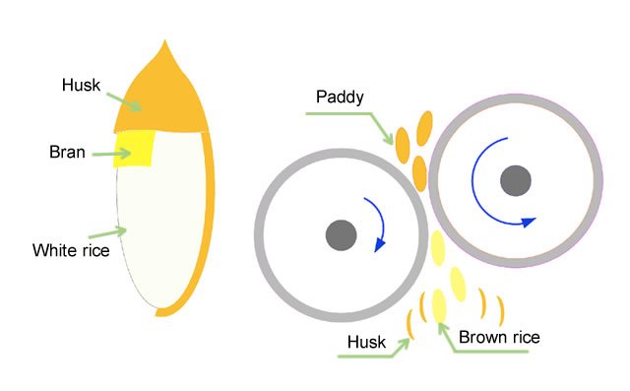
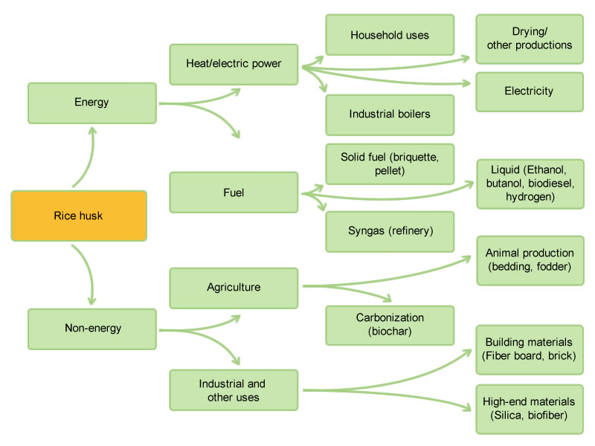
2. Rice grading: Rice husk
Paddy grain and its products after husking
Options for the use of rice husk
Rice husk is composed of organic fibers and inorganic silica, which has been widely used to prepare energy materials, high-purity silica and water glass.
6

Slide 7
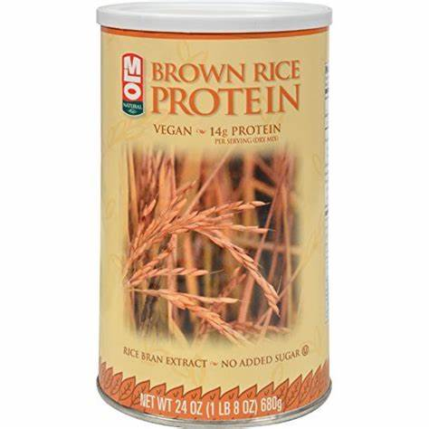
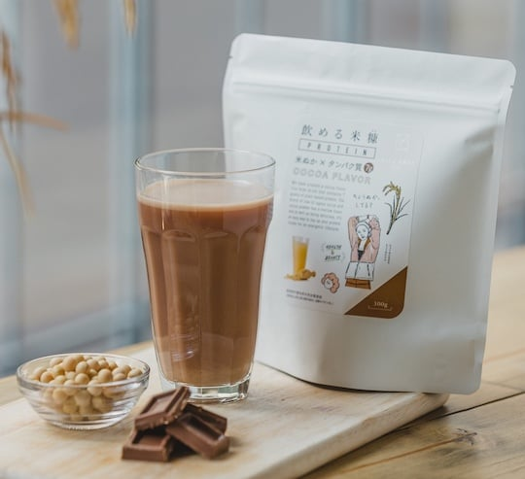
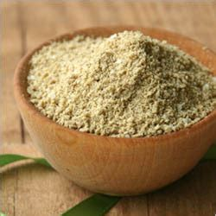
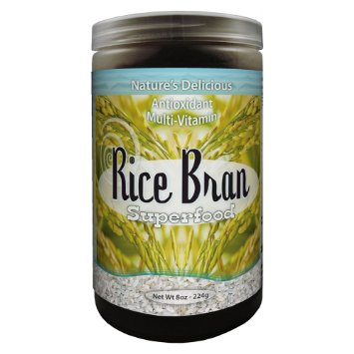
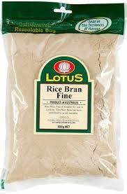
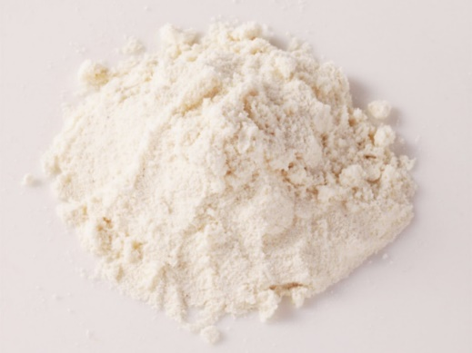
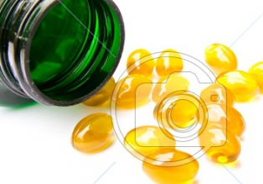
2. Rice grading: Rice bran
Rice bran protein
Dietary fiber
Functional ingredients
Minerals
(K/Ca/Mg/Fe)
Rice
bran oil
Coarse bran
(from the first whitening step)
Fine bran
(second whitening step)
Polish bran
(the polishing step)
Related products of rice bran
7
Notes:
Rice bran is the brown outer layer of rice kernel.
It contains appreciable quantities of nutrients like protein, fat, and dietary fiber.
It contains substantial amount of minerals like K, Ca, Mg, and Fe.
Functional ingredient: , tocotrienols, and γ -oryzanol

Slide 8
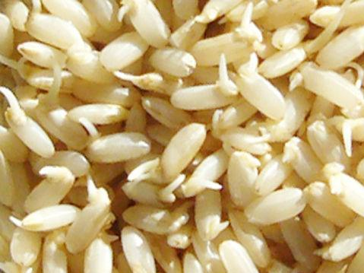
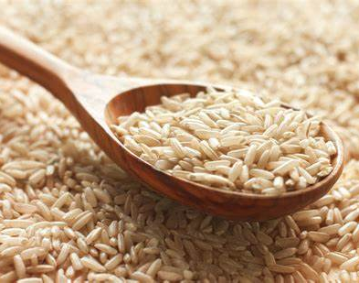
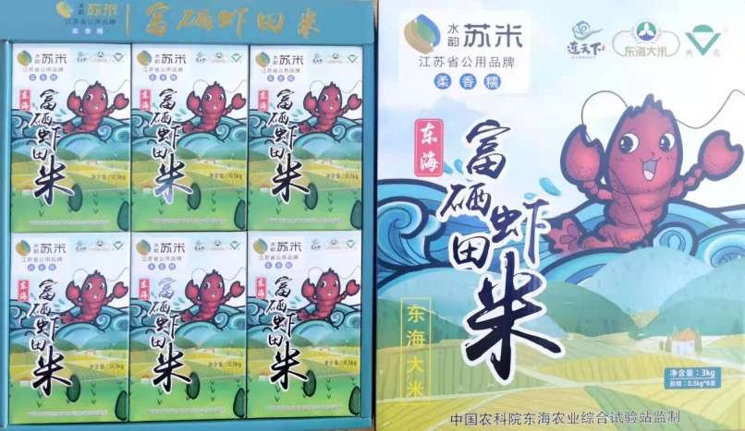
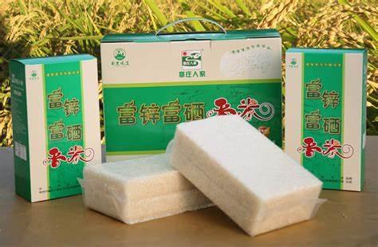
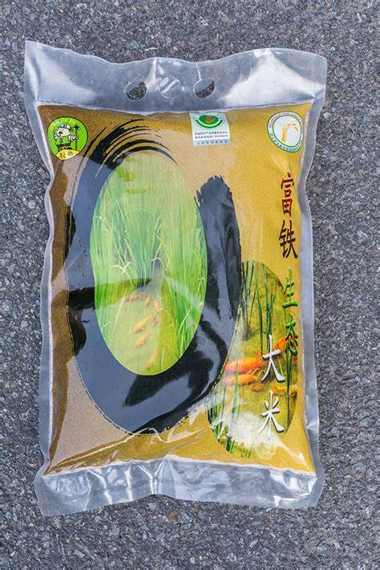
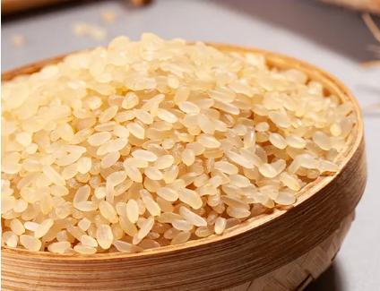
2. Rice grading: Milled Rice products
Common moderately processed rice
Nutritional-fortified rice
Germinated brown rice
Brown rice
Selenium fortified rice
Rice with embryo
Steamed rice
Zinc fortified rice
iron fortified rice
8
Notes:
留胚米（又称胚芽米）是指通过降低碾磨度,保留稻米部分糊粉层且胚芽残留率在 80%以上的稻米产品，是应用适度加工技术生产的代表产品。
发芽糙米是一类糙米全组分保留的稻米产品，不仅营养零损失还富集具有改善神经功能的生物活性成分γ-氨基丁酸，在日本等东亚地区市场比较普遍.
与普通大米相比，蒸谷米营养价值较高的原因在于，稻米经水热处理后，稻米外层维生素和矿物质等水溶性营养物质会渗透到稻米胚乳内部，再次磨米后，维生素B族及钙、铁、磷等矿物质含量均能得到不同程度的提高
富营养米是指稻米中某种营养成分显著高于普通米制品的稻米加工产品。与普通大米相比，富营养稻米的特点在于其营养素含量较高。

Slide 9
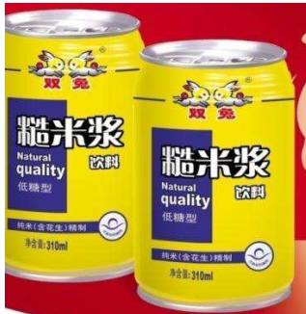
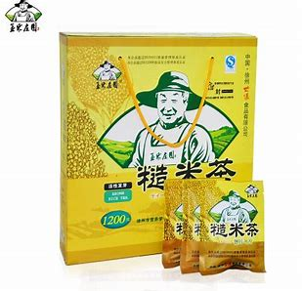
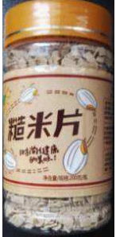
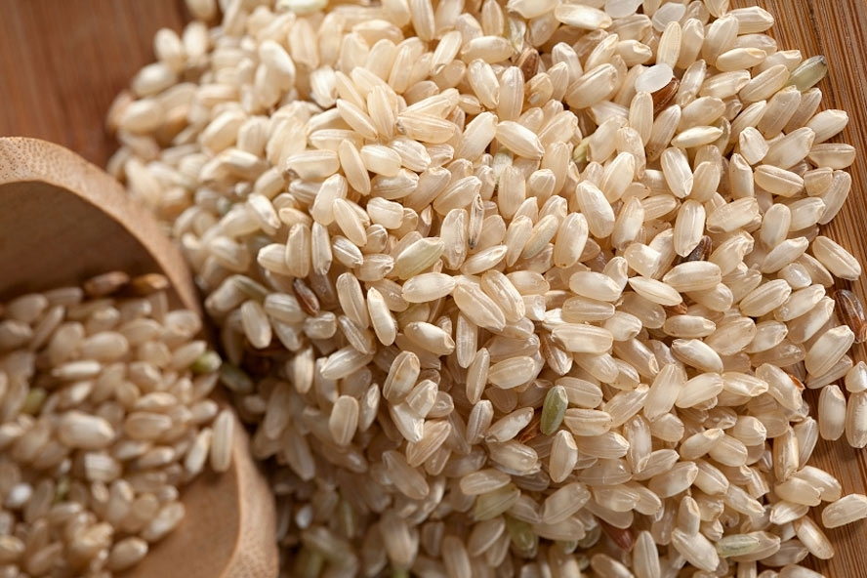
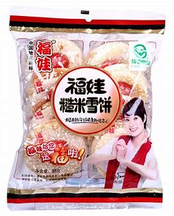
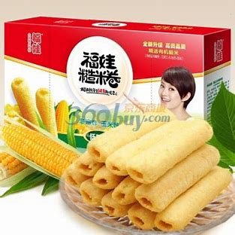
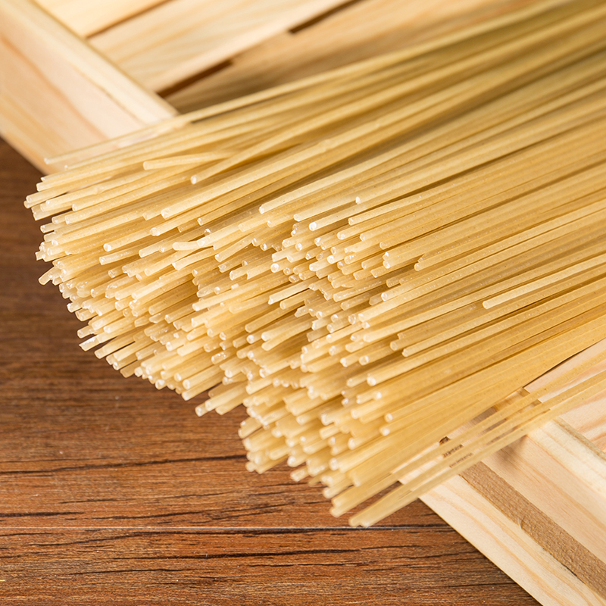
2. Rice grading: Brown rice
Brown rice
Functional ingredients
Brown
Rice
High
protein
Brown rice drink
Brown rice flake
Dietary
fiber
Low
glycemic index
Brown rice noodle
Brown rice cracker
Brown rice roll
9

Slide 10
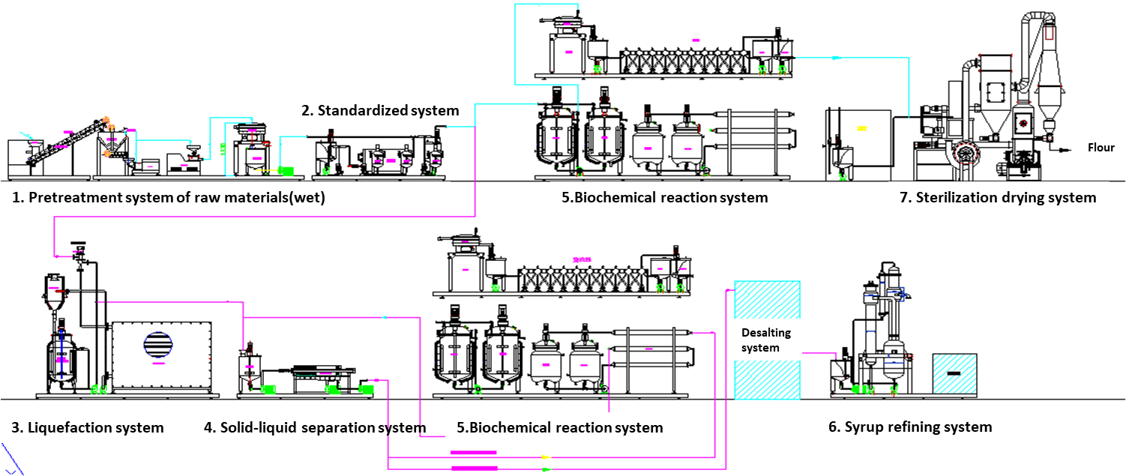
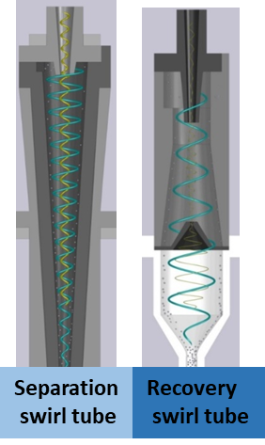
3. Rice nutrition: Rice starch
Rice starch and protein can be successfully separated using this pilot production line.
10

Slide 11
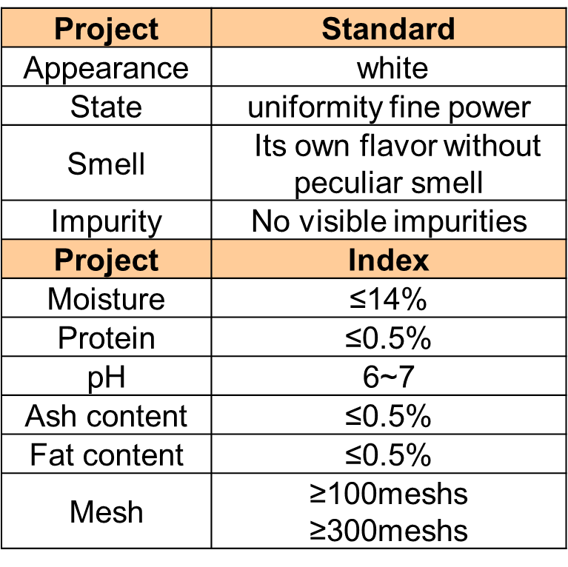
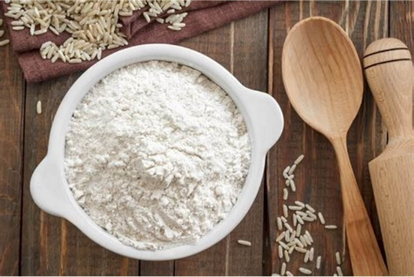
3. Rice nutrition: Rice starch
Rice starch characteristics
High Digestibility
Hypoallergenic
Thermal stability
Non GMO
Small granularity size
Specific surface area
11

Slide 12
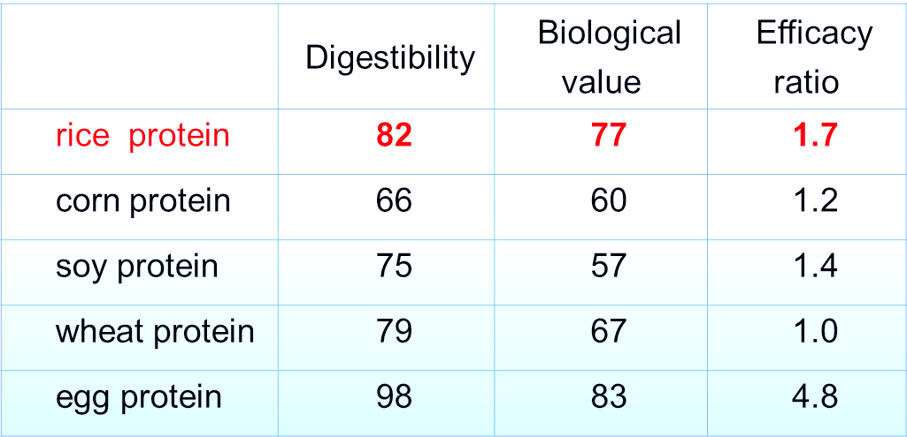
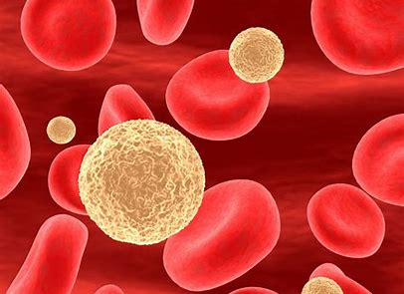
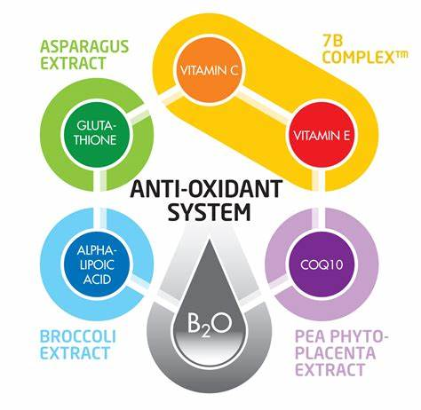
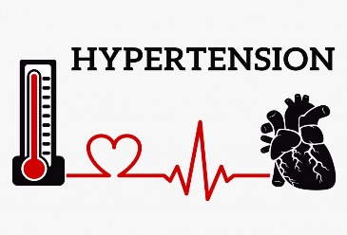
3. Rice nutrition: Rice protein
Rice protein characteristics
The amino acid composition is reasonable.
Essential amino acid content conform to the suggestion model of FAO/WHO.
Antioxidative activity
Hypoallergenicity
Nutrition
Cholesterol Reduction
Anti-diabetes Activities
Hyperlipidemia
Lowering blood pressure
12
Notes:
The nutrition of rice protein is another area that draws attentions of the researchers. Many researchers focused on the bioactivities of rice protein hydrolysates, such as α-Glucosidase and angiotensin converting enzyme (ACE) inhibitory activities, hypoallergenicity activities, and
.

Slide 13
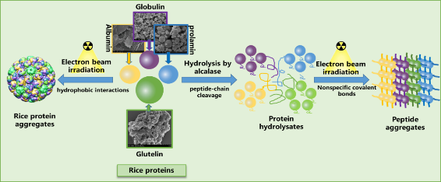
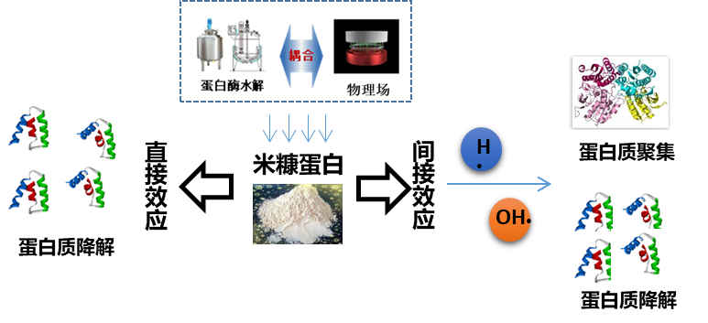
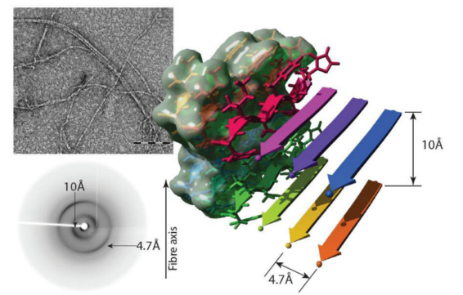
3. Rice nutrition: Rice protein technology
Electron beam treatment
Protein fibrillization
Emulsification
Food Chemistry, 2021, 354, 129554；Food Chemistry, 2023, 398, 133798
These technologies effectively improve the functional properties of rice protein and expand the application range of rice protein.
13

Slide 14
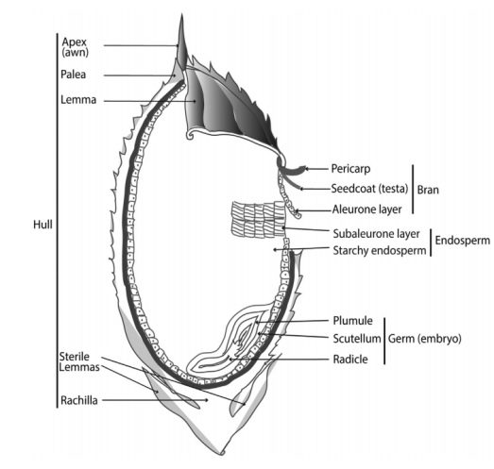
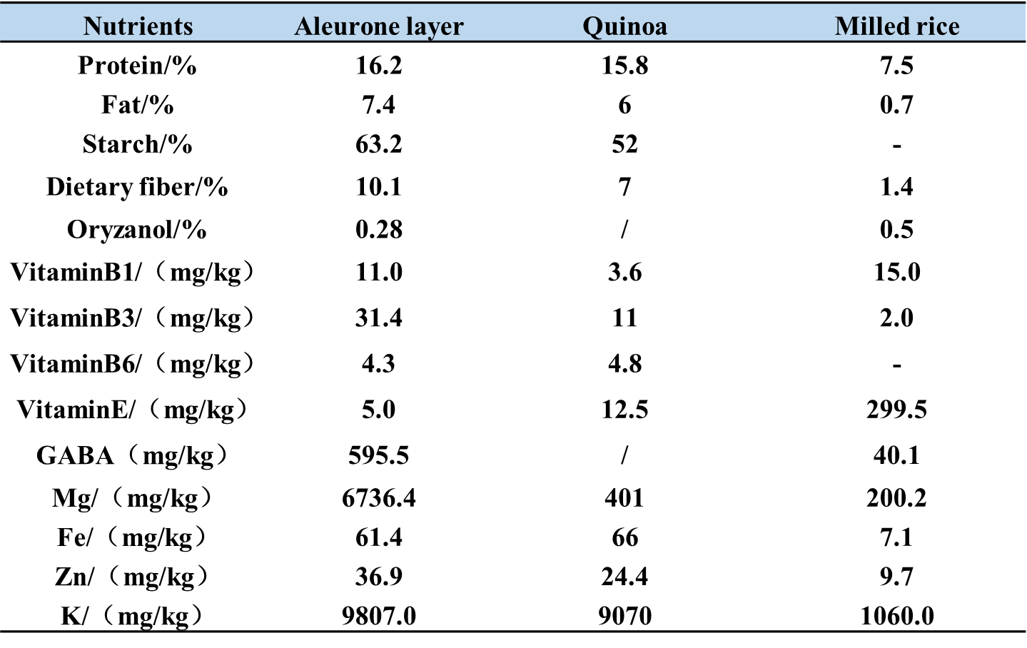
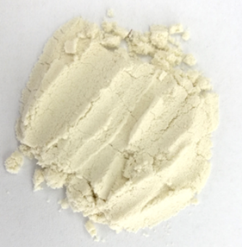
3. Rice nutrition: Rice bran aleurone layer
aleurone layer
14

Slide 15
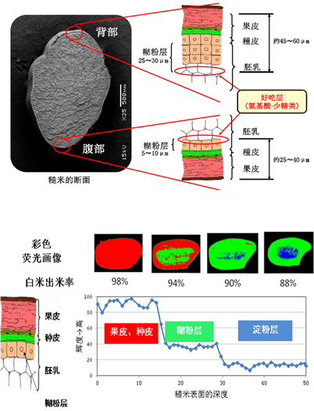
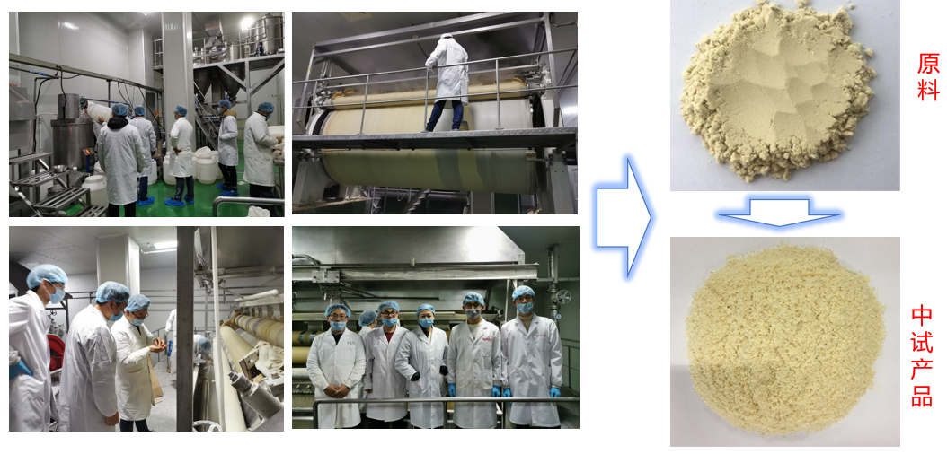
3. Rice nutrition: Rice bran aleurone layer
Aleurone layer isolation
Pilot production line
Stability
Increased by
One time
increased
increased
Lipase inactivation rate
Peroxidase inactivation rate
shelf-life
Authorized Patent，CN201910958800.7
Rice bran aleurone layer is rich in minerals, dietary fiber, phenolic acid and other antioxidant active components.
We explored a technique to improve the stability of the rice aleurone layer.
15

Slide 16
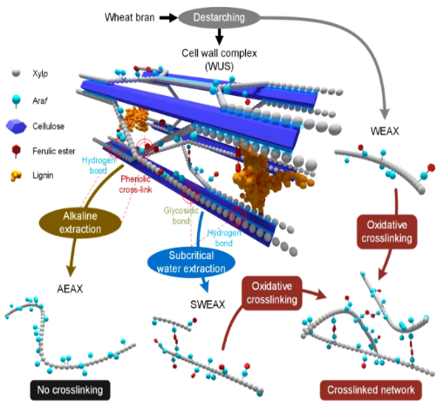
3. Rice nutrition: Rice bran dietary fiber
提高
21%
Nanofiber stability
Subcritical water extraction
Dynamic high pressure treatment
16
LWT, 2021；Carbohydr Polym 2020；J. Food Science, 2017

Slide 17
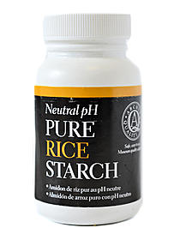
3. Rice nutrition: Related products
Rice starch
Rice protein
Rice bran
Food ingredients
Meal substitute powder
Bakery food
17

Slide 18
3. Rice nutrition: Black Rice nutrition
Black rice
Peeled black rice
Black rice bran
Journal of Nutritional Biochemistry, 2023, 117, 109320
Black rice can obviously alleviate colitis caused by DSS.
Black rice can improve the gut microbiota disorders induced by DSS.
18

Slide 19
Future remarks
Eat full
Eat well
Eat Healthy
Low GI products
Whole grain
Precision Nutrition
Moderate processing
Rice varieties
19

Slide 20
Our Motto: Learning and Practice to Perfection
Thanks
活性馏分，蛋白含量为32.35%
20

