Slide 1
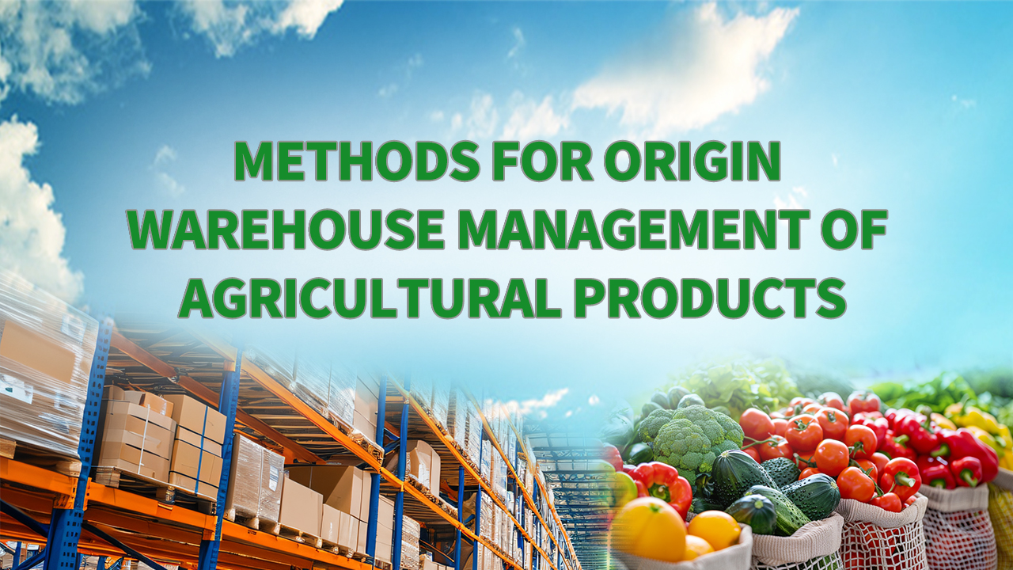
Notes:
Methods for Origin Warehouse Management of Agricultural Products
农产品产地仓储管理方法论

Slide 2

PART.04
Safety Management Measures for Origin Warehouse of Agricultural Products
Notes:
IV.Safety Management Measures for Origin Warehouse of Agricultural Products
四、农产品产地仓储的安全管理措施

Slide 3
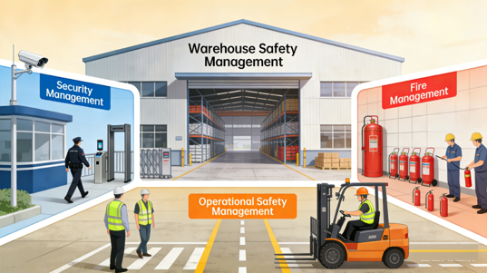
Importance and Key Components
Importance of Safety Management
  Essential foundation for all warehouse operations.
Key Components of Safety Management
  Security control.
  Fire prevention.
  Operational safety measures.
Notes:
如果说环境卫生是农产品仓库管理的重中之重，那么仓库的安全管理就是一切工作的基础，仓库的安全管理主要指的是对仓库治安、消防、作业的综合性管理措施。
While environmental sanitation is the core focus in agricultural warehouse management, safety management constitutes the essential foundation for all operations.
Warehouse safety management primarily covers security control, fire prevention, and operational safety measures.

Slide 4
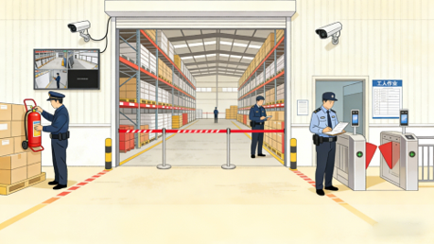
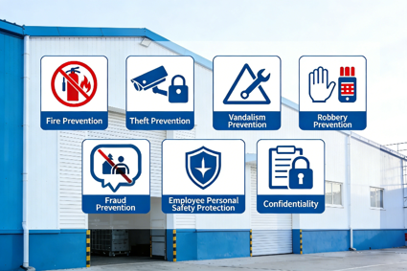

1. Warehouse Security and Fire Safety Management
Warehouse Security Management
  Fundamental Principles
    Prevention first.
    Focus on key areas.
    Enforce strict control.
    Ensure overall safety.
  Key Elements
    Fire prevention.
    Theft prevention.
    Sabotage prevention.
    Robbery and fraud prevention.
    Personnel safety protection.
    Confidentiality.
Notes:
（一）仓库治安与消防管理
仓库治安保卫管理是仓库安全管理的重要环节，其基本原则是坚持预防为主，确保重点，严格管理，保障安全。治安保卫工作的主要内容包括防火、防盗、防破坏、防抢、防骗、员工人身安全保护、保密等工作。
1.Warehouse Security and Fire Safety Management
Security and fire safety management is an essential component of overall warehouse safety.
The fundamental principles are prevention first, focus on key areas, enforce strict control, and ensure safety.
Key elements of security management include fire prevention, theft prevention, sabotage prevention,
robbery and fraud prevention, personnel safety protection, and confidentiality.

Slide 5
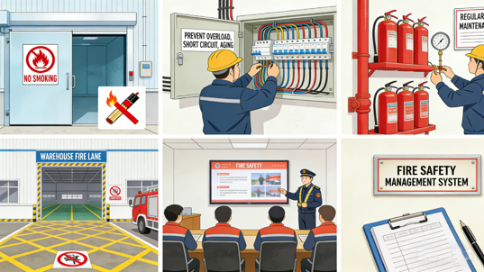
1. Warehouse Security and Fire Safety Management
Specific Requirements
  Prohibition of open flames.
  Safe electrical use.
  Proper installation and maintenance of firefighting equipment and facilities.
  Maintain clear fire truck access routes and establish effective protective measures outside the warehouse.
  Strengthen fire safety training and awareness among personnel.
  Establish a comprehensive fire safety management system.
Notes:
具体来说可分为以下几个方面：
1. 禁止明火存在。
2. 安全用电，防止超负荷、短路、绝缘老化。
3. 按规定配置维护消防设备设施。
4. 库房外要有消防车通道和有效的防范措施。
5. 加强人员的消防安全教育，提高安全意识和素质。
6. 有健全的消防安全管理制度等。
Specific safety requirements include:
a)Prohibition of open flames.
b)Safe electrical use — prevent overloading, short circuits, and insulation deterioration.
c)Proper installation and maintenance of firefighting equipment and facilities.
d)Maintain clear fire truck access routes and establish effective protective measures outside the warehouse.
e)Strengthen fire safety training and awareness among personnel.
f)Establish a comprehensive fire safety management system.

Slide 6
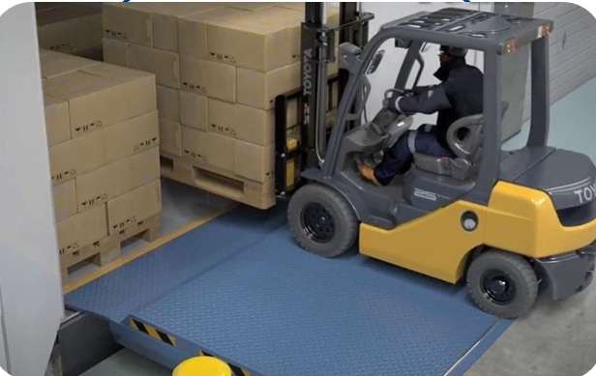
2. Warehouse Operational Safety Management
Key Points
  Focus on protecting personnel, goods, and equipment.
  All warehouse activities must be:
    Standardized.
    Carried out in accordance with established procedures.
Notes:
（二）仓库作业安全管理
仓库作业安全主要涉及人身、货物及设备的作业安全，为保证安全操作，仓库作业必须实行制度化管理。
2.Warehouse Operational Safety Management
Warehouse operational safety focuses on protecting personnel, goods, and equipment.
To ensure safe operations, all warehouse activities must be standardized and carried out in accordance with established procedures.

Slide 7
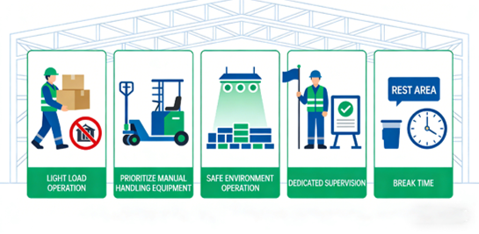
2. Warehouse Operational Safety Management
Basic Requirements for Manual Operations
  Manual work should be limited to light-load tasks.
  Use mechanical assistance whenever possible.
  Operate only under safe environmental conditions.
  Assign on-site supervisors to guide and enforce safety protocols during operations.
  Schedule appropriate rest breaks to prevent fatigue.
Notes:
人力操作的基本要求为：
1. 人力作业仅限制在轻负荷作业。
2. 作业时尽可能采取人力机械作业。
3. 只在安全环境下作业。
4. 作业过程中应有专人在现场指挥和安全指导，严格按安全规程指挥作业。
5. 合理安排工间休息。
Basic requirements for manual operations:
a)Manual work should be limited to light-load tasks.
b)Use mechanical assistance whenever possible.
c)Operate only under safe environmental conditions.
d)Assign on-site supervisors to guide and enforce safety protocols during operations.
e)Schedule appropriate rest breaks to prevent fatigue.

Slide 8
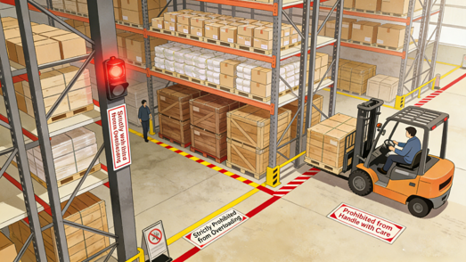
2. Warehouse Operational Safety Management
Shelf Usage Requirements
  Prevent overloading and excessive height/width of stacks.
  Avoid collisions, handle goods gently.
  Follow the principle of light goods on top, heavy goods at the bottom.
  When stacking on upper shelves, operators should avoid standing directly beneath the shelf.
Notes:
使用货架时的注意事项有：
1. 防超载，防超高超宽。
2. 防撞击，尽量轻拿轻放。
3. 应尽量遵循高层放轻货，底层放重货的原则。
4. 货架上方摆放货物时，操作人员尽量不要直接进入货架底部。
Shelf usage requirements:
a)Prevent overloading and excessive height/width of stacks.
b)Avoid collisions, handle goods gently.
c)Follow the principle of light goods on top, heavy goods at the bottom.
d)When stacking on upper shelves, operators should avoid standing directly beneath the shelf.

Slide 9
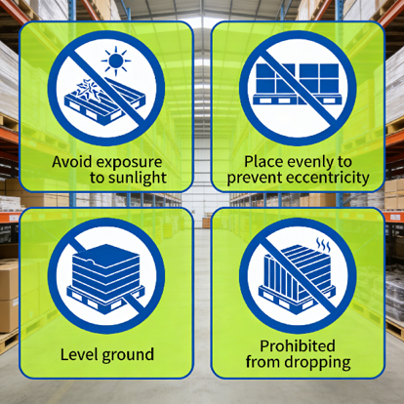
2. Warehouse Operational Safety Management
Pallet Safety Requirements
  Avoid direct sunlight exposure to prevent pallet aging and reduced service life.
  Determine an appropriate stacking method, ensure goods are placed evenly, and avoid eccentric stacking.
  Place heavily loaded pallets on flat, stable surfaces; do not drop pallets from any height.
Notes:
托盘使用的安全要求有：
1. 托盘应避免遭受阳光暴晒，以免引起老化、缩短使用寿命。
2. 合理确定货物在托盘内的堆放方式，货物均匀放置，不要偏心堆放，承载重物的托盘应放在平整的地面或物体表面，严禁将托盘从高处抛落。
Pallet safety requirements:
a)Avoid direct sunlight exposure to prevent pallet aging and reduced service life.
b)Determine an appropriate stacking method for the goods on the pallet, ensuring they are placed evenly, and avoid eccentric stacking.
c)Place heavily loaded pallets on flat, stable surfaces; do not drop pallets from any height.

Slide 10
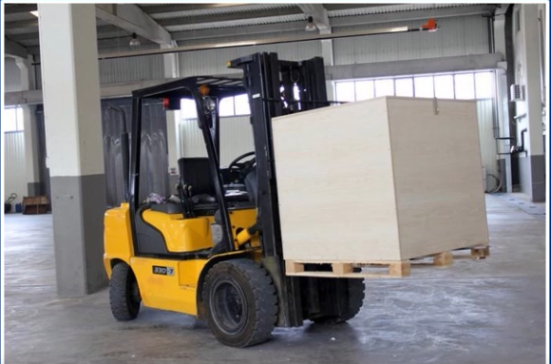
2. Warehouse Operational Safety Management
Forklift Operation Safety Requirements
  Do not lift forks excessively high or block driver visibility during travel.
  No personnel should stand near or on the forks during operation.
  Do not allow people to stand on the forklift to hold items or act as a counterbalance while the forklift is lifting, lowering, or traveling.
Notes:
叉车使用中的安全要求有：
1. 行驶时不得将货叉升得太高，载物高度不得遮挡驾驶员视线。
2. 叉车叉物作业时，严禁人员站在货叉周围。
3. 叉车起重升降或行驶时，禁止人员站在叉车上把持物品或起平衡作用。
Forklift operation safety requirements:
a)Do not lift forks excessively high or block driver visibility during travel.
b)No personnel should stand near or on the forks during operation.
c)Do not allow people to ride or balance on moving forklifts.
c)Do not allow people to stand on the forklift to hold items or act as a counterbalance while the forklift is lifting, lowering, or traveling.

Slide 11
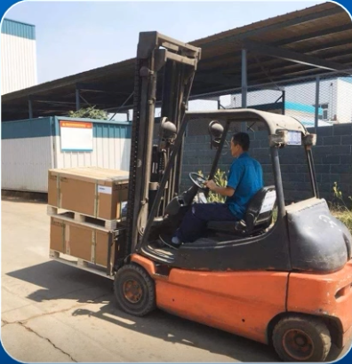
2. Warehouse Operational Safety Management
Loading and Handling Safety Requirements
  Equipment must be in good working condition.
  All operations should be directed by qualified personnel.
  Maintain safe operating distances.
  Cranes must be fully stabilized before use.
  No passengers are permitted on moving load-handling equipment.
Notes:
装卸搬运过程中的安全要求有：
1. 设备应具有良好的状态。
2. 由专人进行指挥。
3. 注意保持安全间距。
4. 移动吊车必须停放稳定后方可作业。
5. 载货移动设备上不得载人运行。
Loading and handling safety requirements:
a)Equipment must be in good working condition.
b)All operations should be directed by qualified personnel.
c)Maintain safe operating distances.
d)Cranes must be fully stabilized before use.
e)No passengers are permitted on moving load-handling equipment.

Slide 12
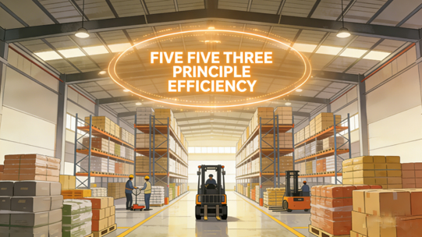
3. The “Five-Five-Three Principle” of Warehouse Operations
Purpose
  Help employees better understand and remember key operational practices.
Importance-a Key Guidance
  Ensures storage safety.
  Improves space utilization.
  Supports orderly and efficient warehouse operations.
Notes:
（三）仓库管理作业之“五五三原则”
为便于员工理解和记忆这里总结出了，仓库管理作业的“五五三原则”。在仓库管理作业中，“五五三原则”是保障货物存储安全、提升仓储空间利用率以及确保作业高效有序开展的关键准则，具体内容如下：
3.The “Five-Five-Three Principle” of Warehouse Operations
To help employees better understand and remember key practices, the “Five-Five-Three Principle” of warehouse operations is summarized below.
It serves as a key guideline for ensuring storage safety, improving space utilization, and supporting orderly and efficient warehouse operations.

Slide 13
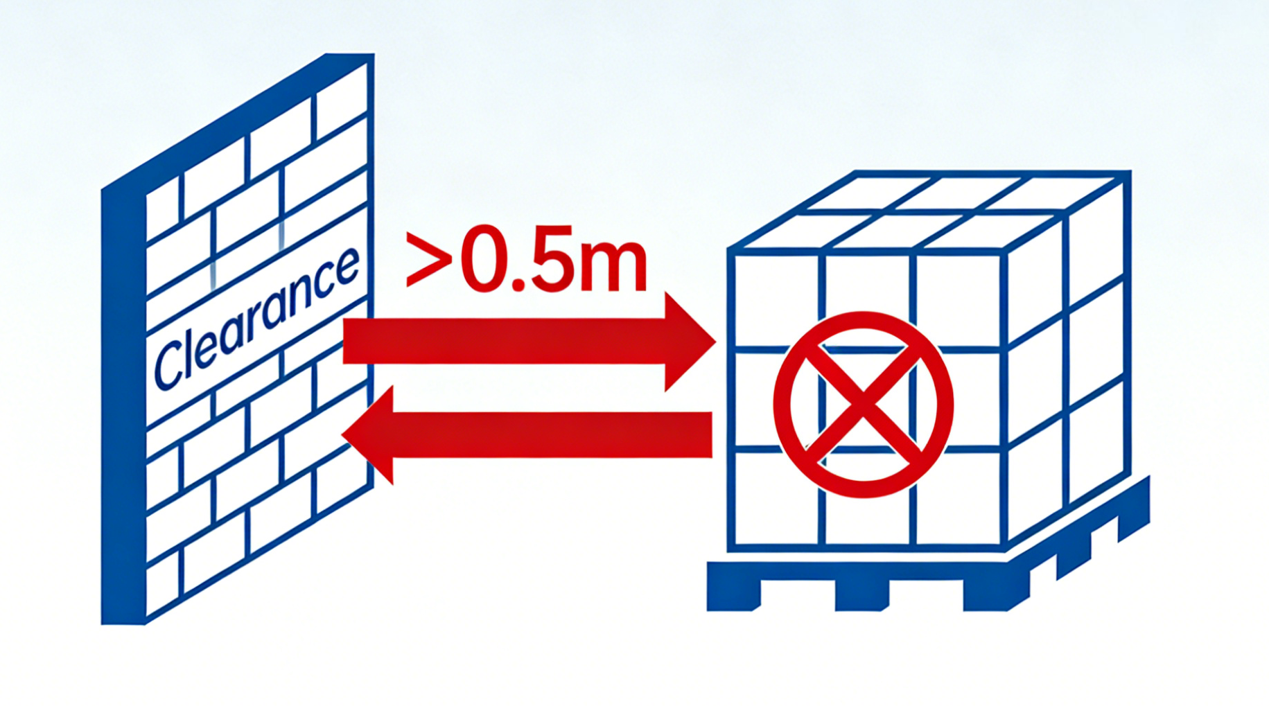
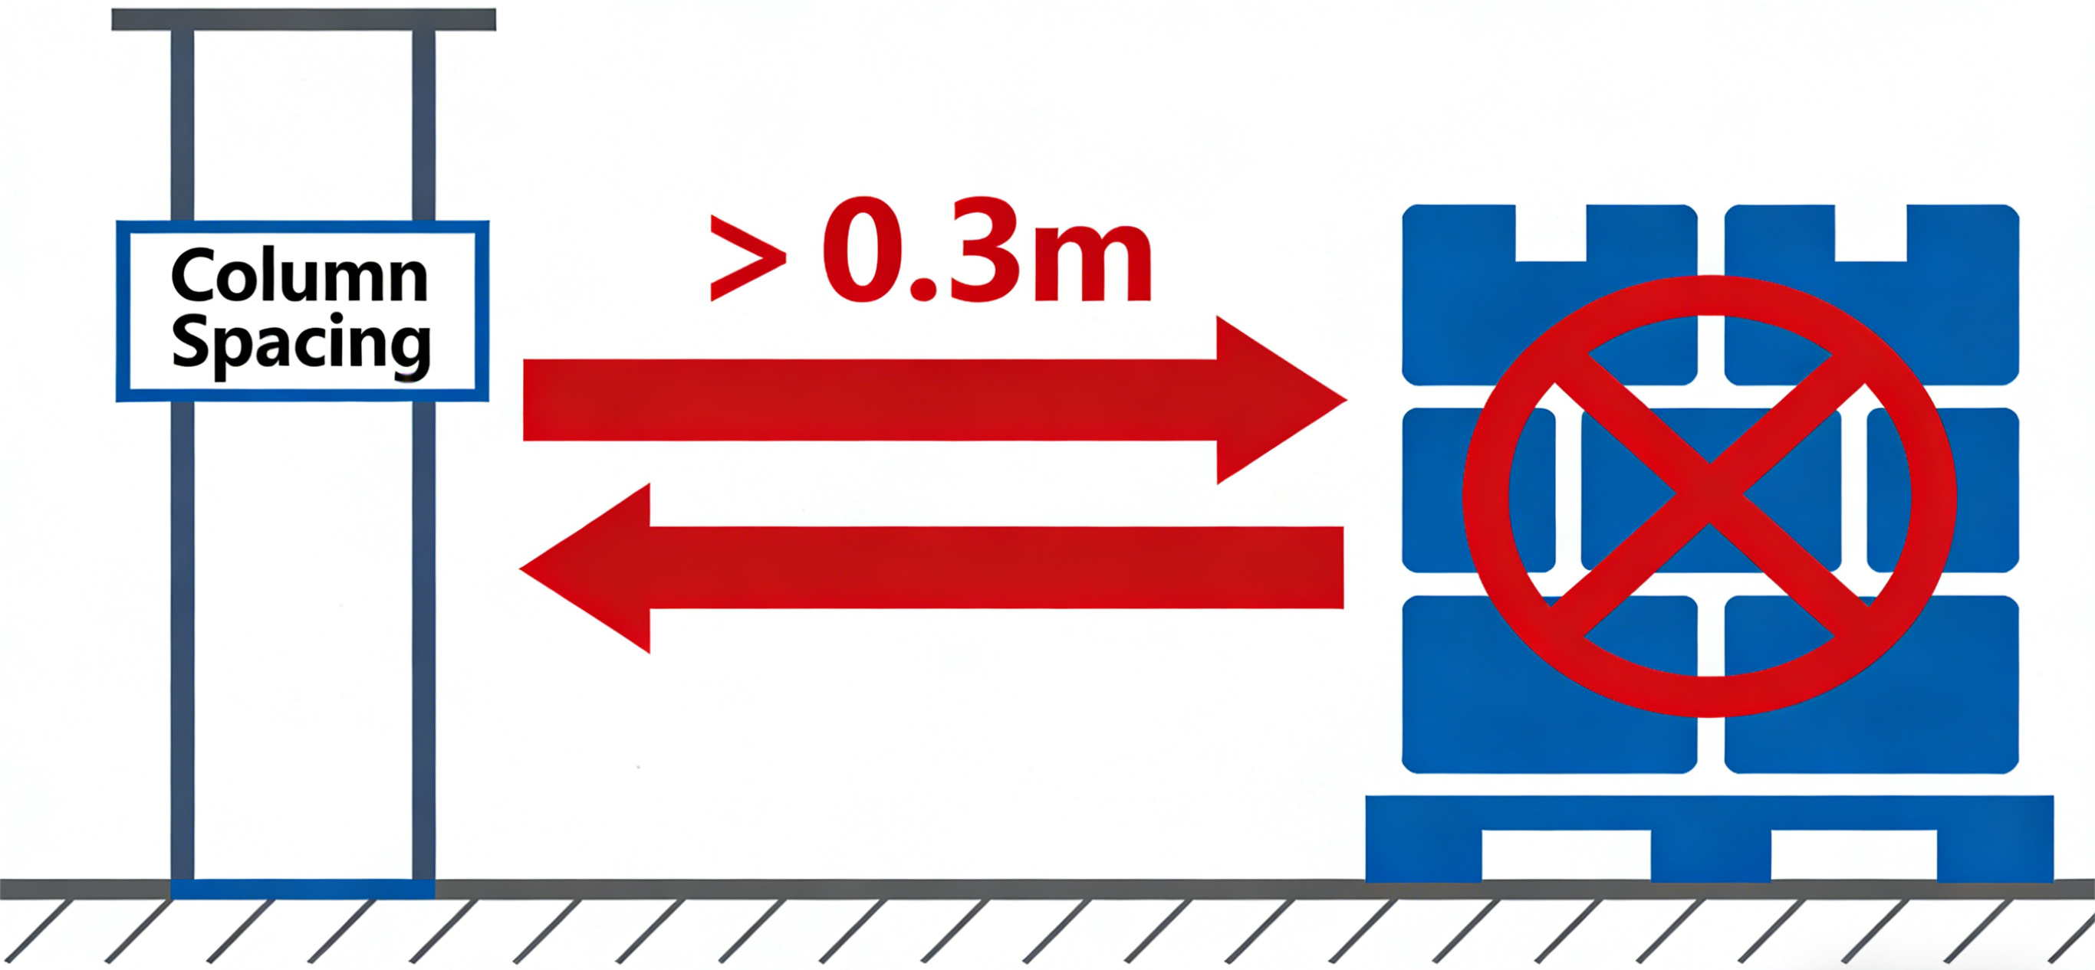
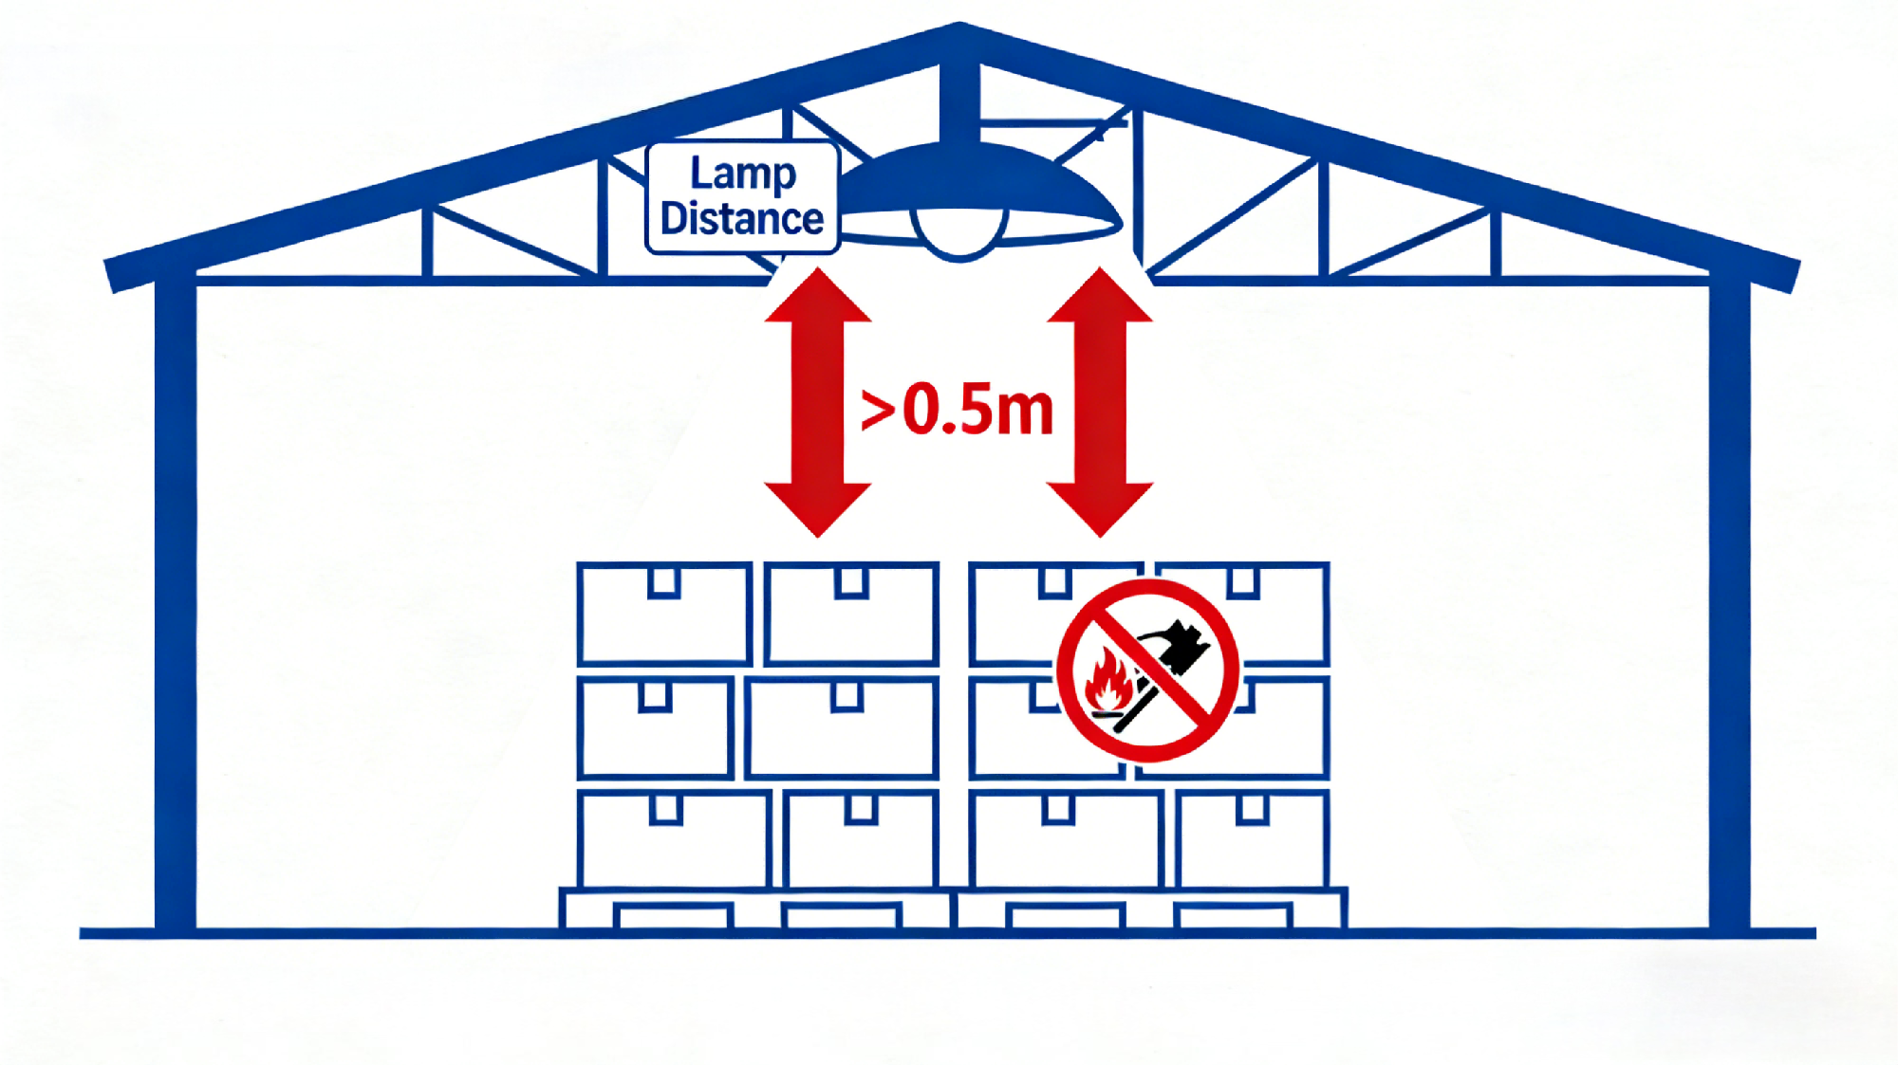
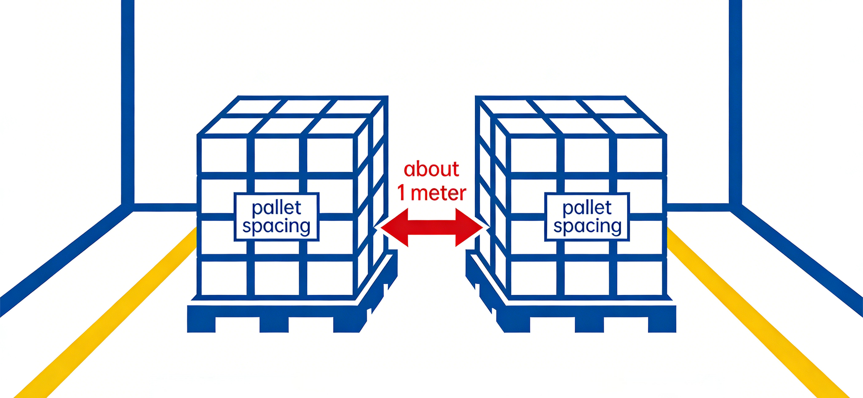
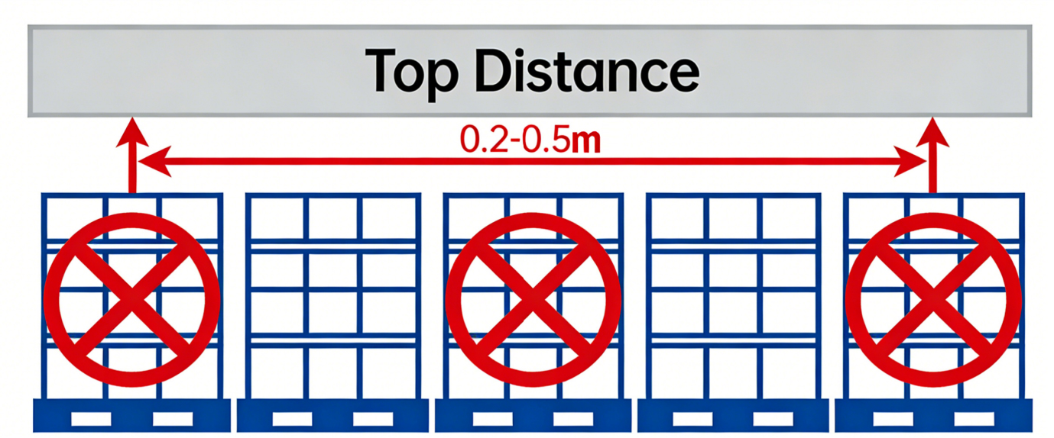
3. The “Five-Five-Three Principle” of Warehouse Operations
Five Safety Distances for Stacking
  Wall Clearance: ≥ 0.5 m between goods and walls.
  Column Clearance: ≥ 0.3 m between goods and structural columns.
  Ceiling Clearance: 0.2–0.5 m between the top of the goods and the ceiling.
  Lighting Clearance: ≥ 0.5 m between goods and lighting fixtures.
  Stack Clearance: approximately 1 m between adjacent cargo stacks.
Notes:
货物堆垛时，必须严格留足“五距”，为仓库的安全运营奠定基础：
墙距：货物与墙壁之间需保持大于 0.5 米的距离；
柱距：货物与仓库柱子的间距要大于 0.3 米；
顶距：货物顶部与仓库顶棚之间的距离应控制在 0.2 到 0.5 米之间；
灯距：货物与照明灯具的距离必须严格保持在 0.5 米以上；
垛距：货垛与货垛之间应保持 1 米左右的间距。
a)The “Five Safety Distances” for Stacking Safety
Adequate clearances must be maintained to ensure safe and efficient warehouse operations:
•Wall Clearance: ≥ 0.5 m between goods and walls.
•Column Clearance: ≥ 0.3 m between goods and structural columns.
•Ceiling Clearance: 0.2–0.5 m between the top of the goods and the ceiling.
•Lighting Clearance: ≥ 0.5 m between goods and lighting fixtures.
•Stack Clearance: approximately 1 m between adjacent cargo stacks.

Slide 14
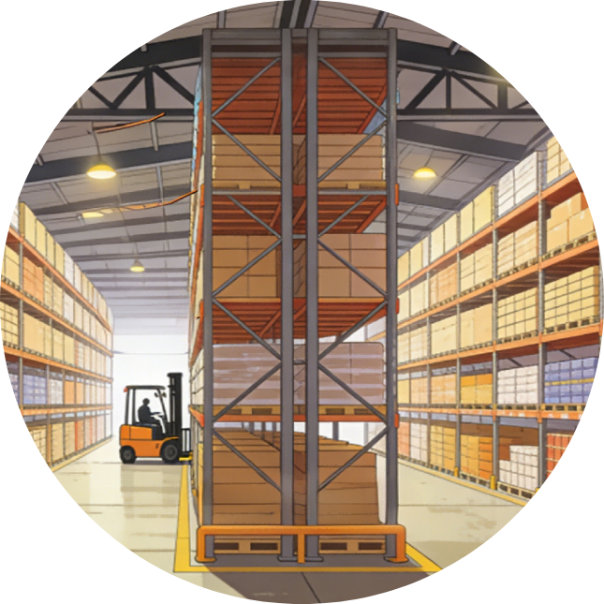





3. The “Five-Five-Three Principle” of Warehouse Operations
No contact with walls
No contact with columns
  Avoid affecting the loadbearing capacity of columns and prevent dampness or structural damage that could lead to stack collapsing.
  Prevent moisture and stains on the walls from damaging goods and allow space for cleaning and inspection.
Five No-Contact Principle
No contact with the roof
  Prevent excessive stacking height from stressing the roof structure or creating leakage risks.
No contact with lighting fixtures
  Prevent fire hazards caused by high temperatures from lighting equipment and reduce the risk of radiant heat damaging the goods.
No contact with ceilings
  Avoid overloading or structural damage to the ceiling that could result in product loss.
Notes:
存储货物时需遵循“五不靠”原则，进一步优化仓库空间利用和货物保护：
四周不靠墙：避免墙壁潮气、污渍侵蚀货物，预留清洁与检查空间。
不靠柱：防止货物堆放影响柱子承重，避免柱体受潮或受损导致货物坍塌；
不靠顶：防止货物堆高压垮屋顶结构，规避屋顶漏水风险；
不靠顶棚：避免顶棚承重超限或结构损坏引发货物损失；
不靠灯：防止照明设备高温引发火灾，减少辐射热对货物的损害；
b)The “Five No-Contact” Principle
To optimize warehouse space utilization and protect stored goods:
•No contact with walls — Prevent moisture and stains on the walls from damaging the goods and allow space for cleaning and inspection.
•No contact with columns — Avoid affecting the load-bearing capacity of columns and prevent dampness or structural damage that could lead to stack collapsing.
•No contact with the roof — Prevent excessive stacking height from stressing the roof structure or creating roof leakage risks.
•No contact with ceilings — Avoid overloading or structural damage to the ceiling that could result in product loss.
•No contact with lighting fixtures — Prevent fire hazards caused by high temperatures from lighting equipment and reduce the risk of radiant heat damaging the goods.

Slide 15
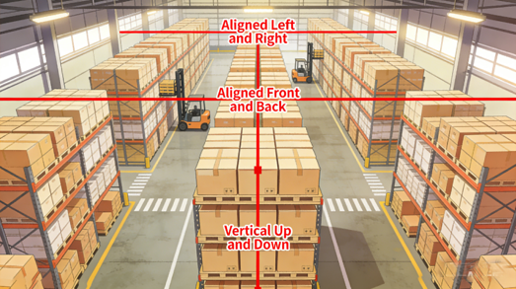
3. The “Five-Five-Three Principle” of Warehouse Operations
Three Alignment Lines Principle
  Vertical alignment — Cargo stacks must remain straight in the vertical direction, with each layer of goods kept properly aligned to prevent tilting or misalignment.
  Front-to-back alignment — When viewed from front to the back of the warehouse, cargo stacks should form a straight line to improve space utilization, keep the layout orderly, and enables staff to quickly locate needed items.
  Left-to-right alignment — Stacks should also be kept neatly aligned in a straight line from left to right to improve operational efficiency.
Notes:
保持“三条线”是确保货物堆垛稳固、整齐的重要标准：
上下垂直：货垛在垂直方向上要保持笔直，每一层货物的堆放都要对齐，避免出现倾斜或错位的情况。
前后成线：从仓库的前方到后方看，货垛应排列成一条直线。这有助于提高仓库的空间利用率，使货物摆放更加有序，便于工作人员快速找到所需货物。
左右成线：在仓库的左右方向上，货垛也要保持整齐排列，形成一条直线，提高作业效率。
c)The “Three Alignment Lines” Principle
Maintaining the “Three Alignment Lines” is an important requirement for ensuring the stable and orderly cargo stacking.
•Vertical alignment: Cargo stacks must remain straight in the vertical direction, with each layer of goods kept properly aligned to prevent tilting or misalignment.
•Front-to-back alignment: When viewed from the front to the back of the warehouse, cargo stacks should form a straight line. This helps improve warehouse space utilization, keeps the layout orderly, and enables staff to quickly locate needed items.
•Left-to-right alignment: Cargo stacks should also be kept neatly aligned in a straight line from left to right to improve operational efficiency.

