Slide 1

Research Status and Progress on Rapid Detection Technology for Mycotoxins in Grains
Presenter：Hongmei Liu
Unit: Academy of National Food and Strategic Reserves Administration

Slide 2
CONTENTS
目录
Current Status of Rapid Detection Technology for Mycotoxins
01
Overview of Fungi and Mycotoxins
02
Development Trends in Rapid Detection Technology for Mycotoxins
Evaluation of Rapid Detection Products for Mycotoxins
03
04

Slide 3
01
Overview of Fungi and Mycotoxins

Slide 4
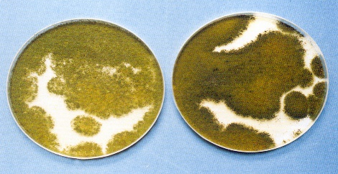
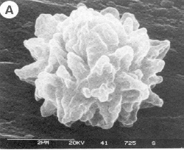
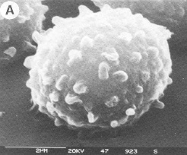
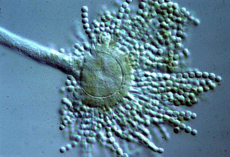
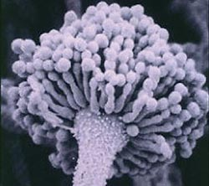
Overview of Fungi and Mycotoxins
Fungi
Eukaryotic microorganisms
Lacking chlorophyll, without roots, stems, or leaves, they survive by parasitism or saprophytism.
They reproduce both sexually and asexually
Fungi capable of producing toxins are termed toxigenic fungi.

Slide 5
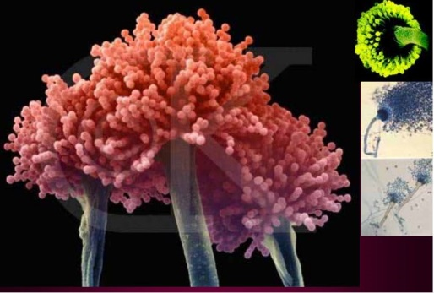
Overview of Fungi and Mycotoxins
Mycotoxin
Mycotoxins are a class of toxic secondary metabolites produced by fungi under suitable conditions.
More than 400 types, including aflatoxins, ochratoxin A (OTA), zearalenone (ZON), and deoxynivalenol (DON), among others.
They have carcinogenic, teratogenic, and mutagenic effects.
*PIC From Rudolf Krska

Slide 6
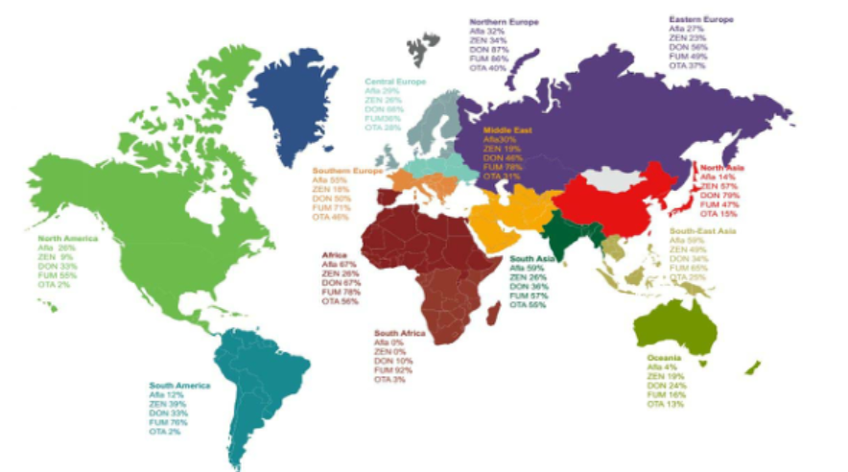

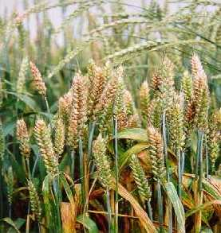
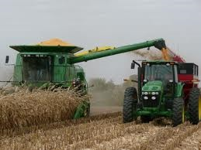
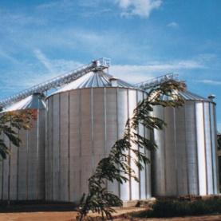

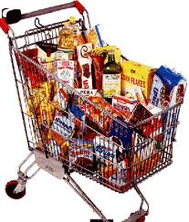

Overview of Fungi and Mycotoxins
In the processes of planting, harvesting, processing, transportation, and storage, the contamination of mycotoxin is widespread.
The issue of fungal toxin contamination has become a hot topic of great concern worldwide.
logistic
planting
harvest
storage
processing
distribution

Slide 7
Overview of Fungi and Mycotoxins
Characteristics of Mycotoxin Contamination
Natural Attribute: Not added artificially
Hazardous: Carcinogenic, teratogenic, mutagenic
Low Threshold: Parts per billion (ppb) level
Heterogeneity: Uneven distribution.
Wheat Warehouse Deoxynivalenol (DON) Distribution Map

Slide 8
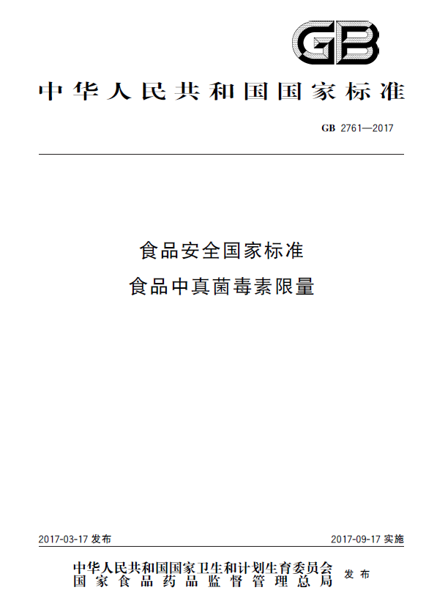
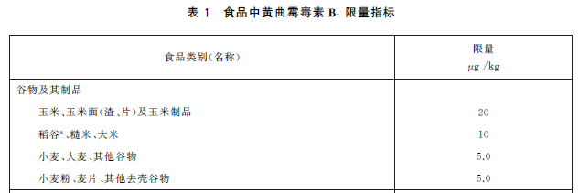
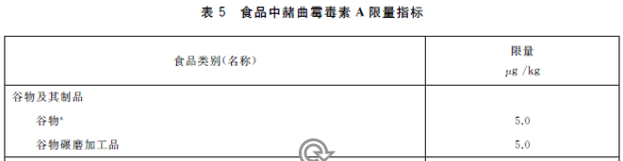
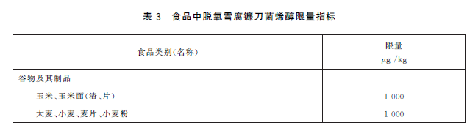
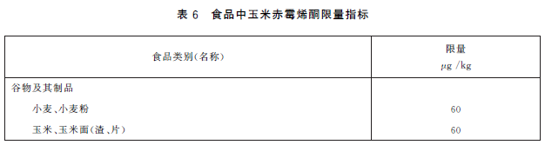
Overview of Fungi and Mycotoxins
Regulatory limits for mycotoxins in grain products
Aflatoxin
Ochratoxin
Deoxynivalenol
Zearalenone
National Standard of the People’s Republic of China GB 2761-2017

Slide 9
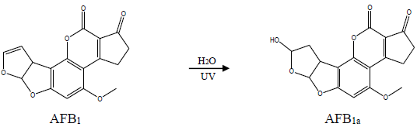
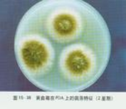
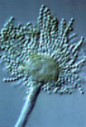
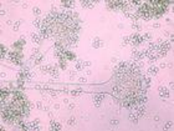
Overview of Fungi and Mycotoxins
Aflatoxin
Produced Aspergillus flavus and Aspergillus parasiticus, mainly including AFB₁, AFB₂, AFG₁, and AFG₂.
Aflatoxins are highly toxic substances, 10 times toxicity of potassium cyanide and 68 times that of arsenic trioxide.
AFB₁ has the strongest toxicity and carcinogenicity and is considered a Class 1 carcinogen.

Slide 10
Overview of Fungi and Mycotoxins
National Standard /GB 2761-2017 :
Table 1 The maximum limit of aflatoxins in cereals and their products
Maximum limit
（μg/Kg）
Food Category (Name)
Cereals and Their Products
Corn, cornmeal (bran, flakes), and corn products
20
Rice grain, brown rice, white rice
Wheat, barley, other grains
Wheat flour, oatmeal, other hulled grains

Slide 11
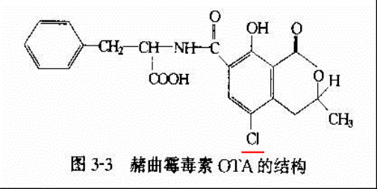
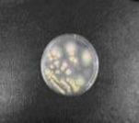
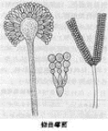
Overview of Fungi and Mycotoxins
Ochratoxin
Produced by Aspergillus and Penicillium
7 structurally similar compounds, with Ochratoxin A (OTA) being the most toxic and classified as a Group 2B carcinogen

Slide 12
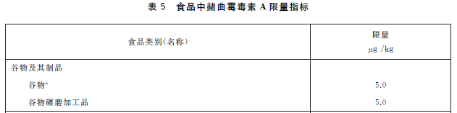
Overview of Fungi and Mycotoxins
National Standard /GB 2761-2017
Table 2 The maximum limit of ochratoxin in cereals and their products
maximum
limit
（μg/Kg）
Food Category (Name) 食品类别 （名称）
Cereals and Their Products
Cereals
Cereals grinding products

Slide 13
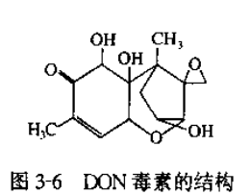
Overview of Fungi and Mycotoxins
Deoxynivalenol（DON）
Produced by Fusarium fungi
DON is a global grain contaminant
relatively weak in toxicity, classified as a Group 3 carcinogen
The structure of DON
DON毒素的结构

Slide 14
Overview of Fungi and Mycotoxins
National Standard /GB 2761-2017:
Table 3 The maximum limit of Deoxynivalenol in cereals and their products
maximum
limit
（μg/Kg）
Food Category (Name)
Cereals and Their Products
Corn, cornmeal (bran, flakes）
Barley, wheat, oatmeal, wheat flour

Slide 15
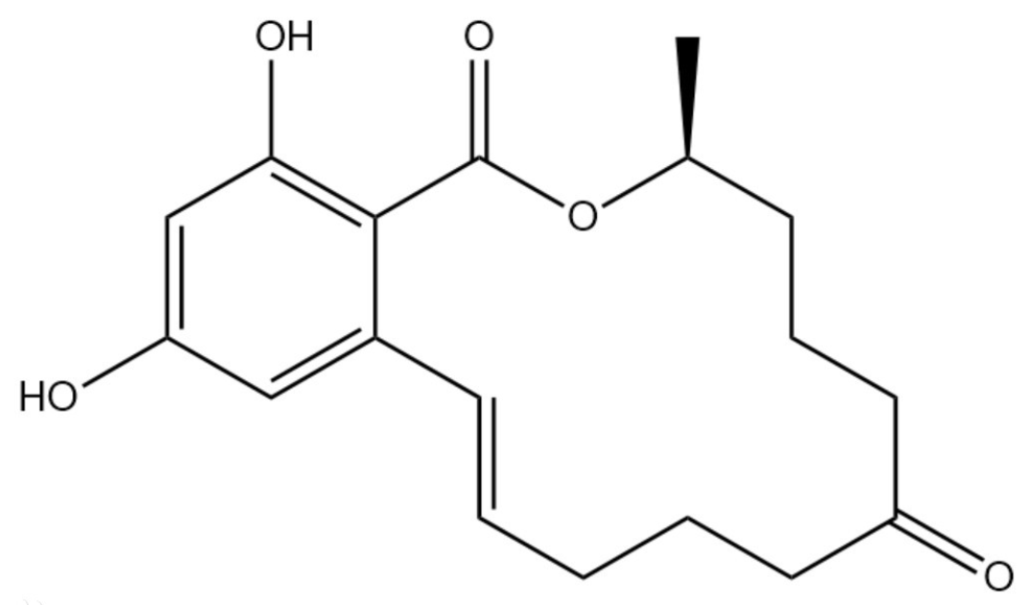
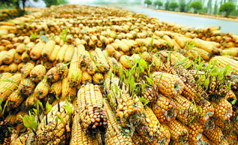
Overview of Fungi and Mycotoxins
Zearalenone
A estrogenic mycotoxin produced by Fusarium
Estrogenic effects, Group 3 carcinogen

Slide 16
Overview of Fungi and Mycotoxins
Table 4 The maximum limit of Zearalenone in cereals and their products
maximum
limit
（μg/Kg）
Food Category (Name)
Cereals and Their Products
Wheat, wheat flour
Corn, cornmeal (bran, flakes

Slide 17
02
Current Status of Rapid Detection Technology for Mycotoxins

Slide 18
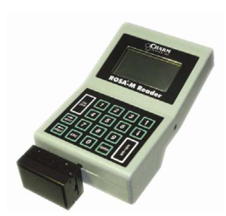
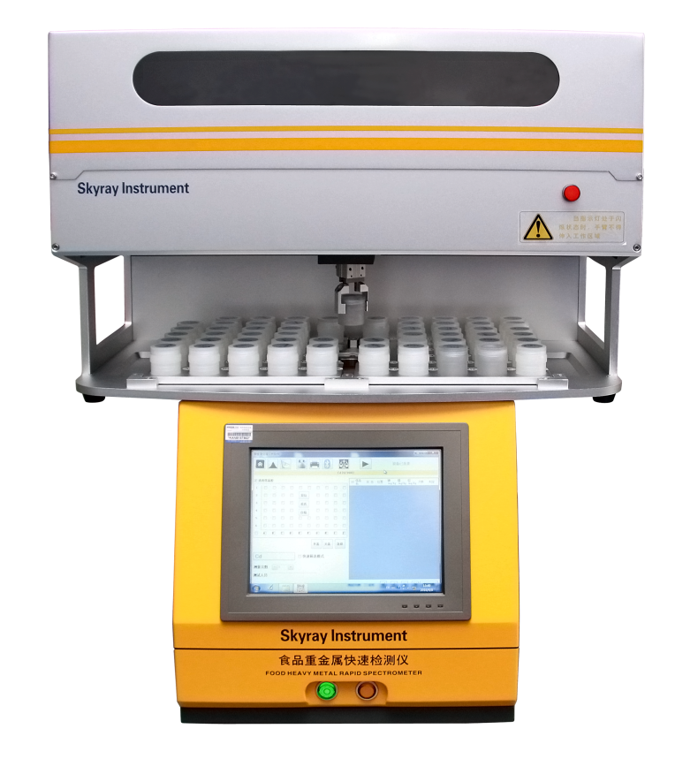
Current Status of Rapid Detection Technology for Mycotoxins
What is rapid detection technology?
International Organization for Standardization (ISO)
performance that meets the appropriate needs of the user
reduces the analysis time
Offers advantages such as ease of operation or the possibility of automation, miniaturization, and reduction of detection costs.
Alternative method

Slide 19
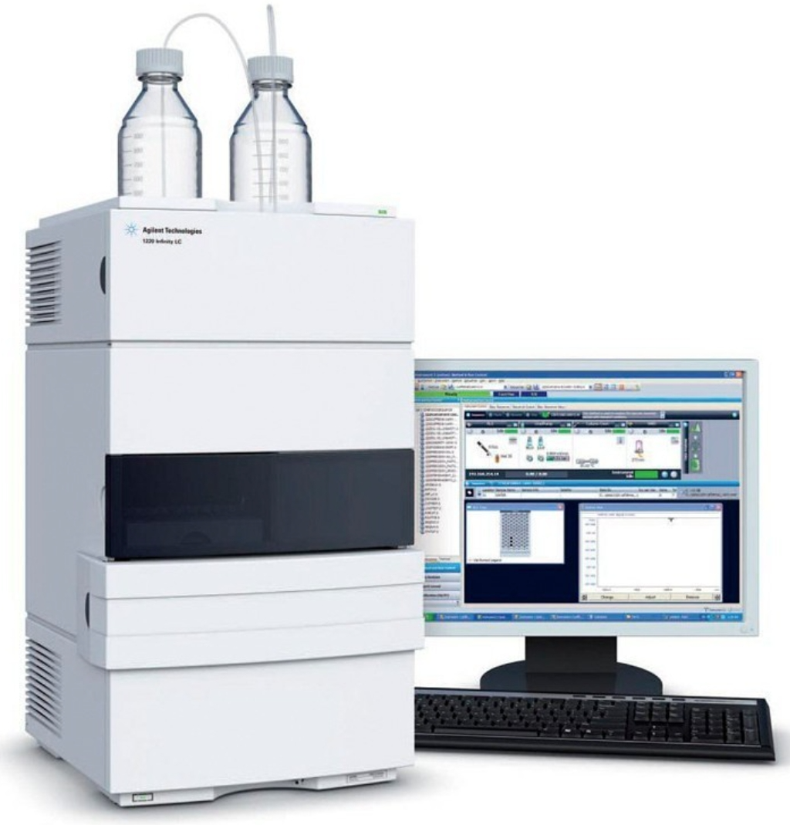
Current Status of Rapid Detection Technology for Mycotoxins
Why use rapid detection technology?
Accurate quantification/confirmation
On-site testing
Simple operation
Low personnel requirements
Low cost
High accuracy
Expensive equipment
Complex operation
High personnel requirements
Screening
Rapid detection technology
Large-scale instrumental detection methods

Slide 20
Current Status of Rapid Detection Technology for Mycotoxins
Supported by multiple laws and regulations
Food Safety Law of the People’s Republic of China
Quality and Safety Law of Agricultural Products of the People’s Republic of China
Measures for the Supervision and Management of Grain Quality and Safety

Slide 21
Current Status of Rapid Detection Technology for Mycotoxins
Supported by multiple laws and regulations
Food Safety Law of the People’s Republic of China
Quality and Safety Law of Agricultural Products of the People’s Republic of China
Measures for the Supervision and Management of Grain Quality and Safety
Rapid detection methods prescribed by the state are used to conduct spot checks on edible agricultural products
If the party being inspected has objections to the test results, they may apply for a retest
The retest shall not use rapid detection methods.

Slide 22
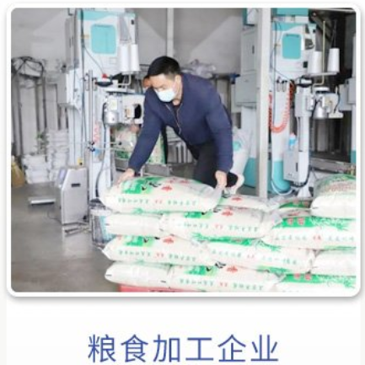
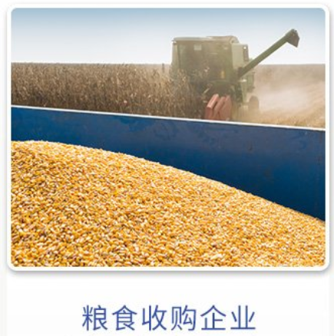
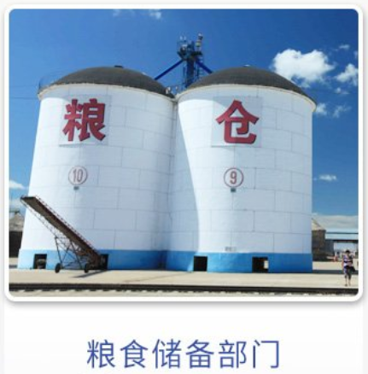
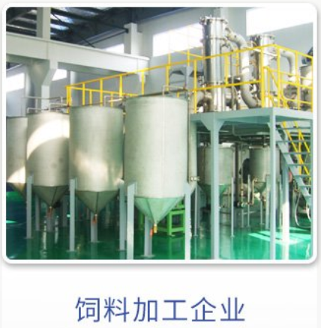
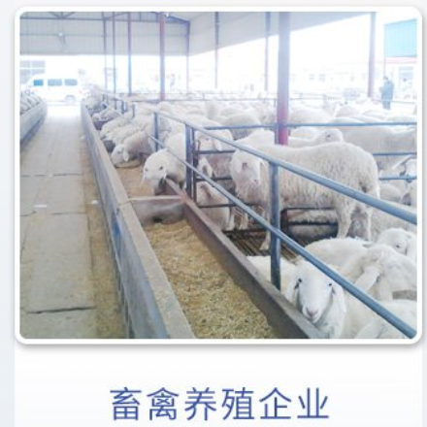
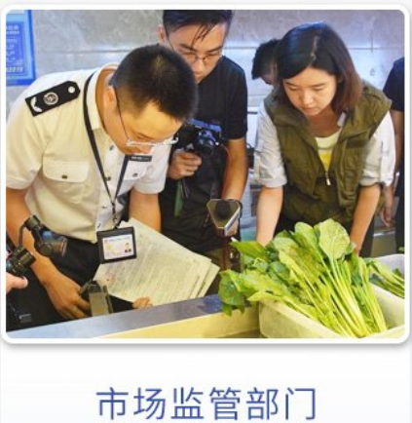
Current Status of Rapid Detection Technology for Mycotoxins
Grain processing enterprise
Grain purchasing enterprise
Grain reserve department
Feed processing enterprise
Livestock and poultry breeding enterprise
Market supervision department

Slide 23
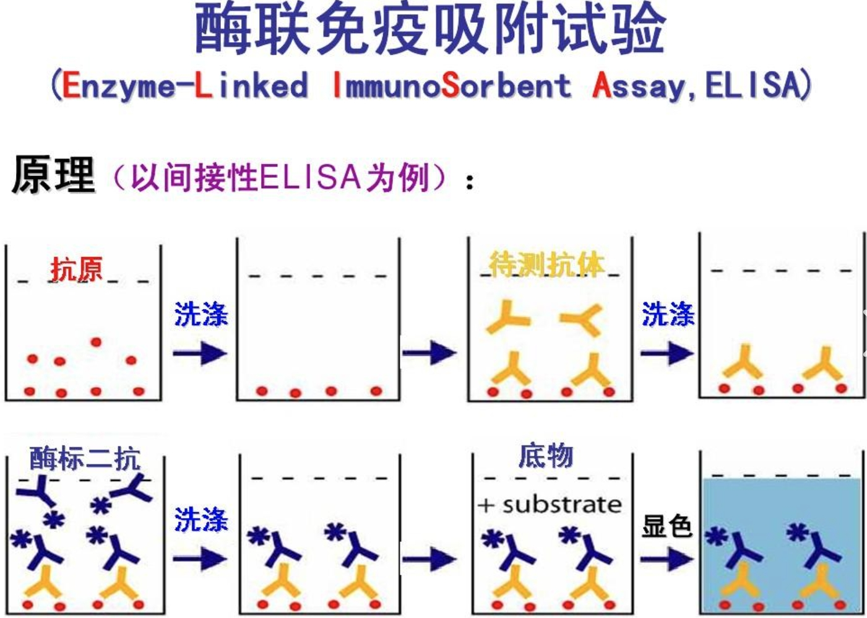
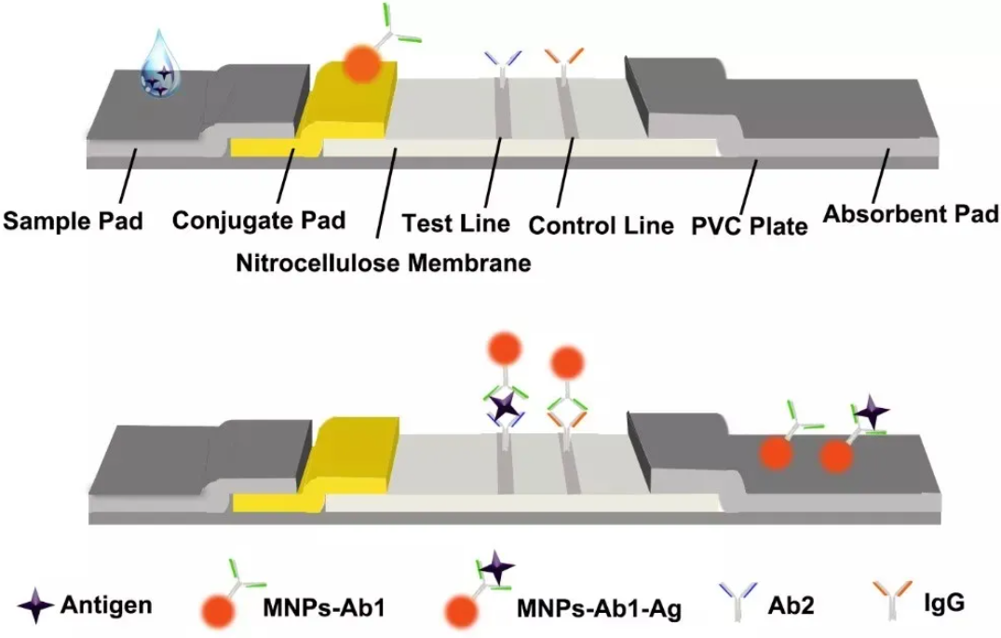
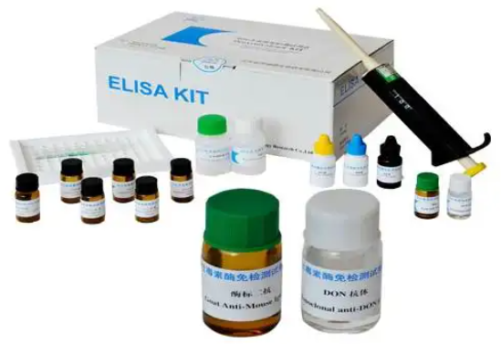
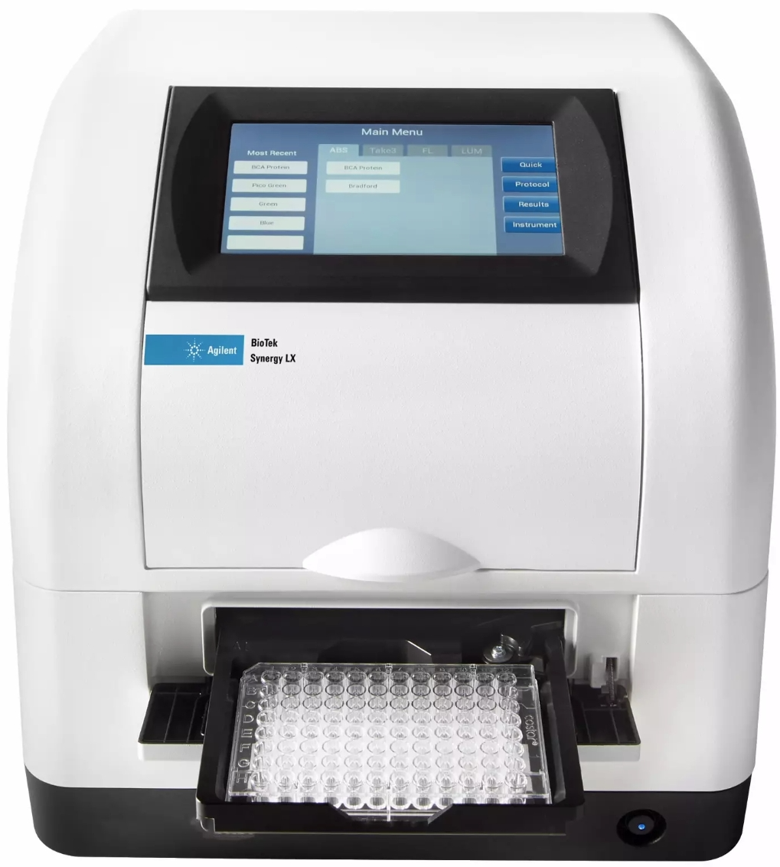
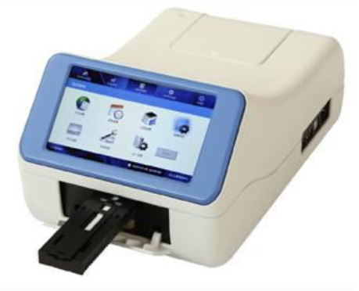
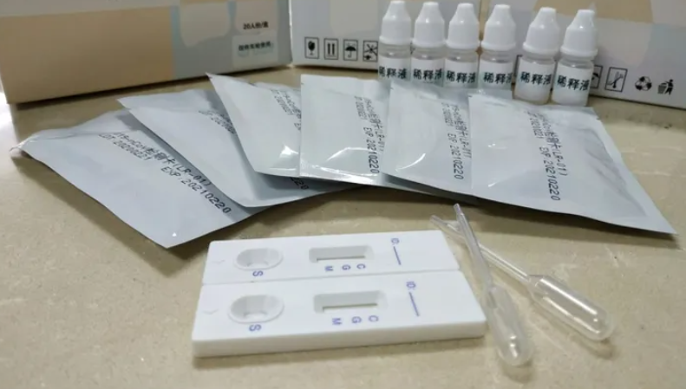
Current Status of Rapid Detection Technology for Mycotoxins
Enzyme-Linked ImmunoSorbent Assay, ELISA
Immuno-chromatography method
Principle
Reagent
Instrument
Reagent
Instrument

Slide 24
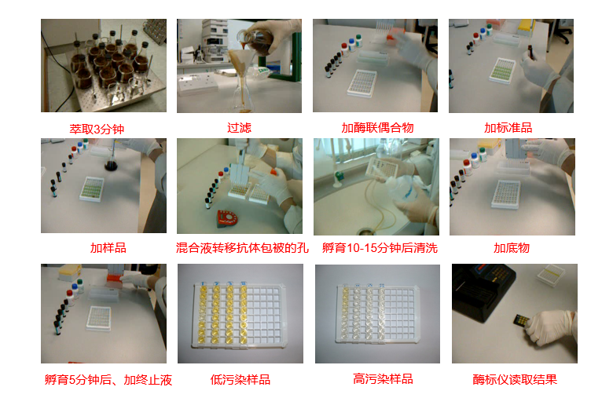
Current Status of Rapid Detection Technology for Mycotoxins
Extract 3 min Filtration Add reagent 1 Add reagent 2
Experimental procedure of ELISA
Add sample Tranfer liquid Incubation Add reagent 3
Incubation Low level High level Reading
Add reagent 4 sample sample

Slide 25
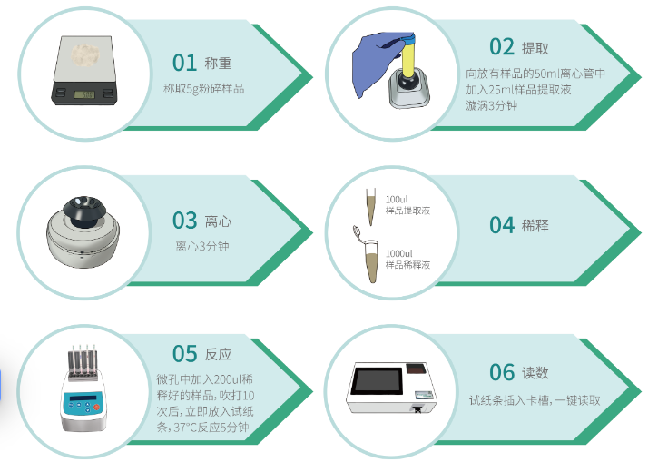
Current Status of Rapid Detection Technology for Mycotoxins
Extraction
Weighing
Experimental procedure of Immuno-chromatography method
Centrifugation
Dilution
Reaction
Reading

Slide 26
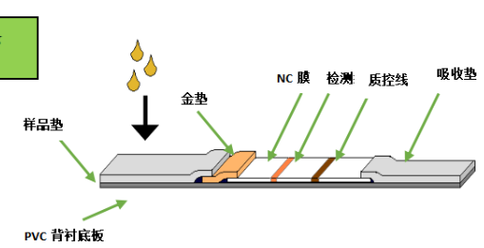
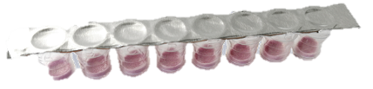
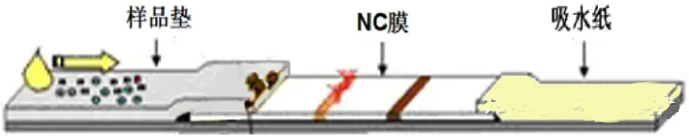
Current Status of Rapid Detection Technology for Mycotoxins
Composition of immunochromatography
The sample pad, nitrocellulose membrane, gold pad (microporous), and absorbent pad, which are sequentially adhered to the PVC backing plate.
Gold Pad Pattern
Microporous Pattern
Control Line
Microporous
nitrocellulose membrane
gold pad
absorbent pad
sample pad
Testing line
nitrocellulose
membrane
absorbent pad
sample pad
PVC backing plate

Slide 27
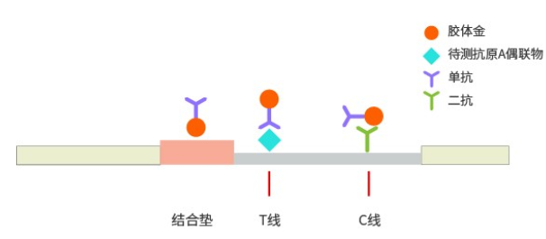
Current Status of Rapid Detection Technology for Mycotoxins
Competitive Method
样品中不含毒素
T line immobilizes the artificial antigen of the toxin to be tested
C line immobilizes secondary antibodies that can specifically bind to the gold-labeled antibodies.
样品中有毒素

Slide 28
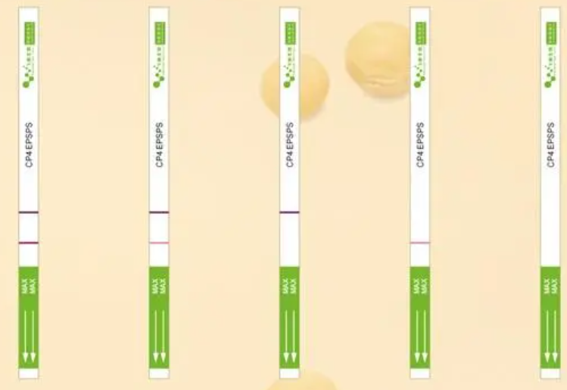
Current Status of Rapid Detection Technology for Mycotoxins
Negative
Positive（less）
Negative（more）
Invalid
Invalid

Slide 29
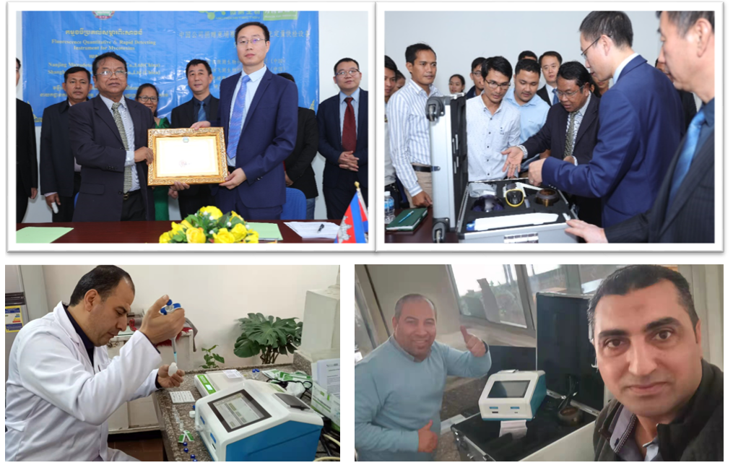
Current Status of Rapid Detection Technology for Mycotoxins
The application of the Immuno-chromatography method in the Ministry of Agriculture of Cambodia and the Ministry of Food Toxins and Pollution of the National Research Center of Egypt

Slide 30
03
Development Trends in Rapid Detection Technology for Mycotoxins

Slide 31

Development Trends in Rapid Detection Technology for Mycotoxins
Automation and intelligence
Sample in- result out

Slide 32
Development Trends in Rapid Detection Technology for Mycotoxins
Principle of the automated magnetic beads-based chemiluminescence immunoassay system
Using magnetic beads as the solid-phase carrier 以SA-MB；
Establishing a magnetic bead chemiluminescent immunoassay based on the principle of indirect competition；
The luminescence value is negatively correlated with the target in the sample。

Slide 33

Development Trends in Rapid Detection Technology for Mycotoxins
Front and top views of the mycotoxin magnetic chemiluminescent reagent strip
Single-sample kit：All experimental reagents and consumables are preloaded in the reagent strip, allowing for immediate testing upon arrival of the sample, thus avoiding reagent wastage and cross-contamination.

Slide 34


Development Trends in Rapid Detection Technology for Mycotoxins
Chemiluminescence-based analyzer
Scanning module
Pipetting module 、
Magnetic bead control module
Signal reading module

Slide 35

Development Trends in Rapid Detection Technology for Mycotoxins
Extract 3 min Filtration Add reagent 1 Add reagent 2
Experimental procedure of ELISA
Add sample Tranfer liquid Incubation Add reagent 3
Incubation Low level High level Reading
Add reagent 4 sample sample

Slide 36
Development Trends in Rapid Detection Technology for Mycotoxins
Extract 3 min Filtration Add reagent 1 Add reagent 2
Experimental procedure of ELISA
Completed by instrument
Easy to use
Reproducibility: without human error
Short time and high throughput: 21 minutes for 6 samples
Add sample Tranfer liquid Incubation Add reagent 3
Incubation Low level High level Reading
Add reagent 4 sample sample

Slide 37
04
Evaluation of Rapid Detection Products for Mycotoxins

Slide 38
Evaluation of Rapid Detection Products for Mycotoxins
Major rapid detection brands for mycotoxins
Brand | Product Category | Country
Romer | Test strip/ELISA | Austria
Charm | Test strip | US
Biopharm | Test strip/ELISA | Grtmsny
Beacon |  | US
Hua an mai ke |  | China
Zhong jian wei kang
Qin bang
An pu nuo
Yi rui
Wei de wei kang
Rui xin
Jin liang zhi ce
A dazzling array of products
A wide variety of products
Significant differences in performance

Slide 39
Evaluation of Rapid Detection Products for Mycotoxins
Core issues:
Is it usable?
How to use it?
How to choose rapid detection products?
How to judge the test results?
It is crucial to conduct a scientific and reasonable evaluation of rapid test products!

Slide 40
Evaluation of Rapid Detection Products for Mycotoxins
When using rapid testing methods for monitoring and spot checks, if the measurement results are at the national standard threshold, a retest should be conducted according to the testing methods prescribed by the national standards.
The difficulty in determining results:
What kind of samples are definitively positive and require retesting?
Example: Aflatoxin B1 at 18 ppb, 30 ppb, how should it be handled?

Slide 41
Evaluation of Rapid Detection Products for Mycotoxins
Maximize the reduction of the probability of false detection to ensure testing reliability.
2. Reduce the workload to reflect the value of rapid screening products.

Slide 42
Evaluation of Rapid Detection Products for Mycotoxins
Internationally mainstream mycotoxin rapid detection product evaluation scheme
United States Department of Agriculture (USDA) Grain Inspection, Packers and Stockyards Administration
Rapid Test Kit Evaluation Program
European Commission
COMMISSION REGULATION (EU) No 519/2014 ANNEX II
Inspired by the procedure from three groups of quantitative rapid screening evaluations involving multiple participants.
Inspired by the concept refers to the determination of the cut-off threshold for quantitative rapid screening products.

Slide 43
Evaluation of Rapid Detection Products for Mycotoxins
Evaluation Principles (Based on Mycotoxin Contamination and the Characteristics of Rapid Detection Products)
1、One item, one evaluation (matrix)
2、Batch-based
3、Multiple person cross-evaluation
4、Evaluation centered around the limit concentration

Slide 44
Evaluation of Rapid Detection Products for Mycotoxins
The evaluation samples will be divided into 3 groups, with 7 samples in each group. Three experimenters will independently extract the samples from each group according to the method provided by the product used.
Evaluator 1
Evaluator 1
Evaluator 1
Sample 1
Sample 1
Sample 1
Sample 1
Sample 1
Sample 1
Sample 1
Sample 1
Sample 1
Sample 1
Sample 1
Sample 1
Sample 1
Sample 1
Sample 1
Sample 1
Sample 1
Sample 1
Sample 1
Sample 1
Sample 1
Group 1
Group 2
Group 3
According to Rapid Test Kit Evaluation Program from GIPSA

Slide 45

Evaluation of Rapid Detection Products for Mycotoxins
Standards of the Grain Industry of the People’s Republic of China
Evaluation protocol for rapid detection method of mycotoxins in grains

Slide 46



Evaluation of Rapid Detection Products for Mycotoxins
a) Evaluation Results
Include the evaluation concentration, recovery rate, relative standard deviation, and critical determination threshold.
Negative critical value
Positive critical value
Negative critical value
Positive critical value
Negative zone
Positive zone.
The standard deviation of 3 groups
Critical value range
Detection value（ppb）

Slide 47
Evaluation of Rapid Detection Products for Mycotoxins
Quantitative Rapid Test Product Evaluation Results
Accuracy
Rrecision
Brand | Batch number | Target toxin | Concentration | Recovery | RSD | Negative critical value | Negative critical value
Brand 1 | 20150724 | DON | 1000 | 93% | 10.4% | 734.5 | 1120.2
Brand 1 | 20150813 | DON | 1000 | 77% | 21.0% | 447.1 | 1096.5
Brand 2 | B007013A-06-EZ | DON | 1000 | 101% | 8.9% | 828.6 | 1185.7
Brand 2 | B007005-06-EZ | DON | 1000 | 92% | 12.0% | 703.3 | 1145.9
Brand 3 | D02260127 | DON | 1000 | 54% | 36.0% | 151.1 | 927.6
Brand 3 | D02261110 | DON | 1000 | 46% | 40.5% | 86.3 | 824.8
Brand 4 | DON16011 | DON | 1000 | 106% | 12.6% | 790.0 | 1330.0
Is it usable?
How to use it?

Slide 48
Selecting and using rapid testing technology well
Fully utilize the role of quality control samples in daily work.

Slide 49
Application of quality control samples in mycotoxin rapid detection
Quality control for routine analysis and determination (blind samples)
Evaluate the performance of instruments during the purchase of rapid detection equipment
Test the rapid detection products in the process of accepting the rapid detection products
Training and assessment of personnel

Slide 50


Application of quality control samples in mycotoxin rapid detection
Mycotoxin component analysis standard reference materials of grain

Slide 51

Thank You
Hongmei Liu
E-mail：lhm@ags.ac.cn
Tel：18911037211
Sharing for Learning

