Slide 1
Rice Storage, Processing and Nutrition Seminar on China-Africa Rice Value Chain Rice Consumption and Supply Chain integration in China
Xia Zhao
Nanjing University of Finance and Economics
June ,2023
Notes:
Good afternoon everyone,
I’d like to thank you for giving me the chance to atand here. Well
The topic I’m going to deal with is “Rice Consumption and Supply Chain integration in China”

Slide 2
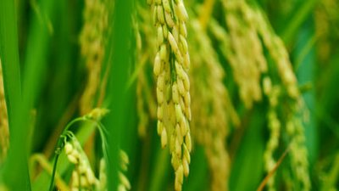
CONTENTS
1.Characteristics of rice supply and demand in China
2.New trends of rice consumption in China
3. Changes in rice storage
4.Key areas of rice supply chain integration in China
Notes:
This is the outline of my presentation.

Slide 3
1. Characteristics of rice supply and demand in China
（1）Largest producer in the world, second largest grain crop in China
Rice productive structure in the world（2022）
Grain productive structure in China（2021）
Notes:
I’ll start with the characteristics of rice supply and demand in China.
We all know that China is the largest rice producer in the world, accounting for nearly 30 percent in Two thousand and twenty two.2022.
Looking from the domestic productive structure, rice is the second largest grain crop in China, accounting for 32 percent of the total grain yield in Two thousand and twenty one.2021.

Slide 4
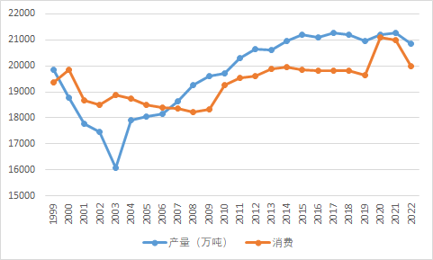
1. Characteristics of rice supply and demand in China
（2）Absolutely self-sufficient in rice supply
Since 2006, China’s rice yield is much more than consumption, it’s absolutely self-sufficient in rice supply, And in recent years, the rice consumption is reducing.
Trend of rice output and consumption
Notes:
China is Absolutely self-sufficient in rice supply. Since 2006, China’s rice yield is much more than consumption, And in recent years, the rice consumption is reducing.

Slide 5
1. Characteristics of rice supply and demand in China
（3）The absolute proportion of ration consumption
Rice is the staple grain of more than 60 percent of China's population.
In 2019, rice consumption was 214,963,500 tons, and ration consumption accounted for 80%
Rice consumption structure（2019）
Notes:
rice is the staple grain of more than 60 percent of China's population, and in 2019, rice ration consumption accounted for 80%.

Slide 6
2. New trends of rice consumption in China
（1）More nutritional
（2）Better taste
（3）More Exquisite
（4）New marketing channel
（5）More Convenience
Notes:
The second part of my presentation is new trends of rice consumption in China.

Slide 7
2. New trends of rice consumption in China
Nutrient content of rice /100 kg Unit: milligram
（1）More nutritional
With the increase of consumer income, high-income groups have the behavior of upgrading staple grain. Compared with white rice, germ rice has outstanding nutritional advantage, and is becoming the preferred staple grain.
nutrient substance
DF
Calcium
Phosphorus
Vitamin B1
Vitamin B2
Pantothenic acid
Vitamin B6
Vitamin K
Brown Rice
1600
21
332
120-500
66
1520
650
10000
Germ Rice
1000
21
332
120-500
66
1520
650
10000
White Rice
300
17
186
54
33
750
37
1000
Notes:
in recent years, consumers pay more attention to the high nutritional quality.
With the increase of consumers’ income, high-income groups have the behavior of upgrading staple grain. Compared with white rice, germ rice has outstanding nutritional advantage, and is becoming the preferred staple grain.

Slide 8
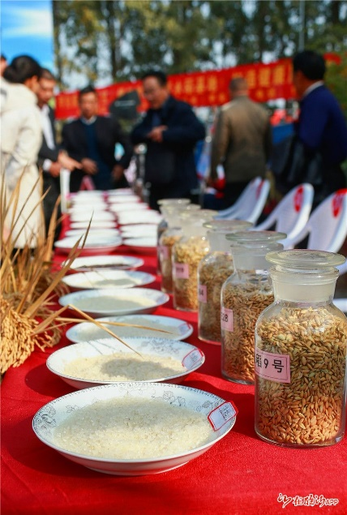
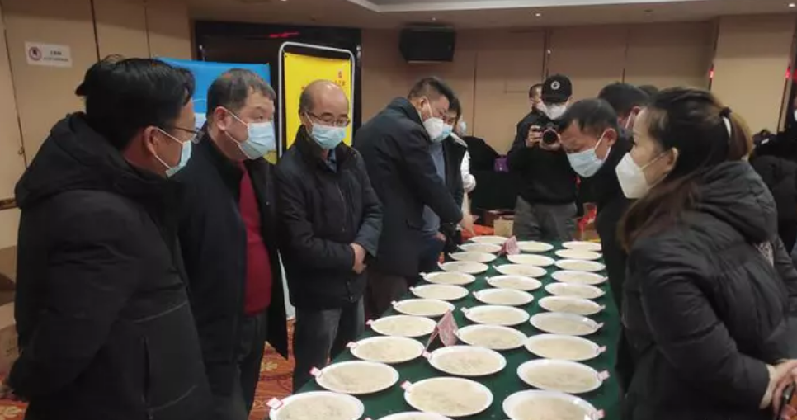
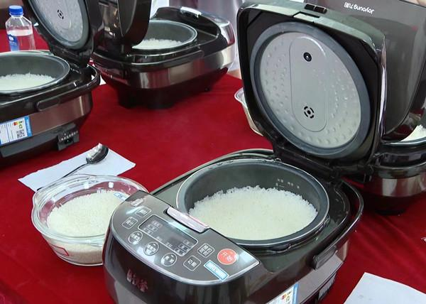
2. New trends of rice consumption in China
（2）Better taste
Every year, Chinese provinces and regions hold rice tasting events in order to provide consumers with high-quality rice.
Notes:
Second, consumers put more attention to the rice eating quality. And every year, in order to provide consumers with high-quality rice, chinese provinces and regions hold rice tasting events. The photos shows some activity scenes.

Slide 9
2. New trends of rice consumption in China
Evaluation of contents |  | Description
Smell | special fragrance | rich；faint；ordorless
 | bad smell | smell of old rice and unhappiness
Exterior | color | normal color and white rice; abnormal color, yellowish, grey
 | gloss | glossy，non-glossy
 | integrity | compact structure, partially compact structure, loose structure
Taste | viscidity | smooth, sticky
 | tenderness | Pressure on molars: without adhesion to teeth
 | elasticity | chewy, without chewy
 | purity, persistence | taste of chewing: sweet, fragrance, purity and persistence of taste
Texture of cold rice | in groups, viscoelasticity,hardness | The texture of the rice as it cools
National standard:
GB/T 15682-2008
Inspection of grain and oils-Method for sensory evaluation of paddy or rice cooking and eating quality
Notes:
And Chinese government has issued the national standard, Inspection of grain and oils-Method for sensory evaluation of paddy or rice cooking and eating quality, it offers four criteria for assessment, they are smell, Exterior, taste and Texture of cold rice.

Slide 10
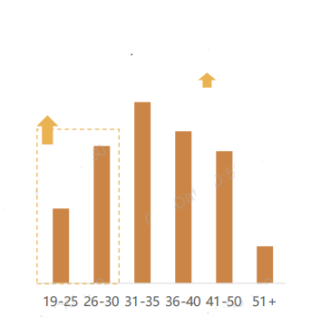
2. New trends of rice consumption in China
（3）More Exquisite
As young consumers have become the main consumption group, the attitude of exquisite grain is driving consumers to pay more attention to the diversity, functions and applicability of staple grain.
Age distribution of grain consumption
Increase compared with last year
Notes:
NOW, young consumers is becoming the main consumption groups of staple grain, the attitude of exquisite grain is driving them to pay more attention to the diversity, functions and applicability of staple grain.

Slide 11
2. New trends of rice consumption in China
（3）More Exquisite
IndicaVS Japonica
Fresh rice VS New rice VS stale rice
Functional rice: rice with special nutritional and health functions:
Germinal rice
Selenium rich rice
Glucan rice
Fresh rice
New rice
stale rice
100%
70%
20%
Nutrition
Notes:
they will compare the classification, freshness and function for different food.
For example ,Indica is more suitful for egg fried rice.
From the picture, we can see when the storage time is longer, the nutrition is lower.
And we pursuit different Functional rice with special nutritional and health functions.
we choose different types of rice.留胚米、富硒大米、葡聚糖大米

Slide 12
2. New trends of rice consumption in China
（4）New marketing channels
"Adopted farm" : Consumers adopt paddy fields through online platform, observe the growth of the rice remotely through the Internet, and work in the fields by themselves on weekends or holidays. After harvesting paddy, the rice will be sent to the adopter's home for free.
Meet the needs of consumers to experience pastoral life and consume organic food.
Notes:
The Forth is consumers prefer to new marketing channels.
Adopted farm is most popular for consumers , consumers adopt paddy fields through online platform, observe the growth of the rice remotely through the Internet, and work in the fields by themselves on weekends or holidays. . After harvesting paddy, the rice will be sent to the adopter's home for free.
This pattern meets the needs of consumers to experience pastoral life and consume organic food.

Slide 13
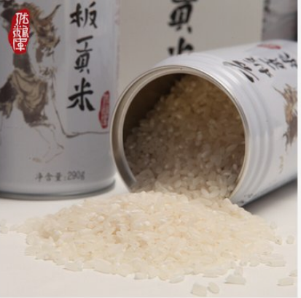
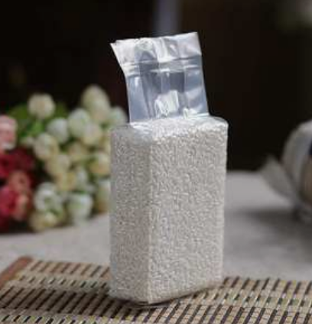
2. New trends of rice consumption in China
（5）More Convenience
Purchasing channels: Online vs offline
Quantity purchased: Family pack vs Meal for one
Grain storage: large packaging VS vacuum hypoxic packaging, separate packaging, etc
Notes:
Finally, consumers are appreciating the convenience of consumption. More consumers like purchasing rice through online channels,
And prefer to small packs and vacuum hypoxic packaging, separate packaging.

Slide 14
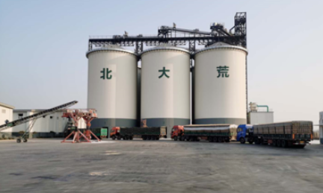
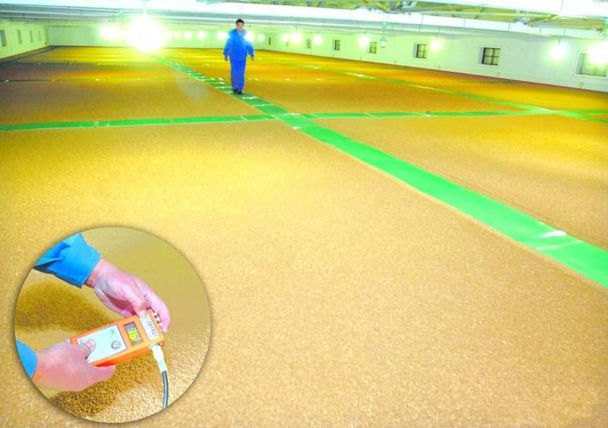
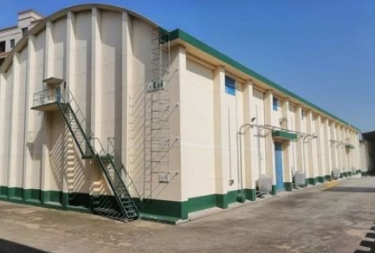
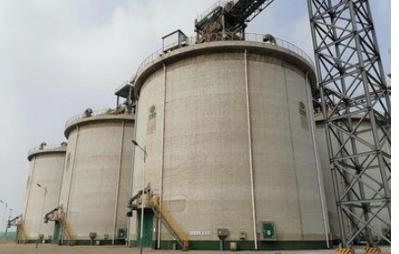
3. Changes in rice storage
In China, in order to ensure that the quality of rice meets the needs of consumers, grain processing enterprises have gradually use classification storage.
according to rice variety, good or bad, new or old, dry or wet, insects or no insects, we store rice in different granaties.
Notes:
In China, in order to ensure that the quality of rice meets the needs of consumers, grain processing enterprises have gradually realized the classification of rice storage.
according to rice variety, good or bad, new or old, dry or wet, insects or no insects, we store rice in different granaties
The first picture shows the state of rice inside the depot.
The remaining three photos show three different warehouse types.平房仓\浅圆仓\立筒仓
Cottage warehouse \ shallow round warehouse \ vertical silo

Slide 15
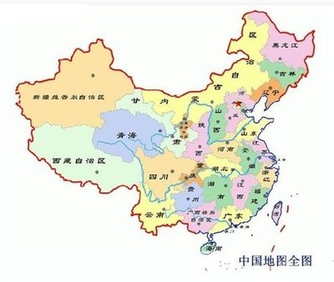
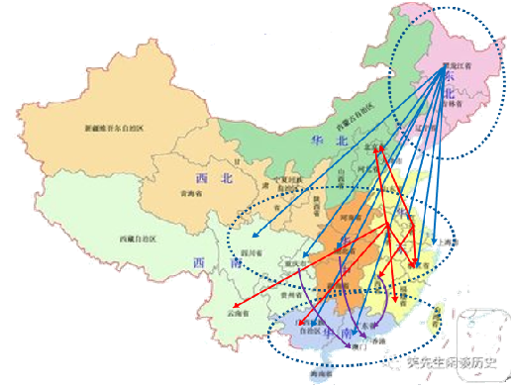
4.Key areas of rice supply chain integration in China
（1）Planting area integration
Rice producing area determines the direction of rice flow, and the dispersion of rice producing area restricts the effect of scale economy, increases production cost and reduces production efficiency.
By integrating dispersed rice producing areas in different regions to form large-scale planting bases, it is helpful to reduce production costs, improve production efficiency and achieve stable supply.
Notes:
The last part is key areas of rice supply chain integration
The First key areas is planting area integration. Rice producing area determines the direction of rice flow, and the dispersion of rice producing area restricts the effect of scale economy, increases production cost and reduces production efficiency.
By integrating dispersed rice producing areas in different regions to form large-scale planting bases, it is helpful to reduce production costs, improve production efficiency and achieve stable supply.

Slide 16
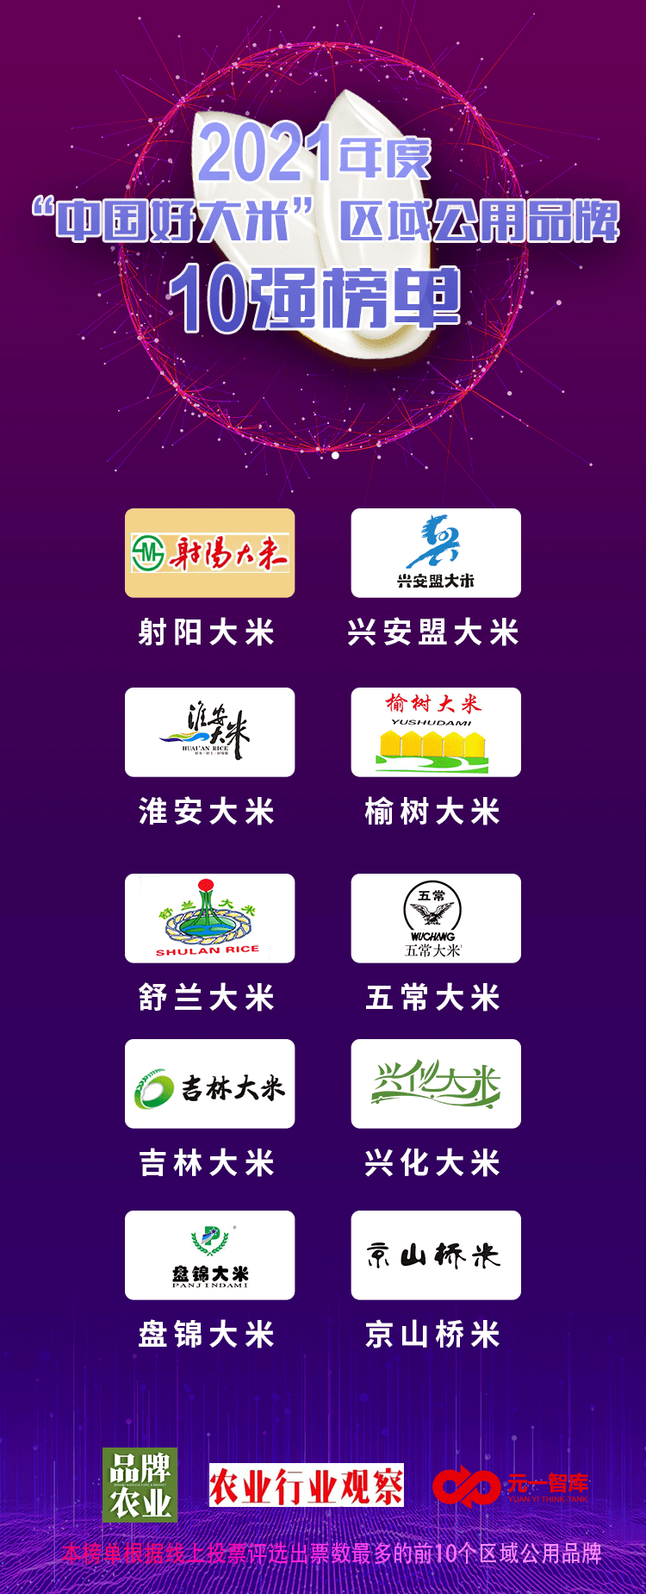
4.Key areas of rice supply chain integration in China
（2）Brand integration
By integrating regional (provincial and municipal) scattered rice brands, forming public brands, improving brand awareness and reputation, enhancing rice competitiveness, promoting industrial upgrading and increasing farmers' income.
Top 10 regional public brands of "China Good Rice" in 2021
Notes:
The Second one is brand integration. By integrating regional (provincial and municipal) scattered rice brands, forming public brands, improving brand awareness and reputation, enhancing rice competitiveness, promoting industrial upgrading and increasing farmers' income.
The right picture is the top 10 regional public brands of "China Good Rice" in 2021.

Slide 17
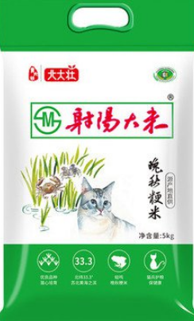
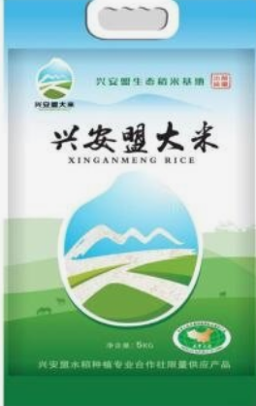
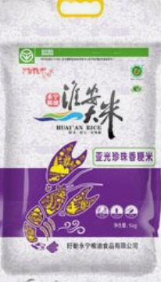
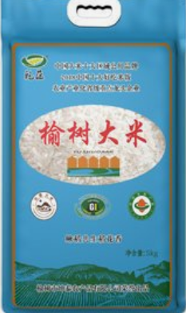
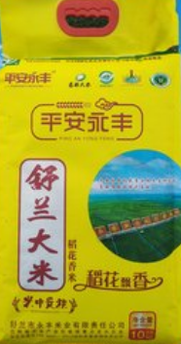
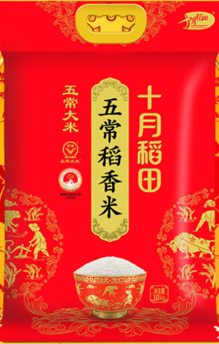
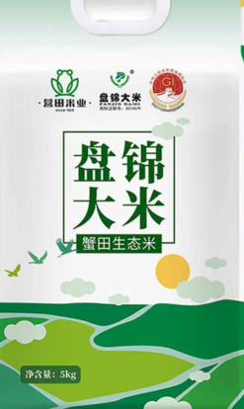
4.Key areas of rice supply chain integration in China
（2）Brand integration
Notes:
Here are some rice packing bags pictures.

Slide 18
4.Key areas of rice supply chain integration in China
（3）Channel integration
Through the integration of rice sales channels, the scattered sales channels can be transformed into large-scale and stable channels, so as to improve sales efficiency and reduce sales costs.
Distribution of sales channels
Offline channel
Online channel
Notes:
The Third is channel integration.
Through the integration of rice sales channels, the scattered sales channels can be transformed into large-scale and stable channels, so as to improve sales efficiency and reduce sales costs.
The Distribution of sales channels include offline channel and online channel.

Slide 19
4.Key areas of rice supply chain integration in China
Special
channel
Traditional channel
E-commerce channel
Catering channel
Offline physical store
Online store
Offline store
Offline store
Cereals & oils store, Supermarket,
Community stores, Wholesale market
Taobao,Suning, Jingdong, etc,
APP,
wechat business
Seize the local catering market means guarantee of enterprise survival.
Shools,
Hroops,
Hotels, etc.
Ignored often.
4
1
2
3
4
Notes:
The traditional channel is offline physical store, such as cereals & oils store, Supermarket, community stores, wholesale market and so on
The online store is becoming more popular because of its convinence.
AND the Traditional sales channels are transformed into e-commerce channels, and multiple sales channels are parallel
餐饮渠道，特殊渠道。
传统销售渠道向电商渠道转化，多种销售渠道并行

Slide 20
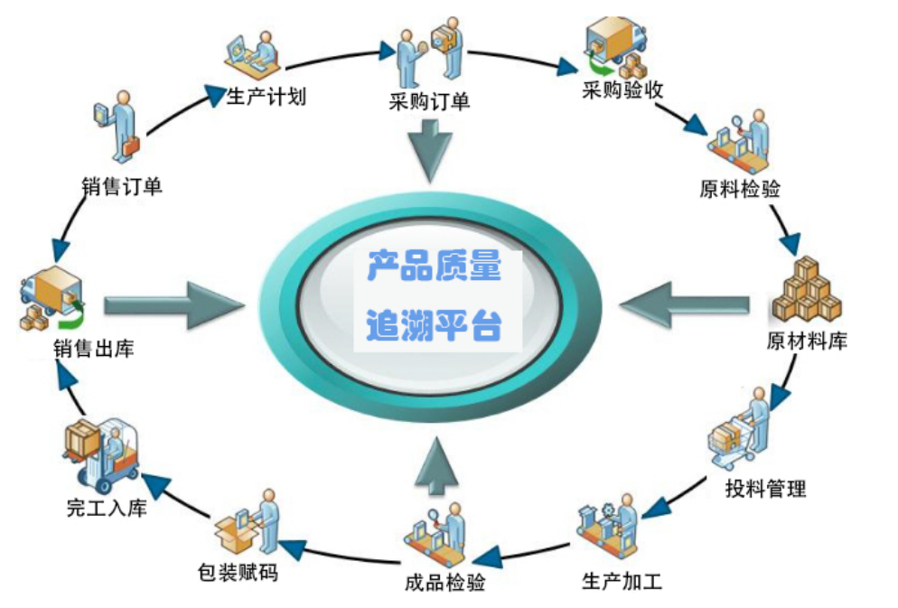
4.Key areas of rice supply chain integration in China
（4）Quality traceability
Record the information of producting, processing, packaging, quality inspecting, transportation, sales and other stages, to reach
source can be traced
destination can be traced
responsibility can be traced
Strengthen the whole process of quality safety management and risk control.
Notes:
The forth is quality traceability.
Rice quality traceability is the record the information of producting, processing, packaging, quality inspecting, transportation, sales and other stages, to reach the source can be traced, destination can be traced, responsibility can be traced, strengthen the whole process of quality safety management and risk control.

Slide 21
谢 谢！
Tel：13913036035
Email：xia.zhao@nufe.edu.cn
Notes:
That’s all. Thanks for your attention!

