Slide 1
国家适应气候变化战略与粮食安全 National Climate Change Adaptation Strategies And Food Security
张志强/Zhiqiang Zhang
国家应对变化战略研究和国际合作中心
National Center For Climate Change Strategy And International Cooperation(NCSC)
2024.5

Slide 2
目录/contents
气候变化对粮食安全的影响因素/Factors Affecting Food Security Due To Climate Change
适应气候变化战略与农业/Climate Change Adaptation Strategies And Agriculture

Slide 3
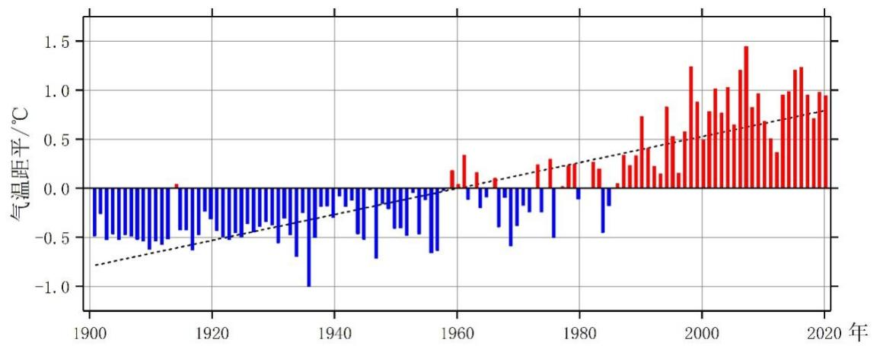
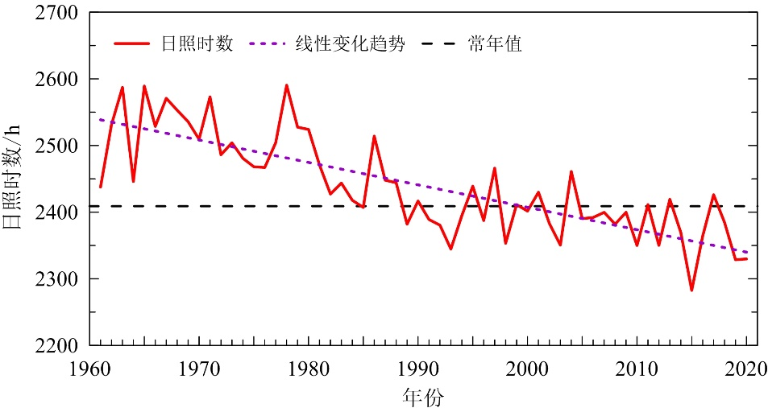
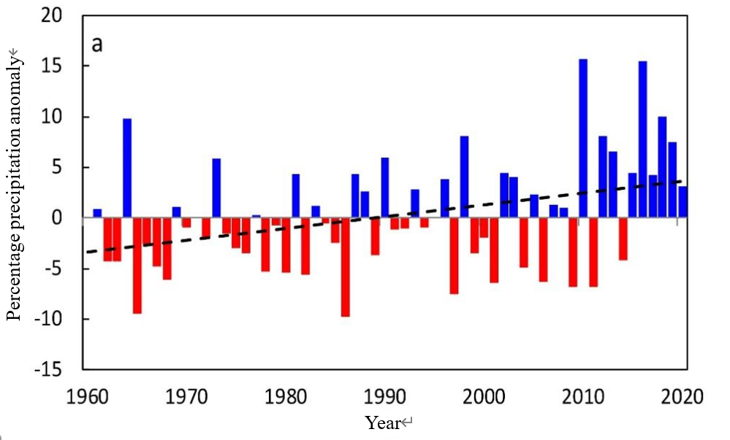
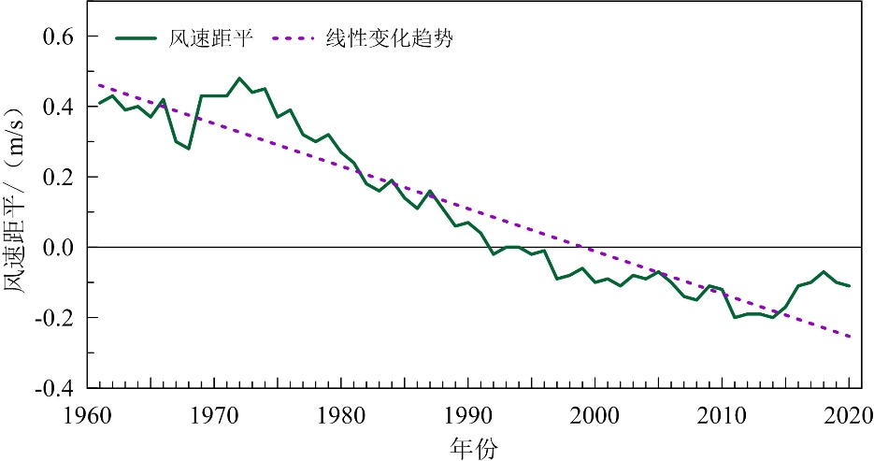
气候变化对粮食安全的影响因素
气温/Temperature
光照/Solar Radiation
Sunshine duration
Linear trend
Normal value
Sunshine duration/h
China’s Annual Average Surface Temperature Anomalies, 1901-2020
Year
Changes in Average Annual Sunshine Duration in China, 1961-2020 (hours)
降水/Precipitation
风速/Wind Speed
Percentage Precipitation Anomalies in China, 1961-2020
Average Annual Near-Surface Wind Speed in China, 1961-2020 (meters/second)

Slide 4
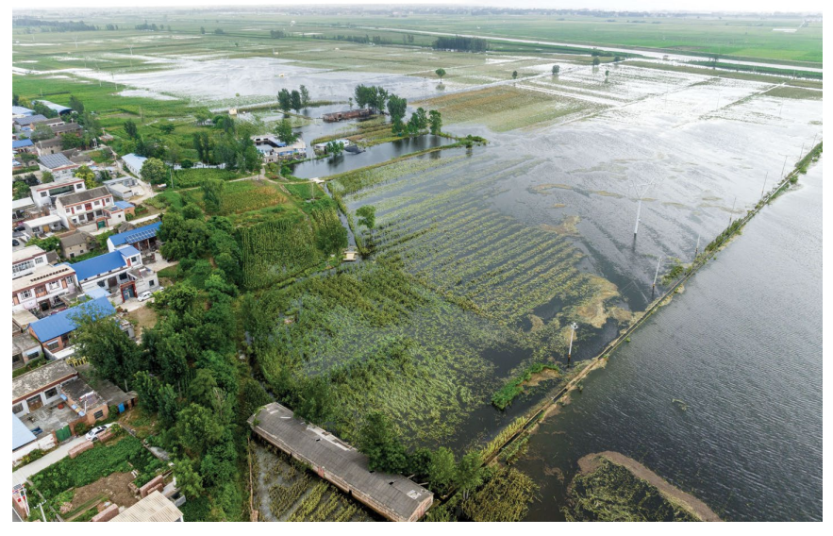
极端气候的影响/The Damage Of The Extreme Weather
生物多样性/Biodiversity
pcc ar6：一项对976种植物和动物的研究发现，47%的动植物灭绝原因与气候变化相关。/A study of 976 species of plants and animals found that 47 per cent of extinct plants and animals had causes of extinction linked to climate change
物种多样性/ Species Diversity
基因多样性/Genetic Diversity
功能多样性/Functional Diversity
农业/Agriculture
农业生产/Agricultural Production Systems
谷物产量/Crop Growth And Yields
植物病虫害/Plant Pests And Diseases
国际玉米小麦改良中心（CIMMYT）预测，到2030年，干旱和气温上升将使全球玉米单产降低高达30%。/The international maize and wheat improvement centre (CIMMYT) predicts that drought and rising temperatures will reduce global maize yields by up to 30 per cent by 2030.
IPCC AR6, 20世纪中叶以来，全世界200条主要河流中约有1/3径流量明显减少，小麦和玉米平均每10年分别减产1.9%和1.2%。/IPCC AR6, since the mid-twentieth century, about one third of the world's 200 major rivers have experienced significant reductions in runoff, with average reductions in wheat and maize yields of 1.9 per cent and 1.2 per cent, respectively, per decade.
降水的减少、干旱的发生也引发了畜禽业的危机，有关研究显示，热应激使美国奶牛的平均产奶量下降了0.38%到1.35%。/Reduced precipitation and the onset of drought have also triggered a crisis in the livestock industry, with studies showing that heat stress has reduced the average milk production of US cows by between 0.38 per cent and 1.35 per cent.
Scenes of flooded cornfields in Dongxuzhuang Village, Jun County, Hebi City, Henan Province.2023, https://news.cau.edu.cn/kxyj/7510baeed91e442aa5930c4da09688e6.htm

Slide 5
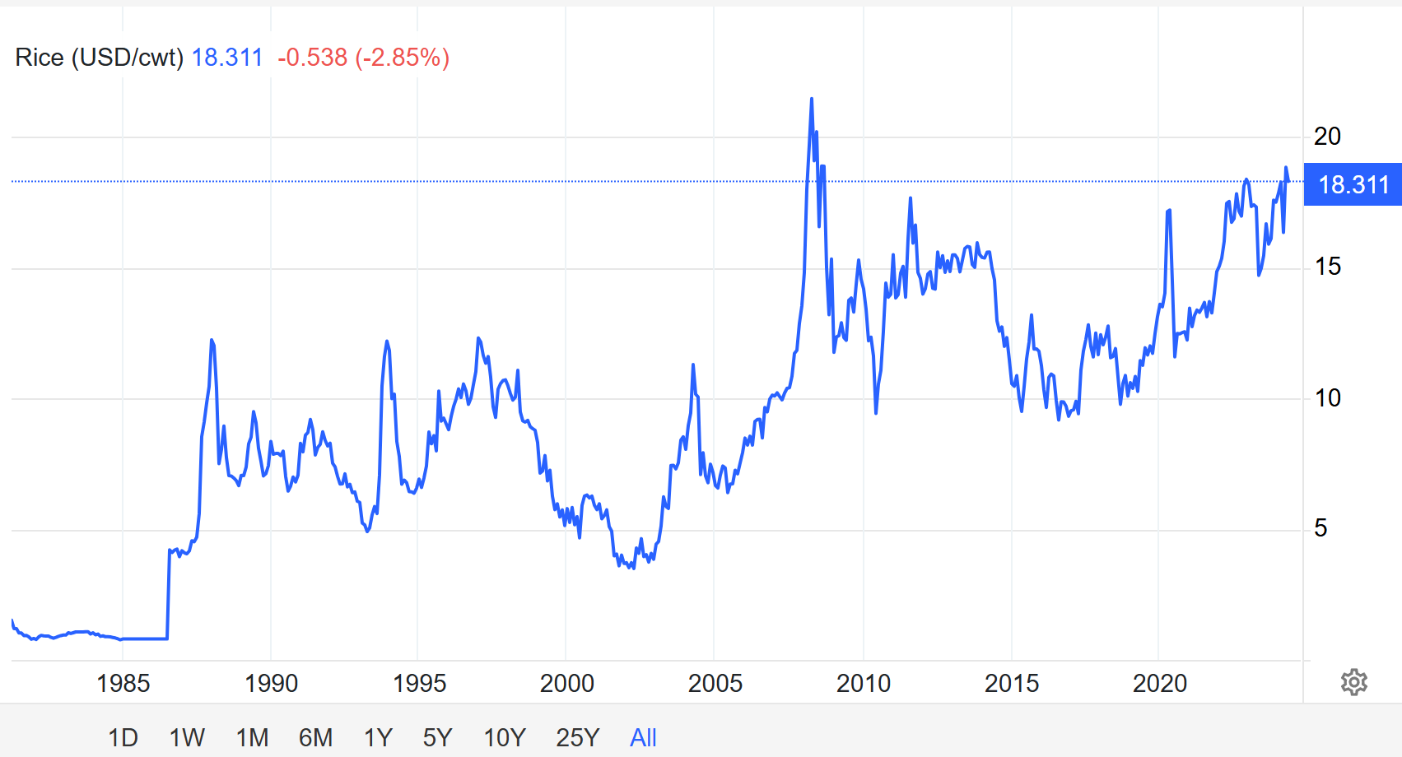
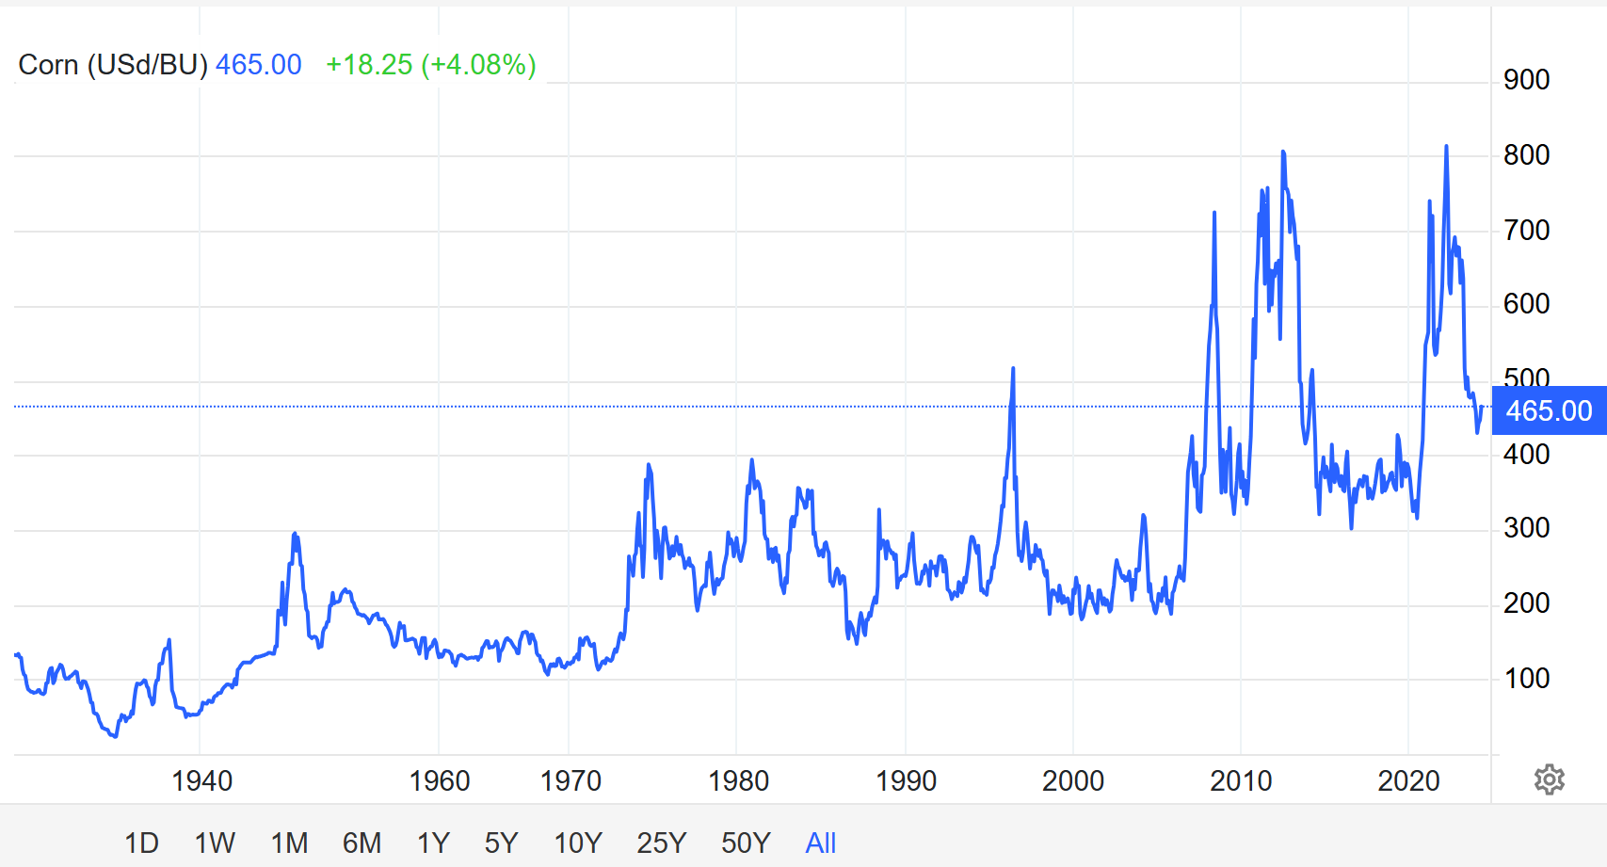
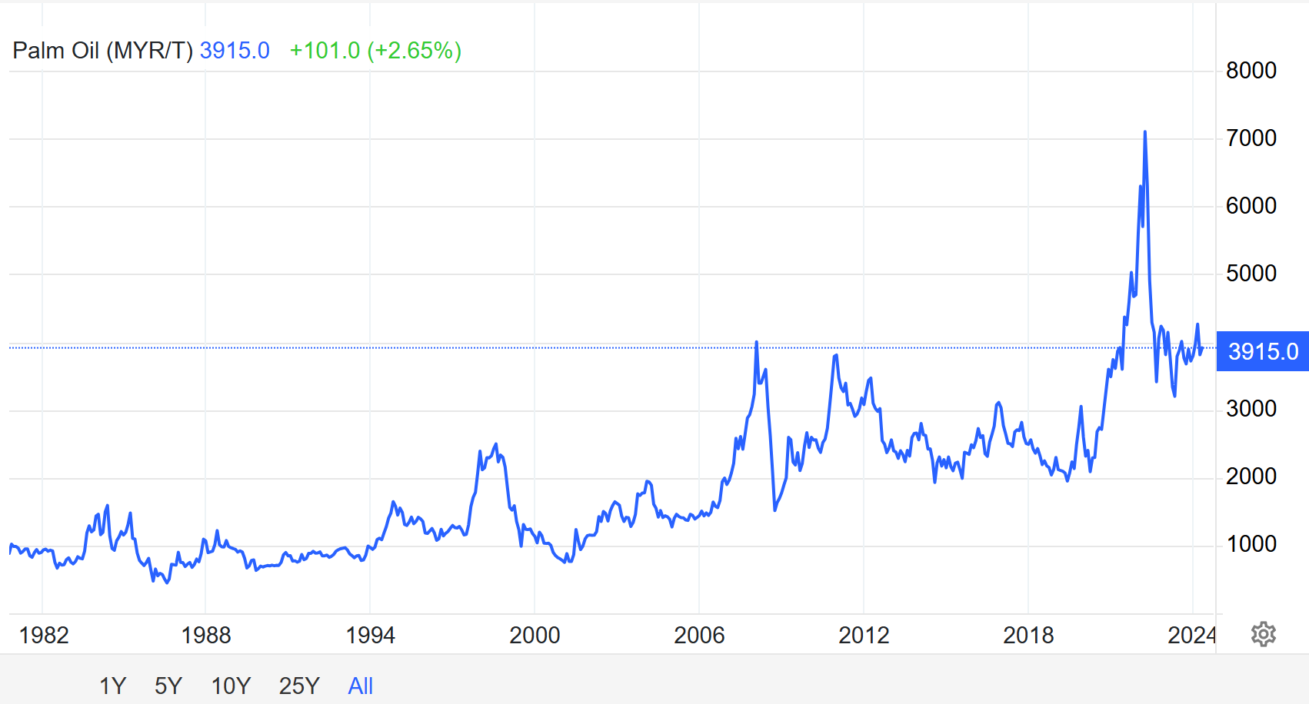
价格/PRICE
Notes:
2008年，大量的玉米、大豆和植物油被用于生产燃料乙醇和生物柴油，特别是玉米和大豆的主产国美国制定了大规模的生物质能源发展计划，形成与人畜争地争粮的局面，再加上近两年澳大利亚和加拿大等小麦主产国因干旱连续减产，造成全球大豆、玉米、小麦等主要农产品价格大幅上涨
据世界银行分析，使用玉米等农作物生产乙醇等生物燃料是导致２００７年植物油和粮食价格大幅上涨的重要原因，而后者对农产品价格指数上涨的贡献率为１５％，对食品价格上涨的贡献率为２０％。（https://www.gov.cn/jrzg/2008-01/28/content_871478.htm）
2020年以来，“拉尼娜现象”已经连续三年出现，给全球气候带来明显扰动，也给多个主要粮食生产国造成了较严重的破坏，影响全球粮食供给、抬高粮食价格。（https://new.qq.com/rain/a/20221108A08AKH00）

Slide 6
2.中国适应战略与农业政策/China Adaptation Policy
2013，国家适应气候变化战略
明确了2014－2020年国家适应气候变化工作的指导思想和原则，提出了适应目标、重点任务、区域格局及保障措施等。
2014 ，国家应对气候变化规划（2014—2020 年）
提出坚持减 缓和适应气候变化同步推动原则，进一步助推强化重点领域和区域 适应气候变化行动。
2016，城市适应气候变化行动方案、关于开展气候适应型城市建设试点的通知
2017年在全国选取28个地区开展国家气候适应型城市建设试点创建工作。
2022，国家适应气候变化战略2035
对未来15年我国适应气候变化工作的总体要求、主要目标、重点任务和战略实施等作出了部署安排。
2013， National Strategy for Adaptation to Climate Change
The guiding ideology and principles of national work on climate change adaptation for the period 2014 - 2020 have been clarified, and adaptation objectives, key tasks, regional patterns and safeguard measures have been put forward.
2014 ， National Climate Change Programme (2014-2020)
It is proposed that the principle of simultaneous promotion of climate change mitigation and adaptation should be adhered to, so as to further facilitate the enhancement of climate change adaptation actions in key areas and regions.
2016， Programme of Action on Urban Adaptation to Climate Change, Circular on Pilot Projects for Climate-Resilient Cities
2017， 28 districts nationwide selected to carry out pilot creation of national climate-adapted city construction
2022， National Climate Change Adaptation Strategy 2035
The overall requirements, main objectives, key tasks and strategic implementation of China's work on adaptation to climate change in the next 15 years have been deployed and organized.

Slide 7
取得的成效/Achievements
The level of climate monitoring and early warning is constantly improving
A comprehensive meteorological observation system comprising ground-based automatic weather stations, radar and meteorological satellites has been built.
It has established a database on regional droughts, heavy rains, high temperatures, dust, typhoons, snowstorms, low-temperature freezes and other meteorological disasters over a long period of time, pushed forward the construction of a risk census database, and completed the nationwide meteorological disaster danger zoning and risk zoning.
The layout of monitoring networks in the fields of forests, hydrology, oceans, ecological environment and health has been continuously improved, and observation networks have been set up for China's offshore and South China Sea, islands and near-shore hydrometeorological monitoring, and the Yellow Sea and Bohai Sea.
A monitoring and early warning and forecasting system for geological disasters has been established, improving the four-tier system of group monitoring and prevention at the county, township, village and group levels nationwide, and carrying out meteorological early warning for geological disasters, initially achieving full coverage of high and medium-risk prone areas for early warning.
气候监测预警水平不断提高
建成由地面自动气象站、雷达、 气象卫星等组成的综合气象观测系统。
建立区域性干旱、暴雨、高 温、沙尘、台风、雪灾、低温冻害等多种气象灾害长时间序列灾情数据库，推进风险普查数据库建设，完成全国气象灾害危险性区划和风险区划。
森林、水文、海洋、生态环境、卫生健康等领域监测 网络布局不断完善，已建立起我国近海与南海观测、岛屿与近岸水文气象监测、黄海和渤海观测网络。
建立地质灾害监测与预警预报体系，完善全国县、乡、村、组四级群测群防体系，开展地质灾害气象预警工作，初步实现高中风险易发区预警全覆盖。

Slide 8
取得的成效/Achievements
积极推进绿色农业和气候智慧型农业
完善农田基础设施，农田防灾抗灾减灾能力显著增强
实施重要生态系统保护和修复重大工程，生态恶化趋势基本得到遏制，自然生态系统总体稳定向好，国家生态安全屏障骨架基本构筑。
截至 2023 年底，已完成 10亿亩高标准农田建设任务，农田灌溉水有效利用系数达到 0.576.
Actively promoting green agriculture and climate-smart agriculture
Improve farmland infrastructure, and significantly enhance the ability of farmland to prevent, resist and mitigate disasters.
Major projects for the protection and restoration of important ecosystems have been implemented, the trend of ecological deterioration has basically been curbed, natural ecosystems are generally stable and improving, and the skeleton of the national ecological security barrier has basically been constructed.
By the end of 2023, the construction of 1,000 million mu of high-standard farmland had been completed, the effective use coefficient of irrigation water on farmland had reached 0.576.

Slide 9
农业与粮食安全的主要措施/ Climate Change Adaptation Strategies And Agriculture
优化农业气候资源利用格局
开展农业气候资源动态评估和精细区划，调整优化产业布局、种植结构和作物品种配置
中高纬度适度提高复种指数，北扩喜温作物， 调整作物品种熟性；
低纬度地区扩大冬种规模，充分挖掘农业生产潜力
选育高产优质抗逆作物、畜禽水产和林果花草适应性良种。
开展气候友好型低碳农产品认证，开发地方特色地理标志农产品， 促进农民增收。
Optimizing patterns of agroclimatic resource use
Carrying out dynamic assessment of agroclimatic resources and fine zoning, and adjusting and optimizing industrial layout, planting structure and crop variety allocation.
Moderately increase the replanting index at middle and high latitudes, expand temperature-loving crops in the north, and adjust the ripeness of crop varieties;
Expanding the scale of winter planting in low latitude areas, and fully tapping the potential of agricultural production.
Selecting and breeding high-yield and high-quality adaptable varieties of antiretroviral crops, livestock, poultry and aquatic products, as well as forests, fruits, flowers and grasses.
Carry out the certification of climate-friendly and low-carbon agricultural products, and develop geographical indications of local specialties, so as to promote farmers' income growth.

Slide 10
农业与粮食安全的主要措施/ Climate Change Adaptation Strategies And Agriculture
Strengthening the agricultural strain mitigation work system
Improve disaster monitoring, early warning and response mechanisms, and improve disaster diagnostic techniques and standards.
Prepare disaster reduction plans for different regions, types of disasters and agricultural species, raise protection standards, and strengthen disaster prevention and reduction material reserves.
Developing intelligent irrigation and drainage of farmland, climate-adapted crops, and popularizing water-saving irrigation, dry farming and other adaptation technologies.
强化农业应变减灾工作体系
健全灾害监测预警和响应机制，完善灾害诊断技术与标准
编制不同区域、不同灾种和农业物种的减灾预案，提高防护标准，加强防灾减 灾物资储备。
发展农田智能化排灌、气候适应型作物、林果应变栽 植和畜禽、水产健康养殖技术体系，推广节水灌溉、旱作农业、抗旱保墒、排涝去渍等适应技术

Slide 11
农业与粮食安全的主要措施/ Climate Change Adaptation Strategies And Agriculture
增强农业生态系统气候韧性
坚持农业发展生态优先，加强土保持与生态防护，在适宜地区推广保护性耕作，发展混林农业和 山区立体农业，推广合理的间作套作体系
推行统防统治与 绿色防控技术。
做好外来入侵生物防控，保护农业生物多样性。推进化肥减量增效，集成推广科学施肥技术。加强耕地质量建设，实 施耕地保护与质量提升行动计划，增加土壤有机质，提升土壤肥力
加强适应气候变化的种质资源保护基地和种子库建设，保护农业动植物濒危物种。
保护传统农业文化遗产，优化农田景观设计，提升农业生态系统服务功能。
Enhancing the climate resilience of agro-ecosystems
Adhering to the ecological priority of agricultural development, strengthening soil conservation and ecological protection, promoting conservation tillage in suitable areas, developing mixed-forest agriculture and three-dimensional agriculture in mountainous areas, and promoting reasonable intercropping and intercropping systems
Promoting the unified control of pests and green prevention and control technologies. Promote unified control and green prevention and control techniques.
Do a good job of preventing and controlling invasive alien organisms and protecting agricultural biodiversity. Promote the reduction of chemical fertilisers and increase their efficiency, and integrate and promote scientific fertiliser application techniques. Strengthen the construction of arable land quality, implement the action plan for arable land protection and quality improvement, increase soil organic matter, and enhance soil fertility.
Strengthen the construction of bases for germplasm resource conservation and seed banks that are adapted to climate change, and protect endangered species of agricultural animals and plants. Protecting traditional agricultural cultural heritage, optimising farmland landscape design, and enhancing agro-ecosystem services.

Slide 12
农业与粮食安全的主要措施/ Climate Change Adaptation Strategies And Agriculture
建立适应气候变化的粮食安全保障体系
调整农业基础设施建设布局。
建立完善国内外主产区粮食产量和生产潜力监测、预测、供需及风险预估系统。
加强耕地保护与质量建设，坚守 18 亿亩耕地红线，落实最严格的耕地保护制度，加强耕地用途管制，实施永久基本农田特殊保护。
推进高标准农田建设，大力发展气候智慧型农业，提高农业综合生产能力。
强化农业适应气候变化技术创新，在农业主产区建立适应气候变化 技术示范基地。
完善农业气象服务体系和风险分担机制，逐步推广 天气指数保险，探索农业巨灾保险机制。
Establishing a food security system
Adjusting the layout of agricultural infrastructure construction. -Establishing and improving systems for monitoring, forecasting, supply and demand, and risk assessment of grain output and production potential in major domestic and foreign production areas.
Strengthen the protection and quality of arable land, adhere to the red line of 1.8 billion mu of arable land, implement the strictest arable land protection system, strengthen the control of arable land use, and implement special protection of permanent basic farmland. It will promote the construction of high-standard farmland, vigorously develop climate-smart agriculture, and enhance comprehensive agricultural production capacity.
Strengthen technological innovation in agricultural adaptation to climate change, and set up demonstration bases for climate change adaptation technology in major agricultural production areas. Improve the agricultural meteorological service system and risk-sharing mechanism, gradually promote weather index insurance, and explore agricultural catastrophe insurance mechanisms.

Slide 13
农业与粮食安全的主要措施/ Climate Change Adaptation Strategies And Agriculture
强化气候变化监测预测预警
开展对气候系统变化事实和主要天气气候事件的全过程监测。
加强全球气候变暖对我国典型脆弱地区影响的监测。
实现提前 1 月预报重大天气过程、提前 1 年预测全球气候异常。构建年代际气候预测系统，提高对未来 10 至 30 年的气候预测水平。
强化极端天气气候事件预警。实现提前 1 小时预警局地强天气、提前 1 周预报灾害性天气，强化预警信息发布和风险防范。
Strengthening climate change monitoring and prediction and early warning
Carry out whole-process monitoring of the facts of changes in the climate system and major weather and climate events.
Strengthen the monitoring of the impact of global warming on typical vulnerable areas in China.
It will be possible to forecast major weather processes one month in advance and predict global climate anomalies one year in advance. To construct an inter-decade climate prediction system and improve the level of climate prediction for the next 10 to 30 years. Strengthen the early warning of extreme weather and climate events.
Early warning of locally intense weather will be achieved one hour in advance, and forecasts of disastrous weather will be made one week in advance, and the release of early warning information and risk prevention will be strengthened.

Slide 14
Thank for your attention!
Zhiqiang zhang
zhangzq@ncsc.org.cn

