Slide 1
WFP SSTC Field Pilot Project in Peru supported by China
Good Practices in Fresh Food Production ——fruits and vegetables
XIAO Hongmei, Ph.D. ,Professor
WFP Centre of Excellence for Rural Transformation
Nanjing Agricultural University
Sharing for Learning
Notes:
good practices in smallholder farmers’ fresh food production and its connection with markets

Slide 2
Personal profiles
Work experience
1994.08~ Nanjing Agricultural University
2014.03~2015.03 Wageningen University And Research, Netherland
2003.02~2004.02 Heriot-Watt University, England
2019.07~2019.10 Department of Agro-Industry, Ministry of Agriculture,
Forestry and Fisheries, Cambodian
Research interest
Food Storage and Process
Detection of Transgenic Food

Slide 3
CONTENTS
Good Practice of Fruits
and Vegetables
01
Supply Chain
02
03
The Contract Farming Model
04
Summary

Slide 4
Questions before introduction
What are the internal and external factors for fresh food production supply chains in our two countries？
How can farmers or growers and related organizations gain and maintain insight into changing consumer demands, especially during COVID-19.
How to improve production quality and food safety from farm to table?
How to strengthen the local competitive of fresh food production to link with public purchases？
Notes:
Fresh food production supply chain in our countries

Slide 5
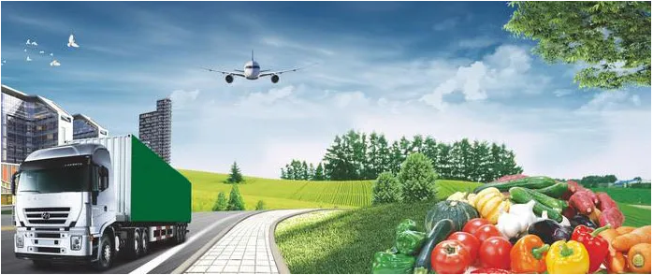
01
Supply Chain

Slide 6
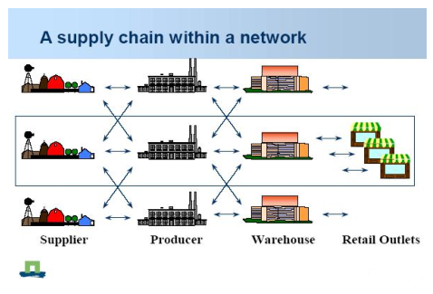
Concept of supply chain
A supply chain in a network of (physical and decision making) activities connected by material, information and money flows that cross organizational boundaries.
All the stages involved in satisfying customer demand.
Notes:
good practices in smallholder farmers ‘fresh food production and its connection with markets (associativity and safety) considering a multi-stakeholder approach

Slide 7
In the last century, Chinese typical traditional supply chain for small farmers’ fresh fruits and vegetables consists of three main stages:
In the first stage, small farmers offer their small harvests to traders in the village markets or first assembly points.
The second stage involves the movement of the accumulated product along the supply chain to secondary collection centers.
The product is then moved in the third stage to central wholesale markets in urban centers.
There is the critical need for improved pre-processing systems such as precooling, washing, cleaning, grading, packaging, refrigerated transport and cold chains for perishable product for better product quality and food safety.

Slide 8
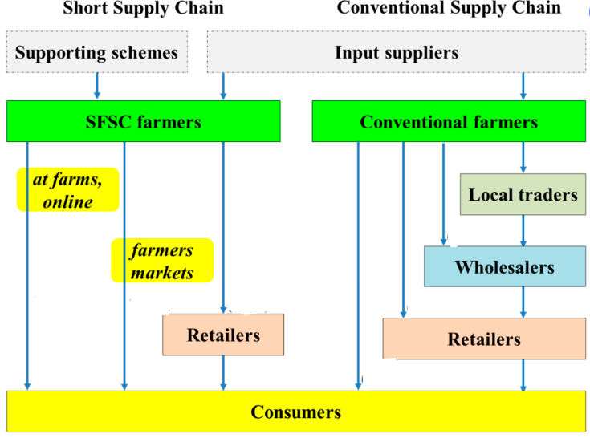
Supply chain
The rapid increases in Chinese economy, environmental pollution, urbanization, health concerns, and technological progress enhance the demand for greener, healthier, and fairer food production and consumption nowadays.
The short food supply chain (SFSC) becomes one of the crucial solutions for these issues.
Such as perishable fruits and vegetables supply chain

Slide 9
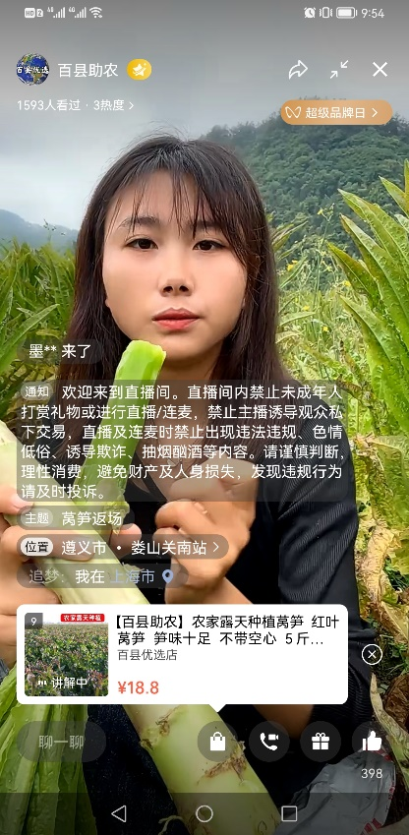
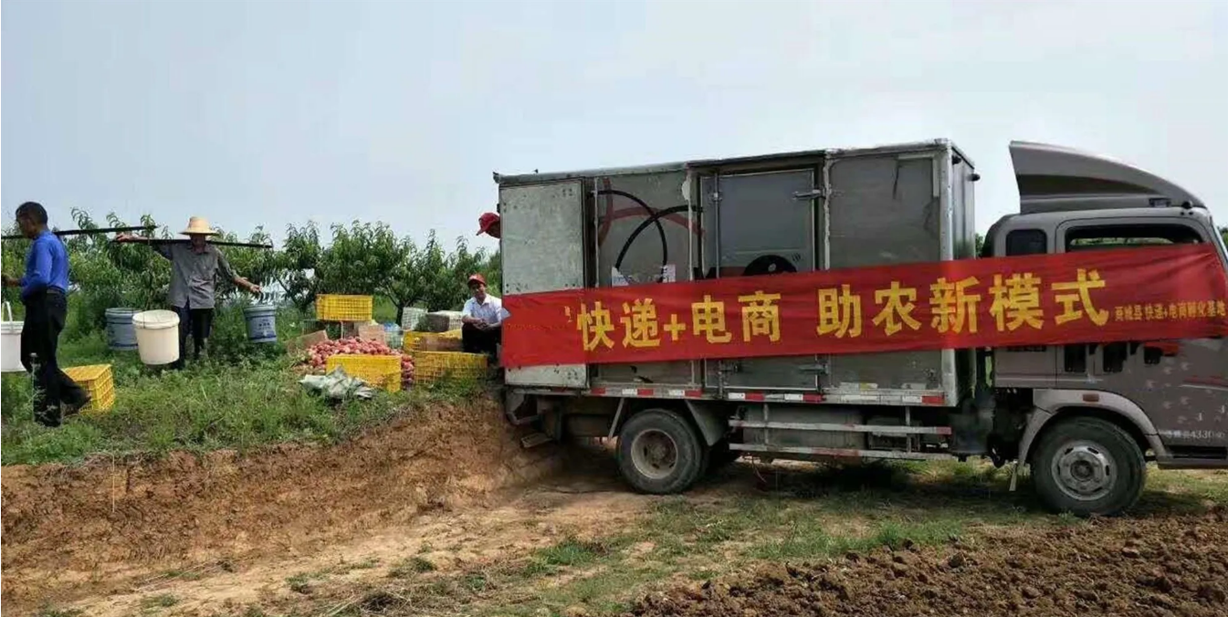
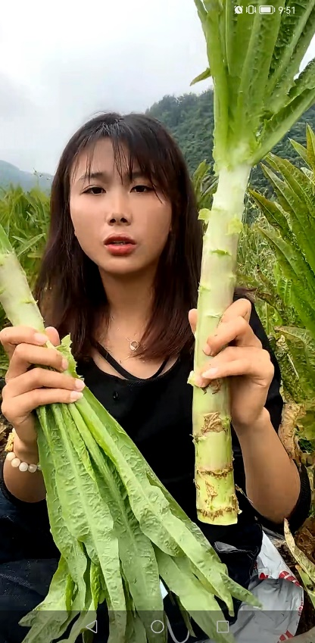
Example:
At farms, online market
Chinese online market develops very rapidly. There are plenty of online stores.
Example: A female farmer is introducing the growth environment, taste and cooking methods of asparagus lettuce in the field, through live WeChat video frequency.
Meanwhile, consumers may order the lettuce by WeChat directly if they fancy the product, and they will normally get the product in 3 days.
Farmer
Online store
AT FARM
Live streaming
Harvesting
Package
Express Delivery
Consumer
Notes:
Farmer is introducing the growth environment, taste and cooking methods of asparagus lettuce in the field.

Slide 10
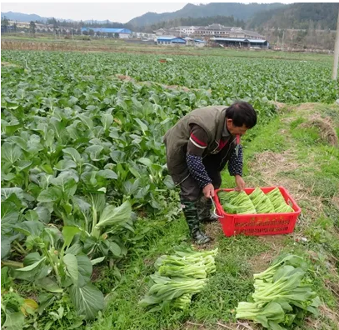
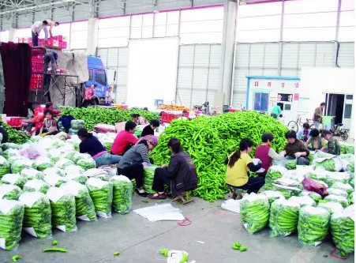
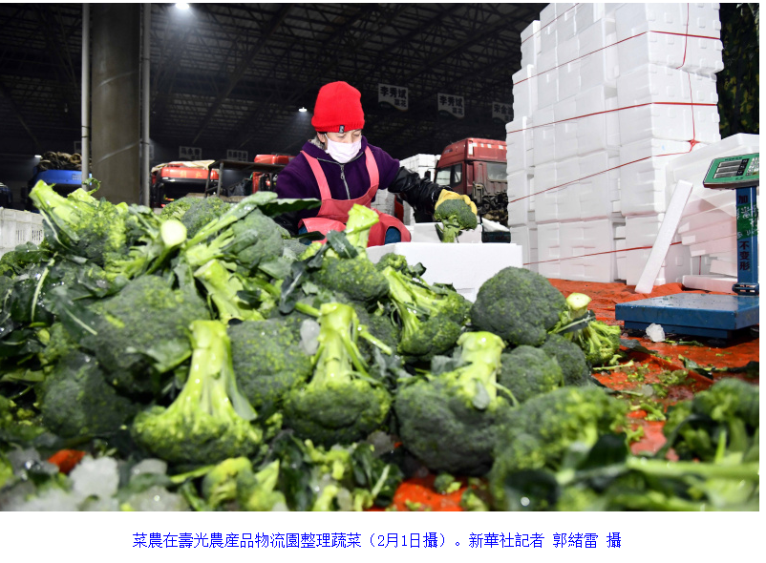
The product flow in SFSC
Hoang, V. Agronomy 2021, 11, 2408. https://doi.org/10.3390/agronomy11122408

Slide 11
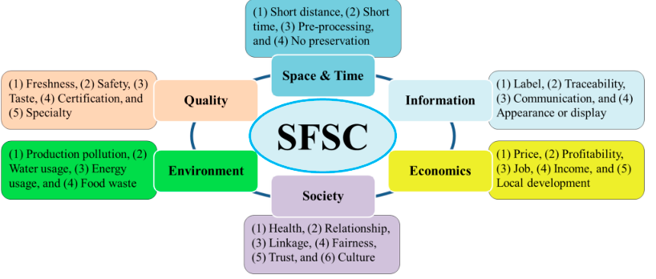
The framework of SFSC
Long distance
Hoang, V. Agronomy 2021, 11, 2408. https://doi.org/10.3390/agronomy11122408

Slide 12
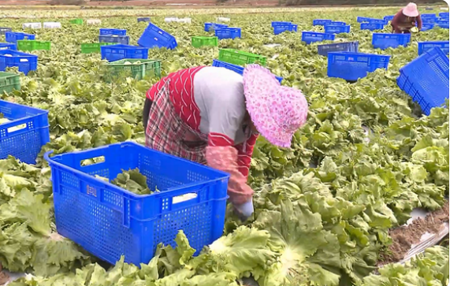
Long distance and long time product flow
harvesting classify cooling
Market refrigerated transport cool storage
Notes:
refrigerated transporting

Slide 13
02
Good Practice of fruits and vegetables

Slide 14
2.1 Quality of fruits and vegetables
The quality of fruits and vegetables constitutes a dynamic composite of their physicochemical properties and consumer perception.
intrinsic characteristics inherent to the nature of the products, dictated by genotypic, agroenvironmental and postharvest factors, and
extrinsic characteristics influenced by socioeconomic and marketing factors which condition consumer perception of the products and formulate quality standards.
The potential quality of fresh fruits and vegetables in the supply chain is defined in the period preceding harvest, however the full development of quality characteristics can be optimized through the use of appropriate postharvest technology.
Postharvest recommendations for harvesting, packaging and handling produce along the supply chain aim at maximizing the period of acceptable quality.
Storage and shelf-life extension are closely associated with the preservation of quality in fresh fruits and vegetables.
Notes:
http://dx.doi.org/10.1016/j.scienta.2017.09.046

Slide 16
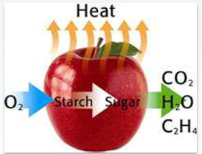
2.2 Postharvest metabolic changes of fruits and vegetables
After the initiation of harvest, several biochemical changes occur in fruits and vegetables, while they are living organisms, even after harvest, and they must remain alive and healthy until they are either processed or consumed.
Notes:
Several metabolic changes are initiated after the harvest of fruits and vegetables. In the case of vegetables, harvesting induces stress responses through reduced availability of water and nutrients, wounding, and exposure to shelf life enhancing storage methods such as cooling. In most cases, these changes help the produce to enhance the shelf life. In the case of fruits, an increase in the biosynthesis of the gaseous hormone ethylene serves as the physiological signal for the initiation of the ripening process. In general, all plant tissues produce a low, basal, level of ethylene. During the ripening process, some fruits evolve large amounts of ethylene, sometimes referred to as an autocatalytic increase in ethylene production, which occurs in conjunction with an increase in respiration referred to as the respiratory climacteric. Fruits are generally classiﬁed into climacteric or nonclimacteric types on the basis of the pattern of ethylene production and responsiveness to externally added ethylene. The climacteric fruits characteristically show a marked enhancement in ethylene production and respiration, as noticeable by the evolution of carbon dioxide. By contrast, the nonclimacteric fruits emit a considerably reduced level of ethylene. (For a list of fruits showing climactericor nonclimacteric pattern of ripening,seeKays,1997,General Reading.) In climacteric fruits such as apple, pear, banana, tomato, and avocado, ethylene evolution can reach 30–500 ppm/(kgh) (parts per million, microliter per liter), whereas in nonclimacteric fruits such as orange, lemon, strawberry, and pineapple, ethylene levels usually range from 0.1 to 0.5 ppm/(kgh) during ripening. Climacteric fruits respond to external ethylene treatment by an early induction of the respiratory climacteric and accelerated ripening in a concentration-dependent manner. Nonclimacteric fruits, on the other hand, show increased respiration in response to increased levels of ethylene concentration withoutshowingaccelerationinthetimerequiredforripening.Vegetablesproduceverylow amountsofethylenemostofthemwithlessthan0.1μL/(kgh),withslightlyhigherlevelsas
P1: SFK/RPW P2: SFK/RPW QC: SFK/RPW T1: SFK
BLBS017-Paliyath.cls September 19, 2008 20:55
10 POSTHARVEST BIOLOGY & TECHNOLOGY OF FRUITS, VEGETABLES, & FLOWERS
in cassava (1.7 μL/(kgh)), breadfruit (1.2 μL/(kgh)), and cucumber (0.6 μL/(kgh)) when measured at 20–25◦C.
It is important to know the biochemical differences between fruits and vegetables and several biochemical pathways that operate in these tissues to develop ideal conditions of storage for the preservation of shelf life and quality.

Slide 17
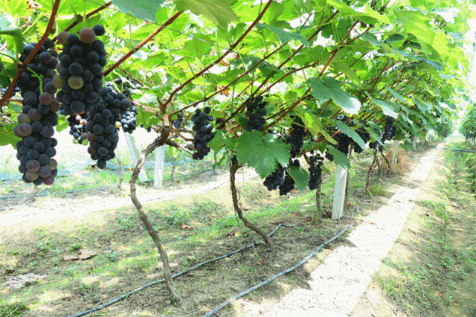
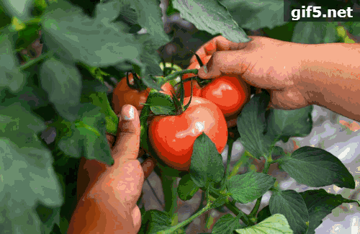
2.3 Good practice of postharvest perspective on quality
Postharvest recommendations for harvesting, packaging and handling produce along the supply chain aim at maximizing the period of acceptable quality.
Harvesting
Postharvest treatment (cleaning is the basic work)
Precooling/Cooling
Sorting and grading
Curing
Chemical treatment
Package
Transportation
Etc.
Notes:
It is important however to emphasize that postharvest practices and technologies applied along the supply chain essentially manage the products’ potential quality that is configured by genotypic and agroenvironmental factors in the period preceding harvest. Postharvest conditions and applications do not alter the inherent, potential quality
of the products but affect the rate at which ripening, senescence and loss of quality occur.

Slide 18
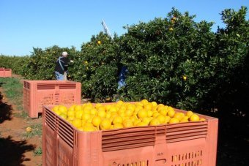
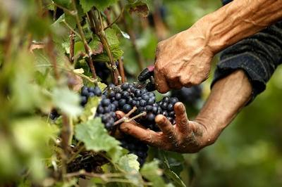
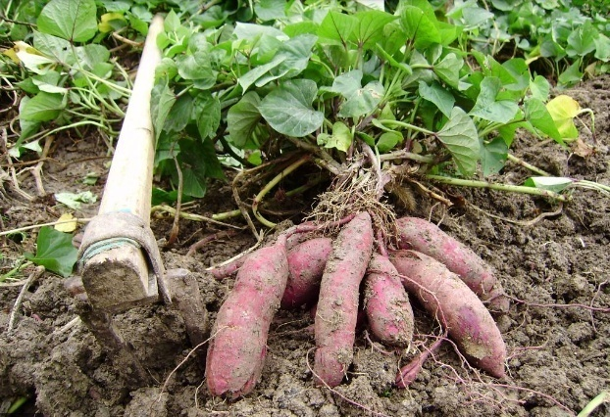
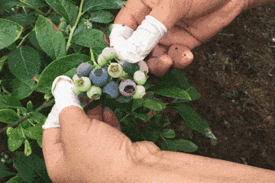
2.3.1 Harvest
No matter manual harvesting or mechanical harvesting, it should be done carefully at proper time without damaging the produce.
In general, harvesting should be done in sunny day at lower temperature, the early morning hours to minimize field heat.
For long period storage, stop irrigation 7days to 2~3 weeks before harvest which hastens and enhances skin set and improve storability.
Notes:
The quality of fruits and vegetable cannot be improved but it can be presented when harvesting is done at proper stage of maturity.
Immature fruits when harvested will give poor quality and erratic ripening.
In some cases, if the produce is to shipped to distant markets, or stored, to wait for a better price, it should be picked in the mature but unripe stage.

Slide 19
2.3.2 Precooling
Precooling is done just after harvest and before transportation, storage or market to remove the field heat of the harvested produce, which is detrimental to keeping quality of fruits and vegetables and it is done to retard ripening and senescence processes.
Prompt cooling conserves the weight and extends the storage life in produce.
Several effective methods for rapid removal of heat from produce are in commercial use. The choice of method depends largely on the perishability and refrigeration equipment of the produce its adaptability to a specific method and the availability of facilities.
Hydro Cooling
Air –cooling or Room Cooling
Vacuum Cooling
Attention:
Precooling ASAP after harvest
Choice proper cooling method
Good cooling speed and final temperature
When cooling completed, the product must be moved to a cold room.

Slide 20
Hydro Cooling:
Cooling with cold water is rapid and effective method of precooling used for cooling a wide range of fruits and vegetable in bulk before packing.
Its use is limited for packed commodities because of the difficulty of achieving sufficient water flow through the containers.
Flooding, spraying or immersion accomplishes hydro cooling.
A properly designed flood system is more efficient than either the spray or immersion system because it combines a great volume of water with rapid movement of cooling medium over the product.

Slide 21
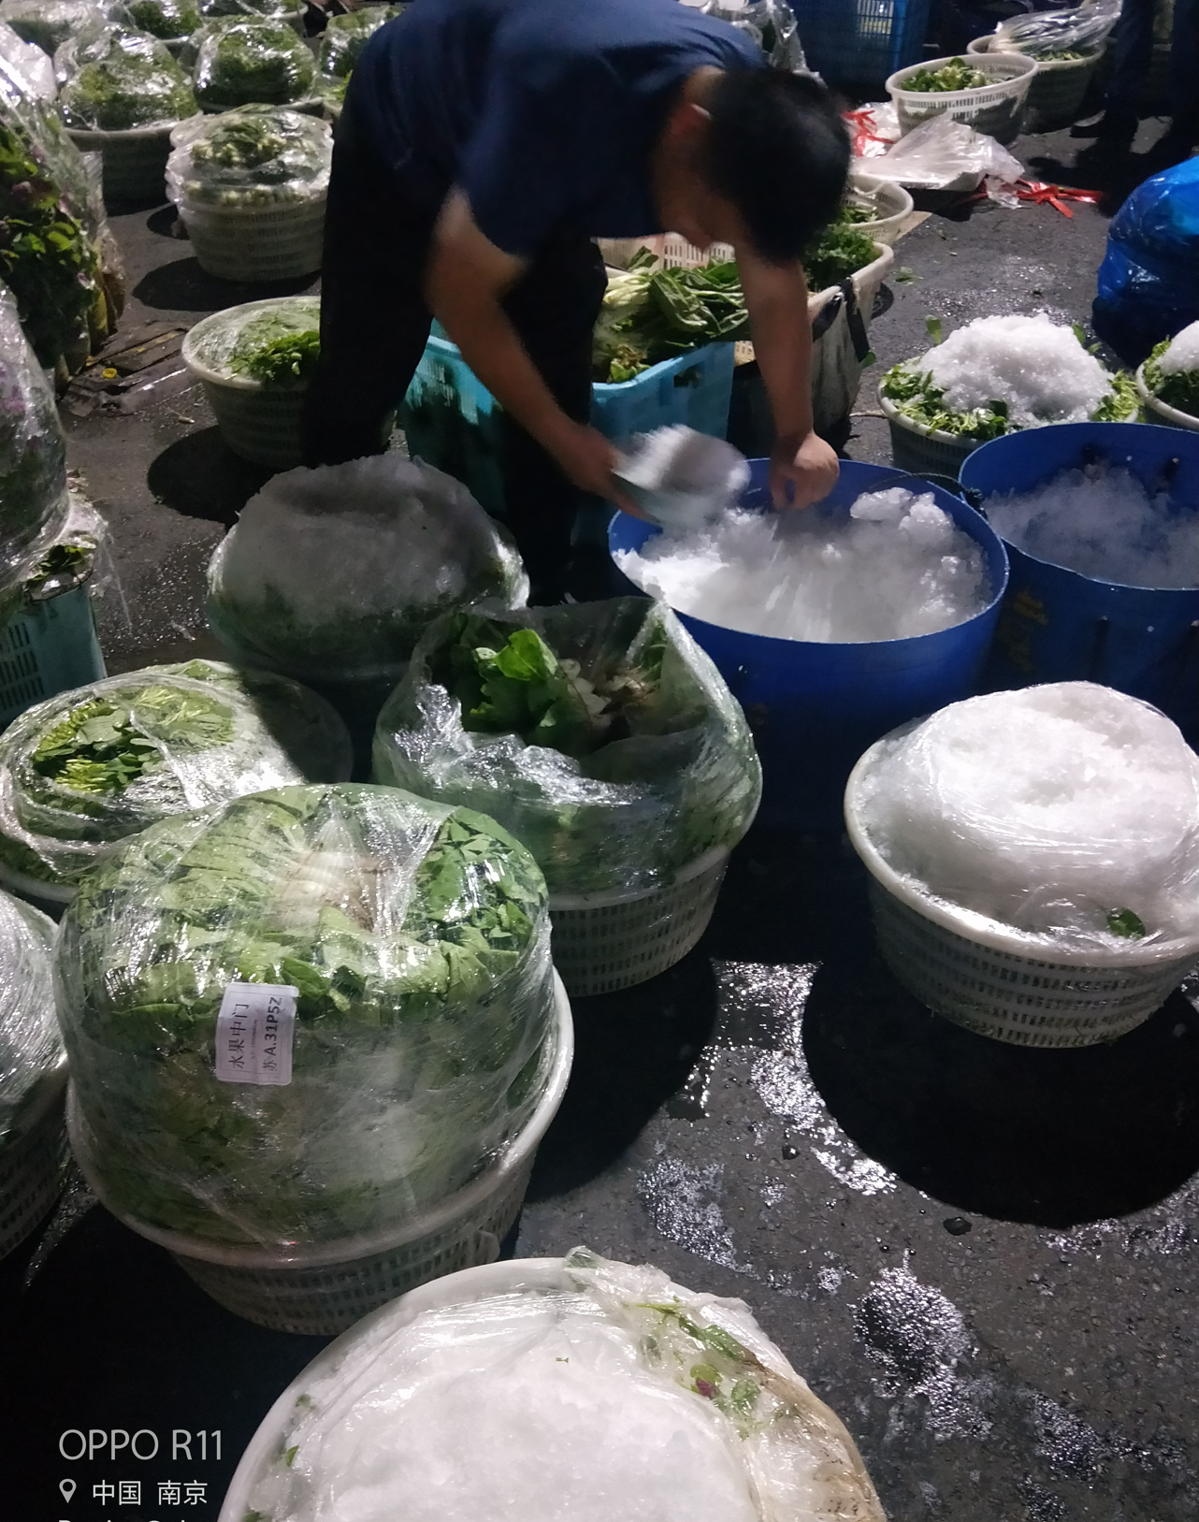
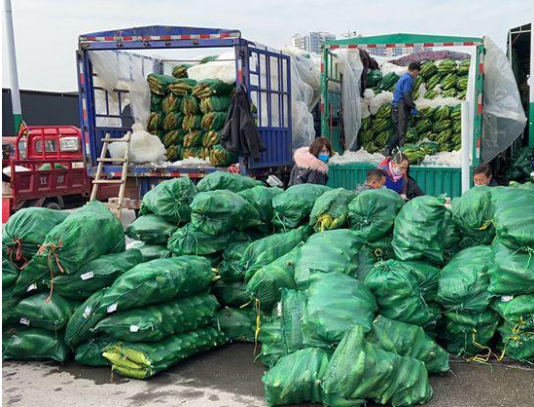
Slurry ice
Slurry ice can be used directly for rapid chilling of precooling for vegetables that can tolerate water such as asparagus, cauliflower, broccoli, green onions, cantaloupes, leafy greens, carrots, sweet corn, spinach, parsley, sprouts.
Handling of slurry ice

Slide 22
Icing pre-cooling
These products can be iced | These items are damaged by direct contact with ice
Artichokes，sparagus，Beets，Broccoli，Cantaloupes，Carrots，Cauliflower，Endive，Green Onions，Leafy Greens，Radishes，Spinach，Sweet Corn，Watermelon | Strawberries，Blueberries，Raspberries，Tomatoes，Squash，Green Beans，Cucumbers，Garlic，Okra，Bulb Onions，Romaine Lettuce，Herbs

Slide 23
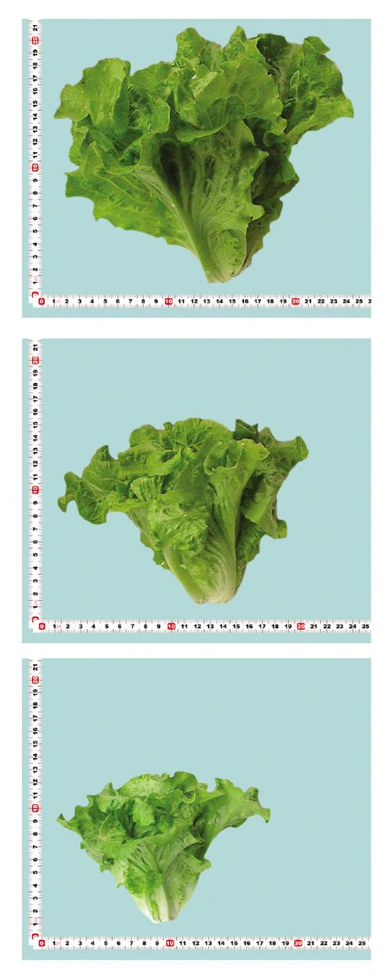
2.3.3 Grading and sorting
Grading on the basis of physical characteristics like weight, size, colour, shape, specific gravity, freedom from diseases depending upon agroclimatic conditions, and volume to fetch high price in market.
The known methods of grading of fruits and vegetables are manual grading , mechanical grading.
The equipment used for sorting is referred to as a sorting line.
Graders are the third party inspectors who evaluate whether or not the packed lot complies with requirements of a grade standard for a predetermined grade classification.
Inspection of samples for this quality control process is more precise than, and differs from, the dynamic inspection of product necessary for sorting.
Notes:
Grading of fruits and vegetables after harvesting is an essential step in post-harvest management.
Sorting is the segregation of edible or marketable product into distinct quality categories.
Advantages of Grading
Losses the selling price due to presence of substandard products or specimen can be easily avoided.
It increased marketing efficiency by facilitating buying and selling a produce without personal selection.
Grading enhanced to set good price for graded products.
Heavy marketing cost in packing and transportation can be avoided by grading.
In grading diseased and defected specimen are not damaged due to contact of diseased specimens and thus gets high price in market.
By grading there is fairness to both Buyers and Sellers.
Properly graded vegetables and fruits are purchased by the consumer easily without inspection.

Slide 24
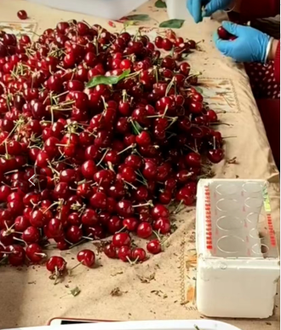
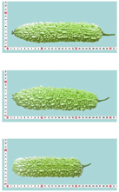
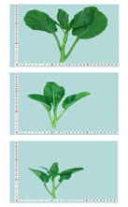
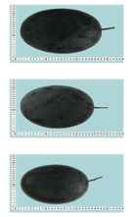
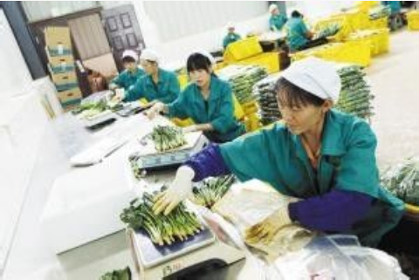
Sizing according to length, weight,diameter
Notes:
果蔬原料采后分级可以解决果蔬由于大小、重量、形状、色泽、成熟度等方面不整齐划给原料的处理、包装、贮运、销售和加工带来的不便；

Slide 25
2.3.4 Curing
Curing is performed immediately after harvest on root, tuber and bulb products, in which the product is exposed to relatively high temperature and relative humidity.
In root and tuber products, curing causes wound healing with the development and suberization of new epidermal tissues, which act as an effective barrier against infection and water loss.
In bulb products, curing is the process of drying of neck tissues and of the outer leaves to form dry scales.
Onions and garlic can be cured in the field. These products can be undercut in the field and left there to dry for 5-10 days.
The products can be cured either in the field or after packing into large fiber or net sacks.
The produce must be checked daily until outer skin and neck tissues have properly dried.

Slide 26
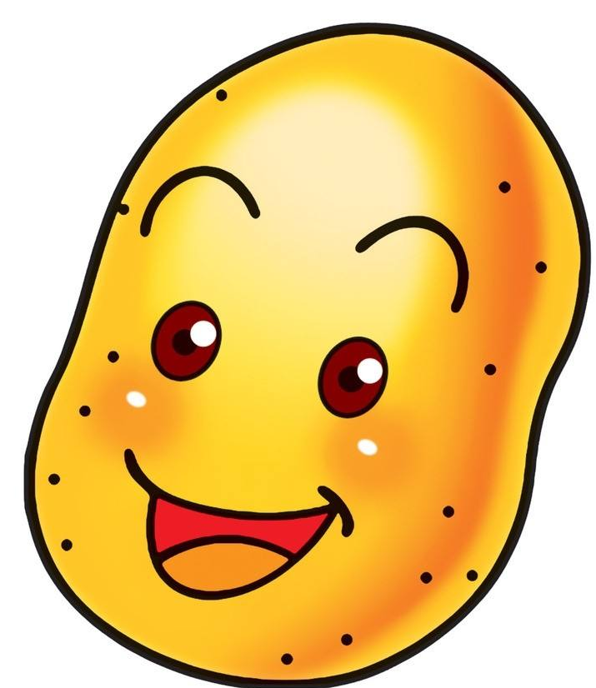
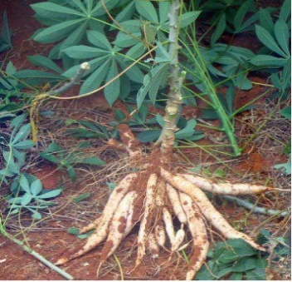
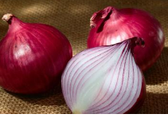
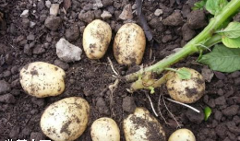
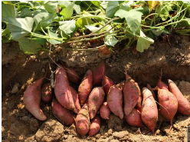
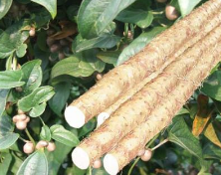
Optimum conditions for curing root, tuber and bulb products
Crop | Temperature (℃) | Relative humidity(%) | Duration (days)
Cassava | 30-40 | 90-95 | 2-5
Onion and Garlic | 27-35 | 60-75 | 1-2
Potato | 15-20 | 85-90 | 5-10
Sweet Potato | 30-32 | 85-90 | 4-7
Yam | 32-40 | 90-95 | 1-4
Notes:
Potato tubers that are bruised due to harvest and grading operations are more prone to weight loss.
This is due to evaporation of water from the wounded area.
These are potential points of entry for microorganisms during storage.

Slide 27
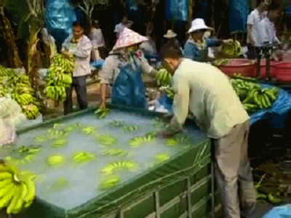
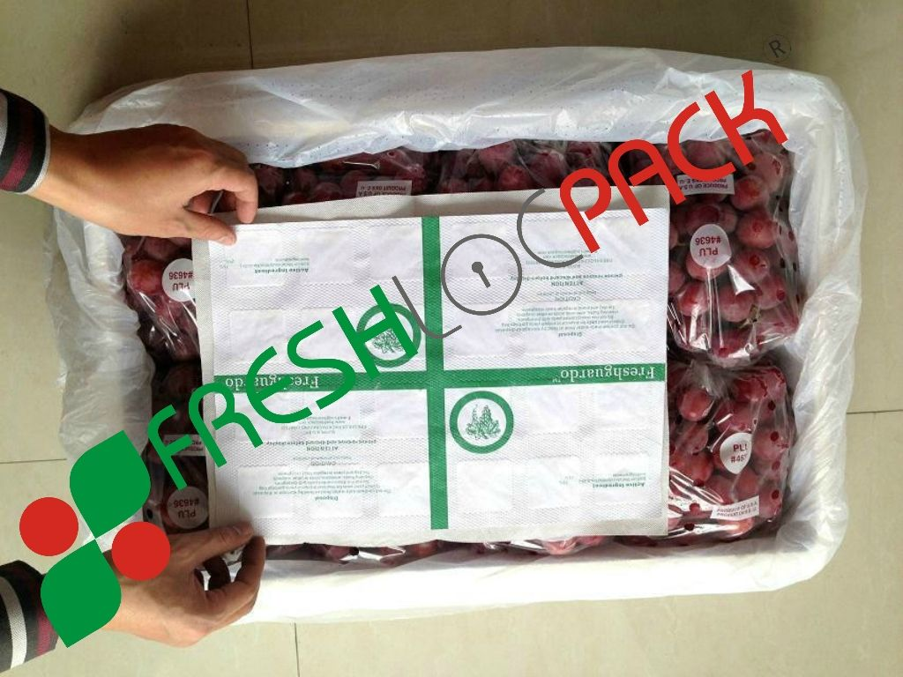
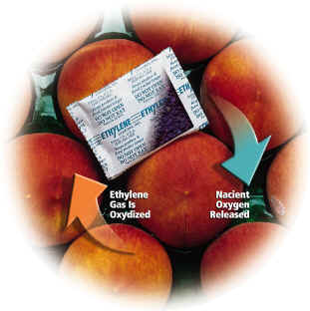
2.3.5 Chemical treatment: prevent decay, reduce water loss, inhibit biological reactions, etc.
Commonly used chemicals：
Fungicide: Carbendazim, Benalaxyl, Tetraconazole, Thiabendazole, SO₂ , ClO₂ , etc.
Plant growth regulators: CK, GA, IAA, Ethylene,1-Methylcyclopropene(1-MCP), etc.
Coating materials: starch, protein, fat, chitin, etc.
Gas absorbers: O₂ and CO₂ absorbers
Notes:
Easy handling: spraying, dipping, washing, smoking, coating at room temperature

Slide 28
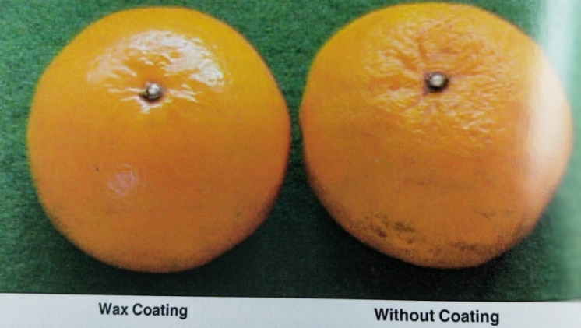
Waxing
Edible coatings are a simple technology by which produce can be physically protected and have their respiration and in some cases, ripening regulated as with passive modified atmospheric packaging (MAP).
Food grade waxes are used to replace some of the natural waxes removed during harvesting and sorting operations.
It can help reduce water loss during handling and marketing.
It also helps in sealing tiny injuries and scratches on surface of produce.
It improves cosmetic appearance by providing shine and prolongs the storage life of produce.
Notes:
Waxing materials:
Lipids, polysaccharides, proteins, resins or combinations of these materials or composite coatings.
Any ‘Generally Recognized As Safe’（GRAS）material that is approved for use in coatings without restriction are considered the U.S. Food and Drug Administration(FDA)
Produces can be waxed:
Apple, pear, citrus, cucumber, plum, tomato, capsicum, etc.

Slide 29
2.3.6 Package
Packaging is an important consideration in vegetable and fruit market, which shelf life can be increased by 5-15 days.
The use of properly designed containers for transporting and marketing of produce can significantly reduce their losses and maintain their freshness succulence and quality for longer period.
Packaging also provides protection from mechanical damage and undesirable physiological changes and pathological deterioration during storage, transportation and marketing.
Packaging can be classified in two groups: containers for shipment or for the consumer.
01
Add wat you want
04
添加需要标题
您的内容打在这里，或者通过复制您的文本后，在此框中选择粘贴，并选择只保留文字。
03
Add what you want

Slide 30
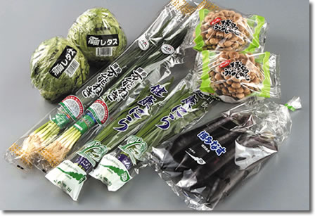
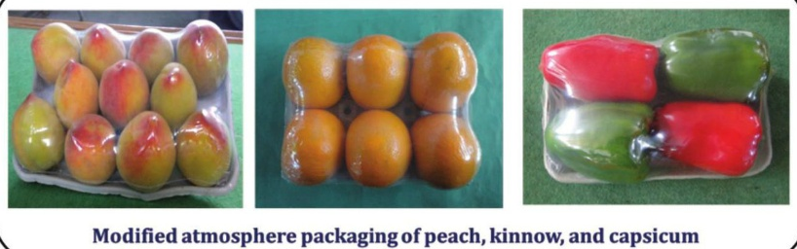
Modified atmosphere packaging(MAP)
MAP may be described as the use of an atmosphere composition surrounding the product.
O₂ ↓, CO₂ ↑, T↓
Two way to modify atmosphere:
Flushing the package with gases
Naturally occurring processes

Slide 31
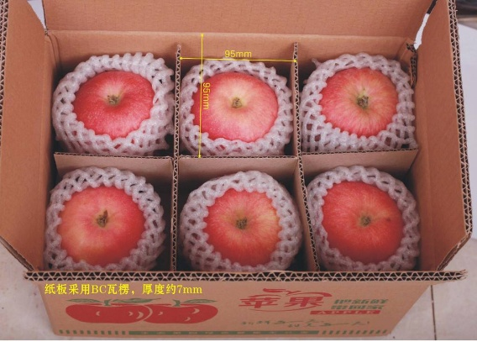
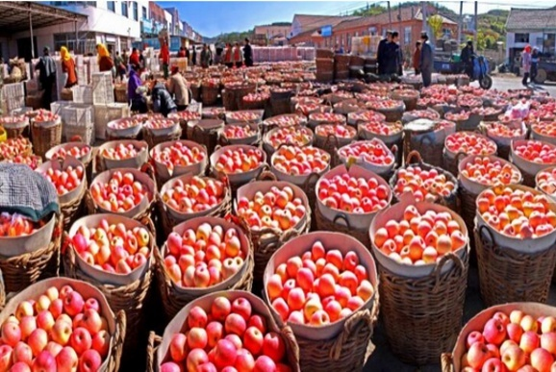
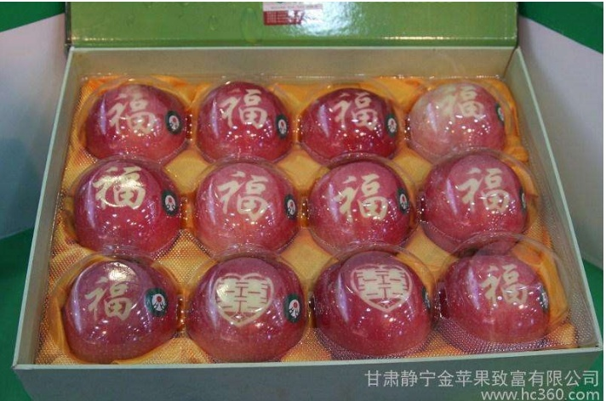
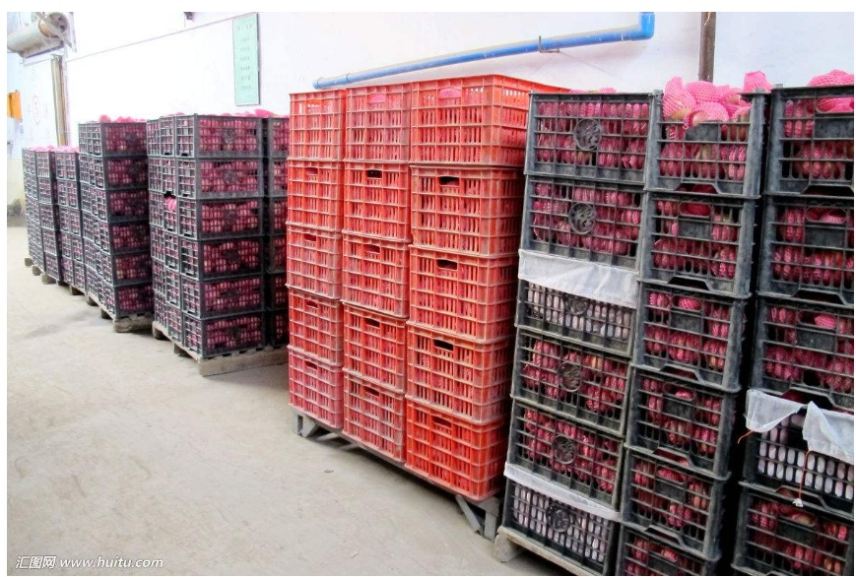
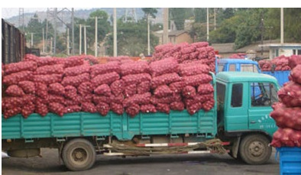
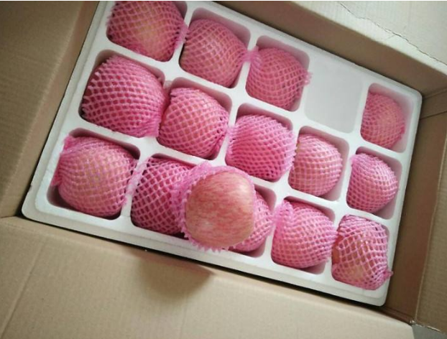
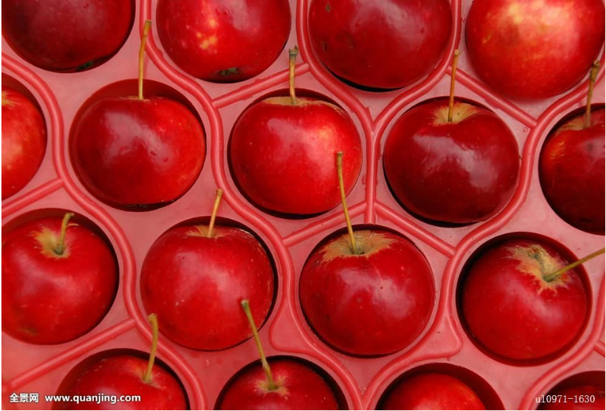

Slide 32
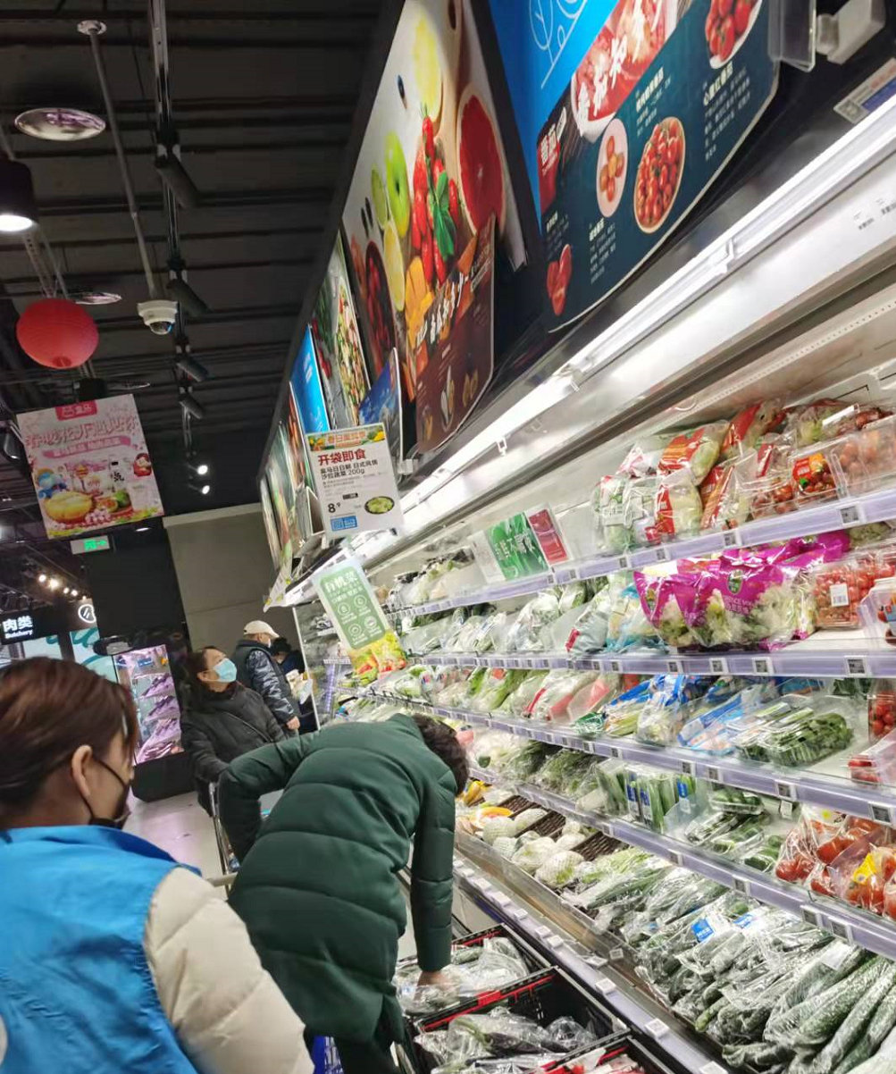
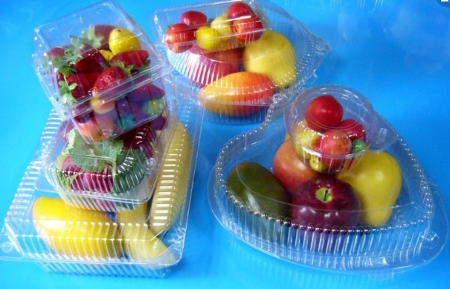
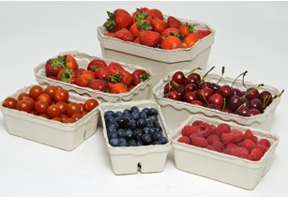
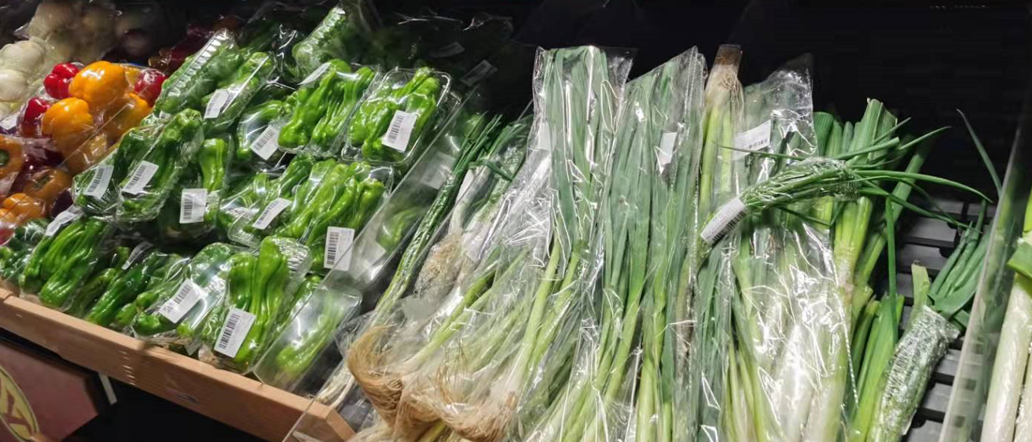

Slide 33
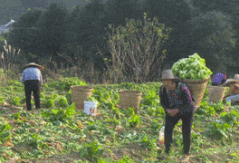
2.4 Transportation
Transportation of fresh product from the farm gate to the primary and secondary collection centers is primarily as shoulder loads or by means of farm animals, wheel barrows, carts, bicycles, motorcycles, and motor vehicles of all sorts in the developing country.

Slide 34
Long distance transportation
truck,
train,
ship,
Plane,
…..

Slide 35
Modern transportation: Cold chain
A cold chain or cool chain is a temperature-controlled supply chain. (air control)
An unbroken cold chain is an uninterrupted series of refrigerated production, storage and distribution activities, along with associated equipment and logistics, which maintain a desired low-temperature range.
It is used to preserve and to extend and ensure the shelf life of products, such as fresh agricultural produce, seafood, frozen food, photographic film, chemicals, and pharmaceutical drugs.

Slide 36
Cold chain

Slide 37
Optimum Transport Conditions and Predicted Storage Life for Some Vegetables

Slide 39
03
The Contract Farming Model
Notes:
As new techniques emerged for chilling and freezing in order to retain the fresh character of food, new products were frequently introduced at the market. So, it was very important during this time to have a solid commodity base of knowledge for the commercial food industry to develop its full potential.

Slide 40
The contract farming model: enterprise + cooperative/ agro-dealer+ farmer: "unified technology, unified standard and unified acquisition”
The farmer cooperative plants certain types of agricultural products and the social enterprise, in turn, procures agricultural products from the farmer cooperative and then resells them to the final market.
Since each farmer’s planting scale is generally small, agro-dealers tend to sign contracts with many small farmers;
Constrained by planting scale, technology and capital, farmers are usually in a weak position while negotiating with agro-dealers on the wholesale price of agricultural products.
Many contract farmers choose to expand their planting scale because the contracts effectively solve the issues of selling agricultural products.
Notes:
支部 +企业+合作社+农户”的模式
按照“统一技术、统一标准、统一收购”

Slide 41
Example 1 : enterprise + farmer Hain
Litchi in Hainan provincein
Farmer:
Plant
Harvest
Transfer
Enterprise:
Collection
Processing:
Ice precooling
Grading
Package
Transportation
Market
A Farmer Enterprise

Slide 42
Exmple 2:
Coucou Catering Management Co., Ltd Hotpot is its main dish.
The fruits and vegetables of the big restaurant such as Coucou Catering Management Co., Ltd are partly from the own production base and partly from the market.
Some production bases are large enterprises, some enterprises use farmers' cooperative mode, which is “enterprise + cooperative + farmer”.
Coucou Catering Management Co.,Ltd

Slide 43
Cooperative Pre-processing Warehouse
Customers/Company

Slide 45
Large wholesale market: collect, pre-process, turnover, customer

Slide 46
04
Summary

Slide 47
What should be considered for postharvest fruits and vegetables?
All chain steps should be included from field to consumer for perishable fruits and vegetables!
What happens at each point?
What should be done at each point?
Is it efficient?

Slide 48
Notes：
A lot of post-harvest handling techniques could be applied to horticultural crops.
When the techniques are used, it should be immediate after harvest and combined together and in a continuous way to meet the requirements of less processing operation and serving time.

Slide 49
Summary
Postharvest loss is high for agricultural product, especially for perishable fruits and vegetables in developing countries, and it pays critical role in the food supply.
Postharvest handling technology could reduce the loss effectively.
The most effective and generally used techniques for fruits and vegetables are refrigerated and controlled atmosphere storage.
The application of these techniques is based on a well understanding of product’s characteristics and storage facilities.
The appropriate and careful management is the key to reducing the postharvest loss of fruits and vegetables.

Slide 50
Thank You!
Contact info：
Food Sci. & Tech. Building, Nanjing Agricultural University
Email: xhm@njau.edu.cn
The SSTC project is funded by: Ministry of Agriculture and Rural Affairs
P. R. China
Sharing for Learning

