Slide 1
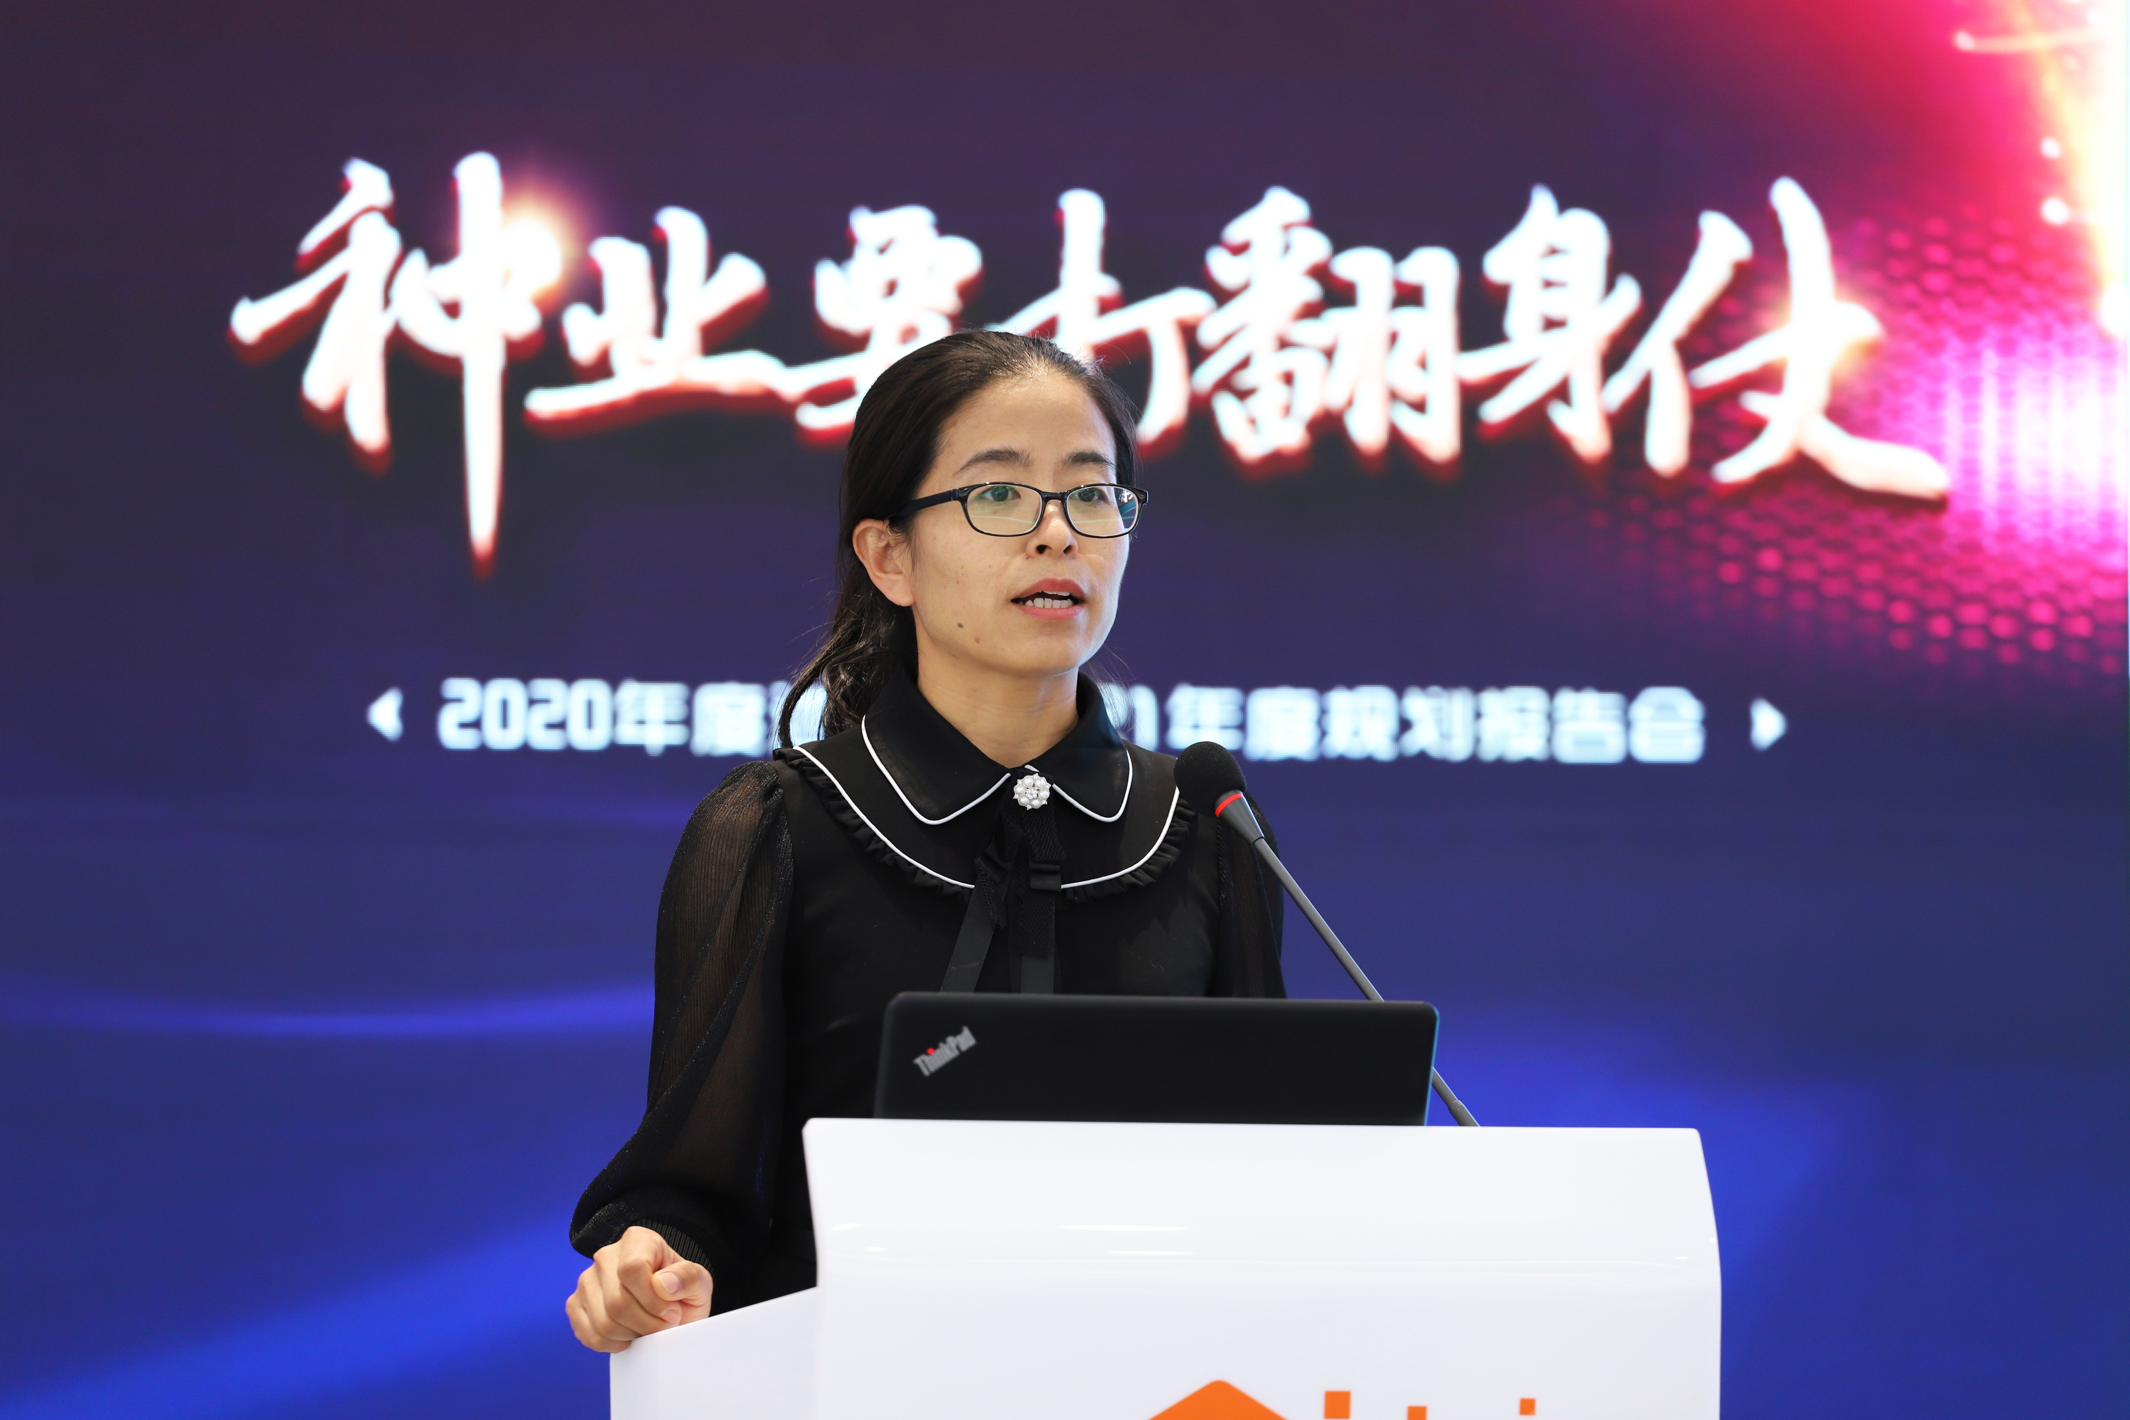
Xiuying Huang
Ph.D. in Preventive Veterinary Medicine.
Production Director of Breeding Company,responsible for production management.including breeder,hatching, feed and disease prevention and control.
Secretary General of the Poultry Disease Branch of the Veterinary Association.

Slide 2
How to perform poultry vaccination
Beijing huaduyukou poultry Co., Ltd
Production Director Xiuying Huang
Nov,2021

Slide 3

目录 CONTENTS
01
Main vaccination methods
02
Procedures and standards
03
Vaccination record and efficacy checking
04
Disinfection of the equipment
05
Waste disposal

Slide 4
01
Main vaccination methods
Notes:
We know that vaccination is an important way of disease control on farms.vaccination has enabled the poultry industry to develop to the scale it is today, through effective control of infectious disease.

Slide 5
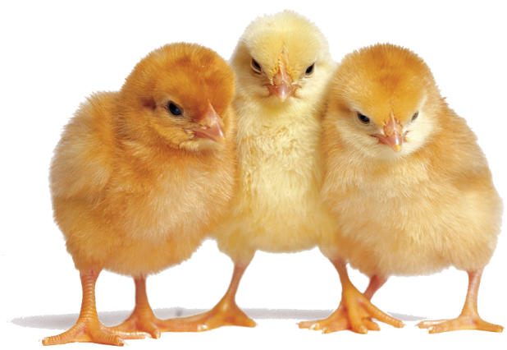
The role of vaccination
4.1
Uniform and effective antibodies
Vaccination
Human
Susceptible animals
Less susceptible animals
Notes:
Why do we vaccinate chickens？What’s the role of vaccination？
During this process,the chicken needs to be inoculated by humans.

Slide 6
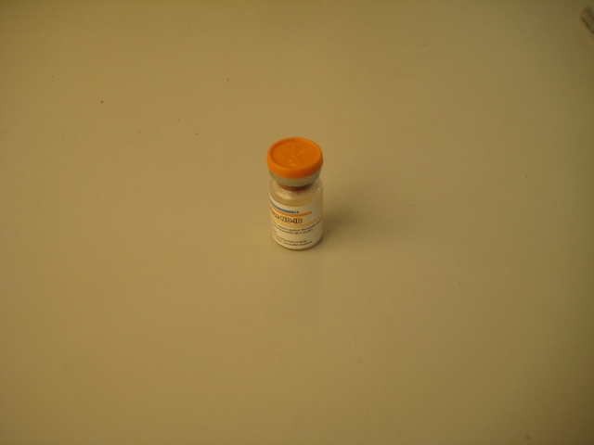
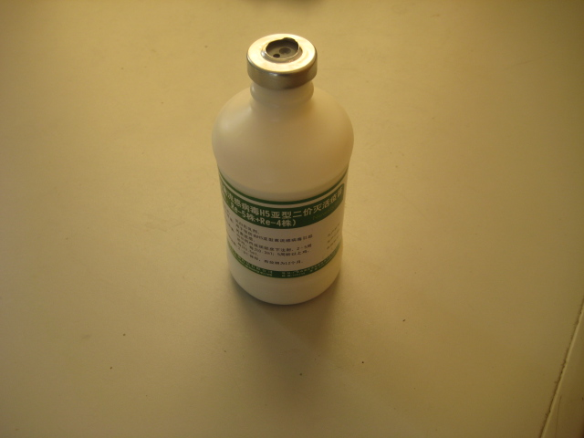
Routes for vaccination
免疫方法
Vaccine types + Characteristics→ Routes of vaccination
滴
鼻 点
眼
饮水/滴口
活苗
(Nose-dripping)
(Drinking water)
(Live vaccine)
气 雾
刺 种
免疫方法
（Vaccination methods）
(Aerosol vaccination)
(Wing-web)
颈部皮下
胸部皮下
Each method has its own operating standards and considerations
(Subcutaneous neck)
(Subcutaneous chest)
油苗
腿部皮下
胸部肌肉
(Inactivated vaccine)
(Subcutaneous leg)
(Chest muscles)
腿部肌肉
Injectable
vaccination
(Leg muscles)
Notes:
So,What are the vaccination methods？How to choose？
The methods of live vaccines usually include
Inactivated vaccine need to be vaccinated by injection

Slide 7
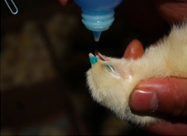
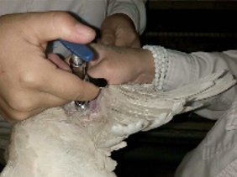
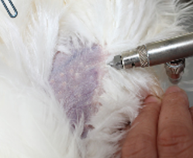
Training content
Nose-dripping and
eye dripping
  Wing-web
  Injection

Slide 8
Key points of vaccination
Inoculate effective vaccines into chickens No environmental pollution
Key points
Before
During
After
Vaccine
Effective
Buy and store
Control stress
Harmless treatment
Chickens
Healthy
Disease free
Disease free
Reduce stress response
Person
Skilled
Meet the requirements
Serious and sober
Observe the effect
Equipment
Clean and accurate
Disinfected, cleaned and calibrated
Work accurately
Disinfected, cleaned
Notes:
these are points we need to consider
we need to make sure the vaccine has been purchased
think about controlling stress，for example Pre-warmed vaccine.
do something to reduce stress response,for example promote feed intake, increase nutrition。Team leader need to observe the effect

Slide 9
02
Procedures and standards

Slide 10
  Part one
  Nose-dripping and eye-dripping vaccination

Slide 11
Nose-dripping and eye-dripping vaccination
Preparation
Procedures and standards
Notice
Notes:
We will explain it from the following aspects，

Slide 12
Preparation

Slide 13
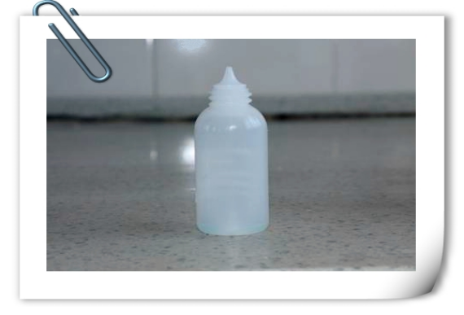
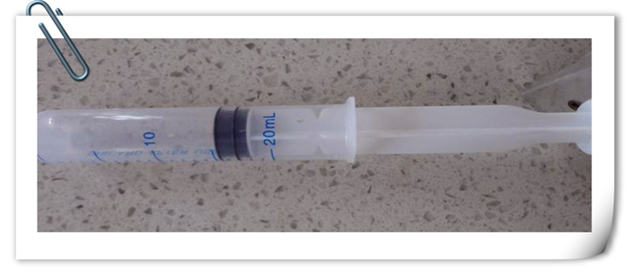
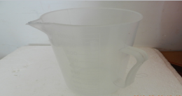
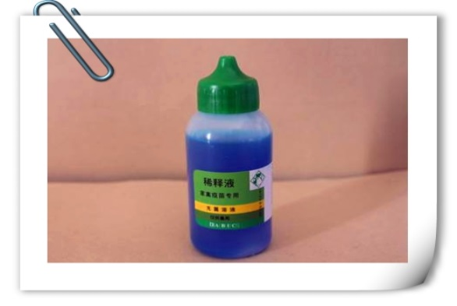
Preparation of materials for inoculation
Drop bottle
Syringe
Measuring cup
Diluent

Slide 14
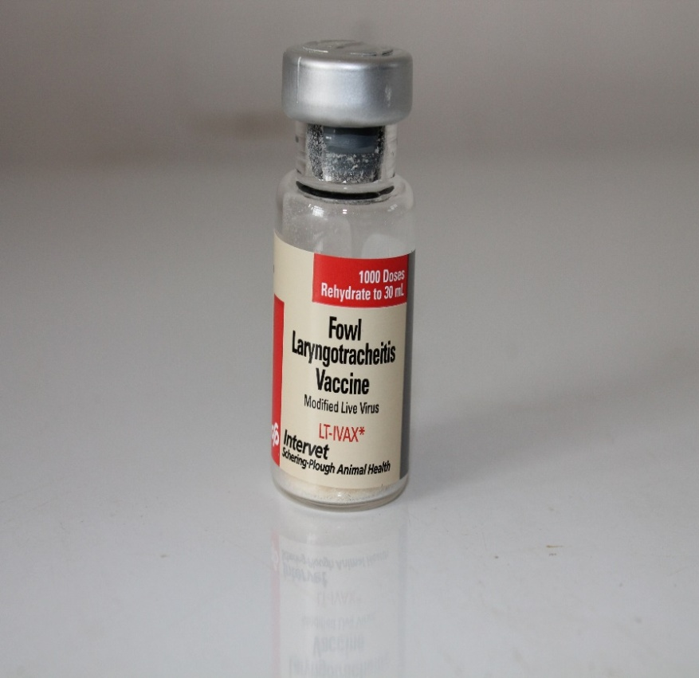
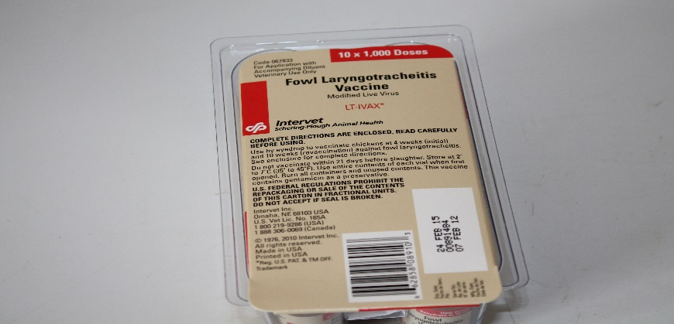
Preparation of the vaccine
Vaccine checking
Types of vaccines
Capacity
Types of vaccines
Capacity
Types of vaccines
Capacity
Production batch number
Shelf-life (expire date)
Storage conditions

Slide 15
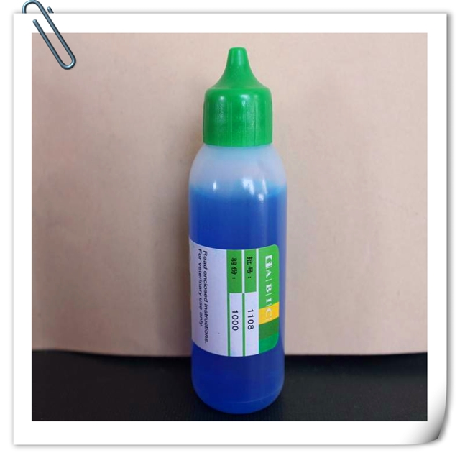
Preparation of the diluent
Diluent bottle checking
Production batch number
Capacity
Expire date

Slide 16
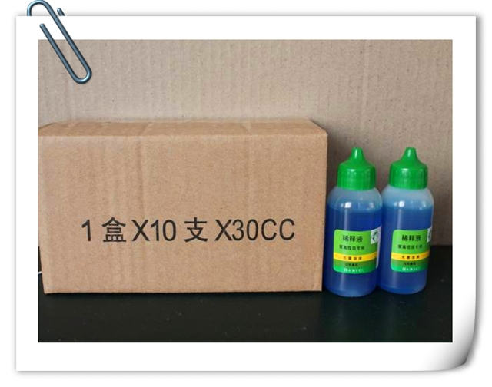
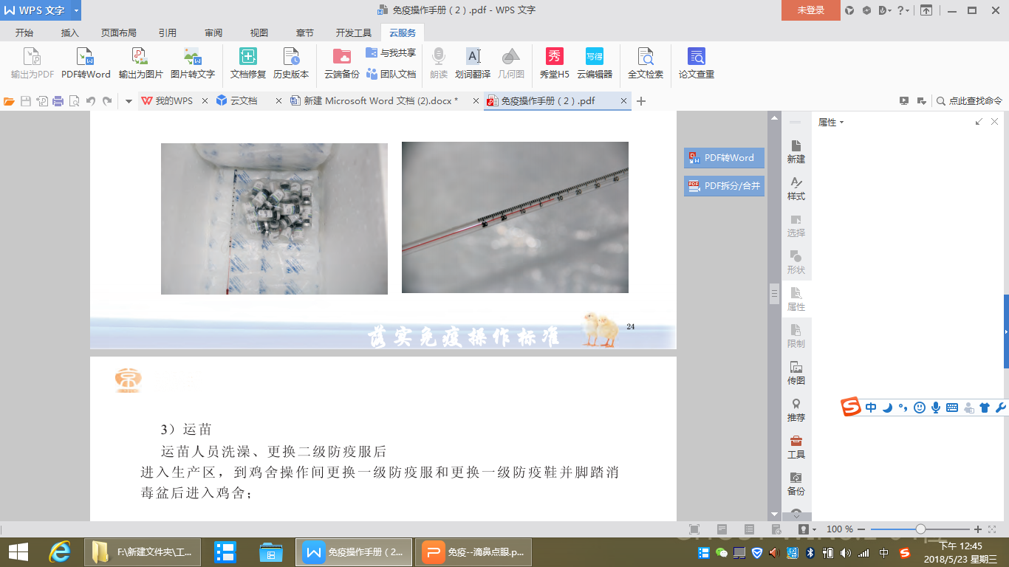
Store conditions
The vaccine should be stored at 2-8°C. If the temperature exceeds the specified range，it needs to add the ice in time to avoid reduction of the potency due to high temperature.
Notes:
Then we should pay attention the vaccines Store conditions,especially during transfer

Slide 17
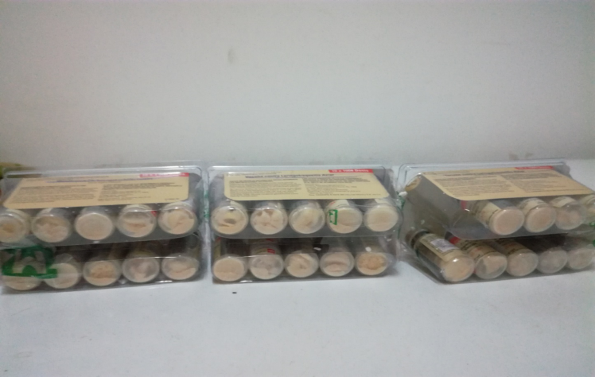
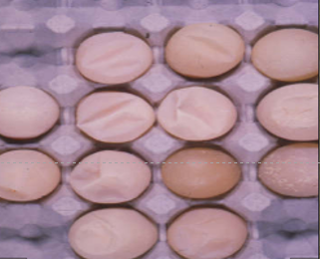
Case
No ice cubes after taking out of fridge
Infecting avian infectious bronchitis
Notes:
Here is a case
cause the vaccine to fail,chicken flocks were infected ib

Slide 18
Calculate the dose of the vaccine
Number of chickens
×
Inoculation dose per chicken
Vaccine dosage
=
1 bottle of vaccine total feathers
For example：10,000 chickens，vaccine is 250ml per bottol，0.5ml per chicken
The calculated amount is：10000*0.5/250=20 bottles
Notes:
equal
multiply by
divide by

Slide 19
Procedures and standards

Slide 20
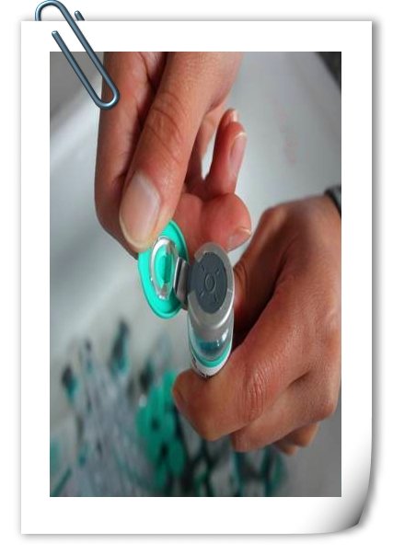
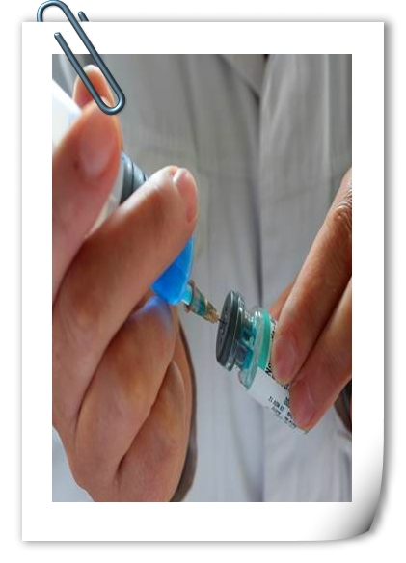
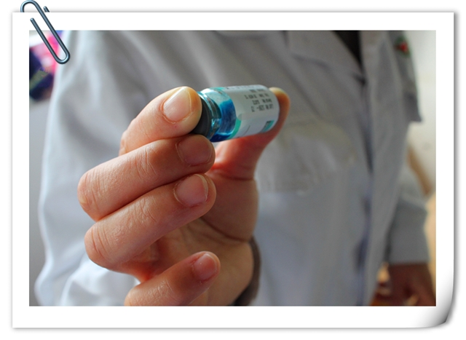
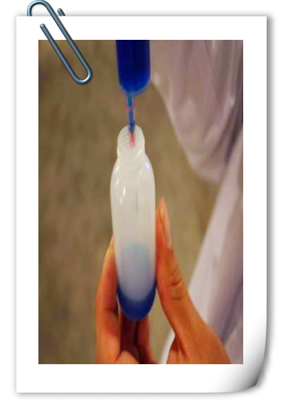
Formulating vaccine
Open vaccine
Dilute vaccine
Mixing
Packing
Dilution：Pour a small amount of diluent into the vial，shake the vaccine gently. After the vaccine is completely dissolved，the vaccine particles are not visible under the light，pour it back into the diluent bottle，rinse the vaccine bottle 3 times with diluent，ensure that there is no residue in the vaccine bottle.
Notes:
The first step is the dilution of the vaccine

Slide 21
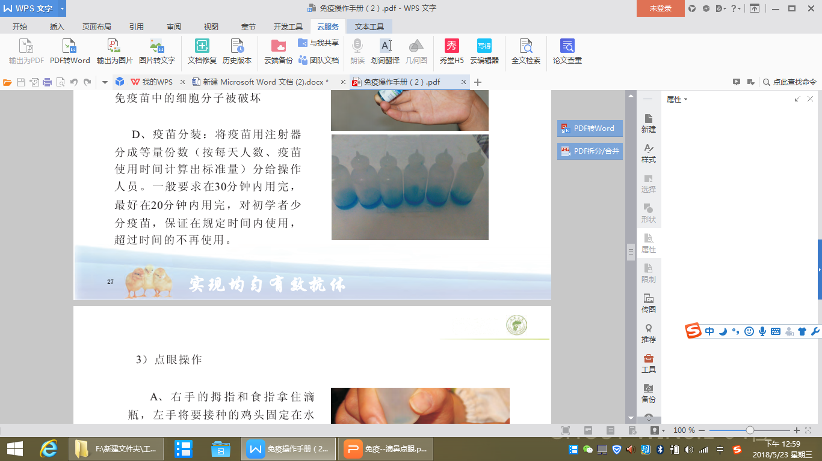
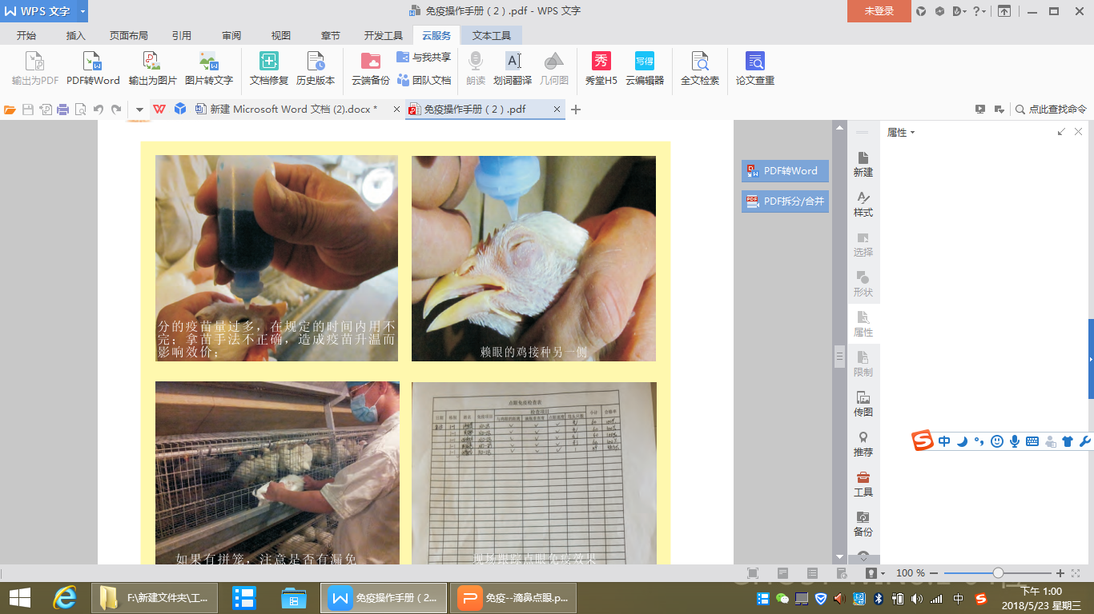
Packing vaccines
Dispense the diluted vaccine into each dropper bottle.
Packing capacity based on 30 minutes vaccination per person.
Don't pack too much. Avoid reducing vaccine potency over time.
Notes:
Avoid reducing vaccine potency over time.

Slide 22
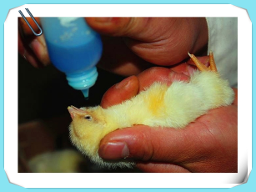
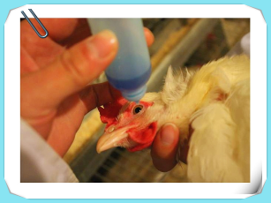
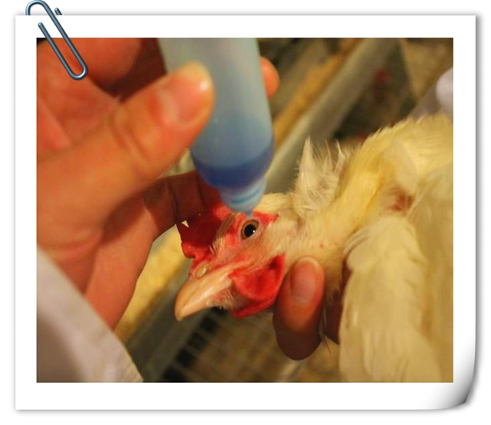

Operating
Catch chicken ：Gently, steady, fast
Notes:
Keep gently, steady and fast when catching chicken,In order to reduce stress。

Slide 23
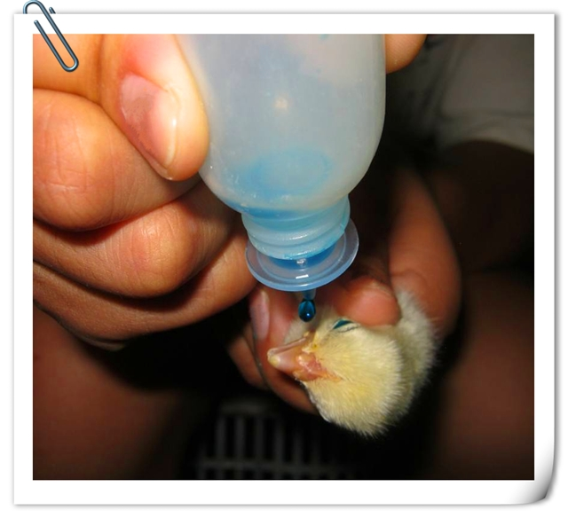
Operating
3. Close the chicken's mouth, cover one side of the nostril, and drop the vaccine into the other side of the nostril. If the chicken 's nostril is blocked, the other side can be replaced.
4.Fix the left eye or right eye during vaccination,If the eyes became red or tearing , replace another eye.
1、Empty dropping bottle to avoid repeated reversals.
2、Fix the head of the chicken horizontally and drop the mouth of the bottle 0.5-1cm from the eye of the chicken. Drop the vaccine solution vertically.

Slide 24
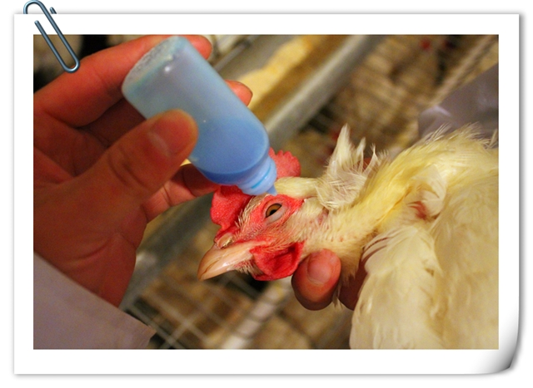
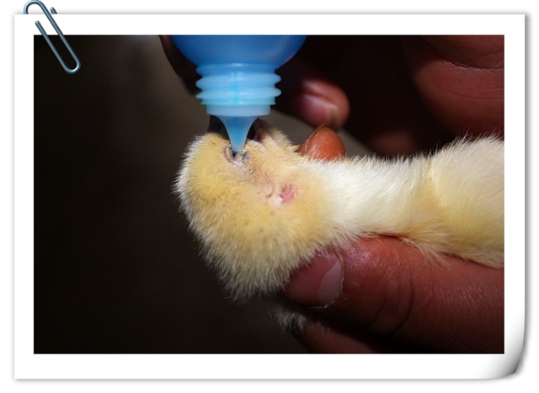
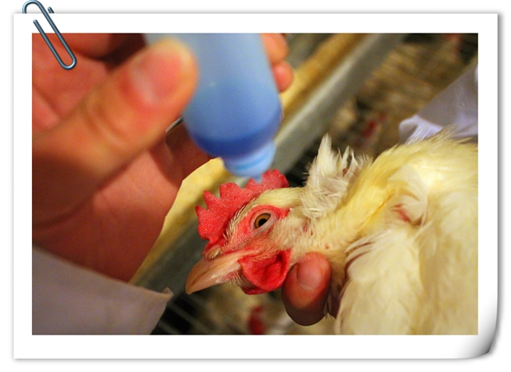
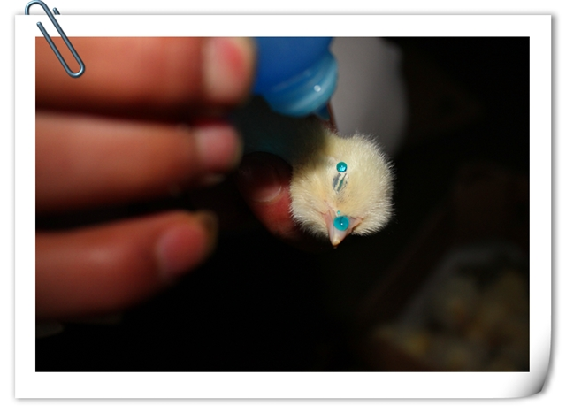

Don’t in operation
Incomplete Absorption, Vaccine dumped
Do not tilt
Close-distance
Far-distance
These errors can lead to wasted vaccine, cross-infection, inaccurate vaccination metering, etc.
Resulting in vaccination failure.
Notes:
Here are some wrong operations,such as

Slide 25
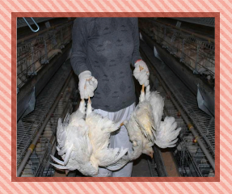
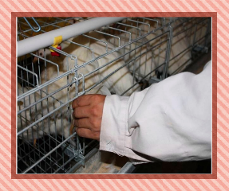
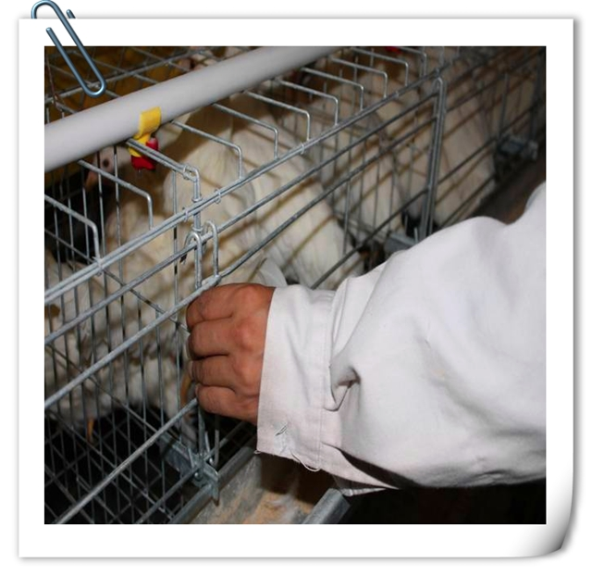
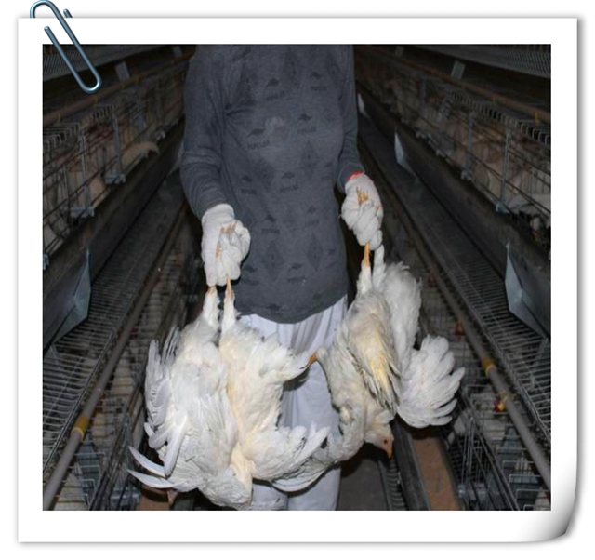
Checking cage door
If change cage position，check whether the cage door is closed
Notes:
After vaccination please

Slide 26
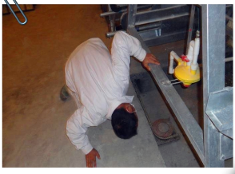
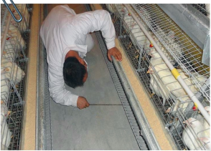
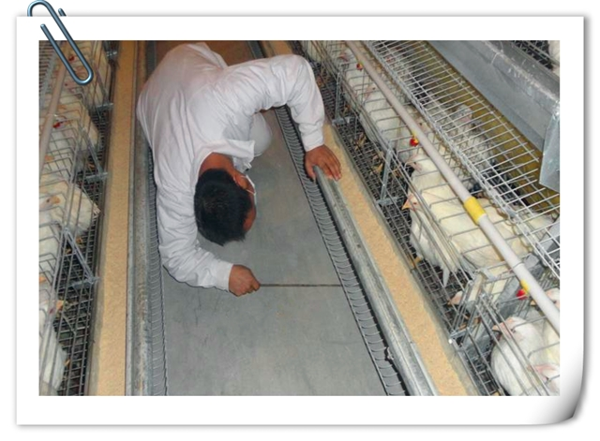
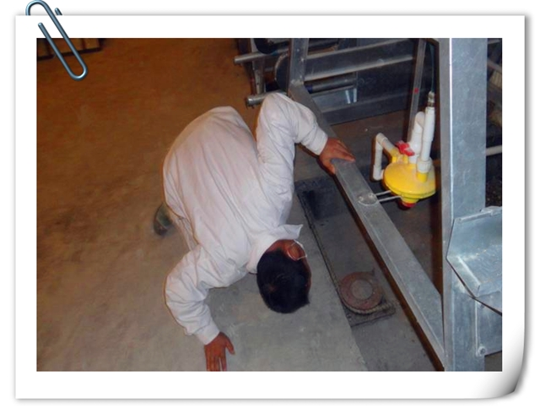
Catching the hens outside the cage
Check if any chickens come out，between aisle？Manure trench？
Catch them，and vaccination again，then put back into the cage.

Slide 27
Notice
Notes:
OK let's go into part two Wing-web vaccination
It also includes three aspects

Slide 28
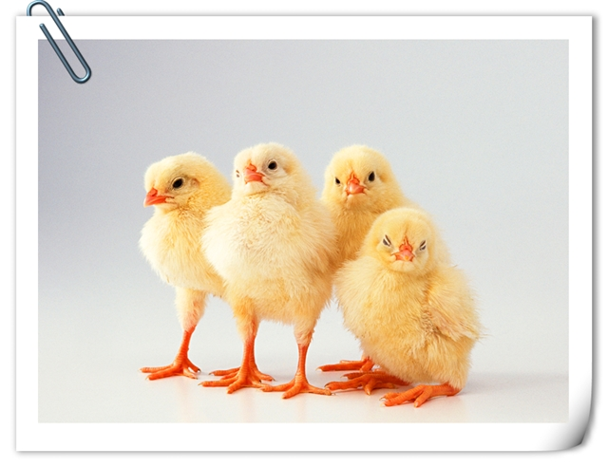
Notes
A henhouse is vaccinated one day.
The henhouse cannot be disinfected 48 hours before and after living vaccine immunization.
Chicken house disinfection, drinking water tube disinfection, external environment disinfection.

Slide 29
  Part two
  Wing-web vaccination

Slide 30
Main content
Preparation
Procedures and standards
Notice

Slide 31
Preparation

Slide 32
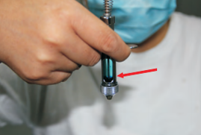
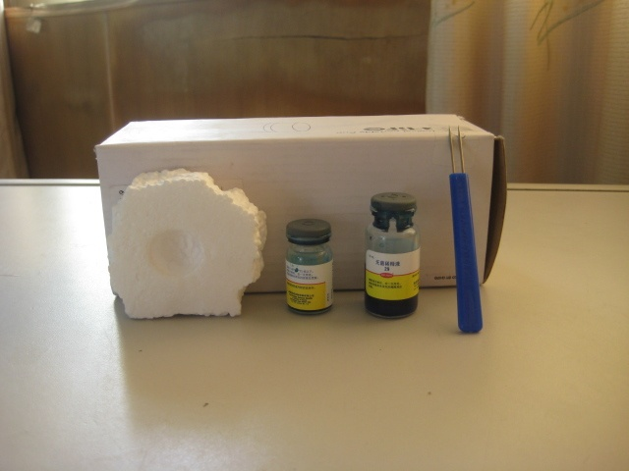
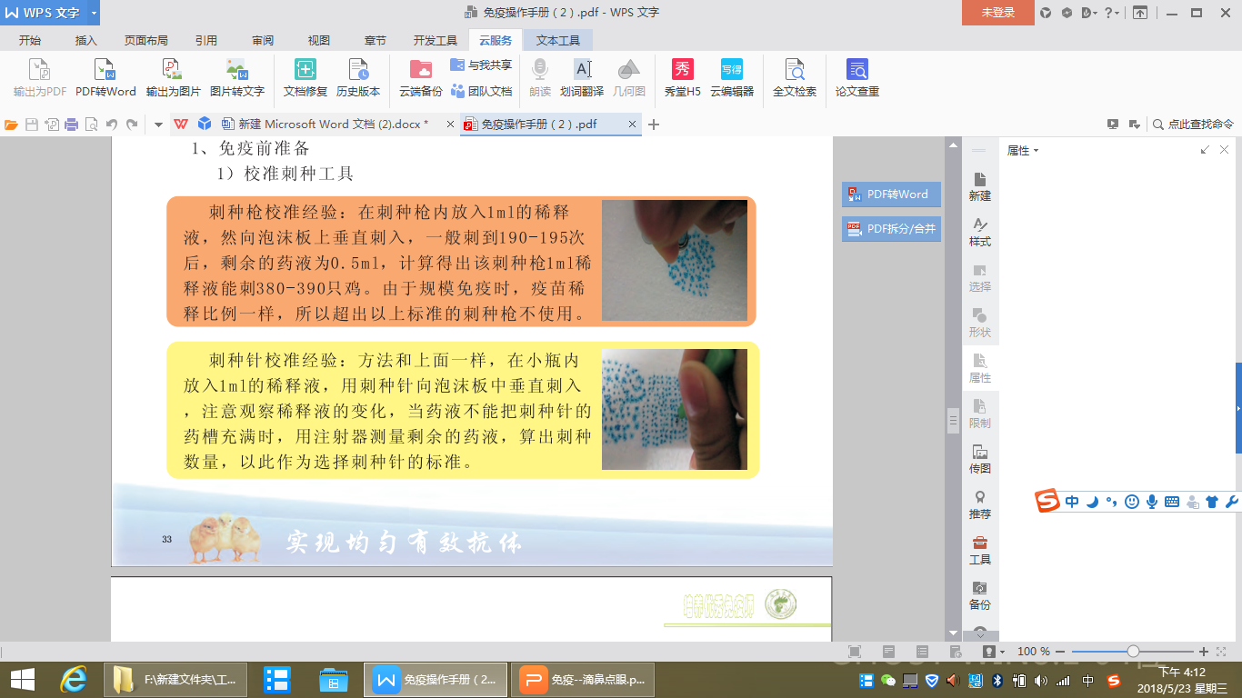
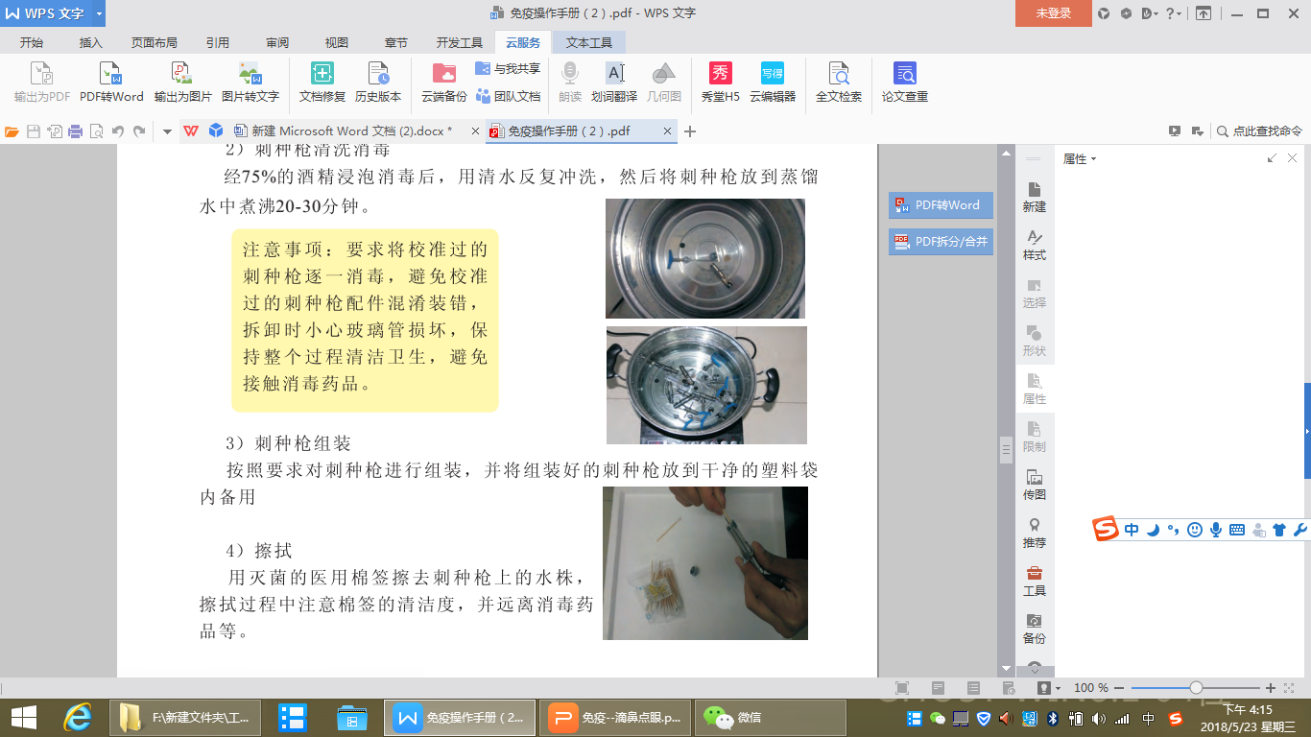
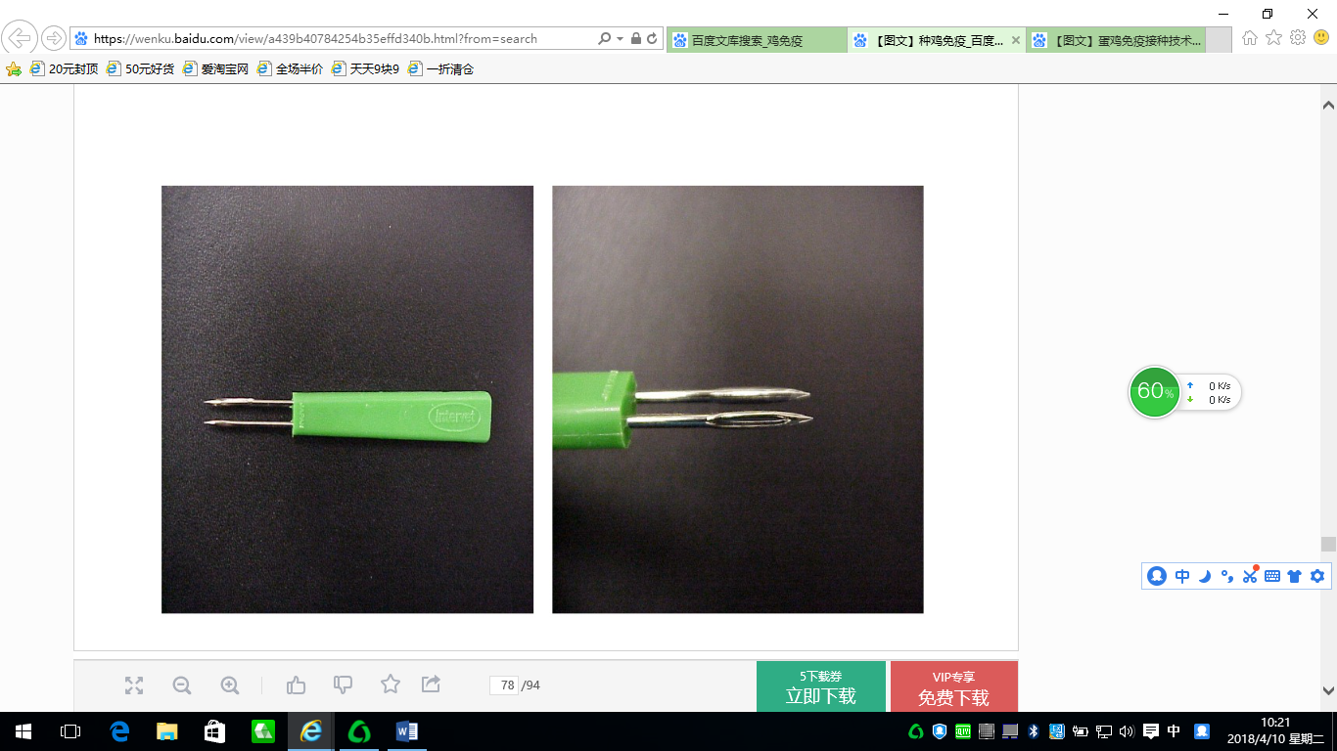
Equipment preparation
Vaccine
Foam board
Pot for sterilization
The foam board is used to calibrate the dose of the needle. You can continuously pierce the foam board 190 times vertically and see if the dosage is 0.5ml. It is generally considered that one drop is 0.0025ml.
Vaccination needle
or
Vaccination gun

Slide 33
Taking vaccine
Check if the vaccine name, manufacturer, batch number,expiration date and packaging are intact;
Check the quality of the vaccine.and store the vaccine in the specified temperature range.

Slide 34
Procedures and standards

Slide 35
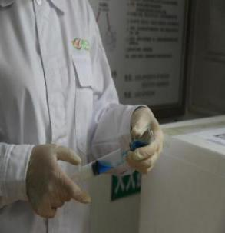
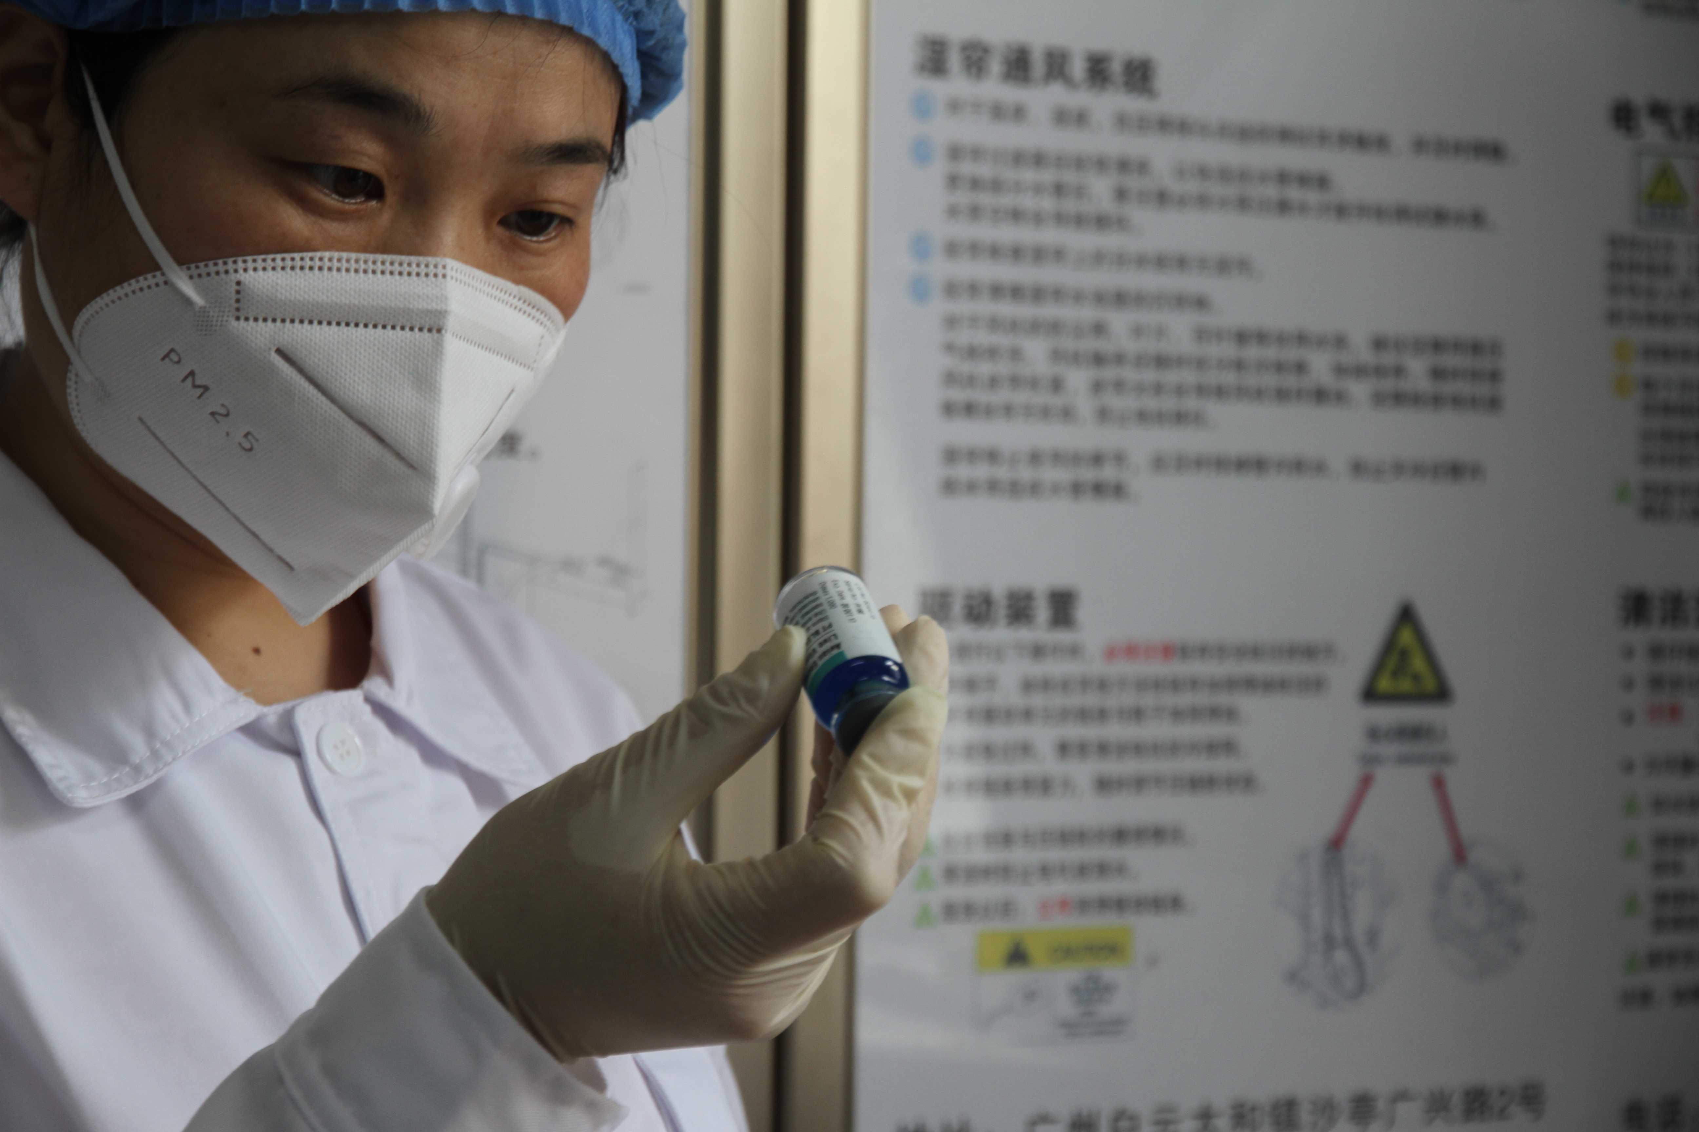
Formulating vaccine
Dilution：Shake the vaccine gently，after the vaccine is completely dissolved，the vaccine particles are not visible under the light，pour it back into the diluent bottle，rinse the vaccine bottle 3 times with diluent，ensure that there is no residue in the vaccine bottle.

Slide 36
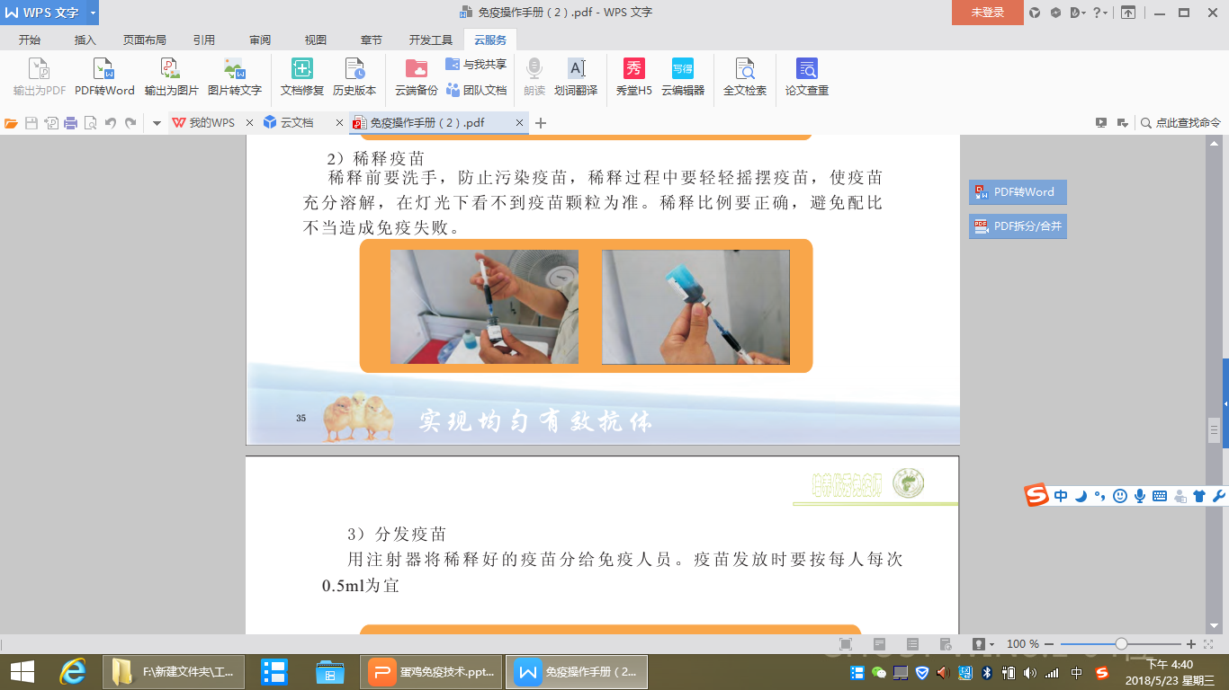
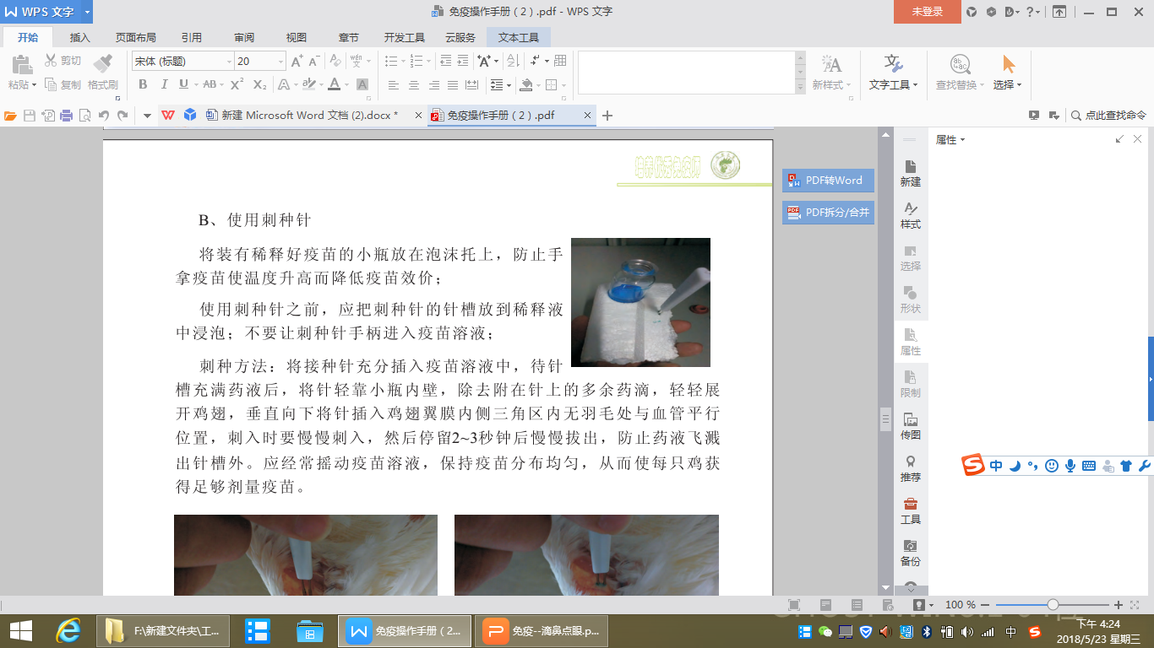

Formulating and packing vaccine
Use a syringe to distribute the diluted vaccine to the vaccinators，0.5ml per person per time is appropriate，ensure that the vaccination is completed within 30 minutes.

Slide 37


Fix the hen and clean the fluff
The hen was fixed lightly and steadily by the catcher, and the feathers of the hen wing triangle were plucked away with the thumb and placed horizontally.

Slide 38



Dip vaccine
When the vaccine is dipped, the vaccine liquid surface is completely immersed in the needle slot of the needle.
Prick needle vertical in and out, to avoid contact with the bottle wall needle slot.

Slide 39



Wing-web vaccination
The needle vertically puncture the inner wings of the hen.
Moderate strength and speed.
In the inoculation operation, insert the needle groove vertically, and pull out obliquely.
Avoid stabbing blood vessels and muscles.
90º

Slide 40


Catching the hens
Catch the hens outside the cage.

Slide 41
Notice

Slide 42

Notice
The spines Pierce the wings.
A henhouse is inoculated one day.
When stabbing , make sure that there are no feathers in the stabbing part.
The vial containing the diluted vaccine should not be directly touched by hand.
The henhouse cannot be disinfected 48 hours before and after living vaccine immunization.

Slide 43



Case analysis
For example:In the process of vaccination, since the vaccinators inoculated with a needle that not dipped into the vaccine, there were puncture holes in the puncture site, but the dose was insufficient, resulting in fowl pox.
Successful puncturing
Failed puncturing
Consequences

Slide 44
  Part three
  Vaccination by Injection
Notes:
Let's continue to part three Vaccination by Injection

Slide 45
Main content
Preparation
Procedures and standards
Notice

Slide 46
Preparation

Slide 47


Equipment preparation
The needles and syringes to be used 1 day before vaccination shall be soaked in 75% alcohol, cover the container well to prevent alcohol from evaporating.
After disinfection, replaces the alcohol in the the syringe with boilled water or distilled water.
Then disassemble the syringe and rinse it with boiling or distilled water before assembling and injecting distilled water.

Slide 48




Dosage based calibration
Inject the vaccine 10 times consecutively into the volumetric vial to see if it is 5ml.
Adjust with water first, and calibrate with inactivated vaccine.
Check the number of chickens after the first bottle of vaccine.

Slide 49

Taking vaccine
Vaccine checking
Types of vaccines
Capacity

Slide 50


Taking vaccine
Cold-chain storage and transfer
Notes:
Taking vaccine is the same as the what I said before,cold-chain storage and transfer

Slide 51


Vaccine pre-warming
Before inoculation, the vaccine was preheated in warm water at 36-38°.
Notes:
this is very important,Vaccine temperature is too low will cause flock stress，Especially in winter。

Slide 52


Checking and mixing
Checking the uniformity: Put the vaccine under the light or sunlight to see if there is delamination.
Mix the vaccine: Shake the vaccine up and down for 1 minute before using the vaccine, not too fast or too violently.

Slide 53


Dose adjustment, dressing needle
According to the age of the flock, install the required injection needle and use the pliers to rotate one circle to fix it.

Slide 54


Install syringe needle
Adjust the direction of the bevel of the needle according to the vaccinator's habit of using the syringe, and pay attention to the needle with burrs not to use.

Slide 55

Insert the needle
Needle for inserting a bottle
Needle for deflating air
Insert the bottle insertion needle and the deflation needle into the bottle cap respectively, pull the wrench,start the vaccination after the liquid medicine is injected.

Slide 56
Classification of injection immunization
胸部皮下
颈部皮下
翅根皮下
胸部肌肉
翅根肌肉
腿部肌肉
(Subcutaneous chest)
(Subcutaneous wing root)
(Wing root muscle)
(Subcutaneous neck)
(Chest muscles)
(Leg muscles)
抗体上升与维持、鸡群应激
（The rise and maintenance of antibody、hens stress）
Notes:
Classification of injection immunization include subcutaneous injection and intramuscular injection.
Subcutaneous injection can be in the chest, neck, and wing roots,
intramuscular injection can be in the chest, leg, wing root area.
The choice of which method is based on factors such as antibody rise and maintenance, flock stress, etc.
We often choose subcutaneous injections.

Slide 57
Procedures and standards

Slide 58

Neck subcutaneous injection
The posterior epidermis of the neck is lifted to generate an air cavity between the skin and the cervical epidermis.
The injection needle is inserted into the air cavity.
The needle should be directed towards the poultry body, and the injection site should be 1/3 below the central line of the neck.

Slide 59


Neck subcutaneous injection
Correct
Wrong
Consequences
Notes:
the needle should be parallel to the neck, not inserted directly into the neck，causes malabsorption of vaccine and neck injury.

Slide 60


Chest subcutaneous injection
15-30°
When subcutaneous injection of chest is carried out, one hand grabbed the wings and the other hand grabbed the legs. The chest is up and grabbed parallelly. The injector pulled the chest feather away, and the needle is 15 – 30° to inject the vaccine. At the same time, the injection site is pressed with the thumb to spread the vaccine and prevent leakage.

Slide 61
Notice

Slide 62
Notice
Vaccines should be kept away from light.
Pre-warming: It must be pre-warmed to room temperature before use, and in winter, it must be pre-warmed to close to the body temperature of the chicken (37-40℃) before injection.
Shake thoroughly: Shake every 15 minutes during injection to prevent vaccine precipitation and uneven antigen.
Calibration of syringe：Correction before vaccination, calibration is performed once for every 500 pigeons inoculated during vaccination.
Replace the needle:Needle replacement every 500 birds.
Change chicken position：Avoid missed vaccination.

Slide 63


Case
Irregular operations: Needle horizontally inserted into chest and vaccine injected into the epidermis lead to vaccines leakage or vaccine kits in the chest of hen.
Notes:
Share a case

Slide 64


Legend of inoculation site
So each inoculation should be fixed and inoculated in different areas.
Alternate vaccination site before and after, up and down, and left and right.
Notes:
We all know that chickens are vaccinated many times in their lifetime.
Multiple doses of the same site can result in poor vaccine absorption.

Slide 65
03
Vaccination record and efficacy checking
Notes:
The above content is the vaccination operation part
Next let us enter vaccination record and efficacy checking

Slide 66


Fill in vaccination record
Vaccination information:
Chicken house number, date, number of chickens, age of _x0008_vaccination, vaccine name, manufacturer, batch number, expiry date, Vaccination method and dose.
Personnel information:
Signature of vaccination Team Leader, Client and Major Vaccination Personnel.

Slide 67

Check the effect
Checking methods for nose drops and eye drops
Check during inoculation
1. Close eyes, blink, eyes without vaccine
2. Swallowing movement in the mouth
Check after inoculation
Oral staining with diluent
Notes:
1.The chicken should be inoculated again
proof of successful inoculation.

Slide 68

Check the effect
Checking methods for Wing-web vaccination
Check during inoculation
Check after inoculation
The inoculated chickens have the blue liquid medicine
5 to 7 days after inoculation, the site of the prickle was scab like, indicating that the inoculation was successful

Slide 69


Check the effect
Checking methods for injection vaccination
Check during inoculation
Check after inoculation
1. Depth of injection
2. Immune site
3. Vaccine spillover
4. Needle replacement per 500 hens
5. Standard operation
1. Vaccine leakage
2. Broken leg /broken wing
3. Hemorrhage in injection site
4. Missed vaccination

Slide 70
04
Inoculation equipment maintenance

Slide 71



Cleaning
After vaccination, the equipment needs to be cleaned, usually with 100 ℃ water or sterile normal saline or boiling water with detergent added for several times.

Slide 72

Regular inspection
Check the equipment, such as aprons, springs, hoses, etc., and replace them in time if they are found to be damaged.

Slide 73
Dose calibration
The equipment must be calibrated before use to ensure that the dose is accurate during vaccination.

Slide 74

Disinfection/Boil disinfection
Boil at high temperature for disinfection.
Suitable for some equipment that can not carry out too high temperature.

Slide 75

Disinfection/Alcohol disinfection
Alcohol disinfection
It can soak and wipe the surface of equipment to achieve the purpose of disinfection

Slide 76


Disinfection/High pressure sterilization
High pressure sterilization
Mainly used for high temperature resistant instruments.

Slide 77



Save
Equipment should be stored in clean packaging

Slide 78
05
Waste treatment
Notes:
Waste treatment is very important

Slide 79




Waste disposal
Avoid diluents and vaccine bottles left in the henhouse, high temperature or disinfectant disinfection after all packed into bags, waiting for the relevant departments for recycling.

Slide 80
Summary
Inoculate effective vaccines into chickens No environmental pollution
Key points
Before
During
After
Vaccine
Effective
Buy and store
Control stress
Harmless treatment
Chickens
Healthy
Disease free
Disease free
Reduce stress response
Person
Skilled
Meet the requirements
Serious and sober
Observe the effect
Equipment
Clean and accurate
Disinfected, cleaned and calibrated
Work accurately
Disinfected, cleaned
Notes:
That is all about the poultry vaccination
You need to remember the key points of vaccination，Precautions before, during and after vaccination。

Slide 81

感谢聆听！
Notes:
OK，That's all for today,thank you.

