Slide 1
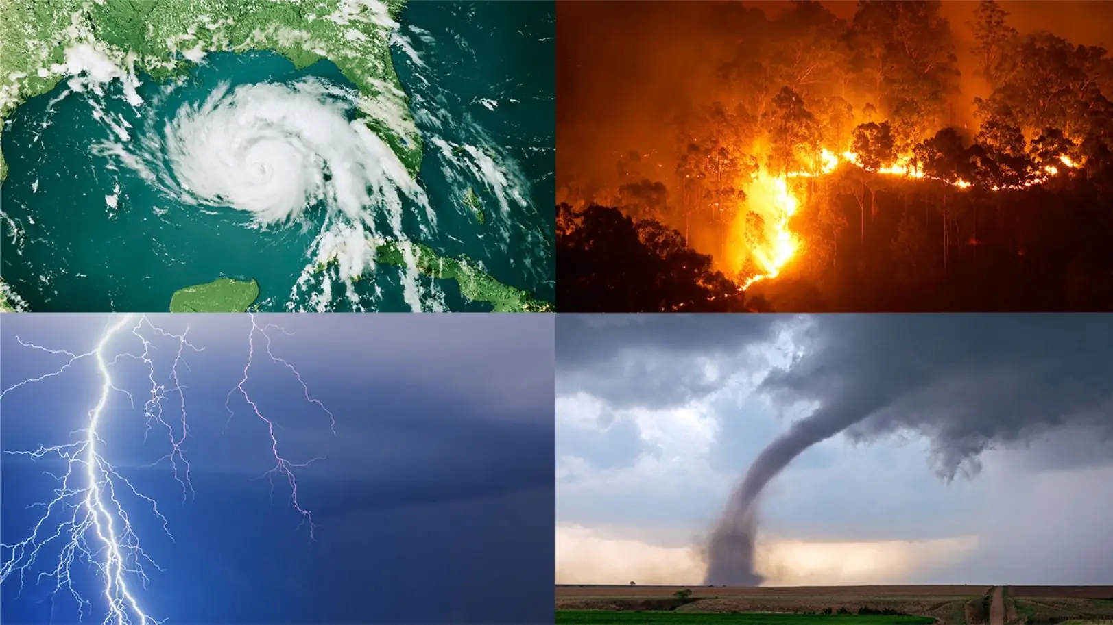

Strengthening Agricultural
Preparedness through Impact
Based Forecasting
Leila Salarpour Goodarzi
July 2026

Slide 2

What is Impact-Based Forecasting and why?
Traditional forecasting provides us with information on what the weather will be
      It will (might) rain
      How should we use this information?
We need to use additional information to understand what the weather will do
      What will (might) Happen to a specific crop?
Notes:
Let me take you through some of the new tools and features. While the Portal includes more than 10 different tools for different stakeholders, today I will highlight four tools that raise its usefulness across the region: a Risk Atlas for the entire region, Country Decision Support Systems for targeted policymaking for 10 countries, Policy Storyboards for regional cooperation and our Rapid IBF translating forecasts into impacts. Taken together, we hope that these will shorten the path from evidence to decisions. With that, let me get started with the foundation for this suite of tools: the Risk Atlas.

Slide 3
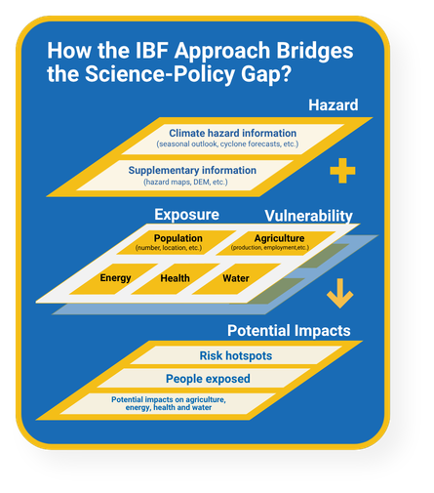
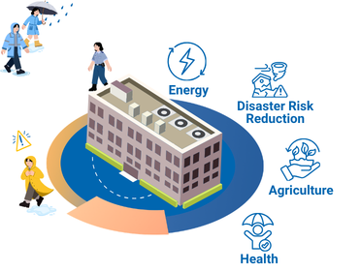
Impact-Based Forecasting
IBF empowers users to take risk-informed anticipatory action across sectors, leaving no one behind!
Notes:
Let me take you through some of the new tools and features. While the Portal includes more than 10 different tools for different stakeholders, today I will highlight four tools that raise its usefulness across the region: a Risk Atlas for the entire region, Country Decision Support Systems for targeted policymaking for 10 countries, Policy Storyboards for regional cooperation and our Rapid IBF translating forecasts into impacts. Taken together, we hope that these will shorten the path from evidence to decisions. With that, let me get started with the foundation for this suite of tools: the Risk Atlas.

Slide 4
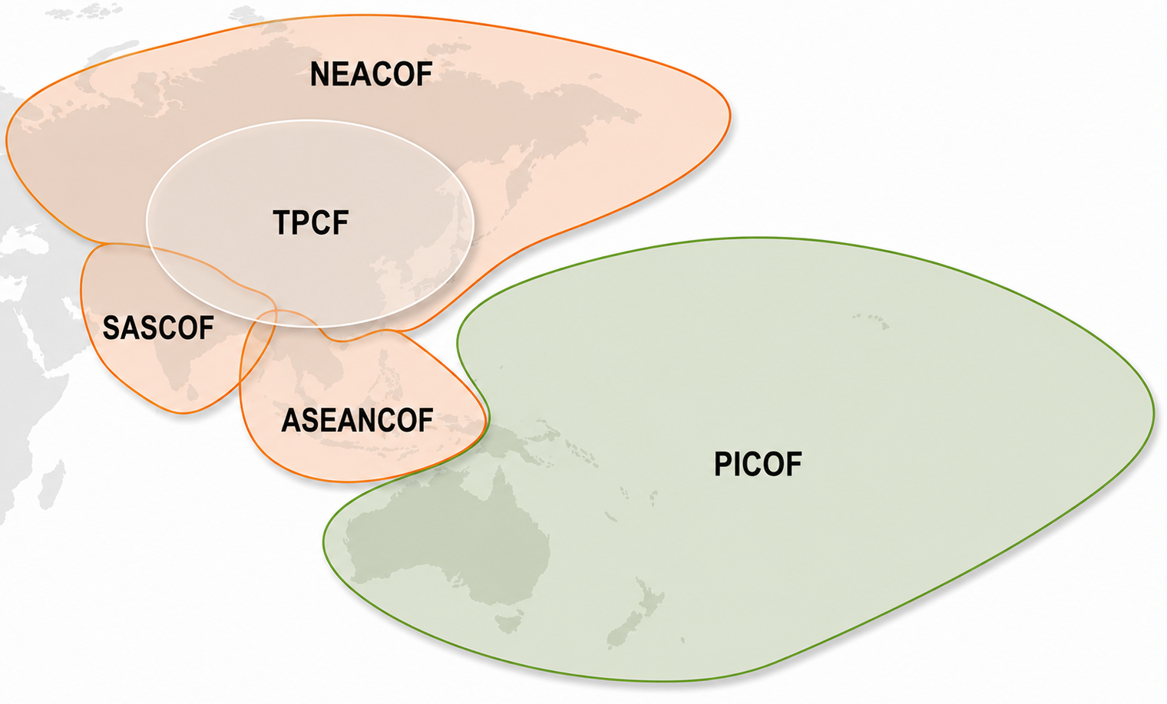
ESCAP’s work on Impact-Based Forecasting as part of COFS
Following the WMO global framework for climate services
Hazards → Leverages Seasonal Outlook for precipitation and temperature data + Climate indicators
  Tmin, Tmax, Precipitation - Below normal, above normal
Exposure -
  Using Open-Source data for subregional analysis
  Populations, agriculture (rice, wheat, maize), Hydropower
Notes:
Let me take you through some of the new tools and features. While the Portal includes more than 10 different tools for different stakeholders, today I will highlight four tools that raise its usefulness across the region: a Risk Atlas for the entire region, Country Decision Support Systems for targeted policymaking for 10 countries, Policy Storyboards for regional cooperation and our Rapid IBF translating forecasts into impacts. Taken together, we hope that these will shorten the path from evidence to decisions. With that, let me get started with the foundation for this suite of tools: the Risk Atlas.

Slide 5
Why do seasonal and sub-seasonal IBF both matter?
Long-term decisions
Strategic decisions
Operational & Tactical decisions
Strategic planning & deployment
Vulnerability reduction
Exposure reduction
Early warning & crisis management
Years ahead
Few year ahead
Sub-seasonal and Few days ahead
One season ahead
Climate policy tools
Finance, budgeting, adaptation process, NDC
Sector plans and budgeting
What type of crop for expansion?
Downscaled climate decision support systems
Inter-ministry coordination, anticipatory action, climate impact forecasting
Improving coordination
Automated seasonal impact forecasting (ex. crop-based analysis)
Targeted resilience building
What might happen to crops? Prepare budget, ready for warning
Providing warnings and guideline bulletins
What needs to be done (harvest early)
Deploying subsidies and support
Notes:
The Risk and Resilience Portal provides a seamless integration of weather and climate information to support critical sectors through a structured timeline of actions. It addresses four key areas: early warning and crisis management, exposure reduction, vulnerability reduction, and strategic planning and deployment. For short-term needs, such as a few days ahead, the Portal facilitates emergency preparation by providing tools like 5-day flood forecasts for food and energy infrastructure through platforms like Google Flood Hub. For medium-term planning, it supports targeted resilience-building one season ahead, using tools like automated seasonal impact forecasting to guide interventions for vulnerable communities, districts, and infrastructure.
In the longer term, the Portal enables vulnerability reduction by providing downscaled climate decision support systems for forecasting climate impacts and coordinating anticipatory actions for sectors like energy and agriculture. For years-ahead planning, it supports strategic deployment by integrating finance, budgeting, and adaptation processes into national and sectoral plans, utilizing climate policy tools tailored for specific sectors. This integrated approach ensures that stakeholders can address immediate risks while planning for future resilience, aligning actions across timescales for sustainable disaster risk reduction and climate adaptation.

Slide 6
What is needed for successful disaster risk reduction?
A comprehensive approach that covers
Different time frames
Agricultural vulnerabilities
would ensure a sustainable strategic outcome.
Impact-Based Forecasting (IBF)
  Reveal cascading risks across climate, disaster, & Socioeconomic
  Turn data into action with evidence‑based insights
  Empower smarter planning & budgeting with risk tools
  Translate complex hazards into local, practical solutions
Notes:
Let me take you through some of the new tools and features. While the Portal includes more than 10 different tools for different stakeholders, today I will highlight four tools that raise its usefulness across the region: a Risk Atlas for the entire region, Country Decision Support Systems for targeted policymaking for 10 countries, Policy Storyboards for regional cooperation and our Rapid IBF translating forecasts into impacts. Taken together, we hope that these will shorten the path from evidence to decisions. With that, let me get started with the foundation for this suite of tools: the Risk Atlas.

Slide 7
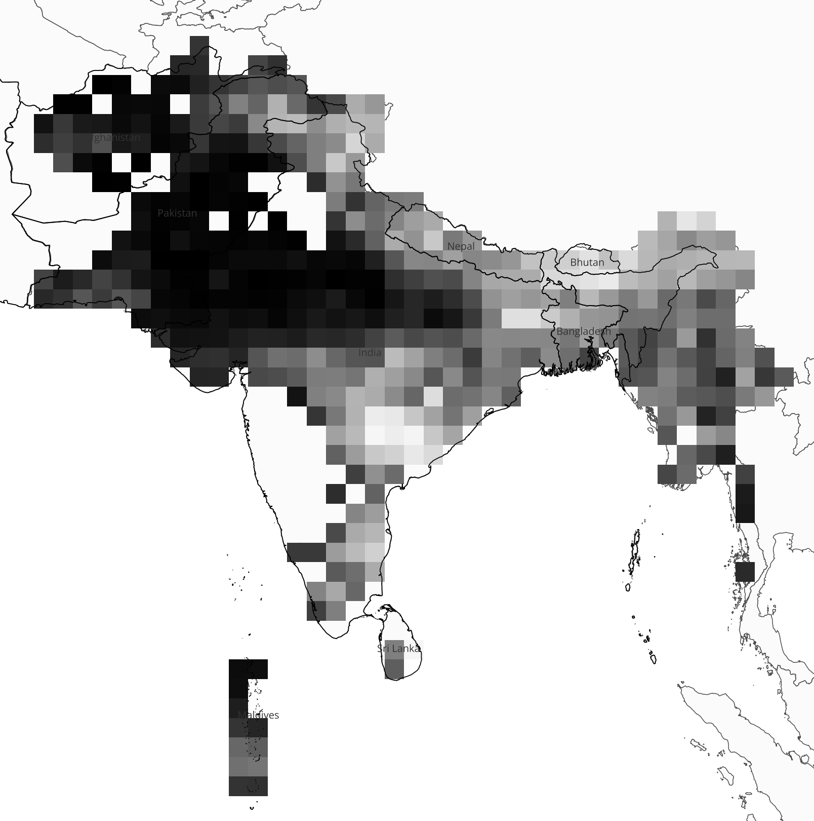
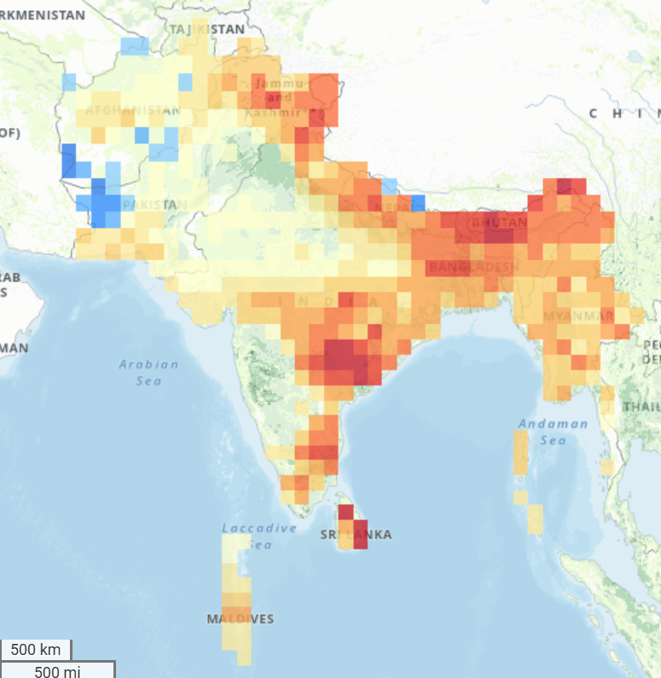
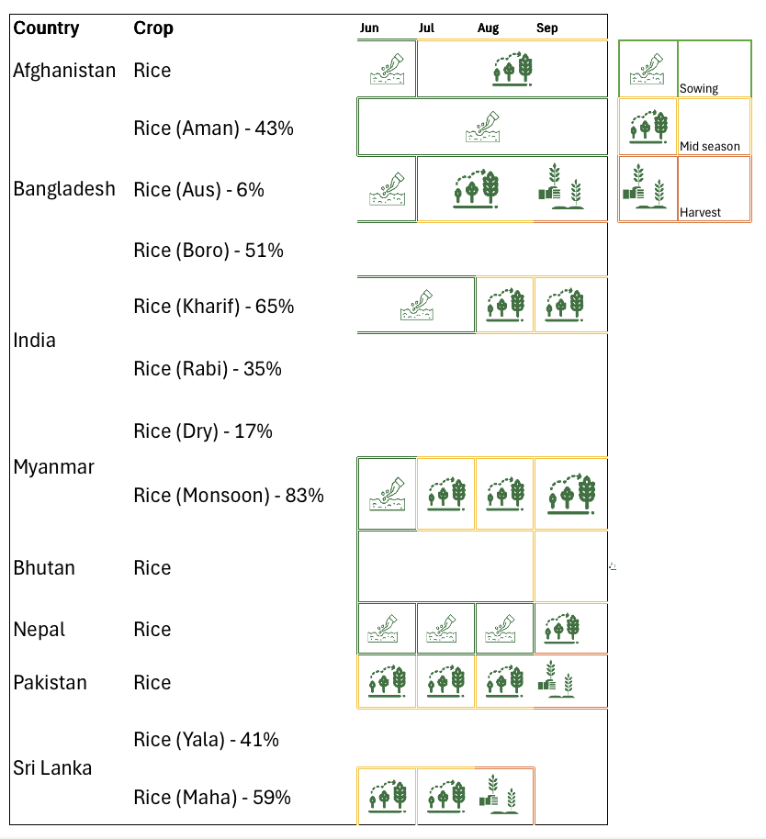
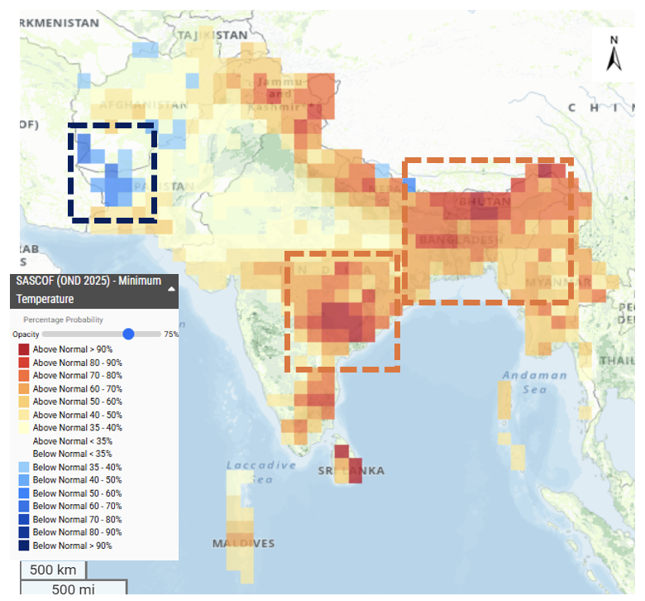
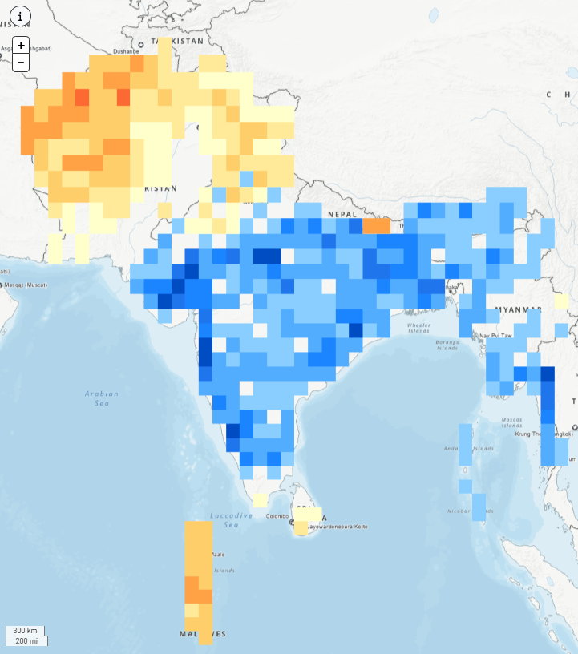
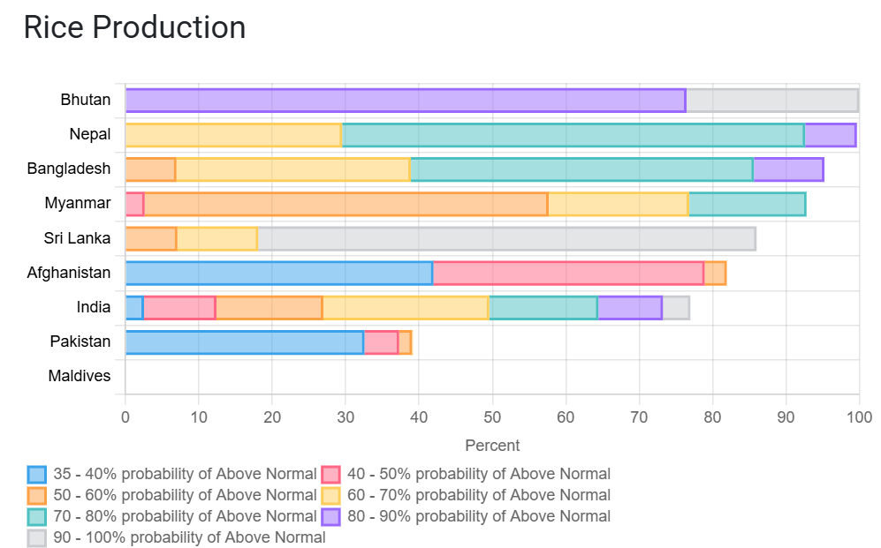
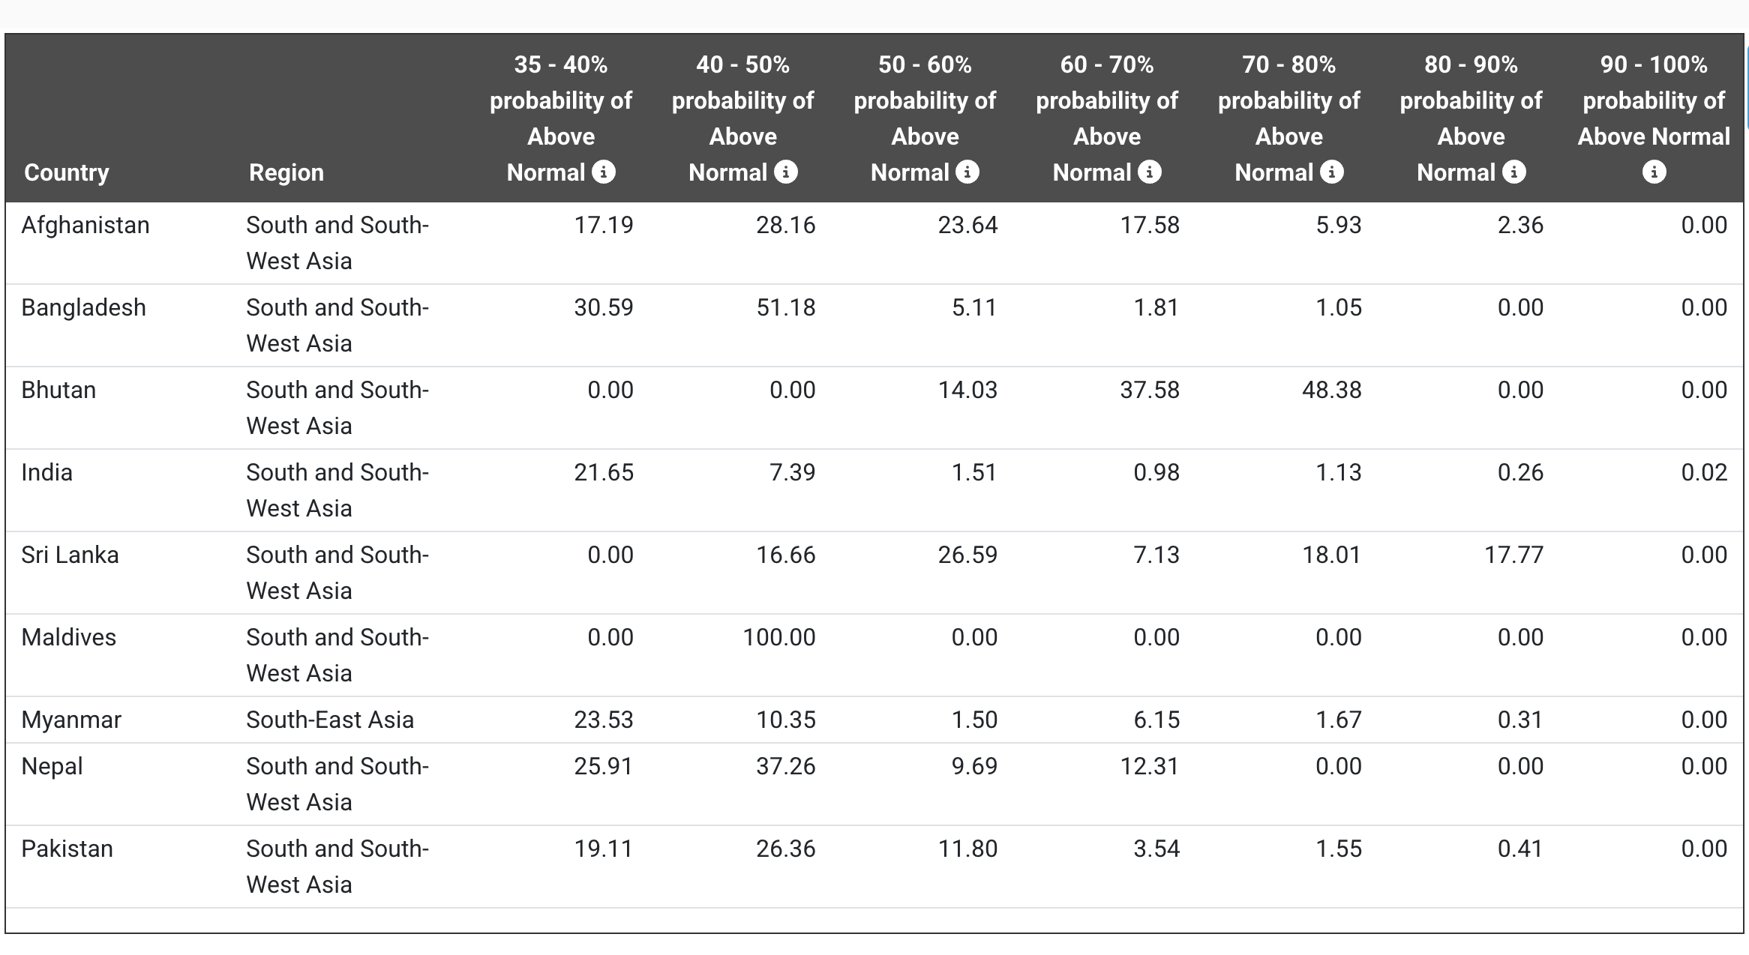
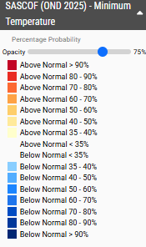
Agriculture IBF: Integrating Seasonal Crop Calendars
Overlay forecast with Exposure
Integration of regional crop calendar + additional Vulnerabilities if available
Identification of Risk Hotspots
Seasonal Outlook: Temperature and Precipitation
Hazard Reclassification
Target, Observe, and Plan

Slide 8
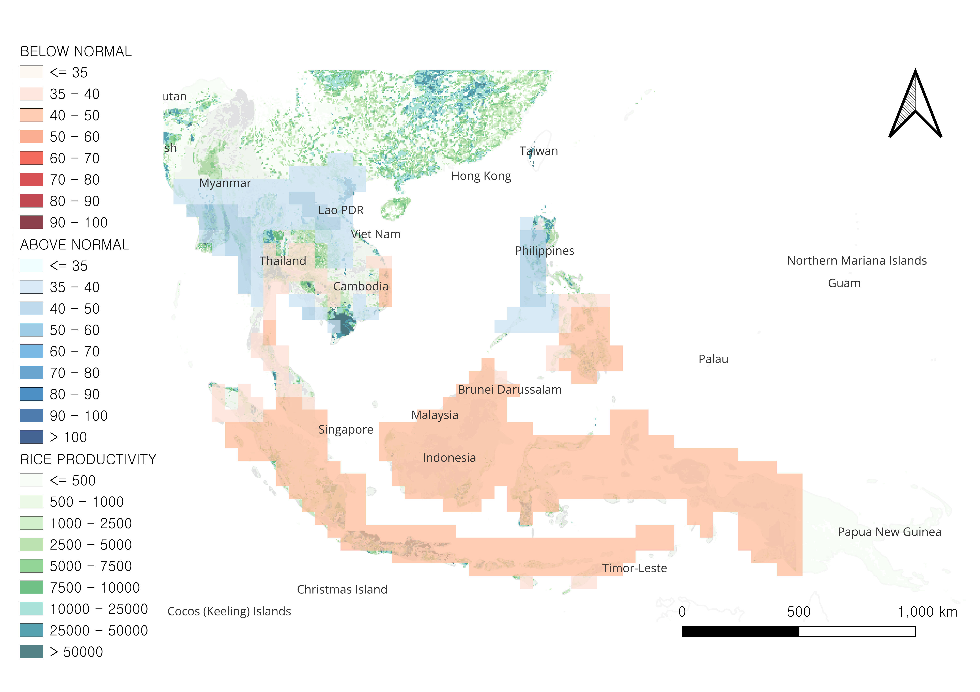
ESCAP Work on ASEAN Region in June – September 2026 Season
Potential Impacts of Below-Normal Precipitation on Agriculture (Rice)
Below-normal rainfall is likely to have a detrimental impact as water stress reduces tillering, head development, and grain filling of the rice crop.
Indonesia, the Philippines, and Viet Nam are likely to face the most severe impact on rice production due to low rainfall.
Country | Low (35-50%) | Moderate (50-70%) | High (70-90%) | Extreme High (90-100%) | Total Exposed
Brunei Darussalam | 0 | 2K (100.0%) | 0 | 0 | 2K
Cambodia | 4.1 million (36.2%) | 0 | 0 | 0 | 4.1 million
Indonesia | 2.8 million (5.2%) | 48.1 million (90.2%) | 0 | 0 | 50.8 million
Lao PDR | 90 (0.0%) | 0 | 0 | 0 | 90
Malaysia | 581K (25.8%) | 477K (21.2%) | 0 | 0 | 1.1 million
Myanmar | 401 (0.0%) | 0 | 0 | 0 | 401
Philippines | 1.2 million (6.7%) | 4.0 million (22.1%) | 0 | 0 | 5.2 million
Thailand | 15.0 million (48.7%) | 195K (0.6%) | 0 | 0 | 15.2 million
Timor-Leste | 0 | 49K (100.0%) | 0 | 0 | 49K
Viet Nam | 946K (2.2%) | 1.6 million (3.7%) | 0 | 0 | 2.5 million
Source: ASEANCOF Outlook for JJA 2026 and UN Geospatial, Blue and Red hues indicate below and above normal probabilities. The color opacity is set to 75%, and the <=35 class is displayed as transparent. Locations of power plants are gathered from Asia Pacific Energy Portal. Production of rice are gathered from FAO MAPSPAM 2020. Population count data is gathered from WorldPop 2025.​
Disclaimer: The boundaries and names shown and the designations used on this map do not imply official endorsement or acceptance by the United Nations. The dotted line represents approximately the Line of Control in Jammu and Kashmir agreed upon by India and Pakistan. The final status of Jammu and Kashmir has not been agreed upon by both parties.
Notes:
Below normal Rainfall is likely to have detrimental impact as water stress reduces tillering, head development and grain filling of rice crop.
In Indonesia – Nearly 95.4% (50.8 million metric tons) of rice production is likely to be exposed to Below Normal Rainfall, with 48.1 million metric tons (90.2% of total rice production) exposed to moderate likelihood (50-70%).
In Philippines – Nearly 28.8% (5.2 million metric tons) of rice production is likely to be exposed to Below Normal Rainfall, with 4.0 million metric tons (22.1% of total rice production) exposed to moderate likelihood (50-70%).
In Viet Nam – Nearly 5.9% (2.5 million metric tons) of rice production is likely to be exposed to Below Normal Rainfall, with 1.6 million metric tons (3.7% of total rice production) exposed to moderate likelihood (50-70%).

Slide 9
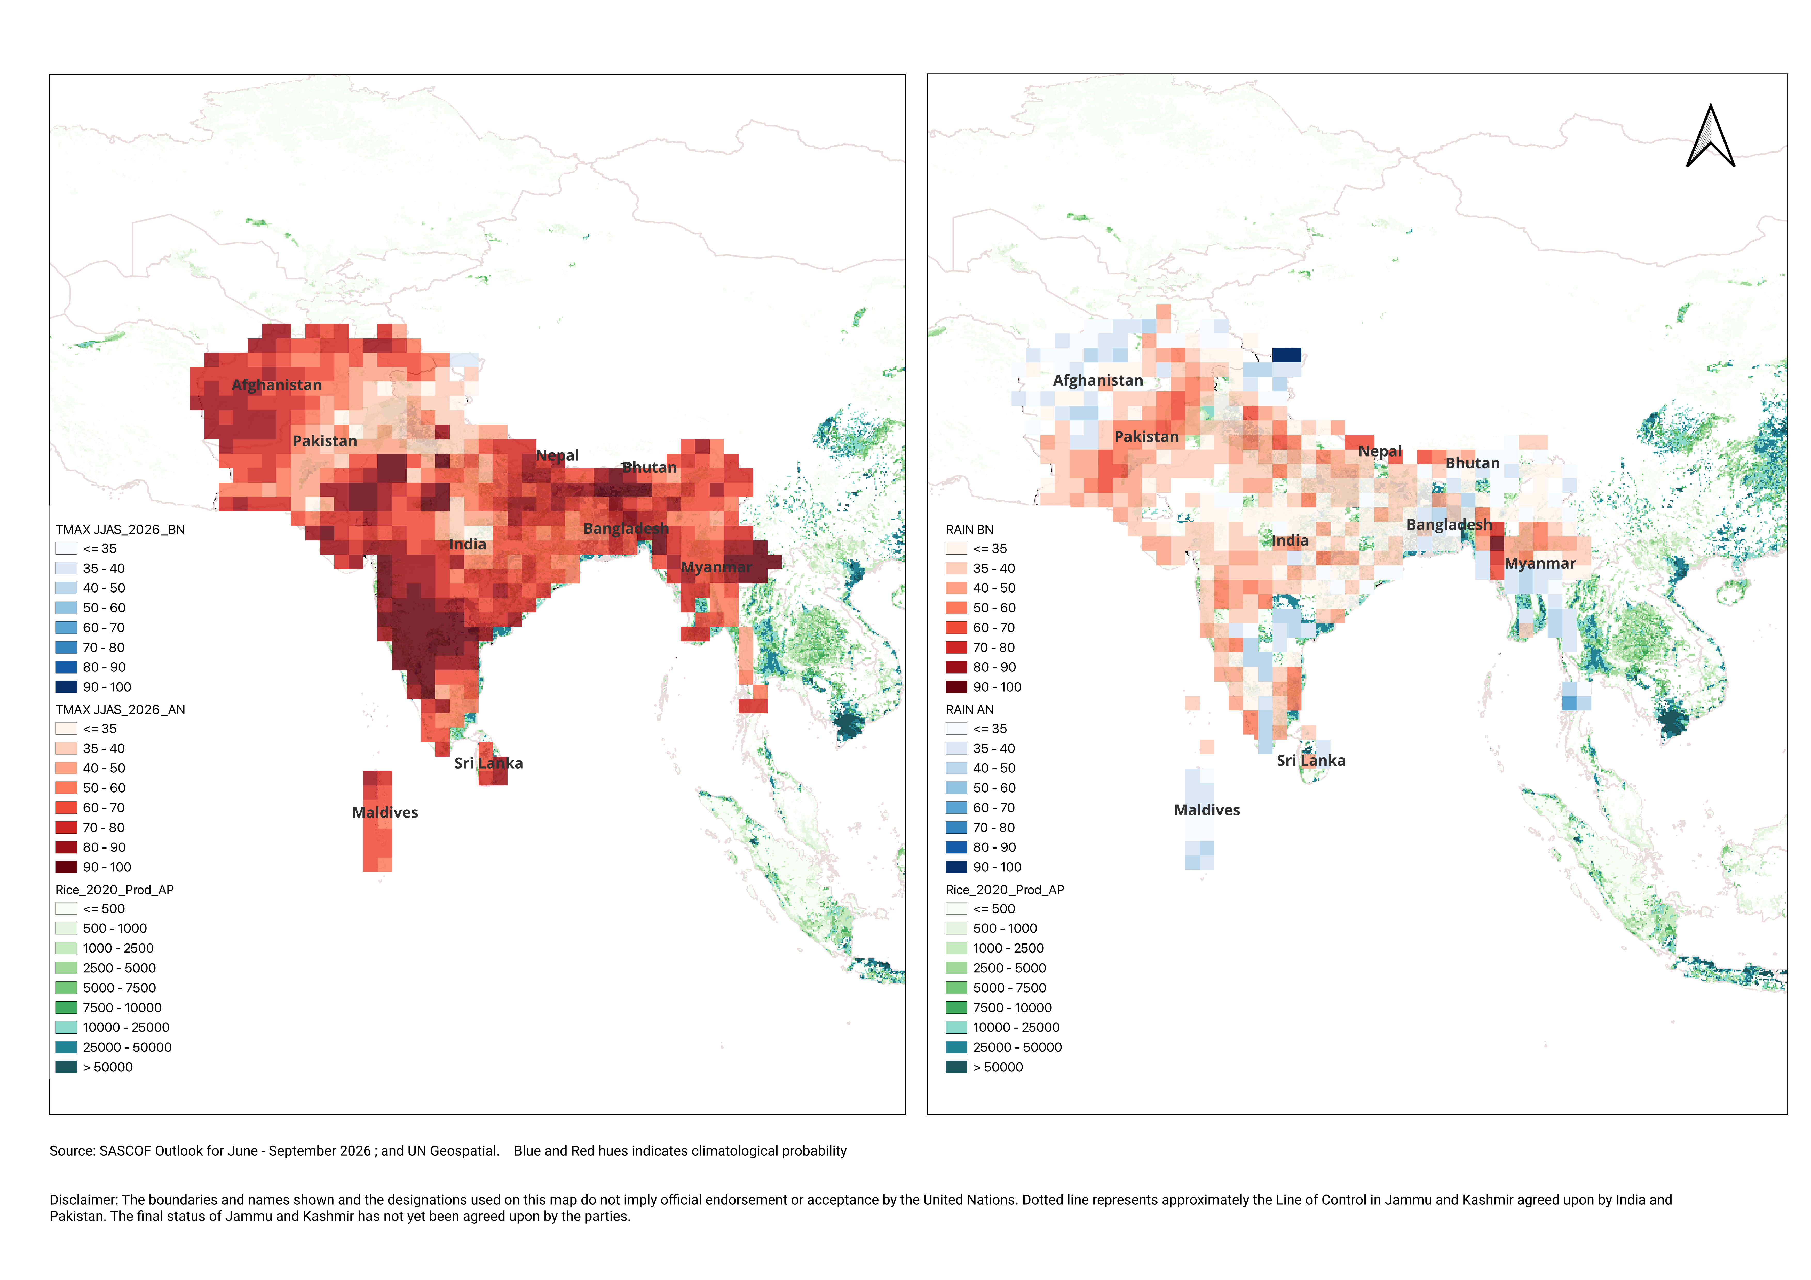
ESCAP Work on SASCOF Region in June – September 2026 Season
Compound Climate Signal: Dual Stress on crops due to Low Rainfall and Warm Nights
Temperature
Rainfall
Based on the Crop Calendar for South Asia
During June- Sep months
Rice is at the Sowing Stage
Sind and Punjab regions of Pakistan and rainfed cultivation in Bangladesh are most likely to be negatively affected by this compound stress.
Rainfed regions are more likely to face the impact on rice production; irrigated regions are likely to face increased energy demand.
Below Normal Rainfall => Soil Moisture
Above Normal Tem (Daytime)=> Evapotranspiration
Combine effect
Notes:
Bangladesh: Aus rice (pre-monsoon rice) cultivating regions (from April to August) and aman rice crop that follows the monsoon rains, is mainly rainfed (July to December) and likely to be severely affected by this pattern.

Slide 10
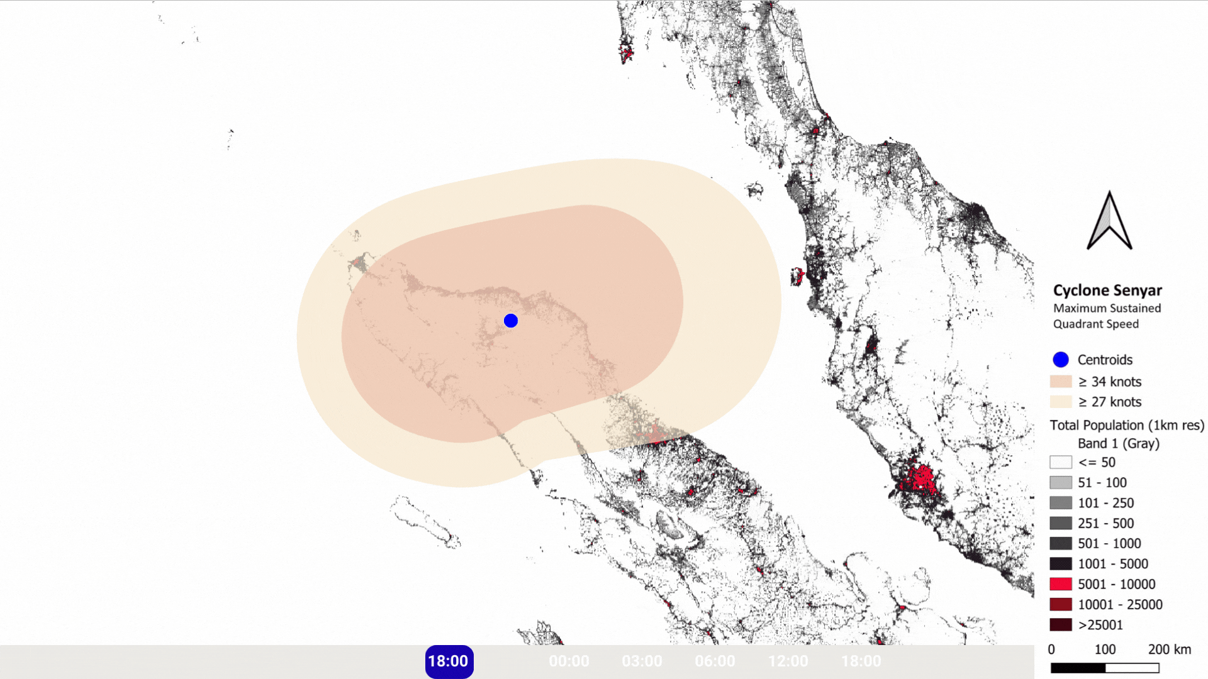
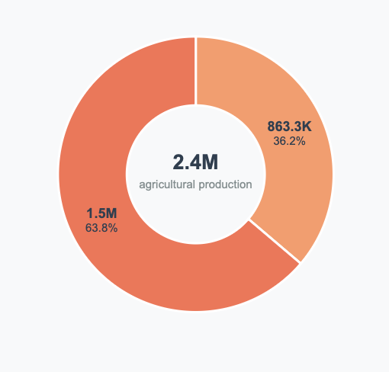
Foreseeing Impact Of Cyclones
Cyclone Senyar
Share of potential rice production exposed in each regency (kabupaten)
on Day and Time of Landfall 26 November 2025 12 AM
Source: IMD, India on cyclone track and Maximum Sustained Wind Speed,
Cyclone Forecasted Windspeed Map
On 26th November 12 AM , Cyclone Senyar hit Aceh and Sumatera Utara provinces of Indonesia.
We estimate the potential rice production in the region exposed to the cyclone aftermath.
Areas exposed to windspeed > 27 kt come under moderate risk.
Areas exposed to windspeed >34 kt come under Moderate to High risk.
Overlaid with
Total Population and Rice Production in the region
Potential Impacts and Risk Hotspots

Slide 11
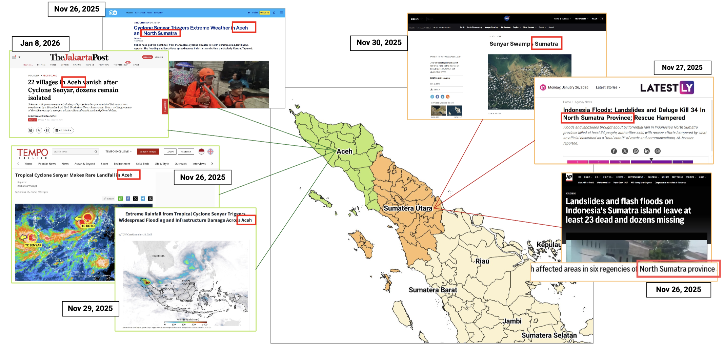
Foreseeing Impact Of Cyclones
Validation of results was conducted using reports from areas severely affected by the cyclone.​
Source: Situational Assessment Reports, News articles on cyclone impact

Slide 12
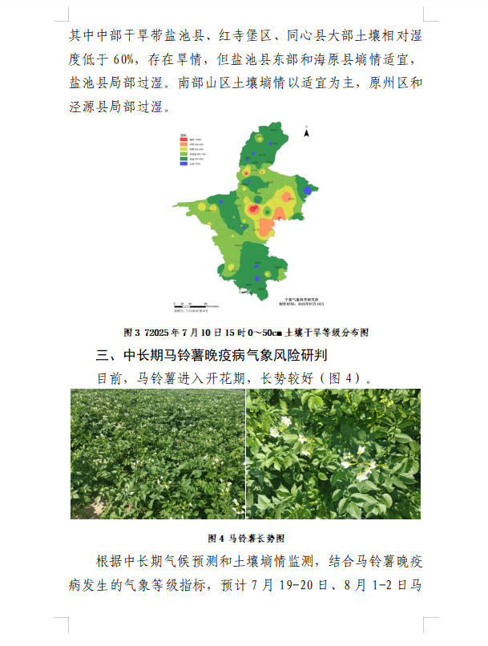
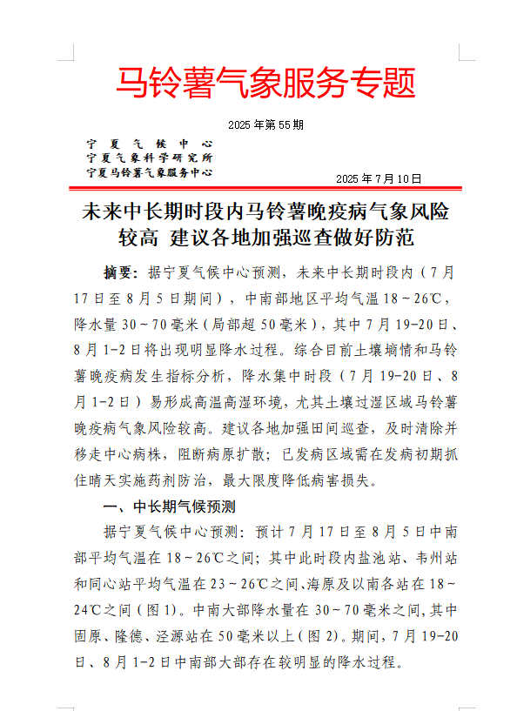
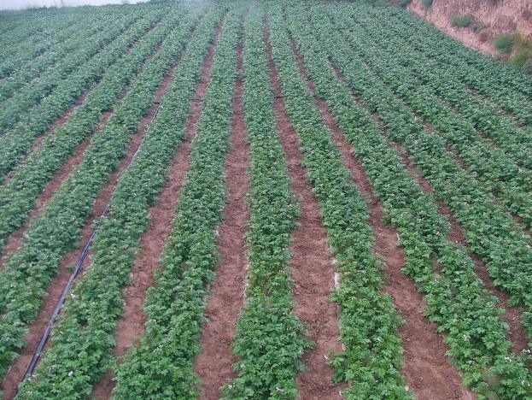
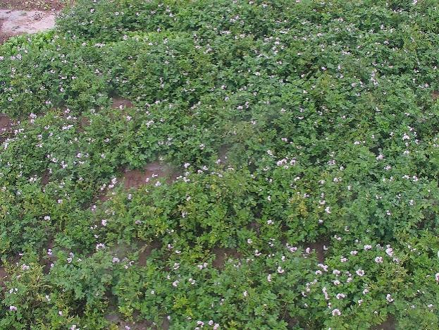
Sample IBF Agriculture Analysis-Ningxia (potato), China
Start observing the seasonal and continue at the sub-seasonal level (providing info around every 10 days)
Climate impact prediction
service products
Climate impact prediction indicators for critical potato growth stages
1.High‑temperature heat damage
2.Frost indicators (first and last frost)
3.Forecast indicators for late blight
4.Heat accumulation thresholds for harvest
5.Storage dormancy weather indices
6.Harvest suitability forecast indices
7.Spraying suitability forecast indices
8.Fertilization suitability forecast indices
9.Inflorescence-flowering suitability grades
Daily Mean T & Precip Forecast Maps
6‑km daily gridded forecast data
TMAX、TMIN、TAVE、PREC
Issues special service bulletins through WeChat groups, emails, and other channels, providing meteorological support for the high‑quality development of the potato industry.
Notes:
Let me take you through some of the new tools and features. While the Portal includes more than 10 different tools for different stakeholders, today I will highlight four tools that raise its usefulness across the region: a Risk Atlas for the entire region, Country Decision Support Systems for targeted policymaking for 10 countries, Policy Storyboards for regional cooperation and our Rapid IBF translating forecasts into impacts. Taken together, we hope that these will shorten the path from evidence to decisions. With that, let me get started with the foundation for this suite of tools: the Risk Atlas.

Slide 13
Sample IBF Agriculture Analysis-Ningxia (potato), China- Bulletin
The meteorological risk of potato late blight is relatively high in the medium to long term. It is recommended that all regions strengthen patrols and take preventative measures.
Abstract: According to the Ningxia Climate Center's forecast, in the medium to long term (July 17 to August 5), the average temperature in the central and southern regions will be 18-26℃, with precipitation of 30-70 mm (locally exceeding 50 mm). Significant precipitation is expected on July 19-20 and August 1-2. Based on the current soil moisture and potato late blight occurrence indicators, the concentrated precipitation periods (July 19-20 and August 1-2) are likely to create a hot and humid environment. In particular, the meteorological risk of potato late blight is higher in areas with excessively wet soil. It is recommended that all regions strengthen field inspections and promptly remove and relocate central diseased plants to prevent the spread of pathogens. In areas where the disease has already occurred, it is necessary to take advantage of sunny days in the early stages of the disease to implement chemical control measures to minimize disease losses.
I. Medium- and Long-Term Climate Forecasts
According to the Ningxia Climate Center, the average temperature in central and southern Ningxia is expected to range from 18 to 26℃ from July 17 to August 5. Specifically, the average temperature at Yanchi, Weizhou, and Tongxin stations is expected to be between 23 and 26℃, while at Haiyuan and stations south of there, it is expected to be between 18 and 24℃ (Figure 1). Precipitation in most of central and southern Ningxia is expected to be between 30 and 70 mm, with Guyuan, Longde, and Jingyuan stations receiving over 50 mm (Figure 2). Significant precipitation is expected in most of central and southern Ningxia from July 19-20 and August 1-2.

Slide 14
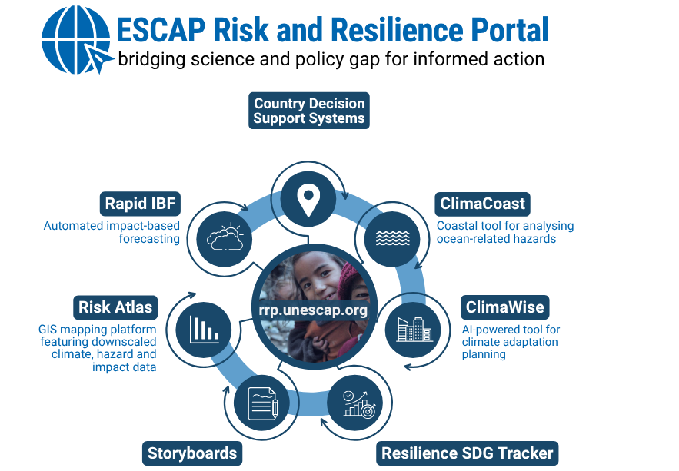






Slide 15
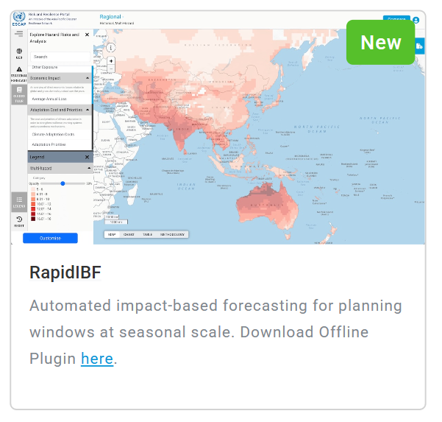

Slide 16
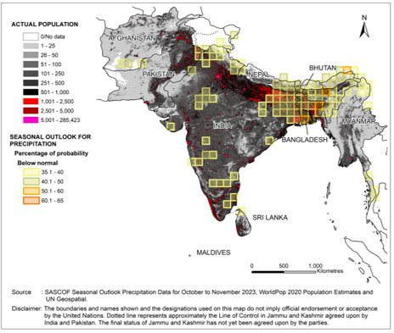
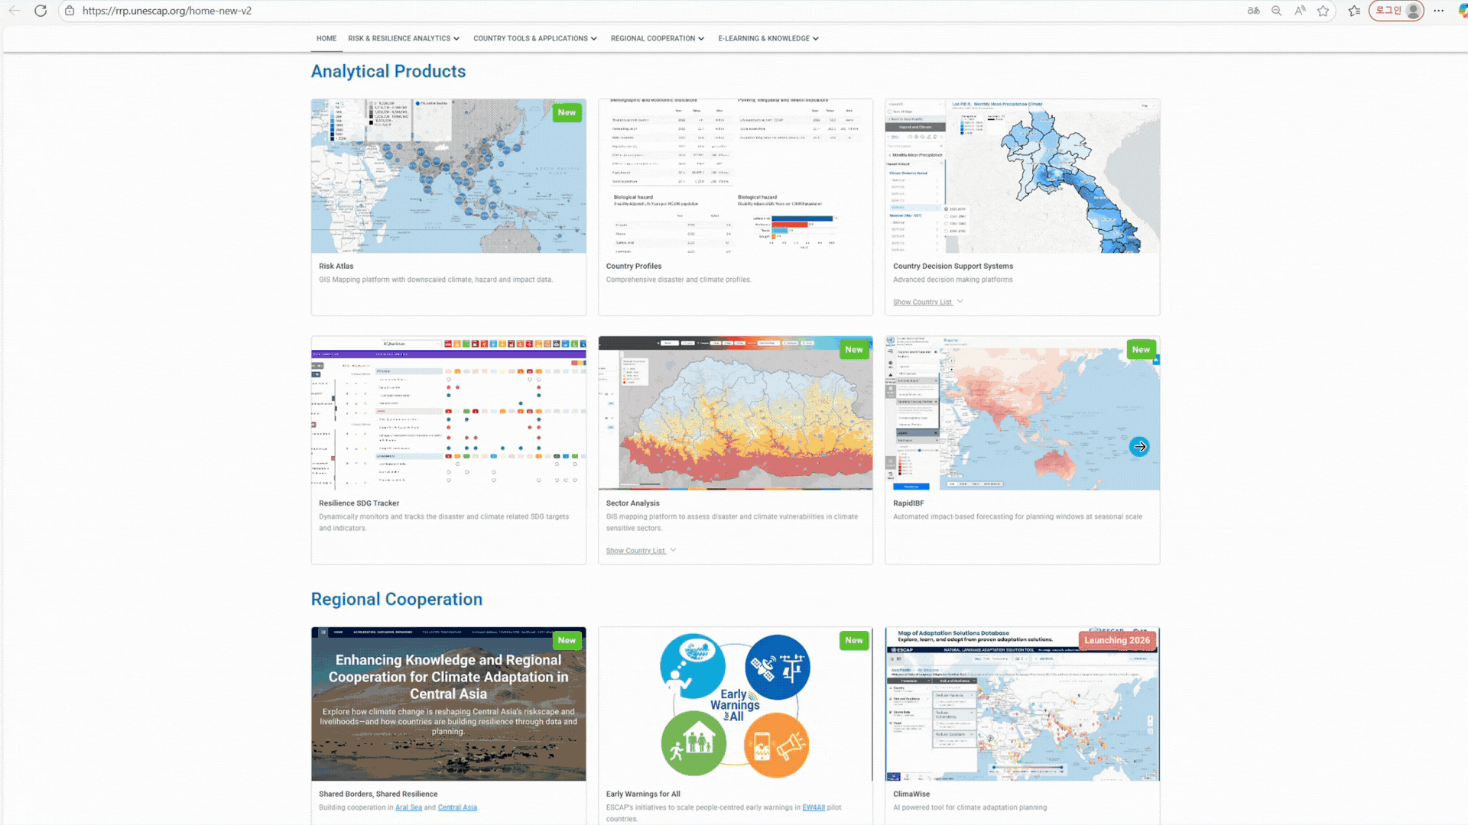
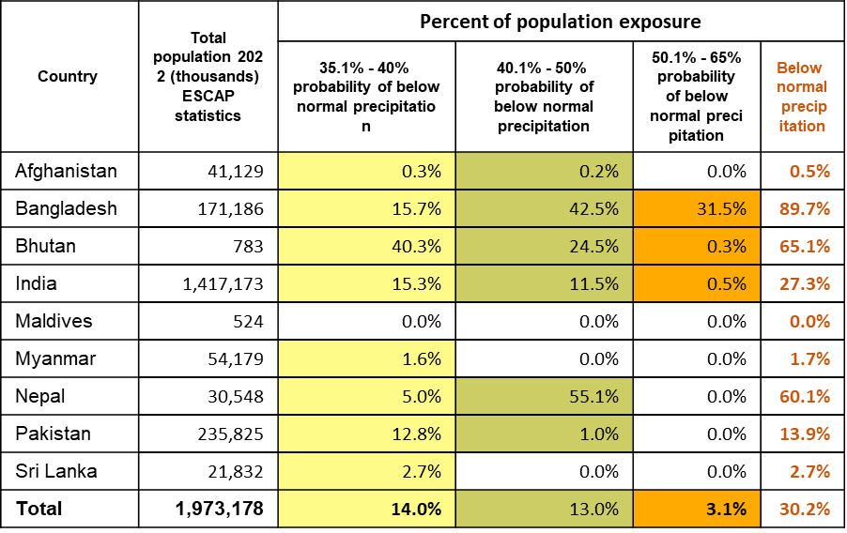
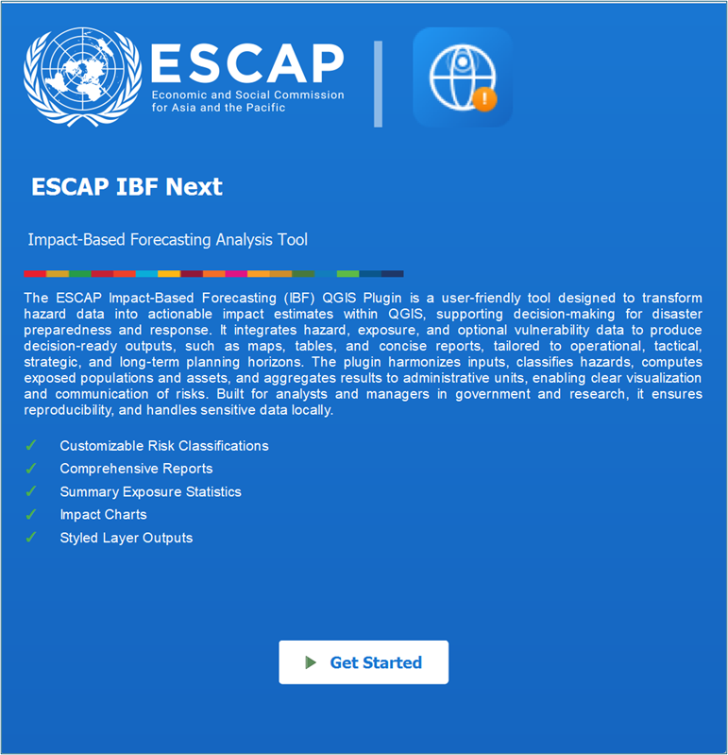
ESCAP’s Tools: Rapid IBF: Automated seasonal impact forecasting
Next-gen operational IBF : upload forecast → automated impact analysis in minutes
Offline download for customizing
Deployed across Regional Climate Outlook Forums
Upload a seasonal forecast to instantly rank country exposure across population, infrastructure, transport, agriculture and economic assets, with ready-to-brief maps and tables.
Notes:
The 3rd tool is the RapidIBF. ESCAP has supported impact-based forecasting across the region for years, especially through the Regional Climate Outlook Forums. Rapid IBF is our next-generation operational tool with AI capabilities: you can upload forecast data and, in minutes, it preprocesses the data, applies the right method to your chosen exposure layer—population, infrastructure, transport, agriculture, economic assets—and computes likely impacts of what the weather will do. What used to take days of manual processing now takes minutes, which is particularly valuable for seasonal early warning—so we can quickly spot emerging hotspots and move from outlook to targeted early action. In addition to the online version, we also have an offline version that can be downloaded with additional functionalities for impact analysis. We have a full session of exploring the tool in this workshop.

Slide 17
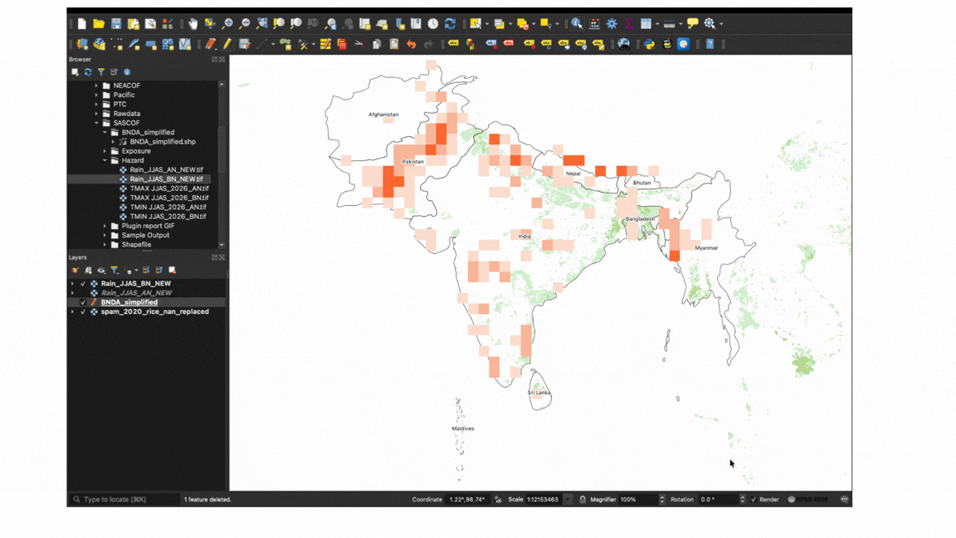
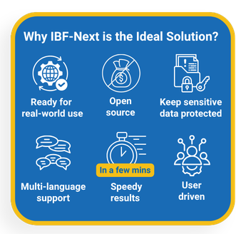

ESCAP’s Tools: IBF-Next Plugin Offline Tool, Data Entry
Sample Sub-Regional Report (SASCOF)
(Agriculture- Rice Production)

Slide 18
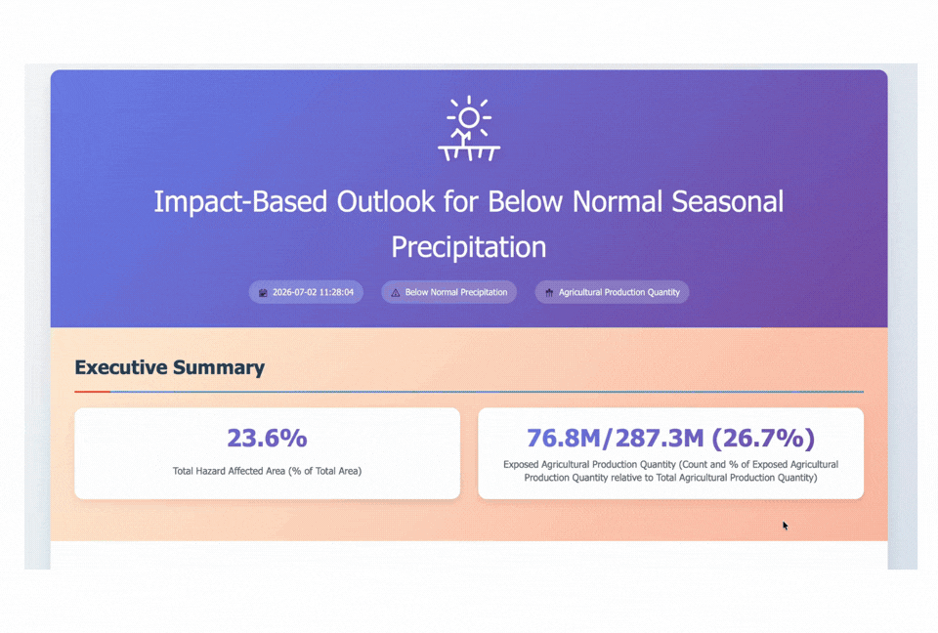
ESCAP’s Tools: IBF Next Plugin Offline Tool, Comprehensive Report
Sample Sub-Regional Report (SASCOF)
(Agriculture- Rice Production)

Slide 19
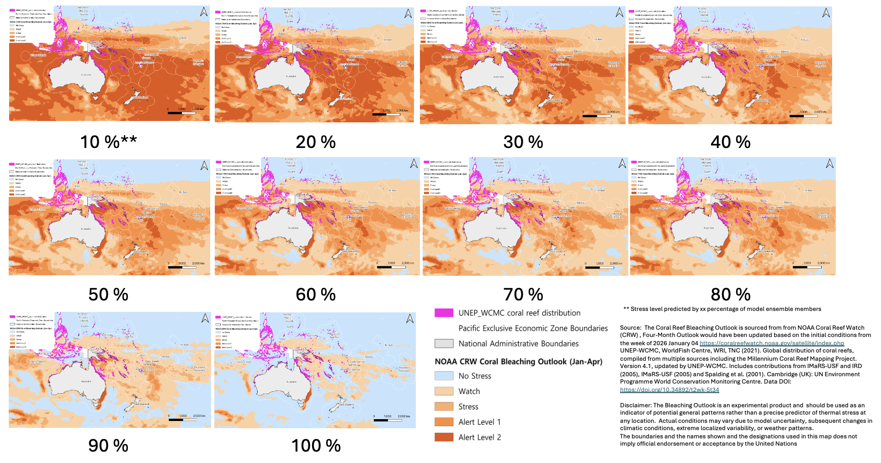
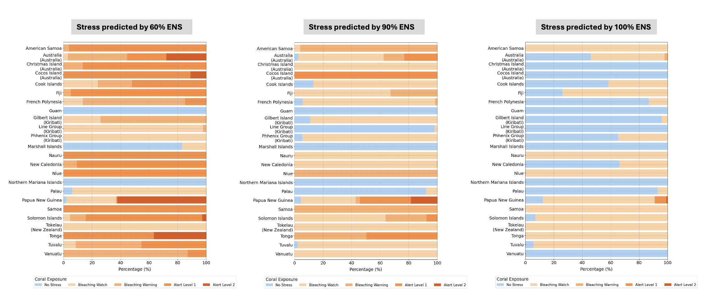
IBF on Coral Bleaching: Case study from Pacific
NOAA CRW Coral bleaching Outlook Jan-Apr 2026
Coral Bleaching | National Oceanic and Atmospheric Administration(NOAA) Coral Reef Watch (Liu et al., 2018) Sea Surface Temperature − Maximum Monthly Mean above a threshold (≥ 1°C) is accumulated over 12 weeks to compute Degree Heating Weeks (DHW) DHW is used to classify coral bleaching risk (No Stress, Watch, Stress, Warning Alert Level 1 , Warning Alert Level 2).
Coral Reef Distribution | UNEP-World Conservation Monitoring Centre (WCMC) Coral Reef Distribution (UNEP-WCMC et al., 2021) Compiled from multiple sources using high-resolution satellite imagery by UNEP-WCMC and the WorldFish Centre, in collaboration with World Resources Institute(WRI) and The Nature Conservancy (TNC). The dataset includes both warm and cold corals.
Marine Exclusive Economic Zone Boundary | Boundaries of Exclusive Economic Zones (Flanders Marine Institute, 2024) The EEZ polygons used in this analysis are typically derived from global maritime boundary datasets obtained from Pacific Ocean Portal.
Using the Coral Bleaching Outlook (from NOAA) and Coral Reef Distribution data (from UNEP WCMC), bleaching stress was estimated for each country/territory in pacific region.

