Slide 1
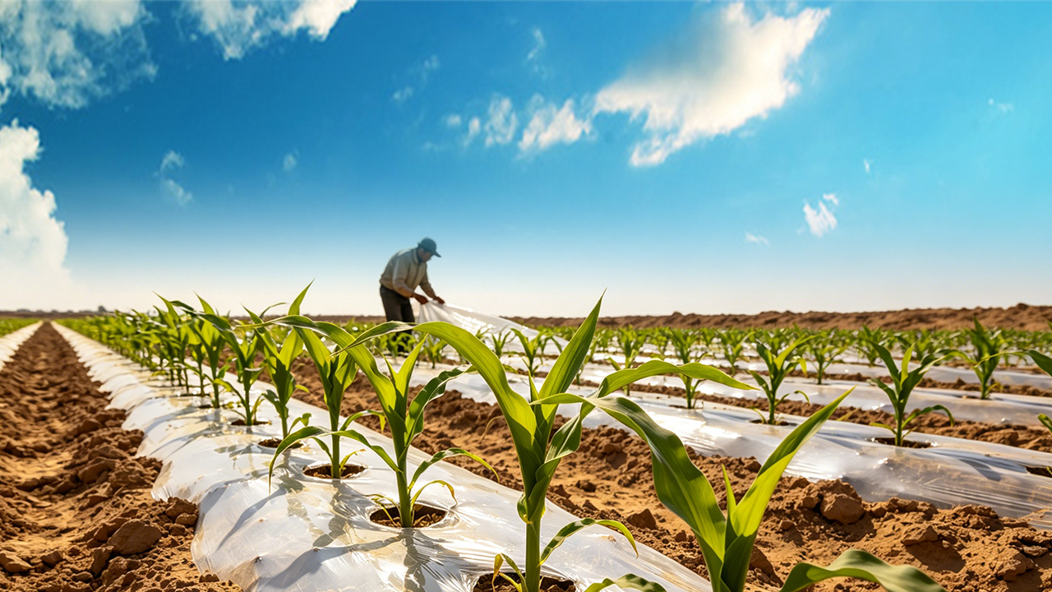
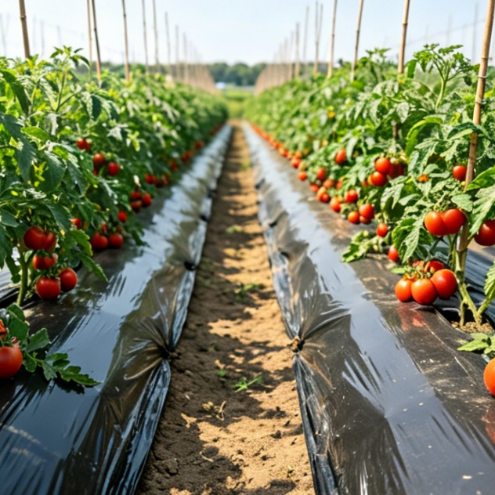
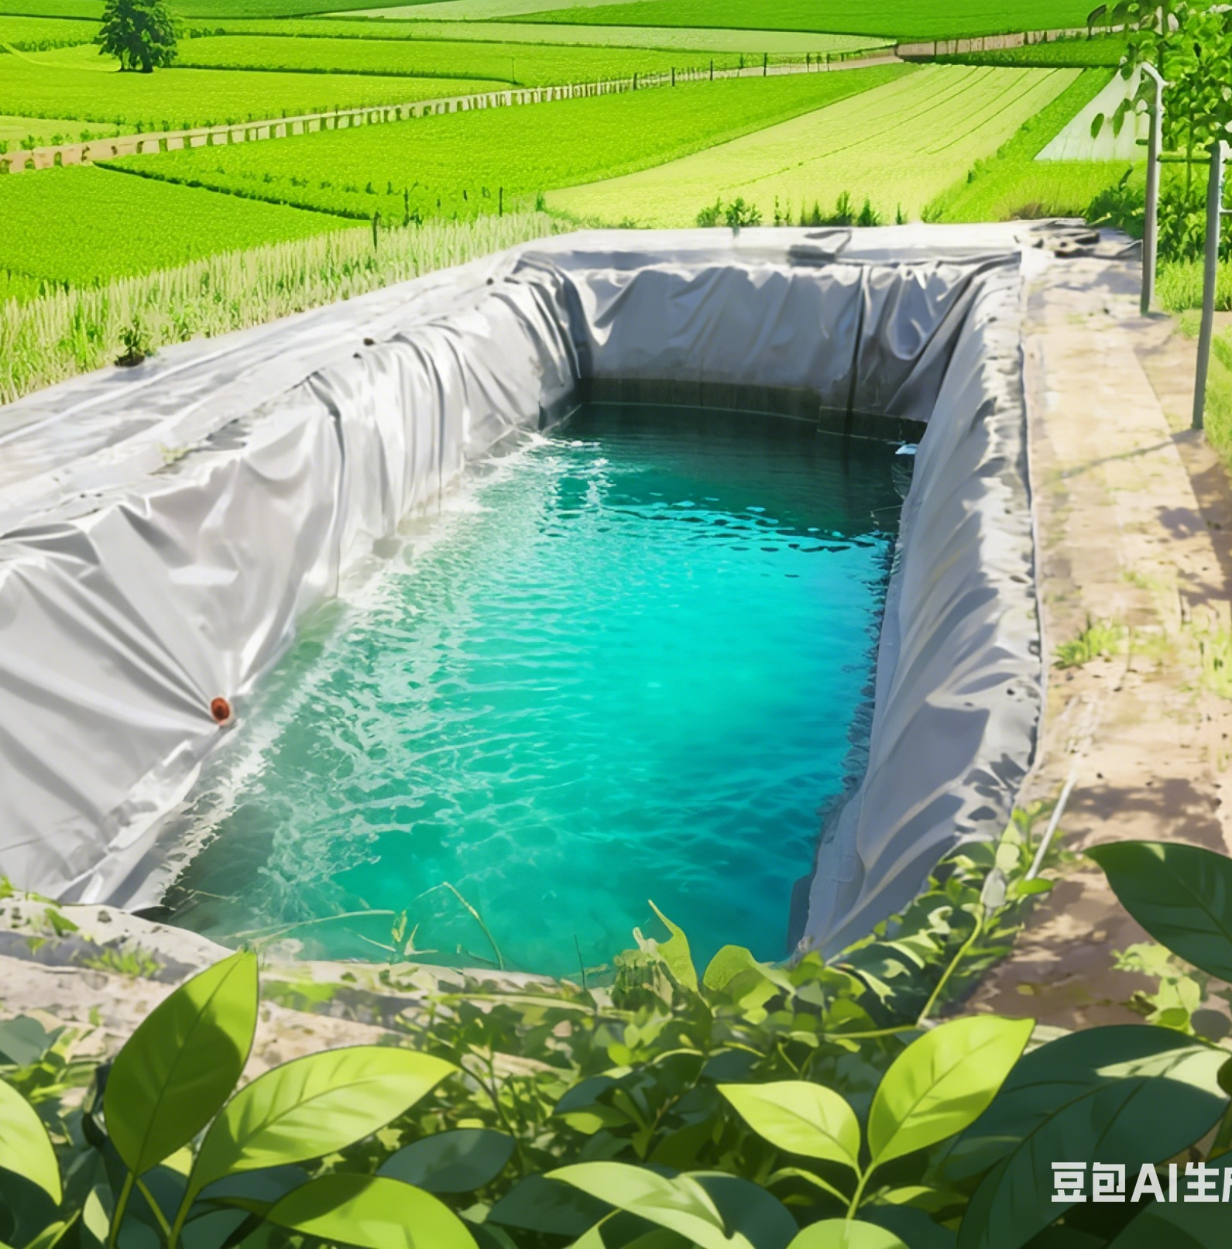
High-efficiency Plastic-Film Mulching Cultivation Techniques for Dryland Farming
Notes:
High-efficiency Plastic-Film Mulching Cultivation Techniques for Dryland Farming
旱作农业地膜覆盖高效栽培技术

Slide 2

PART.04
Partial-Film-Mulched Pepper Cultivation with Ridge Planting and Furrow Irrigation
Notes:
Partial-Film-Mulched Pepper Cultivation with Ridge Planting and Furrow Irrigation
四、辣椒半膜覆盖垄作沟灌技术

Slide 3
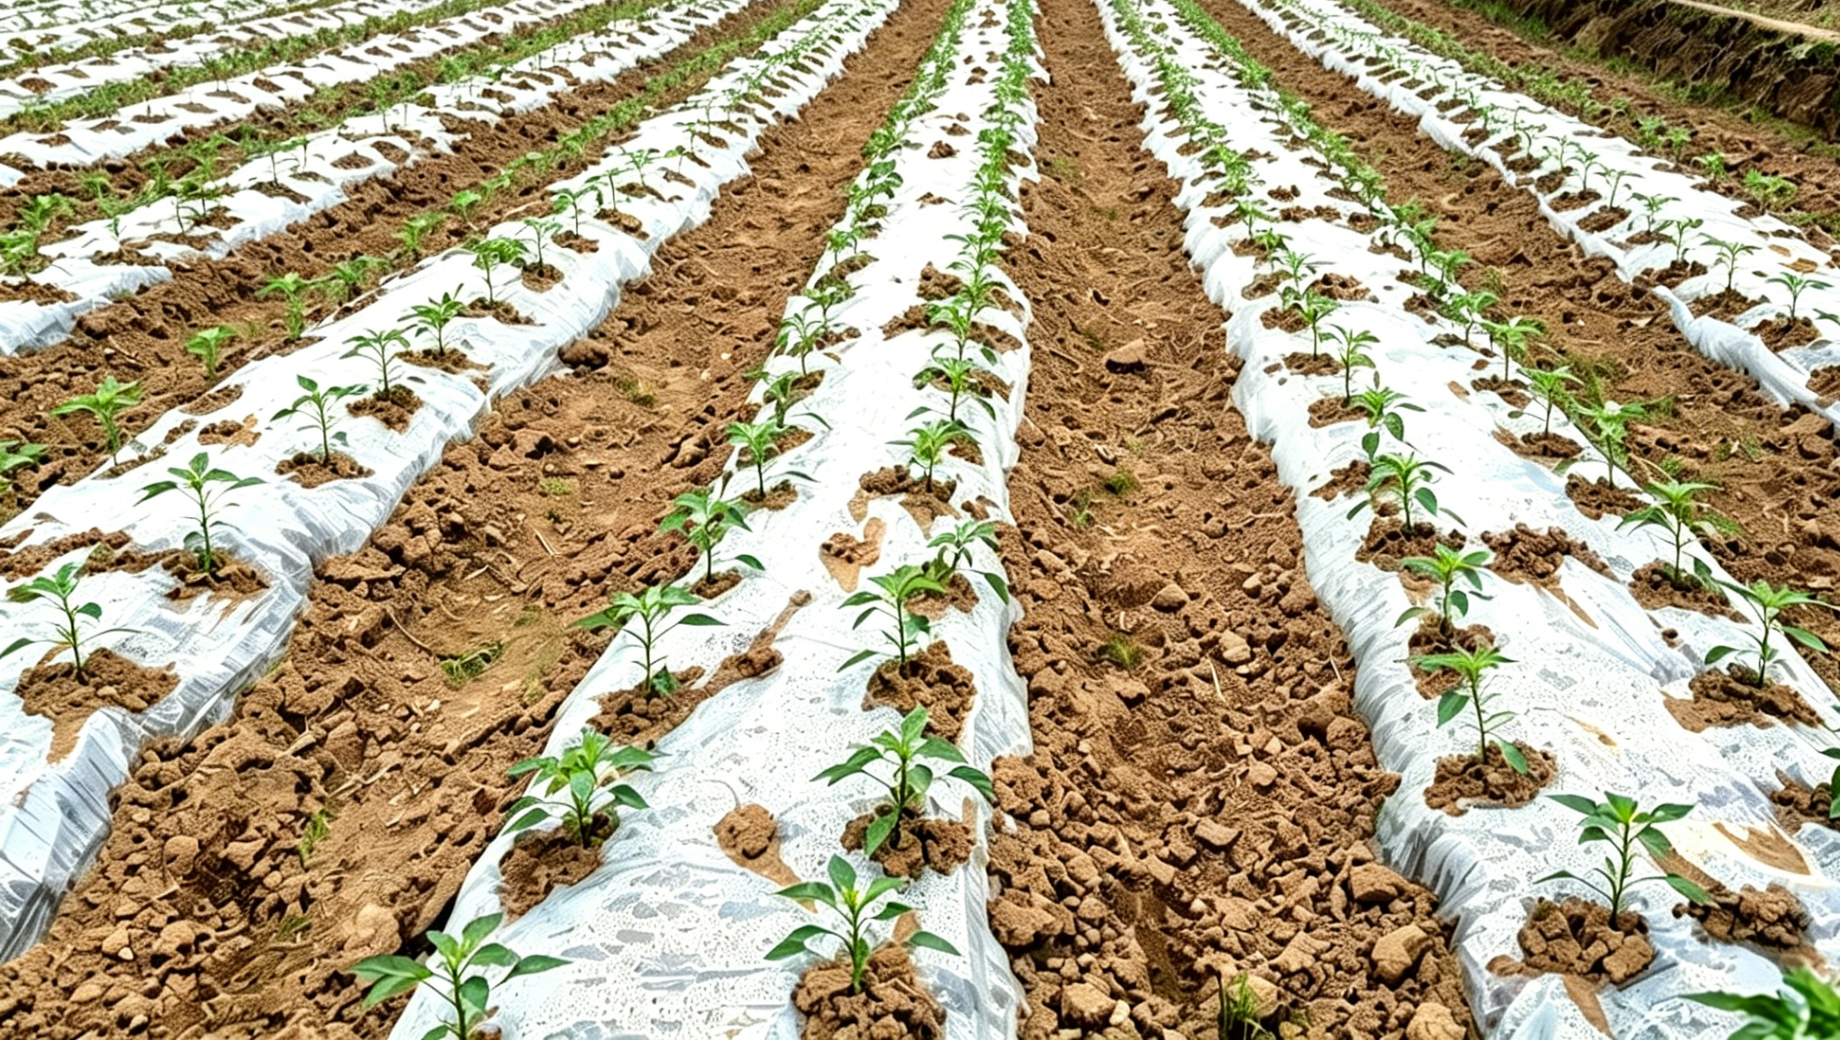
Overview
Cultivation Characteristics
  Partial-film-mulched ridge planting and furrow irrigation for pepper → efficient, water-saving, disease-reducing cultivation method.
Suitable Irrigation Conditions
  Regions irrigated with river or reservoir water.
  Areas relying on groundwater.
  Locations using a combination of surface and groundwater irrigation.
Benefits with Proper Field Management
  Increase yields.
  Lower disease risks.
≫ This technology is an important method in modern pepper cultivation.
Notes:
辣椒半膜覆盖垄作沟灌技术是一种高效、节水、防病的栽培模式，特别适用于依靠河流或水库引水灌溉的地区、主要抽取地下水灌溉的地区、以及地表水与地下水联合灌溉的地区。该技术通过科学的田间管理，既能提升产量，又能降低病害风险，是现代辣椒种植中值得推广的重要方法。
The partial-film-mulched ridge planting and furrow irrigation system for pepper is an efficient,
water-saving and disease-reducing cultivation method.
It is particularly suitable for
regions irrigated with river or reservoir water,
areas that rely on groundwater,
and locations that use a combination of surface and groundwater irrigation.
With proper field management,
this technology can increase yields
and lower disease risks,
making it an important method in modern pepper cultivation.

Slide 4
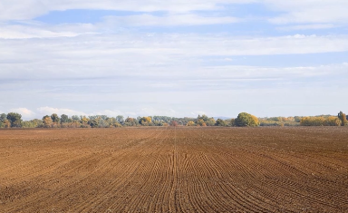
1. Land Selection and Preparation
Land selection criteria
  Preferred types
Loam or sandy loam with good air aeration.
Deep soil layers.
High organic matter content.
  Types to avoid
Saline-alkali soils.
Pre-sowing Field Preparation
  Crop residues and debris from the previous season removed.
  Ploughing → soil crushing → land levelling → ridge formation.
Notes:
（一）地块选择与整地
辣椒半膜覆盖垄作沟灌栽培，要选择透气良好、土层深厚、腐殖质丰富的壤土或砂壤土为宜，避免盐碱地。播种前要清除前一季的秸秆和杂物，并进行翻地、碎土、平整土地和起垄作业。
4.1Land Selection and Preparation
For partial-film-mulched ridge planting with furrow irrigation,
loam or sandy loam with good air aeration,
deep soil layers
and high organic matter content is preferred,
while saline-alkali soils should be avoided.
Before sowing,
crop residues and debris from the previous season should be removed
and followed by ploughing,
soil crushing, land leveling and ridge formation.

Slide 5
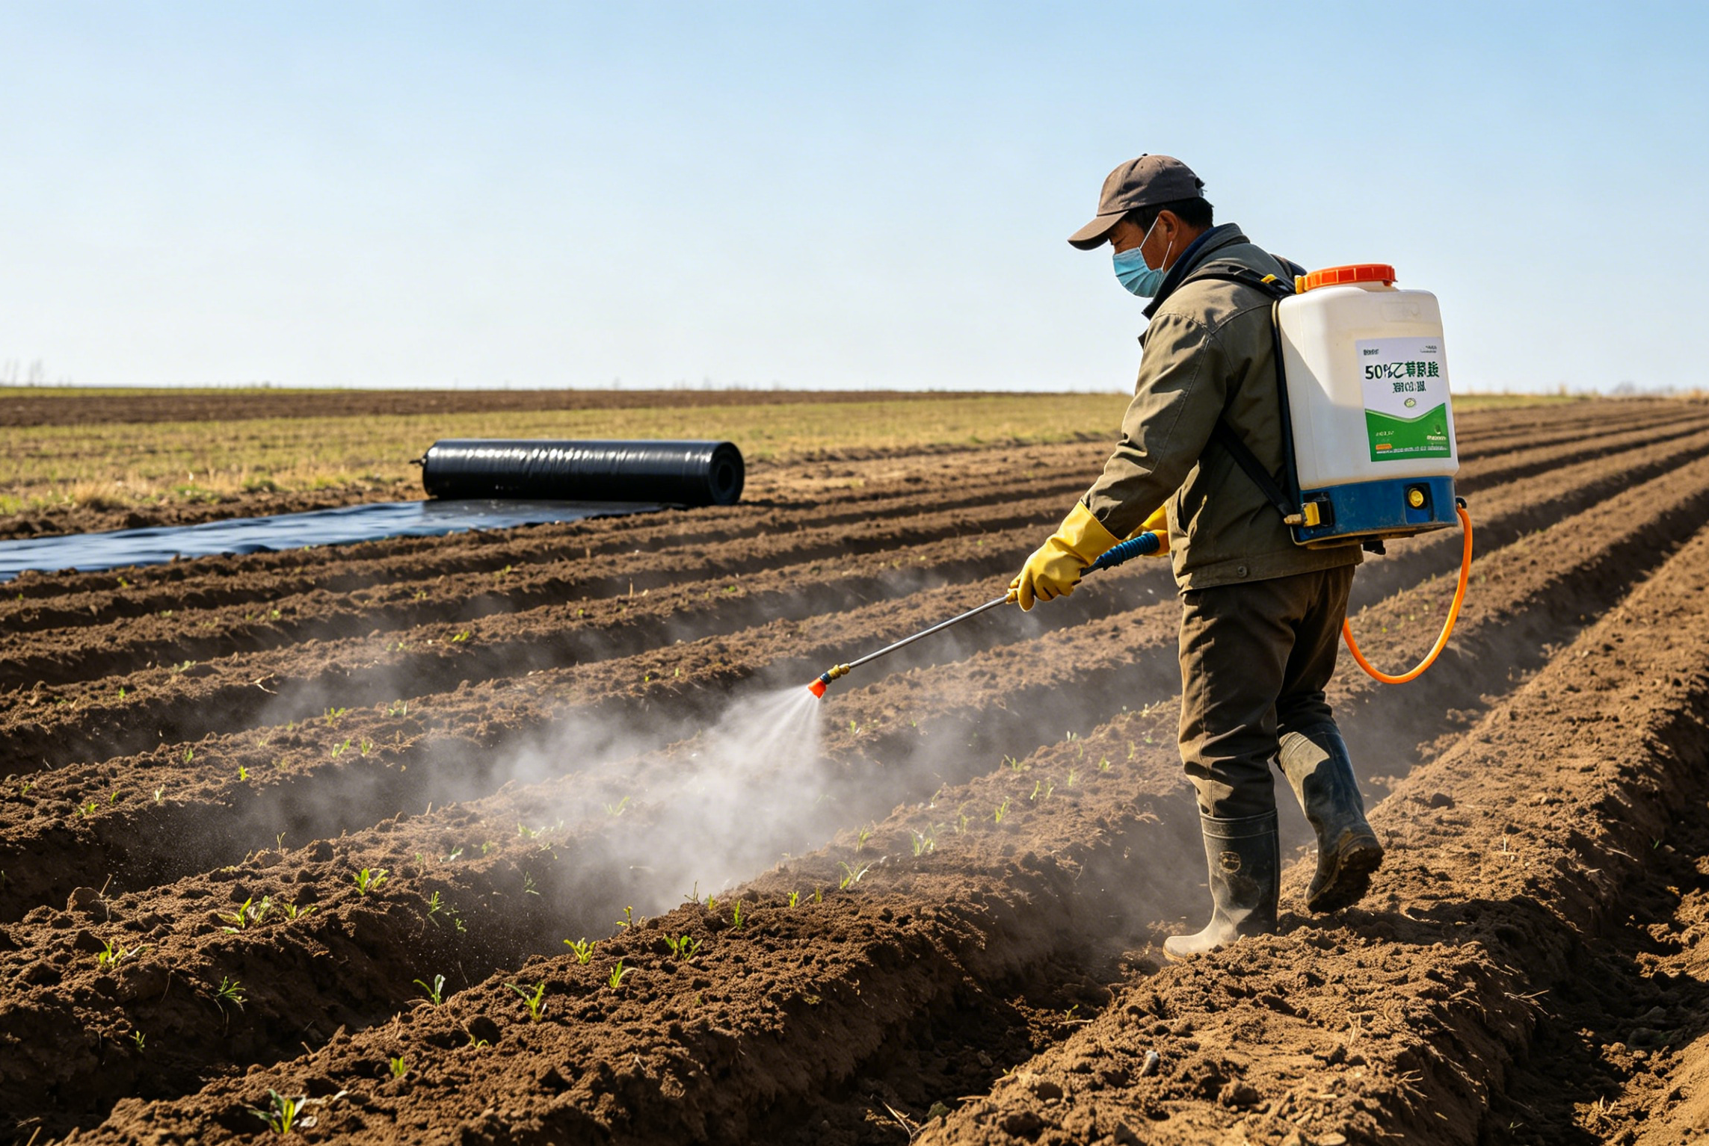
2. Fertilization Management
Nutrient Application Rates
  300–375 kg/ha pure nitrogen.
  120–165 kg/ha of phosphorus.
  60–75 kg/ha of potassium.
  Formula fertilization may be used based on soil testing results.
Fertilizer Application Timing and Methods
  Timing: during spring ploughing.
  Method: placed at the base of ridges during ridge formation.
Weed Control in Fields with Severe Weed Pressure
  Method: 750–1050 g/ha of 50% acetochlor EC diluted in 450 kg of water applied as soil-surface spray.
  Timing: after ridge formation and before film mulching.
Notes:
（二）施肥管理
全生育期每公顷需施入纯氮300-375kg、磷120-165kg、钾60-75kg，或根据测土结果进行配方施肥。肥料在春耕时施入，或在起垄时集中施入垄底。杂草危害严重的地块，起垄后覆膜前，每公顷用50%乙草胺乳油750-1050g，兑水450kg，进行地面喷雾防治。
4.2 Fertilization Management
In general,
300–375 kg of pure nitrogen,
120-165 kg of phosphorus,
and 60-75 kg of potassium should be applied per hectare over the entire growth period,
or formula fertilization may be used based on soil-testing results.
Fertilizers may be applied during spring ploughing
or placed at the base of the ridges during ridge formation.
In fields with severe weed pressure,
750-1050 g of 50% acetochlor EC per hectare should be diluted in 450 kg of water and applied as a soil-surface spray
after ridge formation and before film mulching to control weeds.

Slide 6
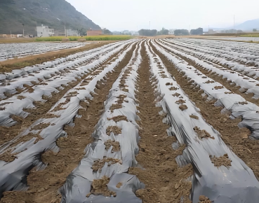
3. Ridge Formation and Film Mulching
Ridge Formation Timing
  Early to mid-March.
  Plough layer thawed.
Ridge & Furrow Specifications
  Ridge width 60 cm.
  Ridge height 15 cm.
  Furrow width 30 cm.
  Ridge surfaces should be levelled.
  Ridge crests kept uniform in height.
Mulching Requirements
  Plastic film with a width of 90–100 cm selected for mulching.
  Film tightly attached to ridge surface and stretched flat.
  Complete ridge formation and film mulching when soil thaws during the day & freezes slightly at night → helps conserve moisture.
Notes:
（三）起垄与覆膜
一般在3月上中旬，耕作层解冻后就可以起垄，垄宽60cm，垄高15cm，垄沟宽30cm。要求垄面平整，垄脊高低一致。选用幅宽90-100cm的地膜进行覆盖。覆膜时，地膜要与垄面贴紧拉平，提倡在土壤白天解冻、夜晚仍会轻微结冰的时候，及时完成起垄和覆膜作业，以利于保蓄土壤水分。
4.3 Ridge Formation and Film Mulching
Generally,
ridge formation can be carried out in
early to mid-March once the
plough layer has thawed.
Ridges are 60 cm wide
and 15 cm high,
330 cm in width.
The ridge surfaces should be leveled
and the ridge crests kept uniform in height.
Plastic film with a width of 90–100 cm should be selected for mulching.
During mulching,
the film should be tightly attached to the ridge surface and stretched flat.
It is recommended to complete ridge formation and film mulching in a timely manner when the soil thaws during the day and freezes slightly at night, as this helps conserve soil moisture.

Slide 7
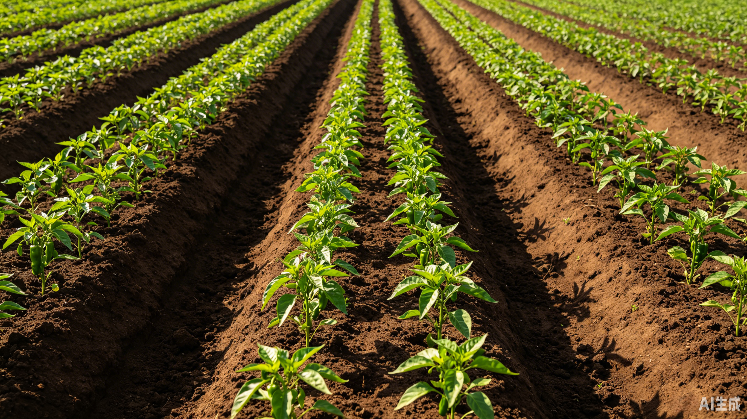
4. Variety Selection and Sowing
Variety Selection
  Strong disease resistance.
  High quality.
  High yield.
  Good marketability.
Sowing Time
  Mid-to late March.
  Soil temperature in plough layer > 10 °C.
Direct Seeding & Plant Density
  Direct-seeded on ridges.
  Average row spacing 45 cm.
  Plant spacing 20–25 cm.
  Two rows per ridge.
  Final population 90,000–111,000 plants/ha.
Notes:
（四）品种选择与播种
选择抗病、优质、高产、商品性好的辣椒品种。一般在3月中下旬播种，当土层温度稳定在 10℃以上时就可以播种。辣椒采用垄上直播栽培，平均行距45cm，株距20-25cm，每垄种植两行。每公顷保留90,000～111,000株。
4.4Variety Selection and Sowing
Pepper varieties with strong disease resistance,
high quality,
high yield
and good marketability should be selected.
Sowing is generally carried out in
mid- to late March
when the soil temperature in the plough layer remains above 10℃.
Peppers are
direct- seeded on the ridges at an
average row spacing of 45 cm
and a plant spacing of 20-25 cm,
with two rows per ridge.
A final population of 90,000-111,000 plants per hectare should be maintained.

Slide 8
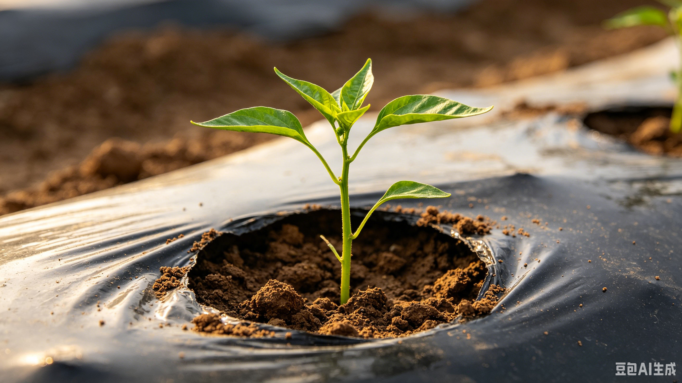
5. Field Management
Emergence Timing
  Takes ∼15 days for film-mulched peppers emerge after sowing.
Rainfall & Seedling Protection
  Rainfall occurs during seedling emergence → crust on soil surface should be loosened promptly.
  Seedlings trapped beneath mulch film should be released in time → to prevent heat injury or pressure damage from the film.
Notes:
（五）田间管理
覆膜辣椒从播种到出苗，大约需要15天左右。在出苗期间如遇雨，应及时疏松土壤表层硬块，并把长到地膜下面的幼苗及时放出来，避免高温灼伤或膜面压迫。
4.5 Field Management
It takes about 15 days for film-mulched peppers to emerge after sowing.
If rainfall occurs during seedling emergence, the hard crust on the soil surface should be loosened promptly,
and any seedlings trapped beneath the mulch film should be released in time to prevent heat injury or pressure damage from the film.

Slide 9
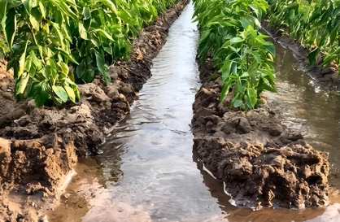
5. Field Management
Irrigation Requirements
  Carried out at key growth stages:
Budding stage →the plants begin to produce small flower buds.
Flowering & fruit-setting stage → from flowering to young fruit formation.
Fruit enlargement stage → when the fruits grow rapidly.
  A total of 6–7 irrigations applied over the entire growth period → total volume 4500–6000 m³/ha.
  For pepper grown on ridges using furrow irrigation:
Irrigation depth ≤ two-thirds of furrow depth.
Flooding of ridges strictly prohibited.
Notes:
灌水需掌握在现蕾期（植株开始出现小花蕾）、开花坐果期（开花至幼果形成）、果实膨大期（果实快速长大）等关键时期进行。全生育期一般灌水6-7次，总灌溉水量控制在每公顷4,500～6,000m³。垄上种植辣椒采用沟灌方式，灌水深度不得超过沟深的2/3，严禁大水淹垄。
Irrigation should be carried out at key growth stages,
including the budding stage (when the plants begin to produce small flower buds),
the flowering and fruit setting stage (from flowering to young fruit formation),
and the fruit enlargement stage (when the fruits grow rapidly).
A total of 6-7 irrigations is generally applied over the entire growth period, with total irrigation volume controlled at 4500-6000 m³ per hectare.
For pepper grown on ridges using furrow irrigation,
the irrigation depth should not exceed two-thirds of the furrow depth,
and flooding of the ridges is strictly prohibited.

Slide 10
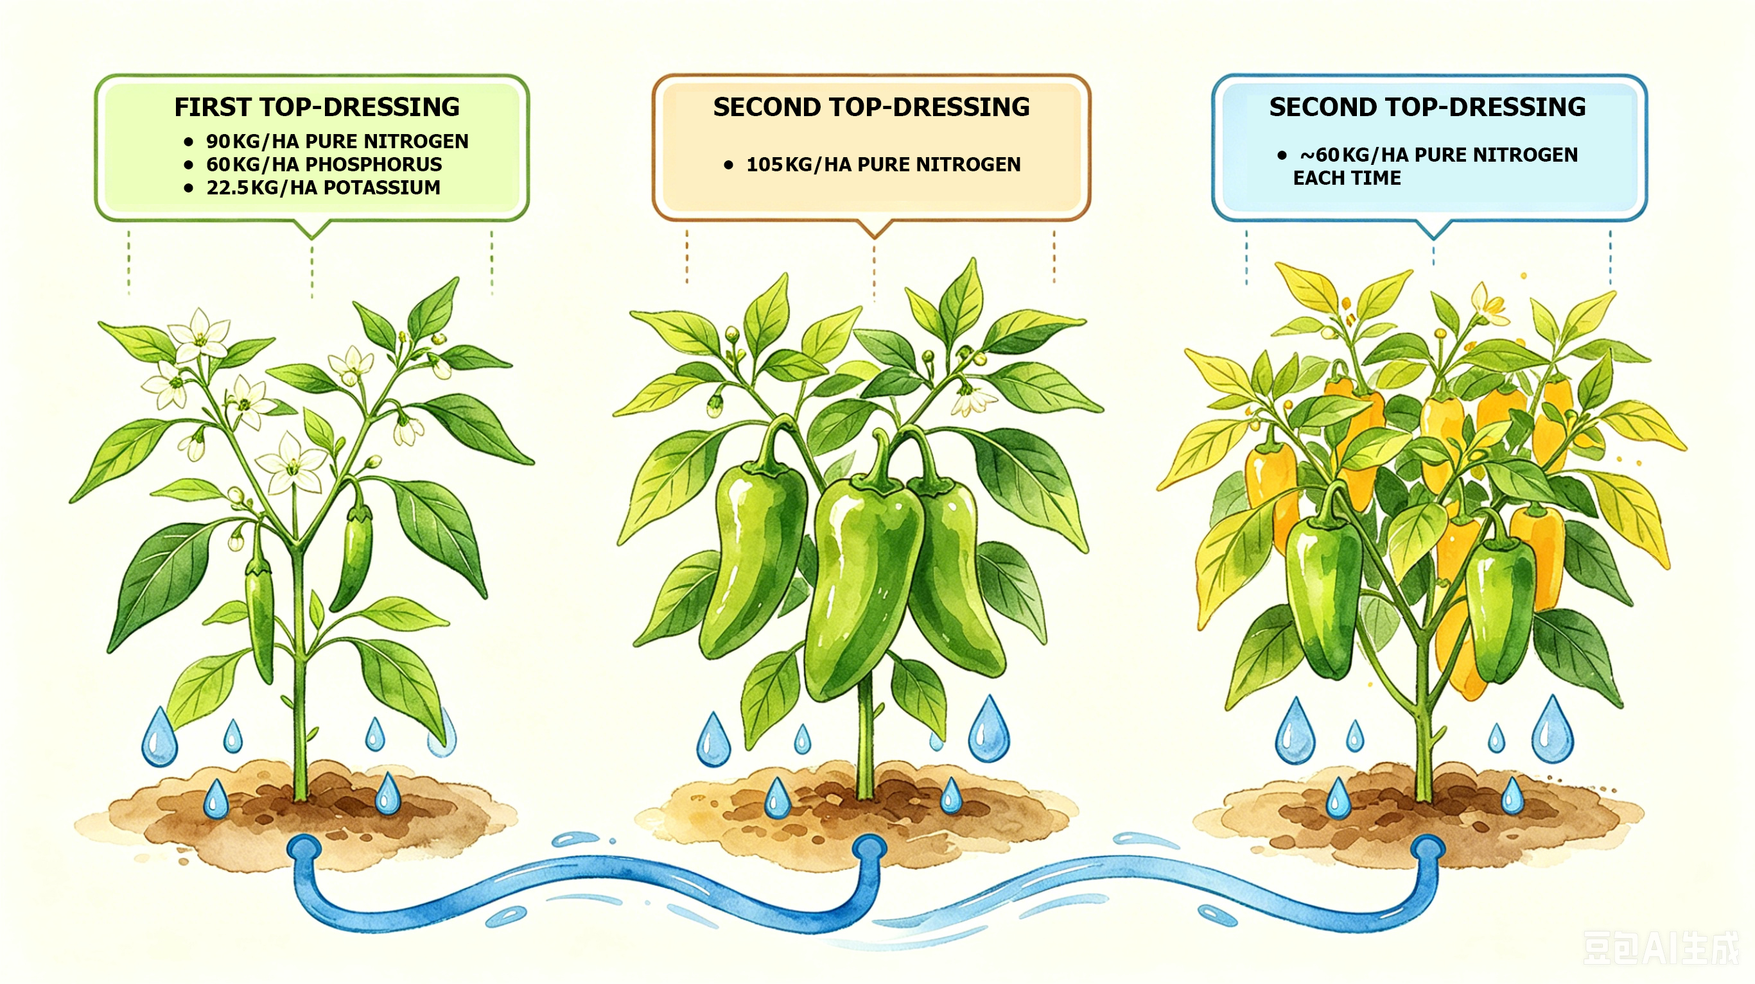
5. Field Management
Top-dressing Strategy
  Applied five times in combination with irrigation.
First Top-dressing
  Timing: Applied in combination with the first irrigation when the pepper plants begin to produce small flower buds.
  Application principle:
  Nutrient supply:
Light early application.
90 kg/ha pure nitrogen.
Heavier mid-season application.
60 kg/ha phosphorus.
Supplemental late-season application.
22.5 kg/ha potassium.
Second Top-dressing
  Timing: when first fruit cluster of pepper expands significantly and enters fruit enlargement period.
  Nutrient supply: 105 kg/ha pure nitrogen.
Subsequent Top-dressings
  Appropriate topdressing applied with each irrigation according to plant growth.
  Nutrient supply: ~60 kg/ha pure nitrogen each time.
Notes:
全生育期结合灌水追施肥料5次，追肥以“前轻、中重、后补”为原则；
当辣椒植株开始出现小花蕾时，结合第一次灌水进行首次追肥，每公顷施用纯氮90kg、磷60kg、钾22.5kg；当辣椒第一簇实开始明显长大、进入膨果期时，每公顷追施纯氮105kg；以后根据辣椒长势，每次灌水时可适当追肥，每公顷追施纯氮约60kg左右。
Top-dressing is
applied five times during the entire growing period in combination with irrigation.
The applications follow the principle of
light early application,
heavier mid-season application,
and supplemental late-season application.
•The first topdressing is
applied in combination with the first irrigation when the pepper plants begin to produce small flower buds.
It supplies 90 kg of pure nitrogen, 60 kg of phosphorus and 22.5 kg of potassium per hectare.
•When the first fruit cluster of pepper begins to expand significantly and enters the fruit enlargement period,
105 kg of pure nitrogen per hectare is applied.
•Thereafter, appropriate topdressing may be applied with each irrigation according to plant growth,
supplying about 60 kg of pure nitrogen per hectare each time.

Slide 11
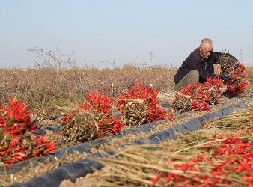
6. Harvesting and Subsequent Handling
Harvesting Requirements
  Harvest in batches → once meeting market or processing requirements.
  ⇨ Reduce plant burden and maintain fruit quality.
Post-harvest Field Management
  Residual mulch film → promptly removed.
  ⇨ Facilitate agricultural production in the following year.
Notes:
(六)采收与后续处理
当辣椒达到商品或加工要求时分次分批采收，减轻植株负担，保证果实品质。收获后要及时清除田间残膜，便于来年生产。
4.6Harvesting and Subsequent Handling
Peppers should be harvested in batches once they meet market or processing requirements.
This helps reduce the burden on the plants and maintain fruit quality.
After harvest, the residual mulch film in the field should be promptly removed to facilitate agricultural production in the following year.

