Slide 1
Overview of China’s
Rice Storage and Processing
中国稻米仓储与加工总体概况
Prof. Xie Jian 谢 健
Chief engineer 总工程师
China Grain Wuhan Sci. Res. & Design Institute Co. Ltd.
国粮武汉科学研究设计院有限公司
2023.06.20 Wuxi

Slide 2
1. China’s Rice
中国稻米概况
2. China’s Rice Storage
中国稻米储存
3. China’s Rice Processing
中国稻米加工

Slide 3
1. China’s Rice 中国稻米概况
Paddy production: >200,000,000 Mt/year in recent 10 years，>1/3 of total cereal production
稻谷年产量：近10年超过2亿吨，约占粮食总产1/3
Rice is staple food for > 2/3 of the population
大米是我国三分之二以上人民的主粮
The consumption of rice > 60% of the total staple food
大米消费量占主粮消费总量的60%以上。
Rice is the most important food in China！
稻米是中国最重要的粮食。

Slide 4
2. China’s Rice Storage 中国稻米储存
to ensure the quality and quantity of rice by keep rice in right condition
以适宜条件储存稻米，以确保稻米的质量和数量
keep in sealed facilities：to prevent damaged by rats, bird, insects，to reduce quality loss & quantity loss due to moisture over decline.
密封：防止鼠、虫、鸟害，减少水分过低——数量和质量损失
keep in suitable moisture content：to reduce quality loss due to over high moisture，to reduce quantity loss due to over low moisture
适宜水分：减少因过高水分——质量损失，过低水分——数量损失
keep in low temp. / low O₂ condition：to reduce quality loss, such as higher FAV （fatty acid value）,due to higher temp or O₂ concentration
低温/ 缺氧/低氧（气调处理）：减少因过高温度或氧气浓度造成质量损失
（如脂肪酸值过高）

Slide 5
2. China’s Rice Storage 中国稻米储存
2.1 Storage facilities 稻米储存设施
2.2 Storage technology 稻米储存技术

Slide 6
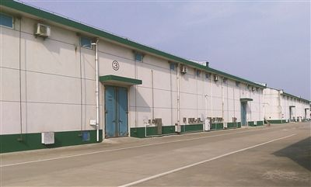
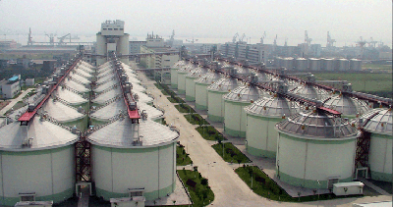
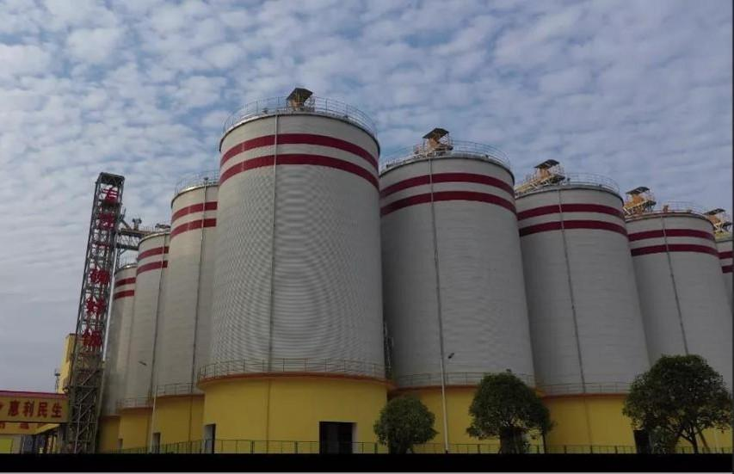
2.1 Storage facilities 稻米储存设施
2.1.1 House type warehouse 房式仓
2.1.2 Squat silo +Silo 浅圆仓 +立筒仓

Slide 7
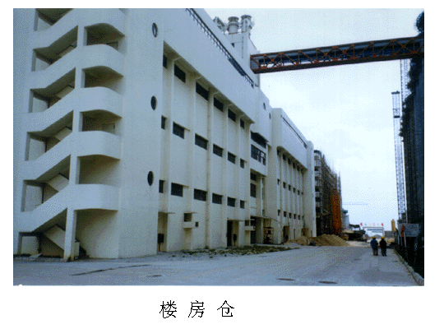
2.1.1 House type warehouse 房式仓
（1） large size horizontal warehouse
高大平房仓
for bulk paddy，or bagged grain
储存散粮
（2）multi-storied warehouse
楼房仓
for bagged paddy / brown rice/
white rice/ milled rice
储存包装稻谷、糙米、白米等

Slide 8
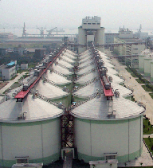
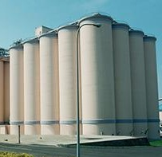
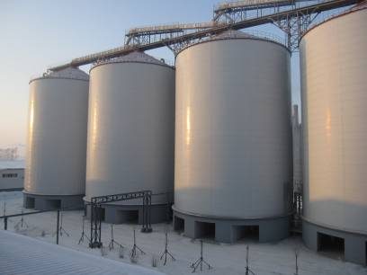
2.1.2 Squat silo / silo 浅圆仓/筒仓
（1）reinforced concrete 钢筋混凝土
（2）steel structure + thermal isolation 钢板仓+隔热
reinforced concrete
钢筋混凝土
steel+thermal isolation
钢板仓+隔热

Slide 9
2.2 Storage technology 稻米储存技术
seal/air-tight 密封/气密
ventilation/horizontal ventilation 机械通风/横向通风
grain chilling/ vacuum cooling 谷物冷却
fumigation/recirculation fumigation 熏蒸/环流熏蒸
multi-agent prevental 多介质防治
inert dust for insect prevention 惰性粉防虫
condition of grain monitoring & control 粮情测控
control atmosphere（by purging CO₂ or N₂）气调
……

Slide 10
“ 4-in-1” storage “new4-in-1” storage
“四合一”储粮 “新四合一”储粮
consist of
condition of grain monitoring & control
粮情检测
ventilation
机械通风
recirculation fumigation
环流熏蒸
grain chilling
谷物冷却
consist of
multi-parameter monitoring
& control
多参数粮情（检测）
horizontal ventilation
横向通风
multi- agent prevental
多介质防治
vacuum cooling
负压谷冷

Slide 11
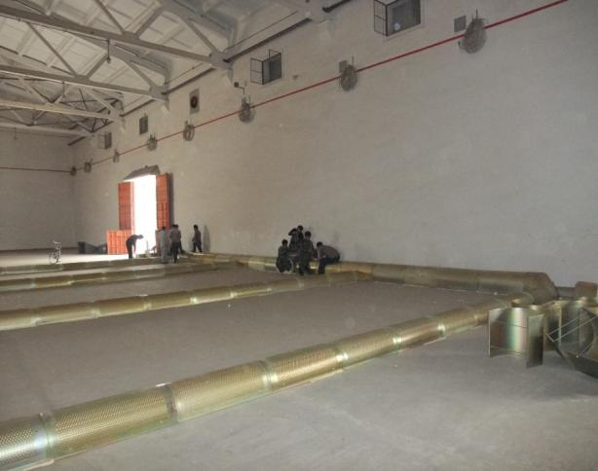
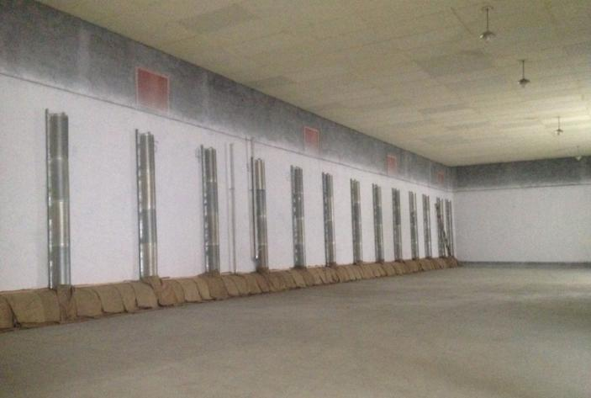
ventilation 机械通风
horizontal ventilation 横向通风
film
fan
ventilation 机械通风 horizontal ventilation 横向通风
for house type warehouse 房式仓通风系统

Slide 12
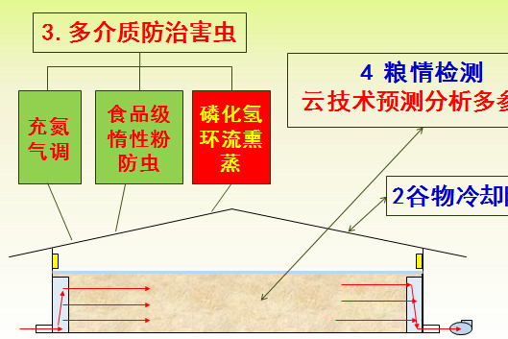
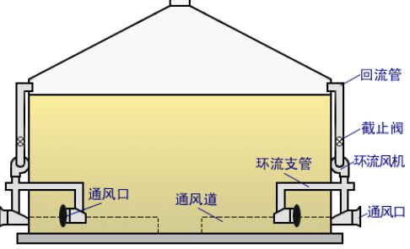
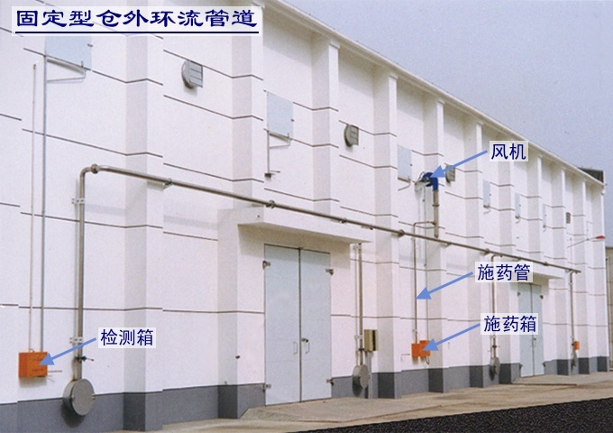
recirculation fumigation 环流熏蒸
multi- agent prevental 多介质防治
Controlled atmosphere by
filling N₂
充氮气调
food grade inert powder for insect prevention
食品级惰性粉防虫
phosphine recirculation fumigation
磷化氢环流熏蒸
multi- agent prevental
多介质防治
recirculation fumigation
环流熏蒸

Slide 13
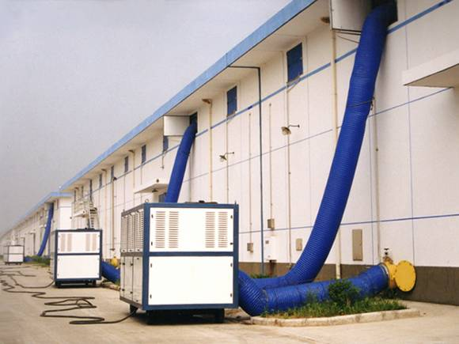
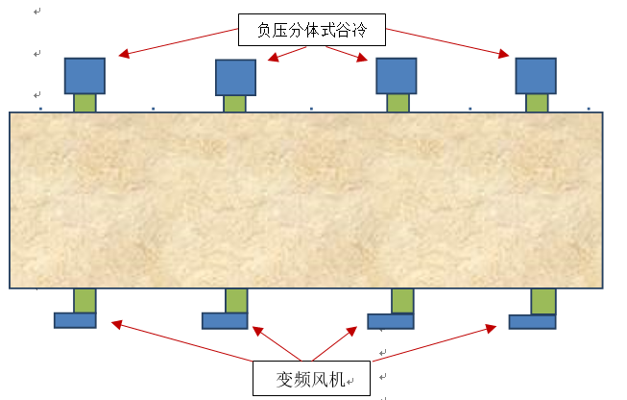
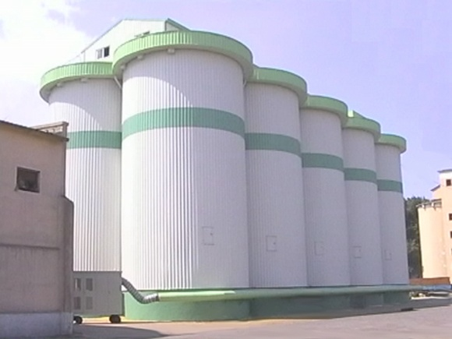
grain chilling 谷物冷却
vacuum cooling 负压谷冷
air tight + heat isolation + ventilation system / air conditioner / grain chiller
气密+隔热+通风+空调/谷物冷却系统
vacuum cooling
负压谷冷

Slide 14
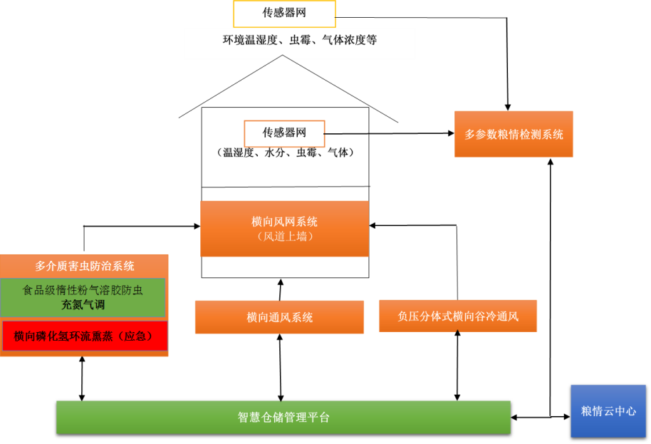
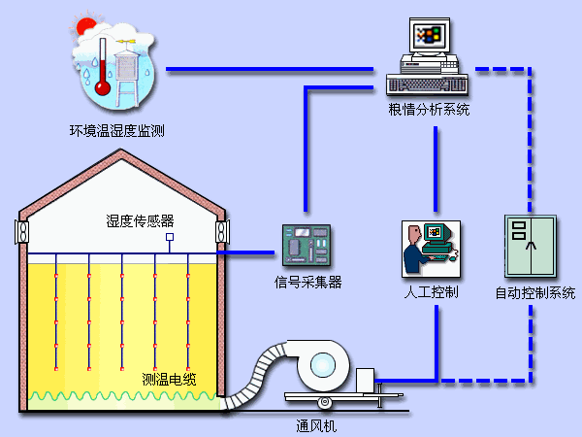
condition of grain monitoring & control
计算机粮情测控
“4-in-1” multi-parameter monitoring
粮情测控 多参数粮情测控

Slide 15
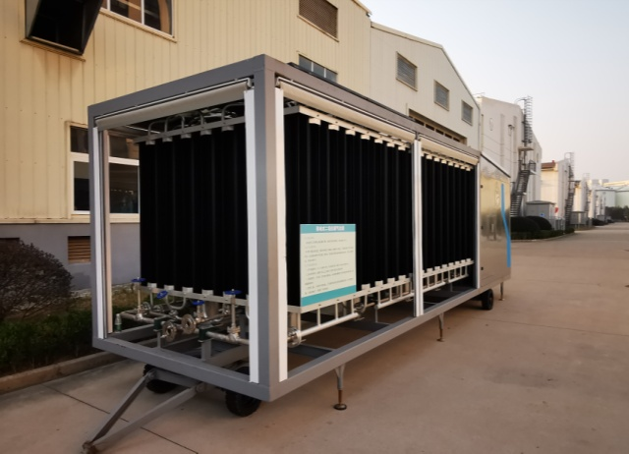
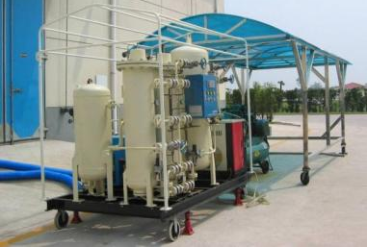
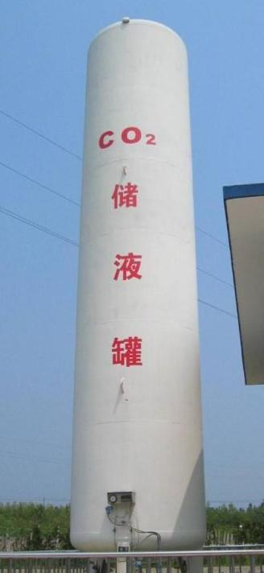
control atmosphere （by + CO₂ or N₂）
气调储粮（充CO₂ 或 N₂）
CO₂ gasification unit
N₂ separator
warehouse
粮仓
CO₂ tank

Slide 16
3. China’s Rice Processing 中国稻米加工
mill the rice in right way 适宜方式加工大米
3.1 Rice products
稻米加工产品
3.2 Rice processing facilities
稻米加工设施
3.3 Rice processing equipment
稻米加工装备

Slide 17
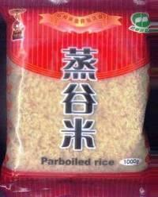
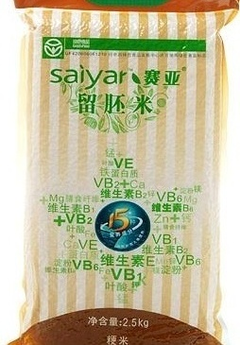
3.1 Rice products 稻米加工产品
Milled rice 大米
Parboiled rice 蒸谷米
Germ-remained milled rice 留胚米
Milled rice
大米
Parboiled rice
蒸谷米
Germ-remained milled rice
留胚米

Slide 18
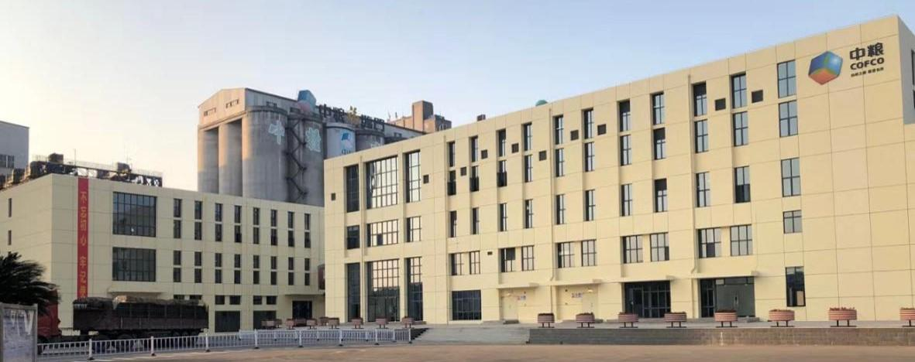
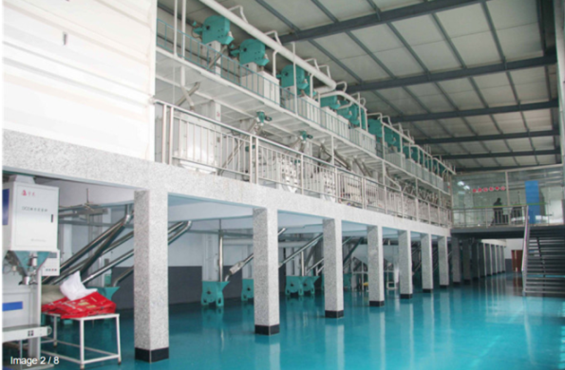
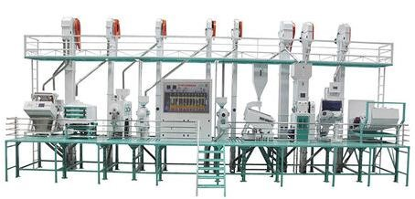
3.2 Rice processing facilities 稻米加工设施
3.2.1 multi-floor type 楼房式
3.2.2 platform type 平台式
3.2.3 steel frame type 钢架式

Slide 19
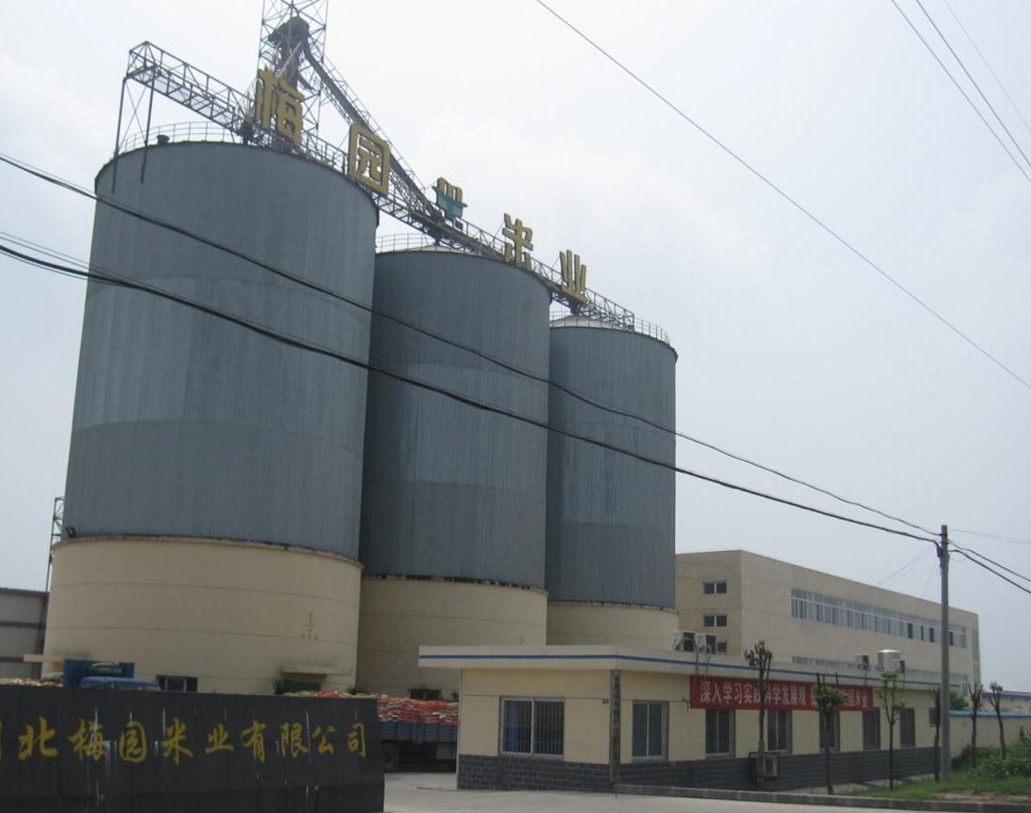
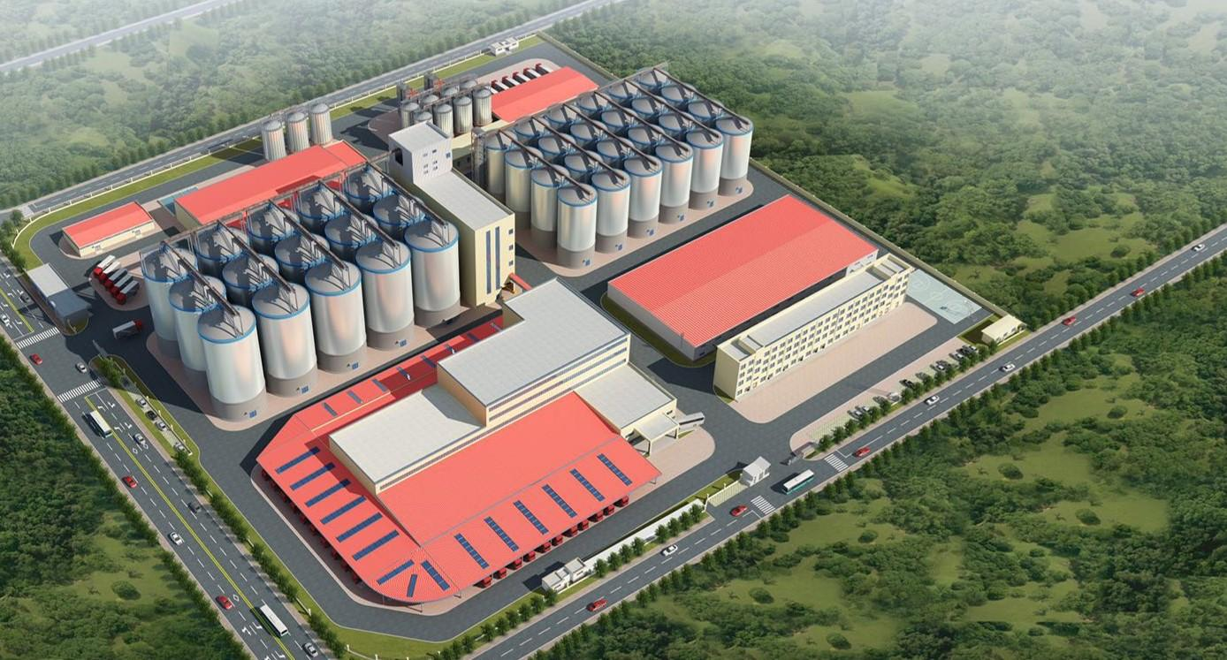
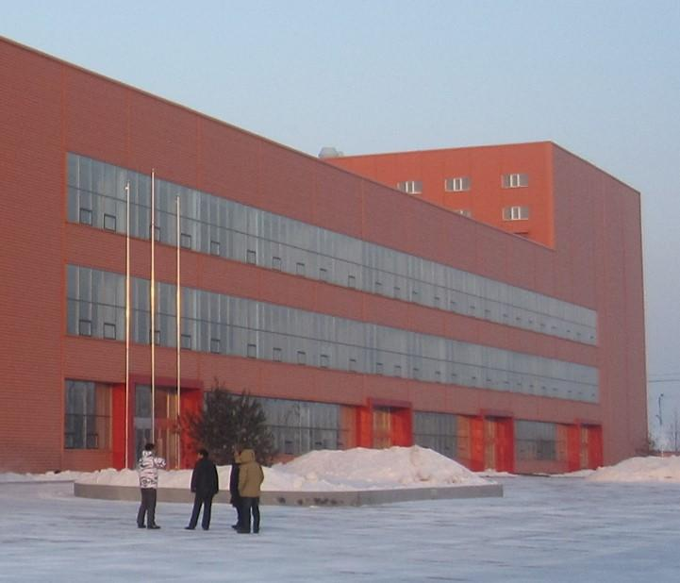
3.2.1 multi-floor type
楼房式 （≥ 500 Mt paddy/ 24h）

Slide 20
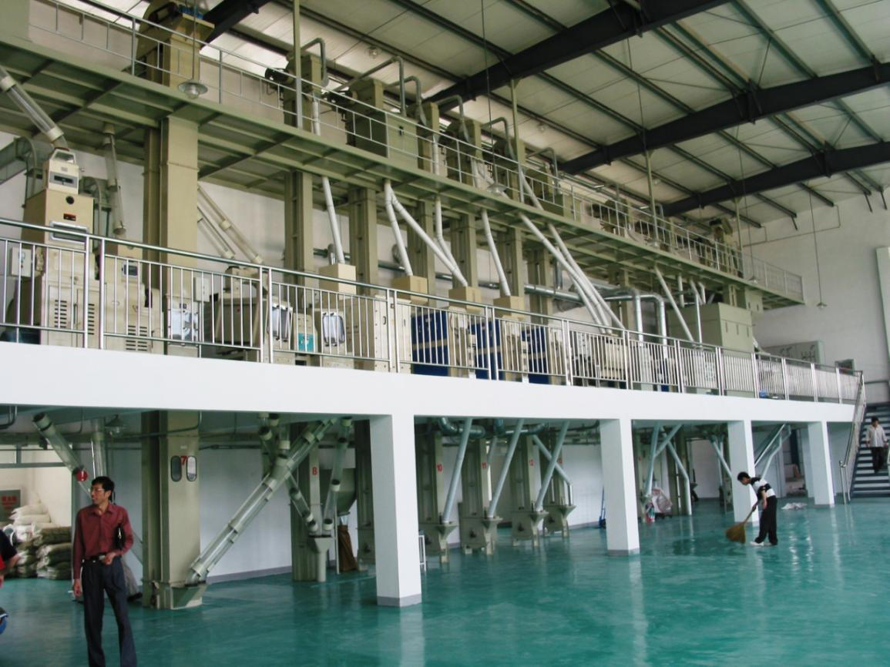
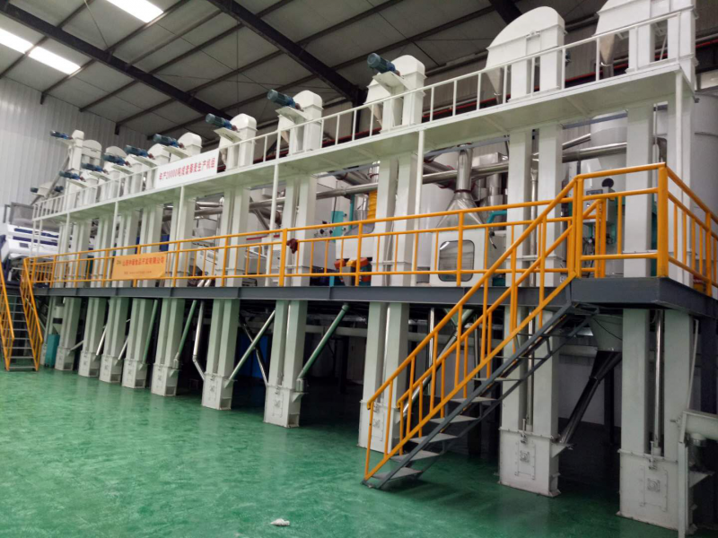
3.2.2 platform type（in single floor workshop）
平台式（ 100~ 500 Mt paddy/ 24h）
made of reinforced concrete or steel for main equipment
钢筋混凝土平台或钢结构

Slide 21
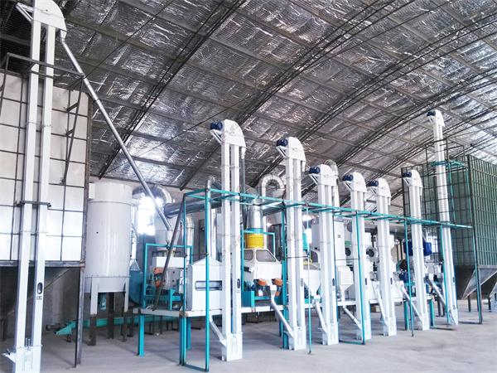
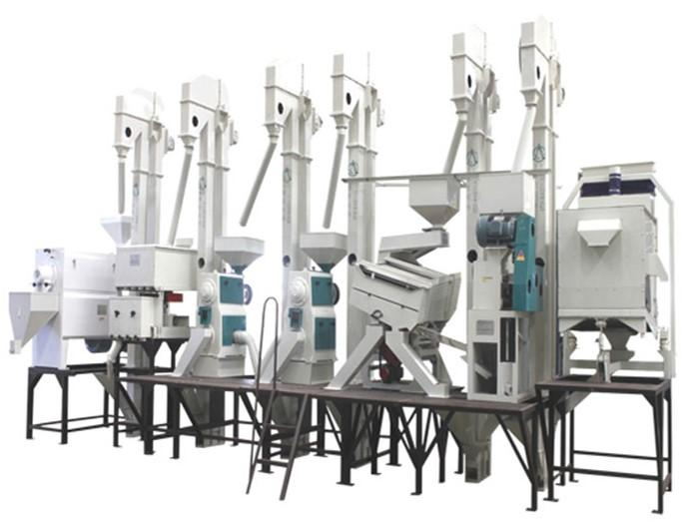
3.2.2 steel frame type
钢架式（≤ 100 Mt paddy/ 24h）

Slide 22
3.3 Rice Processing equipment
稻米加工设备
3.3.1 individual equipments 单机
3.3.2 complete combined type 组合式
3.3.3 Electric power by husk 稻壳发电系统
3.3.4 Parboiling system 蒸谷系统

Slide 23
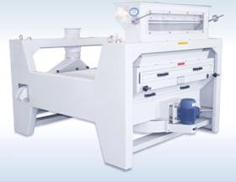
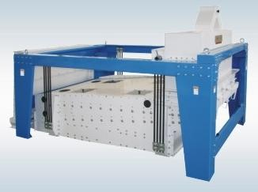
3.3.1 individual equipments—cleaning
单机——清理工段
paddy→cleaning →husking→whitening →redressing→packing
稻谷→清理→砻谷→碾米→白米整理→包装
to separate all impurities from paddy
去除所有杂质
cleaning sieve 清理筛 destoner 去石机

Slide 24
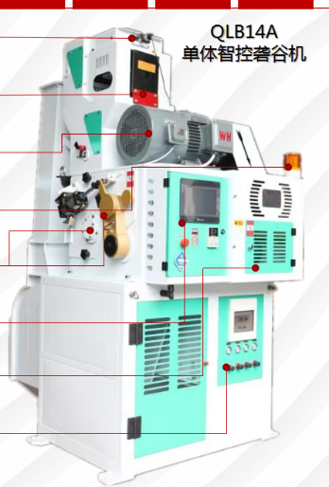
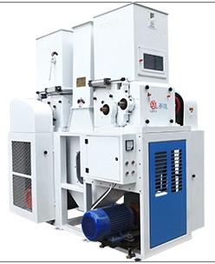
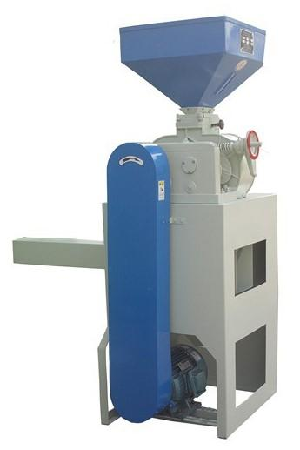
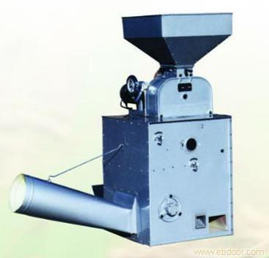
3.3.1 individual equipments—husking
单机——砻谷工段
paddy→cleaning →husking→whitening →redressing→packing
稻谷→清理→砻谷→碾米→白米整理→包装
to remove all husk
去除所有稻壳
husker + husk separater 砻谷机 +谷壳分离器

Slide 25
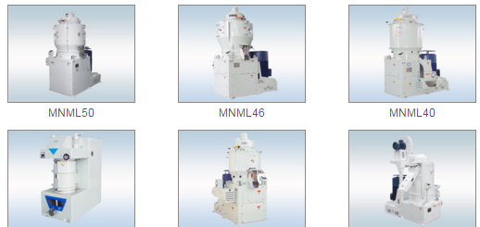
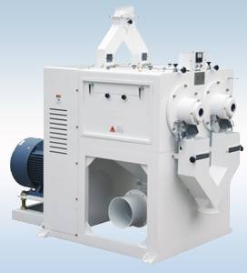
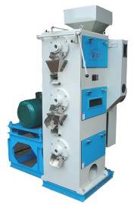
3.3.1 individual equipments—whitening
单机——碾米工段
paddy→cleaning →husking→whitening →redressing→packing
稻谷→清理→砻谷→碾米→白米整理→包装
to remove almost all bran & germ from brown rice
去除糙米上几乎所有米糠和米胚
whitening machine 碾米机

Slide 26
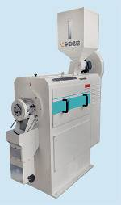
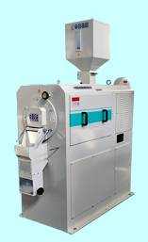
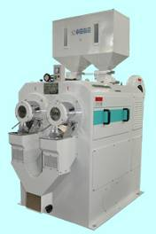
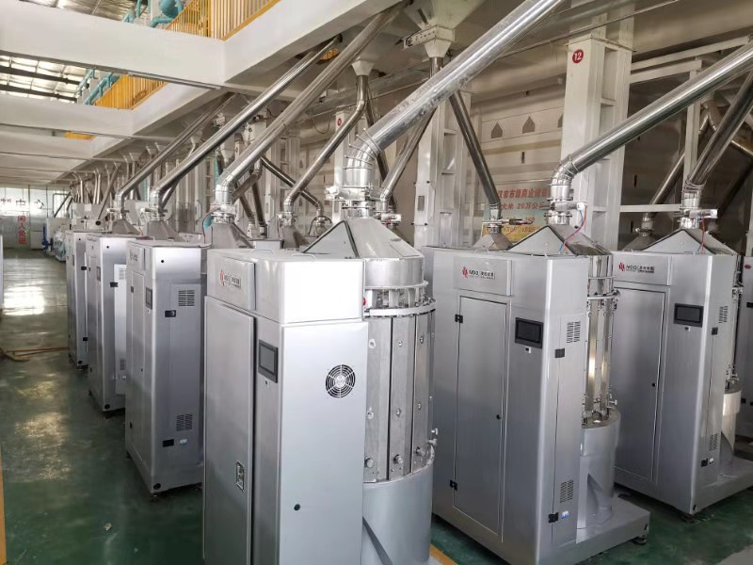
3.3.1 individual equipments—whitening
单机——碾米工段
paddy→cleaning →husking→whitening →redressing→packing
稻谷→清理→砻谷→碾米→白米整理→包装
to remove almost all bran & germ from brown rice
去除糙米上几乎所有米糠和米胚
whitening machine （lower temp. raise type) 低温升碾米机

Slide 27
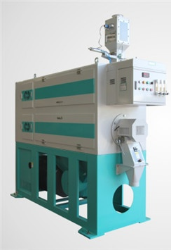
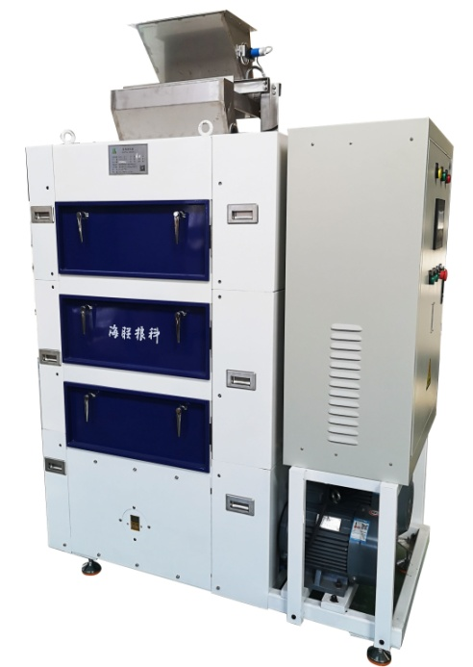
3.3.1 individual equipments—redrassing
单机——白米整理工段
paddy→cleaning →husking→whitening →redressing→packing
稻谷→清理→砻谷→碾米→白米整理→包装
to remove almost all bran powder from white rice
去除白米表面几乎所有糠粉
polishing machine 抛光机 brushing machine 刷米机

Slide 28
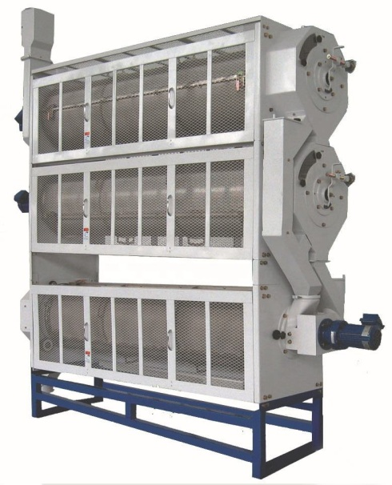
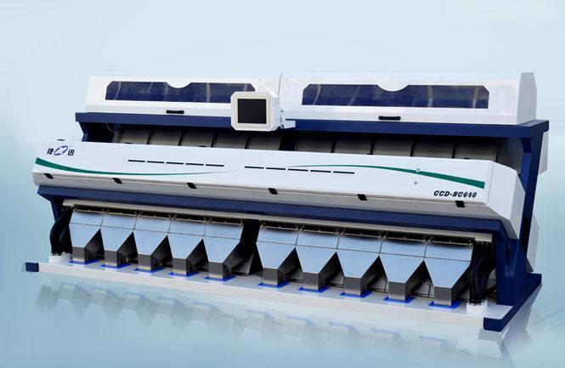
3.3.1 individual equipments—redrassing
单机——白米整理工段
paddy→cleaning →husking→whitening →redressing→packing
稻谷——清理——砻谷——碾米——白米整理——包装
to separat broken kernels，chalky kernel，yellow kernel from white rice 分离白米中的碎米、垩白粒、黄粒米等。
sifter length grader color sorting
白米筛 白米长度精选机 大米色选机

Slide 29
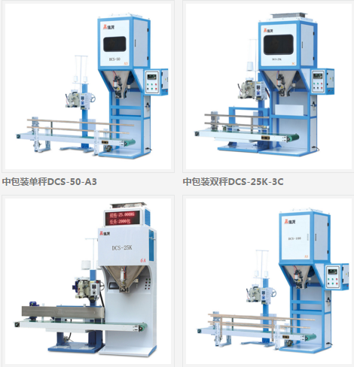
3.3.1 individual equipments—packing
单机——包装工段
paddy→cleaning →husking→whitening →redressing→packing
稻谷——清理——砻谷——碾米——白米整理——包装
weighing + sewing machine（PE bag）自动秤+缝口机

Slide 30
3.3.1 individual equipments—packing
单机——包装工段
paddy→cleaning →husking→whitening →redressing→packing
稻谷——清理——砻谷——碾米——白米整理——包装
weighing +vacuum +sealing machine 自动秤+真空+封口机

Slide 31
3.3.2 complete combined type
组合式
2 or more functions combined in one unit
2项及多项功能组合在一台设备
husker + whiting machine machine complete combined type
砻碾组合米机 成套组合设备

Slide 32
3.3.2 complete combined type(mobile)
组合式（移动式）
rice processing machine + tractor
大米加工设备 + 拖拉机
mobile rice processing machine, driven by diesel engine
移动式大米加工机组（柴油机驱动）

Slide 33
3.3.3 Electric power by husk
稻壳发电系统
husk → gasifying →gas cleanning→gas tank→
→internal combustion engine+generator→ electricity
稻壳→气化→燃气净化→储气罐→内燃发电机→电力
gasifying internal combustion gas engine+generator
稻壳气化炉 燃气内燃机+发电机

Slide 34
3.3.4 Parboiling system
蒸谷系统
paddy→cleaning→ soaking→steaming→drying→parboiled paddy
稻谷→清理→浸泡→干燥→蒸谷稻

Slide 35
Thank you
谢谢大家！
邮箱：pxiejian@126.com

