Slide 1
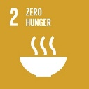
WFP SSTC Field Pilot Project in the Republic of Congo supported by China
Advances in Banana Processing Technologies and Products
Wei ZHOU
Ph.D. Food Science, Associate Researcher
WFP Centre of Excellence for Rural Transformation
Chinese Academy of Tropical Agricultural Sciences
Sharing for Learning

Slide 2
Expert’s Profile
Mr. Wei ZHOU
Education Degree: Ph.D.
Academic Title: Director of Food Processing Laboratory, Associate Researcher
Specialism: Excavation and Exploitation of Functional Factors of Tropical Characteristic Food

Slide 3
CONTENTS
01
Banana Production
02
Banana Nutrition
03
Banana Preservation
04
Banana Processing

Slide 4
01
Banana Production

Slide 5
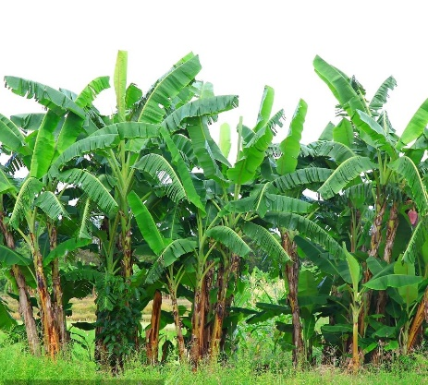
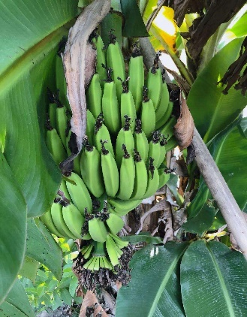
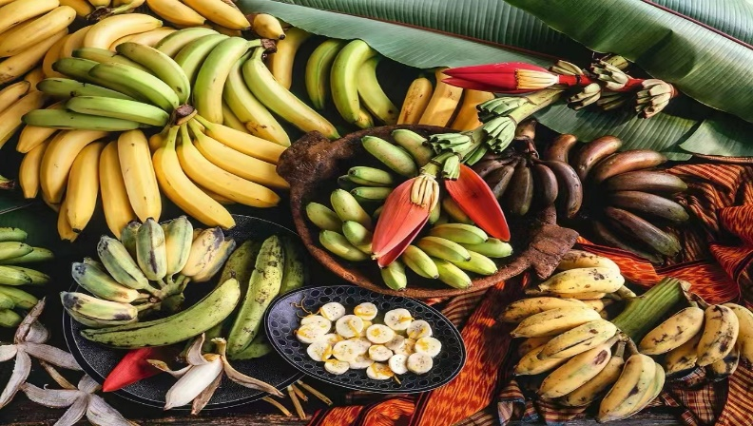
Bananas are monocotyledons and belonging to the Musaceae family and cultivated primarily for fruit.
The earliest reference to banana dates back to about 500 BC. Some horticulturists suspected that banana was the earth’s first fruit.
Banana is reported to be the fourth most demanded food after rice, wheat and corn.
As many as 100 million people subsist on bananas as their staple food and main energy source.

Slide 6
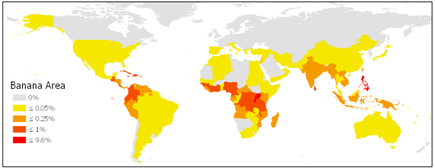
Figure. Percentage of banana production in different continents in world production(date source: FAOSTAT, 2020)
Bananas originated mainly in Southeast Asia and the Western Pacific, gradually spread throughout tropics and subtropics.
Banana is the second largest produced fruit, contributing about 16% of the world’s total fruit production.
India is the largest producer of bananas (32.0 million metric tons, 2020), large banana producing countries are mostly African countries (1.74 million hectares, 2020).

Slide 7
Table. Banana production of major producing countries in Latin America (FAO, 2020)
Table. Banana production of major producing countries in Africa (FAO, 2020)
Country | Production/metric tons
Equador | 7,931,060
Brazil | 6,978,310
Guatemala | 2,621,500
Mexico | 2,103,360
Colombia | 2,034,340
Peru | 2,007,280
Country | Production/metric tons
Uganda | 9,550,000
Ghana | 3,537,730
Tanzania | 2,924,700
Rwanda | 2,749,150
Nigeria | 2,733,300
Cameroon | 2,604,100
Cote d’Ivoire | 1,600,000
Congo | 1,250,690
Kenya | 791,579
Table. Banana production of major producing countries in Asia (FAO, 2020)
Country | Production/metric tons
India | 31,897,900
China | 9,848,895
Indonesia | 5,814,580
Philippines | 1,101,340

Slide 8
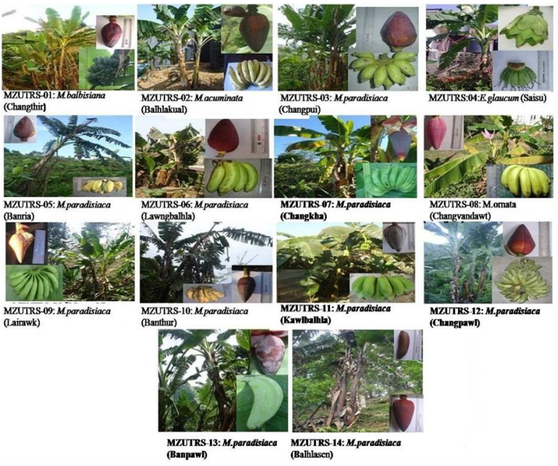
More than 1000 varieties of bananas produced and consumed in the world.
Banana consists of two genera Musa Linnaeus. and Ensete Bruce. Almost all the edible cultivated bananas are derived from genus Musa.
Three common species of Musa are Musa cavendishii, Musa paradisiaca, and Musa sapientum.

Slide 9
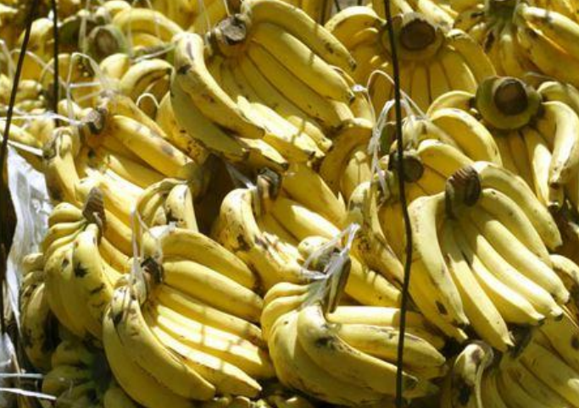
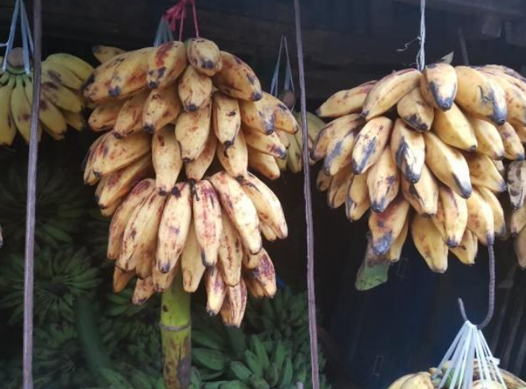
M. cavendishii, known as dessert banana, is sweeter and less starchy.
M. paradisiaca and M. sapientum are cooking bananas, characterized by higher starch concentration.
Musa cavendishii
Musa sapientum

Slide 10
02
Banana Nutrition

Slide 11
Table. Pulp and peel composition (fresh weight basis) of dessert bananas (AAA and AAB variety)
First choice for athletes’ energy supply: two bananas provide energy for 90 minutes of workout
Best sources of potassium: one banana fulfils 8% of the daily recommended value
Low glycemic index (GI): resistant starch and non-starch polysaccharides
Rich in polyunsaturated fatty acids: linoleic acid and α-linolenic acid

Slide 12
Pharmacological Activities of Banana
(1)Antioxidant Activity
Phenolic Compounds
(2)Anticancer Effect
Saponins
(3)Antidiabetic Effect
Vitamin C
(4)Antimicrobial Activity
Vitamin B
(5)Wound Healing Attribute
Sterols
(6)Effect on Atherosclerosis

Slide 13
03
Banana Preservation

Slide 14
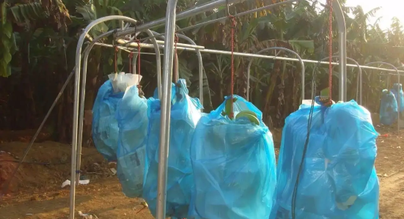
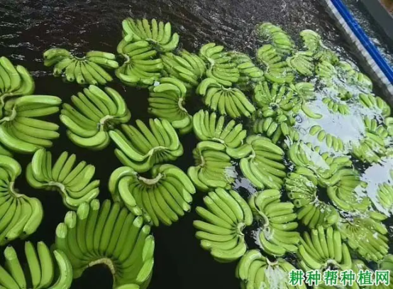
Post-harvest Processing of Banana
Picking
Preservation
Classification
Package
Storage and Transportation
Ripening
Physical Preservation Technology
The production of bananas is subjected to serious post- harvest losses, mainly due to harvesting at improper maturity stage, poor handling and storage practices and post-harvest diseases.
Preservation Methods
Chemical Preservation Technology
Biological Preservation Technology

Slide 15
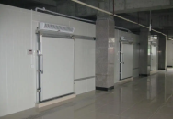
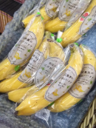
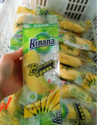
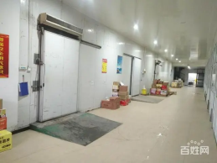
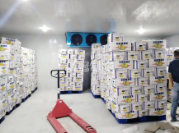
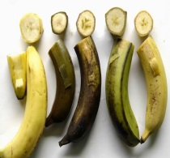
Physical Preservation Technology
Low Temperature Preservation
Modified Atmosphere Packaging
Control
Cold injury
Inhibiting related enzyme activities and reducing respiration intensity
Storage at 13~15℃ to avoid cold damage
Reducing O₂ and increasing CO₂ concentration to inhibit the physiological activities of fruits and microorganisms
Irradiation Preservation
Hot Water Treatment
Y-rays interfere with the basic metabolism of fruits and the growth of decaying microorganisms
Hot water treatment of 30~55℃ reduces postharvest diseases and improves the cold tolerance of banana fruits

Slide 16
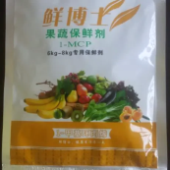
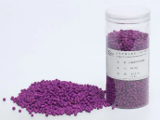
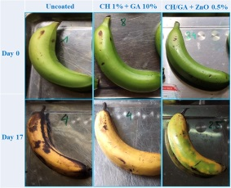
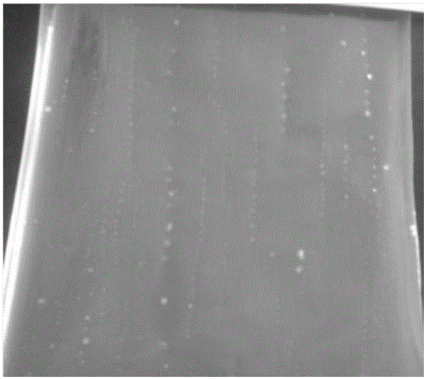
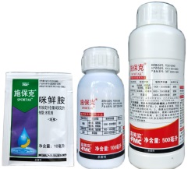
Chemical Preservation Technology
Ethylene Antagonists and Absorbents
Edible Coatings
Ethylene antagonists (1-MCP) binds irreversibly to ethylene receptor proteins
Perlite or active aluminum is used to soak in saturated potassium permanganate solution as ethylene absorbent
Polysaccharides, lipids, proteins and other natural products and their complexes commonly used as coatings
Exogenous Plant Growth Regulators
Chemical Fungicide
Salicylic acid, methyl jasmonate, citric acid and oxalic acid are commonly sprayed or daubed on banana surface.
Various chemical fungicides can effectively control banana rot when used alone or in combination.

Slide 17
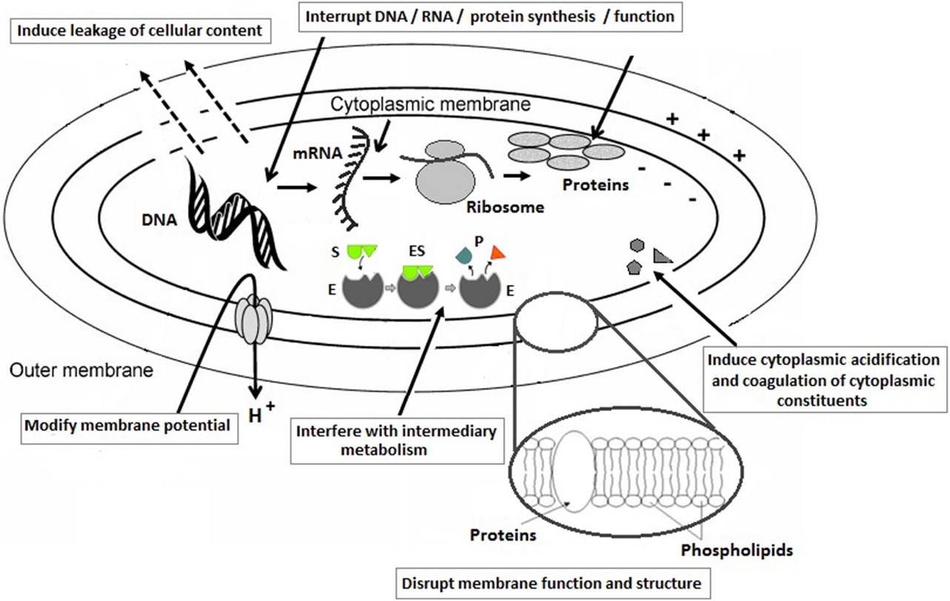
Biological Preservation Technology
Plant Extract Preservation
Microbial Antagonism Preservation
Yeast and Bacillus subtilis inhibit post-harvest diseases of bananas and slow down decay by means of nutrition and space competition and producing antibacterial substances.
Natural plant extracts, such as plant essential oil show good antibacterial and antioxidant activities and are widely used in the preservation of banana fruits.
Biological Enzyme Preparation Preservation
Enzyme can eliminate the adverse factors from the outside in the storage process of bananas through its catalytic effect, so as to achieve the purpose of preservation.

Slide 18
Banana Preservation Technology |  | Storage Period
Physical Preservation Technology | Low Temperature Preservation | 45-50 d
 | Modified Atmosphere Packaging | 35- 40 d
 | Irradiation Preservation | Optimal dose (25 krad) 25-30 d
 | Hot Water Treatment | 20-25 d
Chemical Preservation Technology | Ethylene Antagonists And Absorbents | 0.5µL/L 1-MCP treatment (40-45 d) Ethylene absorbent treatment (30-35 d)
 | Chemical Fungicide | 20-25 d
 | Edible Coatings | 30-35 d
 | Exogenous Plant Growth Regulators | 30-35d Eg: 50 mg/L gibberellin treatment (30d)
Biological Preservation Technology | Plant Extract Preservation | 20-25 d Eg: 15 μL/L Peppermint essential oil (25 d)
 | Microbial Antagonism Preservation | 20-25 d Eg: Pichia kluyveri (B1) (25 d)
 | Biological Enzyme Preparation Preservation | 20-25 d

Slide 19
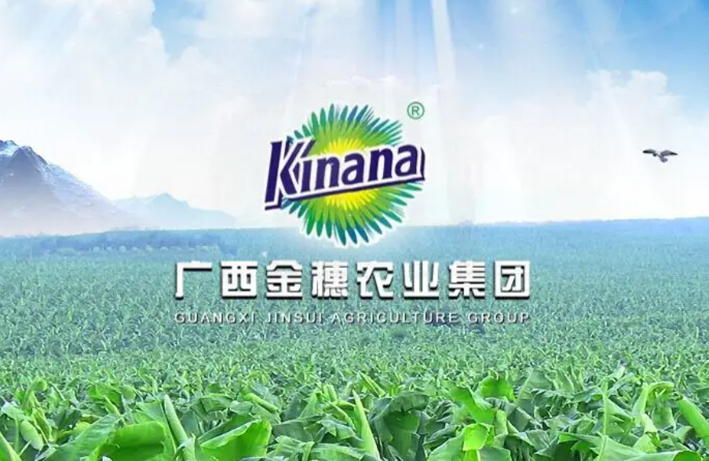
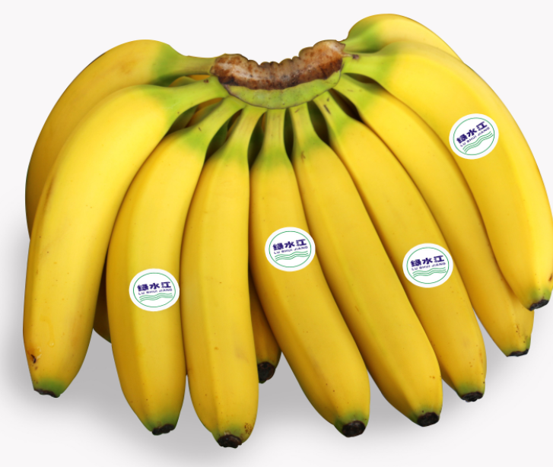
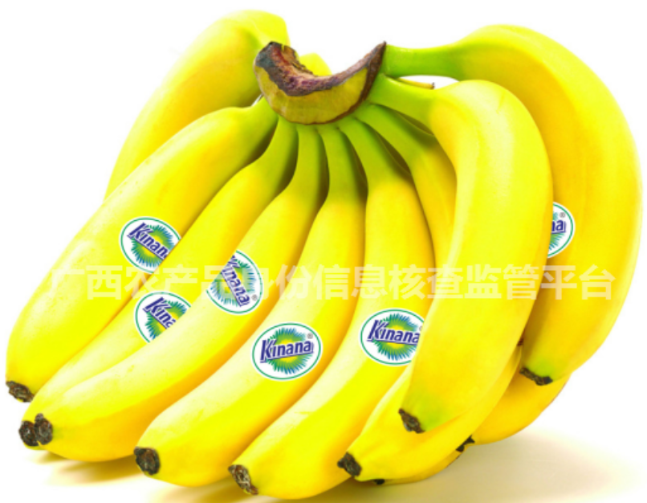
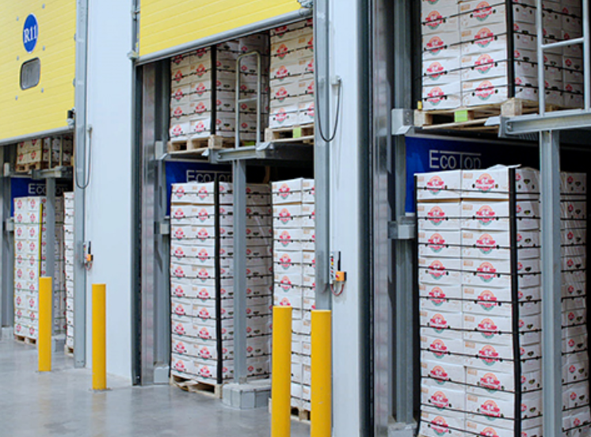
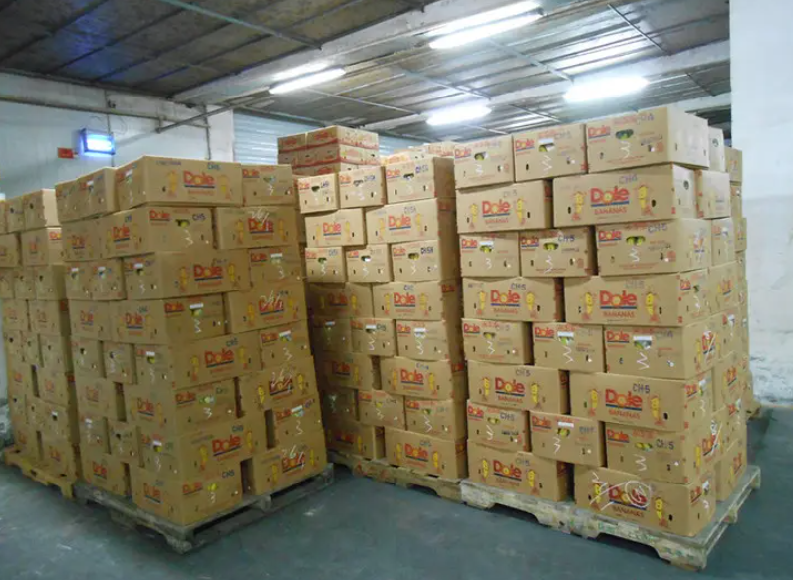
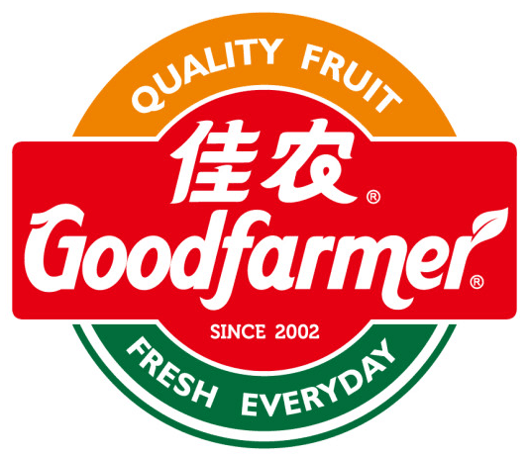
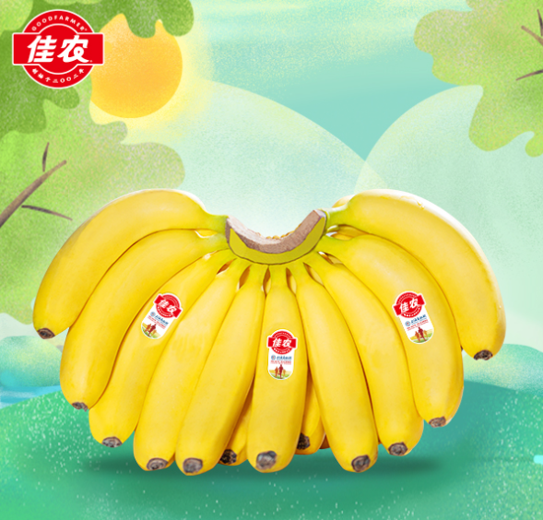
High Quality Banana Preservation Technology
Low temperature preservation combined with controlled atmosphere storage
Storage life can exceed two months
Good fruit appearance and inner quality
Guangxi Jinsui Agricultural Group
Goodfarmer Foods Holding (Group )

Slide 20
04
Banana Processing

Slide 21
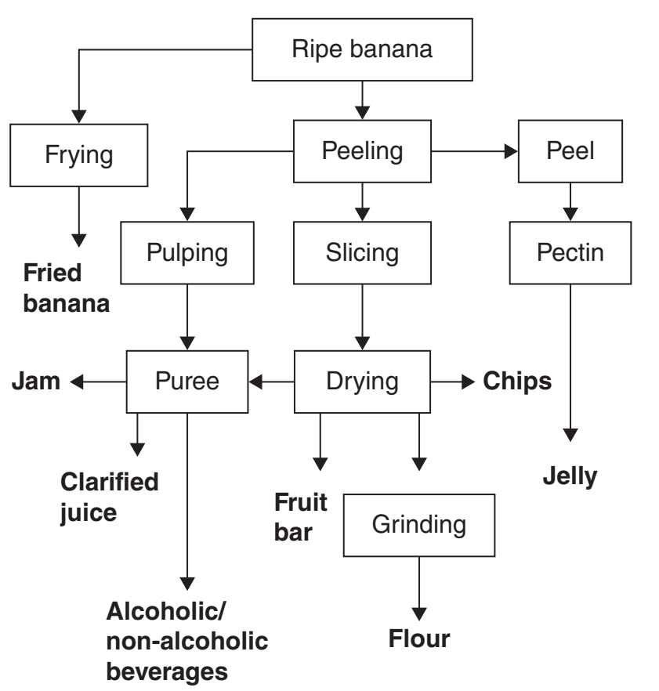
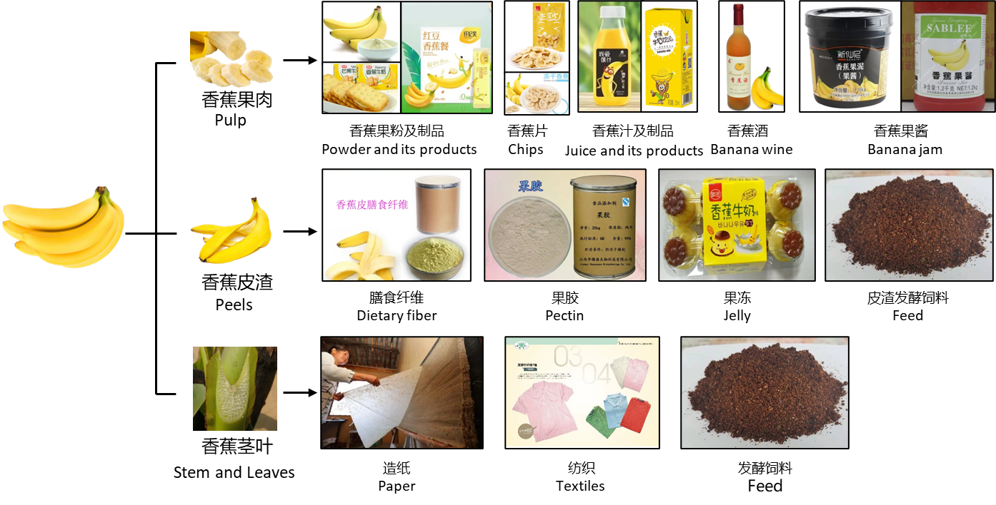
Comprehensive Exploitation of Bananas

Slide 22
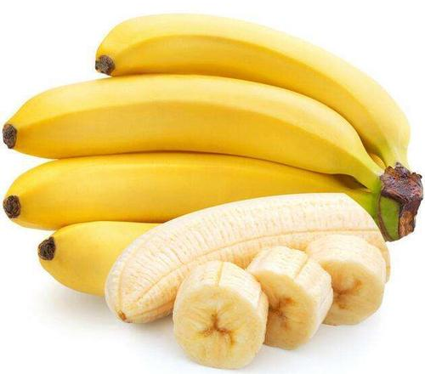
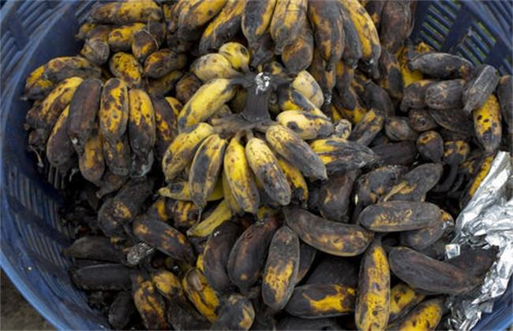
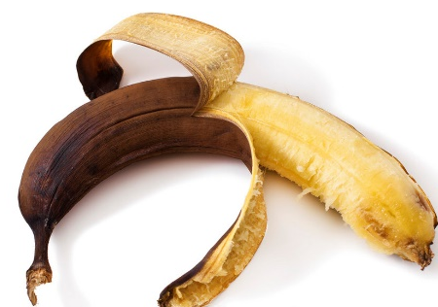
Bananas are usually consumed in fresh form. Very small portion of total banana production undergoes industrial processing.
Fresh bananas are highly perishable, with a very little shelf life ranging from days to weeks. Product degenerates while storage and transport, causing a lot of loss of income.
To avoid the loss of income from degeneration, bananas are encouraged to be processed into different products.
Fresh-cut Bananas
鲜食香蕉
Browning
褐变
Corruption
腐败

Slide 23
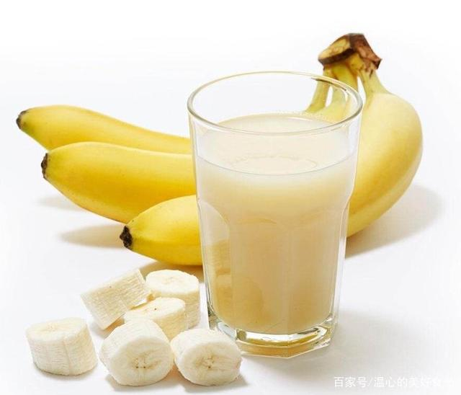
(a) Banana Juice
Juice extraction is achieved by a mechanical press and/or by enzyme application.
Juice yields of 54%–80% from peeled fruit pulp depending on the banana variety used.
Banana juice have a moderate acidity, a very good sugar content.

Slide 24
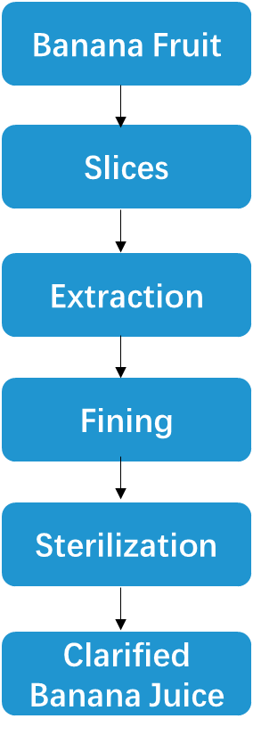
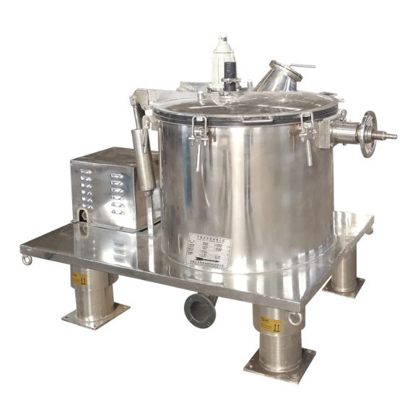
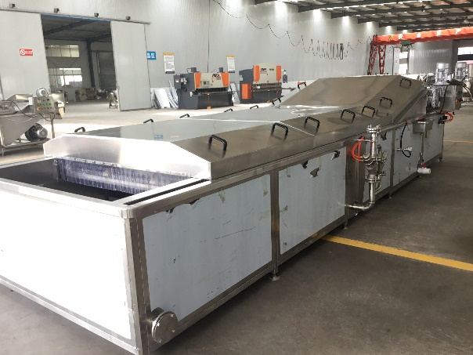
(a) Banana Juice
Conventional Processing Steps and Technologies of Banana Juice
High Speed Centrifugation
Pasteurization

Slide 25
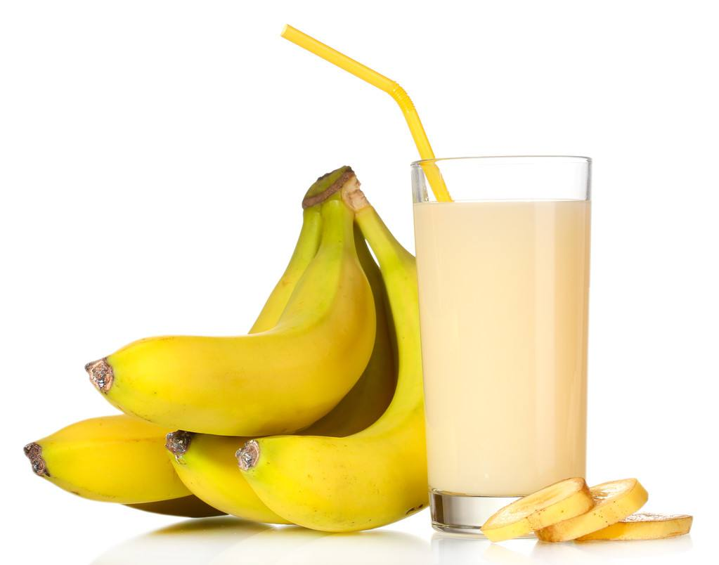
(a) Banana Juice
Key Technique 1：
Fining
Difficult to get clear banana juice
Reason 1: Settlement of pectins
Reason 2: Binding between polyphenolic compounds and fining agents
Reason 3: Bonding of proteins to form foam

Slide 26
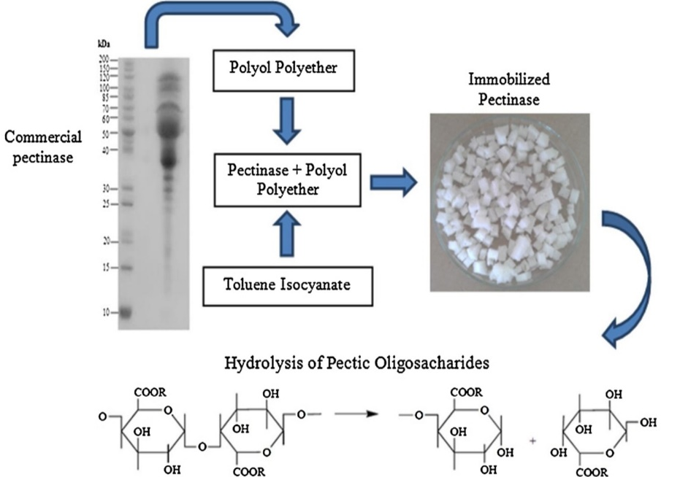
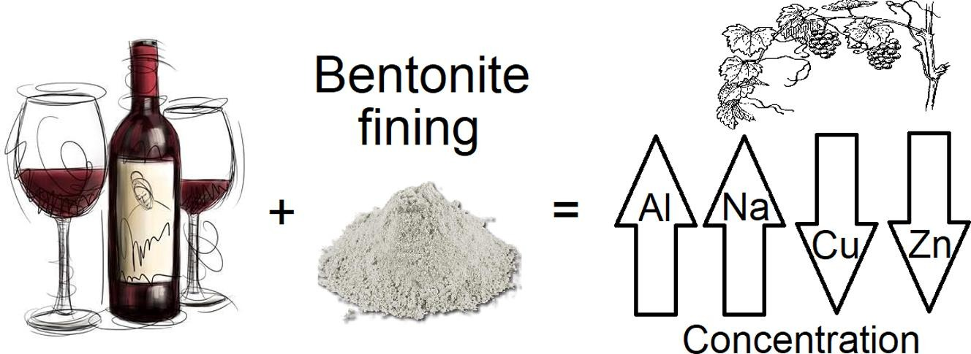
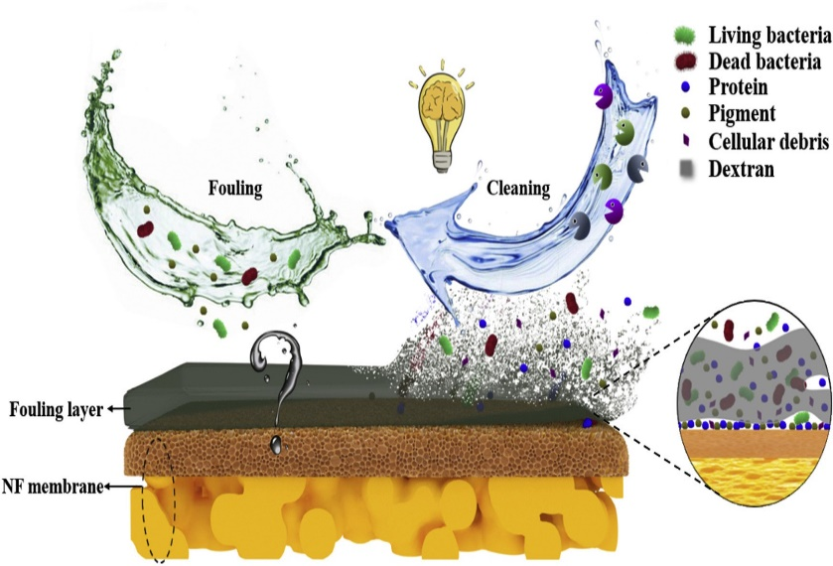
(a) Banana Juice
Treatment with Enzyme
Fining Agents
Membrane Technology
Microfiltration/Ultrafiltration/Nanofiltration/Reverse osmosis
Amylase/Pectinase
Bentonite/Gelatine

Slide 27
(a) Banana Juice
Key Technique 2：
Oxidation Prevention
Browning and loss of ascorbic acid
Reason 1: Polyphenol oxidase and peroxidase enzyme activity
Reason 2: Thermal processing

Slide 28
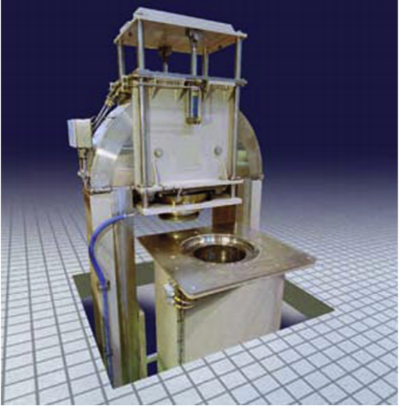
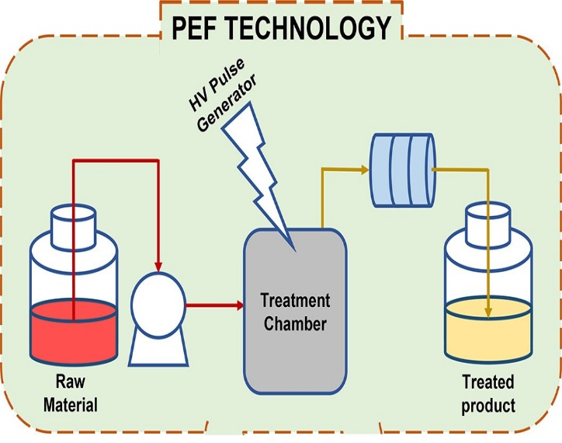
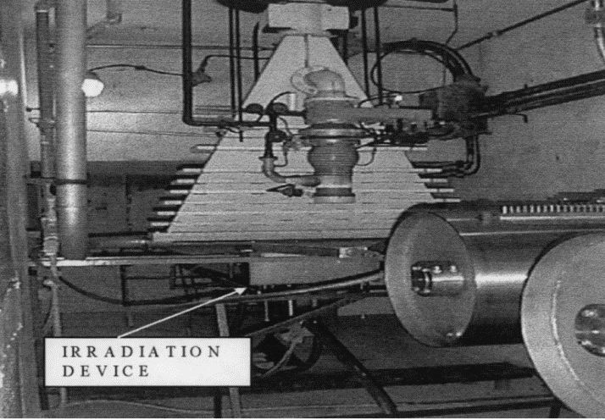
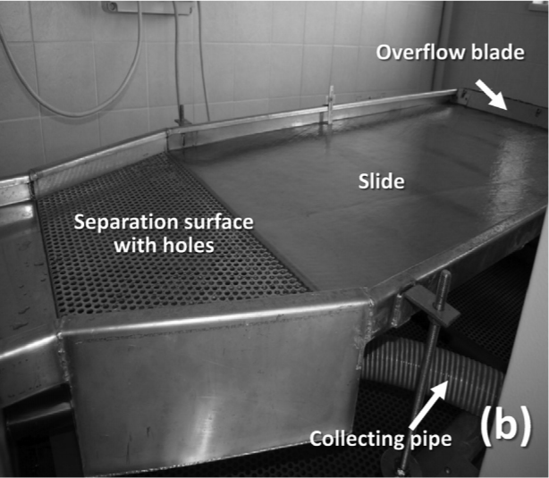
(a) Banana Juice
Non-thermal Processing Technologies
Dipping into Antioxidant Solution before Heating
High Pressure Processing (HPP)
Pulsed Electric Fields (PEF)
Irradiation Processing
Preservation of Banana Juice
Keeping Ascorbic Acid

Slide 29
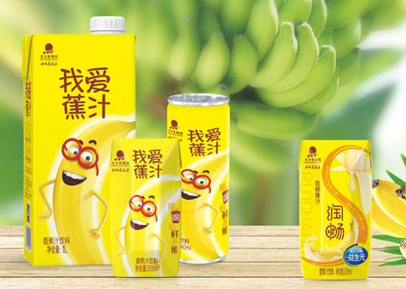
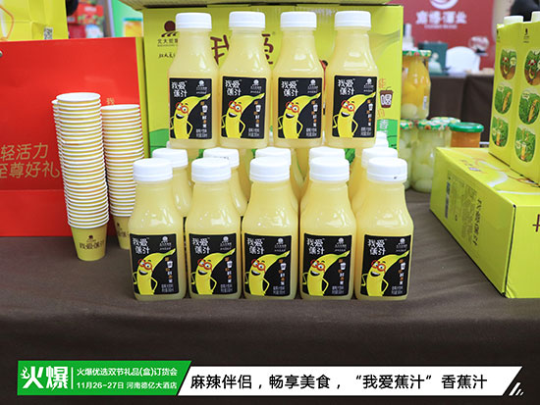
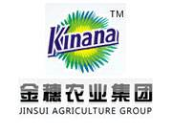
(a) Banana Juice
Commodity Grain Production Base
Non-thermal Extraction
Banana Standardization Production Enterprise
The first non-compound banana drink
Taking the lead in solving the problem of banana juice browning

Slide 30
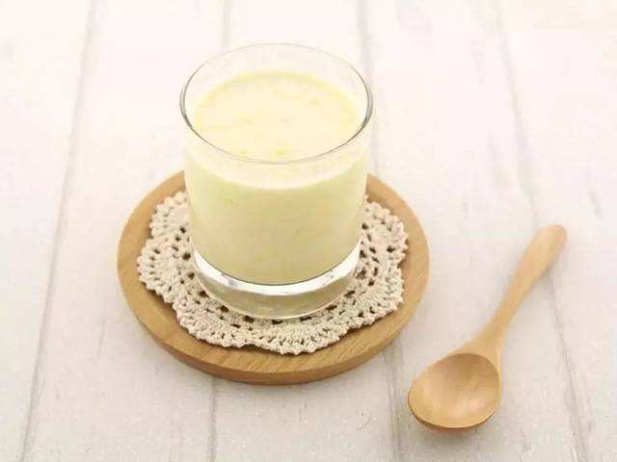
(a) Banana Juice
In combination with milk
Milk shake
奶昔
Milk power
奶粉
Various Applications of Banana Juice
In combination with thickening agent
Jelly
果冻
Fudge
软糖
Fermented
Wine
酒
Vinegar
醋

Slide 31
(b) Banana Powder
Banana powder is actually used as an additive and ingredient in different kinds of food products.
Banana powder is prepared from green unripe cooking bananas with high starch content.
Banana powder possesses a very good nutritional profile.

Slide 32
(b) Banana Powder
Heating Effect
Conventional Processing Steps and Technologies of Banana Powder
Spray Drying

Slide 33
(b) Banana Powder
Key Technique：
Drying
Lightness and yellowness are negatively affected.
Low emulsion stability
Low oil and water holding capacity
Lower content of resistant starch

Slide 34
4.Banana Processing
Flesh Processing
(b) Banana Powder
Freeze Drying
Freeze drying is considered to be the best dehydration method for heat-sensitive materials.
High-temperature Short-time (HTST) Process
Extrusion processing change the structure and morphology of powder more soluble in water.

Slide 35
(b) Banana Powder
Australian Green Banana Powder
Freeze Drying
High resistant starch
Regulate blood sugar
Regulate intestinal flora
Extrusion Processing
Fine particle size
Soluble in water
Sweet tase of ripeness
Bananas Produced in Ecuador
French Diana Food

Slide 36
(b) Banana Powder
From ripe bananas with high sweetness
Syrup
糖浆
Ice Cream
雪糕
Various Applications of Banana Powder
From unripe bananas with high dietary fiber
Pasta
意大利面
Bread
面包
Biscuit
饼干
Noodle
面条

Slide 37
(c) Banana Chips
Banana chips are a popular snack food especially in America, Europe, China, and Japan.
Banana chip is a product with a crispy taste and golden yellow color.
Usually, the chips are produced from under ripe bananas.

Slide 38
(c) Banana Chips
High Temperature Frying/Baking for a Long Time
Conventional Processing Steps and Technologies of Banana Chips
Frying Machine/Oven

Slide 39
(c) Banana Chips
Key Technique：
Oil Intake Control
Quality of chips will deteriorate in terms of physical and chemical changes.
Chips may not be preferred by health-conscious consumers.
Chips may become rancid after long storage because of lipid oxidation.

Slide 40
(c) Banana Chips
Methods to Control Oil Absorption
Vacuum Microwave-drying
Hydrocolloids
Sweet Pre-treatment
Osmotic Dehydration
Heat penetrates materials effectively to reduce frying time.
Chips dip in alginate, CMC or pectin before frying.
Chips dip in sugar solution before frying.
Chips dip in osmotic solutions.

Slide 41
(c) Banana Chips
Quality of Product
Thin and crispy
Low oil and sault
Strong banana aroma
Dao Ji Cao
Philippine Banana Chips Processing
Banana chips dipped in sugar solution before frying
Banana Master
Loraine Peralta

Slide 42
(c) Banana Chips
Cost and Profitability of Banana Chips Production in Indonesia, 2017
Banana chips business has an important role in Indonesian economy, contributing significantly to job creation, and poverty reduction.
Cost of IDR 1,000,000 banana chips business will generate revenue of IDR 1,740,000
Every IDR 1,000,000 invested in banana chip business will result in a profit of IDR. 740.000

Slide 43
(d) Canned Banana
Best quality canned bananas are obtained from fruit at an early stage of ripeness.
The slices are processed in syrup of 25deg.Brix with pH about 4.2.
Canning increases the shelf life of bananas and also help in transportation and storage.

Slide 44
(d) Canned Banana
Key Technique：
Color and Shape Preservation
Processing Steps
Rapid browning and difficult to ensure the proper shape and hardness of slices
Reason 1: Polyphenol oxidase and peroxidase enzyme activity
Reason 2: Cells damage during the peeling and slicing

Slide 45
(d) Canned Banana
Color Preservation
Shape Preservation
Acidic Sodium Sulphate, Citric Acid, or L-ascorbic Acid
Calcium Chloride or Calcium Lactate
Blanching

Slide 46
(e) Banana Wine
Banana fruit wine with low alcohol content is a kind of nutritious beverage, which is favored by the elderly and teenagers.
Fermenting banana juice is considered to be an attractive means of utilizing surplus and overripe bananas.
The cost of production of banana based alcoholic beverages is much cheaper than other fruit based beverages.

Slide 47
(e) Banana Wine
Conventional Processing Steps and Technologies of Banana Wine
Indigenous use of spear grass and feet to extract juice from bananas in Africa

Slide 48
(e) Banana Wine
Key Technique：
Increase Juice Yield
High turbidity and viscosity of banana wine
Reason: Polymeric carbohydrates like pectin and starch in banana

Slide 49
(e) Banana Wine
Pectinase and α-amylase were used to pretreat banana pulp before wine fermentation
Recombinant yeast strains with genes coding for enzymes able to degrade different polysaccharides

Slide 50
(e) Banana Wine
Enzyme Treatment
Fermentation
Banana Liqueur
Quality of Product
High clarity
Low alcohol vol
Base for cocktail
Guangxi Nanning lvyue Food Co., Ltd

Slide 51
(e) Banana Wine
Banana Beer Costs and Margins (in US$) for Retailers in African Countries
 | Country
 | Rwanda | Burundi | Congo
Costs
Buying Price (Banana Beer 16Lt) | 4.00 | 3.21 | 2.98
Transport Costs | 1.06 | 0.84 | 1.45
Total Variable Costs | 5.06 | 4.06 | 4.44
Revenues
Revenue (Banana Beer 16Lt) | 6.84 | 5.38 | 5.53
Gross margin (Banana Beer 16Lt) | 1.78 | 1.32 | 1.09
Banana beer processing plays an important role in the overall income generation and food security of rural communities in African countries.

Slide 52
Each hectare of banana plantation is estimated to produce biomass waste about 220 tons.
India alone produces about 190 million tons of biomass waste from banana plantations. (Worldwide, 1.243 billion tons)
It takes about two years to biodegrade banana waste, causing environmental problems.
Banana waste has a good nutritional profile.
Banana Peels
Banana Leaves and Pseudo-stems

Slide 53
(a) Fiber
Sanitary Napkins
Material for absorbent core and barrier sheet
3 to 6 months to biodegrade
Natural, cheap and 50% higher absorption strength than cotton fibers
Saathi Health Care Company in India
100% biodegradable and chemical-free pads made of banana fiber
Sanfe India’s Female Hygiene Brand
Pads from banana fiber with repeated usage up to 120 washes

Slide 54
(a) Fiber
Paper Industry
Non-wood raw materials for paper production can protect forest.
Banana fiber has the potential for paper production due to high cellulose, lower hemicellulose and lignin.
Production of currency paper, cheque paper, writing paper and anti-grease paper
Paper made from 100% banana fiber was found most absorbent and abrasion resistant.
Japanese Yen notes are made of banana fiber.

Slide 55
(a) Fiber
Textiles
Long banana fiber with high tensile strength and stiffness is a promising material for textile.
Japan and Philippines have been employing banana fiber at a large scale for commercial making of garments, table-mats, bags, hangings ropes and curtains.
Lightweight
Comfortable

Slide 56
(a) Fiber
Dietary Fiber
Banana stem is a rich source of fiber helps control obesity and aids in detoxifying the body.
Bread containing 30% banana peel flour is considered as prebiotic, utilized to promote the survival of probiotics.
Instant noodles with added banana flour, rich in dietary fiber, have good nutritional quality and sensory acceptability
The water holding capacity and oil holding capacity of bread with BP flour were higher as compared to the bread control.

Slide 57
(b) Nutrient Source
Polyunsaturated fatty acids: linoleic acid and α-linolenic acid
Essential amino acids: Except for lysine, all essential amino acids are higher than FAO standard.
Micronutrients: K, P, Ca, Mg
Oil: amyl acetate
A good feed material for cattle and poultry

Slide 58
(c) Renewable Energy
Direct combustion: Banana peel waste is a renewable source for generating energy with minimized waste volume and higher calorific (22 MJ/kg).
Biomethanisation: The anaerobic fermentation of banana peel waste generates renewable biogas and fertilizer.
Activated carbon: Porous structures with large surface areas to remove heavy metals, pesticides and dyes in wastewater.
Energy Storage Systems: Use of biomass-derived carbons in banana peels for lithium-ion batteries

Slide 59
Conclusions and Prospects
Bananas are among the world’s leading fruit crops with good nutrition profile.
Banana normally has a short shelf life and start deteriorating just after plucking.
Preservation and processing technologies should be further improved to produce banana fruits and products with good quality.

Slide 60
Thank You!
Contact info:
Chinese Academy of Tropical Agricultural Sciences
E-mail: weizhou111@foxmail.com
The SSTC project is funded by: Ministry of Agriculture and Rural Affairs P. R. China
Sharing for Learning

